Slide 1
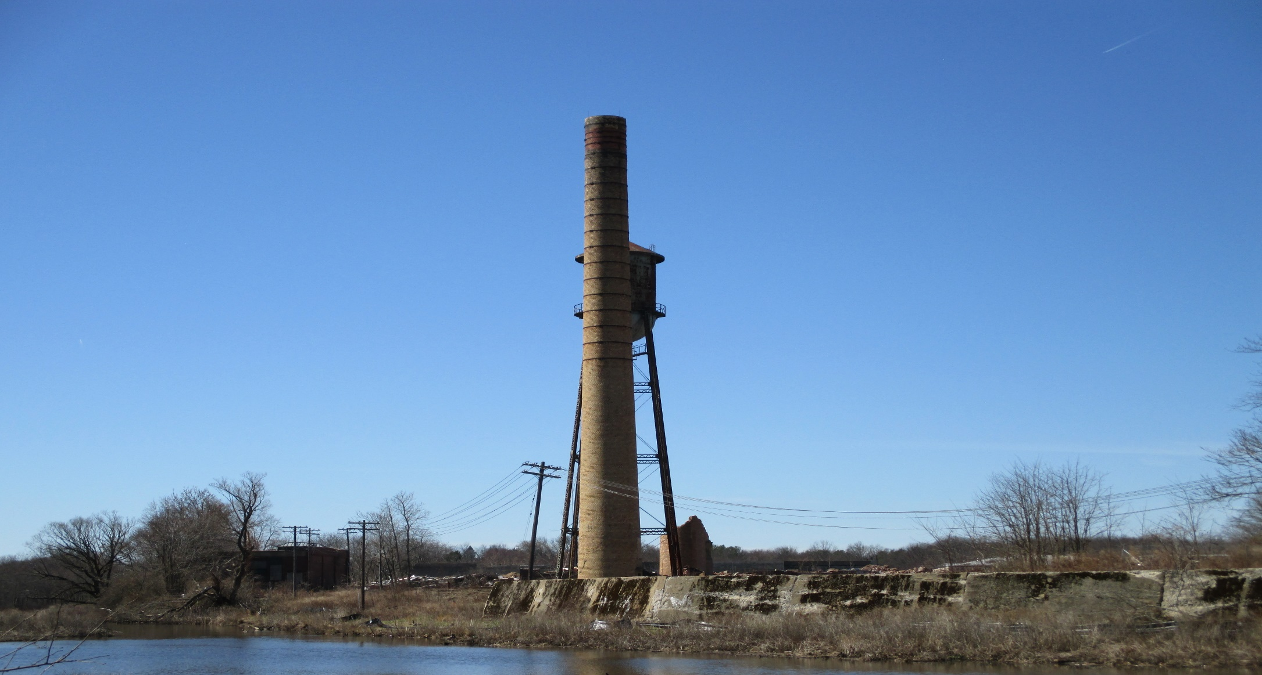
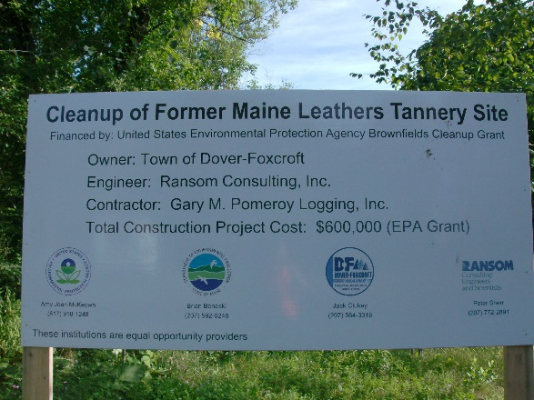
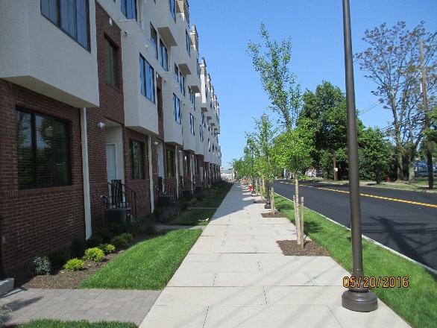
New Jersey Institute of Technology Technical Assistance to Brownfield Communities Program (NJIT TAB)
Sean Vroom
July 16, 2019

Slide 2
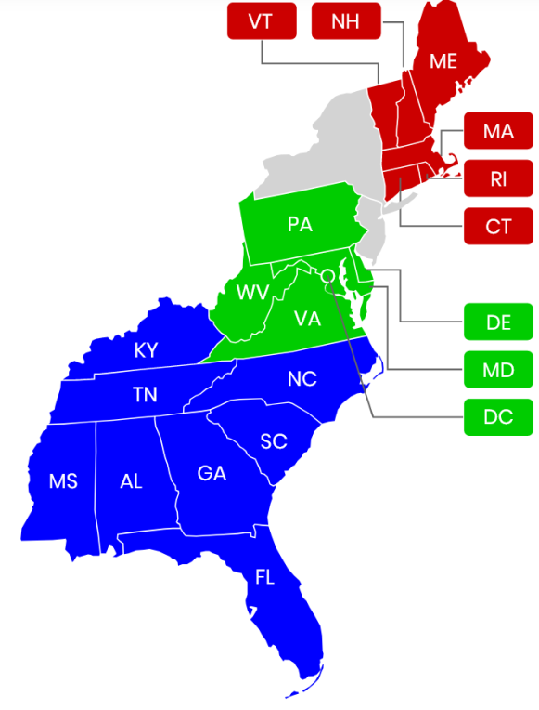
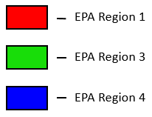
What is TAB?
a technical assistance program, funded through a cooperative agreement with the USEPA
serve as independent resource to: state, regional, county, tribal, and local governments; and nonprofits attempting to cleanup and reclaim brownfields
Regions 1, 3, and 4
Assistance is FREE of charge!

Slide 3
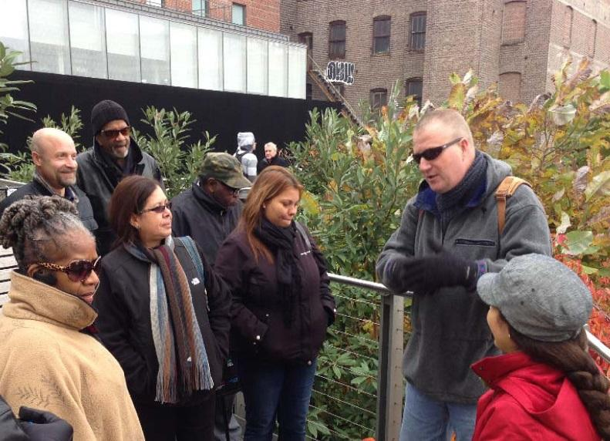
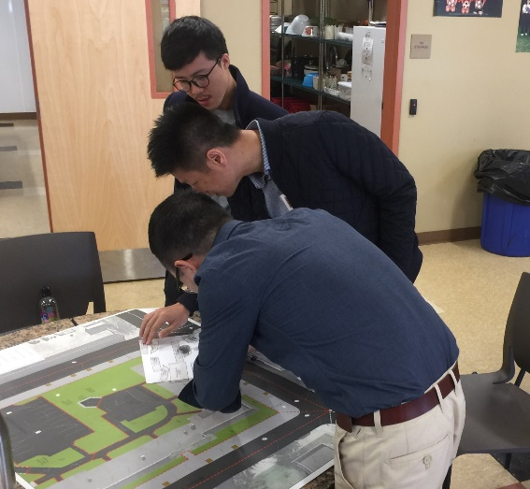
Who is the NJIT TAB Team?

Slide 4
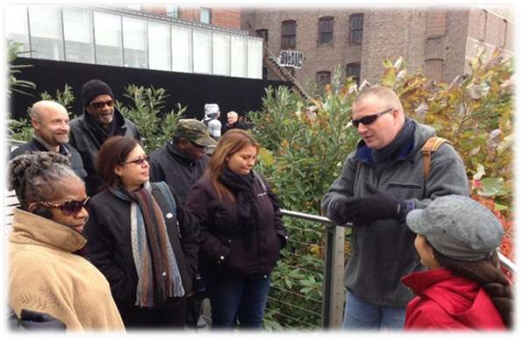
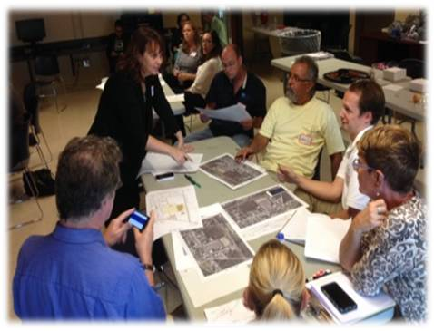
NJIT TAB
NJIT TAB provides assistance throughout the entire brownfields redevelopment process.
Assistance is provided through…
Resource Center
Educational Forums
Direct Technical Assistance

Slide 5
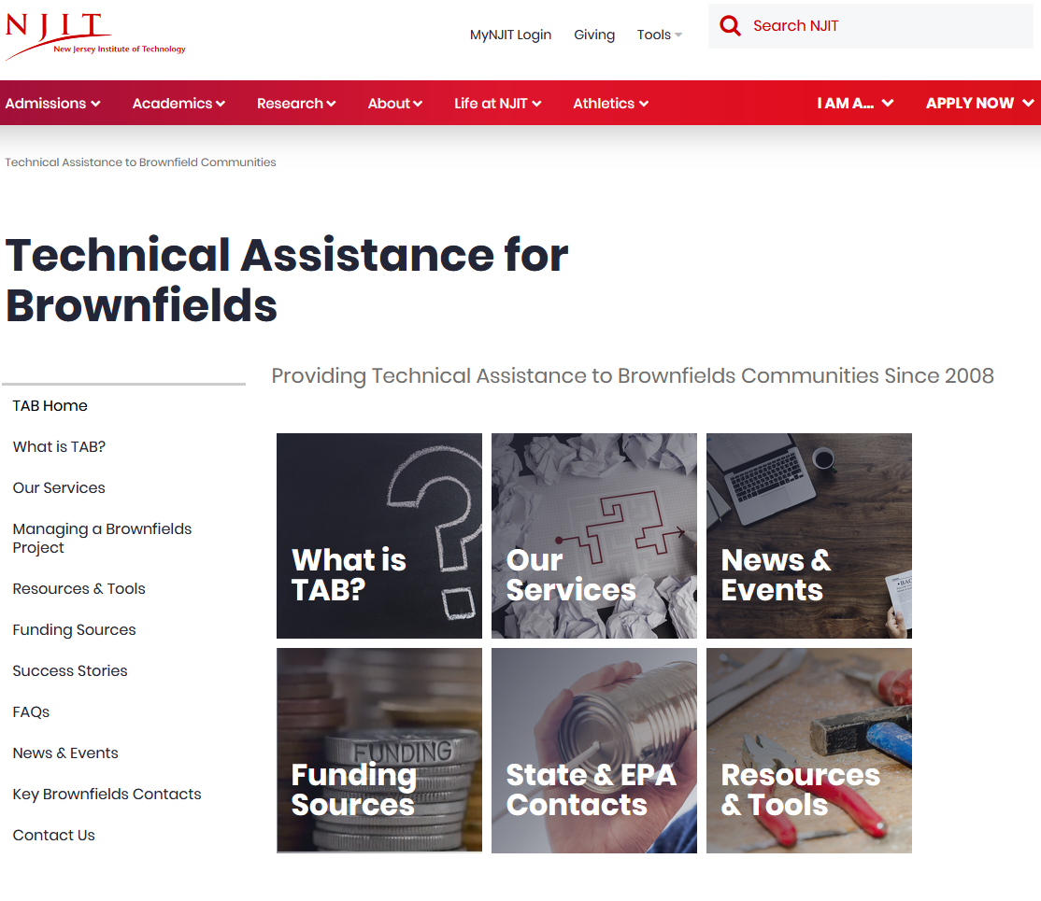
Resource Center
www.njit.edu/tab
Resources and Tools:
Info on managing a brownfields project
news and upcoming events
Federal and state funding sources
key state and EPA contacts
previously recorded webinars
suite of tools
downloads of workshop and seminar presentations
sample RFPs
how-to videos

Slide 6
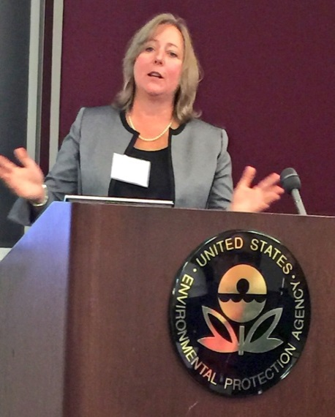
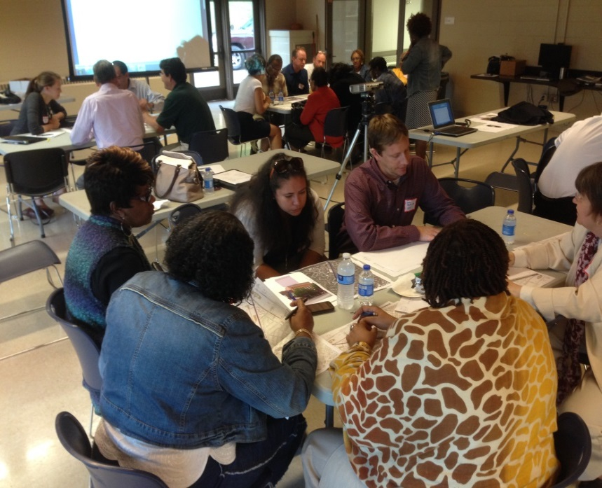
Educational Forums
Conferences: pre-conference workshops, learning labs, panel sessions, office hours
Workshops: 2 to 4 hour interactive sessions on brownfield related topics
Seminars: deeper dive into specific brownfield related topics
Brownfield Boot Camps: more intensive, deep dive into specific brownfield related topics
Webinars: range from introducing the TAB program to specific brownfield topics

Slide 7
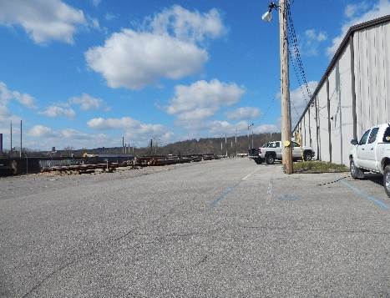
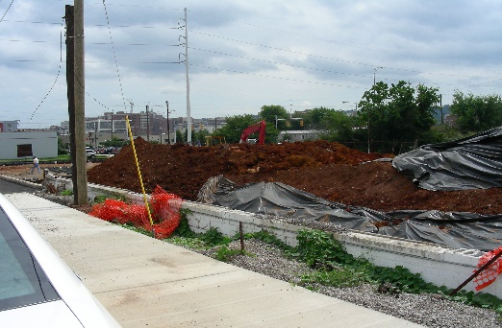
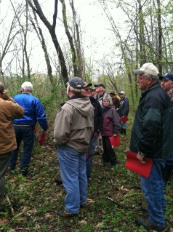
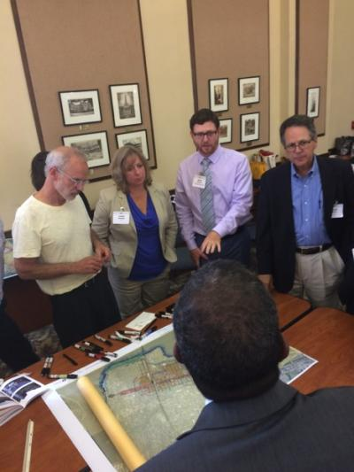
Direct Technical Assistance
Brownfields Redevelopment Spectrum
Site Funding
Site Identification
Site
Investigation
Site
Remediation
Site
Redevelopment
Identification of funding opportunities
Contractor Procurement
Prioritizing Brownfield Sites
Evaluate Proposed Remedies
Integrated Remediation and Redevelopment
EPA Brownfield Grant Reviews
Review SOW for Phase I/II Assessments
Visioning and Community Engagement
Explain Cleanup Technologies
Attracting Development
Every community is different and every community’s needs are different.
The type and depth of assistance NJIT TAB provides is tailored to the needs of the community – from a quick call to more involvement.

Slide 8
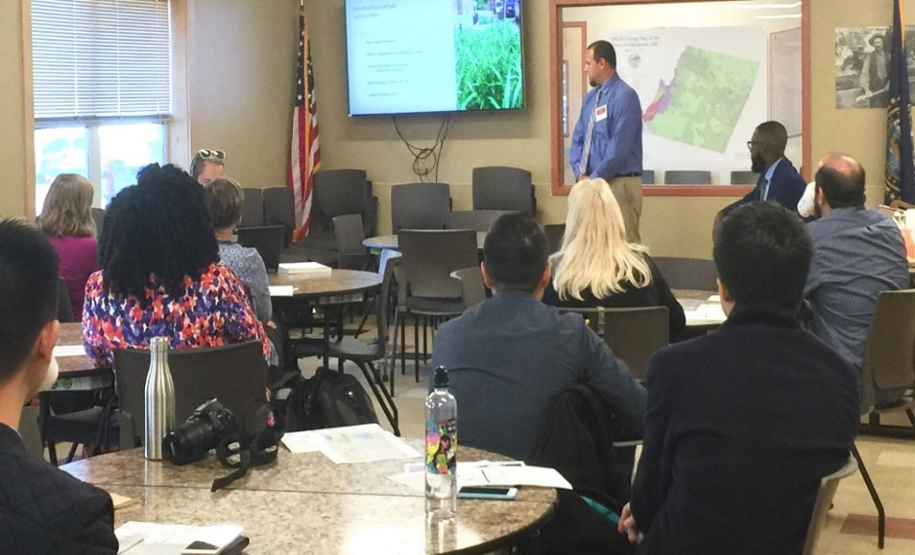
Direct Technical Assistance
Community Engagement
Visioning
Assets and Needs
Environmental Justice

Slide 9
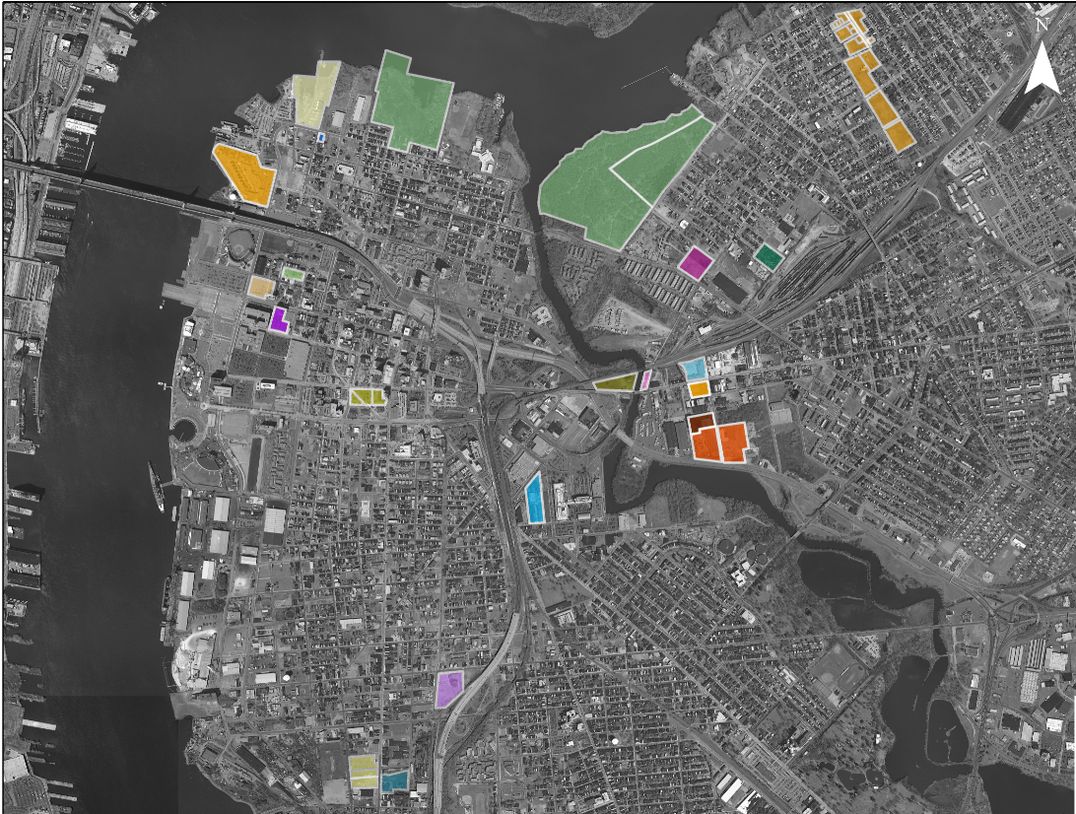
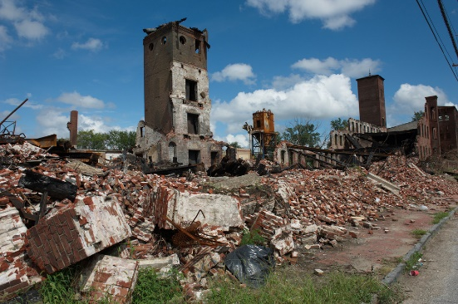
Direct Technical Assistance
Brownfields Prioritization
Prioritization Criteria Development (zoning, access, plan consistency, size, etc.)
Prioritization Criteria Application
Site Ranking
Identification of Potential Reuses

Slide 10
Direct Technical Assistance
Technical Document Review and Interpretation
Brownfields Grant Critiques
Brownfield Redevelopment Roadmap

Slide 11
Who Can Receive NJIT TAB Assistance?
Government Entities
Local
State
Regional
Tribal
Non-Profits

Slide 12
How Do I Get Assistance?
CALL:
Hotline 973-642-4165
Email:
tab@njit.edu
Sean Vroom
973 596-6415; svroom@njit.edu

