Slide 1


Technical Assistance to Brownfields (TAB) Resources for New EPA Grantees
In EPA Regions 5, 6, 7, and 8
  Kansas State University
  Technical Assistance to Brownfields (TAB) Program
  July, 2019

Slide 2
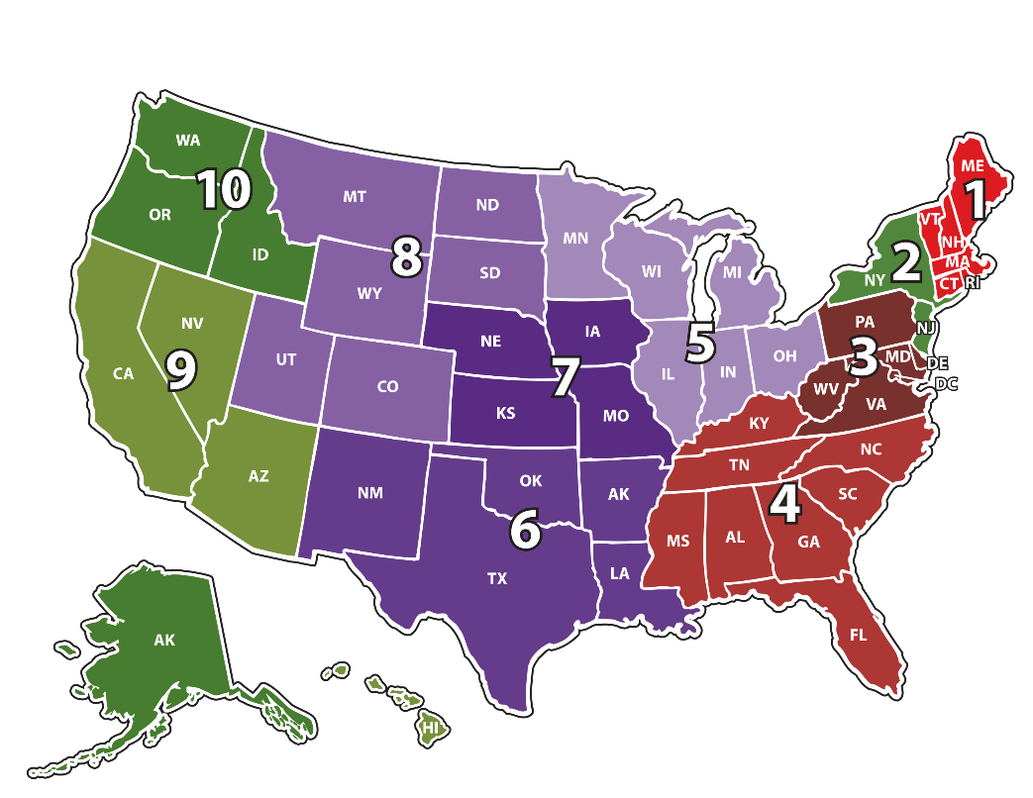
Technical Assistance to Brownfields (TAB) Program
Assistance with planning, environmental, and economic development
Free to Local & Tribal governments and nonprofits
Funded by EPA
K-State assists in EPA Regions 5, 6, 7 and 8
Notes:
Services may include:
Community outreach planning
Help identify funding sources
Educational workshops
Help with redevelopment plans and visioning sessions
Review of grant applications
Help finding and evaluating environmental consultants
Review of project plans and technical reports
Fact sheets and information
Other assistance, as needed and agreed upon

Slide 3
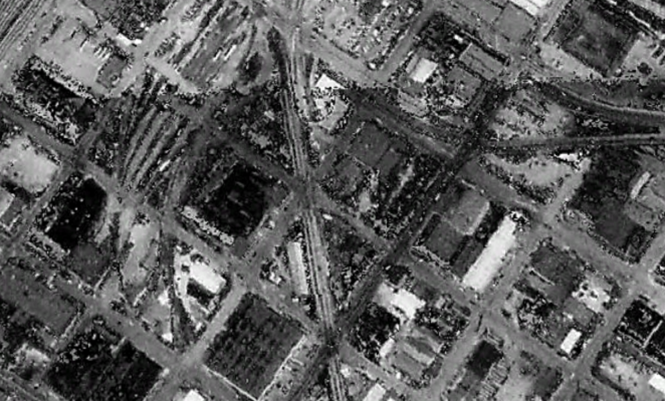
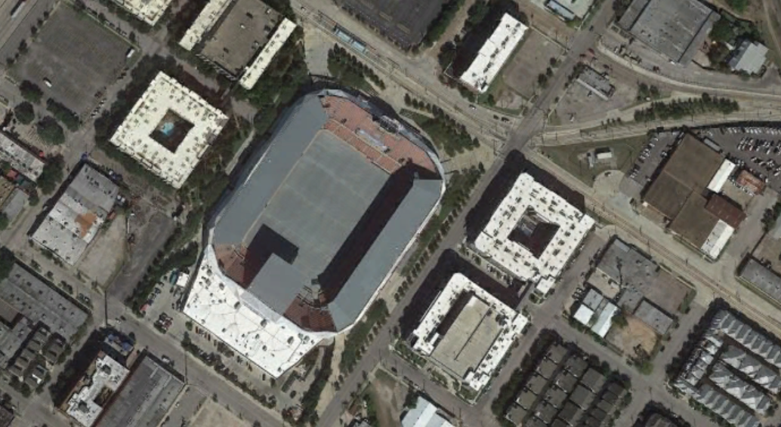


The Brownfields Redevelopment Process
Areas Where TAB Can Assist…….
1. Re-Use Planning
2. Environmental Investigation & Cleanup
3. Redevelop
Notes:
TAB can provide communities assistance in all stages of brownfield redevelopment.

Slide 4

Services May Include
Help identifying and inventorying brownfields
Strategic planning and redevelopment visioning
Economic feasibility and sustainability analysis
Educational workshops
Community outreach and input
Help identify funding sources
Review of grant applications
Help finding and evaluating environmental consultants
Review of project plans and technical reports
Fact sheets and information
Other assistance, as needed and agreed upon

Slide 5
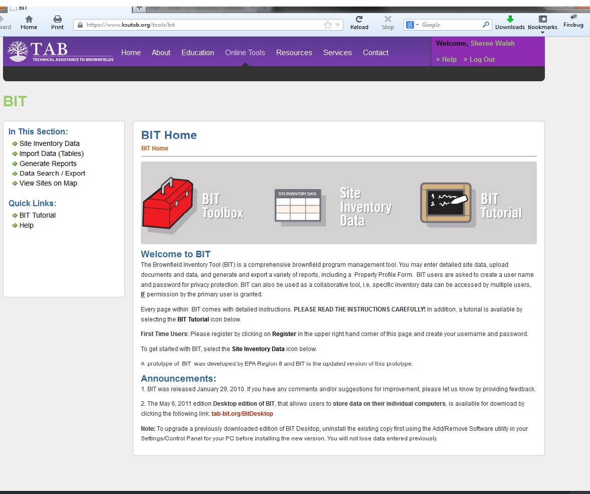

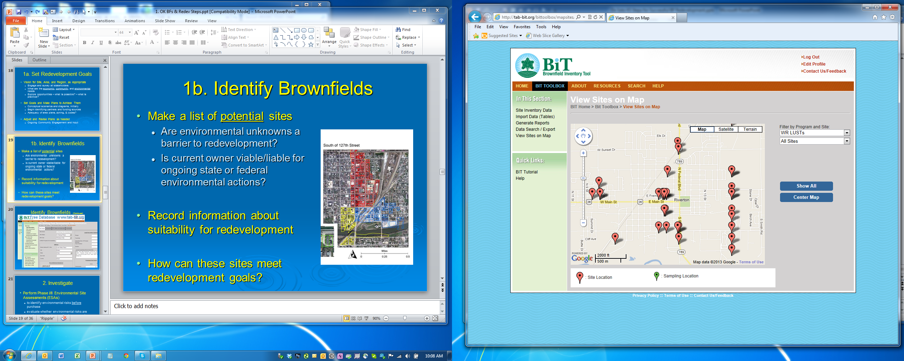
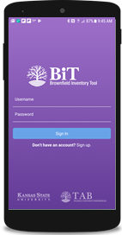
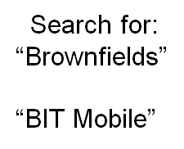

Inventory & Prioritize Sites
www.ksutab.org - Free
Inventory and Prioritize Sites
  Criteria for Revitalization (Examples):
    Health threat?
    Gateway location?
    Blight?
    Utilities?
    Condition?
    Property Access?
    Re-Use Plan & Partners?
  Match to Revitalization Goals

Slide 6
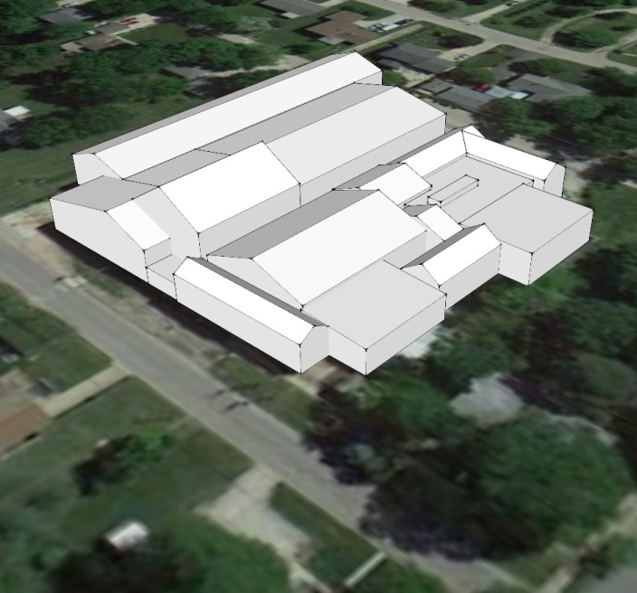
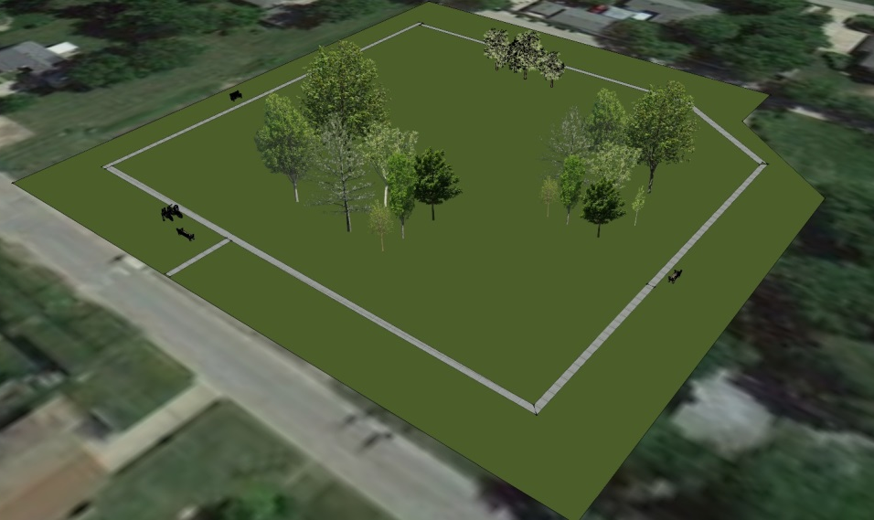
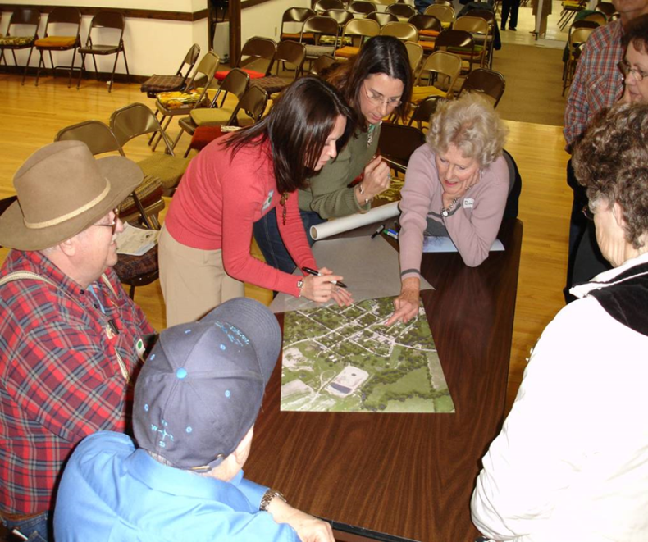
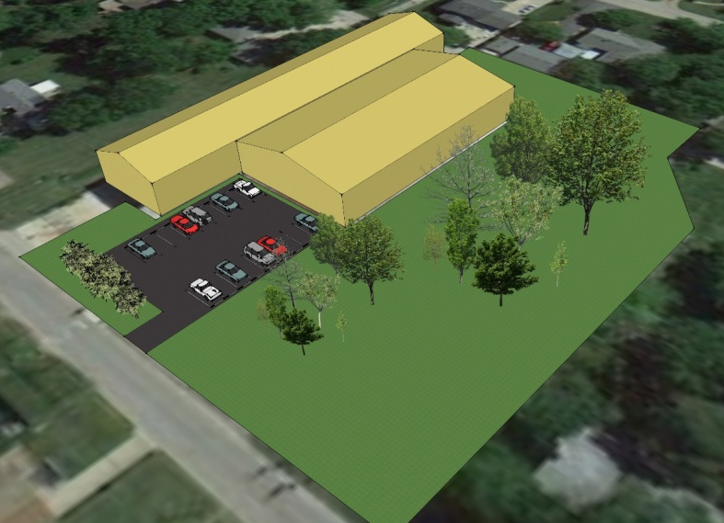
Redevelopment Planning Assistance
Redevelopment Options – based on Community Input
Current
Ottawa, IL
Full Demo for Greenspace or New Residential
Partial Demo for Community/ Business or Multi-family Housing
Leelanau County, MI

Slide 7
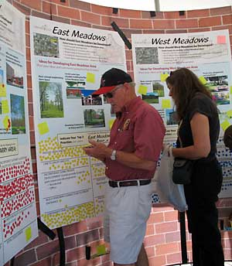
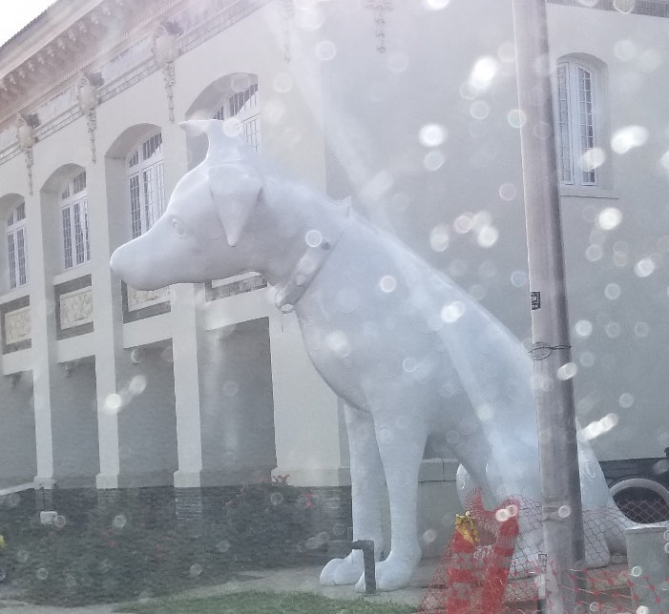
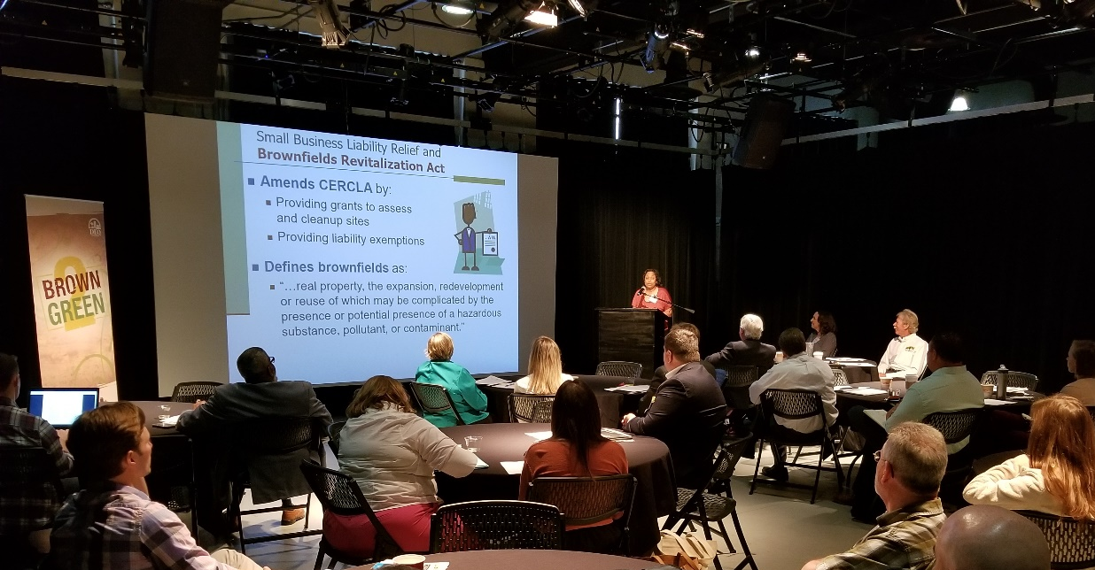
Importance of Community Involvement
  Fact Sheets & News Releases
  Public Meetings
  Workshops/Seminars
  Community Day/Fairs
  Bus Tours
  Walking Tours
  Creates supporters
Springfield, MO
Shreveport, LA

Slide 8
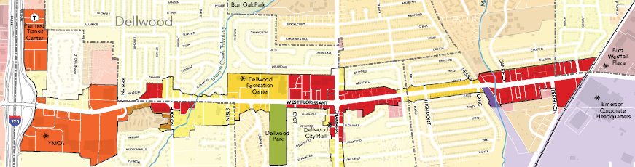
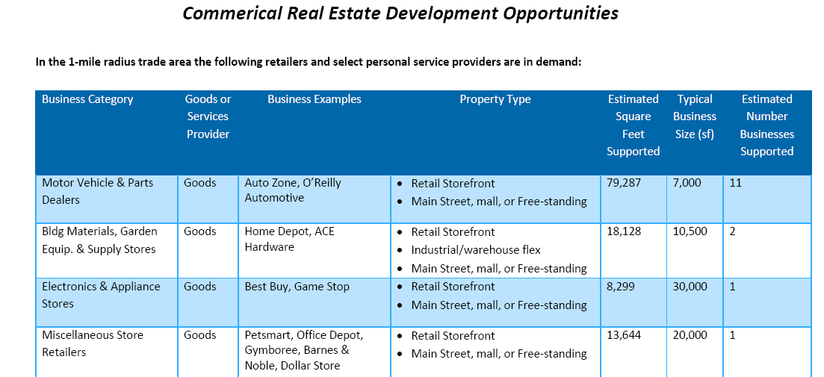
Economic Feasibility
Business Opportunity analysis for several sites on West Florissant Avenue Corridor, MO, by DRP, Inc., a TAB Partner
for Select Business, Retail and Service Categories

Slide 9
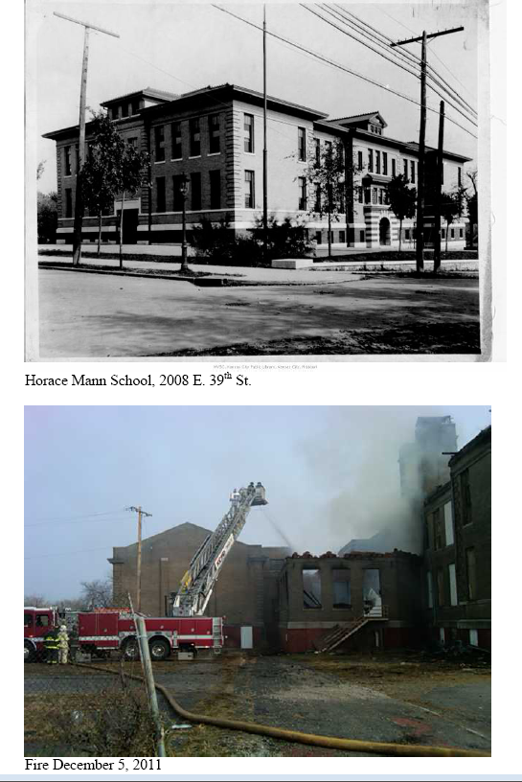
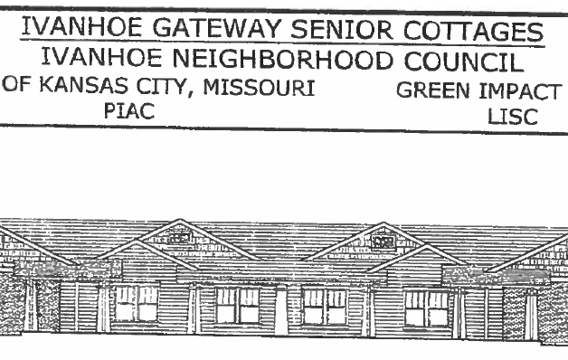
TAB Can Provide Examples, and Review/Provide Comments on Technical Documents . . .
Environmental Assessments & Cleanup
RFPs and Solicitations for Hiring Consultants
Work Plans, QAPPS, Phase I & II ESAs, ABCAs, etc.

Slide 10
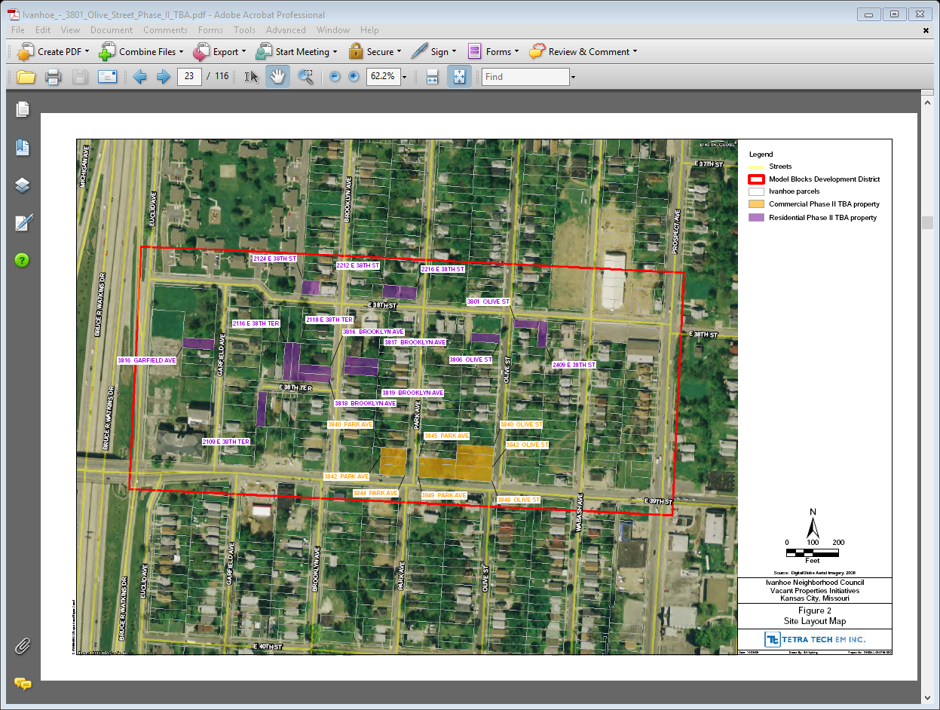
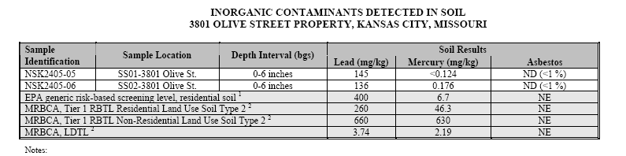
TAB Review
- Area-wide environmental assessment scope & results
Suitable locations for community gardening

Slide 11
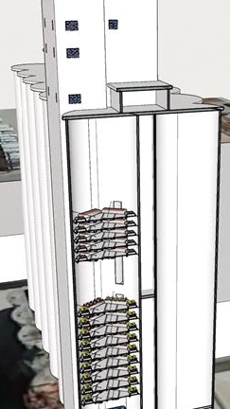


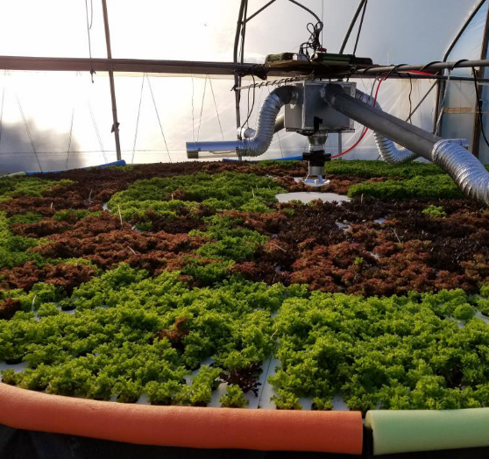
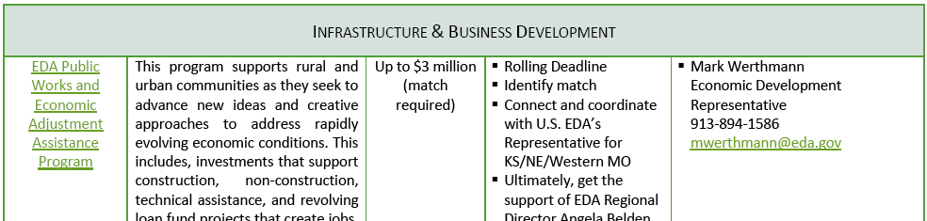
Funding Roadmaps
Funding Road Map, by Sustainable Strategies DC, aTAB Partner, to pursue a funding shortfall for vertical hydroponics garden in Springfield, MO

Slide 12


Thank you
Please contact us
Blase Leven
KSU TAB Programs Director
Ph: 785-532-0780(o)
785-565-8198(m)
baleven@ksu.edu
Scott Nightingale
National Tribal TAB Coordinator
Ph: 785-532-6028
scottnight@ksu.edu
www.ksutab.org
Notes:
Applying for TAB Assistance
Contact by phone or email
Set up a meeting to discuss needs and TAB capability
Agree to a course of action; Get Started!

Slide 13


National Technical Assistance to Brownfields (TAB) Resources
Available to Tribal and Non-Tribal Communities
All EPA Regions
  Kansas State University
  Technical Assistance to Brownfields (TAB) Program
  July, 2019

Slide 14
National TAB Programs
National Workshops
National Webinars
National E-Tools
Tribal TAB Program

Slide 15

Workshops & Webinars
National Workshops
  Brownfields Basics
  Redevelopment Roundtables
  Tribal Response Program
  Tribal Leveraging Resources
  Tribal Redevelopment Planning
New Grantee Webinar Series (recording/slides available!)
2018 First Things First – Getting Started with your EPA ARC Brownfield Grant https://www.ksutab.org/education/webinars/details?id=323
2018 New EPA ARC Grantees: Getting a Contractor On Board https://www.ksutab.org/education/webinars/details?id=331
2019 Tech Basics for New Grantees https://www.ksutab.org/education/webinars/details?id=339
2019 Site Investigation Basics – Sampling and QAPPs Anyone? https://www.ksutab.org/education/webinars/details?id=352
July 18, 2019 Community Engagement 101: Ideas, Rationale, and Methods for Facilitating Public Participation in Brownfield Redevelopment https://www.ksutab.org/education/webinars/details?id=364

Slide 16

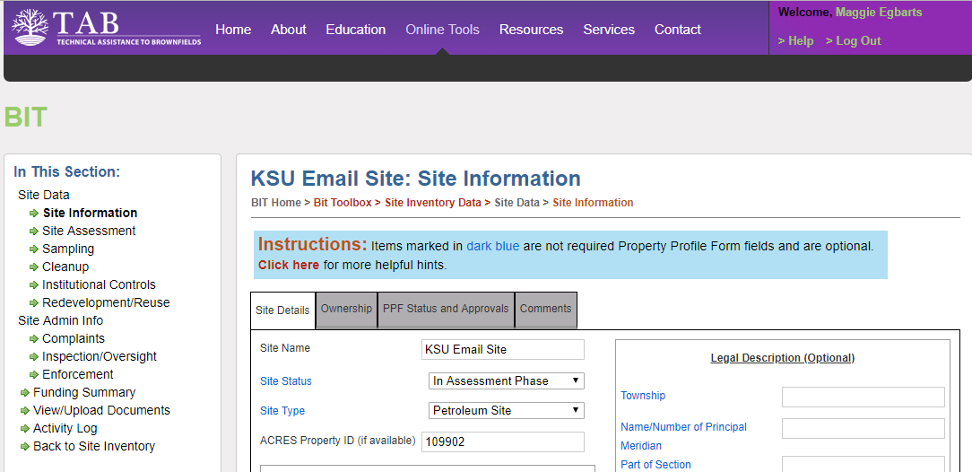
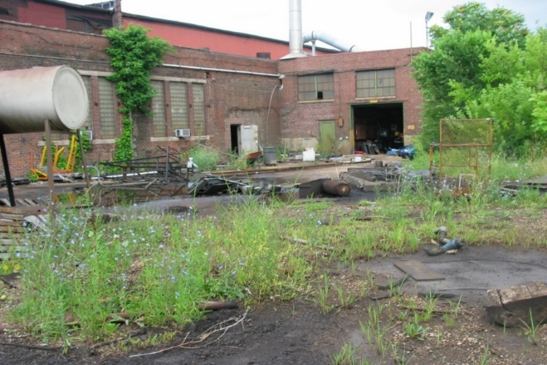
Stores & Manages Site Data:
Site survey & inventory
Structured to mirror the brownfields redevelopment process
  Site details
  Assessment, cleanup, institutional controls
  Redevelopment
Upload photos and documents
Generate maps
www.ksutab.org/tools

Slide 17

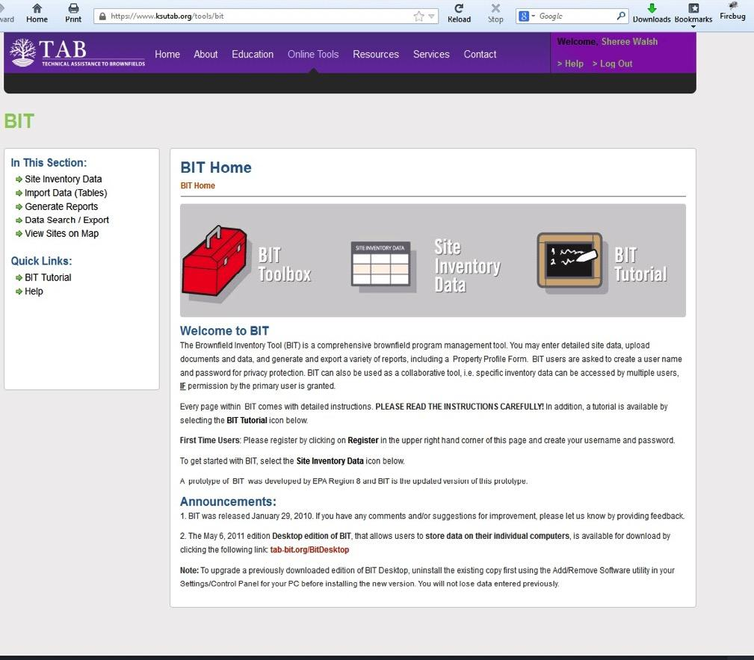
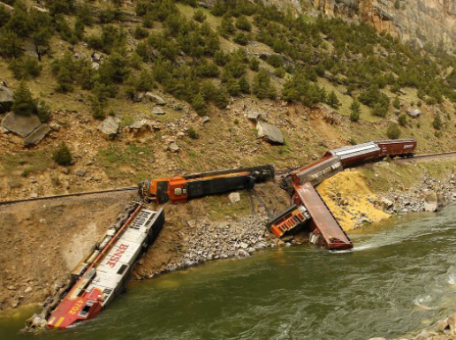
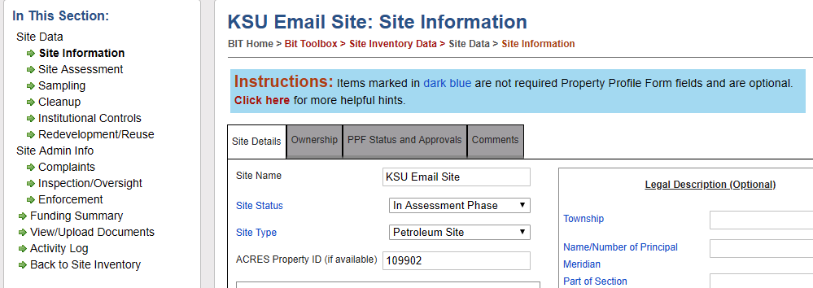
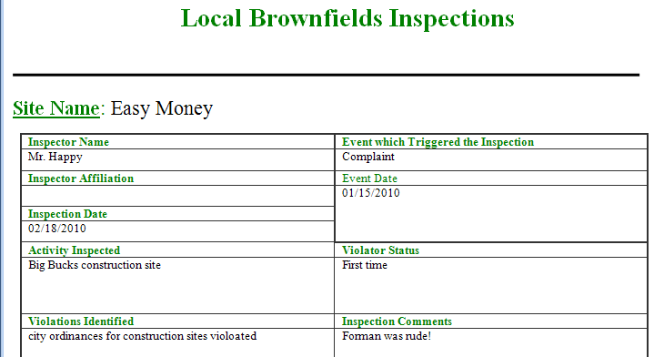
Stores & Manages Site Data:
Also Oversight/enforcement/completion of Response actions
  Complaints
  Inspection/Oversight
  Enforcement
Sampling data too!
Activity log
Public record & community outreach

Slide 18


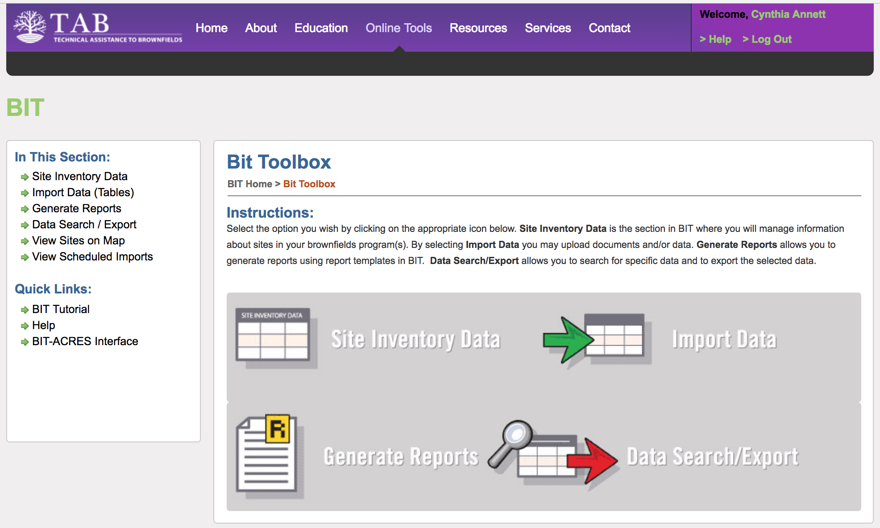
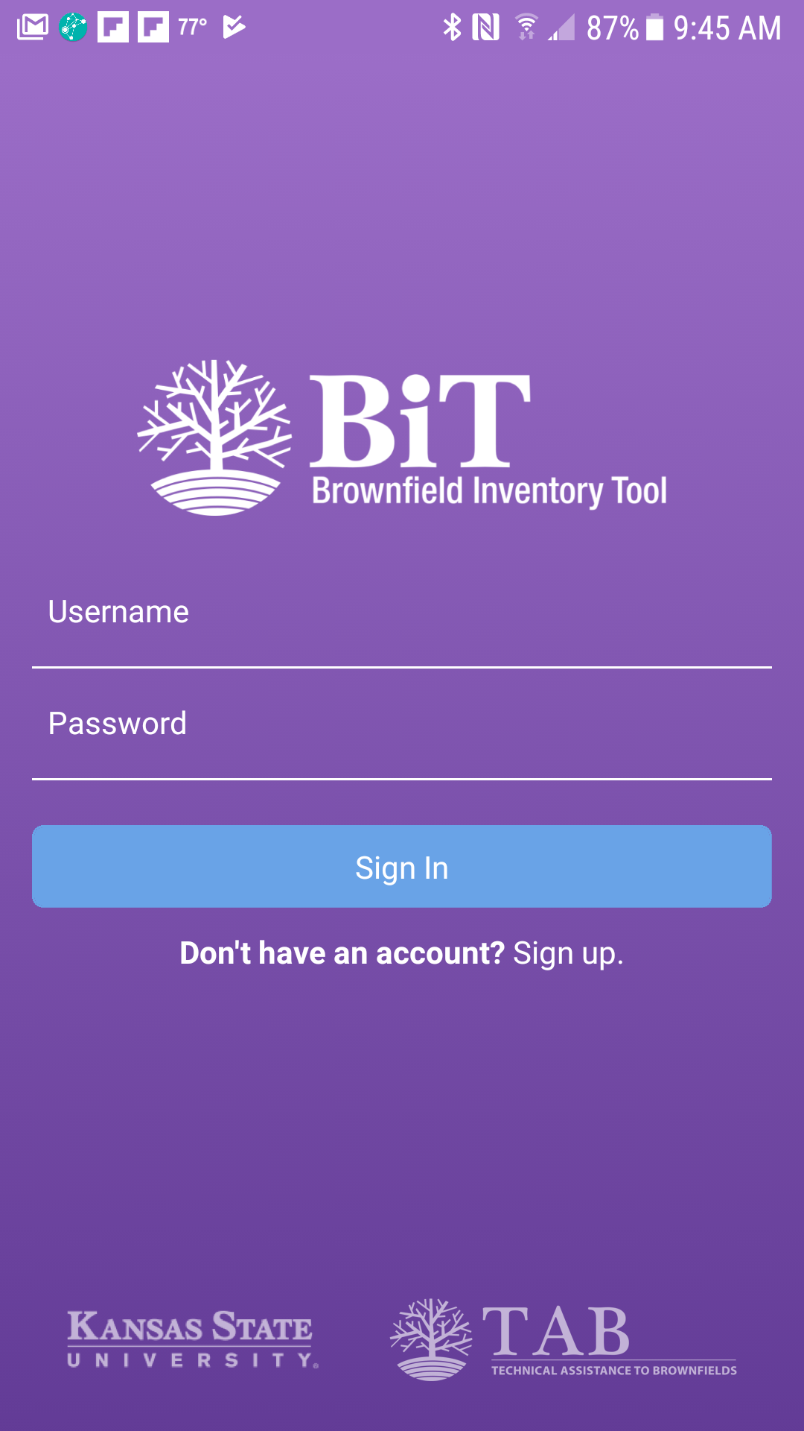

Desktop or Laptop
Online
Mobile
Online/offline
BiT app
BiT
EPA ACRES

Slide 19
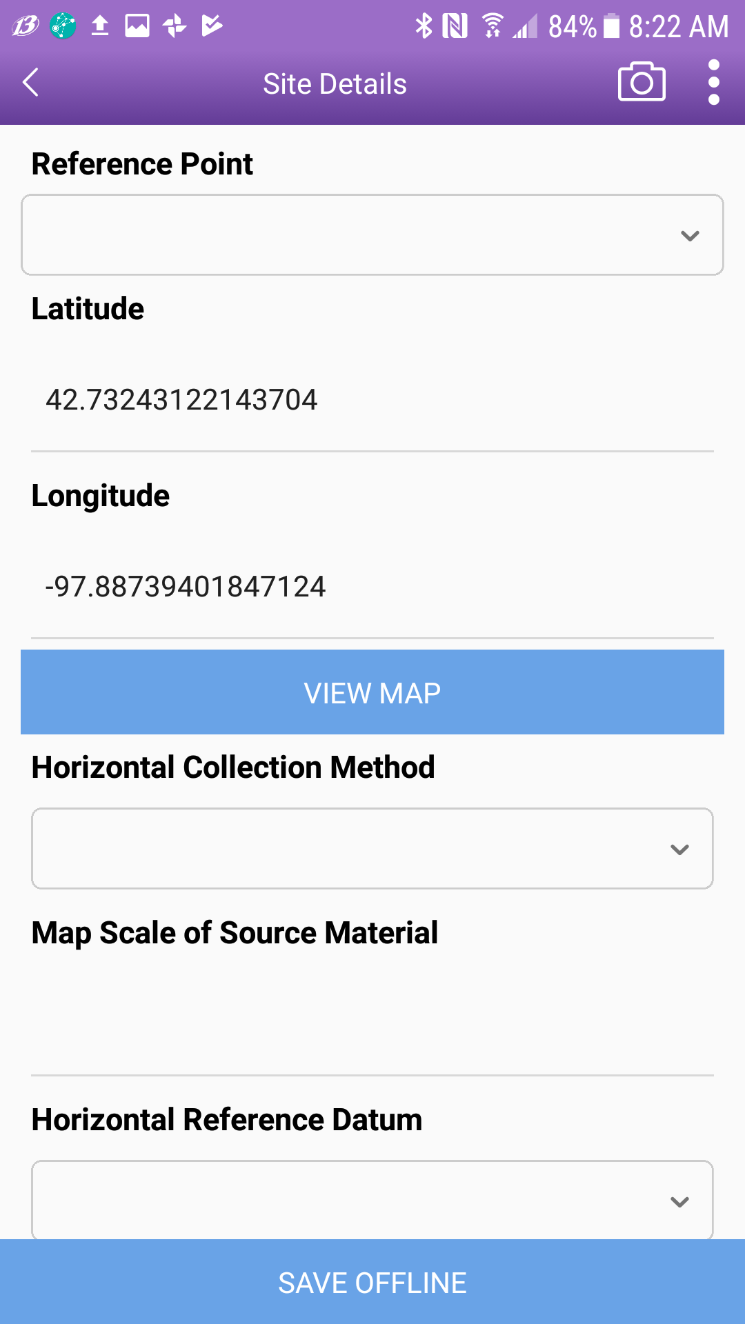
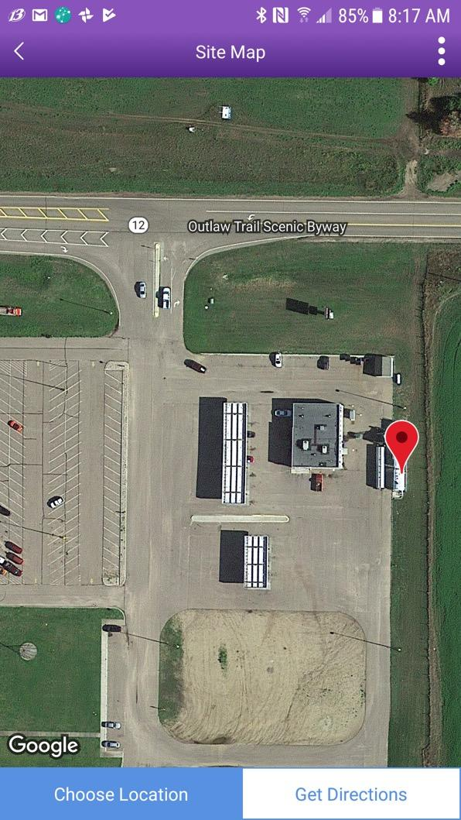
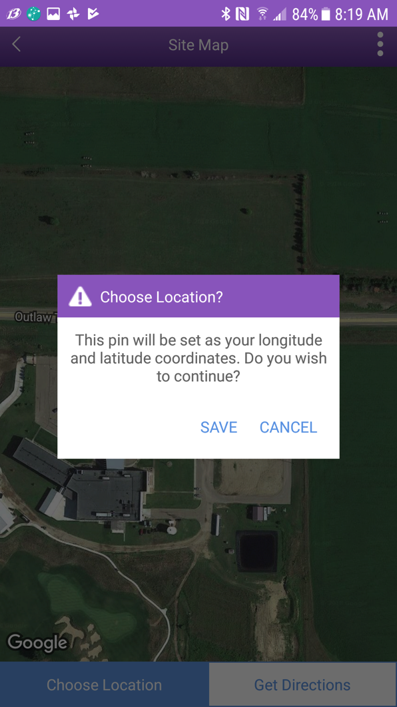
Collect Photos, GPS Coordinates, and More in the field!
To move pin touch the screen (lightly) in new location

Slide 20
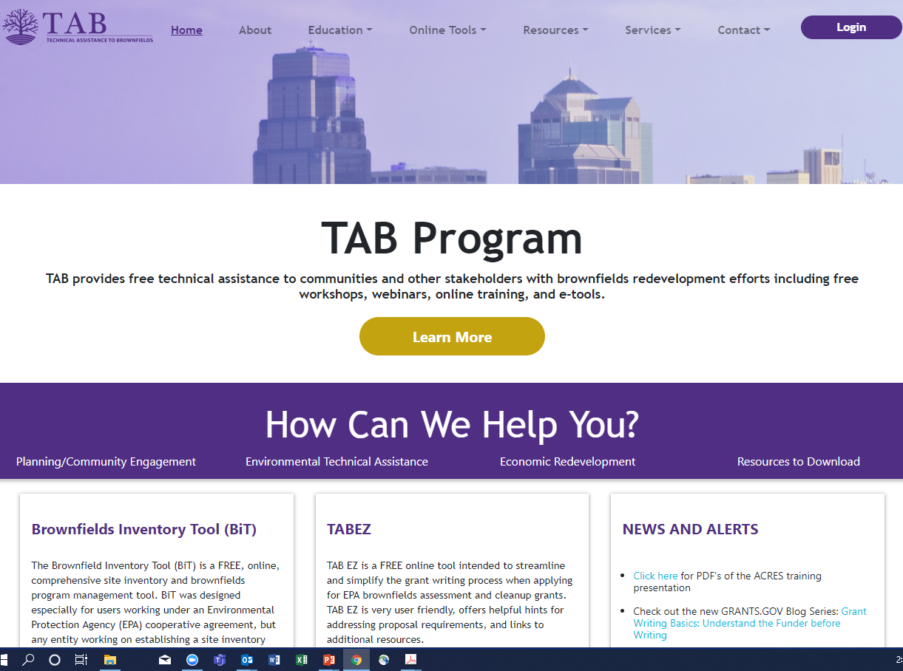
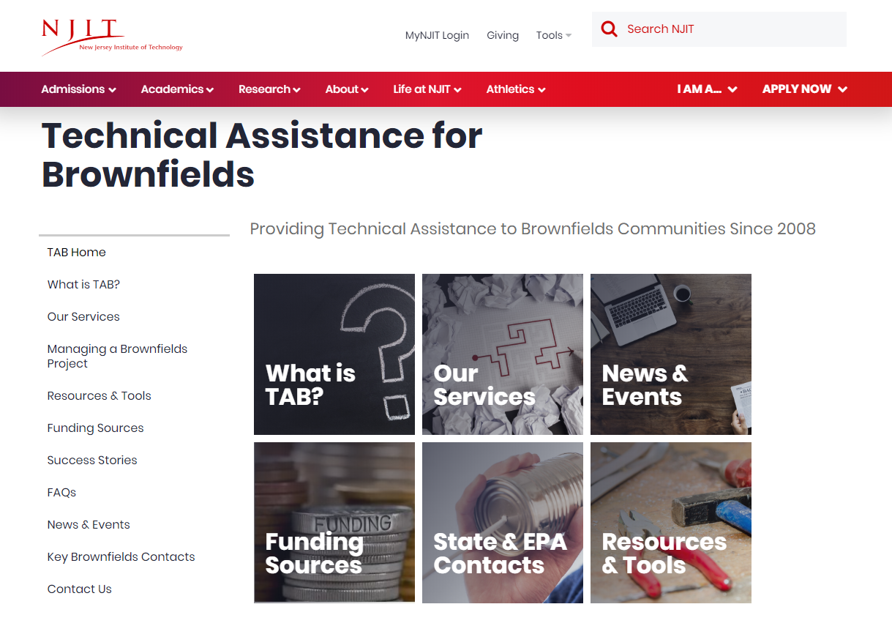
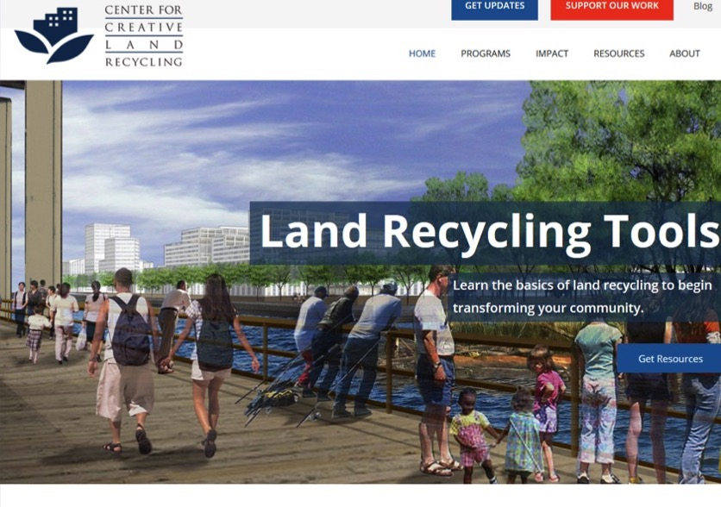
TAB Program Websites
www.ksutab.org
www.njit.edu/tab
www.cclr.org

Slide 21


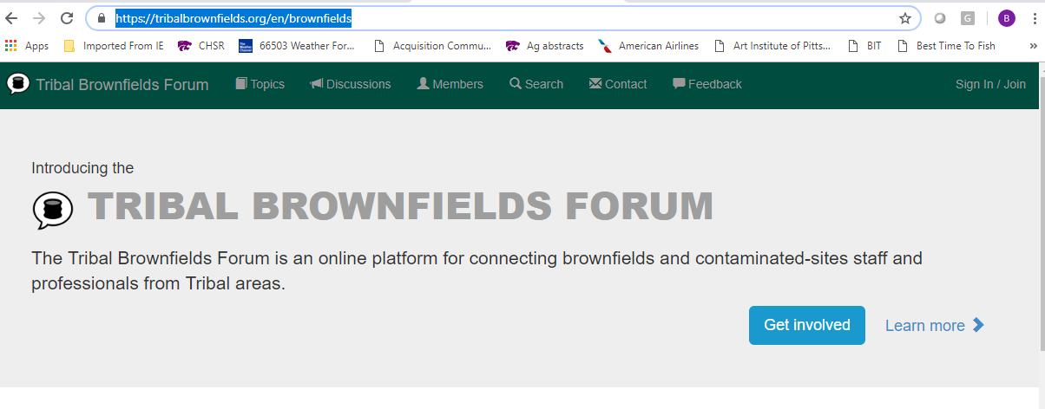
Tribal Environmental Professional Networking Platform – Try it!
https://tribalbrownfields.org
Demo

Slide 22

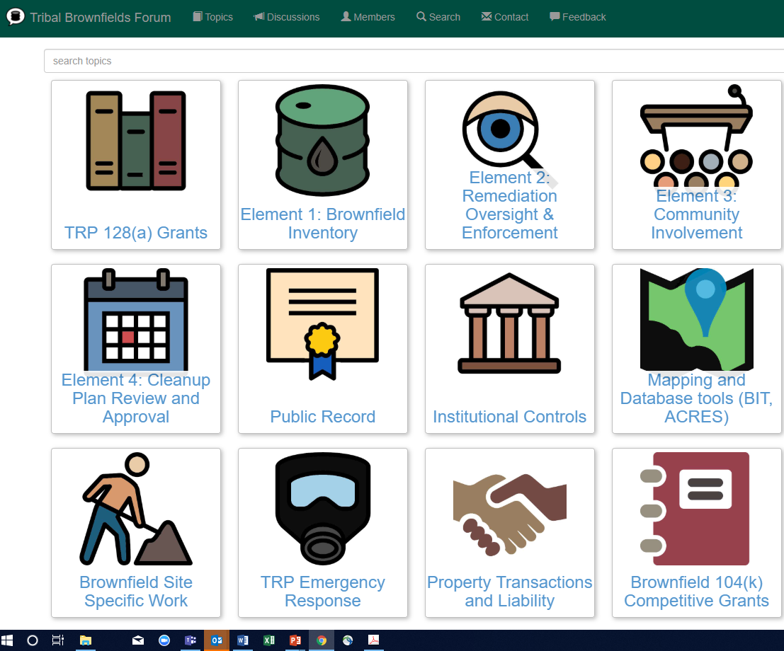

EPA Tribal Technical Assistance to Brownfields (TAB) Program
Blase Leven
KSU Tribal TAB Program

Slide 23
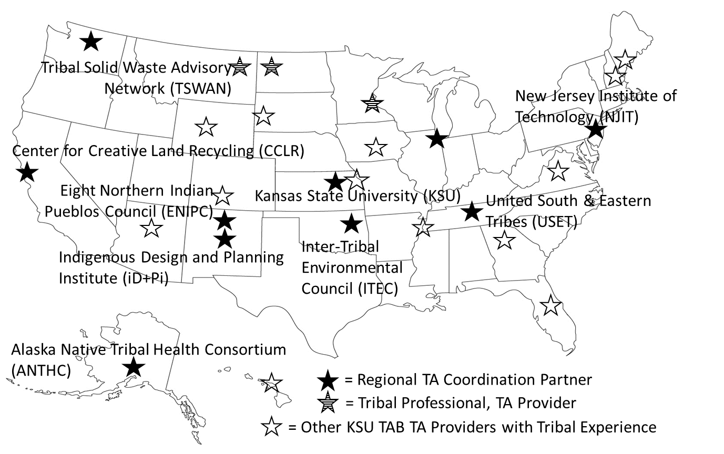
Tribal Technical Assistance to Brownfields (TAB) Program
Free help with planning, environmental and economic development
Funded by EPA via a grant to Kansas State University
Coordinated through TRP/brownfields coordinator
Notes:
Services may include:
Community outreach planning
Help identify funding sources
Educational workshops
Help with redevelopment plans and visioning sessions
Review of grant applications
Help finding and evaluating environmental consultants
Review of project plans and technical reports
Fact sheets and information
Other assistance, as needed and agreed upon

Slide 24
One-on-One TAB assistance Includes:
Help with contracting, finding and evaluating environmental consultants
Review of site project plans, QAPPs and technical reports
Community engagement and re-use planning
Review of 104(k) competitive brownfields grant applications
Web tools
Other assistance, as needed and agreed upon

Slide 25
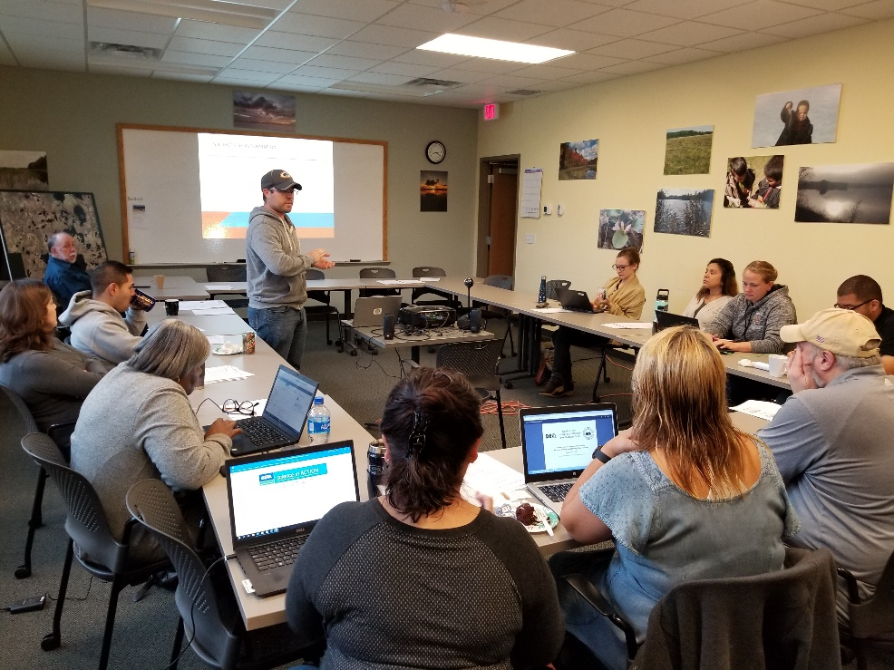
Assistance & Training to Tribes
Training sessions at conferences
Workshops & Roundtables
RTOC meetings
Local Tribal meetings
Tribal Mentors
Troy Techlin, Saginaw-Chippewa Brownfields Coordinator

Slide 26
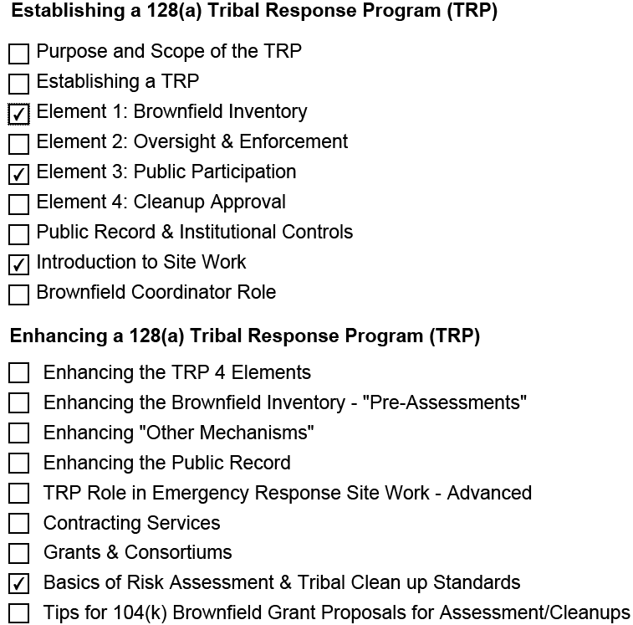
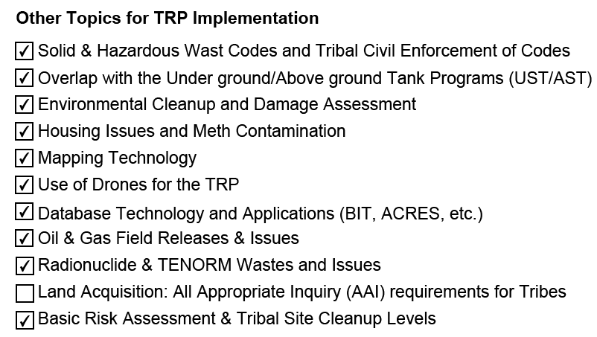
Assistance and Training Topics

Slide 27
Thank you
Please contact us
Blase Leven
KSU TAB Programs Director
Ph: 785-532-0780(o)
785-565-8198(m)
baleven@ksu.edu
Scott Nightingale
National Tribal TAB Coordinator
Ph: 785-532-6028
scottnight@ksu.edu
www.ksutab.org
Notes:
Applying for TAB Assistance
Contact by phone or email
Set up a meeting to discuss needs and TAB capability
Agree to a course of action; Get Started!

