Slide 1
Moderator
Malcolm Guy IV
Coordinator, Government & External Affairs
Council of Development Finance Agencies
See all of CDFA’s resources online at www.cdfa.net/resources
Notes:
Hello! My name is Malcolm Guy and I’m a Coordinator of Government & External Affairs here at CDFA. I work on the Brownfields Program with my colleagues..
I’d like to first thank the EPA for inviting us to present about the CDFA Brownfields Technical Assistance Program. The program would not be possible without the support of the EPA.

Slide 2
Legal Disclaimer
CDFA is not herein engaged in rendering legal, accounting, financial or other advisory services, nor does CDFA intend that the material included herein be relied upon to the exclusion of outside counsel or a municipal advisor. This publication, report or presentation is intended to provide accurate and authoritative general information and does not constitute advising on any municipal security or municipal financial product. CDFA is not a registered municipal advisor and does not provide advice, guidance or recommendations on the issuance of municipal securities or municipal financial products. Those seeking to conduct complex financial transitions using the best practices mentioned in this publication, report or presentation are encouraged to seek the advice of a skilled legal, financial and/or registered municipal advisor. Questions concerning this publication, report or presentation should be directed to info@cdfa.net.
Notes:
CDFA does not provide legal, accounting, or professional advice. Similarly, CDFA is not herein engaged in rendering legal, accounting, financial, or other advisory services. We encourage you to seek expert counsel should you need direct advice about the subject matter.

Slide 3
Financing Toolkit
Webinar
Series
Project
Marketplace
Project Response Teams
CDFA Brownfields Technical Assistance Program — www.cdfabrownfields.org
Notes:
I’d like to first thank the EPA for inviting to present to everyone about the CDFA Brownfields Technical Assistance Program. The program would not be possible without the support of the EPA so we thank them for that as well.
I also wanted to briefly introduce CDFA. The Council of Development Finance Agencies is a 37 year old national non-profit trade association devoted to providing research, resources, education and networking opportunities to community and economic development finance practitioners across the U.S. From bond financing to TIF and Special Assessment to Tax Credits to Revolving Loan Fund, CDFA touches the whole gamut of financing tools available to communities to support their economic development ecosystem. About 70% of the people we work with are from the public sector and the quasi-public sector and the remaining 30% are from the private and non-profits sector.
Our Brownfields Technical Assistance Program is a part of our research and technical assistance team. The Program has 4 key characteristics and opportunities for communities with Brownfields sites to gain some information, resources and guidance on what is often the most difficult part of redevelopment: financing. I’m going to walk through them very briefly in this presentation.

Slide 4
Notes:
First I’d like to introduce you to our Brownfields program’s website. You can find it by visiting cdfabrownfields.org. You can also find it on our main website cdfa.net by clicking to the Brownfield Research page.

Slide 5
Brownfields Financing Toolkit
Notes:
The first major benefit that we provide to communities with Brownfields is resources. Our Brownfields Financing Toolkit is an database full of Brownfield specific case studies and information on all of the tools we cover here at CDFA. CDFA has both a long history of research and an incredible research team who is constantly searching for new examples of great projects, ideas and innovative solutions to financing Brownfields redevelopment. All resources in the Brownfields Financing Toolkit are free and available to communities so I encourage you to visit our website and explore.

Slide 6
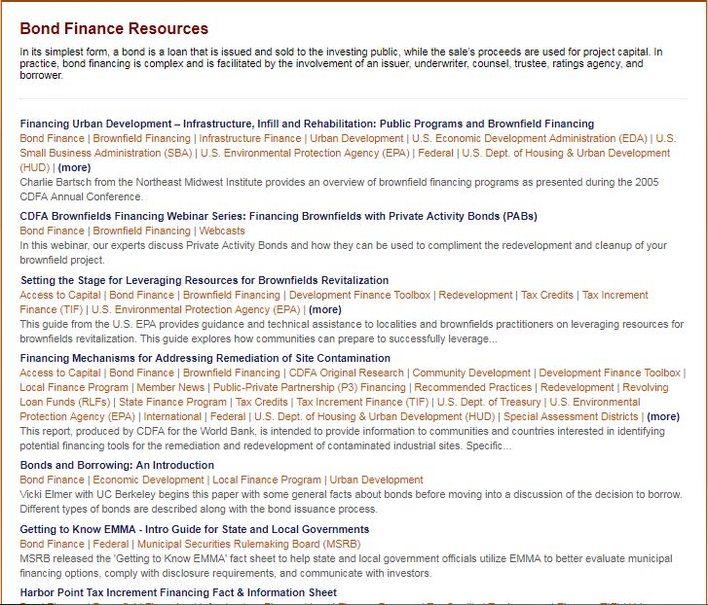
Notes:
I wanted to briefly show an example of one of those resource pages. Here is our Bonds section. You’ll finds each toolkit page some good core resources to explain the who, what and how of each tool.

Slide 7
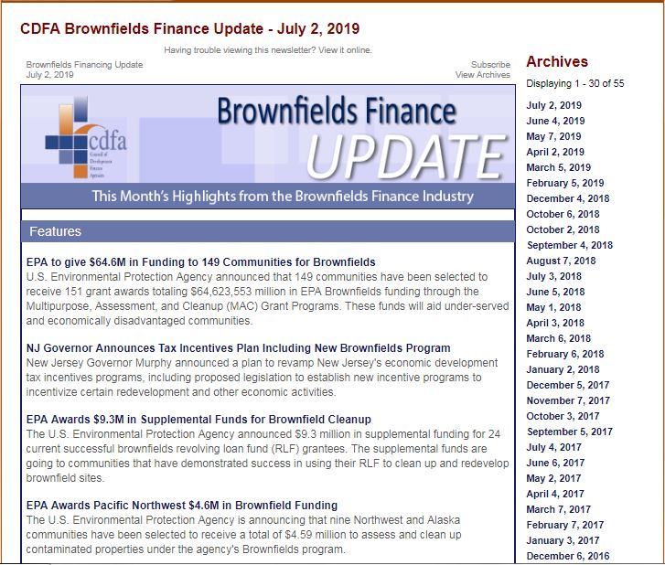
Notes:
Another significant resource that I’d like to mention is our Brownfields Finance Update newsletter. Also completely free, this monthly newsletter is the best way to keep up with Brownfield projects across the U.S. CDFA staff aggregates headlines daily on all topics we cover and then handpicks each month, the best of the best of what’s happening in the Brownfield finance world.

Slide 8
Brownfield Financing Webinar Series
Previous Topics Include:
Reimaging Brownfields as Transit Oriented Developments
Hazardous to Healthy: Financing Solutions for Recovering Brownfields
Financing Brownfields with Private Activity Bonds
Reviving Economic Activity on Former Manufacturing Sites
Strategic TIF Structuring for Brownfield Redevelopment
Reaching Your Redevelopment Goals with Brownfields Revolving Loan Funds
Brownfields to Brightfields
Opportunity Zones and Brownfield Redevelopment
Notes:
Another part of our Technical Assistance Program that I’d like to discuss is our webinar series. For the past five year, CDFA has been producing hyper-specific and topical Brownfield Financing Webinar on everything from TIF Structuring to Renewable Energy Development on Contaminated Land to Food Systems development on Brownfields. The webinars are an hour and a half and you can view recordings and download the presentations for every one we’ve produced for free on the CDFA Brownfields website.

Slide 9
Brownfields Project Marketplace
What is the Marketplace?
Forum that connects communities
looking to finance brownfield redevelopment projects with development financiers and brownfield project experts
Community Benefits:
Discover financial resources
Direct access to financial advisors and brownfield experts
Notes:
Next, I’d like to talk about our direct Technical Assistance work. The first way to gain direct technical assistance is through a Brownfields Project Marketplace. Typically CDFA’s technical assistance is most applicable, as I mentioned earlier, to figuring out end-use financing. The Brownfields Project Marketplace is a way for communities at the very early stages of thinking about the end-use of their Brownfields site. Communities present either online or in-person at an event to a group of advisors and can get quick pointed feedback on financing and redevelopment strategies for the communities specific project.

Slide 10
Project Response Teams
What is a Project Response Team Visit?
1-2 Day visit of brownfield site with CDFA staff members and hand-picked project specific advisors
Project team meets with stakeholders and develops a Roadmap to Redevelopment report to provide next recommendations
Community Benefits:
Completely free to the community
Specific and targeted financing recommendations for the project
Provide real resources and financing tool information to community in the form of a written report
Notes:
Next, I want to give you a little information about our most powerful and value-added type of technical assistance which is on-site project response teams. CDFA staff and two hand-picked advisors attend one and a half to two days of meetings with stakeholders from the community. We learn about the project from every perspective, learn about the challenges, constraints and opportunities. Out team then produces a Road to Redevelopment Report with both our next step recommendations to get the project moving and our financing recommendations based on the proposed end use.
Communities are chosen for this technical assistance based on their readiness to discuss their project in terms of financing. We are best suited for communities with an end use already proposed. We provide the best feedback when communities already have soft development numbers or are thinking thorough any gap financing.

Slide 11
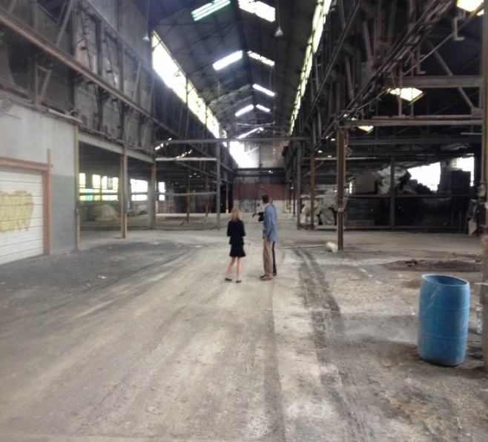
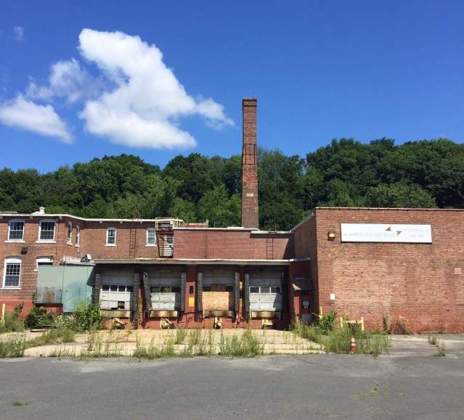
Project Response Teams
Previous Recipients:
Texarkana, TX
Tulsa, OK
Kalispell, MT
Josephine County, OR
Longmont, CO
New Bern, NC
Englewood, IL
Bedford Heights, OH
Lee, MA
New Orleans, LA
Springfield, MO
Burlington, VT
Bend, OR
Pueblo, CO
Sheridan, CO
Texarkana, AR
Fresno, CA
Ponce, PR
Pensacola, FL
Fresno, CA
Dellwood, MO
Casper, WY
Greenfield, OH
Everett, WA
Arnaudville, LA
Oregon City, OR
Williamsport, PA
Anchorage, AK
Troy, NY
St. Mary, GA
Duluth, MN
Notes:
Here are all of the technical assistance trips we’ve made over the past five years. We’ve definitely hit quite a few places!

Slide 12
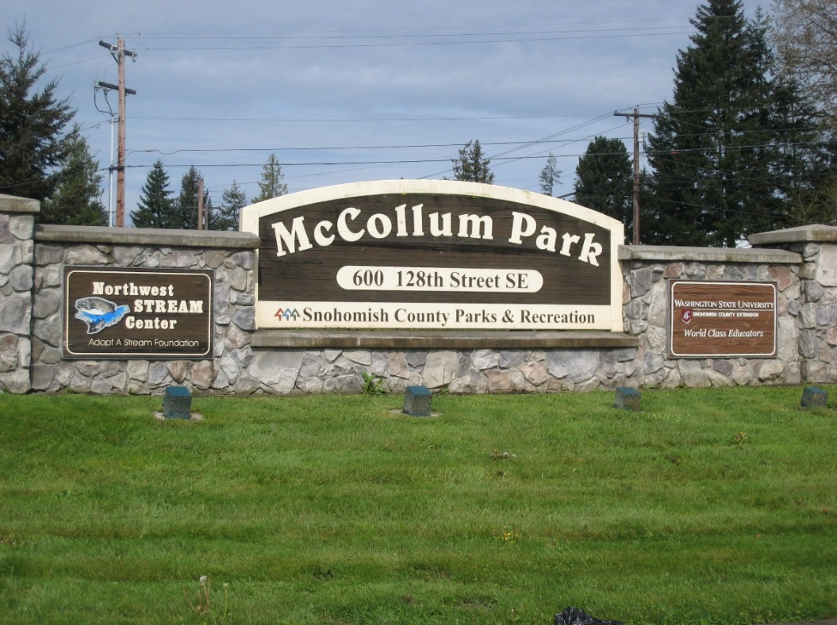
Snohomish County Food Hub Everett, WA
Challenges:
Adjacent to a capped unregulated landfill
Was not at its highest and best use
Community was looking for better ways to support their farming community and local food system
Financing Strategies:
GO Bonds
Federal Grants, State Grants
Revolving Loan Funds, TIF, Special Assessment
Notes:
I wanted to give you just a couple of project examples. Snohomish County wanted to reuse a former landfill, now municipal park into a new food hub for the local communities. With aggregation facilities, a farmer’s market and commercial kitchen space. The community wanted to give more outlets that supported farming in the county north of Seattle which had seen a significant farmland reduction over the past 20 years.

Slide 13
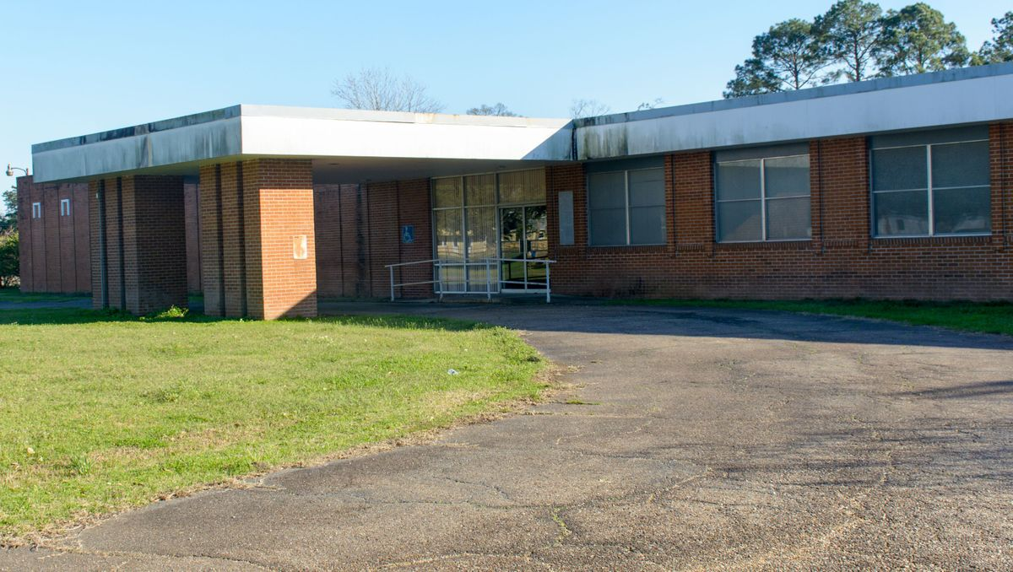
St. Luc’s Cultural Immersion Center Arnaudville, LA
Challenges:
Urgently needed $300K to acquire property
Business Plan needed updated
State and Local Financing Partners needed to be further engaged.
Financing Strategies:
501(c)3 Bonds
Historic Tax Credits
Federal, State & Local Grants
Notes:
This one we did in February with Arnaudville, Louisiana where they wanted to reuse an abandoned hospital as a new Cultural Immersion Center for Cajun, Creole and French Louisiana. This center had the potential to be significant economic driver of their already strong place-based economic development initiatives. We met and discussed some of the studies and documentation that needed to be done to update their business plan and then worked on educating the community on potential public finance tools like 501(c)3 Bonds and historic tax credits

Slide 14
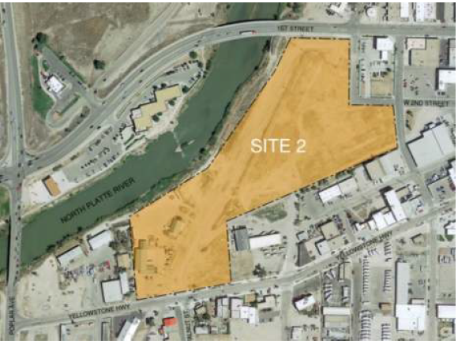
Casper Hotel & Conference Center Casper, WY
Challenges:
Community needed a new large gathering place for statewide events
Construction costs are high
Taxes are relatively low and are not often used to finance new development
Financing Strategies:
Opportunity Zone Investment
Private Activity Bond Financing
New Markets Tax Credits
Notes:
Another project we provided technical assistance for was in Casper, Wyoming where they were looking to embark on a large hotel and conference center as part of their downtown revitalization. We discussed many of the challenges associated with two potential project sites and educated the communities on Opportunity Zones, Private Activity Bonds and New Markets Tax Credits.

Slide 15
Upcoming Events
On-Line Project Marketplace
July 25, 2019
30 minute sessions available: 12:00-2:00pm Eastern
REGISTER!
Contact:
James Metz
Coordinator, Research & Technical Assistance
614-705-1316
jmetz@cdfa.net
In-Person Project Marketplace – Tampa, FL
Nov 7, 2019
CDFA National Development Finance Summit
REGISTER!
Now Scheduling Interviews for Project Response Teams!
Notes:
Lastly, just to mention a couple events coming up….we have technical assistance openings for our project response team visits and the project marketplaces.

Slide 16
Contact:
Pearl-Jean Mabe
Director, Research & Technical Assistance
614-705-1315
pmabe@cdfa.net
Malcolm Guy
Coordinator, Government & External Affairs
614-705-1306
mguy@cdfa.net
James Metz
Coordinator, Research & Technical Assistance
614-705-1316
jmetz@cdfa.net
CDFA Brownfields Technical Assistance Program — www.cdfabrownfields.org

Slide 17
Upcoming Events
CDFA Summer School
August 12-16, 2019 | Detroit, MI
Register online at www.cdfa.net

Slide 18
Upcoming Events
CDFA National Development Finance Summit
November 6-8, 2019 | Tampa, Florida
Register online at www.cdfa.net
Notes:
We have an in-person project marketplace at our National Summit this year.

Slide 19
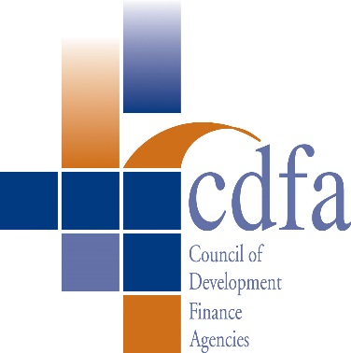
Pearl-Jean Mabe
Director, Research & Technical Assistance
614-705-1315
pmabe@cdfa.net
James Metz
Coordinator, Research & Technical Assistance
614-705-1316
jmetz@cdfa.net
This webcast is designed to provide accurate and authoritative information in regard to the subject matter covered. It is available with the understanding that CDFA and the panelists are not engaged in rendering legal, accounting, or other professional services. If legal advice or other expert assistance is required, the services of a competent professional should be sought.
Notes:
Any questions? Reach out! We’re happy to chat.

