Slide 1
Equitable Development Technical Assistance from Groundwork USA
Brownfield Resources Webinar Series
July 2019
Cate Mingoya. Cate@groundworkusa.org

Slide 2
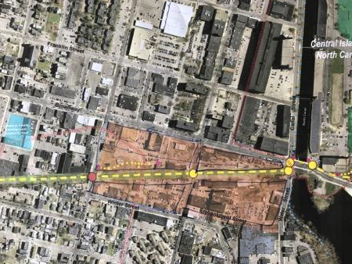
What we’ll cover today:
Introduction to GWUSA
Ready to Roll Tools and Resource
Free Technical Assistance Program
Notes:
Hi everyone!
Thank you so much for being with us today and a big thank you to Aimee Storm for organizing this webinar. I’m Cate Mingoya, Groundwork USA’s director of Capacity building. We’re lucky enough to receive generous funding from the EPA to offer equitable development technical assistance. During my presentation I’ll tell you a little about us and the work we do, discuss, high level, our T.A> offerings, introduce you to some ready to roll tools and resources and finish it up with a discussion around our one-on-one client technical assistance program.

Slide 3
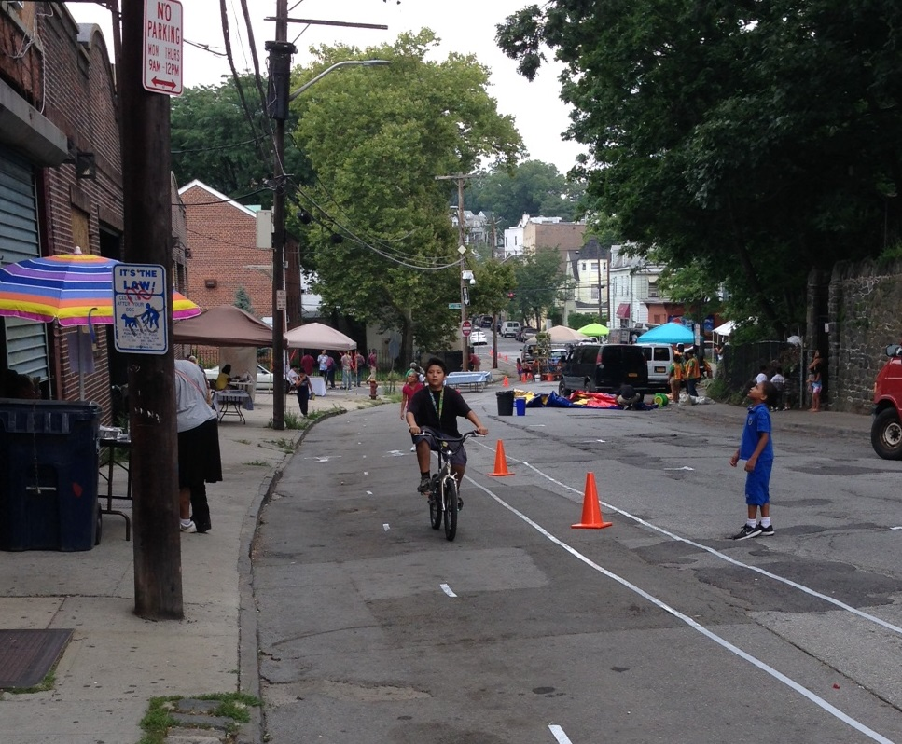
About Groundwork USA
People-centered environmental organization focusing on urban areas and the relationship between community and environmental wellbeing.
Notes:
A little bit about us.
We are a people-centered environmental organization that sees a strong connection between the built environment, how it’s used and one’s wellbeing.

Slide 4
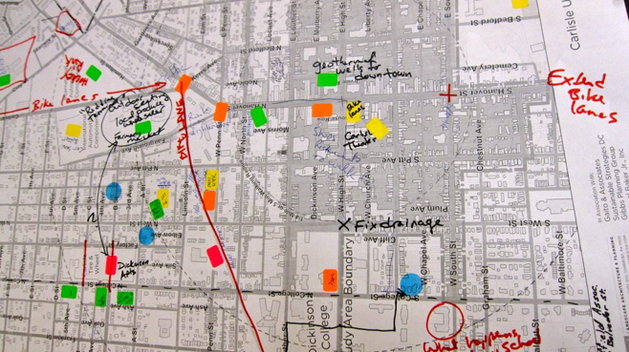
About Groundwork USA
Changing Places
Land reclamation + transformation
Waterway restoration + enhancement
Changing Lives
Education + Youth Development
Workforce Development + Job Training
Environmental stewardship
Changing Systems
Community Assessment + Visioning
Community mobilization
Advocacy + Partnerships
Learn more at Groundworkusa.org
Notes:
Our main focus over the past 20-ish years has been changing places through the reclamation and transformation of underutilized and often contaminated land into community-driven assets, and encouraging the restoration and enhancement of urban waterways through our Urban Waters Learning Network; changing lives through robust youth and young adult education, workforce development and environmental stewardship, and changing systems by prioritizing relationships and partnerships in the name of building capacity in communities so that they can develop and lead their own visions for developing their communities.

Slide 5
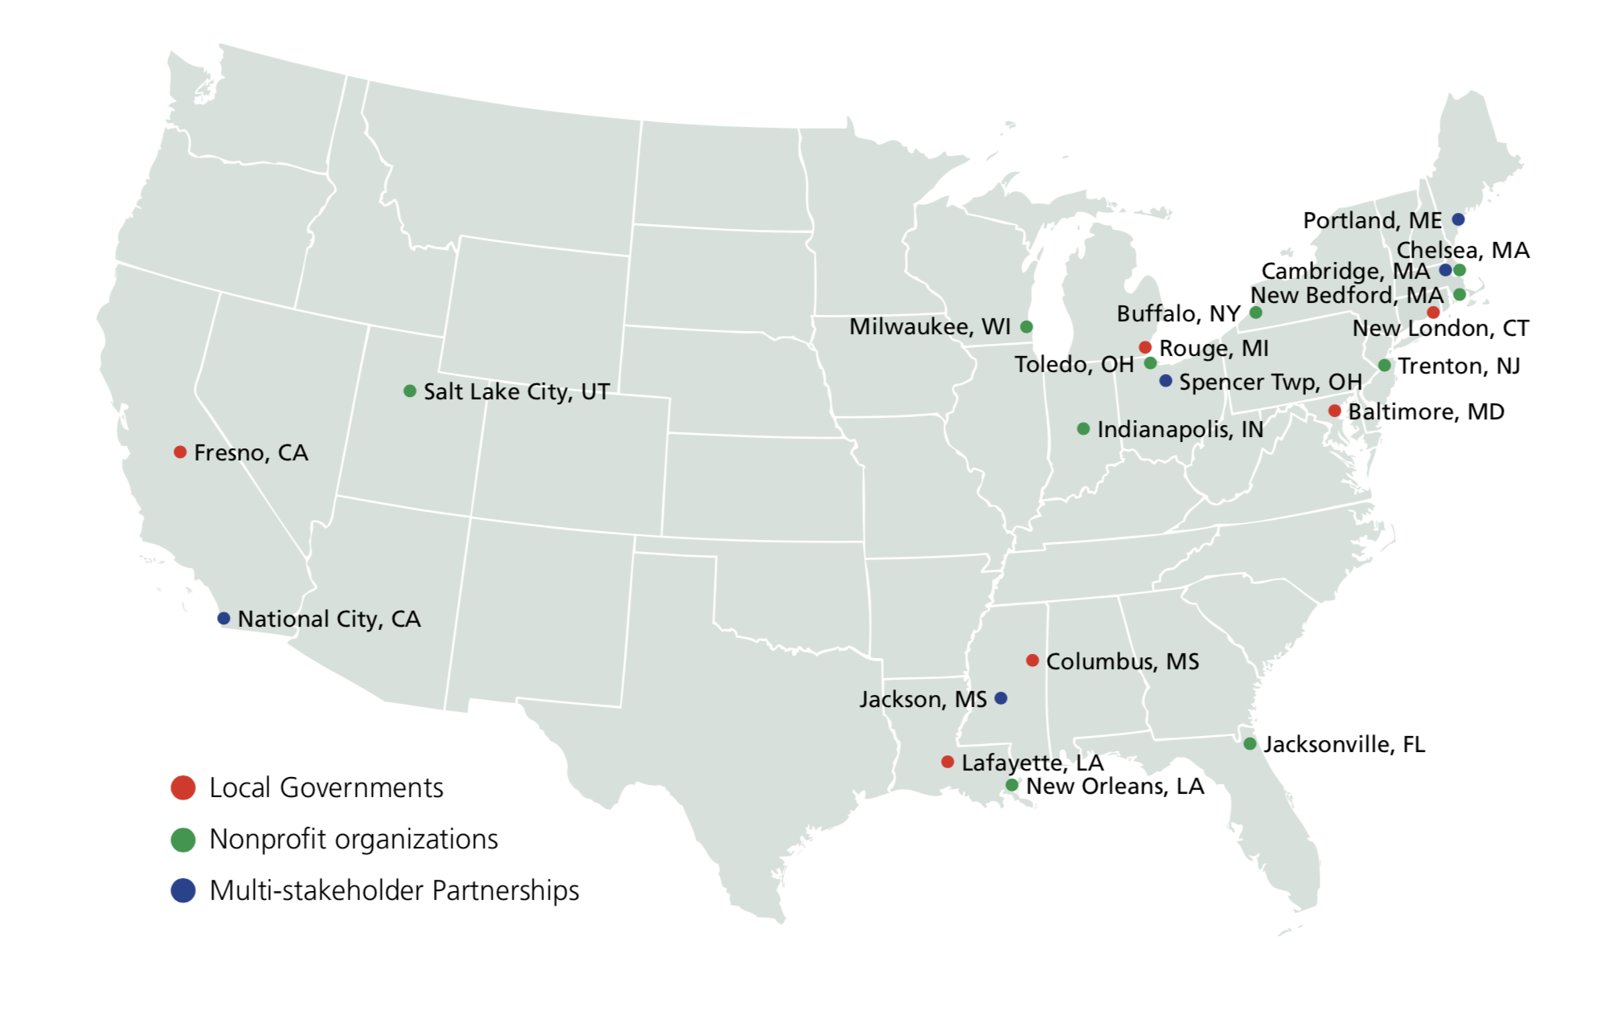
GWUSA- Brownfield Connection
GWUSA offers FREE technical assistance for communities with brownfields
EPA’s Brownfield and Land Revitalization
Sign up for FREE brownfield TA at Groundworkusa.org or Cate@groundworkusa.org
Notes:
Groundwork USA is connected to brownfield work in two ways.
First- through our K7 Program- Over the past four years, we’ve provided free equitable development technical assistance training for communities working with brownfields. From Buffalo to Baltimore from SLC to SCP to We’ve worked with municipalities, nonprofits, community groups, state officials and mixed groups to develop community engagement action plans, deliver trainings on equitable development and environmental justice, draft logic models and a whole host of other community-specific projects that I’ll talk about more later.

Slide 6
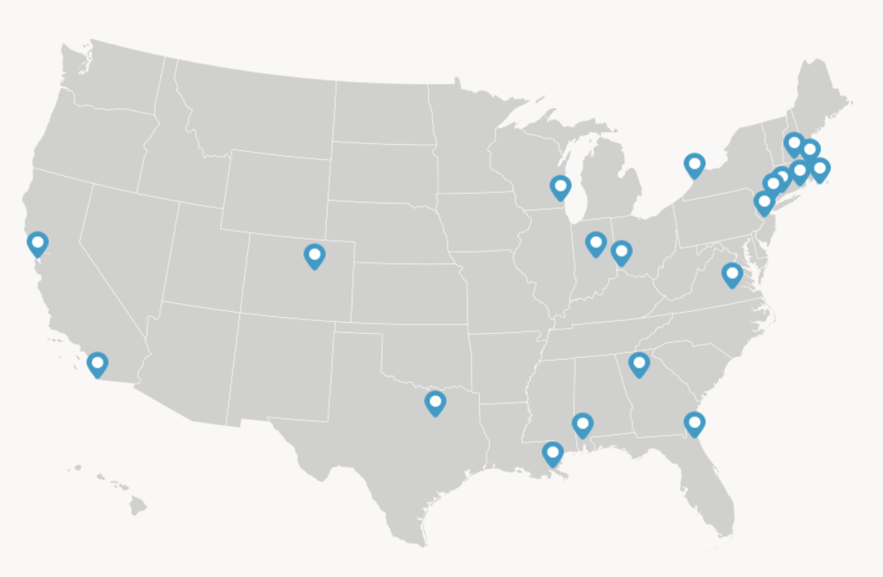
GWUSA- Brownfield Connection
Groundwork Trusts in 20 cities, nationwide
Transforming brownfield sites into community assets
Sign up for FREE brownfield TA at Groundworkusa.org or Cate@groundworkusa.org
Notes:
Second- We are part of a network of 20 trusts around the country, many of whom do brownfield work- restoring those spaces into public assets like urban farms, community gardens, education spaces and parks!

Slide 7
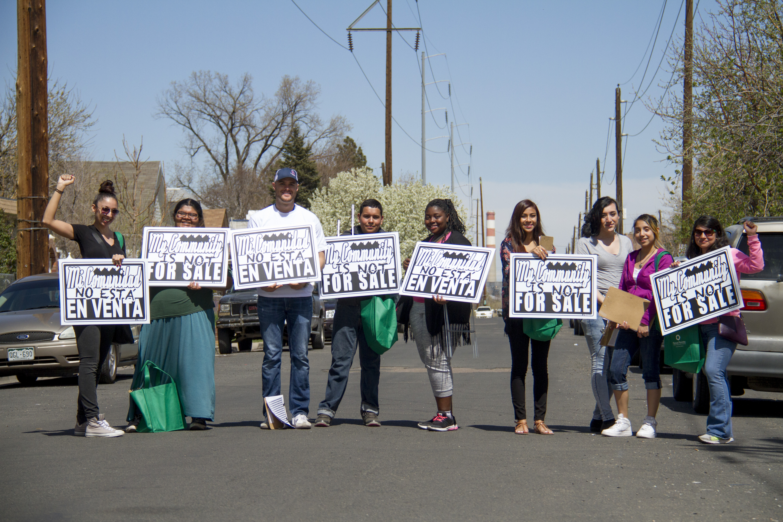
Questions you might be asking
What is equitable development?
Why does it matter?
How will pursuing it benefit my community?
How can Groundwork USA help me?

Slide 8
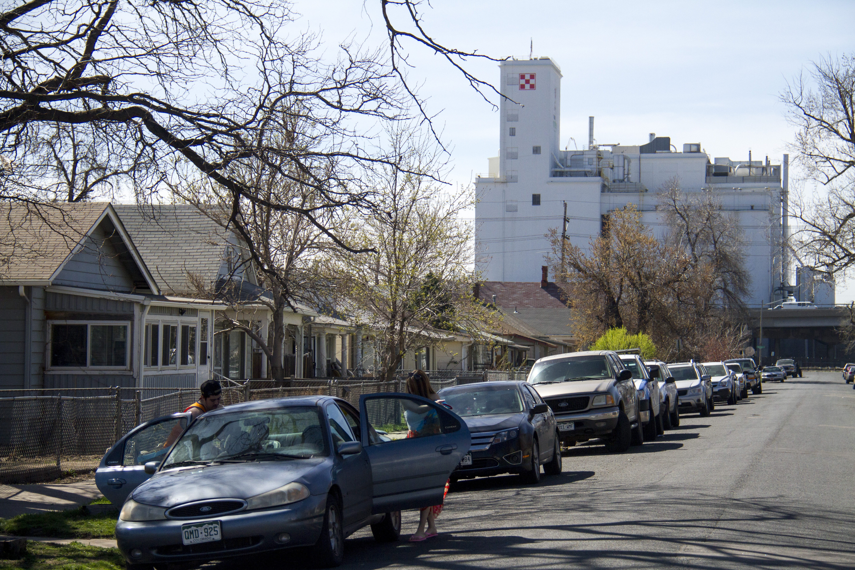
Community Realizes the Benefits of Redevelopment
Wiser, stronger, stable solutions
Respond to community needs
Help to right history of injustice
Speak to the reality instead of perceptions

Slide 9
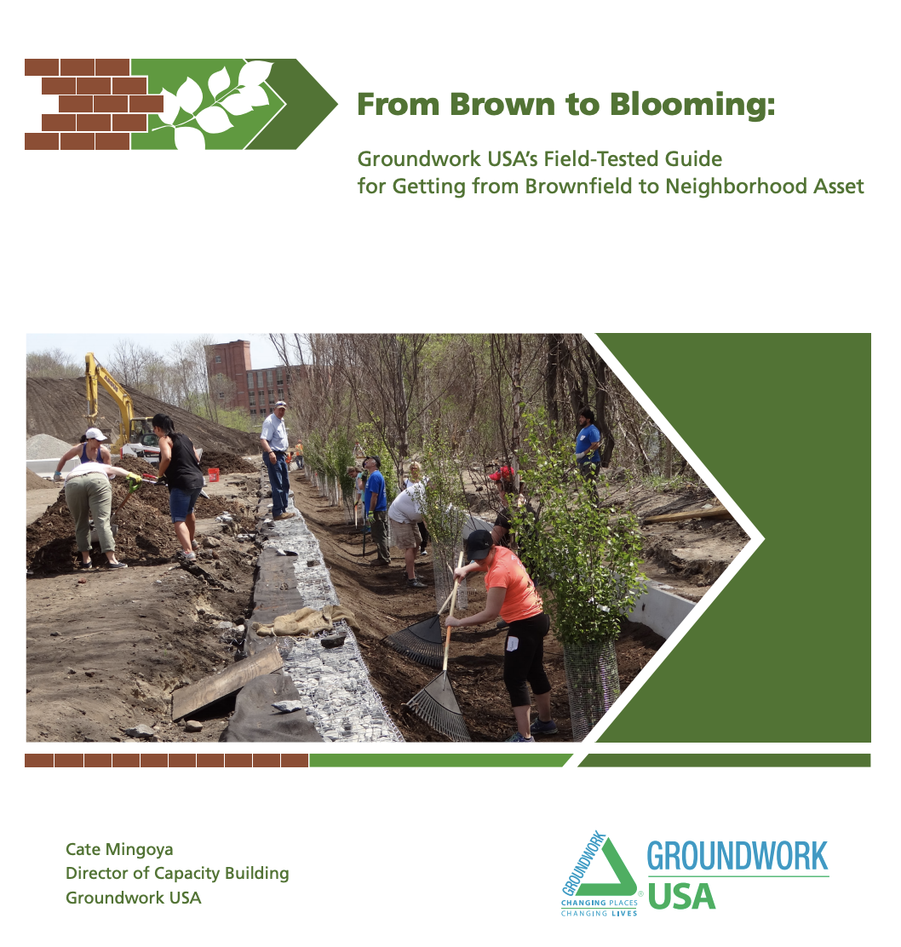
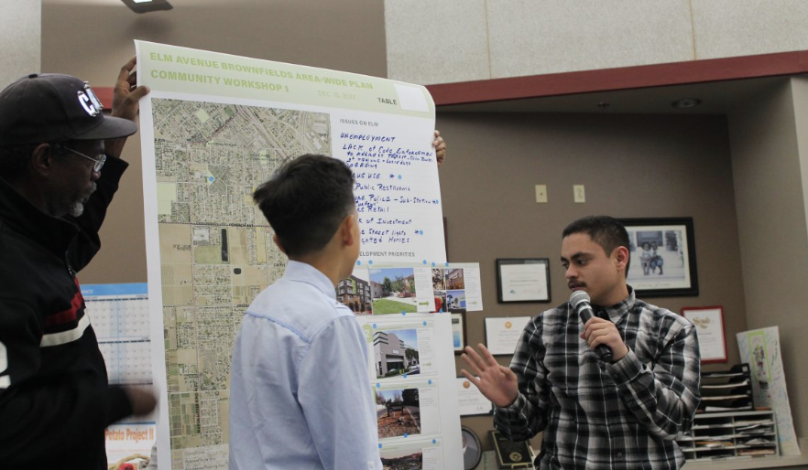
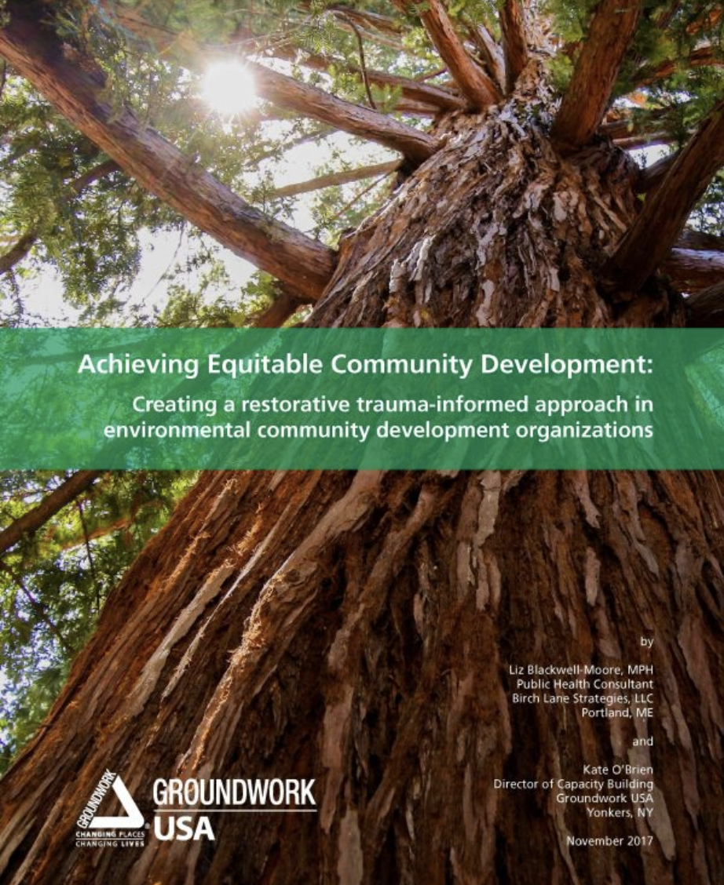
Tools and Resources
Brownfield to Parks Guide
Neighborhood Voices Curriculum
Trauma –Informed Equitable Development
Best practices and action plans

Slide 10
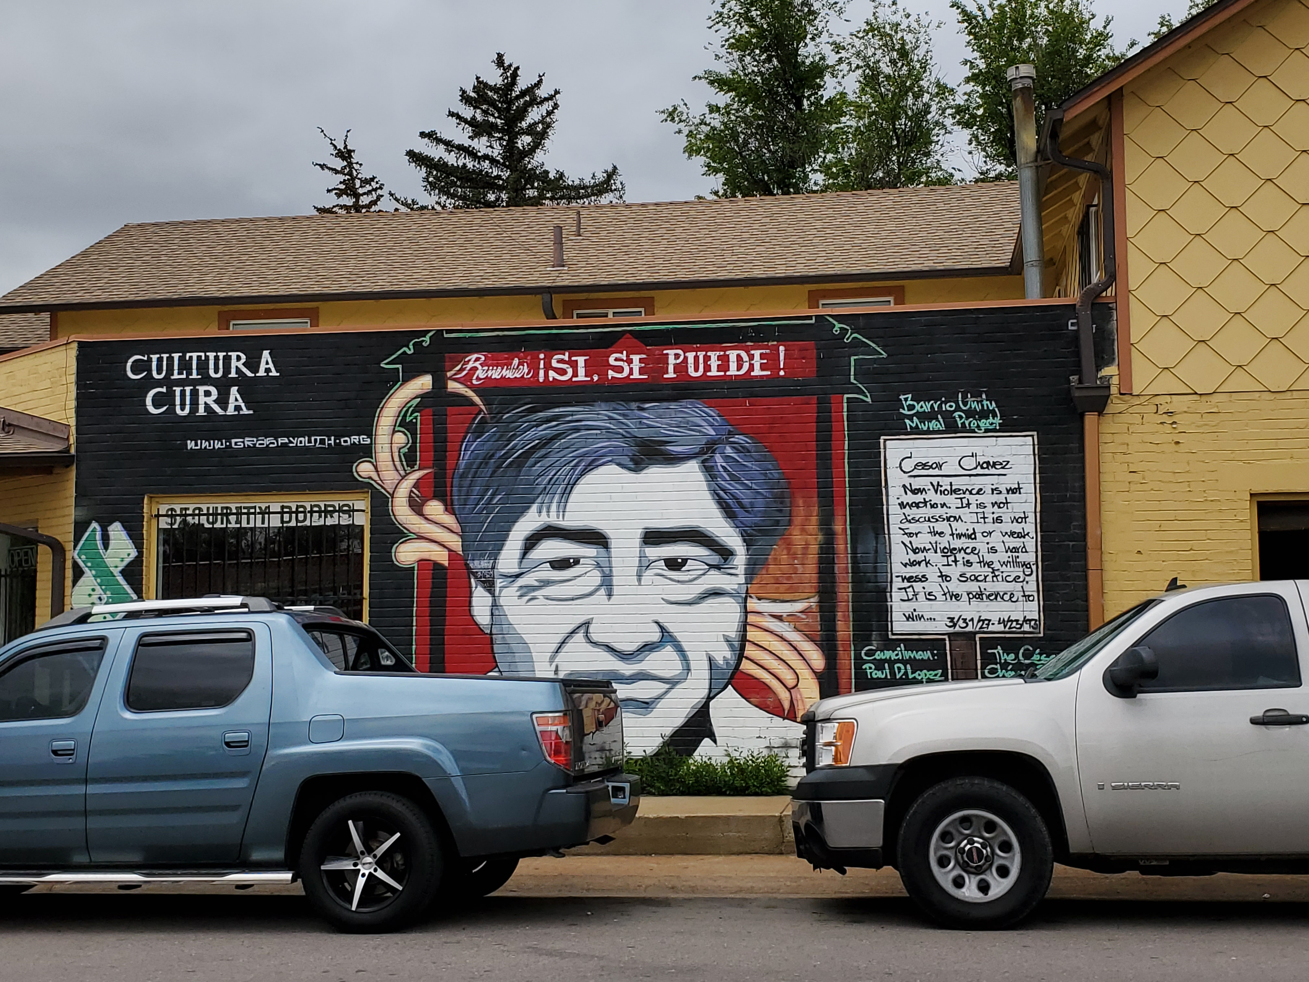
Need Something Different? Don’t Know Exactly What you Need?
One on One Technical Assistance
Help you figure out what you need to work towards equitable development of brownfield sites

Slide 11
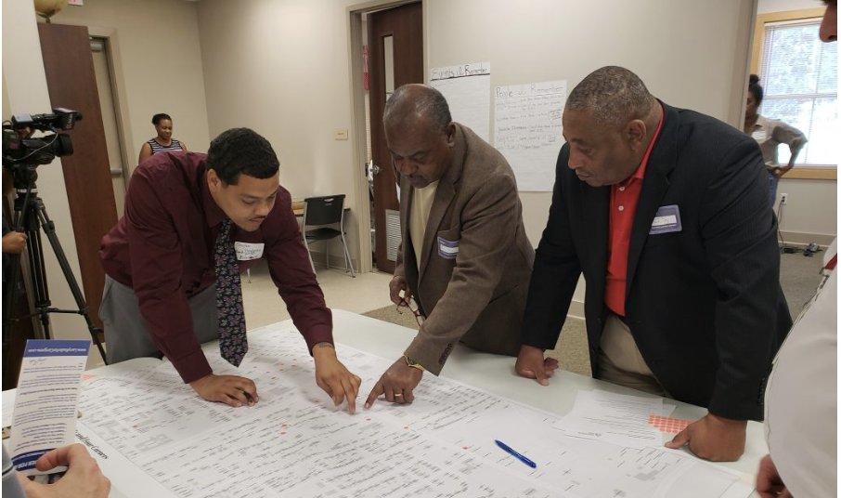
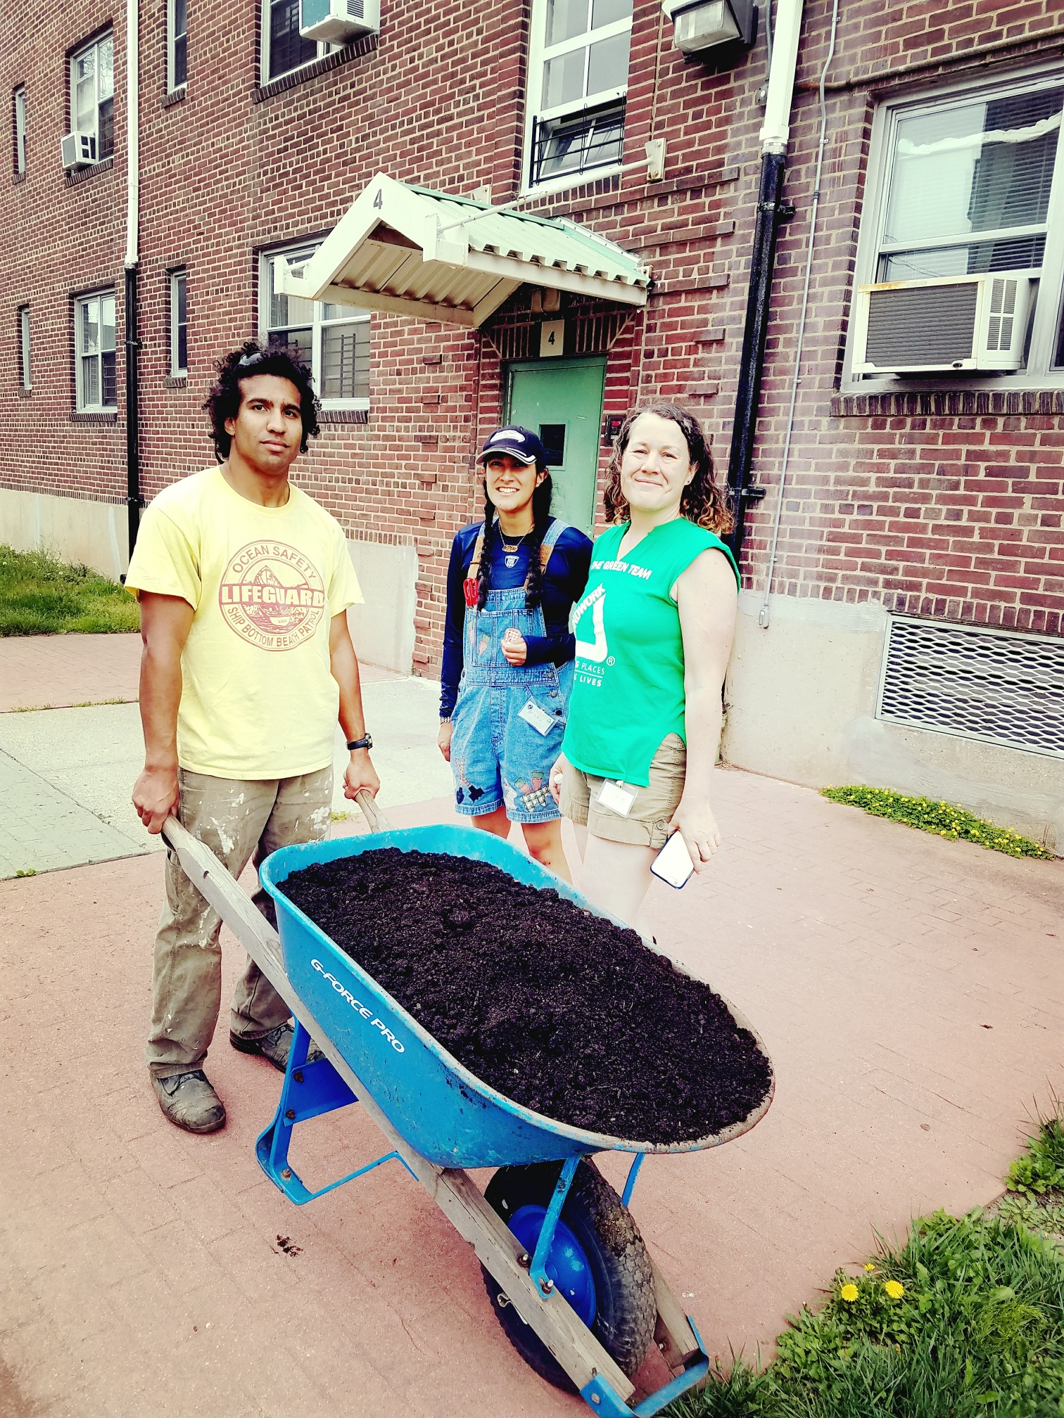
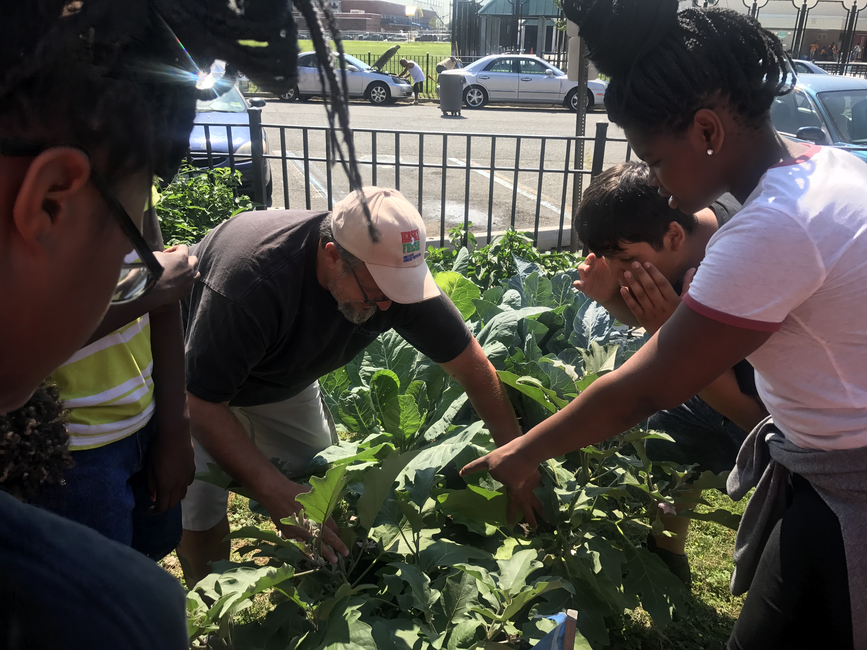
Technical Assistance (Examples)
Community engagement
How to build a big tent of stakeholders
Theory of Change
Logic Model
CBAs
Brownfields 101 training
PhotoVoices
Process education
Right-sizing projects
Notes:
Examples of Technical Assistance
Develop community engagement and visioning action plans
Creative ideas for meaning community engagement
Strategize around stakeholder interactions
Help you develop theories of change and logic models for your work
Review and give feedback on community benefits agreements
Offer trainings on Brownfields, community engagement strategies, tactical urbanism, stakeholder development, and more!
Connect you to technical resources regarding brownfield redevelopment
Teach you and your colleagues about the brownfields to community asset process
Help you figure out the scale and pacing of your projects and how and where to i

Slide 12
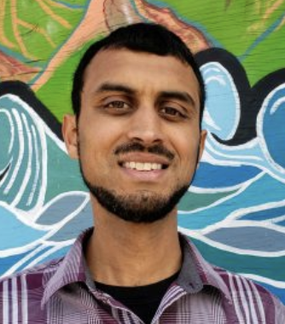
Brownfield Equitable Development Team and Specialties
Cate Mingoya
Director of Capacity Building
-Stakeholder development
-Cross-sector partnerships
-Negotiation
- Intergenerational engagement
Adi Nochur
Deupty Director of Capacity Building
-Active transportation
-Arts and culture
-Climate equity
Stacey Moran
Director of Operations
-Community visioning
-Youth engagement
-PhotoVoices
-Urban Agriculture

Slide 13
Have a brownfield project in mind? Reach out!
Cate@groundworkusa.org
Free technical assistance for equitable development of brownfield sites: www.groundworkUSA.org

