Slide 1

Frequently-Asked Questions about monitored Natural attenuation in GROUNDWATER
Charles Newell, Ph.D., P.E.,
David Adamson, Ph.D., P.E.

Slide 2



PROJECT TEAM
Presenters and Project PIs:
Charles Newell, GSI Environmental Inc.
David Adamson, GSI Environmental Inc.
Other Key Contributors:
Peer Review Panel
Poonam Kulkarni, GSI Environmental Inc.
Shahla Farhat, GSI Environmental Inc.
Travis McGuire, GSI Environmental Inc.
Michal Rysz, GSI Environmental Inc.
Mindy Vanderford, GSI Environmental Inc.
Project Sponsored by:

Slide 3
PRESentation outline
1.
Motivation
2.
What’s an “FAQ” document?
3.
MNA themes – Part I
4.
Interview w/ John Wilson (followed by Initial Q&A)
5.
MNA themes – Part II (including poll questions)
6.
Tour through the interactive version
7.
Final Q&A

Slide 4
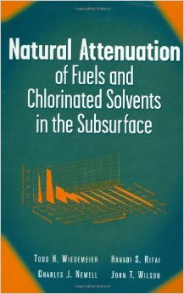
MOTIVATION
MNA in 2014: multiple sources of info, different vintages, different focus, need a library
Example: 1999 MNA book
  Great info, but we’ve learned a lot in the last 15 years!
SOLUTION: Frequently-Asked Questions document about MNA to easily communicate MNA issues and alternatives

Slide 5

WHAT’s AN “FAQ” Document?
“Frequently-Asked Questions”
Similar to previously-published guides on chlorinated solvent releases
Concise and accessible

Slide 6
WHAT’s AN “FAQ” Document?
Published for ESTCP ER-201211
Interactive Version
PDF Version
http://serdp-estcp.org/Program-Areas/Environmental-Restoration/Contaminated-Groundwater/Persistent-Contamination/ER-201211/
6

Slide 7
MNA THemes
MNA AS AN EVOLVING TECHNOLOGY:
THE BASIS FOR MNA:
NEW CONTAMINANTS FOR THE MNA LINEUP:
NEW TECHNIQUES, NEAT TOOLS:
EMERGING ISSUES FOR EVALUTING MNA AS A REMEDY:
IMPLEMENTATION AND SITE CLOSURE:

Slide 8
MNA THemes
MNA AS AN EVOLVING TECHNOLOGY:
Do we still need MNA?
What key protocols explain how to implement MNA?
What are the most important new MNA developments?
THE BASIS FOR MNA:
NEW CONTAMINANTS FOR THE MNA LINEUP:
NEW TECHNIQUES, NEAT TOOLS:
EMERGING ISSUES FOR EVALUTING MNA AS A REMEDY:
IMPLEMENTATION AND SITE CLOSURE:

Slide 9
FAQ 1: Do we still need MNA?
MNA from a Technical-Regulatory-Scientific Perspective:
3 Views on How MNA fits in (quotes from recent ITRC docs)
1.
Active remediation technologies rarely achieve complete remediation of all contaminant mass; thus, in effect, MNA is typically a component of every chlorinated-solvent site remedy.
2.
(Natural Source Zone Depletion) is also of significance because engineered remedial actions typically do not always completely remediate soils and NSZD may be useful to address the residual hydrocarbon.
3.
Monitored natural attenuation (MNA) may also be a viable remedial alternative for situations in which the potential for adverse impacts to public health or sensitive environmental receptors is very low.

Slide 10
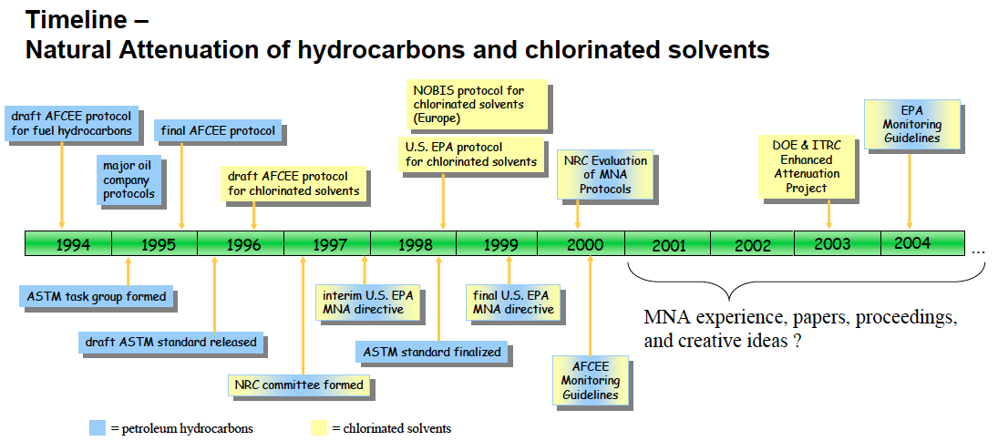
FAQ 2: How has MNA changed over time?
New technologies, concepts, and increasing use
Through 2004
Early MNA – Adapted from ITRC, 2008

Slide 11
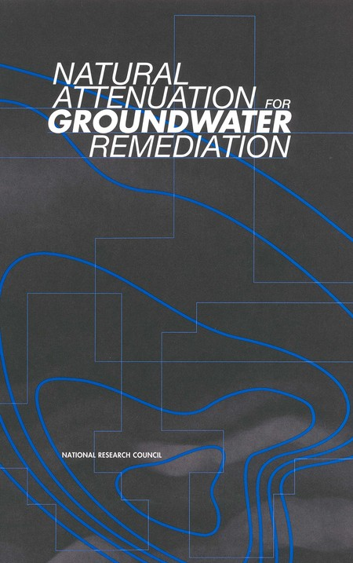
FAQ 2: How has MNA changed over time?
KEY POINTS:
Move away from scoring systems following National Research Council review of early protocols
Better understanding of attenuation processes
More contaminants, settings
Incorporate new generation of tools

Slide 12
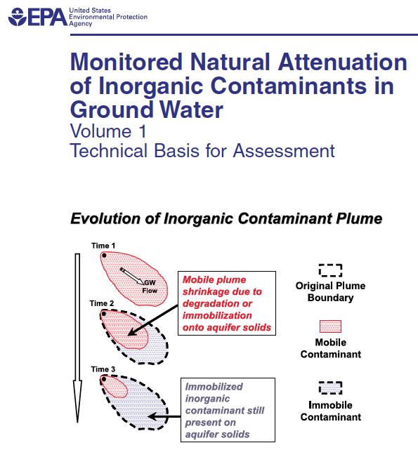
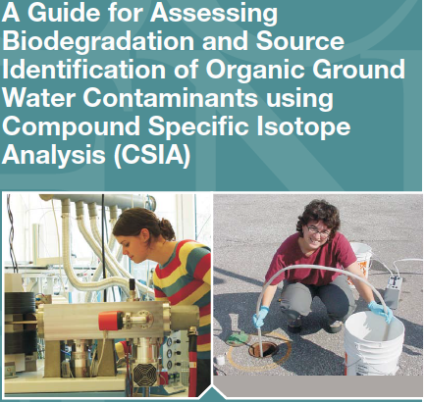
FAQ 3: What are the most important new MNA developments?
Year
New Contaminant
New Measurement
New
Process
New
Tools
2000- 2005 | MTBE-TBA | Two types of rates | Source attenuation of hydrocarbon sites | BIOChlor MAROS NAS SourceDK
2005- 2010 | Metals-Rads | Compound-Specific Isotopes Molecular Biological Tools | Biogeochemical/abiotic trans. of chlor. solvents Matrix diffusion Oxidation of chlor. solvents at low DO | REMChlor Mass flux toolkit BIOBALANCE Scenarios for chlor. solvents MNA Sustainability
Probably the most important “recent” development?

Slide 13
FAQ 3: What are the most important new MNA developments?
Year
New Contaminant
New Measurement
New
Process
New
Tools
2010-present | “Emerging Contaminants” | CO₂ traps for NSZD | Natural source zone depletion (NSZD) Source attenuation of chlorinated solvent sites Attenuation in low-k zones | PREMChlor Matrix Diffusion Toolkit Scenarios for metals/rads Source History Tool
Coming Attractions: ESTCP ER-201129
Development and Validation of a Quantitative Framework and Management Expectation Tool for the Selection of Bioremediation Approaches (MNA, Biostimulation and/or Bioaugmentation) at Chlorinated Solvent Sites

Slide 14
MNA THemes
MNA AS AN EVOLVING TECHNOLOGY:
What is the philosophy behind MNA?
What evidence is needed for MNA?
MNA lines of evidence—how have they changed?
MNA for the source zone—how does this work?
THE BASIS FOR MNA:
NEW CONTAMINANTS FOR THE MNA LINEUP:
NEW TECHNIQUES, NEAT TOOLS:
EMERGING ISSUES FOR EVALUTING MNA AS A REMEDY:
IMPLEMENTATION AND SITE CLOSURE:

Slide 15




What is the philosophy behind MNA?
Nature can help!
It is harder and more expensive to clean these sites up than first thought.
Nature is amazing and seems to be degrading or sequestering some of these chemicals.
Let’s let nature do the job.
But you have to do three things:
Understand
Watch
Protect

Slide 16
FAQ 5: What evidence is needed for MNA?
Typically Multiple Lines of Evidence
Historical (based on USEPA, 1999)
WHY
WHAT
WHEN
LOE 1: Historical contaminant mass reduction - monitoring data vs. time | “I shrink, therefore I am” | Direct method to demonstrate decreasing trend | Always
LOE 2: Hydrogeologic or geochemical data | Need to know more than just it is decreasing | Indirect method to demonstrate degradation process or rate | Most of the time
LOE 3: Field or microcosm studies | Need to know for than LOE 1 or 2 | Direct method to demonstrate particular knowledge | Rarely; used to prove specific process

Slide 17
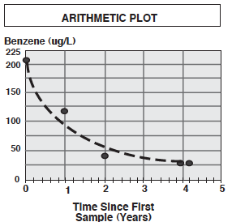
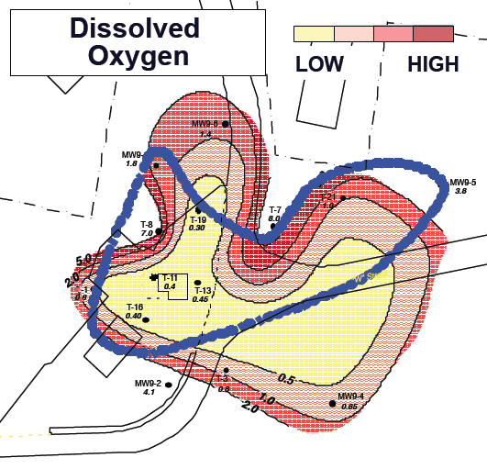
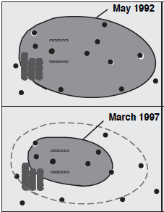
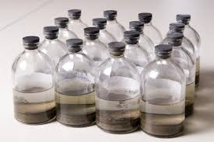
FAQ 5: What evidence is needed for MNA?
New Trends in LOEs
LOE 2: Hydrogeologic or geochemical data
LOE 1: Historical contaminant mass reduction
LOE 3: Microcosm or Field data
LOE: “Lines of Evidence”

Slide 18
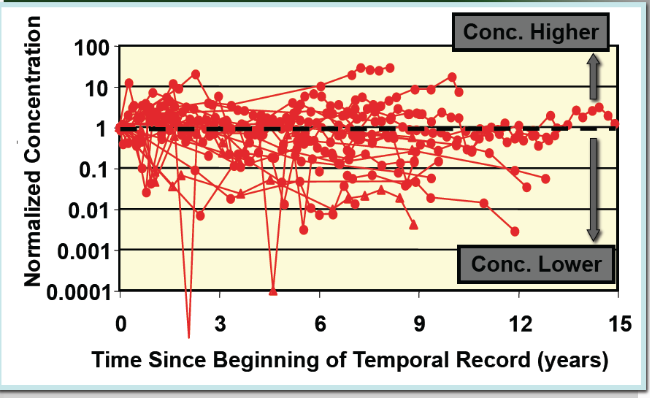

FAQ 7: MNA for the source zone too?
An emerging consensus: YES
Long-term monitoring data showing source attenuation
Source attenuation modeling tools (BIOChlor, REMChlor, NAS)
Long-term temporal records from 22 monitoring wells at 13 Untreated TCE Sites (Newell et al., 2006)
2004 survey of 191 plumes - MNA was the sole remedy (no active source remediation) at 21% of sites with CVOC concentrations > 10 mg/L (McGuire et al., 2004)

Slide 19

FAQ 7: MNA for the source zone too?
An emerging consensus: YES
Source attenuation protocols
Field studies demonstrating Source Zone Natural Attenuation (SZNA)
ITRC, 2009
“[Natural source zone depletion (NSZD)] is of significance because engineered remedial actions typical do not always completely remediate soils and NSZD may be useful to address the residual hydrocarbon”
Methodology developed at Arizona St. Univ.
Site | Contaminant | Hydrogeology | Loss Rate from Dissolution (kg/year) | Loss Rate from Dissolved Transport Related Biodegradation (kg/year) | Loss Rate Estimate Due to Vadose Transport* (kg/year)
Guadalupe Diluent Tanks | Hydrocarbon | Sand dune | 500 - 1600 | 600 - 1600 | 140,000 (O₂ Flux)
Guadalupe Compressor | Hydrocarbon | Sand dune | 300 - 500 | 0 | 16,000 (O₂ Flux)
NAS Jacksonville | Chlorinated Solvent | Silty sand, clay | 12 - 32 | - | 0.27 - 0.79 (Vapor Flux)
Parris Island | Chlorinated Solvent | Silty clay, sand stringers | 1.8 - 5 | - | 0.22 - 0.68 (Vapor Flux)
Selected results from NSZA studies at several sites (Ekre et al., ESTCP ER-0705 Short Course, 2011)

Slide 20
MNA THemes
MNA AS AN EVOLVING TECHNOLOGY:
Can I apply MNA to metals, inorganics, and radionuclides?
I can apply MNA to BTEX, but how about oxygenates?
Which emerging contaminants are MNA candidates?
THE BASIS FOR MNA:
NEW CONTAMINANTS FOR THE MNA LINEUP:
NEW TECHNIQUES, NEAT TOOLS:
EMERGING ISSUES FOR EVALUTING MNA AS A REMEDY:
IMPLEMENTATION AND SITE CLOSURE:

Slide 21
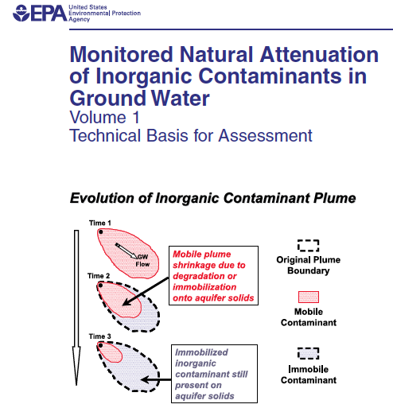
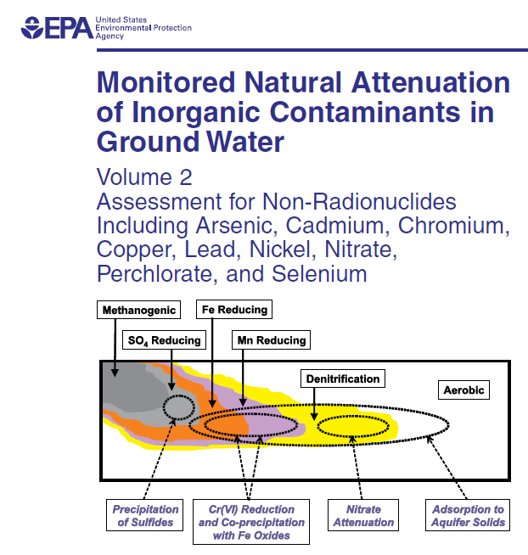
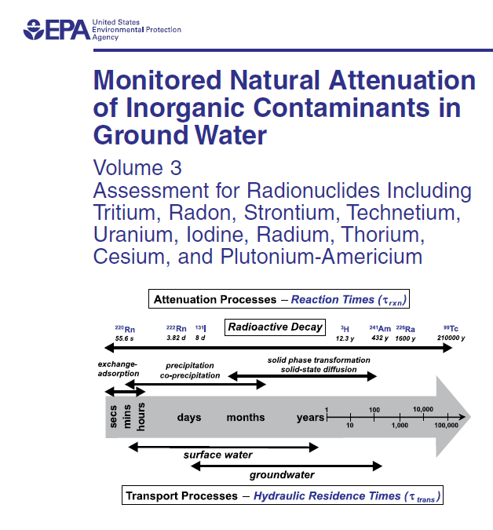
FAQ 8: Can I apply MNA to metals, inorganics, and radionuclides?
YES, says USEPA
2007
2008
2010
Plume is not expanding and sorption is occurring
ID the attenuation mechanism and estimate rate
Determine capacity and sustainability
Develop monitoring and contingency measures
Tiered Lines-of-Evidence Approach (similar to protocols for organics)

Slide 22
FAQ 8: Can I apply MNA to metals, inorganics, and radionuclides?
KEY POINTS:
Primary attenuation pathway for many inorganics is transformation to less mobile forms through co-precipitation or sorption
Reactions are generally more complex and highly influenced by geochemical conditions
Contaminant | Biological Reaction |  | Abiotic Reaction | Sequestration
 | Anaerobic | Aerobic
Nitrate | Yes, degradation | No | Yes (reactive iron) | No
Perchlorate | Yes, degradation | No | Conflicting Data | No
Chromium (Cr), Selenium (Se), Copper (Cu), Cadmium (Ca), Lead (Pb), Nickel (Ni), Zinc (Zn), Beryllium (Be), Arsenic (As) (metalloid) | Valence change, generally favorable | Valence change, generally unfavorable | Valence change, generally favorable | Yes (sorption, co-precipitation)
Uranium, Technetium, Strontium, Cesium, Radium, Iodine | Valence change, generally favorable | Valence change, generally unfavorable | Valence change, generally favorable | Yes (sorption, co-precipitation)

Slide 23
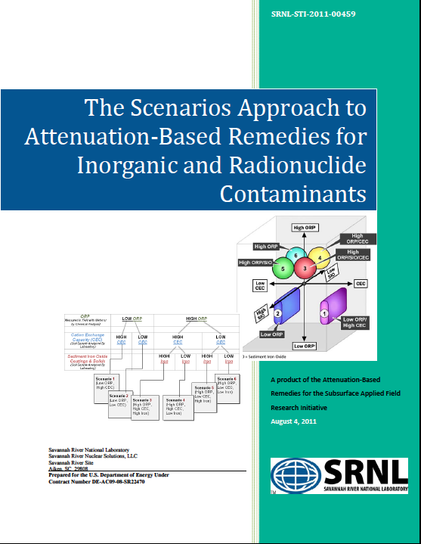
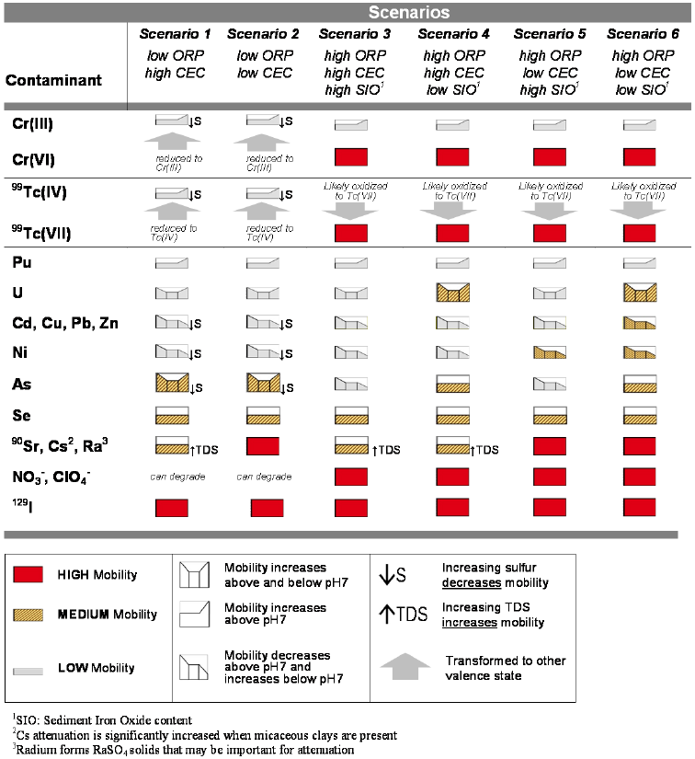
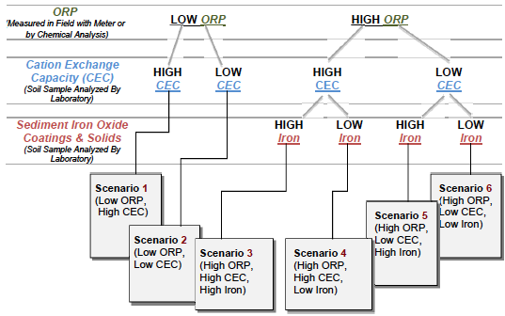
FAQ 8: Can I apply MNA to metals, inorganics, and radionuclides?
ADDITIONAL GUIDANCE:
“SCENARIOS”DOE, 2011
A
B

Slide 24
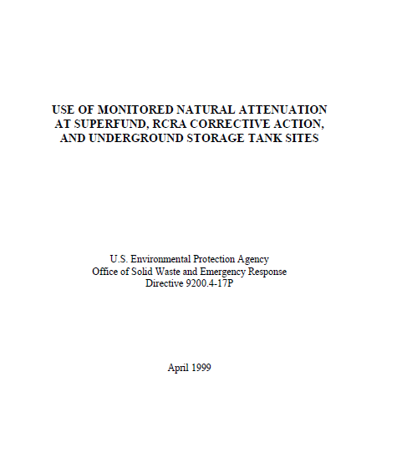
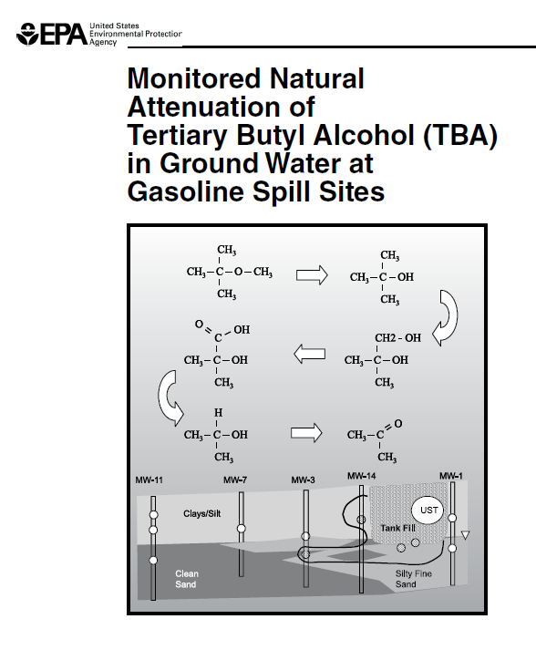
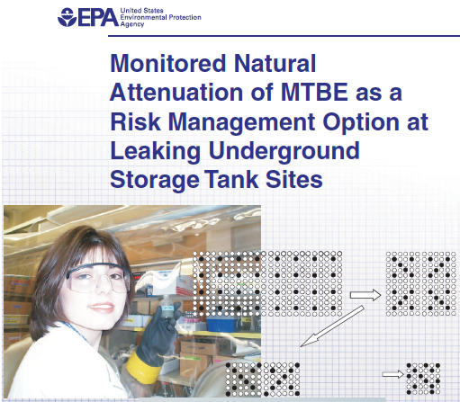
FAQ 9: I can apply MNA to BTEX, but how about oxygenates?
Originally No, But Now YES
USEPA MNA Directive, 1999
Not promising in early protocols
Lots of research and field work in the following 5-10 years, and we ended up with a completely different story!
MTBE had been found to “…migrate large distances and threaten downgradient water supplies at the same sites where the BTEX component of a plume has either stabilized or diminished due to natural attenuation” and included MTBE among compounds “…that tend not to degrade readily in the subsurface”.
USEPA, 2005 & 2007

Slide 25
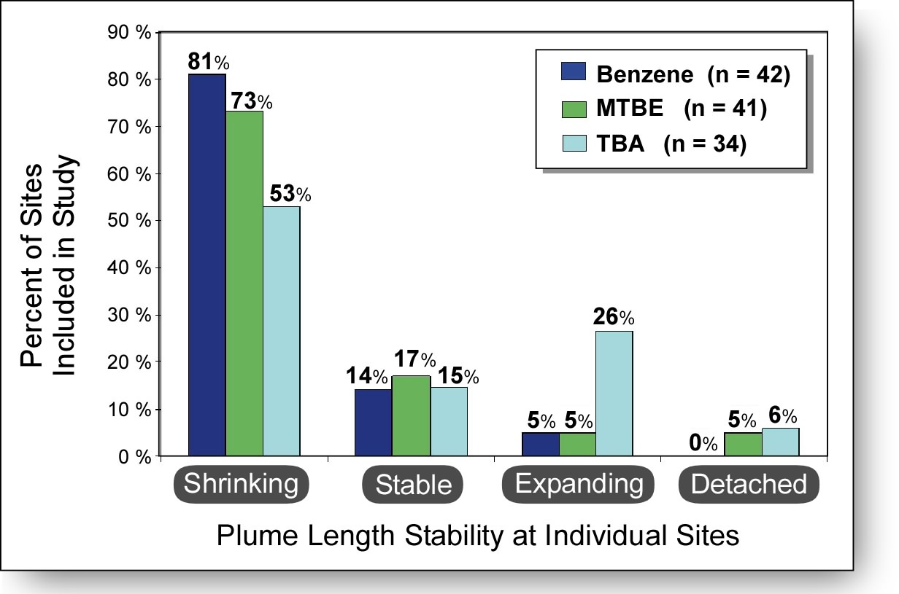
FAQ 9: I can apply MNA to BTEX, but how about oxygenates?
What do the data say?
Several plume studies have documented that majority of MTBE/TBA plumes are relatively short and/or attenuating
Kamath et al., 2012
MTBE exhibits similar characteristics to BTEX in terms of median plume size (142 ft) and attenuation rate (-0.63 yr⁻¹)
TBA also similar to BTEX but fewer are stable/shrinking

Slide 26
FAQ 9: I can apply MNA to BTEX but how about oxygenates?
Contaminant Class | Biological Degradation
 | Anaerobic | Aerobic
MTBE | YES (may require acclimation period) | YES
TBA | YES if electron acceptors are readily available (may be limited in methanogenic conditions) | YES (generally faster than in anaerobic conditions)
Ethanol | YES (tends to be preferentially degraded over BTEX) | YES (tends to be preferentially degraded over BTEX)

Slide 27
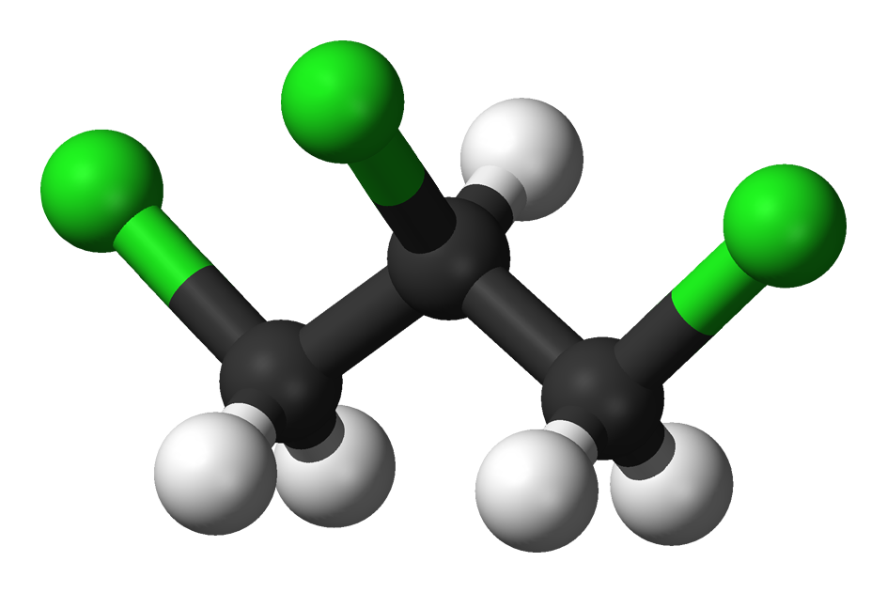
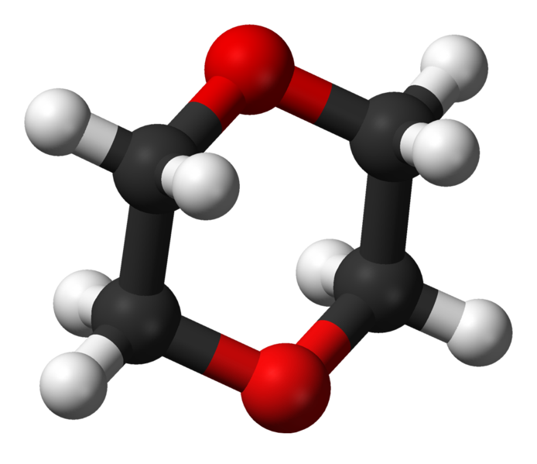
FAQ 10: Which emerging contaminants are MNA candidates?
Dioxane, TCP, NDMA, Phthalates, and Maybe Others?
DoD general goal for emerging contaminants:
Other problems
“Identify chemicals or materials that either lack human health standards or have an evolving science and regulatory status.”
Prevalence at individual sites is largely unknown
Absence of well-established treatment technologies
Absence of tools for establishing MNA (e.g., CSIA, MBTs)
1,2,3-Trichloropropane
1,4-Dioxane

Slide 28
FAQ 10: Which emerging contaminants are MNA candidates?
Emerging Contaminant | Biological Degradation |  | Abiotic Degradation | Sequestration
 | Anaerobic | Aerobic
1,4-Dioxane | Limited | YES (mostly lab studies; can be cometabolic or used as a carbon source) | Not documented | No (poor sorption)
Perfluorinated Compounds | Very limited (incomplete pathway) | Very limited (incomplete pathway) | Limited (a reliable light+Fe(III) reaction has been established) | Moderate (primarily electrostatic sorption to ferric iron minerals; limited organic carbon sorption)
N-Nitrosodimethylamine (NDMA) | YES | YES (cometabolic) | No (several ex situ methods, including UV photolysis) | No (poor sorption)
1,2,3-Trichloropropane | YES (slow, often incomplete pathway) | YES (slow, incomplete pathway) | Very limited (reactive iron, base hydrolysis) | Limited (moderate sorption)

Slide 29
MNA THemes
MNA AS AN EVOLVING TECHNOLOGY:
Can isotopes prove contaminants are being destroyed?
How can molecular biological tools help me with MNA?
How can you show attenuation that occurred before the start of your monitoring program?
Can DO measurements be a problem for MNA studies?
What are CO2 traps and how do they help me show attenuation?
How do I estimate rates and timeframes for MNA?
What is required for MNA monitoring?
What is the new thinking about monitoring frequency?
Statistics for 2 questions: how far and how long?
Which computer models work best for MNA?
Are MNA reactions sustainable? Is MNA sustainable?
THE BASIS FOR MNA:
NEW CONTAMINANTS FOR THE MNA LINEUP:
NEW TECHNIQUES, NEAT TOOLS:
EMERGING ISSUES FOR EVALUTING MNA AS A REMEDY:
IMPLEMENTATION AND SITE CLOSURE:

Slide 30
FAQ 11: Can isotopes prove contaminants are being destroyed?
Yes, and more
USEPA, 2008
“Stable isotope analyses can provide unequivocal documentation that biodegradation or abiotic transformation processes actually destroyed the contaminant.”
USEPA, 2008

Slide 31
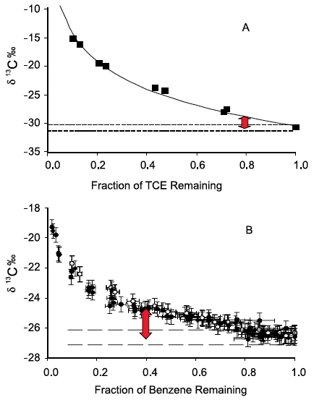
FAQ 11: Can isotopes prove contaminants are being destroyed?
KEY PRINCIPLE:
Isotopic Fractionation
=
Lighter isotopes are used preferentially during degradation, such that the remaining non-degraded compound becomes enriched in the heavier isotope
carbon (¹³C/¹²C)
oxygen (¹⁸O/¹⁶O)
nitrogen (¹⁵N/¹⁴N)
chlorine (³⁷Cl/³⁵Cl)
hydrogen (²H/¹H)
KEY BENEFITS (continued next page):
Demonstrating that parent compound is being degraded
Estimating the extent of degradation
δ¹³C data from several studies as compiled in Hunkeler et al., USEPA, 2008

Slide 32
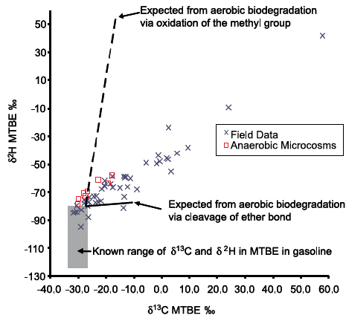
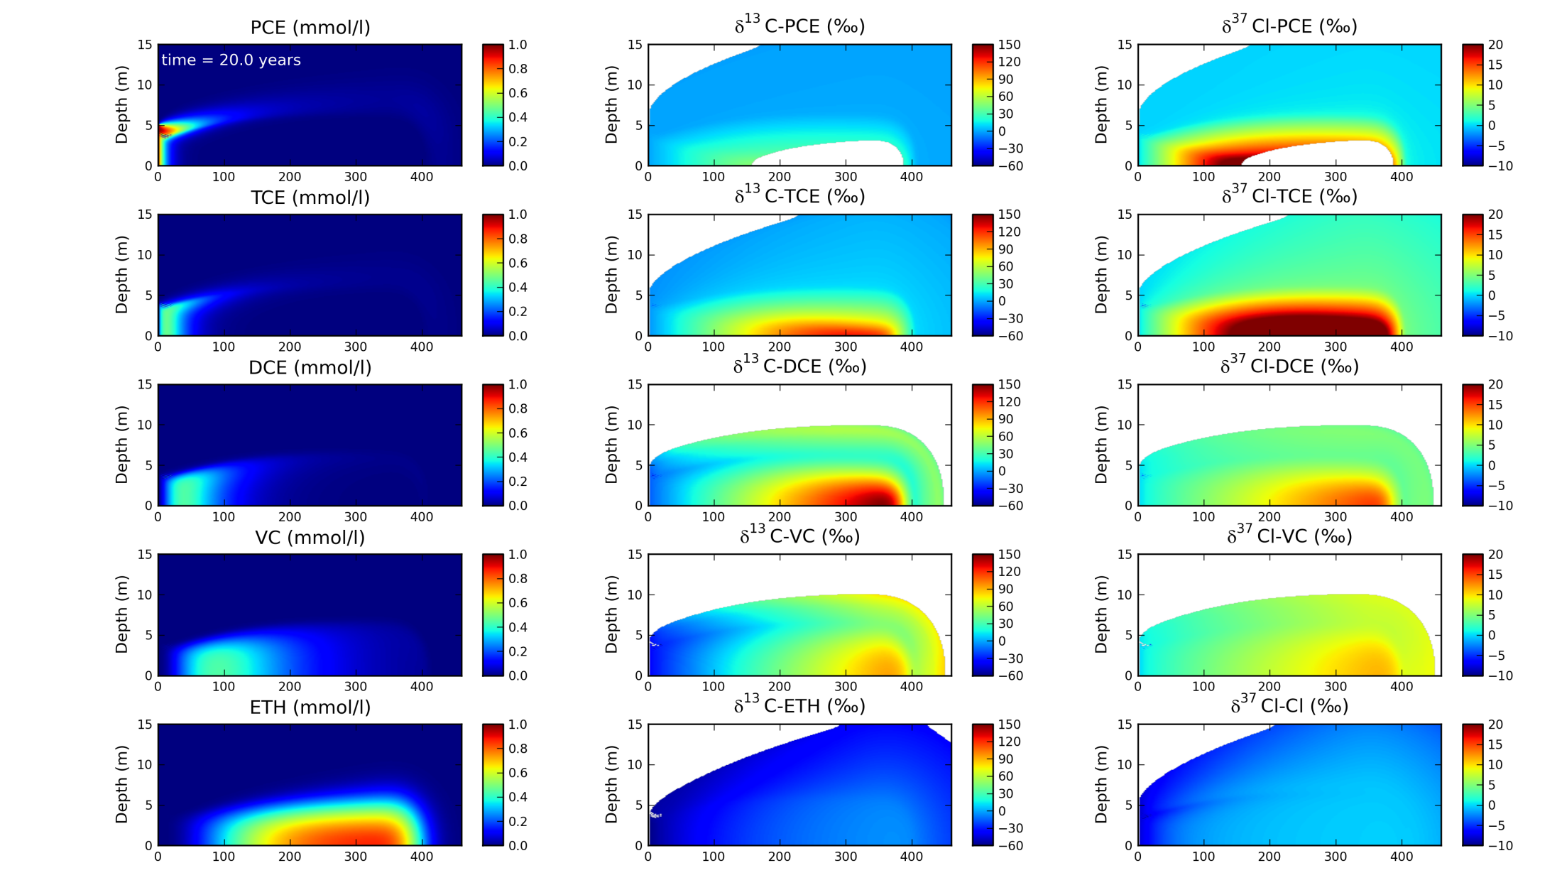
FAQ 11: Can isotopes prove contaminants are being destroyed?
KEY BENEFITS (continued):
Differentiating between destructive and non-destructive pathways
Differentiating between various destructive pathways
Demonstrating that complete degradation has occurred
Estimating rate of degradation
Source identification and differentiation
Can be incorporated into reactive transport modeling
2-D plot of δ¹³C and δ²H in MTBE in groundwater to associate natural biodegradation of MTBE in groundwater with an anaerobic process (from Hunkeler et al., USEPA, 2008)
Example of CSIA-based reactive transport modeling from ESTCP ER-201029 (see Van Bruekelen et al., 2008 for method description)

Slide 33
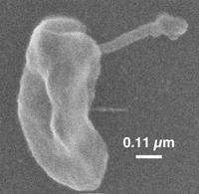
FAQ 12: How can molecular biological tools help me with MNA?
MBTs provide strong, but not definitive evidence of MNA
1.
Show that key organisms are present (e.g., Dehalococcoides, Dehalobacter)
Show that key enzymes are present (e.g., vcrA, oxygenase-encoding genes)
Establish relative abundance of key microbial populations
2.
3.
Our friend, Dehalococcoides
(Apkarian and Taylor)
KEY ISSUE: Most tests focus on presence, not activity!

Slide 34
FAQ 12: How can molecular biological tools help me with MNA?
MOST POPULAR?
Evaluating chlorinated solvent degradation using PCR-based methods for tracking Dehalococcoides (Dhc)
Tools | MNA Application | MNA Limitations
PCR / qPCR | Identify if key organisms / enzymes Determine if abundance of key biomarkers is increasing | Many techniques cannot differentiate between live and inactive cells Attempts to correlate in situ activity and gene expression still in infancy Target mostly well-known pathways (others in development)
Others:
Stable Isotope Probing (SIP), microbial fingerprinting, microarrays, enzyme activity probes

Slide 35
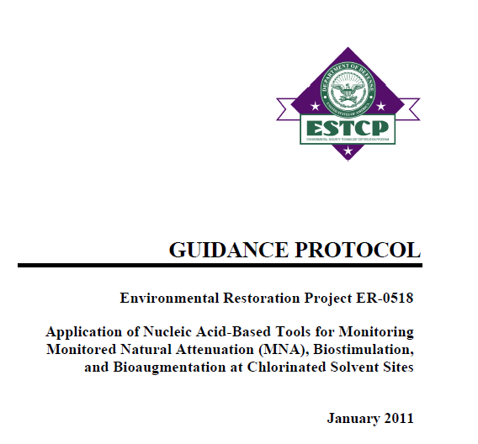
FAQ 12: How can molecular biological tools help me with MNA?
HOW TO COLLECT AND USE THE DATA?
Groundwater or Soil using established procedures
  starting at about $200 per sample/target)
Quantitative Rules for MNA.
  Specific recommendations for MNA
  Lu et al., 2006: “generally useful” attenuation rates of cis-1,2-DCE and VC (> 0.3/yr) were associated with sites where Dhc was detected, while no attenuation was observed at sites where it was absent
Dhc at 10⁴ to 10⁶ gene copies/L can support MNA
Dhc at > 10⁶ gene copies/L is the target threshold for ensuring ethene production

Slide 36
INTERVIEW: John Wilson
What are the most important new developments you’ve seen since the original protocols were developed in the 1990s?
How did you get involved in isotopes? What is the key message in the the document you wrote with Hunkeler and others in 2008?

Slide 37
INTERVIEW: John Wilson (continued)
You just completed a Short Course at Battelle on calculating and applying rates for MNA processes. What is the key message from your short course?
You got involved in MNA statistics with your 2011 document: “An Approach for Evaluating the Progress of MNA in Groundwater”. Why did you write this one? Are you a pretty good statistician? Any thoughts on sampling frequency?
What is the big question to answer for MNA?

Slide 38
BREAK FOR INITIAL Q&A
Go to:
http://serdp-estcp.org/Program-Areas/Environmental-
Restoration/Contaminated-Groundwater/
Persistent-Contamination/ER-201211/
Or Google:
“MNA” + “FAQ” + “ESTCP”

Slide 39
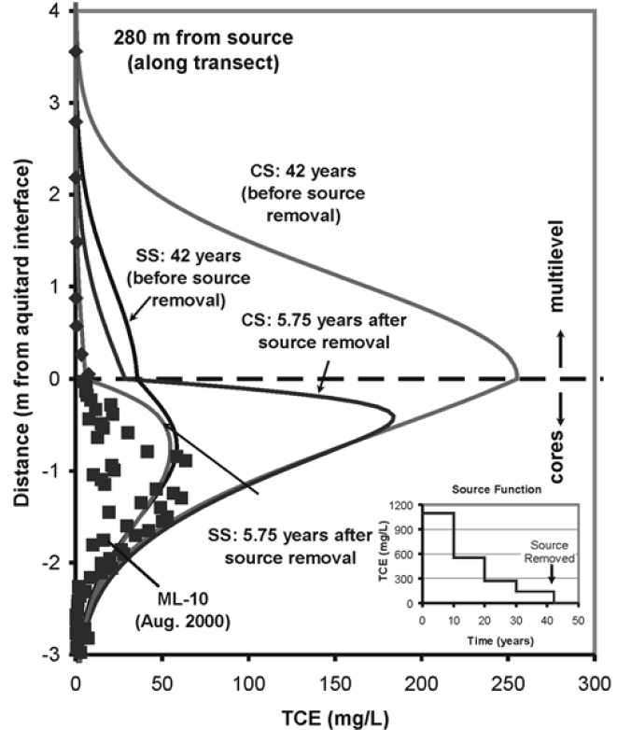
FAQ 13: How can you show attenuation that occurred before the start of monitoring?
By Using Clay Diffusion Profiles or Tree Rings
“Source History” using soil data from Low Permeability Zone (e.g., clay)
Combo of high-res characterization and inverse modeling
Core acts like “tree ring” to provide information on the source concentration over time in adjacent aquifer
New FREE software tool developed for applying this method: http://www.serdp.org/Program-Areas/Environmental-Restoration/Contaminated-Groundwater/Persistent-Contamination/ER-201032
Example of “Source History” estimate from Chapman and Parker, 2005 – best fit with Stepped Source (SS) (see inset)

Slide 40
FAQ 13: How can you show attenuation that occurred before the start of monitoring?
ALTERNATIVE: Use actual tree rings as part of a “phytoforensic” approach
Assay cores for Cl for chlorinated solvents, S for petroleum hydrocarbons
Applied at > 20 sites
1988
1993/1994
Cl⁻ patterns (shown on y-axis as x-ray fluorescence counts) over time in tree core (shown on x-axis in mm of core). Pattern identifies potential exposure events (releases) in 1988 and 1993/1994, along with continuing impact at date when core was collected (far right hand side)
(from Balouet et al., 2007)

Slide 41
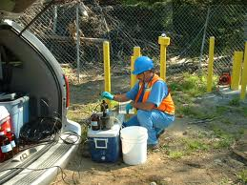

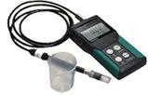
FAQ 14: Can DO measurements be a problem for MNA studies?
YES, if not carefully done
Some early conclusions of ESTCP 2011-29 project:
Great care should be taken to minimize oxygen introduction by measuring at well head using a flow-through cell
Erroneous DO measurements are often recorded and reported which can cause misinterpretation of subsurface conditions
Measured and actual DO concentrations rarely coincide

Slide 42
FAQ 15: What are CO₂ traps and how do they help me show attenuation?
A new tool for measuring natural source zone attenuation at LNAPL sites
What’s the principle?
  LNAPL is subject to degradation following release, with essentially all being converted to CO₂
How do they work?
  Collect CO₂ that has migrated to surface using a passive adsorption device installed at grade
  Correct for background/non-fossil fuel-related CO₂
  Convert CO₂ to LNAPL attenuation rate (gallons/acre/yr)
Example of Colorado State University CO₂ trap installation; other approaches have been developed by Ariz. St. Univ. and Univ. of Brit. Columbia

Slide 43
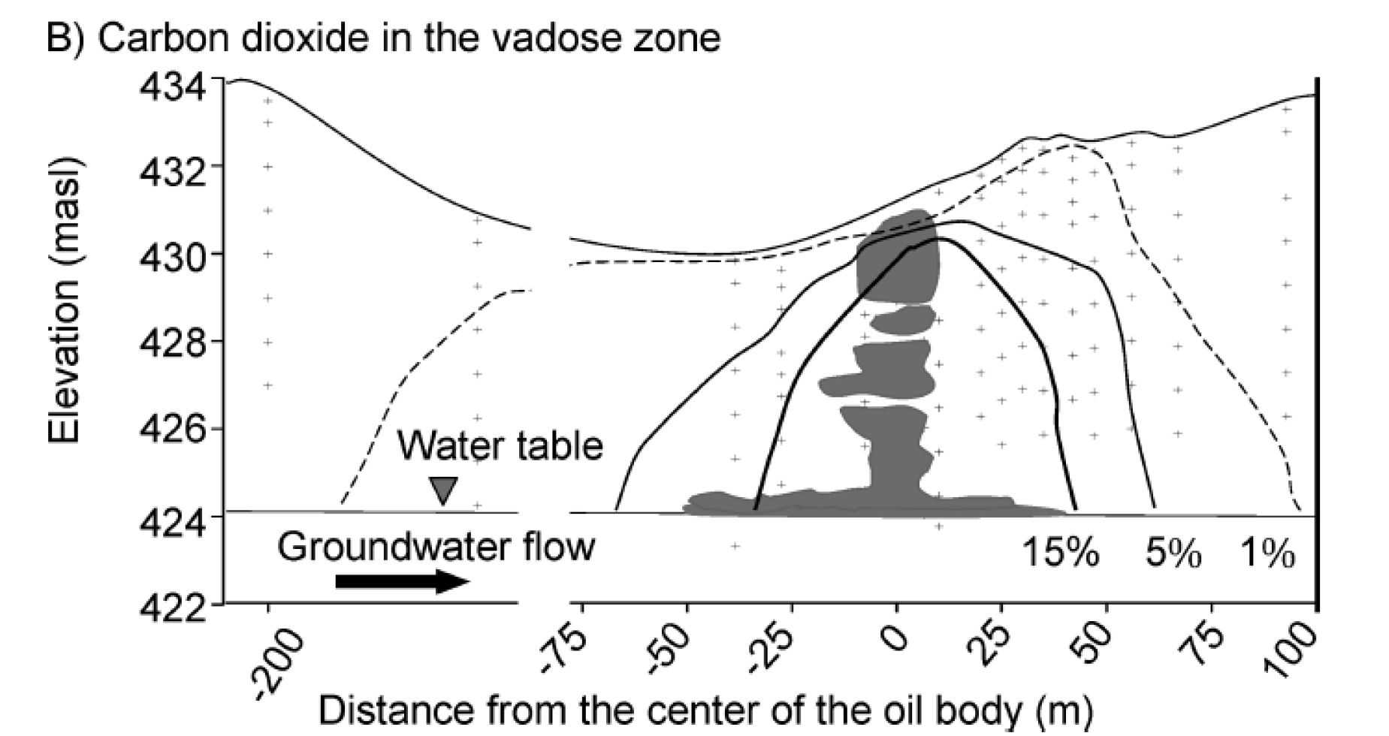
FAQ 15: What are CO₂ traps and how do they help me show attenuation?
Traps have been deployed at multiple sites and have documented large CO₂ fluxes equivalent to 100s to 1000s of gallons of LNAPL per acre per year
What do the data say?
Equivalent to
> 3000 gallons of LNAPL degraded per acre per year
Sihotra et al., 2011
Example of field site where CO₂ traps were used to delineate LNAPL natural loss rates.

Slide 44
Break for Poll questions

Slide 45
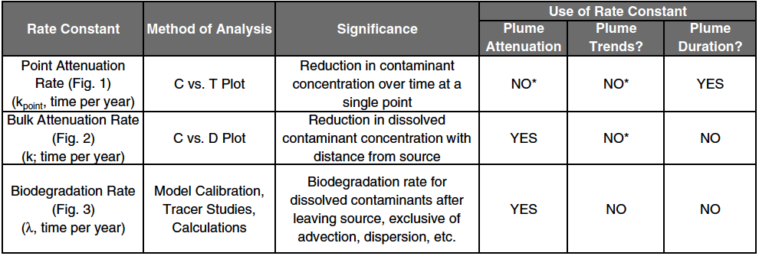
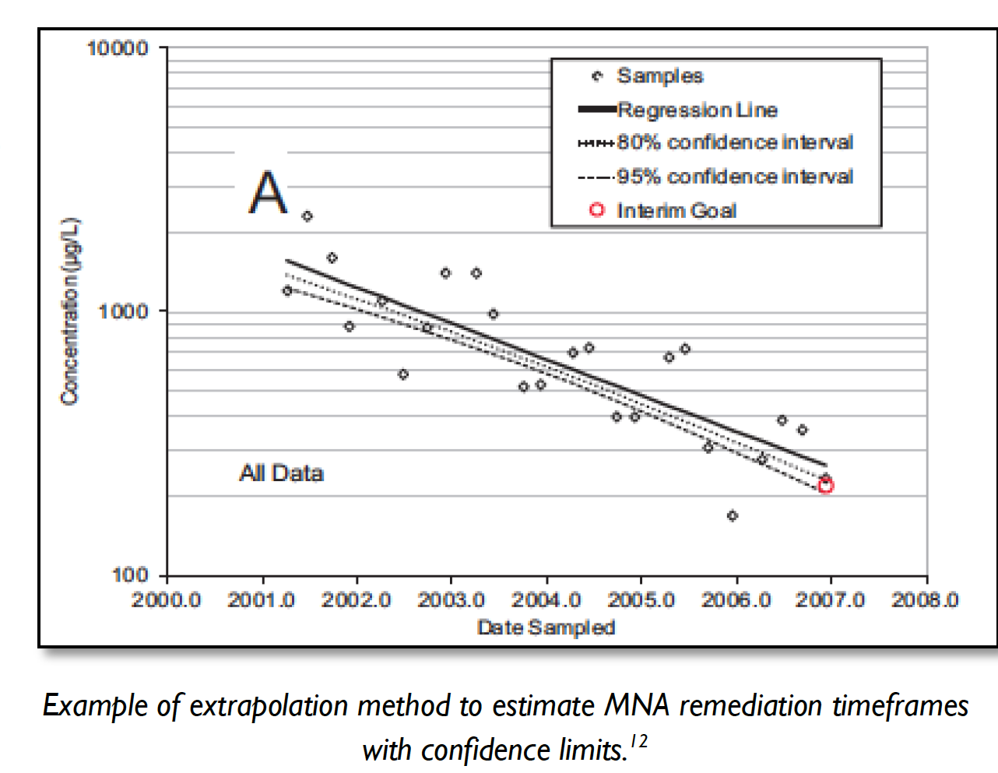
FAQ 16: How do I estimate rates and timeframes for MNA?
By extrapolating monitoring well data and the right rate…
from Wilson, USEPA, 2011

Slide 46
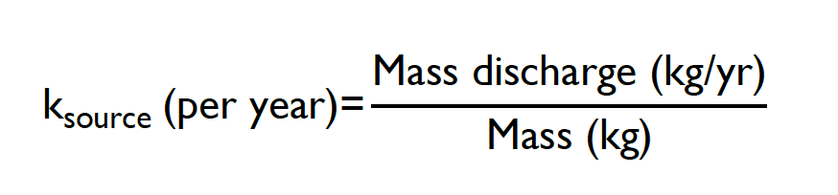
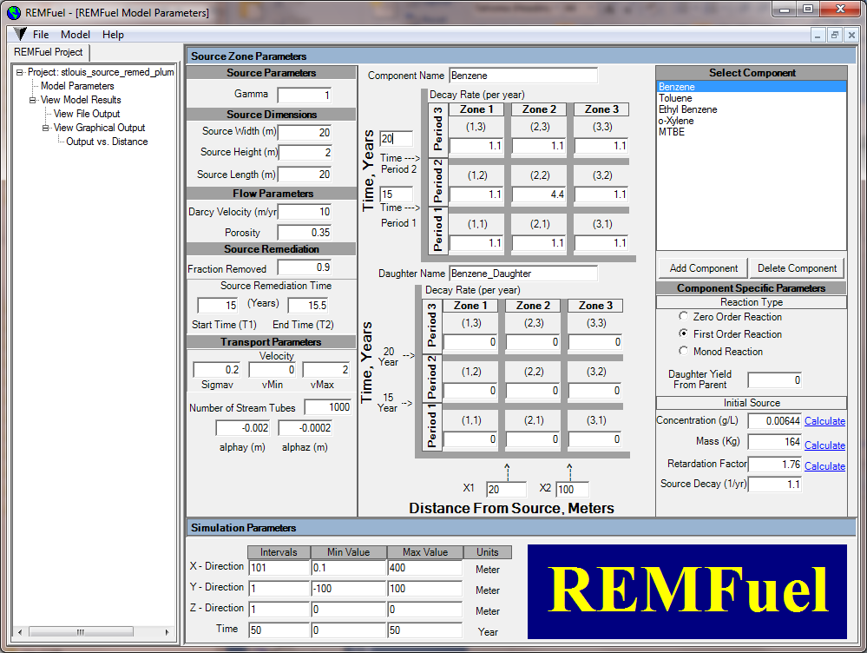
FAQ 16: How do I estimate rates and timeframes for MNA?
By using mass balance methods in simple models…
Simple mass balance model for first order decay in source concentration
REMChlor Model
(Falta et al., 2007)
and
NAS Software
(Widdowson et al, 2005;
Chapelle et al., 2007)

Slide 47
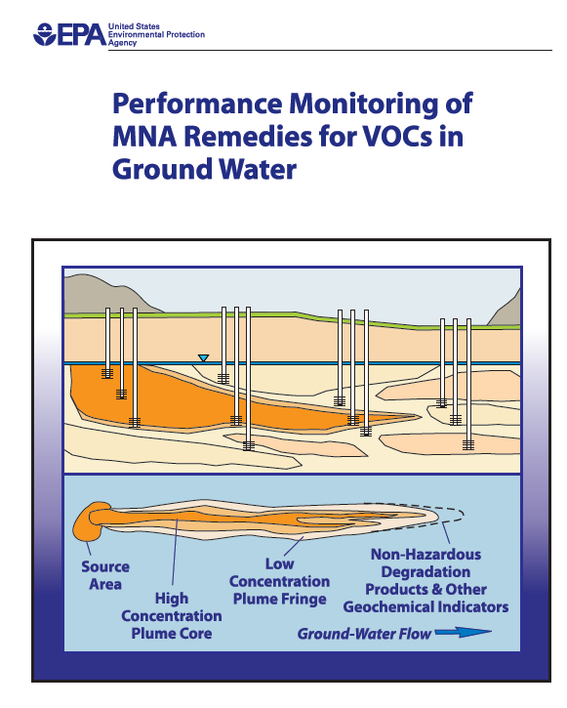
FAQ 17: What is required for MNA monitoring?
Follow and understand USEPA Guidance
From USEPA Performance Monitoring of MNA | Our Comments
Sample both contaminated and uncontaminated areas. | Source zones can change the geochemical conditions
Monitor areas supporting site hydrogeology. | Use piezometers to better understand groundwater flow
Match screen length to stratigraphic unit or contaminant loading interval. | it is critical to get flow-weighted concentrations from transmissive zones that would be utilized by a receptor. This may mean long well screens.
Be aware of changing groundwater flow directions. | See graphics in USEPA 2004 doc
USEPA, 2004

Slide 48
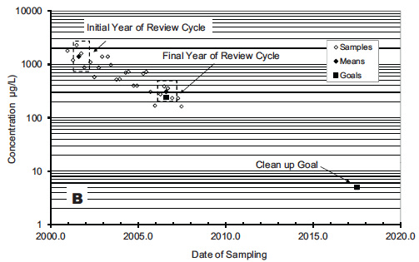
FAQ 18: What is the new thinking about monitoring frequency?
  SERDP ER-1705 Monitoring Variability Study: Short-term variability masks long-term trend
KEY POINT: Groundwater monitoring data can be highly variable, so it may take many years to establish attenuation trends
Key Approaches Described in FAQ 18 and FAQ 19
  Wilson, USEPA Guidance, 2011: Focus on longer review cycles to answer these questions

Slide 49

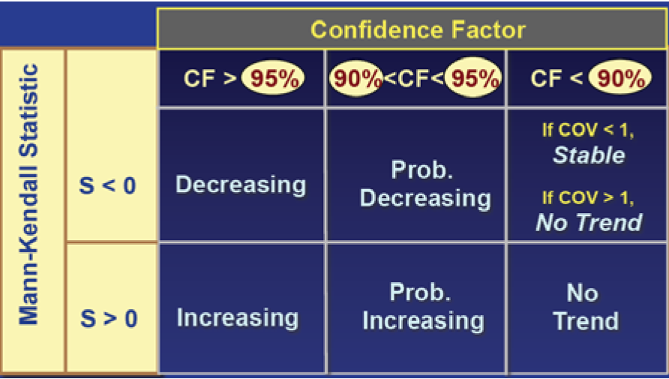
FAQ 19: Statistics for two questions: How far and how long?

Slide 50
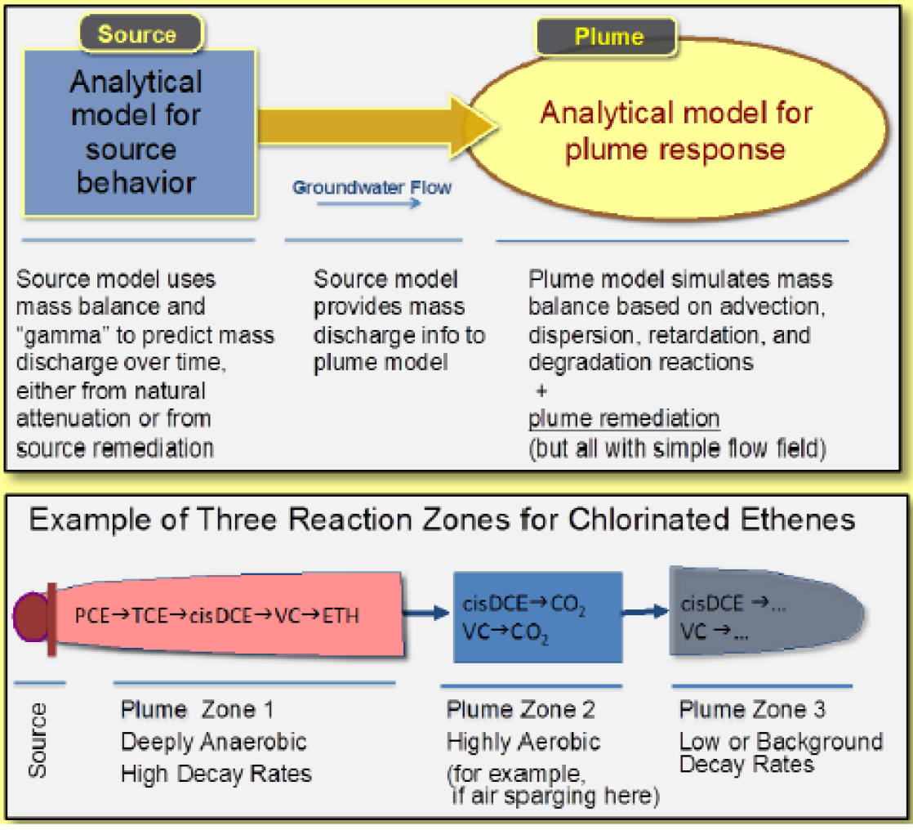
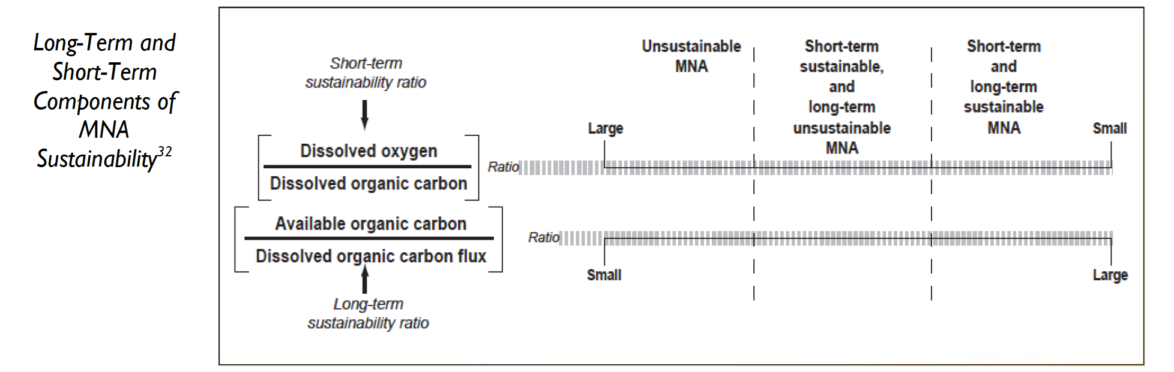
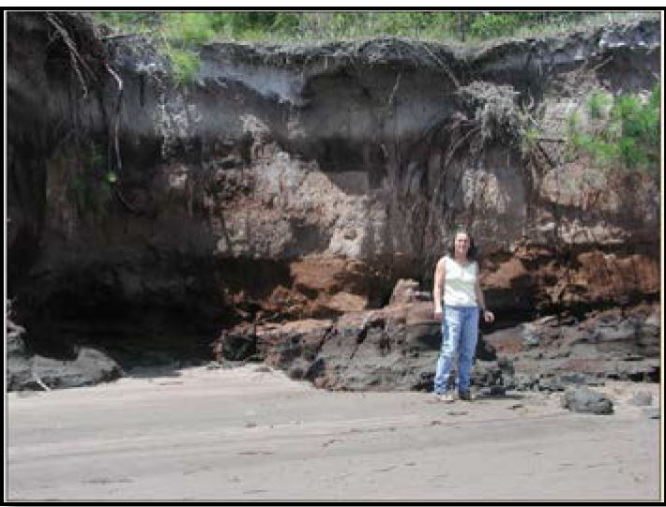
FAQ 20, 21: Which computer models work best for MNA? Are MNA Reactions Sustainable?
REMChlor and REMFuel
(Falta et al., 2007; USEPA, 2012)
NAS Software
(Widdowson et al, 2005;
Chapelle et al., 2007)

Slide 51
MNA THemes
MNA AS AN EVOLVING TECHNOLOGY:
What is matrix diffusion? How does it affect MNA?
Do contaminants in low-permeability units attenuate?
Why are interfaces important for MNA?
How do reactive mineral species contribute to attenuation?
What is a low-risk site? How is MNA involved?
THE BASIS FOR MNA:
NEW CONTAMINANTS FOR THE MNA LINEUP:
NEW TECHNIQUES, NEAT TOOLS:
EMERGING ISSUES FOR EVALUTING MNA AS A REMEDY:
IMPLEMENTATION AND SITE CLOSURE:

Slide 52

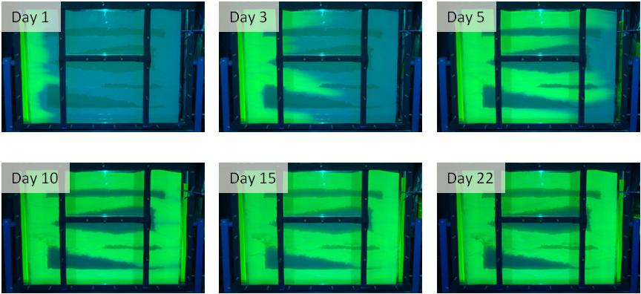
FAQ 22: What is matrix diffusion? How does it affect MNA?
Doner and Sale, Colorado State University
To Download: www.gsi-net.com bottom right part of screen

Slide 53

FAQ 23: Do contaminants in low-permeability units attenuate?
Sometimes, we think
Some evidence based on lab/field studies, but simply not investigated much yet
Even slow attenuation could be significant
Impact of Abiotic Degradation Rates in Rock Matrix on Mass Reduction Timeframes
(data described in Schaefer et al., 2013)
Characteristics That Favor Attenuation | Characteristics That Hinder Attenuation
Long retention times (little advection/flushing) | Smaller pore throat size restricts migration of microbes, influx of nutrients/carbon sources, and growth density
Reducing conditions are common; favorable for biological and biogeochemical reductive dechlorination | Salinity can be high and may limit microbial activity
Potentially large reservoir of organic carbon (silts/organo-clays) | Limited bioavailability of organic carbon
Potentially large reservoir of reactive mineral species | Reactivity of mineral species may be limited due to dependence on microbial activity (e.g., iron reduction)

Slide 54
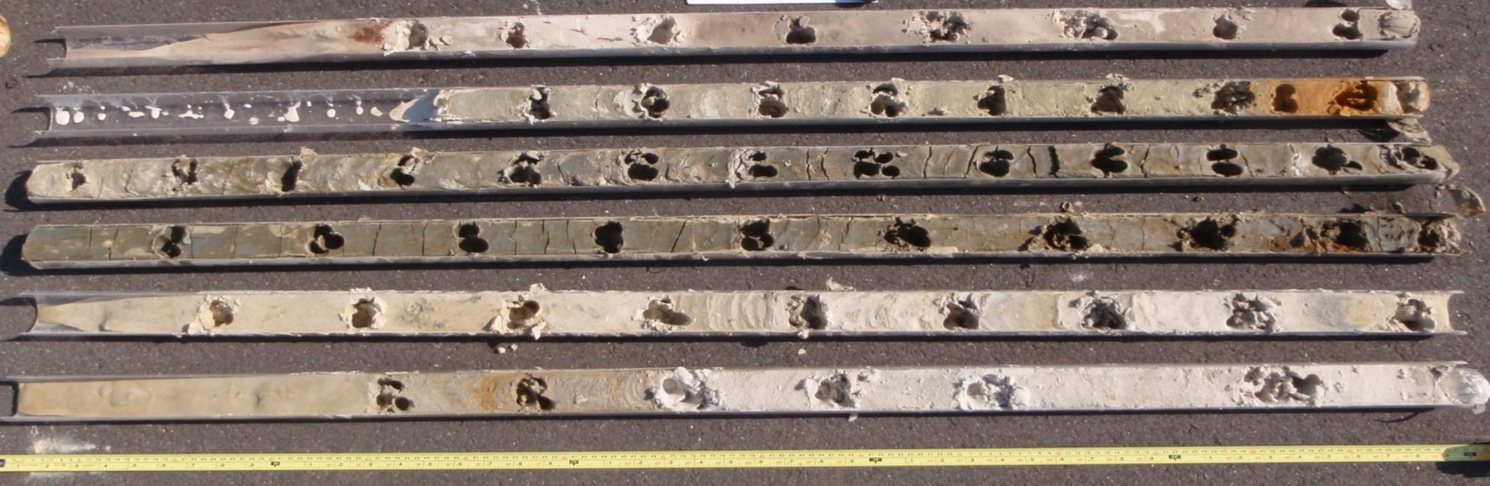
FAQ 23: Do contaminants in low-permeability units attenuate?
Potential lines of evidence for low k zone attenuation to support MNA
Molecular biological data confirming presence and/or activity of degraders within low k zone
Daughter product distribution suggests greater extent of degradation in low k zone relative to adjacent transmissive zone
Favorable geochemical conditions within low k zone
CSIA data showing higher fractionation within low k zone
Mineralogical analysis of low k zone soil samples that show minerals capable of abiotic degradation of contaminants
Example of high-resolution sub-sampling of soil cores for assessing attenuation in low-k zones

Slide 55
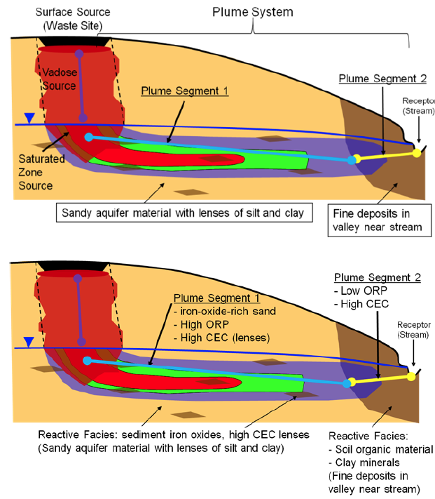
FAQ 24: Why are interfaces important for MNA?
Interfaces are where the action is at many sites!
Interfaces between groundwater and surface water – hyporheic zone
Transitions between aerobic zones and more reducing conditions
Biogeochemical gradients at the interface between different geologic conditions
Interface between vadose zone and saturated zone

Slide 56
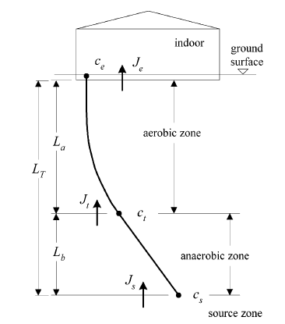
FAQ 24: Why are interfaces important for MNA?
KEY POINT: Big changes that occur across short distances can drive attenuation
Hyporheic zone example (USGS study by Landmeyer et al., 2010)
Vadose zone example (Kurt, Shin, & Spain, 2012)
“MTBE, TBA, and TAME concentrations in groundwater discharge in a 5-foot (1.5-m) thick section of the hyporheic zone were attenuated between 34% and 95%, in contrast to immeasurable attenuation in the shallow aquifer during contaminant transport between 0.1 and 1.5 miles (0.1 to 2.4 km)”.
INTERFACE
Thin (2-3 mm) anaerobic/aerobic interface was found to have a “remarkable capacity” to degrade chlorobenzene (2000 to 4200 milligrams per meter squared per day) and nitrobenzene.
Conceptual model for
vadose zone degradation
(from Devaull, 2007)

Slide 57
FAQ 25: How do reactive mineral species contribute to attenuation?
Naturally-occurring minerals can degrade contaminants
CVOC degradation that is abiotically-mediated by a number of reactive mineral species
Basis for ZVI and other PRB designs, but significant evidence of natural attenuation in anaerobic environments
Iron(II) Sulfide (FeS)
Mackinawite –(Fe_{1+x}S )
Pyrite (FeS₂)
Magnetite (Fe₃O₄)
Goethite (α-FeO(OH))
Hematite (Fe₂O₃)
Lepidocrocite (γ-FeO(OH))
Green Rust--(Fe²⁺ and Fe³⁺ cations, O²⁻ and OH⁻ anions, with loosely bound [CO₃]²⁻ groups and H₂O molecules between the layers)
Example of abiotic TCE degradation by magnetite (from ESTCP/AFCEE/NAVFAC, 2007)

Slide 58
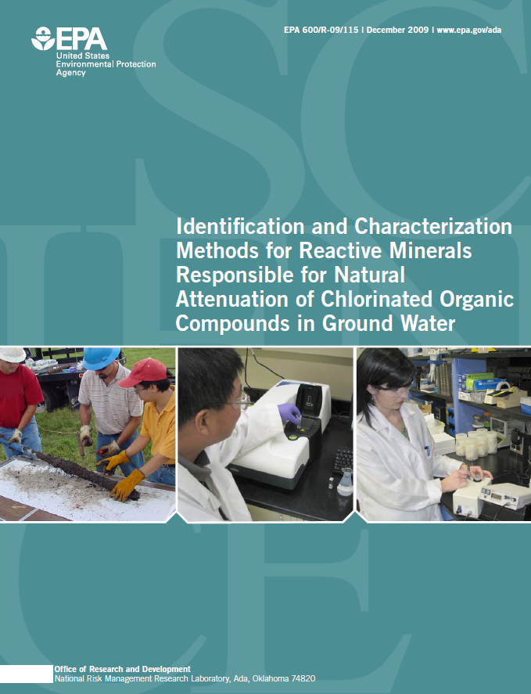
FAQ 25: How do reactive mineral species contribute to attenuation?
While contaminants are degraded abiotically, formation of reactive minerals typically have a biological component
  e.g., biological iron reduction and/or sulfate reduction to produce iron sulfide
Methods for assessing abiotic degradation capacity are available and/or being developed
  E.g., magnetite in sediments via magnetic susceptibility testing
Current research suggests slow but sustainable attenuation rates
EPA, 2009 –
detailed descriptions of important methods

Slide 59

FAQ 26: What is a low-risk site? How is MNA involved?
Low-Risk means MNA the rest of the way
Recognition that at many sites complete closure is difficult and/or unattainable
Concentrations may be very low and pose no significant risk
Being adopted as part of state regulatory programs (e.g., California)
Low-Risk Site Closure Guide for Air Force (Farhat et al., 2012)

Slide 60
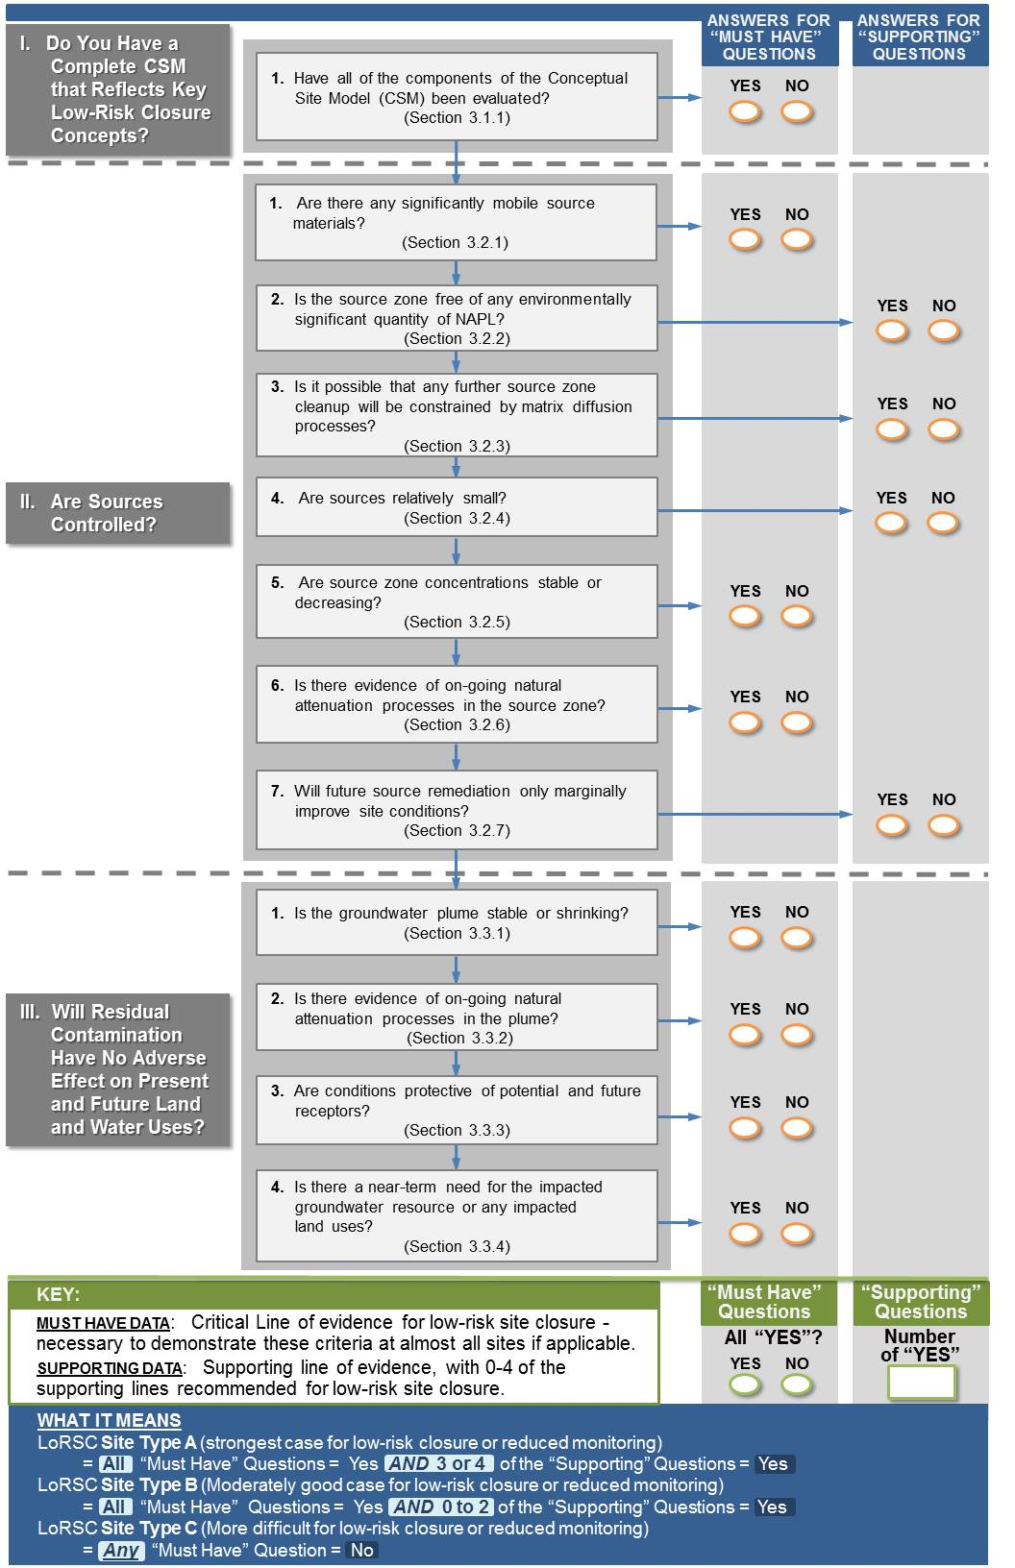
FAQ 26: What is a low-risk site? How is MNA involved?
Air Force LoRSC Manual Methodology to Determine Low Risk Sites – Parts I and II

Slide 61
MNA THemes
MNA AS AN EVOLVING TECHNOLOGY:
Can MNA be a stand-alone remedy? When should you transition a site to MNA?
How can stakeholders considering MNA make better decisions?
THE BASIS FOR MNA:
NEW CONTAMINANTS FOR THE MNA LINEUP:
NEW TECHNIQUES, NEAT TOOLS:
EMERGING ISSUES FOR EVALUTING MNA AS A REMEDY:
IMPLEMENTATION AND SITE CLOSURE:

Slide 62
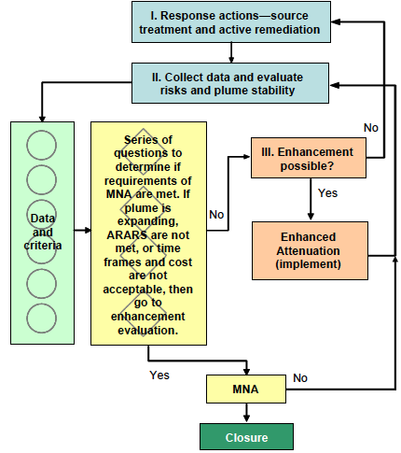
FAQ 27: Can MNA be a stand-alone remedy? When should you transition to MNA?
It depends
1999 EPA Directive:
Lots of data suggesting MNA being used extensively
  Sole remedy
  Some source treatment with MNA as sole grounwater remedy
Many states have specific risk-based criteria for MNA as default remedy (e.g., Florida)
MNA should not be considered a default or presumptive remedy, and that it should be applied “very cautiously as the sole remedy” and that “source control will be fundamental components of any MNA remedy.”

Slide 63
FAQ 27: Can MNA be a stand-alone remedy? When should you transition to MNA?
MNA Transition Flowchart, ITRC 2008
Are the risks acceptable?
Is the plume stable or shrinking?
Are conditions sustainable?
Is the remediation timeframe acceptable?
Are the cost-benefits acceptable?
NO?
Enhanced Attenuation
(instead of MNA)

Slide 64
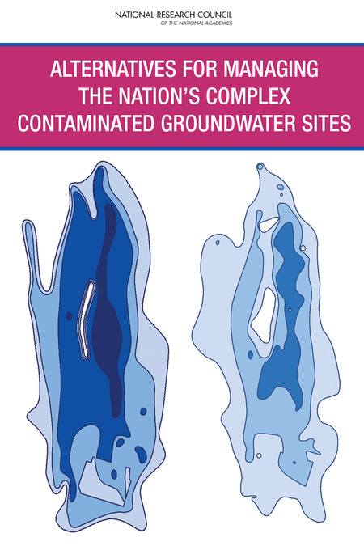
FAQ 27: Can MNA be a stand-alone remedy? When should you transition to MNA?
NRC “Complex Sites” Report, 2012
Transition Assessment Concept
At many complex sites, contaminant concentrations in the plume remain stalled at levels above cleanup goals despite continued operation of remedial systems. There is no clear path forward to a final end state embodied in the current cleanup programs, such that money continues to be spent, with no concomitant reduction in risks. If the effectiveness of site remediation reaches a point of diminishing returns prior to reaching cleanup goals and optimization has been exhausted, the transition to monitored natural attenuation or some other active or passive management should be considered using a formal evaluation. This transition assessment would determine whether a new remedy is warranted at the site or whether long-term management is appropriate.

Slide 65
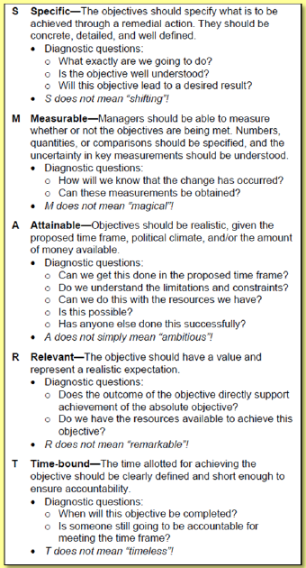
FAQ 28: How can stakeholders considering MNA make better decisions?
Use SMART Objectives
“Absolute (objectives based on broad social values, such as protection of public health) or functional (steps or activities taken to achieve absolute objectives, such as supplying bottled water to affected residents). Functional objectives are established to demonstrate attainment of absolute objectives and have often been missing, difficult to measure, or unattainable”
Specific
Measurable
Attainable
Relevant
Time-Bound
Functional Objectives must be:
from ITRC Integrated DNAPL Site Strategy (IDSS), 2012

Slide 66
INTERACTIVE “FAQ”
Advantages:
Easy to navigate
Hosted on ESTCP and GSI websites
Does not require download
LET’S TAKE A QUICK TOUR!
Interactive Version
http://serdp-estcp.org/Program-Areas/Environmental-Restoration/Contaminated-Groundwater/Persistent-Contamination/ER-201211/
66

Slide 67
INTERACTIVE “FAQ”
LET’S TAKE A QUICK TOUR!
5 minute run-through of interactive version
67

Slide 68
FINAL Q&A
Go to:
http://serdp-estcp.org/Program-Areas/Environmental-
Restoration/Contaminated-Groundwater/
Persistent-Contamination/ER-201211/
Or Google:
“MNA” + “FAQ” + “ESTCP”

