Slide 1
Navy’s Portfolio Optimization: In Situ Remediation Sites
Presented By
Mike Singletary, P.E.
Naval Facilities Engineering Command (NAVFAC)
Southeast
Federal Remediation Technology Roundtable (FRTR) Webinar, September 27, 2018 1:00 – 3:00 PM

Slide 2
Overview
Portfolio Optimization
Shift focus from individual site reviews to portfolio-wide evaluation of cleanup program
Develop common findings/themes
Identify focus areas for future optimization
Discuss challenges complex sites pose to the Navy’s Environmental Restoration Program
Adaptive Site Management
Systematic approach to managing site uncertainty
Example site – Former NWIRP McGregor, TX

Slide 3
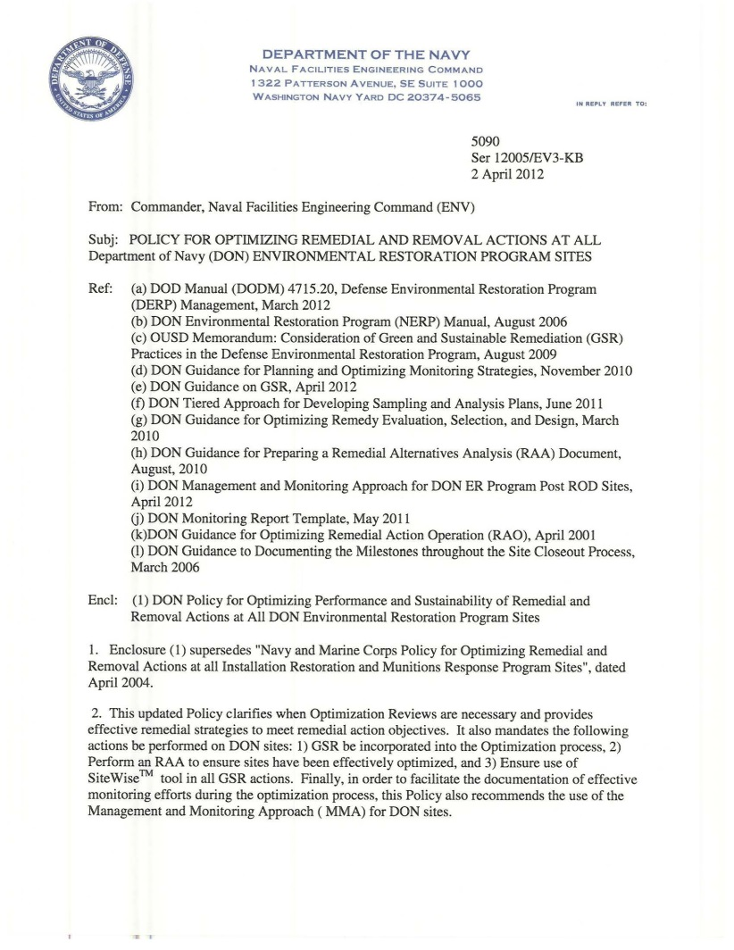
Navy Optimization Policy and Guidance
DON Policy for Optimizing Remedial and Removal Actions at all DON Restoration Sites
April 2012
Guidance for Optimizing Remedial Action Operation
October 2012
Guidance for Planning and Optimizing Monitoring Strategies
November 2010
Guidance for Optimizing Remedy Evaluation, Selection, and Design
March 2010

Slide 4
Navy’s Cost to Complete Status (FY17)
Total Marine Corps Sites: 1,104 (25%)
(17%)
168 Sites (18%)
$0.45B (18%)
158 sites
(83%)
754 Sites (82%)
$B
Marine Corps
(12%)
Total Navy Sites: 3,394 (75%)
(88%)
$B
Projects Only
Notes:
37 new Navy Sites with CTC of $57.6M
27 new MC Sites with CTC of $6.6M
List of MC Activities FY 2017 Execution

Slide 5
FY17 Snapshot of Navy Program
EOY FY2017
IRP
4,498 Sites (EOY16: 4,435 Sites)
RC: 3,685 (81.9%)
$4,495M CTC = $2,528M (IRP) + $1,967M (MRP)
Projects Only
MRP

Slide 6
Complex Sites Challenge
Straightforward sites largely been addressed
Remaining sites pose technical challenges to Navy’s Environmental Restoration Program
2013 National Research Council (NRC)
Approximately 10% of sites are “complex”
Will not meet cleanup objectives in reasonable timeframe
Cost to remediate ~$127 billion
Alternative management approaches needed

Slide 7
NRC 2013 on Achieving Site Closure
“…at complex sites characterized by multiple contaminant sources, large past releases of chemicals, or highly complex geologic environments, meeting the DoD’s ambitious programmatic goals for remedy in place/response complete seems unlikely and site closure almost an impossibility.”
“Rather, the nation’s cleanup programs are transitioning from remedy selection into remedy operation and long-term management (LTM), potentially over long timeframes.”

Slide 8
Site Challenges
Technical Challenges | Examples |  | Non-Technical Challenges | Examples
Geologic conditions | Fractured bedrock, karst geology, low-permeability sediments |  | Site objectives | Deviations from promulgated screening values or closure criteria (e.g. MCLs)
Hydrogeologic Conditions | Groundwater table fluctuations, groundwater-surface water interactions |  | Managing changes that may occur over long time frames | Phased remediation, multiple PRPs, loss of institutional knowledge
Geochemical Conditions | Low/high pH, alkalinity, elevated electron acceptors |  | Overlapping regulatory responsibilities | Federal/state cooperation, numerous stakeholders
Contaminant-related Conditions | LNAPL/DNAPL, emerging contaminants, back diffusion |  | Institutional controls | Tracking and managing ICs, enforcement
Large-scale site | Size and depth of plume, number and variety of receptors |  | Changes in land use | Site access, redevelopment, land/water use change
 |  |  | Funding | Uncertain funding, politics
Source: Modified from ITRC 2017

Slide 9
2003 NRC Adaptive Site Management
NRC 2003 study on latter stages of site remediation at Navy installations
NRC report proposed comprehensive and flexible approach – “Adaptive Site Management”
Express recognition that system responses will be monitored, interpreted, and used to adjust approach in iterative manner over time
Source: NRC 2003

Slide 10
Navy Portfolio Optimization (P-OPT) Review of Complex Sites (2015-17)
Primary objectives were to identify opportunities to reduce remediation timeframe (accelerate RC), improve remedy effectiveness, and achieve cost avoidance
In-house Navy subject matter experts (SMEs) and outside consultants reviewed each site and developed preliminary findings and recommendations
Portfolio-wide themes were developed
Site findings and recommendations implemented by RPMs and adjusted based on additional insights from end users
Common themes used to develop Navy policy and guidance to properly manage complex sites and to prioritize future optimization efforts

Slide 11
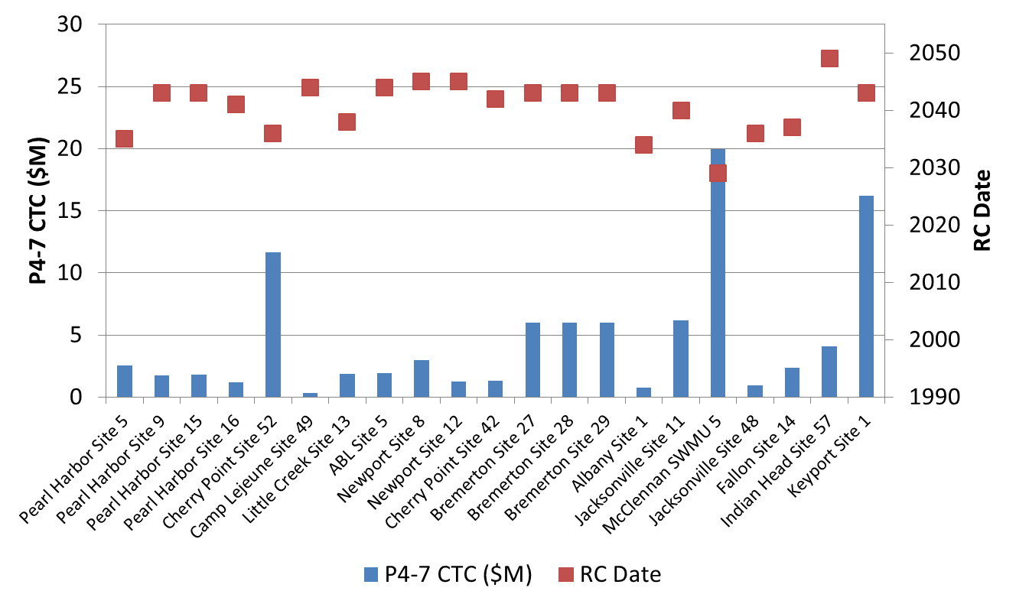
Complex Sites with In Situ Treatment Trains

Slide 12
Summary of Site Findings
Restoration timeframes estimated at >30 years for all sites (actual timeframe typically greater)
Source reduction technology (e.g. bioremediation, ISCO) typically implemented with natural attenuation and other passive technologies to treat/control downgradient plume
Few opportunities to accelerate remediation timeframes
Inherent technical difficulties prevented site closure, meeting MCLs
DNAPL, complex geology, contaminant back diffusion
Long-term monitoring/management drive costs
Guidance needed to determine when to transition sites from active treatment to natural attenuation or long-term passive management

Slide 13
Key Site Management Questions
Tools and Analysis
Potential Actions
Vapor intrusion analysis
Groundwater ingestion
Groundwater to surface water discharge
Is there an ongoing impact to actual receptors?
Control risk by controlling source, pathway, and/or exposure
Benefit to further source treatment? (e.g. predictive modeling of remedial options)
Yes
No
Mann-Kendall Analysis
MAROS Tool
Conc. vs. time plots and graphs
Impacting off-site receptors?
Yes
Will a treatment barrier stop plume expansion?
What are impacts if plume expands?
Is the plume expanding?
No
Do shut-down test – rebound occur?
Convert to “toe-only” pumping?
Redesign P&T for long haul?
Will further source treatment help?
Is active P&T containment required?
Continued effectiveness of P&T over long timeframes?
Can MNA continue to prevent plume migration?
MNA long-term sustainability?
Is plume controlled by P&T or MNA?
P&T
Pursue risk-based closure (e.g. low-threat closure guidance)
Reduce long-term monitoring costs, continue optimization
MNA

Slide 14
Key Messages on Complex Sites
Approximately 10% of all sites classified as complex (NRC 2013)
Navy P-OPT identified a subset of complex sites where it will be difficult to meet restoration goals within 30 years
P-OPT identified few opportunities to accelerate remediation timeframes
Adaptive Site Management most suitable approach for addressing complex sites
P-OPT recommended phased technical approach prioritizing sites exhibiting unacceptable risk to human health and environment
Life cycle CSM used to guide decision-making throughout restoration process
Long-term passive management appropriate long-term goal for most complex sites
Focus remedial efforts on sites with uncontrolled risks
Long-term cleanup goals (e.g. MCLs) achieved through natural attenuation
Interim institutional controls to prevent exposure
Continuously update CSM and optimize remedy

Slide 15
Key Messages (Cont.)
Interim goals often necessary to guide progress towards overall site objectives
P-OPT recommended use of transition goals to focus initial remedial efforts on sites with unacceptable risks
Phased remediation approaches – feedback loop, updated CSM
Transition assessments to select new remedies or transition to long-term management
P-OPT recommended additional RPM guidance on transition assessments and development of new tools
Case studies demonstrating successful transition assessments (e.g. NWIRP McGregor)

Slide 16
Adaptive Site Management Example - Former NWIRP McGregor, TX

Slide 17
NWIRP McGregor Background
Naval Weapons Industrial Reserve Plant (NWIRP) McGregor used until 1995 as a bomb and rocket motor manufacturing facility
Isolated industrial sites located on 9,700 acres, 20 miles west of Waco, Texas
Ammonium perchlorate was released into the environment through “hog out” operations of rocket motors
Property transferred property to City of McGregor in 1995
Leased portions of property to industrial and agricultural companies
SpaceX static rocket test and launch/landing facility
Navy maintains cleanup responsibility/liability and continues active remediation and long-term monitoring on properties through access agreements

Slide 18
Former NWIRP McGregor
Source: NAVFAC SE 2017

Slide 19
Life-Cycle Optimization Timeline
Initial optimization efforts to improve automation and remote monitoring of fluidized bed reactor (FBR) (2004-05)
Long-term monitoring optimization (2005–17)
Evaluate attenuation capacity of groundwater to surface water pathway (2014-15)
Change groundwater classification from Class II to Class III (raising cleanup level X100) and reducing size of Plume Management Zone (PMZ) (2016)
Risk evaluation of ecological surface water exposure to perchlorate (2016)
Transition groundwater collection and FBR system to a series of passive in situ bio-barriers (2017-2020)

Slide 20
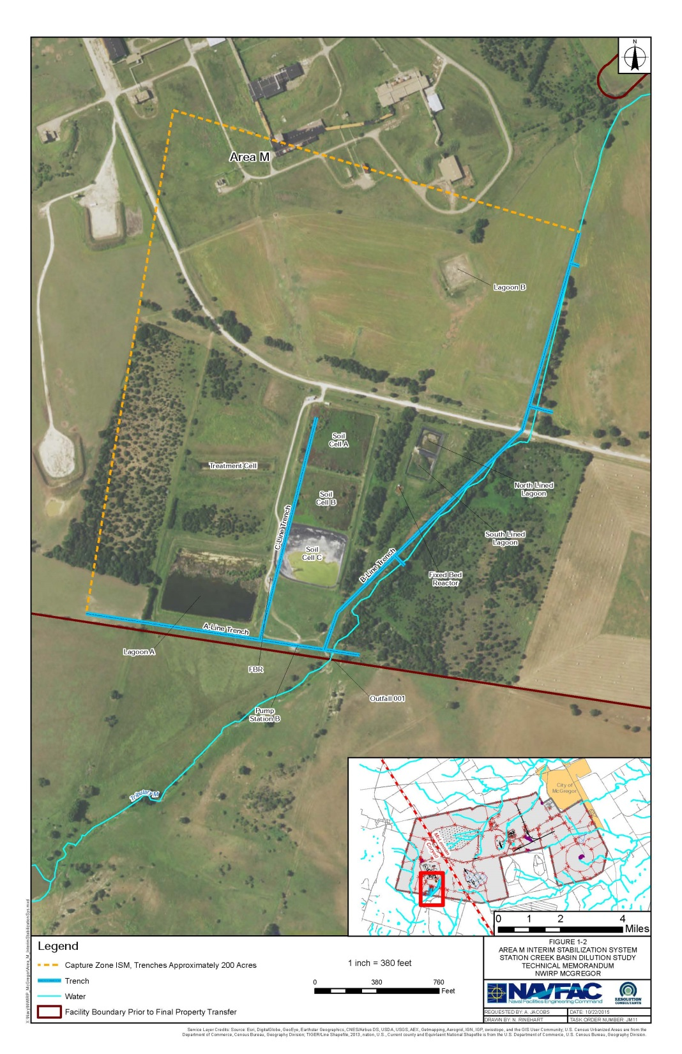
NWIRP McGregor
A-Line Trench – 1,680’ long, 20-25’ deep
B-Line Trench – 2,950’ long, 12-15’ deep
C-Line Trench - 1,425’ long, 15-18’ deep
Pump station maintains groundwater elevation to prevent discharge to unnamed tributary
Source: NAVFAC SE 2017

Slide 21
Conceptual Site Model
Streams and tributaries at the facility experience both gaining and losing conditions
Majority of precipitation occurs in Spring
Perchlorate effectively attenuated through dilution and mixing within dynamic system
Dilution study conducted in 2014-15 to evaluate perchlorate concentrations along GW/SW flow path
Source: NAVFAC SE 2017

Slide 22
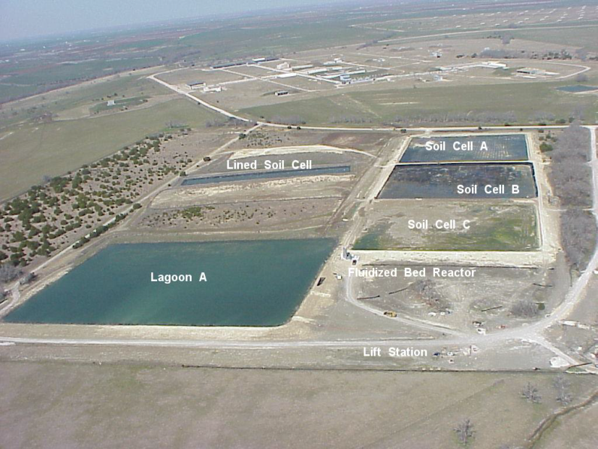
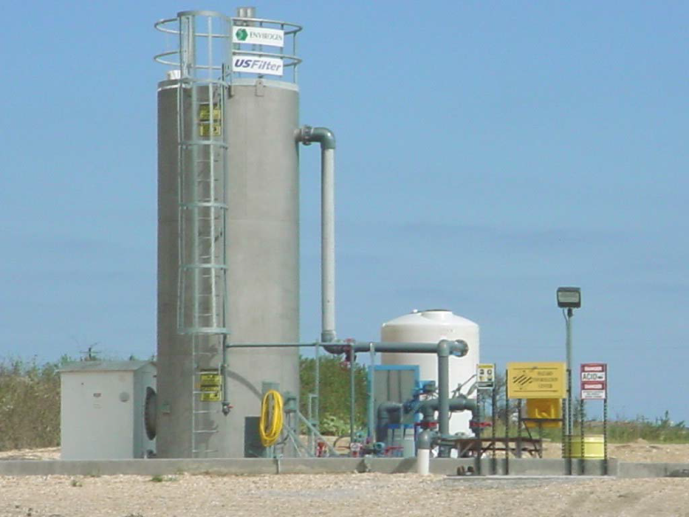
Groundwater Treatment System
Interceptor trench system and aboveground water storage
Lagoon A – 10.8M Gal
Soil Cell A – 1.2M Gal
Soil Cell B – 1.5M Gal
Soil Cell C – 1.7M Gal
Fluidized bed reactor
Treats up to 400 gpm
Discharges directly to outfall or to aboveground storage
Source: NAVFAC SE 2017

Slide 23
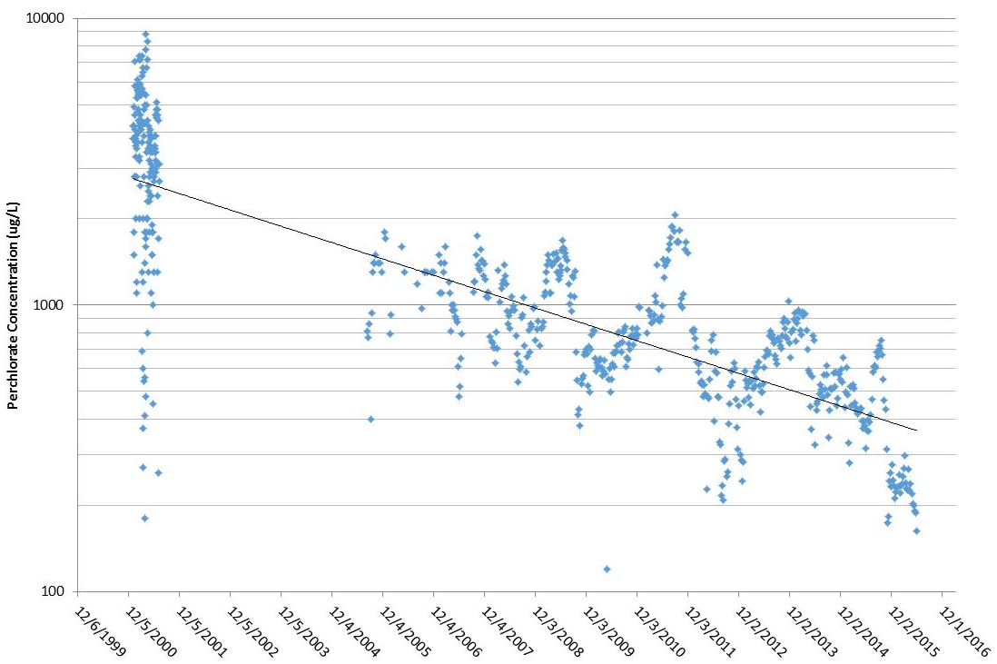
Perchlorate Influent History
Source: NAVFAC 2017
Perchlorate influent concentrations from 2000 to 2016 show overall decreasing concentrations
Combination of source removal, natural flushing, and mixing with un-impacted groundwater resulted in perchlorate attenuation over time

Slide 24
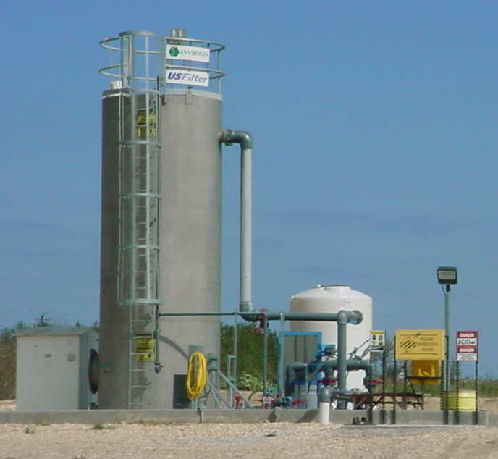
Transition Assessment
Goal to transition from aggressive pump and treat technology to passive in situ remediation
Reduce O&M, monitoring, and energy costs
Rely on in situ containment of the perchlorate plume
Navy negotiated with TCEQ to temporarily shut down treatment system during 2016-17
Continue to monitor groundwater and surface water quality in evaluating attenuation capacity
Pilot test in situ bio-borings to control perchlorate migration from source
Fluidized Bed Reactor
Source: NAVFAC SE 2017

Slide 25
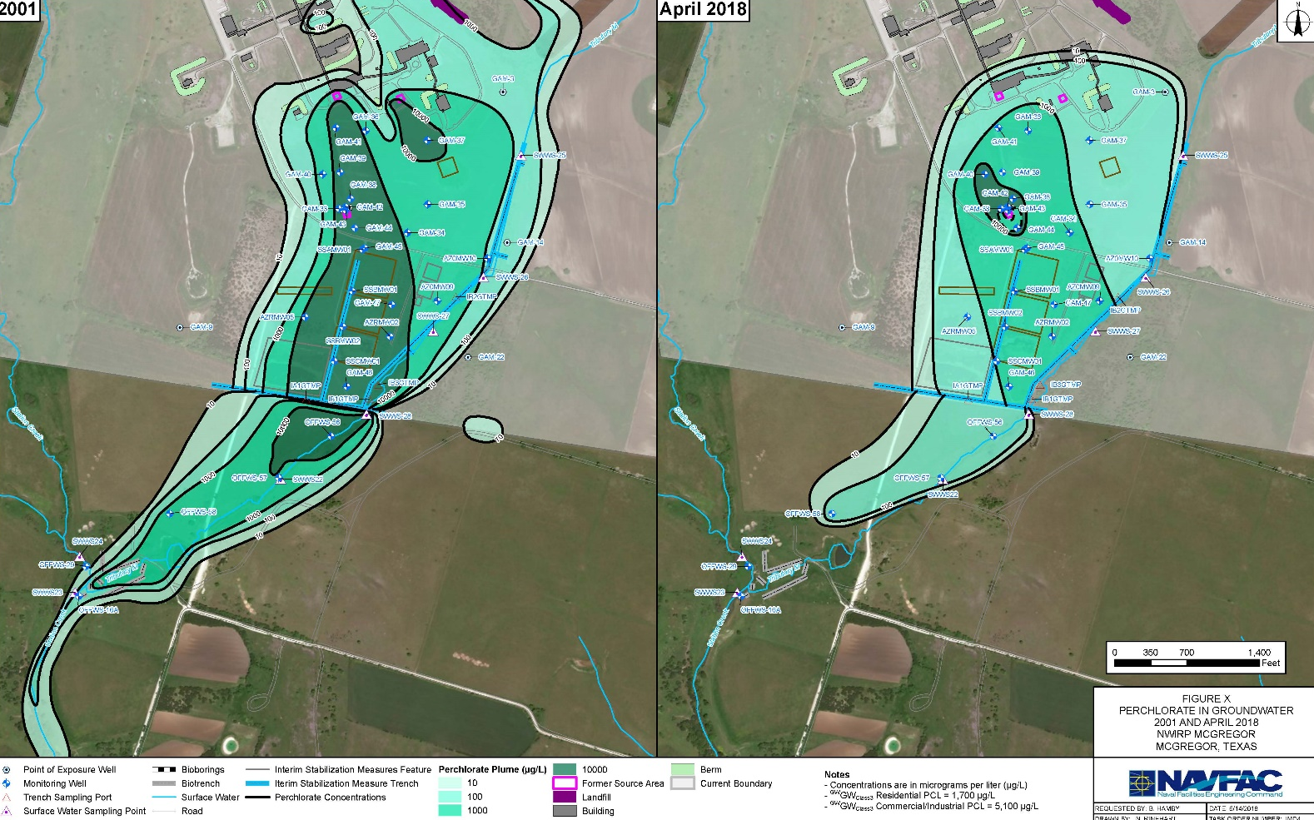
Transition Assessment (Cont.)
2001
2018
Focused treatment on remaining perchlorate hot spot
Two rows of bio-borings installed for a total of 25 wells in August 2016
Injected emulsified oil in July 2017
Reductions of perchlorate and nitrate and increase in methane concentrations
Source: NAVFAC SE 2017

Slide 26
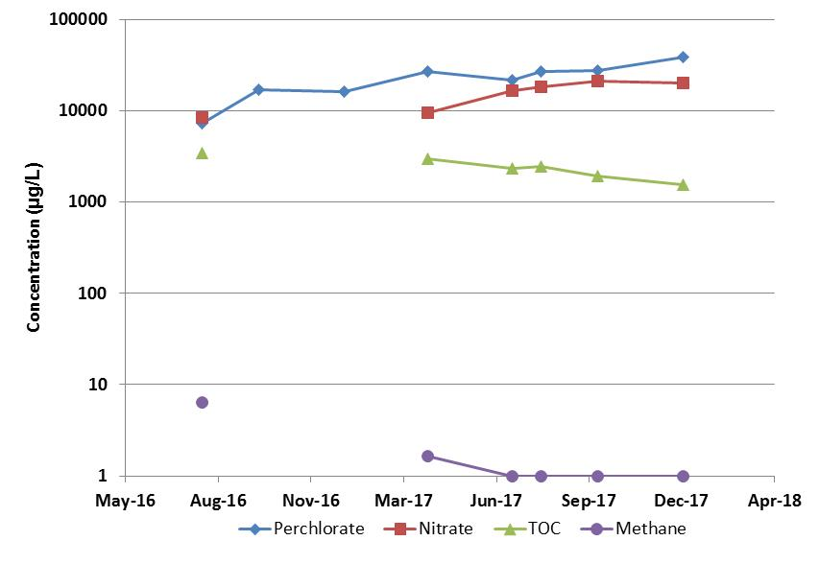
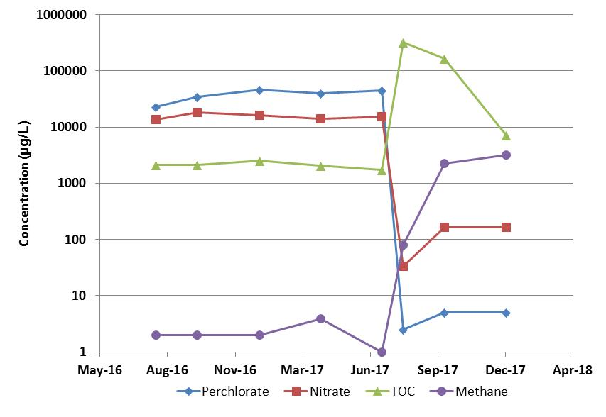
Bio-Boring Performance Monitoring
GAM-42 (Upgradient Well)
GAM-43 (Downgradient Well)
Bio-Boring
Emulsified Oil Injection
Bio-Boring
Emulsified Oil Injection
Source: NAVFAC SE 2017
Following injection of emulsified oil, rapid perchlorate and nitrate reduction, methane production
Bio-borings will likely require frequent emulsified oil replenishment to maintain containment of residual perchlorate source

Slide 27
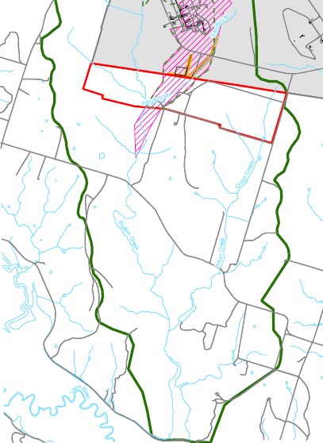
Groundwater Reclassification
Southern Boundary of PMZ
Former NWIRP McGregor
Texas A&M Property
TCEQ’s PCLs Onsite Area PMZ
Medium | Commercial/Industrial (µg/L) | Ecological (µg/L)
Class II Groundwater Classification * TRRP §350.52 | 51.1 | >8,000
Class III Groundwater Classification ** TRRP §350.52 | 5,110 | >8,000
Surface Water | -- | >8,000
Southern Boundary of PCLE Zone
Station Creek Basin
Source: NAVFAC 2014

Slide 28
Adaptive Site Management Example Summary
Life-cycle optimization achieved through a combination of management approaches
Groundwater re-classification resulted in less stringent perchlorate cleanup standard (5,100 µg/L vs. 51 µg/L)
Developed natural attenuation conceptual model (e.g. flushing and mixing in groundwater/surface water system)
Transitioned pump and treat system to passive in situ bioremediation of plume
Ecological risk assessment documented no adverse impacts to sensitive receptors from exposure to perchlorate in surface water
Long-term adaptive site management approach will result in significant annual cost avoidance while maintaining protection of human health and environment

Slide 29
Contacts and Questions
Points of Contact
NAVFAC Southeast: Mike Singletary, P.E. michael.a.singletary@navy.mil
Questions ?

