Slide 1


Claire Tiedeman, US Geological Survey
Developing Conceptual Site Models of Contaminated Fractured Rocks to Support In-Situ Remediation
Co-Authors:
Allen Shapiro, Dan Goode, Paul Hsieh, Tom Imbrigiotta,
Pierre Lacombe, US Geological Survey
Warren Barrash, Boise State University

Slide 2



Acknowledgements
Toxic Substances Hydrology Program
New Jersey Water Science Center
Earth System Processes Division
National Innovation Center

Slide 3
Outline
Motivation: Importance of Hydrogeologic Conceptual Site Models (CSMs) to In-Situ Remediation
Former Naval Air Warfare Center (NAWC) Site
Developing a CSM to Inform Bioremediation Design and Expectations
Using Hydraulic Tomography to Develop a CSM for Source Zone Remediation
Final Thoughts

Slide 4
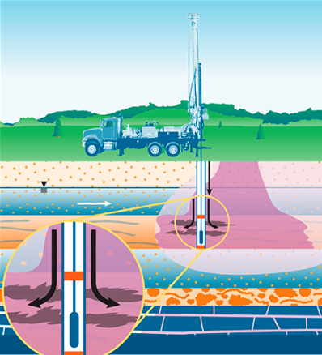
In-Situ Remediation of Fractured Rocks:
Importance of Hydrogeology
In-situ remediation typically involves injection of amendments to stimulate biological or chemical contaminant degradation and transformation processes.
Distribution of hydraulic properties controls groundwater fluxes and the spread of amendments during and after injection.
https://www.itrcweb.org/Team/Public?teamID=80

Slide 5

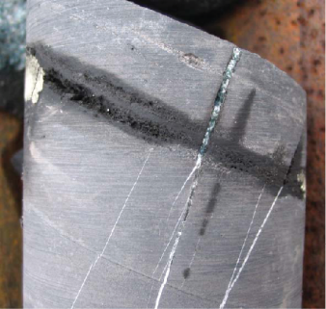
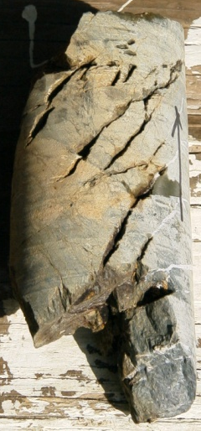
In-Situ Remediation of Fractured Rocks:
Importance of Hydrogeology
Understanding the hydrogeology is thus critical for designing injection strategies that spread amendments to locations of contamination in fractures and the rock matrix.
Amendments might not enter the rock matrix, but enhanced degradation in adjacent fractures leads to enhanced diffusion out of matrix.
Fracture
Matrix
Matrix
TCE
Fracture
TCE
Matrix

Slide 6
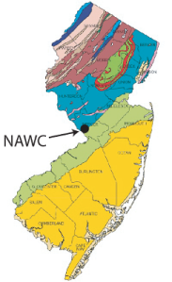
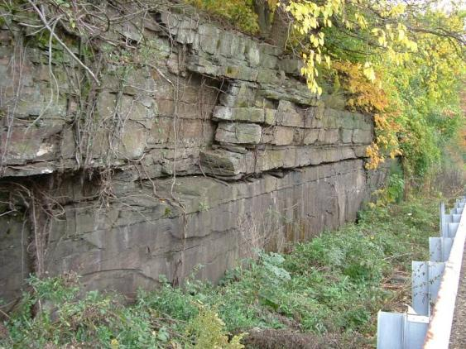
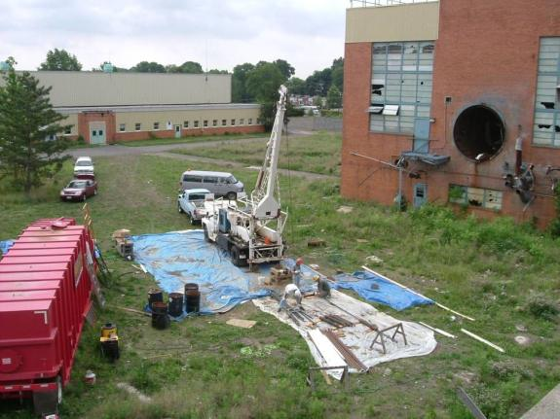
Former Naval Air Warfare Center (NAWC)
West Trenton, New Jersey
Focus site for USGS research on contaminant fate, transport, remediation under Toxic Substances Hydrology Program, 2005-2018.
Dipping fractured sedimentary rocks.
Groundwater highly contaminated with trichloroethene (TCE) and its degradation products DCE and vinyl chloride.

Slide 7
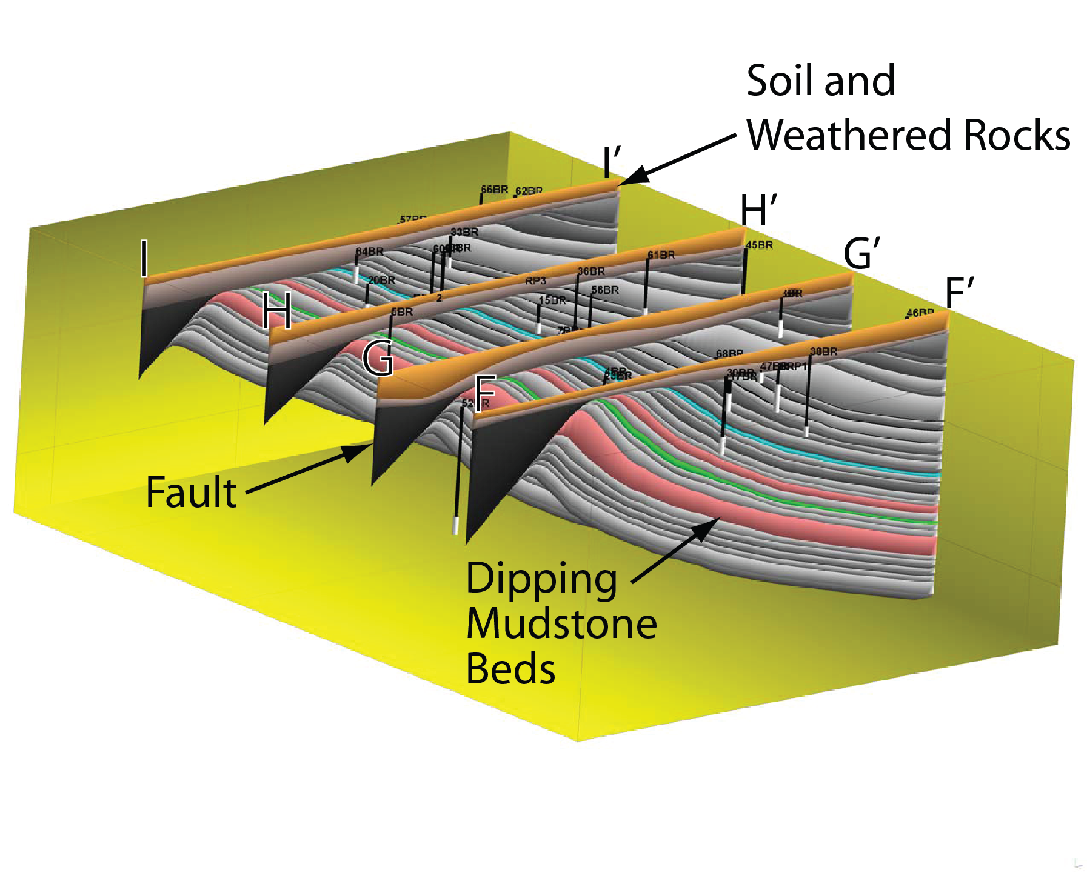
Geologic Framework
Lockatong Formation of Newark Basin.
Competent dipping mudstone beds overlain by weathered rocks & soil/saprolite.
Dominant flow paths along bedding-plane-parting fractures.

Slide 8
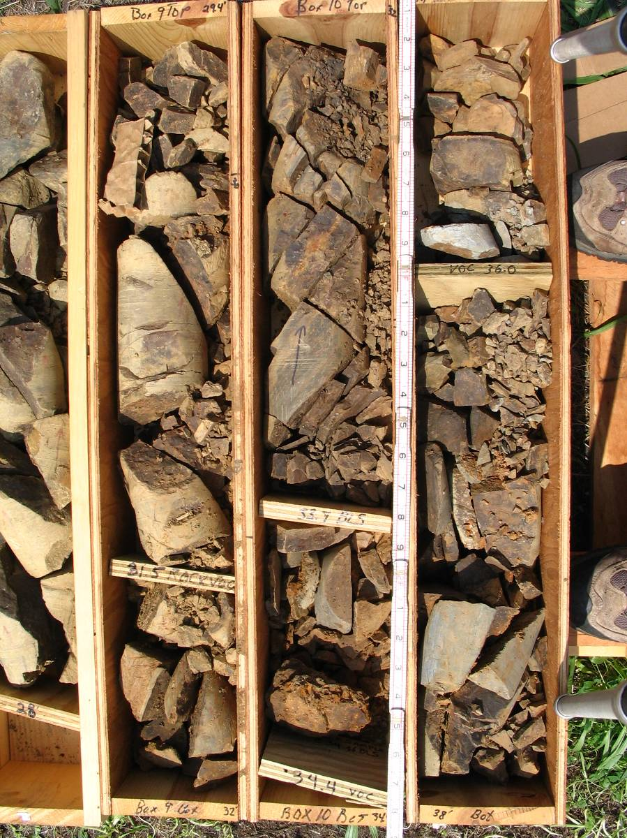
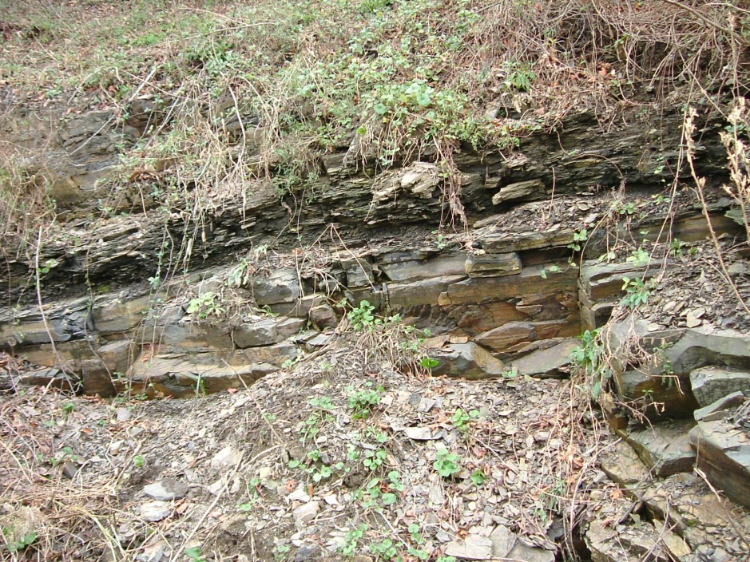
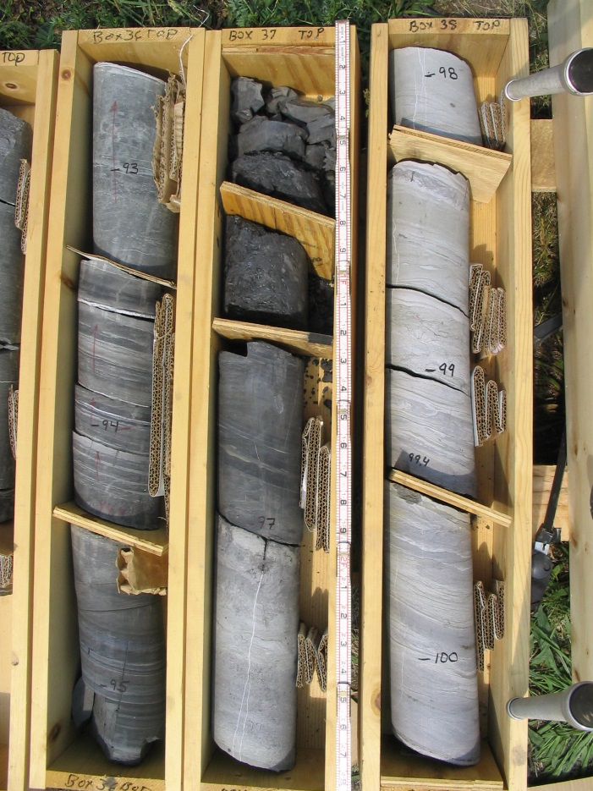

Highly weathered rock
Competent mudstones: fissile, laminated, massive

Slide 9
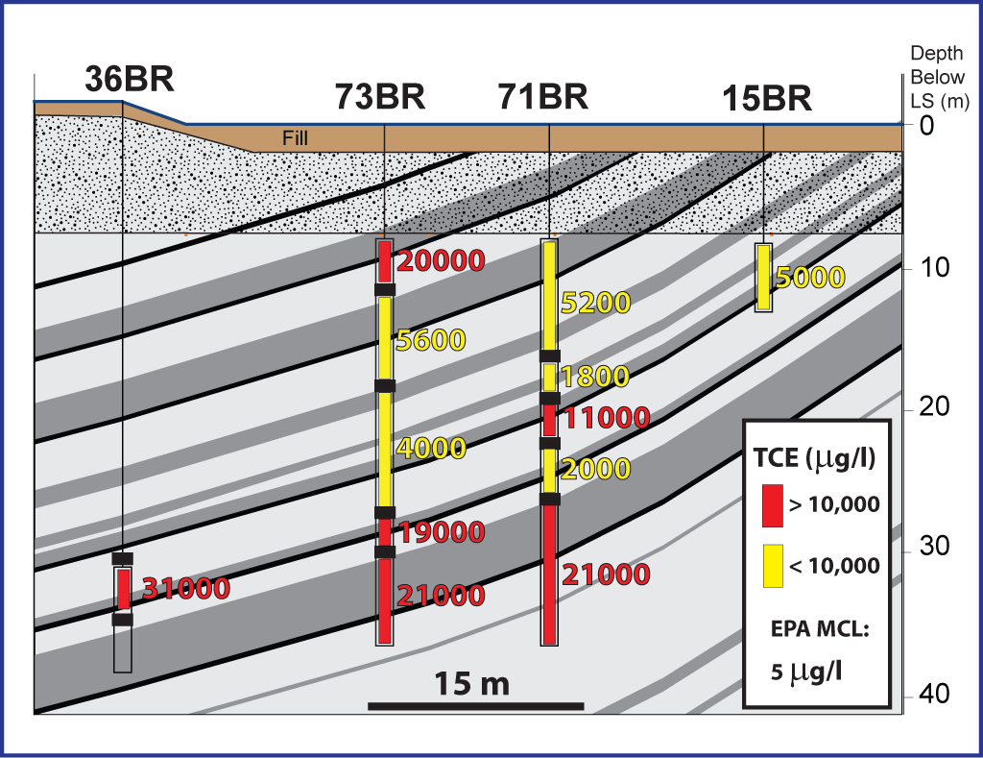
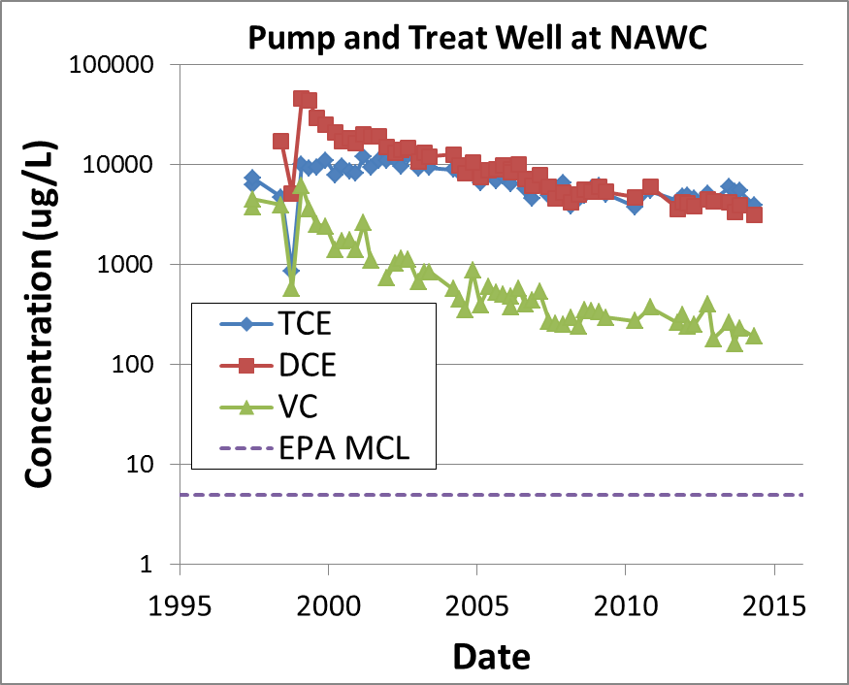
Contamination in NAWC Rocks
Extremely high concentrations of TCE and DCE: Orders of magnitude above U.S. EPA standards.
Extremely persistent: Contaminant concentrations remain high despite 20+ years of pump & treat.

Slide 10
Development and Evolution of a CSM to Inform Bioremediation Design and Expectations

Slide 11
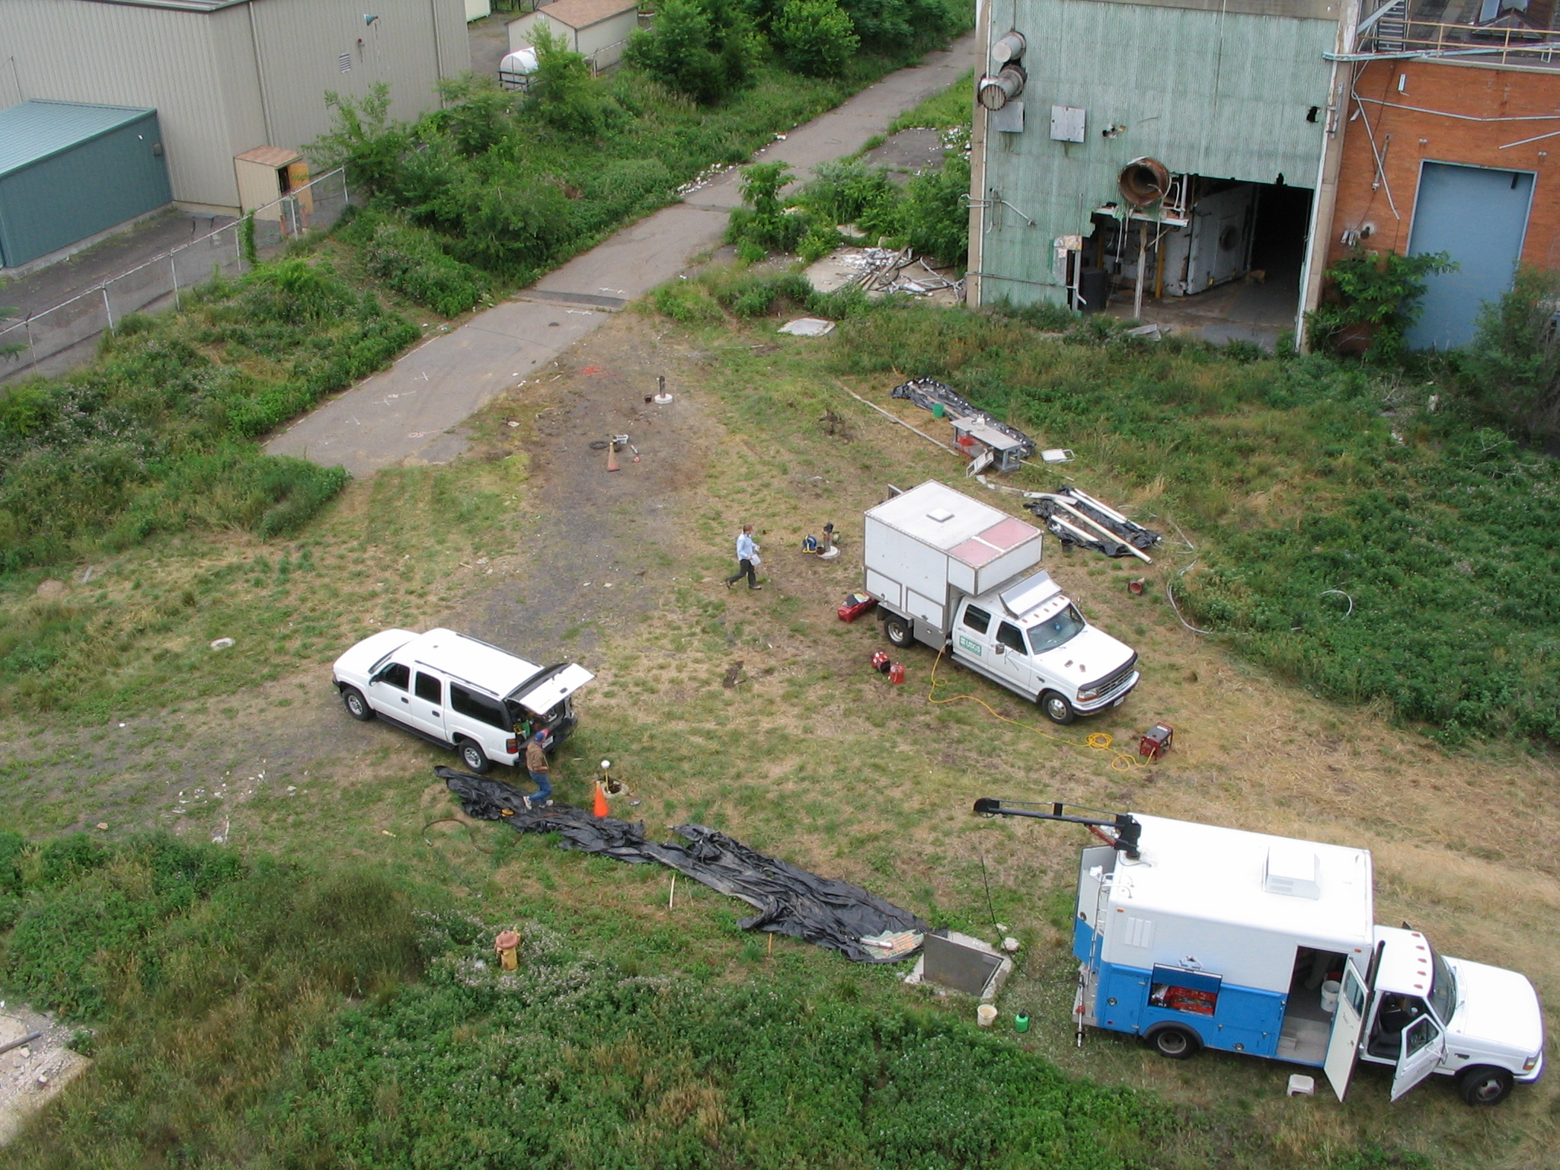
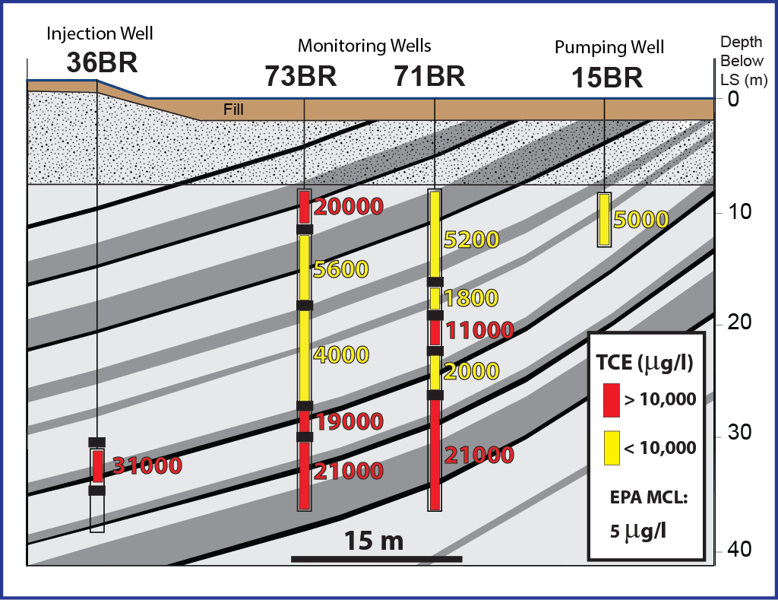
Bioremediation
Area
36BR
73BR
10 m
71BR
Inject
Pump
15BR – Pumping
Electron Donor &
Microbes
TCE → DCE → VC → Ethene
3 Cl⁻ 2 Cl⁻ 1 Cl⁻ 0 Cl⁻

Slide 12
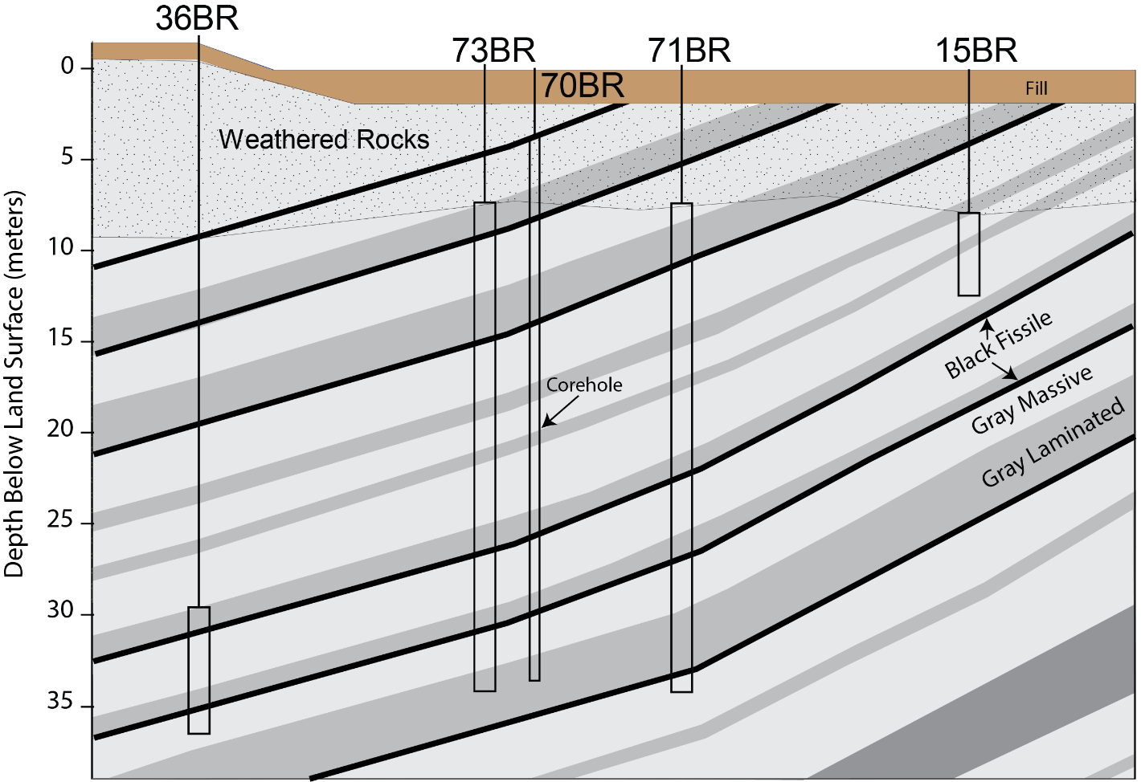
Bioremediation Design and Expectations
Questions related to hydrogeology:
Transport paths between 36BR and 15BR?
Amendment volume to inject?
Pumping rate at extraction well?
Where to expect treatment?
Inject
Pump
?
?
?

Slide 13
Hydrogeologic Investigation to Guide Bioremediation Design
Single- & cross-hole
hydraulic tests
Cross-hole tracer test
Flow & transport
modeling
36BR - Injection
73BR
10 m
71BR
15BR – Pumping
Results will be shown along transect between 36BR and 15BR. In reality, flow and transport are 3D.

Slide 14
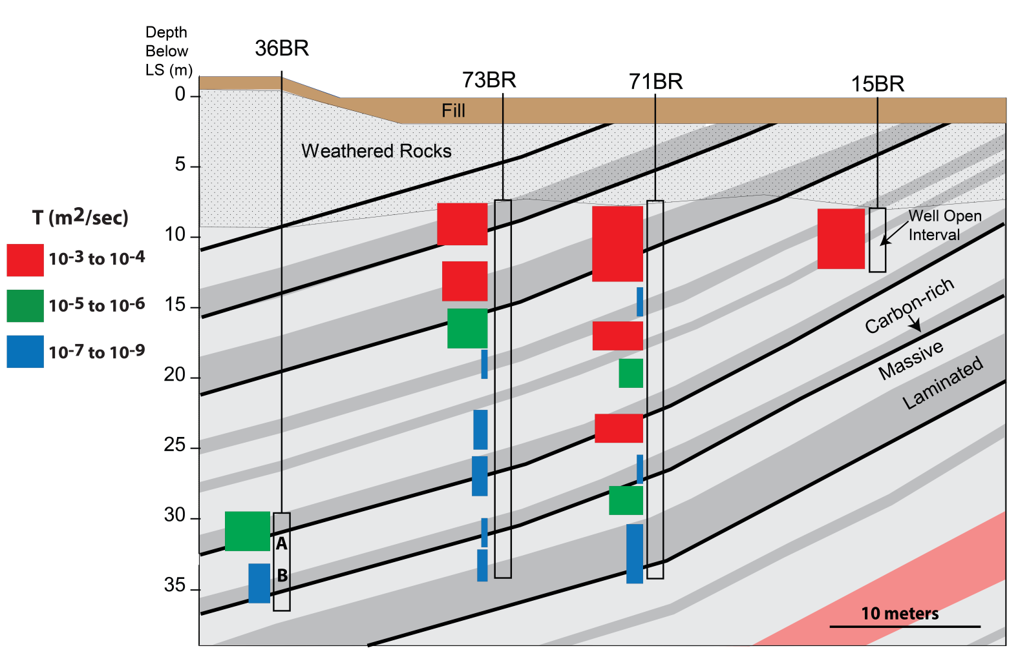
Single-Hole Hydraulic Testing:
Transmissivity Estimates
high K
high K
low K
~low K
Conclusion:
Along beds connecting 36BR & 15BR:
Low K down-dip
High K up-dip

Slide 15
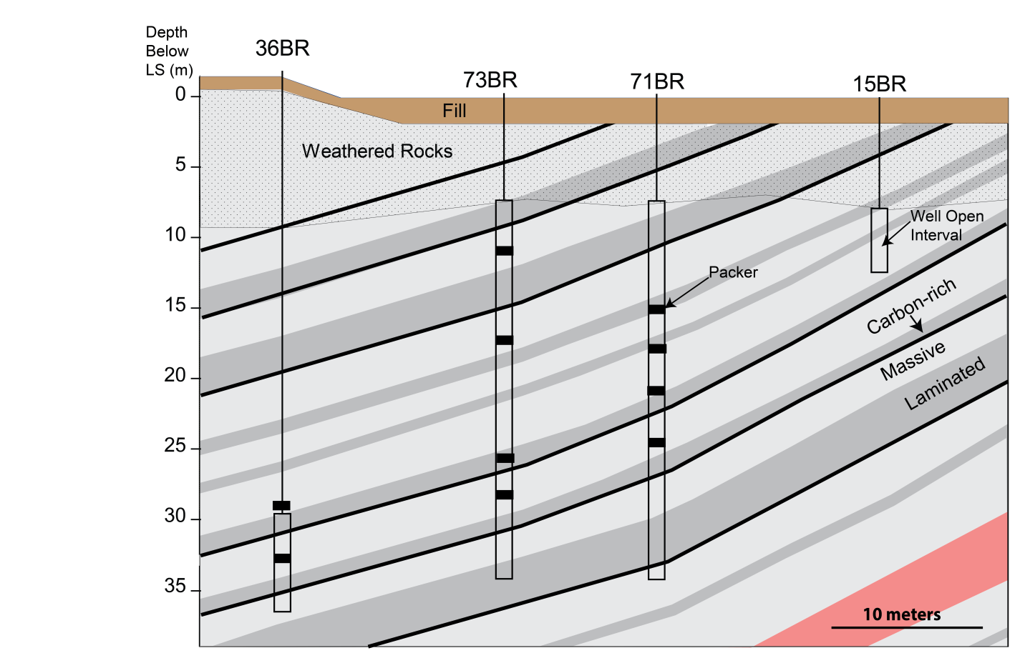
Cross-Hole Aquifer Testing:
Identifying Hydraulic Connections
Shutdown
?
?
Conclusions:
Primary flow paths are along bedding plane fractures in
2 or 3 mudstone beds.
Hydraulically active cross-bed fractures lie between 73BR and 71BR.
?

Slide 16
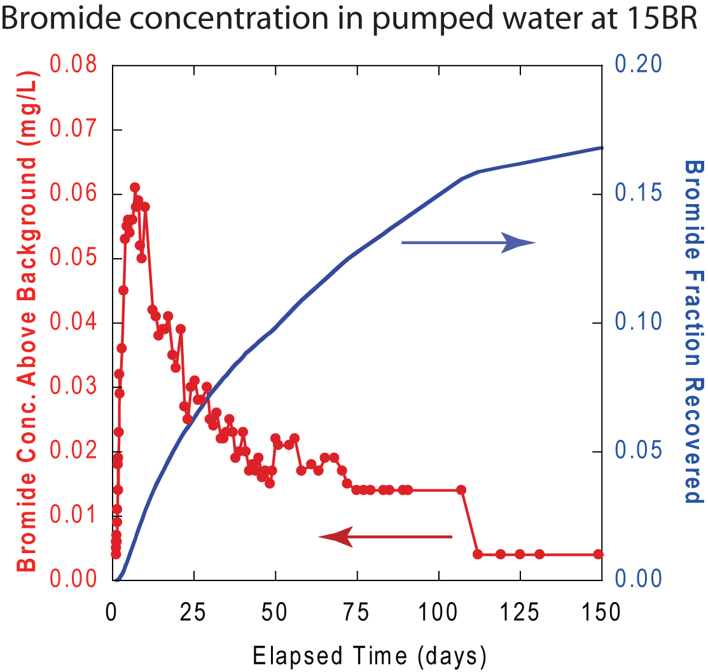
Cross-Hole Tracer Testing: Transport Properties
Pump
Conclusions:
Huge dilution at pumped well:
Only small amount of pumped water comes from the region between 36BR & 15BR.
Large percentage of bromide mass still in aquifer after 5 months.
Inject
3700 mg/L Bromide

Slide 17
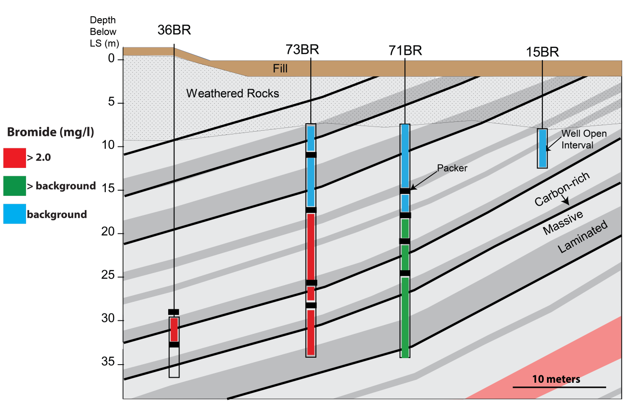
Strong Tracer Retention
6 months after tracer injection
Conclusion:
Most of mass is in downdip region where
low-K rocks/fractures strongly retain tracer.

Slide 18
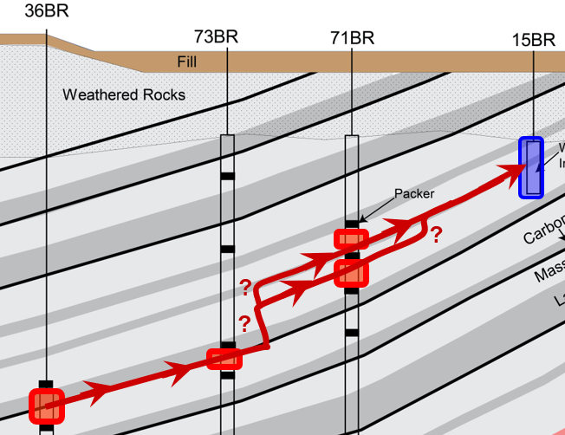
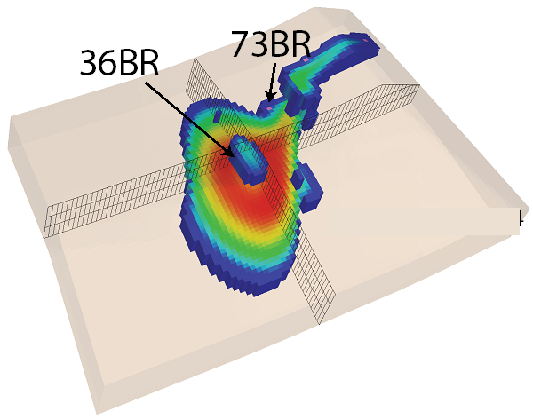
Important Component of Hydrogeologic CSM:
Flow and Transport Modeling
Field characterization: Qualitative info about flow and transport paths and tracer behavior.
No info about distribution and magnitude of groundwater fluxes between 36BR and 15BR, which strongly control amendment transport.
Flow modeling provides fluxes.
Bromide transport modeling uses these fluxes to simulate time-varying tracer distribution, which informs the expected advective transport of injected amendments.

Slide 19
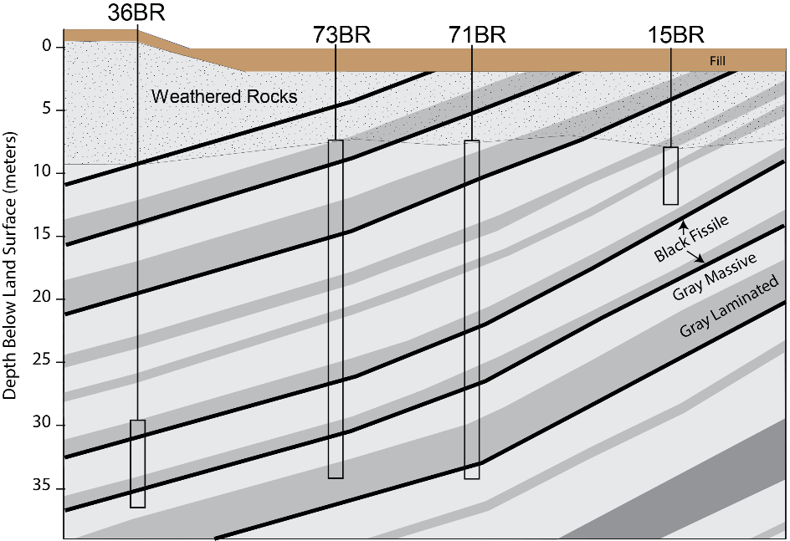
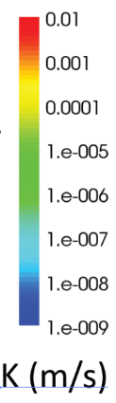
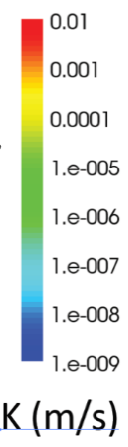
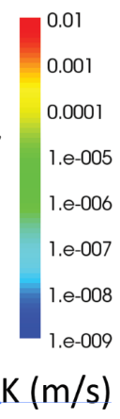
Model Representation of Hydraulic Conductivity
Informed by geology and hydraulic & tracer testing
Upper
Middle
Lower
Pumping
Well
Injection Well
High-K Zone
Cross-Bed
Fractures
Low-K Zone
Upper Model Layer
Middle Model Layer
Lower Model Layer

Slide 20
Groundwater Fluxes
96% of flux entering
cross-bed fracture
Upper
Middle
Lower
4% of flux
entering
cross-bed
fracture
Low-K Zone
Conclusion:
Most of gw flux entering cross-bed fracture is from the high-K region
Lower Model Layer

Slide 21
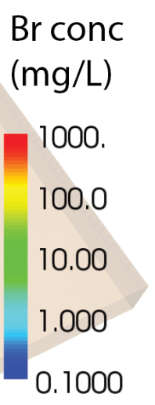
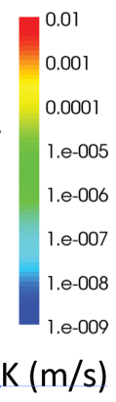
Simulated Bromide Tracer Test: Insight Into Expected Amendment Transport
1.5 hrs: End of injection
Low-K Zone
K Distribution
Bromide Transport

Slide 22
Simulated Bromide Tracer Test: Insight Into Expected Amendment Transport
10 hrs: Similar solute distribution
Low-K Zone
K Distribution
Bromide Transport

Slide 23
Simulated Bromide Tracer Test: Insight Into Expected Amendment Transport
100 hrs: Solute migrates thru cross-bed fracture and to pumping well
High-K Zone
Cross-Bed
Fractures
K Distribution
Bromide Transport

Slide 24
Role of GW Fluxes
96% of flux entering
cross-bed fracture
71BR
15BR
Conclusions:
Because of retention in low-K zone and dilution in cross-bed fracture, tracer concentrations are lower downgradient of this fracture.
Don’t expect high amendment concentrations at well 71BR.
4% of flux
entering
cross-bed
fracture

Slide 25
Bioremediation Design and Expectations
Inject
Pump
Electron Donor &
Microbes
Answers from hydrogeology:
Amendment volume to inject?
Inject enough volume to spread amendments widely over low-K zone. Ambient flow field will not produce much spreading in this zone.
Pumping rate at extraction well?
No need to reduce rate. Large quantities of amendments will not be pumped out, because of strong retention in low-K zone.
Where to expect treatment?
In low-K zone. Because of dilution, don’t expect substantial treatment at 71BR and 15BR.

Slide 26
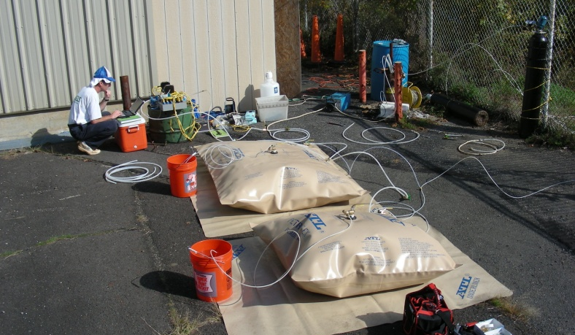
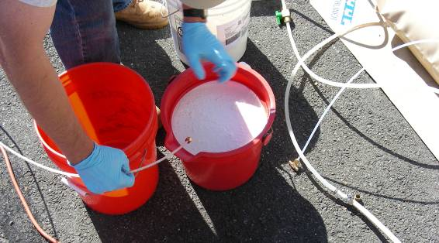
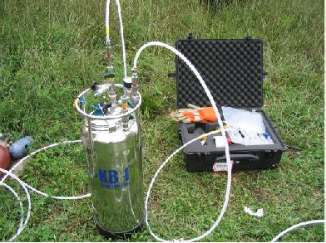
Bioremediation
36BR
Final pre-bioremediation characterization activity:
Push-pull tracer test in 36BR that showed 650 liters injectate volume is needed to spread amendments to 73BR (near edge of low-K zone).
October 2008:
Injected 670 liters amendments plus borehole flush water into 36BR:
  470 liters EOSTM solution
  20 liters KB-1TM
  180 liters borehole flush water
Injection bladders
EOSTM – Emulsified soybean oil
KB-1TM – Microbial consortia containing complete dechlorinators

Slide 27
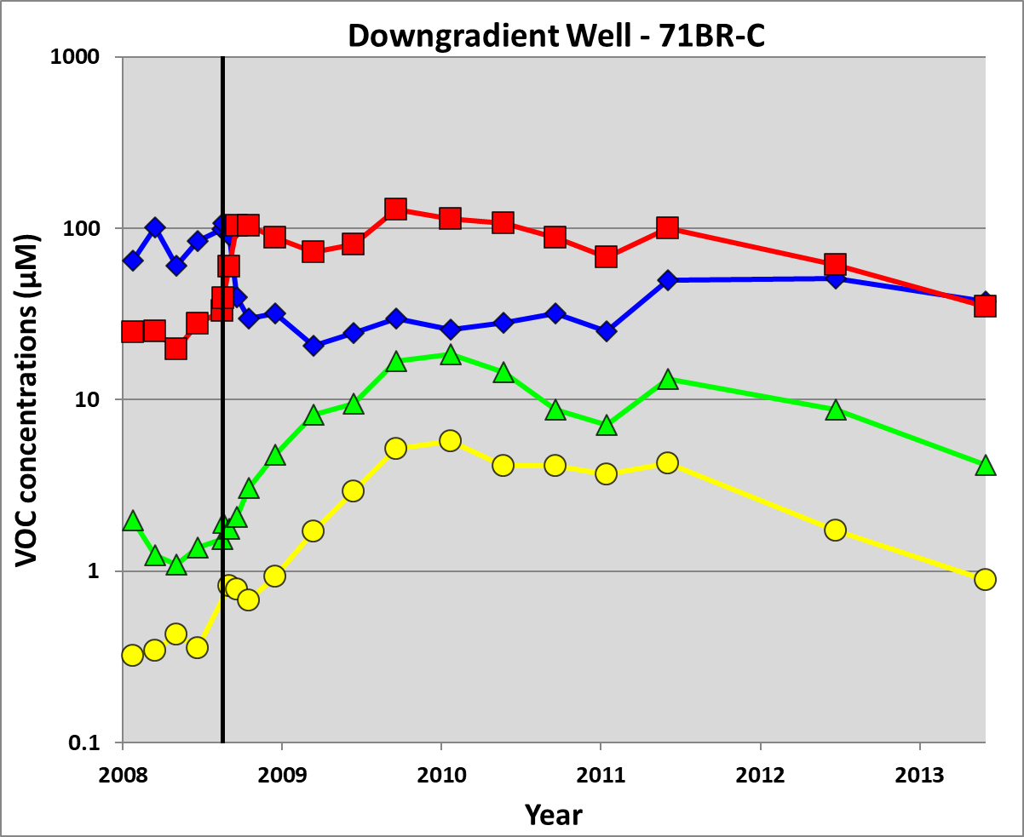
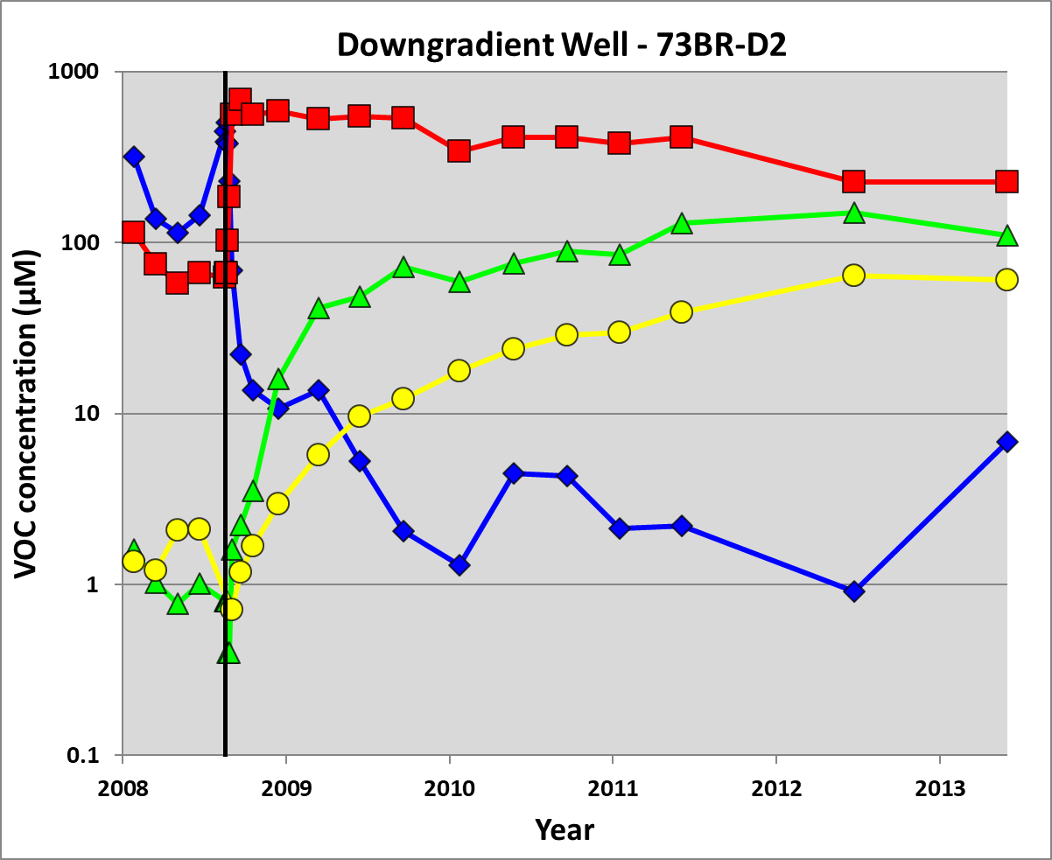
Bioremediation Effects 2008 - 2013
In low-K zone:
TCE quickly degraded
DCE produced and remains high
Rates of degradation to VC & ethene are moderate
DCE
TCE
VC
DCE
Ethene
VC
Injection of Amendments
Ethene
Downgradient of low-K zone at 71BR:
TCE degradation & DCE production to a lesser degree
Minor VC & ethene production
TCE
Injection of Amendments

Slide 28
Expectations Versus Reality
Expected more complete treatment of VOCs in low-K zone.
Amendments were spread into this zone, and included microbes capable of completely degrading TCE to ethene.
However, degradation of DCE and vinyl chloride is incomplete.
DCE
VC
Ethene
TCE
Injection of Amendments

Slide 29
Cause of High DCE
DCE
High DCE Production Rate:
  Bioremediation rapidly degrades TCE in fractures, producing DCE.
  Reduced TCE in fractures increases TCE diffusion out of rock matrix.
  New TCE in fractures also rapidly degrades to DCE.
VC
Ethene
TCE
Injection of Amendments
Moderate DCE Degradation Rate:
(work by J. Underwood, D. Akob, M. Lorah, USGS)
  Microbial community analyses show that partial dechorinators and other microbes dominate the post-injection population, rather than native and injected microbes capable of transforming DCE to VC to ethene.
  Analyses suggest that the population of complete dechlorinators remained suppressed because of competition and toxicity effects.

Slide 30
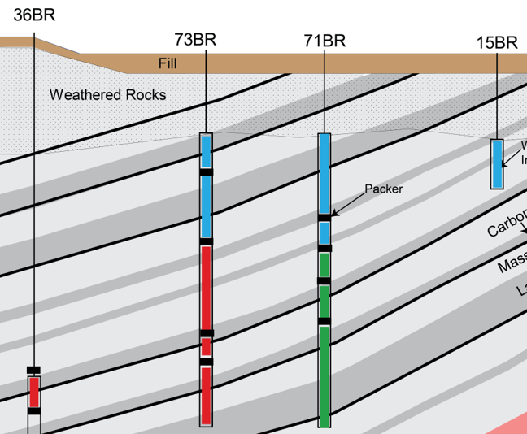
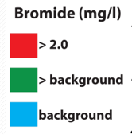
Bioremediation: Summary
Hydrogeologic characterization and modeling are key components of a CSM for designing in-situ bioremediation, by providing information about:
  Transport pathways
  Injection volume
  Expected spatial variability of amendment effectiveness

Slide 31
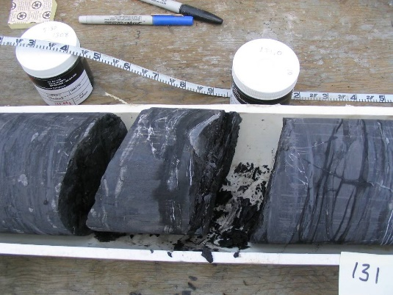
DCE
Bioremediation: Summary
VC
Ethene
Additional important components of CSM for designing bioremediation and setting expectations about treatment:
  Characterization of biogeochemical processes that affect evolution of microbial community after amendments are injected.
  Consideration of effects of large contaminant mass in rock matrix on biodegradation processes.
TCE

Slide 32
Using Hydraulic Tomography to Develop High-Resolution CSM in Support of Source Zone Remediation

Slide 33
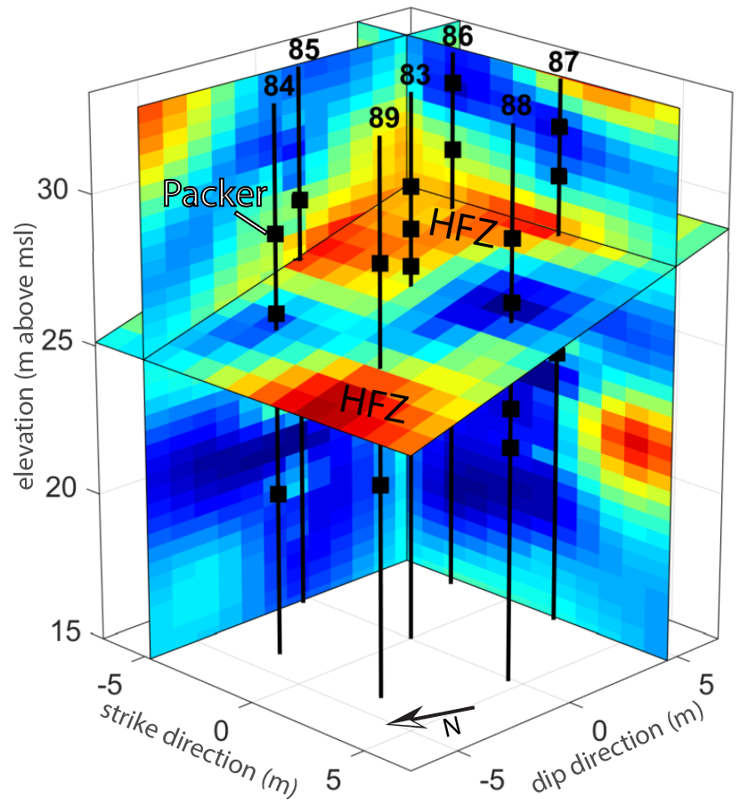
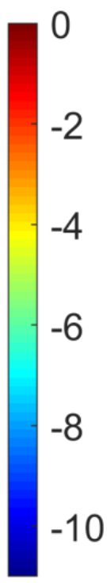
Hydraulic Tomography (HT)
A method of estimating high-resolution hydraulic conductivity (K) in an aquifer volume, using drawdown data from multiple pumping tests.
Aquifer volume dimensions:
~10 – 20 m laterally and vertically.
High resolution:
K variations at a scale of ~1 m.
Log₁₀(K [m/s])

Slide 34
Value of High-Resolution K to In-Situ Remediation
Bioremediation study:
K characterized at relatively low resolution – data and modeling supported estimating zones of K.
Enabled simulating important flux heterogeneities over a 40 m transect.
Estimation of higher-resolution K distribution supports understanding flow and transport at smaller scales, and more targeted delivery of remediation amendments.

Slide 35
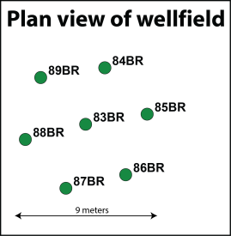
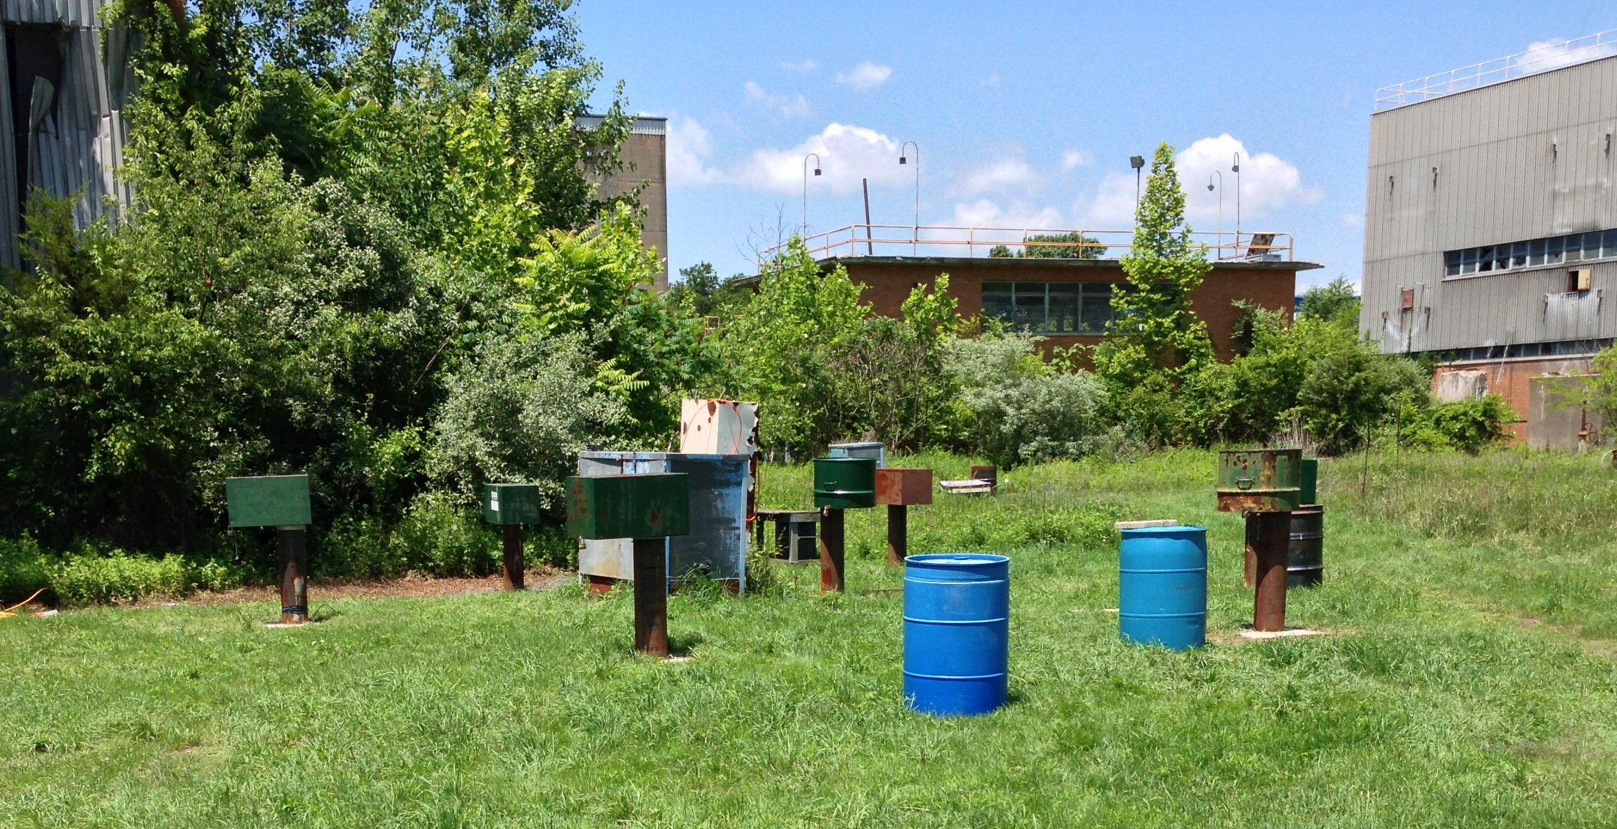
Field Application of Hydraulic Tomography in Fractured Rocks
Naval Air Warfare Center (NAWC)
West Trenton, NJ, USA
9 meters

Slide 36
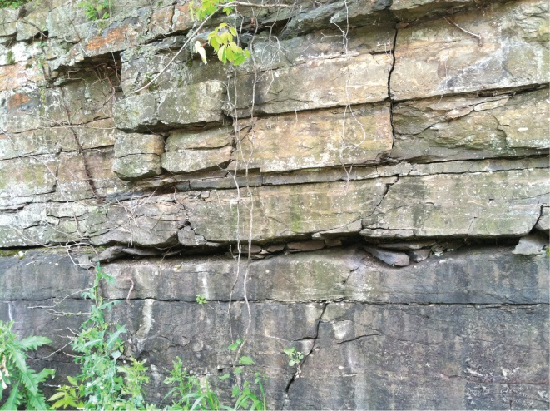
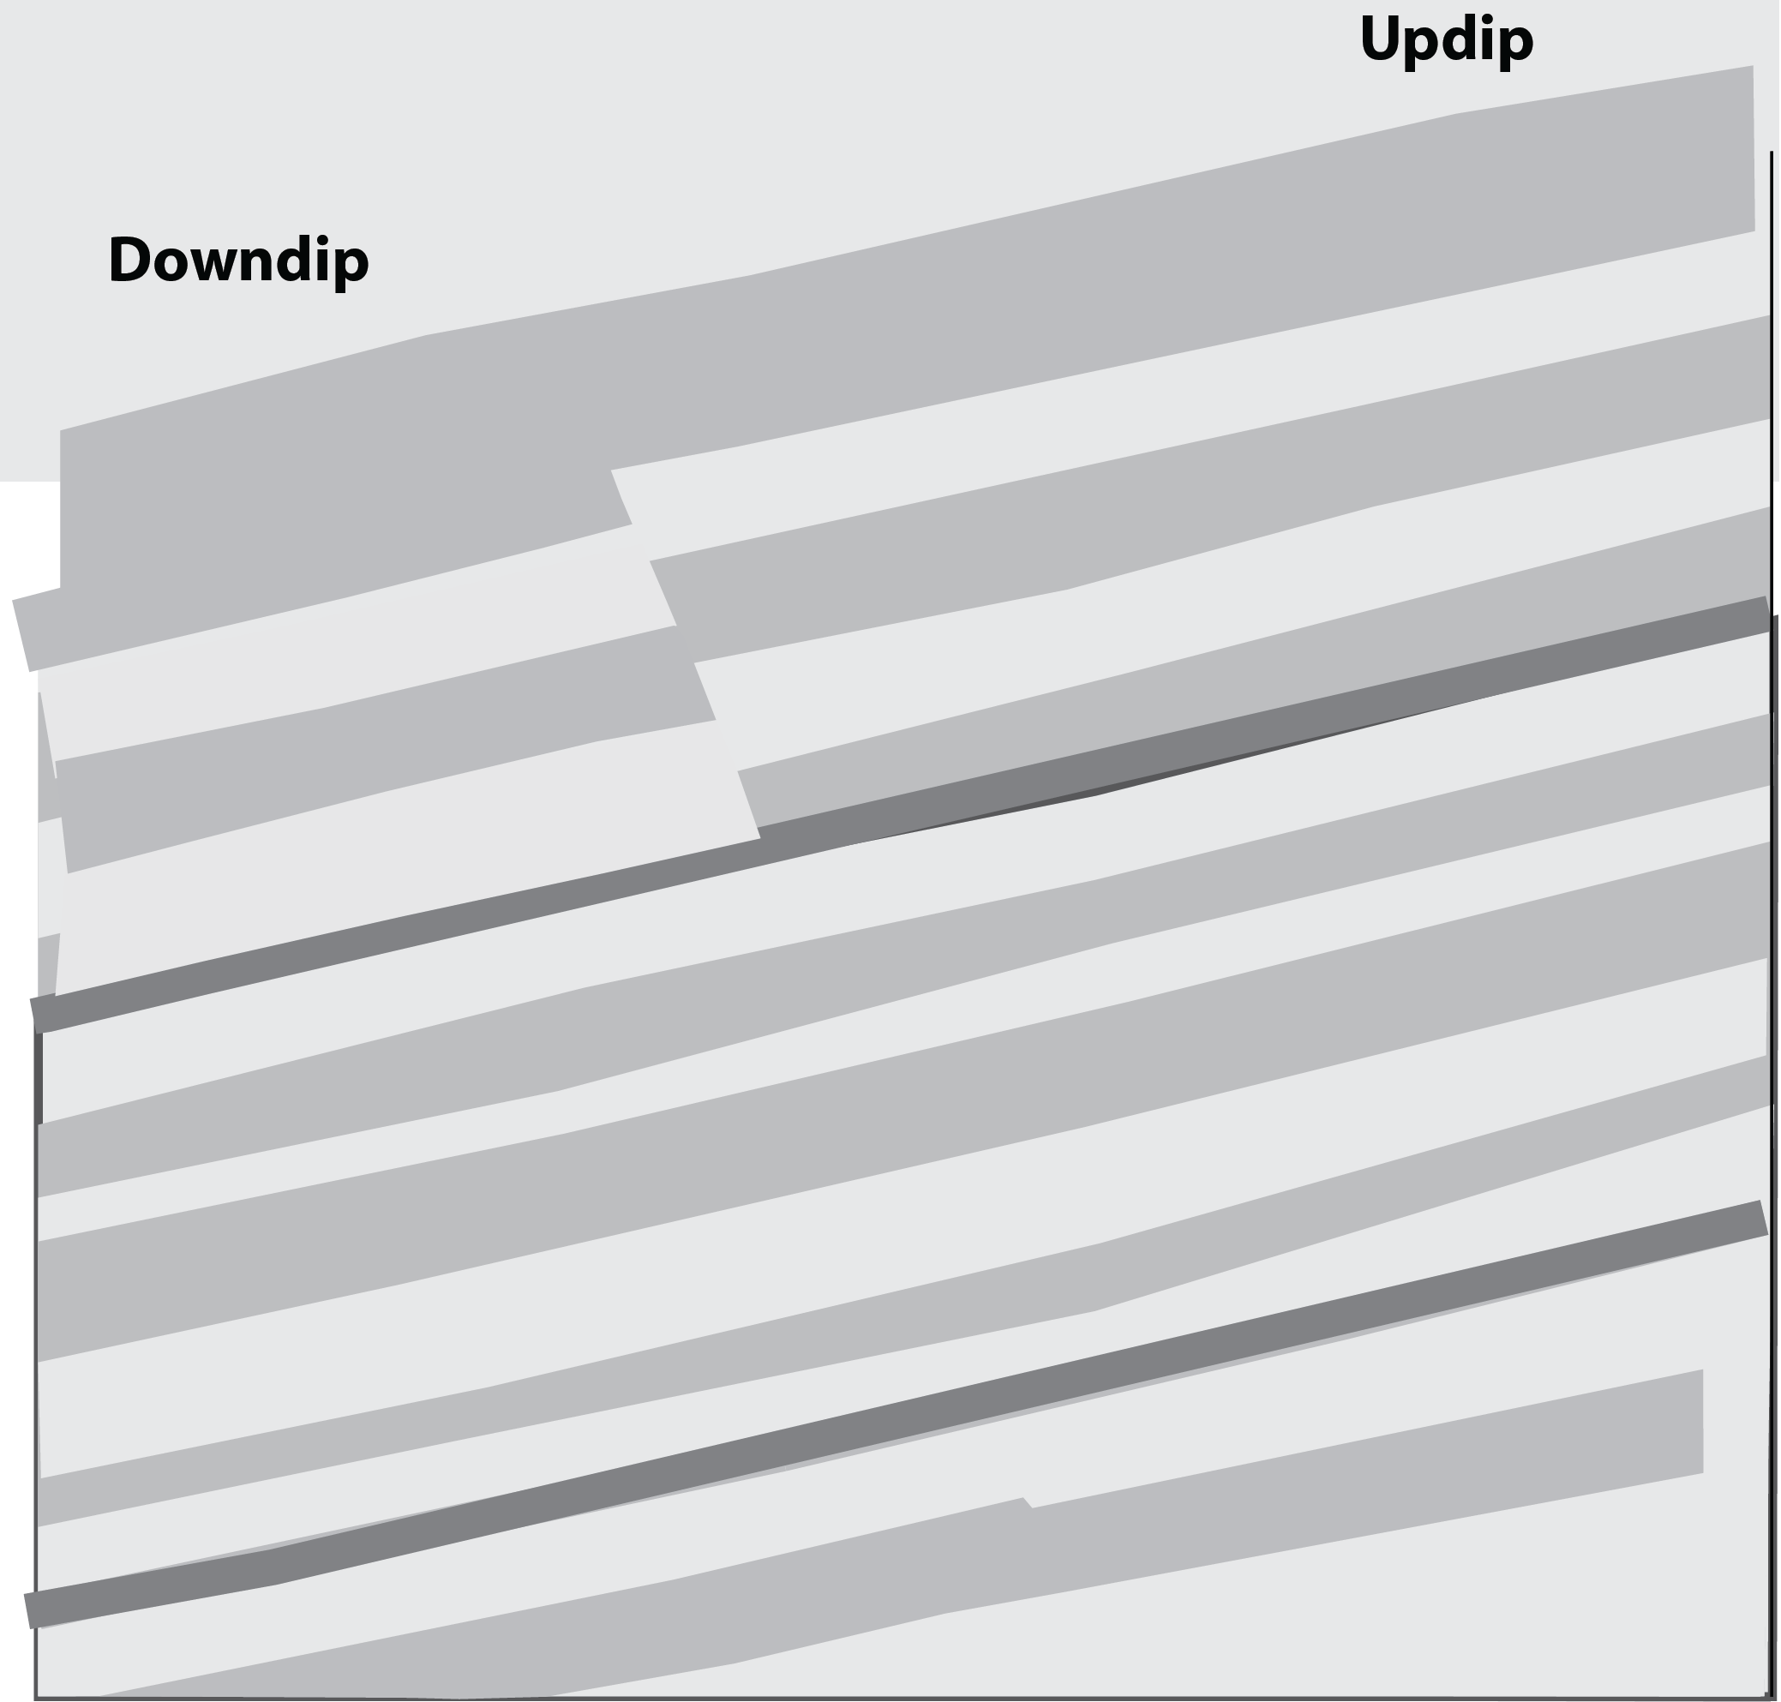
83-89 Wellfield
Road Cut
Boreholes cased through weathered rock and have ~15 m of open hole.
Acoustic televiewer logs identify fractures.
Highly fractured zone evident in most boreholes.
86BR
83BR
89BR
Fissile Mudstone
15 m
Laminated Mudstone
Massive Mudstone
9 m

Slide 37
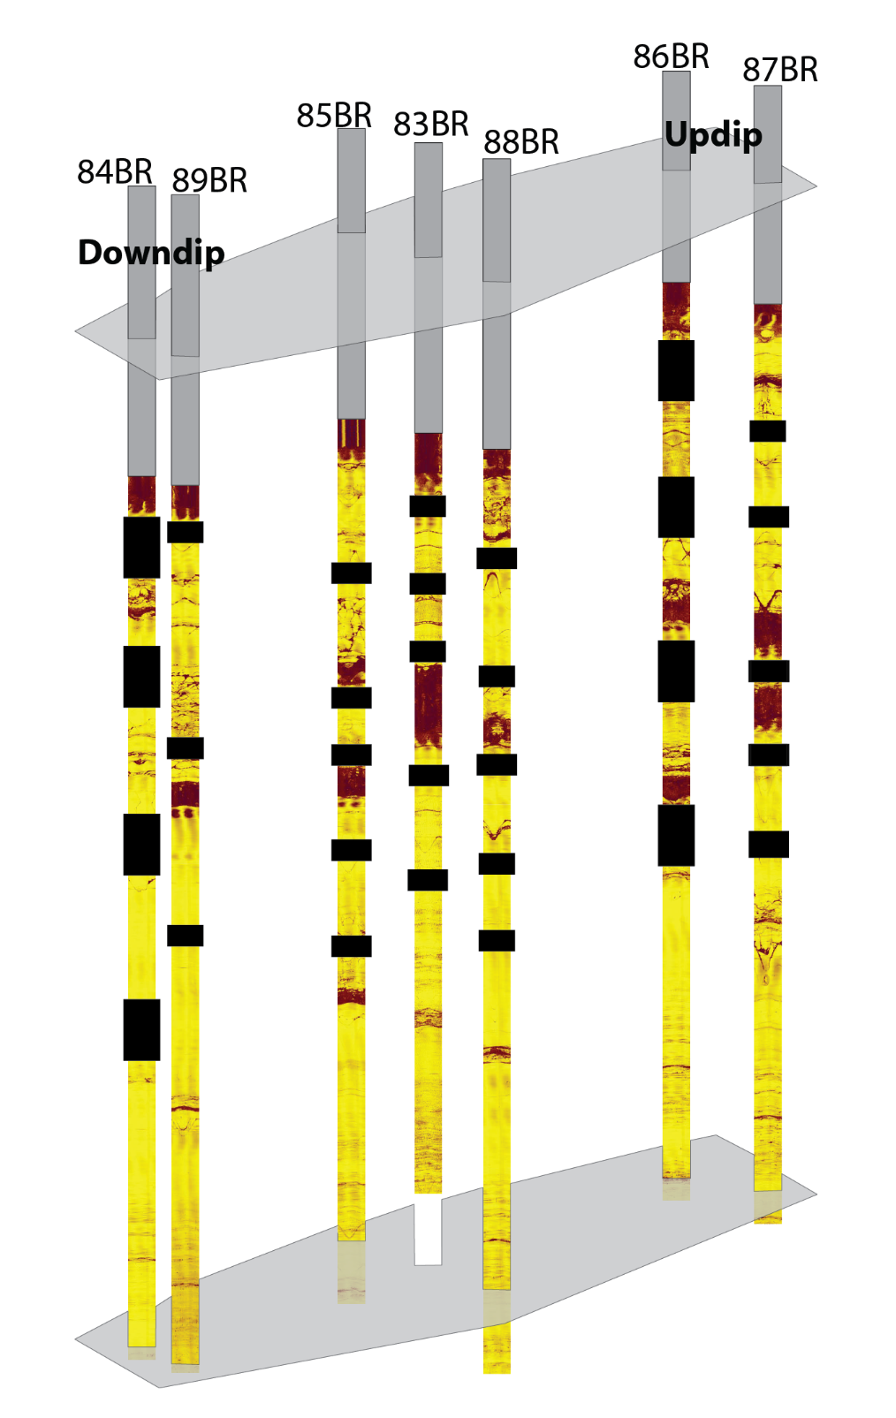
Hydraulic Tomography Field Testing
Install packers to divide boreholes into multiple discrete intervals.
Conduct multiple cross-hole hydraulic tests in discrete well intervals in the rock volume.
Monitor drawdown in all intervals –
a dense 3D observation network.
HT experiment in fractured mudstones: 47 tests, 30-40 observation intervals during each test.
→ 1500 drawdown curves.
Packers
Open
Intervals

Slide 38
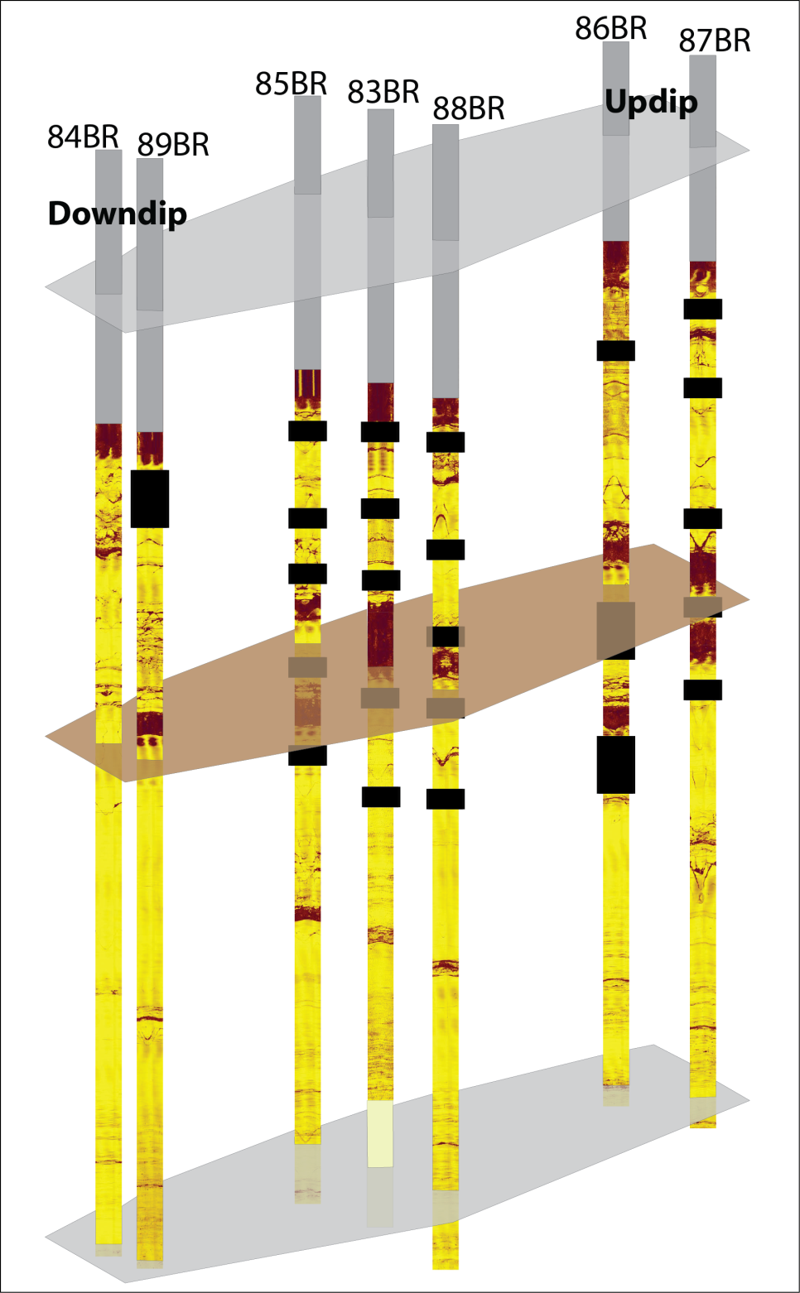
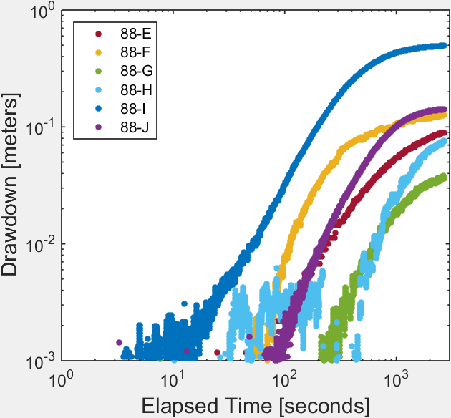
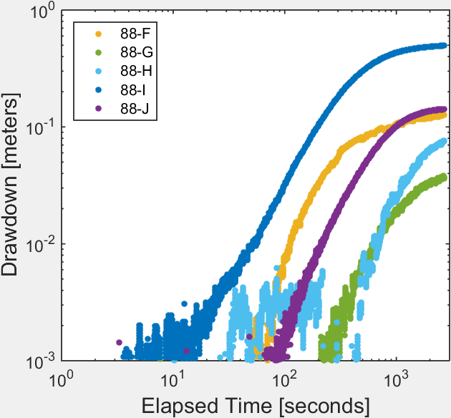
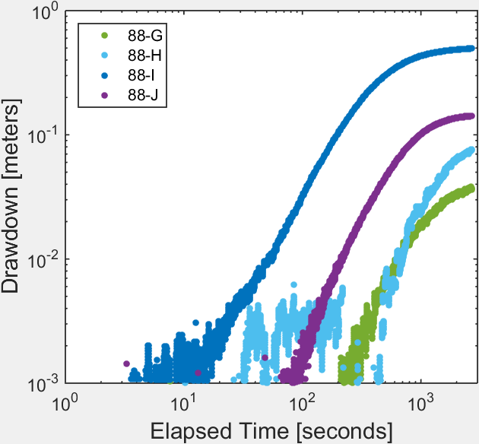
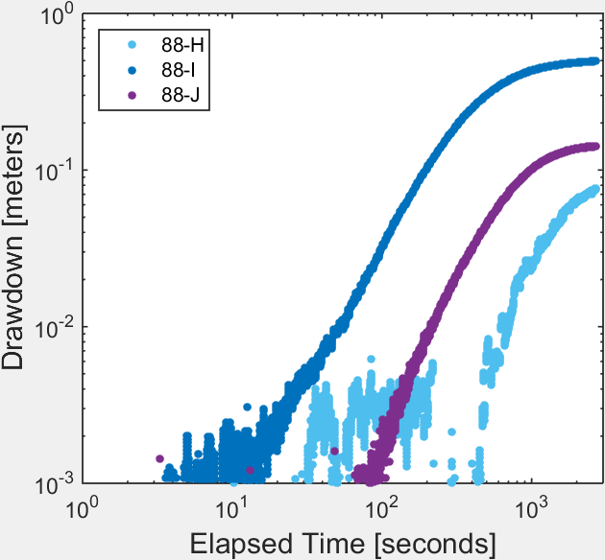
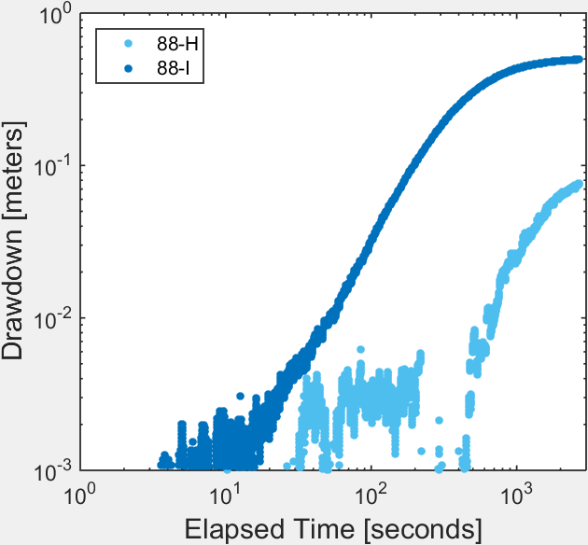
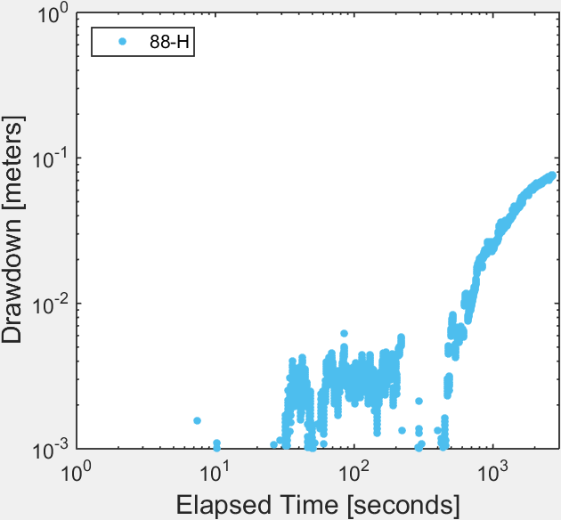
Drawdowns: Evidence of Substantial Heterogeneity
Obs
Well
E
F
G
H
I
Pumped
Interval
J
noise

Slide 39
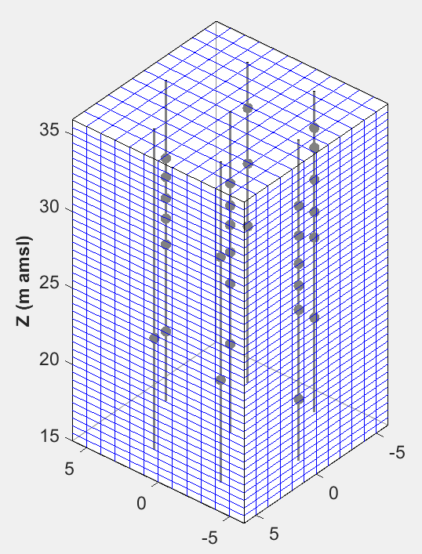
HT Modeling to Estimate K: Approach
MODFLOW forward models simulate the
hydraulic tests.
Geostatistical inversion:
K parameterized on 3D grid covering wellfield
volume; K blocks are 1 m x 1 m x 0.5 m.
Minimize an objective function consisting of two terms:
  Model fit term: Measures match between simulated and observed drawdowns from 42 hydraulic tests.
  Prior information term: Measures conformity of estimated K field with an assumed geostatistical structure.
Model fit term dominates; prior term helps populate parts of K field that are ill-informed by the drawdown data.
3D grid of ~20,000 K blocks

Slide 40
High-Resolution 3D K Estimate
Estimated 3D K field shows features consistent with geologic data.
Log₁₀(K [m/s])
High K at orientation of dipping bed known to have high K at site scale.
(HFZ = Highly Fractured Zone)
Large volumes of low-K rock

Slide 41

High-Resolution 3D K Estimate
The approach estimates volumes in which fractures occur:
Features with elevated K and fracture-like geometries.
Dip-oriented slices along a ‘stretched’ strike-direction axis
Log₁₀(K [m/s])
Strike-oriented fracture

Slide 42
Recall Drawdown Data Illustrating Heterogeneity
Obs
Well
E
F
Order of 1 cm drawdown arrival in the different intervals.
G
H
I
F
J
E
G,H
I
1 cm
Pumped
Interval
J

Slide 43







Simulated Drawdown:
Pumping in Interval of Well 83
83
88
E
F
drawdown
(m)
Observed order of drawdown arrival in intervals of well 88:
G
Pump
H
1 cm
I → F → J → E → G & H
I
Simulated order:
I → J → F → E → G → H
J

Slide 44

Most-Hydraulically- Active Fracture Network
MODPATH used to track particles across wellfield under imposed hydraulic gradients.
Identified model cells that contain channelized fast particle paths.
  Channelized: > 10 particles travel through a model cell
  Fast: Each of these particles have average velocity > a criterion
Collective set of model cells describes the most-hydraulically- active fracture network.

Slide 45
Most-Hydraulically- Active Fracture Network
Network near wells 87 and 88 is consistent with interpretation of TCE distribution in rock core samples (Shapiro et al. 2019 JCH).
At depth in the wellfield:
More TCE occurs in rock matrix at 87 and 88 than at other wells, suggesting the presence of a fracture network that facilitated NAPL and aqueous-phase TCE transport.
TCE conc in matrix (µg/g)
50-200
>200
Shapiro et al., 2019

Slide 46


Informing In-Situ Remediation
Example injection & pumping strategy – Locations and rates
Estimated fracture network guides injection and pumping strategy for spreading amendments to contaminants.
Particle tracking shows this strategy achieves advective transport over the entire
discrete network at depth.
Pump
0.05 L/min
Inject
0.05
L/min

Slide 47
Hydraulic Tomography: Summary
Log₁₀(K [m/s])
HT is a robust approach for estimating
high-resolution K distribution, which leads
to improved understanding of small-scale variability in flow and transport processes.
Is HT worth it? Expense needs to be weighed in context of value HT provides to remediation actions and management decisions:
  Likely low value: Less-contaminated parts of a site.
  Potential high value: Source zone with DNAPL and high aqueous concentrations, where HT can inform improved amendment delivery strategies.

Slide 48
Final Thoughts: Developing Hydrogeologic CSMs for In-Situ Remediation
K characterized at different scales
Bioremediation: Site scale
  K heterogeneities 10 – 100 m
  K structure largely imposed and relies
  heavily on a priori geologic framework
  in addition to hydraulic information.
Hydraulic Tomography: Wellfield scale
  K heterogeneities 1 – 5 m
  K structure estimated from hydraulic data; prior geologic info deliberately omitted.
25 m
5 m

Slide 49
Final Thoughts: Developing Hydrogeologic CSMs for In-Situ Remediation
Consistencies across scales:
High-K along fissile bed with known
high permeability.
Substantial volume of very low K rocks.
Strike-oriented horizontal anisotropy at site scale; strike-oriented fractures at wellfield scale.
Cross-bed fracture connectivity important.
25 m
5 m

Slide 50
Final Thoughts: Developing Hydrogeologic CSMs for In-Situ Remediation
K characterization at both scales
is important:
High-resolution K in source zones:
Supports targeted amendment delivery.
Lower-resolution K over much larger
site-scale volumes:
Supports forecasting downgradient effects and informing long-term management of contamination.
5 m
25 m

Slide 51











Acknowledgements
Dan Goode
Paul Hsieh Pierre Lacombe
Allen Shapiro
Tom Imbrigiotta
Carole Johnson
Denise Akob
Michelle Lorah
Warren Barrash
Rob Rosman
Jen Underwood
Gary Curtis

Slide 52
References: Bioremediation and HT at NAWC
Goode, D.J., Imbrigiotta, T.E., and Lacombe, P.J., 2014, High-resolution delineation of chlorinated volatile organic compounds in a dipping, fractured mudstone--Depth- and strata-dependent spatial variability from rock-core sampling: Journal of Contaminant Hydrology, v. 171, p. 1-11.
Révész, K.M., Sherwood Lollar, B., Kirshtein, J.D., Tiedeman, C.R., Imbrigiotta, T.E., Goode, D.J., Shapiro, A.M., Voytek, M.A., Lacombe, P.J., and Busenberg, E., 2014, Integration of stable carbon isotope, microbial community, dissolved hydrogen gas, and ²H_{H2O} tracer data to assess bioaugmentation for chlorinated ethene degradation in fractured rocks: Journal of Contaminant Hydrology, v. 156, p. 62-77.
Shapiro, A.M., Tiedeman, C.R., Imbrigiotta, T.E., Goode, D.J., Hsieh, P.A., Lacombe, P.J., DeFlaun, M.F., Drew, S.R., and Curtis, G.P., 2018, Bioremediation in fractured rock--2. mobilization of chloroethene compounds from the rock matrix: Groundwater, v. 56, no. 2, p. 317-336.
Shapiro, A. M., Goode, D. J., Imbrigiotta, T. E., Lorah, M. M. and Tiedeman, C. R. 2019. The complex spatial distribution of trichloroethene and the probability of NAPL occurrence in the rock matrix of a mudstone aquifer. Journal of Contaminant Hydrology 223.
Tiedeman, C.R., Shapiro, A.M., Hsieh, P.A., Imbrigiotta, T.E., Goode, D.J., Lacombe, P.J., DeFlaun, M.F., Drew, S.R., Johnson, C.D., Williams, J.H., and Curtis, G.P., 2018, Bioremediation in fractured rock--1. modeling to inform design, monitoring, and expectations: Groundwater, v. 56, no. 2, p. 300-316.
Tiedeman, C.R., and Barrash, W., 2019, Hydraulic tomography--3D hydraulic conductivity, fracture network, and connectivity in mudstone: Groundwater, doi:10.1111/gwat.12915.

Slide 54
Extra Slides

Slide 55

Initial Geologic Interpretation
Inject
Pump
Conclusion:
Transport from 36BR to 15BR occurs primarily along a single mudstone bed.

Slide 56

Refined Geologic Interpretation
Inject
Pump
Refinement using data from new wells and corehole (& revisit 15BR):
Optical televiewer logs
Gamma logs
Rock core
?
?
?
Conclusion:
More complex pathways from 36BR to 15BR, including cross-bed paths in unknown locations.

Slide 57
Role of GW Fluxes
99% of 15BR pumping rate
1% of 15BR pumping rate
Conclusions:
Very little water from low-K zone contributes to pumped volume.
Don’t expect to observe bioremediation effects at pumping well.

Slide 58

Treatment at Pumped Well 2008 - 2013
VOC concentrations at 15BR show no effect of bioremediation
DCE
TCE
VC
Injection of Amendments
Ethene

Slide 59


Separating Wells into Multiple Intervals
Open
Intervals
Packers
Packers for isolating borehole intervals
Packer assembly

Slide 60


Setup for Monitoring Drawdown
Pipes & tubes leading to packed-off intervals
Fiber-optic pressure transducers

Slide 61



3 Packer Configurations
Shallow
Middle
Deep

Slide 62

Forward Models of Hydraulic Tests
MODFLOW flow models
MODFLOW can represent and simulate highly heterogeneous K distribution
MODFLOW computation grid discretized very finely within wellfield
K discretized more coarsely: 1 m x 1 m x 0.5 m blocks
Pumped Interval

Slide 63


Fit to Drawdown Data
Blue: Observed
Red: Simulated
Calibration: Data used in Inversion
Quality Check: Data not used in Inversion
Tests and observation intervals in shallower part of wellfield

Slide 64


Uncertainty in Estimated K
Standard Deviation of Log10(K [m/s])
Uncertainty magnitude:
Smallest at well locations.
Moderate in between wells.
Large outside of wellfield.

Slide 65





HT in Practice
HT is a fairly mature technology; numerous demonstrations of HT in unconsolidated aquifers.
Fewer in fractured rocks.
Field implementations are customized but components (packers, transducers, pumps) are readily available.
HT inverse modeling methods are robust and well demonstrated, but no off-the-shelf solutions yet.

