Slide 1
Using Remedy Implementation Information to Guide Remedy Optimization
Federal Remediation Technology Roundtable Webinar
Kate Amrhein, U.S. Department of Energy
Emerald Laija, U.S. Environmental Protection Agency
Michael Truex, Pacific Northwest National Laboratory
April 1, 2020
Notes:
Emy

Slide 2
Outline
Hanford Case Study Site Description
Conceptual Site Model (CSM) Elements of Remedy Selection
CSM Refinement: Input from Remedy Implementation and Performance Assessment
Identified Remedy Optimization Targets
  Optimization Study Approach and Adaptive Site Management
Notes:
Emy

Slide 3
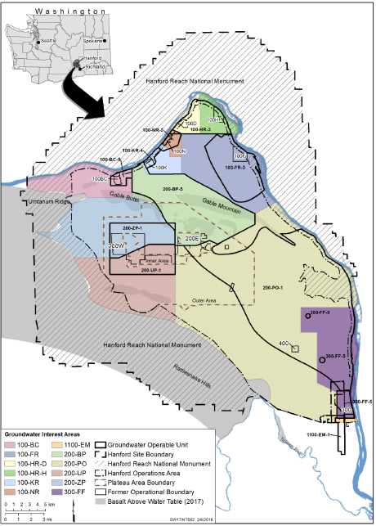
Hanford Site Groundwater Units
Notes:
Kate

Slide 4
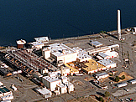
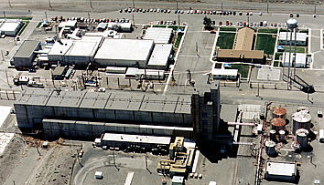
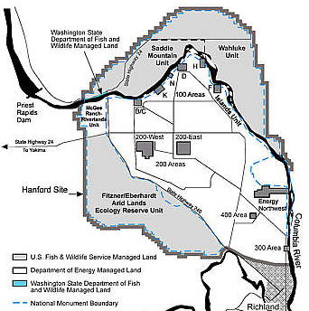
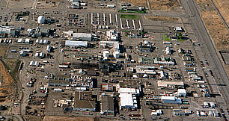
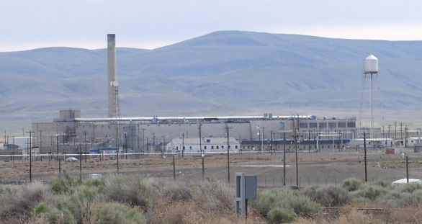
Historical Hanford Processes
Irradiate Fuel Elements
Chemical Separations
Manufacture Fuel Elements
Plutonium Finishing
Notes:
Kate

Slide 5
200-ZP-1 OU Conceptual Site Model
Carbon tetrachloride (CCl₄) disposed of in three nearby locations
Large groundwater mound spread CCl₄ in the groundwater (10-square-kilometer plume, over 50 meters thick)
Early action of Soil Vapor Extraction (SVE) removed 80,000 kilograms; no continuing source
No dense nonaqueous phase liquid (DNAPL) below water table
Groundwater mound has dissipated; groundwater flow rate is slow
Groundwater concentrations 1,000 times the remedial action objective (RAO); natural attenuation occurs, but plume is too concentrated and large for passive-only remedy
  Radionuclide and inorganic co-contaminants are present
Notes:
Kate

Slide 6
200-ZP-1 OU Conceptual Site Model (cont.)
Addressed by SVE
Hanford
Approx. 75 m
Historic groundwater mound:
Broad plume spread multiple directions
Ringold E
No DNAPL
Approx. 50+ m
Ringold Lower Mud
Window to lower part of aquifer
Ringold A
Notes:
Kate
The source in the shallow part of soil column was treated through SVE
Note: we assumed there was limited communication between Ringold E and A during the RI/FS.

Slide 7
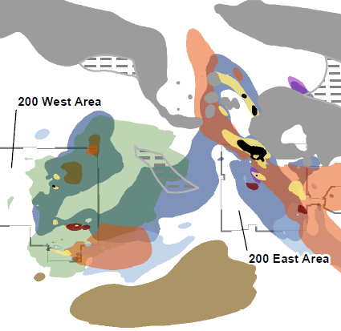
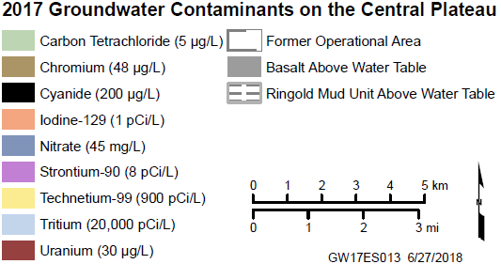
Co-Contaminants
Notes:
Kate

Slide 8
Conceptual Site Model – Remedy Selection
RAO to restore aquifer
Source addressed by SVE and no DNAPL present
Large plume with co-contaminants difficult for in situ remediation
Pump-and-treat (P&T) systems can effectively diminish plumes; difficulty in reaching RAO
If plume is diminished, natural attenuation can reach RAO
Notes:
Kate

Slide 9
Conceptual Site Model – Remedy Selection (cont.)
Remedy applies P&T with transition to Monitored Natural Attenuation (MNA)
  Anticipated 25 years of P&T and 100 years of MNA to meet RAO based on Feasibility Study CSM
    CCl₄ distribution – uncertainty in mass (collect data during remedy)
    Attenuation rate – uncertainty est. 41–290-year half-life (implement study)
Notes:
Kate

Slide 10
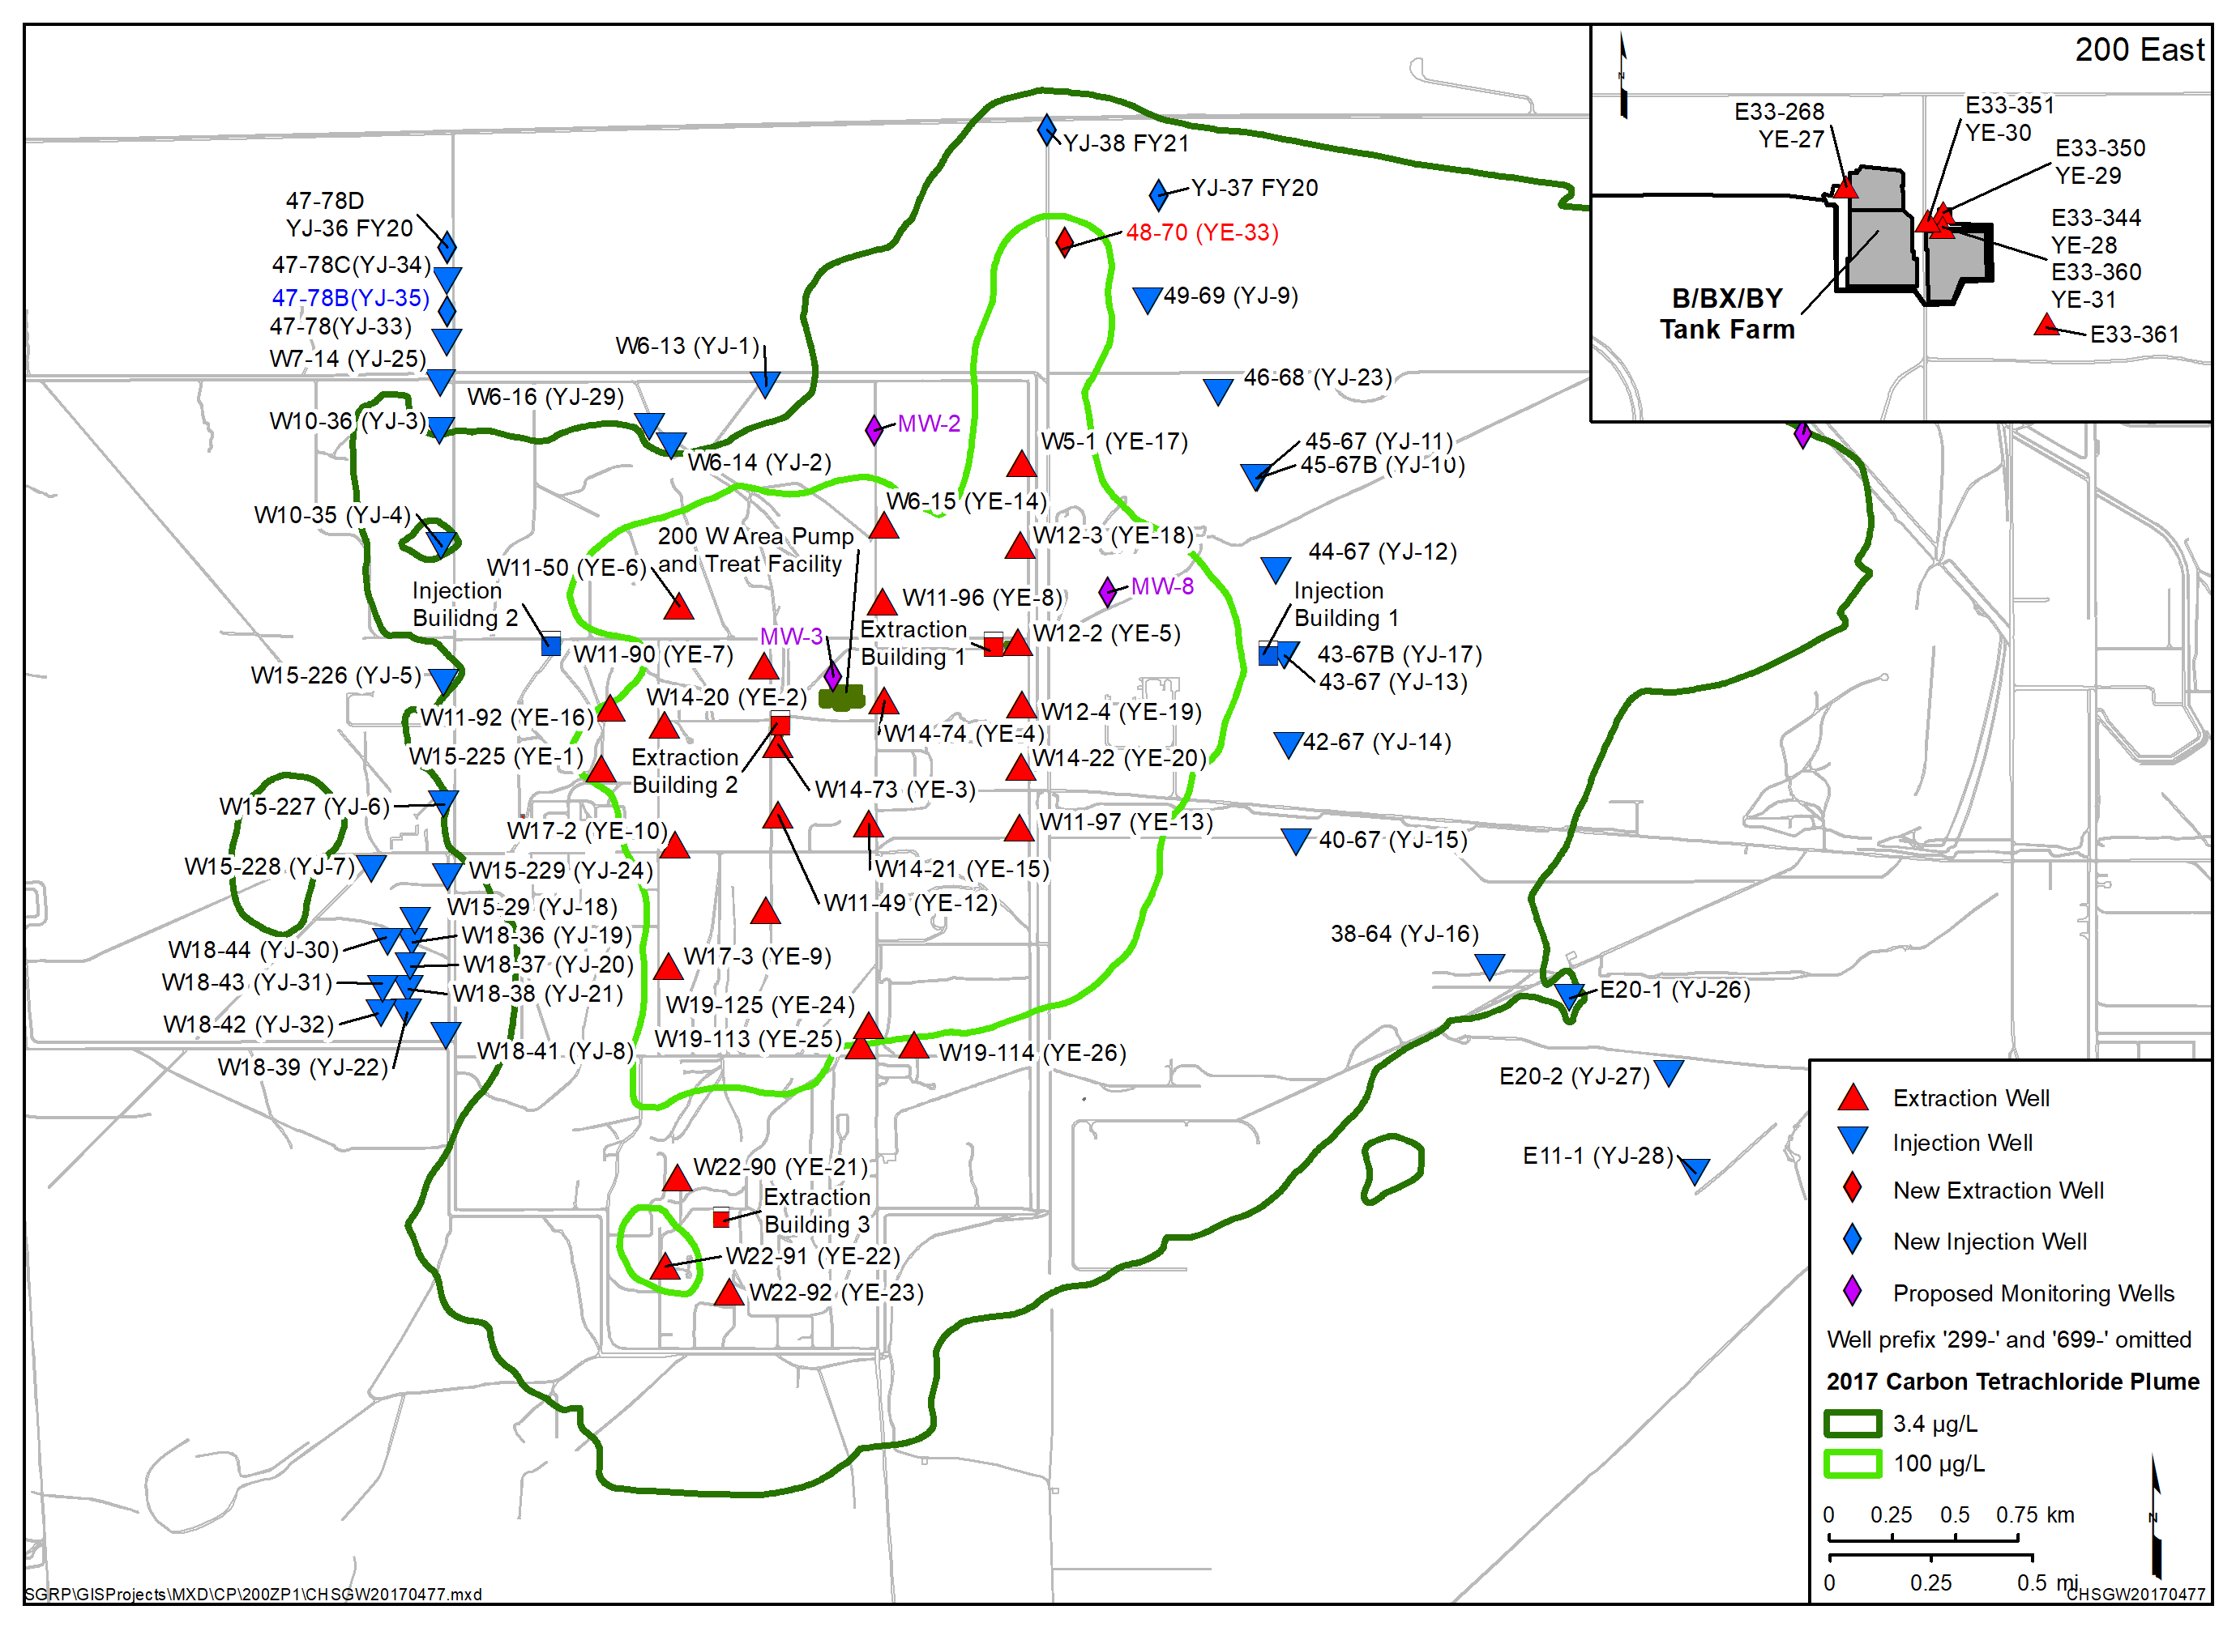
200 West P&T Well Network
Natural attenuation,
flow control, and
institutional controls
downgradient of
eastern injection
wells
200 West P&T Well Network
Began operations in 2012
33 Extraction Wells located within carbon tetrachloride plume
35 Injection Wells on the outer edges of the highest concentration area
Former
Source
Area
Notes:
Mike
The former source area is no longer in the center of the plume
We are dealing with the dissolved phase plume

Slide 11
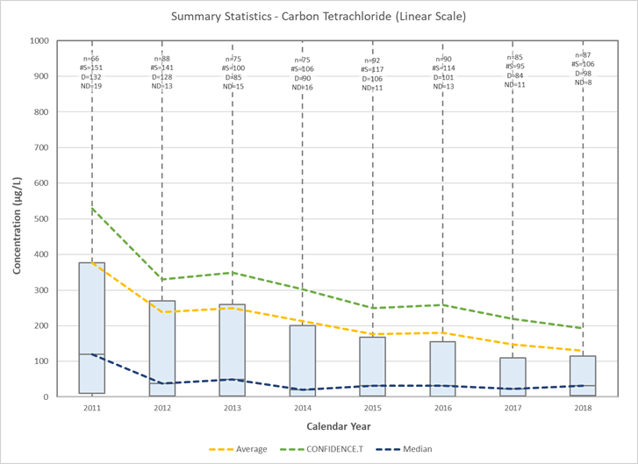
Implementation and Performance Data
3-D plume mapping
  Monitoring well concentrations
  Extraction/injection concentrations
  Characterization depth profile concentrations
  Extraction mass removal rate compared to predicted mass removal rate
Notes:
Mike

Slide 12
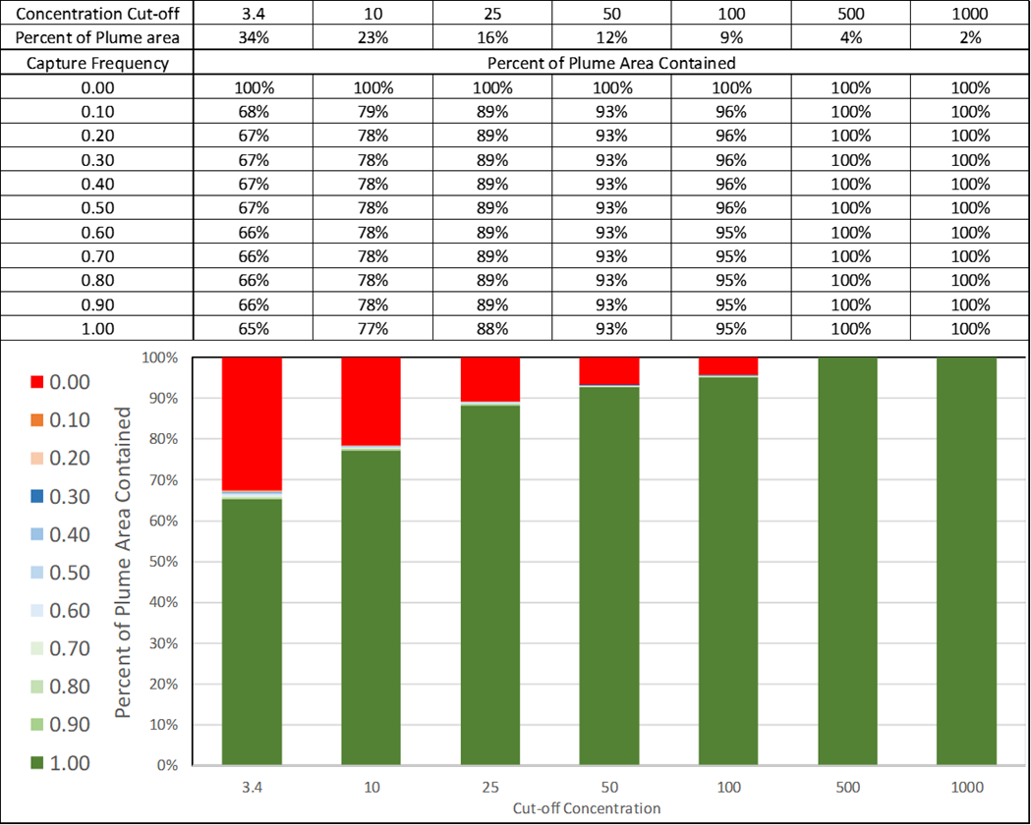
Implementation and Performance Data
Hydraulic data
Water levels
Capture analysis
Notes:
Mike

Slide 13
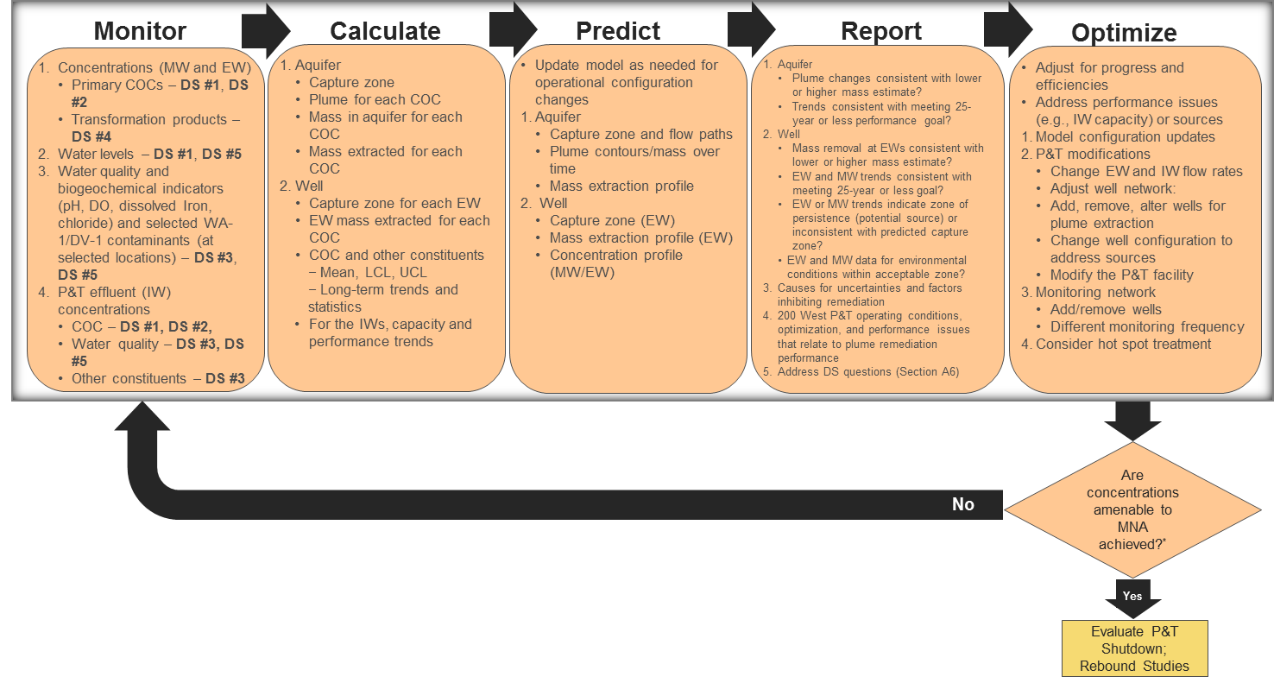
Implementation and Predictive Modeling
Notes:
Mike
Periodic model updates (~3-yr cycle)
Baseline model configuration
Predict performance
Collect and assess data
Update baseline model

Slide 14
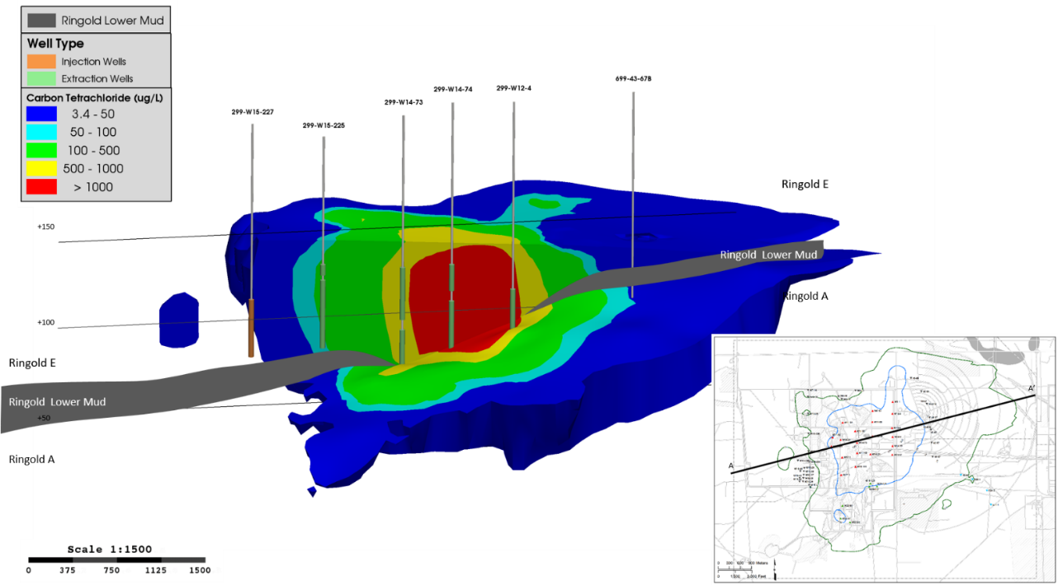
Challenges Identified
More CCl₄, including more below the Lower Mud Unit (Ringold A) than understood during the feasibility study (FS)
  Total within FS uncertainty but higher than baseline estimate
  Ringold A 25% versus 12% of total
Characterization is planned to define the extent of contaminants of concern in Ringold A and its hydraulic properties
Notes:
Emy

Slide 15
Challenges Identified (cont.)
Abiotic degradation of CCl₄ (hydrolysis) is slower than FS assumption
  630 versus 41–290-year half-life
  Previous information extrapolated from high temperature
  Data at site-specific temperature shows lower rate (6-year study)
Currently studying other degradation mechanisms at the site
Notes:
Emy
70 degrees C versus 16 degrees C for our site-specific

Slide 16
Evaluation of CCl₄ Information
Need more intensive mass removal during the P&T period to enable transition to MNA
May need more MNA time
Need more information in the Ringold A to assess the best approach
Notes:
Emy

Slide 17
Nitrate Considerations
Sufficient nitrate may have been removed from Ringold E to stop active biological treatment and start transition to MNA as identified in the record of decision (ROD)
  Blending during P&T
  Natural attenuation after P&T
Suspending biological treatment would:
  Enable more efficient approach for increasing CCl₄ treatment capacity
  Eliminate operational difficulties associated with biofouling in wells
Notes:
Emy

Slide 18
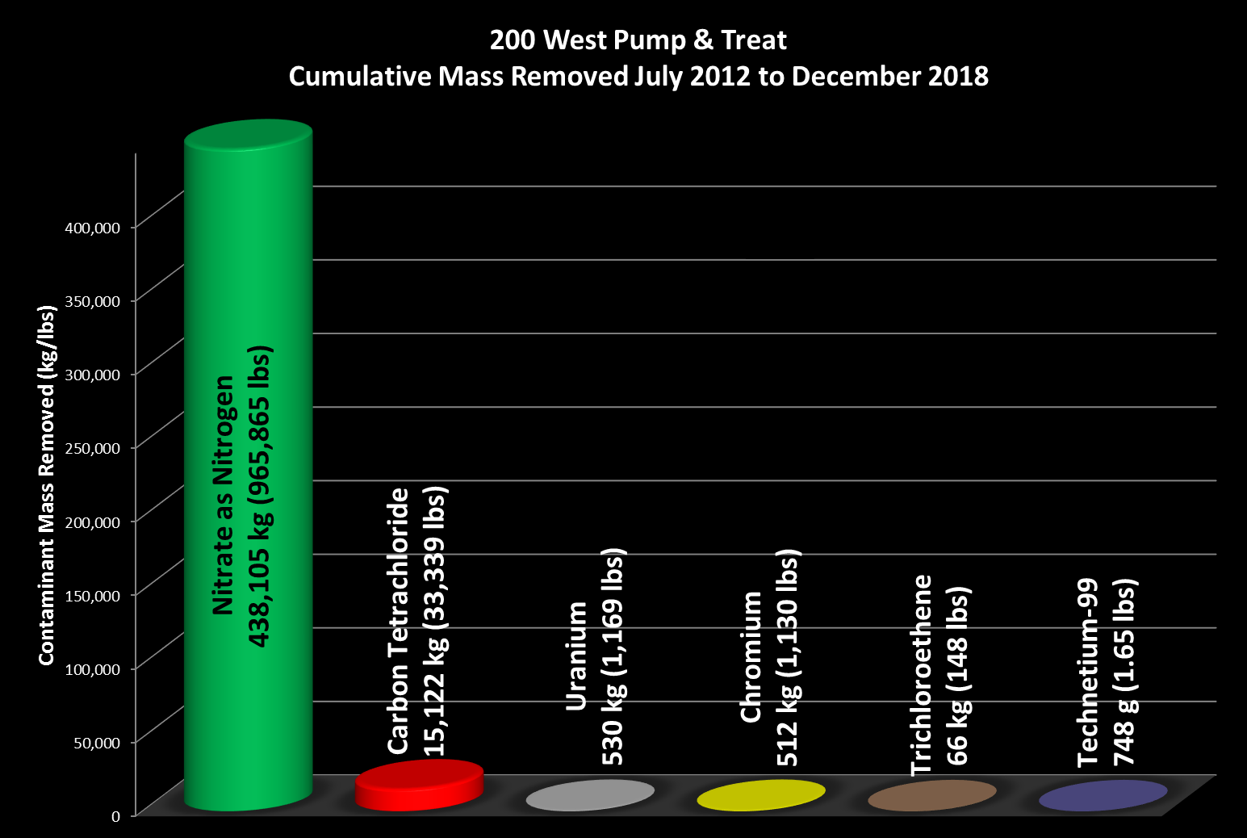
Contaminants of Concern – Mass Removed, 2012 through 2018
Notes:
Emy
Key point is that sufficient nitrate may have already been removed. (comparison to carbon tetrachloride removal less important in this context)

Slide 19
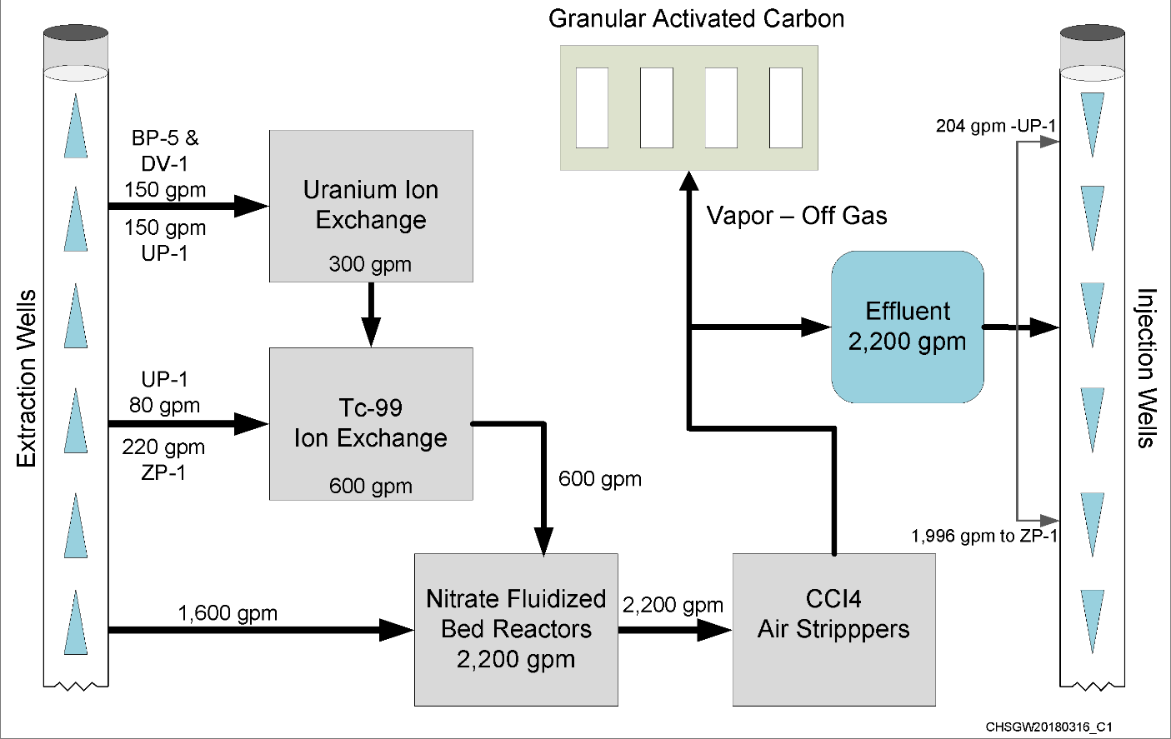
200 West Central Treatment Facility Current Treatment Capacity
Approximately 40% of Operations and Maintenance cost is due to nitrate treatment
Biofouling issues with wells would decrease significantly with removal of FBRs/MBRs.
Limits flow through the system
Notes:
Emy
Remedy design included treating nitrate in accordance with the ROD.
Nitrate is a bottleneck/pinch point for the entire system, limiting treatment capacity and flow.
Biological treatment system presents challenges with biofouling

Slide 20
Optimization Study Rationale
Evaluated six years of 200 West P&T operation data
Current remedy as designed is projected to be insufficient for meeting remedial action objectives due to
  Larger mass of CCl₄ in the aquifer
  Slower degradation rate
Important to consider remedy optimization for CCl₄ because it is the most significant risk driver; unlike other contaminants, its concentration is up to 1,000 times greater than the RAO
Notes:
Emy

Slide 21
Optimization Study Plan
Suspend biological treatment for specified amount of time and gather data on contaminant behavior in the aquifer
Treatment capacity for CCl₄ will be increased with an additional air stripper and expanded well network
Intended to be an iterative process of data evaluation and decision-making
Once sufficient data is collected and evaluated, the site and regulators will work together to determine if the remedy needs to be changed
  Will consider if RAOs and timeframes listed in ROD can be achieved
  No intent to change cleanup levels
Notes:
Emy

Slide 22
EPA Support for Optimization
September 2012: EPA released a National Strategy to Expand Superfund Optimization Practices from Site Assessment to Site Completion.
  Envisions the application of optimization concepts throughout all phases of the remedial process
Systematic site review at any phase of the cleanup process to:
  Identify opportunities to improve remedy protectiveness, effectiveness and cost efficiency
  Facilitate progress toward completion of site work
Notes:
Emy
We are very proud that we are trying to incorporate optimization at the Hanford Site.

Slide 23
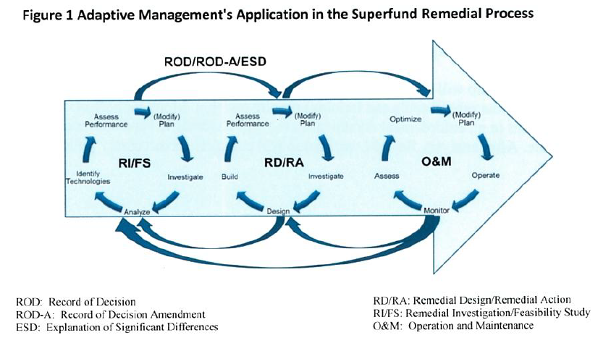
EPA Support for Use of Adaptive Management
Adaptive management is a formal and systematic site or project management approach centered on rigorous site planning and a firm understanding of site conditions and uncertainties. This technique, rooted in the sound use of science and technology, encourages continuous re-evaluation and management prioritization of site activities to account for new information and changing site conditions. A structured and continuous planning, implementation and assessment process allows EPA, states, other federal agencies, or responsible parties to target management and resource decisions with the goal of incrementally reducing site uncertainties while supporting continued site progress.
EPA Memo, Broaden the Use of Adaptive Management, July 2018
Notes:
Emy

Slide 24
Questions
Notes:
All

