Slide 1
ASTM E2893-16 Greener Cleanup Self-Declaration at Marine Corps Base Camp Lejeune
June 28, 2018
Monica Fulkerson, P.E., ENV SP, Project Manager, Jacobs
Betsy Collins, P.E., LEED Green Associate, Project Engineer, Jacobs
Paul Favara, P.E., Senior Technical Consultant, Jacobs
David Cleland, P.G., Remedial Project Manager, NAVFAC
Charity Delaney, P.E., Environmental Management Division, Marine Corps Base Camp Lejeune
CH2M is now Jacobs

Slide 2
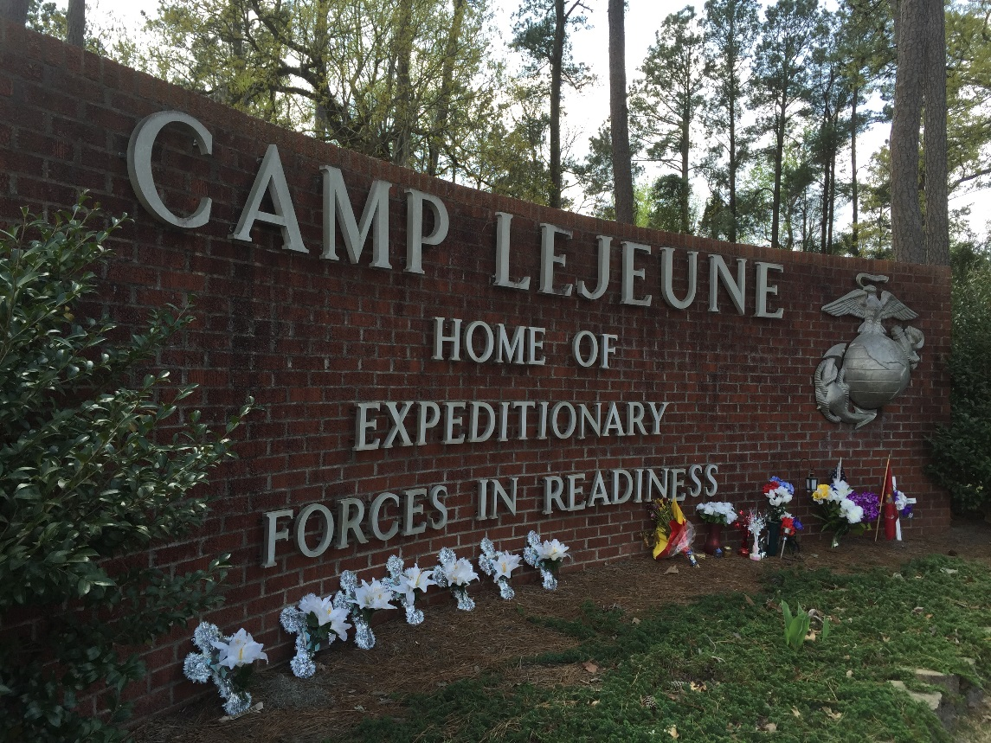
Agenda
Review ASTM E2893-16: Standard Guide for Greener Cleanups Process
Present MCB Camp Lejeune Self-Declaration
Discuss Benefits of Self-Declaration
Agenda
Process
Implementation
Key Take-Aways

Slide 3
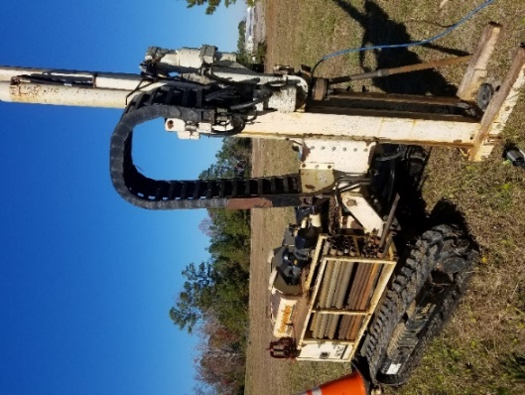
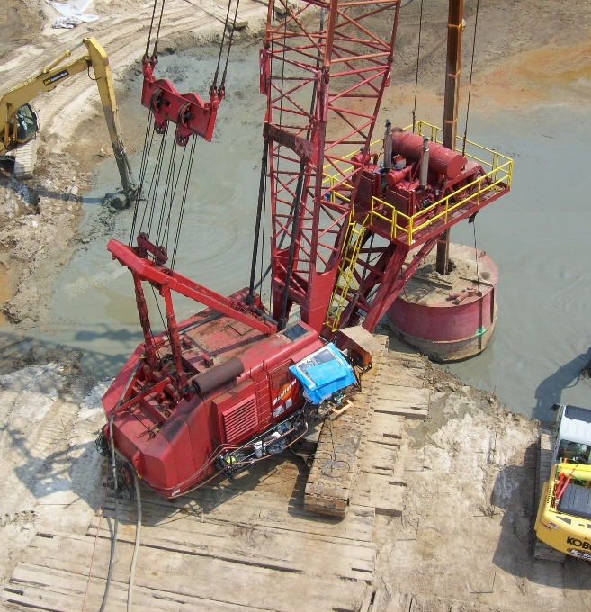
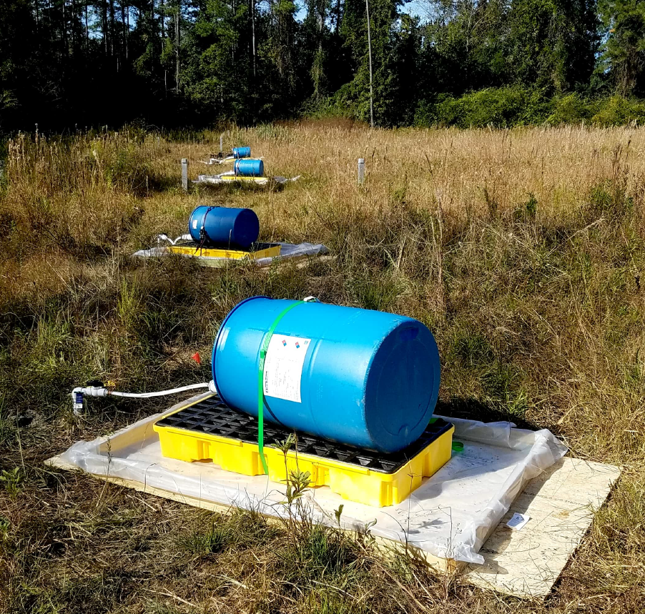
What is the Standard Guide for Greener Cleanups?

Slide 4
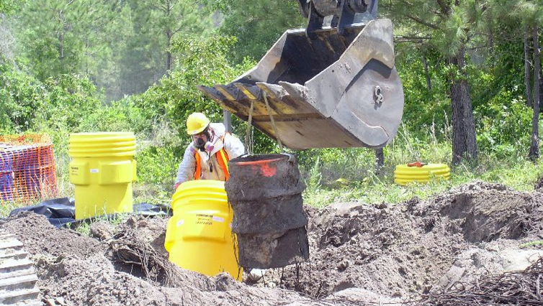
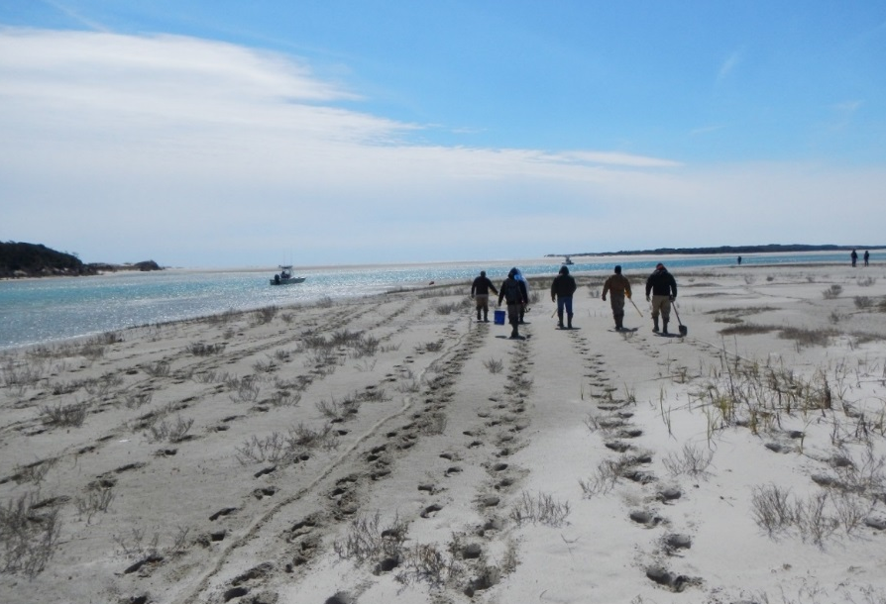
Overview of ASTM E2893-16: Standard Guide for Greener Cleanups
The act of cleanup creates its own environmental impacts
Energy requirements
Air pollution
Water use
Material production/waste disposal
Land and ecosystem impacts
Standard provides process for identifying, evaluating, incorporating, and documenting best management practices (BMPs) during cleanup
Agenda
Process
Implementation
Key Take-Aways

Slide 5
Overview of ASTM E2893-16: Standard Guide for Greener Cleanups
BMP Process
Opportunity Assessment
Prioritization
Selection
Implementation
Documentation
Agenda
Process
Implementation
Key Take-Aways

Slide 6
Overview of ASTM E2893-16: Standard Guide for Greener Cleanups
BMP Process
Opportunity Assessment
Prioritization
Selection
Implementation
Documentation
Opportunity Assessment
Review 114 listed BMPs
Organized by category
Buildings
Materials
Power
Residual Waste
Vehicles
Identify applicable BMPs
Agenda
Process
Implementation
Key Take-Aways

Slide 7
Overview of ASTM E2893-16: Standard Guide for Greener Cleanups
BMP Process
Opportunity Assessment
Prioritization
Selection
Implementation
Documentation
Prioritization
Based on ability to reduce footprint
Low
Medium
High
Professional judgement
Supported by quantitative evaluation, if appropriate
Agenda
Process
Implementation
Key Take-Aways

Slide 8
Overview of ASTM E2893-16: Standard Guide for Greener Cleanups
BMP Process
Opportunity Assessment
Prioritization
Selection
Implementation
Documentation
Selection
Based on potential footprint reductions
Considers typical comparison criteria
Reasons for exclusion
Technology screened out
Inability to meet project requirements
Negative effect on core element
Less impact with standard approach
Agenda
Process
Implementation
Key Take-Aways

Slide 9
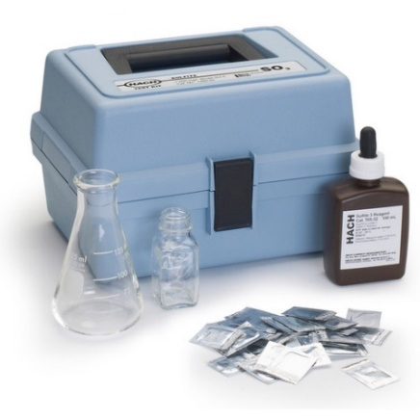
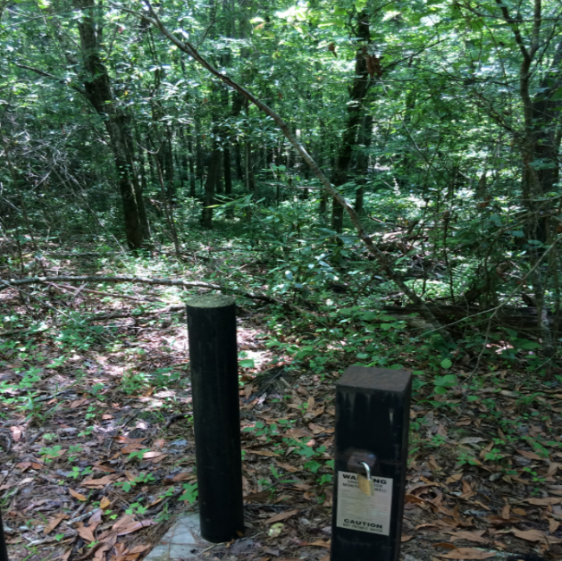
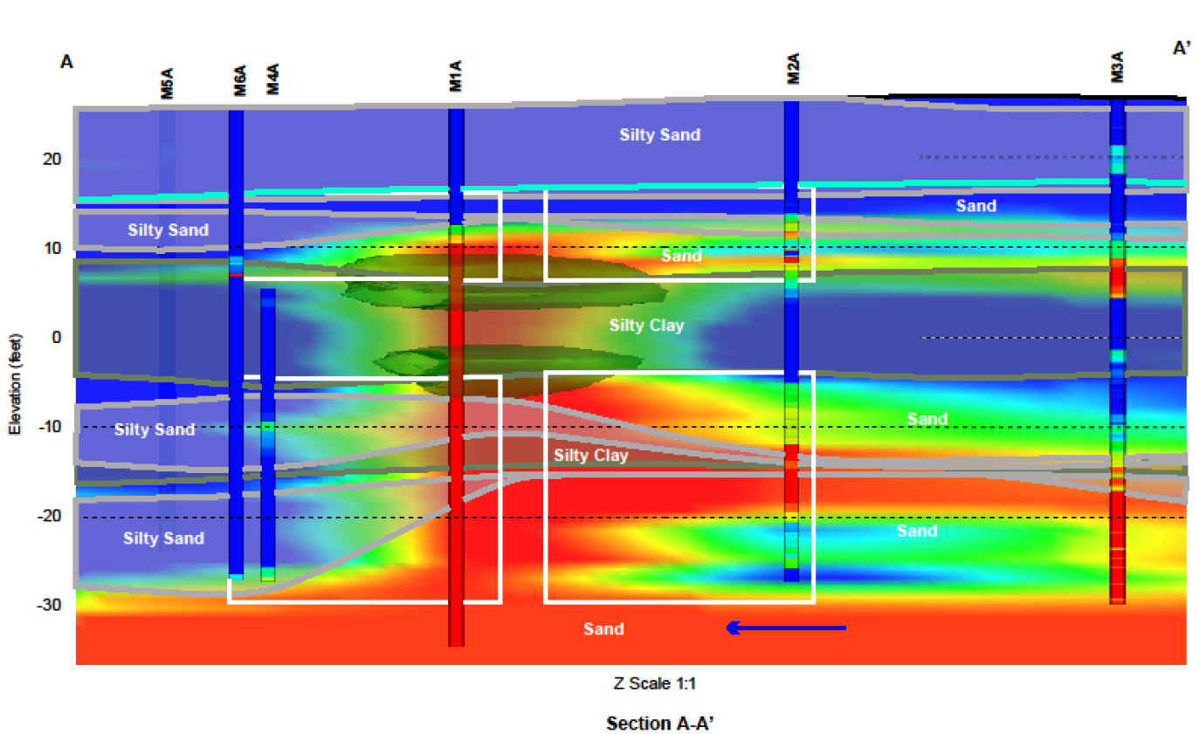
Overview of ASTM E2893-16: Standard Guide for Greener Cleanups
BMP Process
Opportunity Assessment
Prioritization
Selection
Implementation
Documentation
Agenda
Process
Implementation
Key Take-Aways

Slide 10
Overview of ASTM E2893-16: Standard Guide for Greener Cleanups
BMP Process
Opportunity Assessment
Prioritization
Selection
Implementation
Documentation
For each cleanup phase
Public submittal
Agenda
Process
Implementation
Key Take-Aways

Slide 11
Agenda
Process
Implementation
Key Take-Aways

Slide 12
Marine Corps Base Camp Lejeune’s Self-Declaration

Slide 13
MCB Camp Lejeune Greener Cleanup Self-Declaration
MCB Camp Lejeune
Mission: Maintain combat-ready warfighters for expeditionary deployment
Second largest Marine Corps Base in the USA (approximately 236 square miles)
49 active environmental sites
Agenda
Process
Implementation
Key Take-Aways

Slide 14
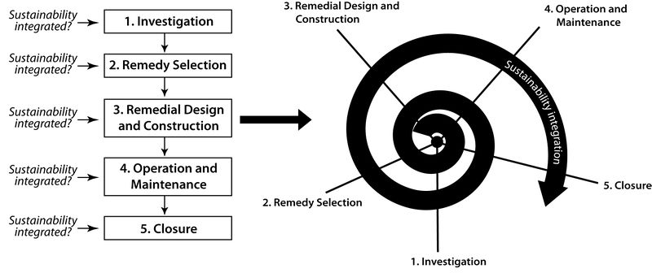
MCB Camp Lejeune Greener Cleanup Self-Declaration
Self-declaration completed in 2017
BMP evaluation
29 potentially applicable
18 implemented
2 user-defined
Complemented strategy to achieve remedy objectives
All phases of site work
Holland et al, 2011

Slide 15
Project Highlights

Slide 16
Solar Powered Subgrade Biogeochemical Reactor
Applicable BMPs
Biobased and non-refined materials (locally sourced mulch and soybean oil)
Uncontaminated site soil for backfill
Solar powered pump
Impacts
Reduced landfill waste and greenhouse gas emissions
Maximized use of renewable energy
Reduced concentrations in source area and potential time to site closure
Agenda
Process
Implementation
Key Take-Aways

Slide 17
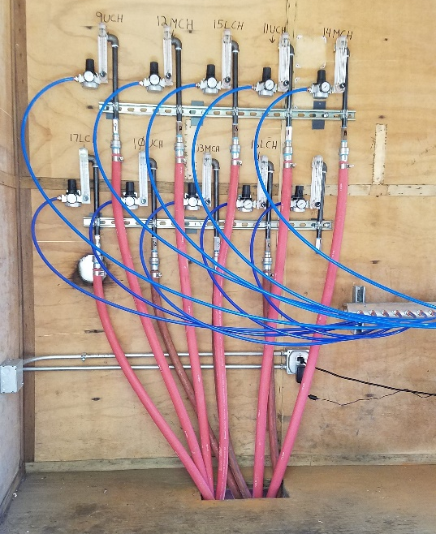
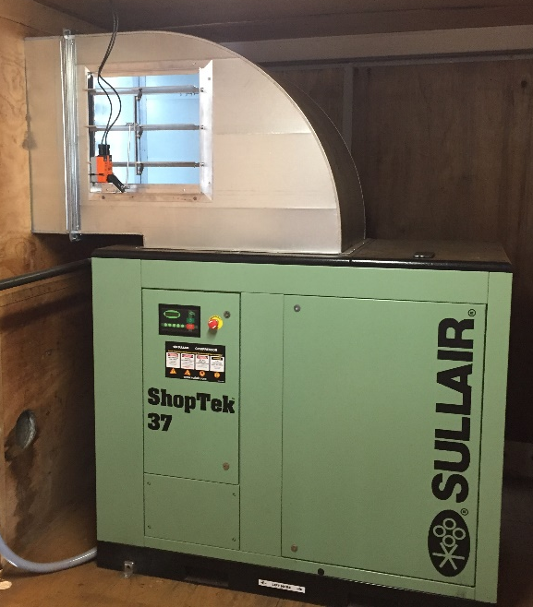
Air Sparging Remedial Actions
Applicable BMP
Set milestones to system shut down
Equipment reuse
Impacts
Savings of ~800,000 kilowatt hours per system per year per system
Reduced cost and GHG emissions associated with electricity production
Avoided O&M vehicle travel
Agenda
Process
Implementation
Key Take-Aways

Slide 18
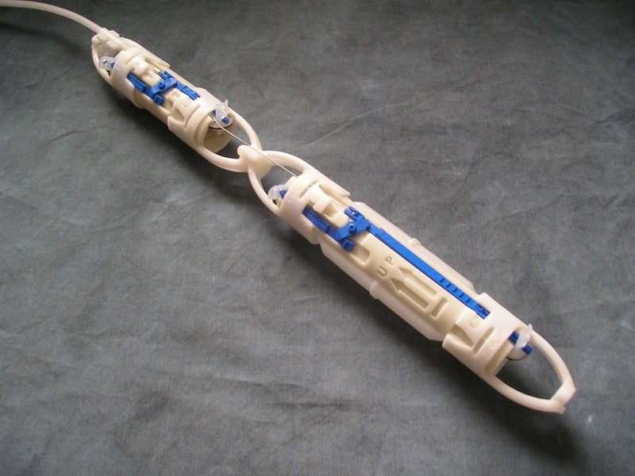
Long Term Monitoring Program
Applicable BMPs
No purge technology, 300 wells/year
Optimized well network and utilized existing wells
Impacts
Minimized waste management
Avoided ~1,500 gallons aqueous waste/year
Eliminated need for ~15,000 feet of tubing/year
Reduced greenhouse gas emissions related to transportation
Reduced time and cost
~600 hours or $32,000/year
Agenda
Process
Implementation
Key Take-Aways

Slide 19
Sitewise Analysis
Remedy Selection
Compare alternatives in terms of a consistent set of sustainability metrics
Conducted at 8 sites
Remedy Implementation
Identifies opportunities to reduce footprint during design
AS
ISCO
ERD
Total Energy Used - ISCO
Construction
Operations
Monitoring
Agenda
Process
Implementation
Key Take-Aways

Slide 20
Why Self-Declare?

Slide 21
Benefits to Self-Declaration
Get recognition for BMPs already being applied at sites
Optimize existing remedies to reduce time, cost, and environmental impacts of cleanup
Minimize environmental impacts for future cleanup actions
Trigger “The Virtuous Cycle”
Agenda
Process
Implementation
Key Take-Aways

Slide 22
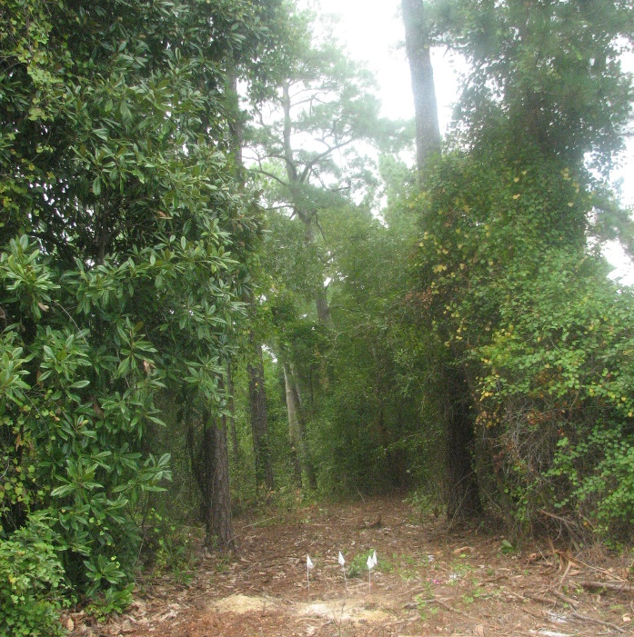
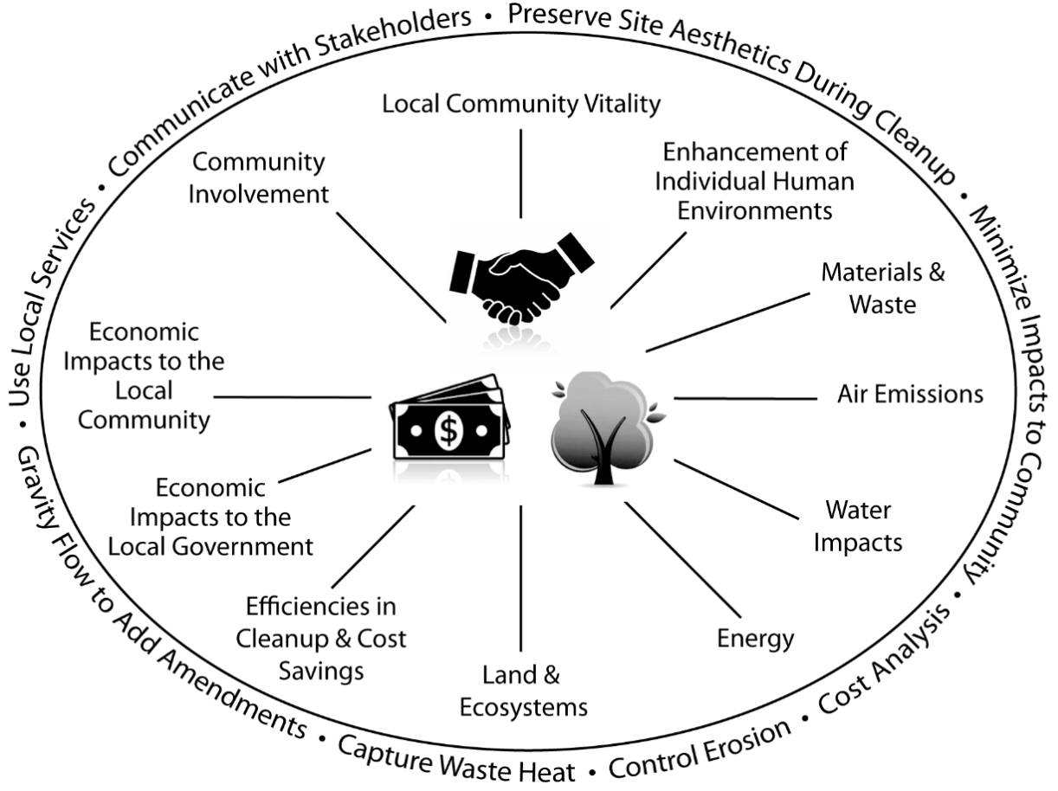
Conclusions
ASTM E2893-16: Standard Guide for Greener Cleanups Process
A useful tool to document successes
Self-declaration at MCB Camp Lejeune
Documented past successes
Will continue to utilize BMPs moving forward
Establish a culture of green sustainable remediation
Trigger the virtuous cycle
ASTM International
Agenda
Process
Implementation
Key Take-Aways

Slide 23
Thank you!
Monica L. Fulkerson, P.E., ENV SP
Notes:
With that, I thank you for your time and attention and welcome any questions.

