Slide 1


Green Up Your Cleanup
Using the ASTM Standard: A Primer
Deb Goldblum, EPA Region 3
Clu-In Webinar
September 28, 2016

Slide 2
Myths and Truths
Greener Cleanups Are….
NOT just about GHG
NOT about the greenest technology
The same as green remediation
Integral to more sustainable cleanups

Slide 3

Broader View
Particulate emissions
Waste generation
NOx
Site Cleanup
CO₂
Material use
SOx
Water use
Energy use

Slide 4






EPA Greener Cleanup Principles
August 2009

Slide 5

Two Approaches: Same Endpoint
Cleanup Objectives
Apply BMPs
Any Site
Large/Complex Site
Quantitative Evaluation
Focus key activities
Estimate impacts
Identify hidden contributors

Slide 6
ASTM’s Standard Guide for Greener Cleanups
  Supports the tenets of EPA’s Greener Cleanup Principles
  Applicable to individual or multiple phases of a cleanup
  Identifies and employs best management practices “BMPs”
  Offers an option for a quantitative evaluation
  Promotes transparency through a robust reporting structure
November 2013

Slide 7
Estimated Number of Contaminated Sites = 294,000
(United States, Cleanup horizon: 2004 – 33):
Source: www.clu-in.org/market

Slide 8
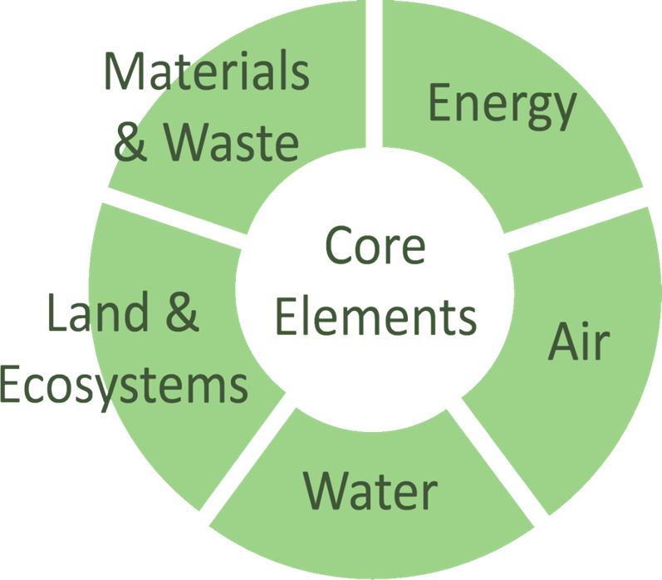
Standard Works at Any Site

Slide 9
Best Management Practice Process
Step 1: Opportunity Assessment
Step 2: BMP Prioritization
Step 3: BMP Selection
Step 4: BMP Implementation
Step 5: BMP Documentation
Particulate emissions may be important for a region in non-attainment
The water footprint may be important in arid lands
Waste generation may be important for a community with concerns regarding landfill space
GHG emissions may be important to a municipality with GHG reduction goals

Slide 10
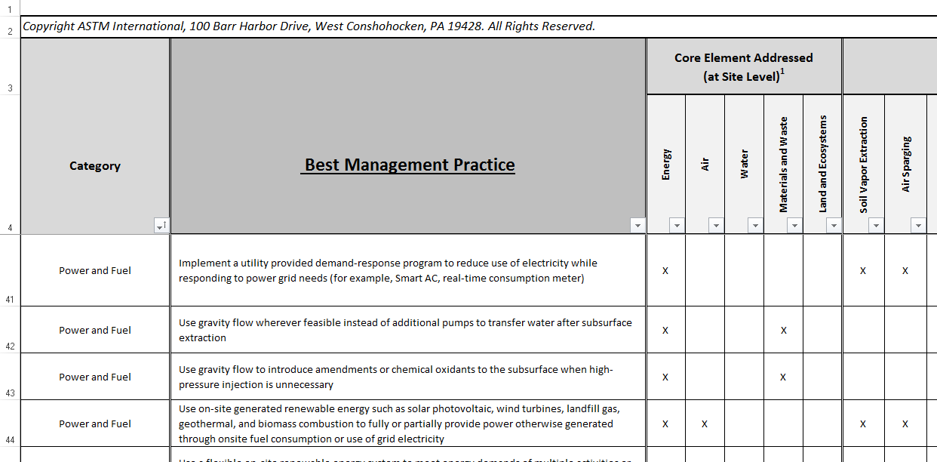
Step 1 BMP Opportunity Assessment
Appendix X3 BMP Table

Slide 11
Step 1 BMP Opportunity Assessment
Best Management Practice | Applicable
BMP 1 | X
BMP 2 | X
BMP 3 | X
BMP 4 | X
BMP 5 | X
High
BMP 6
X

Slide 12
Step 2 BMP Prioritization
Best Management Practice | Priority
BMP 1
BMP 2
BMP 3
BMP 4
BMP 5
BMP 6
High
High
Med
High
Low
Low
Med

Slide 13
Step 2 BMP Prioritization
Best Management Practice | Priority
BMP 1 | High
BMP 3 | High
BMP 2 | Med
BMP 6 | Med
BMP 4 | Low
BMP 5 | Low
High

Slide 14
Step 3 BMP Selection
Best Management Practice | Priority | Select/Rationale
BMP 1 | High | X
BMP 3 | High
BMP 2 | Med | X
BMP 6 | Med | X
BMP 4 | Low | X – required by law
BMP 5 | Low
Cost
Effectiveness

Slide 15
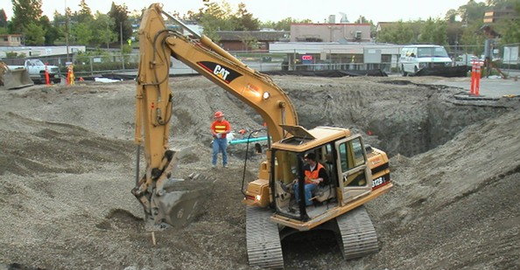
Step 4 BMP Implementation

Slide 16
Step 4 BMP Implementation
Best Management Practice | Priority | Select/Rationale
BMP 1 | High | X
BMP 3 | High
BMP 2 | Med | X
BMP 6 | Med
BMP 4 | Low | X – required by law
BMP 5 | Low
Cost
X
Effectiveness

Slide 17
Step 5 BMP Documentation
Best Management Practice | Priority | Select/Rationale
BMP 1 | High | X
BMP 3 | High
BMP 2 | Med | X
BMP 6 | Med
BMP 4 | Low | X – required by law
BMP 5 | Low
Cost
Stuff Happens
Effectiveness

Slide 18

Reporting
Publicly Available: BMP Tables, Outcomes & Self-certification
Best Management Practice | Priority | Select/Rationale
BMP 1 | High | X
BMP 3 | High | Cost
BMP 2 | Med | X
BMP 6 | Med | Stuff Happens
BMP 4 | Low | X – required by law
BMP 5 | Low | Effectiveness
ASTM will post on website - Contact Kate Chalfin at: kchalfin@astm.org

Slide 19
Uses
Protocol Tool Reference

Slide 20
Outcomes
Defines greener cleanup
Provides a level playing field
Promotes culture change

Slide 21


