Slide 1
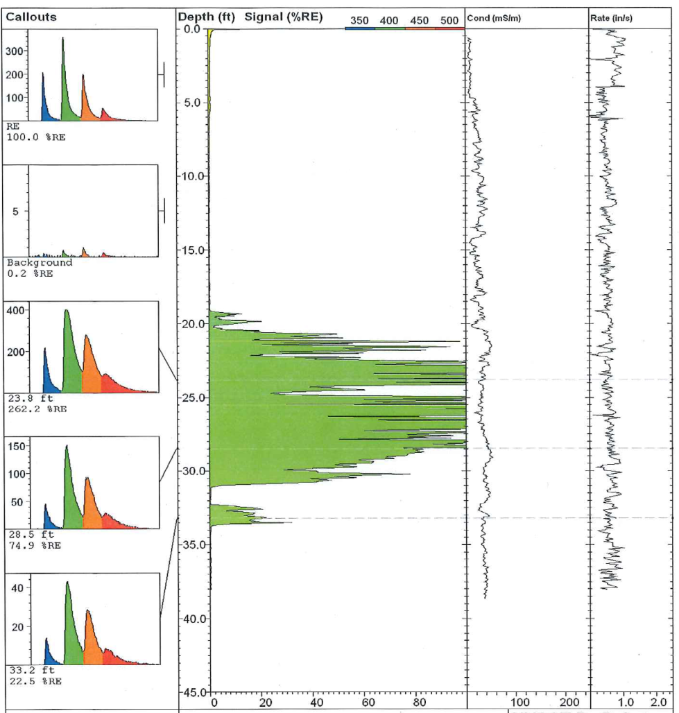
High Resolution Site Characterization – Pragmatic Approaches to Remediation Success: Case Histories
EPA Webinar: February 20, 2018
David Swimm
Wisconsin Professional Geologist
Notes:
Data obtained: Laser Induced Fluorescence (LIF) and Electrical Conductivity (EC)
Two goals:
Define the 3-D extent of the LNAPL accumulation, and
Define its geologic entrapment (most LNAPL is trapped because most is at residual saturations).
Third goal is to determine relative LNAPL mobility - determined by competent LNAPL transmissivity testing.
To fulfill goals data needs to be interpreted and integrated
Work products provide improved LNAPL conceptual site models (CSM), which in turn can be used to better assess potential remedial actions.

Slide 2
Two LNAPL Remedial Case Histories:
Both had expensive, historical remedies performed
Both had relatively poor results
Both had post-remedy, high resolution surveys conducted (LIF/EC) that resulted in the following:
Site 1 :
Provided improved focus on LNAPL distribution
Provided context (soil distributions) for LNAPL accumulations
Approved funding for a second remedial action
Site 2:
Confirmed post-remedy shallow LNAPL distribution
Indicated lack of any deeper LNAPL accumulation
Provided detailed soil distributions
Denied funding for further active treatment
Helped focus additional work – confirmation potable well sampling and vapor intrusion (VI) assessments
Notes:
Total historical costs per site was in the $600-$700K range
First two bullet for Site 1 and first 3 bullets for Site 2 are goals fulfilled.

Slide 3
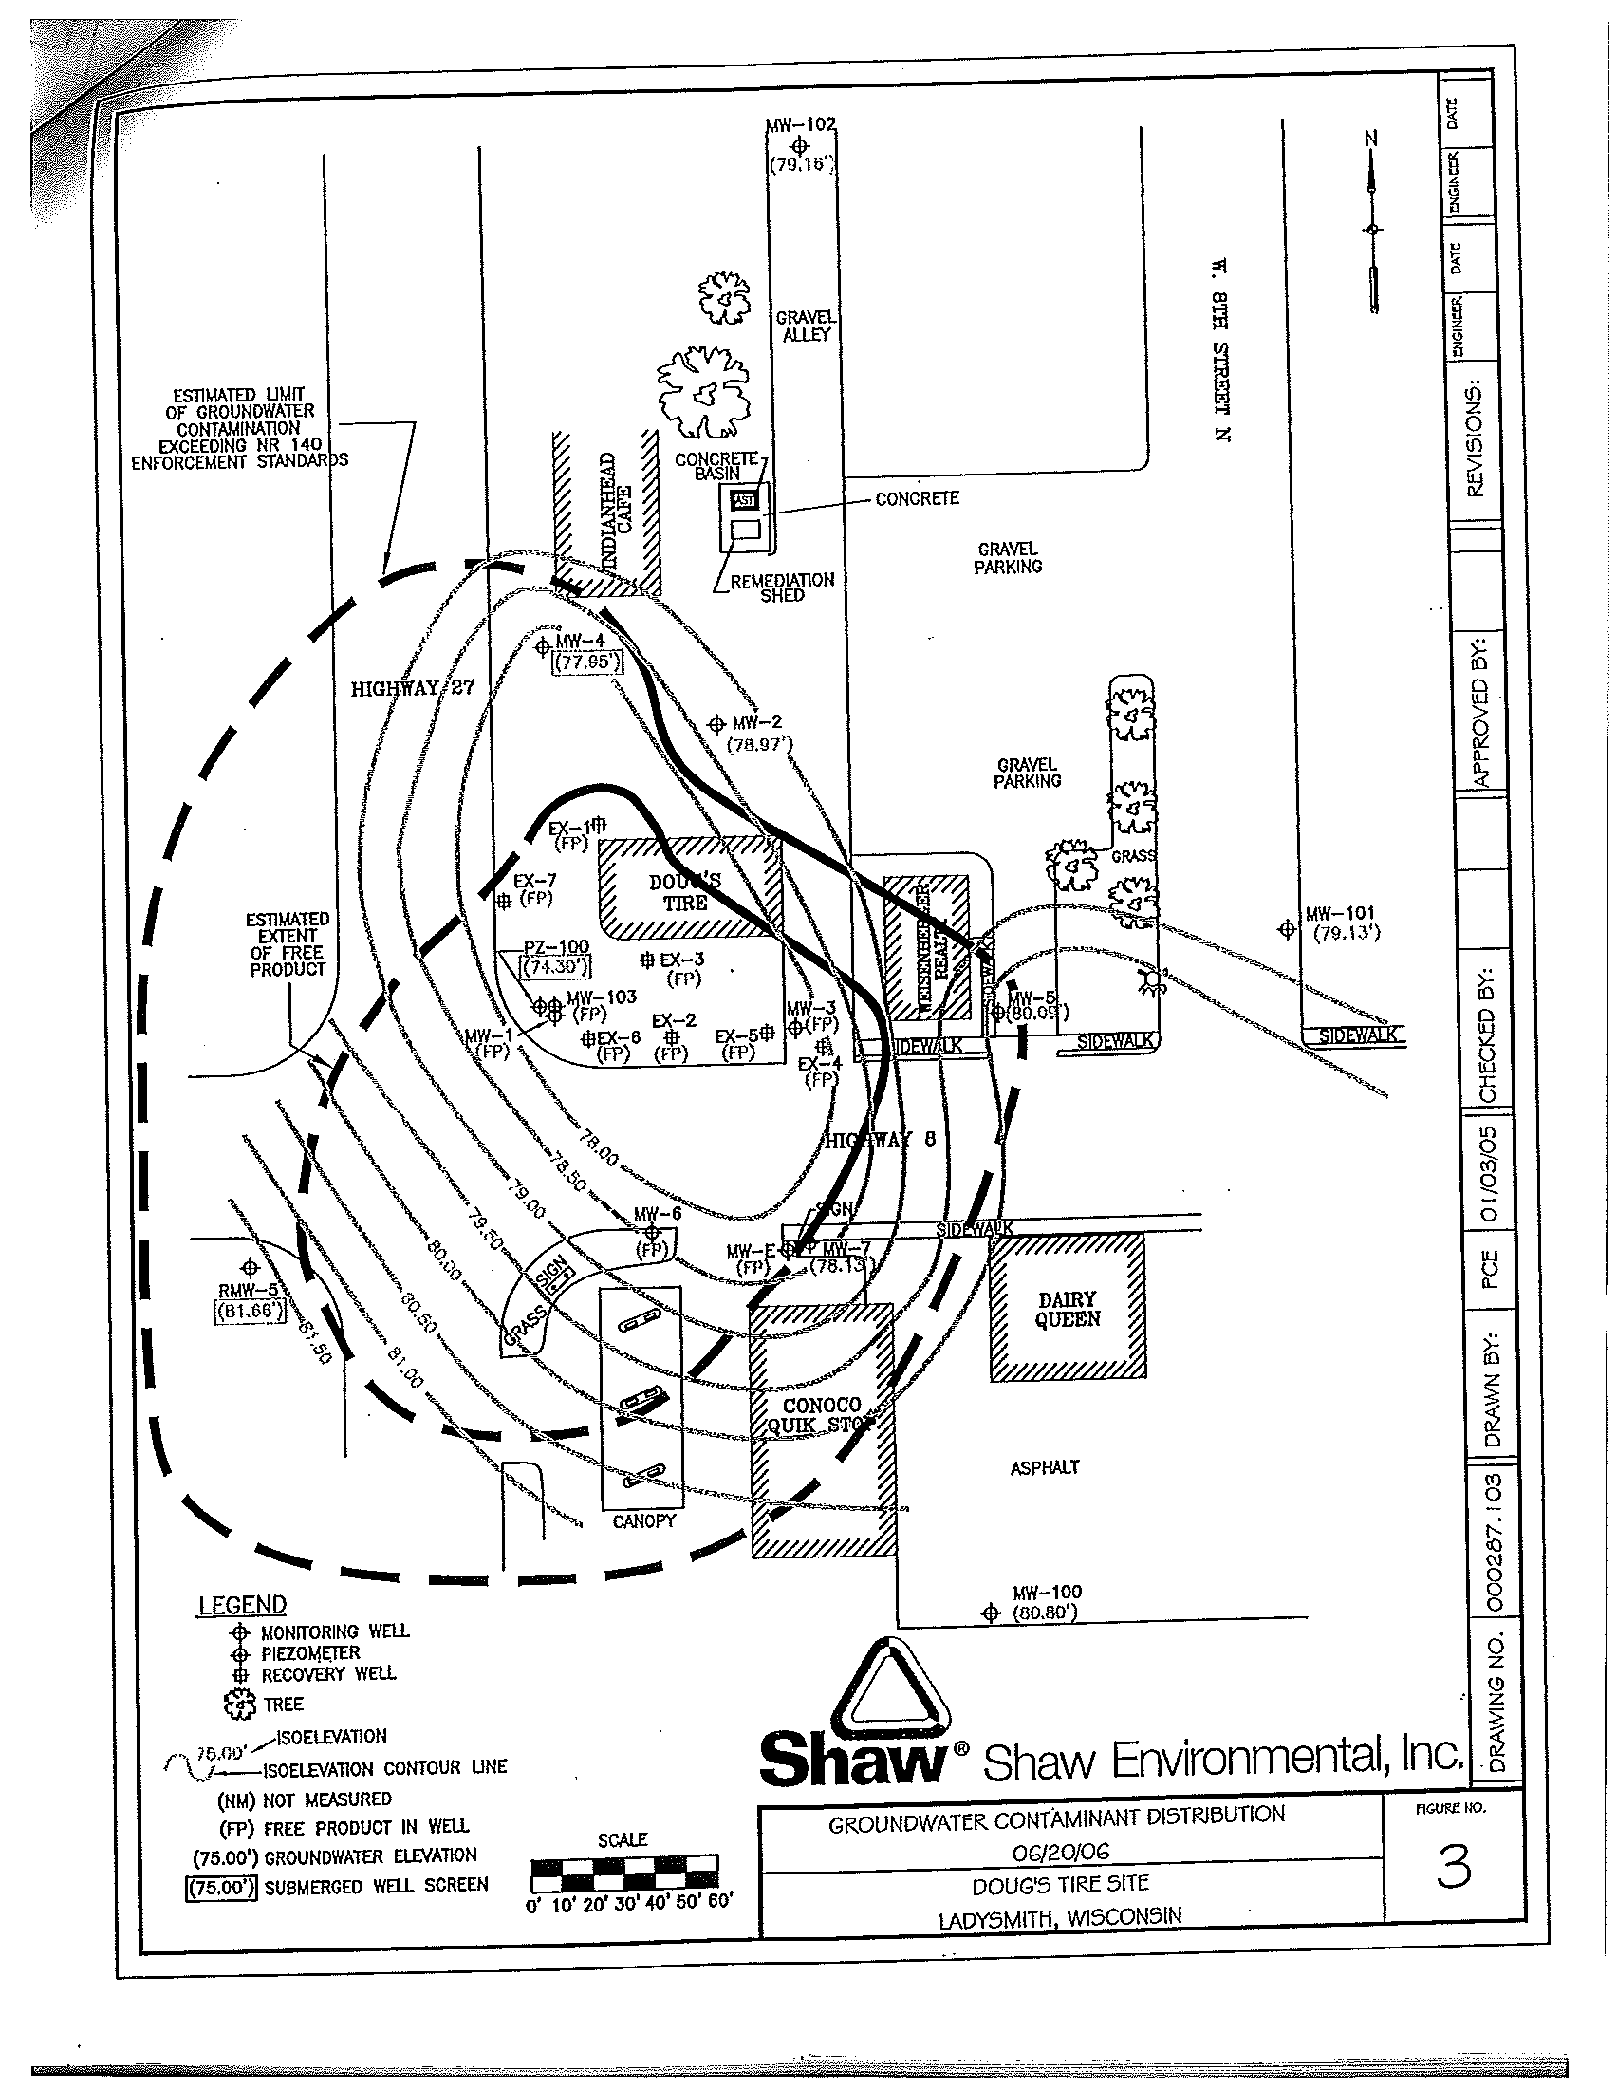
Site 1 - Post-Remedy
Perceived LNAPL Distribution
Subject Site
7-well pneumatic skimmer system
Operated 2003-07
Extracted diesel and gasoline (two sources)
7K gals. LNAPL reportedly removed
$670K reimbursed
MWs still contain 2-4 ft. LNAPL post-remedy
Downgradient PZs heavily impacted post-remedy
Station Bldg.
LNAPL Accumulation
Additional LUST Sites w/LNAPL
Notes:
Orientation Slide:
Consultant’s perceived post-remedy extent of LNAPL for subject site.
Subject site is along NE corner of busy road intersection – two other LUST sites (with their own LNAPL sources) are along NW and SE corners of intersection
NW corner site historically had LNAPL/GW extraction performed
SE corner site was in the investigation phase at time of LIF/EC survey.
All three had considerable LNAPL remaining, and all three had LIF/EC surveys conducted during 2012. Why?
Because:
Besides the on-site LNAPL volumes, a considerable volume appeared to exist beneath the roadway
active treatments effectively ended 4-5 years earlier
the remaining LNAPL was still “potent” (i.e., relatively un-weathered), and
Downgradient piezometers remained heavily impacted.

Slide 4
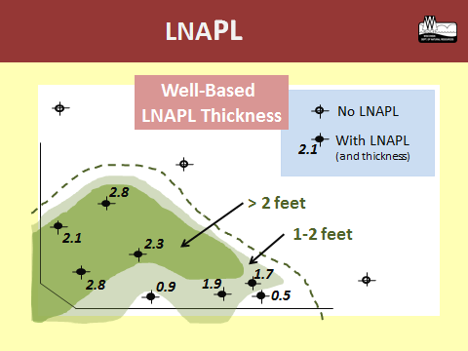
Post-Remedial
LNAPL Lateral Distribution
SM
1997 Investigation Section
Top Elevated PID
SP
SZ
SP
SP
SW
Notes:
Pre-LIF/EC survey CSM - LNAPL everywhere and within the context a sand smear zone.
Given the reported 7,000 gallons removed and simple CSM, folks argued to “just rehabilitate the existing system and turn it on” (instead of incurring the cost of the LIF Survey).
If conducted in that fashion the second treatment effort would have remained unfocused and likely would have been unsuccessful.

Slide 5
Conducted Laser Induced Fluorescence (LIF) Survey during 2012
LNAPL Signal:
Laser provided UV light induces some LNAPL compounds to excite enough to emit light (fluorescence) that reflects back to tool
Fluorescence response is calibrated to a known LNAPL standard - plotted as a percentage of Reference Emitter (%RE)
Frequency spectrum (i.e., “waveform callouts”) of induced fluorescence can differentiate product types
Low range responses can include false positives
Soil Discriminator - Electrical Conductivity (EC):
Conductivity between dipoles
Lower EC reflects coarse grained soils; higher reflects finer grained soils, including clay minerals which can enhance electrical flow
Performed LNAPL Transmissivity (Tn)Testing:
Results were 0.15 - 0.40 ft²/d
Eliminated further consideration of hydraulic removals
Notes:
Fluorescence as an indicator of NAPL has been recognized and used in the oil industry for many decades
4th bullet along with practical interpretation needs is why the %RE needs to have a discriminator (bias threshold) above which the signal can considered meaningful
Besides false positives, low range LIF responses may only reflect low overall LNAPL saturations

Slide 6
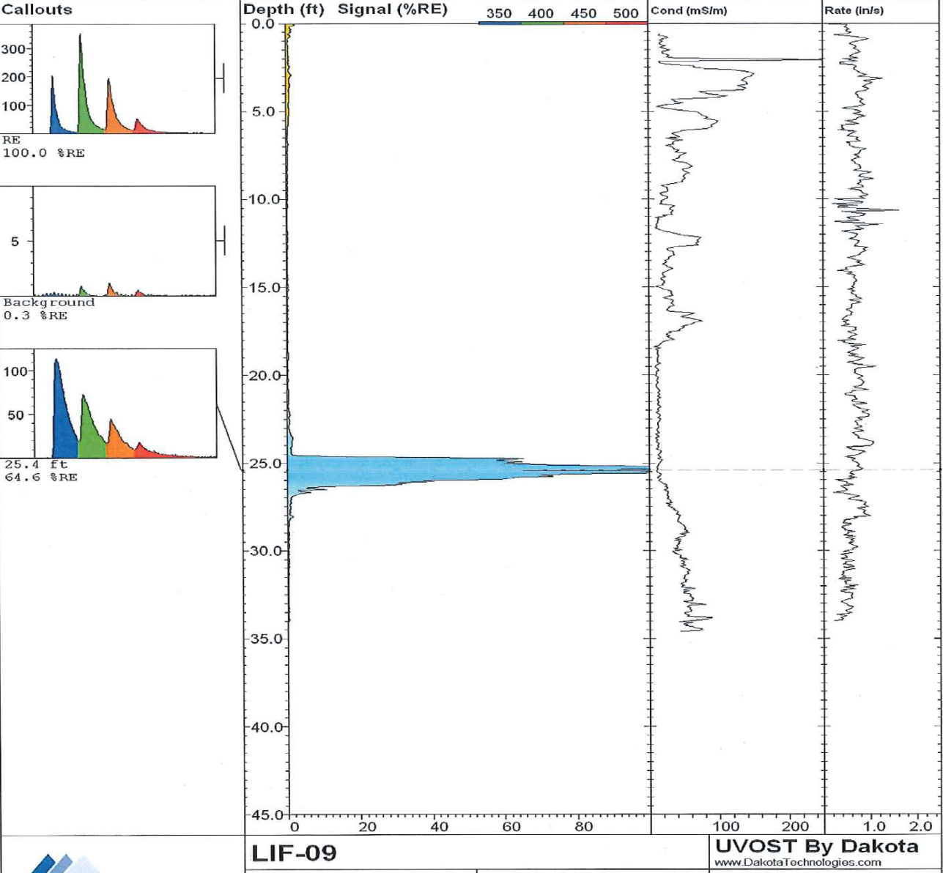
Example LIF Boring Log: LIF-9
Located near MW-3
ML & SM
Waveform Callouts
MW-3
24.8
26.5
RE= Reference Emitter
SM
Fluorescence
Signal
SW
10% RE
50% RE
Electrical Conductivity
Penetration
Rate
30 mS/m
Notes:
Illustrates a robust fluorescence response near MW-3 - day of the survey showed about 2 feet of LNAPL
The biases indicated above (10% and 50% RE, and 30mS/m for soil) are all for interpretation purposes (i.e., based on what is needed to be illustrated/mapped).
As shown on Slide 11, the conductivity bias used was confirmed by multiple soil sieve test data
LNAPL appears to be an accumulation along the base of the interpreted sand
Note the waveform callouts (i.e., blue coloration of fluorescence response)
Note the shallow ML/SM zone (light brown), which is across the entire site
Already was defined by conventional soil borings
May explain relatively un-weathered nature of the LNAPL (i.e., acts to limit infiltration/oxygen)
Fresh product could not be explained by more recent releases – tanks were removed decades ago at subject site, and LIF results proved new tanks on site to south were not leaking
Importantly probably defines the cap for “vapor treatment container”

Slide 7
Net Feet >10%RE Signal
(Smear Zone at 17-26’ bgs)
Diesel LNAPL plume
Gasoline LNAPL plume
LIF boring
(contoured
values)
G
2.8
2.1
upper smear
zone signal
2.3
L12
L9
2.8
0.5
1.7
1.0
NA
0.9
1.9
L10
0.5
Well LNAPL
Thickness (red)
>1.0 net feet
Notes:
Net footage mapped reflects formation LNAPL thickness
Diesel-related LIF spectral response was different than the gasoline response
Dark green shading on map is for >1 foot of gasoline-related LNAPL .
Formation thickness matters
Volume
Saturations that can develop
Recoverability
Focusing on the NW side of the gasoline LNAPL plume, there is little to no water table LIF signal, yet three wells show >2’ LNAPL .
Focusing along the SE side, well thicknesses generally agree with the LIF survey contours, however formation thickness appear to vary over short distances (i.e., L10 and L12).
Note how the gasoline LNAPL extends to the edge of roadway – this dove-tails with LIF results across the street to south (i.e., implies significant LNAPL beneath the ROW).
.

Slide 8
5050%%“More Focused”
Net Feet >50% RE Signal
(Smear Zone at 17-26’ bgs)
Notes:
Higher %RE bias provides a more focused illustration of the LNAPL distribution.
Perhaps highest LNAPL saturations

Slide 9
Net Feet >10%RE Signal
(Below Smear Zone: > 26’bgs)
L9
Notes:
Below smear zone LNAPL has significant remedial implications

Slide 10
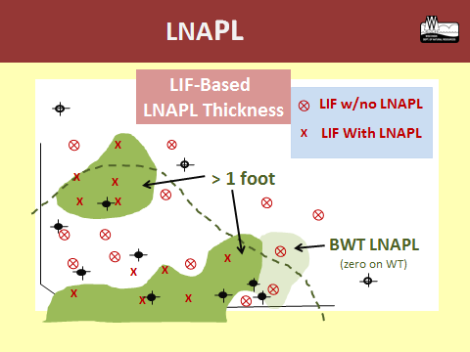
Improved Lateral LNAPL Resolution
Old
New
Notes:
Summary Slide:
Monitoring wells are poor indicators of LNAPL formation thickness.
Many new state guidance documents (not so new now) acknowledge this issue.

Slide 11
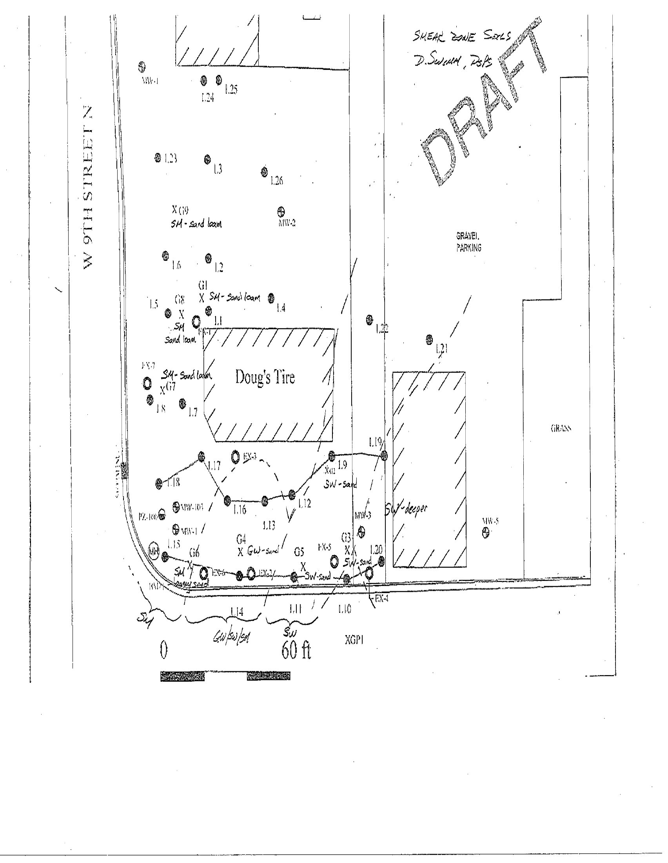
LIF Boring EC Responses w/Sieve Results
Soil Type Distribution - Smear Zone Interval
Soil Sieve Analyses
SM
SW
L12
1997 Boring
Log X-Section
A’
A
B
B’
GW/SW
L10
Notes:
Orientation map for cross sections:
Mapping reflects predominant soil type across smear zone - based on EC interpretation
Confirmed by sieve testing

Slide 12
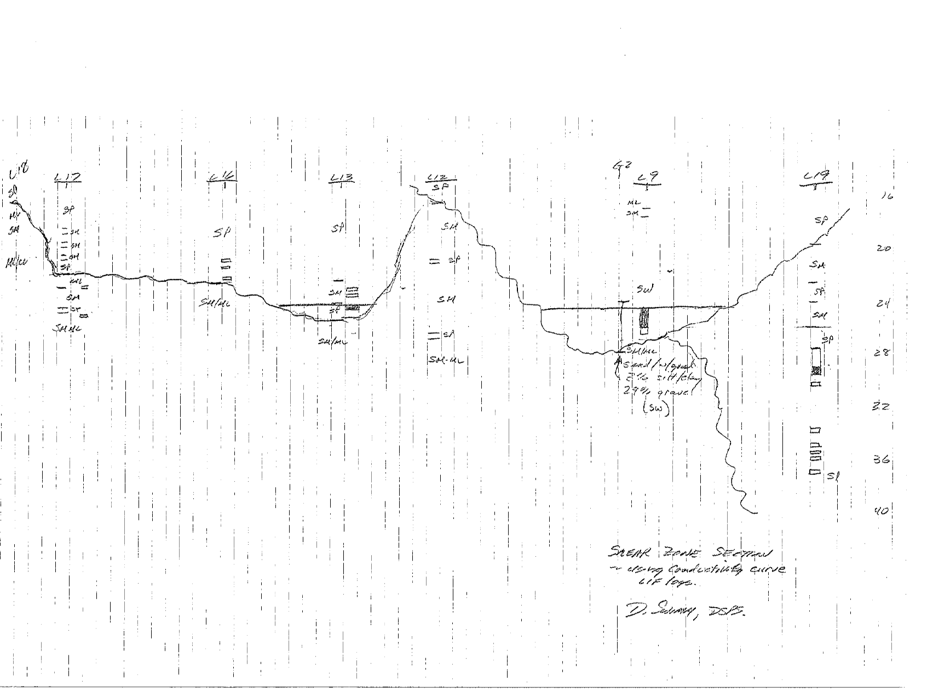
Soil Type Distribution - Smear Zone Interval
LIF Boring EC Responses
A
A’
L 18
L 17
L 16
L 13
L 12
L 9
L 19
SX
16
GW/SW
20
SZ
SW
SM
24
SZ
28
LIF > 50% RE
32
36
20 ft.
LIF 10-50% RE
(approx. horizontal scale)
40
Notes:
Note the lack of fluorescence response at L12 which is all silt across the smear zone - interpreted as an older silt between younger channel sand cuts
LNAPL preferentially retained in the more porous channel sands
Scale is on par with an outcrop
Volatilization, a significant component of NSZD, is occurring along the LNAPL/vadose zone interface; however the vapor container, as previously discussed (Slide 6), appears to be sealed.

Slide 13
Improved Vertical LNAPL Resolution & Geologic Context
Old
SZ
SP
SW
SP
New
PID suggested LNAPL smear zone
SW
SM
SZ
SM
SM
LIF-Indicated LNAPL
Notes:
Summary Slide:
New LNAPL CSM allows for a more focused and realistic remedial options evaluation
Focused: conduct active treatment along SE portion of site (locus of sand deposition and gasoline-related formation LNAPL), and due to tighter soil conditions at the diesel LNAPL accumulation, excavation.
Realistic: understanding that some LNAPL is trapped below the measured SZ, and that little mobile LNAPL exists despite monitoring well thicknesses.
Also, had low Tn test results from MW-3

Slide 14
Lessons Learned
LIF Survey results need to be interpreted and integrated:
They are expensive
Fluorescence results provide formation LNAPL thickness independent of wells, and can distinguish between product types
Conductivity results provide detailed smear zone soil distributions in much greater detail than boring logs
Integrated results provide LNAPL distributions within their geologic context, including accumulations below the water table
LIF Survey & LNAPL Transmissivity (Tn) Results
SVE Pilot Testing
Notes:
LIF surveys can cost $8-12K for modestly sized UST sites. Consequently, time needs to be spent on interpreted and integrating results so they can be used to benefit remedial decisions.
Benefits (bullets 2-4) can readily translate to collecting and using this data during the investigation phase (e.g., best locations for monitoring wells)
New LNAPL CSM along with Tn results, allowed for planning second active treatment – tentatively SVE, subject to the results of pilot testing.
Enhanced volatilization– encourages phase change and will provide an outlet for the vapor container (remember the LNAPL is potent)
Vacuum through the porous sand would allow venting access beneath the roadway
Wide smear zone continually creates new volatilization exposures
AS would have been an obvious complement to vapor extraction, but problems included
Deep and numerous utilities
Nearby buildings

Slide 15
Smear Zone SVE Pilot Test Results
(Inches of Water Column)
Site 1
Site 1
27
10
SM
1
SM
0.5
0.5
1
EC-based soil transition
66
0
60 ft.
0
60 ft.
Pilot Test Extraction Well
Notes:
LIF Survey was also conducted during investigation for site across road to the south of Site 1
Also defined lateral smear zone soil transition - mostly silty sand (SM) to west/mostly sands to the east
SVE pilot test obviously shows less smear zone permeability on site to south
Importantly both tests show some communication beneath the roadway.

Slide 16
Remedial Results
SVE Operation - Gasoline Sources:
2 year operation (10/15 - present)
Single system w/extraction from both sites
8,500 gals. LNAPL extracted to-date (9/17)
Anticipate 10,000+ gals. by shut-down
Excavation – Diesel Source:
Approx. 2,500 tons removed
Included some mass below water table
Diesel Source Excavation
Bldg.
SM
SVE Extraction Well
System Bldg.
Notes:
Currently assessing on-going results (effluent concentrations and flow rates)
Planning optimized system cycling
Systematically fill and empty vapor container

Slide 17
Site 2
Post-System, 2013 LIF Boring Survey
Remedies conducted:
Limited Excavations
DPE Extraction – 5 wells
Credible operations 2009-12
3K gallons LNAPL removed
$600K reimbursed (overall)
Risks Still Present:
LNAPL at various depths, including confined
Potable well risk
PVI risk
Consultant requested additional funds for system re-start and expansion
Drinking Water Wells
Recovery Well
Excavation Areas
LIF Borings
Notes:
The map is not meant to be easily read – it simply illustrates the extent of the prior efforts to monitor and remediate.
Remediation by boring?

Slide 18
LIF Response (%RE)
Maximum Amplitude Map
LIF 15
LIF 16
Problems:
Does not discriminate LNAPL formation thickness
Does not show soil/geology context for accumulation
Does not show separate confined accumulation
LIF 3
Notes:
Consultant provided map reportedly showing the extent of the LNAPL accumulation, however
Only three of the 25 LIF boring had any significant fluorescence response (circled)
LIF15 and LIF16 (water table accumulation) are in the orange “bull’s eye”
LIF3 (confined LNAPL) is beneath the ROW.
LIF borings along perimeter of the amplitude map contouring (edge of blue) were all at very low % RE values

Slide 19
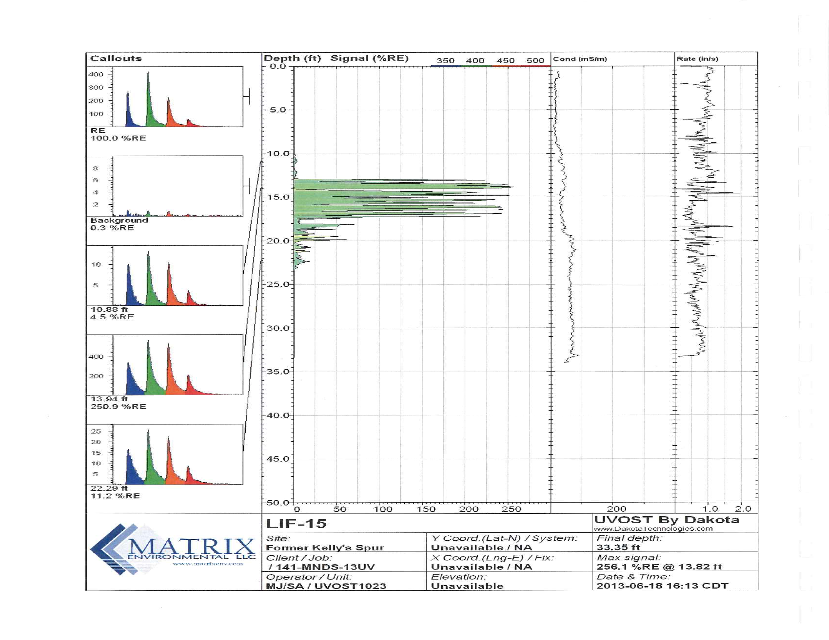
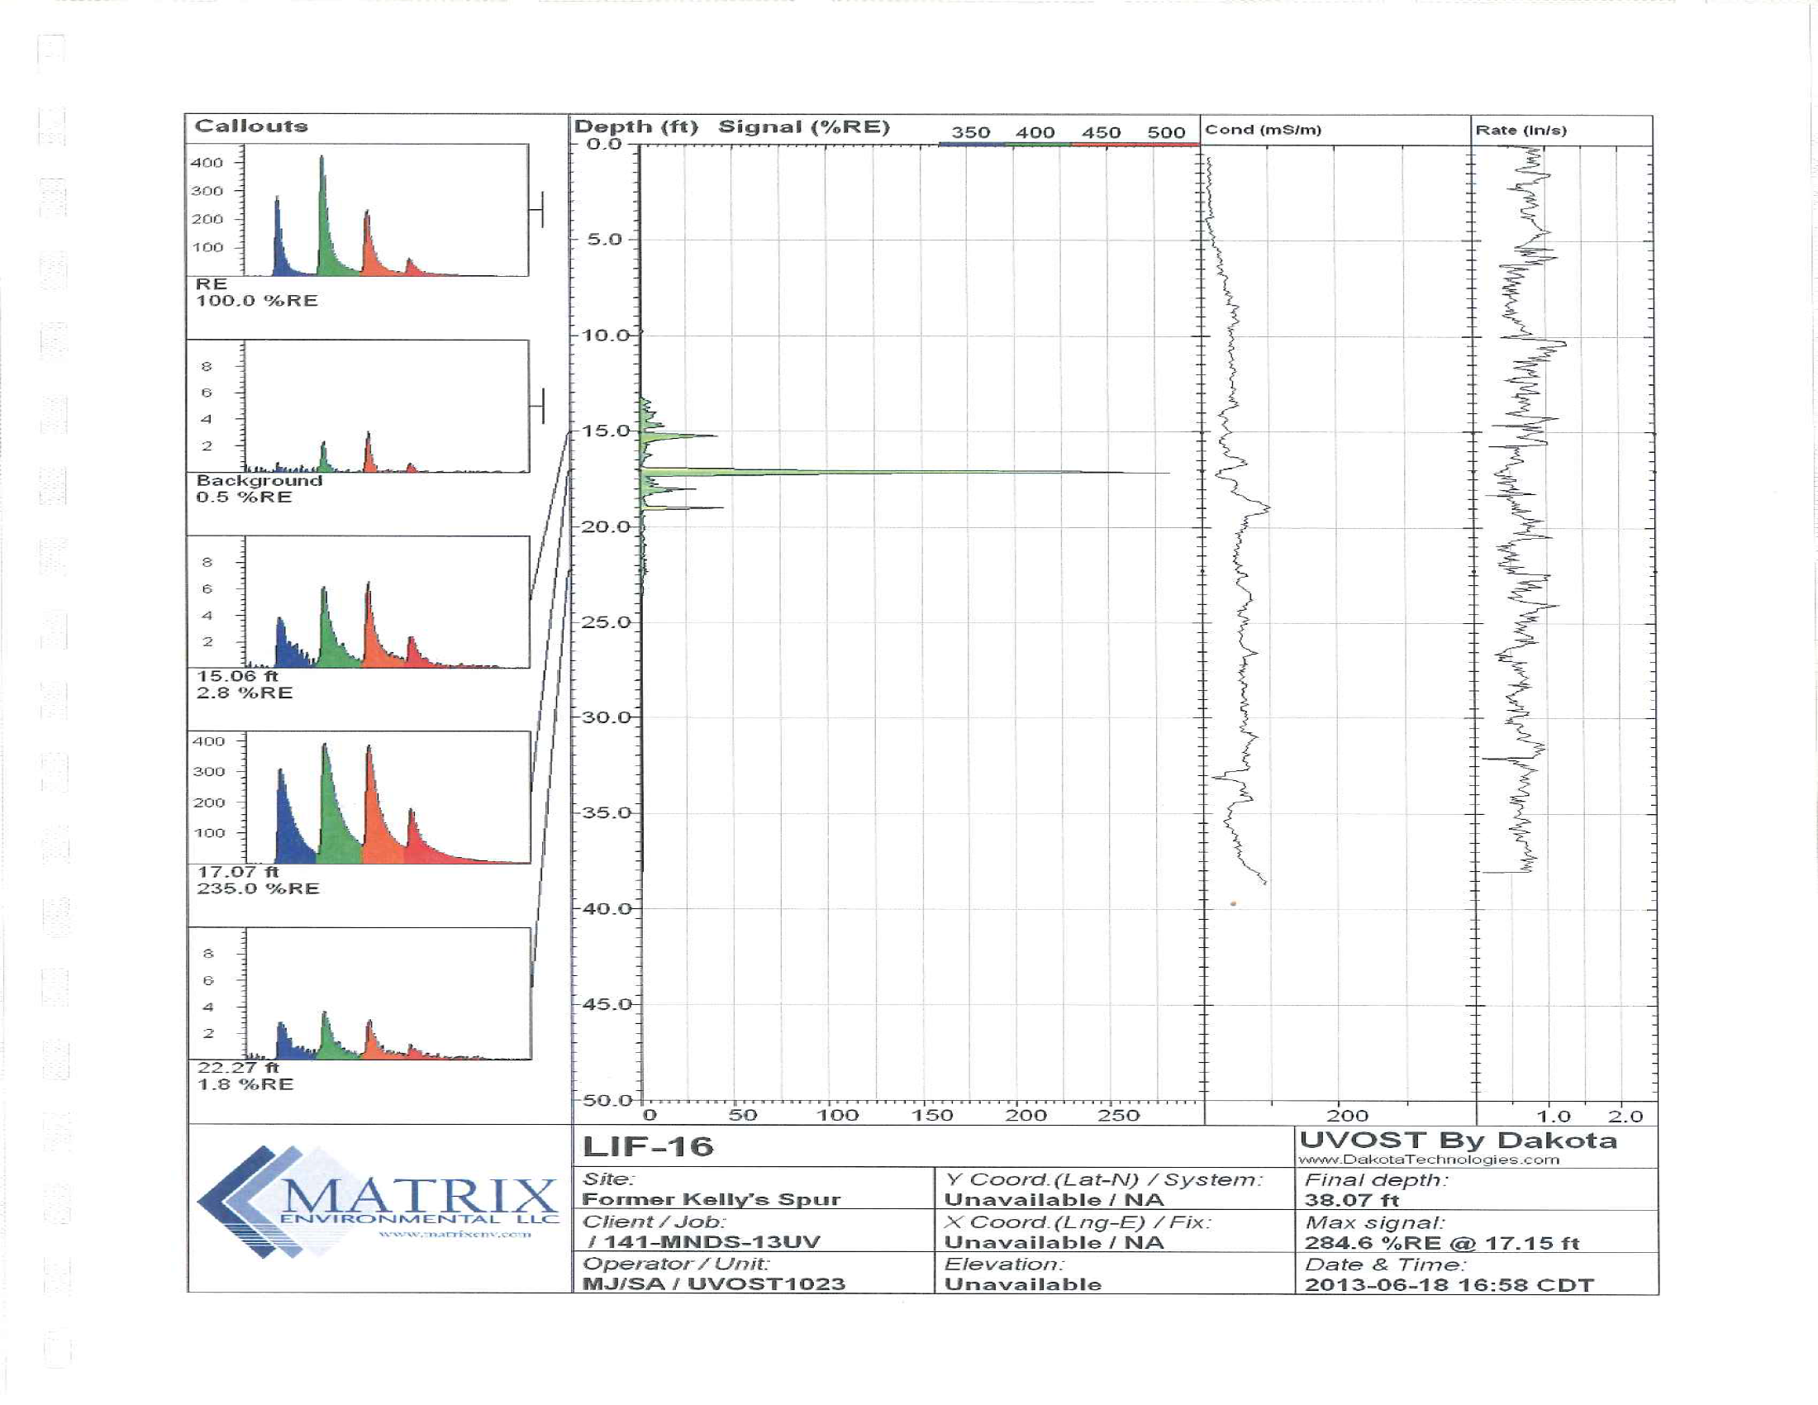
Amplitude “Bulls Eye”
(Water Table LNAPL Accumulation)
LIF-15
LIF-16
Maximum Fluorescence
Responses
Notes:
Two LIF borings are from center (orange “bull’s-eye”) of the amplitude map
Both show water table expressions of LNAPL, but
Reflect very different implications regarding in-place LNAPL volume, mobility, and potential remedial recovery (i.e., LNAPL thickness matters).
Note green fluorescence response coloration is due to spectral response

Slide 20
Recon: “Meaningful” LNAPL Signal
(Confined LNAPL Beneath Roadway)
LIF Bias - discriminates robust signal:
Likely >LNAPL sats.
Eliminates noise
Look to correlate w/well accumulations
LIF-3
OW-7
(nearby/contains LNAPL)
Base confinement
Max. Response
Again, max response does not discriminate LNAPL thickness
Fluorescence
Bias (25% RE)
EC Response – Soil Discriminator
Finer Grained Soils →
Notes:
Illustrates LNAPL accumulation below the water table
Confined by overlying tighter soils
LIF thickness > bias was used to map LNAPL formation thicknesses across site.
Illustrates first step in interpretation; initially review (recon) all the boring logs to assess meaningful LIF signal.
For example, comparing response from 20-22’ interval (>25 %RE bias) to 27.5’ (<<bias) likely reflects qualitative differences in overall LNAPL saturations.
Note: LIF responses are not a quantitative measure of overall LNAPL saturation and do not discriminate the mobile fraction; nevertheless the signal may qualitatively reflect overall saturations.

Slide 21
Soil Interpretation
25% RE
smear zone
Base 1st Confining
Sieve Calibration: ML (64% fines)
SM
Top 2nd Confining
ML
Correlation Markers (3)
LIF-3
Conductivity
Bias (~70 mS/m)
Notes:
Illustrates use of conductivity bias to interpret soil type
Sieve sample result from about 25 bgs feet helps “calibrate” curve.

Slide 22
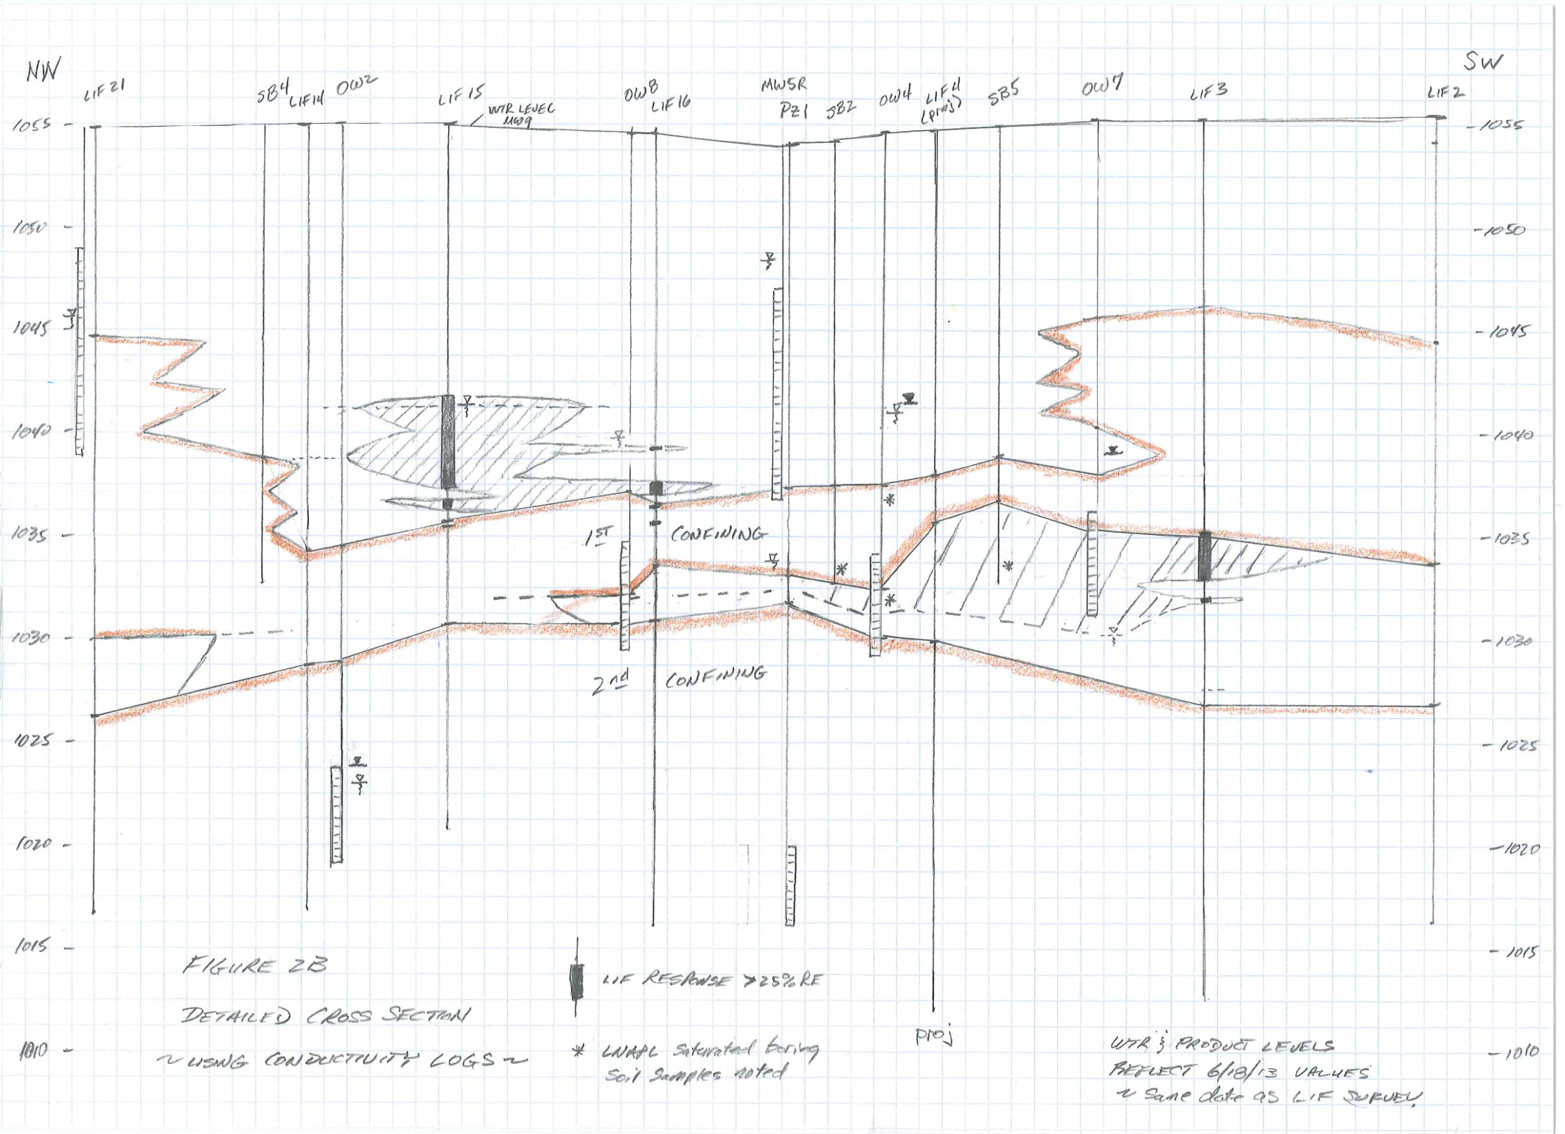
Confirmed LNAPL Accumulation
Slide 19
Well & borings that intersect confined LNAPL
*
1st Confining Layer
*
*
*
LIF-15
2nd Confining Layer
LIF-14
Previous
Slide
OW-2
*
Notes:
Source area cross section llustrates
Continuous confining ML layers (brown colored)
Uncolored layers contain mixtures of sands, SM, and discontinuous ML
Note: Confined LNAPL is present in OW2
no nearby survey log fluorescence response (LIF-14 or LIF-15) only 5-10’ away
Consequently, OW-2 well “accumulation” was de-emphasized in regards to remedy – little to no formation LNAPL volume.

Slide 23
LIF 16
Slide 25
?
?
?
?
?
Consultant Indicated
Residual LNAPL Volume
Notes:
Same cross section with consultant’s indication of LNAPL distribution
perceived deeper accumulations was the main focus for additional active treatment funding
next slide shows LIF 16

Slide 24
LIF-16
Base 1st Confining
SM
Top 2nd Confining
Fluorescence
Bias (25% RE)
ML
Conductivity
Bias (~70 mS/m)
no response
Notes:
Not just low, but no response indicates no LNAPL in formation
lack of any deeper LIF response resulted in decision not to fund additional active DPE removal or expansion of the system
Already treated shallower LNAPL accumulations

Slide 25
Predominant Soils – Beneath 1st Confining
(EC-based Interpretation)
Bldg.
Site 2:
Improved GW Flow Interpretation:
Regional GW Flow
LIF Borings
Explained local, lateral flow deviation from regional
Focused risk on potable wells to the NW
Recognized previously sampled potable wells (clean) were too close
SM
ML
SW
X
X
X
ML
0
40’
1040
1045
Confined LNAPL
(defined by LIF 3 & well/borings)
Notes:
Using EC-based soil distributions helped explain local GW flow divergence from regional
Potable well production zones at approx. 100’ bgs
NW downward trajectory for diving plume suggests nearby sampled potable wells were effectively “too close” (i.e., effectively up- or side-gradient)
Suggested additional potable sampling to the NW.

Slide 26
Site 2
Interpreted LIF Survey Results - Practical Implications
Did not approve funding for renewed DPE treatment or system expansion
NA assessment showed significant post-treatment reductions, especially along the upper (water table) portion of plume (i.e., NSZD)
By elimination helped us focus on remaining risk pathways:
Expanded potable well sampling - NW and downgradient
VI risk, not related to the LIF-defined LNAPL
Notes:
With suggestion of no additional active treatment focus fell to
NA assessement
Expanded potable well sampling to NW
VI risk, not related to LIF-defined LNAPL

