Slide 1
Hazardous Waste
Import-Export Final Rule Requirements and Implementation
December 12, 2016

Slide 2
Agenda
Webinar Instructions (5 minutes)
Overview of Requirements (70 minutes)
  Exports
  Imports
Health Break (10 minutes)
Demo of EPA’s Waste Import Export Tracking System (WIETS) and Central Data Exchange (CDX) (85 minutes)
Converting to Electronic Border Process for Export Shipments (5 minutes)
Next Steps (5 minutes)

Slide 3
Export Requirements for Shipments under New Regulation (i.e., w/o Current Consent)
Exports of hazardous waste under RCRA Parts 262, 266 and 273 under new regulation w/o consent
  OECD requirements
  EPA ID numbers
  Consent numbers on manifest
  Phase in of electronic process at the border
  Electronic submittal of export notices using CDX and WIETS
Exports of CRTs under Part 261
  Phase in of electronic process at the border
  Electronic submittal of export notices using CDX and WIETS
Export of hazardous waste samples over 25 kg

Slide 4
Where to Find Export Requirements
40 CFR 262.83:
  general export requirements
  notification requirements
  RCRA manifest instructions for export shipments
  international movement document requirements for export shipments
  the exporter’s duty to return or re-export (to a third country) export shipments of waste that cannot be managed in accordance with the terms of the contract or consent and cannot be managed at an alternate facility in the country of import
  contract requirements
  annual reporting requirements
  exception reporting requirements
  recordkeeping requirements

Slide 5
Export Process for Exports under New Regulation
(i.e., for Shipments w/o Current Consent)
https://www.epa.gov/sites/production/files/2016-11/documents/final_20161104_flowchart_for_subpart_h_exports.pdf

Slide 6
Questions?

Slide 7
Requirements for Export Shipments with Consent Issued Prior to 12/31/16
Export shipments comply with requirements listed in Acknowledgement of Consent (AOC) letter plus two new requirements
  Converting to electronic process at the border
  Listing waste stream consent numbers on RCRA manifests
https://www.epa.gov/hwgenerators/resource-conservation-and-recovery-act-rcra-requirements-previously-consented-exports

Slide 8
What is Happening to Export Notices Now
Paper export notices submitted already are being processed; most are still being reviewed by country of import
  EPA has reached out to the countries asking them to process consent by 12/30/16 if at all possible
EPA is no longer accepting paper export notices, as it is impossible to receive consent prior to 12/31/16
Any paper notice that does not receive consent by 12/31/16 will have to be resubmitted electronically using WIETS with all information required in 40 CFR 262.83(b)

Slide 9
Questions?

Slide 10
Import Requirements for Shipments under New Regulation (i.e., w/o Current Consent)
Imports of hazardous waste under Parts 262, 266 and 273 w/o consent
  OECD requirements
  EPA ID numbers
  Consent numbers on manifest
Import of hazardous waste samples over 25 kg

Slide 11
Where to Find Import Requirements
40 CFR 262.84:
  general import requirements
  notification requirements when country of export does not control as hazardous waste export
  RCRA manifest instructions for import shipments
  international movement document requirements for import shipments
  the importer’s duty to return or export (to a third country) import shipments of waste that cannot be managed in accordance with the terms of the contract or consent and cannot be managed at an alternate facility in the US
  contract requirements
  Confirmation of recovery or disposal
  recordkeeping requirements

Slide 12
Import Process for Imports under New Regulation
(i.e., for Shipments w/o Current Consent)
https://www.epa.gov/sites/production/files/2016-11/documents/final_20161104_flowchart_for_subpart_h_imports.pdf

Slide 13
Questions?

Slide 14
Requirements for Import Shipments with Consent Issued Prior to 12/31/16
Import shipments comply with requirements in force when consent documentation sent to receiving facility plus one new requirement
  Listing waste stream consent numbers on RCRA manifests
https://www.epa.gov/hwgenerators/resource-conservation-and-recovery-act-rcra-requirements-previously-consented-imports

Slide 15
What is Happening to Import Notices Now
Import notices submitted by other countries are being processed
Consent will be required for all import shipments of hazardous waste or hazardous waste samples over 25 kg that occur on or after 12/31/16
Companies currently importing hazardous waste without consent (e.g., from maquiladora facilities in Mexico) should submit paper import notice to EPA listing all information required in 40 CFR 262.84(b) as soon as possible
EPA will soon be testing electronic import notices in WIETS

Slide 16
Questions?

Slide 17
Health Break
(10 minutes)

Slide 18
Demo of EPA’s Waste Import Export Tracking System (WIETS) and Central Data Exchange (CDX)

Slide 19
Intro
Today we will go over:
What are WIETS and CDX
Different User Types for WIETS
CDX Registration
Using WIETS

Slide 20
About WIETS and CDX
WIETS is the United States Environmental Protection Agency (EPA) Waste Import/Export Tracking System responsible for managing hazardous waste notice and reporting data. EPA has extended use of WIETS by hazardous waste importers and exporters to include electronic submission and signature of hazardous waste notices and annual reports. Exporters shipping hazardous waste internationally must use WIETS to electronically submit notices, and may use WIETS to electronically submit annual reports to EPA. Importers submitting notices when the country of origin does not control the shipments as hazardous waste exports will be required to use WIETS to electronically submit notices to EPA at a future date. WIETS is not used for tracking of internal domestic shipments.
CDX is the point of entry on the Environmental Information Exchange Network (Exchange Network) for environmental data submissions to the Agency. Its use is supported by the Cross-Media Electronic Reporting Rule (CROMERR) which provides the legal framework for electronic reporting under all of EPA's environmental regulations.

Slide 21
Different Types of Users
Notice Preparers – Preparers are hazardous waste industry representatives that can enter notice and report data into WIETS but do not have the legal authority to sign or submit notices and reports to EPA. Preparers must be sponsored by a US hazardous waste industry representative with legal authority to sign the notices and reports and must assign a certifier to each notice/report for signature and submission to EPA.
Notice Certifiers – Certifiers are US hazardous waste industry representatives that legally sign off on the hazardous waste notice submissions. Along with being able to enter notice data, certifiers can provide electronic signatures for notices and reports and submit them to EPA.

Slide 22
Signing Up and CDX
Steps Include:
Creating an account in CDX
If you are a certifier and will be signing notices and reports, getting the account identity proofed for signing
Setting up sponsorships between other preparers/certifiers

Slide 23
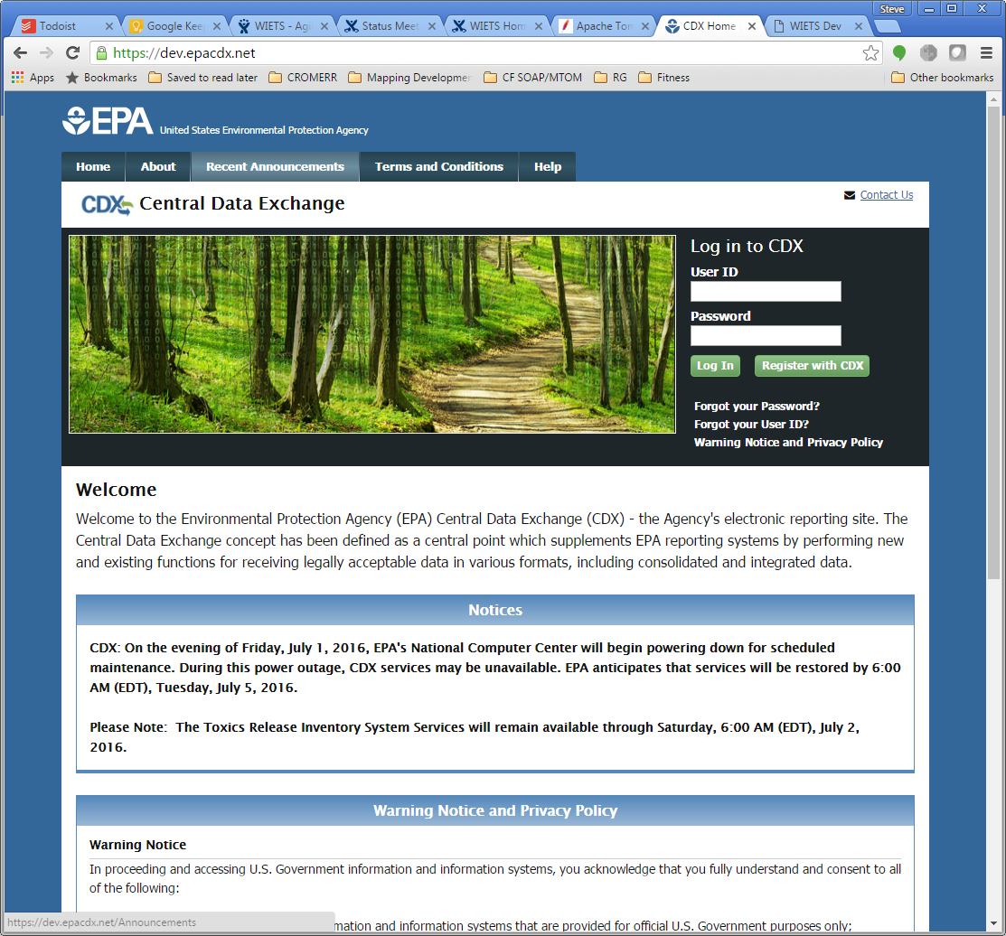
CDX Home Page
In production at https://cdx.epa.gov

Slide 24
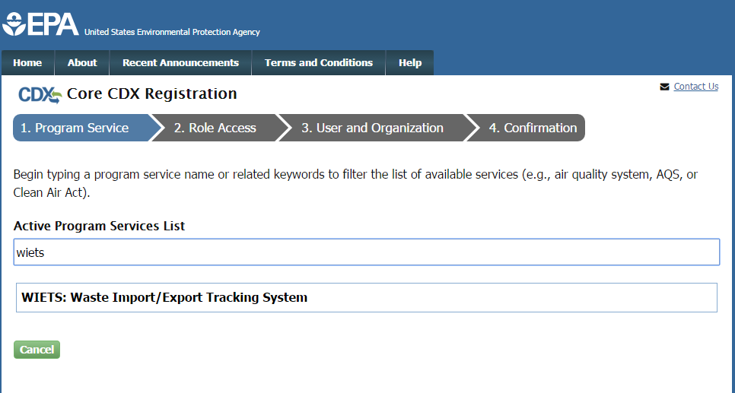
CDX Program Selection
When registering, choose “WIETS” as your program service

Slide 25
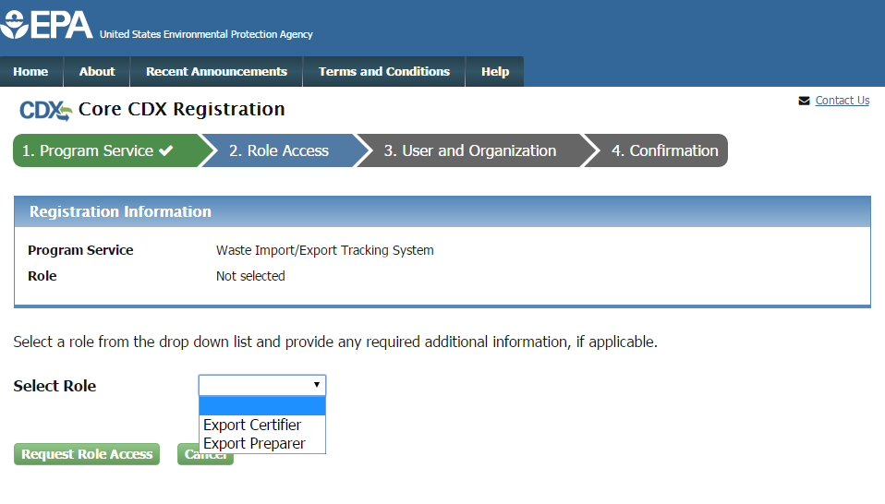
CDX Role Selection
If you will be signing and submitting notices to EPA, select Certifier as your role from the dropdown list. If you will be preparing notices on behalf of another signing entity, select Preparer. If you are not sure if you are a preparer or certifier, please refer to the WIETS User Roles section above.

Slide 26
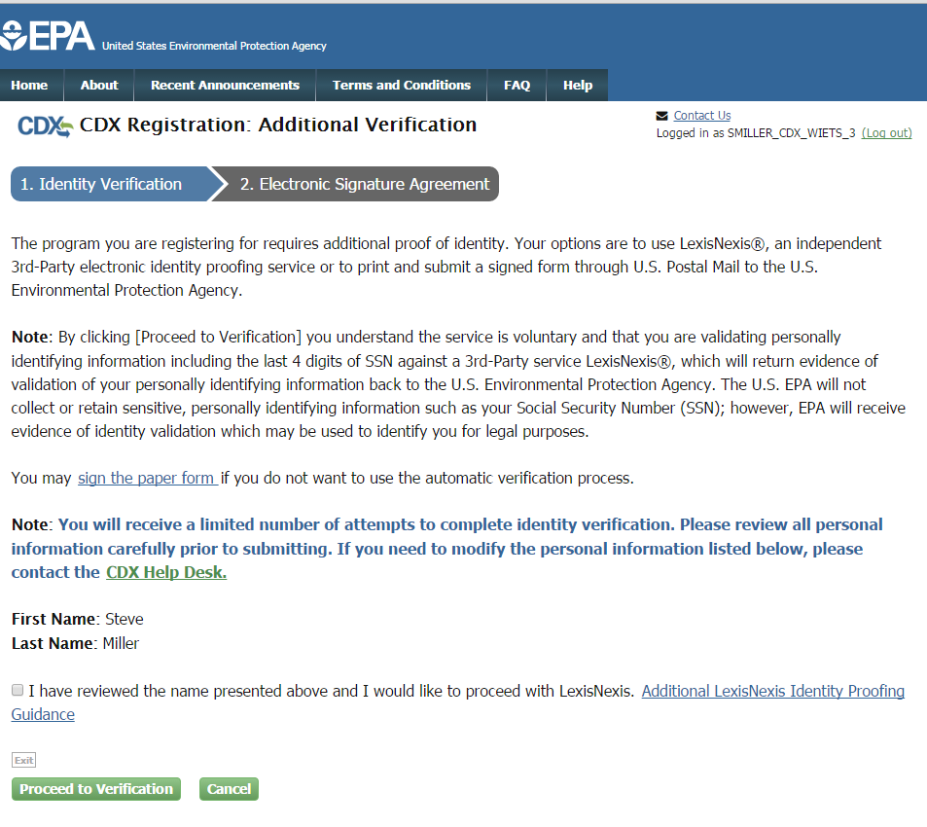
CDX Certifiers – Identity Proofing

Slide 27
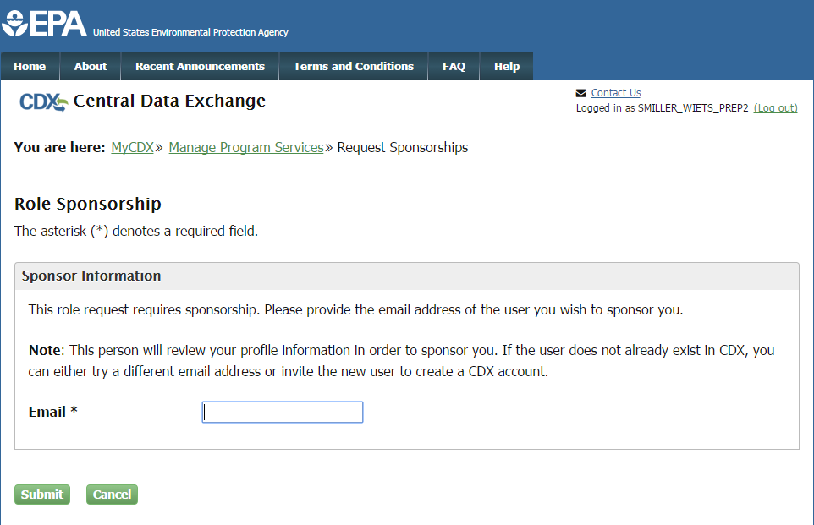
CDX Preparers – Email a Certifier

Slide 28
Questions?

Slide 29
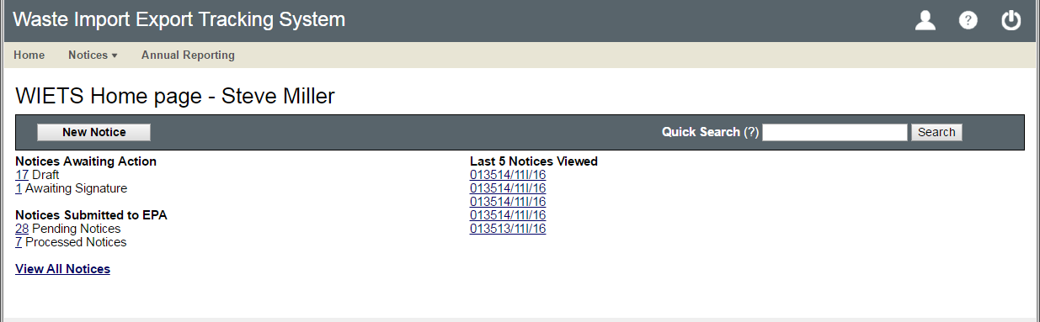
WIETS Home Page

Slide 30
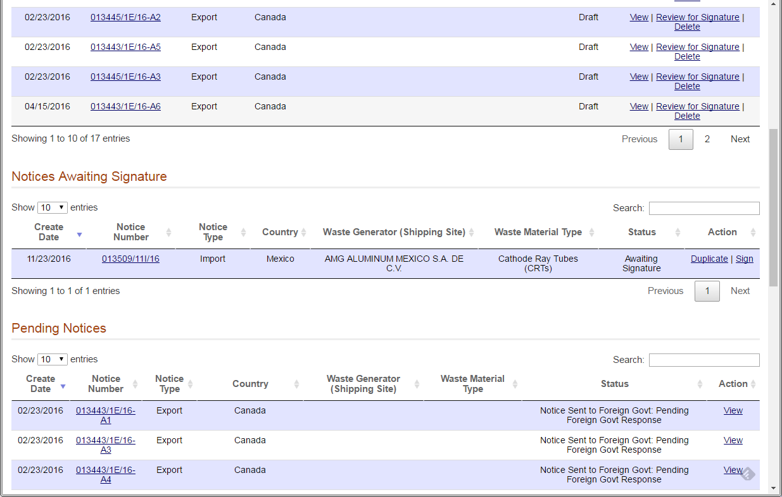
WIETS Notice Listings

Slide 31
WIETS Notice Lifecycle
Draft: While notice data is being entered into WIETS, the notice is in Draft status. Both preparers and certifiers can edit these notices. When all notice data is completed, preparers can assign a certifier to the notice for signature, and certifiers can continue to sign and submit the notice to EPA.
Awaiting Signature: These notices have been assigned a certifier and are awaiting review and signature for submission to EPA. Notices in this status are still editable. Once the notice is signed and submitted to EPA, the notice becomes read-only.
Pending: These notices have been signed and submitted to EPA, but no determination (consent or objection) has been made on the notices. These notices are read-only in WIETS.
Processed: These notices have been signed and submitted to EPA and a determination (consent or objection) has been made on the notice. These notices are read-only in WIETS.

Slide 32
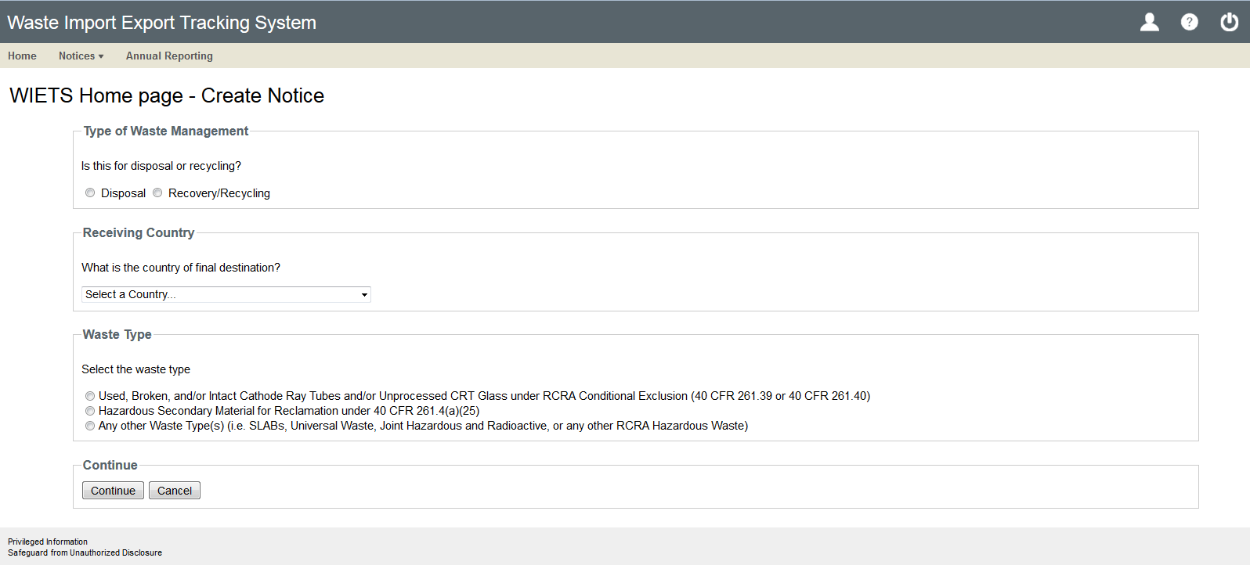
WIETS Notice Creation

Slide 33
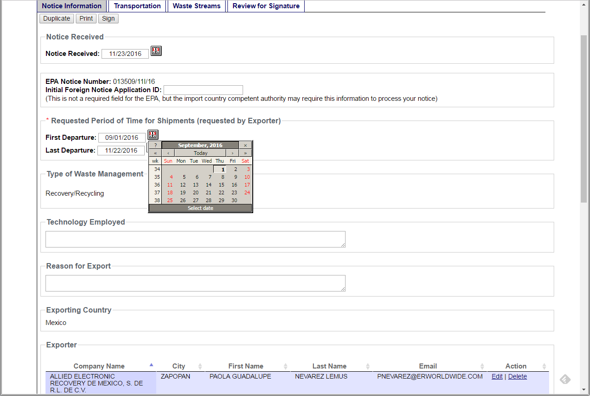
WIETS Notice Info Tab

Slide 34
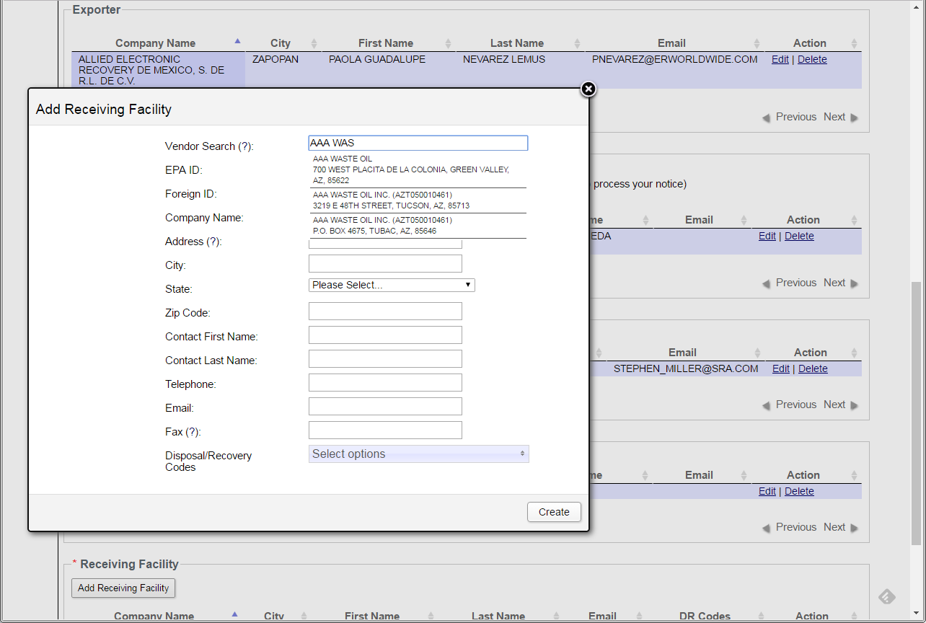
WIETS Contacts

Slide 35
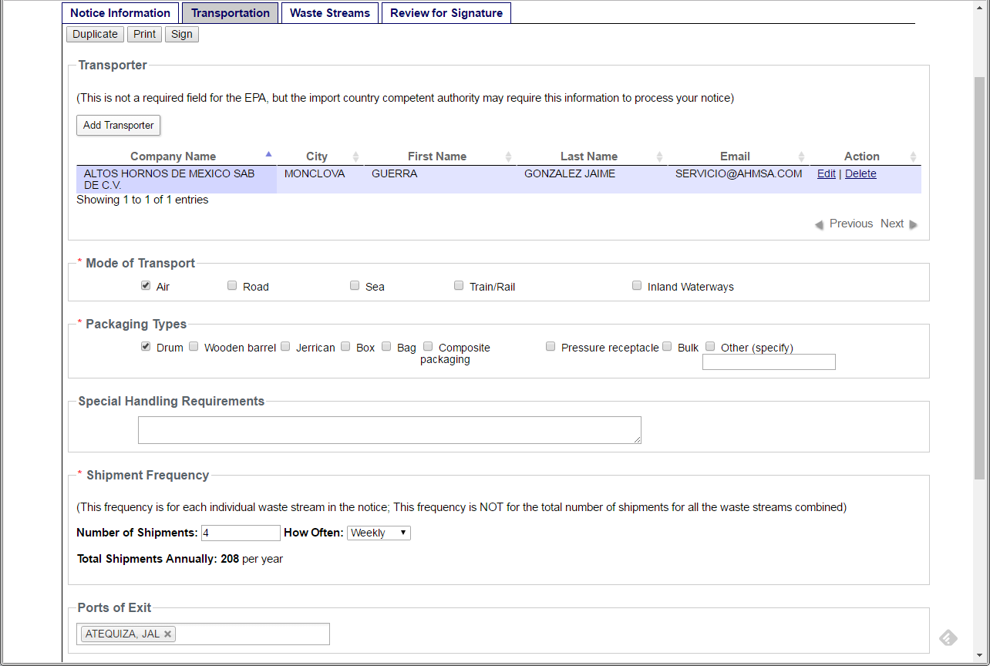
WIETS Transportation Tab

Slide 36
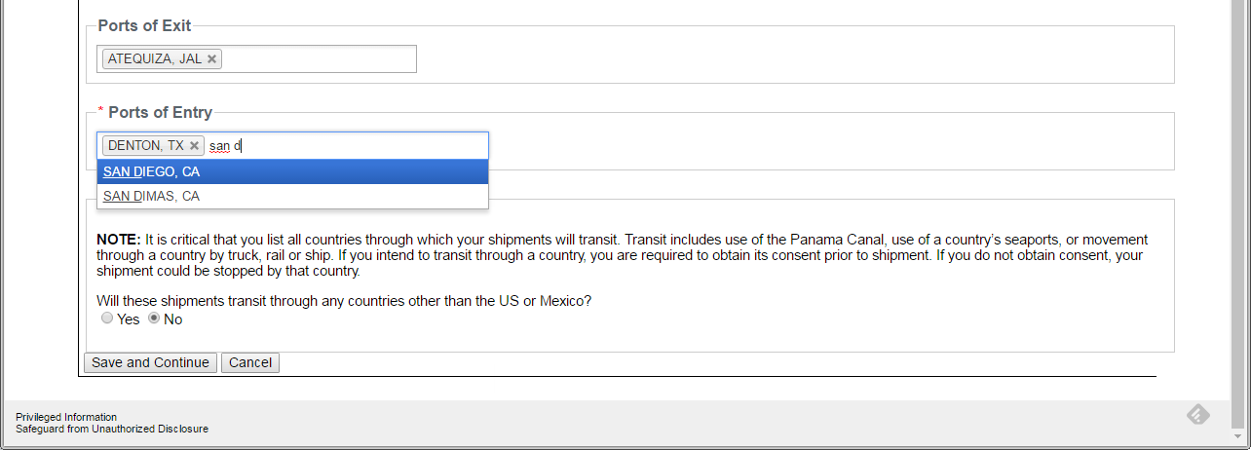
WIETS Ports

Slide 37
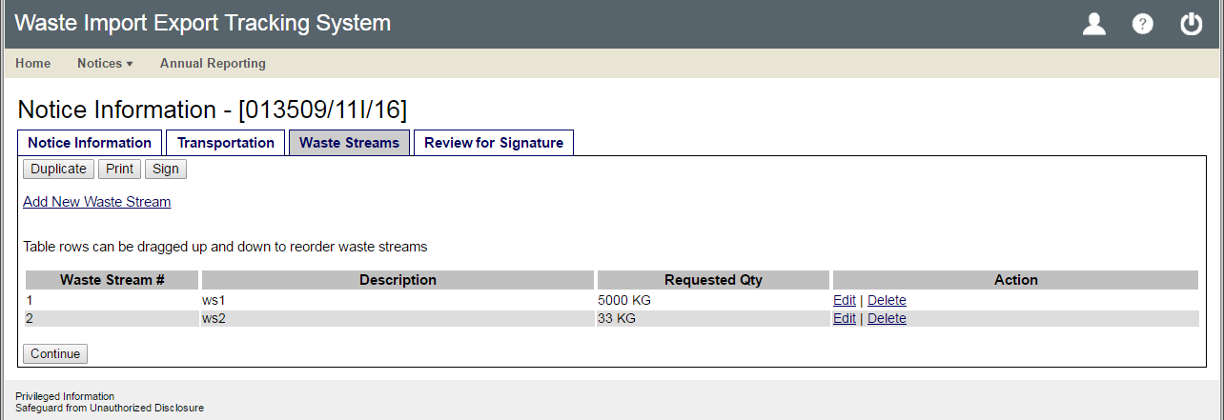
WIETS Waste Streams

Slide 38
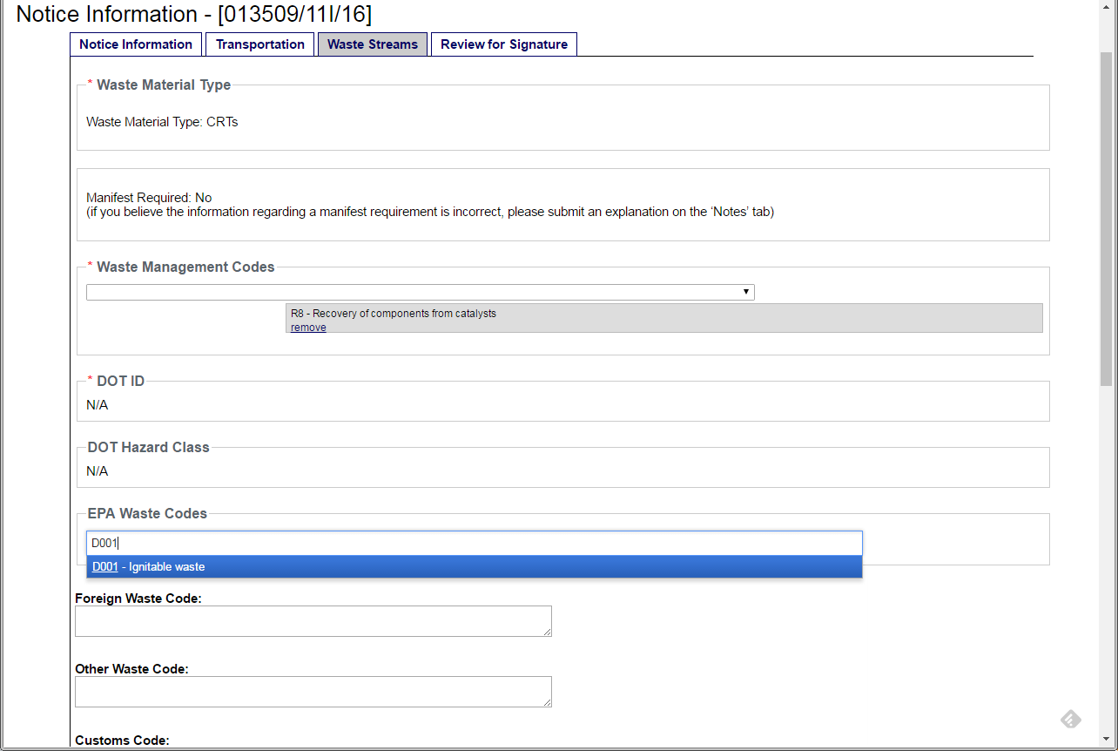
WIETS Waste Streams

Slide 39
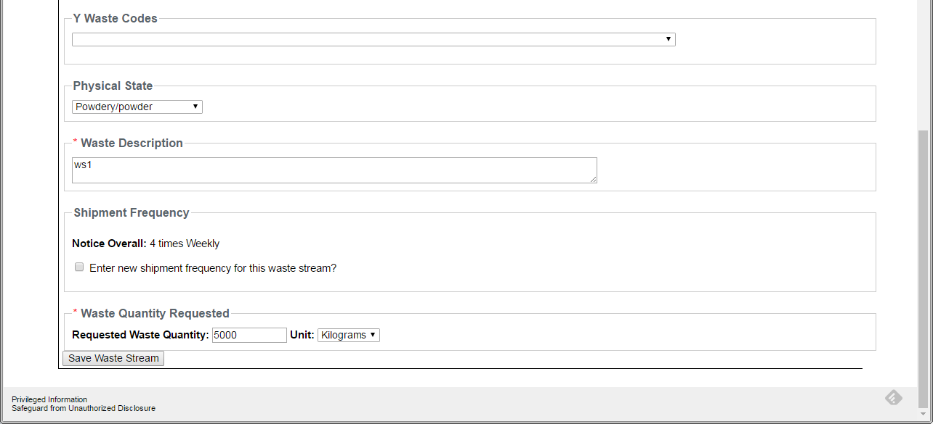
WIETS Waste Streams

Slide 40
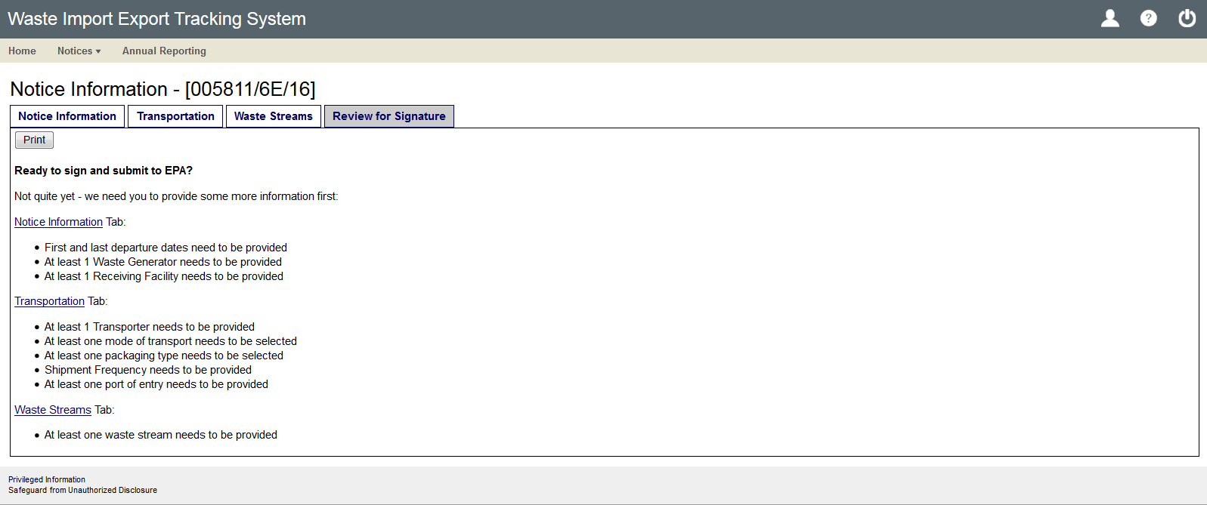
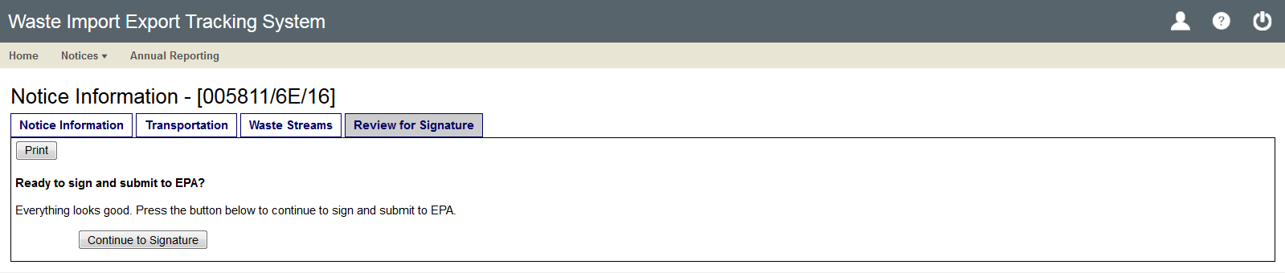
WIETS Review

Slide 41
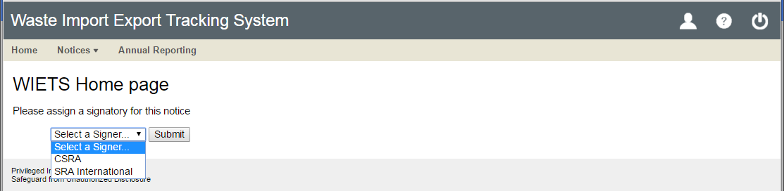
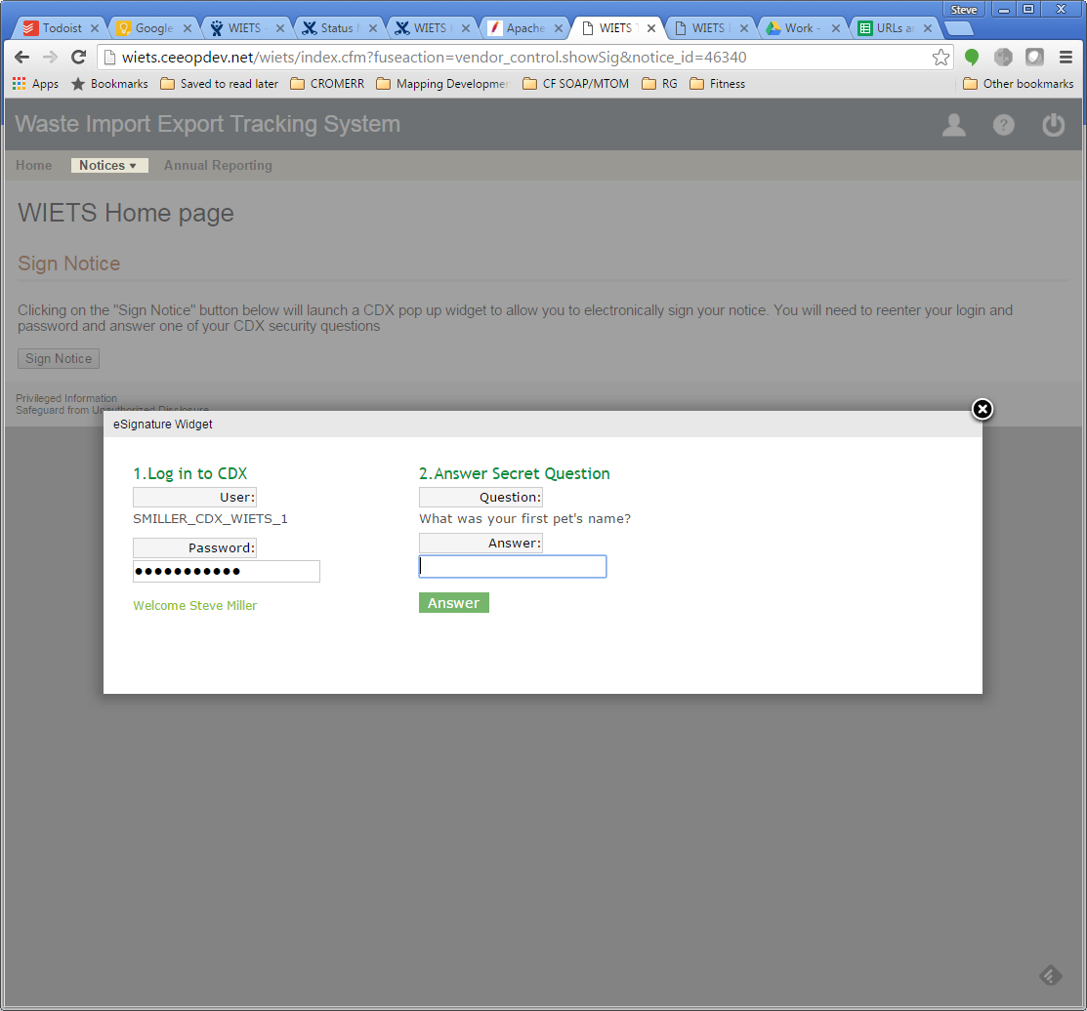
WIETS Signature

Slide 42
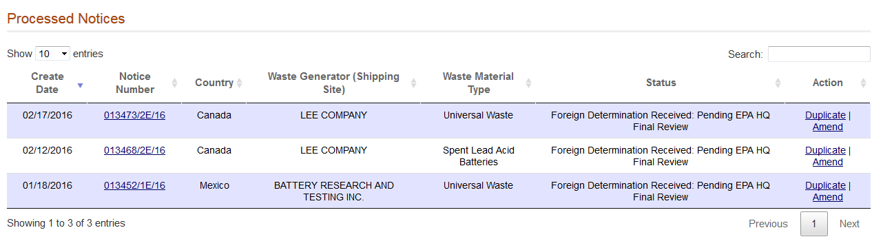
WIETS Amendments
Users can amend the following notice data:
Transporters
Ports of Exit and Entry
Shipment Frequency
Waste Stream EPA Codes
Waste Stream DOT IDs and Hazard Classes
Waste Stream Requested Quantity
Waste Stream Shipment Frequency

Slide 43
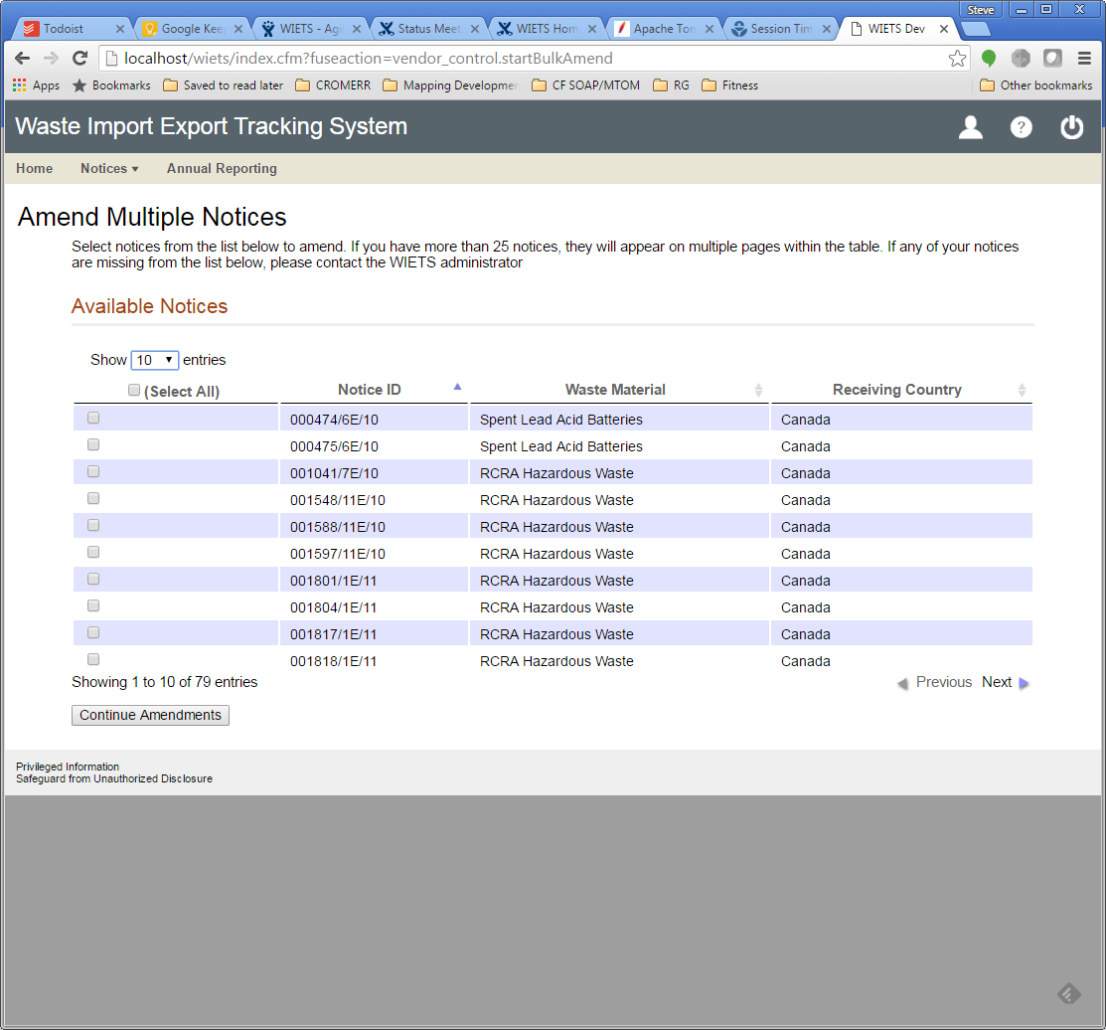
WIETS Amendments
Only Ports of Entry/Exit and Transporters can be amended through the Amend Multiple Notices interface.

Slide 44
Questions?

Slide 45
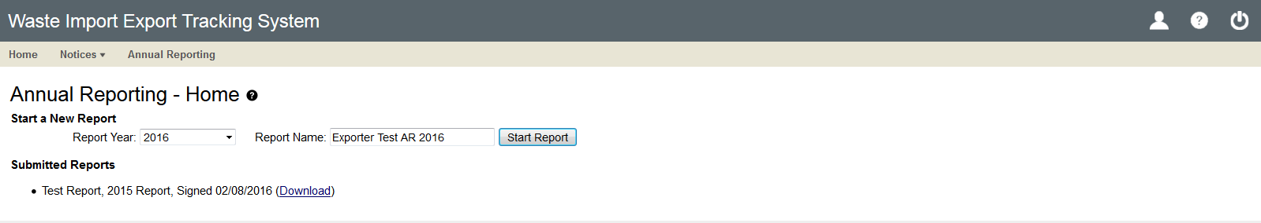
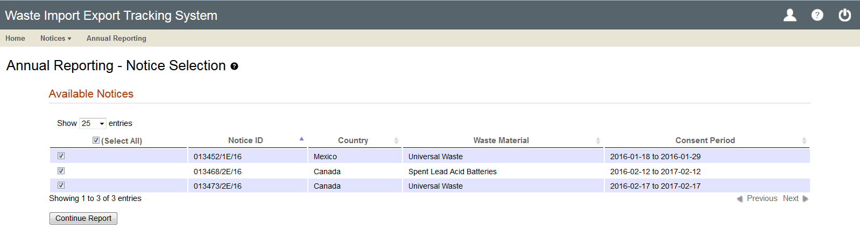
WIETS Annual Reporting

Slide 46
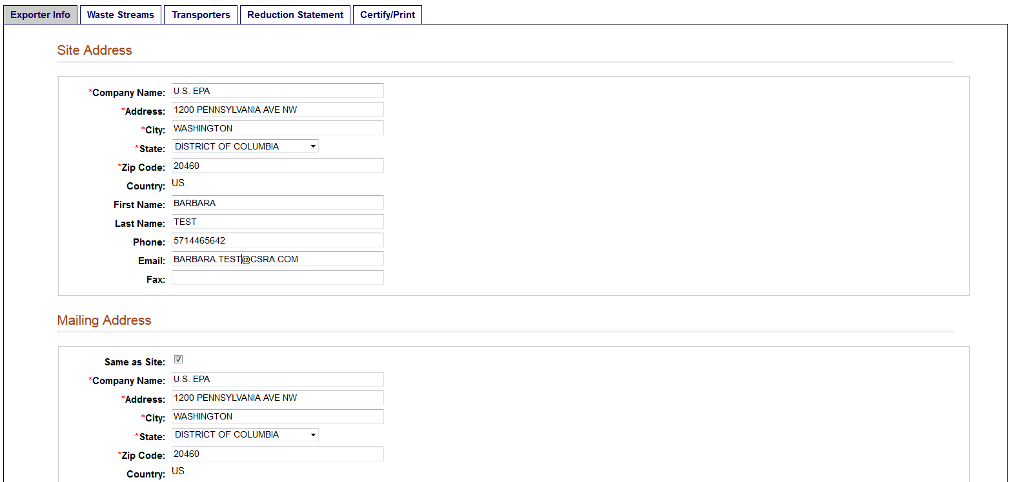
WIETS Report Contacts

Slide 47
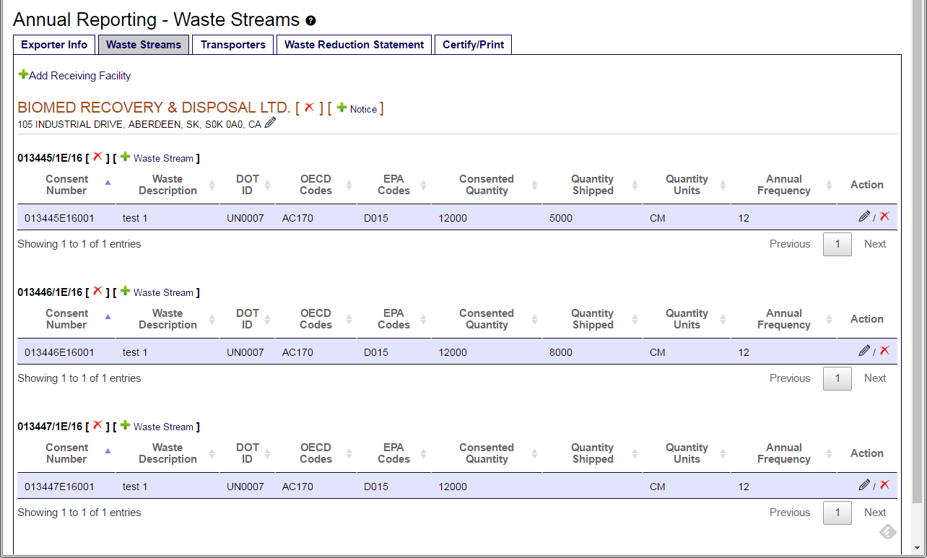
WIETS Report Waste Streams

Slide 48
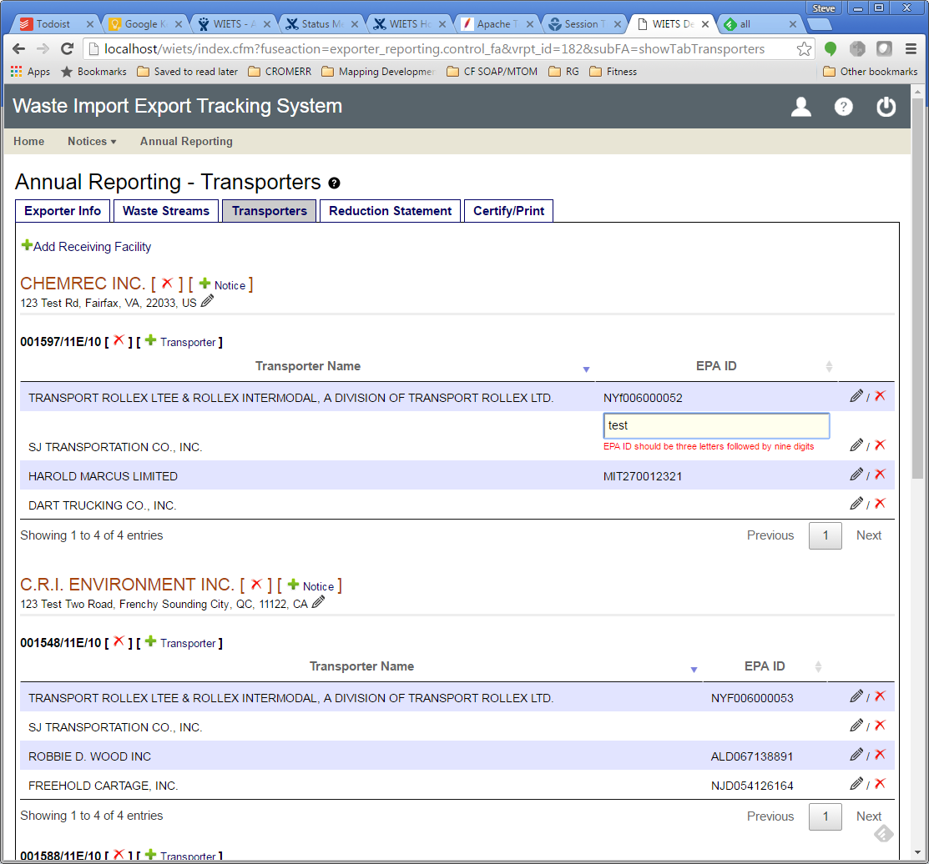
WIETS Report Transporters

Slide 49
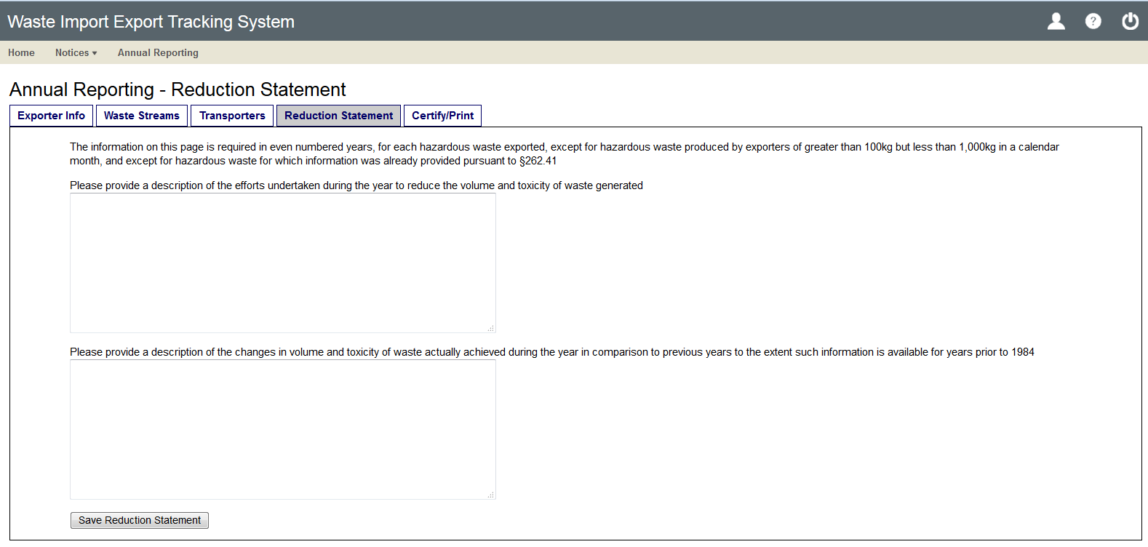
WIETS Report Waste Reduction

Slide 50
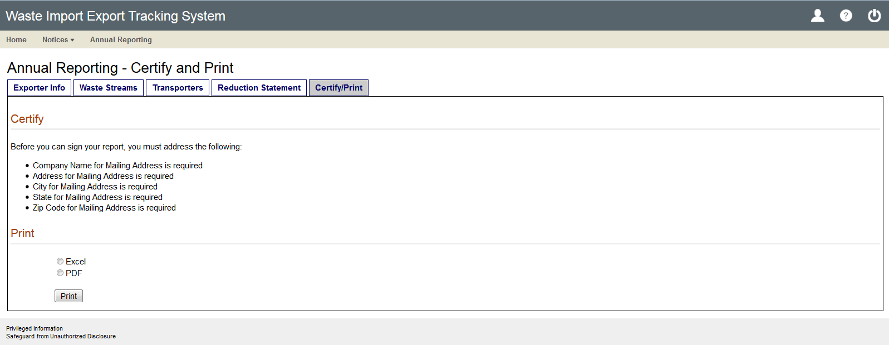
WIETS Report Certify and Print

Slide 51
Questions?

Slide 52
Converting to Electronic Border Process for Export Shipments
Automated Export System (AES) run by U.S. Customs and Border Protection
Successful validations of consent along U.S.-Mexico border in 2015 and 2016
More information at https://www.cbp.gov/trade/aes
January 18, 2017 webinar on AES filing of consent data for exporters and their authorized Electronic Export Information filers

Slide 53
Next Steps
Need for Additional 2017 Webinars?
Where to find more information and register for future webinars
Feedback on this webinar
For Exporters? | For Importers?
For Transporters? | For Receiving Facilities?
For SLAB imports and exports? | For universal waste imports and exports?

Slide 54
More Questions?
Check the Frequent Questions list at https://www.epa.gov/hwgenerators/frequent-questions-about-hazardous-waste-imports-and-exports to see if your question has been addressed
Email questions regarding the new regulations to Laura Coughlan at coughlan.laura@epa.gov
Email questions or comments about WIETS or CDX roles to the following administrators:
  Jana Tatum - Tatum.Jana@epa.gov (Notice Officer)
  Stephen Miller – Stephen.miller@csra.com (Technical Administrator)

Slide 55
Additional Rule Resources
Federal Register publication of final rule on November 28, 2016 at https://www.federalregister.gov/documents/2016/11/28/2016-27428/hazardous-waste-export-import-revisions
Information concerning the final rule at https://www.epa.gov/hwgenerators/final-rule-hazardous-waste-export-import-revisions
Overview of the new import and export requirements at https://www.epa.gov/hwgenerators/basic-information-resource-conservation-and-recovery-act-rcra-export-and-import
Two Frequently Asked Questions (FAQs) sections:
  https://www.epa.gov/hwgenerators/frequent-questions-about-hazardous-waste-export-import-revisions-final-rule
  https://www.epa.gov/hwgenerators/frequent-questions-about-hazardous-waste-imports-and-exports

