Slide 1
Toward Biomedical Research as a Digital Enterprise
Allen Dearry, Ph.D.
Director, Office of Scientific Information Management
National Institute of Environmental Health Sciences
National Institutes of Health
Superfund Research Program
June 24, 2015

Slide 2
The NIH Fire Hose Slide

Slide 3
Clinical Data Challenges
About the BD2K Program
Data Discovery Index Coordination Consortium
Data Sharing
Centers of Excellence for Big Data Computing
Initial FY 2014 funding of $32M.
Proposed investment of $656M through 2020.
Funded by ALL NIH Institutes and Centers.
Scientist Training Awards
Software and Tool Development
Data Science Courses
Database Sustainability
Open Educational Resources
Software Discovery and Sustainability
Community Based Standards

Slide 4
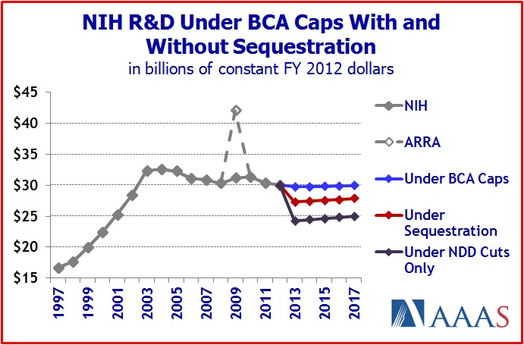
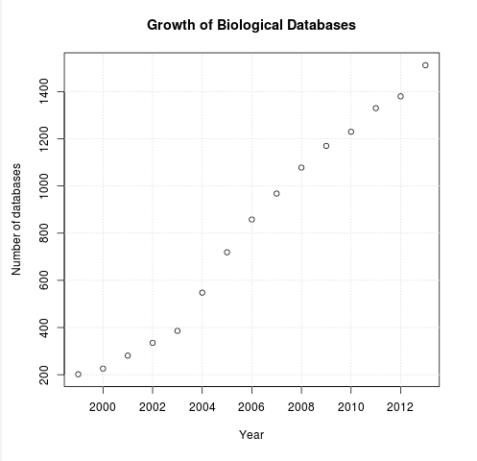
Sustainability 101
Source Michael Bell http://homepages.cs.ncl.ac.uk/m.j.bell1/blog/?p=830

Slide 5
Elements of The Digital Enterprise
Community
Policy
Sustainability
Collaboration
Training
Infrastructure

Slide 6
Policies – Now & Forthcoming
Data Sharing
Goal: legitimize data as a form of scholarship
Now: Genomic data sharing announced
Coming: Data sharing plans on all research awards
Data sharing plan enforcement
Machine readable plan
Repository requirements to include grant numbers
http://www.nih.gov/news/health/aug2014/od-27.htm

Slide 7
Infrastructure - The Commons: Conceptual Framework
Research Objects
(with UIDs)
Discoverability
(Search & Find)
The Commons
Open APIs
Data and tools
Containers
Packaging software
Computing Platform(s)

Slide 8
Community – Training: Data Science Training Goals
Build an OPEN digital framework for data science training
NIH Data Science Workforce Development Center
Develop short-term training opportunities
Courses, educational resources, etc.
Develop the discipline of biomedical data science and support cross-training
OPEN courseware

Slide 9
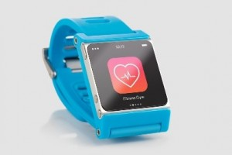
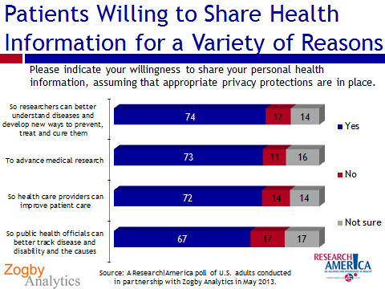
Alignment of Opportunities
Advances in Scientific Knowledge
Advances in Technology and Computing
Americans’ Growing Desire to Be Partners in Research

Slide 10
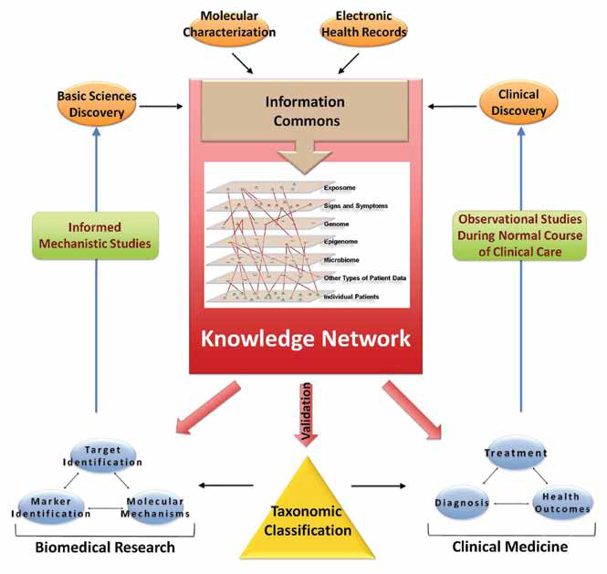

Slide 11
Precision Medicine Initiative: The Time Is Right
 | Ten Years Ago | Now – 2014 (most recent data)
Cost of sequencing a human genome | $22,000,000 | $1000 - $5000
Amount of Time to Sequence a Human Genome | 2 years | <1 day
Number of smart phones in the United States | 1 million (<2%) | 160 million (58%)
EMR Adoption, (% providers) | 20-30% | >90%
Computing Power | n | n x 16

Slide 12
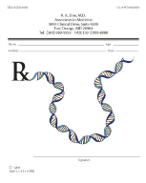
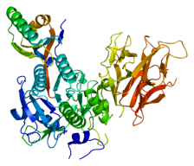
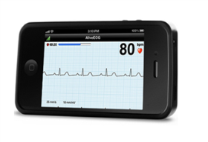
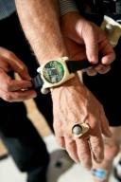
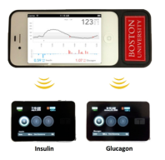
National Research Cohort: What Early Success Might Look Like
A real test of pharmacogenomics—right drug at the right dose for the right patient.
New therapeutic targets by identifying loss-of-function mutations protective against common diseases.
PCSK9 for cardiovascular disease
SLC30A8 for type 2 diabetes
Resilience – finding individuals who should be ill but are not.
New ways to evaluate mHealth technologies for prevention/management of chronic diseases.
Notes:
http://ghr.nlm.nih.gov/gene/PCSK9
The PCSK9 protein appears to control the number of low-density lipoprotein receptors. Loss-of-function mutations in the PCSK9 gene lead to an increase in the number of low-density lipoprotein receptors on the surface of liver cells. The extra receptors can remove low-density lipoproteins from the blood more quickly than usual, which decreases the amount of cholesterol circulating in the bloodstream. Studies suggest that people with reduced cholesterol levels caused by PCSK9 mutations have a significantly lower-than-average risk of developing heart disease.
Researchers suspect that normal changes (polymorphisms) in the PCSK9 gene are responsible for some of the variation in blood cholesterol levels among people without inherited cholesterol disorders. In particular, scientists are working to determine which polymorphisms are associated with relatively low levels of cholesterol in the blood and a reduced risk of heart disease.
http://ghr.nlm.nih.gov/gene/SLC30A8
Encodes a zinc transporter, mostly expressed in the pancreas. Specific variants are associated with a reduction in the risk for type 2 diabetes.
Individuals who have three known genes for early onset familial Alzheimer’s and yet don’t express the disease.

Slide 13
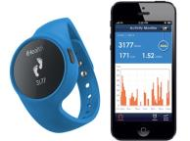
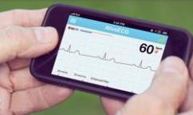
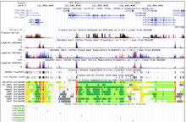
Partnerships
EHRs
Technologies
Genomics
Data Science

Slide 14
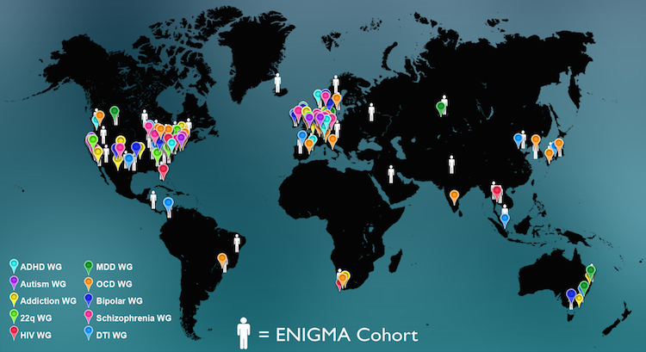
Consider an example…
Enigma Consortium
Researchers in imaging, genomics, neurology and psychiatry, to understand brain structure and function, based on MRI, DTI, fMRI, genetic data, and many patient populations.
http://enigma.ini.usc.edu/about-2/

Slide 15
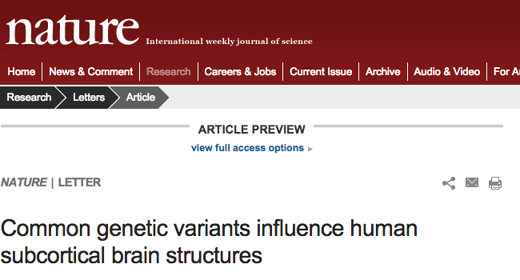
Big Data: MRI images & GWAS data from over 30,000 people.
Collaboration: Data came from 190 worldwide sites across 33 countries.
Methods: To homogenize data from different sites, the group designed standardized protocols for image analysis, quality assessment, genetic imputation, and association.
(Nature, 2015)
Found five novel genetic variants influencing volume of brain regions.
Results provided insight into the variability of brain development, and may be applied to mechanisms of neuropsychiatric dysfunction.

Slide 16
Community – Enigma, BD2K, crowdsourcing
Policy
Improved consent methods
Cloud accessibility for human subjects data
Trusted partners
Data sharing
Infrastructure
Standards, compute resources, software

Slide 17
National Institute of
Environmental Health Sciences (1/2)
Establish Office of Scientific Information Management.
Data standards
Development of a framework for EHS vocabulary.
2013 and 2014 workshops.
Ongoing interest group.
Lead trans-NIH BD2K initiative on Community-based standards for data and metadata. FY16 FOA.
Training
Lead trans-NIH BD2K K01 (individual training).
Lead trans-NIH BD2K training coordinating center.
Sustainability
Lead trans-NIH BD2K sustainability initiative on sustainability of data repositories.

Slide 18
National Institute of Environmental Health Sciences (2/2)
Data access, reuse, and interoperability
Challenges (crowdsourcing)
With EPA challenge to produce device to measure atmospheric pollutants and biologic response (2013).
Toxicogenomics challenge with NTP/NIEHS, UNC, and Sage/DREAM to predict response to a given chemical based upon individual genetic susceptibility (2014).
With HHS to generate visualization tool to demonstrate impact of climate change on health risk (2016).
Research Data Alliance Interest Group, Toxicogenomics Databases Interoperability.
CHEAR data science center.
Leadership and coordination
Trans-NIH, BD2K
Interagency Big Data Senior Steering Group

Slide 19
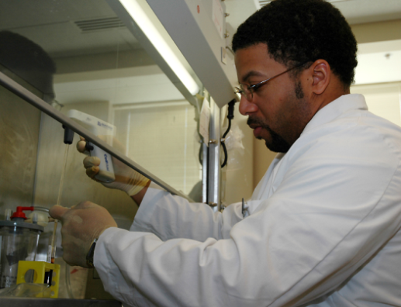
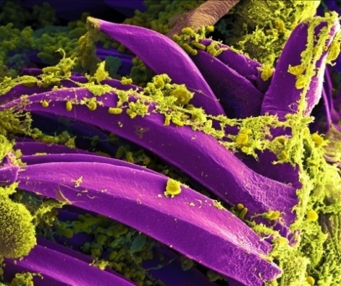
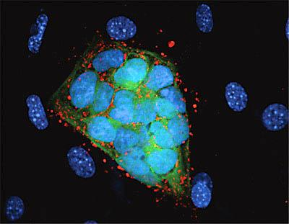
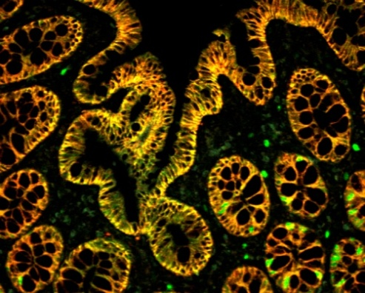
dearry@niehs.nih.gov
datascience.nih.gov
NIH…
Turning Discovery Into Health

