Slide 1

The Metals Exposure Study in Homes (MESH):
Examining children’s exposure to metals near the Iron King Superfund Site.
Miranda Loh, Paloma Beamer (College of Public Health)
Walt Klimecki (College of Pharmacy)
University of Arizona

Slide 2
Acknowledgements
Study Participants
MESH Team
  Co-Investigators: Walt Klimecki, Paloma Beamer
  Study Coordinator: Nathan Lothrop
  Sampling and lab coordinator: Anastasia Sugeng
  Pediatrician: Melissa Cox
  SRP Translation Coordinator: Sarah Wilkinson
Field Staff
  Rose Eitemiller, Christina Brooks, Kim Nathe, Robin Yonker
Arizona Laboratory for Emerging Contaminants (ALEC):
  Mary Kay Amistadi & Leif Abrell
Statistics Consulting Laboratory at the BIO5 Institute:
  Dean Billheimer and Isaac Jenkins
Undergraduate Assistants
  Ariana Munoz, Abigail Pena, Maria Ojeda, Sara Penquite, Stephanie Ruehl
NIEHS Superfund Research Program (Grant #P42 ES04940)

Slide 3
Today’s Presentation
Background – Iron King Site
Study objectives
Methods
Results
Discussion

Slide 4
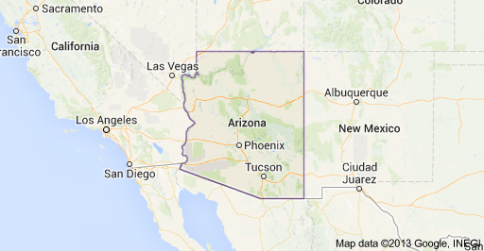
Study Site
Iron King Mine

Slide 5
Iron King Mine
The Iron King mine and Humboldt smelter operational from late 1880s/early 1900s to late 1960s
Copper, lead, zinc, gold and silver were extracted from mine and processed at smelter
Millions of square feet of left-over materials and by-products at mine and smelter
Several areas with exceptionally high concentrations of lead and arsenic in the tailings
Previous measurements found levels of aluminum, arsenic, beryllium, cadmium, chromium, nickel and lead that exceeded screening levels

Slide 6
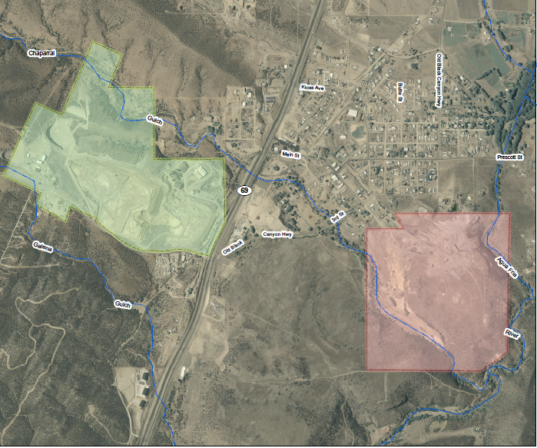
IRON KING
MINE
HUMBOLDT
SMELTER

Slide 7
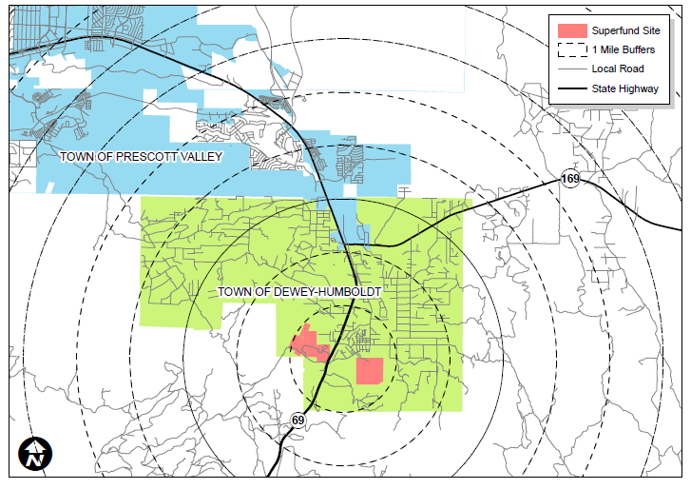
Study Area
M
5
4
3
2
1
S
1
Notes:
5 miles encompasses all of DH and the bottom of PV

Slide 8
What is MESH trying to do?
What levels of exposure to metals do residents in the area surrounding the site have?
  Especially interested in children as they have behaviors that predispose them to higher exposures and tend to intake more per unit body weight than adults – also still developing
What are the exposure pathways?
Could these exposures be coming from the site?
  How do they compare to general population levels?
  Are there any markers that we can compare to the site?

Slide 9
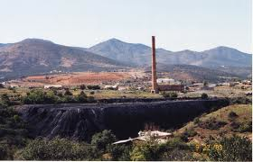
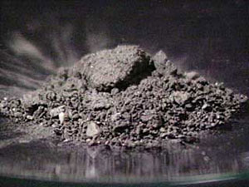
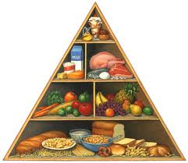
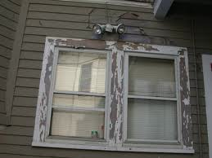




Potential Metal Sources
the earth
food and drink
$$?$$
Superfund Site
house paint
items used in hobbies/work
household items

Slide 10
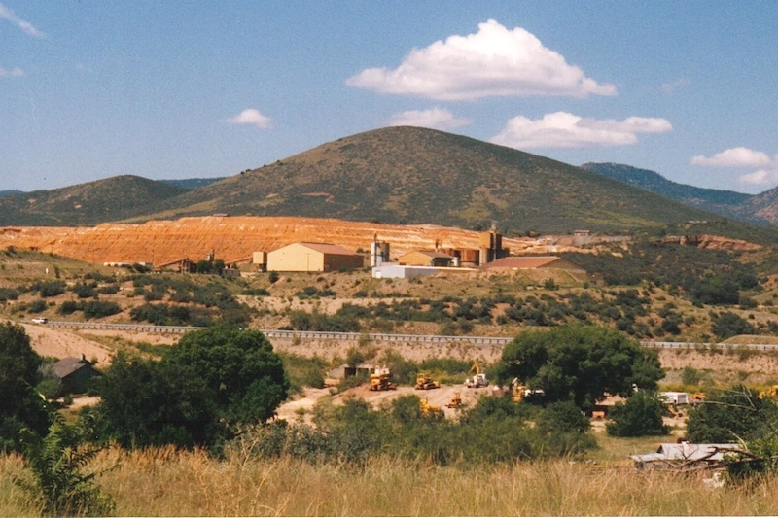
Methods

Slide 11
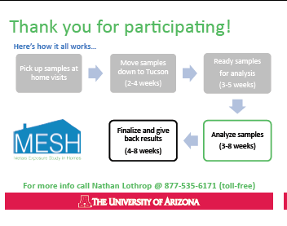

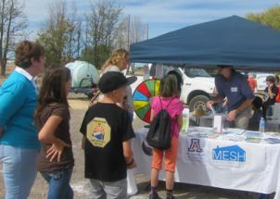
Recruitment &
Community Interaction
Recruitment methods:
    Agua Fria Festival 2011/2012
    DH Newsletter& PV Tribune Ad
    Mass Mailing
    Door-to-Door
    Personal Reference
Community informational meetings
Field staff from community
Advisory board of community members
Sending postcards with updates
Reporting back results
Notes:
Door-to-door is good, but someone has to be home
2 sources such as seeing a flyer and then getting a mailing worked often
Personal referral also effective
Can’t just send mailing and expect it to work

Slide 12
Home Visits Overview
Initial Contact and Scheduling
HOME VISIT #1
Consent to be in study
Questionnaire
Instructing /providing material to family for collecting biological samples from kids and tracking food and activities
Dust fall filters set out
Reminder call
Field Office
Pre-Home Visit
Field Office
Post- Home Visit
(one week in between home visits)
Reminder call
HOME VISIT #2
Pick up material from family
Administer questionnaires
Collect environmental samples
Field Office Post- Visit
Field Office
Pre-Home Visit
Store samples at field office

Slide 13
Sample Collection
Sample Type | Collection Method
Soil | Used trowel on all 4 sides of house
Personal Vacuum Bag | Obtained bag or contents from family’s vacuum
Vacuumed Dust | Field staff vacuumed floor and collected into filter
Dust Fall | Passive collection of dust fall on filters in home for at least 1 week
Water | Kitchen tap + other sources
Urine (1+ kids/home) | Morning void after 4-day food and time-activity log
Toenails (1+kids/home) | Clipped by participant/parent
Blood (1+kids/home) | Venous puncture at Labcorp (certified lab)
Questionnaires | Observational; Housing characteristics and household routines; Child health; Demographics
Child Food Log and Time-Activity Log (1+ kids/home) | Filled out by parents of participating children for 4 days prior to urine sample

Slide 14
Sample Processing Overview
Samples, data sheets, Qxs, and Consent storage at field office
Everything transported to UA campus in Tucson
Sample Processing
Sample analysis at ALEC
Questionnaires and data sheets into database
Data analysis and database management
Results back to participants

Slide 15
Sample Processing and Analysis
Sample | Processing | Analysis | Analytes
Blood | None | Labcorp | Pb
Toenails | Washed and digested | ICP-MS (ALEC) | Be, Al, Cr, Ni, As, Cd, Pb
Urine | pH and SG and creatinine testing | ICP-MS and As speciation (ALEC) | Be, Al, Cr, Ni, As, Cd, Pb; As(III), As(V), DMA, MMA, AsB, ASC
Water | Preserved pH<2 and tested turbidity | ICP-MS and As speciation (ALEC) | Be, Al, Cr, Ni, As, Cd, Pb; As(III), As(V), DMA, MMA, AsB, ASC
Soil and Dust | Sieved <63µm and digested | ICP-MS (ALEC) | Be, Al, Cr, Ni, As, Cd, Pb

Slide 16
Data Analysis
Urine was corrected for specific gravity
Samples blank corrected and LOD/sqrt(2) substituted for values<LOD
Distributions compared to standards, guidelines, or NHANES values
Spearman correlations

Slide 17
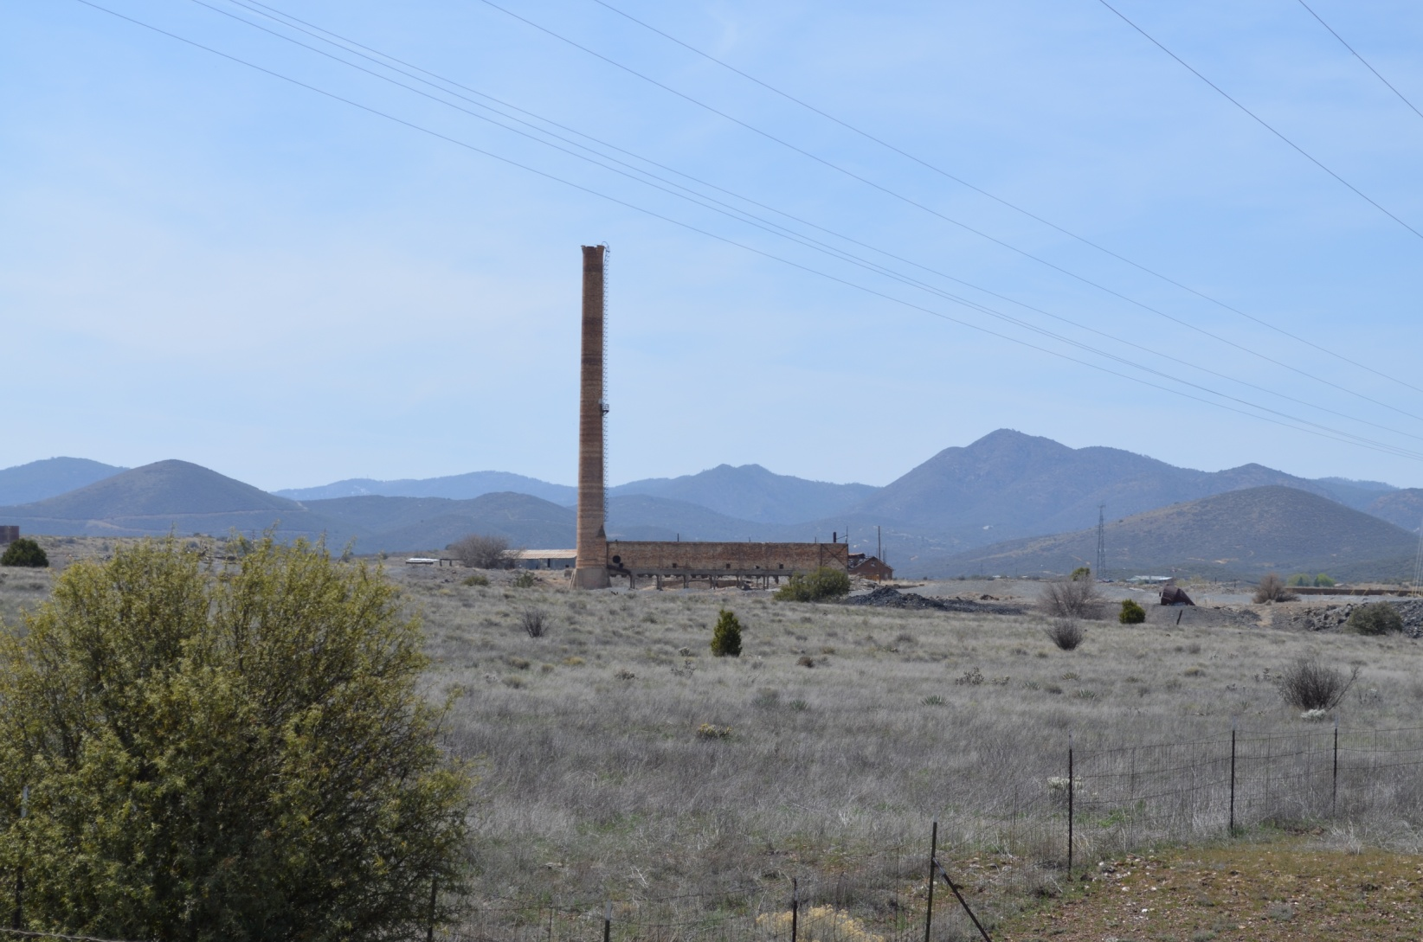
Interim Analysis Results*
*These early results and analyses are subject to change

Slide 18
General Area Demographics
Demographic | Total
Population in Dewey-Humboldt | 3,894
Households in Dewey-Humboldt | 1,589
Households in Study Area | 1,325
Est. Households w/ Children in Study Area* | 279
Households Enrolled | 34
Participation Rate of Households w/ Children in Study Area | 12.2%
Children Eligible (1-11 years age) | 392
Children Enrolled | 68
Participation Rate of Eligible Children | 17.3%
*Note that this estimate includes homes with non-eligible children (12+ years old). There is no way of estimating eligible kid households , therefore, we cannot calculate the participation rate of eligible households, only Households w/ Children in Study Area.
Notes:
Est. Households w/ Children in X geographic area = #HHs in X geographic area * ( 335 (HHs w kids under 18) / 1,589 (Total HHs))
*Note that “Children” is the legal age definition of children unless otherwise noted with ages, therefore, the participation rate of homes with kids is lower than it should be. There’s no practical way to calculate the eligible households w/ kids in age range – this is an important point to note.
**All ‘Est.’ numbers assume no in-migration, out-migration, or births in study area from 2010 until now. This is impractical, however, the population is too small to accurately calculate population shifts from spring 2010 to summer/fall 2012. Therefore, it’s assumed that births, deaths, in/out migrations will cancel each other out and the population will age in place.

Slide 19
Blood lead
Of Active Children: | # of Children
Total | 65
Males | 33
Females | 32
Average Age | 6.23
Blood lead | ND – 3 µg/dL (7 > detection limit)

Slide 20
Sampling - Soil
n=34
+ denotes EPA soil screening level
Note: AZ soil remediation level is a guideline for further investigation

Slide 21
Sampling – Vacuum Bag
+ denotes EPA soil screening level
n=32 | Be | Al | Cr | Ni | As | Cd | Pb
% ND | 3% | 0% | 0% | 3% | 0% | 3% | 0%

Slide 22
Soil – vacuum bag correlations
Metal | Spearman’s rho | P-value
Beryllium | -0.091 | 0.637
Aluminum | 0.218 | 0.254
Chromium | -0.205 | 0.285
Nickel | 0.154 | 0.423
Arsenic | 0.591 | 0.001*
Cadmium | 0.495 | 0.007*
Lead | 0.487 | 0.008*
*significant at the p<0.05 level

Slide 23
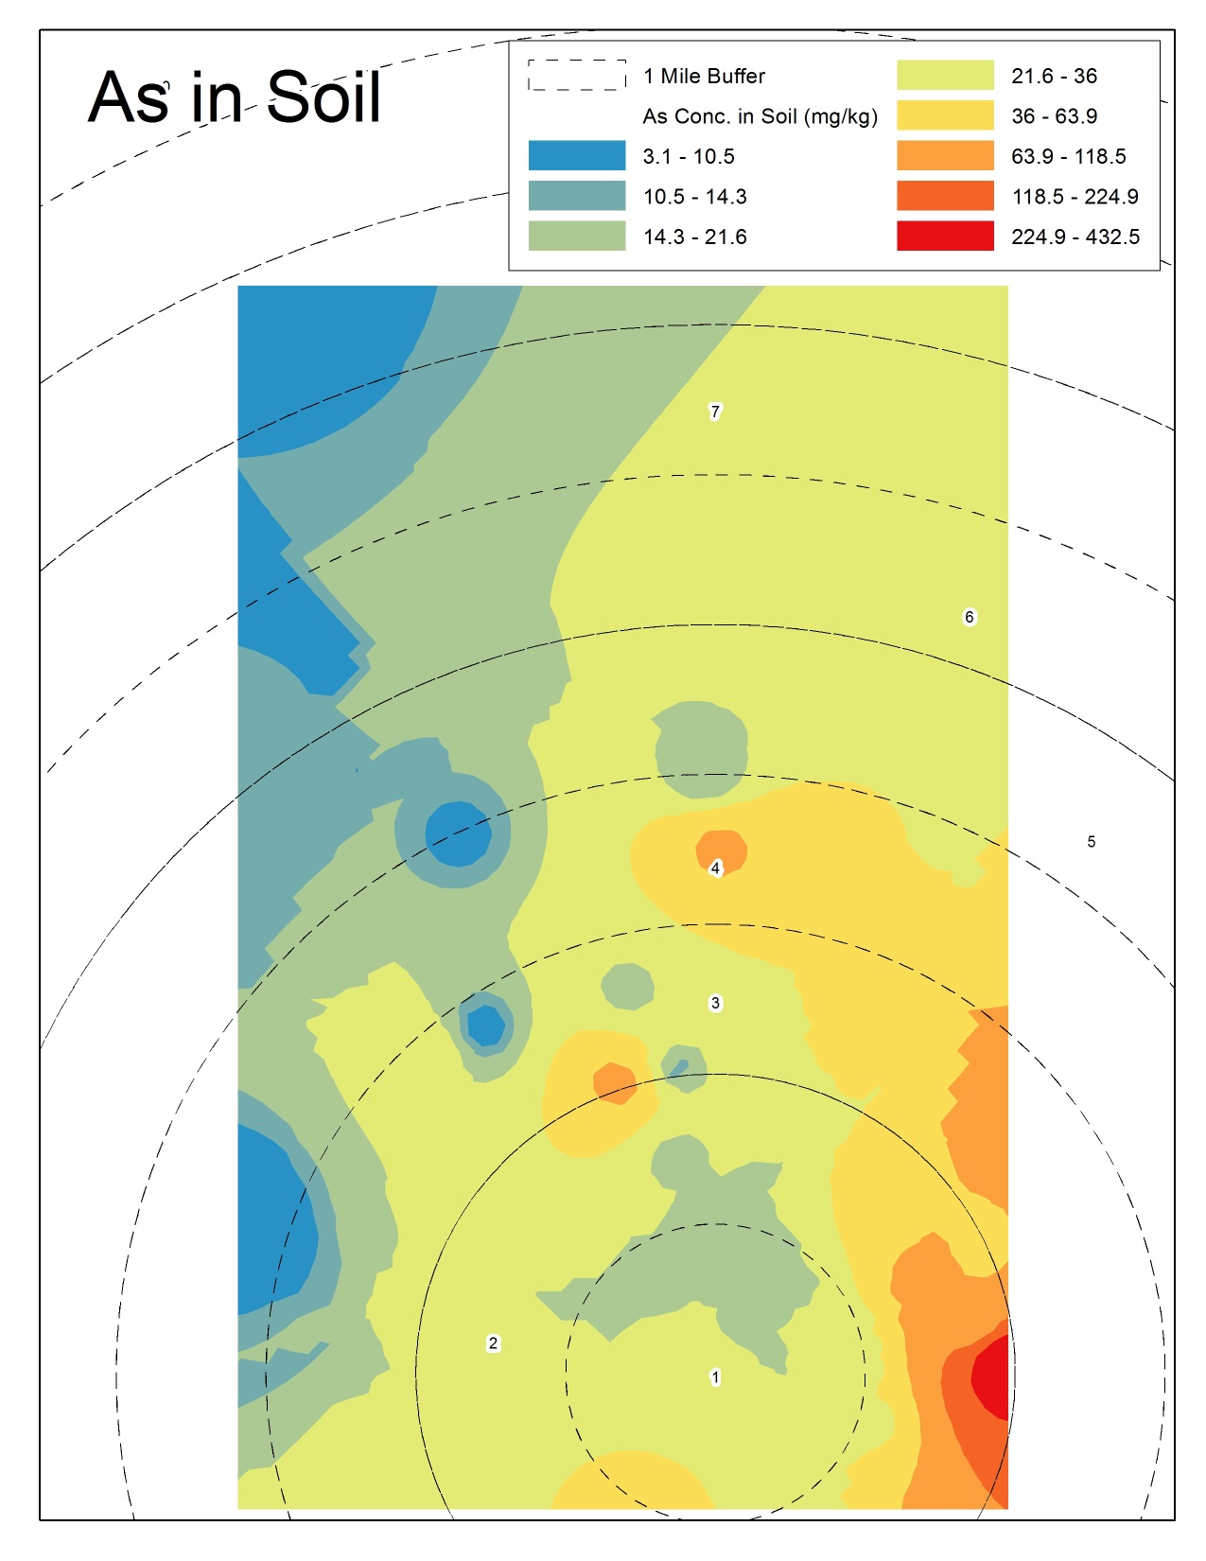
For <63 μm fraction only

Slide 24
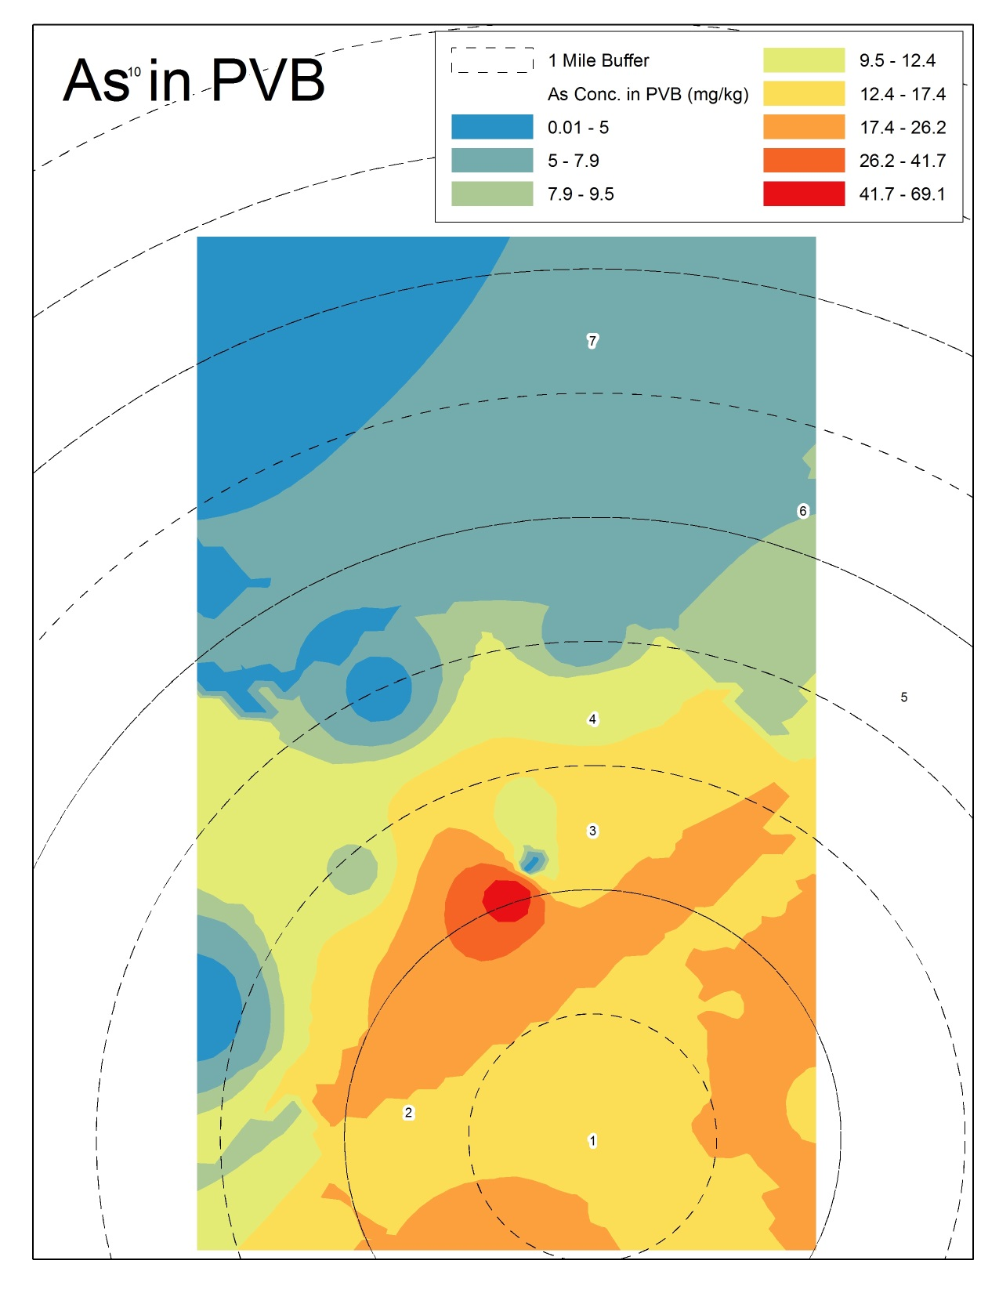
For <63 μm fraction only

Slide 25
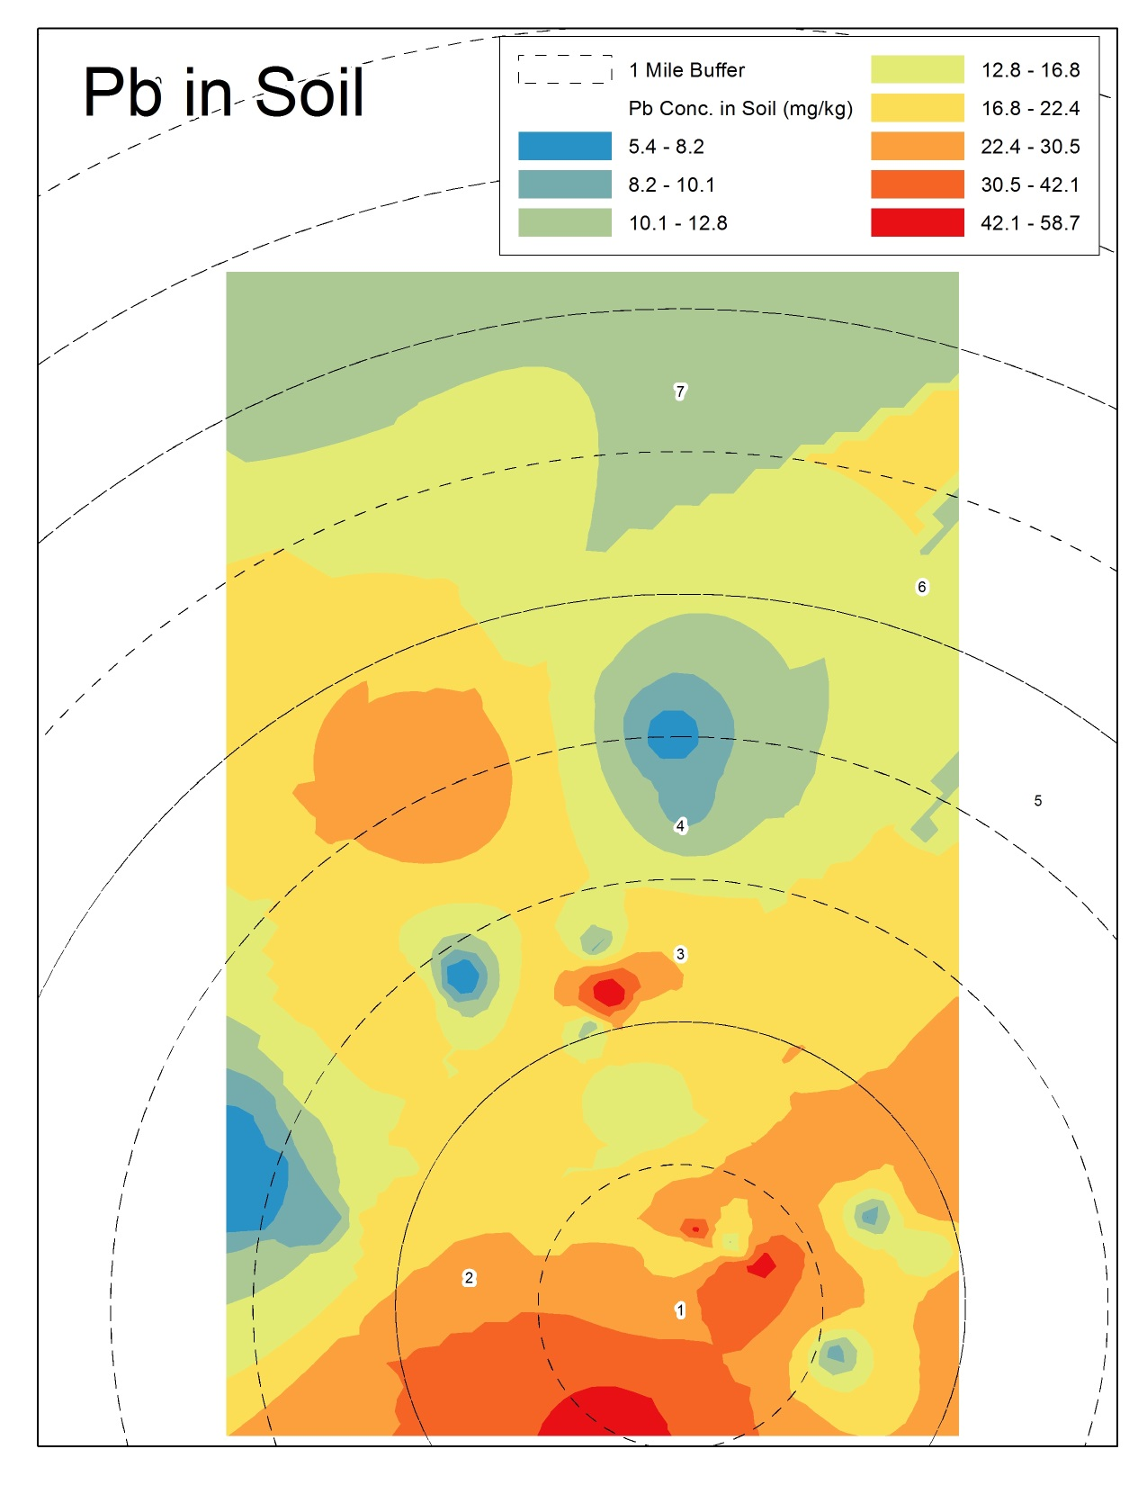
For <63 μm fraction only

Slide 26
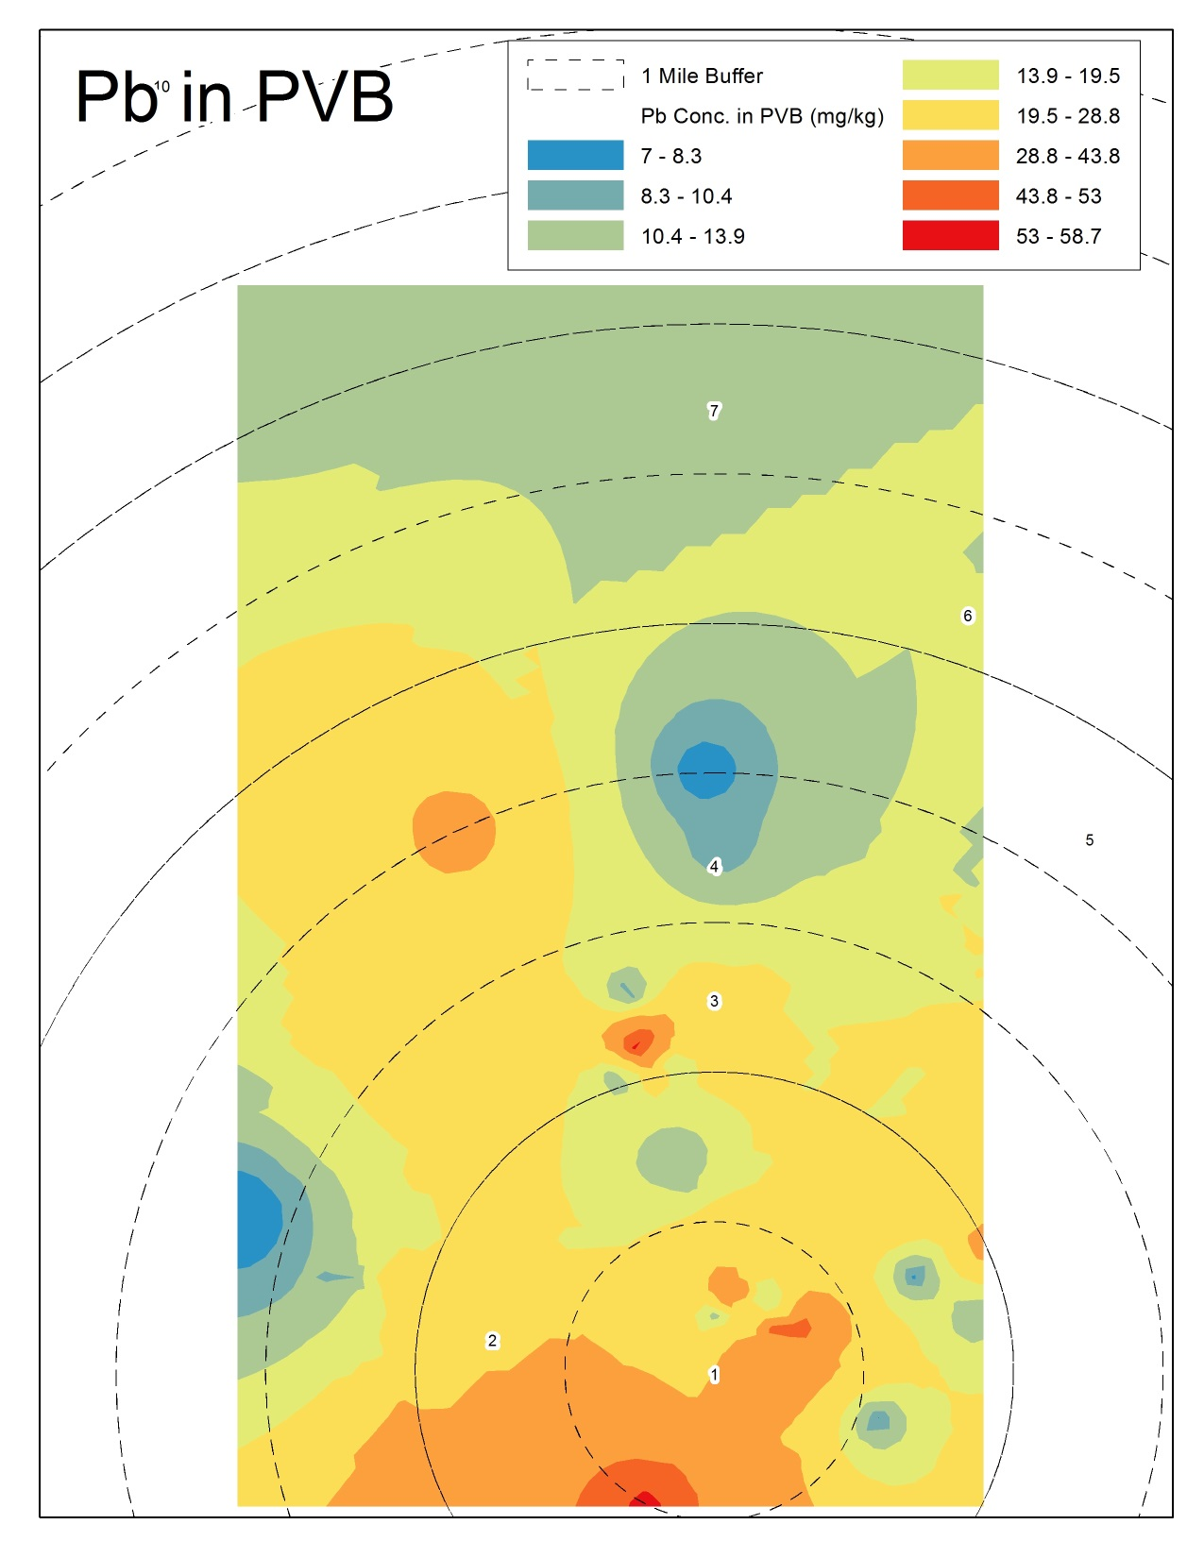
For <63 μm fraction only

Slide 27
Sampling - Water
n=25 | Be | Al | Cr | Ni | As | Cd | Pb
% ND | 80% | 32% | 8% | 96% | 4% | 72% | 76%

Slide 28
Sampling – urine (total)
n=51 | Be | Al | Cr | Ni | Cd | Pb
% ND | 49% | 2% | 12% | 0% | 2% | 12%

Slide 29
Urine As species
p=.5360
p=.0014
p=.0037
p=.0010
p=.0001
p=.9465
p=.0007
In NHANES 2009-2010, AsCh, AsIII, AsV are <LOD at 50th and 95th percentiles for children 6-11 years of age
Notes:
Note that our population distribution is shifted to the right – i.e. is higher than the national distribution.

Slide 30
Sampling - Toenails

Slide 31
Urine Correlations
 | Dust |  | Soil |  | Water
 | Spearman’s rho | P-value | Spearman’s rho | P-value | Spearman’s rho | P-value
Beryllium | 0.029 | 0.831 | 0.194 | 0.146 | -0.275 | 0.1
Aluminum | 0.043 | 0.750 | -0.108 | 0.421 | -0.059 | 0.73
Chromium | -0.078 | 0.5636 | -0.354 | 0.006 | 0.627 | <0.001
Nickel | 0.091 | 0.502 | -0.209 | 0.115 | -0.187 | 0.267
Arsenic | 0.021 | 0.875 | -0.107 | 0.424 | 0.392 | 0.016
Cadmium | 0.300 | 0.023 | -0.068 | 0.612 | -0.059 | 0.729
Lead | 0.029 | 0.831 | 0.352 | 0.007 | 0.018 | 0.918
Bold and italicized numbers indicate significant correlations with p<0.05

Slide 32
Toenail Correlations
 | Dust |  | Soil |  | Water
Metal | Spearman’s rho | P-value | Spearman’s rho | P-value | Spearman’s rho | P-value
Beryllium | 0.123 | 0.381 | 0.226 | 0.090 | -0.287 | 0.111
Aluminum | -0.307 | 0.025 | 0.047 | 0.727 | -0.028 | 0.882
Chromium | 0.263 | 0.056 | -0.185 | 0.167 | -0.043 | 0.816
Nickel | 0.424 | 0.002 | 0.023 | 0.865 | -0.146 | 0.426
Arsenic | 0.335 | 0.014 | 0.250 | 0.060 | 0.365 | 0.042
Cadmium | -0.072 | 0.610 | -0.268 | 0.044 | 0.577 | 0.002
Lead | 0.160 | 0.253 | 0.192 | 0.151 | 0.097 | 0.599
*inorganic only
Bold and italicized numbers indicate significant correlations with p<0.05

Slide 33
Discussion
For arsenic and lead, indoor house dust concentrations likely influenced mostly by outdoor soil
Distribution of children’s exposure tends to be higher than national sample
Exposure to arsenic may be influenced most by water and dust ingestion

Slide 34
Further Work
Examine determinants of biomarker levels and environmental levels using questionnaire and activity/food log data
Bioavailability of metals in dust and soil
Isotopic analysis to better understand sources of metals in soil and dust
Development of predictive model for indoor concentrations of metals in dust and air for exposure and risk assessment

Slide 35
Questions?

