Slide 1
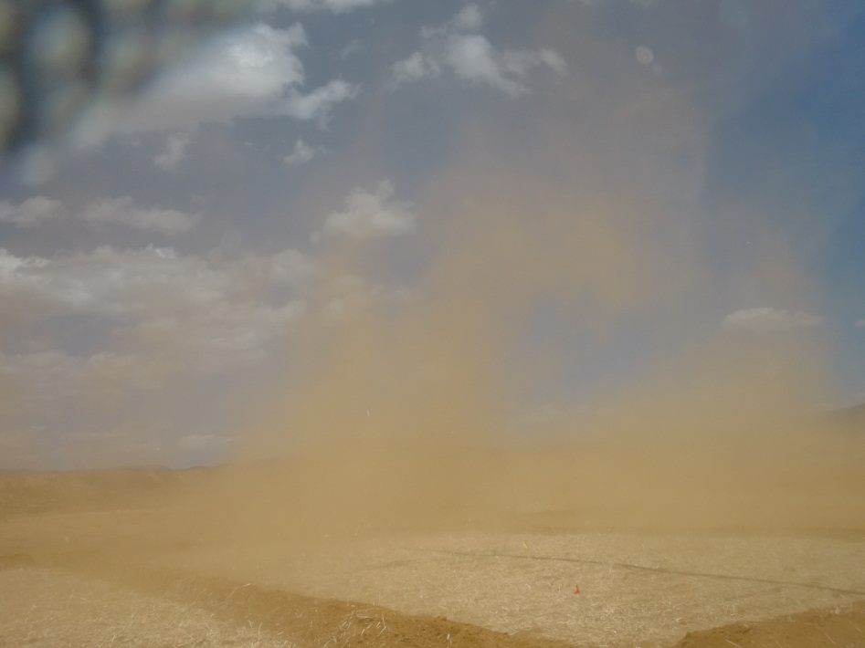
Combining molecular-scale speciation
with in vitro bioassays to interrogate the bioaccessibility of As in mine tailings
Robert Root PhD
robroot.az@gmail.com
Sept. 3, 2013

Slide 2
Introduction
Problem
Characterizing bioaccessibility of
fugative dust from mine waste
Procedures and results
Bioassay
Spectroscopy and imaging
Predicting bioaccessibility
Conclusions

Slide 3
Introduction
Problem
Characterizing bioaccessibility of
fugative dust from mine waste
Procedures and results
Bioassay
Spectroscopy and imaging
Predicting bioaccessibility
Conclusions
28 August 2013
3

Slide 4
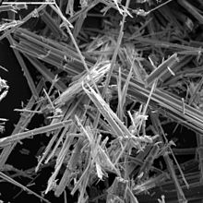
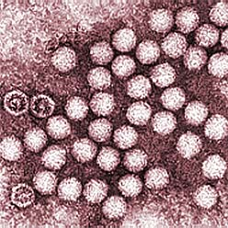
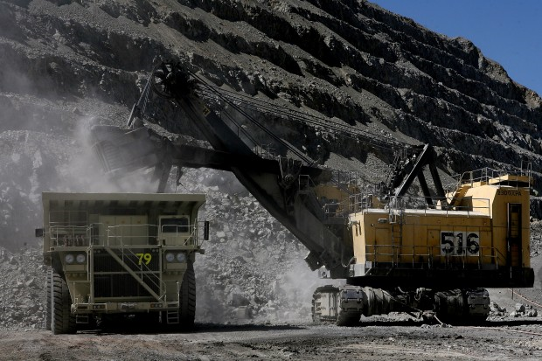
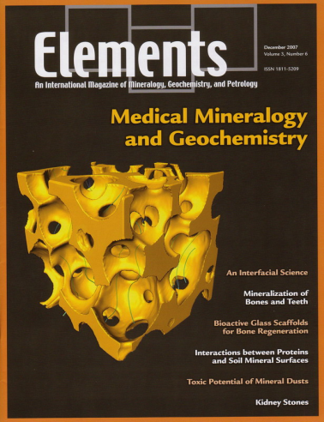
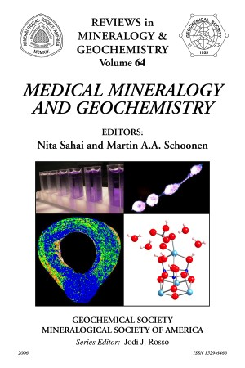
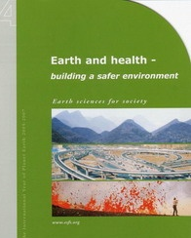
Toxicological Geochemistry
Interdisciplinary approach to investigating Earth Materials
Mineral dusts
Arsenic poisoning
Valley Fever
Asbestosis
Radiation poisoning
Understanding of the health effects resulting from occupational and environmental exposures to a wide variety of earth materials
Fate and transport
Exposure
Bioavailability
asbestos
rift valley fever
iron/metal(loid) dusts
4
4

Slide 5
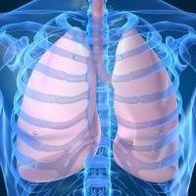
Routes of Exposure Human Interaction with Earth Materials
Inhalation
Ingestion
Dermal absorption
Airborne Particles
>100 um fall out of the air quickly
<1um can stay suspended for years
<150 um can enter the mouth and nose
Respirable particles <10 um pass to the lungs
<2.5 um pass deeply into the lung.
Cilia trapped particles are subsequently swallowed
Physiological interactions are strongly influenced
by the physical and chemical properties of the toxin

Slide 6
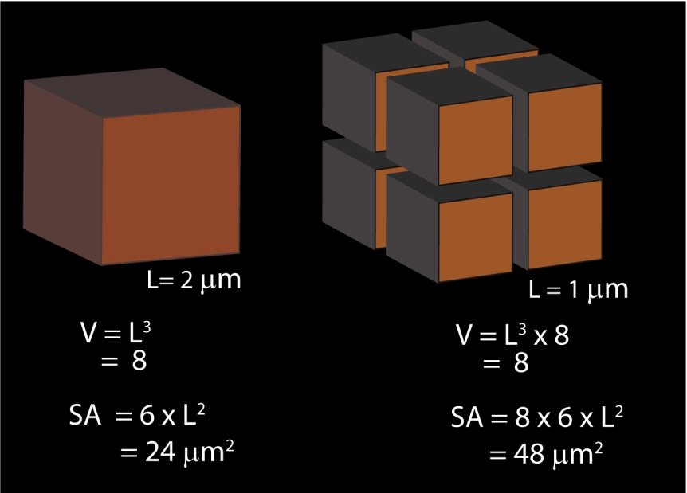
in vitro Bioaccessibility
metal(loid) released in syn. bio-fluid (μg)
Bioaccessibility (%) = x 100%
metal(loid) present in tailings sample (μg)
Bioaccessibility ∝ Solubility
Concentration + time (dose)
Surface area
Solubility constant
ionic strength, f(I) & common ion
Temperature
Environment (pH, pe)
Notes:
Bioaccessibility is the amount of a substance that will dissolve and be absorbed by a target biological region
Solubility is Driven by T, logK and S_{A}
f(Ci, time –dose-, S_{A,} logK, ionic strength, activity coef, Log KH₂O, T, pH, env)
Env encompasses the parameters of

Slide 7
Introduction
Problem
Characterizing bioaccessibility of
fugative dust from mine waste
Procedures and results
Bioassay
Spectroscopy and imaging
Predicting bioaccessibility
Conclusions

Slide 8
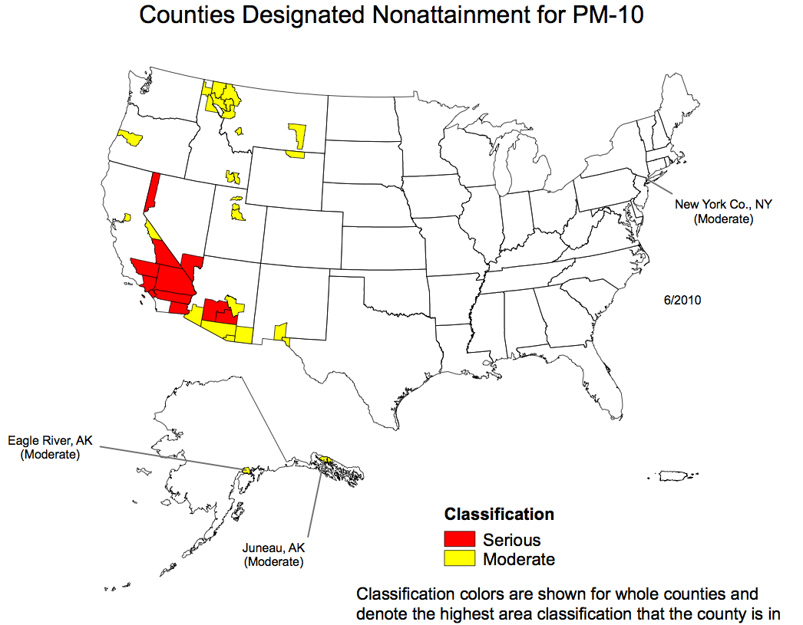
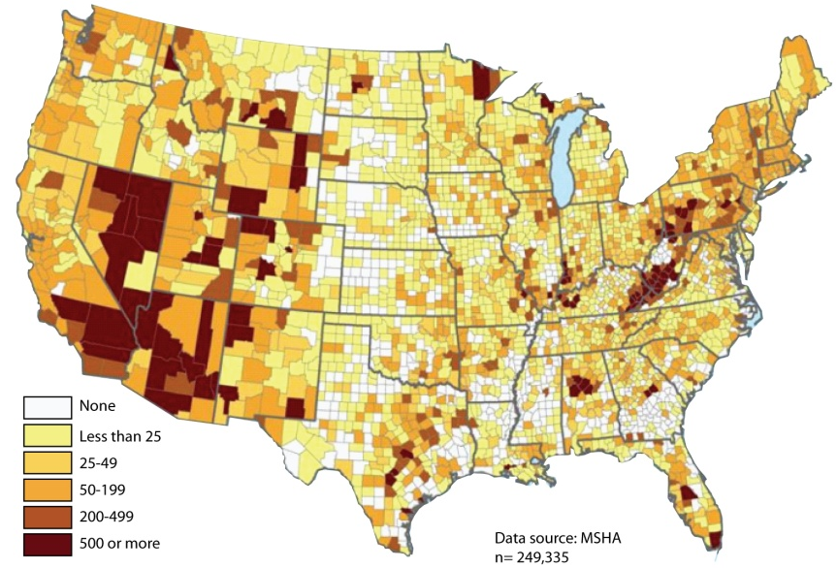
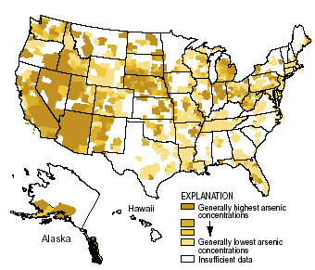
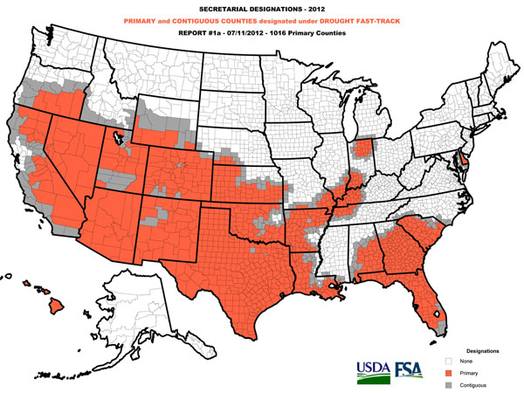
Confluence of Environmental Issues
PM-10 Nonattainment
2010
Mine Workers
2010
www.epa.gov
www.cdc.gov
As in DW
Drought
None
Contiguous
Drought
www.USDA.gov
www.USGS.gov

Slide 9
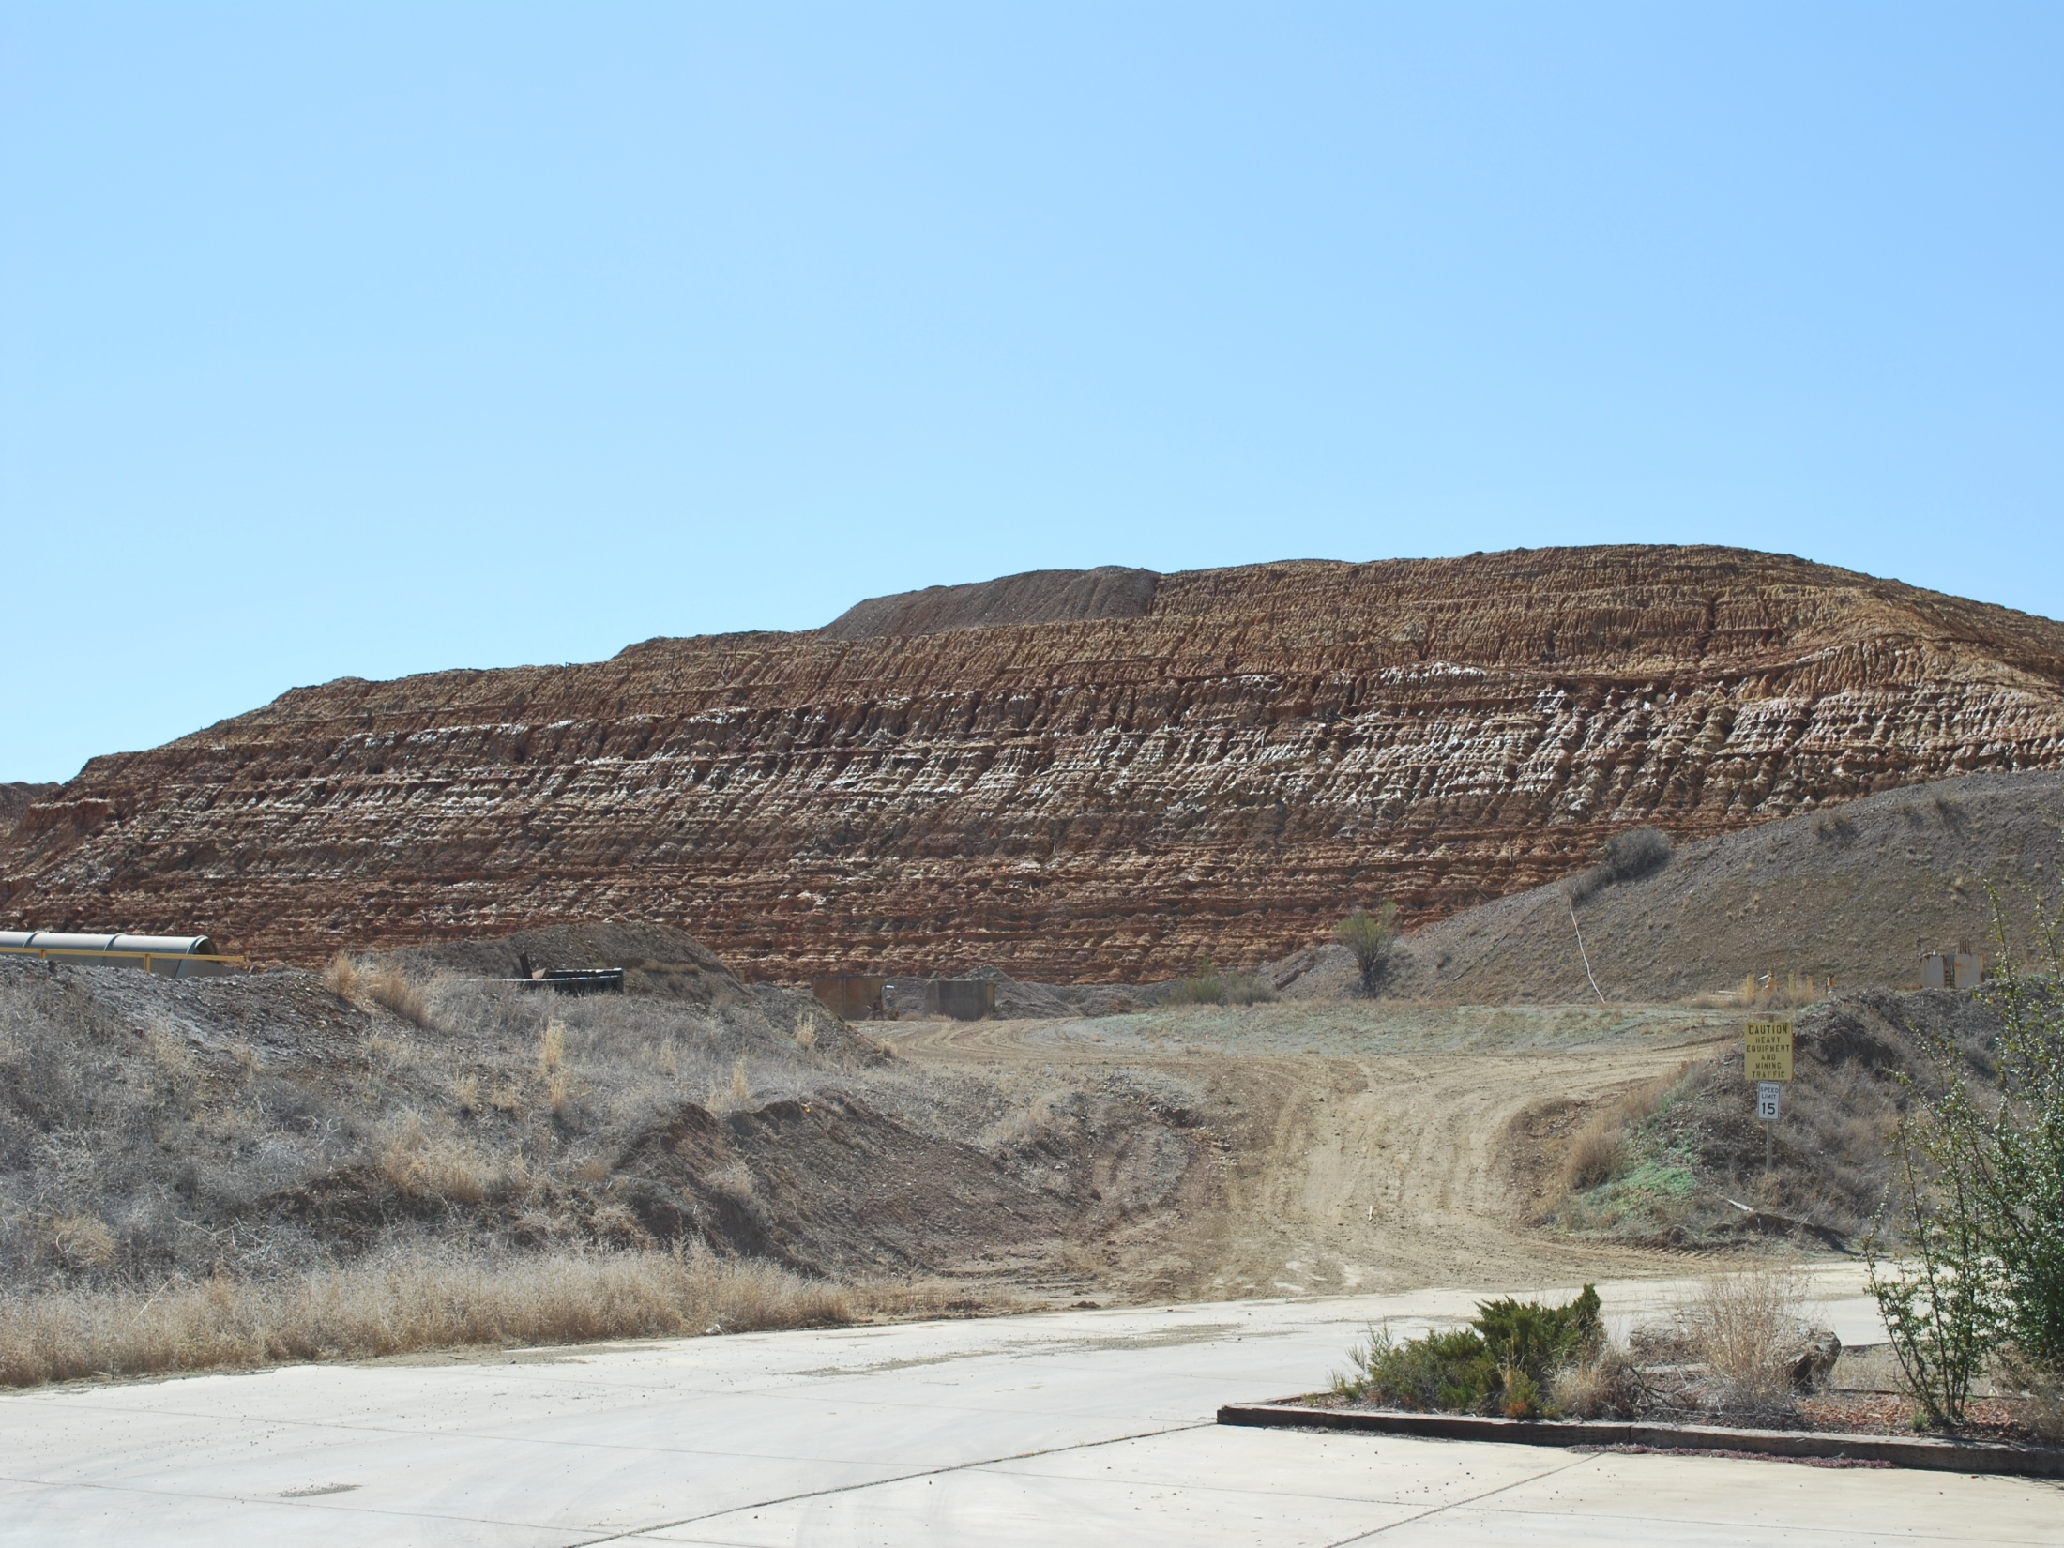
Fugative Mine Dusts
Tailings piles are disproportionately in arid regions;
5x10⁹ tons of tailings worldwide;
700 million kg of metals in mine tailings;
>95-99% of ore becomes tailings;
Mineable ore ca. 0.2% at metal of interest;
Sulfide tailings are the main source of heavy metals
Just in AZ 60k – 100k abandoned/inactive mines;
Notes:
AZ mines are generally associated hydrothermal deposits:
massive sulfide ore deposits (small, high-grade)
porphyry deposits (large, low-grade).

Slide 10
Sulfide ore body discovered in 1880
En echelon schist replacement
3250 ft deep and 40 miles of shafts
Most of AZ Pb & Zn, #1 Ag, #3 Au
Closed 1967

Slide 11
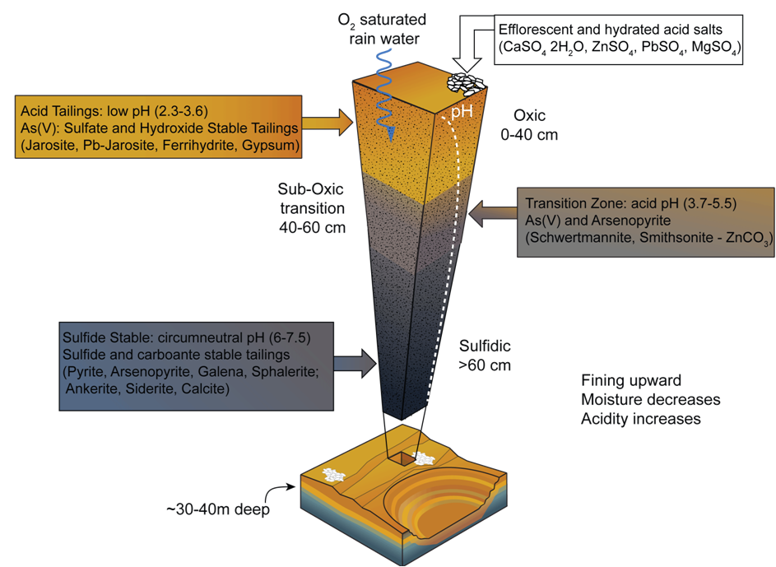
Iron King Mine Tailings
.
Notes:
Particles size: crushed to <2 mm
Tailings are barren, no rocks, no plants, no cryptobiotic crust, there is a physical surface crust and a deeper ferricrete
we’ve seen a wide range of particles at the surface of the tailings

Slide 12
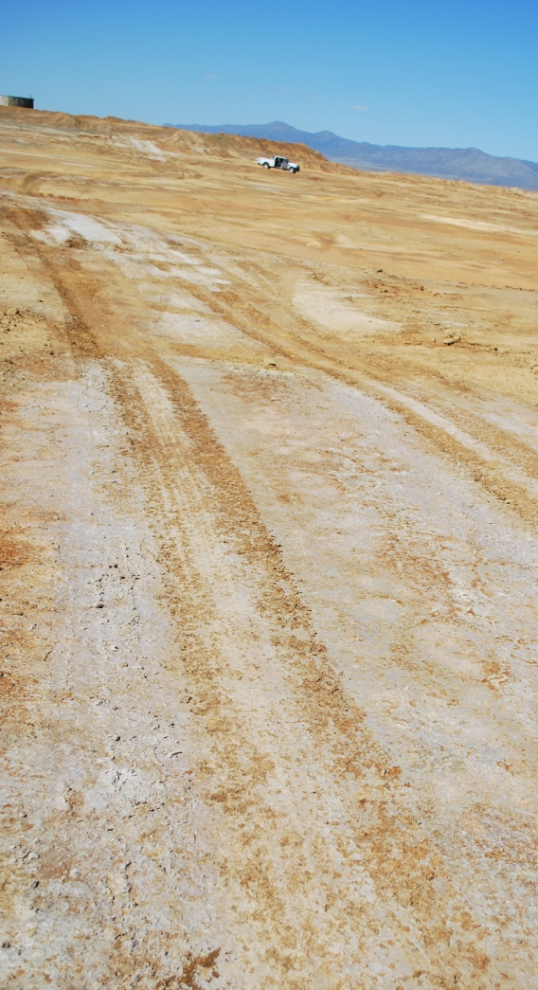
Research Questions
How does molecular speciation affect the bioaccessibility and release kinetics of metal(loids) in geo-dusts from mine tailings?
Is there a predictable link between the molecular species and bioaccessibility?
12
Notes:
Define Bioaccessibility:

Slide 13
Introduction
Problem
Characterizing bioaccessibility of
fugative dust from mine waste
Procedures and results
Bioassays
Spectroscopy and imaging
Predicting bioaccessibility
Conclusions

Slide 14
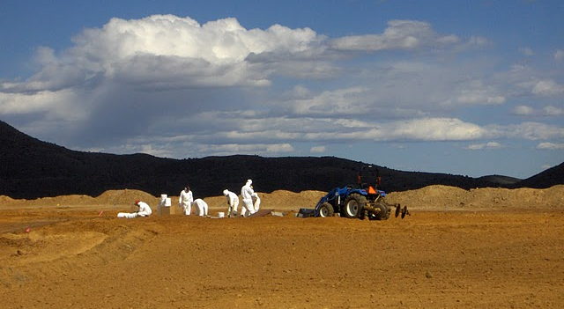
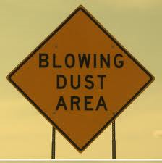
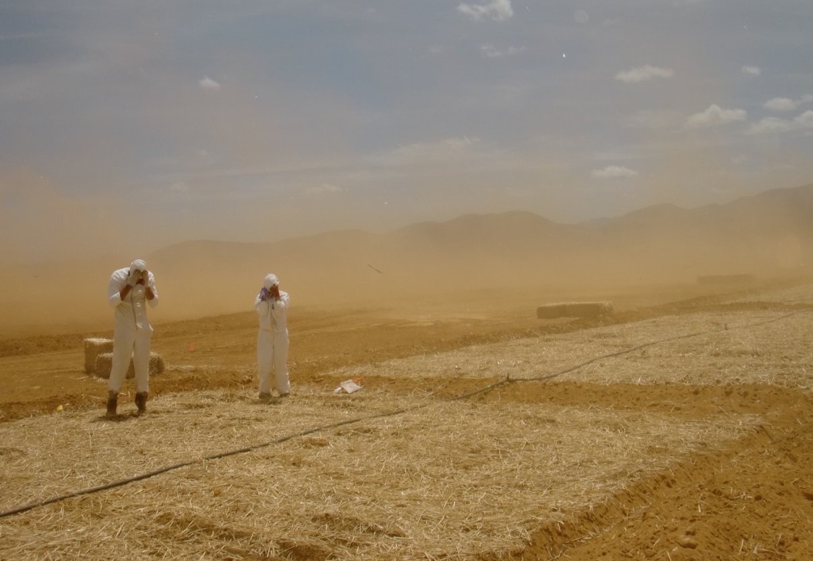
In vitro studies of synthetic body fluid extractions are bench scale techniques
The synergetic use of X-ray techniques and in vitro extractions offers unique molecular scale access to toxic release
Assumptions:
Bioavailable < Bioaccessible < Total Concentration
Fate of fugitive dust is a multiple scale process
Process
Scale
redox -
biochem
precip. -
nucleation
saltation -
weathering
transport
nm km
atomic
molecular
particle
field

Slide 15
Modified from US EPA Bioavailable Pb
0.15 g dust (n=3)
Bio-fluid
Centrifuge
supernatant
solids
1 h
24 h
Mine dust
mixed 1:100
solid:solution
Shake
30s – 7d
37ºC
Dark
48 h
Splits for speciation
Aqueous:
bioaccessible
Target Extractant
Gastric fluid 0.4 M glycine, dark at 37°C, pH 1.5 with HCl
Lung Alveolar Gamble’s solution, dark at 37°C, pH 7.4
Notes:
Specific to mine tailings as this is targeting As and Pb
Limitations:

Slide 16
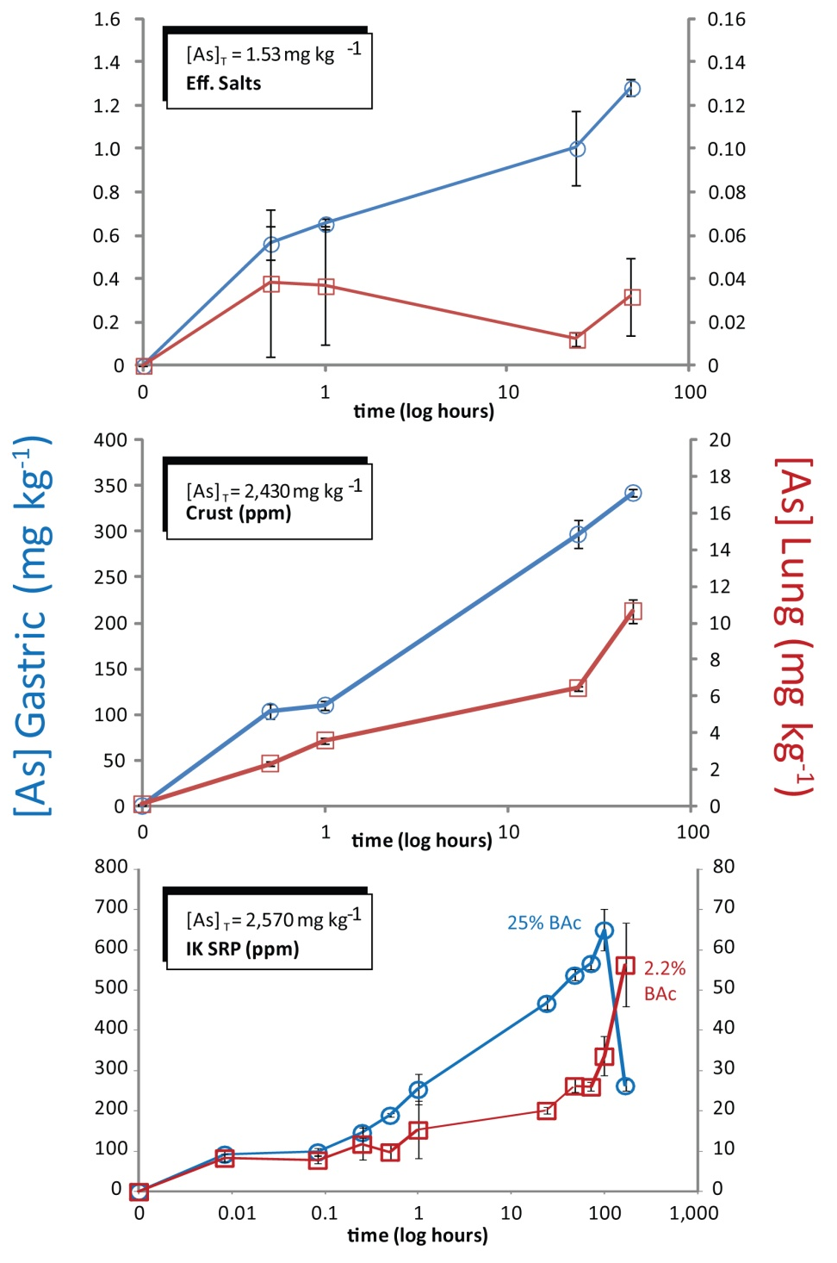
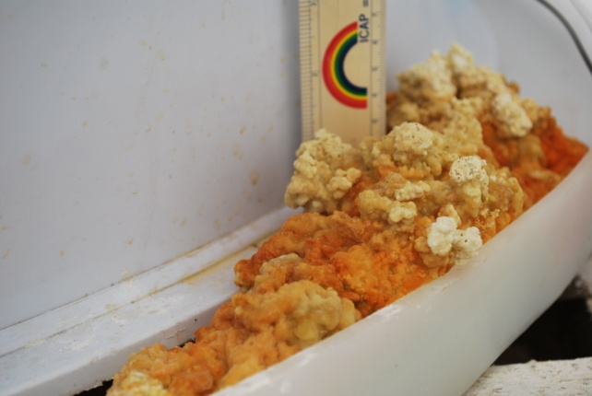
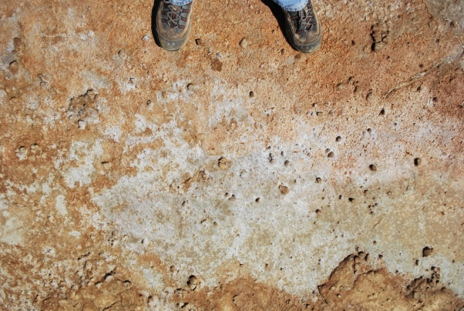
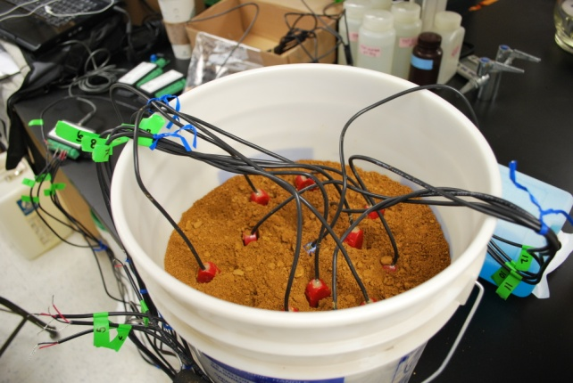
Bioaccessible Arsenic
Efflorescent salts formed from the percolation of irrigation water through IK mine tailings: <75 μm
Surface crust (top 1 cm) formed at the IK tailings site :
<150 μm
Bulk tailings
(top 25 cm) homogenized and <150 μm

Slide 17
Gastric Bioassay (pH 1.7)
In vitro Bioaccessibility
[Total mg kg⁻¹], (Max %BAc)
Tailings
Rel. BAc
Efflorescent Salt
[As] = 2570 (25.3%)
[Pb] = 3180 (18.2%)
[Fe] = 124,000(33%)
<<
<<
<<
[As] = 1.56 (84.9%)
[Pb] = 6.0 (66.7%)
[Fe] = 7,200 (68.8%)
Alveolar Bioassay (pH 7.4)
[As] = 2570 (2.2%)
[Pb] = 3180 (0.17%)
[Fe] = 124,000(0.15%)
<
<<
<<
[As] = 1.56 (8.9%)
[Pb] = 6.0 (100.%)
[Fe] = 7,200 (20.8%)
17

Slide 18
Bioassay Summary
18
Notes:
Surface Tailings
Change in solubility over duration of extractions
SLF: As, Pb increased with time
Fe decreased
SGF: Fe, As, Pb increased with time

Slide 19
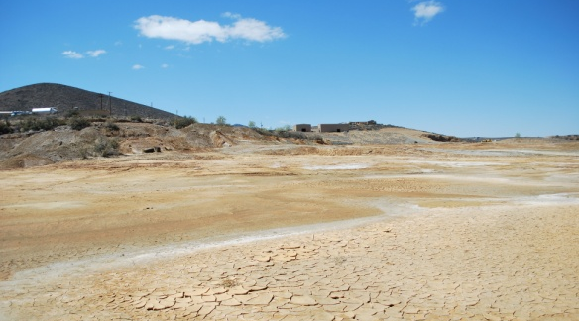
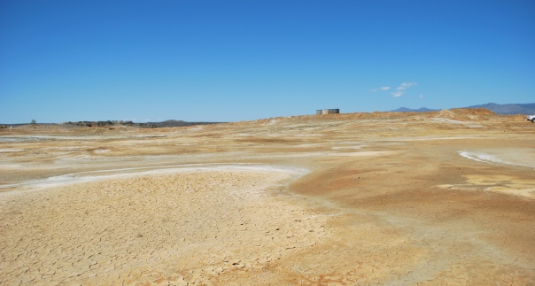
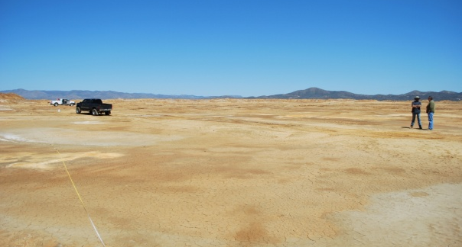
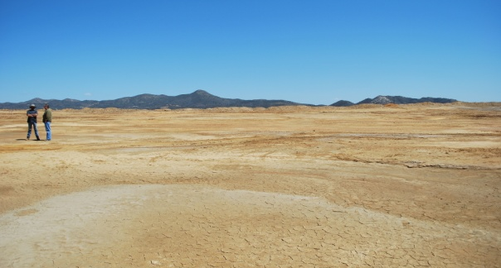
Speciation and target organ
Mineral solubility product (K)
Used to predict solubility and stability
of contaminant and sorbents
Thermodynamic equilibrium ₌ K
Instantaneous concentration Q
K < Q = (super)saturated, expect precipitation
K > Q = under saturated, expect dissolution
19
19
Notes:
Too educational !!!

Slide 20
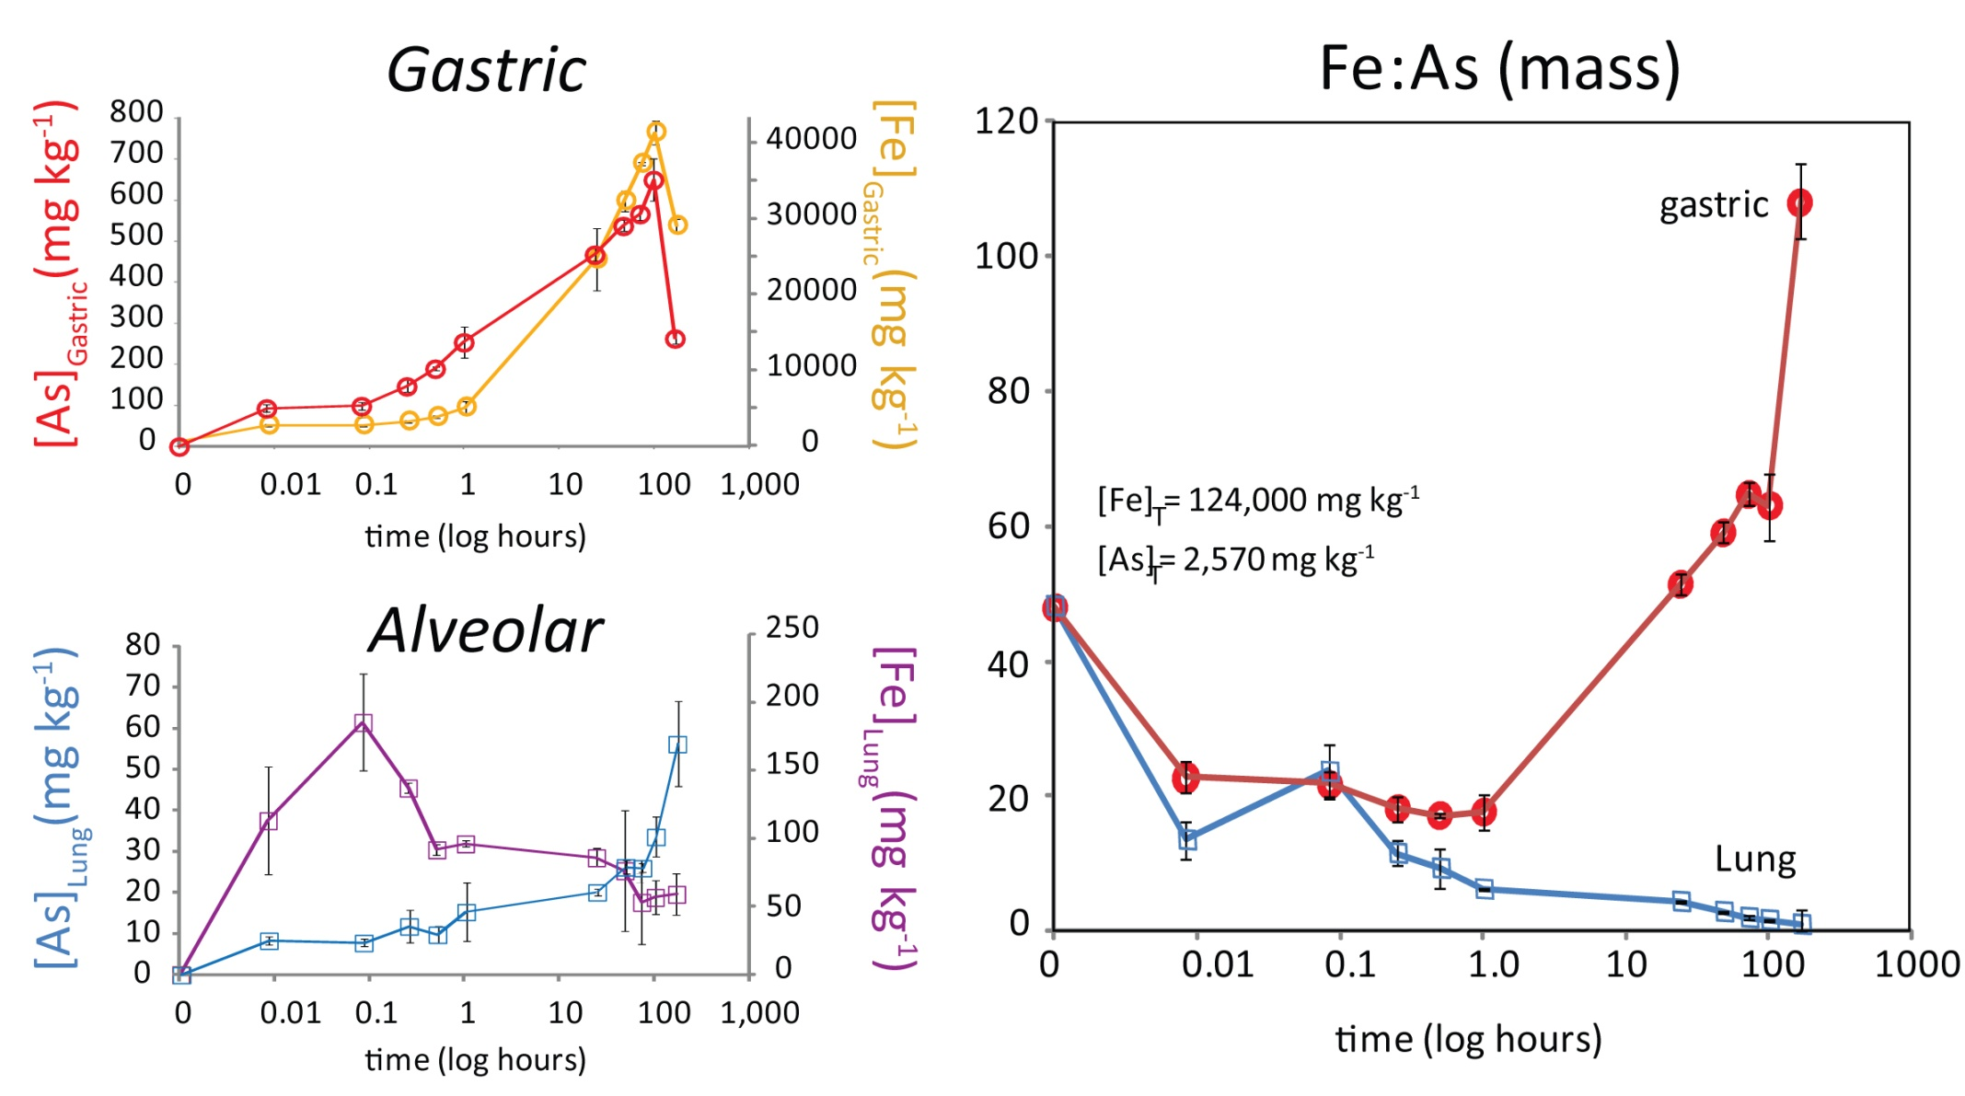
Bioaccessible As & Fe from kinetic bioassay
alveolar
Notes:
The gastric extraction dissolves SO4 salts and Fh first,
As is mostly associated as a sorbed species on Fh
The dissolution of Fh does not rel. all the As
A secondary precipitation of an amorphous FeAsSO4
Fh surface sites are reduced, As competes with SO4 in SC Jar and FeAsSO4
Low pH promotes ppt of FeAsSO4, which may not occur in high pH intestinal bioassay

Slide 21
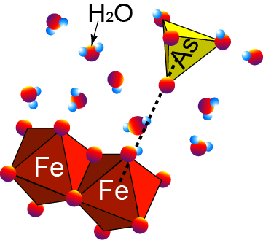
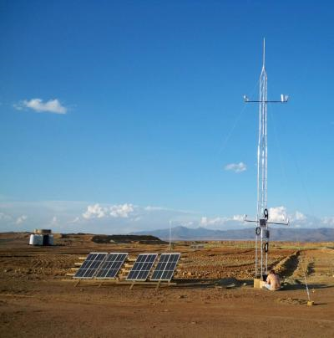
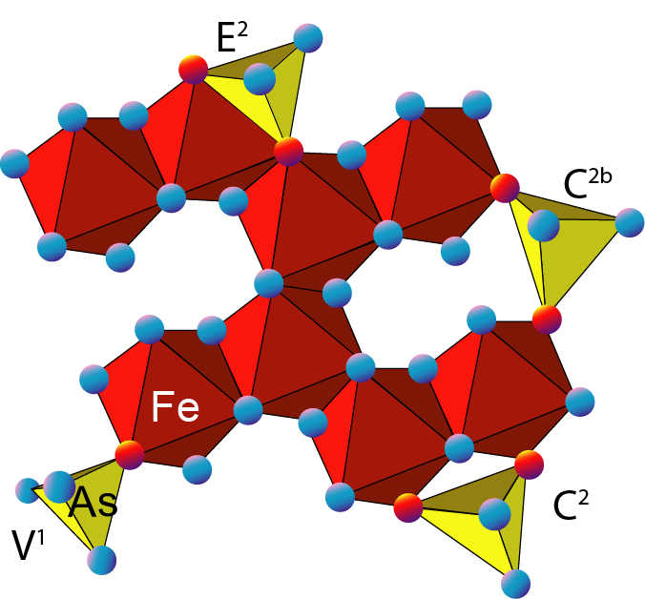
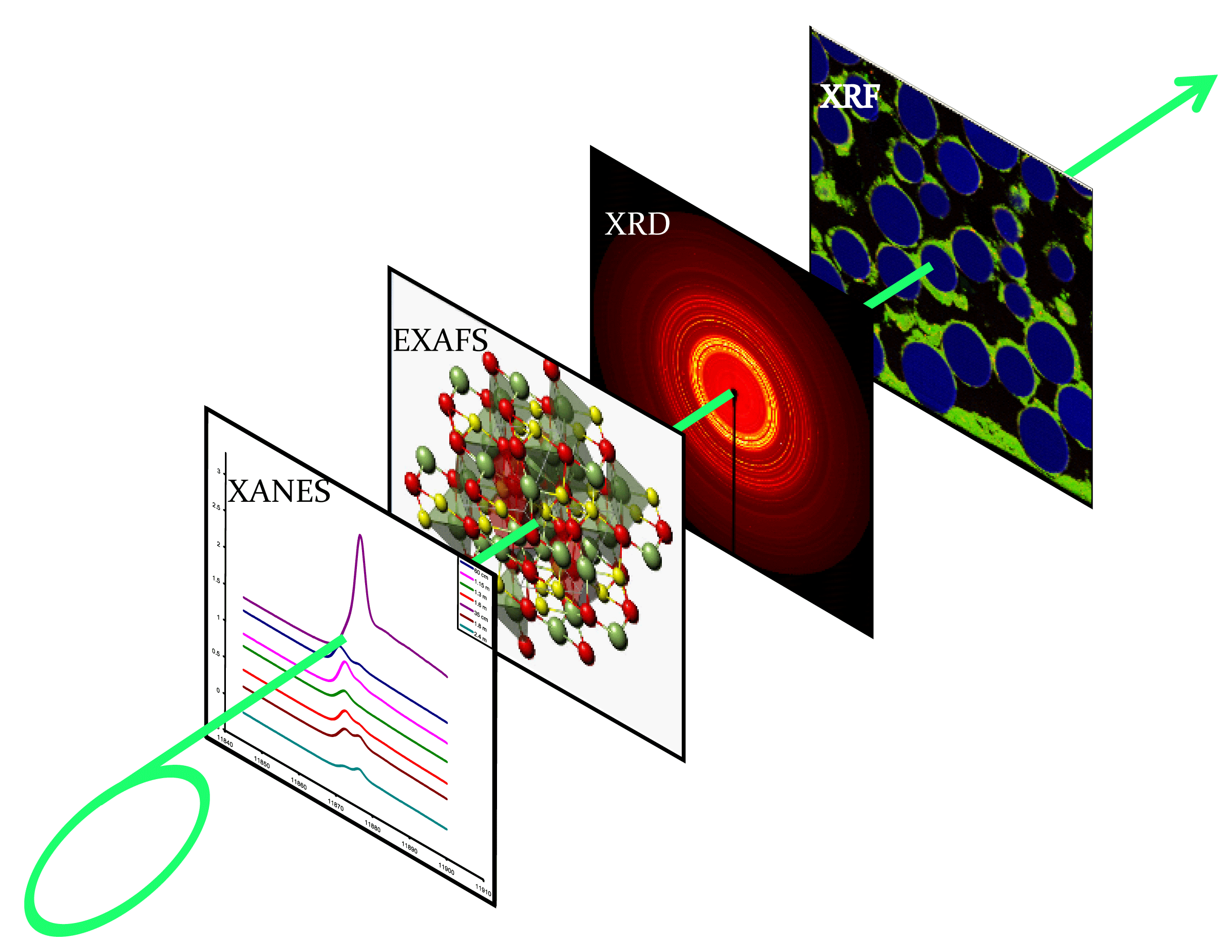
Fe and As species
In vitro Extractions bioaccessible
Synchrotron X-ray
XRD crystallite (um)
XRF crystallite (nm)
XAS molecular (Å)

Slide 22
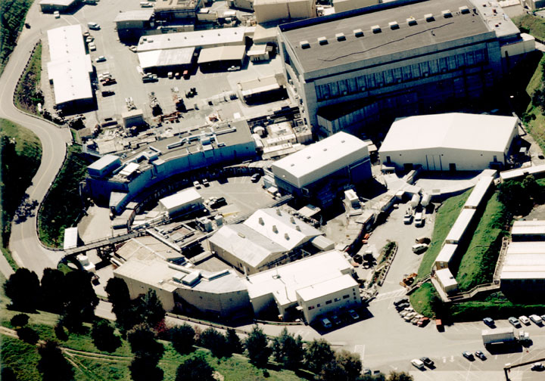
Synchrotron X-ray source

Slide 23
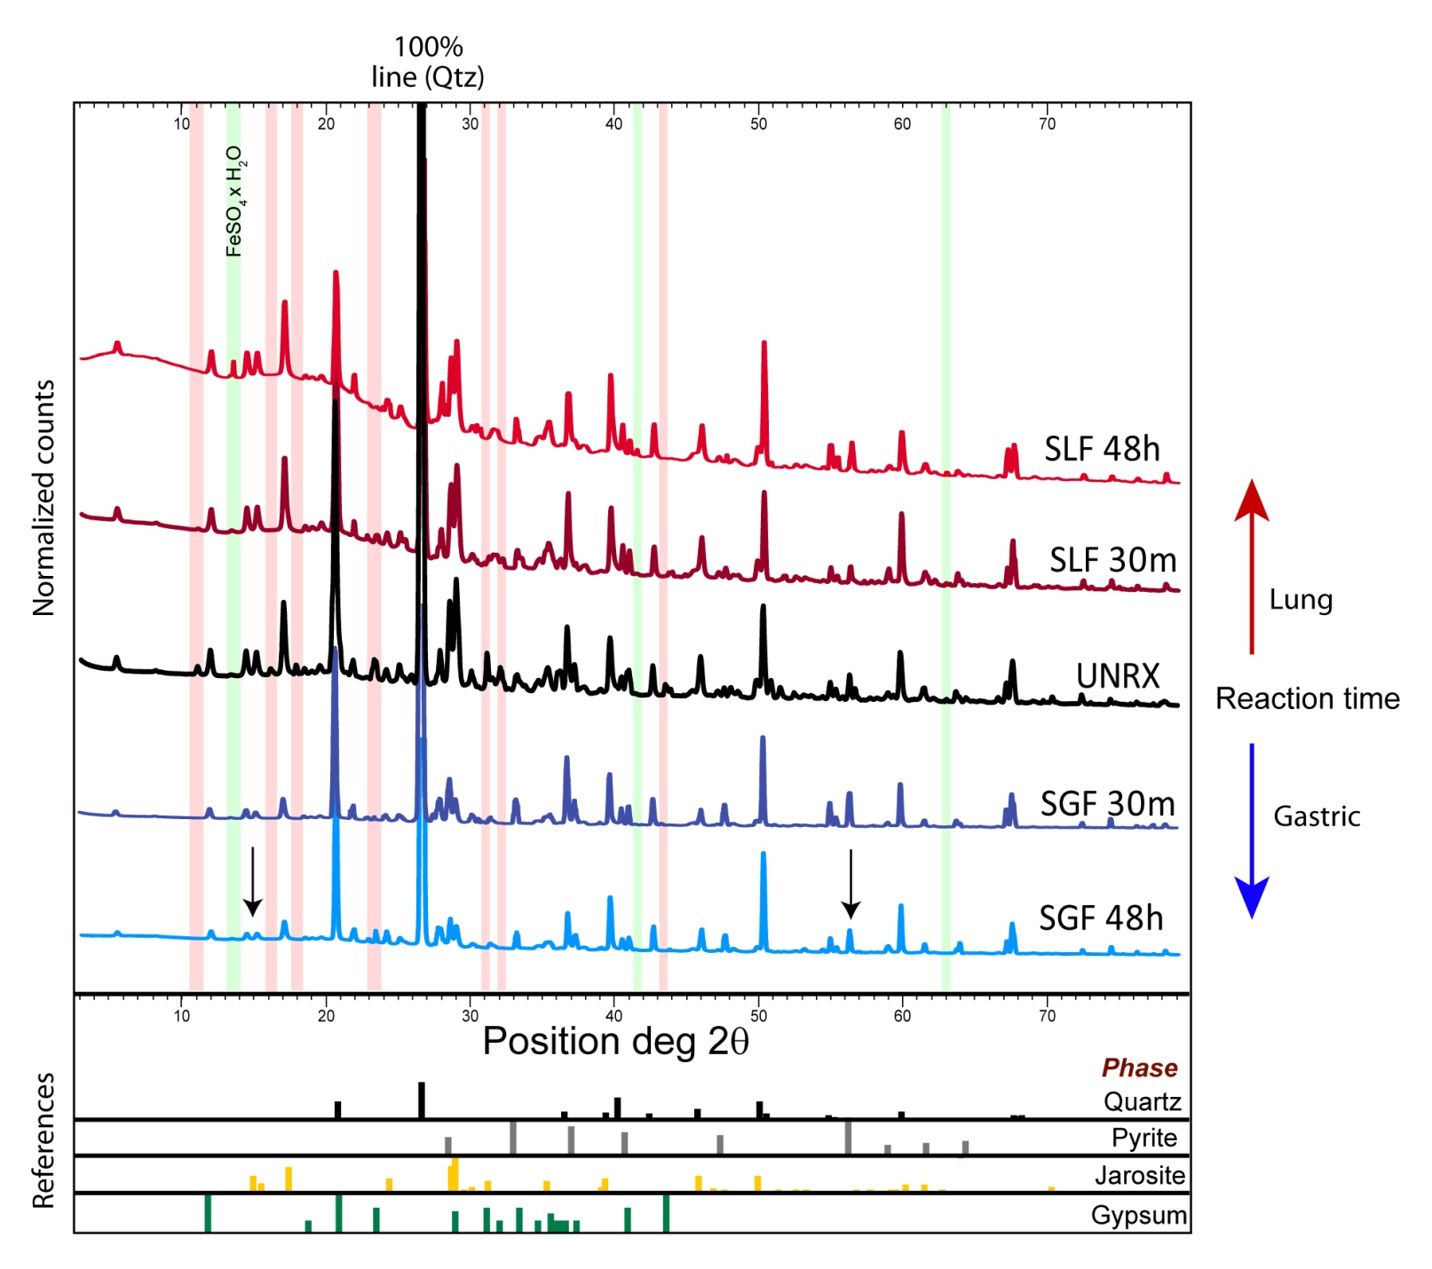
Synchrotron X-Ray Diffraction
Notes:
Red notes reflections that dissolve, green notes reflections that precipitate
The background flattens out with time for gastric, and becomes pronounced with time in lung fluid
Ferrihydrite is not observed in XRD (am phase is masked by xtl phases)
decrease gastric jarosite peak
Could be ppt a new am FeAsO4 phase similar to scorodite (Savage et al.)
lung gets new am phase – likely Al hydroxysulfate hydrobasaluminite –

Slide 24
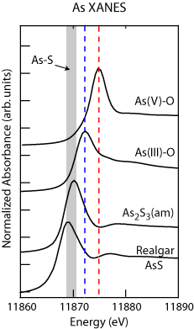
Arsenic Speciation
As^{(V)}
As^{(III)}

Slide 25
Fe XAS speciation
hours
SO4 salts and Fh dissolved first,
As is mostly associated with Fh
Dissolution of Fh does not rel. all the As
A 2⁰ precipitation of an amorphous FeAsSO₄
Fh surface sites are reduced
As competes with SO₄ in SC Jar and FeAsSO₄
Low pH promotes ppt of FeAsSO4,
May not occur in high pH intestinal bioassay
Notes:
Fe XAFS comparison of unreacted half hour and 48 hour in simulated gastric fluid.
The gastric extraction dissolves SO4 salts and Fh first,
As is mostly associated as a sorbed species on Fh
The dissolution of Fh does not rel. all the As
A secondary precipitation of an amorphous FeAsSO4
Fh surface sites are reduced, As competes with SO4 in SC Jar and FeAsSO4
Low pH promotes ppt of FeAsSO4, which may not occur in high pH intestinal bioassay

Slide 26
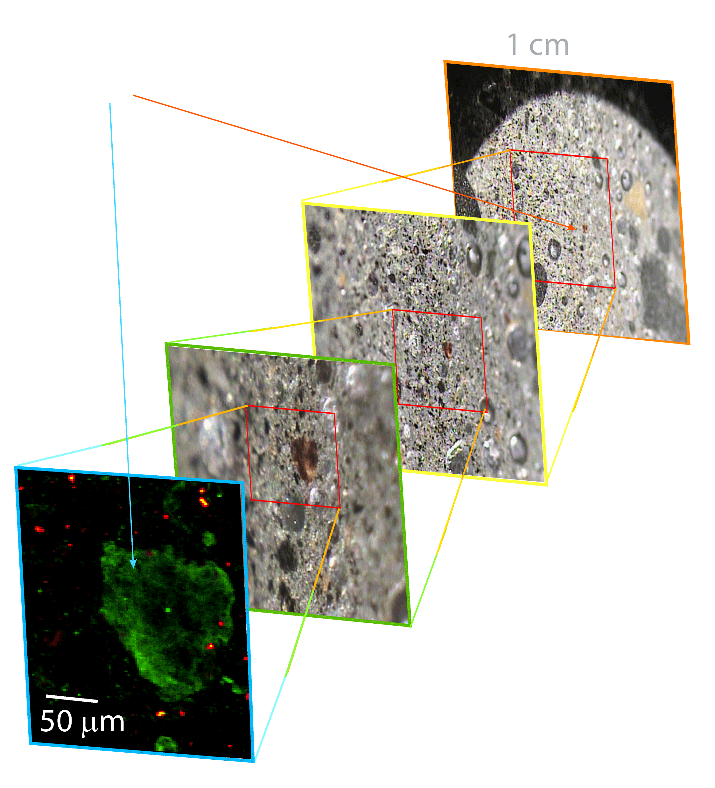
Multiple energy X-ray fluorescence
(ME)μXRF
iron-rich
grain

Slide 27
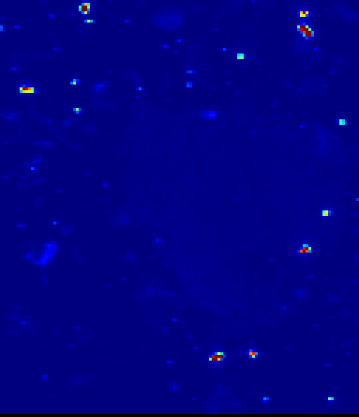
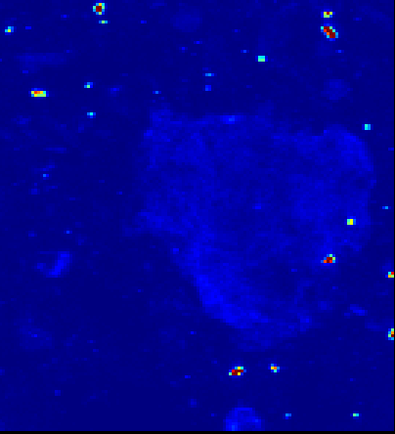
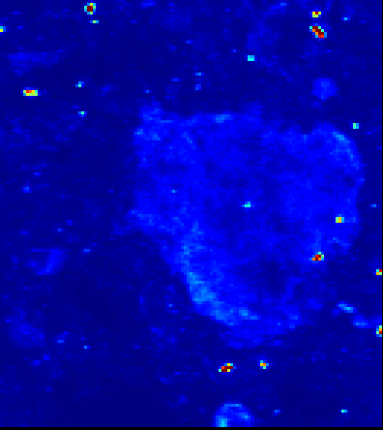
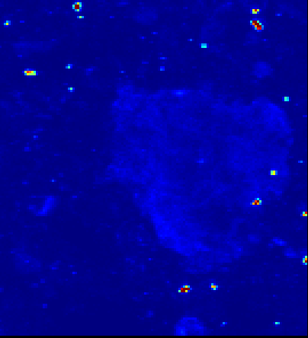
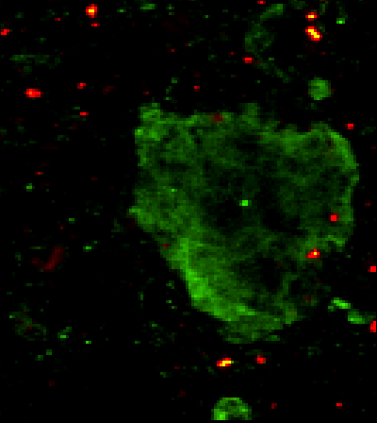
ME-μXRF mapping
Fe XANES
As XANES
Combine images collected at specific energies to create a multi-species image
11869 -As
11872 -As
11875 -As
11880 -As
40μm
As(V)
Sulfide

Slide 28
GI t₀ unreacted surface tailings
Ferrihydrite
As(V) is mostly associated with ferrihydrite, EXAFS showed innersphere complex
Jarosite and pyrite are present but not strongly associated with As.
Pyrite
Jarosite
μXANES

Slide 29
GI t_{0.5h} surface tailings
As is all As(V) and still associated with ferrihydrite;
Jarosite and Fh are less isolated in ~30 μm grains
Pyrite present but not assoc. with As.
μXANES

Slide 30
GI t_{48h} surface tailings
No Ferrihydrite;
As(V) assoc. with Jar or an Jar_{(am)} phase and FeAsS;
Jar_{(am)} looks similar to reported ferric arsenate (Savage et al., 2005);
Pyrite and arsenopyrite observed
μXANES

Slide 31
Unique findings from Gastric Bioassay by X-ray Techniques
XRD - Gastric fluid dissolves sulfates jarosite
XRD – FeSO₄ and am. phases precip. in lung bioassay
XANES - As species does not change in vitro
EXAFS - Fe mineralogy changes in vitro
ME- μXRF – As is strongly assoc. with Fh, not assoc. with pyrite. Fe minerals change: Fh dissolves and a new Fe_{x}(AsO₄ )_{y}(SO₄)_{z} mineral precipitation.

Slide 32
SEM gastric
Pyrite
No (As)
Fe(OH)3
Gastric reacted 48h
Fe(OH)3
Fe:As = 15
Unreacted tailings

Slide 33
SEM alveolar
Unreacted tailings
New “needle” morphologies
Alveolar reacted 48h

Slide 34
PM10 (future experiments)

Slide 35
Introduction
Problem
Characterizing bioaccessibility of
fugative dust from mine waste
Procedures and results
Bioassay
Spectroscopy and imaging
Predicting bioaccessibility
Conclusions

Slide 36
Findings: gastric fluid
The in vitro gastric BAc As is ~25% and Fe is ~30%;
High surface area phases are removed first;
Ferrihydrite is removed by 48 hours;
it has a high affinity for As, but As is not all released;
As in the gastric fluid for 100h, but decrease at 7 d (168h)
Loss of jarosite and no new crystalline phases;
An amorphous phase with FeAsO₄ forms – scavenging As.

Slide 37
Findings: alveolar fluid
The in vitro alveolar BAc As is ~2% and Fe is ~0.2%
Pb bioaccessibility is very low
The Fe and As are not congruently released
At 7 days, [As]>[Fe] in SAF
As release increases continuously for up to 7 days,
Expected to continue as no new Fe-Ox surfaces formed
Neophases are formed that precipitates Fe-SO₄ surfaces
37

Slide 38
Use Speciation to Predict Solubilities
precip. toxin
kinetic ctrl
toxin in
solid phase
Bioaccessible
nontoxic
From O’Day 1999

Slide 39
Potential Arsenic “vectors”
Efflorescent salt with substituted/adsorbed As^{V}
Ferrihydrite with adsorbed As^{V} (esp. GI)
Jarosite with substituted As^{V}
Arsenopyrite
Bioaccessibility
Pathway
Toxin
Human
39
Notes:
Dissolution of Gypsum release Ca and SO₄²⁻
Dissolution of Ferrihydrite and release of Fe²⁺ sorbed As
SO₄²⁻ causes ppt of Fe^{II}SO4
Hydrobasaluminite [Al₄(SO₄)(OH)₁₀ ppt in lung fluid (100% removal of As in lab studies)

Slide 40
Introduction
Problem
Characterizing bioaccessibility of
fugative dust from mine waste
Procedures and results
Bioassay
Spectroscopy and imaging
Predicting bioaccessibility
Conclusions

Slide 41
Conclusions
The bioavailability of metals in tailings is controlled by metal speciation, not total mass concentration;
Secondary mineral precipitation (incl. ferric- and alumino-hydroxy sulfates and ferric arsenates) may play an important role in the availability of contaminants;
Tailings in arid and semi-arid climates may present a greater human health risk associated with direct particulate exposure.
Follow up aim
Combine in vitro extraction studies with in situ molecular-scale spectroscopic studies to constrain in silico models
to create predictive assessment of bioavailability.
41

Slide 42
Acknowledgements
Many Thanks:
Prof Jon Chorover SRP co-PI (geochemist)
Nazune Menka PhD Student
Steve Schuchardt Site owner
Mary Kay Amistadi Director of ALEC Laboratory
Corin Hammond PhD Candidate
Juliana Gil PhD Student
Prof Eduardo Saez SRP co-PI (As transport -dust)
Prof Qin Chen Director NIEHS Training Grant
Prof Clark Lantz Assoc SRP Dir and VP for Res.
Prof Jay Gandolfi Previous SPR Director
Prof Raina Maier SPR Director
NIEHS Grant R01 ES017079
NIEHS Toxicology postdoc training T32 ES007091-31

