Slide 1
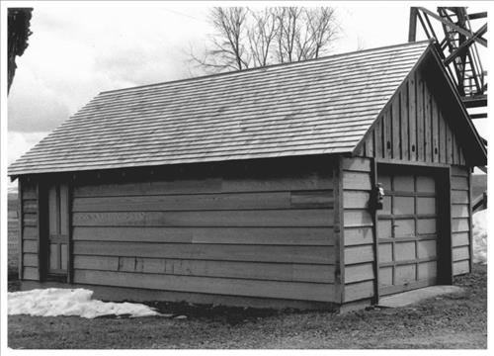
National Historic Preservation Act Section 106 Review Under the Comprehensive Environmental Response, Compensation, and Liability Act
Earl Liverman, US EPA R10 On-Scene Coordinator (Ret.)
Notes:
Throughout this presentation, a variety of sites included in or eligible the National Register of Historic Places are shown to provide a sense of the diversity of such sites:
Unity Ranger Station Cabin (1986), Baker County, OR; areas of significance – architecture, conservation, politics/government

Slide 2
Overview
Course provides participants with an overview of the National Historic Preservation Act (NHPA) and Section 106 requirements under the Comprehensive Environmental Response, Compensation, and Liability Act (CERCLA)
Topics covered:
  Overview of the NHPA
  NHPA under CERCLA
  Pre-Incident Planning and Emergency Response Under Section 106
  Comparison of Key Elements of the Section 106 Process under NHPA and CERCLA
  Section 106 Process: Case Studies Under CERCLA
  Summary: Compliance with Section 106 Under CERCLA

Slide 3
I. Overview of the National Historic Preservation Act
Notes:
Objectives of this module:
An introduction to the National Historic Preservation Act
A discussion of the Section 106 Process regulatory framework
A discussion of the definition of certain key terms used in Section 106

Slide 4
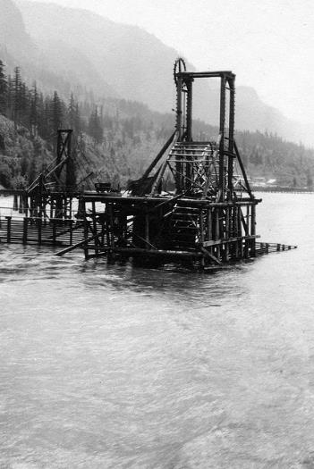
National Historic Preservation Act
Environmental review process initiated with passage of the 1966 National Historic Preservation Act (NHPA), as amended (P.L. 89-665; 80 Stat. 915; 16 U.S.C. 470)
Section 106 requires federal agencies to:
  Take into account effects of undertakings on historic properties
  Provide the Advisory Council on Historic Preservation (ACHP) with a reasonable opportunity to comment
  Consult with State Historic Preservation and Tribal Historic Preservation Offices, Indian tribes, and Native Hawaiian Organizations
Notes:
As massive government-sponsored construction projects, such as the interstate highway system and urban renewal in older cities became commonplace after World War II, an estimated 25% of the nation’s finest historic sites were lost
In response to growing public concern about the loss of historic sites, Congress passed the NHPA in1966
Law established a national policy for protection of important historic buildings and archaeological sites, and outlined responsibilities for federal and state governments to preserve the nation’s heritage
Section 106 is the portion of the NHPA that is concerned with Federal undertakings
NHPA requires federal officials to “stop, look, and listen” before making decisions that may impact historic properties
NHPA also authorizes the National Register of Historic Places, 36 CFR Part 60 and National Historic Landmarks Program, 36 CFR Part 65

Slide 5
Overview of the Section 106 Review Process
NHPA applies to your project if your project constitutes an undertaking and will have a potential effect on a property that is eligible for or included in the National Register of Historic Places
Identification of Historic Properties
36 CFR § 800.4
Assessment of Adverse Effects
36 CFR § 800.5
Resolution of Adverse Effects
36 CFR § 800.6
Initiation of Section 106 Process
36 CFR § 800.3
Notes:
Before beginning any project associated with a federal agency, you must determine whether any NHPA requirements apply to your project (accomplished through Section 106 process): the following steps provide a broad overview of the 106 Process
Step 1. Federal agency determines whether the proposed action is an undertaking and if it is the type of activity that has the potential to cause effects on a property that is eligible for or included in the National Register of Historic Places; identify appropriate consulting parties
Step 2. Determine the area of potential effects of the undertaking; identify any historic properties within that area
Step 3. When historic resources may be affected, determine whether the undertaking will affect such properties, and if so, whether the effects may be adverse
Step 4. After a finding of adverse effects, develop and evaluate alternatives or modifications to the undertaking that could avoid, minimize, or mitigate any identified adverse effects on historic properties
→ NOTE: more to come later in a separate module regarding the 106 Process

Slide 6

Responsibility for Compliance with Section 106
Responsibility for Section 106 compliance lies with the federal agency funding the project or action
[36 C.F.R. § 800.2]
Section 106 regulations do not mandate a timeframe within which a federal agency must complete its review
[36 C.F.R. § 800.1]
Notes:
Mention Executive Order No. 12580 and 13016 which delegate President’s response authority to EPA, USCG, DoD, DOE and other Federal agencies
40 CFR § 300.120

Slide 7
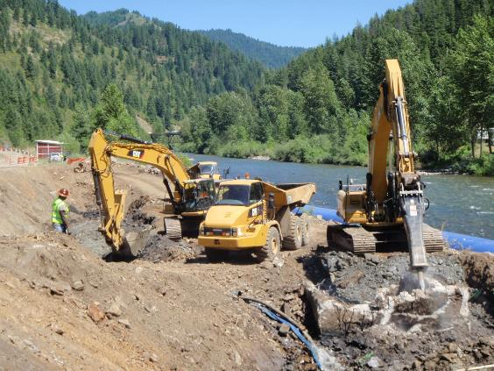
What is a Federal “Undertaking?”
A project, activity, or program either funded, permitted, licensed, or approved by a Federal Agency
May take place on or off federally controlled property and include new and continuing projects, activities, or programs
[36 CFR §§ 800.3, 800.16(y)]
Notes:
Let’s define a number of key terms associated with the NHPA beginning with “undertaking”

Slide 8
Examples of Federal Undertakings
EPA conducting Fund-lead cleanup action; EPA oversight of a PRP-lead cleanup action
Bureau of Land Management permitting a company to build a road on public land
County highway construction financed in part with federal funds
Federal Energy Regulatory Commission relicensing of a private hydroelectric facility
US Army Corps of Engineers building or modifying a dike
US Forest Service building a recreation site on National Forest System land

Slide 9
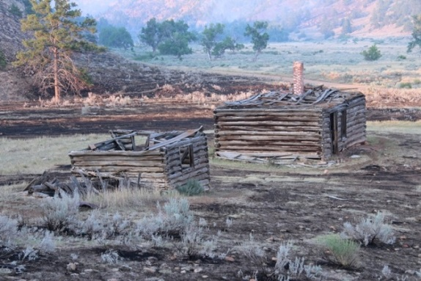
What is a “Historic Property?”
Any prehistoric or historic district, site, building structure, or object included in or eligible for inclusion in the National Register of Historic Places (NRHP)
Includes properties of traditional religious and cultural importance to an Indian tribe or Native Hawaiian organization
[36 CFR §§ 800.4(a),(b),(c), 800.16(l)(1)]
Notes:
National Register-listed or -eligible properties fall into five broad categories:
Buildings: constructions designed principally to shelter human activity, including houses, barns, commercial buildings, government buildings, etc.
Structures: functional constructions not principally designed for human shelter, including bridges, canals, lighthouses, dams, boats, aircrafts, etc.
Sites: Locations of significant events, or prehistoric or historic occupation or activity, including ceremonial sites, battlefields, shipwrecks, trails, designed landscapes, archaeological remains of habitation sites, natural features having cultural significance, etc.
Objects: Constructions that are relatively small in scale, frequently artistic in nature, and associated with a specific setting or environment. They are not museum objects, but include sculptures, monuments, fountains, boundary markers, etc.
Districts: A concentration or continuity of sites, buildings, structures, or objects that are united by their history or aesthetics. The identity of a district results from the interrelationship of its resources. Frequently encountered districts include residential areas, commercial areas, transportation networks, large farms, rural villages, groupings of habitation sites or ceremonial sites

Slide 10
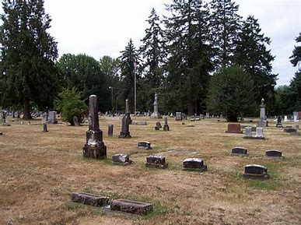
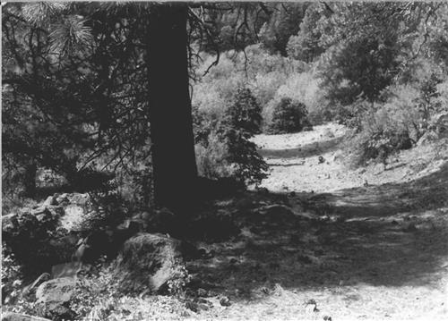
Crystal Lake Cemetery
Barlow Road
Notes:
Crystal Lake Cemetery (2004), Benton County, OR; areas of significance – social history, exploration/settlement
Barlow Road (1992), Clackamas County, OR; areas of significance – transportation, exploration/settlement

Slide 11
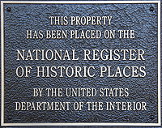
What is the National Register of Historic Places?
Nation’s official list of properties recognized for their significance in American history, architecture, archaeology, engineering, and culture
Criteria for evaluating the eligibility of properties for the National Register are
  Significance
  Age (50 years old or older; ≤ 1916)
  Integrity
  [36 CFR § 60.4]
Notes:
More than 90,000 properties listed in the National Register represent 1.4 million individual resources - buildings, sites, districts, structures, and objects; almost every county in the United States has at least one place listed in the National Register
36 CFR Part 60 (National Register of Historic Places)
Significance. Is the property associated with events, activities, or developments that were important in the past?; with the lives of people who were historically important?; with distinctive architectural history, landscape history, or engineering achievements?; is there the potential to yield important information through archaeological investigation about the past?
Age. Is the property old enough to be considered historic (generally at least 50 years old)
Integrity. Ability of property to convey its significance based on its location, design, setting, materials, workmanship, feeling, and association

Slide 12
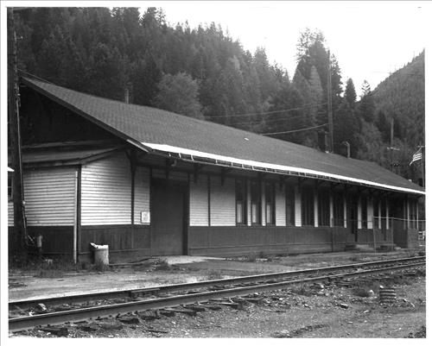
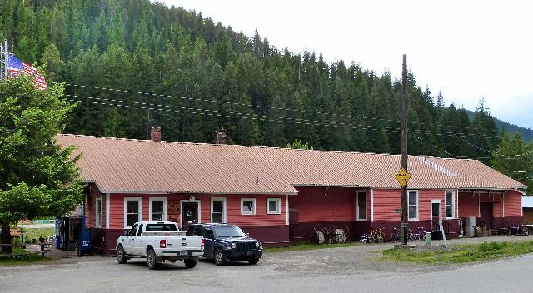
Avery Depot
Notes:
Avery Depot (1984), Shoshone County, ID; area of significance – conservation
Illustrates how historic places can be used

Slide 13

Advisory Council on Historic Preservation
Advisory Council on Historic Preservation (ACHP) generally oversees Section 106 regulations found at 36 CFR Part 800, Protection of Historic Properties
ACHP also consults with and comments to agency officials on individual undertakings and programs that affect historic properties

Slide 14
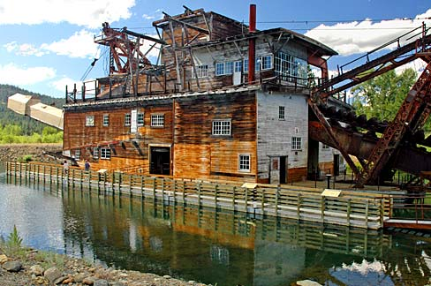
State Historic Preservation Officer (SHPO)
SHPOs administer the national historic preservation program at the state level; SHPOs advise and assist Federal agencies
Most Section 106 consultation takes place between federal agency and SHPO and ACHP (agencies may also consult with THPOs)
[36 CFR §§ 800.2(c)(1)]
Sumpter Valley Gold Dredge
Notes:
Sumpter Valley Gold Dredge (1971), Baker County, OR; areas of significance – industry
Could a SHPO or THPO be viewed as a “trustee” of historic property, similar to a natural resource trustee for natural resources? Probably not.

Slide 15
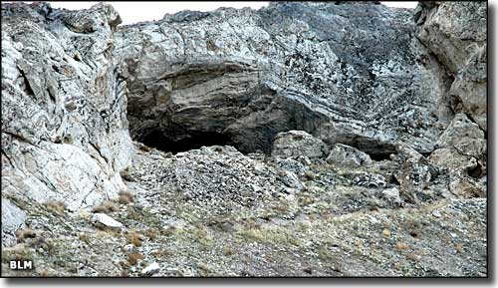
Tribal Historic Preservation Officer (THPO)
Section 106 places particular emphasis on consultation with THPOs, Tribes, and Native Hawaiian organizations (NHOs
Federal agencies must consult THPOs, Tribes, and NHOs about undertakings when they may affect historic properties to which a Tribe or NHO attach religious or cultural significance
Applies regardless of whether the property is located on or off tribal lands
[36 CFR §§ 800.2(c)(2)]
Lovelock Cave
Notes:
Lovelock Cave (1984), Churchhill County, NV; area of significance cultural
Could a SHPO or THPO be viewed as a “trustee” of historic property, similar to a natural resource trustee for natural resources? Probably not.

Slide 16
What is an “Adverse Effect” in Section 106?
An adverse effect is found when an undertaking may alter, directly or indirectly, any of the characteristics of a historic property that qualify the property for inclusion in the National Register in a manner that would diminish the property’s integrity
Adverse effects may include reasonably foreseeable effects caused by the undertaking that may occur later in time, be farther removed in distance, or be cumulative
[36 CFR § 800.5]
Notes:
→ Important reminder:
Under Section 106, a federal agency determines whether its action constitutes an undertaking, and if so, whether the undertaking has the potential to affect historic properties
There is no explicit obligation to actually avoid or minimize adverse effects; Section 106 review encourages, but does not mandate, preservation

Slide 17
Examples of Adverse Effect Activities
Neglect of a property which causes its deterioration
Transfer, lease, or sale of property out of Federal ownership or control without adequate restrictions or conditions to ensure long-term preservation of property’s historic significance
Physical destruction or damage
Relocation of the property
Change in the character of the property’s use or setting
Introduction of incompatible visual, atmospheric, or audible elements
[36 CFR § 800.5(a)(2)]

Slide 18

What is an “Area of Potential Effect?”
Geographic area or areas within which an undertaking may directly or indirectly cause alterations in the character or use of historic properties, if any such properties exist
APE is influenced by the scale and nature of an undertaking and may be different for different kinds of effects caused by the undertaking
[36 CFR §§ 800.4(a)(1), 800.16(d)]
Site
APE
Notes:
Emphasize importance of concept → analogous to importance of definition of “site”
Areas where land-disturbing activities are expected to occur

Slide 19
What is Consultation in Section 106?
Process of seeking, discussing, and considering the views of other participants, and where feasible, seeking agreement with them regarding matters arising in the Section 106 process [36 CFR § 800.16(f)]
Agency official should plan consultations appropriate to the scale of the undertaking and scope of federal involvement [36 CFR § 800.2(a)(4)]
Notes:
Emphasize importance of concept

Slide 20
Consultation vs. Concurrence
Section 106 regulations require the Federal agency to make eligibility and effects findings in consultation with the SHPO/THPO; they do not require the Federal agency to obtain the SHPO/THPO’s concurrence in those findings
Regulations prescribe steps that should be followed when a SHPO/THPO disagrees with a Federal agency’s findings; if agreement cannot be reached, then the ACHP issues formal comments on the undertaking, which the agency must consider before proceeding
Notes:
Emphasize importance of concept

Slide 21
Other Statutes Defining and Protecting Historic Properties
Archaeological Resources Protection Act, 16 USC § 470aa, which provides for the protection of archaeological sites and other resources
Native American Graves Protection and Repatriation Act, 25 USC § 3001, which provides for the protection of Native American human remains and other defined classes of cultural items
National Marine Sanctuaries Act, 16 USC § 1431, which establishes civil penalties for destruction, loss of, or injury to a sanctuary resource, including historic properties
Notes:
Note: Section 106 does not trigger any other environmental compliance requirements; however, other statutes may come into play dependent on the site-specific situation. For example . . . .

Slide 22
Other Statutes Defining and Protecting Historic Properties . . .
Antiquities Act of 1906, 16 USC § 433, which establishes criminal penalties for non-permitted appropriations, excavation, injury, or destruction of any historic ore prehistoric ruin or monument, or any object of antiquity, situated on lands owned or controlled by the federal government
Many States also have laws defining and protecting historic properties

Slide 23
References
The ACHP’s web page provides the most comprehensive information about NHPA requirements (http://www.achp.gov), including links to contact information for federal, state, and tribal historic preservation officers
The National Park Service’s web page (http://www.cr,nps.gov/nr/) provides additional information on properties listed on the NRHP such as location and historic nature of these properties

Slide 24
Questions

Slide 25
II. NHPA under CERCLA
Notes:
Objectives of this module:
A discussion of certain provisions that authorize and govern response actions under CERCLA and the NCP

Slide 26
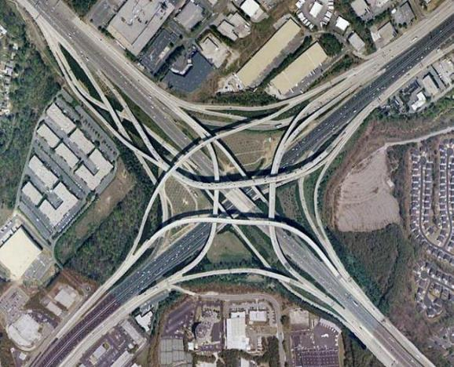
One Designed to Change Effects, the Other to Effect Change
NHPA was designed to change the effects of progress on the places important to communities
Notes:
NHPA: massive government-sponsored projects such as construction of interstate highways and urban renewal projects which did much to change, bisect, and in some instances destroy communities and ways of life – in the name of progress
Instead of trying to address contamination from the effects of the cleanup action, NHPA is aimed at protecting historic properties that may be present from those same effects

Slide 27
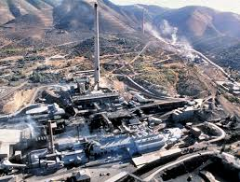
One Designed to Change Effects, the Other to Effect Change . . .
CERCLA was designed and determined to do the opposite of NPHA – to effect change
Notes:
CERCLA: arose out of a need to take action to address hazardous substances that were threatening or had the potential to threaten human health or the environment

Slide 28
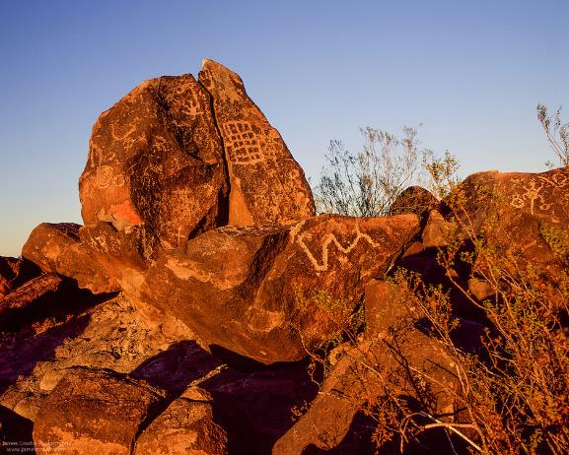
Emergency Response, Removal, and Remedial Actions
Each year, EPA responds to hundreds of hazardous substance releases and oil spill discharges and performs long-term actions to protect the public and the environment
These decisions may affect historic properties, including those that are of traditional religious and cultural significance
Notes:
Painted Rocks (1977), AZ; area of significance – cultural/religious

Slide 29
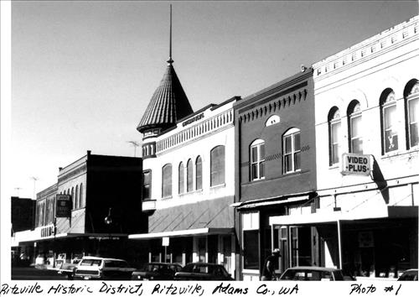
CERCLA and the National Oil and Hazardous Substances Pollution Contingency Plan
Section 104(a) of CERCLA directs EPA to be consistent with the National Oil and Hazardous Substances Pollution Contingency Plan (NCP), 40 CFR Part 300 when implementing any removal action or remedial action
Section 121(e)(1) of CERCLA states no Federal, State, or local permit shall be required for the portion of any removal or remedial action conducted entirely on-site
Notes:
Ritzville Historic District, Ritzville, Adams County, WA); area of significance – architecture/ commerce; applicable criteria – architecture/engineering;

Slide 30
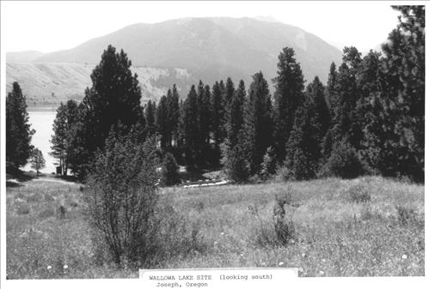
Applicable or Relevant and Appropriate Requirements
NCP requires only those state standards that are promulgated, are identified by the state in a timely manner, and are more stringent than federal requirements may be applicable or relevant and appropriate (ARARs) [§ 300.400(g)(4)]
NCP requires removal actions to attain ARARs of Federal and State laws to the extent practicable considering the exigencies of the situation [§ 300.415(j)]
NCP requires remedial actions to meet ARARs at the completion of an action (or justify a waiver) [§ 300.435.(b)(1)]
Notes:
Nez Perce Traditional Site (1989), Wallowa County, OR; areas of significance – native American

Slide 31
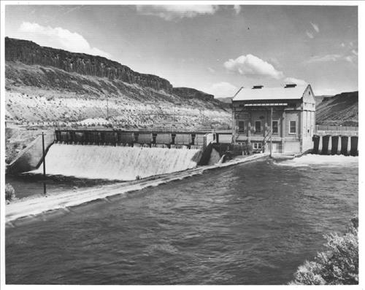
Applicable or Relevant and Appropriate Requirements . .
Scope of ARARs:
  Substantive requirements usually specify a level or standard of control
  Administrative requirements facilitate implementation of substantive requirements
Notes:
Diversion Dam and Deer Flats Embankments (1976), Ada County, ID; areas of significance – industry, conservation, engineering, agriculture
Substantive requirements that pertain directly to actions or conditions in the environment
Examples:
Administrative requirements are those mechanisms that facilitate implementation of substantive requirements of statute or regulation
Examples: Approval by or consultation with administrative bodies, application for permits, documentation, reporting, recordkeeping (CERCLA/Superfund Orientation Manual, EPA/542/R-92-005, October 1992)
However, EPA recognizes the benefits of consultation, coordination, reporting, and other such practices and strongly encourages decision-makers to engage in these activities, as well
CERCLA has its own set of procedures designed to promote the type of consultation and public review, including systematic State, Tribal, and community involvement

Slide 32
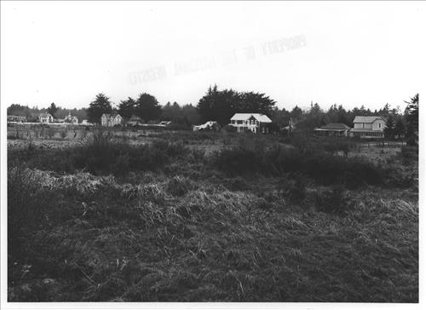
Applicable or Relevant and Appropriate Requirements . . .
NCP requires that only on-site actions need comply with substantive requirements of ARARs [40 C.F.R. § 300.5]
Types of ARARs:
  Action-specific
  Chemical-specific
  Location-specific
Notes:
Oysterville Historic District (1976), Pacific County, WA; applicable criteria – architecture/engineering

Slide 33
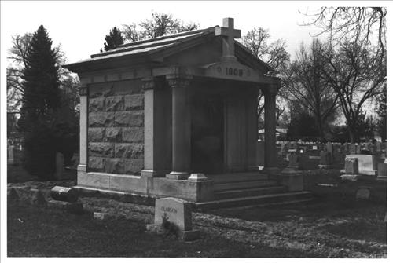
Applicable or Relevant and Appropriate Requirements . . .
Under CERCLA, if NHPA is identified as a location-specific ARAR, the applicable requirements of the NHPA include those that are substantive, rather than those portions that are administrative
Notes:
John Green Mausoleum (1982), Boise, Ada County, ID: areas of significance: architecture

Slide 34
References
Additional information about CERCLA can be found on the EPA Web site: http://www.epa.gov/superfund-cercla-overview
Additional information about the NCP can be found on the EPA Web site: https://www.epa.gov/emergency-response/national-oil-and-hazardous-substances-pollution-contingency-plan-ncp-overview

Slide 35
Questions

Slide 36
III. Pre-Incident Planning and Emergency Response Under Section 106
Notes:
Objectives of this module:
Discussion about pre-incident planning and emergency response under Section 106

Slide 37
Pre-Incident Planning
40 CFR 300.210 defines objectives, authority, and scope of Federal Contingency Plans, including the NCP, Regional Contingency Plans (RCPs), and Area Contingency Plans (ACPs)
  ACPs [§ 300.210(c)] have been developed as a reference document for use of all agencies engaged in responding to environmental emergencies in a defined geographic area
  ACPs adopt national Programmatic Agreement
Under ACPs, Geographic Response Plans (GRPs) guide response actions for a particular shore of waterway, including culturally and historically sensitive sites

Slide 38
Pre-Incident Planning Flow Chart
Identify specific geographic areas or types of areas where categorical exclusions may apply
Develop emergency response strategies that can be reasonably anticipated to protect historic properties
Develop a list of parties to be notified in the event of an incident in a non-excluded area
Identify historic properties that have been listed in or determined eligible for inclusion in the NRHP that might be affected by response to a release or a spill

Slide 39
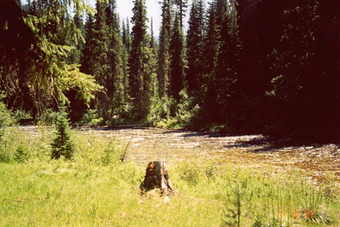
Pre-Incident Planning . . .
May not adequately address federal regional planning and preparedness activities before a response action
Lochsa River, ID
Notes:
For example: downstream of mid-2000 oil spill; searching for crossover point and equipment staging area; UC (EPA, USFS, Nez Perce Tribe) agree to site use; Forest archeologist arrives and informs antidotal historical use

Slide 40
Programmatic Agreement
NHPA was written for planned actions and does not adequately address federal actions under an emergency response
To fill that gap for environmental emergencies, ACHP, National Conference of State Historic Preservation Officers, and eight federal agencies, including United States Coast Guard and EPA, developed and signed the
  Programmatic Agreement on Protection of Historic Properties During Emergency Response Under the National Oil and Hazardous Substance Pollution Contingency Plan (Programmatic Agreement)
Notes:
Programmatic Agreement provides an alternative to Section 106 requirements to ensure appropriate consideration of historic properties during emergency response actions

Slide 41
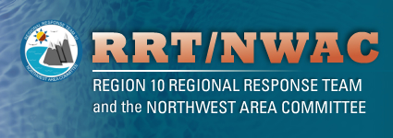
Programmatic Agreement . . .
Programmatic Agreement provides an alternative process to standard Section 106 procedures that allows agencies to meet their responsibilities to protect public health and safety while considering potential impacts to historic properties
A copy of the Programmatic Agreement can be found on the ACHP Web site: http://www.achp.gov/NCP-PA.html
Notes:
Neither Section 106 or the PA are intended to interfere with an emergency response; rather they require that the potential effects of undertakings on historic structures be considered

Slide 42
Emergency Response Actions
Programmatic Agreement defines an “emergency” as that which shall be deemed to exist whenever circumstances dictate that a response action to a release or spill must be taken so expeditiously that normal consideration of the Section 106 process is not reasonably practicable
On-Scene Coordinator (OSC) would make determination as to when such an emergency ceases to exist
Once the emergency response phase is over, the standard 106 process would apply

Slide 43
What types of adverse effects on historic properties may result from emergency response actions?
Certain emergency response actions may include
  Placement of physical barriers to deter the spread of released or spilled substances
  Excavation of trenches to stop the spread of the released or spilled substances
  Ground disturbing shoreline clean up methods
  Establishment of field camps for personnel
  Creation of staging areas for materials or equipment
  Excavation of borrow pits for fill materials
  Construction of access roads

Slide 44
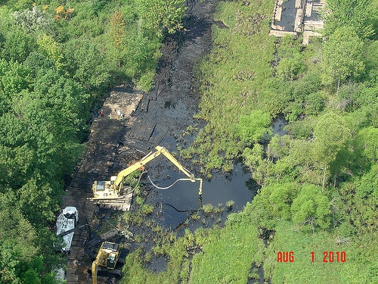
Examples of Potential Emergency Response “Adverse Effect” Activities

Slide 45
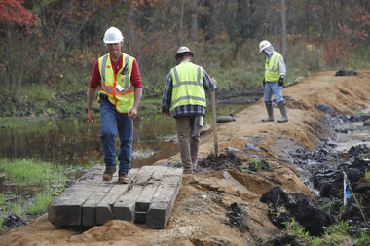
Examples of Potential Emergency Response “Adverse Effect” Activities

Slide 46
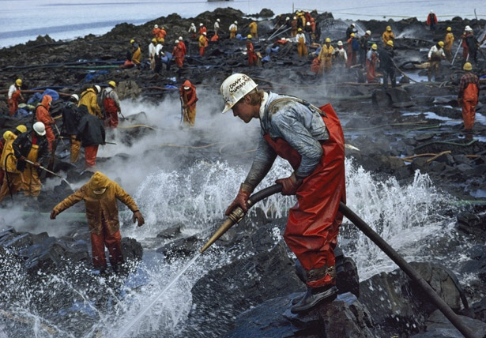
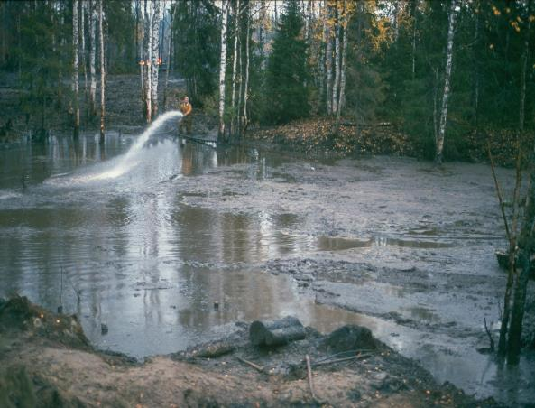
Examples of Potential Emergency Response “Adverse Effect” Activities

Slide 47
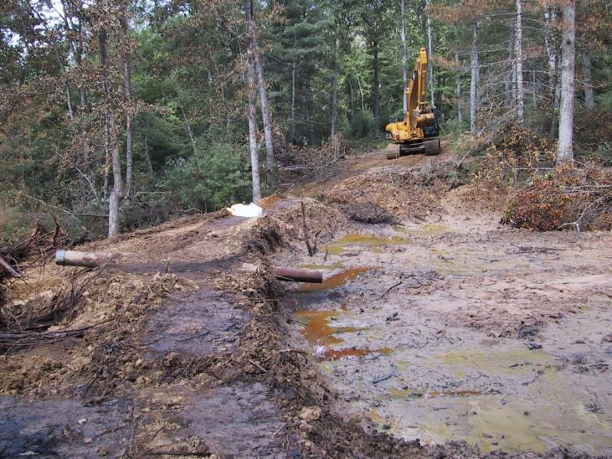
Examples of Potential Emergency Response “Adverse Effect” Activities

Slide 48
Emergency Response Flow Chart: Categorically Excluded
Incident is categorically excluded from Section 106 compliance
Monitor for discovery of previously unidentified historic properties or SHPO categorically excluded release or spill may have potential to affect a significant historic property
Initiate Section 106 Programmatic Agreement Process

Slide 49
Categorically Excluded Areas from Section 106
Spills/releases onto (which stay on):
Gravel pads
Roads (gravel or paved, not including undeveloped right-of-way)
Parking areas (graded or paved)
Dock staging areas less than 50 years old
Gravel causeways
Artificial gravel islands
Drilling mats, pads, and/or berms
Airport runways (improved gravel strips and/or paved runways)
Spills/releases into (that stay in):
Lined pits (e.g., drilling mud pits and reserve pits)
Water bodies where releases/spills will not : reach land/submerged land; and include any emergency response activities with land/submerged land-disturbing components
Borrow pits
Concrete containment area
Spills/releases of:
Gases (e.g., chlorine gas)

Slide 50
Emergency Response Flow Chart: Not Categorically Excluded
Determine if emergency is categorically excluded from Section 106
Activate qualified Historic Specialist (HPS) and develop protective measures for historic properties or cultural resources if determined by consultation
Notify SHPO/THPO for consultation because of overriding factors to categorical exclusion if OSC determines there are historic properties or cultural resources that need to be considered
Assess potential adverse effects of response actions on historic properties; notify SHPO/THPO when emergency response has formally concluded
Initiate Section 106 Programmatic Agreement Process

Slide 51
Important Concepts about Section 106 for the Federal On-Scene Coordinator
OSC may have to make an emergency response decision that adversely affects historic properties and cultural resources; however, the emergency response decision must be an informed decision
OSC must conduct formal consultation with the SHPO/THPO on newly discovered or unanticipated potential historic properties or cultural resources encountered and on adverse impacts due to the response on those properties or resources
Notes:
Explain OSC

Slide 52
Questions

Slide 53
IV. Comparison of Key Elements of the Section 106 Process Under NHPA and CERCLA
Notes:
Objectives of this module:
Discuss the Section 106 process under NHPA and CERCLA
Compare the key elements of the Section 106 process under NHPA and CERCLA

Slide 54
Section 106 Process Flow Chart
Consultation
Initiate Section 106 Process; establish undertaking; undertaking might affect historic properties
No undertaking; no potential to cause effects
Process
Complete
Identify area that might be affected by undertaking; historic properties are affected
No historic properties affected
Assess adverse effects; historic properties are adversely affected
No historic properties adversely affected
____________Resolve adverse effects________
Resolve adverse effects to the extent practicable considering the exigencies of the situation
____36 CFR 800.6(b)___
Section 104(a) of CERCLA
Failure to Agree
ACHP Comment
Notes:
Non-emergency, not categorically excluded
MOAs are appropriate to record agreed upon resolution for a specific undertaking with a defined beginning and conclusion
PAs are appropriate for multiple or complex federal undertakings where (1) effects to historic properties cannot be fully determined in advance, (2) for federal agency programs, (3) for routine management activities by an agency, or (4) tailor to the standard Section 106 process to better fit in with agency management or decision making

Slide 55
Key Elements of Section 106 Process
Roles of Participants
Involving the Public
Consultation
Documentation
Notes:
Congress was clear about its intent for EPA to provide opportunities for members of affected communities to become active participants in the Superfund cleanup process and to have a say in the decisions that affect their communities
Congress wanted EPA to be guided by the people whose lives are affected by Superfund sites and cleanup actions

Slide 56
Comparison of Key Elements: Roles of Participant’s
Section 106 Process
NCP
§ 800.2 identifies participants in 106 review process and outlines their roles and responsibilities
Participants roles and responsibilities in CERCLA response process are stated in the NCP such as §§ 300.135, 300.175 and 300.500, and 300.600
Notes:
Consistent with the NCP is key [CERCLA section 104(e)]
See Sections 300.5 (definition of community relations), 300.135 (Response Operations); 300.155 (Public Information and community relations); 300.170 and .175 (Federal agency participation and Federal agencies additional responsibilities and assistance); 300.180 (State and local participation in response); Subparts F and G.
“Community relations” -
NCP requires specific community involvement activities be undertaken at certain points throughout the Superfund process

Slide 57
Comparison of Key Elements: Involving the Public
Section 106 Process
NCP
Section 106 requires that agencies provide the public with information about an undertaking and its effects and seek public comment
[36 CFR 800(d)(2)]
Activities to inform and encourage public participation in the CERCLA response process are stated in the NCP such as §§ 300.135, 300.415, 300.430, and 300.800
Notes:
Section 106
Approach should plan public involvement appropriate to scale of undertaking and scope of Federal involvement [36 CFR 800.2(a)(4)]
Agencies are encouraged to use their own procedures to satisfy Section 106 general public outreach requirements [36 CFR 800.2(a)(2)]
NCP: NCP requires specific community involvement activities be undertaken at certain points throughout the Superfund process

Slide 58
Comparison of Key Elements: Consultation
Section 106 Process
NCP
Seeking, discussing, and considering views of other participants, and where feasible, seeking agreement with them regarding matters arising in Section 106 process
[36 CFR 800.16(f)]
Activities to engage in dialogue, consultation, and coordination with communities affected by the CERCLA response process are stated in the NCP such as §§ 300.135, 300.415,300.430, and 300.800

Slide 59
Comparison of Key Elements: Documentation
Section 106 Process
NCP
Agency official shall ensure that a determination, finding, or agreement is supported by sufficient documentation to enable any reviewing parties to understand its basis
[36 CFR 800.11]
During all phases of response, the lead agency shall complete and maintain documentation to support all response actions taken under the NCP
[40 CFR 300.16(a)(1)]
Notes:
CERCLA: An administrative record shall be established that contains the documents that form the basis for selection of a response action [40 C.F.R. 300.800]

Slide 60
EPA Options for Completing Section 106 Process at Mixed Ownership Sites
Rely solely on another federal agency’s Section 106 review and consultation, which likely would be accomplished by adopting the other agency’s Programmatic Agreement or Memorandum of Agreement
Complete a separate Section 106 Process

Slide 61
References
A copy of the EPA Superfund Community Involvement Handbook (2016) can be found at: http://www.semspub.epa.gov
A copy of the Section 106 Regulations Flow Chart and Key Elements of the Section 106 Process can be found on the ACHP Web site: http://www.achp.gov/regsflow.html

Slide 62
Questions

Slide 63
V. Section 106 Process: Case Studies under CERCLA
Notes:
Objectives of this module:
Describe and discussion certain case studies involving implementation of NHPA under CERCLA

Slide 64
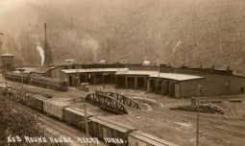
Case Study: Avery Landing

Slide 65
Background
Site (located in Shoshone County, ID) is a former location of a railroad light maintenance and refueling facility used between 1907 and 1977 by the Chicago, Milwaukee, St. Paul & Pacific (Milwaukee) Railroad
Initial PRP-lead non-time-critical removal action (NTCRA) engineering evaluation/cost analysis (EE/CA) effort pursuant to an Administrative Settlement Agreement and Order on Consent (ASAOC) (08/08), including a cultural resources survey (CRS)
Due primarily to an excess of deficiencies associated with the EE/CA, EPA assumed responsibility for completion of project documents, including the CRS

Slide 66
Section 106 Activities
06/04/2011 - 09/11/2012. Initiated and completed substantive requirements of Section 106 Process under CERCLA
06/04/11. EPA submits two reports to ID State SHPO requesting comments, suggestions, or recommendations regarding report conclusions and recommendations:
  PRP-prepared Cultural Resources Assessment
  EPA-prepared Cultural Resources Survey (CRS); recommends pedestrian survey and archaeological field study of Site and finding of no adverse effect
08/25/11. SHPO concurs with recommendation and requests additional field activities (any remains associated with CCC camp or Japanese settlement); and other recommendations for additional actions to mitigate effects from cleanup

Slide 67
Section 106 Activities . . .
08/25/12. EPA submits final CRS report to ID State SHPO; advises EPA initiated cleanup 06/12; additional field activities requested by SHPO were either performed or taken into account during survey and field work
08/30/12. SHPO responds report is
  CRS is “well done and meets the Secretary of the Interior’s Standard’s.”
  “In the future, EPA should have final comments in hand prior to any ground-disturbing activities associated with the project. Without final comments, EPA is not meeting the requirements of Section 106.”
09/11/12. EPA offers government-to-government consultation with Coeur d’Alene Tribe regarding 2012 CRS report; no comments received

Slide 68
Site Architectural Features Identified During CRS
Notes:
Railroad rail imbedded in concrete leading to a storage bay
Closeup of brick

Slide 69
Site Architectural Features Identified During CRS
Notes:
Railroad rail imbedded in concrete used to move locomotives and train cars between turntable and storage bays in roundhouse
Turntable

Slide 70
Site Artifact Scatters
Notes:
Railroad-related debris
Structural debris

Slide 71
Case Study: Bonanza Mine and Mill

Slide 72
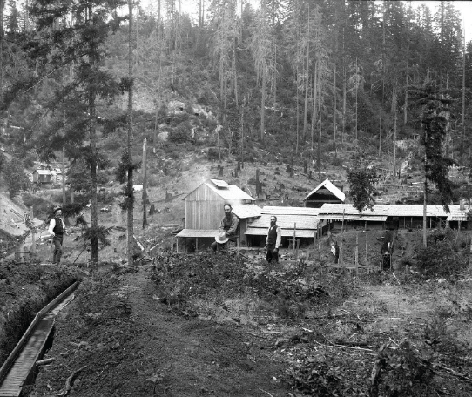
Background
Former mercury mine and mill that operated from the mid-1860s to the 1960s and produced more than 3,000,000 pounds of mercury
In 2014 EPA performed a TCRA at the Site located in Douglas County, OR

Slide 73
Section 106 Activities
06/03/2014 – 09/30/2014. Initiated and completed substantive requirements of Section 106 Process under CERCLA, including
  Consultation with OR SHPO (throughout 106 Process) and interested Tribes
  Completion of a Cultural Resources Survey (CRS)
  EPA determined that the TCRA had no potential to have an adverse effect on historic properties because no such properties remained at the Site
  CRS forwarded to OR SHPO, interested Tribes, and Douglas County Historical Society
  SHPO concurred with no effect determination
State OSC played an influential consultation role throughout the 106 Process

Slide 74
Bonanza Mine and Mill: mid-970s

Slide 75
Mine Workings and Mill Site: 2014

Slide 76
Mine Waste Dumps

Slide 77
On-Site Residences

Slide 78
On-Site Residences . . .

Slide 79
Case Study: Josephine Mill No. 1

Slide 80
Background
Josephine Mill No. 1 Site is an inactive mill located in northeast WA
Site consists of approximately 5.3 acres of land that contains a partially forested steep rock slope with remnant wood and concrete mill structures, tailings and waste rock piles, and miscellaneous metal
Processing at the mill ended in the mid-1930’s and the mill has generally been abandoned since that time
EPA overseeing performance of PRP-lead non-time-critical removal action; PRP is owner of Site

Slide 81
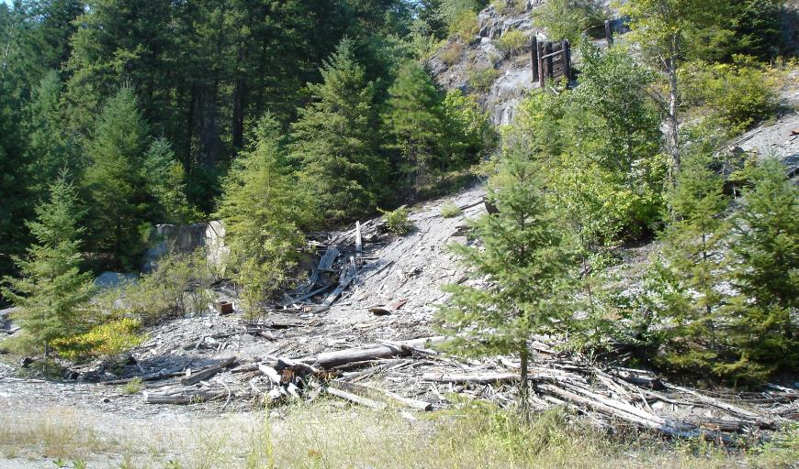
Overview of Mill Site:

Slide 82
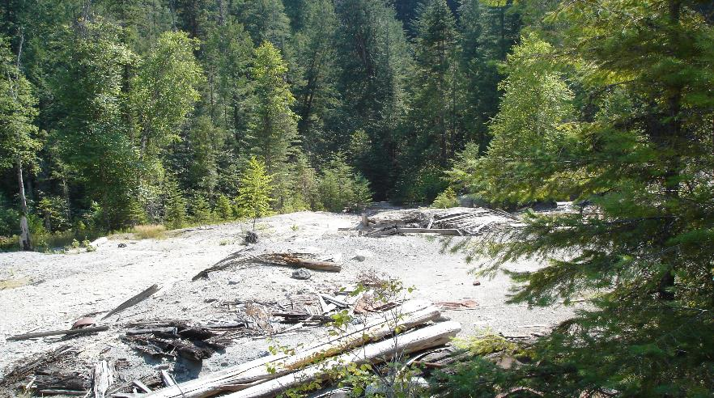
Overview of Mill Site:

Slide 83
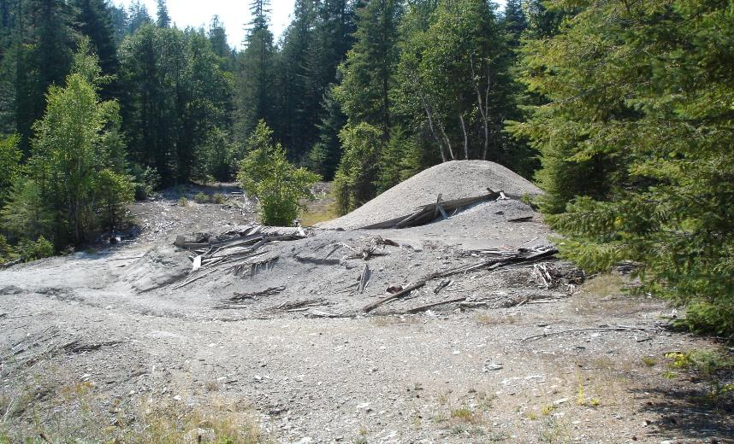
Overview of Mill Site: Wood Flume Remnant

Slide 84
Section 106 Activities
01/2010. PRP-prepared Cultural Resources Survey (CRS):
  Identified three features likely to be adversely affected by removal action (JM-1, JM-2, JM-3)
  Recommended development of an Memorandum of Agreement (MOA) between State of Washington Department of Archaeology and Historic Preservation (DAHP) and EPA, and preliminary excavation at these three features be monitored by qualified archaeologist
09/2010. Project monitoring of features did not identify cultural resources that would significantly add to knowledge of mill; no further cultural resources work recommended for removal action
  DAHP agreed to allow removal action to proceed with preliminary excavation into three features being monitored by a qualified archaeologist

Slide 85
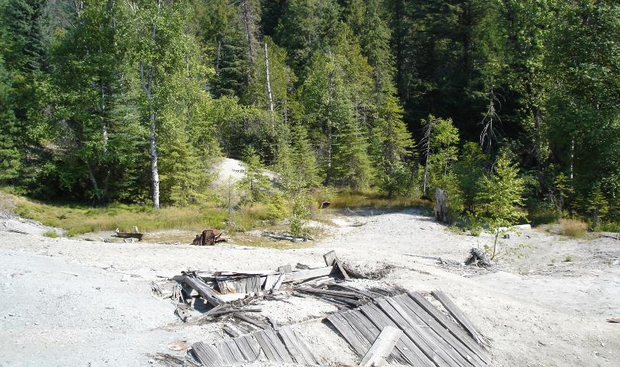
Site Architectural Features: JM-1 Collapsed Wooden Building; JM-3 Remnant Wood Crib Structure
JM-1
JM-3

Slide 86
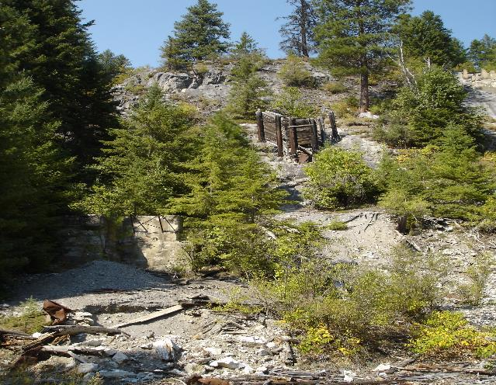
Site Artifact Scatter: JM-2 Trash Scatter
JM-2

Slide 87
A Tale of Two Perspectives: SHPO
SHPO asserts EPA:
  Is required to comply with the administrative and the substantive requirements of Section 106 of NHPA and its implementing regulations, and counterpart State statutes
  Failed to comply with Section 106 by not entering into MOA with DAHP, and not obtaining an permit from the Department enabling it with the capacity to assure appropriate treatment of archaeological resources at the Site

Slide 88
A Tale of Two Perspectives: EPA
EPA asserts:
  It has been following the dictates of CERCLA and NCP; EPA has sought to have the removal action comport with substantive aspects of NHPA

Slide 89
Specific Concerns/Issues - ARARs
NCP requires removal actions to attain ARARs of Federal and State laws to the extent practicable considering the exigencies of the situation [40 CFR § 300.415(j)]
  Need for prompt and thorough response to contamination which presents an ongoing risk to public health and environment, short work season and need to conserve limited work resources
NCP requires only those state standards that are promulgated, are identified by the state in a timely manner, and are more stringent than federal requirements may be ARARs [§ 300.400(g)(4)]
  No comments were received from SHPO (or anyone else) about historic preservation laws during early planning, review of the CRE and engineering evaluation/cost analysis (EE/CA) (both produced in March 2010), or in response to listing NHPA as an ARAR in the Action Memorandum (produced 08/26/10)
  Comments were received from SHPO about State historic preservation laws on 09/14/2010
    SHPO did not provide a satisfactory explanation as to why the historic preservation laws were substantively more stringent than NHPA

Slide 90
Specific Concerns/Issues – MOU and Permits
Section 121(e)(1) of CERCLA states no Federal, State, or local permit shall be required for the portion of any removal or remedial action conducted entirely on-site
NCP requires that only on-site actions need comply with substantive requirements of ARARs [40 CFR § 300.5]
  Approval by or consultation with administrative bodies, application for permits, documentation, reporting, recordkeeping are examples of administrative requirements

Slide 91
ACHP Review of Section 106 Compliance
SHPO notifies ACHP about alleged inadequacy of EPA’s compliance with the NHPA
EPA and SHPO provided documentation to ACHP; ACHP held a hearing/conference call with EPA and SHPO to discuss compliance issues; EPA and SHPO provided additional information as requested by ACHP
ACHP issued a decision basically stating that EPA had not followed proper protocol under the NHPA regulations by failing to timely consult with the SHPO; but that this failure did not require any further consideration because EPA had already mitigated for the loss of potential historic properties by providing SHPO with appropriate documentation and historic evaluation of the properties

Slide 92
Questions

Slide 93
VI. Summary: Compliance with Section 106 Under CERCLA
Notes:
Objectives of this module:
Share several observations regarding compliance with Section 106 CERCLA

Slide 94
Section 106 Process under CERCLA: SHPO Survey
Article titled, Integrating the Preservation of Cultural Resources with Remediation of Hazardous Materials: An Assessment of Superfund’s Record, presents findings of a survey circulated among SHPOs in December 1999
  Survey asked SHPOs to describe experiences with EPA and its willingness to administer Superfund in compliance with NHPA
About 30 SHPOs responded to questionnaire
Notes:
Quivik, Frederic. Integrating the Preservation of Cultural Resources with Remediation of Hazardous Materials: An Assessment of Superfund’s Record. The Public Historian, Vol. 23, No. 2, pp. 47-61. Spring 2001.

Slide 95
Section 106 Process under CERCLA: SHPO Survey . . .
Conclusions:
  Are you aware of one or more Superfund projects in state that have (potentially) had an effect cultural resources?
    12/30 Yes; 17/30 No; 1/30 Unaware
  Has EPA complied with section 106 NHPA and related regulations while planning to implement Superfund remediation in your state?
    8/29 Yes; 7/29 No; 14/29 Other (unknown)
  If so, did EPA step forward voluntarily?
    6/11 Yes; 4/11 No; Other 1

Slide 96
Section 106 Process under CERCLA: SHPO Survey . . .
Has your office had difficulty convincing EPA personnel that EPA is required to comply with section 106?
  8/25 Yes; 6/25 No; 11/25 Other
If EPA complied has complied with section 106 on one or more Superfund projects in your state, how would you rate EPA’s performance compared with other agencies which your office works?
  Determinations of Eligibility: Poorer 4/13; Typical 8/13; Better 1/13
  Determinations of Effect: 4/11; Typical 6/11; Better 1/11
  Considerations of Alternatives: Poorer 7/11; Typical 4/11; Better 0/11
  Mitigation of Adverse Effect: Poorer 4/11; Typical 4/11; Better 3/11

Slide 97
Observations About Section 106
NHPA applies to your project if your project constitutes an undertaking and will have a potential effect on a property that is eligible for or included in the Register of Historic Places
Federal agencies retain the responsibility for final decisions regarding the impacts of cleanup activities on cultural resources
Anticipate having to explain to SHPOs and others the legal parameters of CERCLA such as Section 104(a) and Section 121(e)(1), and the NCP, including 40 CFR § 300.415(j)
Notes:
A federal agency determines whether its action constitutes an undertaking, and, if so, whether the undertaking has the potential to affect historic properties
Federal agency with jurisdiction over an undertaking is responsible for compliance with Section 106; absent statutory authority to do so, this responsibility cannot be delegated; the agency must independently make and is legally responsible for the findings and recommendations required by NHPA regulations

Slide 98
Observations About Section 106 . . .
NHPA does not prohibit federal agencies from having an adverse effect on cultural resources included on (or eligible for inclusion on) the National Register; rather, the act requires agencies to consider the effects of their undertakings
  There is no substantive requirement to actually avoid or minimize adverse effects
Initiate the Section 106 process as early as possible with the SHPO/THPO
Carefully screen archaeological consultant and draft documents (e.g., definition of APE, recommendations, anything outside of context of CERCLA)

Slide 99
Observations About Section 106 . . .
Federal agencies have an obligation to consult with tribes that may attach religious or cultural significance to historic properties that may be affected by an undertaking
See also EPA Policy on Consultation and Coordination with Indian Tribes (Policy), available at https://www.epa.gov/tribal/epa-policy-consultation-and-coordination-indian-tribes
  This policy describes a separate obligation to consult with federally recognized tribes based on the federal government’s trust responsibility

Slide 100
Questions

