Slide 1
Using Organic Amendments. Byproducts and Agronomy in Remediation of Contaminated Sites.
Rufus L. Chaney USDA-ARS-EMBUL, Beltsville, MD,
Webinar,
May, 2013

Slide 2
Pathways for Assessment of Risks From Metal Rich Soils to Highly Exposed Individuals.
Pathway Highly Exposed Individual
1. Soil➔Plant➔Human Farm markets; 2.5% of food.
2. Soil➔Plant➔Human Home gardens; 60% of garden foods; lifetime
3. Soil➔Human Soil ingestion; 200 mg/day
4. Soil➔Plant➔Animal➔Human Farms; 45% homegrown meat.
5. Soil➔Animal➔Human Farms; 45% homegrown meat.
6. Soil➔Plant➔Animal 100% of livestock feeds grown on metal enriched soil.
7. Soil➔Animal Grazing ruminants; soil at 1.5% of diet.

Slide 3
Pathways for Assessment of Metal Enriched Soils Risk to Highly Exposed Individuals.
Pathway Highly Exposed Individual
8. Soil➔Plant Sensitive crops; strongly acidic.
9. Soil➔SoilBiota Earthworms; microbes; metabolic function of soil.
10. Soil Biota➔Predator Shrews; 1/3 of diet is earthworms full of soil.
11. Soil➔Airborne Dust➔Human Tractor operator.
12. Soil➔Surface water➔Human Subsistence fishers.
13. Soil➔Air➔Human Farm households
14. Soil➔groundwater➔Human Well water on farms; 100%.

Slide 4
SOIL-PLANT BARRIER Processes in Soils or Plants Which Limit Excessive Plant Uptake of Elements
Insolubility/adsorption in soil or plants roots: Cr, Ti, Pb, Fe, Hg, Sn, Au, Ag, Zr, Al, F, etc.
Phytotoxicity limits plant yield at plant metal levels which are not toxic for lifetime consumption by livestock (based on NRC):
Zn, Cu, Ni, As, Mn, B, etc.
Exceptions to Soil-Plant Barrier Protections:
Cd risk to subsistence rice consumers; Se possible but livestock more sensitive (one case in China from Se).
Mo, Se, Co possible risk to livestock; Ni inhibits Co availability to plants and of plant Co to animals.
Barrier can be circumvented by ingestion of soils.
F, Pb, Fe, Hg, As,

Slide 5
Complex Equilibria of Nickel Ions with
Components of Soil Environments
Plant
Shoots
Chelated to Organic Matter
Humics; fulvics 
⬆
Plant
Roots

Adsorbed ⬅
on Fe/Mn ➔
Soil Solution
Ni²⁺ + L ⇔ NiL


Soil
Microbes
⬆⬇
Occluded in
Fe/Mn oxides
Inorganic
Solids
L = Ligands
Organic
Inorganic
Ni(OH)₂ Ni-Silicate
NiO Ni-Al-hydroxide

Slide 6
Methods To Remediate Metal Phytotoxic Soils Are Readily Available-1.
Phytostabilization: Uses Soil Amendments to Reduce the Potential for Ni Phytotoxicity to Sensitive Species.
More effective with more complete knowledge of the mechanisms of Ni-induced Fe deficiency in plants.
Raise soil pH to 7 or above to provide long term control of soil pH by making the soil calcareous.
When some soils are made calcareous, they become Mn deficient; if soils at site are susceptible to Mn deficiency (e.g., Lake Plain mucks), one may have to add Mn fertilizer.
May choose to add hydrous Fe and Mn oxides to increase adsorption and occlusion of Ni in soils. Depending on soil fertility, may need to add Mn, Zn and P to soil to prevent the addition of Fe from inducing Mn, Zn or P deficiency.

Slide 7
Methods To Remediate Metal Phytotoxic Soils Are Readily Available-2.
“TAILOR-MADE PHYTOSTABILIZATION MIXTURES”:
Combine limestone equivalent rich residuals with organic residuals and Fe(OH)₃ and other amendments as needed to achieve calcareous soil rich in Fe with adequate Mn to prevent Mn deficiency in the field with sensitive crops.
Limestone sources: wood ash; byproduct lime; etc.
Organic residuals: Compost; Manure, Biosolids, etc.
Fe and Mn byproducts mixed with compost to increase Ni adsorption and occlusion capacity of the amended soil.
Over time, occlusion reduces metal phytoavailability:
Some metals (Ni, Zn, Co) can form Layered Double Hyroxides (LDH), be occluded into goethite and other Fe and Mn oxides, Ni-silicates in soils. Occlusion can reduce the activity of soil Ni²⁺ and reduce Ni phytotoxicity risk even better than normal adsorption and chelation.
Occluded metals are no longer in the “labile pool”.

Slide 8
Phytostabilization of Metal Toxic Sites
Hazardous mining and smelting sites are often so metal phytotoxic and nutrient deficient that plants cannot become established on the site soils.
Phytostabilization has been shown to alleviate risk to ecosystem and support persistent vegetative cover.
Acid soils rich in Zn, Ni, Cu or Mn may prevent plant growth.
Making soil calcareous can fully alleviate metal phytotoxicity.
Applying organic amendments rich in organic-N, P, and other required nutrients, and microbes, can solve infertility issues.
Including adsorbents in the amendments aids remediation.
Selecting plant species fit to purpose.
Adapted to local climate conditions; natives if work; if phtotoxicity and infertility alleviated, no longer difficult.
Metal excluders and low Cd:Zn ratio to protect food chains.
Soil Revitalization, not Ecosystem Restoration

Slide 9
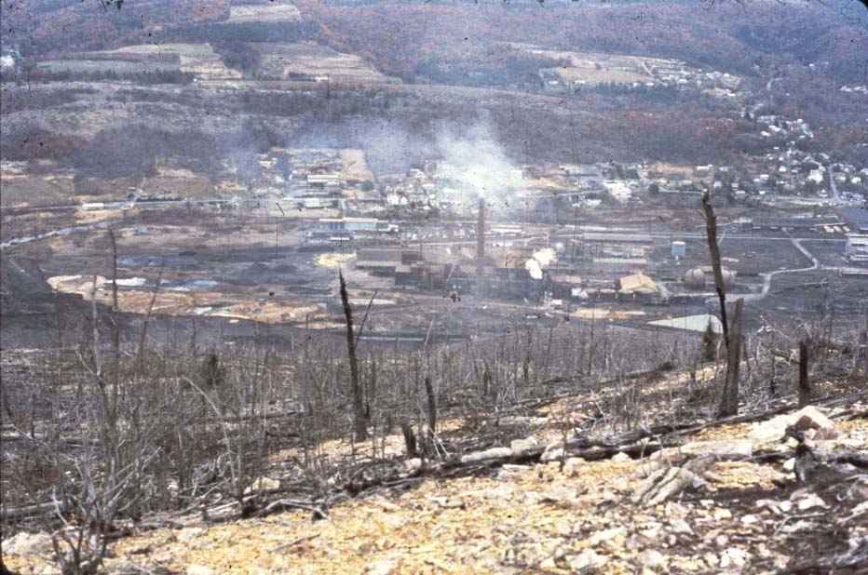
Palmerton, PA, 1980; Dead Ecosystem on Blue Mountain--Zn, Cd, Pb

Slide 10
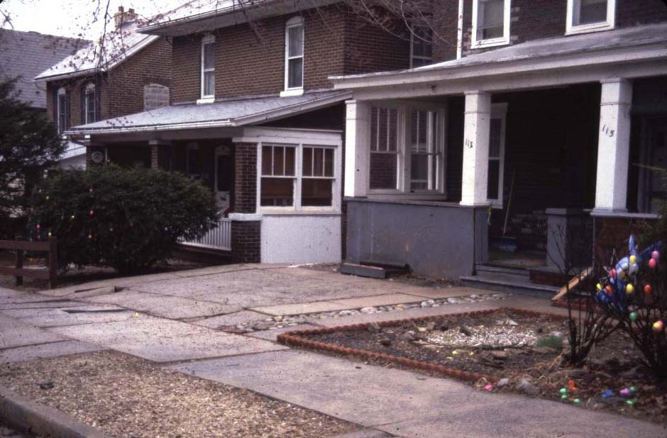
Palmerton, PA, 1980; because lawn grasses died from Zn, many residents covered their lawns with stones or mulch.

Slide 11
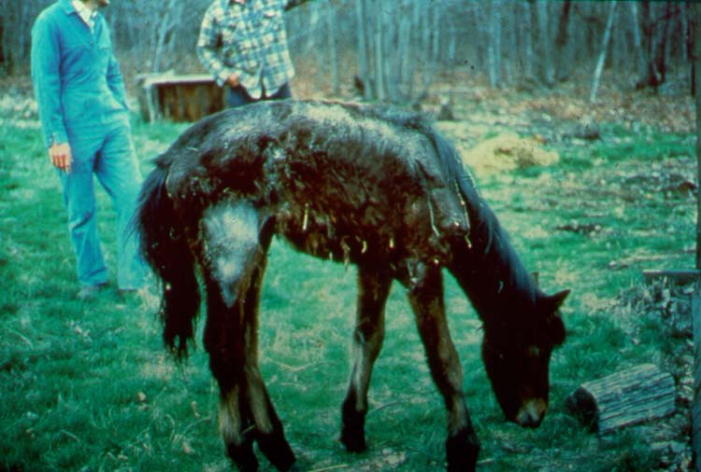
Zn-toxic pony near Palmerton in 1979.
Notes:
Sick colt at Palmerton.

Slide 12
Phytostabilization -- in situ Remediation
Using biosolids, composts, and byproducts in remediation of phytotoxic or infertile soils.
Soil chemistry management may provide persistent/sustainable remediation:
Nearly all sites are intensely P deficient.
Manure, biosolids and their composts are richer in N and P than yard debris composts and many other organic amendments.
Inorganic N fertilizers cannot persist in root zone.
Zn, Cu, Ni and Mn are commonly phytotoxic if acidic.
Make calcareous to prevent metal cation phytotoxicity.
Leaching of alkalinity may alleviate metal toxicity at some sites where metals are in near-surface soil depth.
Amorphous Fe and Mn oxides provide increased metals adsorption and may be built into amendment mixture.

Slide 13
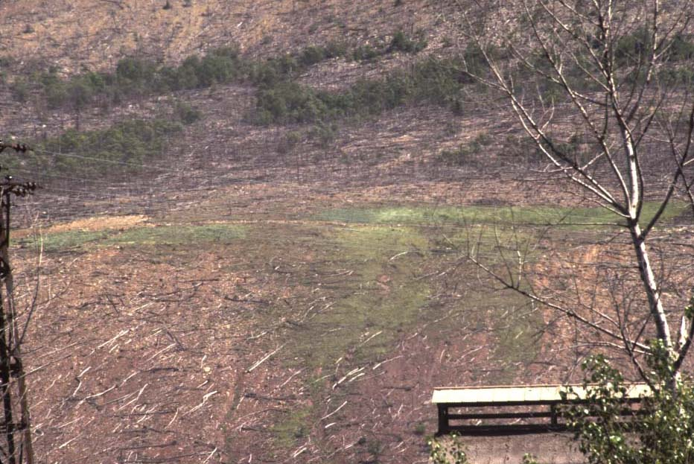
Spread of Zn-Resistant ‘Merlin’ Red Fescue on Blue Mt.,
Palmerton, PA. Helicopter applied seed, fertilizer and limestone.

Slide 14
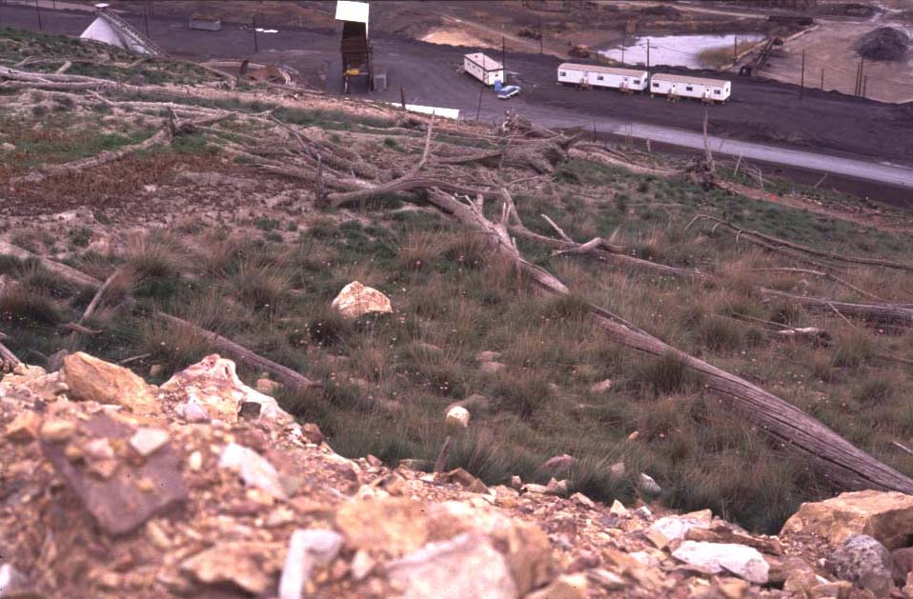
Palmerton, PA, 1990: Oyler’s First Test Plot Using Biosolids + FlyAsh + Limestone, with ‘Merlin’ Red Fescue; adjacent control.

Slide 15
Characteristics of the Blue Mountain North Slope Soils Sampled in bulk in 1998 for Thlaspi studies in the greenhouse (Brown et al.)
mg/kg DW
44,100 Zn
25,500 Fe
8,920 Mn
863 Cd
pH 6.25

Slide 16
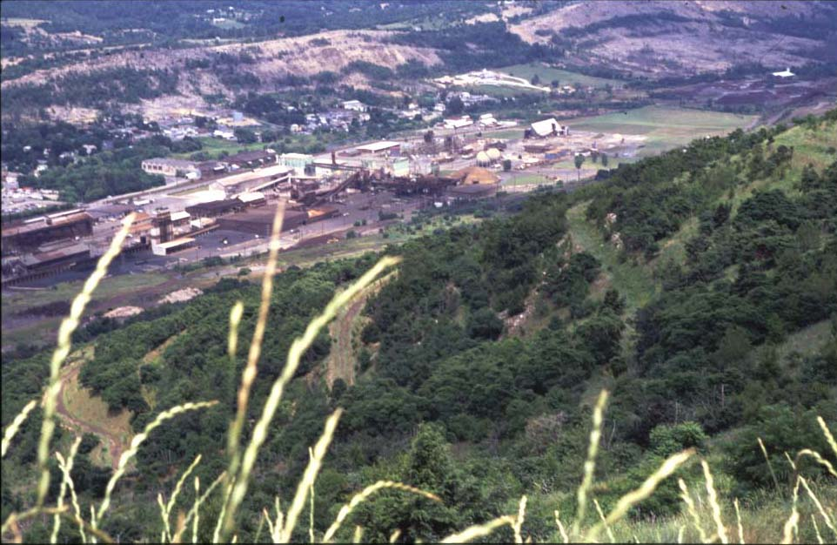
Palmerton, PA, 1999: Looking down revegetated Blue Mt.

Slide 17
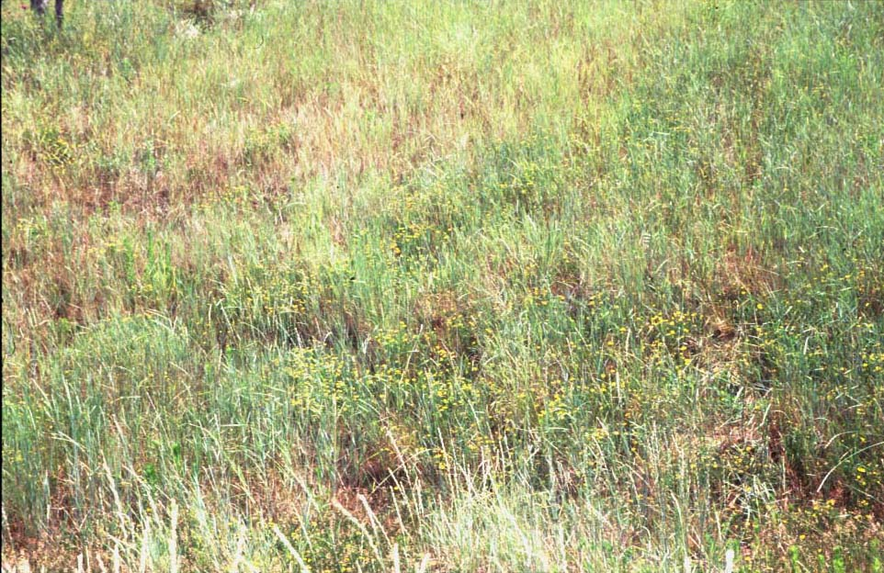
Palmerton, PA -- Revegetated Area in 1999: Area
with good intermediate wheatgrass and lespedeza cover.

Slide 18
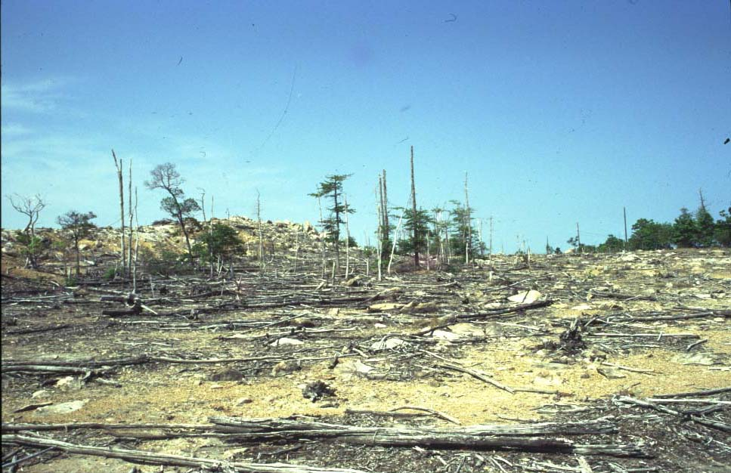
Palmerton, PA: Dead Ecosystem on Stoney Ridge in 1998.

Slide 19
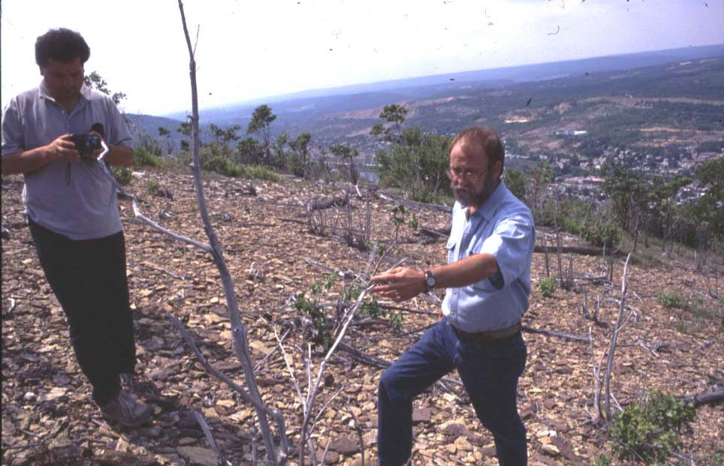
Stuczynski
Oyler
Palmerton, PA 1999; Untreated area adjacent to revegetated.area of Blue Mountain, with John Oyler and Tom Stuczynski.

Slide 20
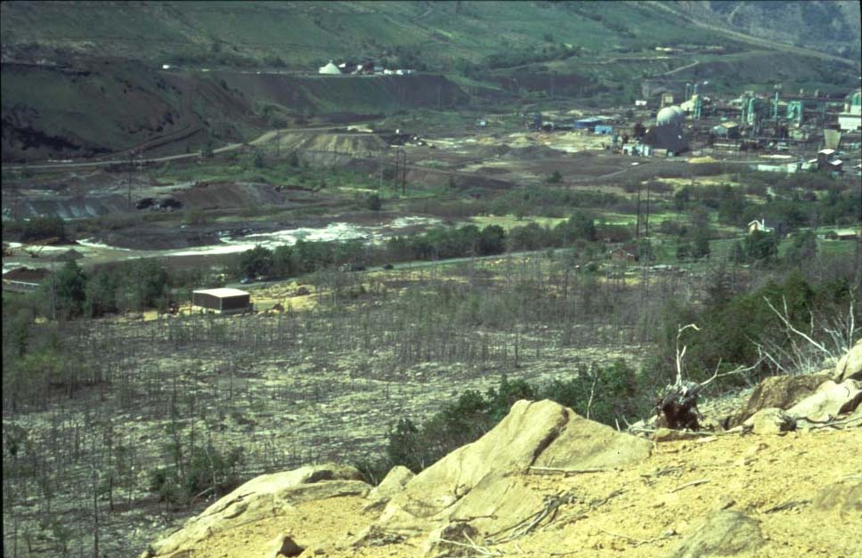
Untreated Stoney Ridge (North Palmerton), still barren today

Slide 21
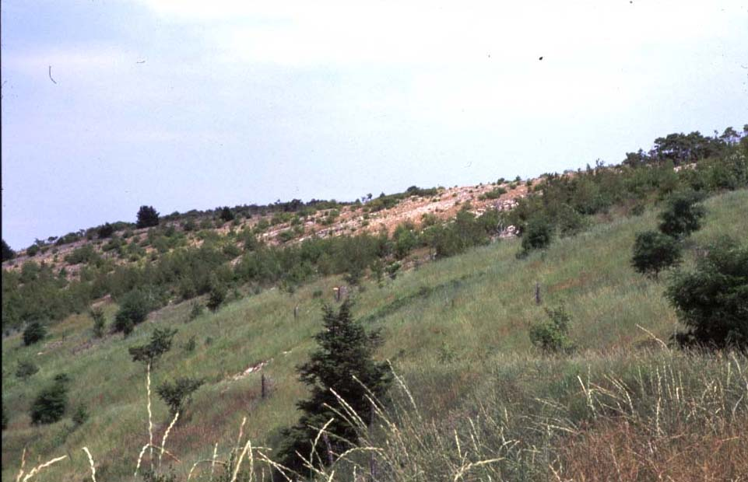
Palmerton, PA: Blue Mountain – 1999; Foreground =
Biosolids+Limestone+FlyAsh; Background = untreated Control

Slide 22
Analysis of Soils to Identify Needed Soil Metal Remediation Actions:
Total Metals (Zn, Cd, Pb, Ni, Cu, Fe, Mn, ….)
Soil pH in water (most important single variable)
Buffer pH if very acidic so determine limestone needed to neutralize soil acidity.
Soil fertility (usual soil test for P, K, Ca, Mg).
Identify need for P, K, or Mg applications
If Mg is low, dolomitic limestone can be used to prevent future lime-induced Mg deficiency.
Organic matter/carbon
Plant available metals (instantaneous toxic)
Use water or 0.01 M Ca or Sr(NO₃)₂, or soil solution.
Not acid extractable such as Mehlich-3 method.
Soluble metals are the toxic form.

Slide 23
DTPA Extractions can be Saturated in High Metal Soils and Give Wrong Results.
Standard DTPA-TEA Extractions use 10 g soil per 20 mL of 5 mM DTPA (1 g soil/2 mL).
5 mM Zn is 318 mg/L
On soil basis, that could be 635 mg Zn/kg
For soils rich in metals, unless one increases the ratio of solution to soil, one will underestimate the plant available metal.
For highly contaminated soils, we had to use as high as 50 mL/g soil
The next slide is an example of extracting metals from the Palmerton Borough soil.
DTPA metals are potentially toxic – pH controls.

Slide 24
Mean total Zn, Cd and Pb, and DTPA-extractable Zn and Cd (at 100 mL extractant/2 g soil) in Palmerton “Revival Field” Test Plots Comparing Traditional and Biosolids Compost Remediation Treatments (Li et al., 2000).
Treatment Total DTPA-Extractable
Zn Cd Pb Zn Cd
-------------------------- mg kg⁻¹ ------------------------
Control 14900 a† 164. a 687. a 4940. a 83.1 a
Limestone 15700 a 161. a 680. a 4980. a 82.9 a
Compost 16000 a 170. a 767. a 4550. a 69.1 b
†Treatment means followed by the same letter are not significantly different at the 5% level (Duncan-Waller-test).
Use of DTPA-TEA extraction required using 5 g/50 mL rather than 10 g/20 mL because high soil metals saturated DTPA chelation capacity.

Slide 25
Zn Phytotoxic Soil-Palmerton, PA
14,000 mg Zn/kg DW, pH 6.0
Effect of Solution:Soil Ratio on DTPA-Extractable Metals.

Slide 26
Mean pH, Sr-extractable metals, pH, organic matter and
oxalate Extractable Fe and Mn in Palmerton “Revival Field”
Plots comparing remediation using traditional or biosolids
compost methods; plots Installed in 1993, last sampled
in 1998 (Li et al., 2000).
Treatment Sr(NO₃)₂-Extr. pH Organic Oxalate-Extr.
Zn Cd Matter Fe Mn
----- mg kg⁻¹ ------ % ----- g kg⁻¹ -----
Control 195. a 1.99 a 5.9 4.6 5.74 a 2.12
Limestone 156. a 1.65 a 6.5 4.7 5.61 a 1.92
Compost 4.8 b 0.033 b 7.2 9.5 16.7 b 2.44
†Treatment means followed by the same letter are not significantly
different at the 5% level (Waller-Duncan test.)

Slide 27
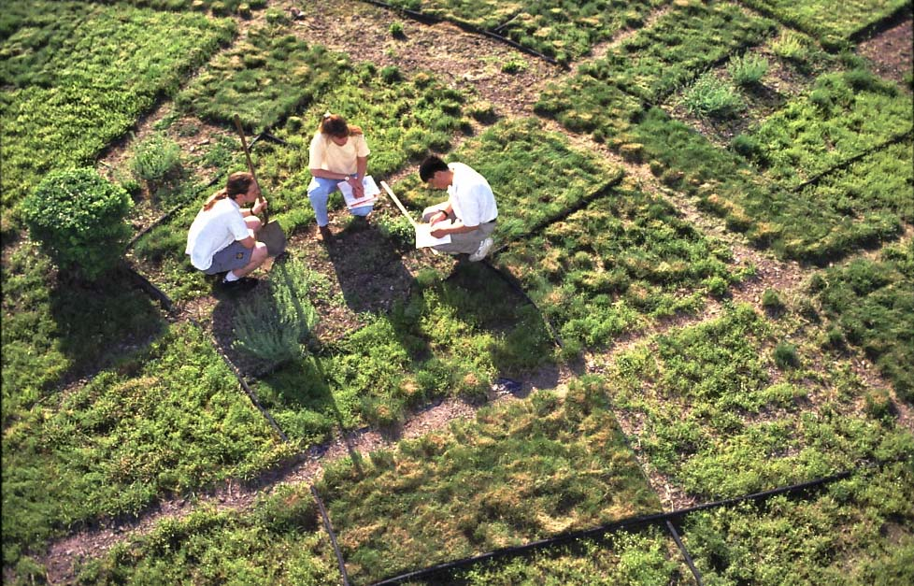
Revival Field-Palmerton: Yin-Ming Li
and Bev Kershner in ARS photograph.

Slide 28
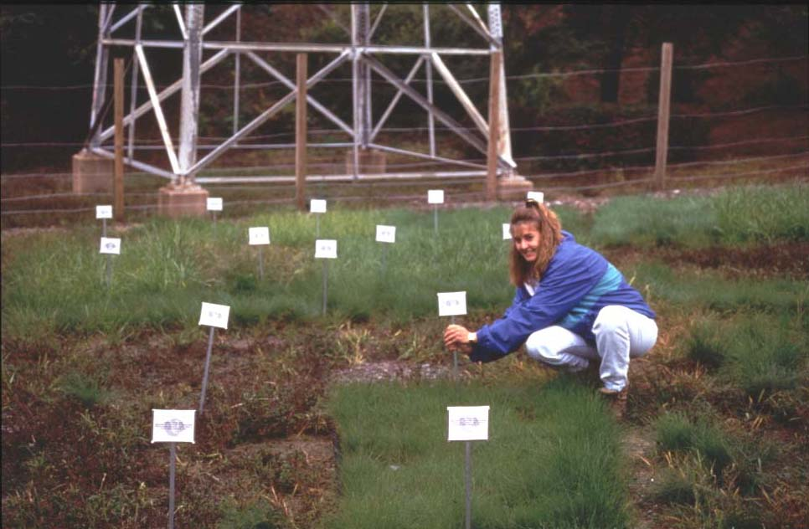
Compost
Bluegrass
Tall Fescue
Merlin
Control
Tall Fescue
Merlin
Palmerton, PA, Revival Field, Year-3: Grasses thrive only on Alkaline
Biosolids Compost Treatment (Cooperator Bev Kershner).

Slide 29
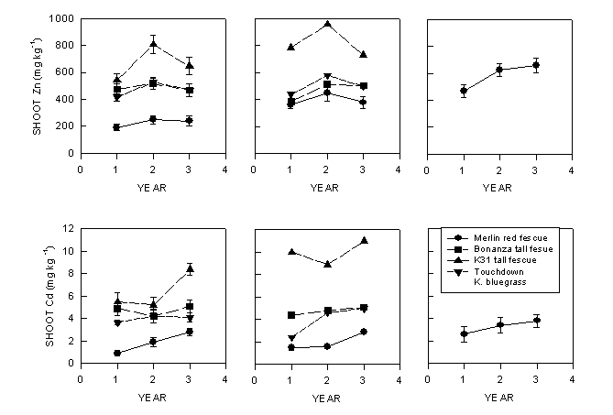
Compost Limestone Control
Cd and Zn in grasses grown on Palmerton Remediation Plots.

Slide 30
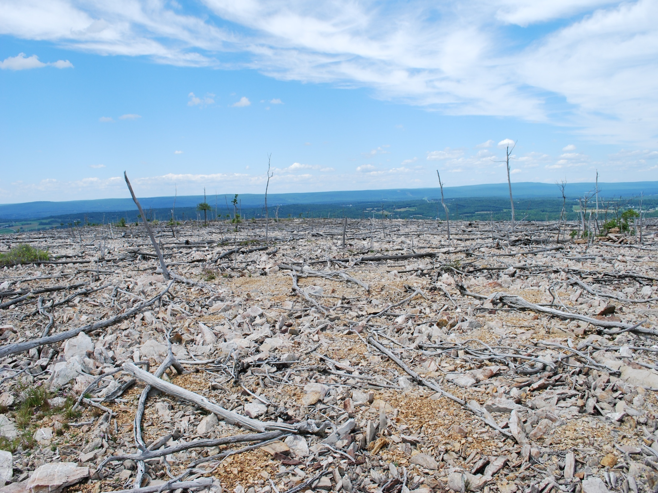
Appalachian Trail remained barren due to Zn phytotoxicity in 2008.

Slide 31
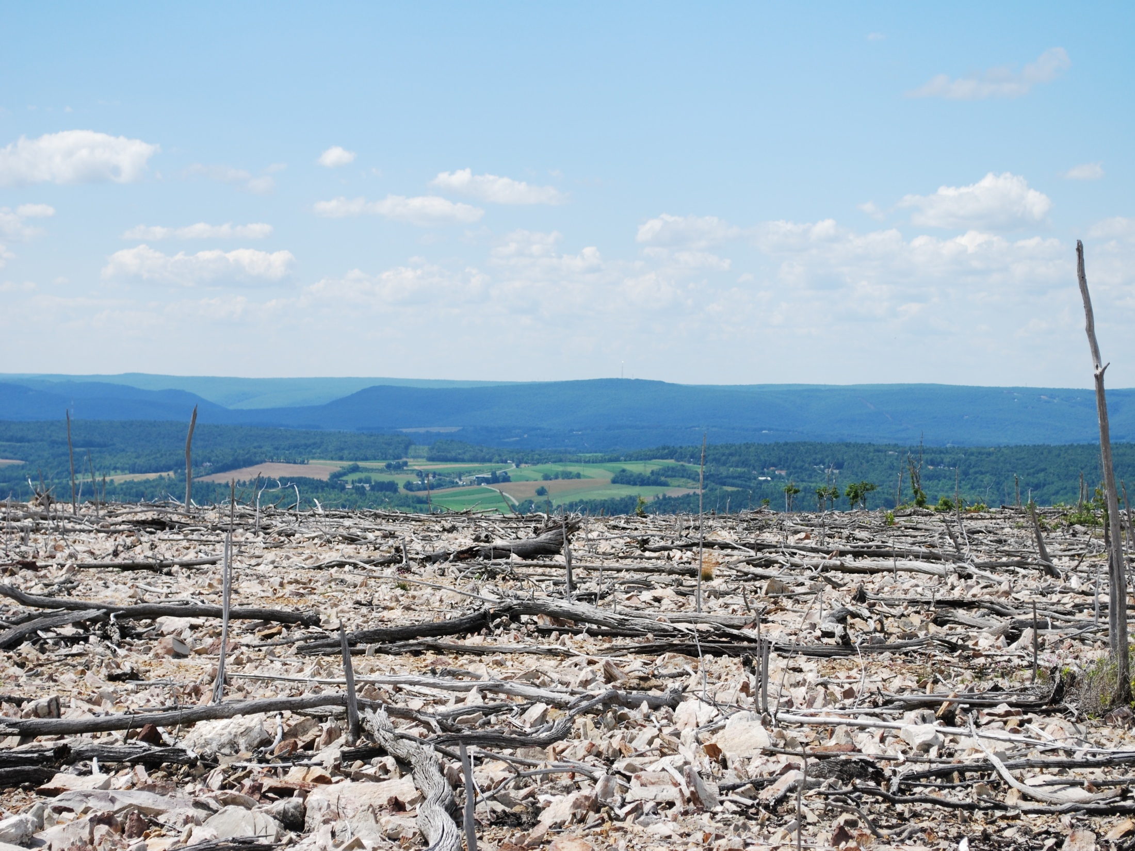

Slide 32
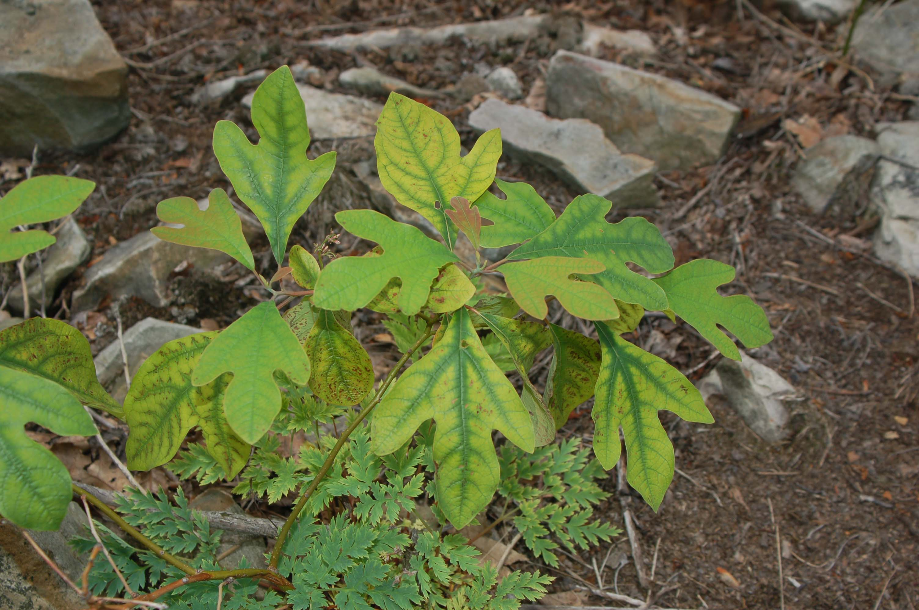
Sassafras growing on south face of Blue Mountain near Palmerton, PA., 6-21-2006
Leaves show severe interveinal chlorosis expected from Zn phytotoxicity.

Slide 33
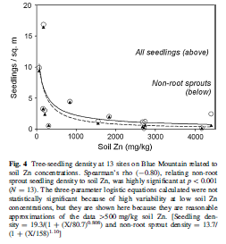
Toxicity of metals in
Palmerton (Blue
Mountain) soils is
increasing as soil pH
declines due to
acidic rainfall. Plants
so not survive during
germination when
soil Zn is too high.
Beyer et al., 2011

Slide 34
Revegetation/Remediation of Heavy Metal Contaminated Soils: Problems.
Low soil pH or pH decline from pyrite oxidation.
Make site calcareous; balance Ca and Mg; Mn if needed.
Limestone with biodegradable organic matter aids leaching
Nutrient Deficiencies, especially P and N.
High Pb soils need higher P addition to precipitate Pb.
Higher available soil P needed to maintain legumes.
No metal tolerant legumes to supply N to grasses.
Need more metal sorption by soil, Fe for grasses.
Grasses obtain Fe using secreted phytosiderophores (chelators), so higher soil Fe aids grasses metal resistance.
Low organic matter and lack of microbes -- Zn Toxicity
Biosolids, manures and composts – inexpensive source of Organic Matter and microbial innoculant.

Slide 35
Revegetation/Remediation of Heavy Metal Contaminated Soils: Solutions.
Make Soil Calcareous Using By-Product Lime
Increases metal adsorption and occlusion.
Protects against pH falling in future.
Increase Metal Adsorption Capacity
Include Fe, Mn hydrous oxides and phosphate.
Provides persistent in crease in metal adsorption, and thus reduction in metal phytotoxicity.
Remediated Soil Must Support Legumes.
Calcareous pH and high soil P aids legume competition, alleviating need for annual N fertilization. Legumes more susceptible to metal phytotoxicity than grasses.

Slide 36
Revegetation/Remediation of Heavy Metal Contaminated Soils: Solutions.
Food Chain Protection: Cd/Zn ratio; calcareous.
Preventing Zn phytotoxicity makes plants safe for wildlife ecosystems.
With Cd:Zn < 0.01, Zn prevents risk from Cd.
Reduced bioavailability of soil Pb, As, Cd, etc. to animals with soil exposure at remediated site.
Phosphate increases formation of pyromorphite, a very insoluble and low bioavailability form of soil Pb.
Adsorption on Fe and Mn oxides also reduces bioavailability of soil Pb, As, Cd, etc.
Effective plant cover reduces soil ingestion.
OM and microbes help recovery of soil fertility and plant friendly soil properties.
OM aids water infiltration and soil water holding.

Slide 37
Tailor-Made Mixtures For Remediation of Metal Toxic Soils
Mix Composts, manures, biosolids and byproducts to complement benefits & improve metal sorption:
APL Biosolids and composts
Composts of Yard Debris or pre-separated MSW.
Agricultural Organic Byproducts
Manures; crop residues; food processing byproducts
Fe, Mn rich Byproducts from industry.
Coal Combustion Byproducts, FGDB, Ash.
Drinking Water Treatment Residues
Limestone equivalent byproducts.
Wood ash; waste lime; fly ash; sugar beet lime; acetylene production lime; etc.

Slide 38
Tailor-Made Biosolids Mixtures For Beneficial Use and Remediation
Apply mixture of limestone equivalent, metal adsorbent, organic soil amendment, and fertilizer value to correct all risks/problems of the contaminated soils:
Zn or Ni Phytotoxicity; make soil calcareous.
Food-chain risks from Cd prevented by Zn.
Soil ingestion risk from soil Pb, As, etc.
N fixation by legumes made possible.
Leaching of limestone equivalent corrects surface and subsurface soil metal phytotoxicity.
One-Shot treatment for comprehensive remediation or Revitalization of contaminated soils.

Slide 39
Why Use High Quality Tailor-Made Biosolids Mixtures in Remediation of Soil Metals?
Fe and phosphate in biosolids increase metal “specific adsorption” ability of the amended soil, reducing metal phytoavailability.
Can remediate Zn phytotoxicity and food chain Cd risk.
Can reduce soil Pb bioavailability by forming Pb pyromorphite
Combining limestone equivalent and biodegradable organic matter causes alkalinity to leach down soil profile.
Incorporation to depth of contamination best alternative when possible to create fertile and non-toxic rooting depth.
Lime corrects subsoil acidity and metal phytotoxicity/leachability.
With pH buffered by applied limestone equivalent, metal adsorption is maximized, and occlusion promoted.
Some metals are occluded in crystalline Fe oxides, Mn oxides; LDH
Organic matter and balanced nutrient supply supports persistent plant cover especially if include legumes!
Tailor-Made Remediation Mixtures can immediately inactivate metals, provide microbial inoculum, add energy and nutrients.

Slide 40
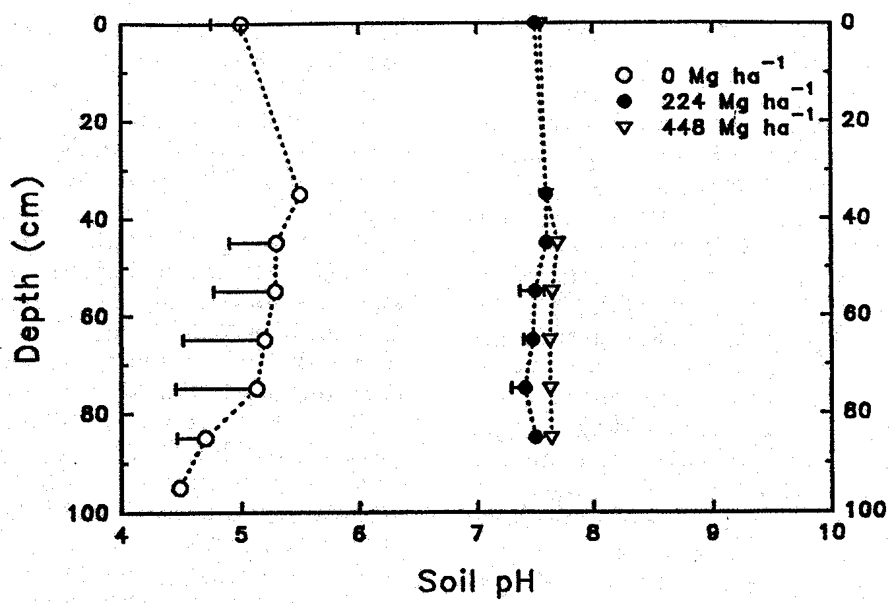
Effect of rates of limed digested biosolids applied to Galestown
loamy sand in 1976 on pH at soil depths in 1992 (Brown et al., 1997).

Slide 41
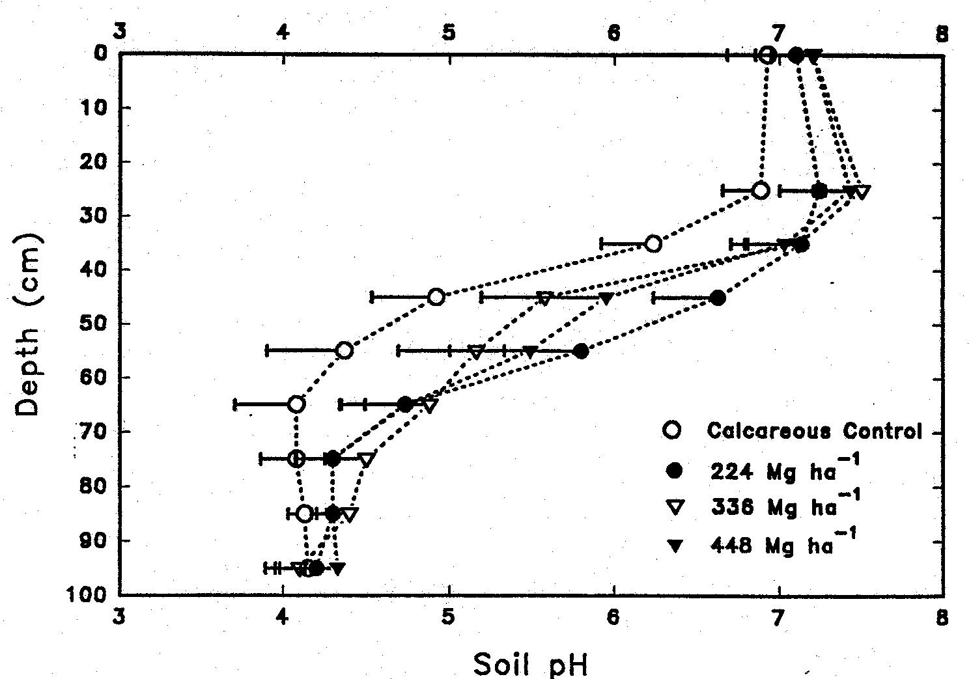
Effect of rates of limed digested biosolids applied to Christiana fine
sandy loam in 1976 on pH at soil depths in 1992 (Brown et al., 1997).

Slide 42
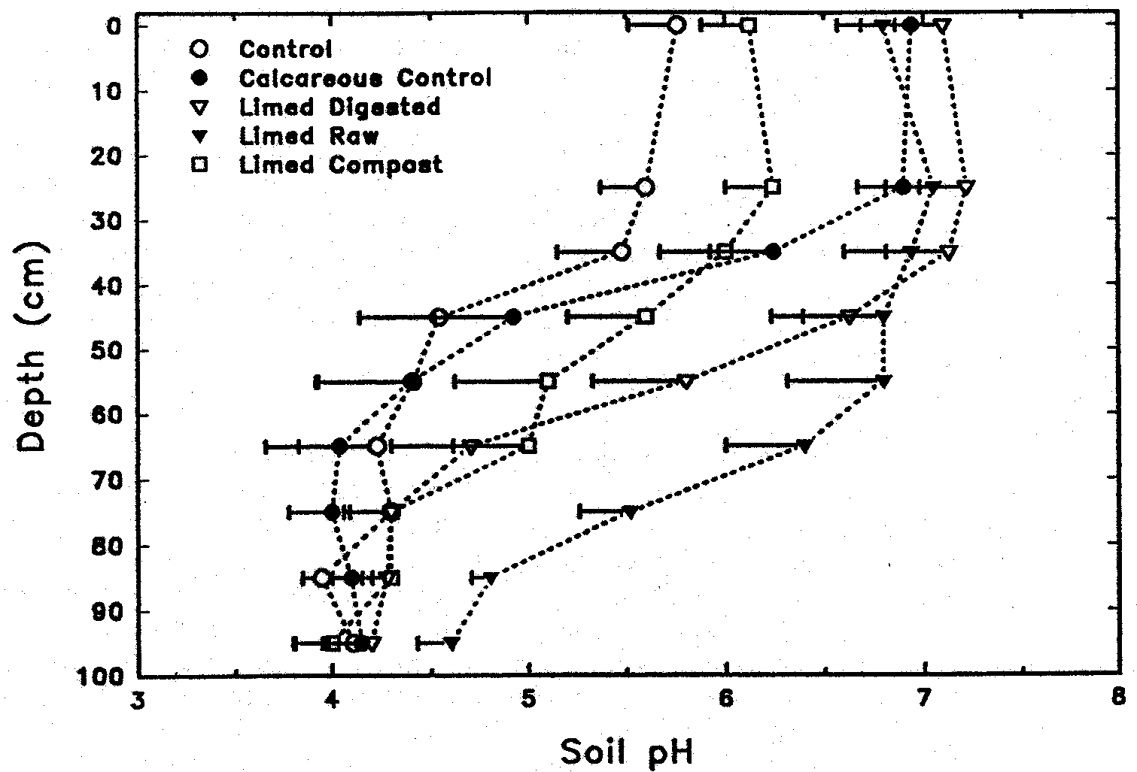
Effect of limed biosolids or composts applied to Christiana fine
sandy loam in 1976 on pH at soil depths in 1992 (Brown et al., 1997).

Slide 43
What Does it Take To Develop Local Tailor-Made Remediation Products?
Risk assessment and value information from testing in field studies of product utilization.
Courageous agencies and businesspersons who will seek out such combinations of biosolids, byproducts, and valuable commercial uses of the products.
Organized valid risk assessment information on:
Phytoavailability of applied and soil elements in field.
Bioavailability of soil and crop elements.
Improved risk communication, and honest risk assessments. Examples from Cd food-chain risk, soil Pb and As risk, and phytotoxicity risks from biosolids show massive errors of conservative assumptions.

Slide 44
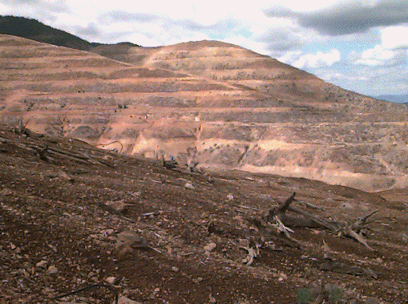
Bunker Hill, Kellogg, Idaho-Superfund Site – Zn, Cd, Pb

Slide 45
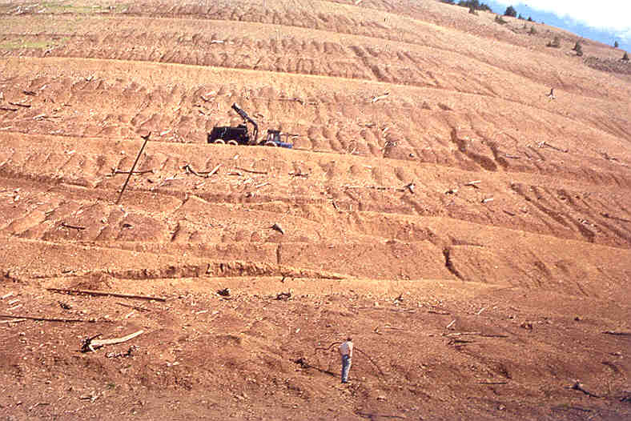
Bunker Hill, Idaho -- Smelter killed ecosystem Superfund Site.

Slide 46
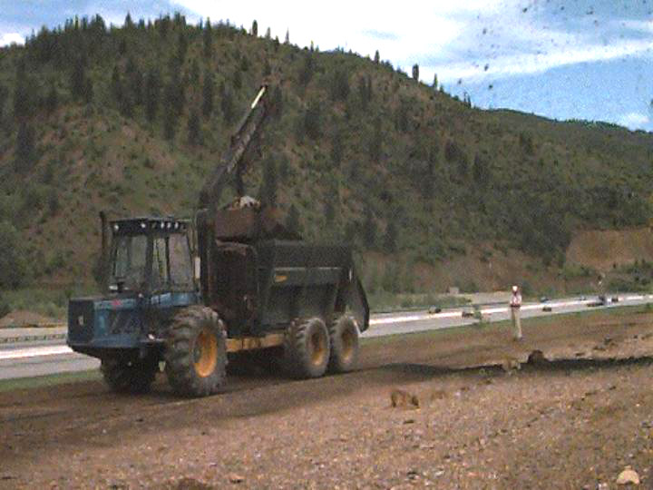
Aerospreader Applying Biosolids-Wood Ash Mixture at Bunker Hill

Slide 47
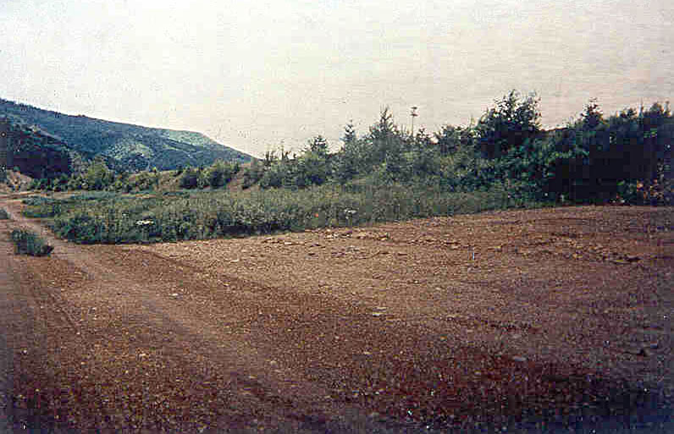
Highly Zn-phytotoxic smelter and mine waste contaminated soils at Bunker Hill, ID (15,000 mg Zn/kg);
Background = Biosolids+Wood-Ash Remediated
Foreground = Seeded control hazardous soil.

Slide 48
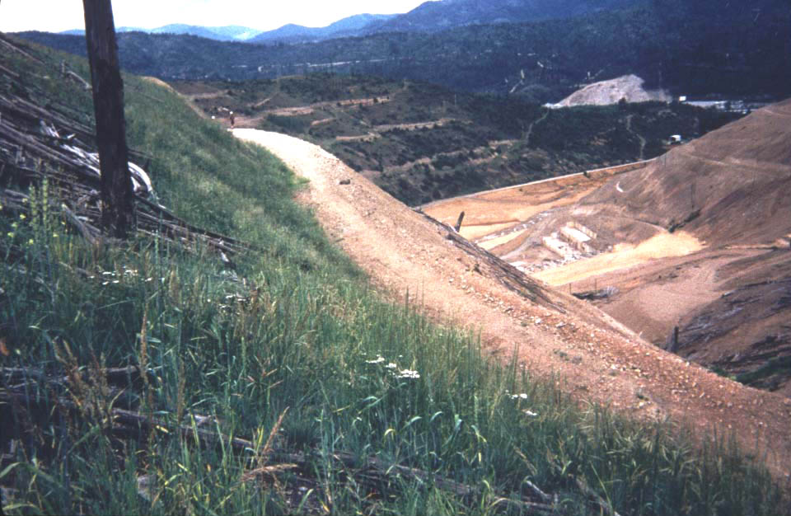
Revegetation of Bunker Hill Hillsides using mixture of biosolids, woodash and logyard debris, after 2 years.

Slide 49
Remediation of Page Swamp
The Page Swamp is a wetland constructed in a Pb-Zn-Cd mining waste storage pile near Kellogg, ID.
In cooperation with US-EPA Superfund ERT, Henry and Brown of Univ. Washington, Chaney et al. tested application of organic amendment plus alkaline byproducts to remediate the highly contaminated site soils.
Before treatment, the site lacked vegetation even when flooded. Further, the acidity allowed soil metals to inhibit soil microbes so that flooded soil did not become sufficiently reducing to form PbS.
Application of the composted biosolids plus wood ash mixture prevented toxicity to microbes or plants, soil became highly reducing and PbS was formed.
Formation of PbS reduces risk to birds which ingest sediments.
Vegetation was low in metals and safe for wildlife consumption.

Slide 50
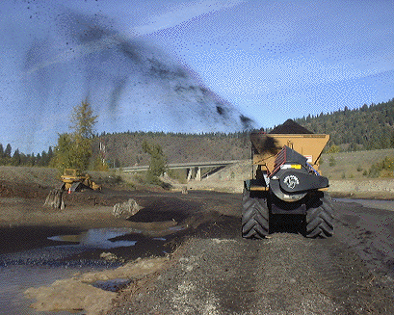
Page Swamp near Kellogg, ID; barren wetland built in mine wastes;
Mixture of compost and wood ash applied by Aerospreader.

Slide 51
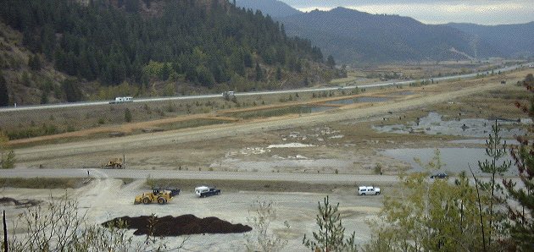
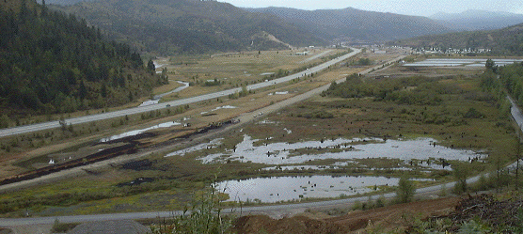
West Page Swamp prior to beginning treatment (10/7/98)
Overview and beginnings of final treatment by blower (9/21/00)

Slide 52
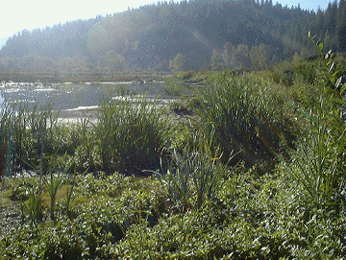
Page Swamp remediated area in next season after reactions
Of soil amendments and natural plant colonization.

Slide 53
Revitalization/Remediation of Zn-Pb Smelter Slag and Mine Wastes in Poland
As part of a cooperative project between EPA and the Government of Poland after the fall of Communism, a team tested remediation of smelter slag and mine wastes in Katowice Province of Poland:
US-EPA, Ken Pantuck
USDA, Rufus Chaney
Virginia Tech, Lee Daniels
IUNG, Tom Stuczynski and Grzeg Siebielec

Slide 54
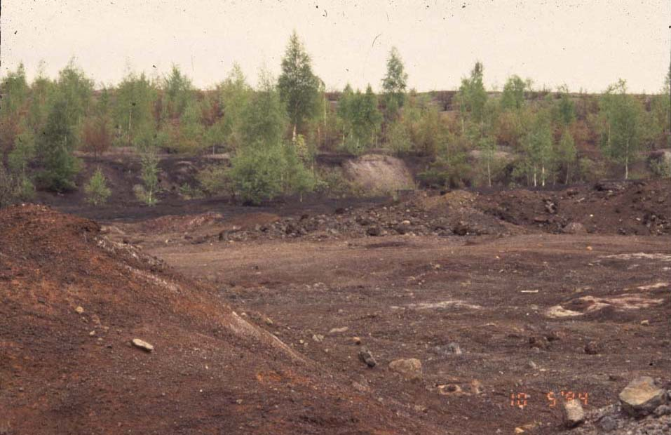
Smelter slag deposit near Katowice, Poland; before treatment.

Slide 55
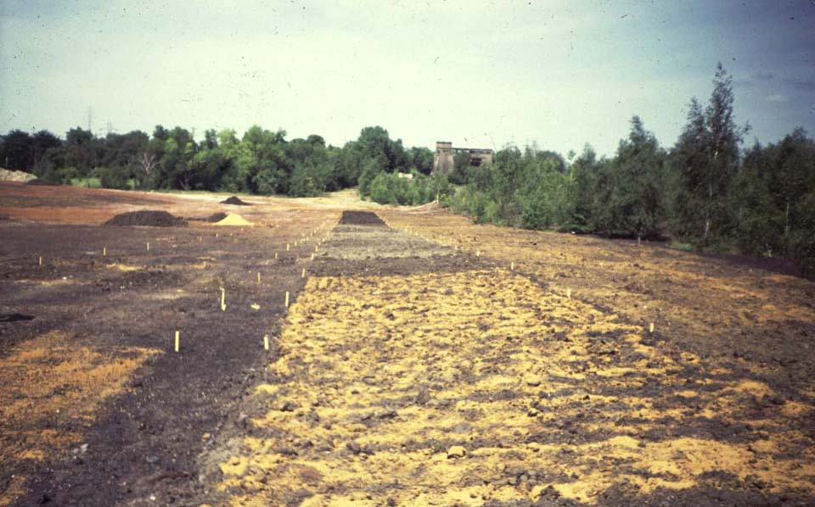
Laying out replicated plots on smelter slag at Katowice.

Slide 56
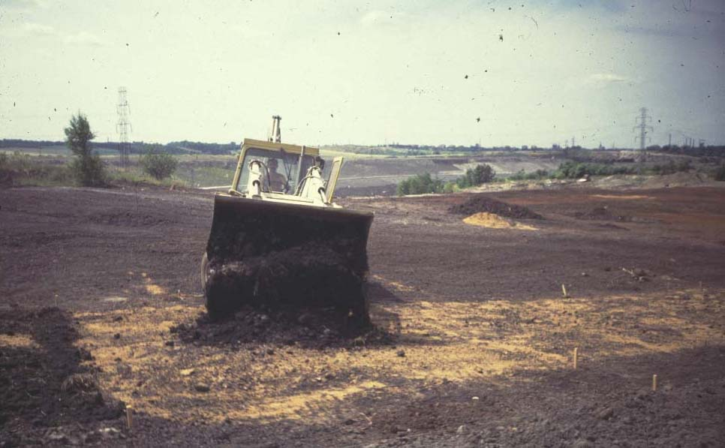
Application of biosolids; byproduct limestone applied before.

Slide 57
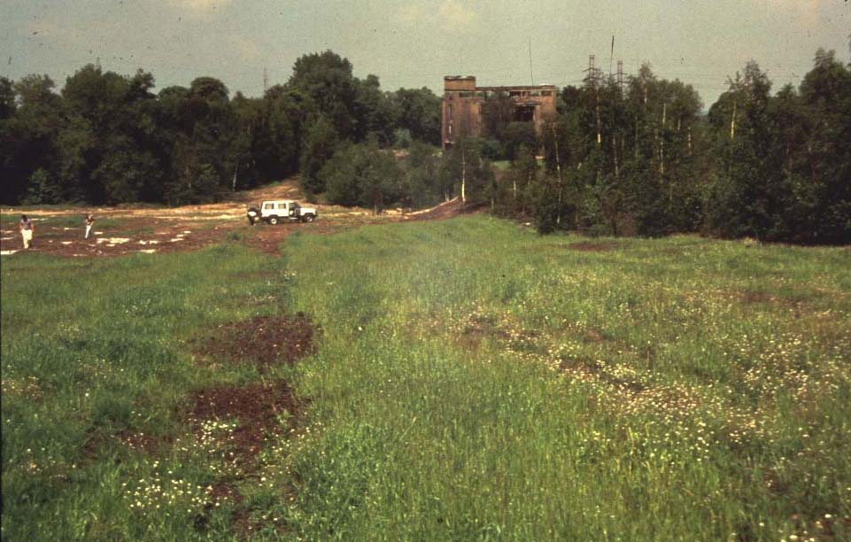
Katowice plots at end of first growing season.

Slide 58
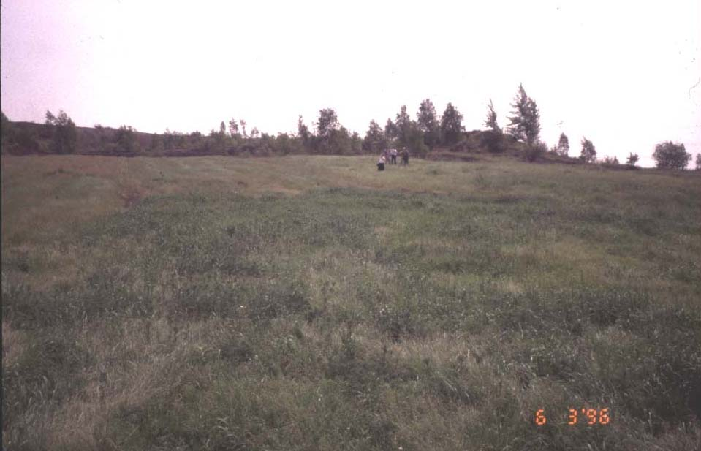
Katowice revegetated smelter slag in year 3.

Slide 59
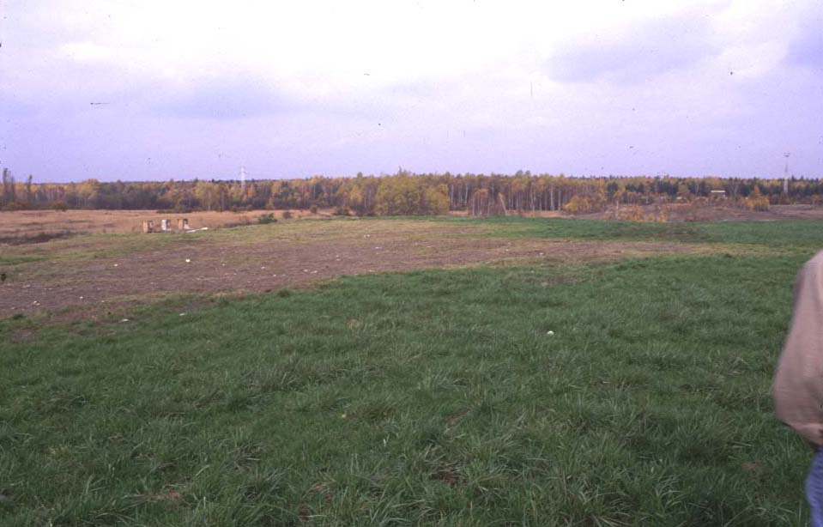
Commercial use of Biosolids + Byproduct Limestone-Katowice

Slide 60
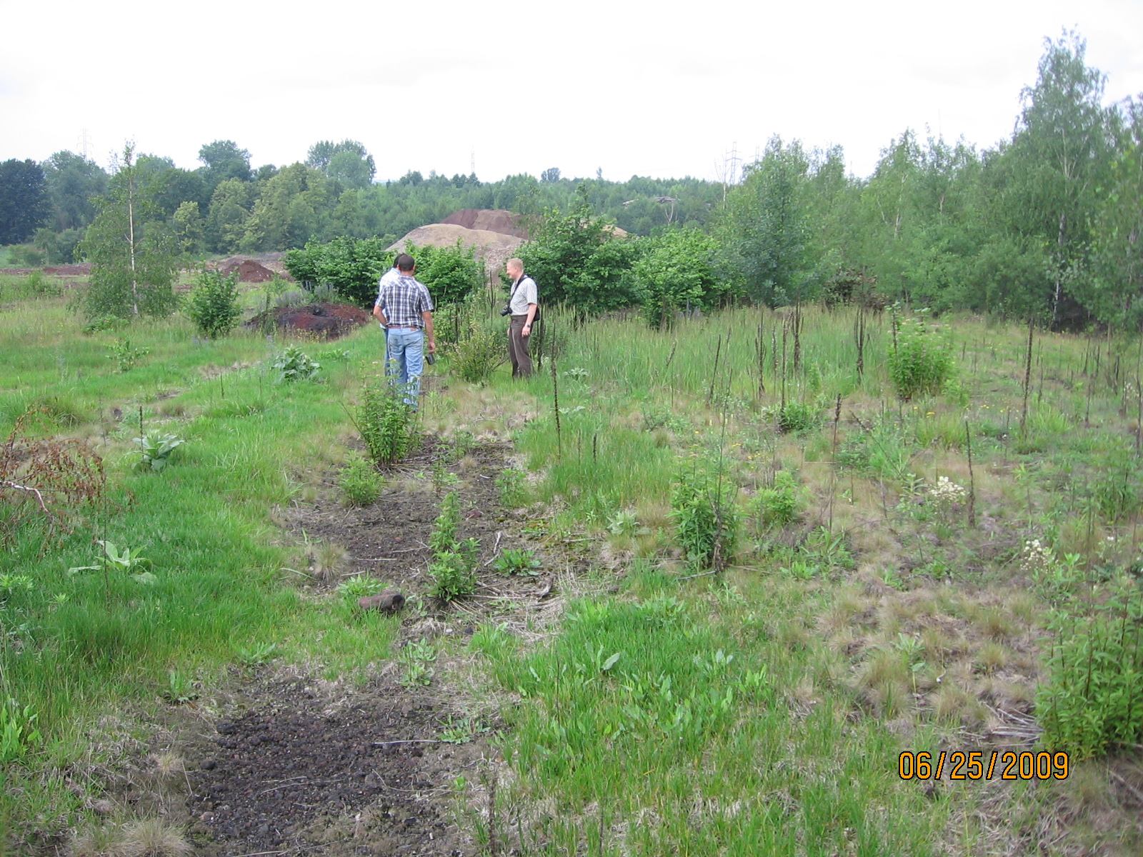
Vegetation persists in 2009 on the parts of plot are with amendments.

Slide 61
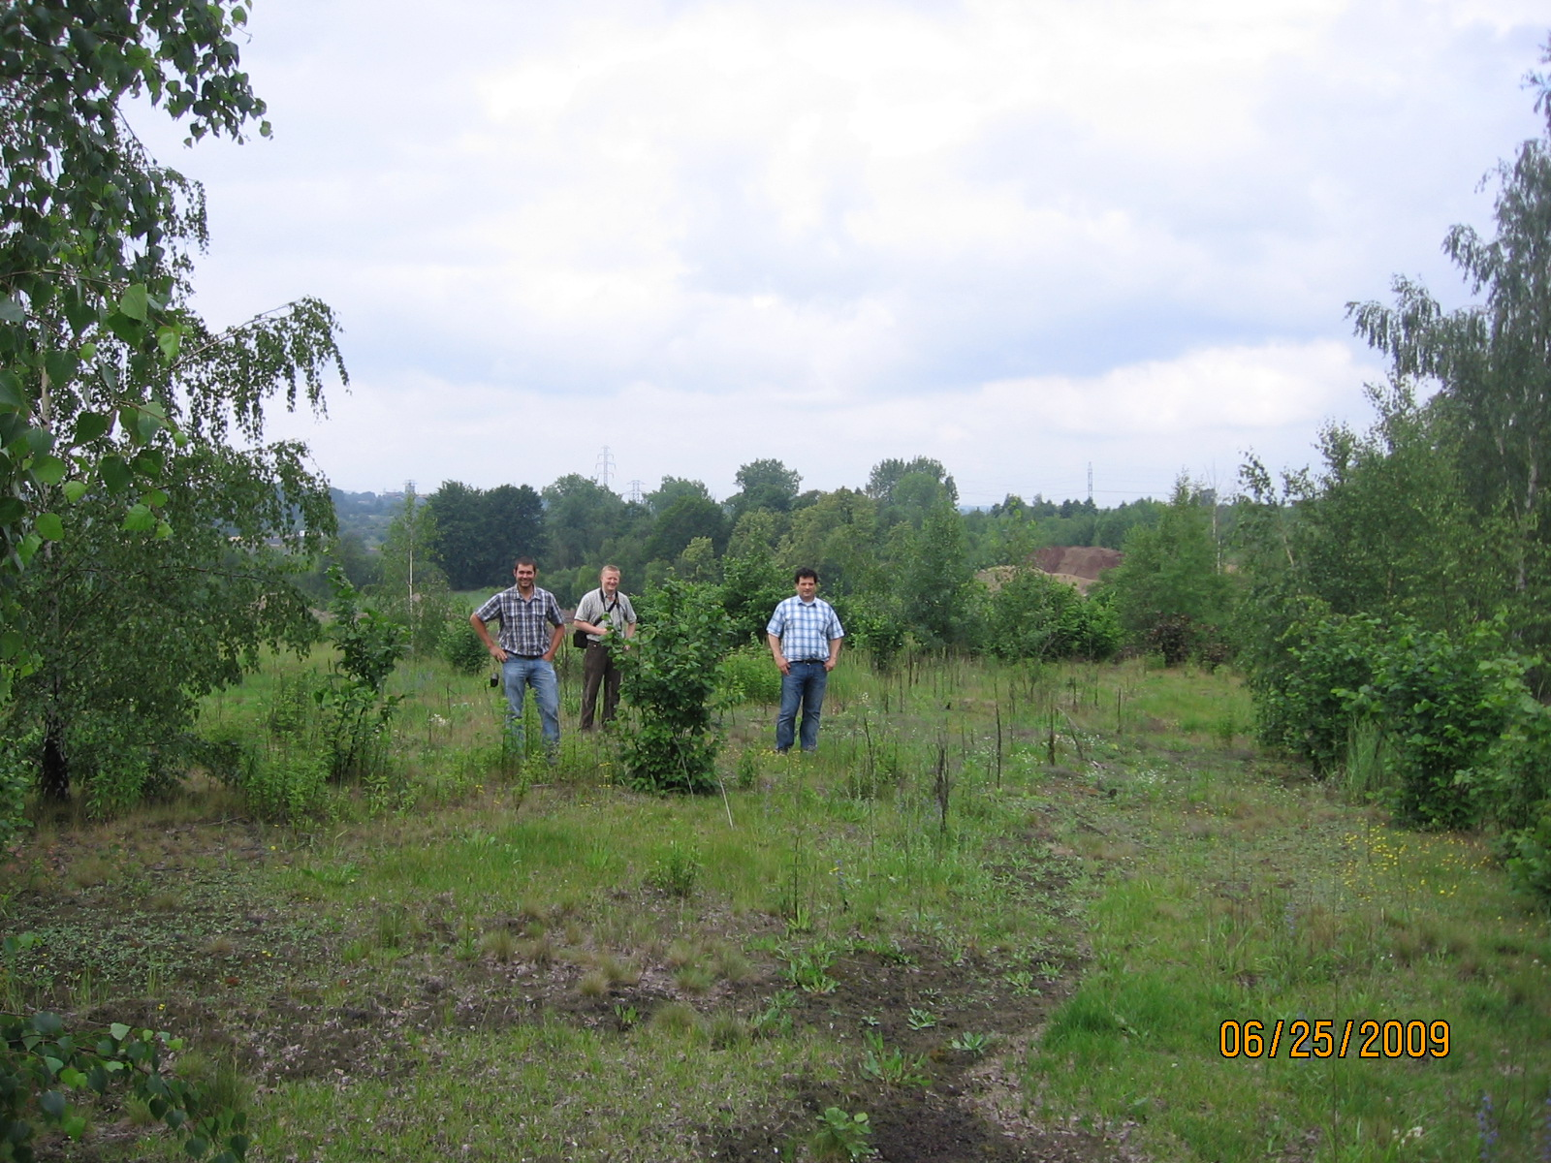
Interior of Welz plots-2009: Treated plots vs. alleys clearly evident. Birch trees have heavily invaded high lime + biosolids plots.

Slide 62
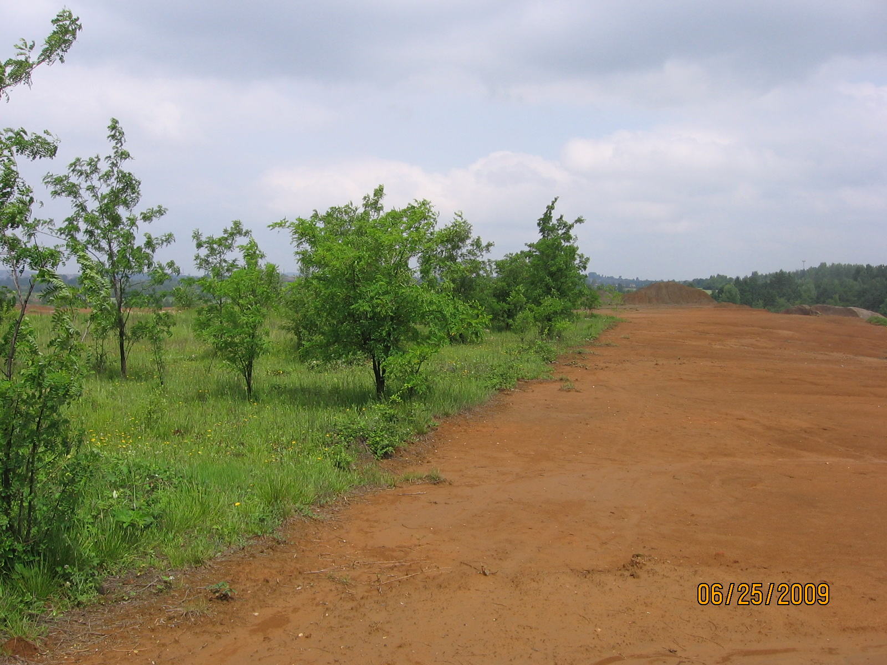
Demo plots on Pb/Zn tailings. All trees have invaded. Up to 40% of live cover is local invading species. Note edge of treatments

Slide 63
Revegetation/Remediation of Heavy Metal Contaminated Soils: Problems.
Low soil pH or pH decline from pyrite oxidation.
Make site calcareous; balance Ca and Mg; Mn if needed.
Limestone with biodegradable organic matter aids leaching
Nutrient Deficiencies, especially P and N.
High Pb soils need higher P addition to precipitate Pb.
Higher available soil P needed to maintain legumes.
No metal tolerant legumes to supply N to grasses.
Need more metal sorption by soil, Fe for grasses.
Grasses obtain Fe using secreted phytosiderophores (chelators), so higher soil Fe aids grasses metal resistance.
Low organic matter and lack of microbes -- Zn Toxicity
Biosolids, manures and composts – inexpensive source of Organic Matter and microbial innoculant.

Slide 64
Revegetation/Remediation of Heavy Metal Contaminated Soils: Solutions.
Make Soil Calcareous Using By-Product Lime
Increases metal adsorption and occlusion.
Protects against pH falling in future.
Increase Metal Adsorption Capacity
Include Fe, Mn hydrous oxides and phosphate.
Provides persistent in crease in metal adsorption, and thus reduction in metal phytotoxicity.
Remediated Soil Must Support Legumes.
Calcareous pH and high soil P aids legume competition, alleviating need for annual N fertilization. Legumes more susceptible to metal phytotoxicity than grasses.

Slide 65
Tailor-Made Biosolids Mixtures For Beneficial Use and Remediation
Apply mixture of limestone equivalent, metal adsorbent, organic soil amendment, and fertilizer value to correct all risks/problems of the contaminated soils:
Zn or Ni Phytotoxicity; make soil calcareous.
Food-chain risks from Cd prevented by Zn.
Soil ingestion risk from soil Pb, As, etc.
N fixation by legumes made possible.
Leaching of limestone equivalent corrects surface and subsurface soil metal phytotoxicity.
One-Shot treatment for comprehensive remediation or Revitalization of contaminated soils.

