Slide 1
Key Tools for Supporting Recreational and Educational Use
Fran Costanzi,
Region 8 Superfund Redevelopment Coordinator
Notes:
SRI has found that sharing examples of successful projects and lessons learned is one of the most effective tools for promoting reuse. It inspires stakeholders with opportunities and vision, shares tools and resources that helped facilitate changes, and provides hope to communities struggling to find a silver lining at a contaminated property.

Slide 2
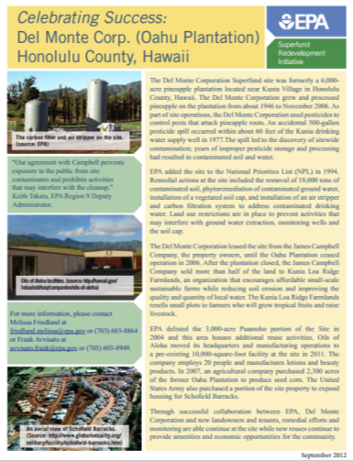
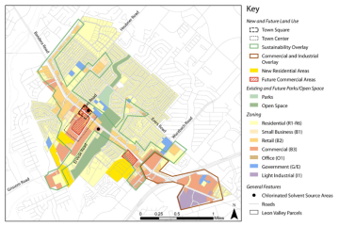
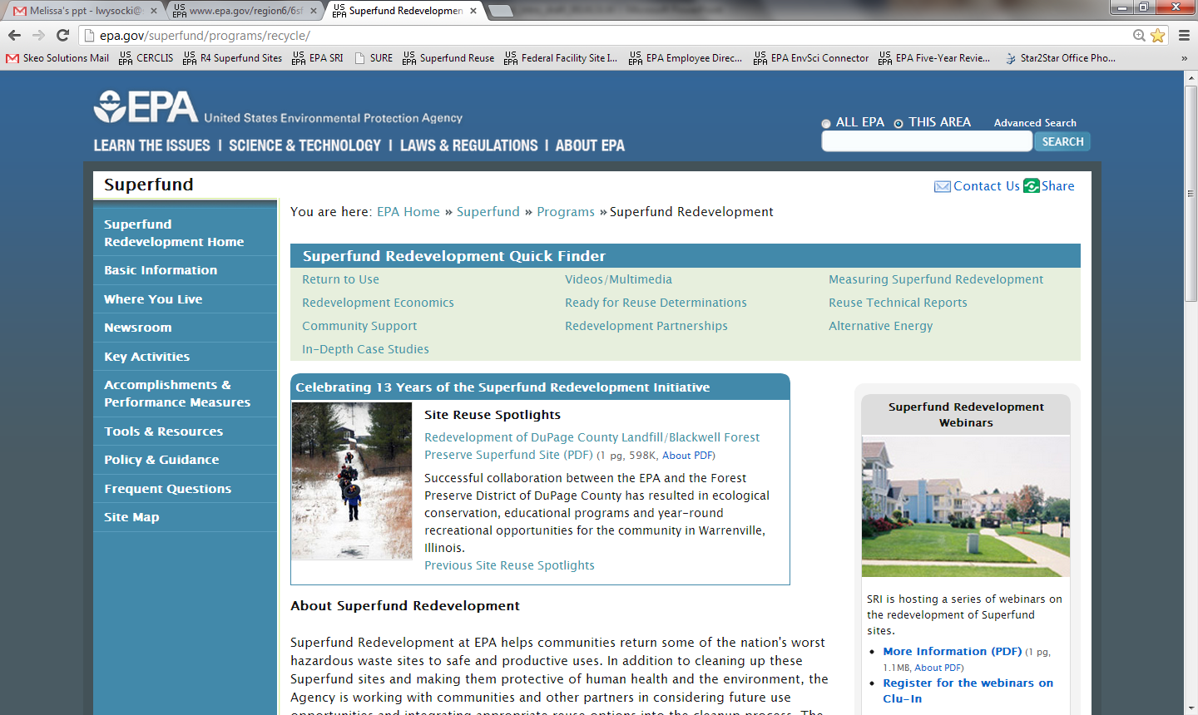
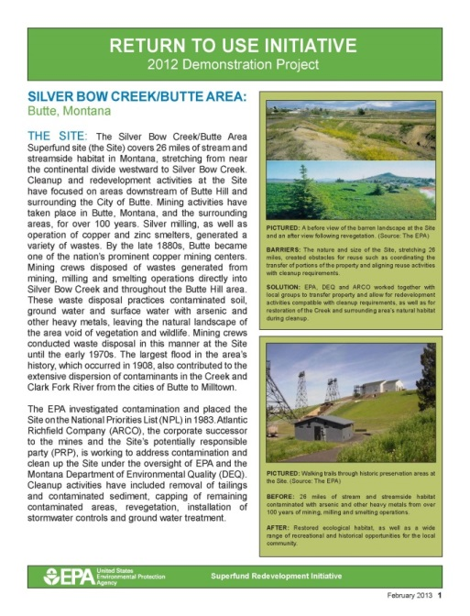
SRI Tools and Resources
http://www.epa.gov/superfund/programs/recycle/
Notes:
SRI has a number of tools and additional resources on our website. You can take a look at reuse planning project examples and get more information about the reuse planning process in the Community Support area of our website. We have collected both national and site-specific redevelopment economic data. We also have fact sheets highlighting successful reuse, technical reports, in-depth case studies, the Sitewide Ready for Anticipated Use performance measure, and guidance documents. These resources highlight tools used at various sites, provide examples for you as an RPM and for community members alike, and present possible strategies for overcoming barriers to reuse.
I encourage you to visit the website and take a look at these materials. Melissa Friedland and Frank Avvisato at EPA Headquarters are a great resource and we also have SRI coordinators in each Region. For example, I’m the Region 8 SRI Coordinator, Tom, who will speak next is the Region 5 Coordinator and Bill is the Region 4 Coordinator. We will have a slide at the end of the session with the names and contact information for all the regional coordinators. Please feel free to get in touch with your coordinator if you have any questions – we are here to help. Keep in mind also that SRI also works closely with other EPA programs and we are able to facilitate collaboration between the EPA site team and site stakeholders.
Pictured: SRI Web Success story and Return to Use demonstration project fact sheets; reuse planning map; the SRI website homepage and link.

Slide 3
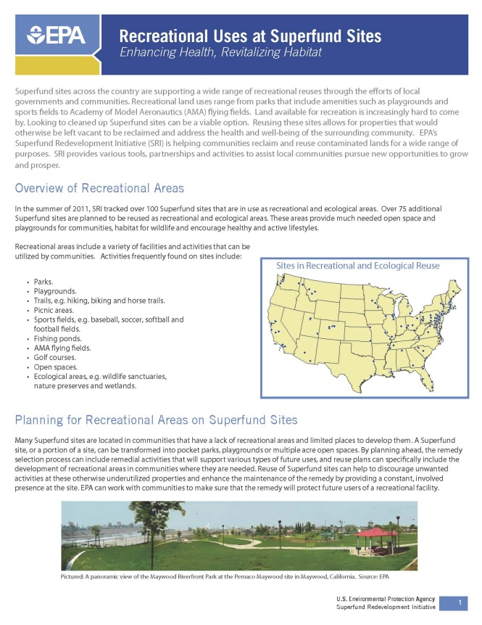
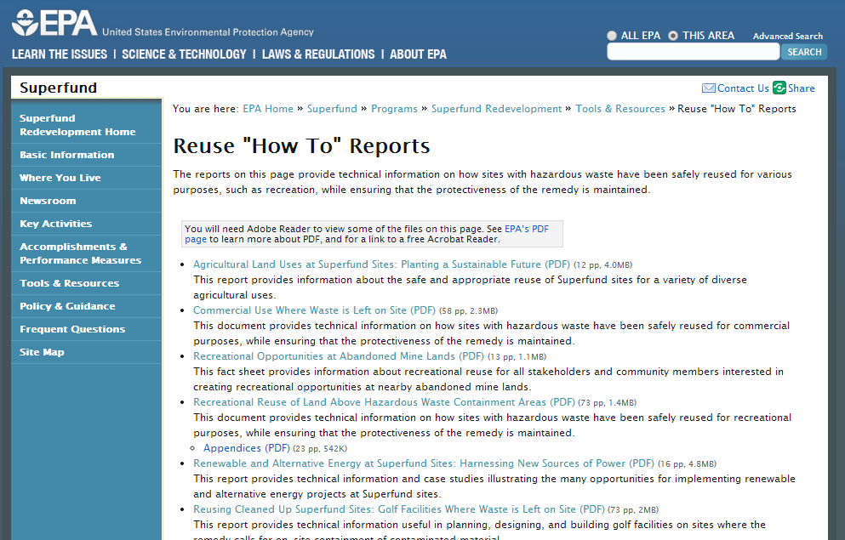
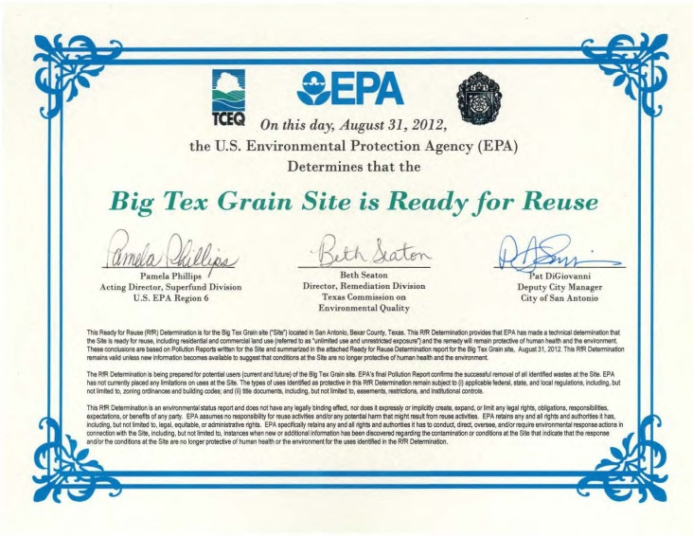
Categories of Key Tools
Outreach Materials
Technical Reports
Reuse Planning
Notes:
It is very important to remember that every site has a different success story because every site started in a unique community with unique needs. SRI has tools that can help fit these individual situations. I would like to talk a little bit about the specific tools that we have found to be most helpful when planning for and implementing recreational and educational reuse.
Key tools for recreational and educational site reuse fall into the following three categories:
Outreach materials
Technical reports/Guidance
Reuse planning
Pictured: a variety of reuse tools: the Technical Reports “how to” area of the SRI website, SRI ‘s Recreational Reuse Fact Sheet, and the Ready for Reuse (RfR) determination for the Big Tex Grain site in Region 6

Slide 4
Outreach Materials
Videos
Fact sheets and handouts
Webinars
http://www.epa.gov/superfund/programs/recycle/info/recreational-video.html
Notes:
The outreach materials that SRI develops are a variety of tools that promote information sharing of successful reuse projects, as well as the reuse planning processes and technologies used at these sites. These tools can be videos, fact sheets, handouts and even webinars. SRI hosts a free quarterly webinar series that discusses different types of reuse that are possible and shares how particular Superfund sites have become reuse success stories.
We have several great outreach tools that speak specifically to recreational and educational reuse: our Recreational Reuse fact sheet, reuse success story fact sheets and our “Reclaiming Recreational Opportunities through the Reuse of Superfund Sites” Video. The Recreational Reuse fact sheet provides an overview of recreational reuse at Superfund sites nationwide, including key considerations and reuse success stories. Return to Use and Web Success Story fact sheets highlight a number of sites that have been redeveloped into parks with playgrounds, trails and other recreational amenities. The handout provides details on everything from ownership and site restrictions to EPA’s role in the process and best practices. We have also hosted several webinar looking at recreational reuse and one, in particular, focusing on reuse as soccer fields, highlighting EPA’s partnership with the US Soccer Foundation.
I would like us to take a few minutes now to watch SRI’s “Reclaiming Recreational Opportunities through the Reuse of Superfund Sites” Video.

Slide 5
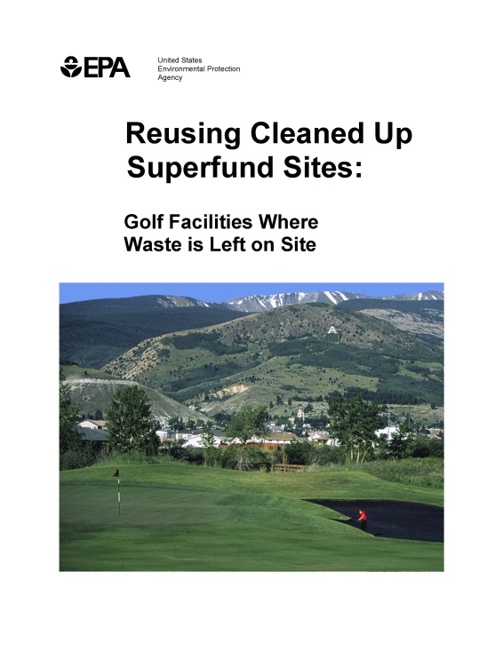
Technical Reports
Recreational Opportunities at Abandoned Mine Lands
Recreational Reuse of Land Above Hazardous Waste Containment Areas
Reusing Cleaned Up Superfund Sites: Golf Facilities Where Waste is Left on Site
Notes:
Our second category of tools helpful for returning sites to productive recreational and educational reuse is technical reports. Part of SRI’s website is dedicated to these technical or “how-to” reports. These reports provide more detailed information about the technologies used to return hazardous waste sites to productive reuse while ensuring that the protectiveness of the remedy is maintained.
Three of our “how-to” reports speak direct to recreational reuse. They detail specific advantages and considerations for redeveloping abandoned mine lands into recreational areas; how sites with waste left in place have been returned to recreational reuse while remaining protective of human health and the environment; and technical details related to planning, design and construction of golf facilities on Superfund sites. These reports are all available in the Reuse Technical Reports section of the SRI website.

Slide 6
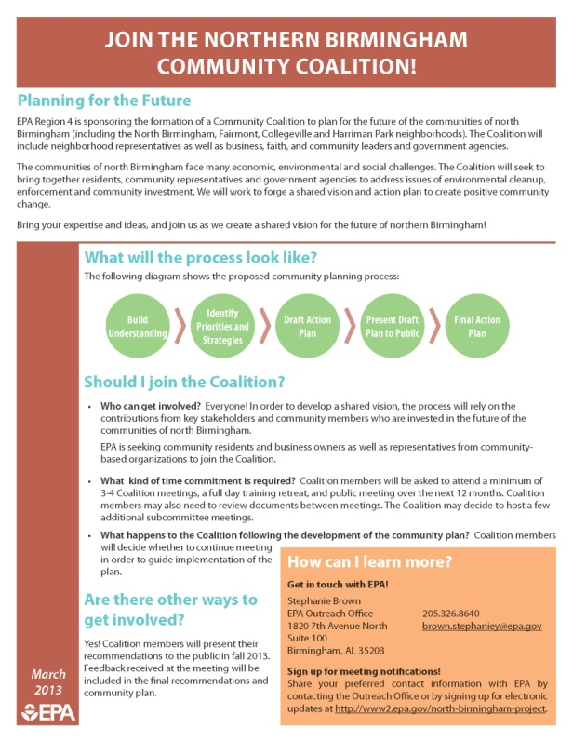
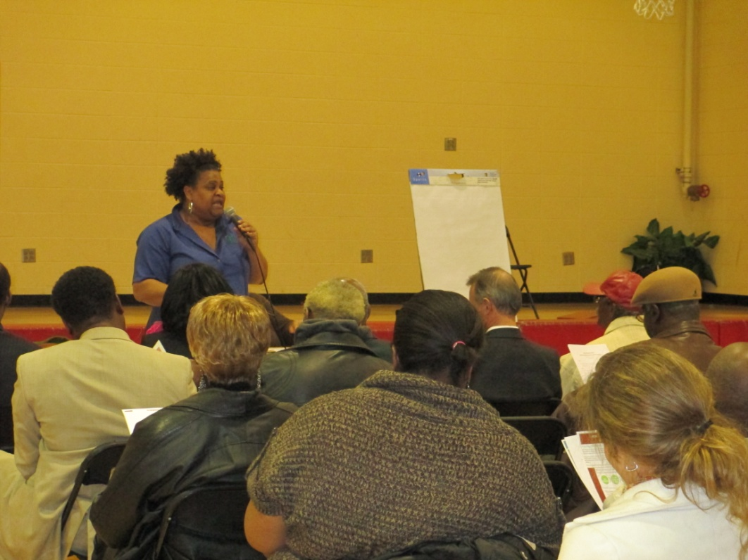
Reuse Planning
Provides rare opportunity to expand recreation and education resources within communities
Helps establish realistic community expectations
Promotes meaningful dialogue among parties
Notes:
Our third category is reuse planning. Reuse planning enables communities to work with EPA and other partners to integrate remedy and reuse considerations and remove unnecessary barriers to reuse, maximizing opportunities for recreational and educational reuse. Each year, SRI sets aside a limited amount of resources to provide in-kind reuse planning services through the assistance of a national contractor with expertise in the reuse of contaminated sites. In addition, EPA regional offices may also be able to provide resources.
Land available for recreation is increasingly hard to come by within existing communities. Planning to reuse Superfund sites for recreational and educational purposes can provide vital resources to underserved communities and link together existing parks and natural areas, creating regional amenities.
Reuse planning also helps establish realistic community expectations for the future use of sites. It can include a market analysis as well as an evaluation of site conditions. Commercial reuses may be viable at sites in high-demand areas with remedies that can support unrestricted use. For the many other sites, however, recreational and educational reuses provide a way forward to reclaim vacant land and address the health and well-being of the surrounding community.
Successful redevelopment projects are the result of people working together. Reuse planning provides a way to bring everyone to the table to discuss issues, opportunities and next steps, and to sustain meaningful community engagement.
Pictured: A meeting of the SRI-funded Community Coalition to plan for the future of the communities of north Birmingham. The Coalition brings together residents, community representatives and government agencies including EPA to address issues of environmental cleanup, enforcement and community investment.
Resources available to RPMs interested in engaging with communities

Slide 7
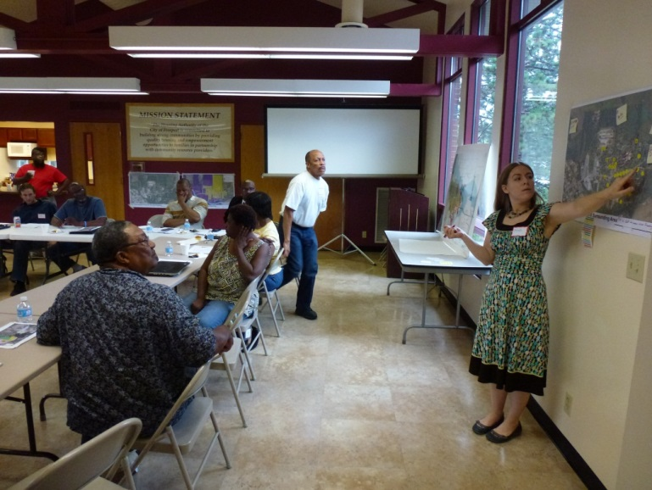
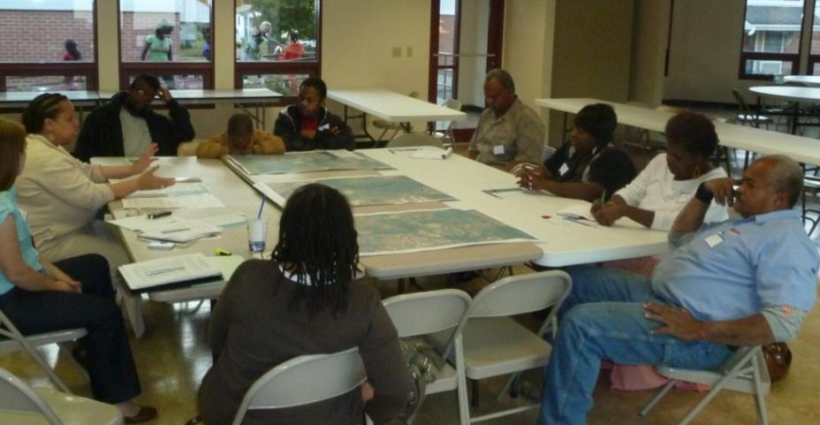
Resources for RPMs
SRI Regional Seeds
Recent focus areas: renewable energy, recreational and educational reuse, area-wide planning, ecological reuse
Notes:
To initiate planning projects, SRI provides Regional seed startup funds for projects around the country. Through this work we have seen that that well-run, community-based reuse planning has the potential to dramatically improve community relations and the public’s perception of the Agency; to streamline the remedial process by clarifying the site’s reasonably anticipated future land use and integrating that with the site’s remedial strategy; and to bring the Agency and communities together around more cost effective remedies that produce the greatest long term value for local communities.
Regional seeds are resources provided by SRI to communities at the request of EPA Region staff. The seed concept provides an initial investment to bring the right stakeholders to the table, clarify remedy constraints, and outline suitable reuse options for the local community to pursue. Additional resources to complete the Regional seed process are provided by the Region. Once the reuse planning process gains momentum, communities can leverage the initial regional seed investment with local resources to continue the process of transforming the Superfund site into productive reuse.
SRI recognizes that there is no one-size-fits-all strategy to make reuse happen. Therefore, SRI offers a number of different types of Regional seeds to support reuse. Recent focus areas include renewable energy, recreational and educational reuse, area-wide planning and green infrastructure.
Pictured: Working sessions and planning meetings with stakeholders and the community at the Freeport Areawide Planning project, an SRI Regional Seed in Region 5

Slide 8
Coming up...
Reuse Planning Case Study Sites
Southside Sanitary Landfill (Region 5)
Rocky Mountain Arsenal (Region 8)
Picayune Wood Treating (Region 4)
Davie Landfill (Region 4)
Notes:
Now that you know a little more about the tools and resources at your disposal, I would like to hand things over to the rest of our panel who will dive into four case study sites that support recreational and educational reuse outcomes.
First we will hear from Tom Bloom about Southside Sanitary Landfill in Indiana. Tom, take it away.....

