Slide 1
RCRA Regulatory Overview for RPMs
Michael Beedle, R5, RCRA Corrective Action, Acting Section Chief
Notes:
This template was developed by US EPA headquarters and is recommended for use by US EPA staff.

Slide 2
Why RCRA is Important to RPMs
Defines what is a hazardous waste
Regulations are applicable or relevant and appropriate requirements (ARARs) for on-site waste management
Must be followed for off-site waste shipments
Affect costs for characterizing, treatment and disposal

Slide 3
Background
1976 Resource Conservation and Recovery Act (RCRA) is an amendment to Solid Waste Disposal Act (SWDA)
RCRA started the regulatory process for hazardous waste and gave Federal Govt enforcement powers

Slide 4
Congressional Findings
Land is valuable resource
Disposal of waste w/o careful planning/management can present a danger and poses substantial risk
More waste is generated from Air and Water controls
If waste management is improper initially, clean-up is likely to be expensive, complex and time consuming
Landfills and surface impoundment least favorable managements methods

Slide 5
RCRA Regs
Meant to prevent the need for remediation
  Prevent future Corrective Action
  Superfund sites
  Protective standards
    secondary containment, inspection requirements
  Public noticed and commented on

Slide 6
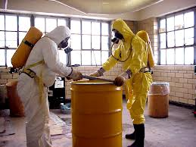
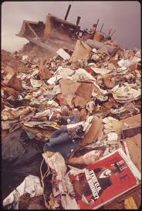
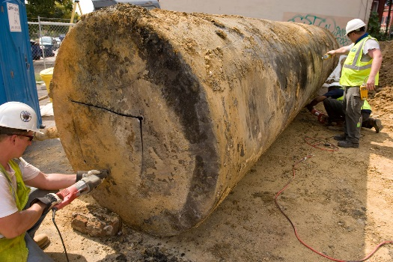
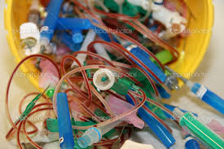
SWDA Subtitles
Programs are often referred by their subtitle letters
  Hazardous waste – Subtitle C
  Solid waste – Subtitle D
  Underground storage tanks – Subtitle I
  Medical waste – Subtitle J

Slide 7
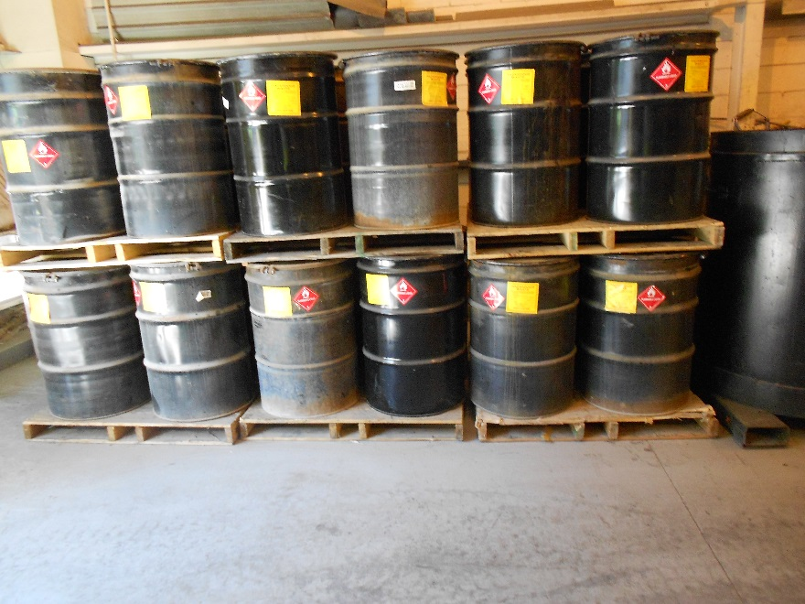
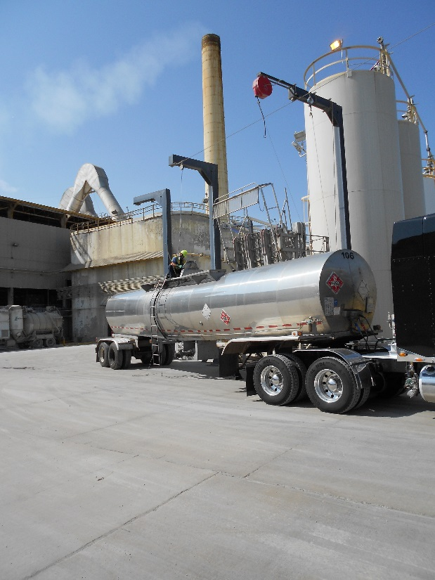
RCRA – C
Cradle to Grave Regs

Slide 8
Hazardous Waste Regulations
Identify what is a solid waste and a hazardous waste
Standards for
  Generator management
  Transporters
  Treatment, Storage and Disposal Facility (TSDF)
Manifests are used to connect the dots

Slide 9
What is a solid waste?
Definition of Solid Waste from the Law:
  Any garbage, refuse, sludge..., and any other discarded material,
  including: solid, liquid, semisolid or contained gaseous material,
  resulting from industrial, commercial, mining, and agricultural operations and from community activities…

Slide 10
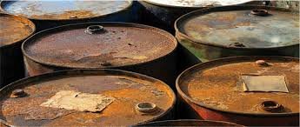
Solid Waste - 40 CFR 261.2(b)
Discarded materials, if not excluded by regulation, are solid waste if they are abandoned by being:
Disposed of; or
Burned or incinerated; or
Accumulated, stored, or treated before or in lieu of being abandoned

Slide 11
Hazardous Wastes
A solid waste is a hazardous waste if
  It exhibits any of the characteristics of hazardous waste
  It is listed hazardous waste (500 specific wastes)
  It is a mixture of solid waste and listed haz wastes (mixture rule)
  It derived from treatment, storage or disposal of haz waste (derived-from rule)

Slide 12
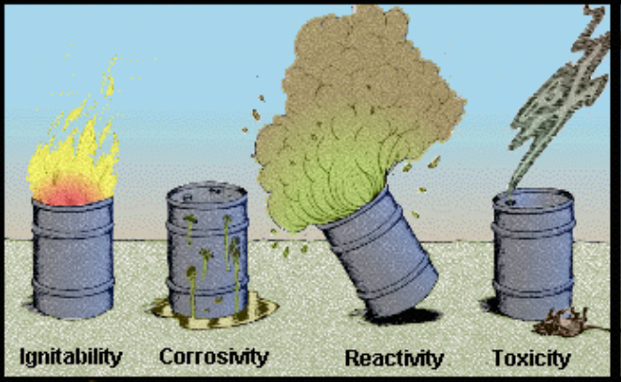
Characteristic Haz Waste – D codes
Ignitability – D001
  Flammable liquid and oxidizers
Corrosivity – D002
  pH <=2 or >=12.5
Reactivity – D003
  Explosives & waste that may produce toxic gases (cyanides sulfides)
Toxicity, D004 – D043
  Metals & organic chemicals concentration based, mg/l (chromium lead, benzene)
  Method that replicates landfill, TCLP, and standards set to protect groundwater

Slide 13
Listed wastes F and K
EPA has applied the listing criteria to numerous of industrial waste streams
F list: Nonspecific Sources
  Solvents, electroplating, wood preserving
K list: Specific Sources
  Industry and process specific
  Organic chemical manufacturing, petroleum refining, iron and steel production, coking

Slide 14
Listed wastes - U and P
Unused or off-spec chemicals
  P list
    Acutely toxic or reactive & toxic
    Cyanides, phosgene
  U list
    Chronic toxicity, ignitable, corrosive or reactive
    Phenol, formaldehyde
Chemical must be pure or sole active ingredient includes container or spill residues

Slide 15
The Contained-In Policy
Requires contaminated environmental media, such as contaminated soils, to be managed as hazardous waste if it contains listed hazardous wastes or exhibits a characteristic of hazardous waste
  Is an ARAR at CERCLA responses
Occurs on a case-by-case basis

Slide 16
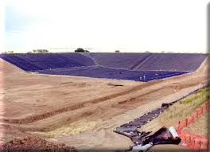
Management Units
RCRA regs are meant to provide safe
  Storage
    container pad, tanks, waste pile, containment bldg
  Treatment
    incinerators, burners, neutralize, stabilize
  Disposal
    landfills, surface impoundments

Slide 17
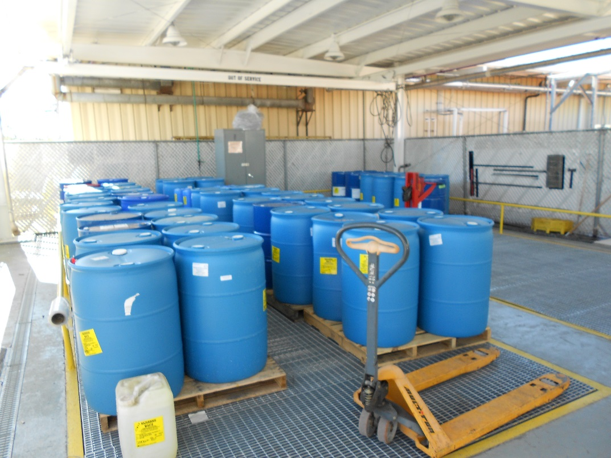
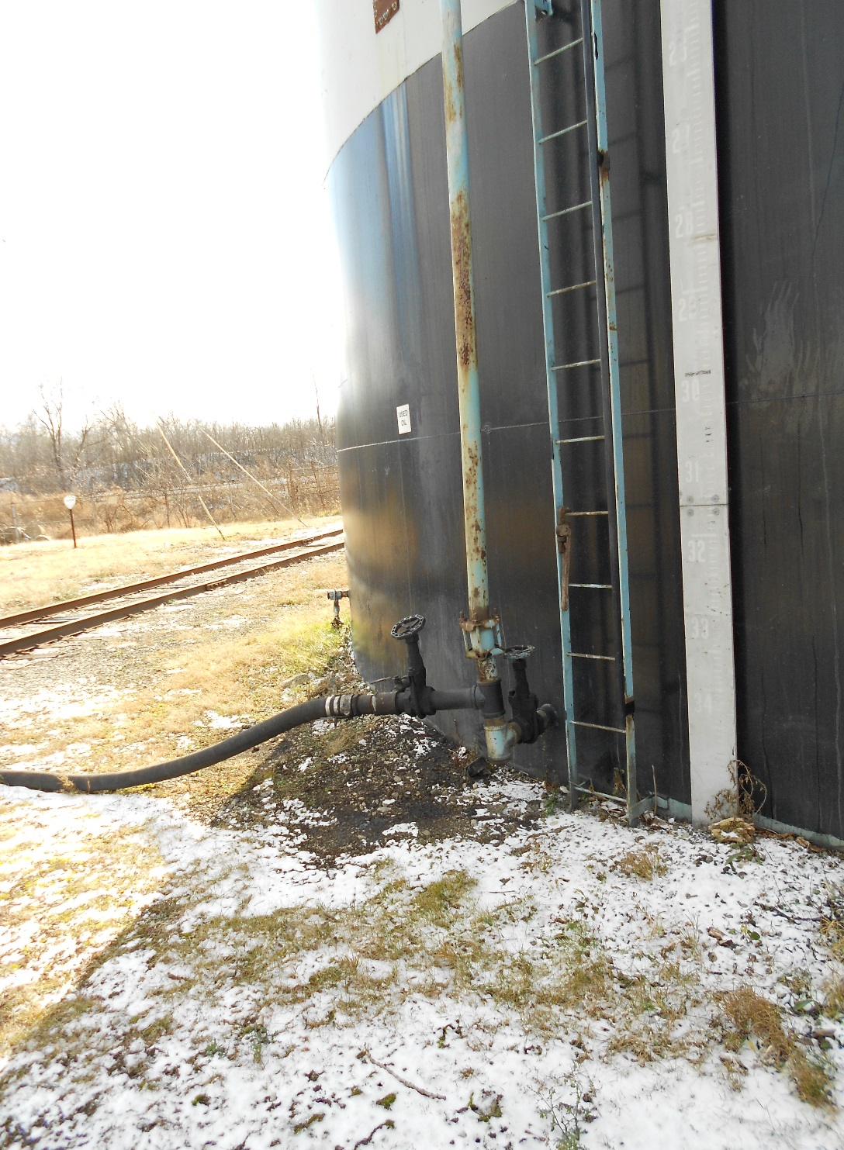
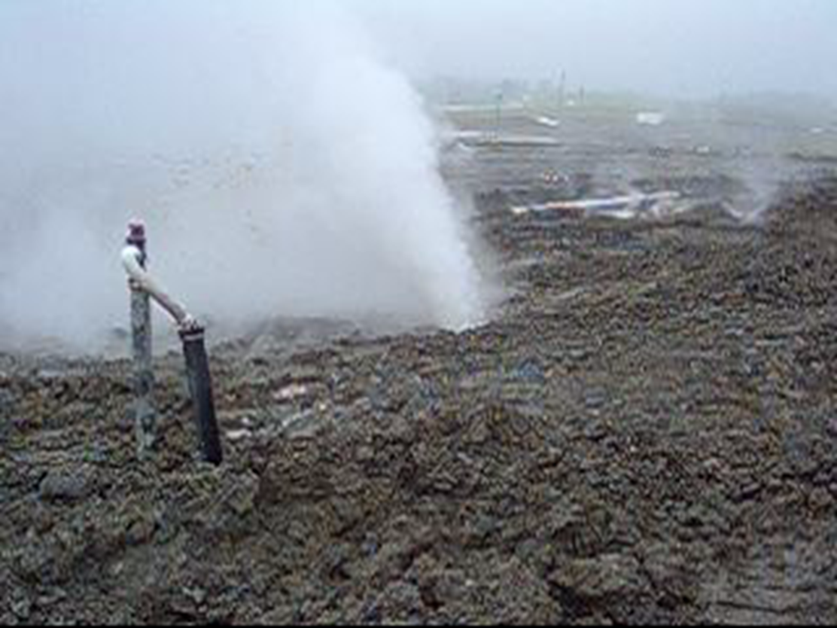

Slide 18
Off-site Shipments of Haz Waste
Must use manifest or other proper shipping document and Land Disposal Restriction notification
Site must be acceptable apply off-site rule
  No releases from receiving unit
  Site must be compliant with regs
Prevents future 2nd cleanup of waste

Slide 19
Land Disposal Restrictions
Land disposal of hazardous waste in municipal landfills not safe, banned in 1984
Must be treated below concentration limit or by prescribed technology
After treatment it can be landfilled
  Haz landfill for listed waste residue
  Non-haz for other treated waste below stds

Slide 20
Treatment Standards
Treated to meet concentration limits
  Risk based – Underlying Hazardous Constituents
  Universal Treatment Standards
Treatment Technologies examples
  Neutralize – corrosive wastes
  Deactivate – removes reactivitiy
  Stabilization - reduces leachability eg cement/lime
  Combustion – burn waste

Slide 21
Alternative Treatment Standards for Contaminated Soil
Created a new treatability group: contaminated soils
Provides the option of meeting LDR standards for contaminated soil versus the standard established for existing industrial wastes
Treatment standard requires that the concentrations of hazardous constituents be reduced by 90 percent

Slide 22
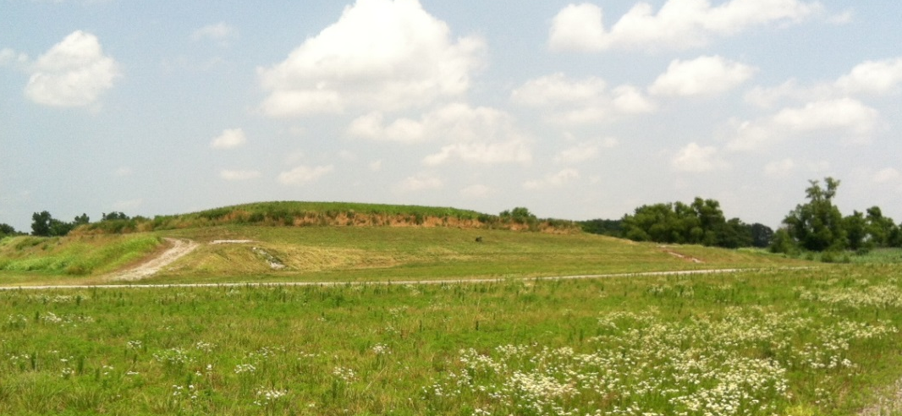
Special Rules for Remediation Waste
Temporary Unit – tank and container storage
Area of Contamination – allows waste consolidation and treatment in place, in situ
Corrective Action Management Unit (CAMU) – RCRA Unit specifically for remediation waste, waste can be moved for other locations onsite

Slide 23
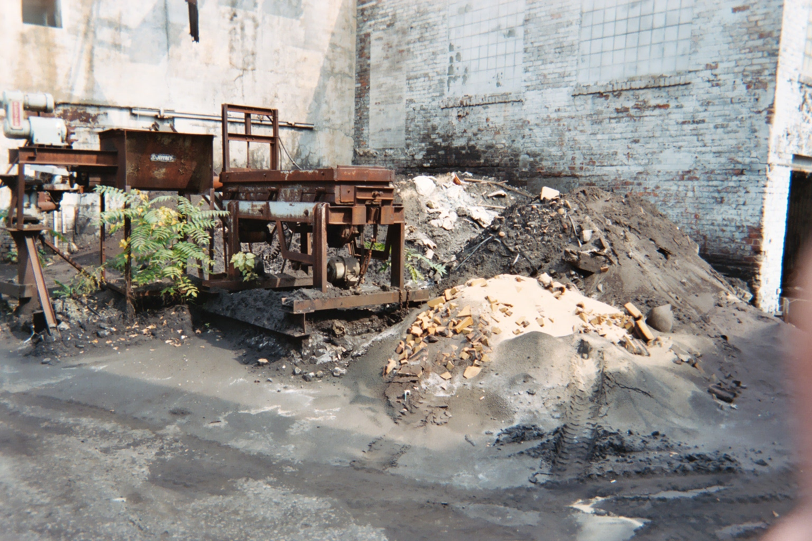
Legal?

Slide 24
Questions?
Next Up
  John Fagiolo, Remedial Project Manager
  RCRA intersecting CERCLA Examples

