Slide 1
John Fagiolo, RPM
U.S. EPA Region 5 Superfund
3 Case Studies of Superfund Sites interacting with RCRA
hazardous waste determination,
land disposal restrictions
management of hazardous waste.
Notes:
This template was developed by US EPA headquarters and is recommended for use by US EPA staff.

Slide 2
ARARS
Applicable or Relevant and Appropriate Requirements (ARARs) are determined at the time of remedy selection. RCRA is always an ARAR when it comes to disposal or containment of spoils (liquid or solid media) from Superfund Cleanups.
- RCRA as ARARs
RCRA (Subtitle C or D) is typically an ARAR when it comes to design/construction of Site remedies such as on-site Landfills, Landfill Liners/Caps, Thermal Treatment, and/or treatment of contaminated groundwater.

Slide 3
Case Study #1- Bofors-Nobel; Muskegon MI
A former specialty chemical production facility.
Known RCRA-Listed compounds were used at that facility as chemical process intermediates and industrial cleaners.
Chemical Process Wastes (sludges, liquids) were improperly disposed of in Lagoons at the Site, adjacent to Big Black Creek.
Notes:
This template was developed by US EPA headquarters and is recommended for use by US EPA staff.

Slide 4
Lakeway Chemical, 1961:
One Lagoon
Notes:
This template was developed by US EPA headquarters and is recommended for use by US EPA staff.

Slide 5
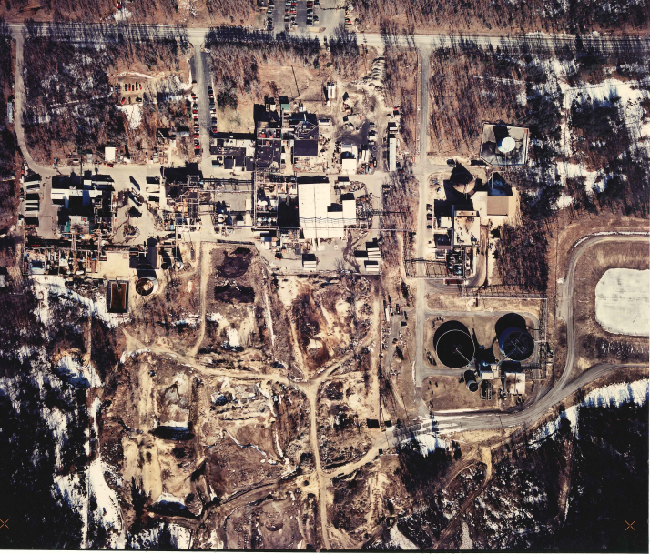
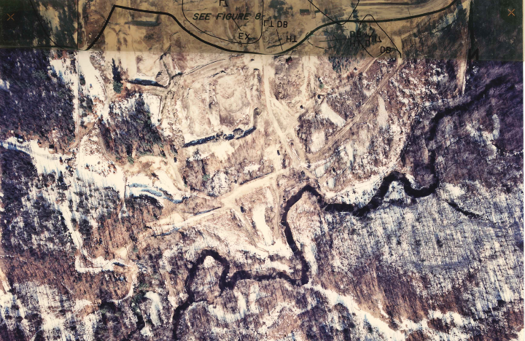
Bofors-Nobel, 1990:
Ten Abandoned Lagoons
Notes:
This template was developed by US EPA headquarters and is recommended for use by US EPA staff.

Slide 6
Bofors-Nobel; Muskegon, MI
RCRA Consultation occurred at the time of the Draft Record of Decision (and subsequent Remedy Decisions).
RCRA personnel noted that if there were Listed wastes in the former production processes, then any improperly disposed-of wastes (by default) must comply with Subtitle C.
If any material or equipment touches RCRA Hazardous Waste, then that material must be handled as hazardous.

Slide 7
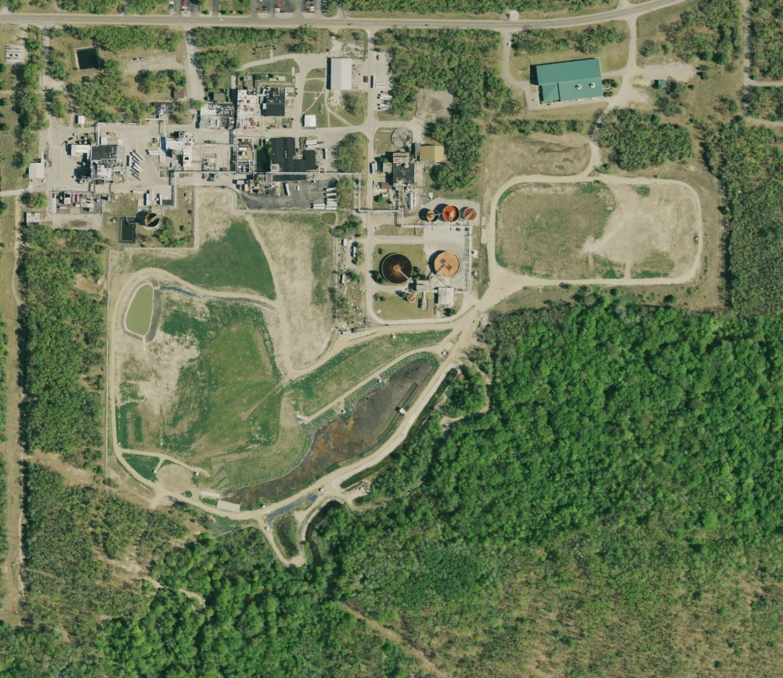

Slide 8
Bofors-Nobel; Muskegon, Michigan
The original “EPA-Lead” remedy that was designed was construction of 2 impermeable Landfill Cells with groundwater pump and treat (capture).
The Landfill Cells' Design required RCRA review and eventually the design (Liners and Caps) complied with RCRA Subtitle C.
These Landfill Cells, however, were never constructed because Potentially Responsible Parties agreed to implement a different but equivalent containment remedy.

Slide 9
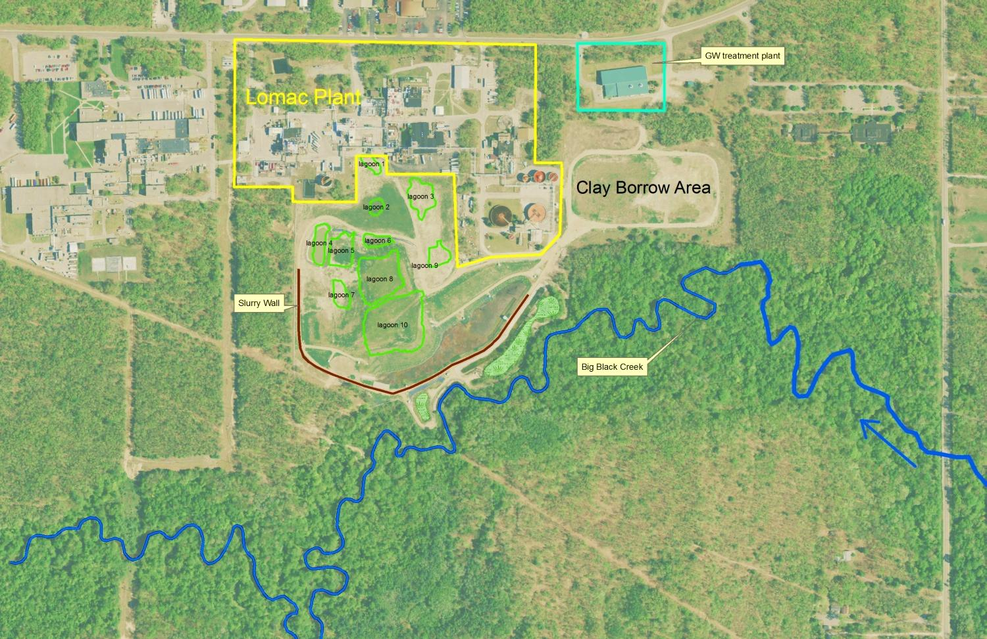

Slide 10
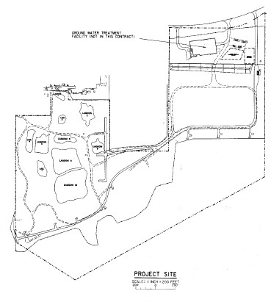
RCRA Subtitle C Compliant Landfill Cells (never constructed).
Notes:
This template was developed by US EPA headquarters and is recommended for use by US EPA staff.

Slide 11
Bofors-Nobel; Muskegon, MI
The 2 impermeable Landfill Cells were to have 12 groundwater extraction wells for pump and treat (capture) with an on-Site Groundwater Treatment Plant (GWTP).
The GWTP was built but instead of the Landfill Cells, the PRPs constructed an in-place containment structure using a bentonite/ concrete Barrier (Slurry) Wall. The Slurry Wall is keyed into a Clay Aquitard Layer.
The GWTP has metals precipitation as a treatment step, so any solids that occasionally get cleaned out must be TCLP tested to determine eventual Land Disposal fate. Historically, the sludge has been non-hazardous.
Notes:
This template was developed by US EPA headquarters and is recommended for use by US EPA staff.

Slide 12
The GWTP, completed by EPA in 1994.
Notes:
This template was developed by US EPA headquarters and is recommended for use by US EPA staff.

Slide 13
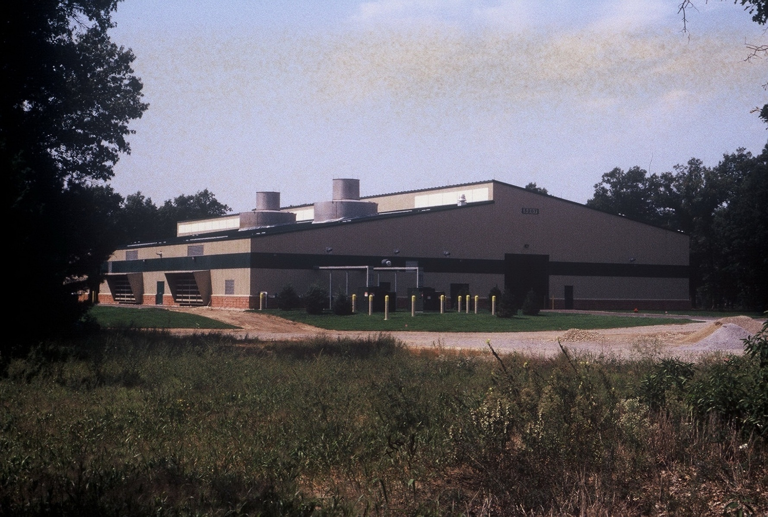
Notes:
This template was developed by US EPA headquarters and is recommended for use by US EPA staff.

Slide 14
“Metals” sludge removal step, to an off-site Landfill.
Notes:
This template was developed by US EPA headquarters and is recommended for use by US EPA staff.

Slide 15
Instead of the Landfill Cells, the Current Bofors-Nobel Site Remedy is containment by a bentonite/ concrete slurry wall around the Lagoons with groundwater extraction. The Lagoons are covered by a non-RCRA protective soil cover to allow infiltration (for GW extraction) and the cover protects trespassers.
Notes:
This template was developed by US EPA headquarters and is recommended for use by US EPA staff.

Slide 16
Case Study #2 -Ott/Story/Cordova;Muskegon, MI
Another former chemical production facility.
The EPA-constructed Site Remedy is a Groundwater pump-and-treat with a Groundwater Treatment Facility (GWTF) that uses Powdered Activated Carbon as the main treatment technology.
The Contaminant Source Area was remediated by excavation of soil that was Landfilled off-Site.
Notes:
This template was developed by US EPA headquarters and is recommended for use by US EPA staff.

Slide 17
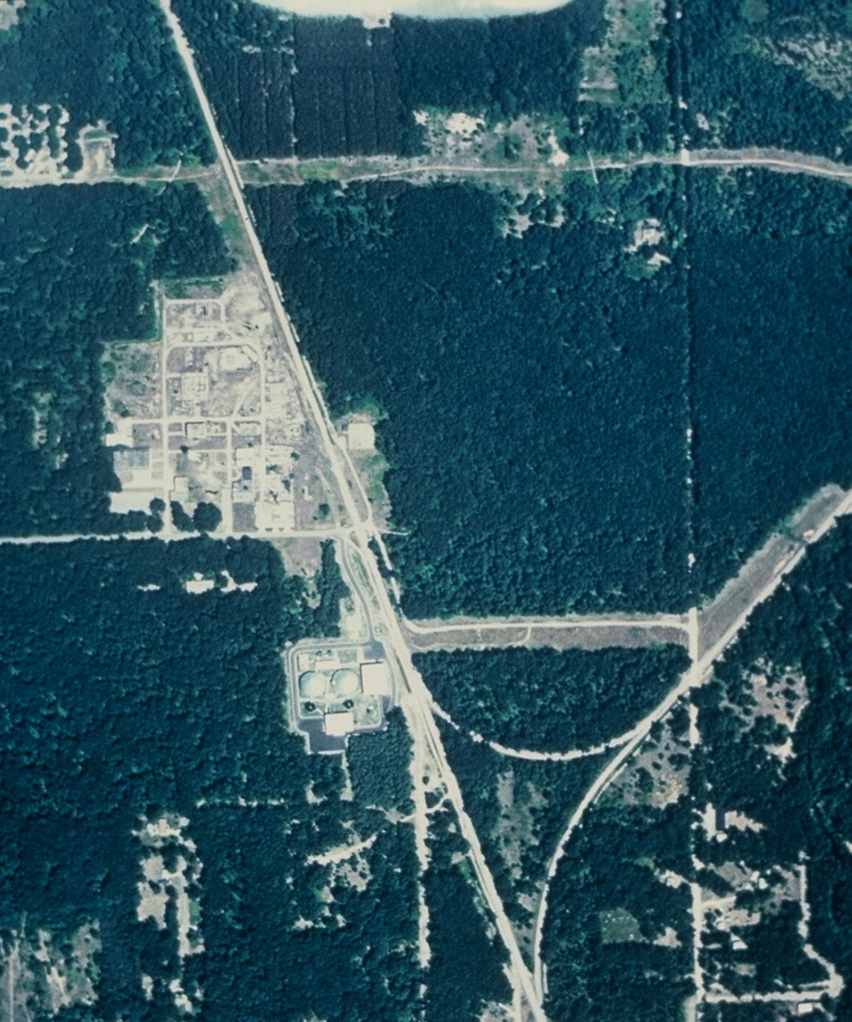
Original Contaminant Source Area, O.U. #3. (Former Chemical Plant)
GWTF Constructed by EPA
Notes:
This template was developed by US EPA headquarters and is recommended for use by US EPA staff.

Slide 18
Ott/Story/Cordova
Soil in the contamination source area was excavated and disposed of off-Site at both non-Hazardous and RCRA Hazardous Landfills, based on chemical and TCLP analyses of specific soil from specific areas.
The soil was CERCLA waste which was a complex mixture of several different wastes, and best demonstrated available technology (BDAT) such as incineration, wasn't appropriate or needed.
Notes:
This template was developed by US EPA headquarters and is recommended for use by US EPA staff.

Slide 19
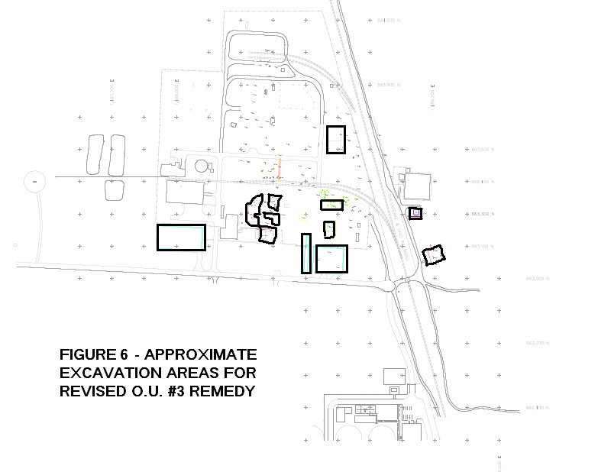
Notes:
This template was developed by US EPA headquarters and is recommended for use by US EPA staff.

Slide 20
Ott/Story/Cordova
Contaminated groundwater is captured and sent to the EPA-constructed GWTF (Design Flow = 800 gpm) where it is treated using Powdered Activated Carbon in large tanks. (“Pump and Treat” technology).
A secondary “polishing” occurs in the GWTF using Granulated Activated Carbon.
The clean treated effluent water then flows through a 3 mile long pipeline and discharged into the Muskegon River. The GWTF and process complies with a State- administered NPDES Permit.
Notes:
This template was developed by US EPA headquarters and is recommended for use by US EPA staff.

Slide 21
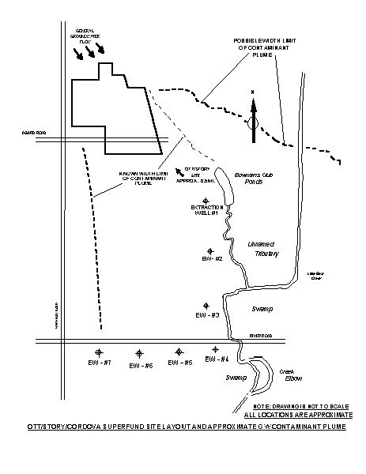
11 Extraction Wells, 7 of which are along the Creek for GW capture. Dotted lines show the approximate plume extent.
Notes:
This template was developed by US EPA headquarters and is recommended for use by US EPA staff.

Slide 23
Ott/Story/Cordova
Powdered Activated Carbon that is saturated with contaminants is removed as Treatment Plant Sludge. The carbon is removed from the treatment train, filter pressed, and disposed of off-site.
The sludge was TCLP tested to determine the disposal requirements. For Ott/Story/Cordova, this sludge has been determined to be "non- hazardous” and is landfilled in a solid waste landfill.
Notes:
This template was developed by US EPA headquarters and is recommended for use by US EPA staff.

Slide 24
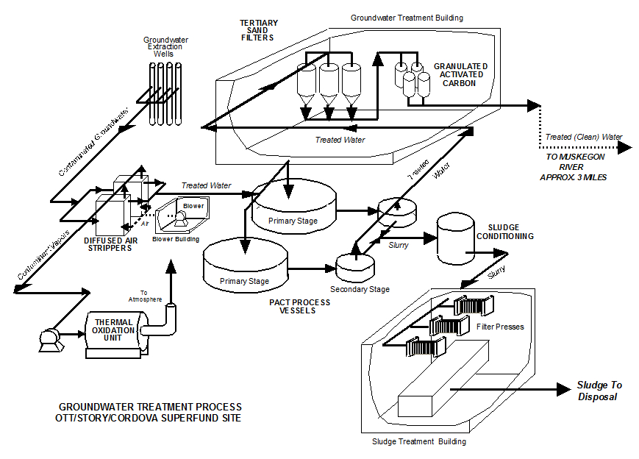
Activated Carbon Sludge (saturated with contaminant) is Filter Pressed and Landfilled (Non-Haz)

Slide 25
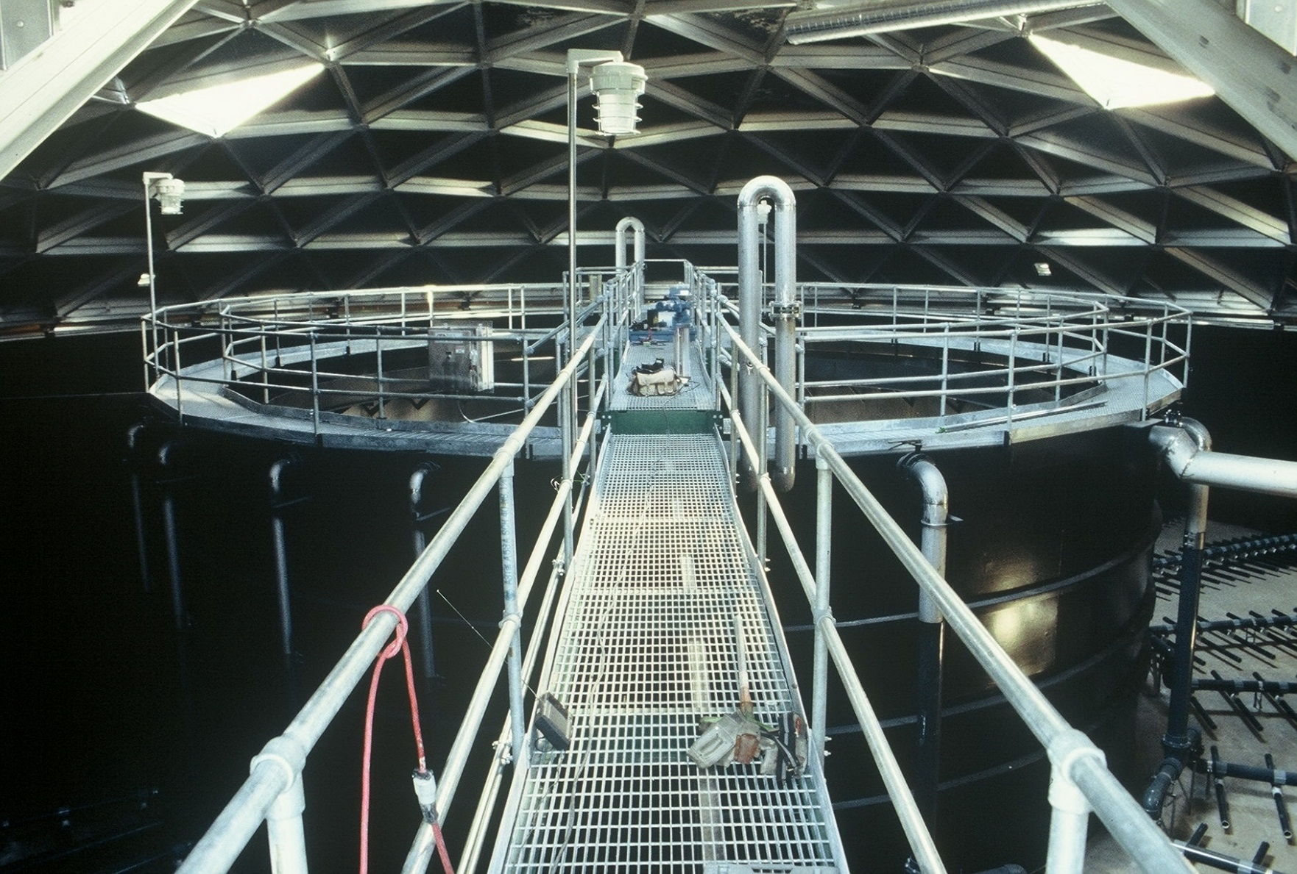
Inside of a PACT Vessel. (before start-up)

Slide 26
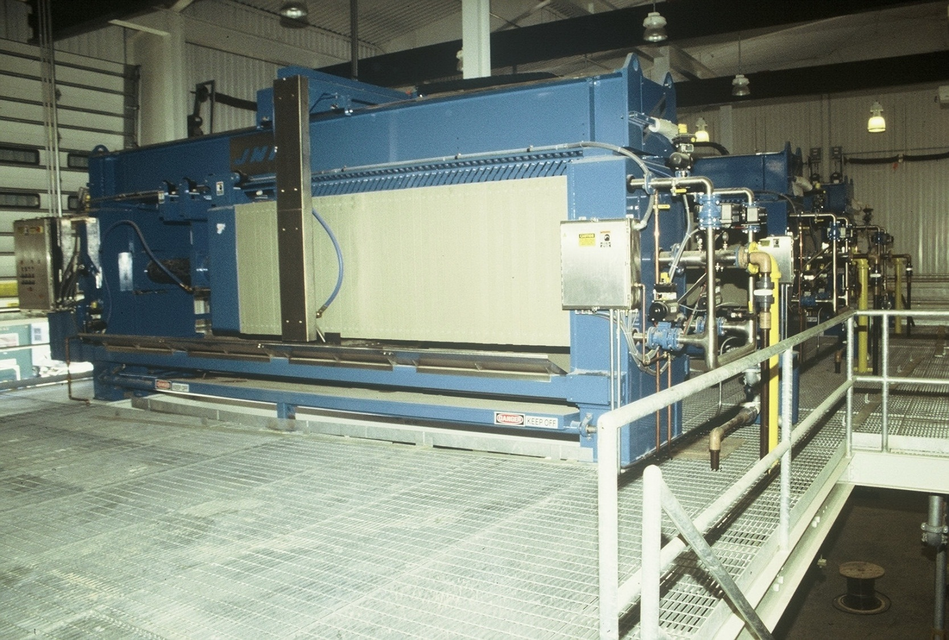
The three Filter Presses.

Slide 27
Case Study #3 -Tri-County/Elgin Landfills;Elgin IL
Two adjacent former municipal waste landfills (now handled as one Site) that ceased accepting wastes in 1976.
Because:
  - these had been municipal waste landfills (generally “non- hazardous”);
  at the time of a remedy decision the placed wastes were mostly decomposed; and
  the waste characterization that happened during the Remedial Investigation did not suggest high concentrations of leaching “hazardous” constituents,
  The design and construction of a landfill cover complied with Title 35, Illinois Solid and Special Waste Management Regulations, Section 807.305, and Resource Conservation and Recovery Act (RCRA) Subtitle D cover requirements.
Notes:
This template was developed by US EPA headquarters and is recommended for use by US EPA staff.

Slide 29
Tri-County/Elgin Landfills; Elgin IL
The Remedial Investigation showed that contaminants on Site were at low enough concentrations to allow for a Subtitle D Cap. The contaminants however were still above acceptable Drinking Water requirements (Maximum Contaminant Levels, or State of Illinois GW Quality Standards, Class I / Class II).
The goal of this remedy is to prevent infiltration and leaching. Since the waste mass is in contact with groundwater, a subtitle D cap was selected instead of a Subtitle C cap because the increased impermeability of a "C cap” was not significant enough to justify higher cost.
The remedy included Landfill Gas collection (with intermittent flaring) and condensate collection.
Notes:
This template was developed by US EPA headquarters and is recommended for use by US EPA staff.

Slide 30
Tri-County/Elgin Landfills; Elgin IL
The Landfill Cap design was modified to use a 40-mil Low Density Polyethylene (LDPE) geomembrane. The LF cap layers from bottom to top are: 6 inch foundation layer located above waste fill and below the geomembrane; the 40-mil LDPE geomembrane; a geotextile cushion layer and or geonet drainage layer; and 18 inches of cover soil.
- A "frost" layer was originally required but because geomembranes are not subject to frost damage, that layer did not need to be buried below maximum frost depth.
- LDRs were not applicable because no placement of RCRA hazardous wastes would occur with the cleanup, and no listed or other "banned" waste was documented at the site.
Notes:
This template was developed by US EPA headquarters and is recommended for use by US EPA staff.

Slide 31
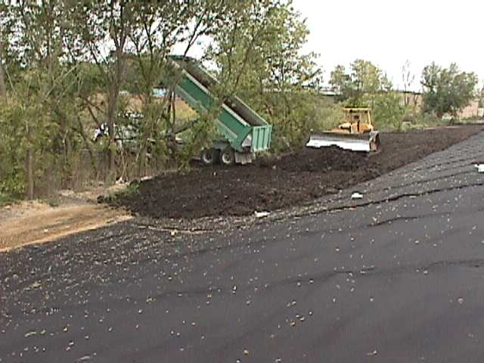

Slide 32
Tri-County/Elgin Landfills; Elgin IL
One section of the Landfill Cap has a "Mat-Con" layer to allow for vehicle parking. In order to obtain approval for this design modification, lab and field surface ponding tests were conducted to show that the Mat-Con cover system provided hydraulic conductivity (impermeability) that met or exceeded fundamental baseline targets for RCRA Subtitle C cover systems.
This was "extra" contingency because only Subtitle D impermeability equivalence was needed.
Notes:
This template was developed by US EPA headquarters and is recommended for use by US EPA staff.

Slide 33
"Keying" into the adjacent LF cap / membrane.
Landfill Cap to the left, and Mat-Con to the right.
Notes:
This template was developed by US EPA headquarters and is recommended for use by US EPA staff.

Slide 34
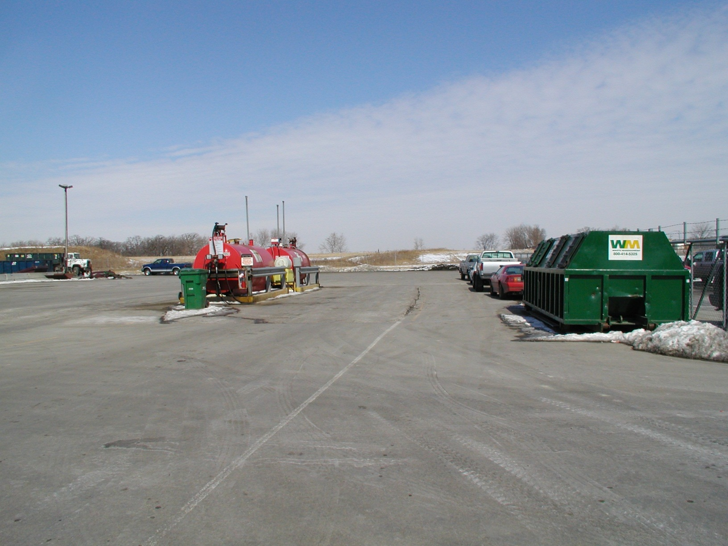
Notes:
This template was developed by US EPA headquarters and is recommended for use by US EPA staff.

Slide 35
In Summary:
Although RCRA Consultation is not always needed in every step of a Superfund Cleanup, it is important because.....
RCRA will determine the fate and destination of where remediated contaminated media is disposed.
RCRA determines the fate and destination of any spoils/effluent of on-Site remediation or waste treatment operation. Disposal must comply with TSD requirements.
RCRA will determine the level of impermeability (containment) and/or BDAT that is required for on-Site disposal/containment remedies.
Although some Superfund cleanups may not need formal paper or administrative RCRA permits, remedies must always meet the RCRA “equivalent” as an ARAR.
Notes:
This template was developed by US EPA headquarters and is recommended for use by US EPA staff.

Slide 36
THANK YOU !!!
John Fagiolo, Remedial Project Manager
U.S. EPA Region 5 Superfund Division; Chicago, IL
312-886-0800; Fagiolo.John@epa.gov
Next Up: Christopher Black
What is RCRA Corrective Action and how does that relate to Superfund RPMs?
Notes:
This template was developed by US EPA headquarters and is recommended for use by US EPA staff.

