Slide 1
NEPA and Mining 101
June 8, 2016
Chad Hood, Minerals and Geology Management Group, USFS WO
Jeanne Geselbracht, NEPA Reviewer, EPA Region 9
Dana Allen, NEPA Reviewer, EPA Region 8

Slide 2
Mining Information Session
Module 1: Mining Fundamentals
Module 2: Environmental Concerns and Issues
Module 3: Regulatory Process and How the Public and Tribes Can Engage

Slide 3
Module 3:
The Regulatory Process Public and Tribal Engagement Overview
Mine Planning and Administration – a Land Management Agency Perspective
National Environmental Policy Act (NEPA)
NEPA Process and Environmental Impact Statement Review
Relevant Regulations and Permits
Notes:
We will discuss these topics. As we go, we will identify places in the process where the public, tribes, and other agencies and interested parties can engage and be heard. Chad will discuss the mine planning process at the U.S. Forest Service.

Slide 4



Mine Planning and Administration
Chad Hood, U.S. Forest Service
The Nuts and Bolts of the
U.S. Forest Service Process
Authorities
Permitting process
Administration of operations

Slide 5



U.S. Forest Service Authorities
Different mineral authorities for:
  Locatables
  Salables
  Leasables
Locatable Mineral = a valuable mineral, which is not specifically excluded by law, that may be located and removed from federal lands in accordance with the following authorities:
Notes:
Mention the U.S. Forest Service’s mission.

Slide 6

U.S. Forest Service Authorities – Locatables
Laws
General Mining Law of 1872
Organic Act of 1897
Leasing Act of 1920
Multiple Use Mining Act of 1955
Regulation
36 CFR 228 Subpart A
Policy and Direction
Forest Service Manuals 2810 and 2840
Forest Plan

Slide 7
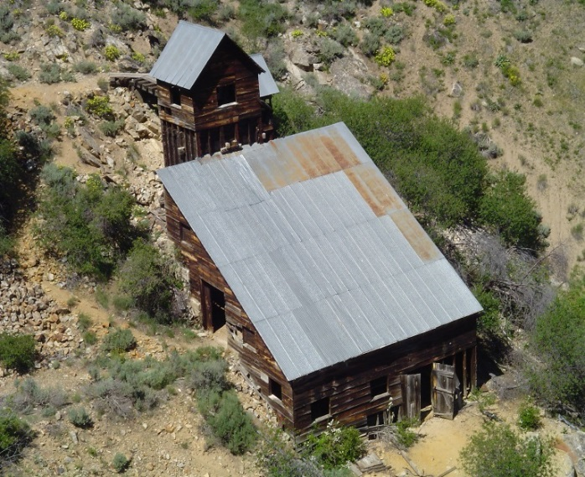
U.S. Forest Service Authorities (cont.)
Laws
  General Mining Law of 1872: except otherwise provided, all valuable mineral deposits are free and open to exploration, occupation and purchase
  Organic Administration Act of 1897: provides USDA Secretary with authority to regulate occupancy and use of National Forest System lands

Slide 8
U.S. Forest Service Authorities (cont.)
Regulations
  36 CFR 228.1: operations authorized by U.S. mining laws…shall be conducted so as to minimize adverse environmental impacts on National Forest Service surface resources
Manuals
  FSM/FSH 2800: provides specific direction to the Agency on implementation of laws and regulations, and states objectives and policies to help guide implementation

Slide 9
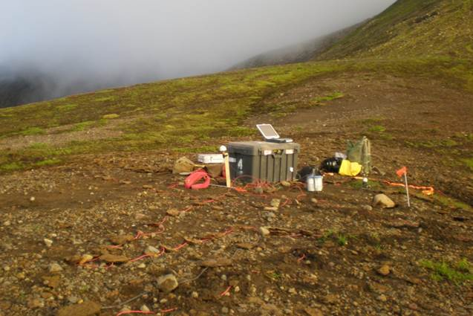
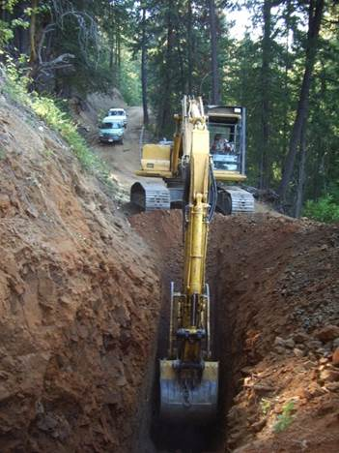
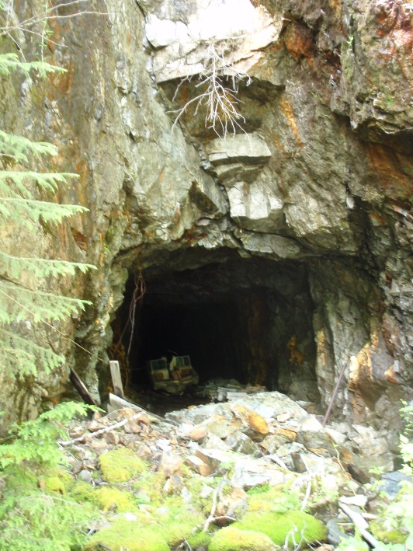
U.S. Forest Service Authorities – Getting Started
Notice of Intent
Plan of Operations
What is the difference?

Slide 10
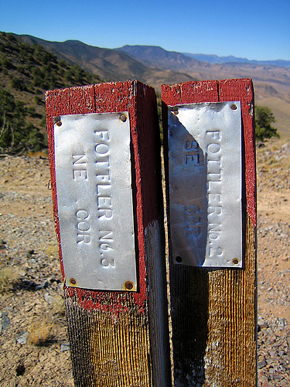
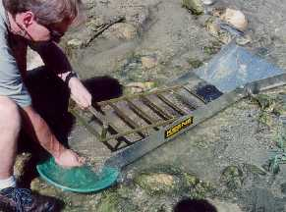
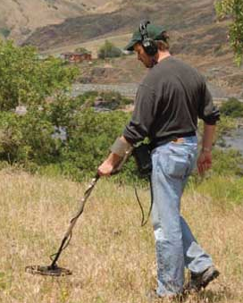
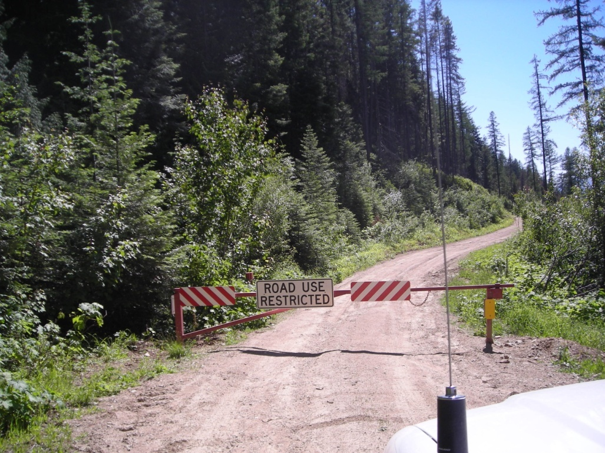
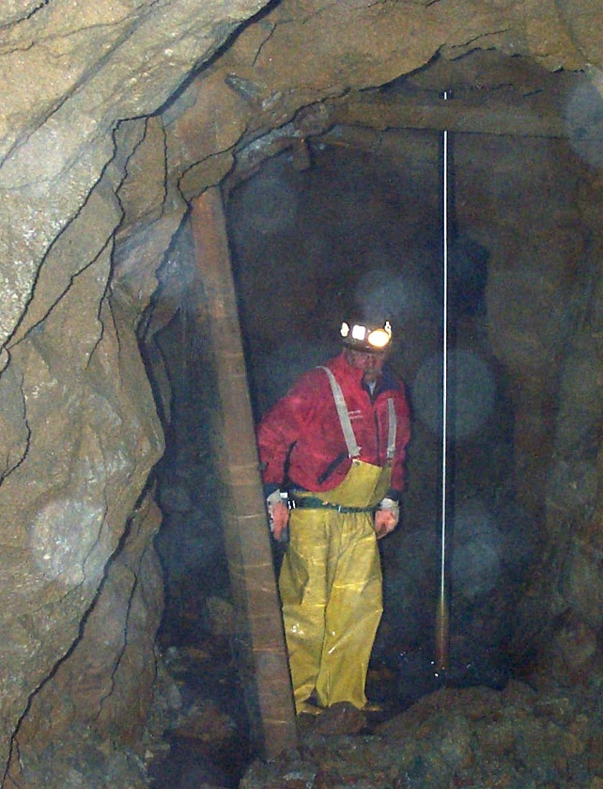
U.S. Forest Service Authorities – Notice of Intent (NOI)
  NOI - 36 CFR 228.4(a)
  Notification from operator of intent to conduct locatable mineral activity on NFS lands
  Operator must file notification any time proposed operations might cause significant disturbance of surface resources
    NOI surface disturbance = not substantially different than that caused by other activities (camping, hiking, mountain biking, horseback riding)
    36 CFR 228.4(a)(1) outlines when NOI is not required

Slide 11
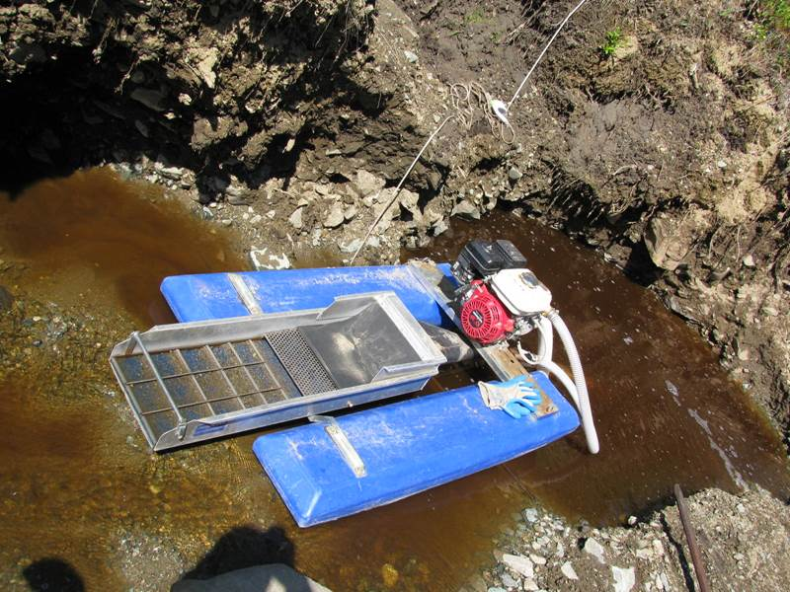
U.S. Forest Service Authorities – NOI (cont.)
  Provide sufficient information for Forest Service to determine if proposed activities require a Plan
  Is not a Forest Service-signed approval or authorization
  Is not bonded

Slide 12
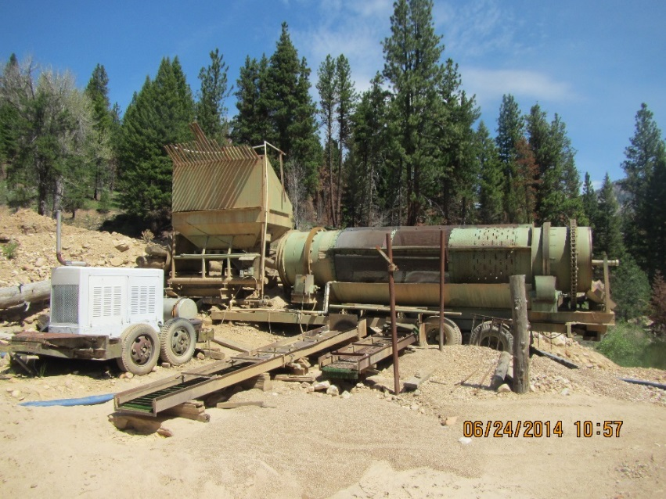
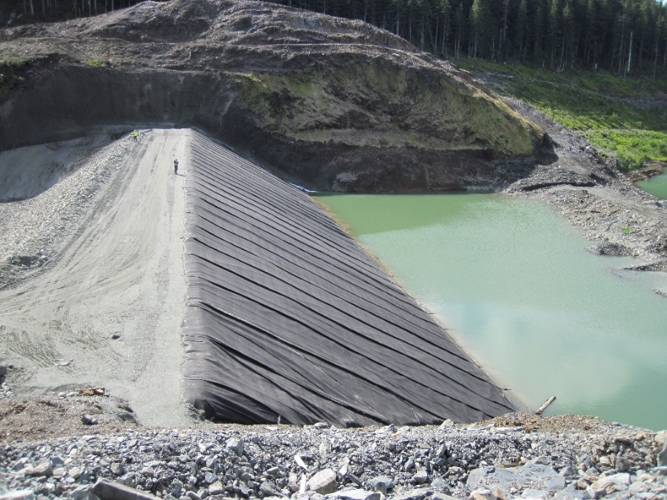
U.S. Forest Service Authorities – Plan of Operations
  Plan of Operations (POO, Plan) 36 CFR 228.4(a)(3)
  Required any time operations will likely cause or are causing significant disturbance of surface resources

Slide 13
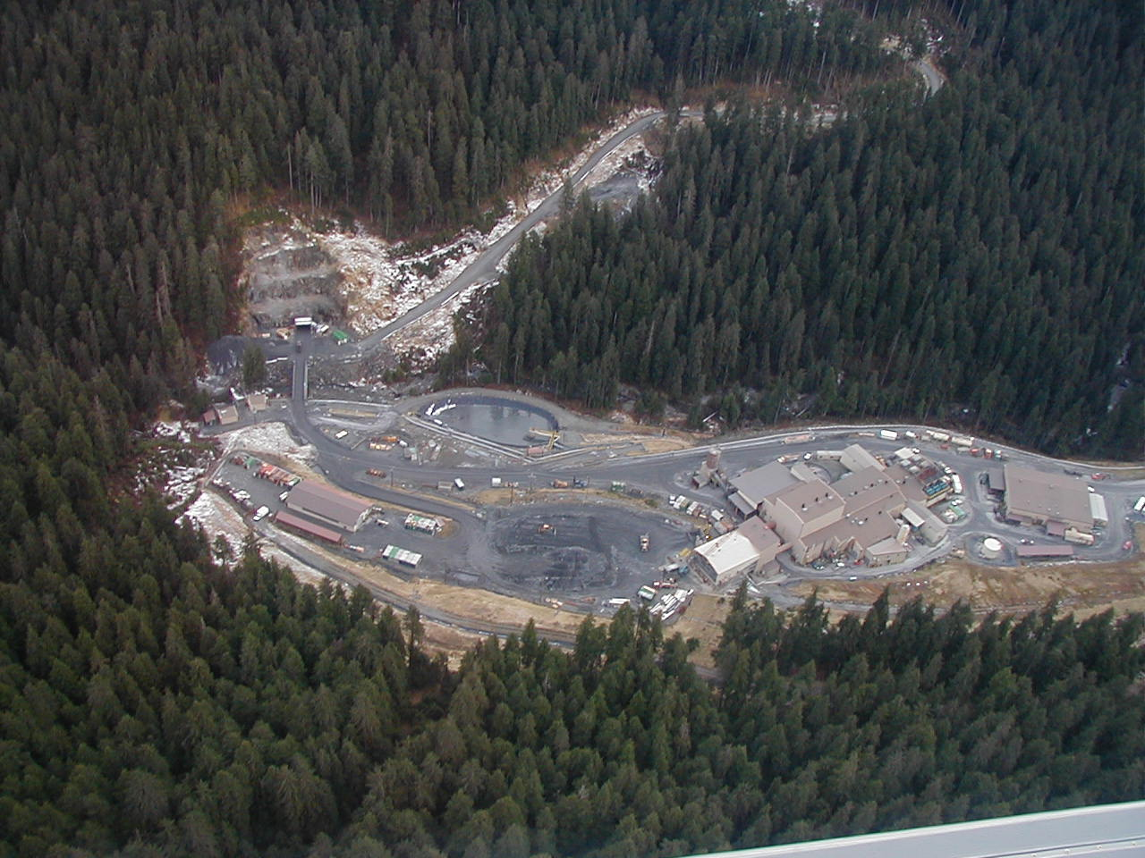
U.S. Forest Service Authorities – Plan of Operations
  Should consider, depending on scale of operations (36 CFR 228.4(c)):
    Schedule of operations
    Baseline Studies
    Water management
    Reclamation
      concurrent, interim, final
    Monitoring
    Mitigations
    Other (site-specific needs)

Slide 14
U.S. Forest Service Permitting Process
Steps in processing a mineral proposal:
Proponent submits proposal to Forest Service
Forest Service replies in writing that proposal was received
  NOI = 15 days
  Plan of Operations = 30 days
Forest Service reviews proposal for completeness, works with proponent if more information is needed
  Is proposal logical and sequential?
  Are activities authorized by law?
  Does proposal explain everything with good maps and illustrations?
  Is there enough information to move forward?

Slide 15
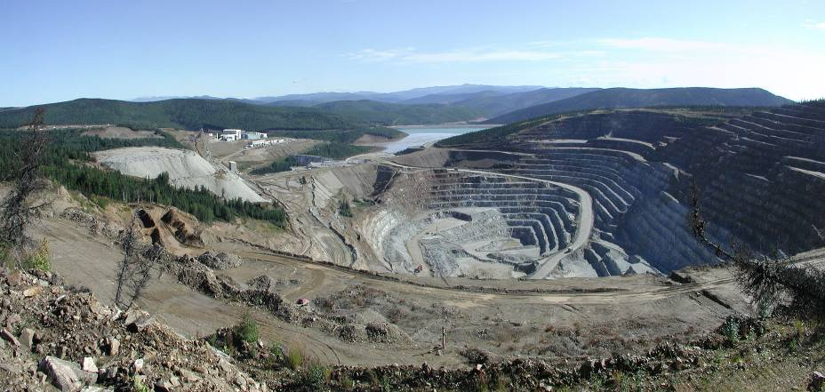
U.S. Forest Service Permitting Process
Steps in processing a Plans of Operations:
Forest Service conducts NEPA review with decision (36 CFR 220)
  Categorical Exclusion
  Environmental Assessment
  Environmental Impact Statement
Defined timelines
  Scoping
  Comment
  Objection process (36 CFR 218)
Fort Knox Mine, AK

Slide 16
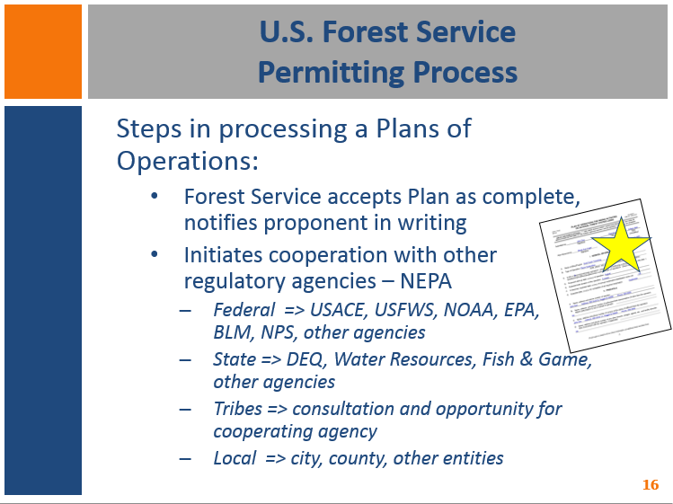
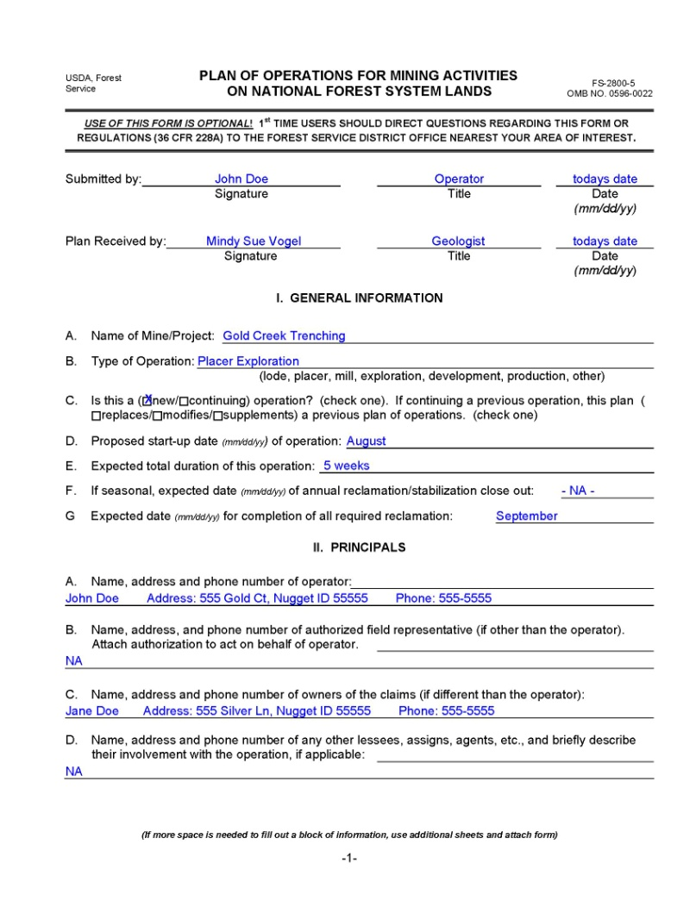
U.S. Forest Service Permitting Process
Steps in processing a Plans of Operations:
Forest Service accepts Plan as complete, notifies proponent in writing
Initiates cooperation with other regulatory agencies – NEPA
  Federal => USACE, USFWS, NOAA, EPA, BLM, NPS, other agencies
  State => DEQ, Water Resources, Fish & Game, other agencies
  Tribes => consultation and opportunity for cooperating agency
  Local => city, county, other entities

Slide 17
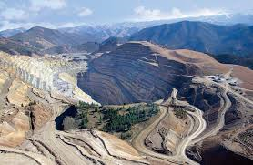
U.S. Forest Service Permitting Process
Steps in processing a Plans of Operations:
Forest Service notifies proponent and public of…
  NEPA decision (not Plan authorization)
  Required mitigations
  Bond information
Forest Service prepares/reviews bond package (with proponent)
Thompson Creek Mine, ID

Slide 18
U.S. Forest Service Permitting Process
Steps in processing a Plans of Operations:
If no appeal, USFS approves Plan = authorization to operate
Litigation (can happen anytime after NEPA decision)
Proponent begins operations
Proponent completes reclamation and monitoring
FS returns bond and closes out Plan of Operations

Slide 19
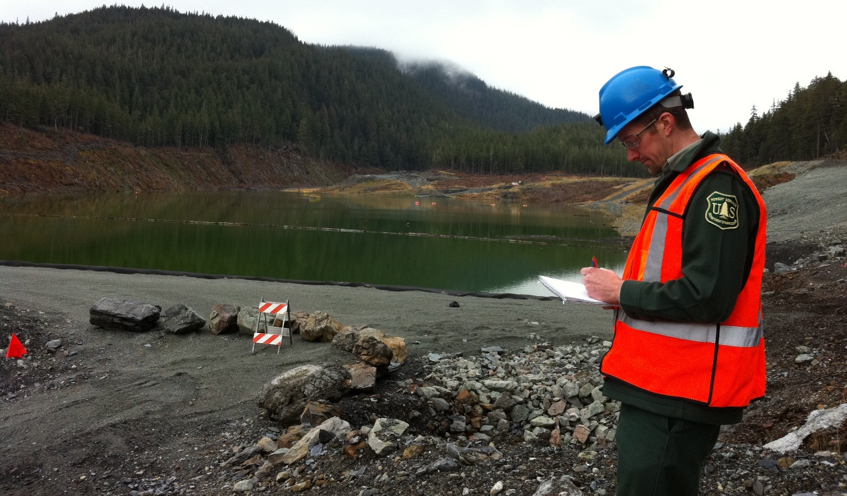
U.S. Forest Service – Administration of Operations
Inspections
  Scheduled and random
  During operations and closure, post-closure
  Compliance with Plan of Operations, laws, regulations and policy

Slide 20
Comparison: BLM and U.S. Forest Service
Casual Use
  Forest Service does not define casual use or recreational mining
Notice of Intent
  Forest Service has higher threshold than BLM…activities cannot have potential for significant surface disturbance
  Forest Service does not have direction for NOI < 5 acres
Bonding
  Forest Service only bonds Plans of Operations, not NOIs
  Forest Service does not require operator to submit bond calculation with Plan
218 Objections and 214 Appeals
  Forest Service elevates to next authority level, not administrative court

Slide 21
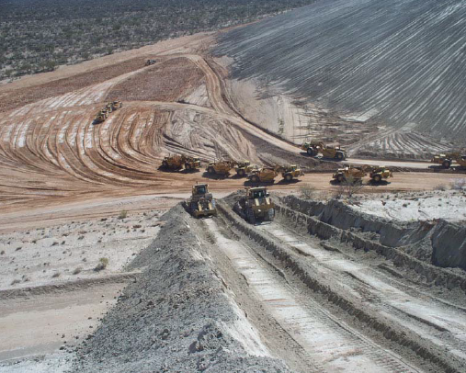
NEPA and Mining
Jeanne Geselbracht, EPA Region 9

Slide 22

Why NEPA?
The National Environmental Policy Act was necessary to ensure that federal agencies would consider environmental concerns when making decisions, because the statutes that created the agencies often did not include an environmental mandate.
Notes:
NEPA is our national charter for environmental responsibility.
It was passed by Congress in 1969 and signed by President Nixon on Jan. 1, 1970. It was necessary to ensure that federal agencies would consider environmental concerns when making descisions.
It also established the Council on Environmental Quality – CEQ- and they wrote the NEPA Implementation Regulations (40 CFR 1500-1508), which Federal agencies must follow in carrying out the NEPA process.

Slide 23
Twin Aims of NEPA
Agencies have the obligation to consider every significant
aspect of environmental impacts of a proposed action
Agencies will inform the public that environmental concerns have been considered in decision-making process
DECISION
Consider
Inform
Notes:
NEPA is about good decisions for good outcomes.
NEPA’s purpose is to ensure that Federal agency decisionmakers understand and take into account the environmental consequences of their actions.
Agencies are obligated to consider all of the potential impacts of the proposed action.
And to inform the public about them.
It requires coordination with other agencies with jurisdiction, as well as transparency and availability of the analysis to the public -- who have the opportunity to review and comment on the documents.
Both CEQ and EPA have web sites with lots of information on NEPA:
https://ceq.doe.gov/ – regulations, Executive Orders, guidance documents
https://www.epa.gov/nepa? – info on NEPA, Citizens’ Guide to NEPA, filing EISs, links to EISs filed since Oct. 2012, and to EPA’s comment letters on EISs.

Slide 24
What Triggers NEPA?
Proposals for legislation
Projects on federal land or affecting federal facilities or resources
  For example: Forest Service or BLM approval of a mine’s Plan of Operation
Issuance of a federal permit, lease or license
  For example: new source NPDES permit or CWA 404 permit
Notes:
What triggers an agency’s obligations under NEPA?
Proposals for legislation – we won’t be talking about this today.
Projects on federal lands or affecting federal resources.
Chad just gave us an example of this trigger – The Forest Service is considering issuing a mining permit.
Other triggers include federal permits, leases, licenses, funding, etc.
The Army Corps of Engineers may have received an application for a CWA 404 permit to fill Waters of the US by a mining company that wants to construct a tailings storage facility.
Or, if EPA is considering issuing an NPDES permit for a new source (say, a mine that wants to discharge into a water of the US), this also triggers NEPA compliance for EPA.
Projects not on Federal land or that do not need permits or licenses or funding from a Federal agency would not trigger NEPA, including permits for programs that have been delegated to the States.
For instance, if a State has primacy for the NPDES program, issuance of that permit by the State does not trigger NEPA.
Many states do have their own public processes for their permits and licenses – it’s just not the NEPA process.

Slide 25
NEPA Planning
Level of analysis:
  Environmental Assessment (EA) – if no significant impacts, otherwise…
  Environmental Impact Statement (EIS)
Who prepares the EIS?
  Lead federal agency, such as:
    Forest Service or BLM (Plan of Operations)
    U.S. Army Corps of Engineers (CWA 404)
  Assistance from cooperating agencies:
    Other federal agencies
    Tribes
    State or county agencies
    Local agencies
Notes:
Agencies have to figure out what level of analysis is appropriate.
If a project is not specifically listed in an agency’s list of Categorical Exclusions, then an EA or EIS is needed.
An EA can be prepared if there are no significant impacts, or if the agency wants to use it as a screening exercise to determine whether there may be significant environmental impacts.
Keep in mind that, under NEPA, “environmental impact” includes the human environment too, such as health, safety, socioeconomics, recreation, etc.
If no significant impacts are anticipated based on the EA, the agency signs a FONSI (Finding of No Significant Impact).
If there may be significant environmental impacts, then an EIS is prepared.
Who should prepare it?
Generally, the Federal agency with the largest role takes the lead for the EIS.
Other Federal agencies sometimes have associated actions that trigger NEPA, and they can become cooperating agencies so they can use the EIS to support their own actions.

Slide 26









Agencies and Mine Authorities
Multiple Agencies and Environmental Laws Regulating Mining Operations and Pollution from Mining Operations
State Agencies
Lands
Water Department
Fish and Wildlife
Historic Preservation
Tribal Governments
Notes:
There often is more than one Federal agency involved in permitting a mine.
For example, let’s say the USFS is the lead agency for a new mine because a POO is needed.
But the project also involves filling 50 acres of waters of the US and there’s a 1-mile slurry pipeline that would cross adjacent BLM land, so a CWA 404 permit from the Corps and a Right-of-Way from BLM are both needed.
These agencies can be cooperating agencies so everyone is using the same document to support their decisions.
Other state and local agencies and tribes can also be cooperating agencies when they have jurisdiction or special expertise or may be affected by the action.
And in states that have their own state version of NEPA, the Federal EIS and State EIS are often issued together as one document to promote efficiency and reduce confusion.

Slide 27
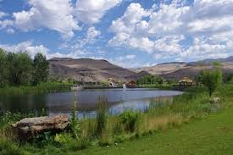






Resources Addressed under NEPA
Floodplains
Wetlands
Water
Threatened and Endangered Species
Air
Notes:
Numerous resources may be affected by a mine project, and the impacts and ways to mitigate them need to be analyzed in the EIS.
John and Shahid mentioned some of these impacts and controls in their Module 2 webinar 2 weeks ago.
They discussed some of the common causes of impacts to water quality (like acid mine drainage, spills, or sedimentation) and to air quality (like fugitive dust from earthmoving equipment, or Hazardous Air Pollutants from processing equipment).
An EIS is required to analyze the potential impacts of the project – and their significance – and address any conflicts between the proposed action and the objectives of Federal, State, regional, local, and tribal plans, policies and laws.

Slide 28
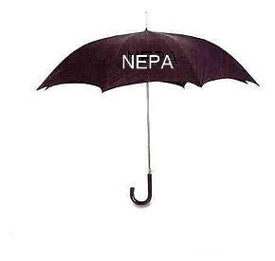
The NEPA “Umbrella”
Farmland Protection Policy Act
Migratory Bird Treaty Act
Executive Orders
Tribal and State regulations/plans
Land Management Plans
Clean Water Act
Safe Drinking Water Act
Clean Air Act
Wild and Scenic Rivers
Endangered Species Act
National Historic Preservation Act
Notes:
You can think of NEPA as the umbrella under which the information on all the potentially affected resources are gathered and analyzed in the context of environmental regulations, policies, plans, and Executive Orders.
As well as in an unregulated context.
Even if all standards and regulations would be met by the project, there may still be significant impacts to resources (for which there may or may not be standards) – so these are addressed too. For example:
Subsistence fishing/hunting/collecting
Recreation (realigning popular trails, backcountry experience)
Traffic patterns, magnitude, school safety
Noise, aesthetics
Lowering of the water table, which affects wells, springs, phreatophytes

Slide 29
NEPA Process
Proposed Agency Action
Categorical Exclusion
No Exclusion
Environmental Assessment (EA)
Significant impact
No Significant Impact
Exclusion Applies
Environmental Impact Assessment (EIS)
Finding of No Significant Impact (FONSI)
Notice of Intent
Scoping Process
Draft EIS
Agency and Public Review
Final EIS
Record of Decision
Implementation of Agency Action
Notes:
This is a schematic of the NEPA process:
As I said earlier, if the project isn’t on a specific list of CatEx’s for the lead agency, then an EA or EIS is prepared.
The EA/FONSI process is not as rigorous as the EIS process, but these are still public documents. So you can get a hold of them.
Many Forests and BLM Field Offices post their Schedule of Proposed Actions (SOPA) online and update them quarterly, but I understand this can be highly variable from office to office.
So if you are interested in a particular forest or field office, or a specific project, you may want to check online and see what they post and how you can get on their mailing list or email list so you can get notifications and updates.
Many offices set up websites for specific EISs, especially for large ones with a lot of public interest.
The EIS kicks off with a scoping process.
The lead agency publishes a NOI in the Federal Register with a brief description of the proposed project and solicits input from interested parties on what the EIS should cover.
This is the public’s first opportunity to weigh in.
There is often a public scoping meeting as well.
Then the Draft EIS is prepared and goes out for public comment for at least 45 days.
Based on the public input, a Final EIS is prepared, which respond to those comments.
Agencies must wait for 30 days after the Final EIS is published before they can sign a Record of Decision.

Slide 30
EIS Content
Purpose and Need
Proposed Project and Alternatives, including “No Action”
Description of Affected Environment
Potential Environmental Effects of proposed project and alternatives
Mitigation and Monitoring
Notes:
The EIS will address these items. This isn’t a complete list, but these are some of the highlights we want to cover today.
We will go through these one by one.

Slide 31
Purpose and Need
Scope and Design of project rely on clear justification for and objectives of the project :
Need for the project: The underlying problem you are trying to solve (e.g., demand for a certain mineral on world market)
Purpose of the project: The objective or result to be accomplished to satisfy the need (e.g., extraction of mineral resources in environmentally acceptable way)
  Should not be so narrow as to exclude reasonable alternatives that satisfy the need
Notes:
The Purpose and Need statement is important because the scope and design of the project rely on clear information supporting the justification for and objectives of the project.
The Need for the project is the underlying problem you are trying to solve: Example -- There is demand for certain minerals on the world market for producing XY&Z products.
The Purpose of the project is the goal or objective to satisfy that need: Example --extraction and processing of that mineral in an environmentally acceptable manner. There may be more than one need and more than one purpose.
The Need for the project is not the Federal agency’s need to issue a permit. The need to issue a permit is the result of someone coming in with an application for a permit to do something. That “something” is what the need and purpose are all about.
The purpose should not be so narrow as to exclude reasonable alternatives to satisfy the need.

Slide 32
Proposed Project and Alternatives
Detailed project description:
Includes sufficient detail on related or connected actions and all project stages
Helps to:
  Accurately identify and assess impacts
  Develop sufficient range of reasonable alternatives to resolve potential conflicts
  Identify and develop appropriate mitigation measures
  Demonstrate that purpose and need will be met
Notes:
The EIS also includes a detailed description of the proposed project.
This includes detail on any connected actions and all stages of the project.
This description helps to:
Identify and assess potential impacts
Develop a sufficient range of reasonable alternatives to reduce impacts and resolve conflicts
Identify and develop appropriate mitigation measures
Demonstrate that the Purpose and Need will be met

Slide 33
Proposed Project and Alternatives
Consideration of alternatives is “heart” of NEPA process, allows for comparative assessment of impacts:
Must “rigorously explore and objectively evaluate all reasonable alternatives,” including those not within jurisdiction of lead agency
Recognizes potential for better ways to accomplish project objectives while avoiding environmental, economic and social concerns
Potential benefits:
  Use resources more efficiently
  Avoid adverse impacts and costs of mitigation
  Enhance community support
Notes:
The EIS must also rigorously explore and objectively evaluate all reasonable alternatives to the proposed action, including those not within the jurisdiction of lead agency.
It may (and very often does) turn out that other alternatives can accomplish the project purpose -- but in a way that reduces the envir, econ or social impacts.
There can be other benefits as well, such as:
More efficient use of resources
Reduced costs of mitigation
Enhanced community support

Slide 34
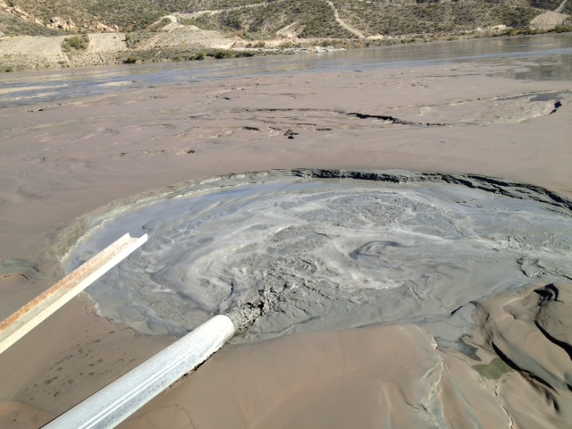
Alternatives
Reasonable alternatives might include:
Alternative sites or configurations for facilities (waste rock, tailings, roads, borrow pits, pit configurations)
Alternative designs (dry stack vs. wet tailings, conveyor vs. road hauling)
Alternative controls (geomembrane liner vs. slimes liner, different cap/cover systems)
Smaller project (shallower pit to avoid dewatering or other resource impacts)
Different timeline (longer or shorter mine life)
Notes:
What are some examples of reasonable alternatives for mine projects?
Alt Sites or Configurations: The ore body can’t be moved, but many of the facilities can be, in order to avoid important resources (e.g., mule deer migration corridor, nesting habitat, waters of the US, cultural resources, etc.).
Or perhaps a different pit configuration could address an issue, like how to divert a stream that runs through the pit area -- Do they allow it to terminate in the pit, as in one NV gold mine pit, or construct a diversion along a pit wall, as in another NV gold mine pit?
Alt Designs: dry stack vs wet tailings, conveyor vs road hauling
Alt Controls: geomembrane liner vs slimes liner, different cap/cover systems
Smaller Project: shallower pit to avoid dewatering, avoidance of important resource.
Different Timelines: longer or shorter mine life to reduce emissions

Slide 35
No Action Alternative
Evaluation of “No Action” serves as a baseline:
Projection of what would happen to affected environment in absence of proposed action
Includes changes to affected environment projected into the future based on trends and planned activities
Notes:
The No Action Alternative must be fully evaluated in every EIS.
No Action serves as a baseline.
The analysis should project out what would happen to the affected environment if the project doesn’t happen.
This includes changes projected into the future based on trends and planned activities.
Example: Let’s say that our proposed new mine is in a mining district where ongoing pit dewatering at several nearby mines is already adversely affecting groundwater, and the cone of depression is expected to grow. The baseline, even without the new project, is a worsening of that condition. That trending baseline would be described under the No Action Alternative.

Slide 36
Description of Affected Environment
Air quality
Cultural resources
Surface water quality/quantity
Groundwater quality/quantity
Wetlands and aquatic resources
Vegetation
Fish and wildlife
Geology and geochemistry
Geotechnical stability
Noise
Socioeconomics
Land use and recreation
Subsistence
Visual resources
Health
Environmental justice
Cumulative impacts
Climate change
Notes:
36
The EIS first describes the affected environment and baseline conditions, and then analyzes the potential impacts of the project.
This list is not necessarily complete, and some projects may not need to analyze all of these issues.
The list for any given project usually shakes out during scoping, and may develop further as they get into the EIS analysis.

Slide 37
Affected Environment
Kinds of data used to characterize the baseline:
Meteorological
Ambient Air Quality and Sources of Air Pollution
Water Quality and Sources of Water Pollution
Hydrology and Hydrogeology
Well Logs, Locations, Usage, Water Rights
Geology, Geotechnical, Geochemistry
Topography, Soils
Biological Communities
Socioeconomic Data (land use, population and housing, economic activity, Environmental Justice, etc.)
Traditional Ecological Knowledge
Notes:
These are some examples of the kind of information that are collected and used to characterize the Affected Environment or Baseline.
I want to spend a minute talking about this last item: Traditional Ecological Knowledge…

Slide 38
Data Gathering:
Traditional Ecological Knowledge (TEK)
TEK is recognized for:
Contributions to resource management
Importance in management of local resources
Stewardship of world’s biodiversity
Providing examples of sustainability
Information is used to:
Characterize sites
Describe resources
Define baselines
Predict impact and mitigation effectiveness
Notes:
TEK has become more recognized over the past several years as important information in
characterizing sites
describing resources
defining baselines
predicting impacts and mitigation effectiveness.
Source: USDA. 2013. Exploring the Role of Traditional Ecological Knowledge in Climate Change Initiatives.

Slide 39
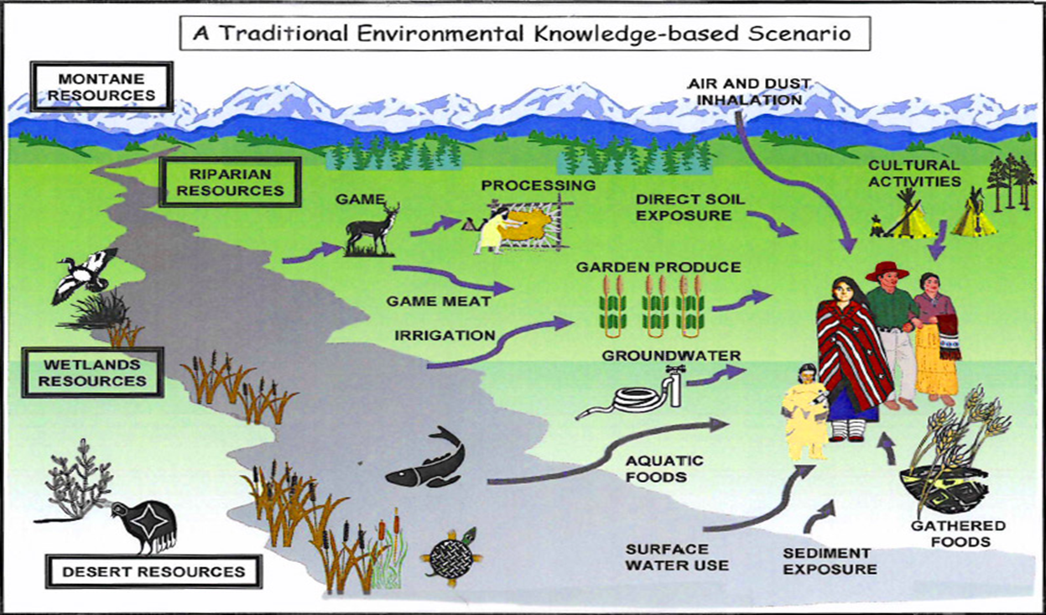
Data Gathering: Traditional Ecological Knowledge (TEK)
Source: Shoshone-Bannock Tribes Environmental Waste Management Program
Notes:
UNESCO (United Nations Educational, Scientific and Cultural Organization) recognizes traditional knowledge in this way: “The indigenous people of the world possess an immense knowledge of their environments, based on centuries of living close to nature. Living in and from the richness and variety of complex ecosystems, they have an understanding of the properties of plants and animals, the functioning of ecosystems and the techniques for using and managing them that is particular and often detailed. In rural communities in developing countries, locally occurring species are relied on for many - sometimes all - foods, medicines, fuel, building materials and other products. Equally, peoples’ knowledge and perceptions of the environment, and their relationships with it, are often important elements of cultural identity.”
Tribes have asked EPA to build better risk assessment models and standard setting processes that incorporate tribal land-use scenarios, including residential, subsistence, cultural, and spiritual uses: EPA has incorporated tribal TEK scenarios into risk assessments at CERCLA remedial actions to the extent practicable and where culturally appropriate.
An example of such a site is the human health and ecological risk assessments performed at the Midnite Mine in Washington. Because the site is located on land owned by the Spokane Tribe of Indians and individual members of the Tribe, the focus of the risk assessment is exposures to tribal members. In this risk assessment, exposure factors and pathways representative of tribal subsistence activities were used, based largely on recommendations from the Spokane Tribe of Indians.
Source: http://www.epa.gov/region10/pdf/sites/midnite_mine/human_health_risk_assessment_sept2005.pdf
Note: For additional research and discussion, work done by Oregon State University includes a research paper examining regional tribal exposure scenarios in the continental U.S.
Source: http://health.oregonstate.edu/research/featured-projects/tribal-grant

Slide 40

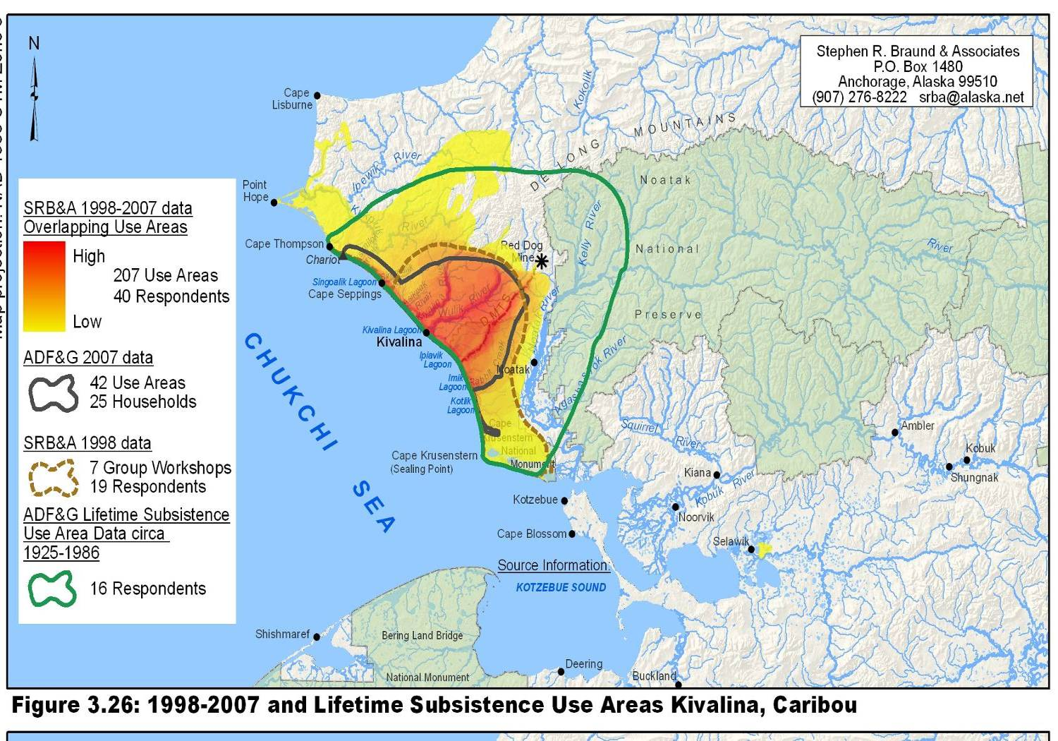
Data Gathering: Traditional Ecological Knowledge (TEK)
Notes:
This slide shows how both TEK and conventional scientific methods were used to gather relevant information for the Red Dog Mine expansion EIS in Alaska.
An extensive study was done to address subsistence harvesting in areas near the mine. The figure in the upper right shows caribou movements determined using a conventional scientific method: collar tracking.
The lower figure represents Traditional Knowledge: based on surveys of where area residents hunt caribou.
This information is important baseline information.
Subsistence hunters may have a lot of useful knowledge about the resource populations, historic changes and stressors on the herd, herd responses to stressors, etc.
This information may help determine potential impacts and the anticipated effectiveness of mitigation measures being considered.
Other people may also have what we call “local knowledge” that is useful and they should weight in whenever they can (for instance, during scoping) to be sure that this information is considered.
This information may come from fisherman, birders, recreationists………………..

Slide 41


Data Gathering: Trail Cams
Elk Cam
El Jefe
Notes:
Information may also be gathered from camera “traps” or trail cams. El Jefe here is the only known jaguar in the U.S. and was captured on trail cams in the area near a proposed mine in Arizona. Likewise, ocelot a threatened species, was captured on trail cams in the area.
Here we have a video from an elk cam set up to monitor an elk herd in a National Forest in Idaho. You can hear elk bugling.

Slide 42
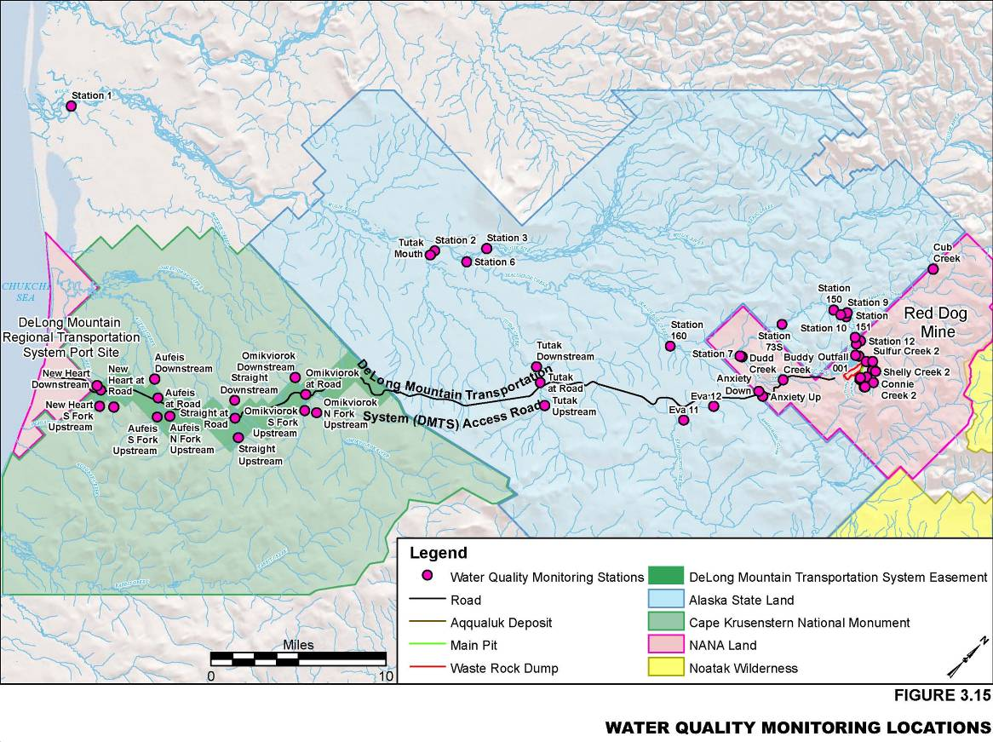
Predicting Impacts
Monitoring data
Geochemical testing data
Treatability studies
Modeling
Surveys
Traditional knowledge
climate change
Notes:
A lot of what was collected for the baseline characterization may also be used to predict impacts of the project and alternatives.
The information used to support the analyses will come from many different sources.
Monitoring data and trend analysis from surface water, wells, met stations, etc.
Geochem results from short and long-term lab tests (Module 2 addressed this).
Treatability studies: experiments on water to be treated before discharge.
Modeling: hydrogeological (gw drawdown, pit lake filling), air emissions and dispersion, fate and transport of contaminants, draindown of tailings and heap leach fluids.
Surveys: socioeconomics
TEK: we just spoke about how that may be used to predict outcomes and responses to mitigation

Slide 43
Types of Impacts
Direct Impacts: occur at same time and place as the action
  Examples: air pollutant emissions; habitat destruction; groundwater drawdown from dewatering; long-term acid mine drainage
Indirect Impacts: occur later in time or at different place from initial action
  Examples: population and economic growth; strain on existing infrastructure; increased hunting, ORV use or different land uses in previously inaccessible habitat because new roads provide access
Cumulative Impacts: the incremental impact of proposed action on common resource when added to other impacts from past, present and reasonably foreseeable future actions
  Examples: groundwater drawdown from dewatering exacerbates historic loss of wetlands; increased pollutants in already impaired stream; further reduction of important habitat
Notes:
The EIS must address Direct, Indirect and Cumulative impacts.
Direct Impacts: occur at same time and place as the action. Usually associated with construction, operation, or maintenance of a facility or activity, including long-term post-closure impacts like acid drainage or contaminated pit lake. EXAMPLES
Indirect OR Secondary Impacts: occur later in time or different place from initial action. Include induced changes to environment, population, economic growth, land use. EXAMPLES
Cumulative Impacts: Are the incremental impact of proposed action on common resource when added to other impacts from past, present and reasonably foreseeable future actions.
These include the collective effects of individually minor actions over a period of time. EXAMPLES

Slide 44
Climate Change
EIS should address:
Project’s greenhouse gas emissions and contributions to climate change
Impacts of climate change on project:
  Identify and discuss need for adaptation strategies (e.g., design facilities for changing storm magnitude or frequency, wetter/ drier, sea level rise if coastal, etc.)
Cumulative climate change impacts on resources also affected by project:
  Groundwater recovery – shorter or longer recovery times
  Spring and stream flows – lower or higher predicted flows
  Riparian vegetation – reduced or expanded riparian areas
  Wildlife habitat/corridors – changes in habitat extent and timing of behavior
Notes:
The EIS should also address Climate Change:
The project’s GHG emissions and contributions to climate change.
The impacts of climate change on the project. It’s important to consider that many mine facilities will be permanent features on the landscape, so adaptation or design considerations may be needed. EXAMPLES
Cumulative climate change impacts on resources also affected by the project. EXAMPLES
You can go to CEQ’s website (at NEPA.gov) to read their Draft Guidance on NEPA and Climate Change (Dec 2014).
One thing we’ve noticed, and CEQ points this out too, is that many EISs conclude that GHG emissions from the individual project will have small, if any, potential climate change effects.
CEQ acknowledges that government action:
occurs incrementally, program-by-program and step-by-step,
climate impacts are not attributable to any single action, but are exacerbated by a series of smaller decisions, including decisions made by the government.
Therefore, the statement that emissions from one government action represents only a small fraction of global emissions is more a statement about the nature of climate change challenge,
and is not an appropriate basis for deciding whether to consider climate impacts under NEPA
and is not an appropriate way to characterize potential impacts of a proposed action.
Council on Environmental Quality. Revised Draft Guidance on the Consideration of Greenhouse Gas Emissions and the Effects of Climate Change in NEPA Reviews.12/14.

Slide 45
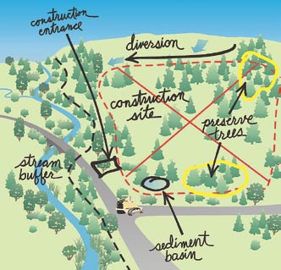
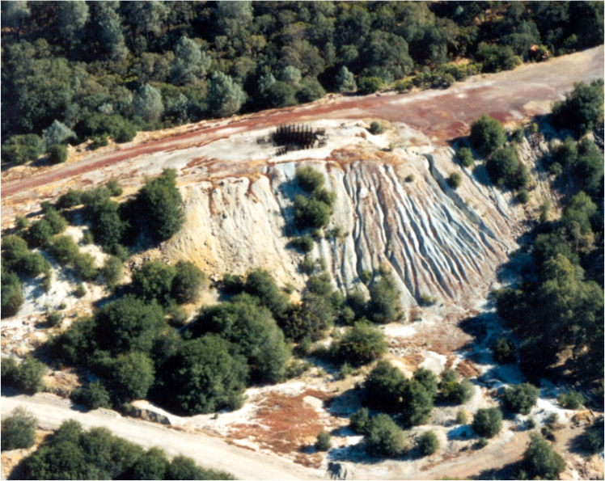
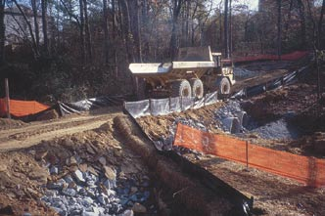
Mitigation
Notes:
Mitigation measures should also be identified and described in the EIS, if they are not already part of the alternative.
The EIS also needs to discuss the anticipated effectiveness of mitigation measures.
For example, it’s not good enough to just say “We will replace the lost wetland habitat elsewhere” because that impact remains unassessed in terms of its significance.
Where will it be replaced?
What’s the replacement acreage?
Is it the same type of wetland habitat and are its functions similar?
Who’s paying for it?
Is it preservation, or creation of new wetlands?
How effective will this replacement actually be?
It’s also not good enough to just say “We’ll monitor and fix things if there’s a problem.”
Monitoring is not mitigation – it is monitoring, and it has a purpose.
The monitoring requirements and results are often tied to commitments in a comprehensive mitigation and monitoring plan.
For more information, see: CEQ Mitigation and Monitoring Guidance: https://www.whitehouse.gov/administration/eop/ceq/initiatives/nepa/mitigation-and-monitoring-guidance

Slide 46
Mitigation and Monitoring
EIS should disclose:
Specific mitigation measures to address all significant adverse environmental impacts
  Technically and financially feasible – with adequate resources for implementation
  Socially and culturally acceptable
Anticipated effectiveness of each mitigation measure
Monitoring requirements (compliance, performance, effectiveness)
Notes:
In discussing mitigation for the project, the EIS should disclose……….SLIDE bullets

Slide 47
Mitigation and Monitoring
Mitigation and Monitoring Plan should include:
Firmly established monitoring and reporting protocols
Specific action criteria/triggers and desired outcomes
Detailed mitigation measures
Schedules and milestones
Financial assurance for entire plan, including contingencies
How plan and financial assurance can be modified based on findings and needs
Identification of responsible parties and commitments to implementation
Notes:
The Mitigation and Monitoring Plan elements can be included in the appropriate resources sections of the EIS, or can be included as a comprehensive document as an appendix.
It should be clear and comprehensive though.
It should include these things: BULLETS

Slide 48
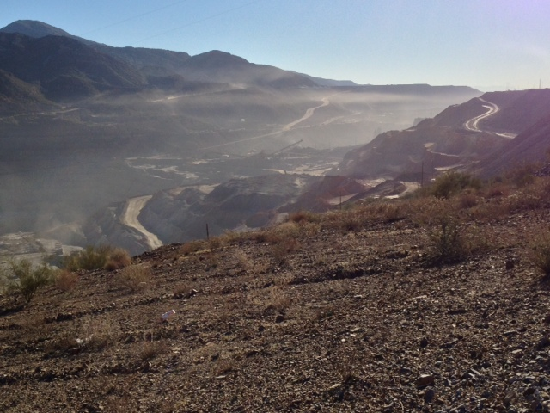
Mitigation – Air Resources
Minimize Particulate Emissions:
Post and enforce speed limits for vehicular traffic
Revegetate disturbed areas as soon as possible after disturbance
Use water trucks, dust palliatives, pavement on roads
Use tackifiers on berms and tailings embankments
Keep soil moist while loading into dump trucks
Employ water injection or rotoclones on all drills
Use chutes and drapes to enclose conveyor transfer points, screens and crushers
Cover conveyors
Notes:
Here we have some typical measures to mitigate fugitive dust at mines that could be included in a Mitigation Plan.
Some of these may have and should have more detailed specifications and/or performance criteria.
For example, the maximum speed limit, or opacity std can be specified.
The facilities where drapes, chutes, covered conveyors would be used can be specified.
We recommend more specificity in the EIS, rather than vague lists.
The EIS should identify applicant-committed measures, so it’s clear whether these are just things that could be done, or things that actually will be done (and enforced).

Slide 49
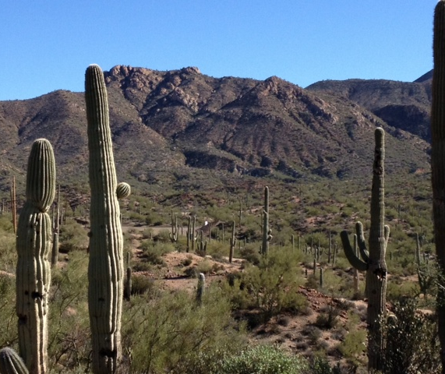
Mitigation – Wildlife and Vegetation
Siting and Design Measures
Use existing facilities to minimize new disturbance
Site facilities away from important ecological resources (e.g., wetlands, water bodies, important habitat, sensitive species populations)
Establish or maintain functional wildlife corridors
Minimize habitat fragmentation
Establish protective buffers for important resources
Locate transmission lines/pipelines to minimize disturbance
Best Management Practices
Educate workers regarding occurrence of important resources in area (e.g., follow speed limits, avoid harassment/disturbance of wildlife)
Schedule activities to avoid disturbance during critical periods (e.g., breeding season)
Limit pesticide use to nonpersistent, immobile pesticides; apply in accordance with label and application permit directions and stipulations for terrestrial and aquatic applications
Apply spill prevention practices and response actions in refueling and vehicle-use areas to minimize accidental contamination of habitats
Notes:
As I mentioned earlier, as alternatives are being developed, siting and design measures can be employed to avoid impacts to resources.
These can be built into the project alternatives themselves.
Here are some Siting and Design examples for wildlife and vegetation/habitat resources. Bullets
Then, beyond what has been built into the alternative, there may be additional best practices that can be employed, such as these. Bullets
You should feel confident in asking for information on all mitigation measures to avoid, reduce and minimize impacts.

Slide 50
Adaptive Management Plans
Adaptive: Relies on feedback from monitoring to confirm effectiveness of mitigation or need to change measures for a more effective outcome
Can be useful in managing for uncertainties over long term (e.g., whether groundwater pumping will overdraft an aquifer)
Should not be used in lieu of rigorous analysis and predictions up front at EIS stage (no kicking the can down the road)
Specify monitoring, management, mitigation requirements and desired outcomes. Should include:
  Management requirements and decision tree
  Identity of technical advisors and decision-makers
  How plan and financial assurance can be modified based on findings and needs
Notes:
An Adaptive Management Plan looks like a comprehensive Monitoring and Mitigation Plan but recognizes there may be a need for an adaptive approach.
When there are legitimate uncertainties regarding what the potential impacts may be (e.g., how gw pumping will affect the aquifer), or how effective the mitigation measures may be, AMPs can be developed to provide commitments to mitigating impacts as they develop based on the monitoring results that come in at any time during the project phases.
It should not be used in lieu of up front rigorous analysis (no kicking can).
It should specify monitoring, management, and mitigation requirements, as well as desired outcomes.
If there is an AMP, it should be flexible to feedback coming in from monitoring, but not vague.
Very specific provisions are committed to up front so they aren’t allowed to be ignored. The approach is to keep circling back and making decisions based on new info and developments.
Because it’s adaptive, the AMP needs to be very clear about:
Management requirements and decision tree
Identity of technical advisors and decision-makers
How the plan and financial assurance can be modified based on findings and needs

Slide 51
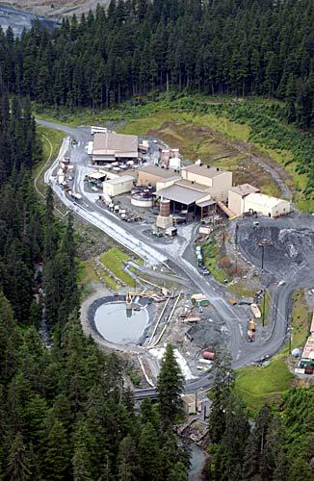
Common Permits and approvals for MINEs
Dana Allen, EPA Region 8

Slide 52
Parallel Processes:
Environmental Review and Permitting
EIS
Process
Federal
Processes
State
Processes
Local
Processes
Mine Application
Technical Reports
Scoping
Draft EIS
Final EIS
Plan of Operations
Mining/Reclamation Permit
NPDES Permit
Groundwater Permit
CWA 401 Cert
Air Permit
Waste Management
Water Quantity and Rights
NPDES Permits . . . .
404 Permit, Wetlands
CWA 401 Cert. . . . .
Air Permits . . . . . .
Tribal Consultation
Endangered Species Act
Historic Preservation
City
County/Borough
Tribal
Mines in Indian County
Tribal Laws and Regs
Record of
Decision
Federal Permit, Certification, Approval
State Permit, Certification, Approval
Planning and Approvals

Slide 53
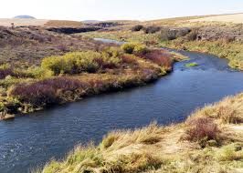
Clean Water Act (CWA) Permitting
CWA § 404 permit – Dredging / Filling Waters of the US, including wetlands
CWA § 402 (NPDES) – Discharging pollutants into Waters of the US

Slide 54
CWA Section 404 Permits
​
Permits issued by Army Corps of Engineers​
  Delineation of Waters of the US including wetlands​
  Acres impacted​
  Wetland functions and values​
Case law for Waters of the US​
Individual or Nationwide 404 Permit? ​
Since 2005, and as upheld by Supreme Court, fill can include mine tailings​
​
Notes:
54

Slide 55
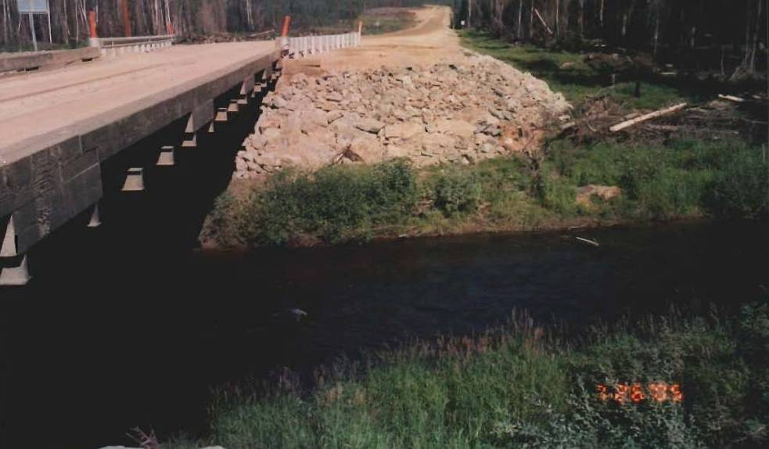
CWA 404 Permits
May be required for:
  Building pads
  Tailings impoundments
  Waste rock disposal
  Stream diversions
  Pipelines
  Road fill

Slide 56
CWA 404 Permits
Waters of the U.S., including wetlands, must be avoided, minimized, mitigated and compensated
U.S. Army Corps of Engineers must select Least Environmentally Damaging Practicable Alternative (CWA 404(b)(1) analysis)
  Most efficient when done in concert with NEPA alternative analysis
Permits reviewed by EPA and certified by State (CWA 401 certification)
EPA can prohibit or restrict use of a site for fill under CWA 404(c)

Slide 57
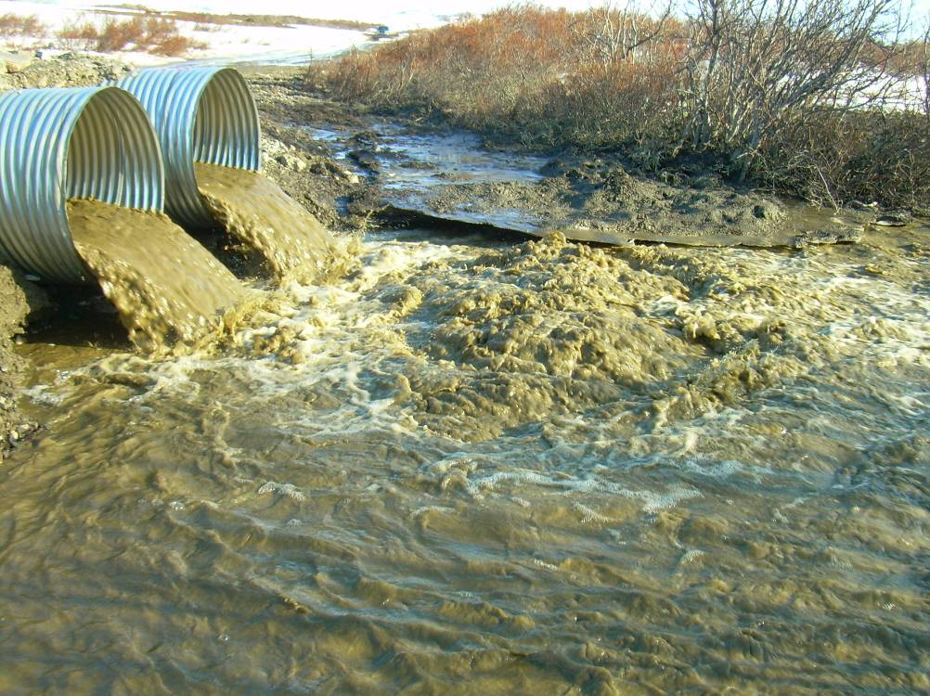
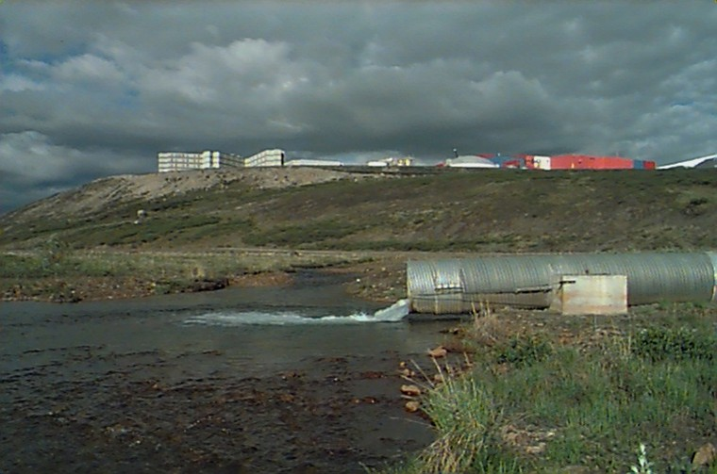
NPDES Permits (CWA 402)
Needed for discharges from mine & mill, tailings ponds, mine drainage
Rock Creek Mine, Alaska
Red Dog Mine, Alaska
Notes:
Permit limits the amount of pollutants to be discharged.

Slide 58
NPDES Permits (CWA 402)
Public Process
  At least a 30-day comment period on draft
  Prepare a Response to Comments
If issued by EPA, potential tribal consultation and ESA consultation
  Offer consultation to tribes in the area
  ESA consultation on threatened and endangered species

Slide 59
Ground Water
Generally Ground Water is regulated by State
Some states have state groundwater protection program requiring permits for mines
State GW permit may be integrated into state mining permit

Slide 60
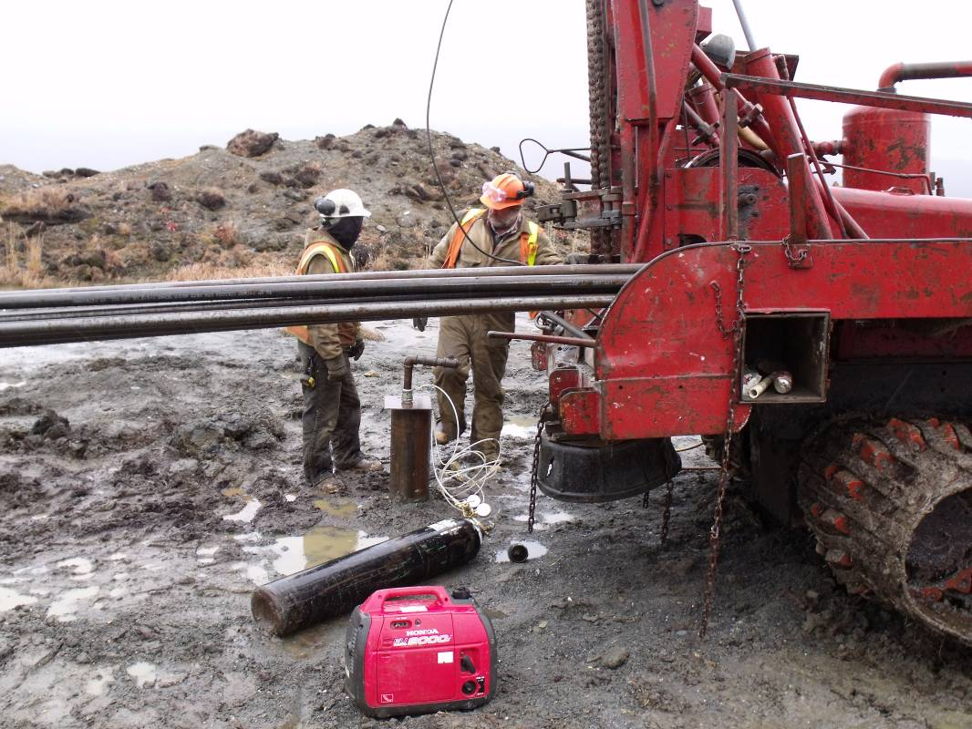
Underground Injection Control (UIC) Permits
Required for injection of wastewater into ground
Issued by EPA or delegated states
Permits require:
  wastewater must not contaminate drinking water sources
  requirements for well construction, operations and closure
Public notice process
Notes:
These may be needed for in-situ leaching projects (uranium, copper) or for getting rid of excess water, such as from pit dewatering.

Slide 61
Clean Air Act
Standards
National Ambient Air Quality Standards (NAAQS) -- CO, NO2, SO2, PM10, PM2.5, Ozone, Lead
National Emission Standards for Hazardous Air Pollutants (NESHAPS) – Hazardous Air Pollutants (HAPS) like mercury, BTEX, formaldehyde
Maximum Achievable Control Technology (MACT) Standards

Slide 62
Clean Air Act
Permits
CAA permit program delegated to the states. EPA permitting authority for Indian Country. Navajo Nation delegated Title V permits.
New Source Review (NSR) -- New Stationary Sources such as boilers & generators; aka preconstruction permit
Operating Permits (Title V of the CAA).
NAAQS Attainment Status – attainment or nonattainment
  General Conformity Regulations
  Different regulations apply depending on attainment status
  State Implementation Plans (SIP) and Tribal Implementation Plans (TIP)
Notes:
Almost all clean air act permit programs have been delegated to the states. EPA is still the permitting authority for Indian Country; with the exception of operating permits on the Navajo nation which has also been delegated. For delegated programs, EPA provides oversight and reviews air permits. Many states have additional air pollution requirements. For example, there are several states which require certain mines to develop and implement a dust mitigation plan.
There are two main kinds of air permits for stationary sources: preconstruction and operating. Mobile sources such as trucks and cars are regulated separately.
New source review permits are needed for new or significantly modified stationary sources such as boilers and generators. For big air pollution emitters such as a smelter or a power plant a PSD permit would be the type New Source review. PSD stands for Prevention of Significant Degradation.
Operating permits outline the air pollution requirements for the operation of the facility such as pollution technology technologies and reporting requirements. It is often referred to as an umbrella permit, which simply documents in one place all the applicable requirements for a facility such as those found in NSPS and NESHAPS.
Air permits include a public process and the issuing agency may hold a public hearing on the draft permit.
Is the area around the mine in attainment or in nonattainment with the NAAQS? For areas that are in nonattainment, there could be additional air protection measures through the general conformity regulations and through the Sate Implementation Plan or Tribal Implementation Plan commonly referred to as SIPs and TIPs. An implementation plan is a set of programs and regulations to improve air quality.
If a project in a non-attainment area will need a conformity determination, EPA usually recommends that the Draft Conformity Determination be included in the Final EIS (Conformity Determination public comment period can run concurrent with the FEIS 30-day wait period), so the agencies Record of Decision is informed by the Conformity Determination.

Slide 63
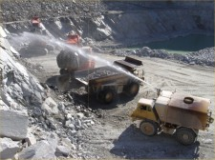
Clean Air Act & NEPA
Limitations of Clean Air Act permits
Air quality mitigation measures

Slide 64

National Historic Preservation Act
Requires federal agencies determine if the project will affect a historic property
Avoid or Mitigate impact to Historic Properties
Consult with SHPO and THPOs – State / Tribal Historic Preservation Officer
Notes:
If the consultation with the SHPO or THPO cannot be resolved then the issue is referred to the Advisory Council on Historic Preservation, states, tribes, and Native American Historic Preservation Officers on actions with potential adverse impacts to historic properties

Slide 65

Endangered Species Act
Applies to all federally associated activities within United States
Federal agencies must consult with USFWS or NMFS on actions that may have adverse impacts on threatened or endangered species or on critical habitat
Notes:
There are also other laws:
EPACRA (Emergency Planning and Community Right to Know Act), from which comes the Toxics Release Inventory (TRI). Industries report emissions of certain pollutants to land, water and air.
RCRA (Resource Conservation and Recovery Act): solid wastes from mining and mineral processing are excluded (Bevill Amendment exempts mine waste from RCRA).

Slide 66

State Authorities
Many States have their own mining permits and programs
State NEPA process
Example: Buckhorn Mt. Mine and Washington State SEPA Process
Notes:
Alaska has a Mine Waste Permit.
Idaho has a Mine Dam permit.
Arizona has an Aquifer Protection Permit.
The Oregon Department of Geology and Mineral Industries has a state-led environmental review process.
Example states with mining and state NEPA process – California, Washington State, Montana, Minnesota.

Slide 67
Guidance and Executive Orders
Council on Environmental Quality:
  Revised Draft Guidance for Greenhouse Gas Emissions and Climate Change Impacts (2014)
  Guidance for Mitigation and Monitoring (2011)
Executive Order
    EO 12898 on Federal Actions to Address Environmental Justice in Minority Populations and Low-Income Populations
EPA
  Environment Justice (EJ) IWG Promising Practices for EJ Methodologies in NEPA Reviews (2016)
  EPA Policy on Environmental Justice for Working with Federally Recognized Tribes and Indigenous Peoples (2014)
Notes:
Guidance, policy, rules and executive orders also are relevant, such as:
CEQ Guidance: climate change – EIS should assess how a project would affect climate (greenhouse gas emissions) and how climate could affect the project (e.g., more frequent or intense storms, loss of habitat).
Environmental Justice Executive Order: EIS should identify minority and low-income populations, and address whether the alternatives would cause any disproportionate adverse impact such as displacement, changes in existing resources or access, or community disruption. The document should also explore potential mitigation measures for any adverse environmental justice effects.

Slide 68
Meaningful Involvement
Request government-to-government consultation (tribes)
Request to be cooperating agency for EIS (tribes)
Maintain early and frequent contact with lead agency and proponent
Provide Traditional Ecological Knowledge and take agencies to see important resources
Ask agency or proponent for site visit
Participate in public hearings and meetings
Provide written comments
Notes:
The last few bullets may apply to other interested parties, not just tribes. Other groups may also have useful information (fishermen, birders, recreation groups, others).

Slide 69
Levels of NEPA Involvement
Steps in EIS Preparation Process | Public | Tribes | Cooperating Agency
Project proponent submits permit application and supporting documents |  |  | ✓
Notice of Intent (NOI) – scoping | ✓ | ✓ | ✓
Scoping comments, resource reports, alternatives, affected environment, environmental consequences |  |  | ✓
Preliminary Draft EIS |  | ✓ | ✓
Notice of Availability (NOA) – Draft EIS public comment period; may hold public hearing | ✓ | ✓ | ✓
Public comments – review |  |  | ✓
Preliminary Final EIS |  | ✓ | ✓
NOA – Final EIS | ✓ | ✓ | ✓
Public comments – review |  |  | ✓
Record of Decision (ROD) | ✓ | ✓ | ✓

Slide 70

Questions and Comments
Please submit feedback and provide any suggestions for future topics.

