Slide 1
Addressing Complex Challenges Posed by Hazardous Substances
William A. Suk, Ph.D., M.P.H.
Director, Superfund Research Program
Chief, Hazardous Substances Research Branch
Division of Extramural Research and Training National Institute of Environmental Health Sciences

Slide 2
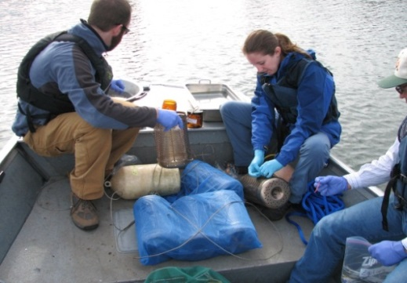
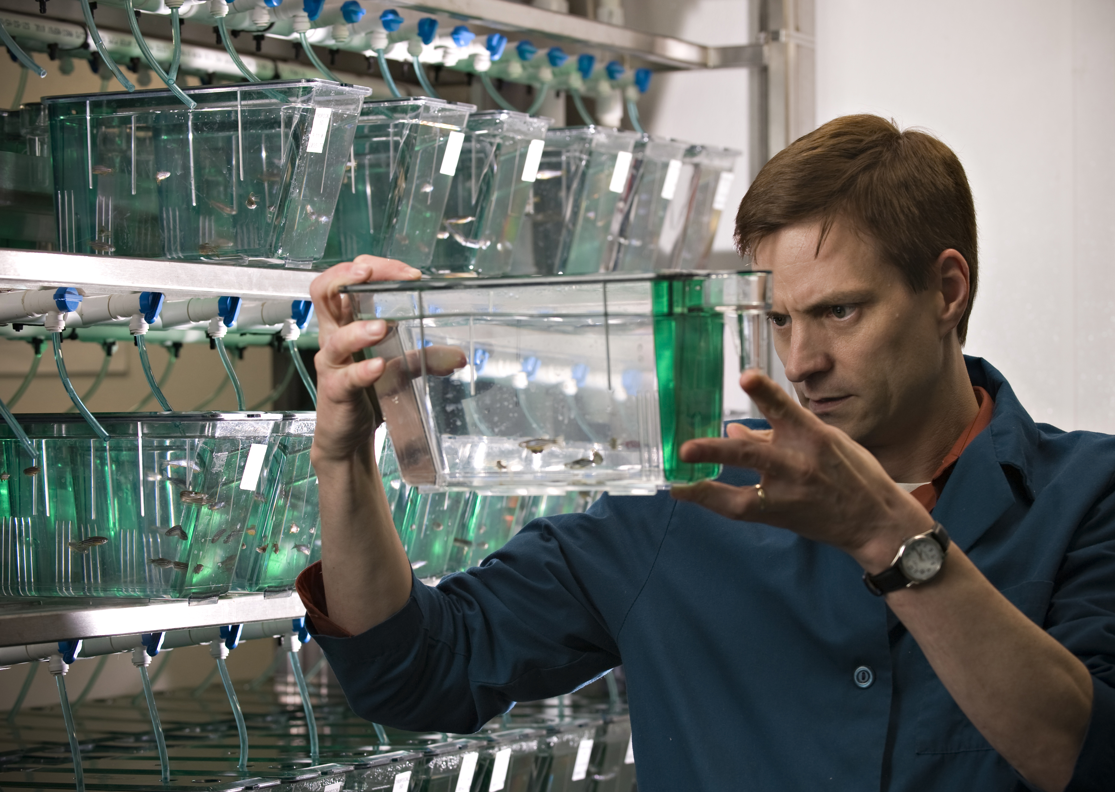
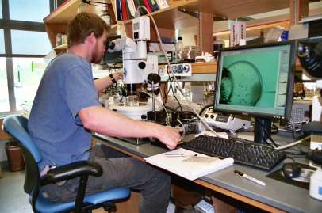
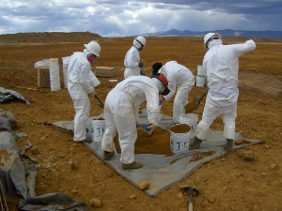
Primary Objectives - SRP Mandates
Supported by the National Institute of Environmental Health Sciences, the Superfund Research Program (SRP) funds research related to the development of:
Methods and technologies to detect hazardous substances in the environment
Advanced techniques for the detection, assessment, and evaluation of the effects on human health of hazardous substances
Methods to assess the risks to human health presented by hazardous substances
Basic biological, chemical, and physical methods to reduce the amount and toxicity of hazardous substances

Slide 3
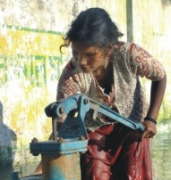
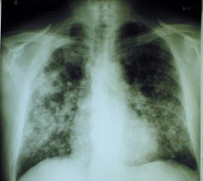
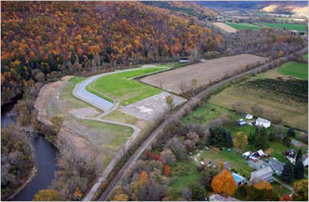
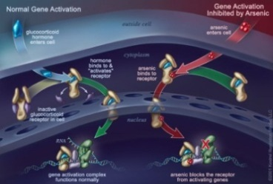
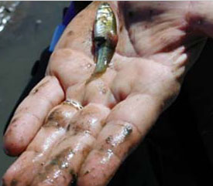
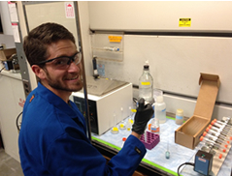
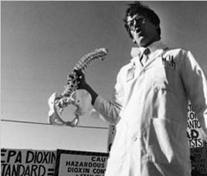
Multidisciplinary research addressing broad, complex issues related to hazardous substance exposure
Fate and Transport
Epidemiology
Health Effects
Remediation
Unifying
Theme
Mechanistic Toxicology
Ecology
Studies
Community Engagement
Research Translation
Training
Training

Slide 4
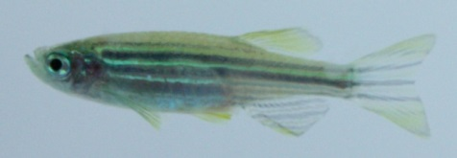
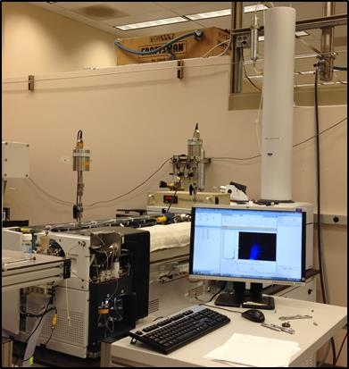
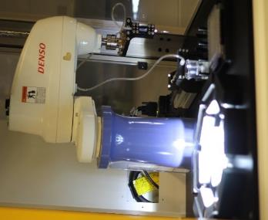
SRP Research Exposure and Health Effects
Tools to assess health effects
Tools to evaluate exposure
Chemical safety evaluation

Slide 5
SRP Research: New Approaches and Alternatives for Toxicity, Fate and Transport, and Ecotoxicity Testing
Notes:
The SRP is well positioned to lead the way in the use of 21st century science to protect human health. By combining multidisciplinary expertise, many of our grantees have been successful in developing alternative models to identify hazards. Some are making progress in disentangling the many questions and uncertainties related to chemical mixtures. They are also creating cutting edge rapid screening tools for environmental assessment and toxicity testing and developing 3D models that more closely mimic biological conditions.
There are many more SRP researchers developing new approaches and alternatives for toxicity, fate and transport, and ecotoxicity testing. I am just providing a few examples of how SRP grantees are advancing 21st century science to protect human health.

Slide 6
Zebrafish: health effects of developmental exposures
Combined panel of zebrafish genes with a rapid testing platform to identify chemicals that induce oxidative stress (University of Washington)
Found that PBDEs can bind to proteins that regulate thyroid hormones and bone development using zebrafish (Duke University)
Zebrafish model to define the toxicity of complex PAH mixtures (Oregon State University)
Learn more from Lisa Truong in Session I of this series
Notes:
Several SRP grantees are using zebrafish to advance the use of 21st-century science in toxicity testing.
The clear embryo of the zebrafish allows researchers to visualize the anatomical changes associated with development, which makes them a useful model for understanding the structural and chemical effects of neurotoxicants, as well as behavioral impairment associated with exposures.
SRP grantees at the University of Washington have developed panel of zebrafish genes that can be combined with a rapid testing platform to identify chemicals that induce oxidative stress. The method, optimized for use on larval zebrafish, is cost-effective and can be performed more quickly and with less tissue than conventional methods.
SRP grantees at the Duke University SRP Center demonstrated in zebrafish that polybrominated diphenyl ethers and halogenated phenolic compounds can bind proteins that regulate thyroid hormones and bone development. Their work highlighted the importance of studying intermediate life stages, and chemical mixtures, since embryonic and adult studies may not be predictive of toxicity when exposure occurs in developing juvenile life stages.
SRP grantees at the Oregon State University SRP Center use zebrafish to define the toxicity of complex polycyclic aromatic hydrocarbon mixtures. According to the researchers, the zebrafish model is uniquely suited to link biochemical, genetic, and cellular changes to observations at the structural, functional, and behavioral level in a high-throughput format.
If you would like to learn more about Oregon State University’s work on zebrafish, you can view the archive of Lisa Truong’s presentation from session 1 of this series.
---------------
References:
Bullet 1: Research Brief: https://tools.niehs.nih.gov/srp/researchbriefs/view.cfm?Brief_ID=269
Bullet 2: https://www.ncbi.nlm.nih.gov/pubmed/27329031
Bullet 3: https://www.ncbi.nlm.nih.gov/pubmed/27016469

Slide 7
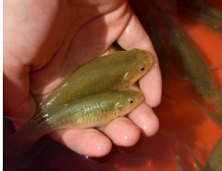
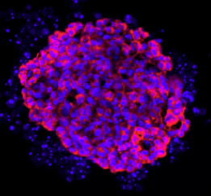
New tools for studying ecotoxicology
Explored the complex genetics involved in how Atlantic killifish have rapidly evolved to tolerate polluted East Coast estuaries (Boston University)
Examined mechanisms of olfactory injury and oxidative stress in salmon (University of Washington)
Developed a 3D liver cell model to screen chemicals for toxicity in fish (Brown University)
Learn more from April Rodd in Session I of this series
Notes:
Several SRP grantees are working to understand how contaminants harm the environment and other organisms.
Boston University SRP Center researchers at Woods Hole Oceanographic Institute have explored the complex genetics involved in how Atlantic killifish have rapidly evolved to tolerate normally lethal levels of environmental contaminants in polluted East Coast estuaries, which may provide new information about the mechanisms of environmental chemical toxicity in both animals and humans. As part of the BU SRP Center, researchers have been studying killifish resistant to contamination in New Bedford Harbor since 1995.
Using approaches that integrate molecular, biochemical, physiological, and behavioral endpoints, University of Washington SRP researchers are investigating how exposure to metals such as cadmium may impact regional survival of fish. This includes mechanisms by which cadmium and copper exposure can lead to damage to the olfactory system of fish.
Researchers at the Brown University SRP Center have developed a new 3D liver cell model that can be used to screen chemicals for toxicity in fish. The model uses fish liver cells cultured to form 3D microtissue so researchers can assess liver toxicants over time after single or repeated exposures. Compared to a single layer of cells often used in toxicology, 3D liver microtissues live longer and are better differentiated, meaning they act more like real livers and can better predict the response of fish.
If you would like to learn more about the 3-D liver cell model from Brown University, you can view the archive of April Rodd’s presentation from session 1 of this series.
---------------
References:
Bullet 1: Research Brief: https://tools.niehs.nih.gov/srp/researchbriefs/view.cfm?Brief_ID=265
Bullet 2: Research Brief: https://tools.niehs.nih.gov/srp/researchbriefs/view.cfm?Brief_ID=224
Bullet 3: Research Brief: https://tools.niehs.nih.gov/srp/researchbriefs/view.cfm?Brief_ID=271

Slide 8
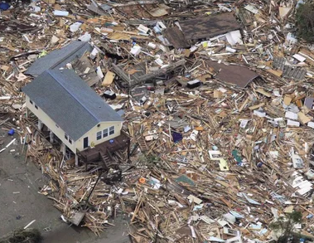
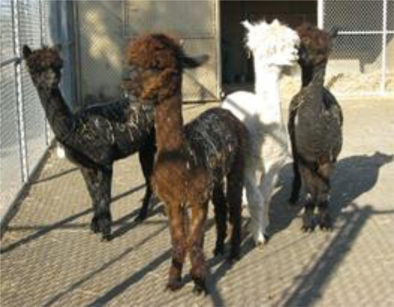
Screening for hazardous chemicals in the environment and in human samples
Cell-based assays combined with imaging and web-based analysis to quickly assess the risks of endocrine disrupting chemicals during environmental emergencies. (Texas A&M)
Immunoassays using VHH antibodies isolated from alpacas to detect PCBs, pesticides, and other compounds and degradation products. (UC Davis)
Notes:
SRP grantees are developing tests using cells and antibodies to screen for hazardous chemicals in the environment and in human samples. For example:
Texas A&M SRP Center grantees at Baylor University are developing rapid imaging platforms and custom automated web-based image analysis and reporting tools to identify the presence of endocrine disrupting chemicals in complex chemical mixtures. The researchers aim to develop cost-effective tools that can be used to quickly assess the risks to human health during natural and man-made environmental emergencies.
Researchers at the UC Davis SRP Center are using VHH antibodies, which are binding fragments of antibodies, to develop immunoassays to detect polychlorinated biphenyls, pesticides, and other compounds and degradation products. These immunoassays, which use VHH antibodies isolated from alpacas, are fast, sensitive, high throughput, and low-cost.
---------------
References:
Bullet 1: Project: https://tools.niehs.nih.gov/srp/programs/Program_detail.cfm?Project_ID=P42ES0277048617
Bullet 2: Publication: https://www.ncbi.nlm.nih.gov/pubmed/27209591

Slide 9
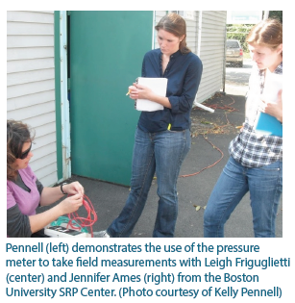
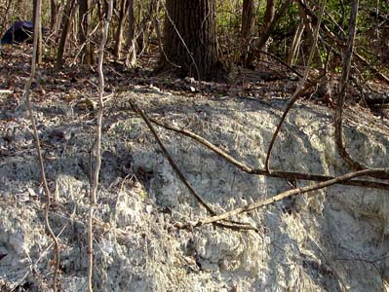
New approaches to understand fate and transport
Developing models to predict vapor concentrations seeping into buildings (Brown University and University of Kentucky)
Assessing pathways that transport PAHs in the atmosphere using spatial and temporal tracking (Massachusetts Institute of Technology)
Using novel statistical methods to fingerprint PFAS measured in fish and drinking water (University of Rhode Island)
Identifying how asbestos forms aggregates and moves through groundwater (University of Pennsylvania)
Notes:
Understanding how chemicals move through and change in the environment are important to identifying potential exposures. SRP grantees are developing rapid screening and other tools to improve our understanding of exposure and environmental fate of contaminants.
Researchers from the Brown University SRP Center have developed process models to predict vapor concentrations that enter indoor environments, a step toward providing a simpler, accurate screening method to determine whether chemicals in underground sources are seeping into buildings and contaminating indoor air. At the University of Kentucky SRP Center, researchers have incorporated multiple lines of evidence, including soil gas measurements and a 3-D model, to better evaluate exposure risks from vapor intrusion into homes and buildings.
As part of the MIT SRP Center, researchers are developing a new method to assess the pathways that transport PAHs in the atmosphere using spatial and temporal tracking. In the atmosphere, PAHs can be quickly transported and can be transformed, creating products that may be of lower or higher toxicity than the original compound. To better understand these processes, the approach integrates state-of-the-art sensors, laboratory studies, and modeling of contaminant chemistry to predict PAH concentrations and fate.
University of Rhode Island SRP Center researchers are using novel statistical methods to fingerprint poly and perfluoroalkyl substances. There are many different types of these substances, with different sources and different effects. They are looking at PFAS profiles from wastewater around a contaminated site and comparing them to PFAS profiles in fish and drinking water to better understand the exposure.
University of Pennsylvania SRP Center researchers are identifying how asbestos forms aggregates and moves through groundwater. Recent findings indicate that the diffusion rates of asbestos, as well as a wide range of natural particles, can be predicted by taking the specific particle shape into account.
---------------
References:
Bullet 1:
Research Brief: https://tools.niehs.nih.gov/srp/researchbriefs/view.cfm?Brief_ID=238
Research Brief: https://tools.niehs.nih.gov/srp/researchbriefs/view.cfm?Brief_ID=257
Bullet 2: Project page: https://tools.niehs.nih.gov/srp/programs/Program_detail.cfm?Project_ID=P42ES0277078758
Bullet 3: Project page: https://tools.niehs.nih.gov/srp/programs/Program_detail.cfm?Project_ID=P42ES0277068682
Bullet 4: Publication: https://www.ncbi.nlm.nih.gov/pubmed/26461183

Slide 10
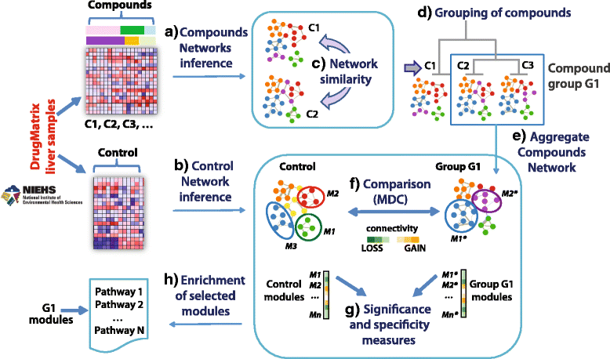
Computational methods to predict the toxicity and exposure
Computational pipeline to construct chemical networks (Boston University)
A novel platform that can rapidly and automatically analyze environmental samples to screen for chemicals (Texas A&M)
Learn more from Erin Baker in Session II of this series
Notes:
SRP-funded researchers are also developing new ways to identify hazards and evaluate chemical safety. This includes novel computational approaches to understand how humans are exposed to chemicals, how they might interact in the body, and how differences between humans play a role. These approaches also have the potential to help scientists evaluate the combined effects of mixtures of chemicals that people are exposed to
At the Boston University SRP Center, researchers developed a computational pipeline to construct chemical networks. They have shown that by grouping chemicals based on the similarity of their associated networks, they can identify groups of chemicals or drugs with similar functions and similar profiles that may damage genes and lead to cancer. These networks can also point to the main molecular pathways triggered by specific chemicals.
Texas A&M University SRP Center grantees at the Pacific Northwest National Laboratory have developed a novel platform that can rapidly and automatically analyze environmental samples. Erin Baker presented this approach in session 2 of this series. She discussed how this platform is a viable way to screen for chemicals in the environment and in biological samples for insight into human exposure and disease mechanisms.
---------------
References:
Bullet 1: Publication: https://www.ncbi.nlm.nih.gov/pubmed/28361664
Bullet 2: Publication: https://www.ncbi.nlm.nih.gov/pubmed/29161511

Slide 11
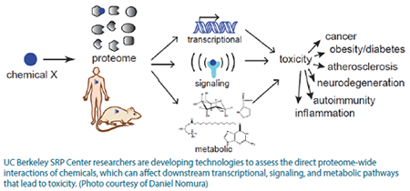
Computational methods to predict the toxicity
Platform to map the reactivity of environmental chemicals (UC Berkeley)
A computational approach using cell-based data to estimate differences in susceptibility to chemicals based on population variability (Texas A&M)
You will hear more from Weihsueh Chiu
Notes:
Here are some additional computational methods being developed by SRP grantees.
Researchers at the UC Berkeley SRP Center found that using a platform to map the reactivity of environmental chemicals across all the proteins in the body may uncover new ways environmental chemicals interact in humans. They are using reactivity-based strategies to uncover distinct sets of proteins and pathways that may be particularly sensitive to environmental chemicals, which may inform how molecules interact in the body and how they might be linked to chemical toxicity.
Using cell-based data, Texas A&M SRP Center grantees developed a computational approach to estimate differences in susceptibility to chemicals based on population variability, or the genetic differences normally found within a population. You will hear more about it in the presentation by Weihsueh Chiu (Pronounced “Wayshway Chu”) coming up next.
---------------
References:
Bullet 1: Research Brief: https://tools.niehs.nih.gov/srp/researchbriefs/view.cfm?Brief_ID=253
Bullet 2: Publication: https://www.ncbi.nlm.nih.gov/pubmed/27960008

Slide 12
Developing models to integrate diverse data sets
in vitro
in vivo
in silico
Chemical safety evaluation
Notes:
New technologies are enabling us to evaluate how chemicals affect biological pathways, or networks of interactions between molecules that together perform biological functions. This includes how chemicals perturb molecules that are a part of a pathway as well as how chemicals perturb interactions within a pathway. These pathway responses reveal mechanistic information that will help us better understand toxicity.
By combining data on biological pathways known to be associated with health effects with data on chemical classes linked to disruptions in key biological events that lead to those health effects, we can better understand links between the environment and disease.
As we move forward, leveraging the wealth of knowledge that alternative models provide and integrating data from new approaches will address knowledge gaps and improve what we know about how complex exposures lead to disease. As knowledge of biological mechanisms continues to evolve, SRP researchers are also developing better computational models that integrate in vitro, in vivo, and in silico data that can be incredibly useful in evaluating the safety of chemicals.

Slide 13
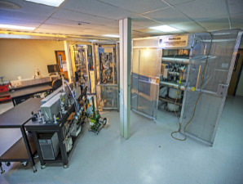
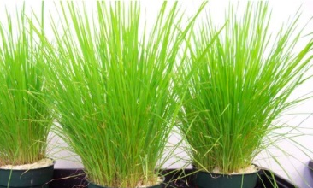
Enhancing environmental health solutions through data integration
Biological response data
Exposure data
Fate and transport data
Sustainable remediation data
Epidemiology data
Reducing the burden of disease
Enhance the knowledge base
Notes:
Fundamental research approaches I’ve discussed today have the ability to challenge the current paradigm of risk assessment. Rather than making presumptions about what chemicals are causing risk, as the current approach to assessing risk requires, new approaches such as metabolomics enable researchers to investigate which chemicals are associated with risk. Because the associations do not prove anything by themselves, researchers must follow up by mechanistically testing the resulting hypotheses in order to understand the mechanisms of toxicity.
SRP is in a unique position because we have data from a variety of scientific disciplines. For 30 years, the SRP has been bringing together research domains that do not normally meet under the same roof to provide and take advantage of different perspectives to solve complex problems.

Slide 14
Past SRP Risk e-Learning Webinars
Archives are available from related SRP Risk e-Learning webinars
Fall 2017: Adverse Outcome Pathways
Introduction to the Adverse Outcome Pathway Framework
Assembling and Assessing AOP Information
Spring 2017: Analytical Tools and Methods
Field-Ready Biosensors to Assess Bioavailability and Toxicity
Techniques for Trace Analysis of Metals and Chemical Mixtures
Fate and Transport of Contaminants
Current series: New Approaches and Alternatives for Toxicity Testing
Notes:
In addition to this series, I wanted to make you aware of two other recent SRP Risk e-Learning series that are relevant to advancing 21st Century Science: One series on Adverse Outcome Pathways and one series on Analytical Tools and Methods.
The archives of each of these sessions are available from the SRP Risk eLearning website.

