Slide 1
Endangered Species Act – Section 7 Consultation Under CERCLA

Slide 2
Overview
The course provides On-Scene Coordinators and Remedial Project Managers with an overview of the Endangered Species Act and Section 7 requirements under EPA's Emergency Response and Removal Program, including a discussion of the responsibility to consider the effects of it's actions on listed species and their habitat and the components of Section 7 consultation.

Slide 3
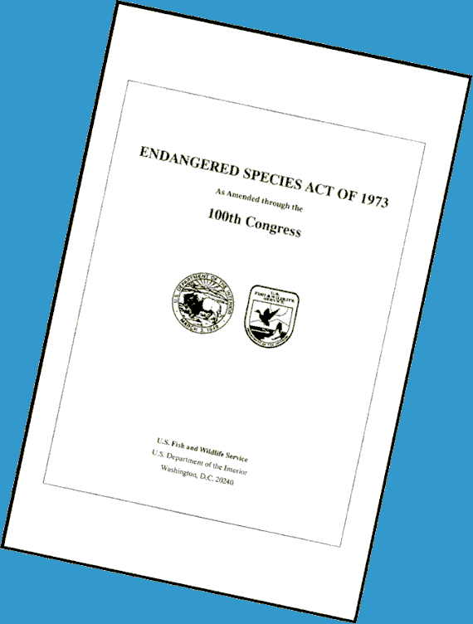
Endangered Species Act
Endangered Species Act (ESA) [16 U.S.C. 1531 et seq.] of 1973 provides a program for the conservation of threatened and endangered plants and animals and the habitats in which they are found
Section 7 of the ESA outlines the procedures for Federal interagency cooperation to conserve Federally listed species and designated critical habitats

Slide 4
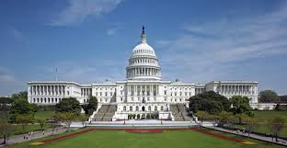
Endangered Species Act . . .
Section 7(a)(1) directs Federal agencies to utilize their authorities in furtherance of the purposes of the ESA by carrying out programs for the conservation of species listed pursuant to the ESA
Section 7(a)(2) directs Federal agencies to insure that any action they authorize, fund, or carry out is not likely to jeopardize the continued existence of a listed species or result in the destruction or adverse modification of designated critical habitat

Slide 5


Endangered Species Act . . .
In fulfilling Section 7 requirements, federal agencies shall consult with the lead agencies for implementing ESA - U.S. Fish and Wildlife Service or the National Marine Fisheries Service
Regulations are published at 50 CFR Part 402

Slide 6
Select Glossary
Endangered species: Any species which is in danger of extinction throughout all or a significant portion of its range
Threatened species: Any species which is likely to become an endangered species within the foreseeable future throughout all or a significant portion of its range
Critical Habitat: Specific geographic areas, whether occupied by listed species or not, that are determined to be essential for the conservation and management of listed species
Harm: An act which actually kills or injures wildlife; such acts may include significant habitat modification or degradation when it actually kills or injures wildlife by significantly impairing essential behavioral patterns including breeding, feeding, or sheltering

Slide 7
Select Glossary . . .
Effects of the action
  Direct effects are those that are caused by the action and occur contemporaneous with the action
  Indirect effects are impacts that are caused by the action but occur later in time
  May affect or no effect are those that are discountable, insignificant, or completely beneficial
  Adverse effect are those that can be measured, detected or evaluated

Slide 8
Select Glossary . . .
Effects of the action (continued):
  Effect (any response to any stressor) = Exposure (organism and habitat) + Response (what happens)

Slide 9
Select Glossary . . .
Take: Term means to harass, harm, pursue, hunt, shoot, wound, kill, trap, capture, or collect, or to attempt to engage in any such conduct
  Harass means an intentional or negligent act or omission which creates the likelihood of injuring wildlife by annoying it to such an extent as to significantly disrupt normal behavioral patterns which include, but are not limited to, breeding, feeding, or sheltering
  Harm means an act which actually kills or injures wildlife; such an act may include significant habitat modification or degradation where it actually kills or injures wildlife by significantly impairing essential behavioral patterns, including breeding, feeding, or sheltering

Slide 10
Select Glossary . . .
Incidental take - take of listed fish or wildlife species that results from, but is not the purpose of, carrying out an otherwise lawful activity conducted by a Federal agency
Biological assessment - Document prepared for the Section 7 process regarding: listed and proposed species and designated critical habitat that may be affected by proposed actions; and the evaluation of potential effects of the proposed actions on such species and habitat
Biological opinion - Document stating the opinion of the Service on whether or not a Federal action is likely to jeopardize the continued existence of listed species or result in the destruction or adverse modification of critical habitat; a summary of the information on which the opinion is based; and (a detailed discussion of the effects of the action on listed species or designated critical habitat

Slide 11
Listed U.S. Species by Taxonomic Groups
Animals (1446)
  Invertebrate (arachnids, clams, crustaceans, insects, snails)
  Vertebrate (amphibians, birds, fishes, mammals, reptiles)
Plants (945)
  Flowering Plants
  Non-flowering Plants (conifers, ferns, lichen)

Slide 12
What is an Action?
All activities or programs of any kind authorized, funded, or carried out, in whole or in part, by Federal agencies in the United States or upon the high seas
Examples include, but are not limited to:
  Promulgation of regulations
  Granting of licenses, contracts, leases, easements, rights-of-way, permits, or grants-in-aid
  Actions directly or indirectly causing modifications to the land, water, or air

Slide 13
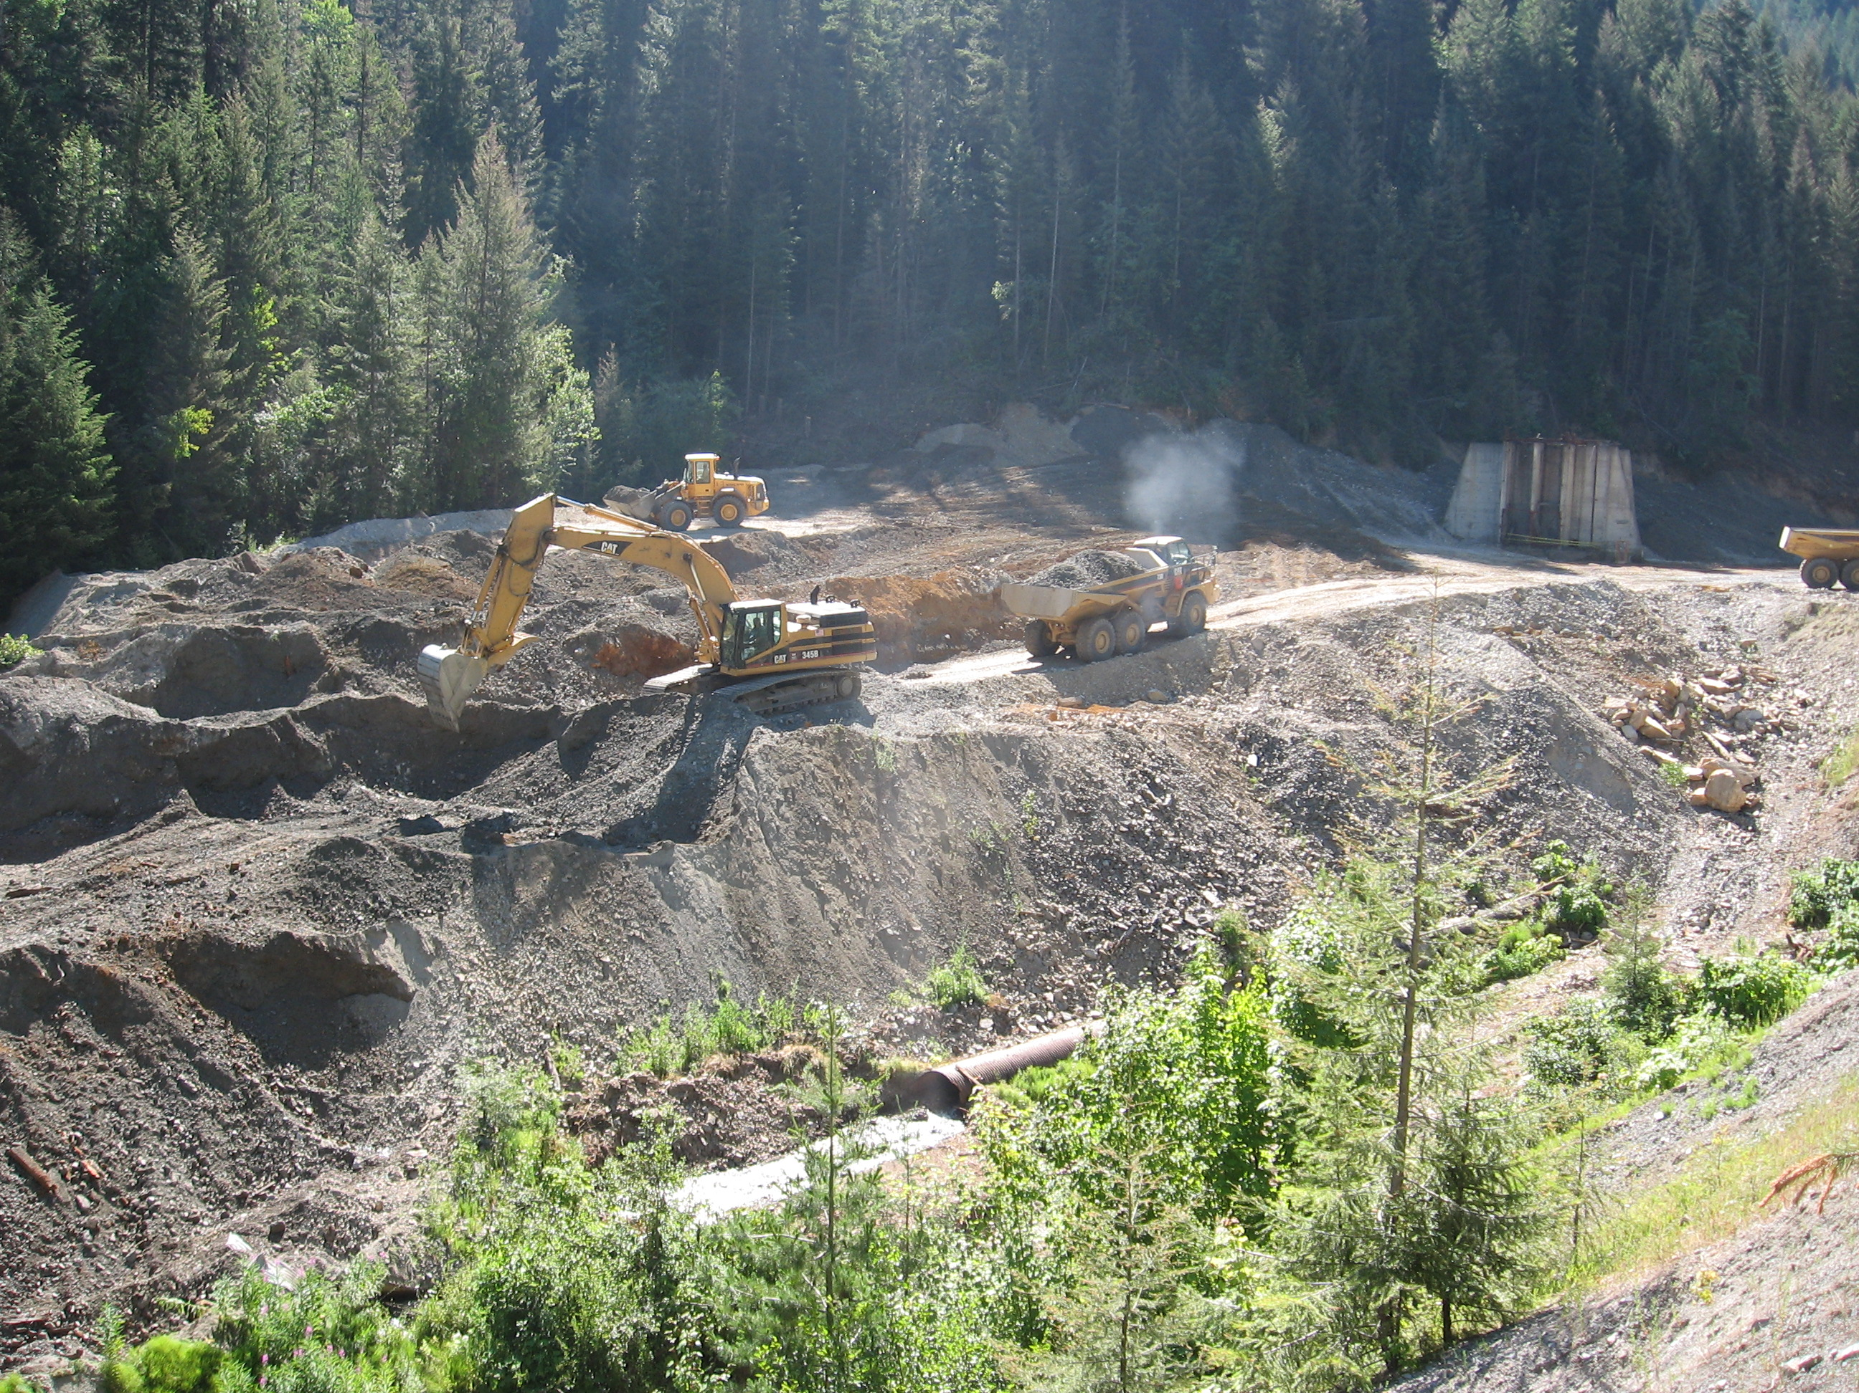
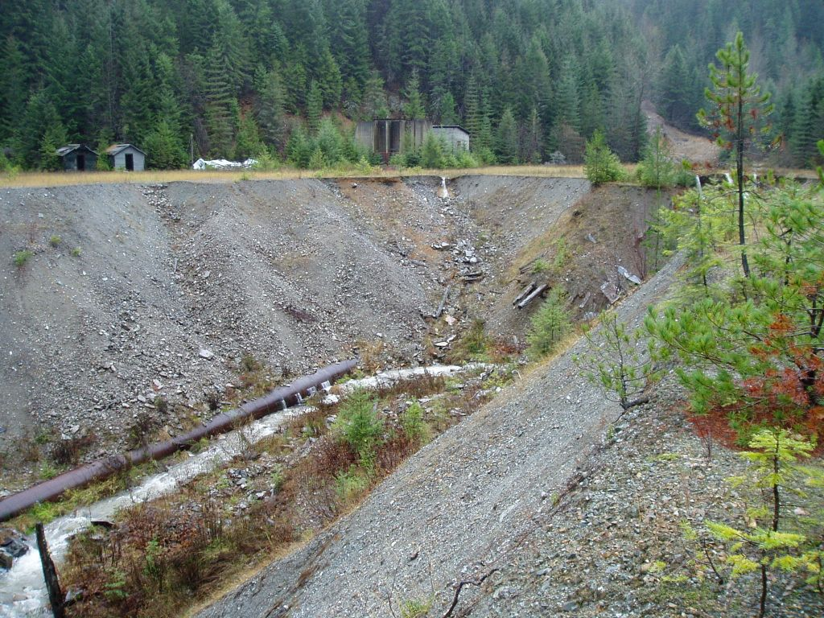
When is Consultation Required?
If an action may affect a listed species or critical habitat

Slide 14
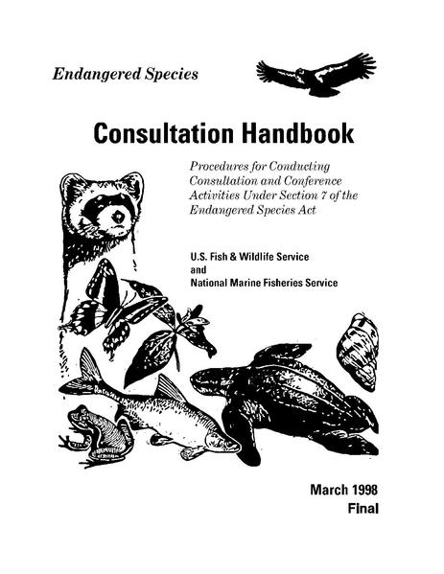
Consultation
All Federal agencies must consult with the Service when any activity permitted, funded or conducted by that agency may affect a listed species or designated critical habitat, or is likely to jeopardize proposed species or adversely modify proposed critical habitat
Consultations can be
  Emergency
  Informal
  Formal

Slide 15
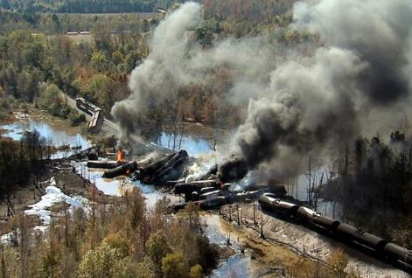
Emergency Consultation
Section 7 regulations recognize that an emergency may require expedited consultation
Emergency consultation procedures allow agencies to incorporate endangered species concerns into their actions during the response to an emergency

Slide 16
Emergency Consultation . . .
Federal action occurs that may affect listed species or critical habitat
Step 1. Federal agency Initiates contact with Service to determine if listed species or critical habitat are present
  If not present, no further action
  If present, solicit advice on measures for minimizing effects of the emergency response action on those species or their critical habitat

Slide 17
Emergency Consultation . . .
Step 2. Continue to evaluate the emergency response action
  If this evaluation indicates that the emergency response procedures may result in jeopardy/adverse modification, and no means of reducing or avoiding this impact are available, Service will advise the responding agency of this and document this conclusion
  Service will not stop or delay their emergency response because of this notification; in such a situation, the Federal agency and Service will discuss actions to address the effects following conclusion of the emergency

Slide 18
Emergency Consultation . . .
Step 3. Once the emergency is over, the action agency will evaluate the emergency consultation measures
  No adverse impacts occurred to listed species or critical habitat – consultation completed
  Adverse impacts occurred to listed species or critical habitat – initiate formal consultation

Slide 19
Emergency Response Consultation Flow Chart
Federal action occurs that may affect listed species or critical habitat
Initiate contact with Service for advice on measures for minimizing effects of response
No further action if listed species or critical habitat are not present
Step 1
Step 2
Ongoing Evaluation
If listed species or critical habitat are present, Service determines impact and makes recommendations
No adverse impacts occurred to listed species or critical habitat – consultation completed
Step 3
Emergency Over
or
Adverse impacts occurred to listed species or critical habitat – initiate formal consultation

Slide 20
Informal Consultation
Informal consultation is a process through which Federal agencies can quickly evaluate potential effects, if any, on listed species and their habitats
Informal consultation can also be used to help determine if there is a need to enter into the more extensive formal Section 7 consultation process.

Slide 21
Informal Consultation . . .
Contact the appropriate local U.S. Fish and Wildlife Service office to determine if listed species and their habitats are present within the action area
Service responds to the request by providing a list of species that are known to occur or may occur in the vicinity
  If the Service provides a negative response, no further consultation is required unless the scope or nature of the project is altered or new information indicates that listed species may be affected

Slide 22
Informal Consultation . . .
If listed species are present, the Federal agency must determine if the action may affect them; a may affect determination includes those actions that are not likely to adversely affect as well as likely to adversely affect listed species
  If the Federal agency determines that the action is not likely to adversely affect listed species (e.g., the effects are beneficial, insignificant, or discountable), and the Service agrees with that determination, the Service provides concurrence in writing and no further consultation is required

Slide 23
Formal Consultation
Contact the appropriate local U.S. Fish and Wildlife Service office to determine if listed species and their habitats are present within the action area
If listed species are present, the Federal agency must determine if the action may affect them
When a Federal action is likely to adversely affect a listed species or its designated critical habitat, the Federal agency involved initiates formal consultation with the Service and concludes with issuance of a biological opinion by the Services

Slide 24
Consultation Process
Federal action occurs that may affect listed species or critical habitat
No effect – end of consultation
“May affect” listed species
Prepare biological assessment
Not likely to adversely affect
Likely to adversely affect
Service does not concur
Service concurs
Formal Consultation
Formal Consultation
End of informal Consultation

Slide 25
Summary
Emergency consultation is available to a Federal agency when an emergency response may affect listed species and/or critical habitat and expedited consultation is necessary
Informal consultation is designed to help the action agency determine whether formal consultation is needed; Federal agencies may use this period to work with the Services on project design and conservation actions that would remove all adverse effects and avoid the need for formal consultation
Formal consultation is a mandatory process for proposed projects that may adversely affect listed species

Slide 26
Summary . . .
Early coordination in the project planning process, interagency collaboration on document development, an open exchange of resource information and quick resolution of elevated issues are all trademarks of successful consultations

Slide 27
Questions

Slide 28
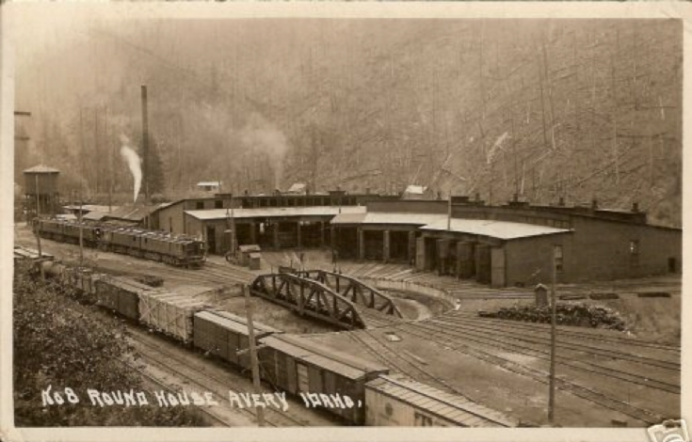
National Historic Preservation Act Section 106 Review And Removal Action Selection Under CERCLA

Slide 29
Overview
The course provides On-Scene Coordinators and Remedial Project Managers with an overview of the National Historic Preservation Act and Section 106 requirements under EPA's Emergency Response and Removal Program, including a discussion of it's responsibility to consider the effects of it's undertakings on historic properties and the components of Section 106 review.

Slide 30
National Historic Preservation Act 1966
(16 U.S.C. 470 et seq)
The National Historic Preservation Act of 1966 (NHPA) established a comprehensive program to preserve the historical and cultural foundations of the Nation
Before any undertaking associated with a federal agency, you must determine whether any of the NHPA Section 106 requirements apply to your project
Section 106 of the NHPA requires
  Federal agencies to take into account the effects of their undertakings on historic properties that are listed in, or eligible for, inclusion in the National Register of Historic Places (NRHP), and
  Afford the Advisory Council on Historic Preservation (ACHP) a reasonable opportunity to comment on such undertakings

Slide 31

Federal Agency Responsibilities under NHPA
Federal agencies are responsible for initiating Section 106 consultation, most of which takes place between the agency and
  State (State Historic Preservation Officer or SHPO) and federally recognized Indian tribes (Tribal Historic Preservation Officer or THPO) or
  Native Hawaiian organization (NHOs) when historic properties of religious and cultural significance to them may be affected
Notes:
Undertaking activities include: are carried out by or on behalf of agencies; receive federal funds; require a permit, license, or approval; are regulated under delegated programs

Slide 32
Federal Agency Responsibilities under NHPA . . .
There is no explicit obligation to actually avoid or minimize adverse effects; Section 106 review encourages, but does not mandate, preservation (sometimes there is no way for a needed project to proceed without harming historic properties)
Regulations published at 36 CFR Part 800, “Protection of Historic Properties,” provide a process to consider the effects of agency undertakings on historic properties, to consult with appropriate entities, and to develop and evaluate ways to minimize or mitigate any adverse effects
If NHPA consultation requirements are applicable to your project, these requirements should be met before and possibly during construction activities

Slide 33
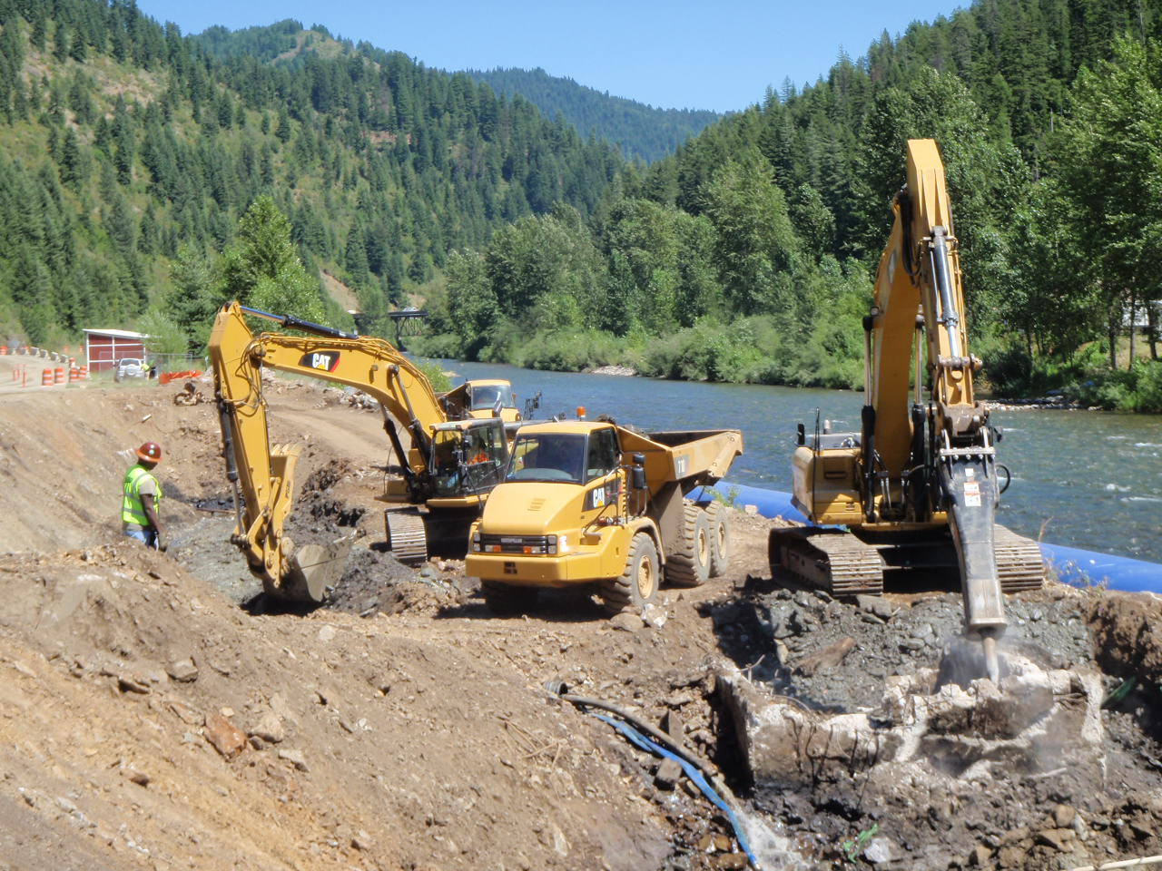
What is an Undertaking?
An undertaking means a project, activity, or program funded in whole or in part under the direct or indirect jurisdiction of a Federal agency; the following activities may constitute an undertaking
  Carried out by or on behalf of the agency
  Carried out with Federal financial assistance
  Requiring a Federal permit, license, or approval
  Subject to state/local regulation administered pursuant to a delegation or approval by a federal agency
Notes:
Criteria:
Significance. Is the property associated with events, activities, or developments that were important in the past?; with the lives of people who were historically important?; with distinctive architectural history, landscape history, or engineering achievements?; is there the potential to yield important information through archaeological investigation about the past?
Age. Is the property old enough to be considered historic (generally at least 50 years old)
Integrity. Ability of property to convey its significance based on its location, design, setting, materials, workmanship, feeling, and association

Slide 34
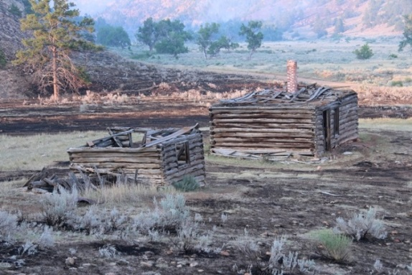
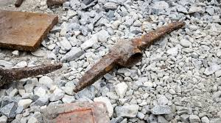
What are Historic Properties?
A prehistoric or historic district, site, building, structure, or object included in or eligible for inclusion in the National Register of Historic Places (NRHP)
  Term includes artifacts, records, and remains that are related to and located within these National Register properties

Slide 36
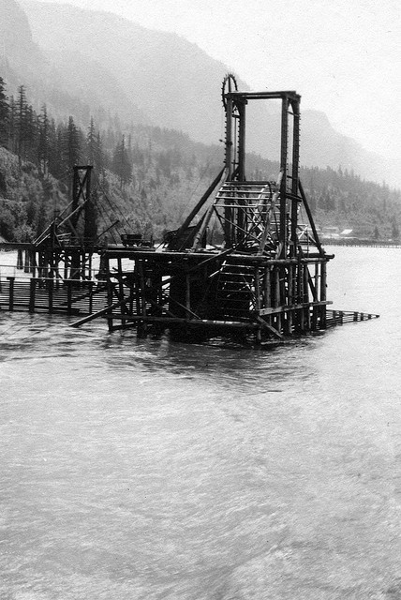
What is the Register of Historic Places?
Nation’s official list of properties recognized for their significance in American history, architecture, archaeology, engineering, and culture
Criteria for evaluating the eligibility of properties for the National Register are
  Significance
  Age (50 years old or older)
  Integrity
Notes:
Criteria:
Significance. Is the property associated with events, activities, or developments that were important in the past?; with the lives of people who were historically important?; with distinctive architectural history, landscape history, or engineering achievements?; is there the potential to yield important information through archaeological investigation about the past?
Age. Is the property old enough to be considered historic (generally at least 50 years old)
Integrity. Ability of property to convey its significance based on its location, design, setting, materials, workmanship, feeling, and association

Slide 37
What is an Adverse Effect?
A project that may alter characteristics that qualify a speciﬁc property for inclusion in the National Register in a manner that would diminish the integrity of the property
Adverse effects can be direct or indirect and include, but are not limited to, the following:
  Physical destruction or damage
  Relocation of the property
  Change in the character of the property’s use or setting
  Introduction of incompatible visual, atmospheric, or audible elements
  Neglect and deterioration

Slide 38

Determining Area of Potential Effect and Scope of Effort
Area of Potential Effect (APE)
Consultation with SHPO in determining APE
Specific requirement to gather information from Indian tribes
APE
Site

Slide 39
CERCLA Removal and NHPA Section 106 Processes

Slide 40
Overview
Emergency Response
Programmatic Agreement
Discovery or Notification
Removal Action
Evaluation and Planning
Implementation
Documentation
Initiate 106 Process

Slide 41
NHPA Section 106 Programmatic Agreement on Historic Properties and Emergency Response
Programmatic Agreement (PA) provides an alternative to Section 106 requirements to ensure appropriate consideration of historic properties during emergency response actions
Neither Section 106 or the PA are intended to interfere with an emergency response; rather they require that the potential effects of undertakings on historic structures be considered

Slide 42
Programmatic Agreement Flow Chart
Initiate Section 106 Programmatic Agreement Process
Assess potential adverse effects of response actions on historic properties
Avoid or reduce adversely affecting historic properties to the extent practicable considering the exigencies of the situation
Make reasonable and timely efforts to notify and consult with appropriate parties
Is incident categorically excluded from 106 compliance?

Slide 43
NHPA Section 106 Consultation Process
Gather information to decide which properties in the area that may be aﬀected by the project are listed, or are eligible for listing, in the NRHP
Determine how those historic properties might be aﬀected
Explore measures to avoid or reduce adverse eﬀect to historic properties
Address adverse effects, to the extent practicable considering the exigencies of the situation

Slide 44
Section 106 Flow Chart
Initiate Section 106 Process
Identify Historic Properties
Assess the effect of the project on identified historic properties
Address Adverse Effects
No undertakings/no potential to cause effects; no further action
No historic properties affected; no further action

Slide 45
Case Study: Josephine Mill No. 1

Slide 46
Background
Josephine Mill No. 1 Site is an inactive mill located in northeast Washington state, approximately 1.5 miles northwest of Metaline Falls, Pend Oreille County, Washington
Site consists of approximately 5.3 acres of land that contains a partially forested steep rock slope with remnant wood and concrete mill structures, tailings and waste rock piles, and miscellaneous metal
Processing at the mill ended in the mid-1930’s and the mill has generally been abandoned since that time.

Slide 47
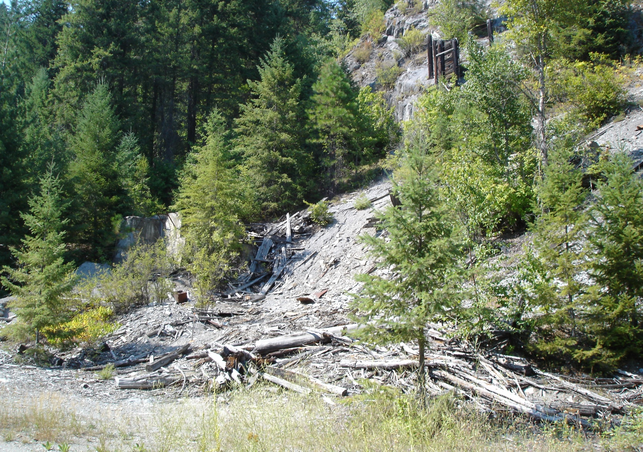
Overview of Mill Site

Slide 48
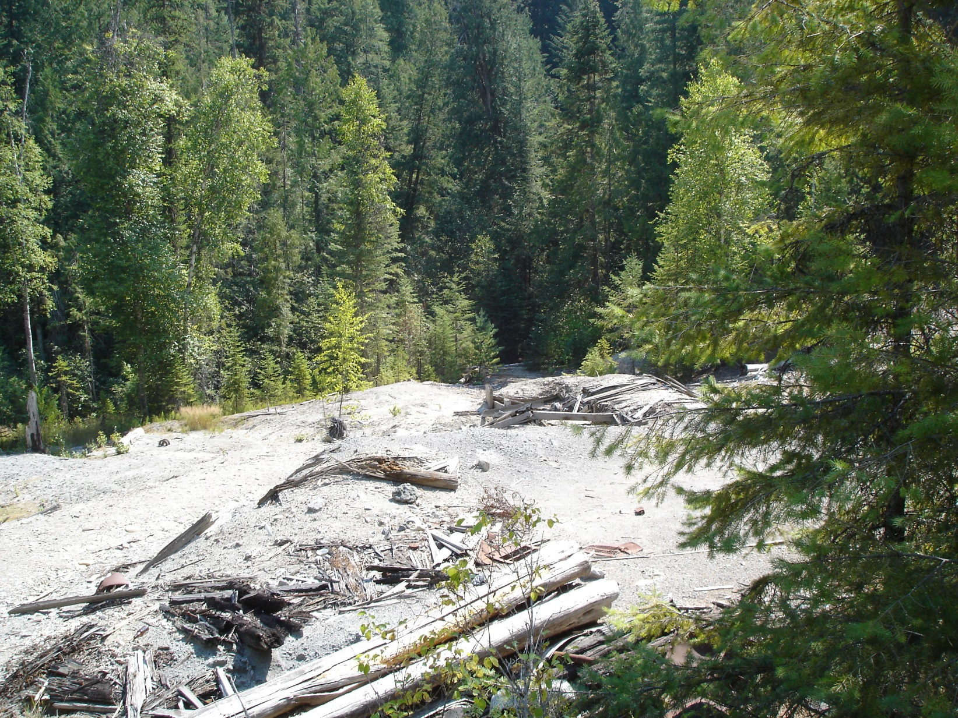
Overview of Mill Site . . .

Slide 49
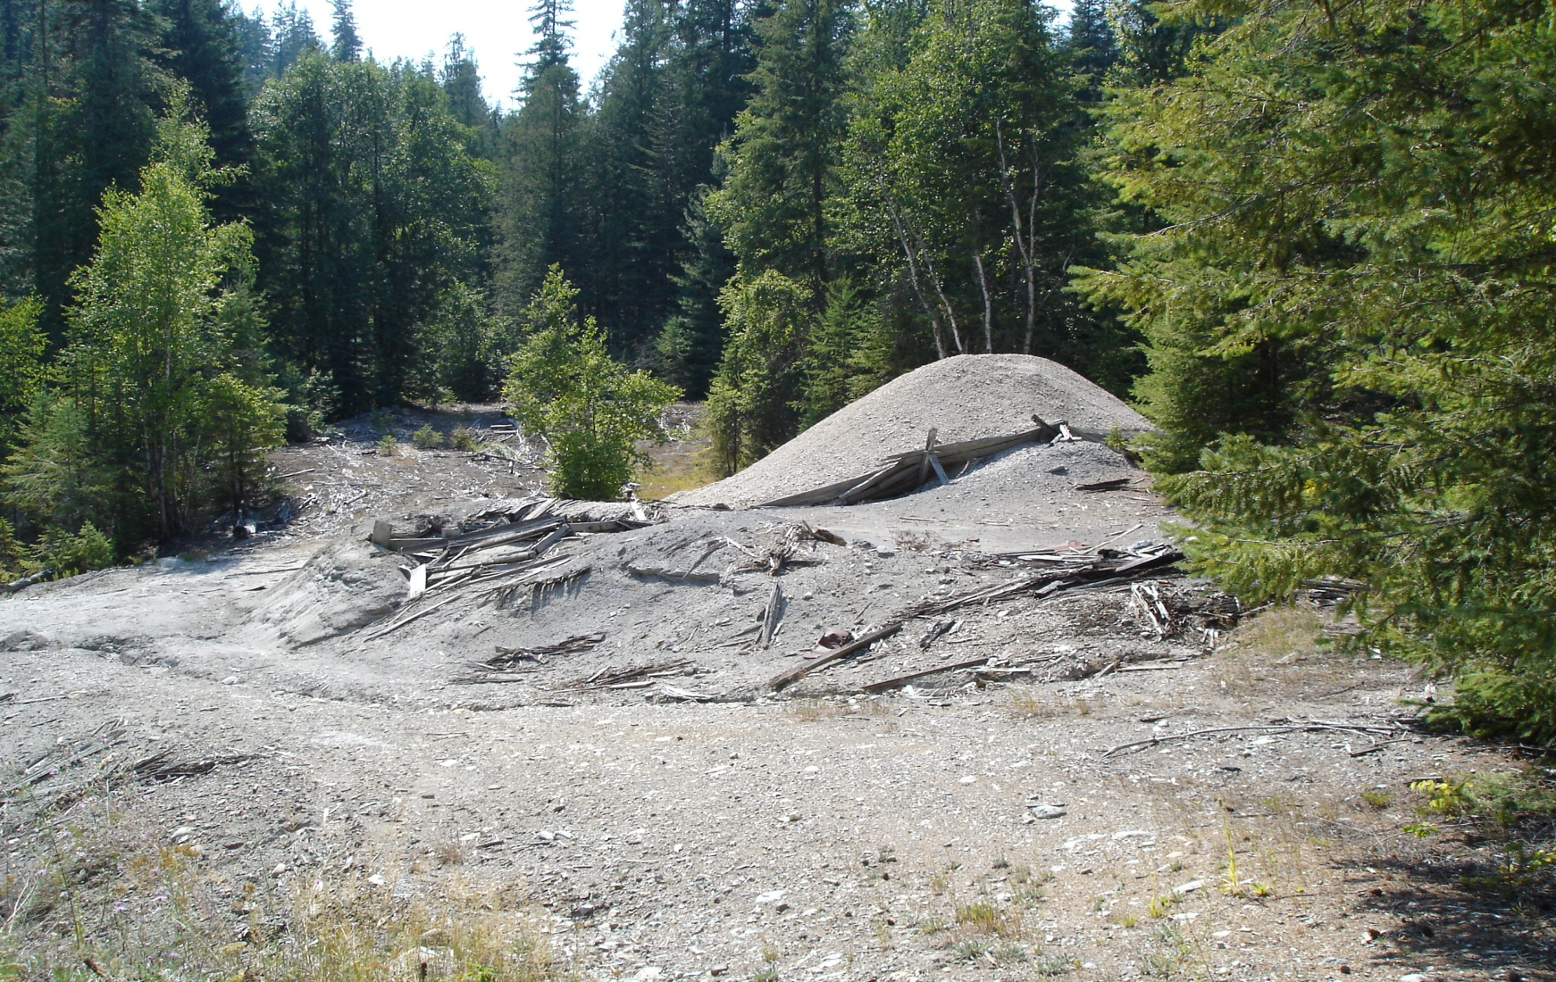
Wood Flume Remnant

Slide 50
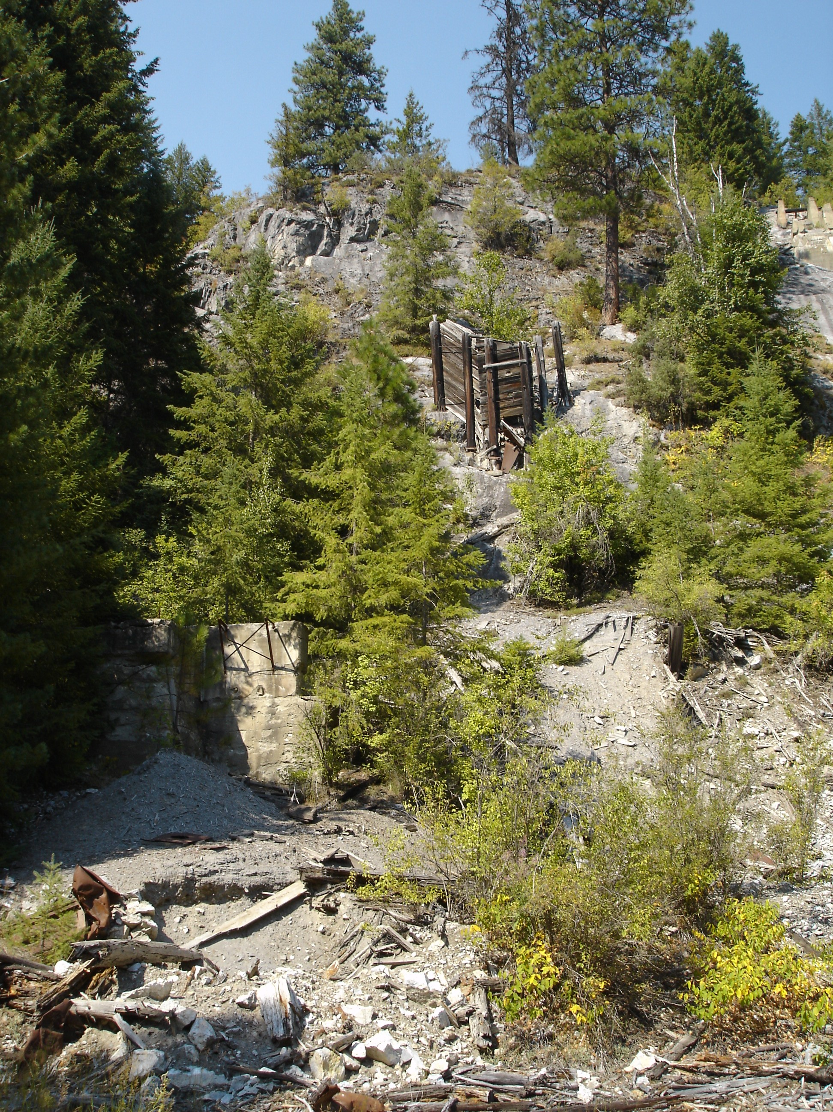
Wood and Cable Crib Structure

Slide 51
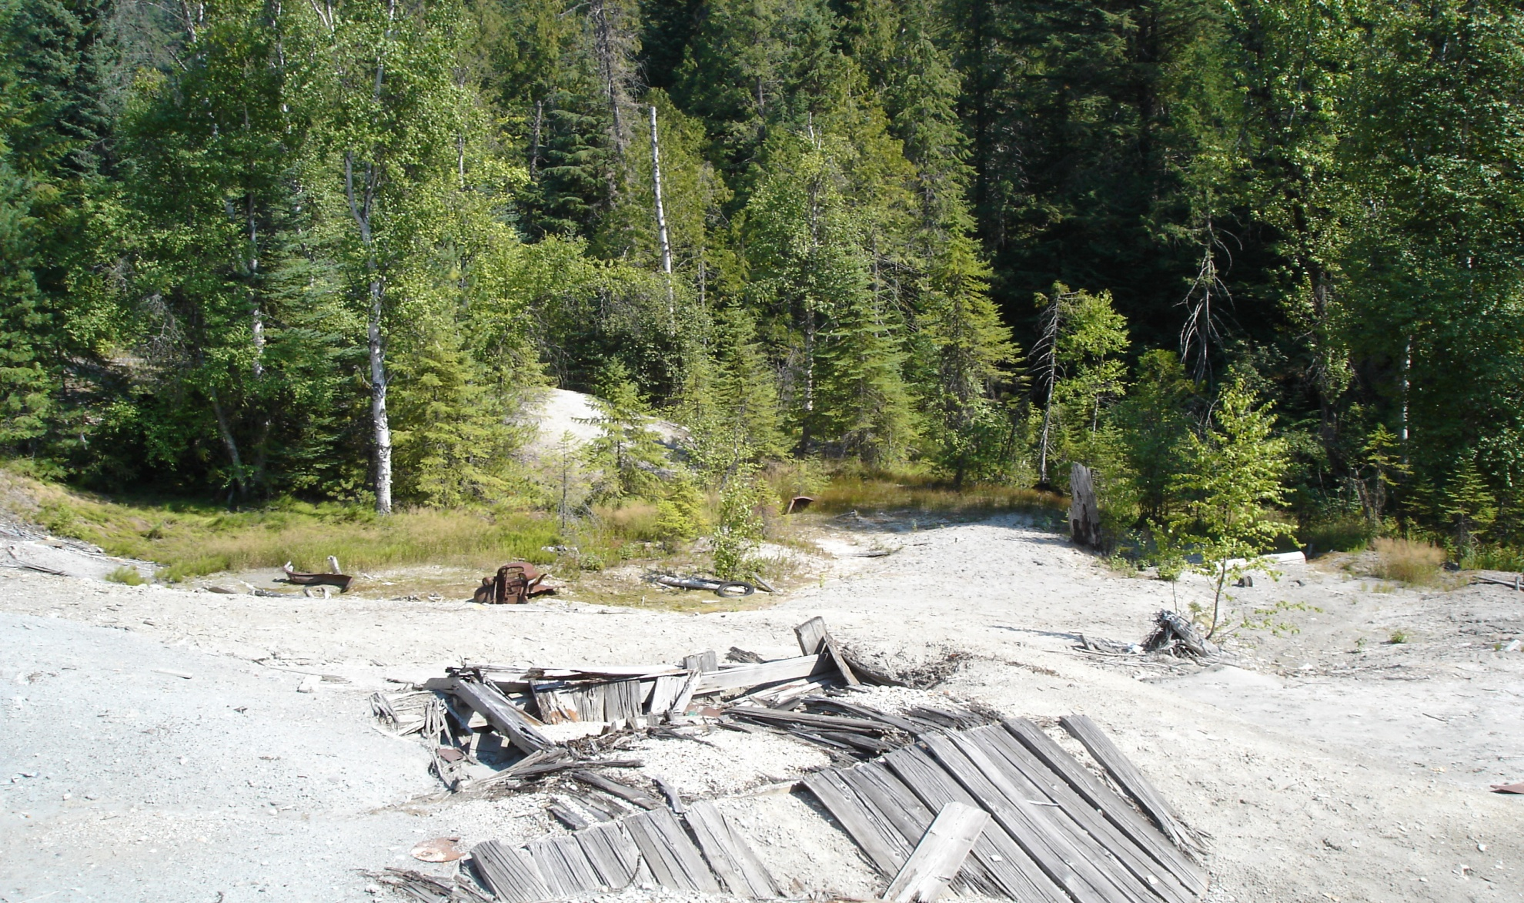
Collapsed Wooden Building

Slide 52


Slide 53
Chronology of Site Events
12/09. Approval Memorandum for Conduct of an Engineering/Evaluation Cost Analysis
01/10. Cultural Resources Survey
03/10. Engineering/Evaluation Cost Analysis
09/10. Action Memorandum
09/10 – 11/10. Potentially responsible party performs removal action with EPA oversight

Slide 54
Protection of Historic Properties
08/10. Cultural Resources Survey submitted to Washington State Department of Archaeology and Historic Preservation (DAHP or SHPO)
  EPA makes a finding that there was no potential effect for adverse effect to historic property within the area of potential effect at Josephine Mill No. 1
  DAHP disputes this finding and EPA and DAHP were not able to resolve this dispute
08/10 – 06/11. Multiple correspondence exchanged and conference calls held between EPA, DAHP, WA Attorney General, and ACHP to resolve interpretation of NHPA in context of CERCLA

Slide 55
Summary: NHPA Section 106 Review And Removal Action Selection Under CERCLA
NHPA is an ARAR (applicable, relevant or appropriate requirement). Under the NCP (National Oil and Hazardous Substances Pollution Contingency Plan) for removal actions, EPA must take into account the NHPA to the maximum extent practicable considering the exigencies of the situation.
  While this could exempt EPA during emergencies from engaging in NHPA consultation, in all other instances, when at all possible, EPA should initiate and participate in the consultation process.
Eligibility for the NRHP is the purview of the ACHP and SHPO, and EPA is best off respecting that authority, and although EPA has final say so in determinations of no adverse effect and litigation measures in cases of adverse effect, when at all possible such determination should be made taking into account the views and opinions of the SHPO/ACHP/Tribes.

Slide 56
Questions

