Slide 1
Ecological Revitalization and Reuse of Contaminated Sites
Michele Mahoney, EPA

Slide 2
Overview
What is Ecological Revitalization?
Case Studies
Sustainability & Reuse
Urban Gardening
Technical Assistance
Resources

Slide 3
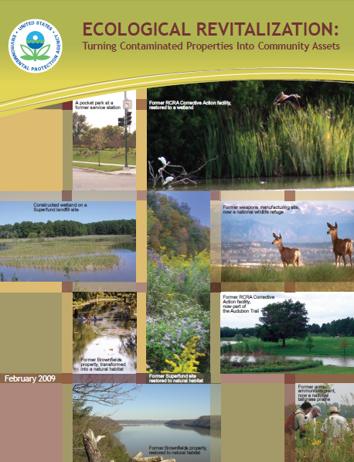
What is Ecological Revitalization?

Slide 4
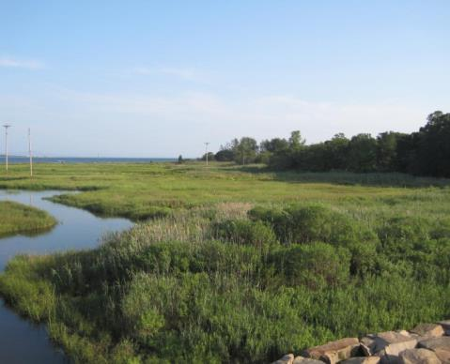
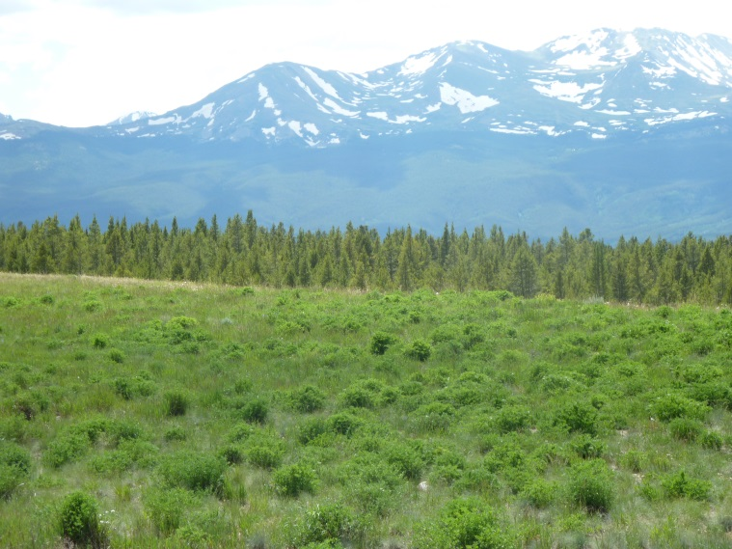
Innovative & Beneficial
Improves soil health
Protects air & water quality
Lowers cost
Requires less maintenance
Provides habitat
Increases biodiversity
Creates sustainability
Benefits the community

Slide 5
Types of Ecosystem Services
Climate regulation
Purification of water and air
Soil formation
Carbon storage and sequestration
Nutrient dispersal and cycling
Seed dispersal
Waste decomposition and detoxification
Crop pollination
Pest and disease control
Food, crops, and spices
Forest products (i.e. timber)
Pharmaceuticals
Energy (i.e. hydropower and biomass fuels)
Recreation
Scientific discovery and education
Aesthetic and spiritual value

Slide 6
Cost Savings
Site | COCs | Soil Amendment Remedy | % Cost Savings
California Gulch, Leadville, CO | Pb, As, other metals Acid mine drainage | Lime biosolids | 50 ($2.5 M)
College Park Landfill, Beltsville, MD | Vinyl chloride, benzene, As, Cd, Fe, Pb, Mn, Ni | Compost (fly ash, animal waste, plant waste) | 54 ($5.4 M)
Palmerton Zinc, Palmerton, PA | Pb, Zn, Cd | Lime, potash, sewage sludge, mushroom/leaf litter compost | 96 ($462 M)
Sharon Steel, Farrell, PA | Metals, PAHs, PCBs, pesticides | Biosolids cap | 59-84 ($16-40 M)

Slide 7
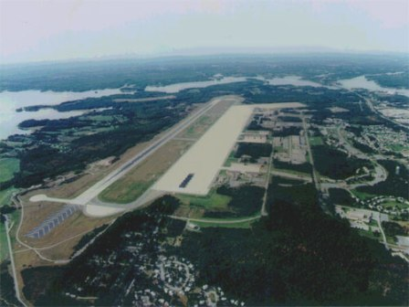
Ecological Revitalization & Superfund
Relation to remedial process
Ecological revitalization can...
Reduce contaminant bioavailability
Improve ground water recharge
Control landfill leachate
Stabilize soil
Lead to ecological
land reuse

Slide 8
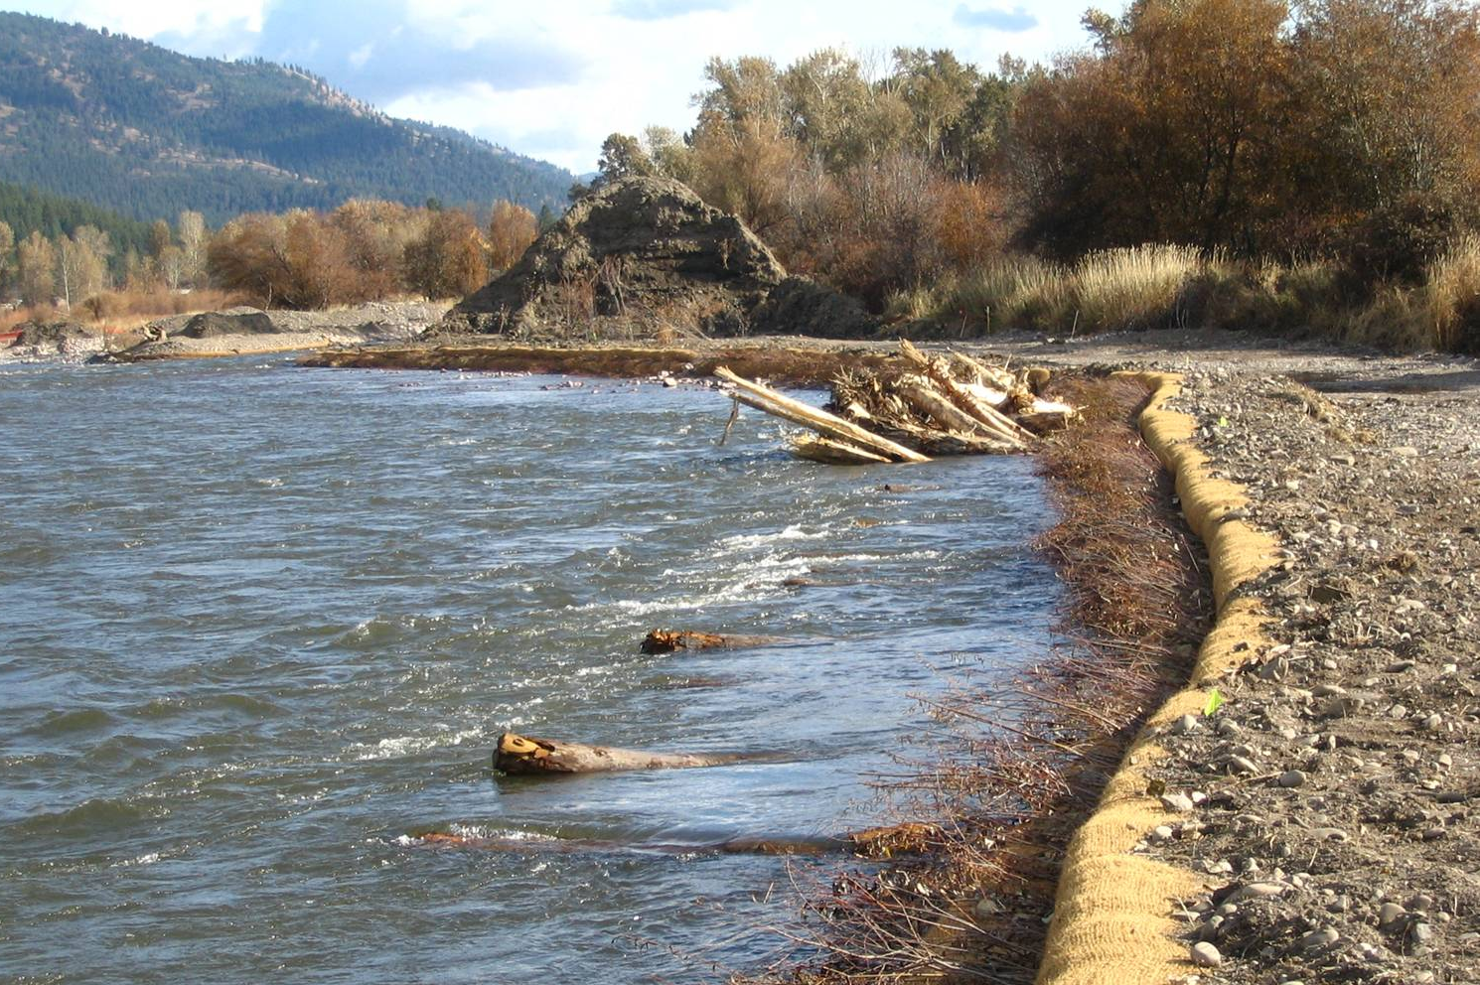
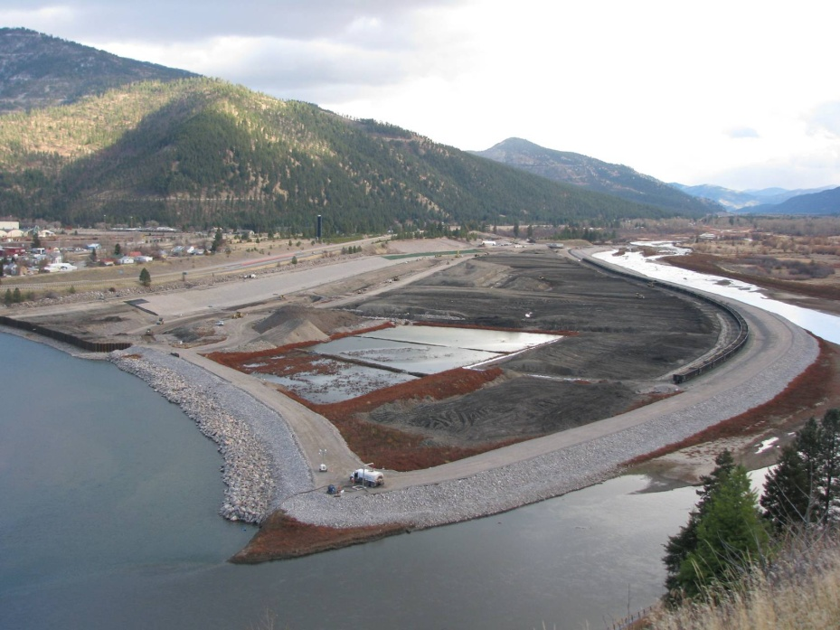
Programmatic Considerations
Remedy Performance
Cleanup Plans
Stakeholder Involvement

Slide 9
Steps for Planning & Implementation
Determine pre-disturbance and reference conditions
Conduct a property inventory
Establish revitalization goals and objectives
Evaluate revitalization alternatives
Develop a property-specific ecological design
Prepare specifications for construction contractors
Construct habitat features
Conduct maintenance and monitoring activities

Slide 10
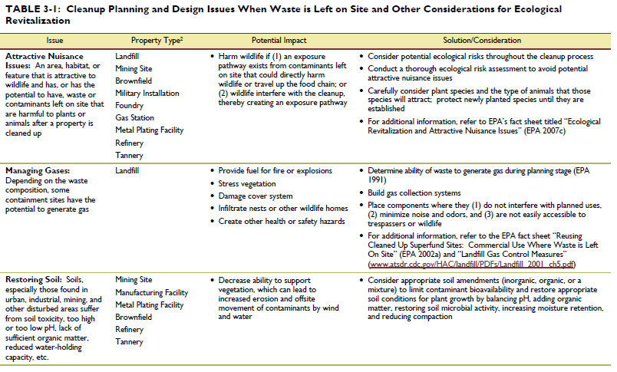
Cleanup Planning & Design Issues

Slide 11
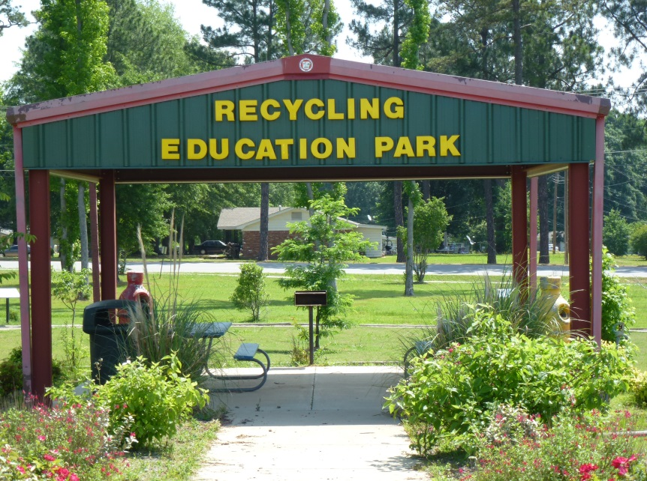
Environmental Education
Teach environmental science, ecology, how natural systems work, community history and heritage
Share stories in a variety of ways
Preserve the past
Support healthy communities
Attract tourism

Slide 12
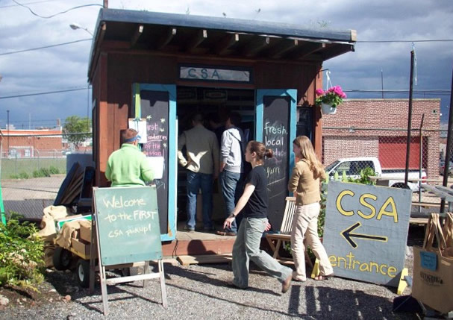
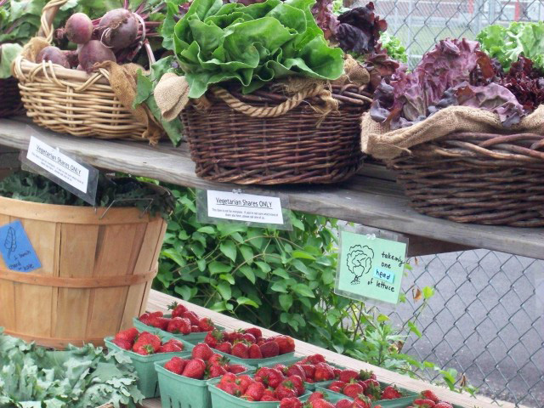
Case Study: Boyle Galvanizing
(Photograph Source: Greensgrow Farm)
“With the right cleanup and lots of hard work, anything is possible.”
-Mary Steton, Greensgrow Farm’s co-founder and chief farm hand

Slide 13
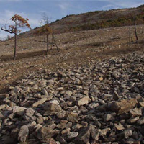
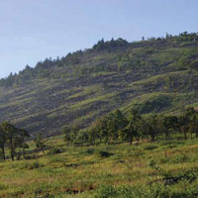
Palmerton Zinc Pile Superfund Site, PA

Slide 14
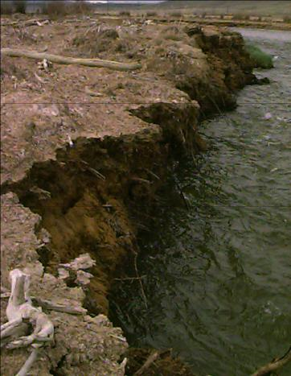
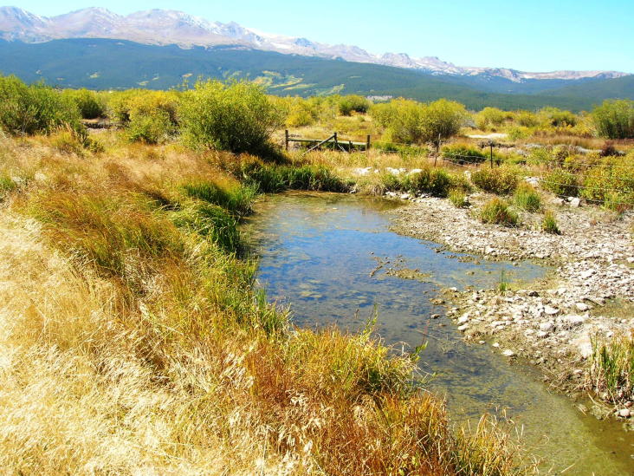
Cal Gulch Superfund Site, Leadville, CO

Slide 15
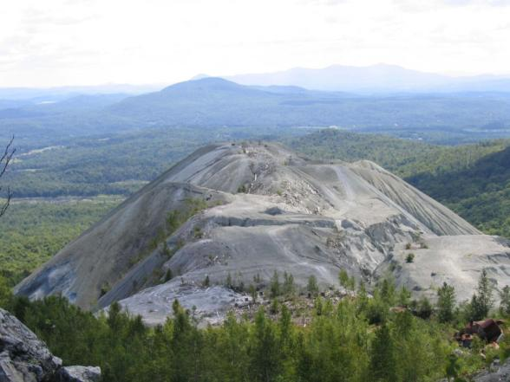
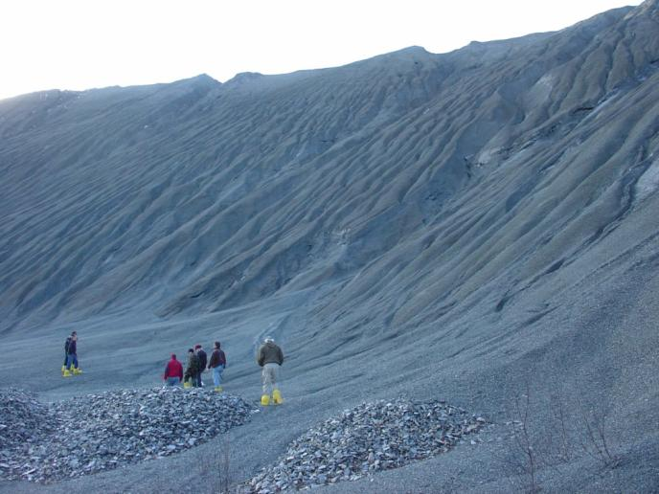
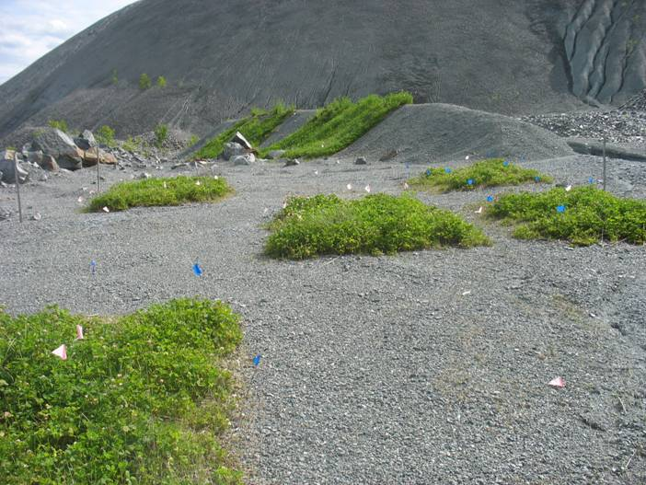
Vermont Asbestos Group

Slide 16
Communication and Outreach
Conference presentations
Web-based seminars
Training courses
Forums
Site documentation
Project profiles database
EcoTools website

Slide 17
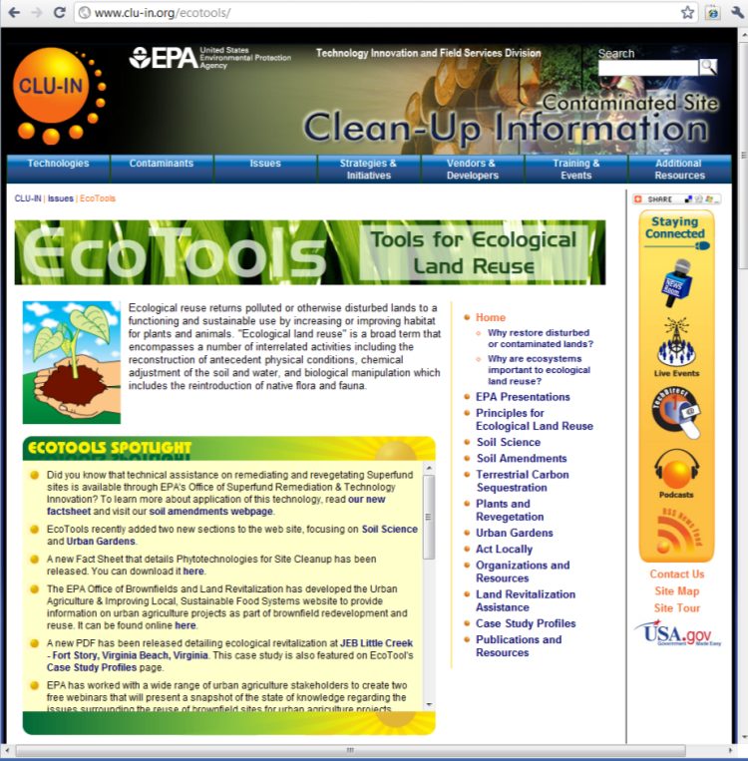
http://www.cluin.org/ecotools

Slide 18
QUESTIONS?
Michele Mahoney
Technology Innovation and Field Services Division
mahoney.michele@epa.gov
(703) 603-9057

