Slide 1
Landia Superfund Site: Green Remediation and Green Infrastructure Support Sustainable Development
Douglas Reid-Green, BASF Corporation

Slide 2
Landia Chemical Company Site

Slide 3
Sustainable Remediation Model
Environmental
Social
Economic

Slide 4
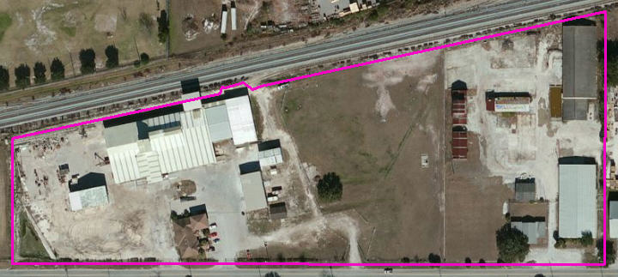
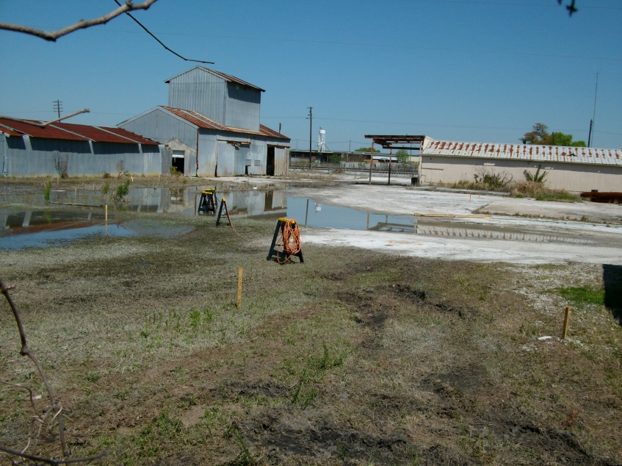
50 years of pesticide and fertilizer blending and formulation
Pesticide and nitrate contamination in soil and groundwater
Soil contamination prevented the business owner from expanding
Abandoned property and buildings were the view for the community
Ecology consisted of mowed weeds, compacted dirt and concrete

Slide 5
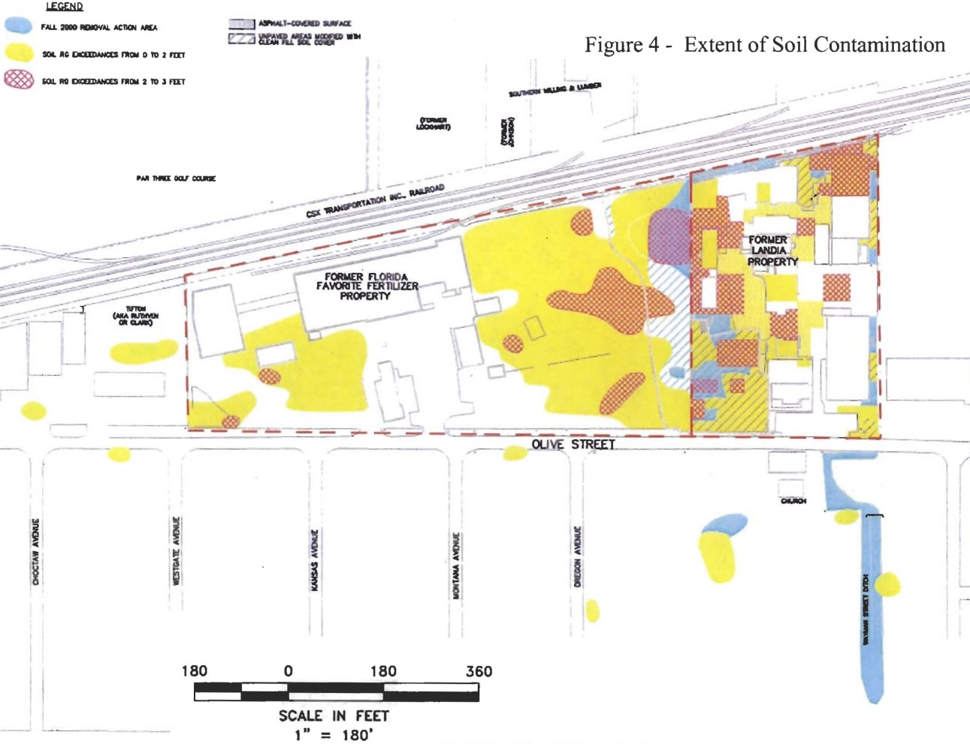
Cleanup Plan Agreed on in 2007
Prevent direct contact with contaminants above health-based levels
Prevent migration of contaminants in soil into groundwater
Meeting goals required removing about 25,000 CY of soil
In 2010, EPA asked that the removal be expanded into the water table

Slide 6
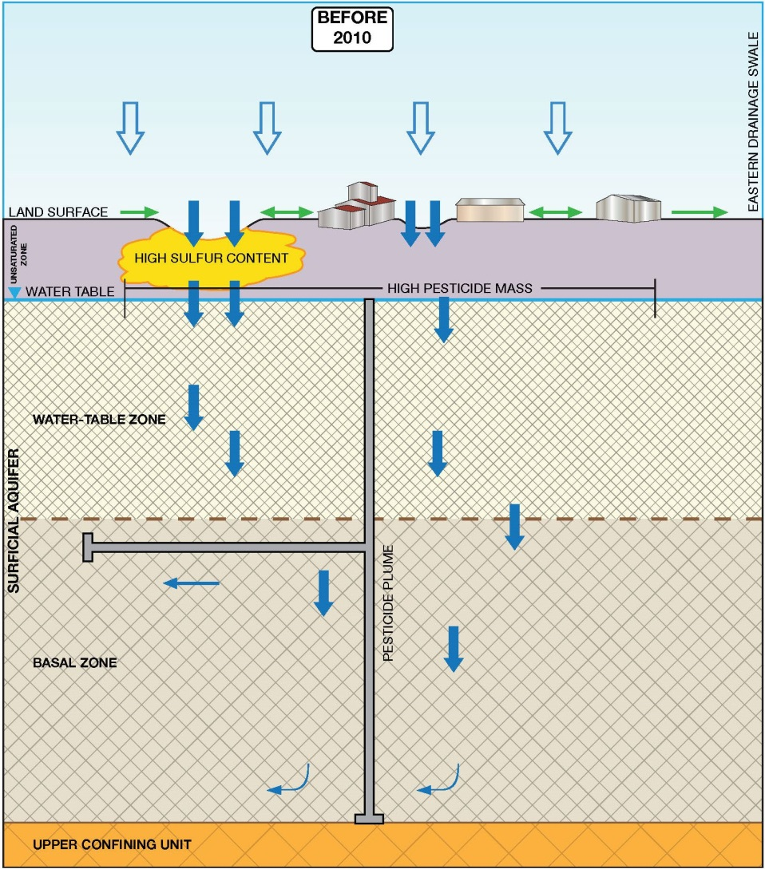
Key Site Condition was Identified in 2010
Most site infiltration was going through most contaminated soil!

Slide 7
Could the Plan be Optimized?
Could this:
Be changed to this:

Slide 8
Remedy was Optimized with EPA’s Help
Major pre-design soil investigation was used to define the excavation areas and volumes
Excavation into the water table where high concentrations were found
Drainage patterns changed to minimize on-site infiltration
Plantings designed to support wildlife and manage infiltration
A portion of the cap was designed to be impermeable to allow for business expansion
Currently – working with state, city and property owner on Restrictive Covenant to keep the property as-is

Slide 9
Optimizing the Soil Remediation
Excavation to 5’ where high pesticide concentrations were encountered
Excavation to 1’ – 2’ in locations where pesticide concentrations were lower
Less soil removal than originally estimated, but more pesticide mass

Slide 10
Designing a Multi-Function Cover
Habitat and phytoremediation cover
Impermeable cap and space for business expansion
Stormwater drainage to retention pond

Slide 11
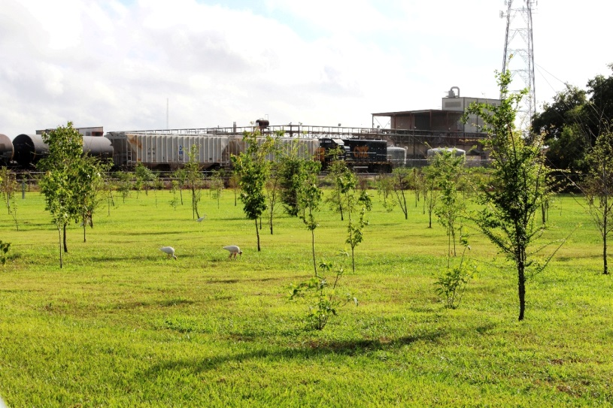
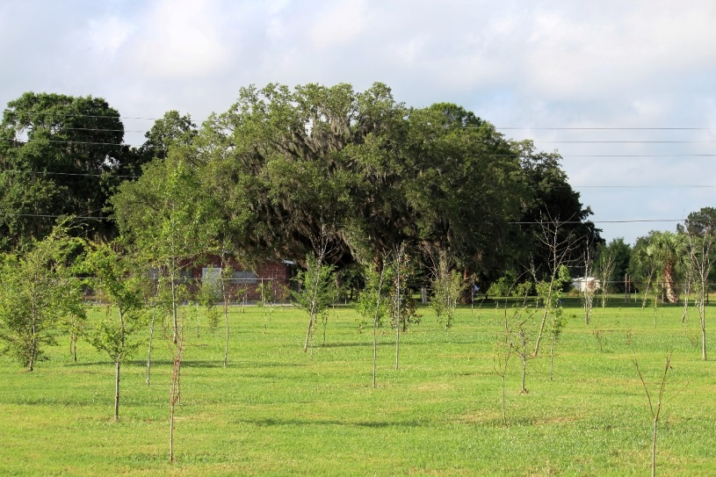
Successful Cap and Maturing Cover

Slide 12
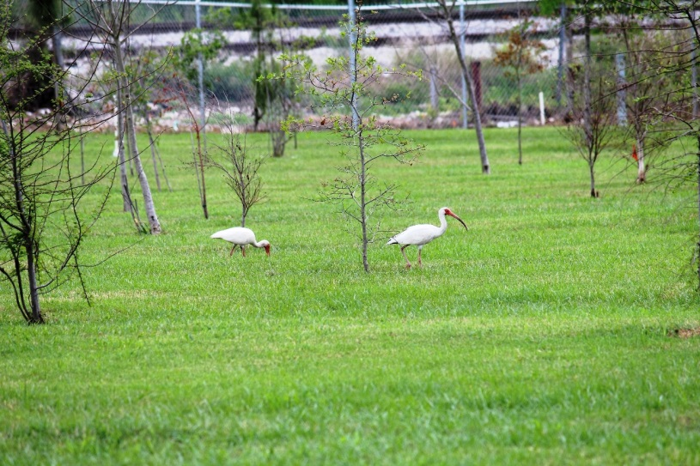
Supporting Wildlife

Slide 13
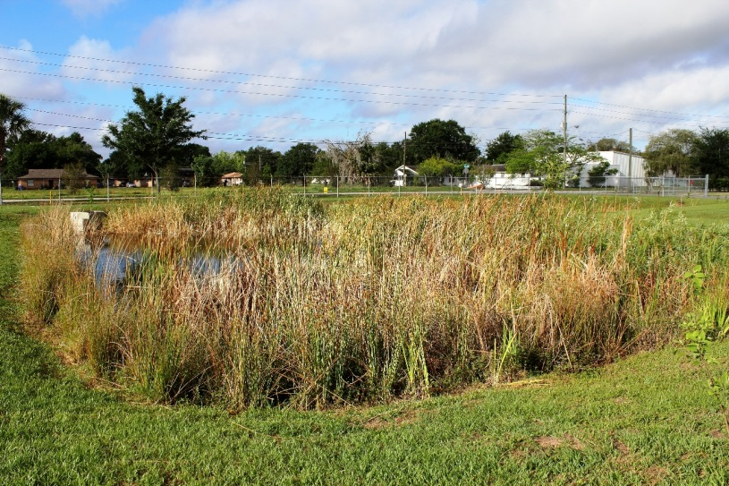
Improved Stormwater Management

Slide 14
The Wildlife Habitat Cover when Fully Grown
Provides green space
for local residence

Slide 15
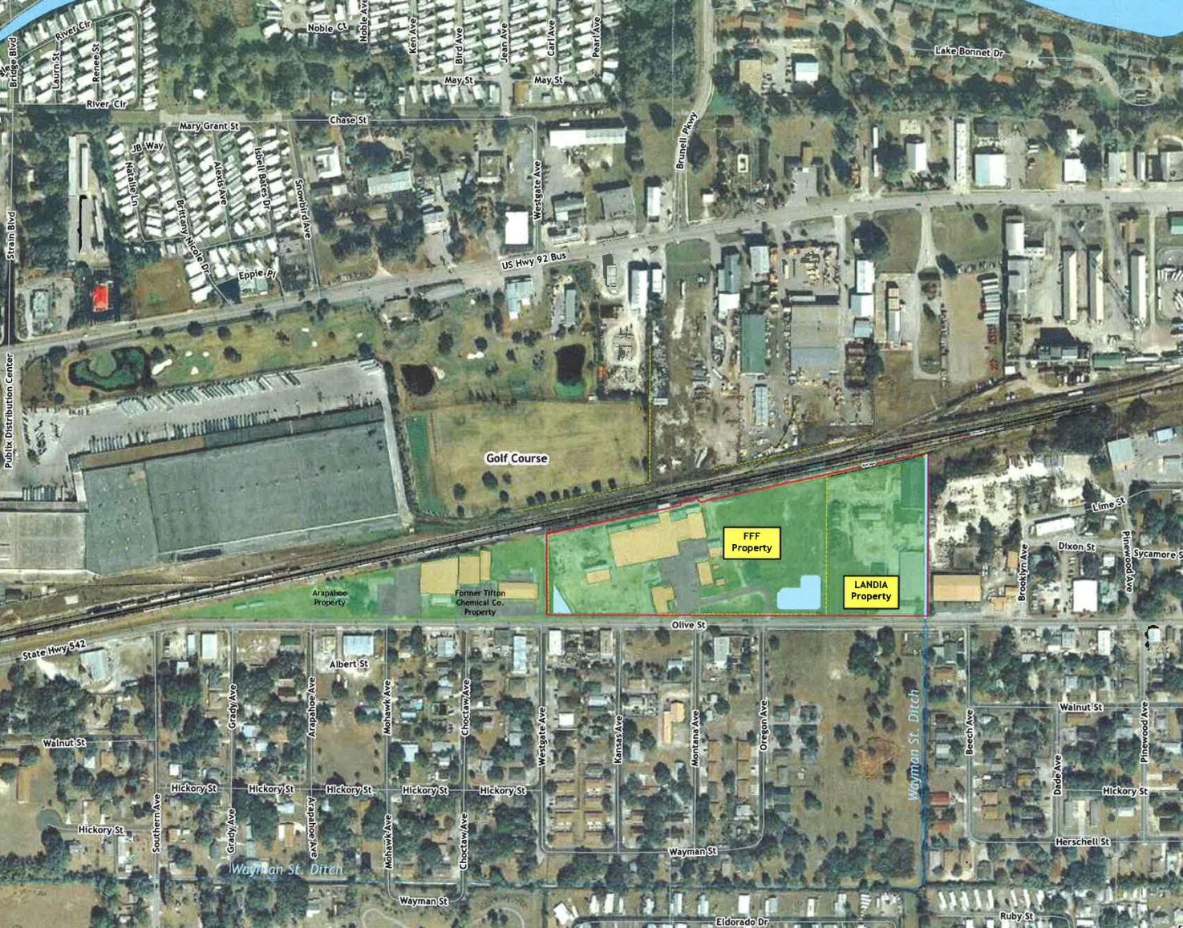
Sustainable Redevelopment
Wildlife habitat created as part of the cleanup of a former pesticide manufacturing site:
Current business owner provided new space to expand operations
Community replaced an eyesore with green space
USEPA made big strides in the cleanup of an old site
RPs received innovative redevelopment award from EPA

Slide 16
Sustainable Remediation
Environmental
Social
Economic
Environmental Benefits:
Eliminate direct contact risk, manage source to groundwater, and provide wildlife ecology.
Social Benefits:
Provide green space for community.
Economic Benefits:
Expansion of local business and Job creation

Slide 17
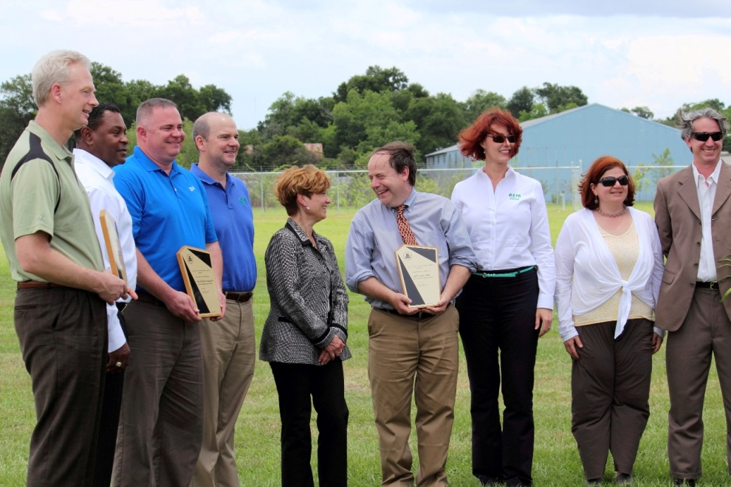
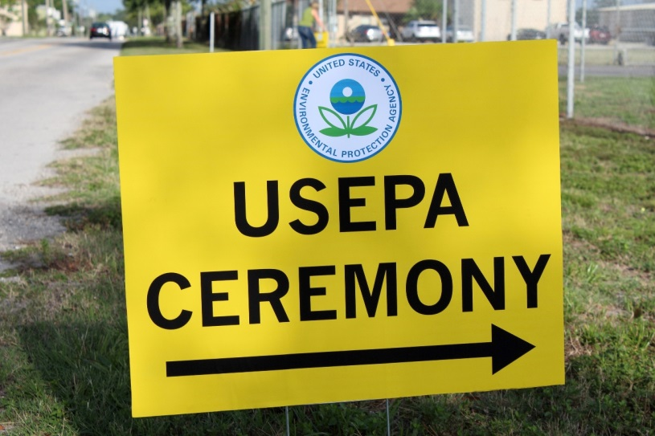
A Successful Project: Region 4 Excellence In Site Reuse Award

Slide 18
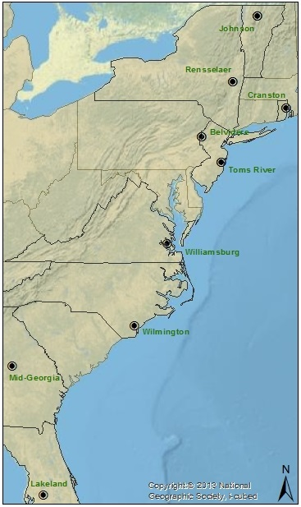
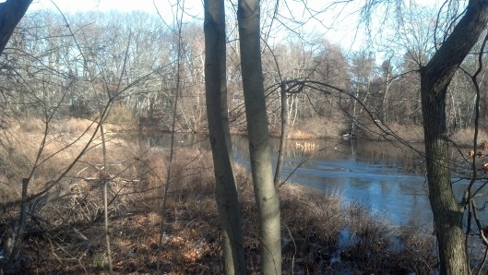
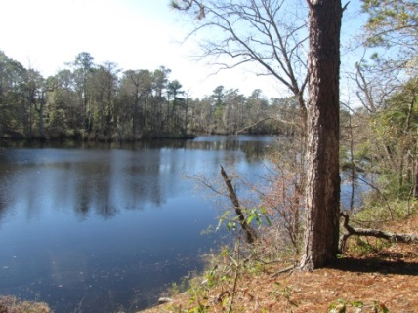
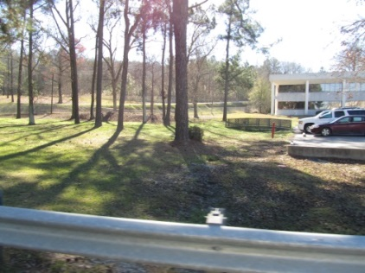
BASF’s Integrated Natural Corridor
Cranston, RI
Rensselaer, NY
Wilmington, NC
Landia, FL
Miga, GA

Slide 19
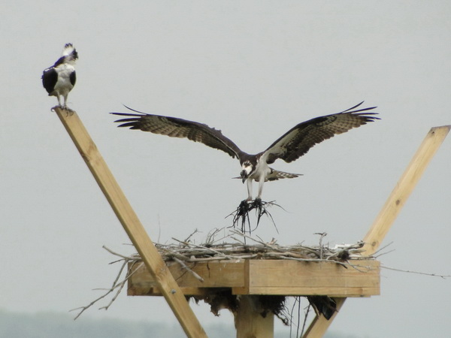
Thank you!

Slide 20
For More Information, Contact
Douglas Reid-Green
BASF Corporation
douglas.reid-green@basf.com
Bill Denman
EPA Region 4
denman.bill@epa.gov

