Slide 1
Arsenic Trioxide and the Summitville Mine Superfund Sites
Frances L. Costanzi, P.E - EPA RPM

Slide 2
Alternative Energy at Superfund Sites
Consider the possibility of adding an alternative energy component to a Superfund site
It doesn’t have to meet all of the site’s energy needs if that isn’t feasible
Incremental options can be worthwhile, including helping to make the cleanup be more sustainable over the long-term
Two examples from Region 8:
Arsenic Trioxide in North Dakota, and
Summitville Mine in Colorado
2

Slide 3
Arsenic Trioxide Summary
One of two National Priorities List sites in North Dakota
Area-wide arsenic contamination in ground water covering much of two counties in southeastern North Dakota
Area is mostly rural and agricultural with several small towns
The Superfund remedy included:
expanding a water treatment plant and system (well fields, distribution lines, pump stations and small, covered reservoirs), and
connecting many rural homes and small towns to the system to provide drinking water than meets Safe Drinking Water Act requirements.
The remedy has been completed and the Site is in operation and maintenance (O&M)
The Site has been deleted from the National Priorities List.
3

Slide 4
Arsenic Trioxide
Several alternative energy options were considered during design
Wind energy – Treatment Plant System managers were concerned about ongoing maintenance costs and State agreed
Area is not conducive to solar options
Water Treatment System managers were intrigued by geothermal heating and cooling
Was not viable in the water treatment plant itself since the large amount water moderated temperatures.
The main operations center manages the remote monitoring for this large water distribution system covering multiple counties.
The distribution system needs to operate efficiently, including during harsh North Dakotan winters.
Geothermal heating and cooling helps to fill this need and reduces long-term operation costs, using renewable energy.
4

Slide 5
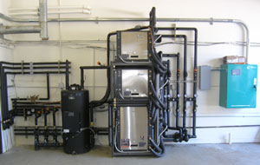
Geothermal Heating and Cooling System Equipment
5

Slide 6
Summitville Mine - Summary
The 1,231-acre Site is located in southwestern Colorado near the New Mexico border
The Site is a former gold and silver mine located at 11,500 feet
Winters are very severe and long-lasting
Mining began in 1870
The Site was abandoned by the operator in 1992.
EPA assumed responsibility, initially as an emergency removal action, later listing it on the National Priorities List in 1994.
The Site achieved construction completion status in 2013.
The treatment plant addresses the acid mine drainage. It will be operating for a very long time and is energy intensive.
The State of Colorado is currently the lead agency and will be paying for the operation and maintenance (O&M) once the long-term response action period ends.
6

Slide 7
Reducing Long-term O&M Costs
EPA heard of a community solar garden located in Antonito, CO
Antonito located is approximately 40 miles to the south of the Summitville Mine, and at a much lower elevation
The State of Colorado signed a 10-kilowatt subscription (about 40 panels)
This is approximately enough to power 2.5 homes and will reduce global warming by 15 metric tons/year
This will only cover a small portion of the treatment plant’s energy needs
We are hoping to acquire a larger subscription in the near future, while continuing to make the plant more efficient.
7

Slide 8
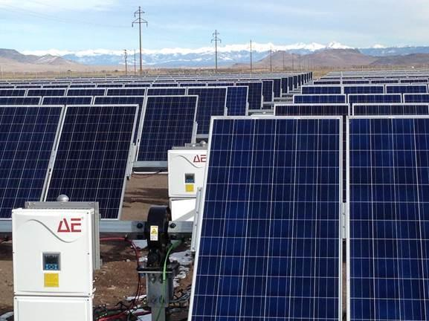
Community Solar Garden in Antonito, CO
8

Slide 9
In Conclusion
While it’s worthwhile to look for big opportunities, don’t overlook smaller, incremental options
Using alternative energy options can assist with long-term O&M costs. This can help make a project more sustainable, especially if it needs to operate for a long time
Arsenic Trioxide http://www2.epa.gov/region8/arsenic-trioxide
Summitville Mine http://www2.epa.gov/region8/summitville-mine
9

Slide 10
For More Information, Contact:
Frances Costanzi
EPA Region 8
(303) 312-6571
costanzi.frances@epa.gov
10

