Slide 1
Area-Wide Planning, Superfund Sites, Environmental Justice and Green Infrastructure: Tying it All Together in the Freeport Community Planning Project
February 13, 2014

Slide 2
Webinar Overview
Introduction to SRI and Why Reuse is an Agency Priority
Tom Bloom: An Introduction to the Freeport Community Planning Project and Site History
Shelly Griswold: Site Selection
Sarah Malpass: Freeport Regional Seed Project
Ronnie Bush: A Community View

Slide 3
Example Title
SRI is celebrating its 15th Anniversary!

Slide 4
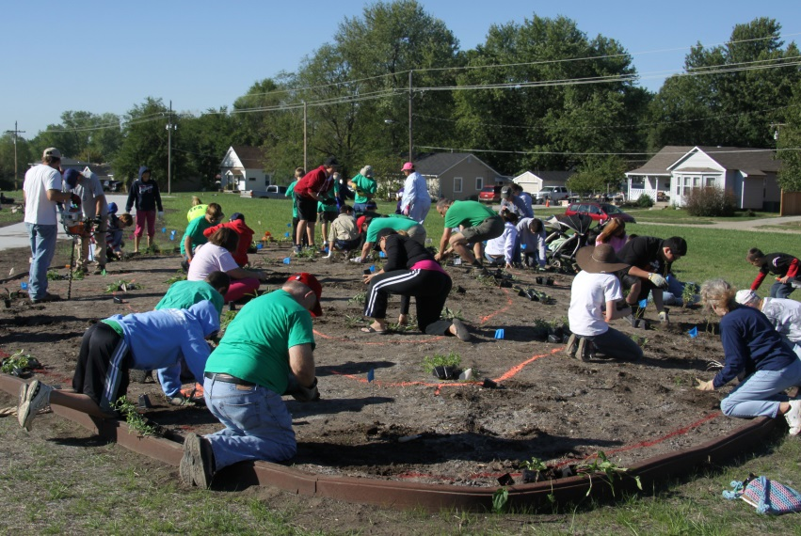
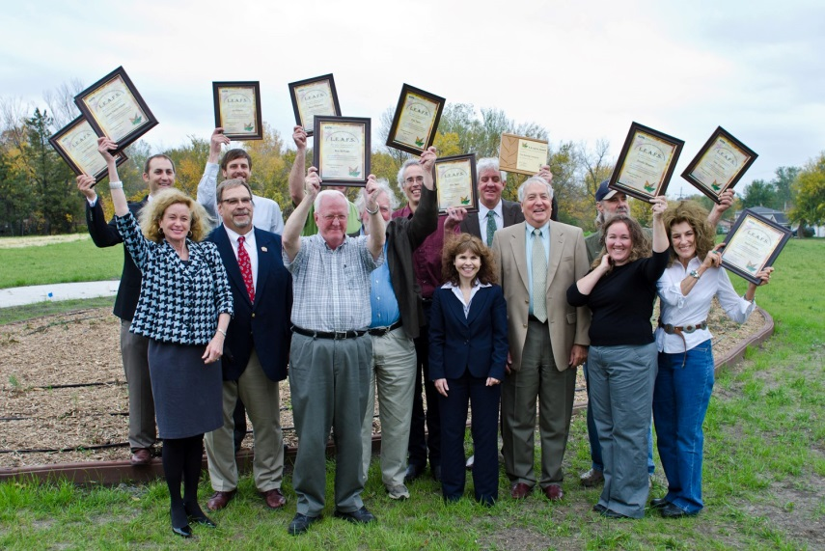
SRI: The Superfund Redevelopment Initiative
Working with communities and other partners in considering future use opportunities and integrating appropriate reuse options into the cleanup process

Slide 5
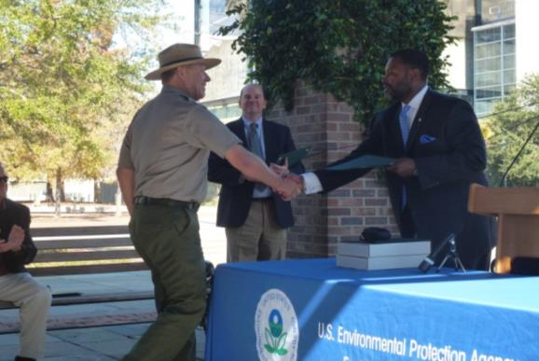
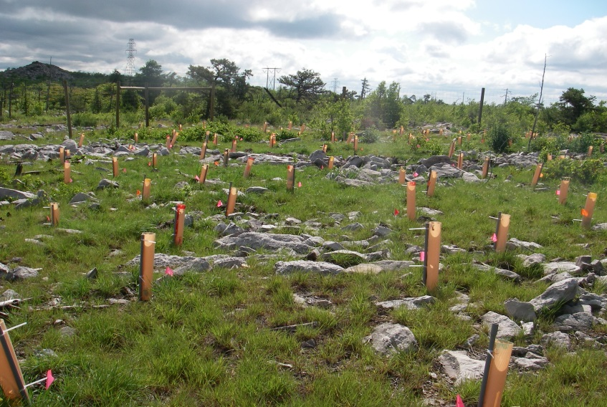
Reuse as a Priority

Slide 6
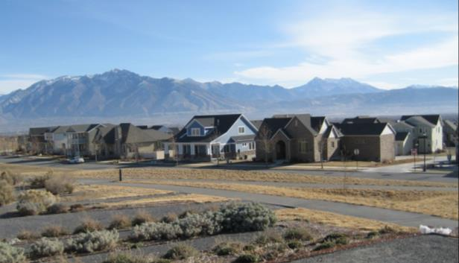
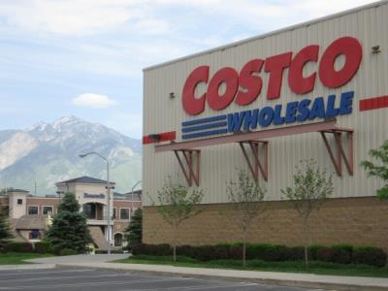
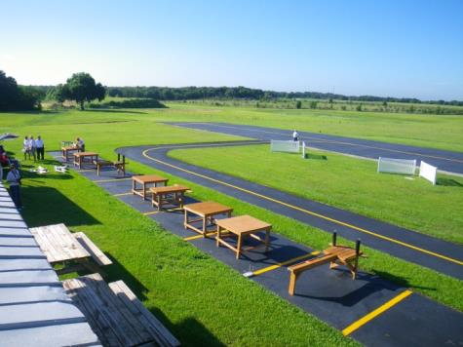
Reuse as a Priority (cont.)
Community Benefits
Economic
Environmental
Social
Cleanup and Enforcement Benefits
Protection of human health and the environment
Long-term stewardship
Encourages expedited cleanups
Saves resources
Helps to achieve program goals

Slide 7
Reuse Directive
Preliminary Assessment, Site Inspection and Listing
Remedial Investigation and Feasibility Study
Remedy Selection
Remedial Design and Action
Construction Completion
Long-Term Operation and Maintenance
Reuse Directive

Slide 8
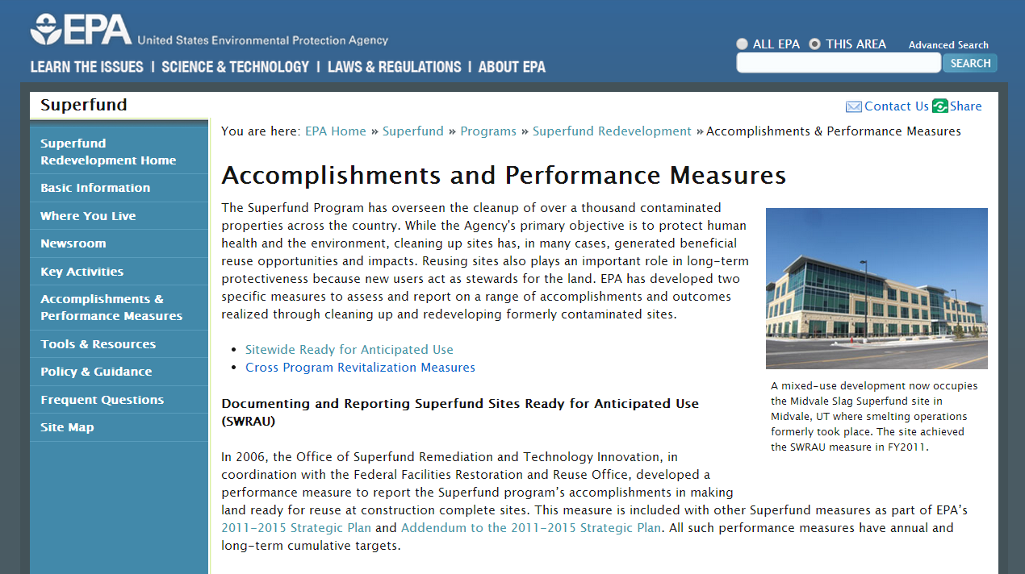
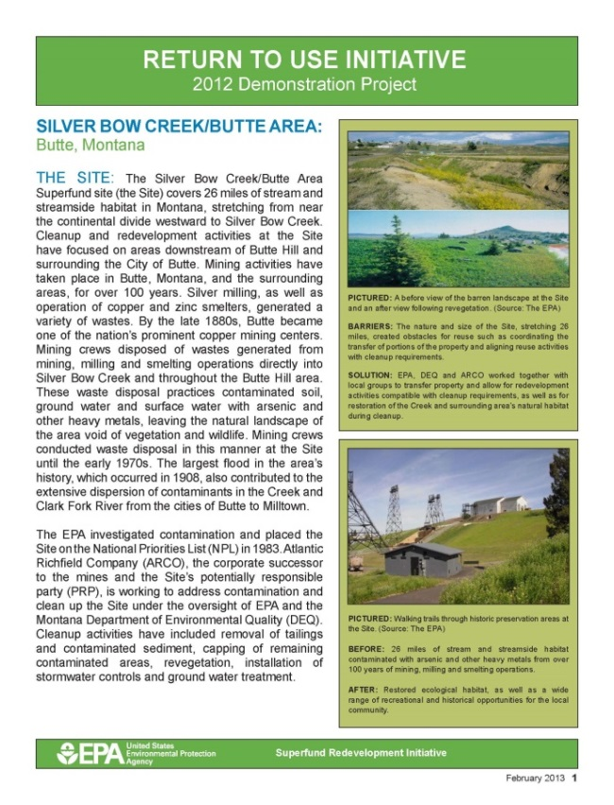
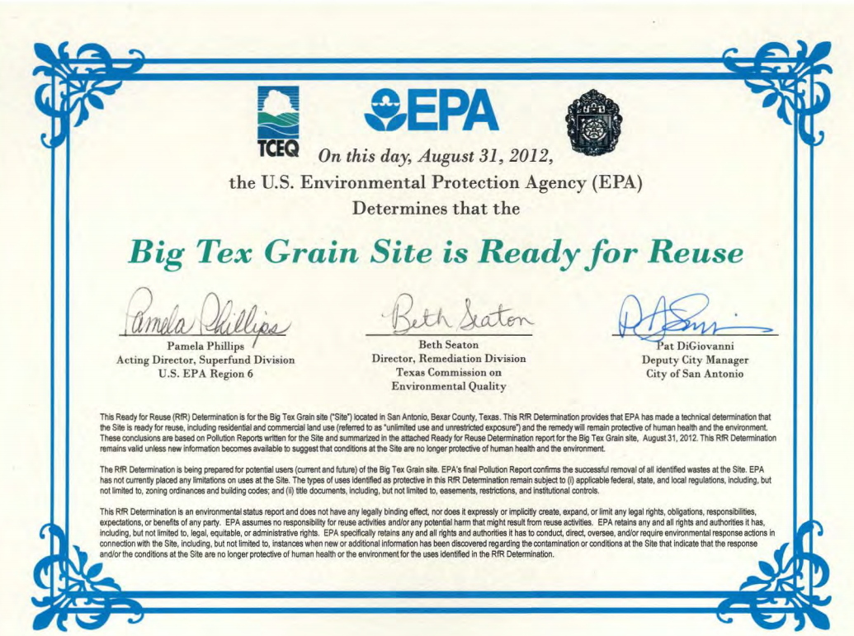
Tools

Slide 9
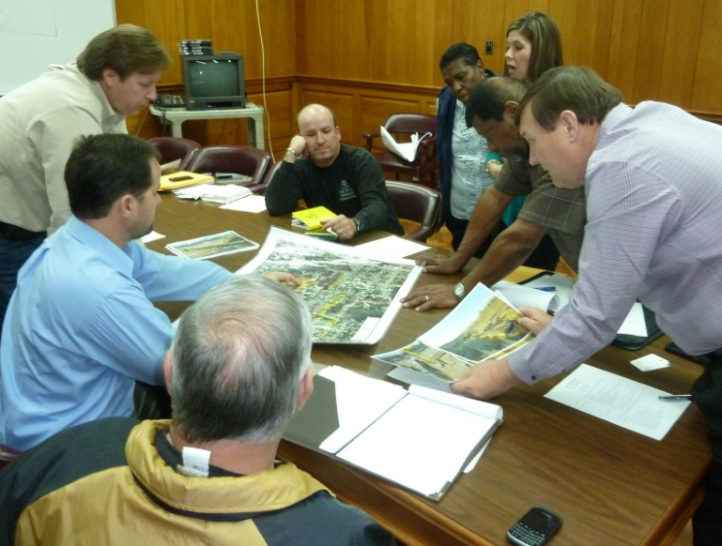
SRI Over the Years: From Pilots to Regional Seeds
Avtex Fibers, one of SRI’s 10 initial Pilot Projects
Picayune Wood Treating, a current SRI Regional Seed project

Slide 10
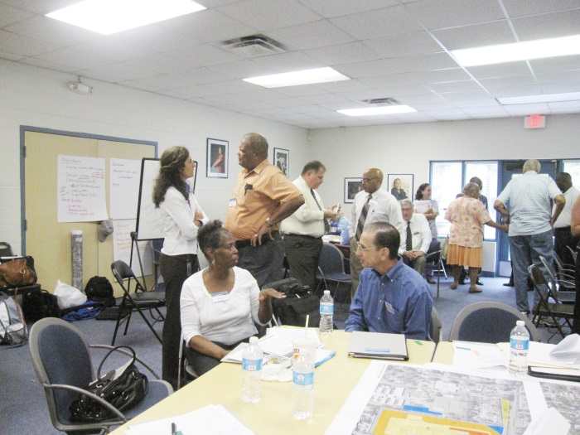
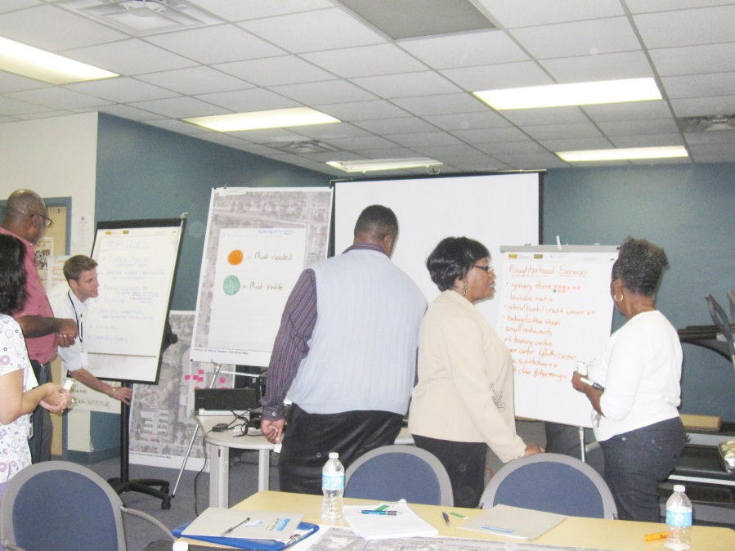
Regional Seeds
Bring the right stakeholders together
Provide site information
Clarify remedy and remedy components
Identify constraints and barriers
Outline goals and needs
Develop next steps

Slide 11
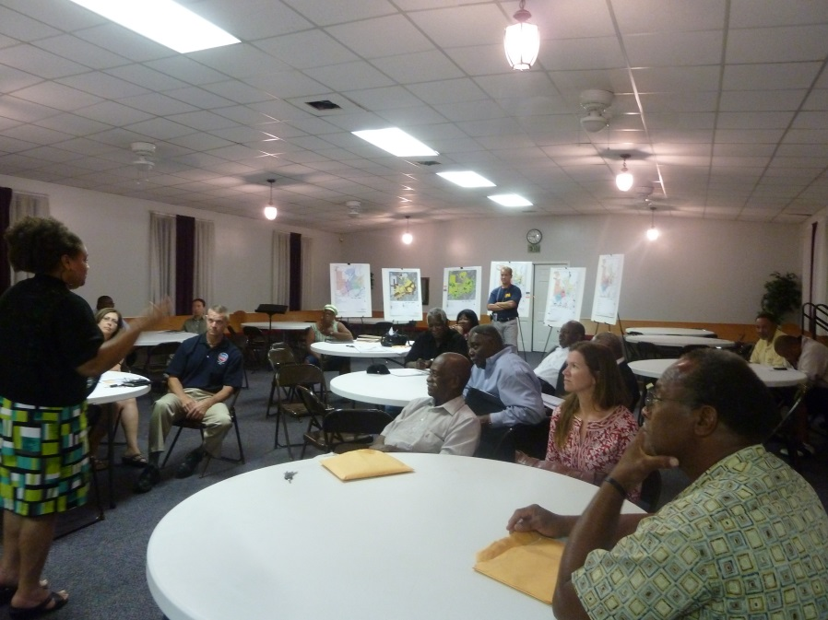
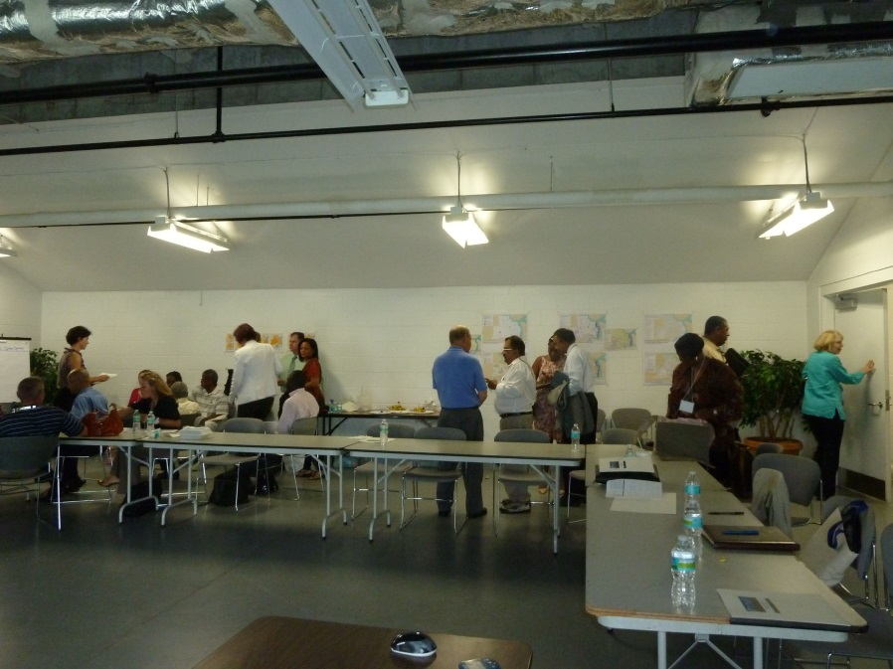
Regional Seeds (cont.)
EPA Headquarters and Regional collaboration is KEY!

