Slide 1
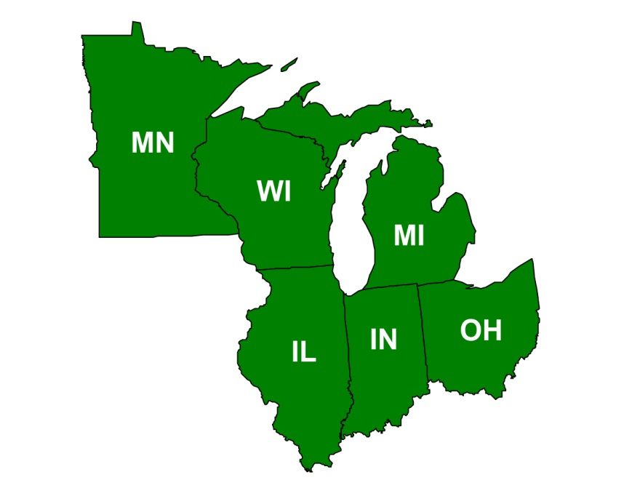
Region 5
Tom Bloom, Regional Superfund Redevelopment Coordinator

Slide 2
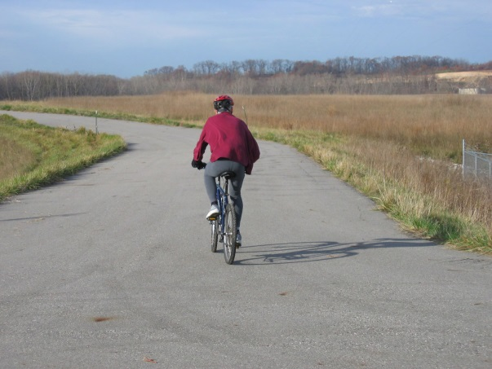
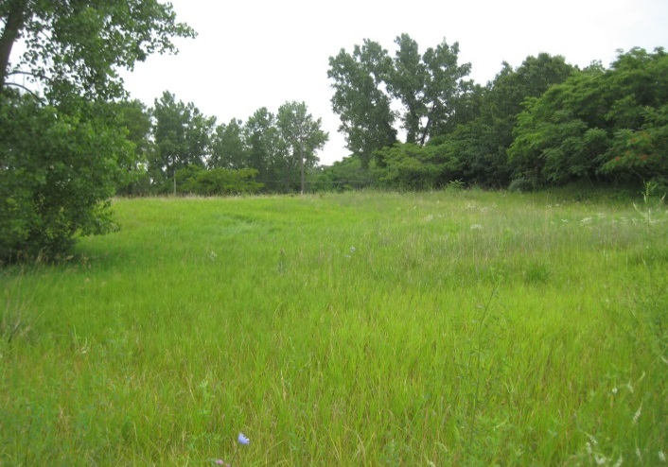
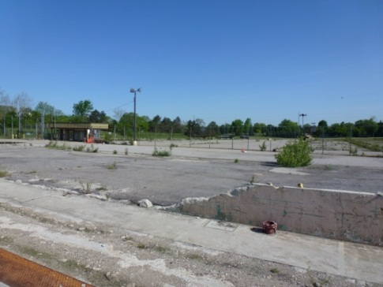
Reuse in Region 5
Butterworth Landfill #2
Waste, Inc. Landfill
GM Lansing

Slide 3
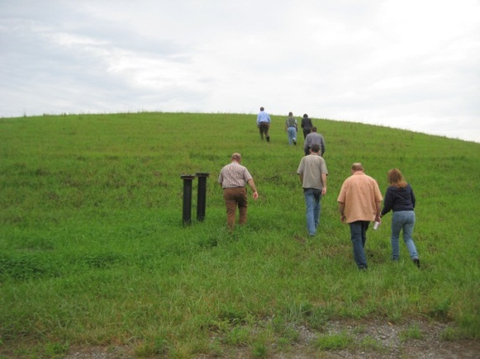
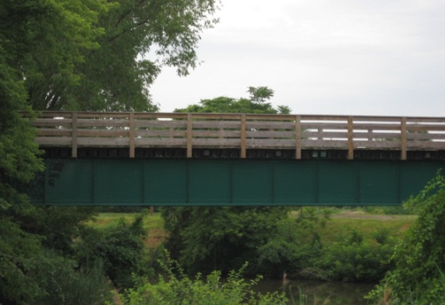
Waste, Inc. Landfill
Site reuse goals
Recreational park
Connect abandoned rail line to greenway trail
Creek access for camping and fishing
Open Space
Bridge over Trail Creek
Recreational Trails

Slide 4
Butterworth #2 Landfill
Reuse plan
Trails for bicyclists

Slide 5
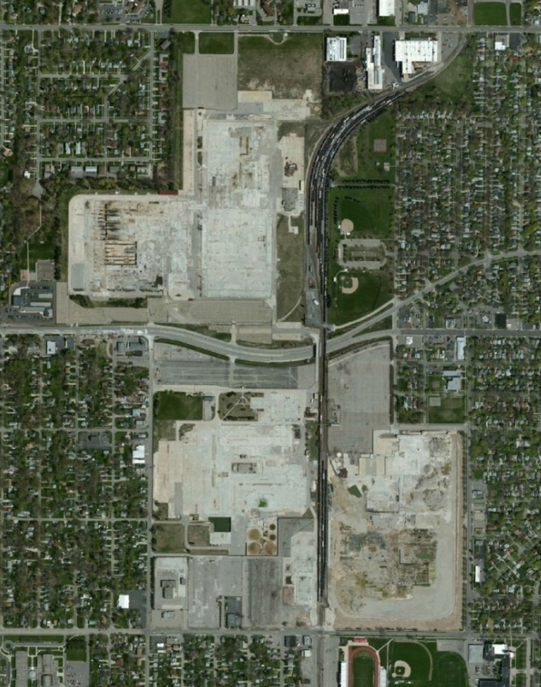
GM Lansing
GM Plant sites aerial photo
GM Plant sites reuse plan

Slide 6
Contact Information
Tom Bloom
Superfund Redevelopment Coordinator
bloom.thomas@epa.gov
312-886-1967

