Slide 1
Introduction to Ecological Revitalization
Michele Mahoney, TIFSD

Slide 2
Overview
What Is Ecological Revitalization?
Benefits of incorporating Ecological Revitalization into Superfund Cleanup
Life-Sustaining Benefits: Ecological Services
Benefits of Using Native Species
Local Economic Benefits
Key Considerations and Steps for Planning and Implementing Ecological Revitalization
Site Examples
Resources and Support

Slide 3
What Is Ecological Revitalization?
www.cluin.org/ecotools

Slide 4
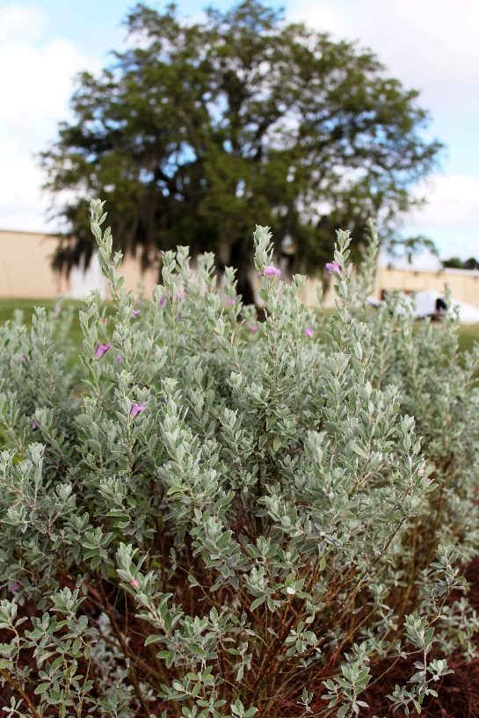
Benefits of Incorporating Ecological Revitalization into Superfund Cleanup
Reduce contaminant bioavailability
Improve ground water recharge
Control landfill leachate
Stabilize soil
Lowers costs
Requires less maintenance
Lead to ecological land reuse

Slide 5
Life-Sustaining Benefits: Ecosystem Services
Climate regulation
Purification of water & air
Soil formation
Carbon storage & sequestration
Nutrient dispersal & cycling
Seed dispersal
Waste decomposition & detoxification
Crop pollination
Pest & disease control
Food, crops & spices
Forest products (e.g., timber)
Pharmaceuticals
Energy (e.g., hydropower and biomass fuels)
Recreation
Scientific discovery & education
Aesthetic & spiritual value

Slide 6
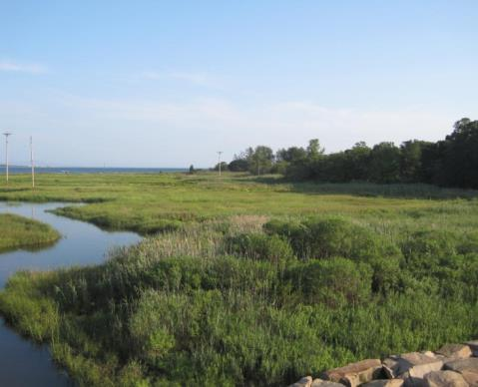
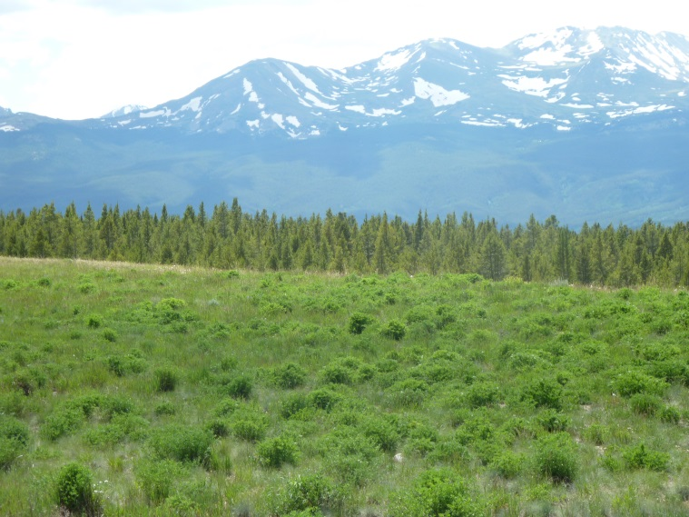
Benefits of Using Native Plant Species
Provide biodiversity
Do not require fertilizers
Do not require pesticides
Require less water (no watering once established) than turf grass (lawns)
Provide shelter and food for wildlife
Are critical to a diverse number of pollinators
Reduce air pollution
Offer economic values (such as easily accessible food, natural medicine, herbs, and landscaping)

Slide 7
Local Economic Benefits
Improves nearby property value increase
Increases tax revenues
Attracts tourism
Promotes healthy lifestyles
Lowers flood control and stormwater management costs
Improves local air and water quality

Slide 8
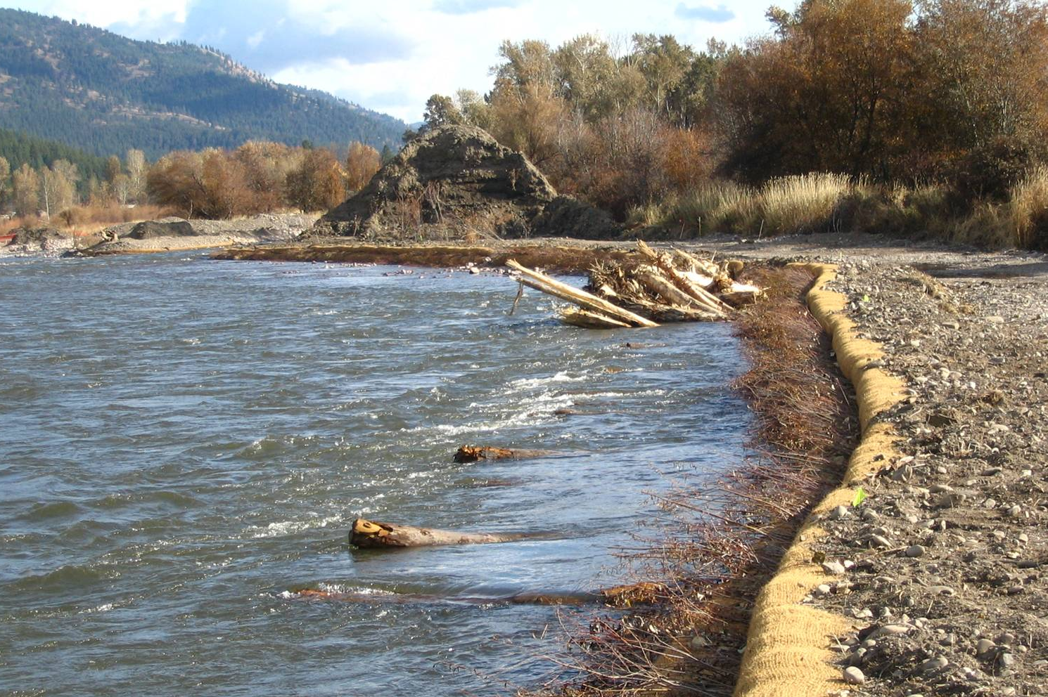
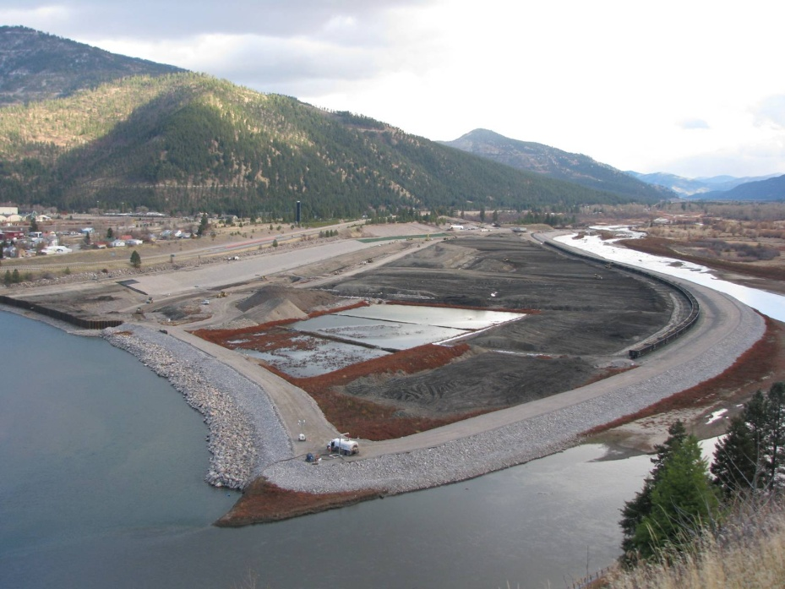
Key Considerations
Remedy Performance
Cleanup Plans
Stakeholder Involvement

Slide 9
Steps for Planning & Implementation
Determine pre-disturbance and reference conditions
Conduct property inventory
Establish revitalization goals & objectives
Evaluate revitalization alternatives
Develop a property-specific ecological design
Prepare specifications for construction contractors
Construct habitat features
Conduct maintenance & monitoring activities

Slide 10
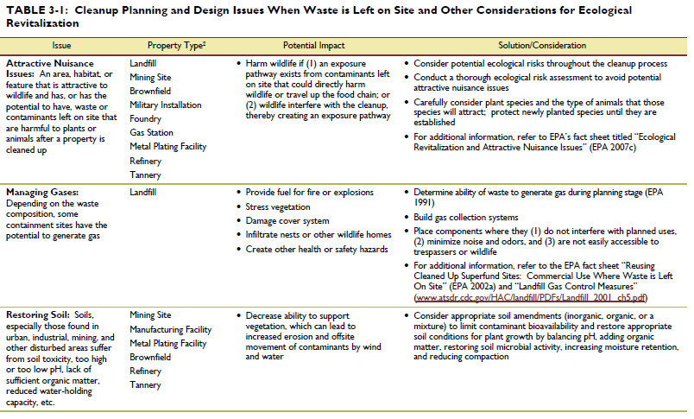
Cleanup Planning and Design Issues When Waste is Left On Site and Other Considerations for Ecological Revitalization

Slide 11
Ecological Revitalization Site Examples

Slide 12
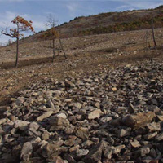
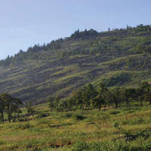
Palmerton Zinc Pile (Pennsylvania)

Slide 13
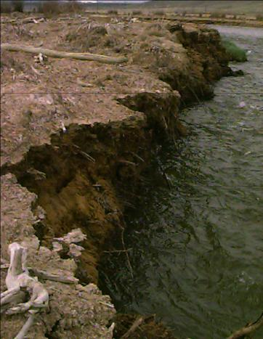
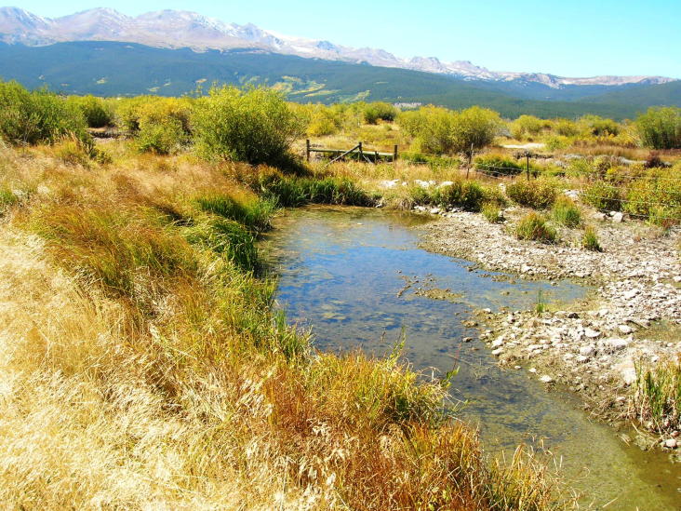
California Gulch (Colorado)

Slide 14
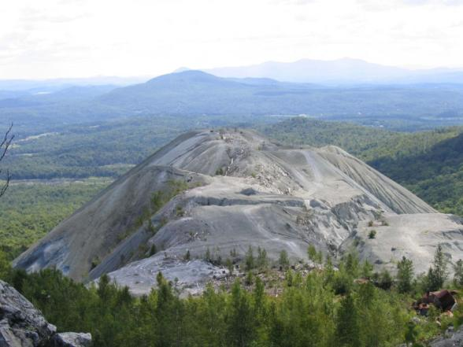
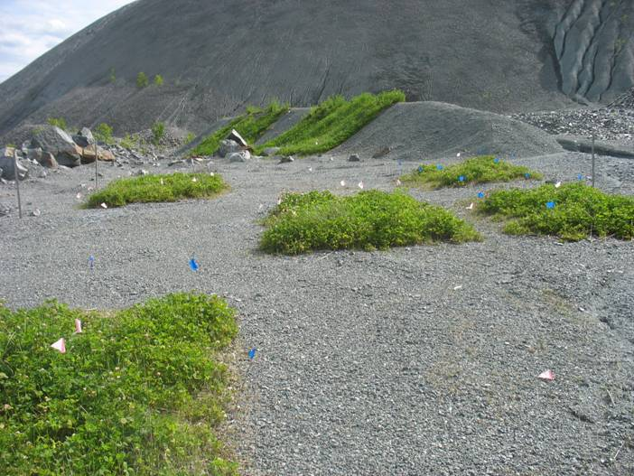
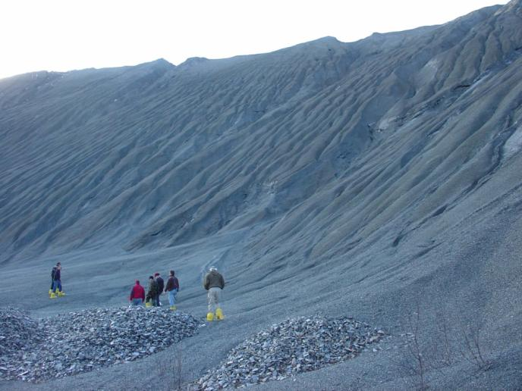
Vermont Asbestos Group Mine (Vermont)

Slide 15
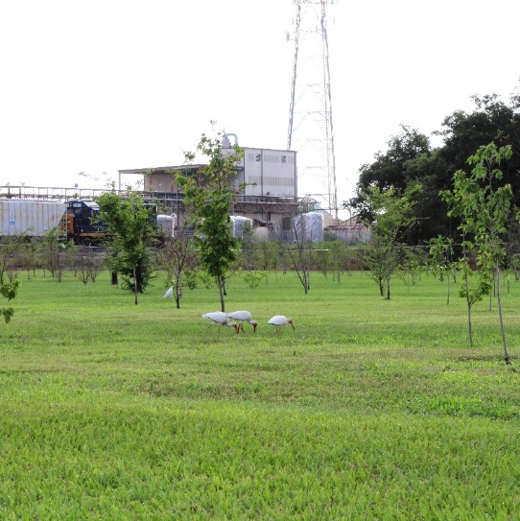
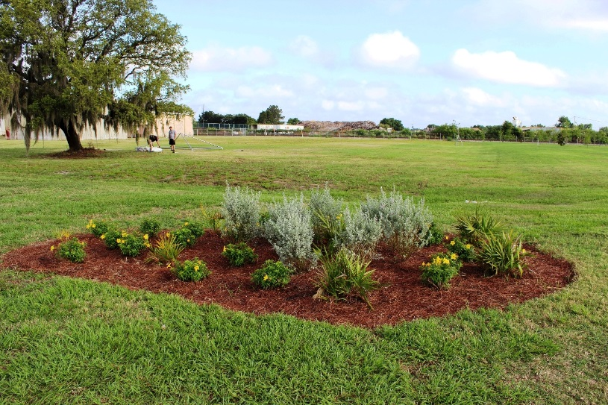
Landia Chemical Company (Florida)

Slide 16
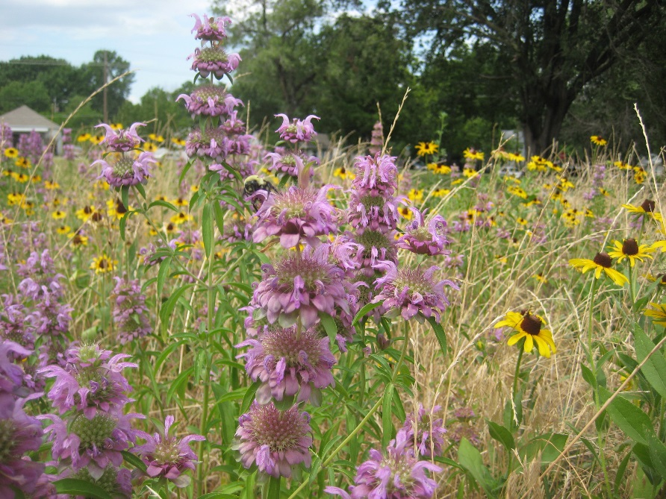
Supporting Pollinators

Slide 17
http://www.cluin.org/ecotools

Slide 18
For More Information, Contact
Michele Mahoney
EPA TIFSD
(703) 603-9057
mahoney.michele@epa.gov
http://www.cluin.org/ecotools

