Slide 1
Supporting Healthy Communities: Jacksonville, Florida
Tonya Spencer
EPA Region 4
Community Involvement Coordinator

Slide 2
Overview
Site Background
  Jacksonville Ash Superfund Alternative site
  Brown’s Dump Superfund Alternative site
Site History
  Jacksonville, Florida, Community
  Historic Challenges

Slide 3
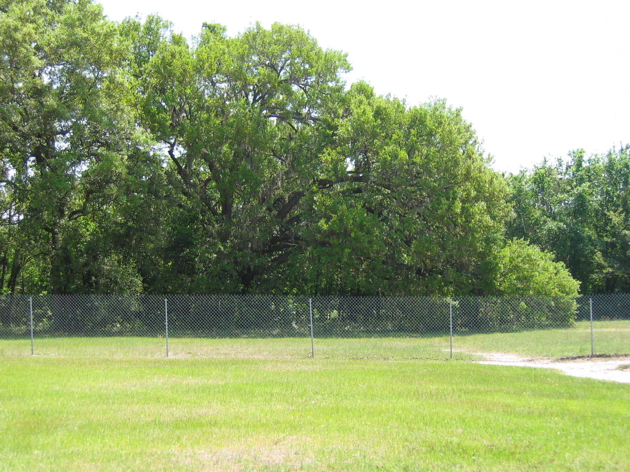
Site Background
– Jacksonville Ash
Former incinerators and ash disposal areas
EPA addressing site through Superfund Alternative Approach

Slide 4
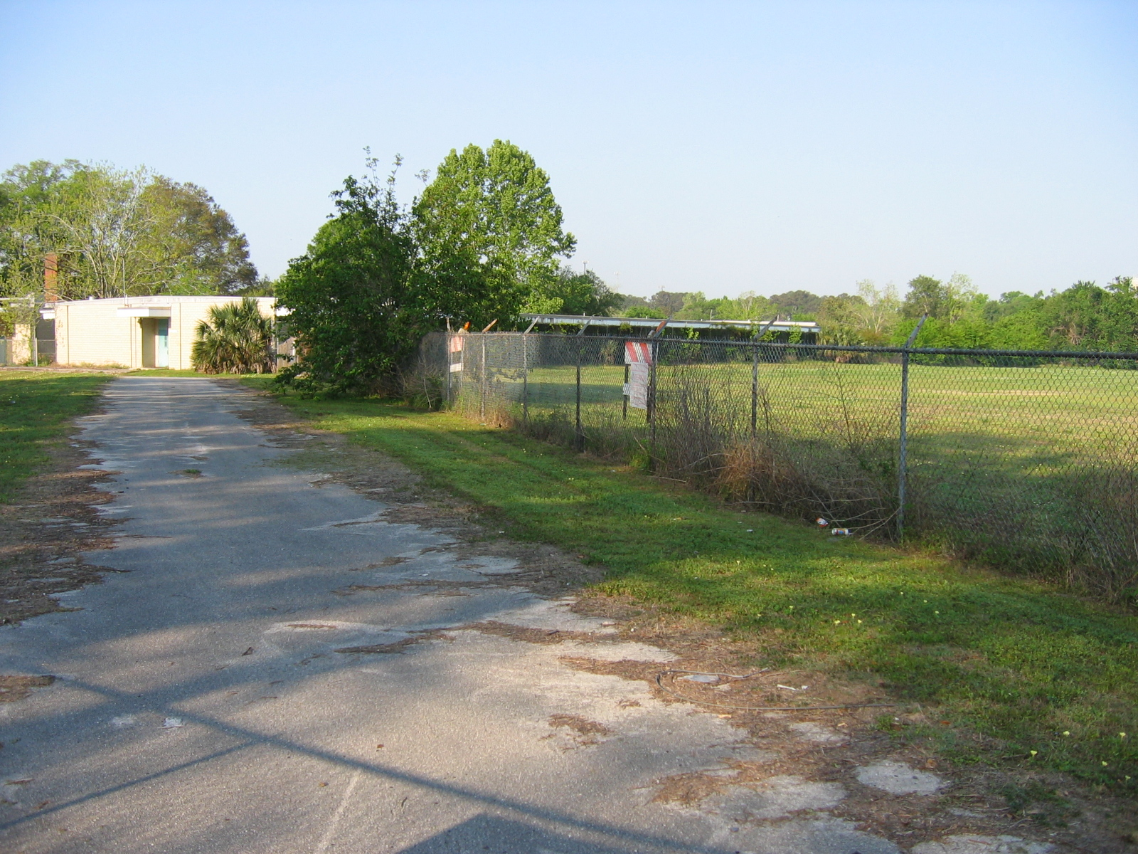
Site Background – Brown’s Dump
Former landfill for municipal incinerator ash
EPA addressing site through Superfund Alternative Approach

Slide 5
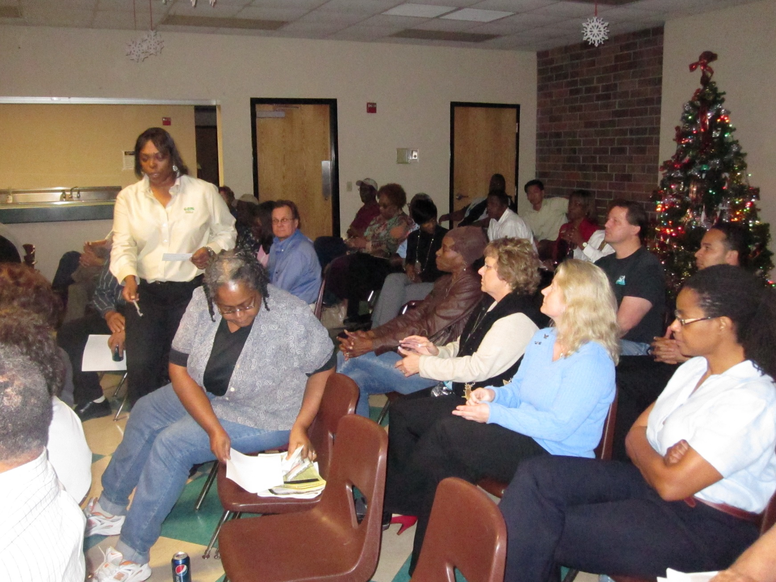
Superfund Alternative Approach
Superfund Alternative Approach Agreement

Slide 6
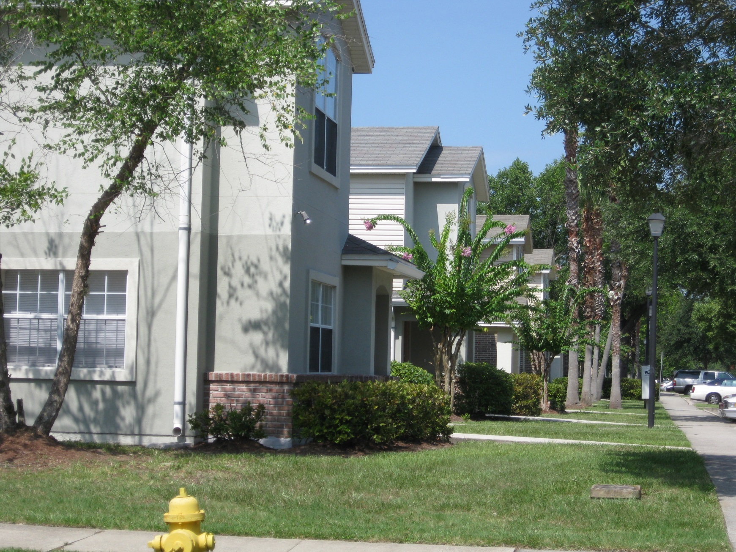
Jacksonville, Florida – Community Background
History of industry
Overburdened community

Slide 7
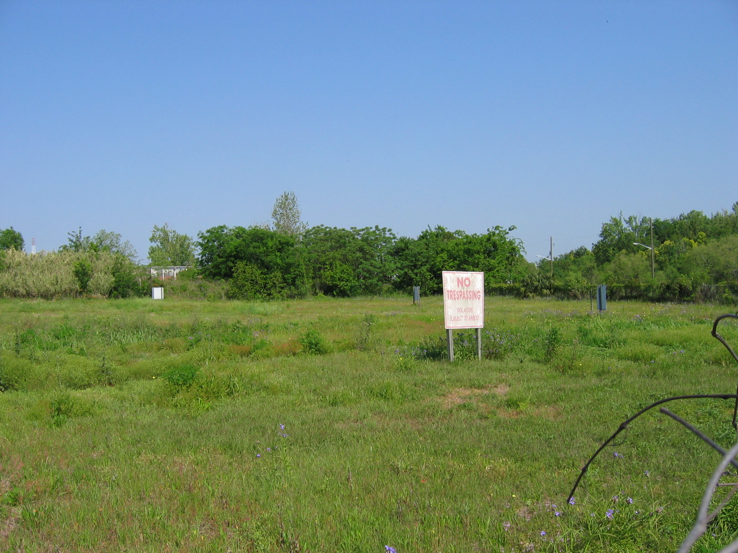
Historic Challenges
Disinvestment
Vacant land

Slide 8
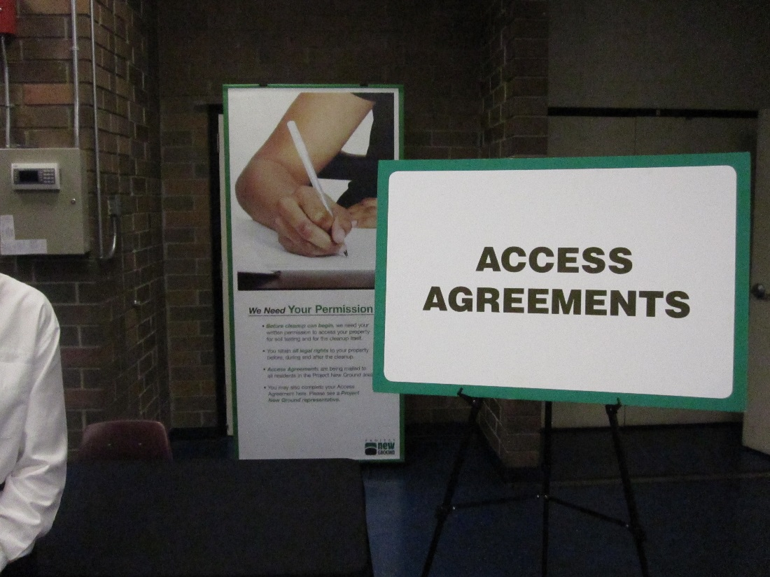
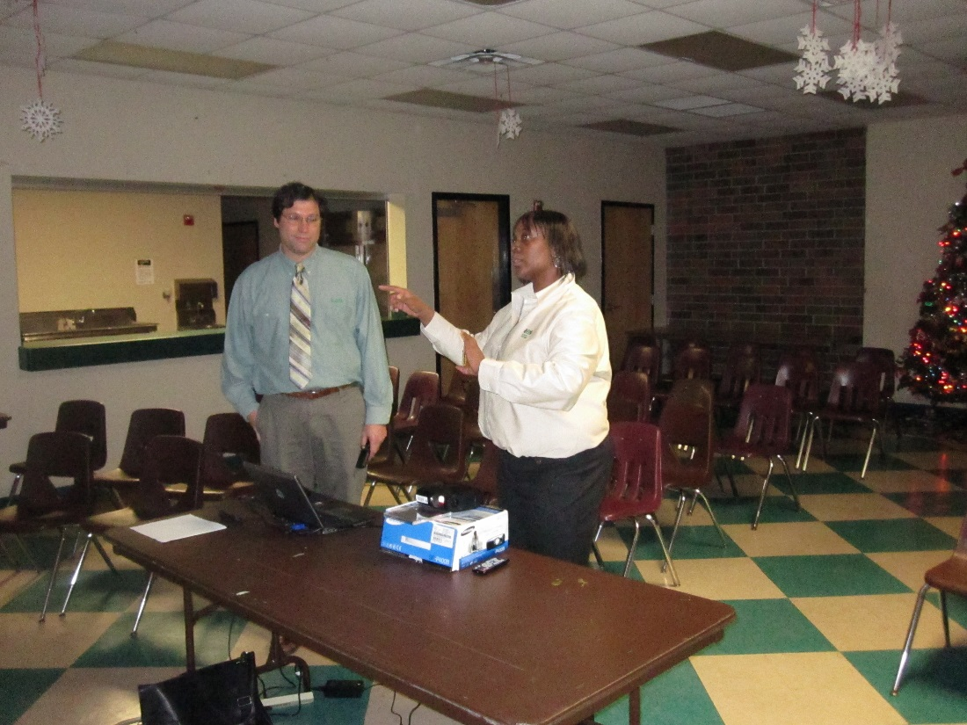

Slide 9

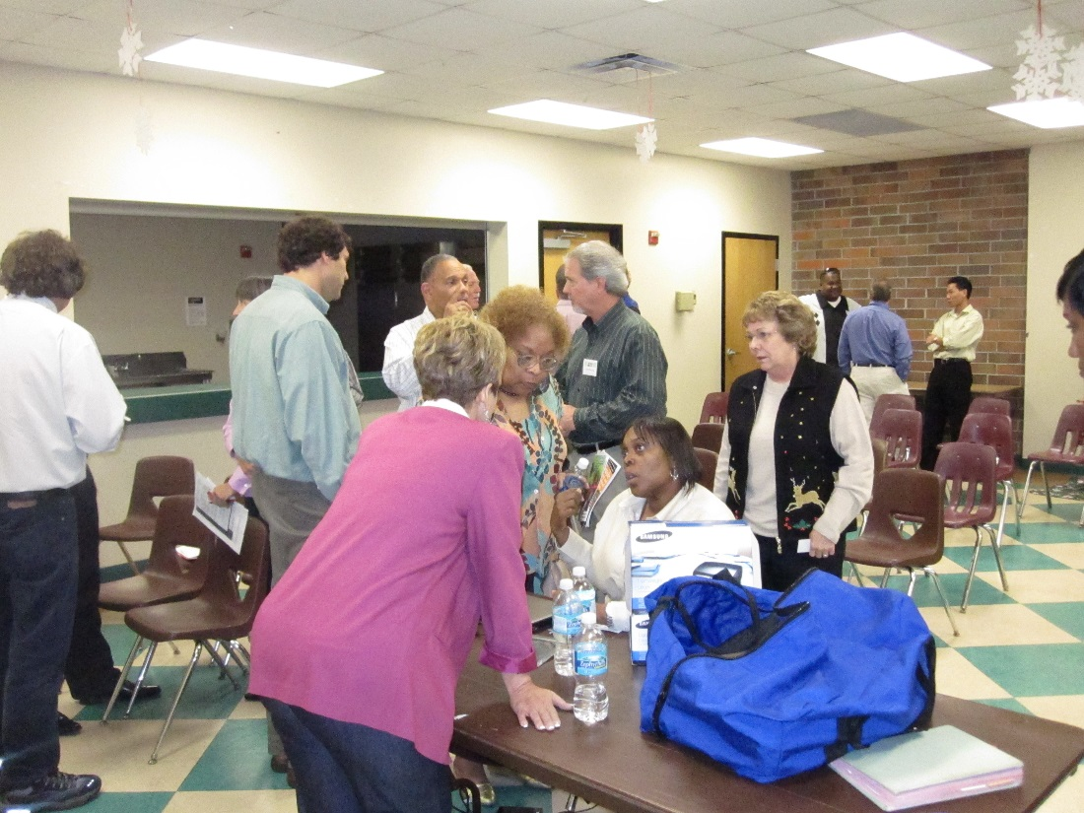

Slide 10
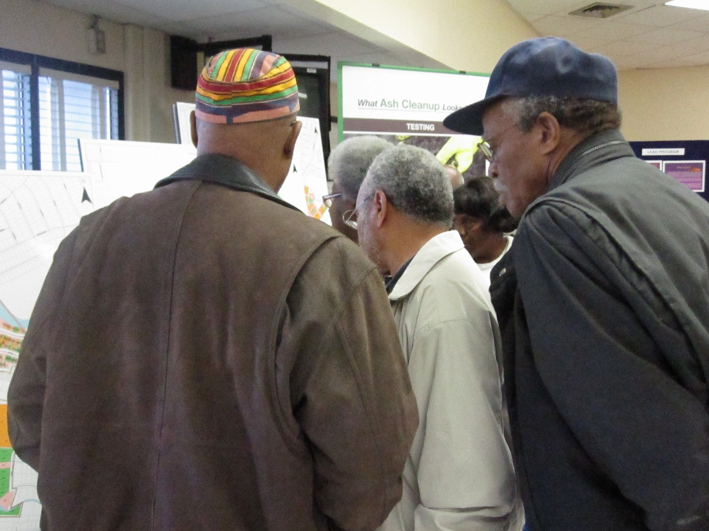
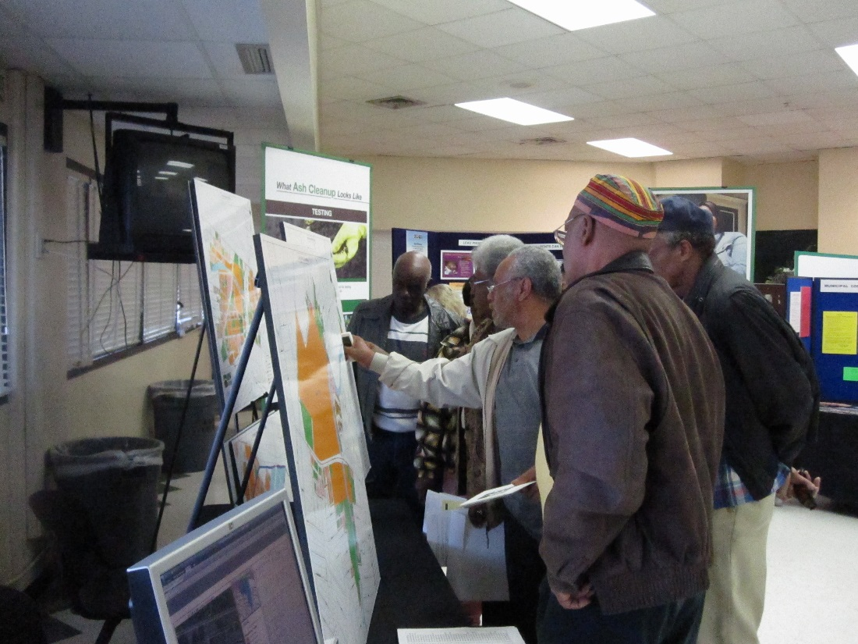

Slide 11
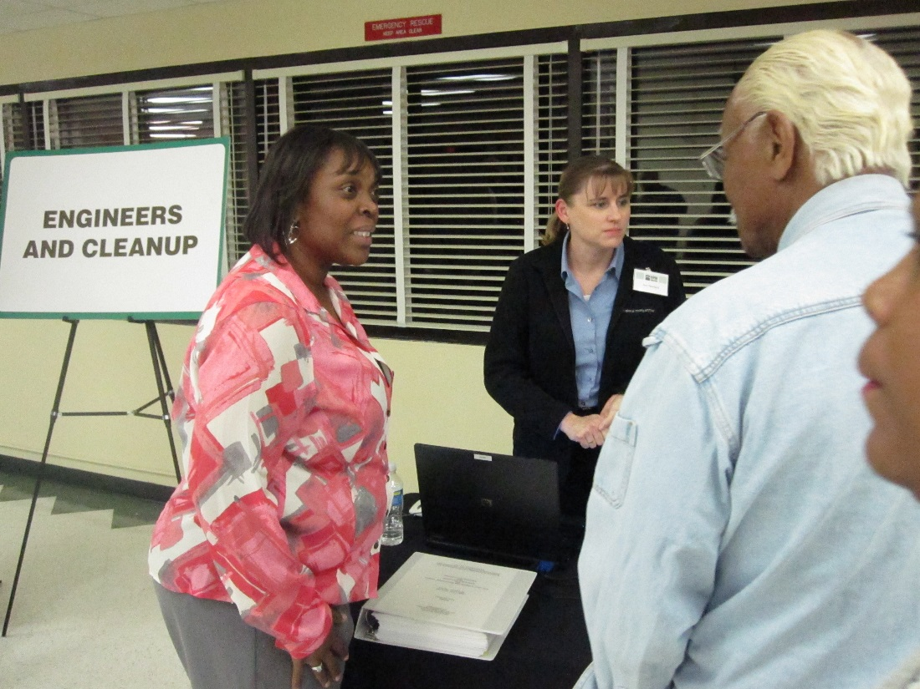
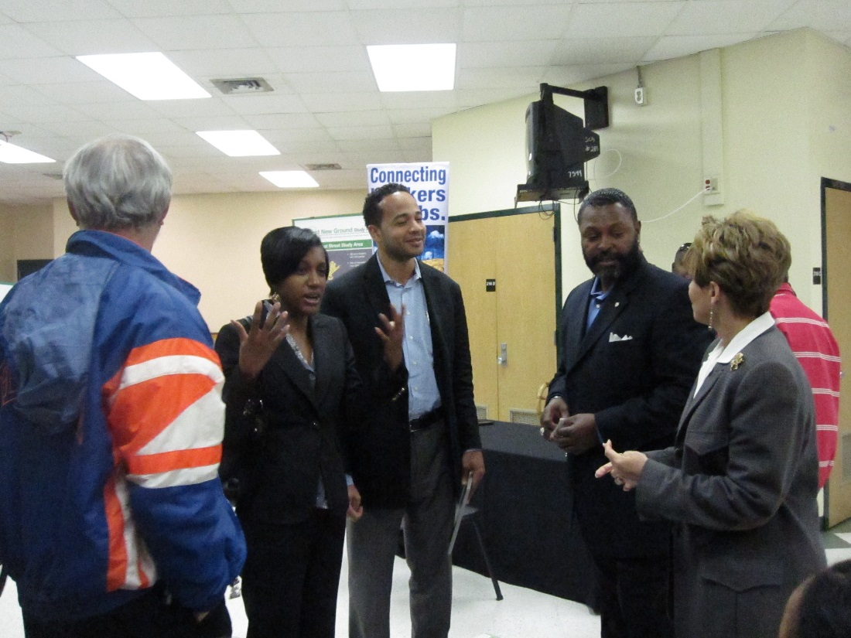

Slide 12
For More Information, Contact:
Tonya Spencer
  EPA Region 4 Community Involvement Coordinator
  (404) 562-8463
  spencer.latonya@epa.gov

