Slide 1
Risk Management and Assessing Liability
Helping Communities Pursue Reuse Opportunities at Contaminated Properties
March 25, 2015

Slide 2
Webinar Overview
Introduction to SRI
Bill Denman, EPA Region 4
Revitalization Handbook – Revitalizing Contaminated Lands: Addressing Liability Concerns
Susan Boushell, EPA OSRE
Ecusta Mill Case Study –Liability Concerns and Reuse Tools
Jennifer Wendel, EPA Region 4
Prepared Workbook – Process for Risk Evaluation, Property Analysis and Reuse Decisions
John Podgurski and Kathleen Castagna, EPA Region 1, Mark Lewis - CT Dept. of Energy and Environment
Resources and Contacts
Bill Denman, EPA Region 4

Slide 3
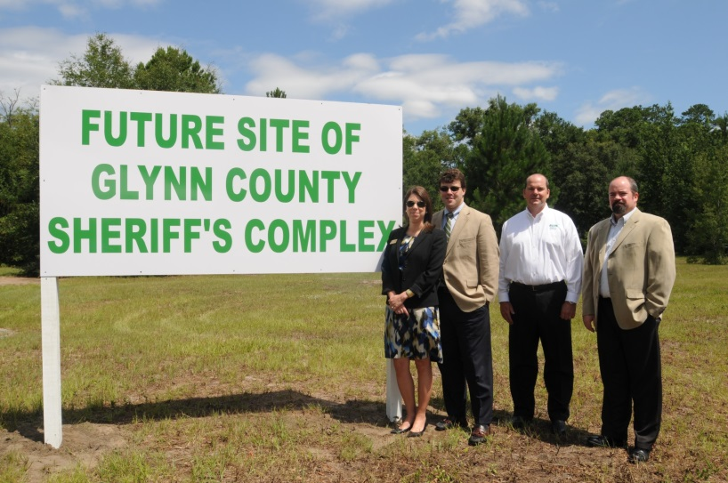
SRI: Superfund Redevelopment Initiative
Working with communities and other partners in considering future use opportunities and integrating appropriate reuse options into the cleanup process

Slide 4
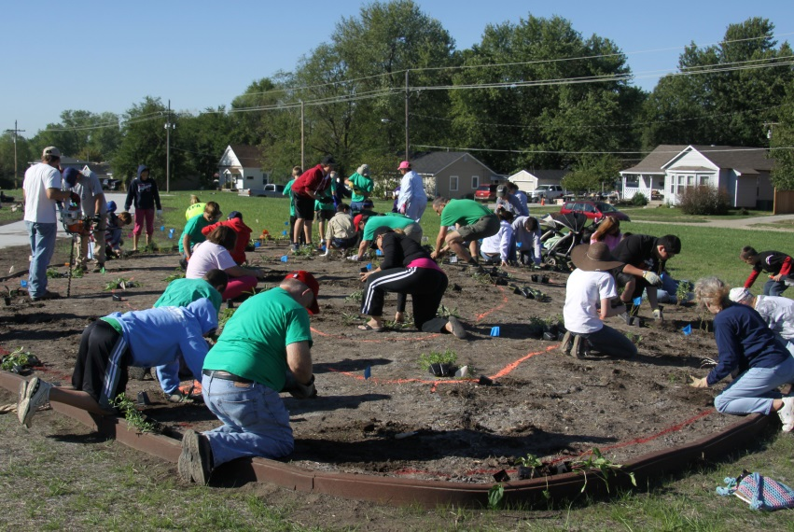
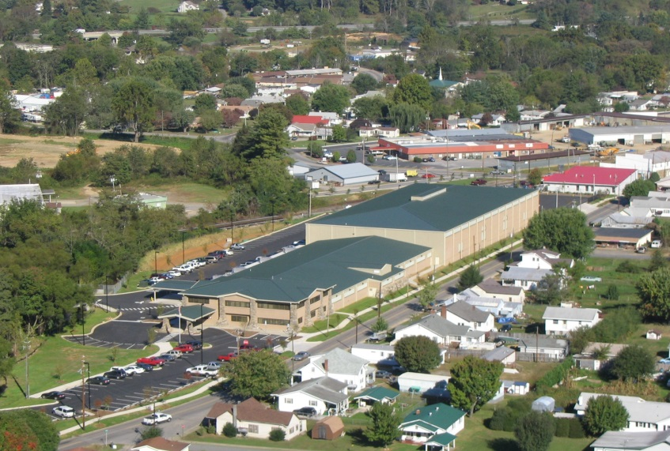
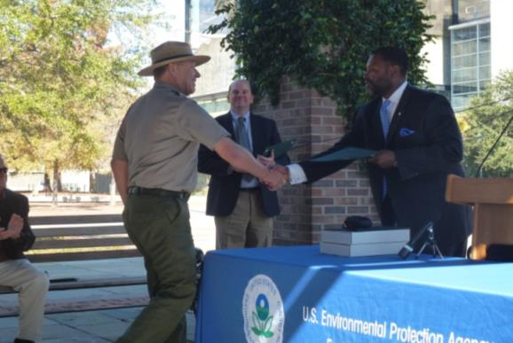
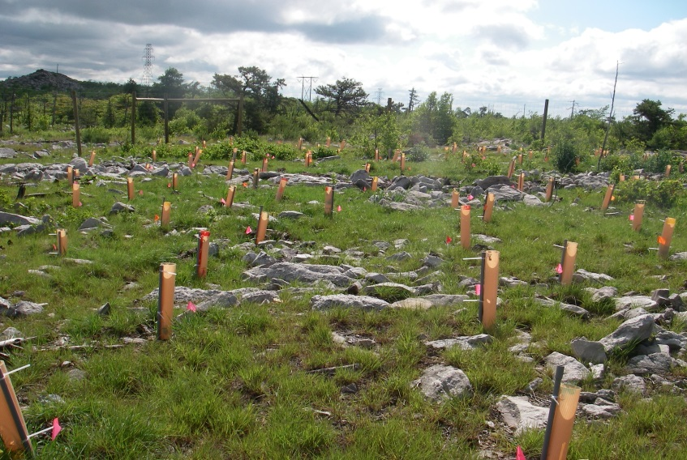
Reuse as a Priority

Slide 5
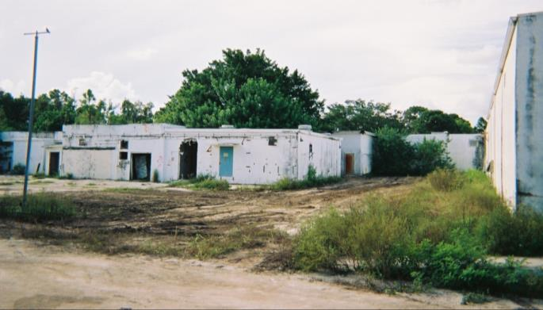
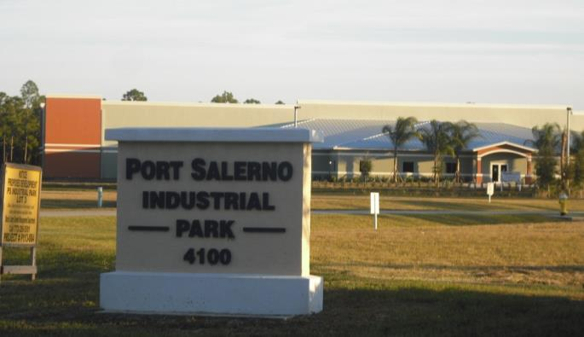
Benefits of Reuse
Economic
Environmental
Social
Protection of human health

Slide 6
Revitalization Handbook and the PREPARED Workbook
EPA's Revitalization Handbook — Revitalizing Contaminated Lands: Addressing Liability Concerns
EPA's Process for Risk Evaluation, Property Analysis and Reuse Decisions (PREPARED) Workbook

