Slide 1
PREPARED Workbook
Kathy Castagna, EPA Region 1
Mark Lewis, CT DEEP
John Podgurski, EPA Region 1
March 25, 2015

Slide 2
Purpose and Overview

Slide 3
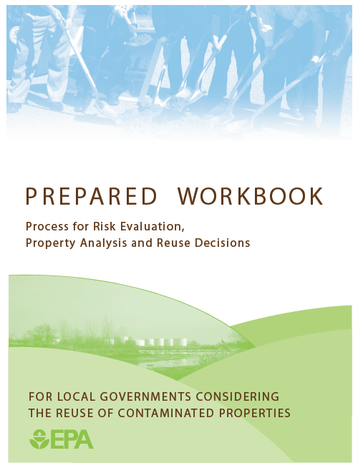
PREPARED
A risk management tool to help cities and towns decide the best approach to brownfield redevelopment
Provides worksheets to guide the process
Use is optional

Slide 4
Why USE It?
Provides a structure for thinking about potential municipal involvement in a reuse project
Improves communication within & outside team (i.e., increases efficiency and effectiveness), including:
Environmental consultants
Legal counsel
Municipal departments
General public
Developers/financial institutions
Documents key considerations and decisions
Promotes clarity and transparency
Builds support for decisions
Brings new- and non-team members up to speed

Slide 5
Risk Management Framework
PREPARED mirrors this decision process
Risk-Based Decisions
identify each risk
evaluate its likelihood and consequences
select an appropriate action to control risks
implement the action to achieve the desired outcome
Typically an iterative process involving the gathering and evaluating of information!!
Select Property Recovery Action
Manage Property Reuse Risks
Establish Goals
Stakeholder Engagement
Assess Property Reuse Risks
Property Reuse Assessment
Identify Property Reuse Obstacles
Pre-Screen Property Recovery Actions
Conduct Due Diligence

Slide 6
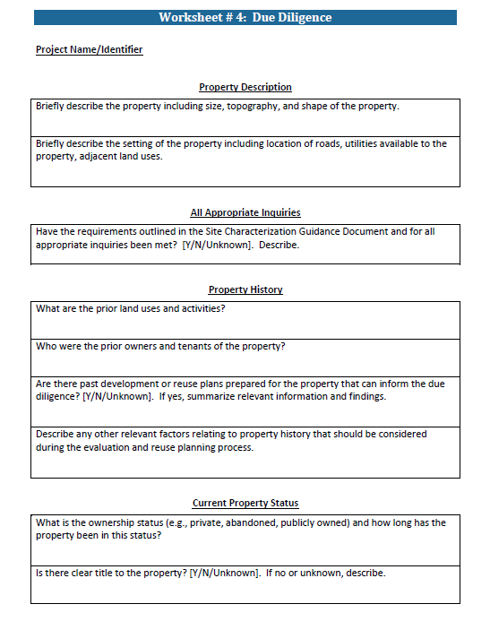
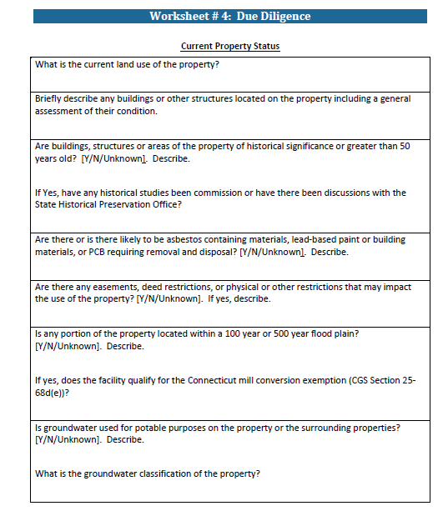
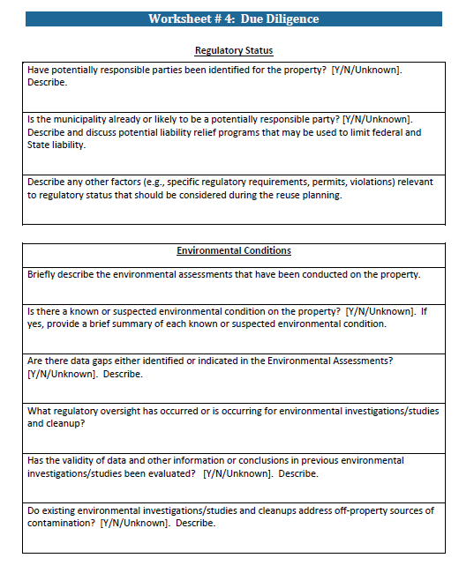
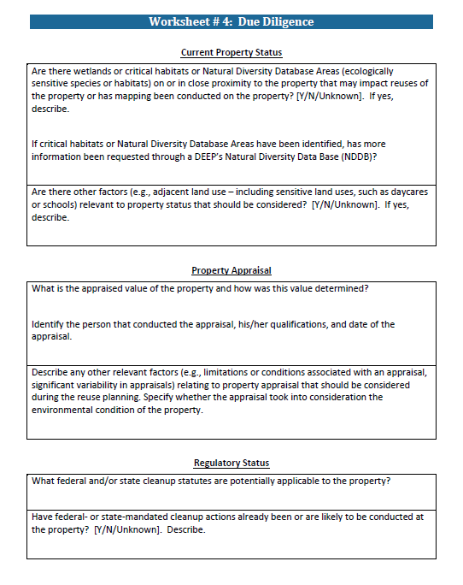
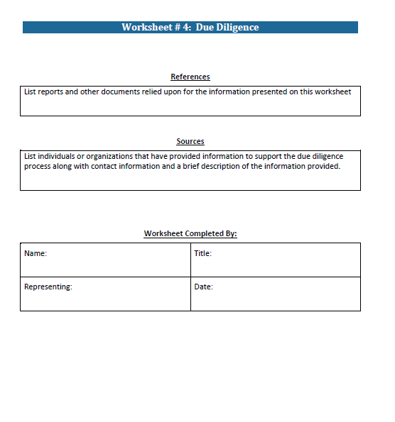
Worksheets
Helps guide and document the process
You don’t have to fill out every one
You don’t have to fill them in completely
Worksheets
1a Stakeholder Information
1 Establish Project Goals
2 Evaluate Potential Property Reuse Options
3 Identify Property Recovery Actions
4 Summarize Due Diligence
5 Identify Obstacles and Risks
6a Financial Analysis, Sources and Uses
6 Options to Manage Risks
7 Project Status
8 Project Summary

Slide 7
Establish Project Goals
“If you don’t know where you’re going any road will get you there”…Lewis Carroll from Alice in Wonderland
Select Property Recovery Action
Goals drive the process
Gain early consensus
Key considerations
what is the desired outcome?
how important is reuse?
how time critical is reuse?
Manage Property Reuse Risks
Establish Goals
Stakeholder Engagement
Assess Property Reuse Risks
Property Reuse Assessment
Identify Property Reuse Obstacles
Pre-Screen Property Recovery Actions
Conduct Due Diligence

Slide 8
Preliminary Reuse Assessment
Obtain information to understand
Status of property
Physical and social opportunities and constraints
Community needs and potential impacts
Market and extent of demand
Potential alternatives for reuse
General cost constraints
Potential for success and level of risk
Select Property Recovery Action
Manage Property Reuse Risks
Establish Goals
Stakeholder Engagement
Assess Property Reuse Risks
Property Reuse Assessment
Identify Property Reuse Obstacles
Pre-Screen Property Recovery Actions
Conduct Due Diligence

Slide 9
Identify Property Recovery Actions
Actions that involve a municipality in the cleanup and reuse of a contaminated property
Each action carries its own set of issues that impact the strategy for managing project risks
Select Property Recovery Action
Manage Property Reuse Risks
Establish Goals
Stakeholder Engagement
Assess Property Reuse Risks
Property Reuse Assessment
More Control
Acquisition and long term ownership
Acquisition and interim ownership
Leasing by municipality
Acquisition and “simultaneous” transfer to a third party
Collaboration with the property owner
Transfer tax liens
Incentives to promote reuse
Less Liability
Identify Property Reuse Obstacles
Pre-Screen Property Recovery Actions
Conduct Due Diligence

Slide 10
Conduct Due Diligence
Essential step in identifying and evaluating project risks
Understand potential impediments to reuse
presence of hazardous substances on the property
reuse obstacles and potential sources of project risk
May protect against potential environmental liability
all appropriate inquiry is required for some types of liability protection under CERCLA
Select Property Recovery Action
Manage Property Reuse Risks
Establish Goals
Stakeholder Engagement
Assess Property Reuse Risks
Property Reuse Assessment
Identify Property Reuse Obstacles
Pre-Screen Property Recovery Actions
Conduct Due Diligence

Slide 11
Identify Property Reuse Obstacles
Anything that would affect the decision to redevelop a property
economic limitations
legal challenges
regulatory hurdles
community concerns
development issues
management considerations
Utilizes information obtained through the due diligence process
Process of identifying is iterative
Prioritize based on how it impacts the project goals
Select Property Recovery Action
Manage Property Reuse Risks
Establish Goals
Stakeholder Engagement
Assess Property Reuse Risks
Property Reuse Assessment
Identify Property Reuse Obstacles
Pre-Screen Property Recovery Actions
Conduct Due Diligence

Slide 12
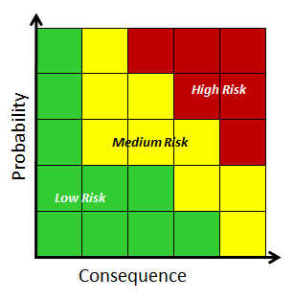
Assess Property Reuse Risks
Obstacles generally are associated with a risk
Risk refers to the probability that an adverse event will occur and the consequences of that adverse event
legal
financial
community issues & acceptance
Select Property Recovery Action
Manage Property Reuse Risks
Establish Goals
Stakeholder Engagement
Assess Property Reuse Risks
Property Reuse Assessment
Identify Property Reuse Obstacles
Pre-Screen Property Recovery Actions
Conduct Due Diligence

Slide 13
Identify Risk Management Options
Risk can’t always be eliminated — only managed
Reduce the probability and impact of a risk
Risk mgt. creates opportunities
avoid
reduce
transfer
share
accept
Select Property Recovery Action
Manage Property Reuse Risks
Establish Goals
Stakeholder Engagement
Assess Property Reuse Risks
Property Reuse Assessment
Identify Property Reuse Obstacles
Pre-Screen Property Recovery Actions
Probability
Risk Management
Conduct Due Diligence
Consequence

Slide 14
Resolving Data Gaps
Select Property Recovery Action
Manage Property Reuse Risks
Establish Goals
Stakeholder Engagement
Uncertainty drives risk
How much information is enough?
Resolve Data Gaps
Assess Property Reuse Risks
Property Reuse Assessment
Identify Property Reuse Obstacles
Pre-Screen Property Recovery Actions
Conduct Due Diligence

Slide 15
Select a Property Recovery Action
Would you move forward with this site?
have obstacles been (or can be) identified?
have risks been (or can be) resolved?
are the necessary resources available?
is the project financially viable and realistic?
is additional information needed?
What alternative (property recovery action) would you select?
Select Property Recovery Action
Manage Property Reuse Risks
Establish Goals
Stakeholder Engagement
Assess Property Reuse Risks
Property Reuse Assessment
Identify Property Reuse Obstacles
Pre-Screen Property Recovery Actions
Conduct Due Diligence

Slide 16
PREPARED: The Next Generation
The Connecticut DEEP PREPARED Municipal Website Interface

Slide 17
CT DEEP Web-Enabled PREPARED Workbook
PREPARED Workbook
Currently only available on EPA Region 1 webpage as a downloadable document
Not state-specific
Connecticut is the first state to web-enable the PREPARED Workbook (Joint CT DEEP/ EPA Region 1 Project)
Improves PREPARED access and usability
Is state-specific- links to Connecticut information & programs
Not a CT DEEP or EPA requirement
Planned launch in April
Check DEEP website- www.ct.gov/deep for rollout announcement
Hopefully a model for other states

Slide 18
Questions/COMMENTS?
Kathy Castagna
Brownfields Project Officer
U.S. EPA Region 1
(617) 918-1429
castagna.kathy@epa.gov
Mark Lewis
Brownfields Coordinator
CT Dept. of Energy and Environment (860) 424-3768
mark.lewis@ct.gov
John Podgurski
Chief, Brownfields Section
U.S. EPA Region 1
(617) 918-1429
podgurski.john@epa.gov
Accessing PREPARED
EPA Region 1Webpage: www.epa.gov/region1/brownfields/prepared
CT DEEP Webpage: Launching soon on www.ct.gov/deep/remediation

