Slide 1
Industri-Plex Superfund Site – SRI Case Study
Joseph LeMay
EPA Region 1

Slide 2
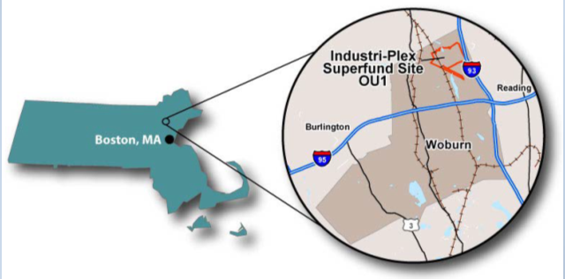
Industri-Plex Superfund Site –
SRI Case Study
Unique setting of original 245-acre site approximately 10 miles north of Boston, Massachusetts
Adjacent Interstate 95 and Interstate 93 highways
Adjacent rail/commuter rail service to Boston
Location, Location, Location

Slide 3
Industri-Plex Superfund Site –
SRI Case Study
Over 110 years of chemical and glue manufacturing (1853- 1969)
Development in 1970s and early 1980s disturbed animal hide piles causing obnoxious “rotten egg” odors released to atmosphere (known at the time as the “Woburn Odor”)
Rotten egg odors from hydrogen sulfide spread across multiple towns, causing many lawsuits and leading to Superfund site listing in 1983
Area known as “Moon Scape” with its barren appearance from 1960s-80s
1993 – Former Manufacturing Area
1988 – Arsenic Pit Area
1988 – East Hide Pile
1988 – Waste Ore Pile

Slide 4
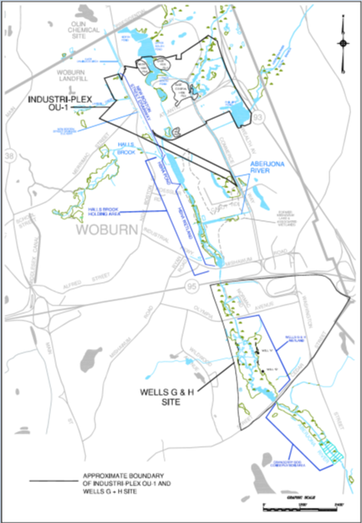
Industri-Plex Superfund Site –
SRI Case Study
Soil/Sediment Contaminants: Metals such as Arsenic, Lead and Chromium
Groundwater Contaminants: Arsenic, Ammonia, Benzene, Toluene and other VOCs
Four Animal Hide Piles
Aberjona River flows through the site
Wells G&H Superfund site approximately 1 mile downstream. The 2 sites are hydraulically connected by the Aberjona River.
Engaged community and municipality

Slide 5
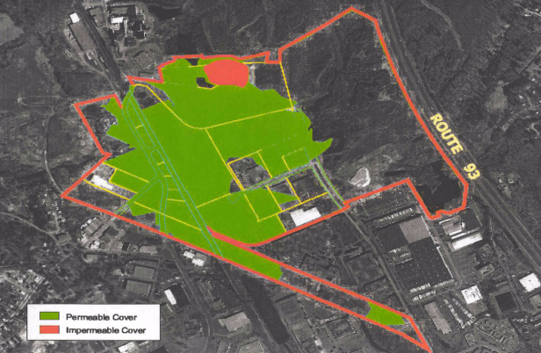
Remedy – 1986 Record of Decision (ROD) https://semspub.epa.gov/src/document/01/14846.pdf
Soil/Sediment Remedy: Permeable cap/cover over 100 acres to prevent contact with contaminated soils and sediments
  Engineered Cover (e.g. typically 16” fill with geotextile and grass, rip rap, pavement, etc.)
  Equivalent Cover (e.g. existing concrete floors/foundations, existing paved roads, existing paved parking lots)
Air Remedy: Impermeable cap & gas collection treatment system to prevent release of odors to the atmosphere
Institutional Controls

Slide 6
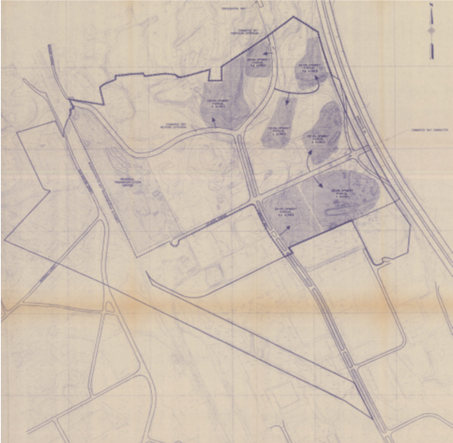
Unique Aspects to Remedy/Consent Decree
Developer (MPT) donated land to satisfy liability
1989 Consent Decree (CD) settlement included former chemical and glue manufacturing companies, property owners and municipality; CD incorporated sale of donated land
Consent Decree created two Trusts:
  “Remedial Trust” to fund the cleanup
  “Custodial Trust” (e.g. Real Estate Trust):
    Hold, manage and sell MPT land
    Record/comply with institutional controls
    Provide access and where appropriate subdivide MPT properties
    Locate purchasers, negotiate, sell and convey property
    Distribute sale proceeds to beneficiaries (net any reasonable Custodial Trust costs)
    Unsellable land into long-term trust
1989 CD: https://semspub.epa.gov/src/document/01/44323.pdf
1992 100% RD Figure 18-1: Site Potential Development Plan

Slide 7
Unique Aspects to Remedy/Consent Decree
Consent Decree forged partnerships among key stakeholders including Custodial Trust, Remedial Trust/Settlers, municipality, and EPA/State through MPT property sales distributions (table below)
Custodial Trust maintained steadfast reuse vision (e.g. improving infrastructure and access to enhance attraction/value), and attracted and led negotiations with state transportation agencies and high end users:
  Public infrastructure improvements: i. multi-modal transportation center; ii. I-93 interchange; and iii. Commerce Way Extension (City of Woburn)
  Private investments: i. Dayton Hudson (Target Stores); and ii. National Development (Raytheon, Residence Inn - Marriott, Boston Sports Club, etc.)
  Aid with securing public grants for infrastructure improvements (e.g. Commerce Way Extension)
Custodial Trust coordinated with Remedial Trust and EPA/State regarding challenging issues (e.g. loan approval from Remedial Trust for funding preliminary interchange design, sales price, etc.,). State Transportation gained legislative approval for $20 Million bond to build transportation center
Custodial Trust distribution of sale proceeds in accordance with Consent Decree:
Custodial Trust sells properties for over $16 million
< $8 Million* | $8 - $10 Million* | > 10 Million
11% EPA | 50% EPA | 70% EPA
Remainder to Settlers | 50% Settlers | 30% Settlers

Slide 8
Industri-Plex Superfund Site –
SRI Case Study
EPA:
  Safely incorporate cleanup and reuse
  Superfund liability concerns with prospective purchasers/developers. EPA resolved with Prospective Purchaser Agreements (PPAs) between 1995-2000 including State transportation agencies, Dayton Hudson and MetroNorth
  Assist with resolving disputes (e.g. property owner impacting remedy action);
  Flexibility with remedy design (e.g. incorporated “Alternative Cap” design into the remedy for transportation center) and adjusted schedules to accommodate property sales/reuse.
    1996 PPA State Agencies: https://sems.epa.gov/src/document/1494519346219/01-246409.pdf
    1997 PPA Dayton Hudson – Parcel A: https://sems.epa.gov/src/document/1494519346219/01-246410.pdf
    1999 PPA MetroNorth – Parcel B: https://sems.epa.gov/src/document/1494519346219/01-246405.pdf
January 11, 2002 Brownfield Bill Revitalization Act:
  Exempts qualified bona fide prospective purchasers (BFPP) from owner/operator liability so long as the person does not impede the performance of a response action or natural resource restoration
  No longer need to negotiate a PPA with EPA and the federal government. In lieu of PPA, the purchaser can meet requirements to become a BFPP.
    Brownfield Bill Amendment: https://www.epa.gov/brownfields/brownfields-laws-and-regulations
    EPA Superfund Redevelopment Initiative Tools: https://www.epa.gov/superfund-redevelopment-initiative/superfund-redevelopment-policy-guidance-and-resources

Slide 9
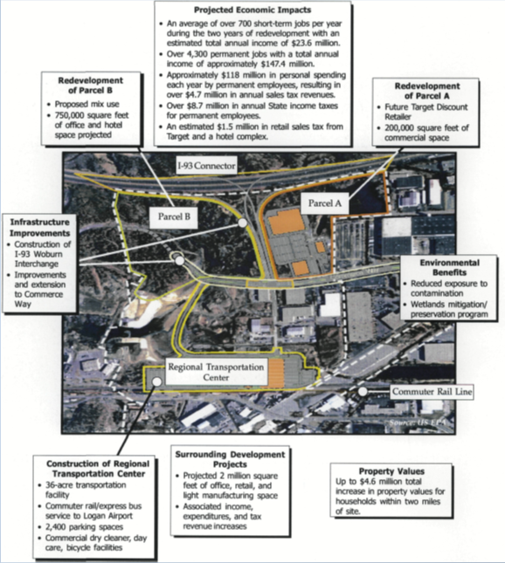
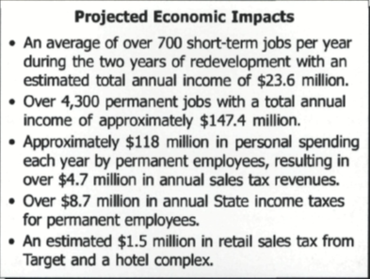
Industri-Plex Superfund Site –
SRI Case Study
Municipality:
  Supports reuse vision and improved future tax roles
  Facilitated any zoning changes
  Extended road through Site to improve infrastructure/access
Remedial Trust:
  Supports reuse vision, increasing land value and offsetting cleanup costs
  Approved loans to the Custodial Trust and were reimbursed with property sales distribution

Slide 10
Unique Aspects to Remedy/Consent Decree
Settlement includes existing landowners who can not disturb their properties unless in accordance with the institutional controls or approved by EPA and State
Institutional controls (ICs)
  "To preserve the continued effectiveness of the remedial actions in order to protect human health and the environment.”
  "To permit the greatest possible use and enjoyment of the Site.”
  In 1995-96, EPA & State led development of IC outline with Remedial Trust, Custodial Trust, and landowners
  EPA & State allow interim institutional controls to be placed on properties transferred for redevelopment
  In 2005, EPA & State release IC design;
  In 2017, Remedial Trust finalize model National Activity & Use Limitation (NAUL) for remaining properties.
2005 IC Design: https://semspub.epa.gov/src/document/01/236969.pdf
  Recorded IC for 112 Commerce Way: https://semspub.epa.gov/src/document/01/457950.pdf
  Recorded IC for 30 Atlantic Avenue: https://semspub.epa.gov/src/document/01/485966.pdf
  Recorded IC for 211 New Boston Street: http://semspub.epa.gov/src/document/01/596262

Slide 11
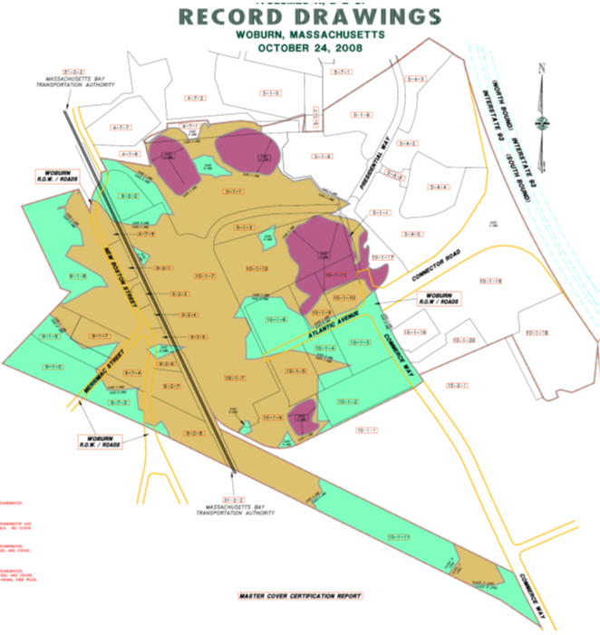
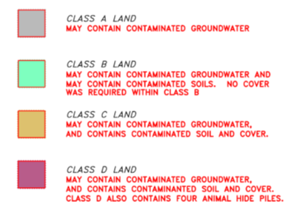
INNOVATIVE - Institutional Controls
Identifies restricted and permitted uses/activities by class of land [A to D Land (least to most restrictive)];
Regulates “How to” disturb/modify cap (Appendix IV/Exhibit I “Work Protocols”):
  LO (or contractor/developer with LO permission) hires “independent professional” (IP) to ensure intrusive work is consistent with IC
  IP prepares work plans, health & safety plans, and completion reports depending on the class of land
  Gov’t approves plans and completion reports for Class C and D intrusive work contacting contaminated media
  If reuse modifies the existing cap, then IP prepares as-built plans
  Where appropriate, the IC may be modified with gov’t approval.
If no recorded IC, then gov’t required LO to follow above IC approach (since 1996) in accordance with CD
Municipality incorporates IC land restriction boundaries on GIS

Slide 12
INNOVATIVE - Institutional Controls
Landowner Obligations:
Annual inspections and inspection reports
Normal maintenance of cap/cover
Notification of remedy failure (within 24 hours; submit work plan to repair within 21 days)
Notification of other violations
Permit and approval related notifications:
  When requesting permit, provide the local, state or federal authority a copy of the IC/restrictions
  Provide EPA and State a copy of any building permit application
Emergency Excavations (e.g. responding to emergency utility repair, fire, flood):
Temporarily suspend IC restrictions:
  Verbal notification < 2 hours, and written notification within 5 days
  Limits disturbance and risk to public and environment
  Manages/disposes excavated/extracted soils, sediments and water
  Reinstates the cap
  Submits emergency excavation report within 30 days

Slide 13
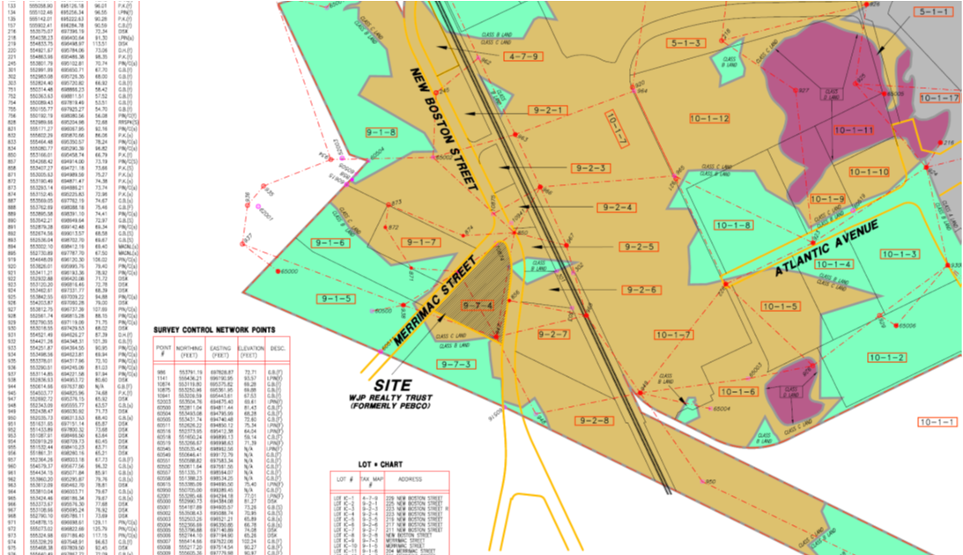
Link to cover certification reports: https://semspub.epa.gov/src/document/01/295879.pdf

Slide 14
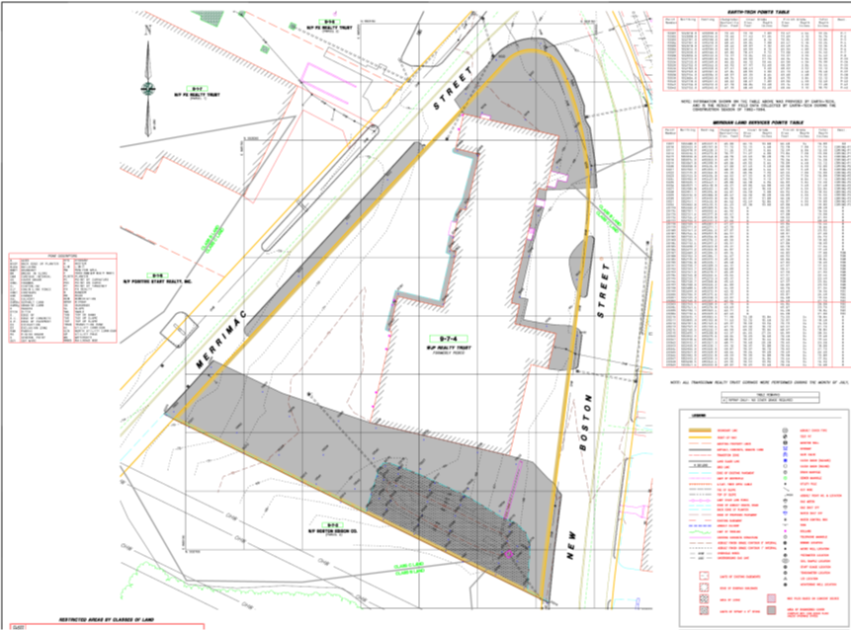
Link to cover certification reports: https://semspub.epa.gov/src/document/01/295879.pdf

Slide 15
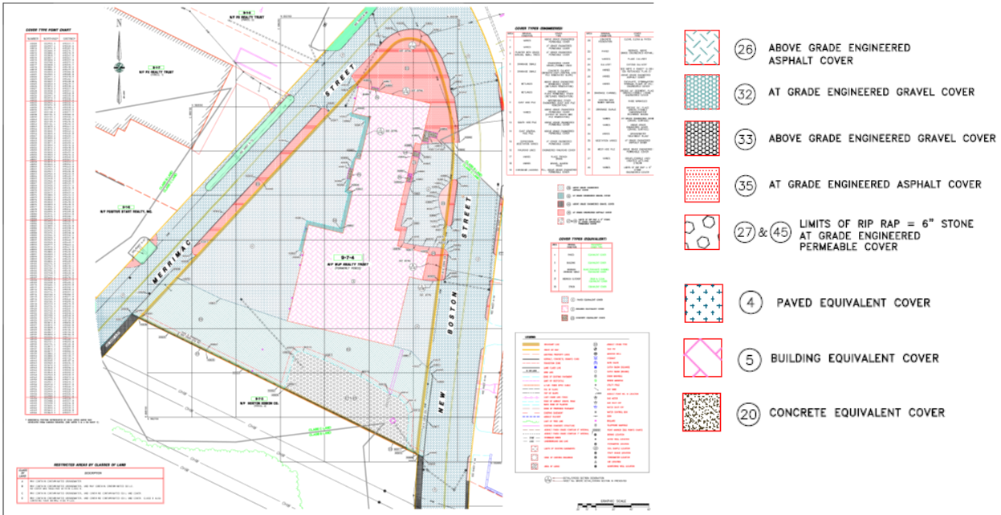
Link to cover certification reports: https://semspub.epa.gov/src/document/01/295879.pdf

Slide 16
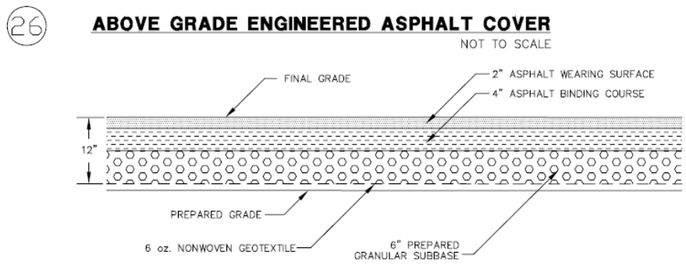
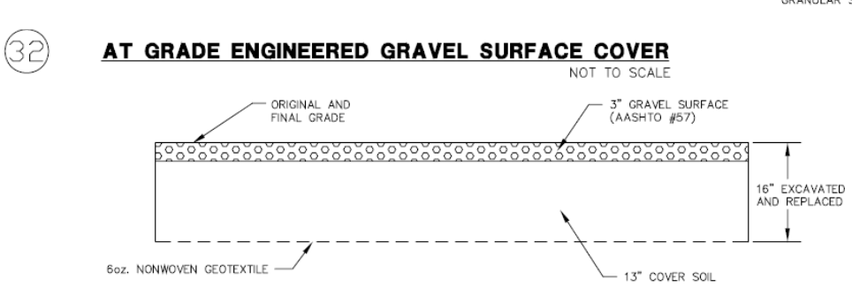
Link cover certification reports: https://semspub.epa.gov/src/document/01/295879.pdf

Slide 17
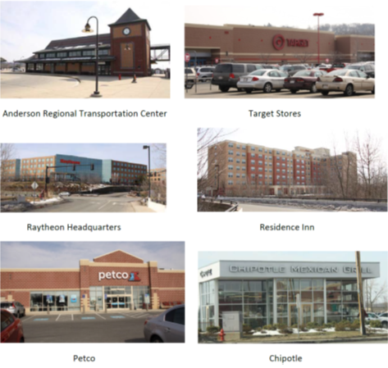
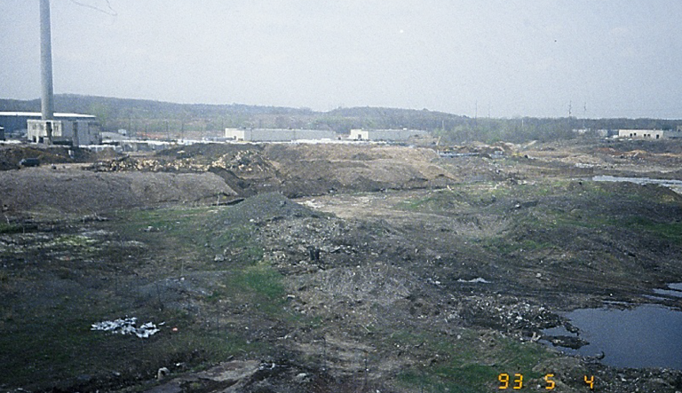
Industri-Plex TRANSFORMATION
Woburn is a Thriving Economic Success Story
Industri-Plex Before
After

Slide 18
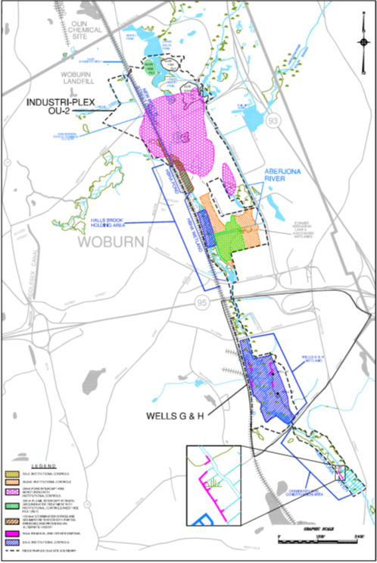
Industri-Plex Superfund Site
OU2
Final groundwater solution addressing arsenic, ammonia, benzene, etc.
OU2 remedy also addresses residual arsenic that historically migrated downstream via dredging, restoration and IC
IC will apply similar OU1 approach including the preparation of work plans, health & safety plans, and completion reports depending on land use restrictions.
Through wetland/floodplain mitigation, incorporated passive recreational reuse into the remedy

Slide 19
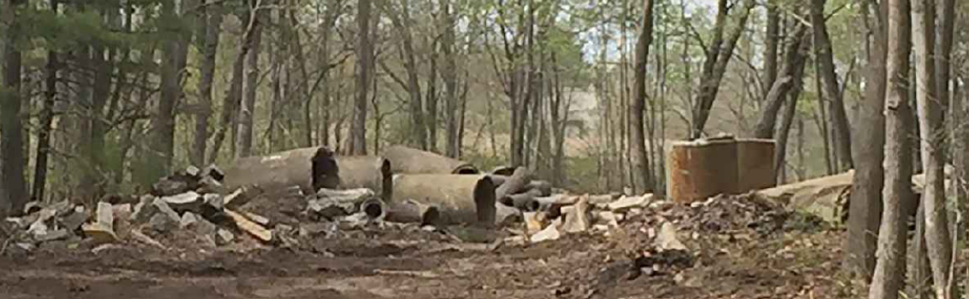
Mitigation: Rifle Range Road, Woburn, MA
1-acre Floodplain Enhancement & Creation of Aberjona Nature Trail
Before: Debris filled floodplain

Slide 20
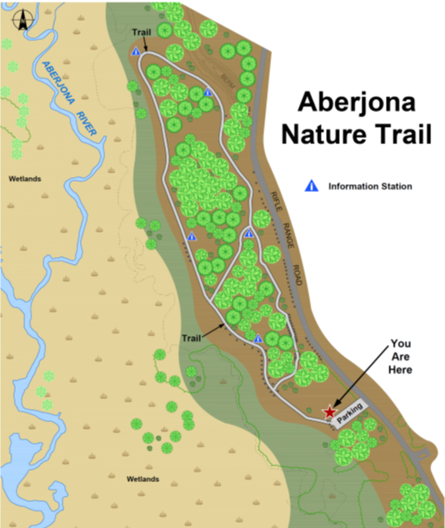
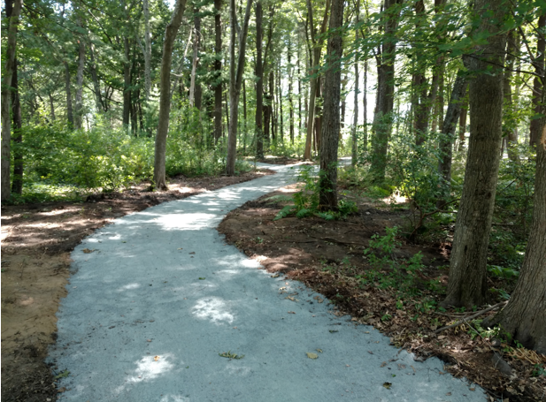
Mitigation: Rifle Range Road, Woburn, MA
1-acre Floodplain Enhancement & Creation of Aberjona Nature Trail
After

Slide 21
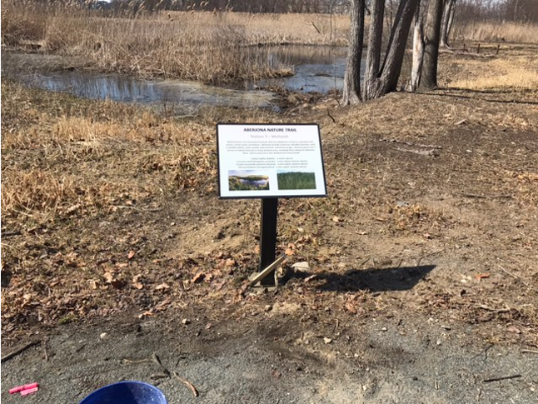
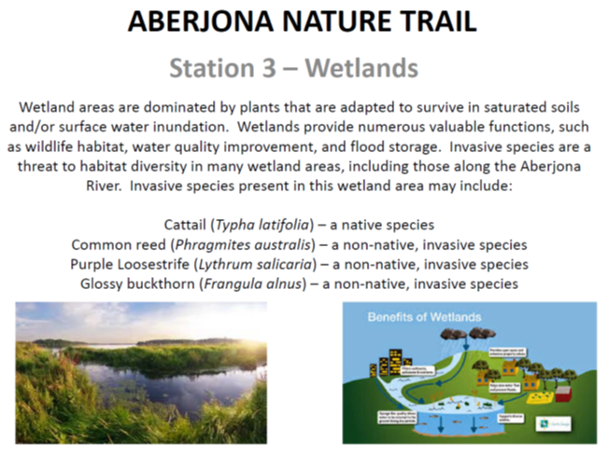
Mitigation: Rifle Range Road, Woburn, MA
1-acre Floodplain Enhancement & Creation of Aberjona Nature Trail
1 of 5 educational wetland stations along the trail
EPA Region 1 – Superfund Works for Communities:
https://semspub.epa.gov/src/document/HQ/100000071.pdf

Slide 22
Contact Information:
Joseph LeMay, P.E.
US EPA Region 1, Five PO Square, mailcode: OSRR 07-4, Boston, MA 02109
telephone # (617) 918-1323
email: lemay.joe@epa.gov

