Slide 1
Hercules 009 Landfill Superfund Site
Scott Martin

Slide 2
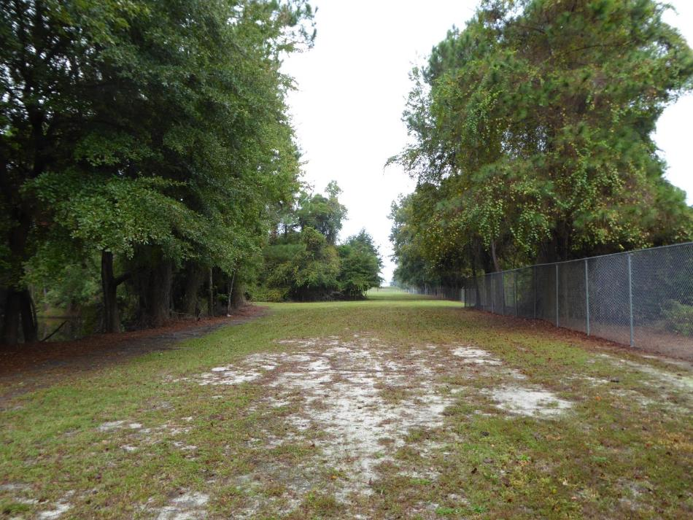
Presentation Overview
Site History
Site Cleanup
Reuse Planning
Reuse Outcomes
Lessons Learned

Slide 3
Site History

Slide 4
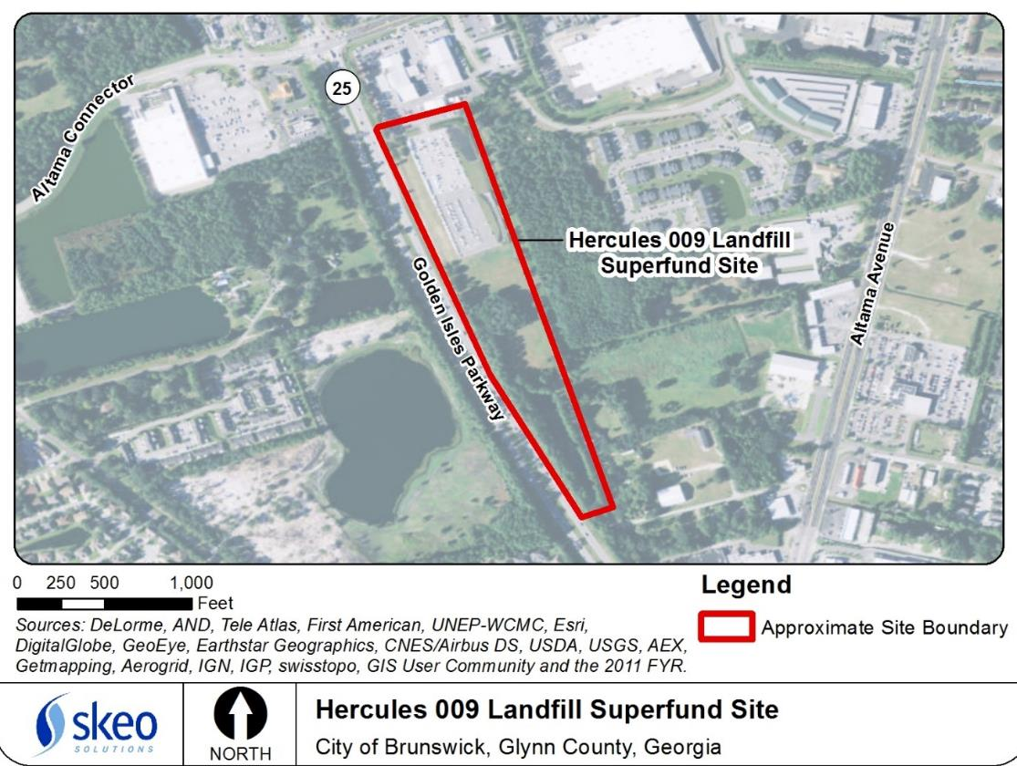
Site History

Slide 5
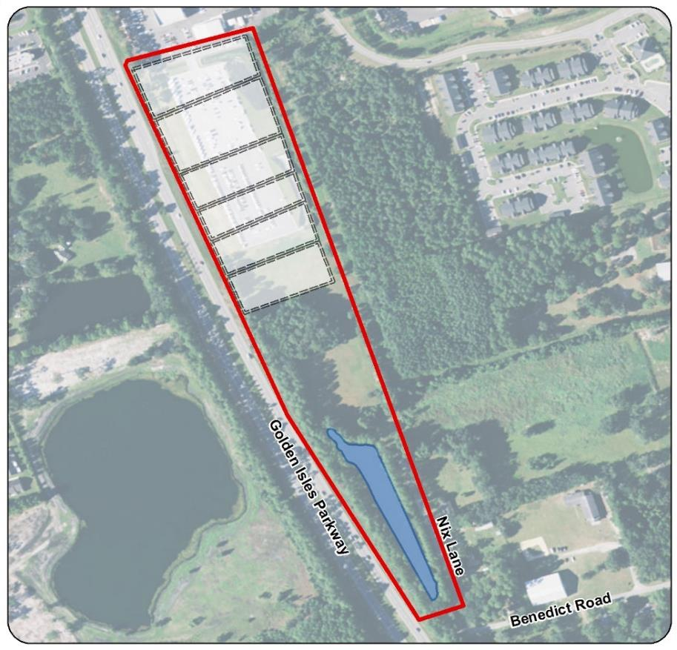
Site Cleanup

Slide 6
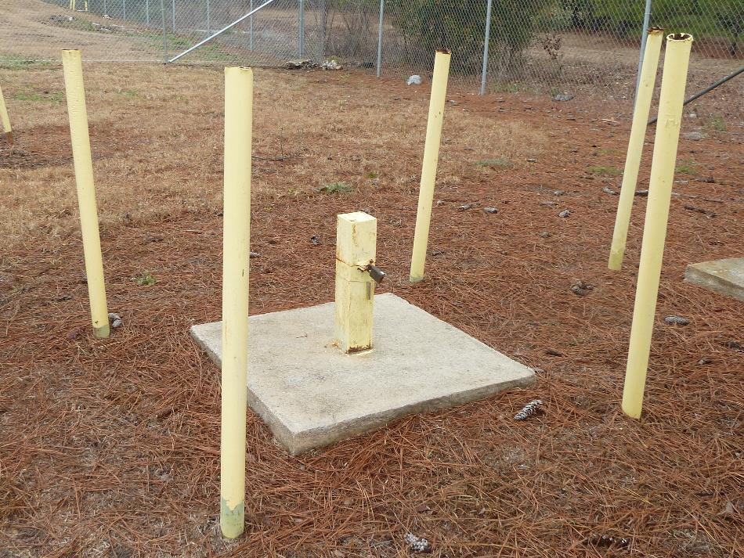
Site Cleanup

Slide 7
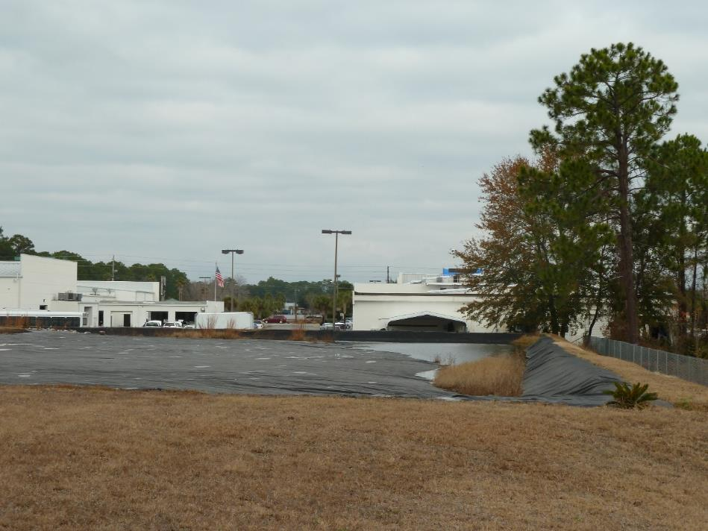
Site Reuse Planning
Modifying the cap for reuse

Slide 8
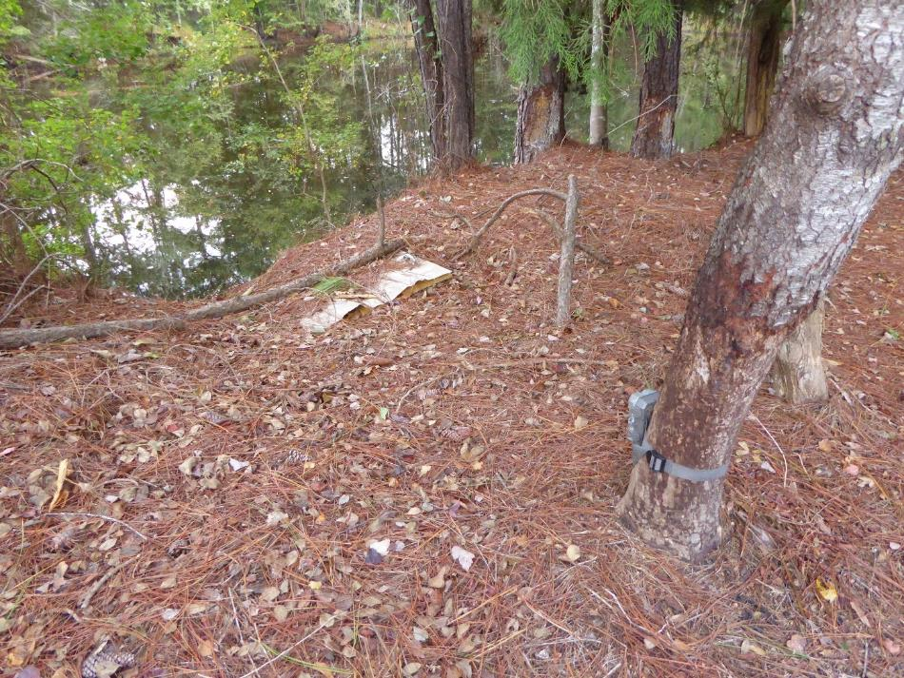
Reuse Outcomes
Southern Site Pond
Partnerships

Slide 9
Reuse Outcomes

Slide 10
Reuse Outcomes

Slide 11
Reuse Outcomes

Slide 12
Reuse Outcomes

Slide 13
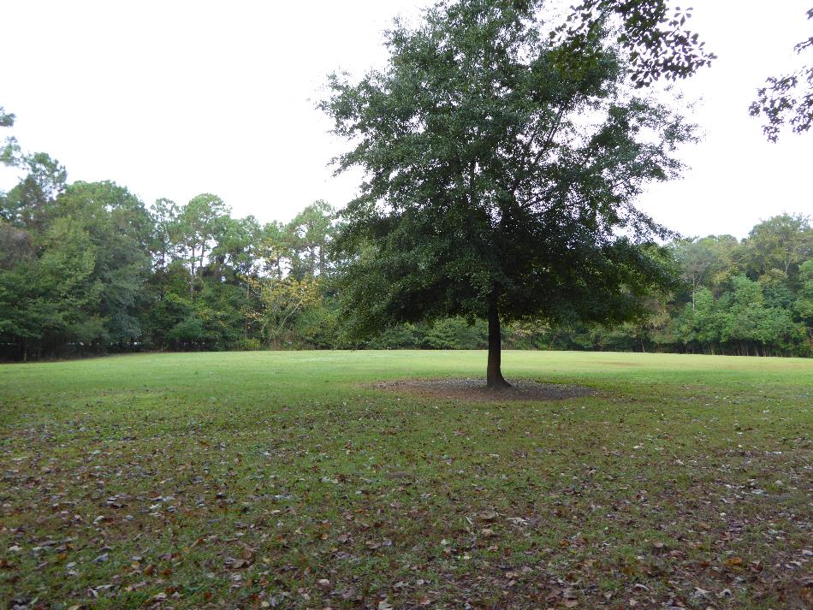
Lessons Learned
Work with stakeholders to consider reuse early in the cleanup process
Reuse can enhance the remedy
Never too late for reuse

Slide 14
Contact Information
Scott Martin
martin.scott@epa.gov
(404) 562-8916

