Slide 1
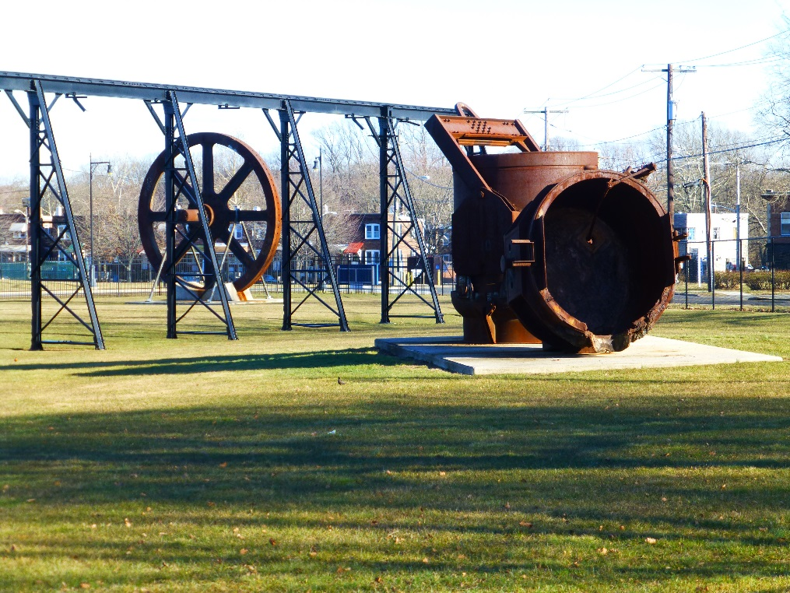
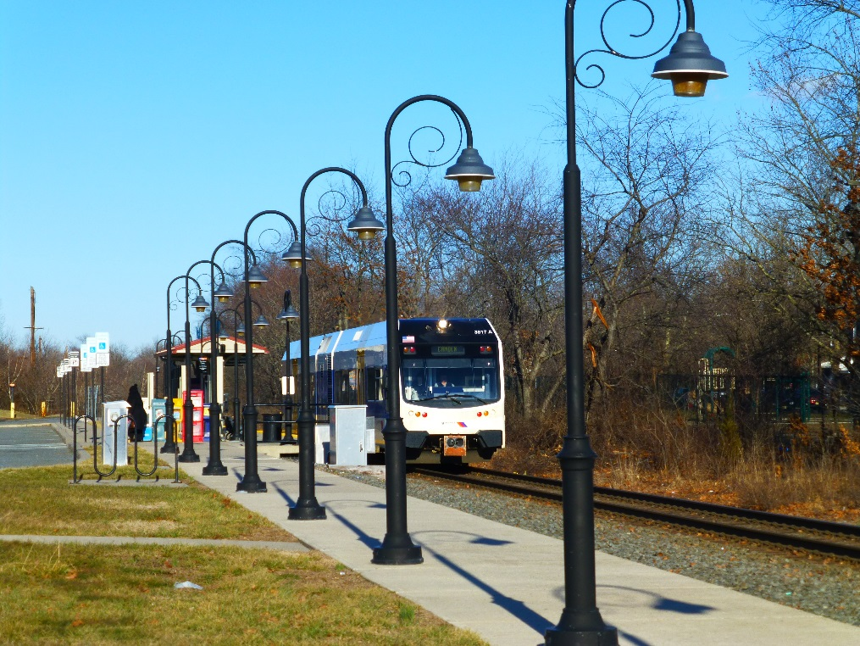
Reuse at the Roebling Steel Co. Superfund Site
Gloria Sosa, Region 2 Superfund Redevelopment Coordinator

Slide 2
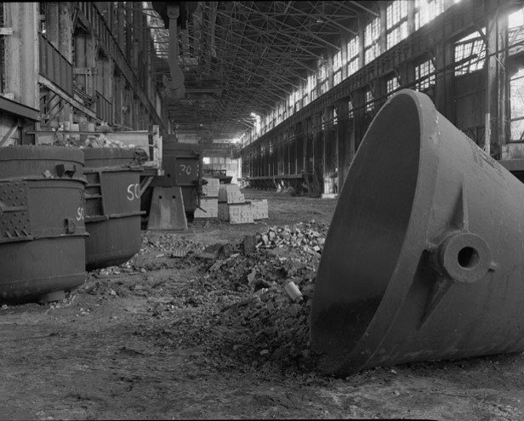
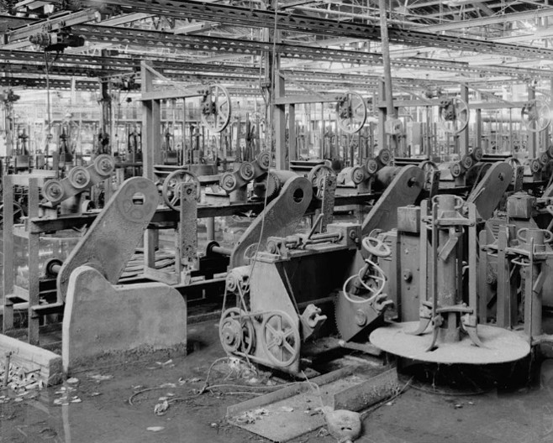
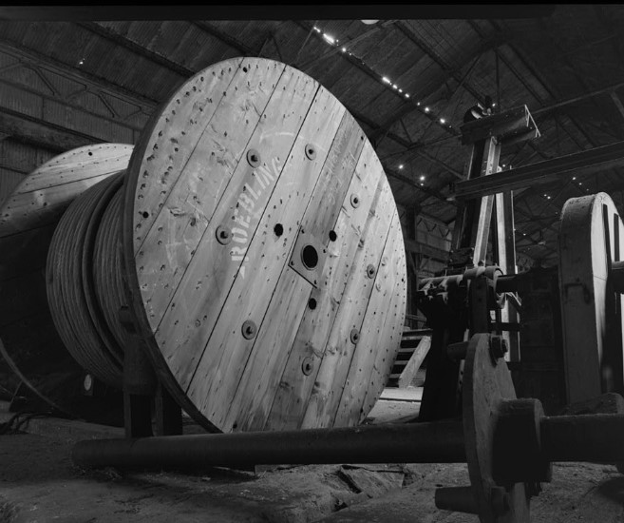
Site Location and History
Florence Township, New Jersey
Site operations: 1906-1982
Site produced wire rope and steel
National Priorities List (NPL) listing: September 1983
Historical site photos from the Library of Congress after facility operations had ceased.

Slide 3
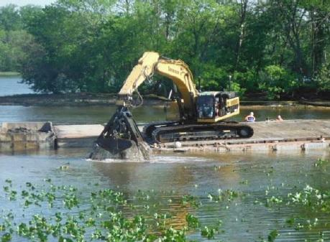
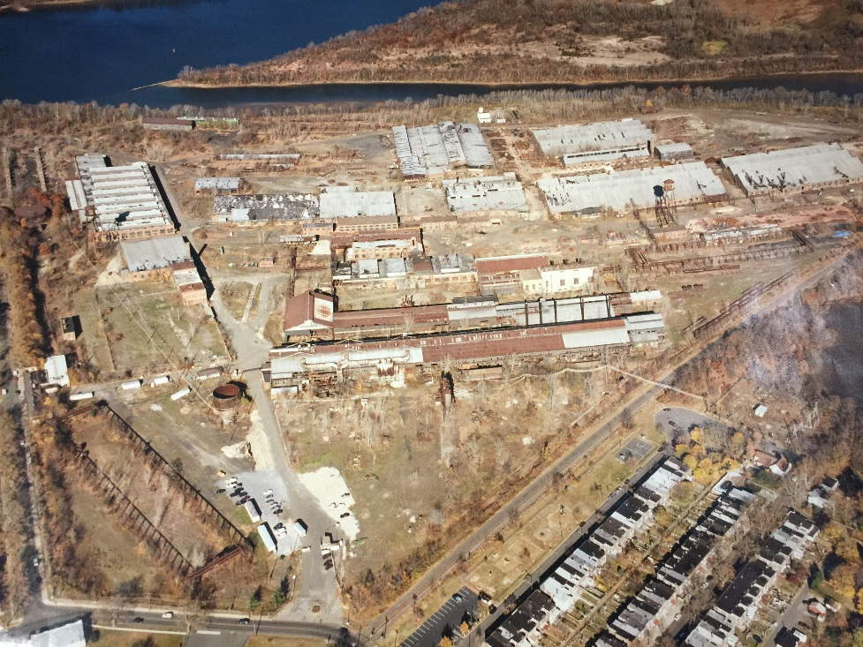
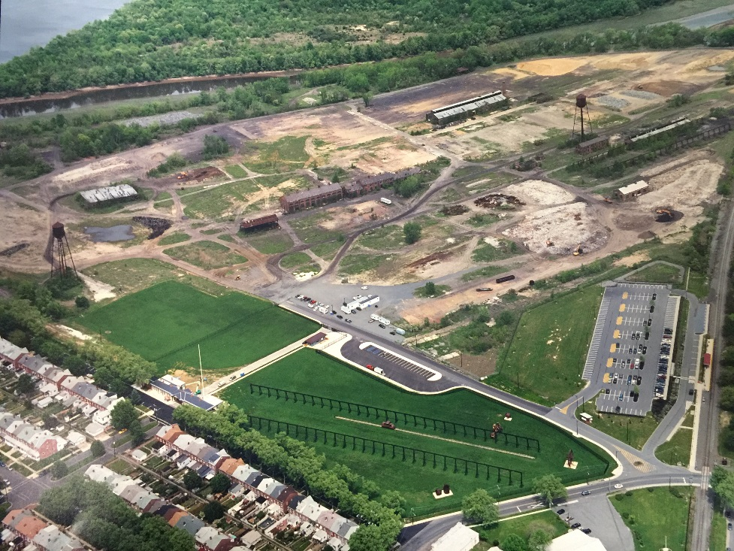
Site Cleanup
EPA site investigations
Initial removal actions
Five Operable Units (OUs)
Cleanup began in 1987 and is still ongoing
Dredging activities at OU5 during cleanup.
Aerial views of the Site, before cleanup (left, dated 1991) and after cleanup (right, dated 2009).

Slide 4
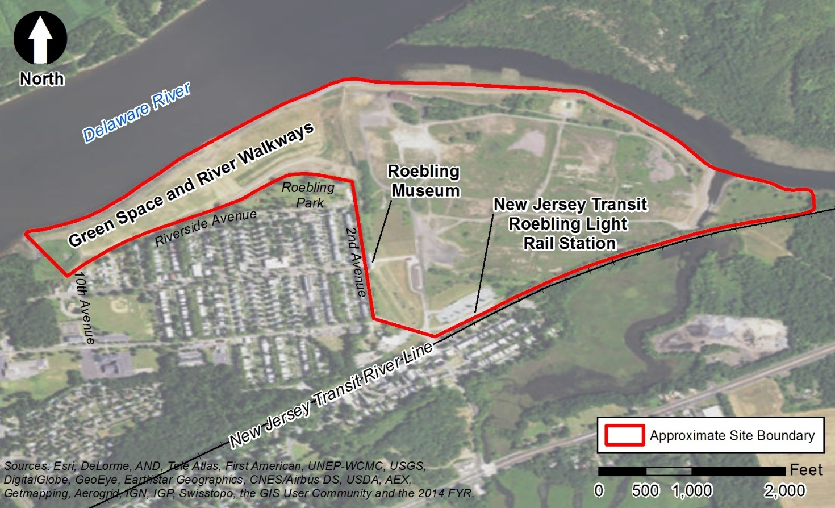
Site Reuse Planning Process
Reuse assessment identified community needs and priorities
Early discussions among the community, site owner, the Township and EPA
EPA coordination with New Jersey Transit
Today, three different reuse projects on site: Roebling Museum, Rail Station and the Roebling Park extension
Site boundary and location of different reuse projects onsite.

Slide 5
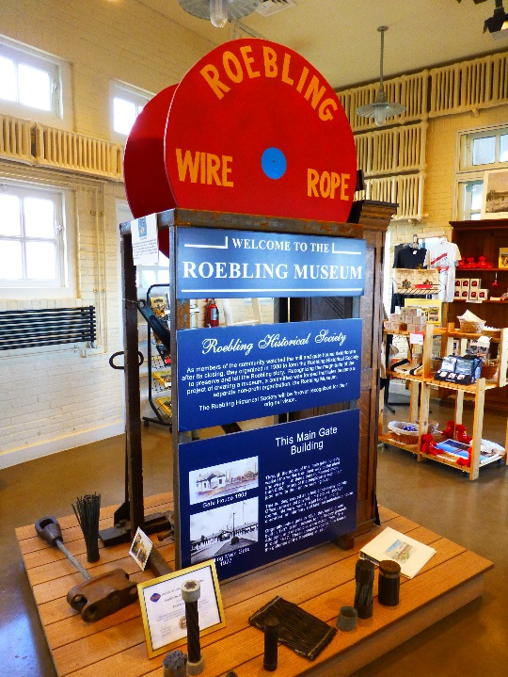
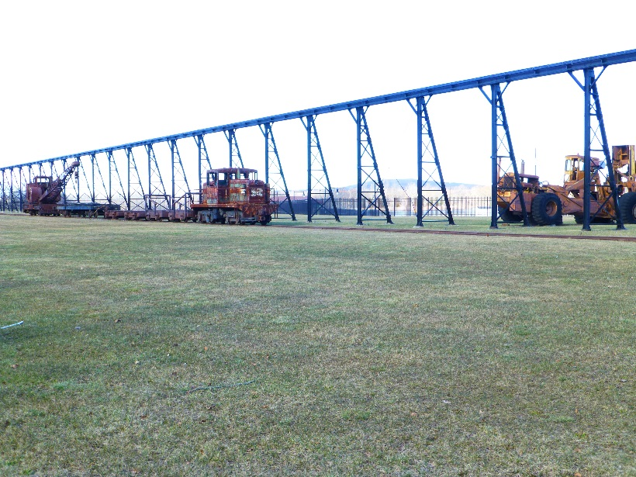
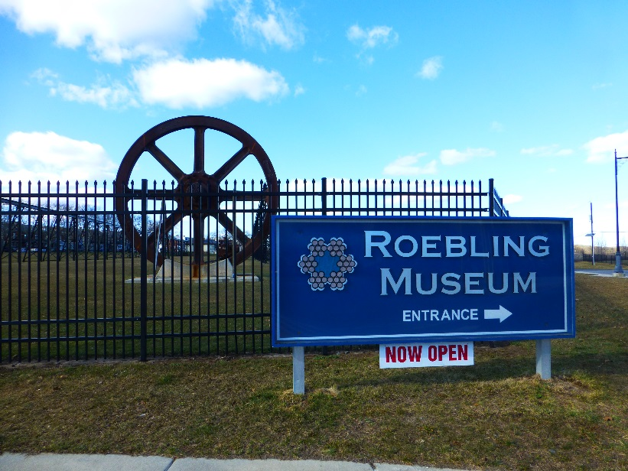
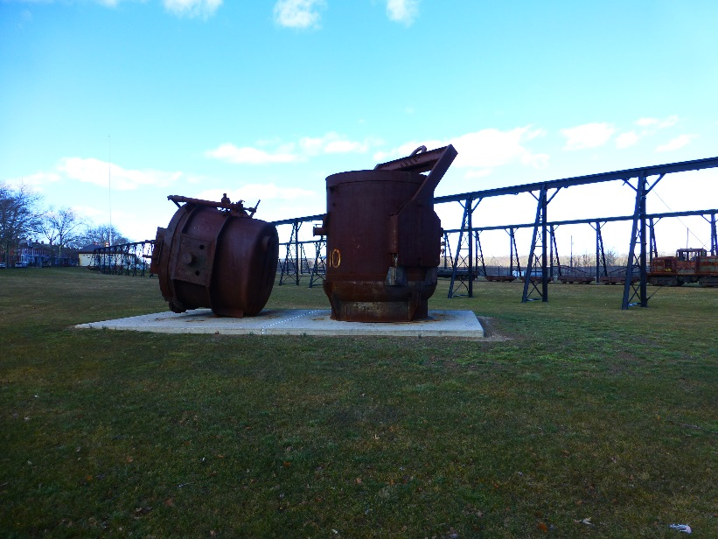
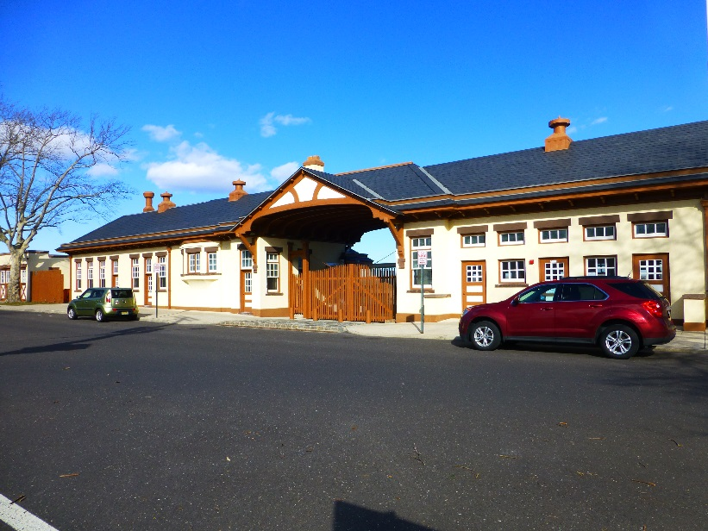
Roebling Museum
Opened in June 2009
7,000 square foot museum in the former Main Gate House
Aims to document the history and engineering accomplishments of John A. Roebling

Slide 6
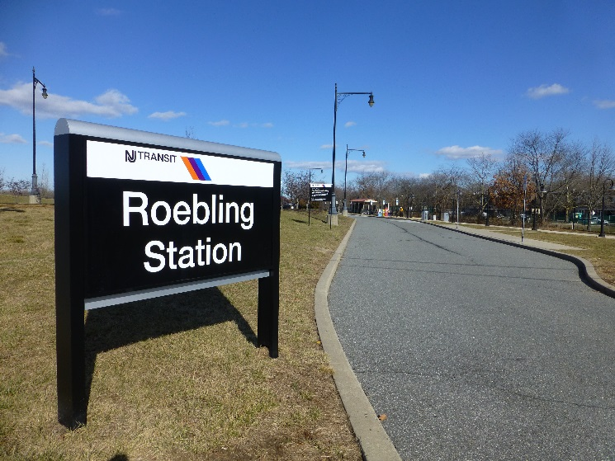
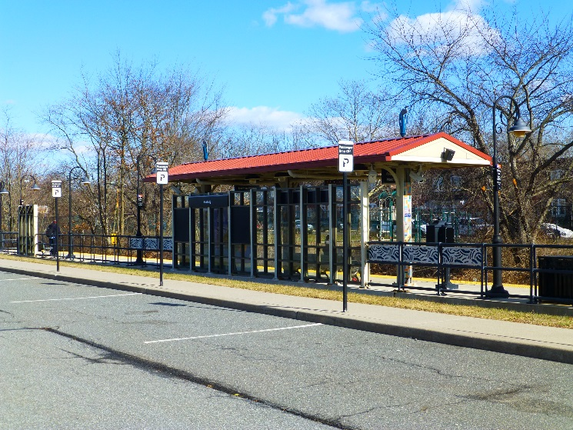
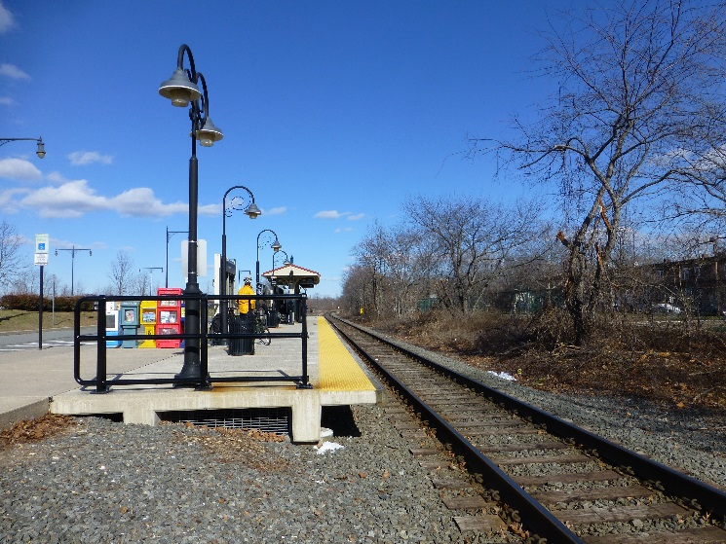
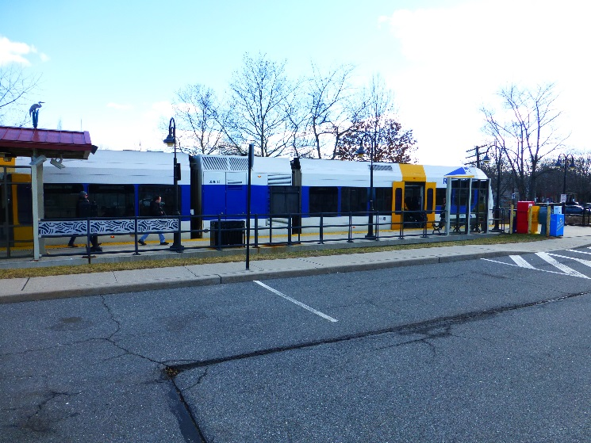
Roebling Commuter Light-Rail Station
Part of New Jersey Transit’s River LINE
River LINE has 21 stations, covers 34 miles and connects Trenton and Camden, New Jersey
River LINE provided 2.9 million passenger trips in 2014
Helps to connect commuters to bigger cities

Slide 7
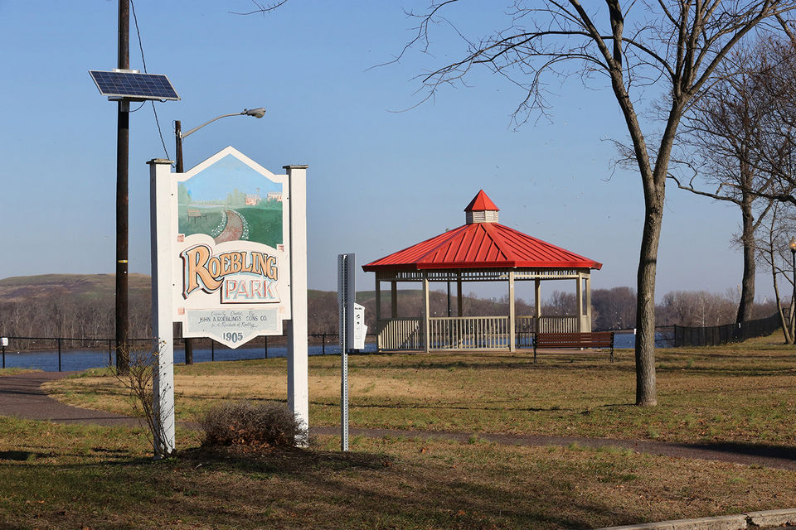
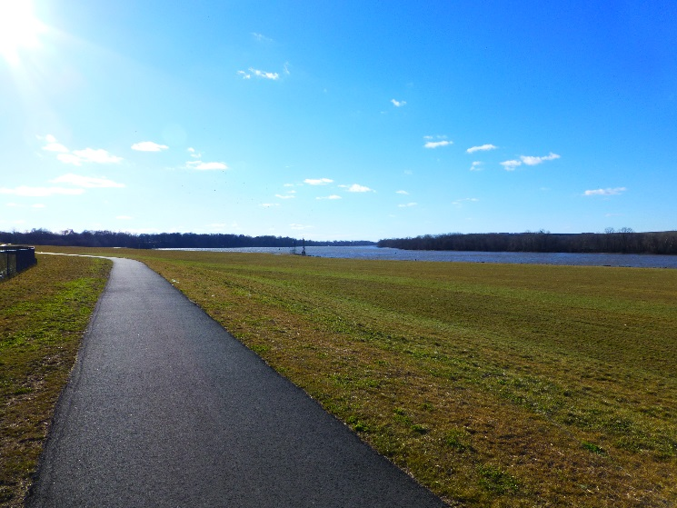
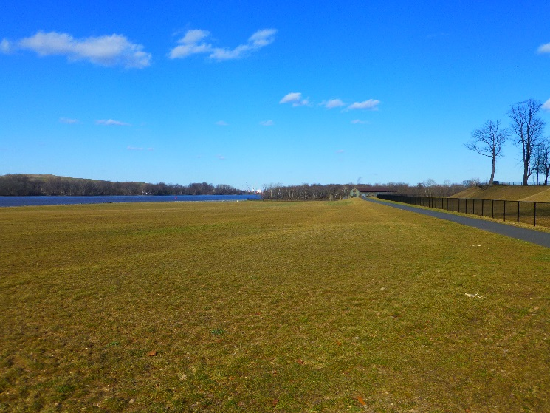
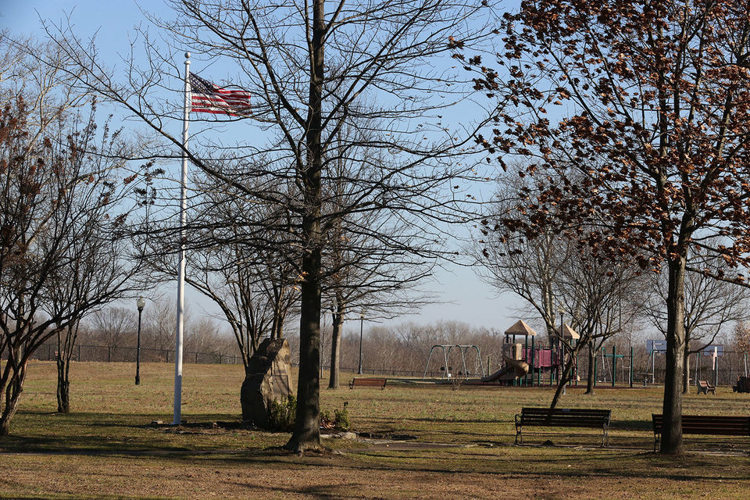
Roebling Park Extension
Park extension adds 34 acres of green space to Roebling Park
Provides views of Delaware River and village of Roebling
Recently added features include upgraded playgrounds, basketball courts and paved pathways
Open green space provides for other recreational activities

Slide 8
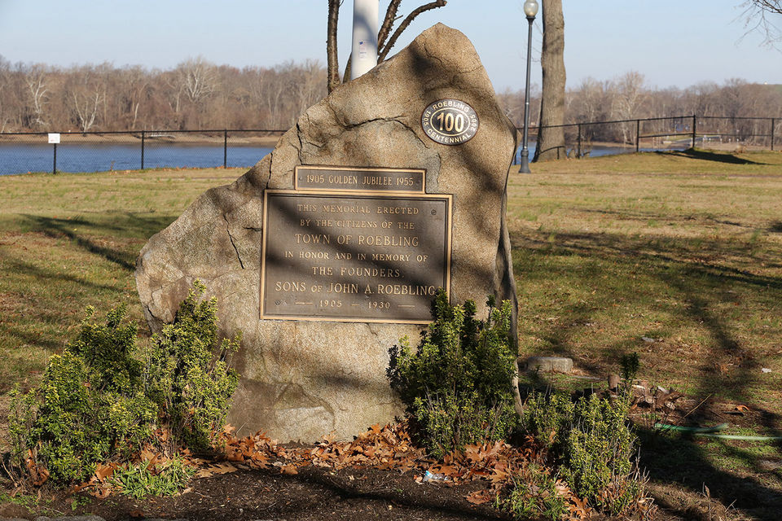
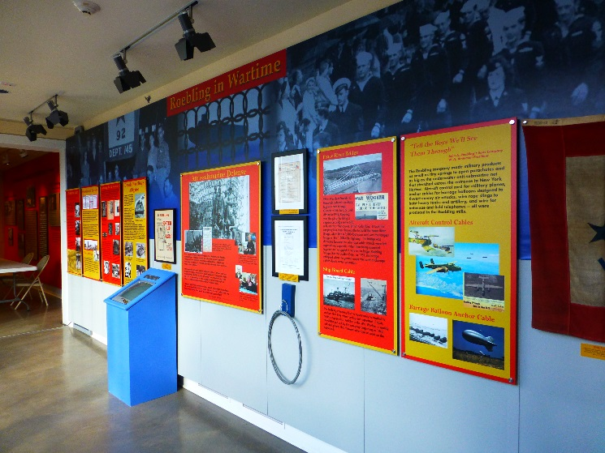
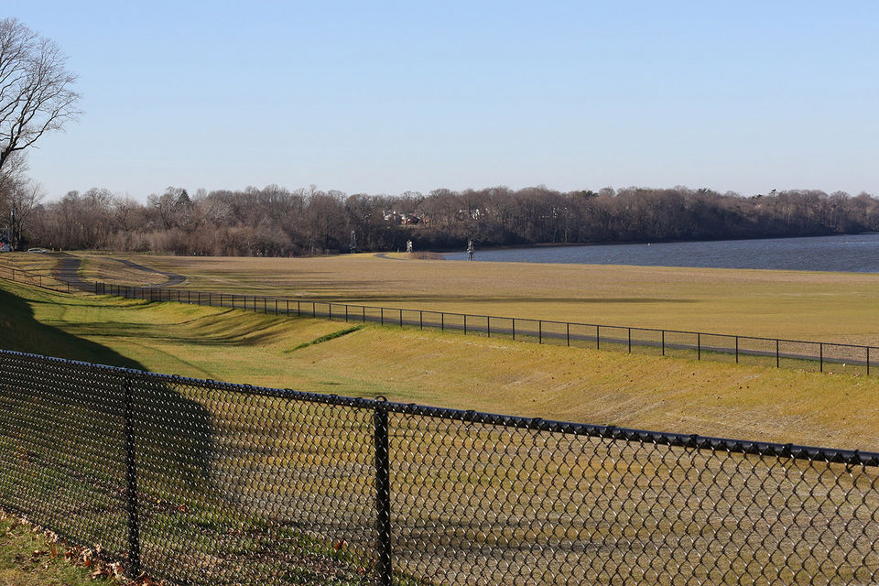
Lessons Learned
Engage early and often with the community when considering cleanup and reuse.
Working with potential purchasers and securing stewardship can help facilitate reuse opportunities.
Cleanup and reuse can be mutually beneficial for both EPA and other organizations.

Slide 9
Contact Information
Tamara Rossi
Remedial Project Manager
(212) 637-4368
Rossi.Tamara@epa.gov
Gloria Sosa (Presenter)
Region 2 Superfund Redevelopment Coordinator
(212) 637-4283
Sosa.Gloria@epa.gov

