Slide 1
Land for People
Scott Dvorak
Parks for People – Newark Program Director
The Trust for Public Land

Slide 2
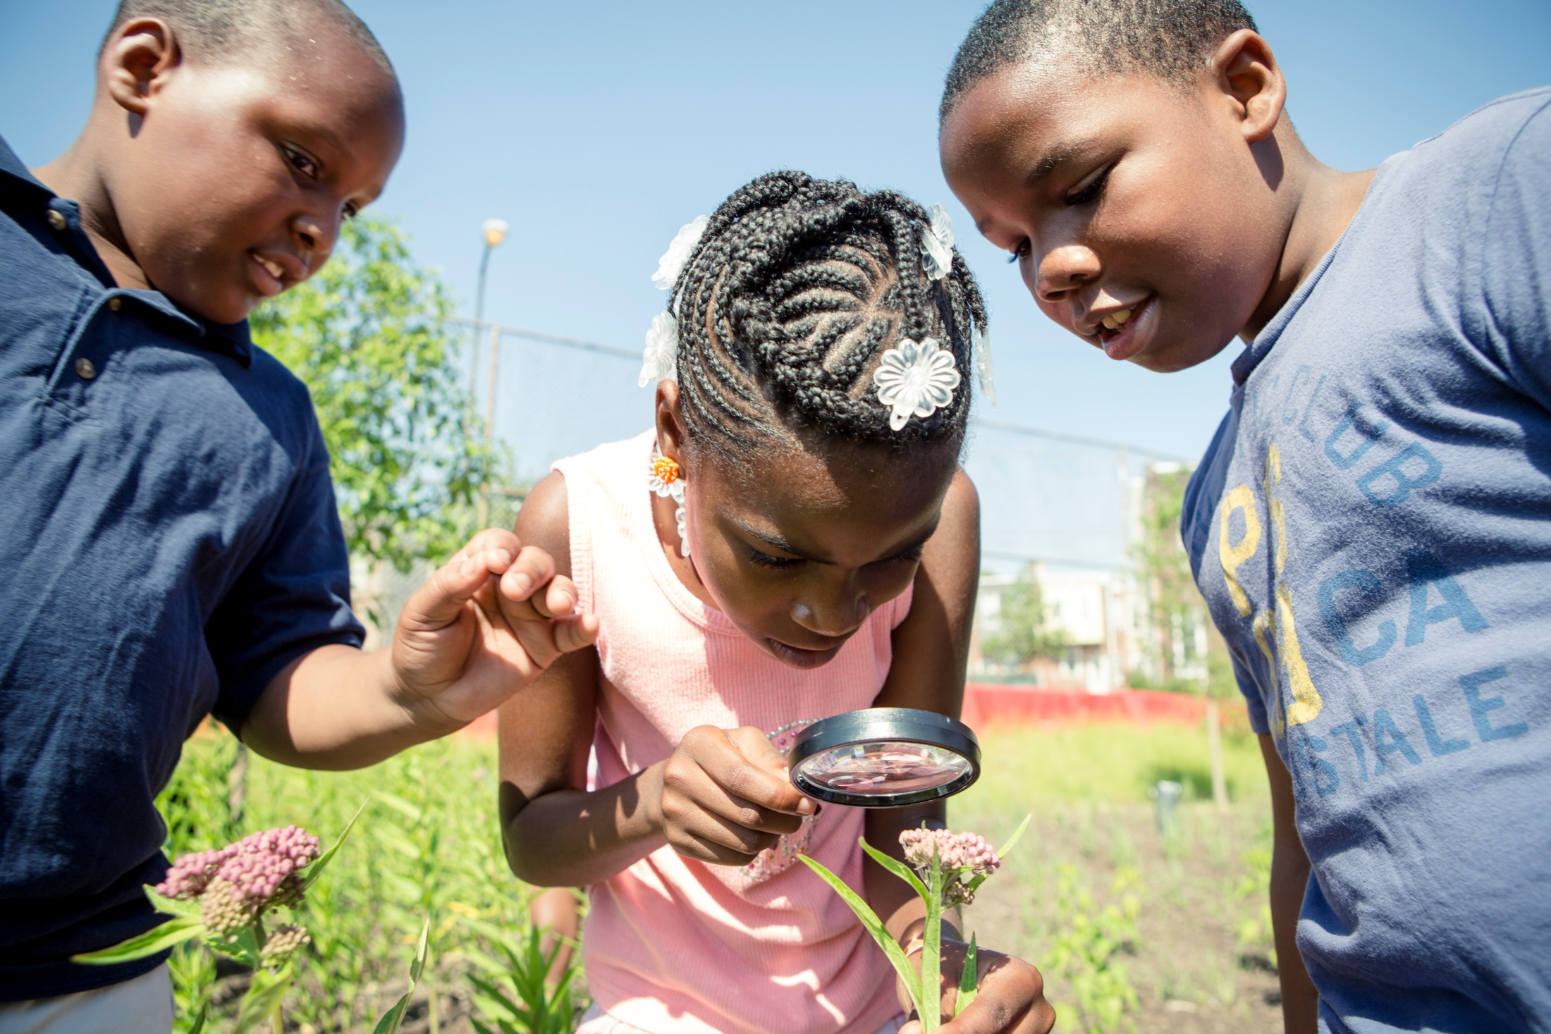
The Trust for Public Land creates parks and protects land for people, ensuring healthy, livable communities for generations to come.

Slide 3
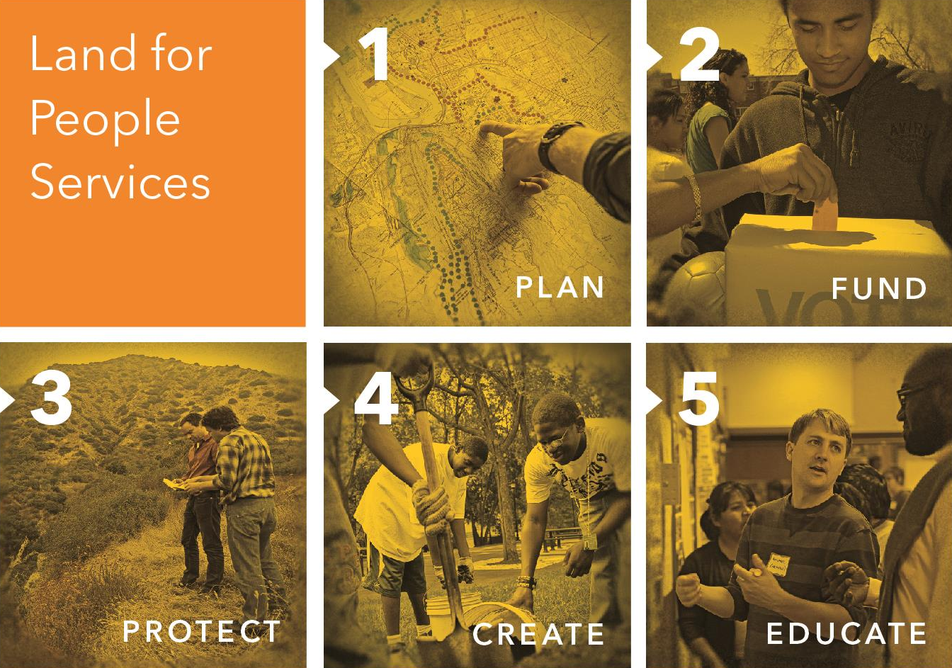

Slide 4
Climate Smart Cities

Slide 5
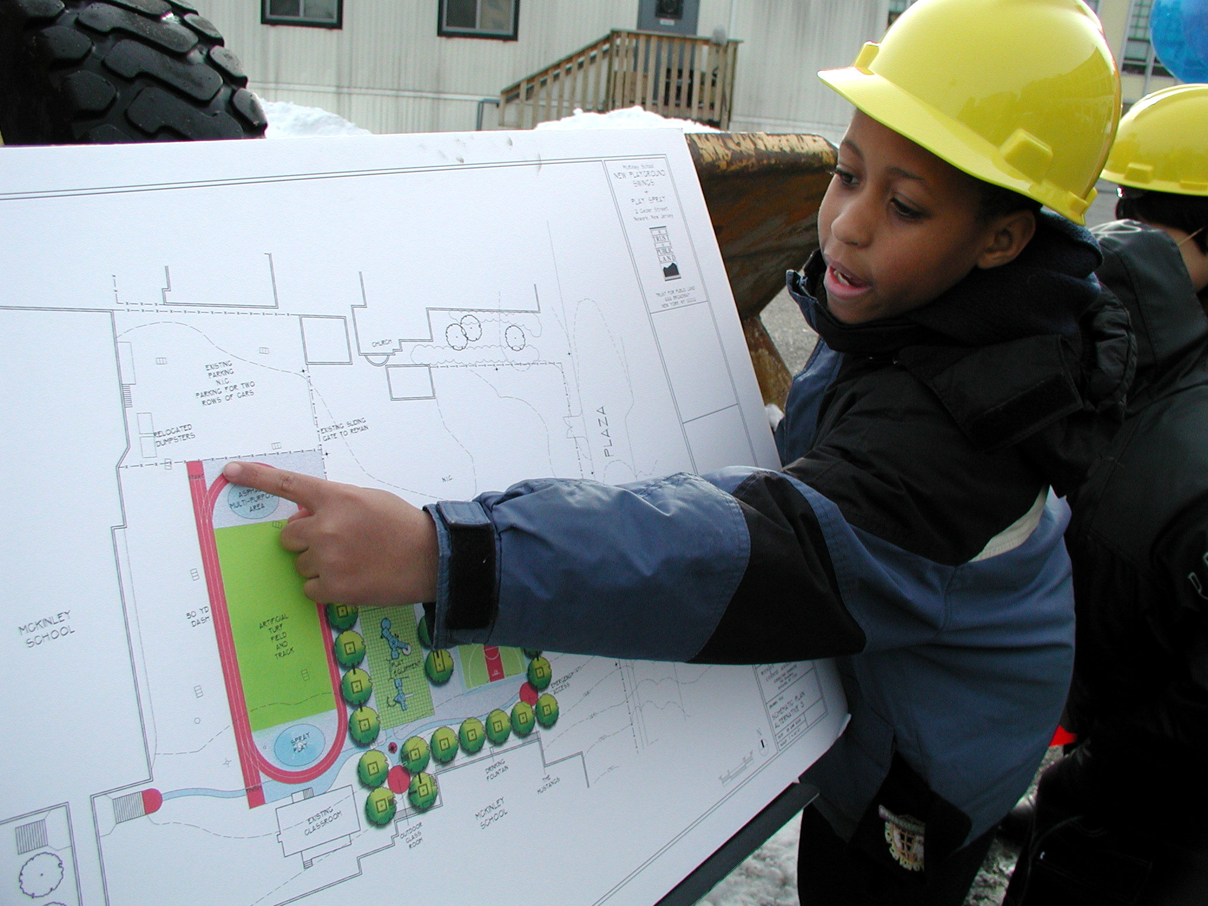
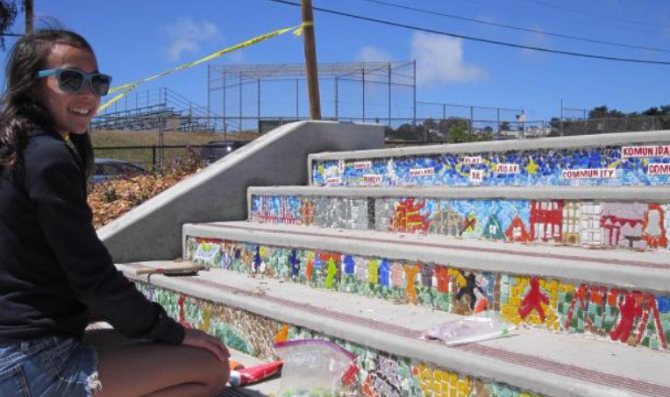
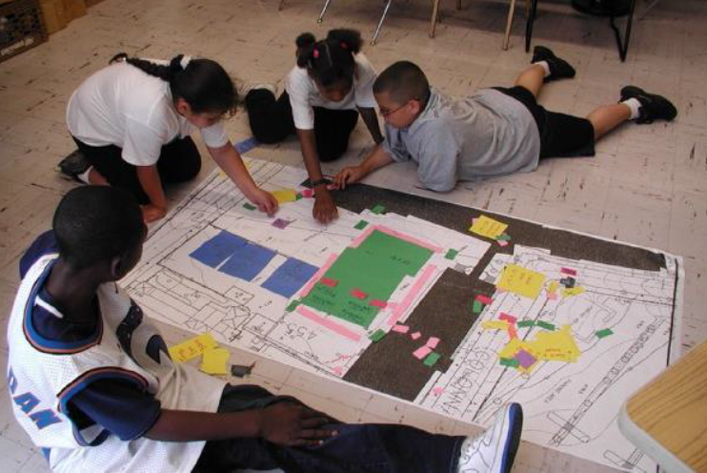
Creative Placemaking

Slide 6
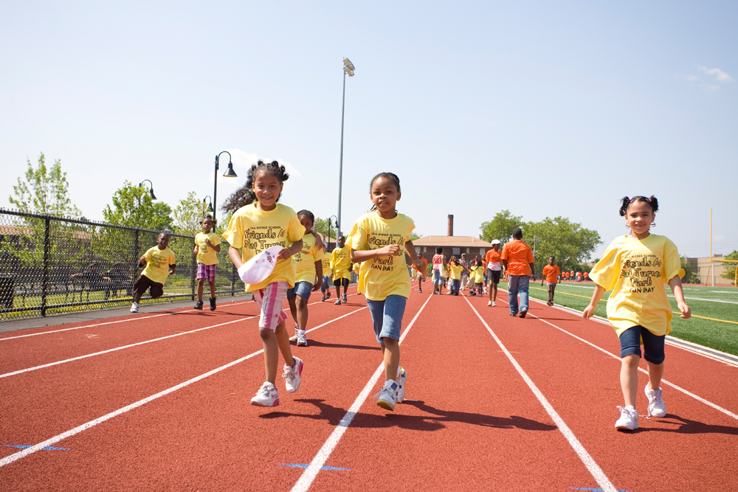
Public Health

Slide 7
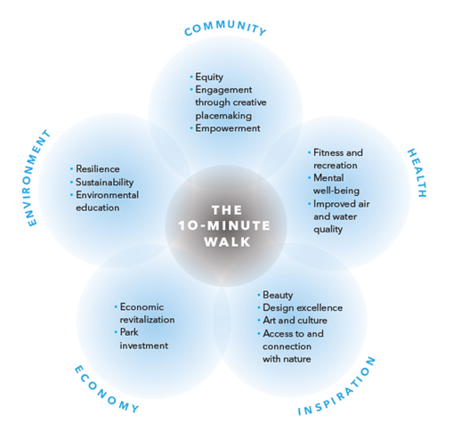
Connecting the Benefits

Slide 9
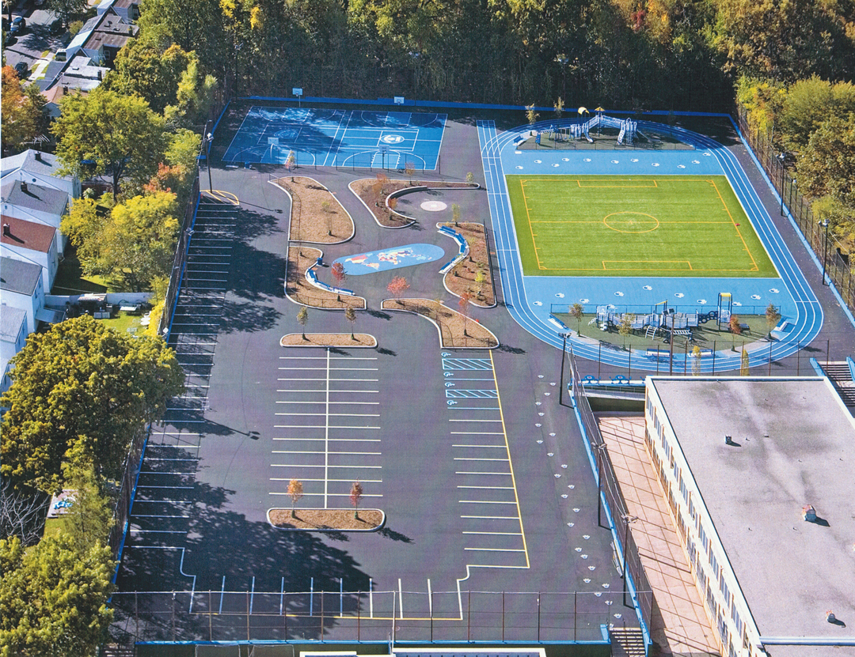
Mt. Vernon School Playground

Slide 10
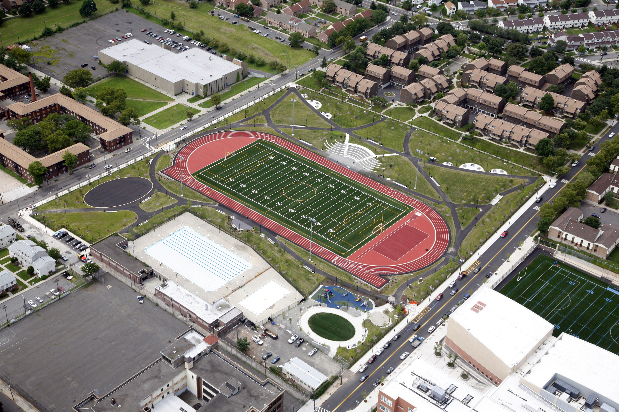
Nat Turner Park

Slide 11
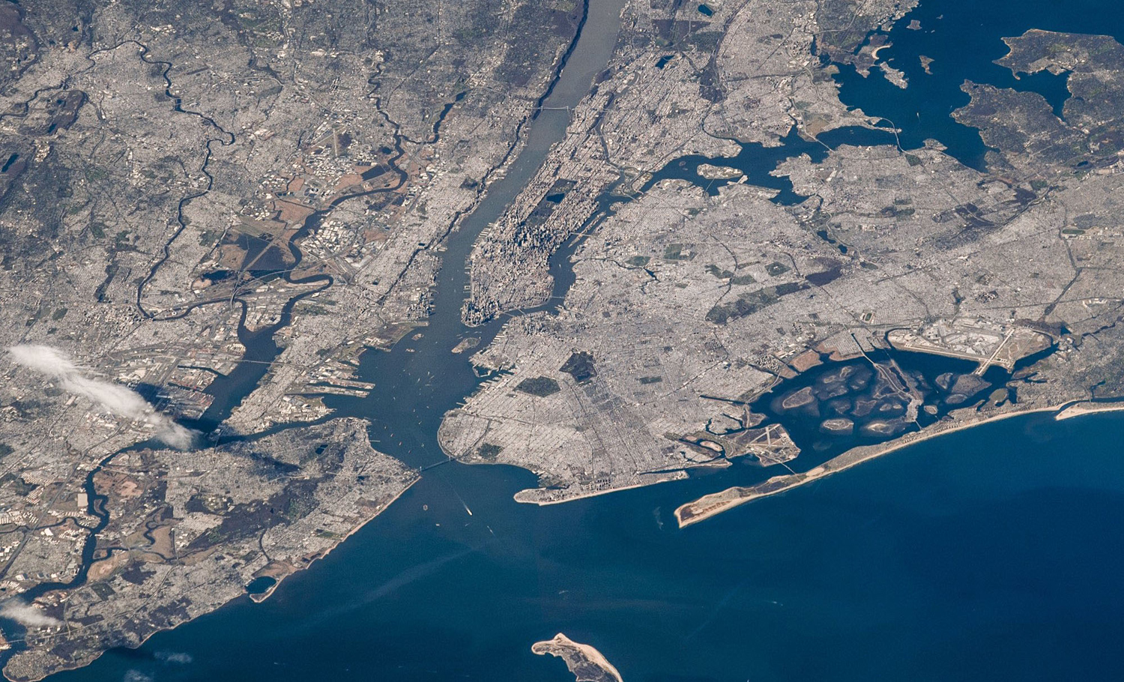
Newark Riverfront Park

Slide 12
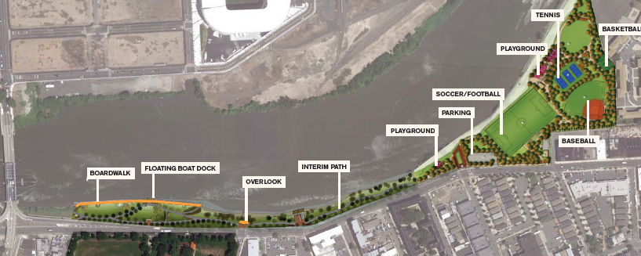
Newark Riverfront Park

Slide 13
Lack of Park and Greenspace
Population of Newark – 277,140
Population of the Ironbound – 55,000
Number of acres of parks per thousand residents in Newark – 3.1 acres
Number of acres of parks per thousand residents in the Ironbound - .5 acres

Slide 14
Site History
Morris Canal
Balbach Smelting Works
Olmstead Park Proposal
Post-Industrial Brownfield
Long history of environmental injustice
Dire lack of park and greenspace
Adjacent to USEPA Passaic River Superfund Site

Slide 15
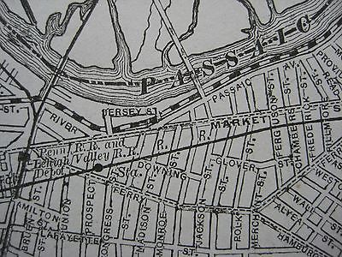
Morris Canal

Slide 16
Balbach Smelting & Refining Company

Slide 17
Post-Industrial Brownfield

Slide 18
Environmental Injustice

Slide 19
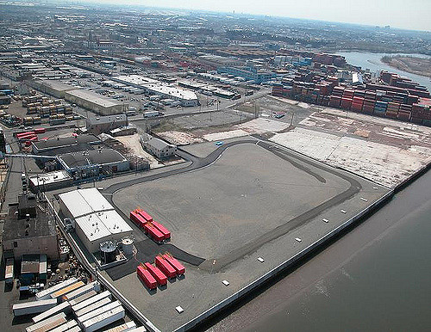
Diamond Alkali Plant Location

Slide 20
Participatory Design

Slide 21
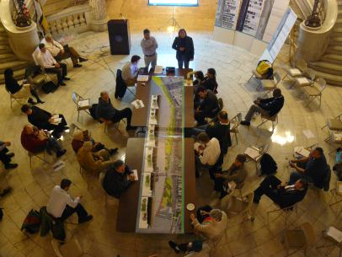
Participatory Design

Slide 22
Goals for Participatory Design
To give residents a say in what is included in their park
To reconnect residents to the river
To highlight the history of the site and the potential future
To create advocates for the river

Slide 23
Permitting
Waterfront Development Permit – NJDEP and US Army Corps of Engineers
State Historic Preservation Office Approval
Remediation Action Work Plan – NJDEP

Slide 24
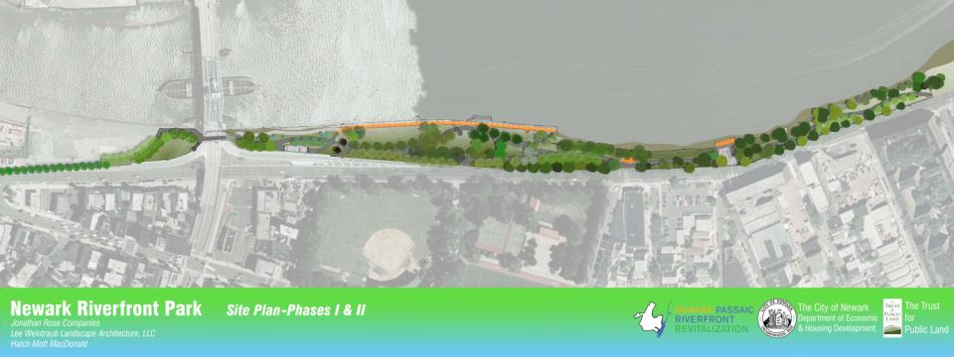
Master Plan

Slide 25
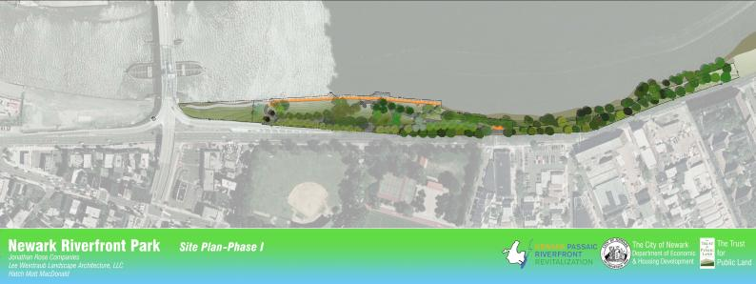
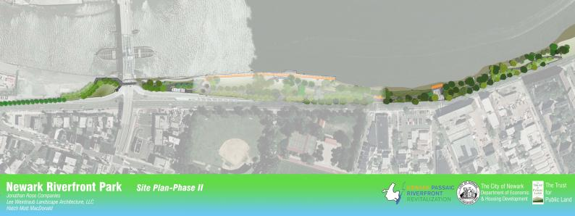
Splitting the project in two

Slide 26
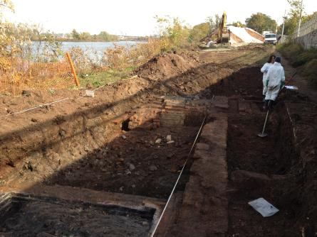
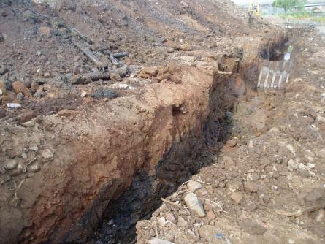
Archeological Work

Slide 27
Olmsted History

Slide 28
Combined Sewer Outflow Netting Facility

Slide 29
Soft Shoreline

Slide 30
Piles to support the boardwalk

Slide 31
Piles in place

Slide 32
Gabion baskets to secure the shoreline

Slide 33
Boardwalk foundation

Slide 34
Boardwalk continues

Slide 35
And we have a problem

Slide 36
Soil, paths, the orange planks arrive

Slide 37
Boardwalk seating starts to take shape

Slide 38
Boardwalk railing and floating dock installed – and the sticks are painted

Slide 39
The trees arrive

Slide 40
Seen from the air

Slide 41
Somme Street entrance plaza

Slide 42
Walking into the park from Somme Street

Slide 43
Old trees preserved – new trees planted

Slide 44
Boardwalk grasses

Slide 45
Boardwalk and dock on a gray day

Slide 46
Western entrance to the boardwalk

Slide 47
Western end of the boardwalk

Slide 48
The lawn

Slide 49
Day before opening day

Slide 50
Day before opening day

Slide 51
Walk to the Water – August 3, 2013

Slide 52
The Parade Arrives

Slide 53
Ribbon Cutting – August 3, 2013

Slide 54
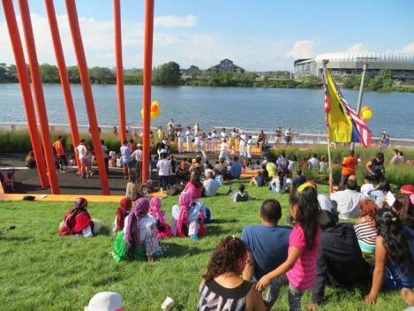
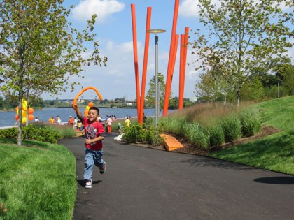
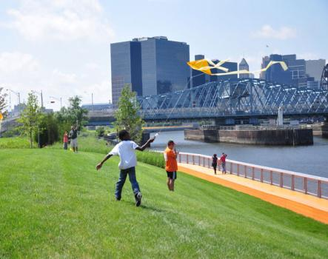
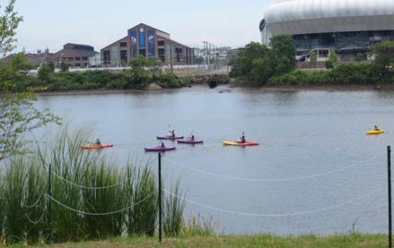
Community Celebration – August 3, 2013

Slide 55
Enjoying the park

Slide 56
Newark Riverfront Park Phase II

Slide 57
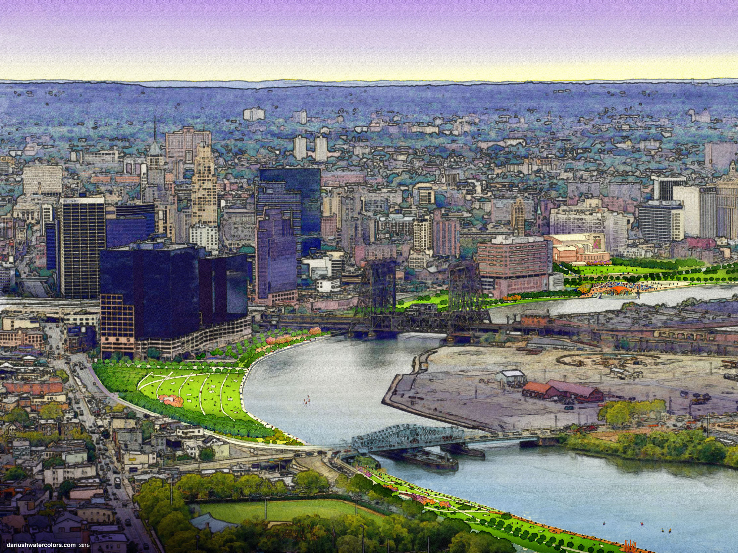
Future Riverfront Park Expansion

Slide 58
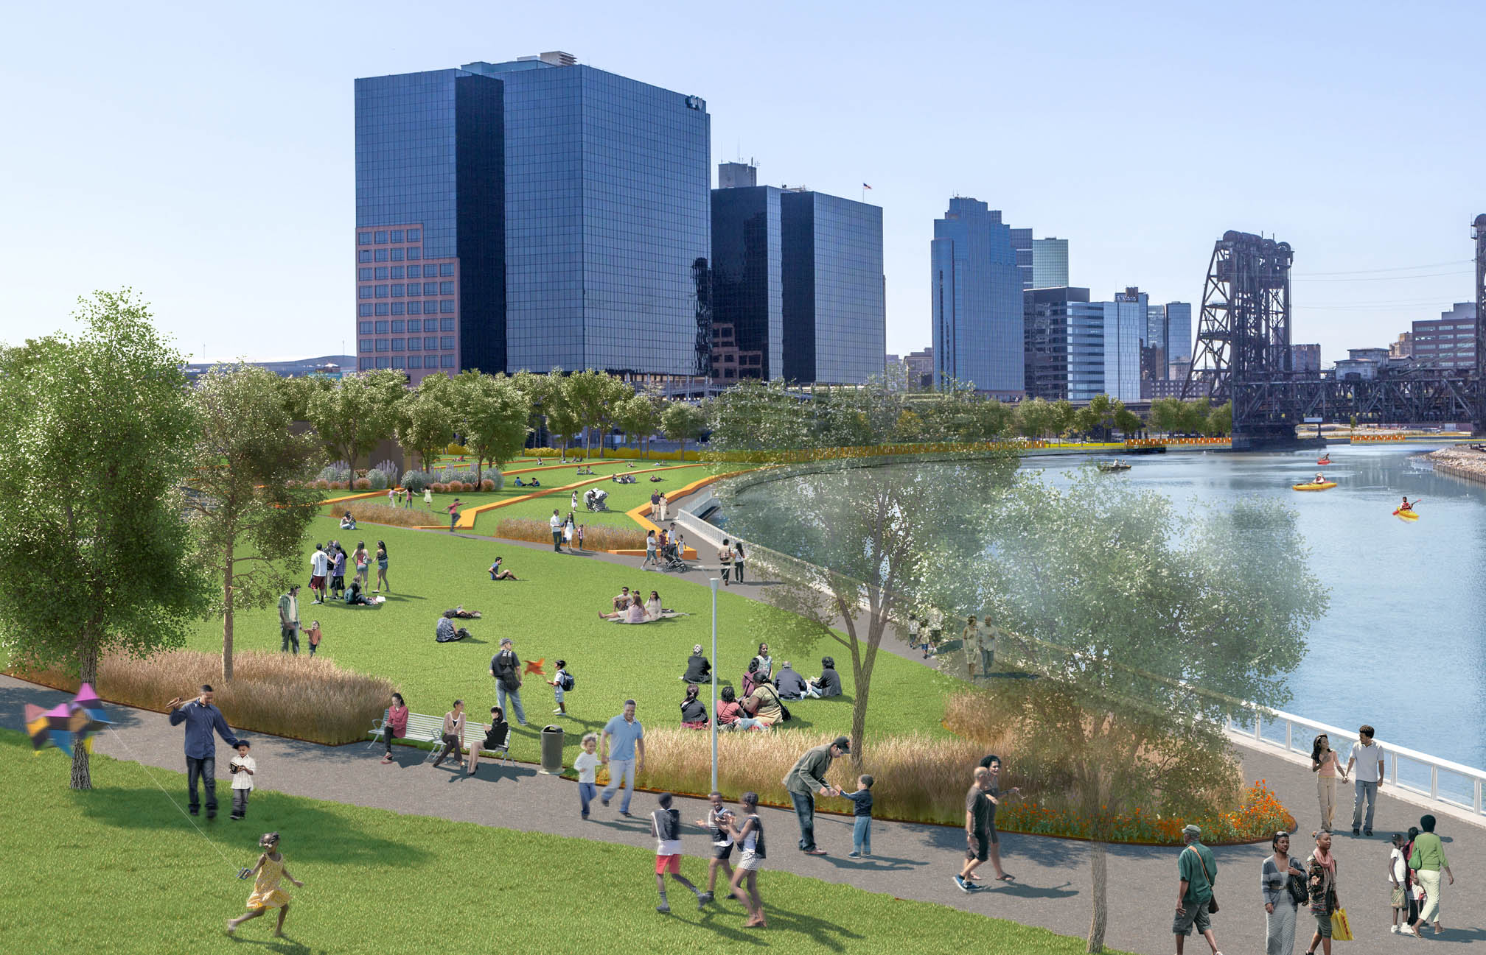

Slide 59
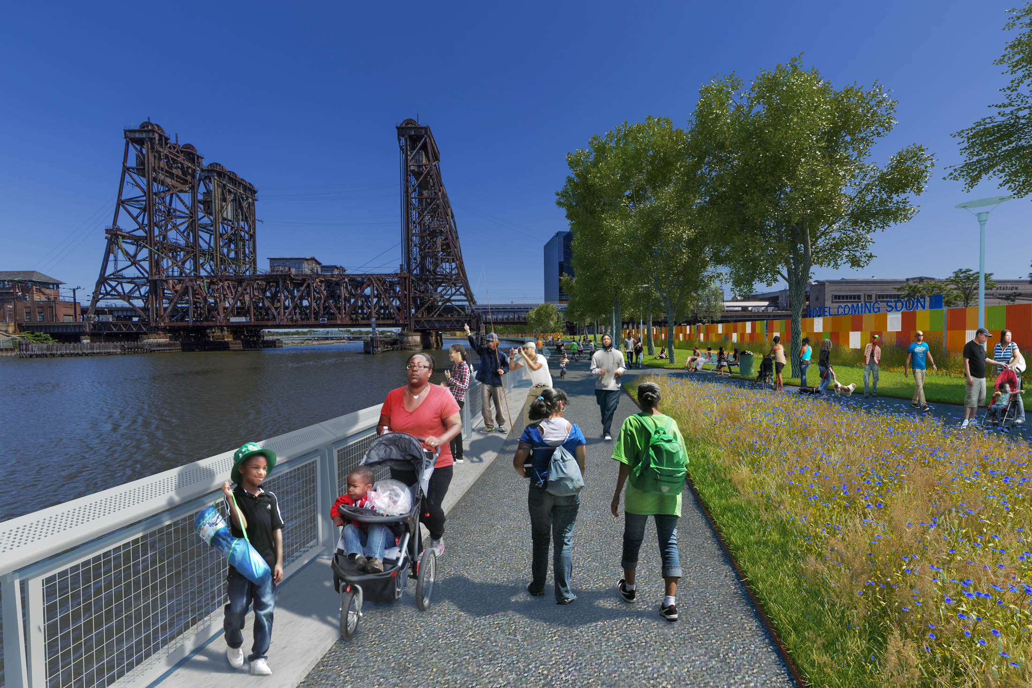

Slide 60
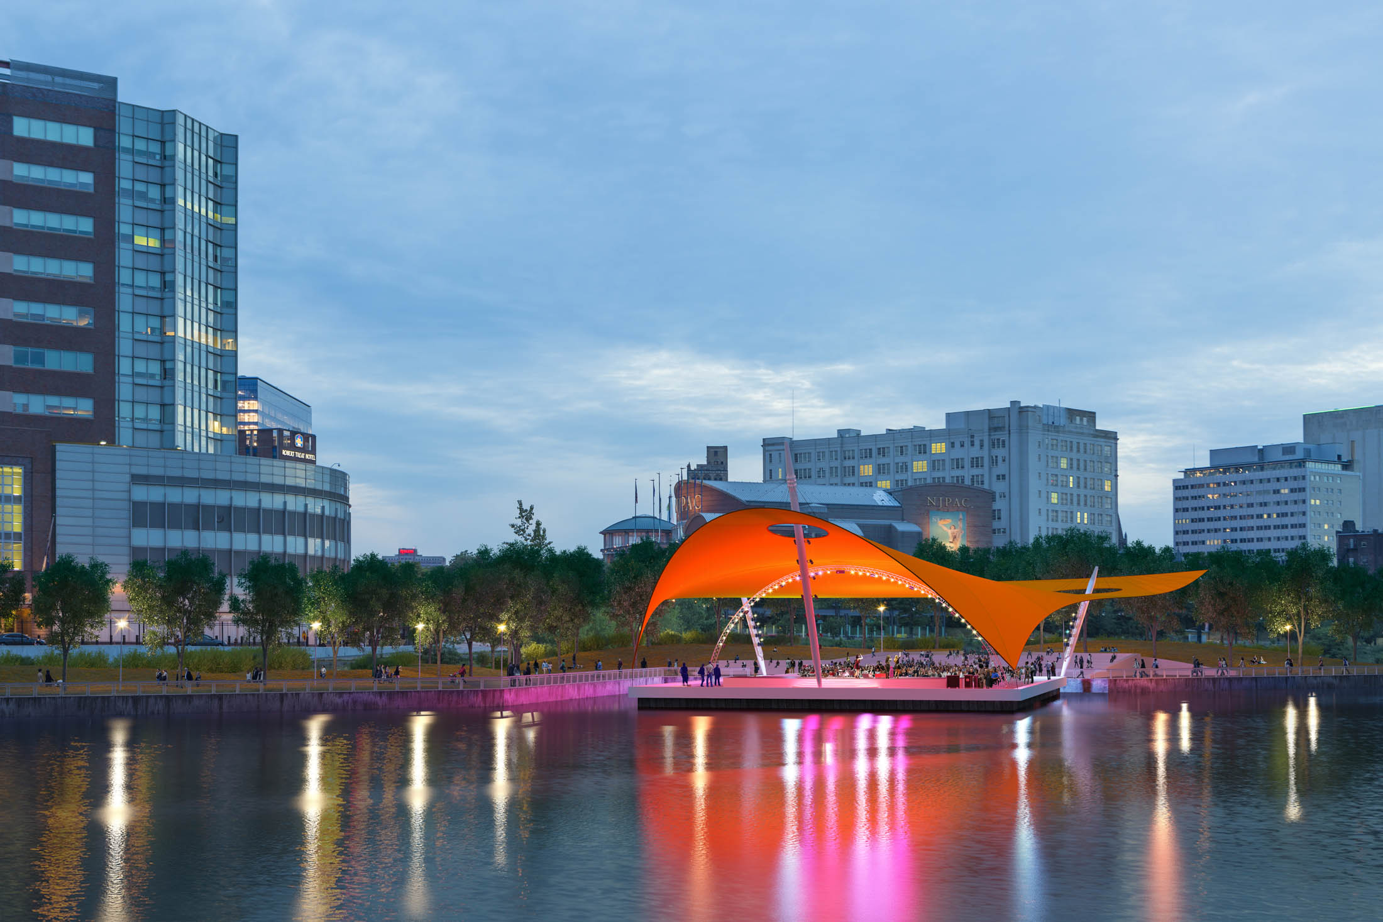

Slide 61
Land for People – Contact Information
Scott Dvorak
Parks for People – Newark Program Director
The Trust for Public Land
Contact Information
973-998-9440 ext. 303
scott.dvorak@tpl.org

