Slide 1
Tools: Documentation to Keep Sites Safe
Cecilia De Robertis and Craig Boehr
U.S. EPA
Office of Site Remediation Enforcement

Slide 2
EPA Settlement Tools
Administrative Agreement
Administrative Order on Consent (AOC)
De Minimis Landowner Settlement
De Micromis Landowner Settlement
Consent Decree

Slide 3
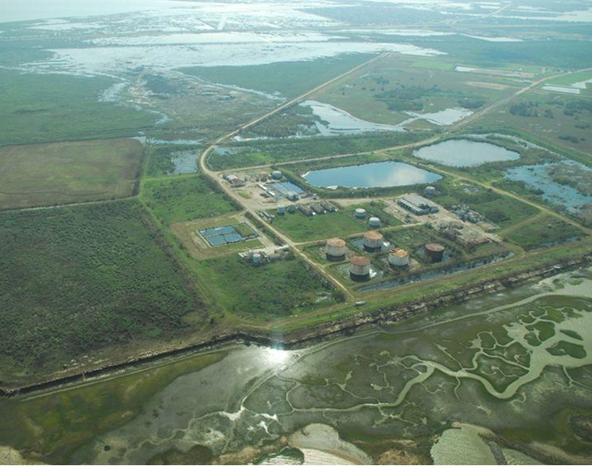
De Minimis and De Micromis Landowner Settlements
The Potentially Responsible Party (PRP) is:
The owner of the property;
Did not permit generation, treatment, storage, disposal of hazardous substances; and
Did not contribute to
the release or threat of
release through any
act or omission.

Slide 4
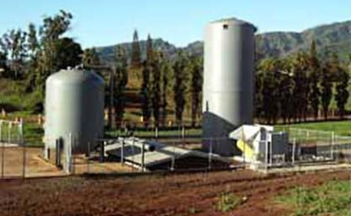
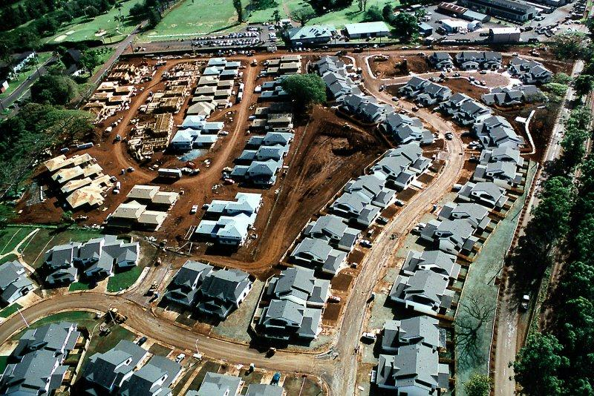
Consent Decrees
Can be tailored to meet the individual needs of a site.
Source: http://www.globalsecurity.org/military/facility/schofield-barracks.htm

Slide 5
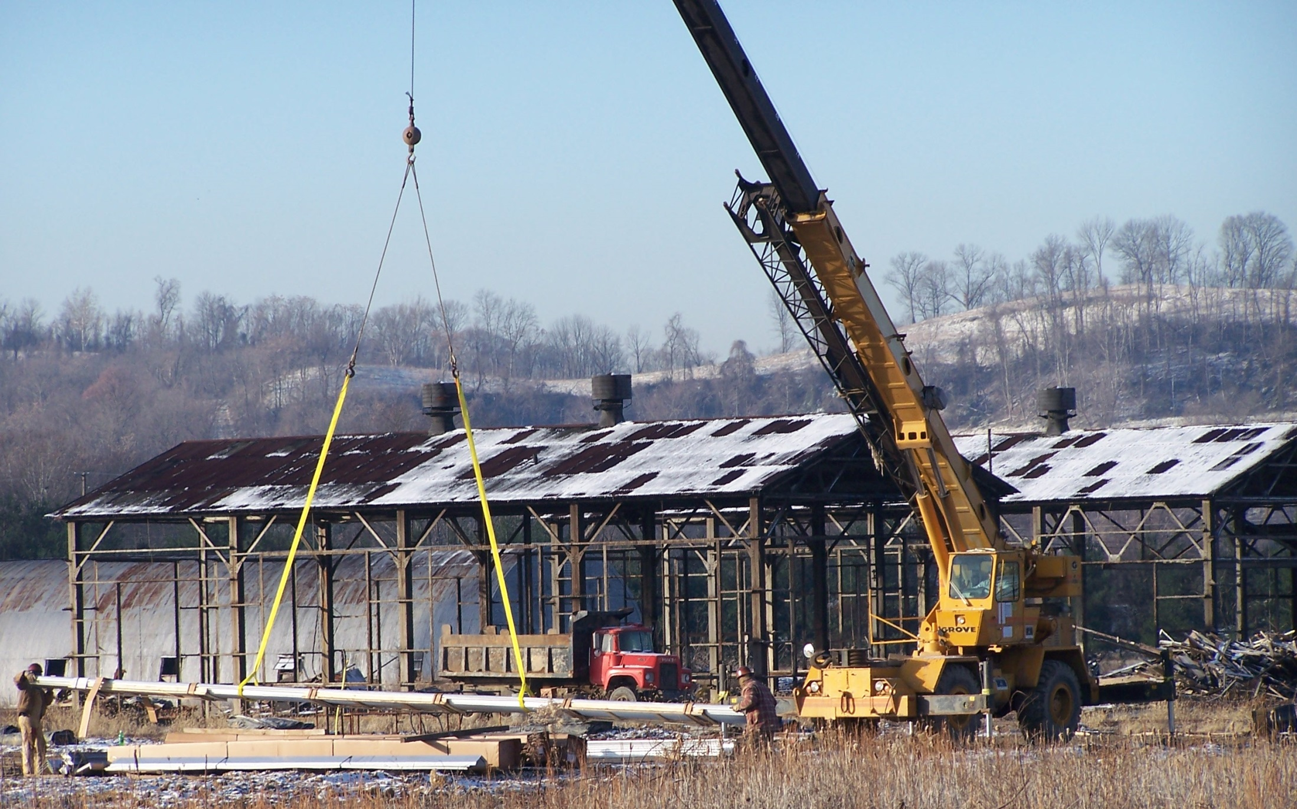
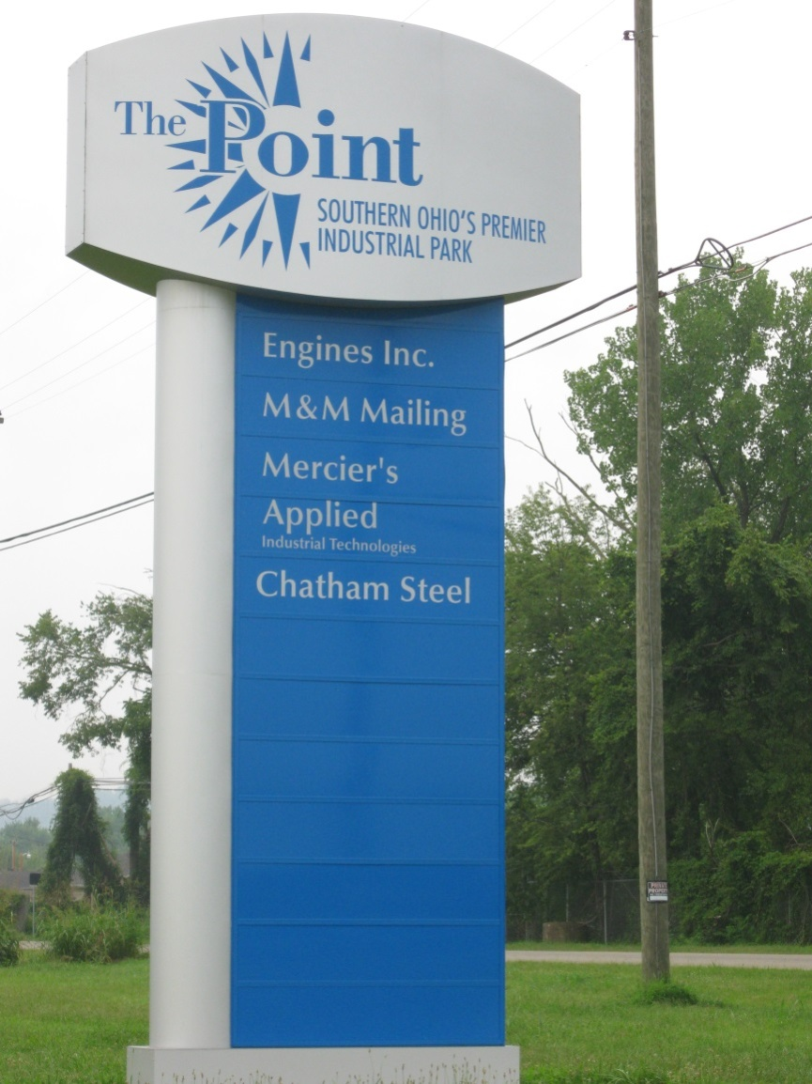
Ready for Reuse Determinations
RfRs identify a site or part of a site as ready for a certain type of reuse

Slide 6
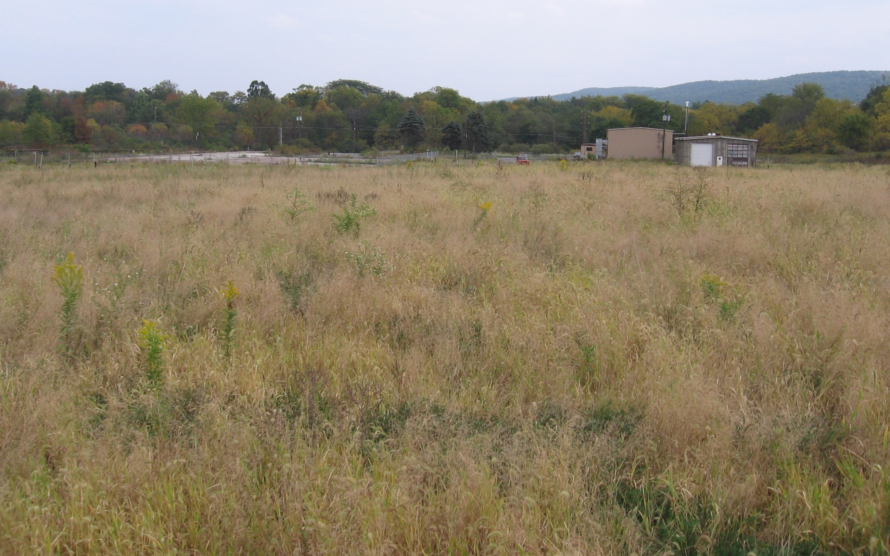
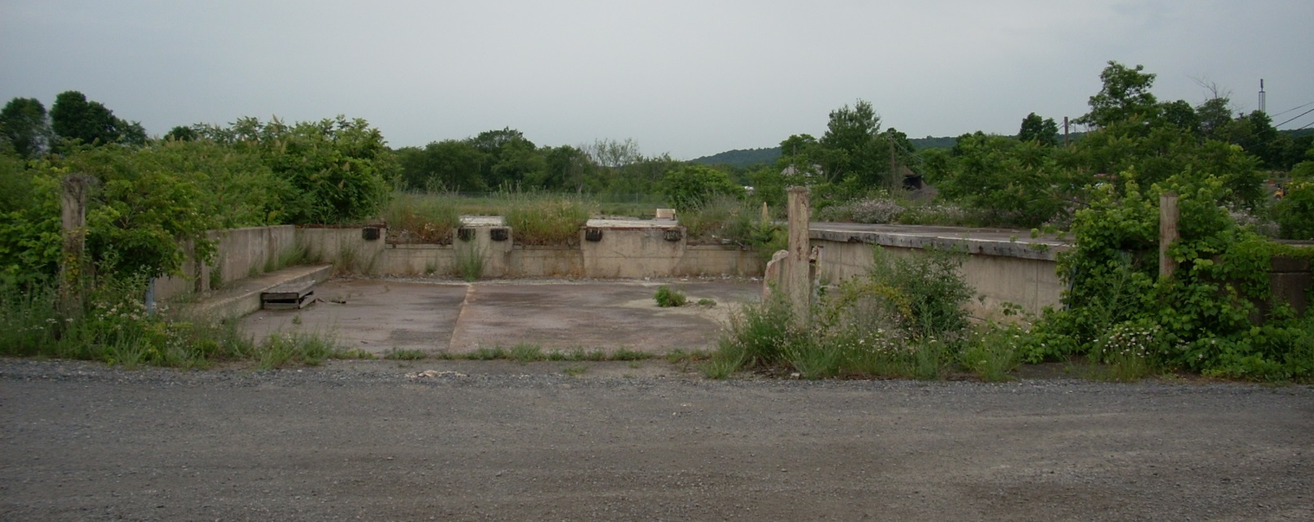
Institutional Controls
Future land use should be considered when considering ICs
Affected parties and local governments should be consulted when considering ICs

Slide 7
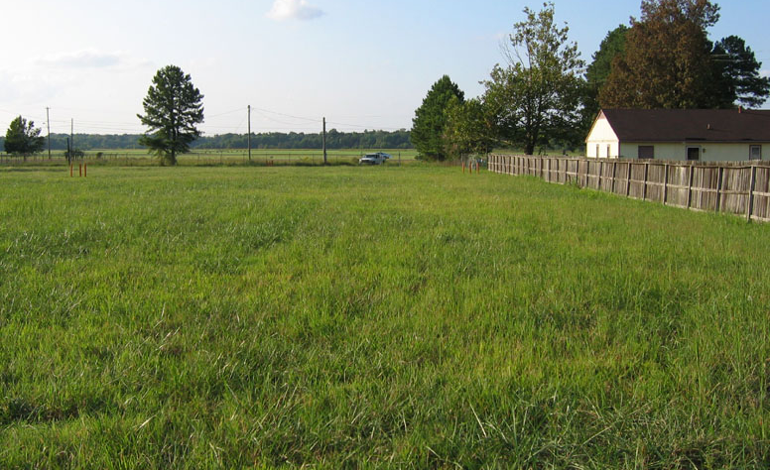
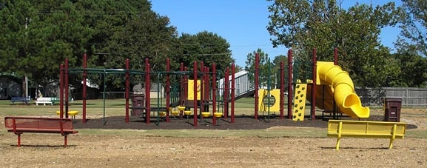
Comfort/Status Letters
Provide “comfort” by helping an interested party to better understand the potential for or actual EPA involvement at a site.
The EPA may issue letter upon request

Slide 8
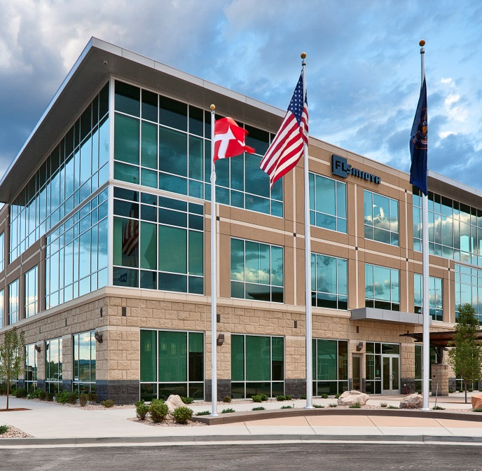
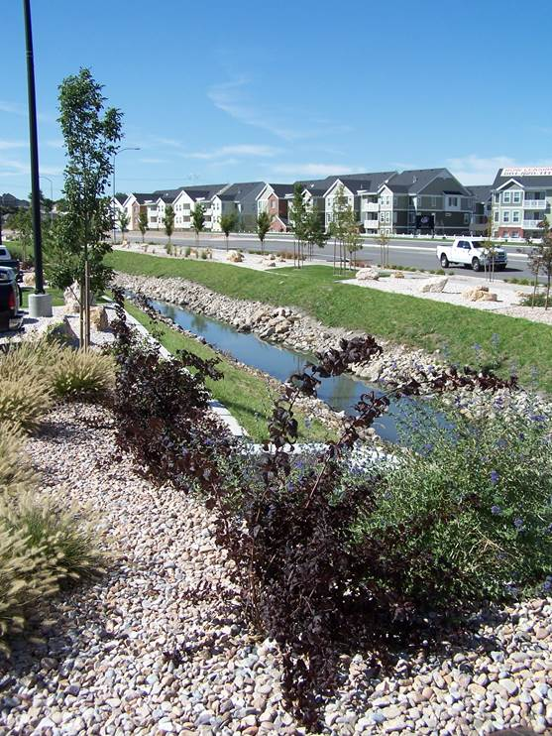
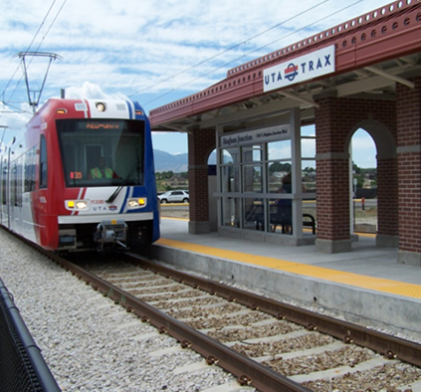
Midvale Slag Superfund Site (Midvale City, Utah) Craig Boehr, Attorney, EPA Office of Site Remediation Enforcement

Slide 9
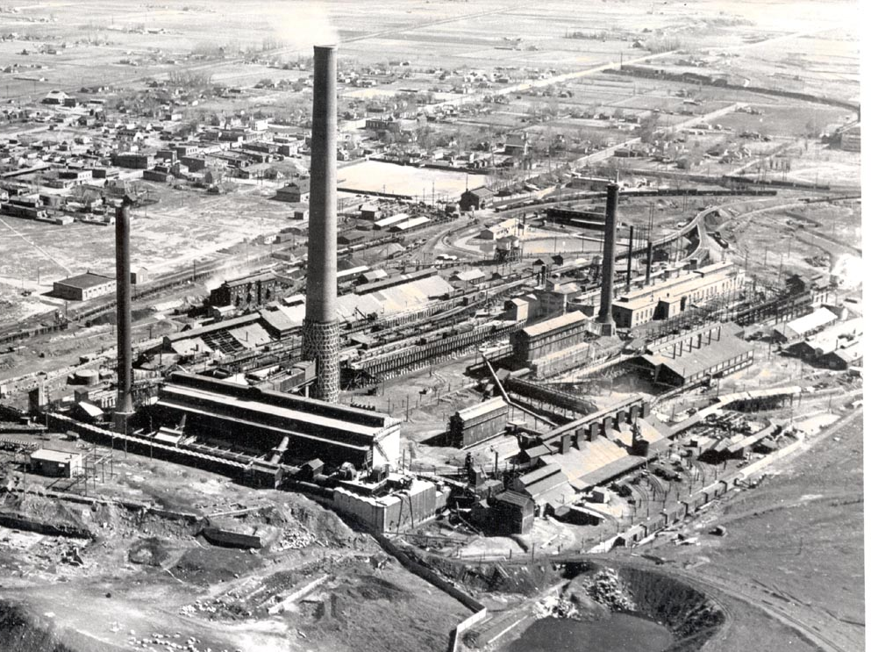
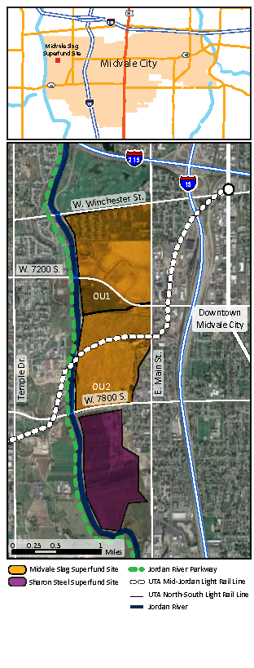
Site History

Slide 10
The 2004 Consent Decree
Littleson, Inc. (site owner)
Responsible for OU2 remedy design and cleanup
Commitment to clean up southern part of the site for $16 million
The EPA
Covenant not to sue
Property lien for unrecovered response costs waived
BFPP section
Midvale City
Voluntary settlement party
Long-tem stewardship: responsible for site’s institutional controls

Slide 11
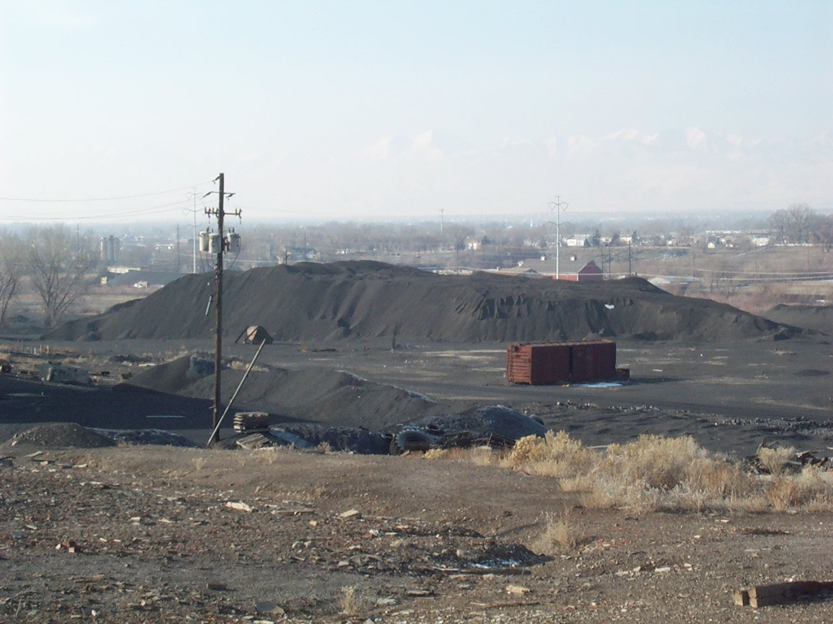
Institutional Control Process Plans
Plan Objectives
Controls on handling and disposal of soils and wastes
Controls on water management and ground water use
Residential land use requirements
Long-term operation and maintenance guidelines
Vapor mitigation controls

Slide 12
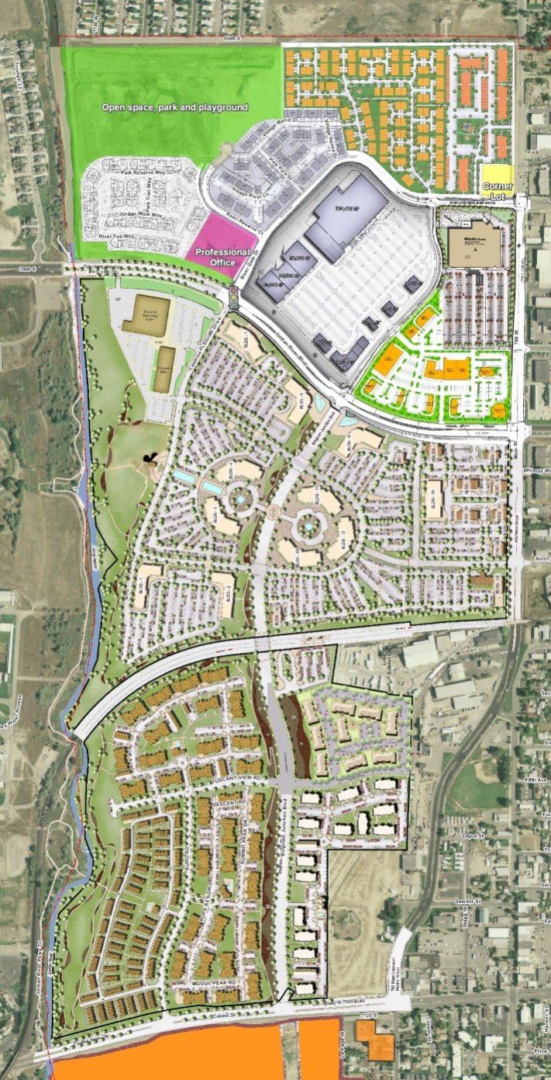
Institutional Control Process Plans
Plan Responsibilities
Midvale City
Updating and managing local land use tools and ordinances
Reviewing site plans
Conducting site development inspections
Verifying private covenants and deed restrictions for residences
The EPA and UDEQ
Ground water monitoring
Oversight of some residential development
Landowners
Plan compliance
Disposal of any excavated contaminated soils in appropriate facilities
Ensuring covenants and deed restrictions are conveyed and communicated during property transactions

Slide 13
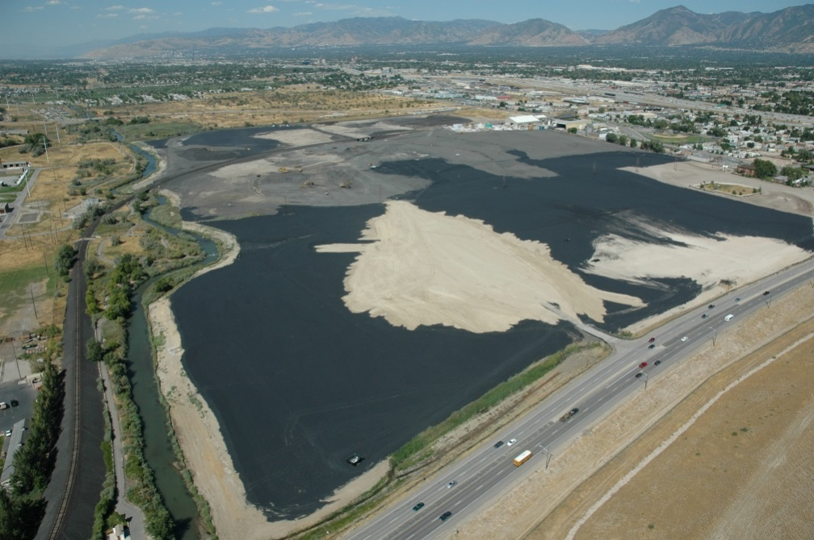
Integrating Remedy and Reuse
Locating infrastructure
Reusing wastes
Preparing areas for redevelopment

Slide 14
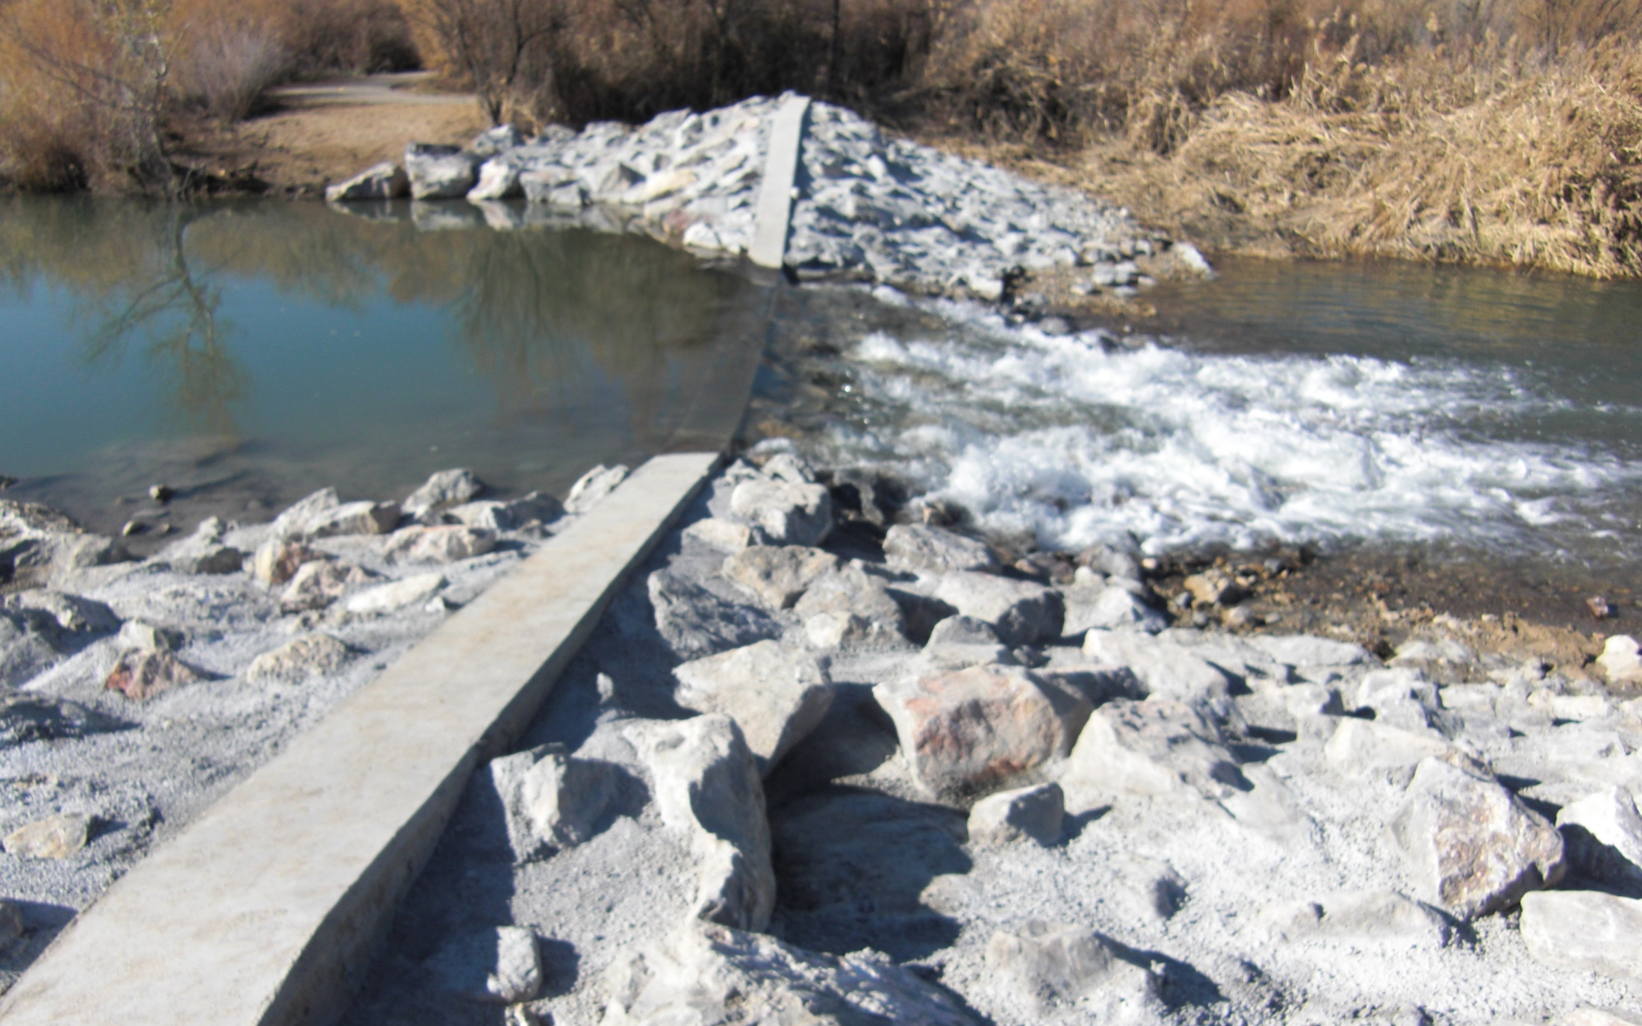
Project Outcomes
Cleanup
Contaminated soils and smelter wastes addressed
Banks of Jordan River stabilized
Ground water and surface monitoring ongoing
Institutional controls in place
NPL deletion on the horizon

Slide 15
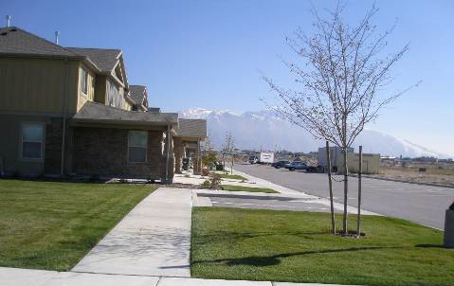
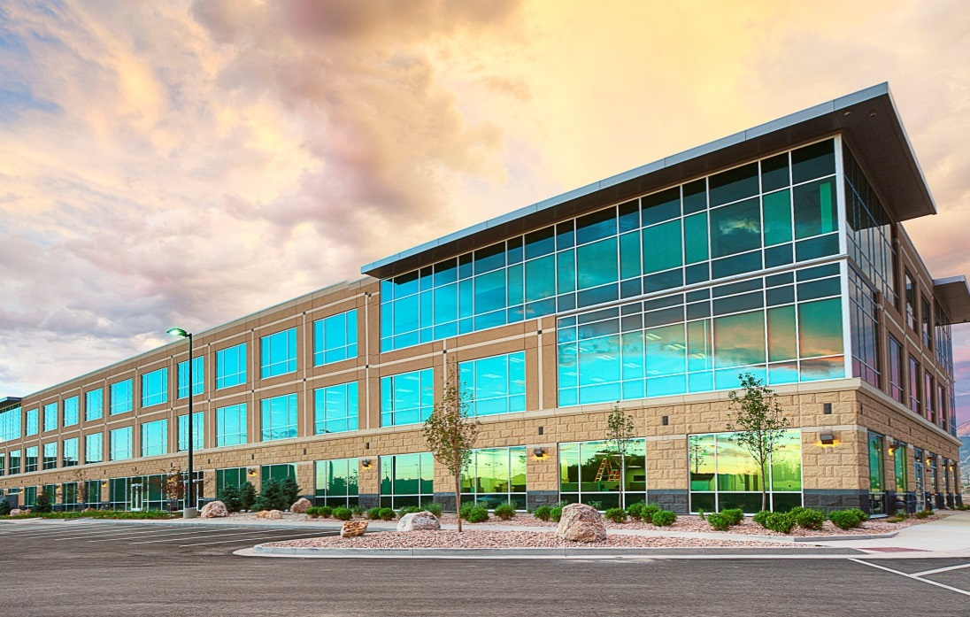
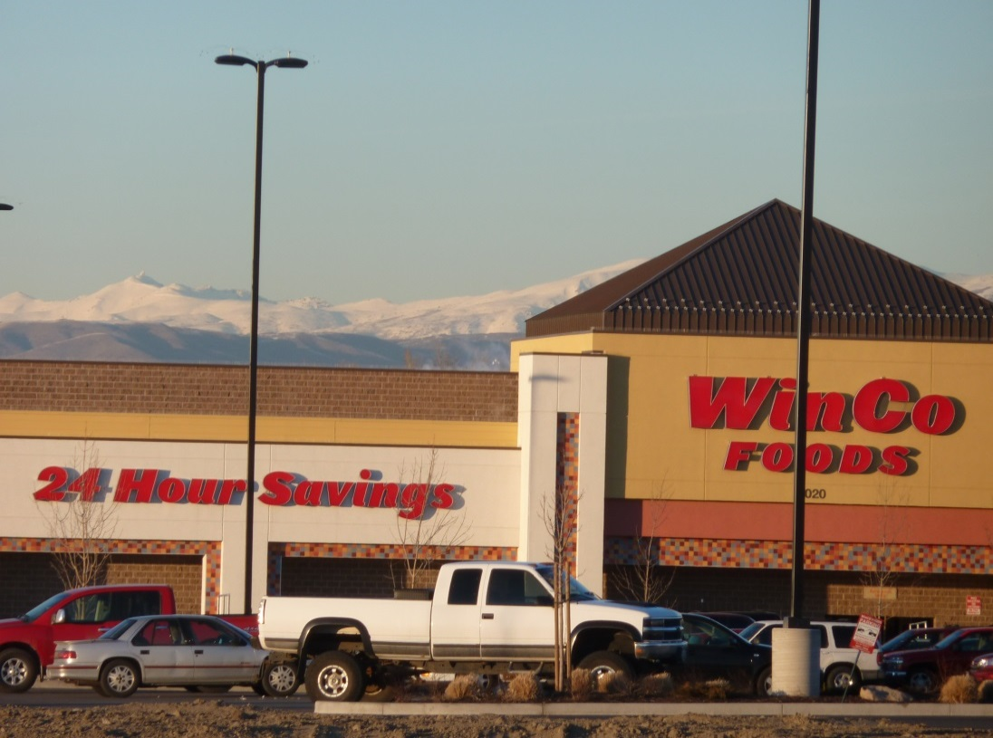
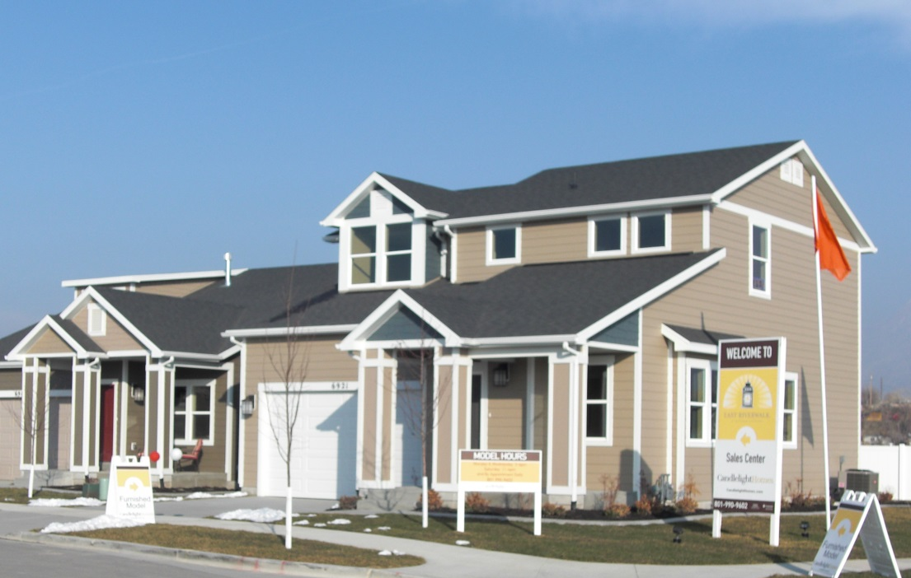
Project Outcomes
Bingham Junction Redevelopment
600 jobs
$1.5 million in annual property tax revenues
$131 million increase in value of site property
Land Uses
Commercial shopping center
175,000 square feet of LEED-certified office space
Over 1,000 completed residential units
UTA light rail station
Riverwalk Park
20 acres of open space with wetland mitigation area

Slide 16
Lessons Learned
Build collaborative relationships with local government and community and state and federal partners
Address enforcement priorities as part of broader approach focused on cleanup and redevelopment
Consider institutional controls early in the Superfund process
http://www.epa.gov/compliance/resources/publications/cleanup/superfund/midvale-sf-success.pdf

