Slide 1
Innovative and Flexible Solutions
Cecilia De Robertis
U.S. EPA
Office of Site Remediation Enforcement

Slide 2
Using the Right Tools at the Right Sites

Slide 3
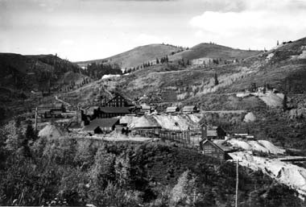
Prospective Lessee Agreement
Empire Canyon Site in Park City, Utah

Slide 4
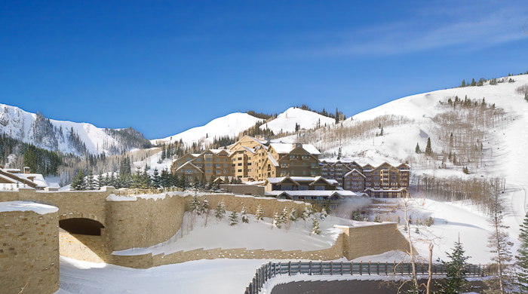
Prospective Lessee Agreement
Empire Canyon Site in Park City, Utah

Slide 5
New Tenants Guidance
The Revised Enforcement Guidance Regarding the Treatment of Tenants Under the CERCLA Bona Fide Prospective Purchaser Provision
http://www.epa.gov/enforcement/cleanup/documents/policies/superfund/tenants-bfpp-2012.pdf

Slide 6
Contiguous Property Owner’s Agreement
The Brownfields Amendments provide CERCLA liability protections for contiguous property owners (CPOs).
If landowners continue to have liability concerns, the EPA can offer assurance that no enforcement action will be brought against a CPO for contamination resulting from a neighbor’s actions, or to enter into a settlement agreement with the CPO, providing the CPOs with cost recovery or contribution protection from potentially responsible parties at the site.

