Slide 1
Former Spellman Engineering Site (Orlando, Florida) Karen Singer, Associate Regional Counsel Office of Environmental Accountability, EPA Region 4

Slide 2
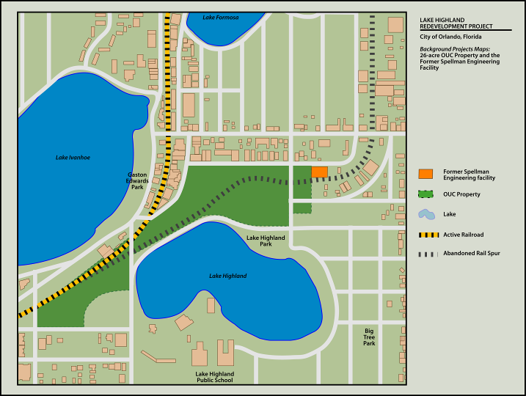
Site History

Slide 3
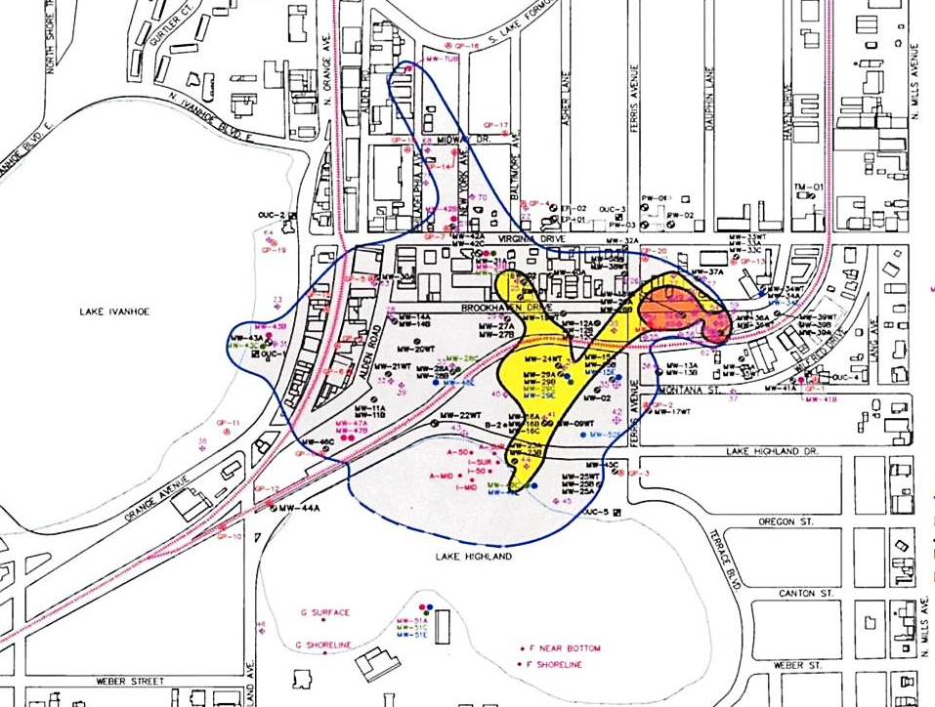
Site Cleanup
No responsible party – City of Orlando led voluntary site investigations (1992-2004)
Reuse option during cleanup, with unrestricted use possible
2004 Record of Decision

Slide 4
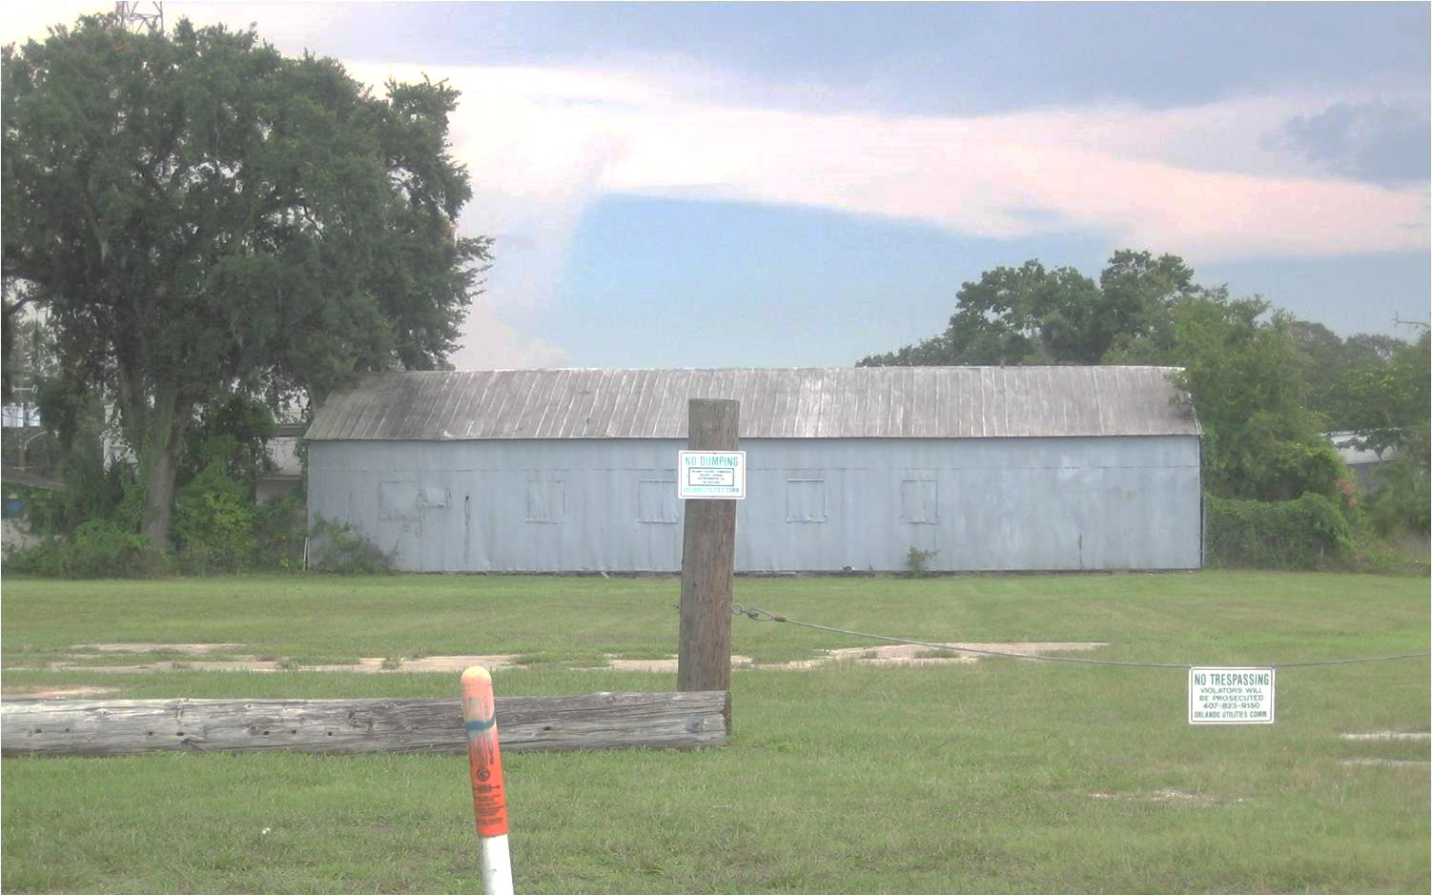
Linking Cleanup and Reuse
City and OUC led public-private partnership effort
The EPA supported third-party cleanup approach
NPL listing option as incentive for action

Slide 5
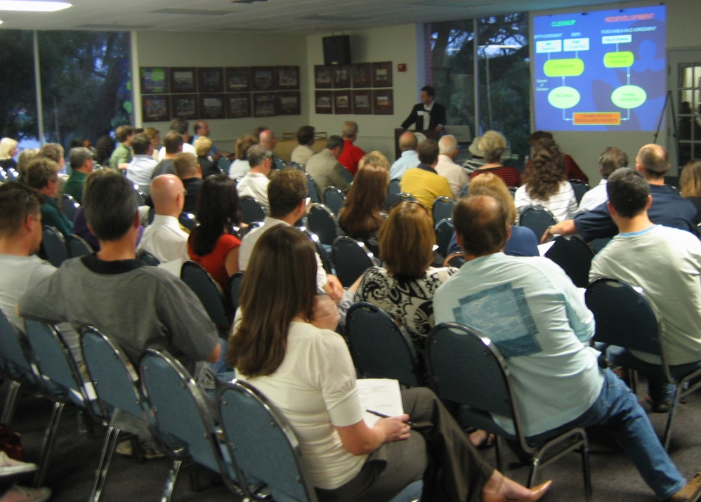
Key Project Components
Restated Joint Resolution
Contiguous Property
Owner Agreement (CPO)
Sale and purchase
agreement
BFPP agreement
Brownfield site rehabilitation agreement (BSRA)
2004 Record of Decision
2010 Explanation of Significant Differences

Slide 6
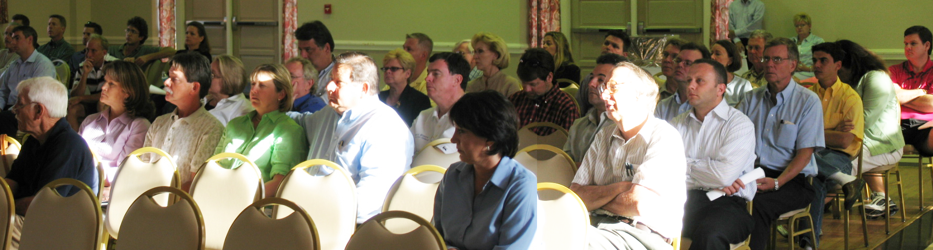
The CPO Agreement
Coordination with OSRE and Department of Justice
Review of model agreements, financial assurance requirements, EPA guidance and Superfund brownfield amendments
Weekly workgroup calls with FDEP and stakeholders

Slide 7
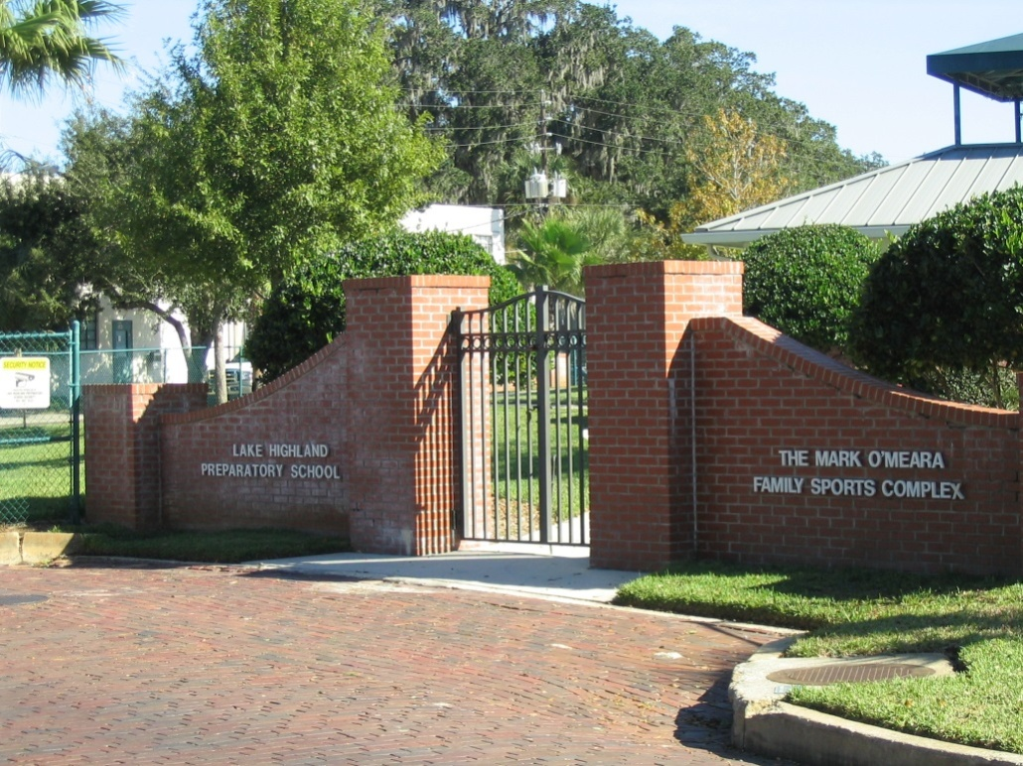
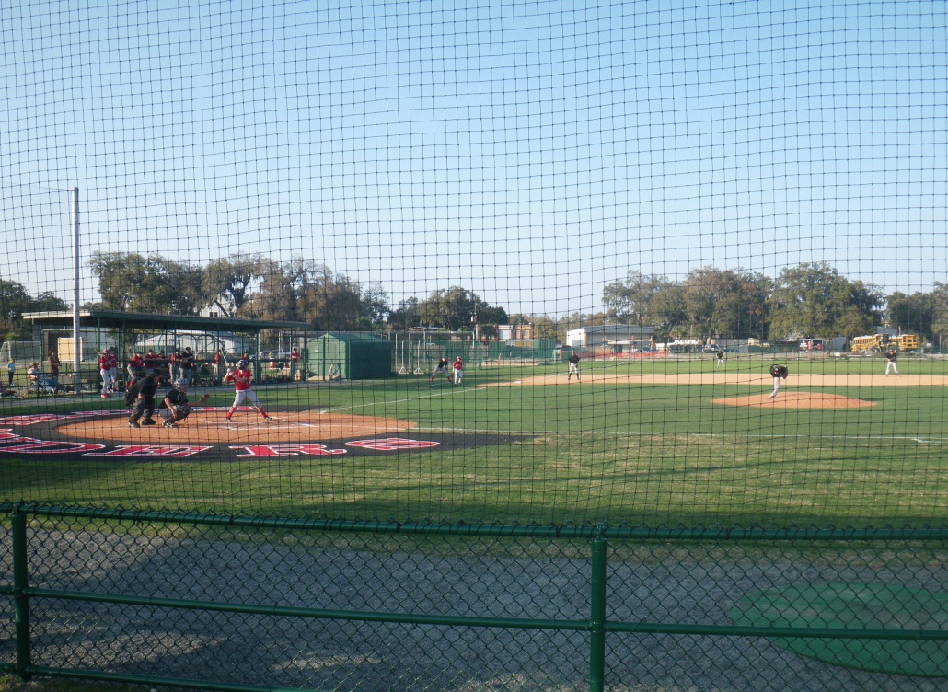
Reuse Outcomes
LHPS O’Meara Sports Complex in active use
Complex expansion (new ball field) and parking opened in January 2011
LHPS planning for additional educational and recreational uses on property
City exploring options for 7-acre area

Slide 8
Other Agreements
Region 4 – BFPP Agreement
Covenant not to sue in exchange for purchase of property which helped finance the clean up
FDEP – Brownfield Site Rehabilitation Agreement (BSRA)
Cleanup liability protection
Lender liability protection
Voluntary Cleanup Tax Credit (VCTC)
Deduct up to $500,000 per year
25% bonus for site rehabilitation completion
Credits are transferable

Slide 9
Reuse Outcomes

Slide 10
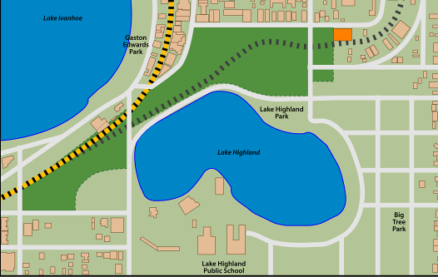
Project Benefits
Expedited site cleanup / Superfund cost savings
Protection of human health and the environment
Removal of community “eyesore”
Public-private redevelopment partnership
New land uses addressing community needs
Expanded school facilities and parking
Increased property values and tax revenues
Redevelopment catalyst for surrounding area

Slide 11
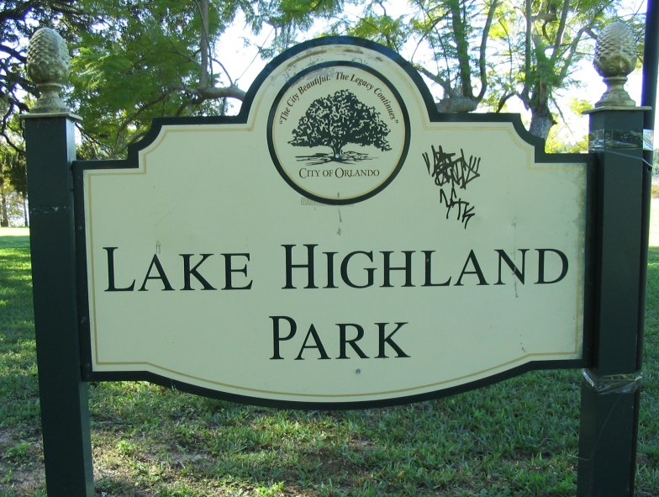
Lessons Learned
Coordinate early and often with
site stakeholders
Engage early with Headquarters
and DOJ for reviews and approvals
Identify opportunities for
stakeholder leadership on cleanup-related projects, with EPA and state oversight
Early engagement can enable communities to access brownfields assistance and resources
Consider opportunities for adaptive management
The journey can be long and winding but worth it

