Slide 1
July 16, 2014

Slide 2
Webinar Overview
Introduction to SRI, Reuse and Capped Sites: Melissa Friedland
Norwood PCBs: Daniel Keefe, EPA Region 1
Ohio River Park: Chris Thomas, EPA Region 3
Rose Park Sludge Pit: Fran Costanzi, EPA Region 8
Brick Township Landfill: Jonathan Gorin, EPA Region 2

Slide 3
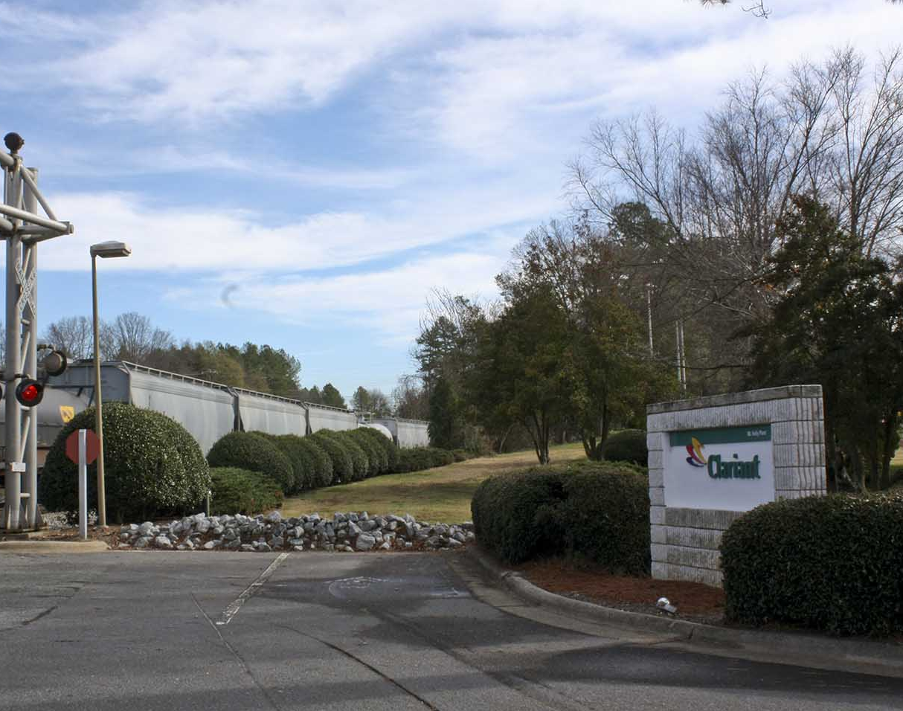
SRI: Superfund Redevelopment Initiative
Working with communities and other partners in considering future use opportunities and integrating appropriate reuse options into the cleanup process

Slide 4
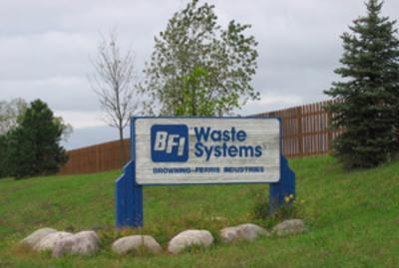
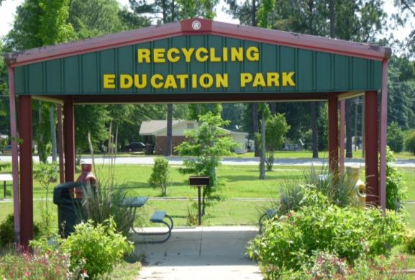
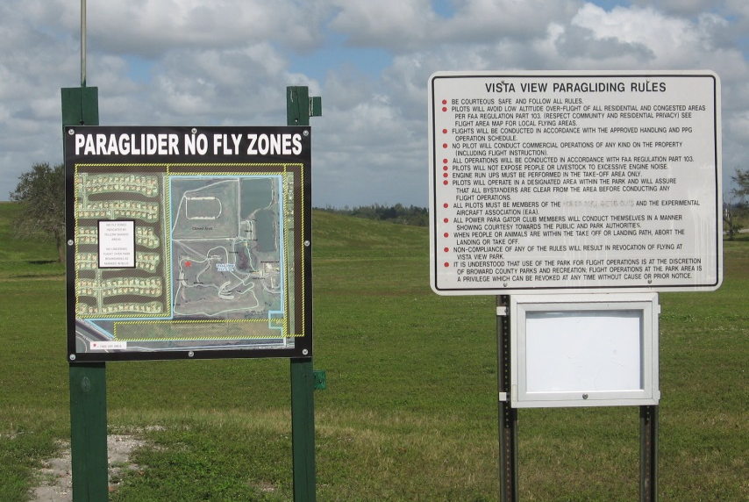
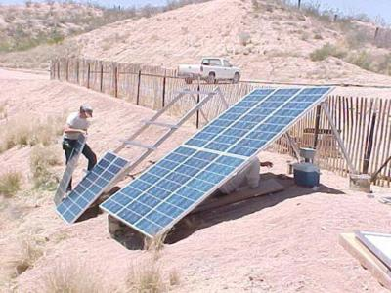
Reuse as a Priority

Slide 5
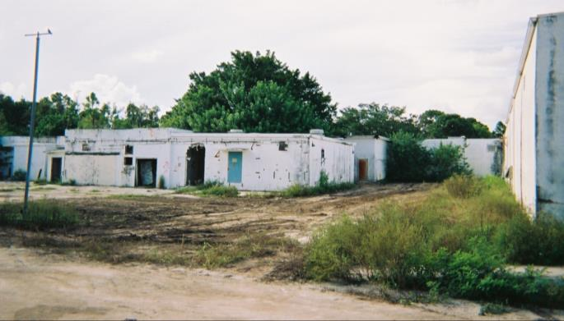
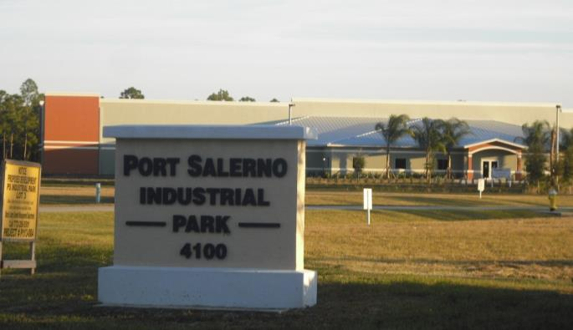
Reuse as a Priority (Cont.)
Benefits
Economic
Environmental
Social
Protection of human health

Slide 6
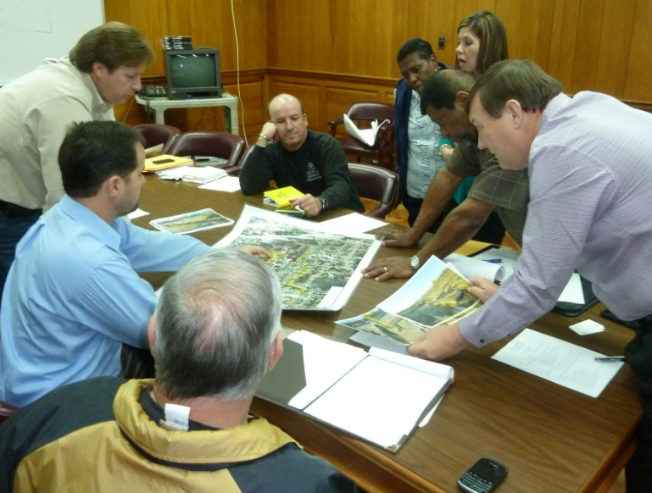
SRI Over the Years: From Pilots to Regional Seeds
Avtex Fibers, one of SRI’s 10 initial Pilot Projects
Picayune Wood Treating, a current SRI Regional Seed project

Slide 7
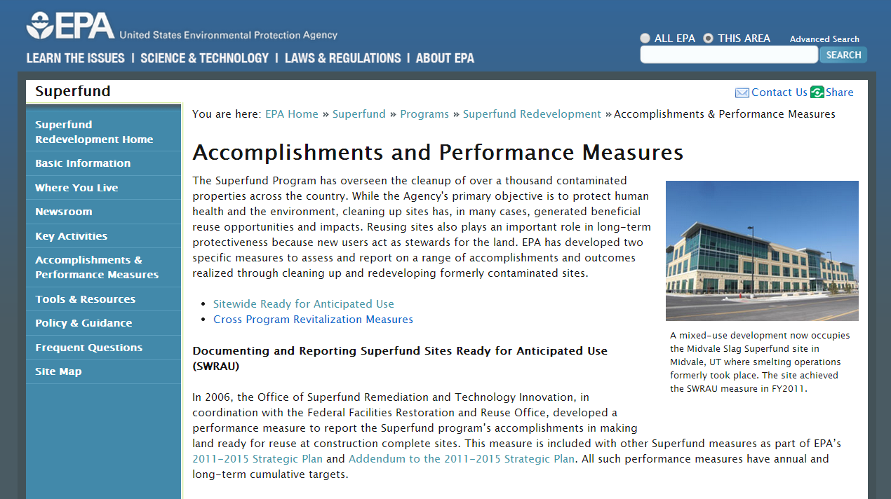
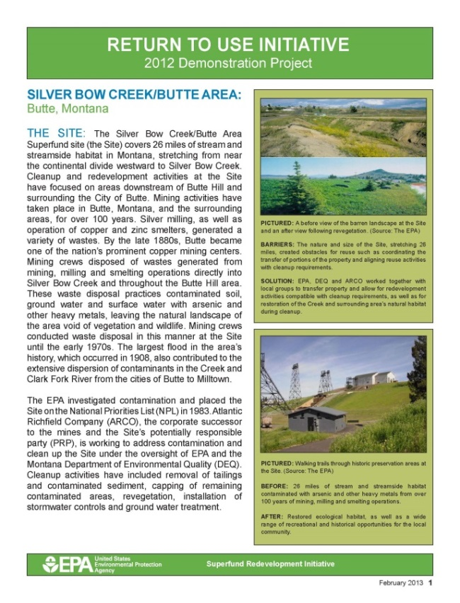
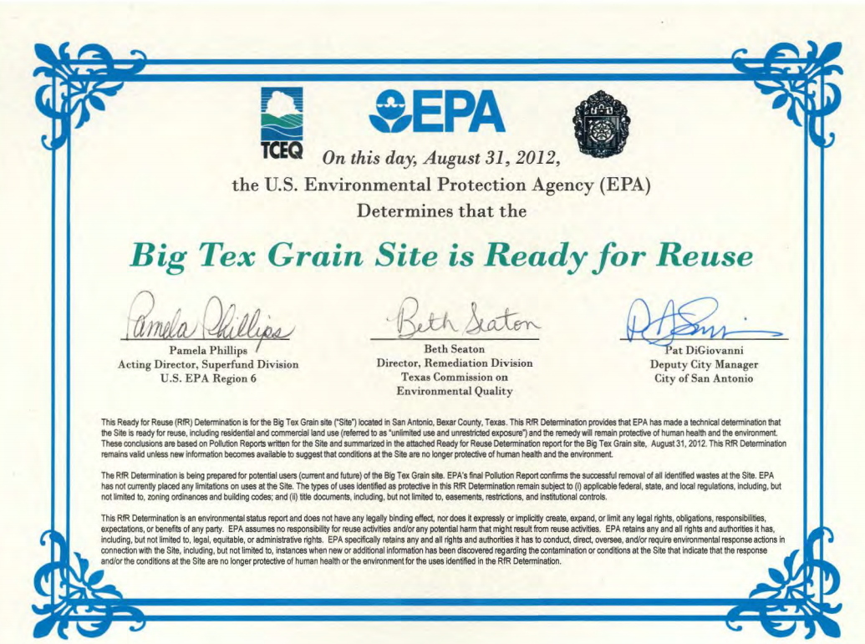
Tools

Slide 8
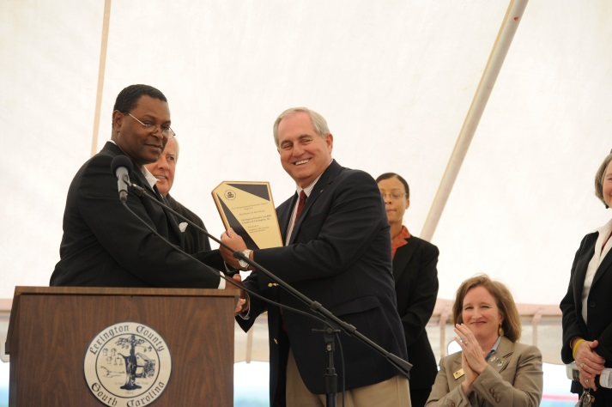
SRI: Then and Now
1990s: Many cleaned-up Superfund sites not in use
1995: EPA’s Land Use Directive
1999: EPA started SRI
2010: EPA’s Reuse Directive

Slide 9
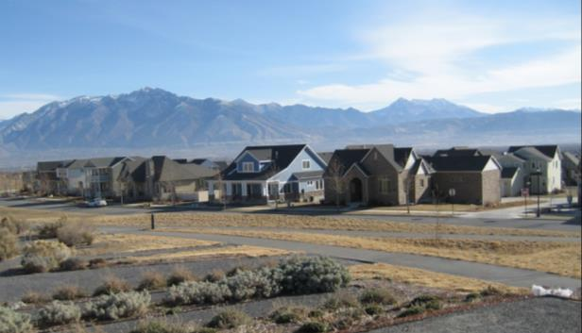
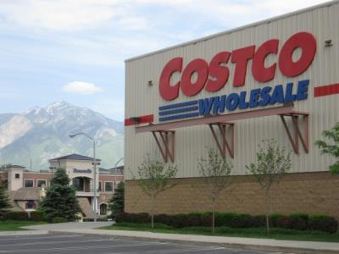
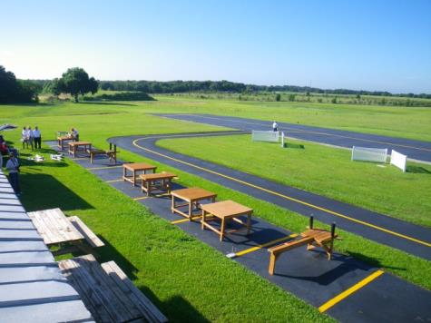
Types of Reuse
Commercial
Public Service
Residential
Industrial
Mixed Use
Agricultural
Green Space
Recreational
Ecological
Alternative Energy

Slide 10
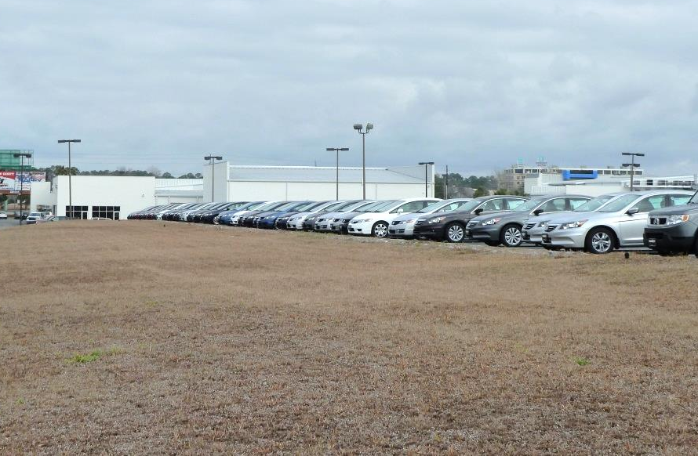
Capped Superfund Sites and Reuse
Caps keep waste in place
Cap type depends on contamination, area climate and future use
Single or multi-layer construction

Slide 11
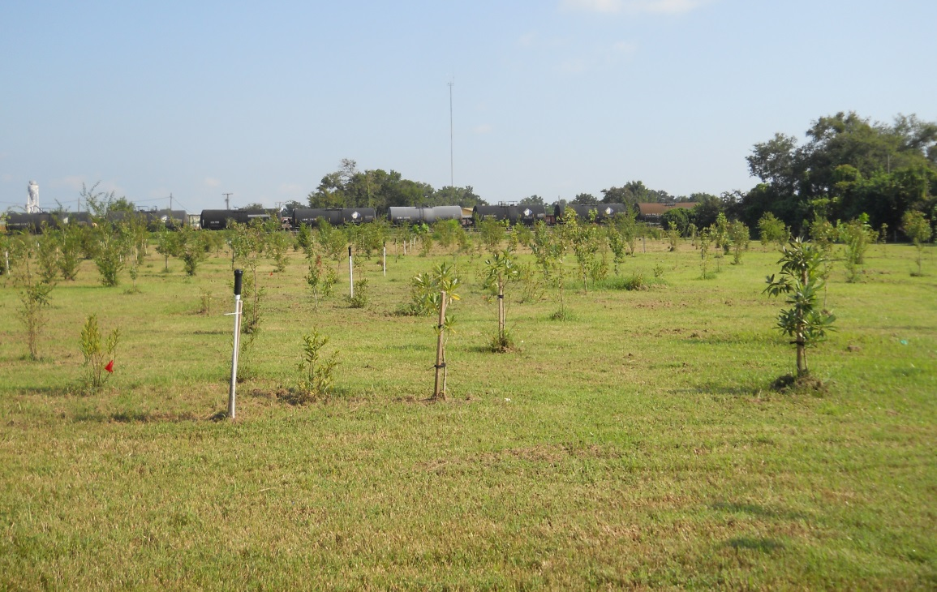
Landia Chemical Company
Ecological reuse and green remediation techniques at a capped site in Lakeland, Florida.

Slide 12
Butterworth #2 Landfill
This capped site in Grand Rapids, Michigan features a bike trail extension and stakeholders are evaluating additional recreational options as well as renewable
energy opportunities.

Slide 13
Dupage County Landfill/Blackwell Forest Preserve
This site is located within the Blackwell Forest Preserve in Warrenville, Illinois and now serves as a recreational area for all seasons.
Source: Forest Preserve District of DuPage County

Slide 14
Mosley Road Sanitary Landfill
Source: http://newsok.com/gallery/articleid/4745683/1/pictures/2560078
Site stakeholders at this site near Oklahoma City, Oklahoma, are implementing a new gas-to-liquid fuel technology demonstration project on site.

