Slide 1
East Helena Smelter East Helena, Montana
Alisa Hefner, Skeo Solutions

Slide 2
East Helena Reuse Theme: Community-wide Revitalization Strategy
Context
Former Asarco Smelter active from 1800s-2001
Much of the land in East Helena affected by contamination from smelter – once the economic engine of the community

Slide 3
East Helena Reuse Theme: Community-wide Revitalization Strategy
Situation
Deferred soil remediation for undeveloped properties required a reuse plan to guide cleanup and community revitalization

Slide 4
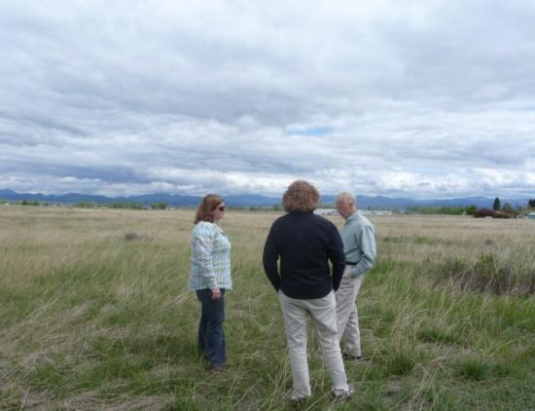
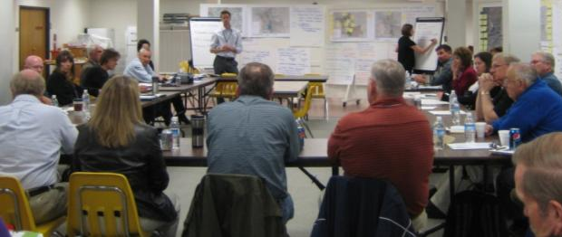
East Helena Reuse Theme: Community-wide Revitalization Strategy
Stakeholders
EPA Region 8
Montana Environmental Custodial Trust
City of East Helena
Lewis and Clark County
Historic preservation & conservation groups
Land owners

Slide 5
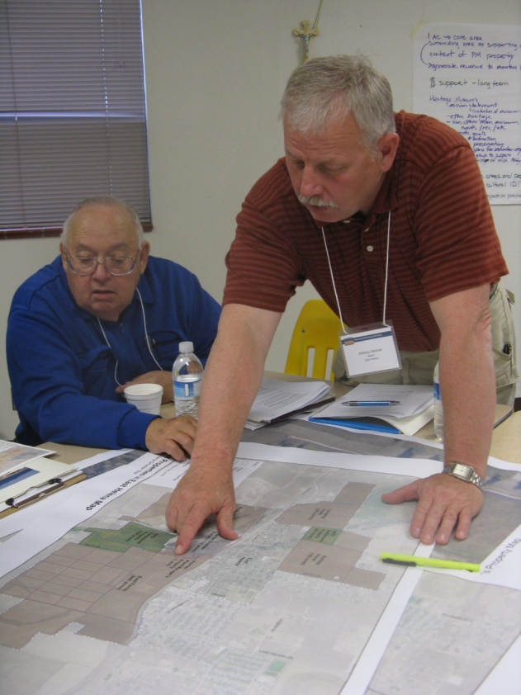
East Helena Reuse Theme: Community-wide Revitalization Strategy
Process
SRI sponsored a reuse planning process and convened a planning charrette with 45 local stakeholders to develop a revitalization strategy
Focus area themes included:
Land use and development
Cultural heritage
Habitat and recreation

Slide 6
East Helena Reuse Theme: Community-wide Revitalization Strategy
TIFSD provided technical assistance in evaluating cleanup options through:
On-site consultation
Participation in day-long charrette to integrate technical expertise into remedy and reuse considerations

Slide 7
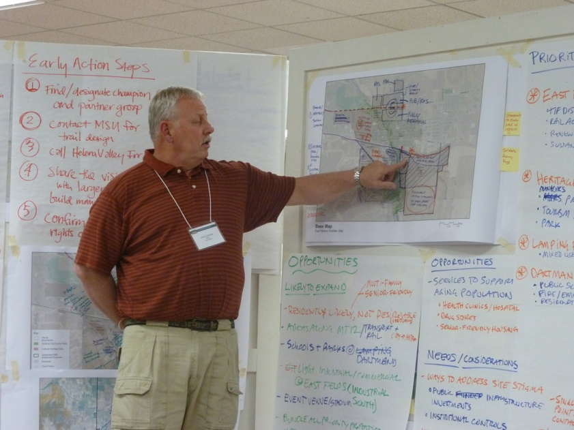
East Helena Reuse Theme: Community-wide Revitalization Strategy
Outcome
Area-wide revitalization strategy to advance revitalization priorities:
Green Infrastructure
Heritage Tourism
Economic Development

Slide 8
East Helena Reuse Theme: Community-wide Revitalization Strategy

Slide 9
East Helena Reuse Theme: Community-wide Revitalization Strategy

Slide 10
East Helena Reuse Theme: Community-wide Revitalization Strategy
Implementation
Montana Environmental Trust Group’s conceptual redevelopment plans/market study

Slide 11
East Helena Reuse Theme: Community-wide Revitalization Strategy

Slide 12
East Helena Reuse Theme: Community-wide Revitalization Strategy
Implementation
Prickly Pear Creek Channel Restoration <http://www.mtenvironmentaltrust.org/east-helena>

Slide 13
East Helena Reuse Theme: Community-wide Revitalization Strategy
Community Benefits
EPA Benefits
Created a common vision
Developed community-wide strategy
Identified near-term actions to guide planning and implementation
Identified range of potential future land use to guide soil cleanup
Increased community understanding of remedial approach

