Slide 1
Reuse Planning at Superfund Sites
A Little Planning
Can Go a Long Way
September 16, 2013

Slide 2
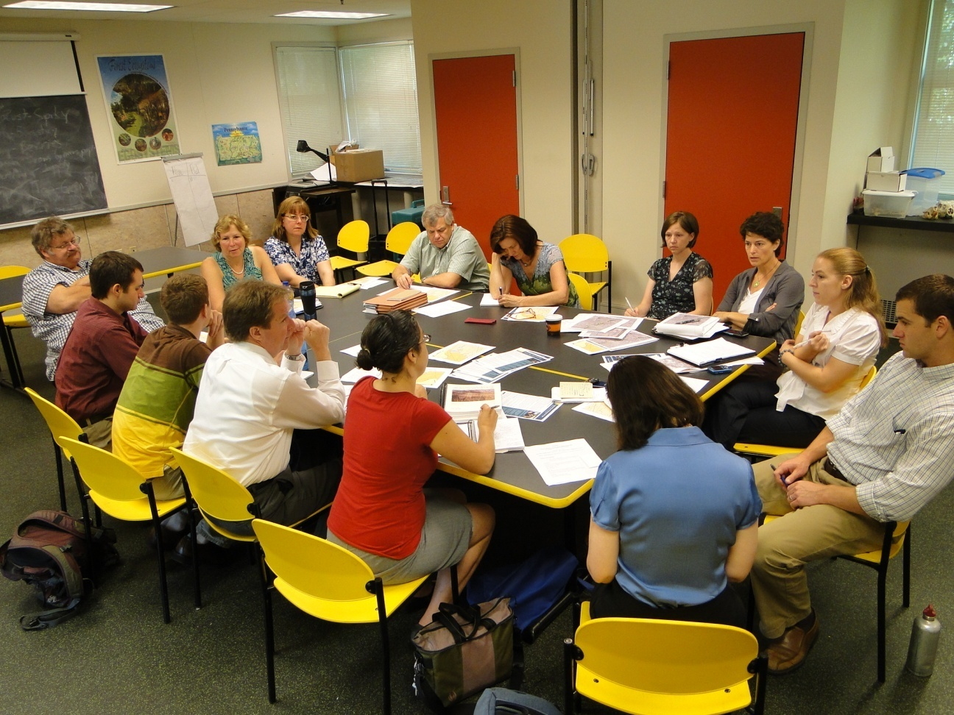
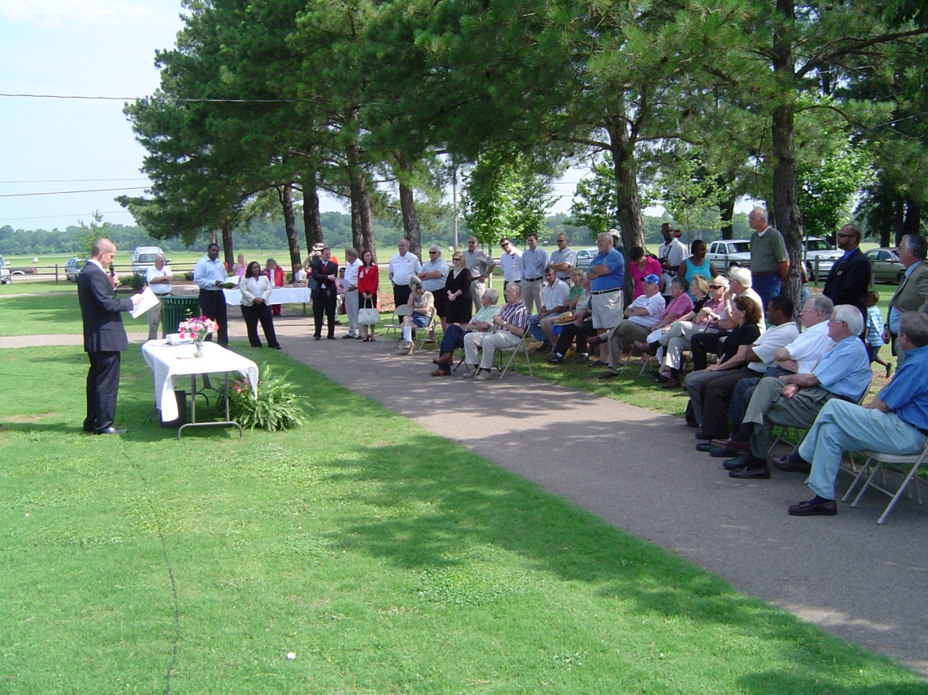
SRI: The Superfund Redevelopment Initiative
Working with communities and other partners in considering future use opportunities and integrating appropriate reuse options into the cleanup process

Slide 3
Webinar Overview
Reuse Planning and Regional Seeds
Case Studies:
Bandera Road (Region 6)
Waste, Inc. (Region 5)
East Helena (Region 8)
Buckbee-Mears Co. (Region 2)
Reuse Planning Tools and Resources
Questions

