Slide 1


Welcome to the CLU-IN Internet Seminar
CEC Training for OSCs...Pesticide Emergencies (FIFRA ER for EPA OSCs)
Sponsored by: EPA Office of Superfund Remediation and Technology Innovation
Delivered: November 13, 2013, 1:00 PM - 4:00 PM, EST (18:00-21:00 GMT)
Instructors:
  Kathy Halbur, EPA Region 5 (halbur.kathy@epa.gov)
  Dan Heister, EPA Region 10 (heister.dan@epa.gov)
  Jim Mullins, Tetra Tech, Inc. (james.mullins52@gmail.com)
  Bob Whittier, EPA Region 10 (whittier.robert@epa.gov)
Moderators:
  Jean Balent, U.S. EPA Technology Innovation and Field Services Division (balent.jean@epa.gov)
Visit the Clean Up Information Network online at www.cluin.org

Slide 2
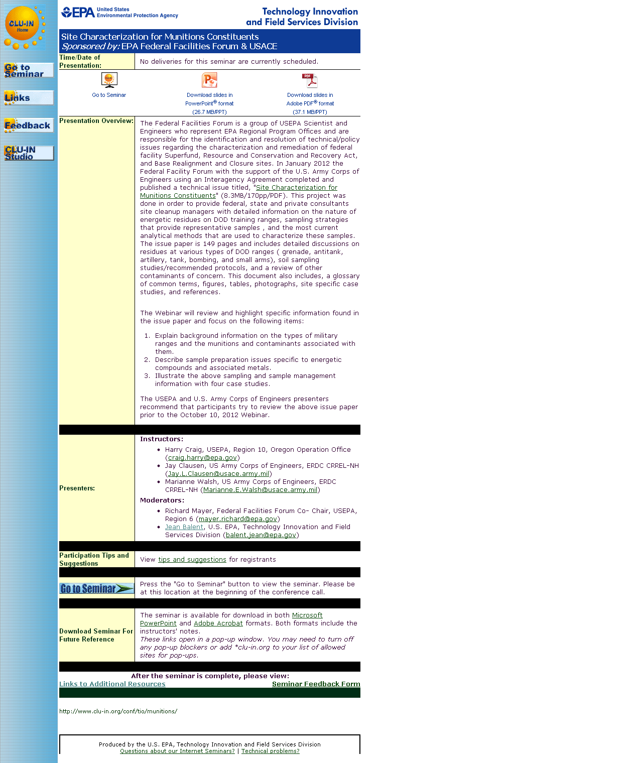
Seminar Homepage
Join the seminar online
Download Slides
Feedback

Slide 3

Housekeeping
Entire broadcast offered live via Adobe Connect
  participants can listen and watch as the presenters advance through materials live
  Some materials may be available to download in advance, you are recommended to participate live via the online broadcast
Audio is streamed online through by default
  Use the speaker icon to control online playback
  If on phones: all lines will be globally muted
Q&A – use the Q&A pod to privately submit comments, questions and report technical problems
This event is being recorded and shared via email shortly after live delivery
Archives accessed for free http://cluin.org/live/archive/
Notes:
Although I’m sure that some of you have these rules memorized from previous CLU-IN events, let’s run through them quickly for our new participants.
Please mute your phone lines during the seminar to minimize disruption and background noise. If you do not have a mute button, press *6 to mute #6 to unmute your lines at anytime. Also, please do NOT put this call on hold as this may bring delightful, but unwanted background music over the lines and interupt the seminar.
You should note that throughout the seminar, we will ask for your feedback. You do not need to wait for Q&A breaks to ask questions or provide comments. To submit comments/questions and report technical problems, please use the ? Icon at the top of your screen. You can move forward/backward in the slides by using the single arrow buttons (left moves back 1 slide, right moves advances 1 slide). The double arrowed buttons will take you to 1st and last slides respectively. You may also advance to any slide using the numbered links that appear on the left side of your screen. The button with a house icon will take you back to main seminar page which displays our agenda, speaker information, links to the slides and additional resources. Lastly, the button with a computer disc can be used to download and save today’s presentation materials.
With that, please move to slide 3.

Slide 4
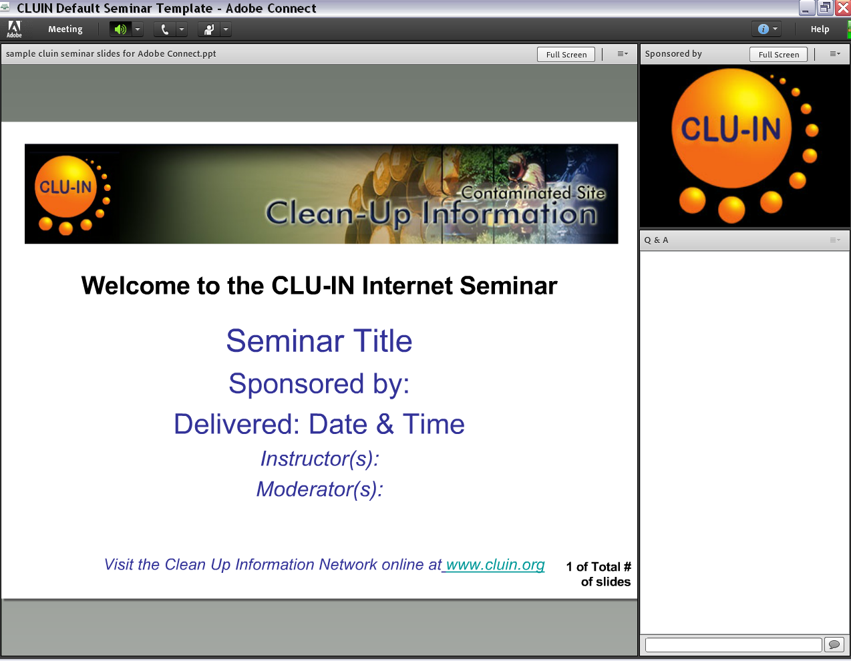


New online broadcast screenshot
Enlarge presentation
Control online audio
View presentation live online here
Information about Sponsors & Speakers
Submit private questions, comments or report technical problems

Slide 5
Instructor Bio
Bob Whittier is an OSC in EPA’s Region 10’s field office in Alaska. Bob has 5 years experience with emergency response in Alaska, and 18 years with the Maine Department of Environmental Protection.
Kathy Halbur is an EPA On-Scene Coordinator in Region 5. Kathy is located in Green Bay, WI. Kathy has been with EPA for nine years; six as an OSC and three years prior to becoming an OSC with ORD’s NHSRC.
Dan Heister is an On Scene Coordinator (OSC) in Region 10 in Portland, OR and has been with the USEPA for twenty-six years. Nine years were in pesticide and toxics enforcement. He has been an OSC for the last thirteen years.
Jim Mullins is a part time employee of Tetra Tech, a support contractor to EPA. Jim retired from the EPA Region 6 Office (Dallas TX) after 25 years in the oil spill and haz mat response organization.

Slide 6
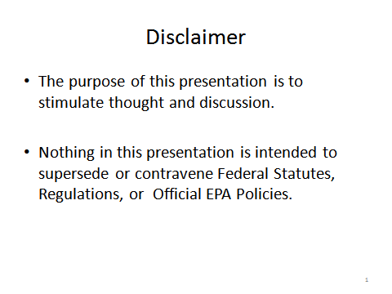
Disclaimer

Slide 7
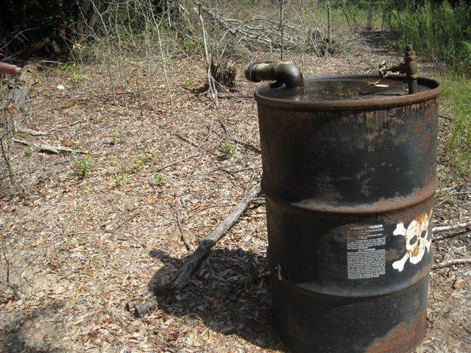
FIFRA and Pesticide ER for OSCs
Introduction
Pesticides and Fed/State Regulations
Case Study / Exercise – Temik Pesticide E.R.
Human Impacts
Hazard Recognition
Case Study – Wildlife Baiting Investigation
Environmental Impacts
Case Study – 15 Mile Creek
Case Study / Exercise – Rodeo Town
Conclusion
Notes:
Pesticide Course Agenda – 2013
fast
We will take about 20 min to speak to the regulations---overview.

Slide 8
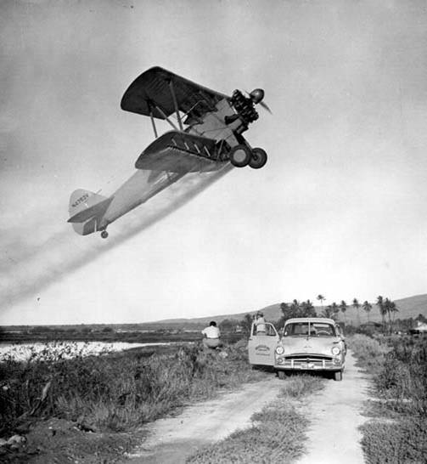
Pesticide Emergencies
Notes:
Discuss overview and how it ties in with the rest of the presentations

Slide 9
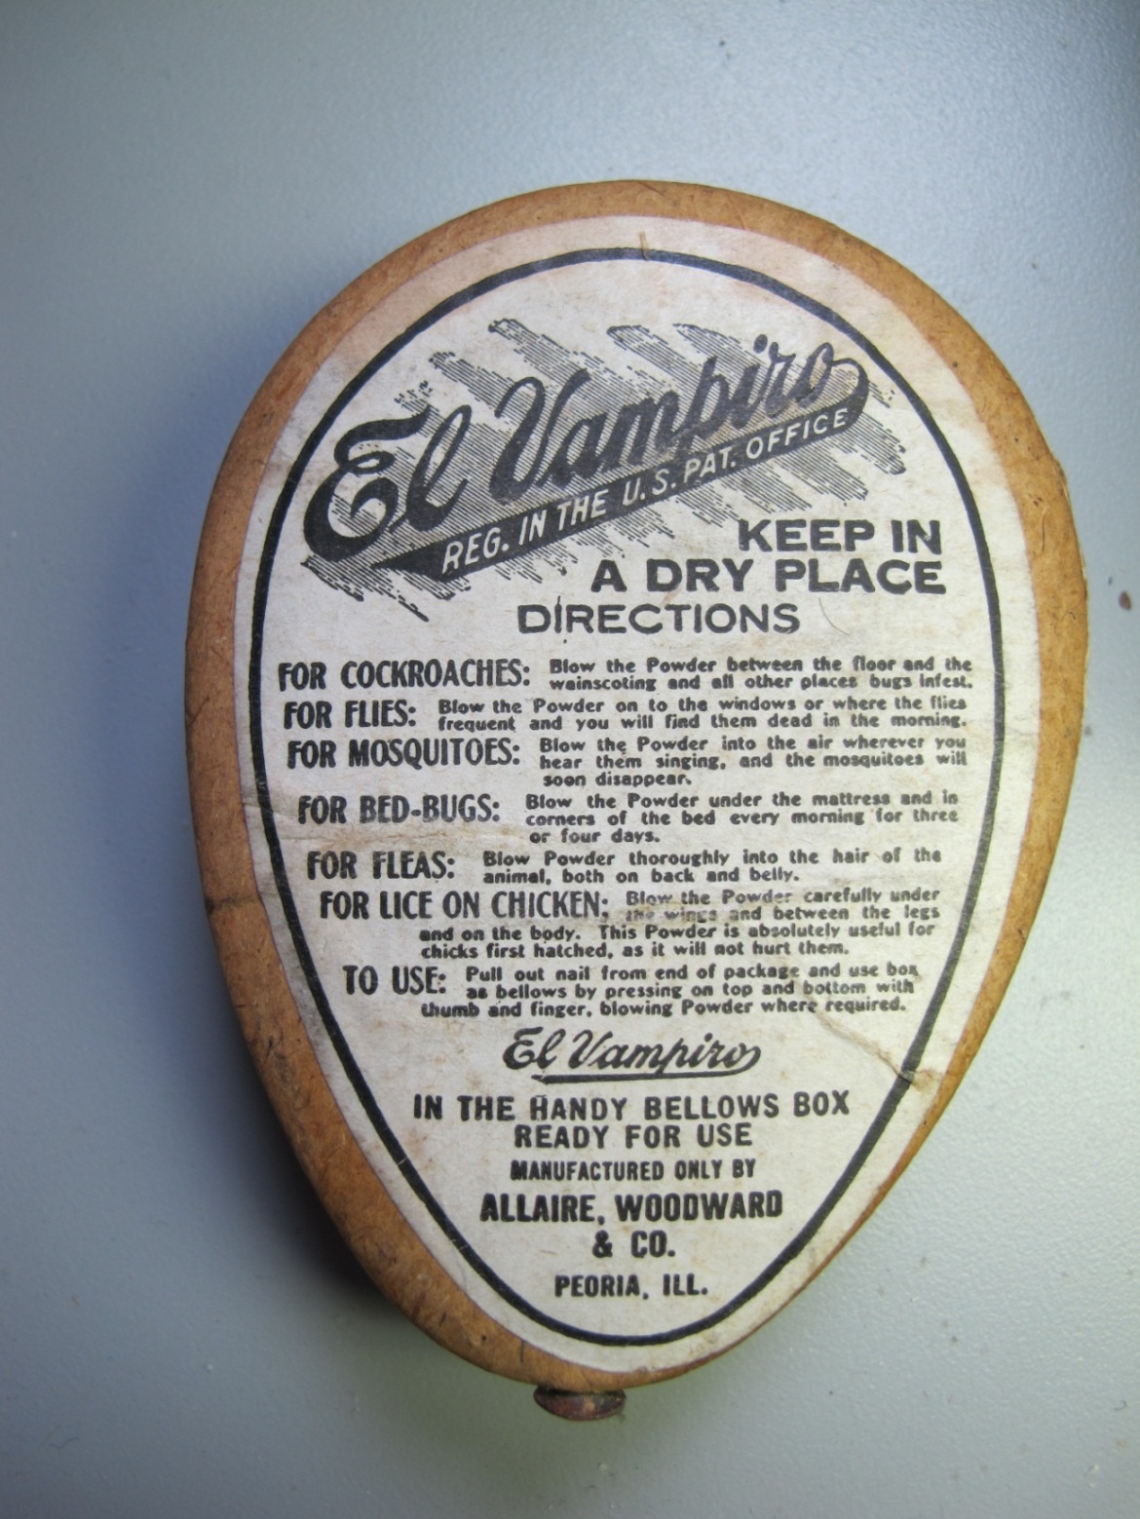
Notes:
A time before regulation or the Snake Oil Era

Slide 10
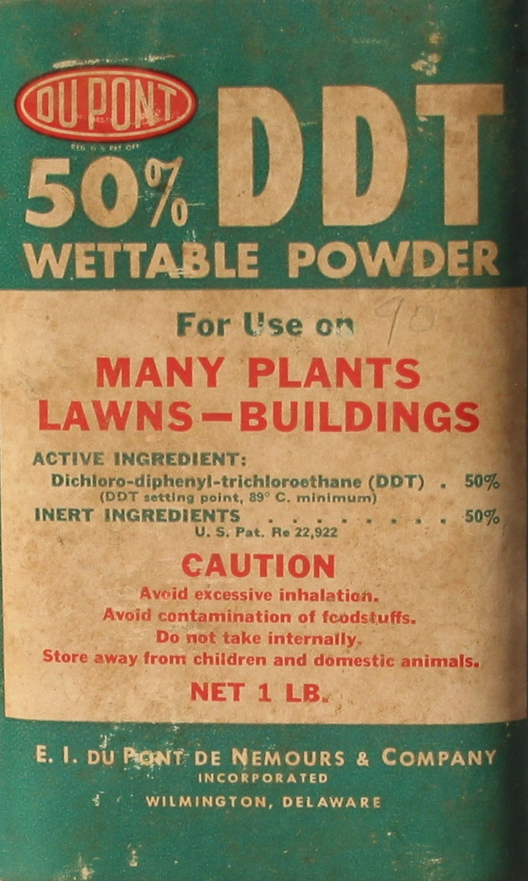
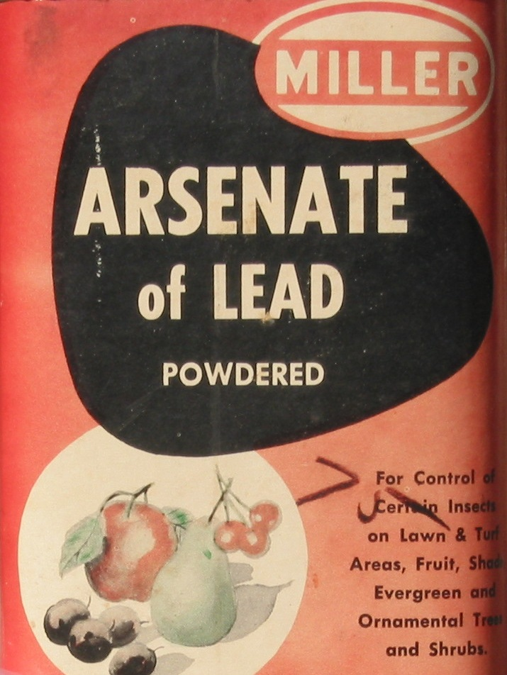
Notes:
Post Snake Oil Pre Carson Era

Slide 11
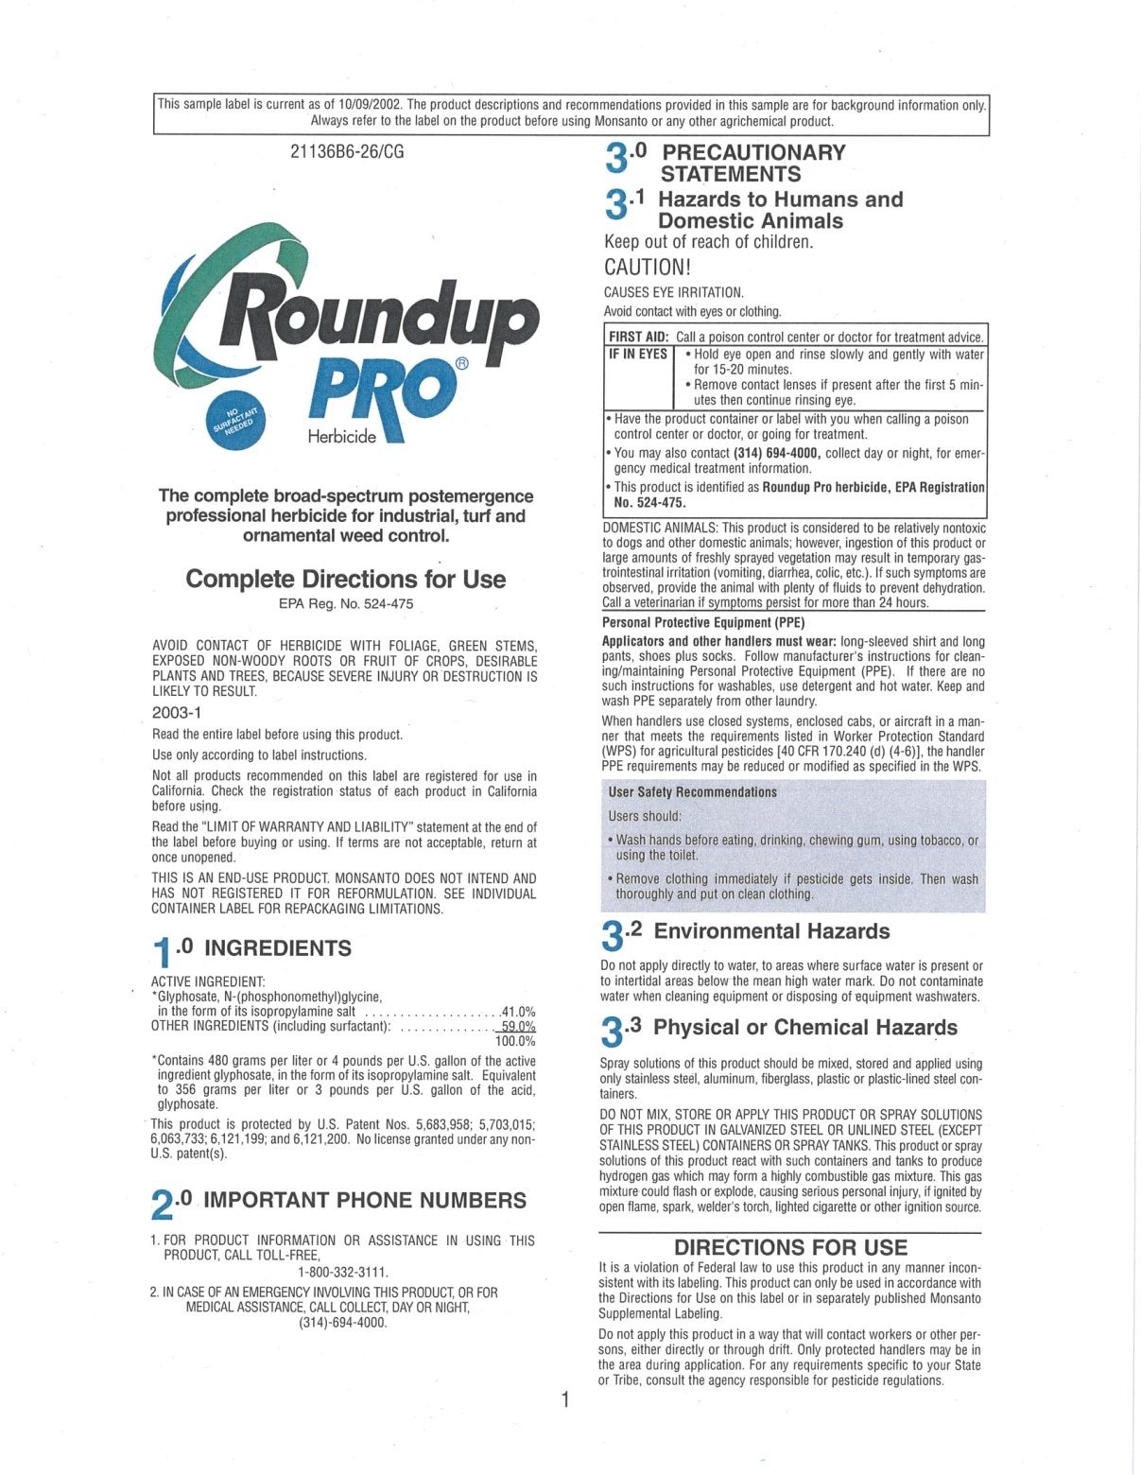
Notes:
The EPA Era, One of six pages, these are just the precautionary statements

Slide 12
Definitions
The Federal Insecticide, Fungicide, and Rodenticide Act (FIFRA) specifies:
  A pesticide is any substance or mixture intended for preventing, destroying, repelling or mitigating any insect, rodent, nematode, fungi, or weeds or any other forms of life declared to be pests. (FIFRA)
  A pest is any form of plant or animal life or virus, bacteria, or other microorganism, except those on or in living man or animals.

Slide 13
CERCLA vs. FIFRA “Mindset”
OPP only EPA program that allows hazardous materials to be willfully introduced into the environment.
CERCLA response
Haz substance, pollutant/contaminant
Release (or threat of) to environment
Discretionary
  Must protect Public Health & Environment
  Define nature/extent of problem-SAMPLE
  Dispose of waste
Normal Pesticide Application
Released to environment
Will not cause unreasonable harm
  Pose health & environmental threats
  Sampling guaranteed to find application
  Residual expected—not waste

Slide 14
Pesticide Classes
Insecticide
Herbicide
Fungicide
Rodenticide
Nematicide
Bactericide
Predacide
Algicide
Miticide
Molluscicide
Slimicide
Silvicide
Disinfectants
Homicide
Fumigants
Repellants
Notes:
Slimicide: Hex Chrome Disinfectatnt: Check your bleach for EPA #

Slide 15
Active Ingredient and Inerts
Active Ingredient: The material that does the claimed action.
Inert* Ingredients: Everything else.
(*Include solvents, surfactants, emulsifying agents and can be flammable, corrosive, and toxic)
Formulations are proprietary
Notes:
Recurring terms inevitable, Jim will be discussing fate

Slide 16
How Pesticides Are Regulated: Federal Level
  The Law = The Label
  USDA: Emphasis on Efficacy (Effectiveness)
  EPA: Human Health, Environment
  Office of Pesticide Programs (OPP)
  Registration, Suspension, and Cancellation
  Regions: Nominal Enforcement, Oversee State Grants
  (EPA’s Oldest and Most Cumbersome Law)
Notes:
Registration is analogous to FDA registration of prescription drugs
Suspension is the beginning of the slipery slope to cancellation. Cancellation rarely has a decent strategy for existing stocks and hence we see a lot of the stuff in barns, garages, and COOPs

Slide 17
The Law--Framework
FIFRA specifies that:
  A pesticide product must be registered by EPA prior to sale or distribution in the U.S. (Sec. 3)
  EPA may grant an exemption from registration for emergencies (Sec. 18)
    Public health exemption
    Crisis exemptions
Notes:
Most relevant to OSC’s Crisis exemption: Capitol Hill Anthrax

Slide 18
The Label: Who, What, When, Where, and How of Use*
Phostoxin: This isn’t a label, it’s an owner’s manual!
* Spills, dumping, abandonment etc.. Not regulated by FIFRA

Slide 19
General and Restricted Use
General
Over the counter available to untrained user
Signal Word Typically
  Caution
Restricted Use
Only available for use by certified applicators
Signal Word Typically
  Danger or Warning
Dealers must keep records of sale
Notes:
Aspirin vs Vicodin
Aspirin vs Vicodin
, Double H records proved valuable in establishing RP,

Slide 20
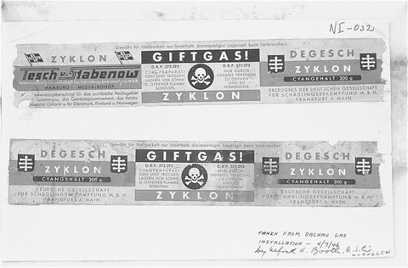
Degesch, the folks who brought you Zyklon B

Slide 21
How Pesticides Are Regulated: State Level
State Ag Agency Typically Lead
Enforces the Law/Label
Certifies Applicators
Registers Pesticides within State
Operate State Labs
Coordinate Pesticide Collections Events
Notes:
Last two bullets most important to OSC

Slide 22
What the State has to Offer*
Knowledgeable Labs
Knowledge of Crops, Growers, Products and Dealers
Assistance interpreting labels
Collection Programs
* Undying love not included
Notes:
The mission of State Ag is to foster agriculture in the state not bust farmers, that doesn’t mean they won’t help.

Slide 23
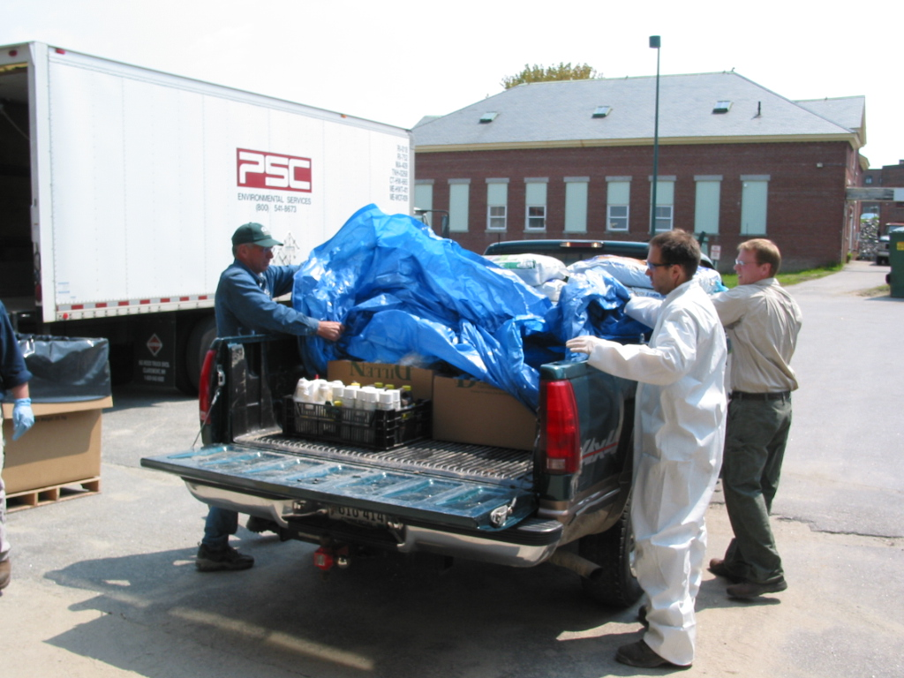
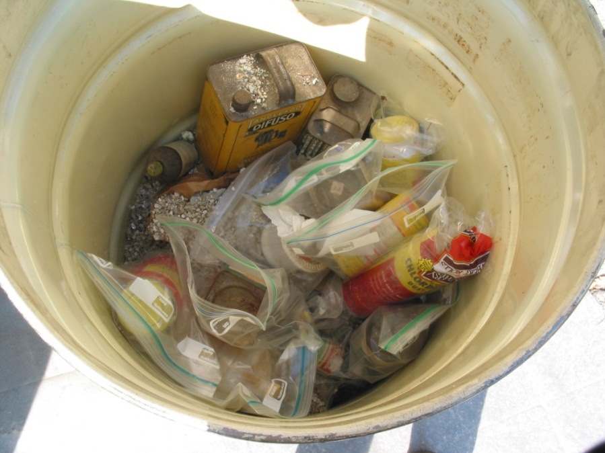

Slide 24
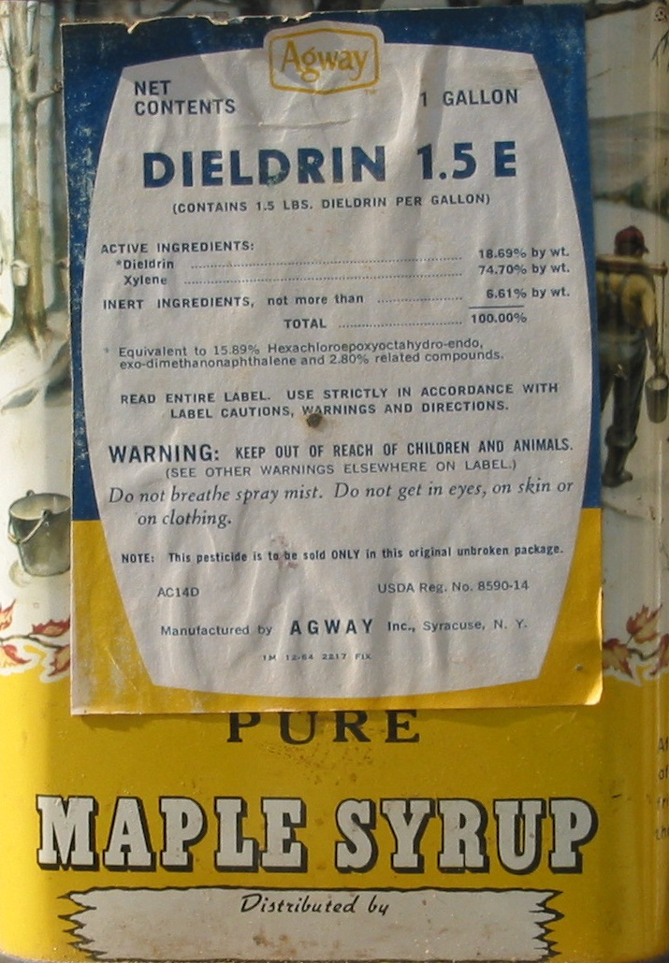
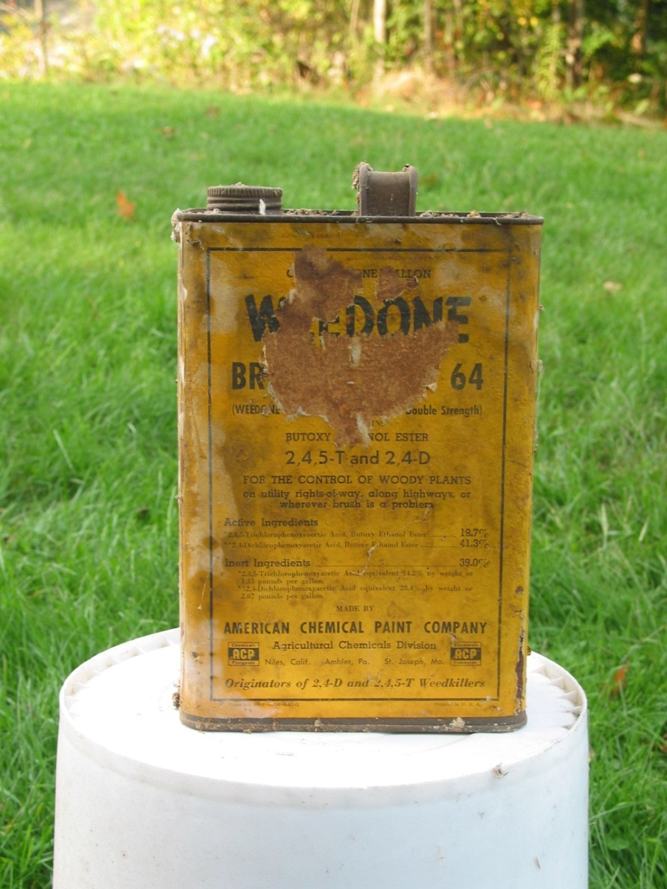
What’s Wrong Here?

Slide 25
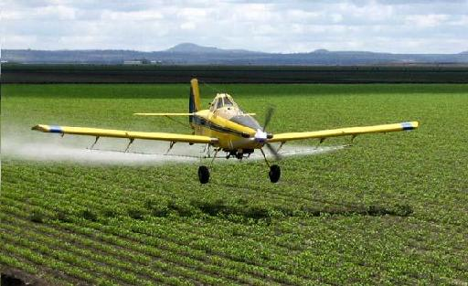
A mint field somewhere in Oregon.
Aerial applicator
Over sprays field
  Sprays non-approved crop
  Sprays farm workers
  Injuries
CERCLA or FIFRA response?
Aerial applicator
Engine fails
  Crashes into river
  Spills pesticide
  Fish kill
CERCLA or FIFRA response?

Slide 26
Pesticide and Superfund Interface
Emergency:
Methyl-Parathion
Anthrax
15 Mile Creek
Removal:
McCormick and Baxter (Wood Treater)
Double H Removal
Notes:
I will go into great detail on 15 Mile Creek.

Slide 27
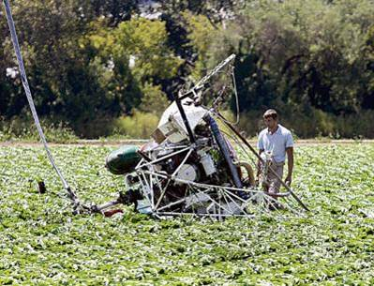
Questions? Comments

Slide 28
FIFRA and Pesticide ER for OSCs
Introduction
Pesticides and Fed/State Regulations
Case Study / Exercise – Temik Pesticide E.R.
Human Impacts
Hazard Recognition
Case Study – Wildlife Baiting Investigation
Environmental Impacts
Case Study – 15 Mile Creek
Case Study / Exercise – Rodeo Town
Conclusion
Notes:
Pesticide Course Agenda – 2013

Slide 29

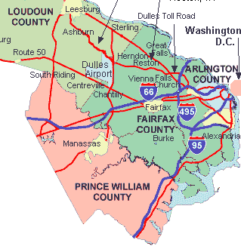
REOC Region 3
TV in Response Center shows a truck accident with a fire.
Fire Dept has closed I-95
  I-95 carries 45,000 vehicles per day
  Aerial news pics are good
FIRE

Slide 30
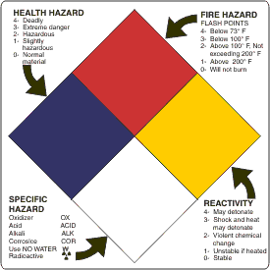
NFPA Diamond from TV
1
4
1
Notes:
This is why the EOC has local TV feeds
OSC look for these signs
What does this tell you?
-highly toxic
-flash point above 200 F
-Unstable if heated
-no specific hazaef info

Slide 31
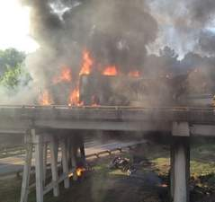
How does NFPA fire diamond affect OSC?
  Identify materials on truck?
What does Red Phone Duty Officer do?
Notes:
Diamond is aimed at firefighters, not OSCs. It does not clearly identify the material. This diamond came from a mfg of Temik, and the explanations outside the diamond are added on (not from mfg)

Slide 32

RED Phone Duty Officer Response
A Calls Fire Department
B Calls State Police
C Calls boss - “I 95 closed for vehicle fire”
D No action
E Calls HQ
Notes:
Pick as many as apply……..choice D is only incorrect
Lets discount item D---read the newspaper---not your lazy OSC—however with limited info available, this option is supportable
“E” is likely most correct….and in the order listed. Who will call HQ? Regional protocol (thresholds?) for calling HQ?

Slide 33
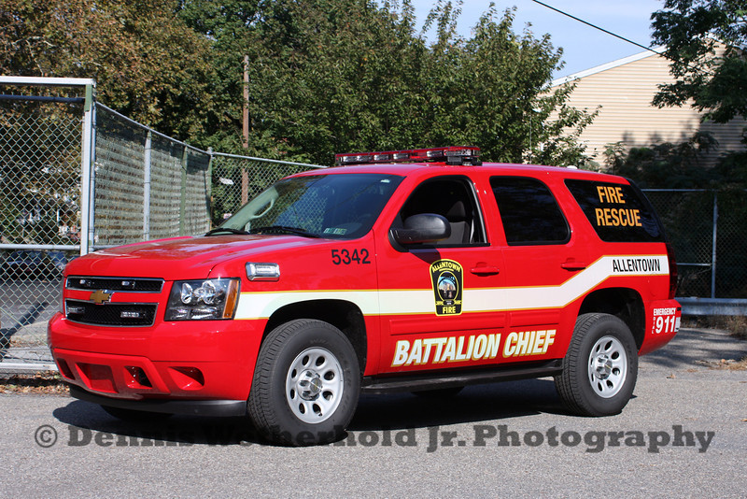
New Fire Department Info
Driver killed
Truck engulfed
  Company name/logo destroyed
Slow info gathering
  Fire not being fought
  Pesticides (NOS) on board?
  FD seeking more info – will call back
Notes:
No passengers on board
FD ELECTED to NOT fight fire due to potentialpesticide danger

Slide 34

RED Phone Duty Officer Questions
What is in the area of the accident?
Weather conditions?
Duty Officer to dispatch OSC and START?
To what purpose?
Safety advice?
Notes:
Engage students with each question …”book answers” on next slide

Slide 35
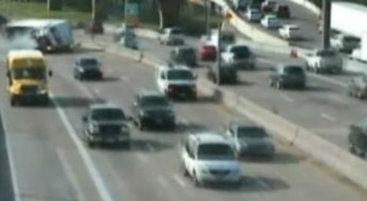
Answers
Dense residential area near accident
July in North VA—near 95F, 30-50% chance of scattered PM thunderstorms
Response OSC & START dispatched
  Coordinate with Battalion Chief on scene
  Possible air monitoring
  BIG Freeway shut down
Stay far away –use binoculars
Notes:
Fast slide

Slide 36

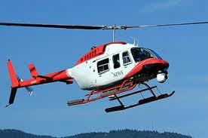
SKY Witness 4
More helo close up video
DOT placard visible
  UN2757
So what?
Notes:
What is UN number?
US DOT (U.S. Department of Transportation) has definitions for each hazmat placard used in transportation. Title 49 of the United States Code of Federal Regulations (49CFR) also known as the Federal Motor Carriers Safety Regulations (FMCSR) requires the use hazardous materials placards when shipping hazardous materials cargo and dangerous goods in the United States. Canada, Mexico and many other countries have similar regulations that also require the use of these placards.
Four Digit UN Numbers on Placards UN/NA numbers found on bulk placards refer to specific chemicals or groups of chemicals and are assigned by the United Nations and/or the United States Department of Transportation. USDOT 2004 Emergency Response Guidebook will help you find out what the four digit numbers you see on placards mean.
What value to OSC?

Slide 37

Need Tech Info
What the heck is UN2757?
http://npic.orst.edu/
Search
Notes:
Npic does not find UN2757 (in any combination I tried)
Google does

Slide 38

Need Tech Info
https://www.google.com/webhp?hl=en&tab=mw
UN2757
Results: Carbamate Pesticide, Solid, Toxic
Specific pesticide or family of pesticides?

Slide 39

Dispatched OSC
Reports In
Fire extinguishment not attempted
Fire Dept reports TEMIK pesticide on board
Battalion Chief to EPA
  Should I call for evacuation?
  Can EPA perform air monitoring?
  What is needed if we have rain?
  Should we restrict air space (news choppers)?

Slide 40
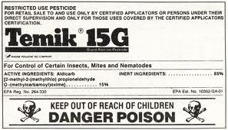
Red Phone Duty Officer Tech Support
http://npic.orst.edu/
Temik
Notes:
Exercise in use here

Slide 41
EPA Recommendations to FD
NPIC Data on Temik
Water solubility?
  EPA Recommendation on fire fighting/rain?
Toxicity
  Temp evac?
    Threshold for lifting?
  Air monitoring?
  Air space restrictions?
Notes:
What are you going to tell the Battalion Chief?

Slide 42


Public Affairs Wants Statement
  What can you give in next 3 minutes?
  Who will get this together for PA?
Notes:
NPIC info

Slide 43

Delegated FIFRA State Agency
Will VA Dept AG help here?
  Why?

Slide 44

9 hrs for fire to burn out
START did air monitoring downwind?
Residential area
  Evac 3 schools & 3 dozen homes
  Others shelter in place for 12 hrs
I-95 closed for 12 hrs
Media “circus”

Slide 45
1 Fatality (driver), 17 first responders seek hospital care
Weather issues- heat stress in PPE, dehydration
Consequence Management - Insurance of carrier hired a cleanup contractor who coordinated with VA Dept of Ag for cleanup levels and disposal.

Slide 46

Notes:
This exercise is based on a real example of a truck wreck in April 1994 on I-30 near Dallas. TX.

Slide 47
FIFRA and Pesticide ER for OSCs
Introduction
Pesticides and Fed/State Regulations
Case Study / Exercise – Temik Pesticide E.R.
Human Impacts
Hazard Recognition
Case Study – Wildlife Baiting Investigation
Environmental Impacts
Case Study – 15 Mile Creek
Case Study / Exercise – Rodeo Town
Course Closing and Evaluation
Notes:
Pesticide Course Agenda – 2013

Slide 48
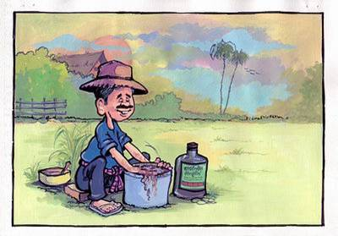
Human Impacts
Module 4
Notes:
Pesticides are designed to be absorbed by a target organism, unfortunately they aren’t particular.

Slide 49
All pesticides are designed to disrupt
essential metabolic processes
of the target pest.
Neural
-Hormonal
-Cellular
-Structural
These modes of action can have similar
effects on humans
Notes:
Origin of the term Pest—any plant, animal, organism not desirable. “cide”—from Latin root meaning “cut” or “kill”
The nerves of a cockroach function exactly like those of an alligator or a human. Many of the pesticides started out as “chemical cousins” of WW1 and WW2 chemical nerve agents. Post war use of the technology applied as “pesticide”

Slide 50

Dose-Time Relationship
The effect of a pesticide is dependent on a number of factors. The most important factor is the dose-time relationship.
  Dose is the quantity of a substance that a surface, plant, or animal is exposed to.
  Time means how often the exposure occurs.
The dose- time relationship is how much of the substance is involved and how often the exposure to the substance occurs.
This relationship gives rise to two different types of toxicity to know and understand:
  Acute
  Chronic
Notes:
Acute definition-- having a sudden onset
Chronic definition--marked by long duration or frequent recurrence
Definitions are not specific time (2 min or 3 days or 6 months)

Slide 51

Acute Toxicity
Acute toxicity of a chemical refers to its ability to cause systemic damage as a result of a one-time short-term exposure to a chemical.
The signal words on the label
are based on the acute toxicity
of the pesticide.
Acute toxicity may be measured as acute oral (through the mouth), acute dermal (through the skin), and acute inhalation (through the lungs).

Slide 52
Acute Toxicity Measures and Warnings
Signal words indicate the relative acute toxicity of the product to humans and animals.
The three possible signal words are:
  CAUTION means the pesticide product is slightly toxic if eaten, absorbed through the skin, inhaled, or it causes slight eye or skin irritation
  WARNING indicates the pesticide product is moderately toxic if eaten, absorbed through the skin, inhaled, or it causes moderate eye or skin irritation
  DANGER means that the pesticide product is highly toxic by at least one route of exposure. It may be corrosive, causing irreversible damage to the skin or eyes.
Notes:
The colors are a crude acute toxicity analogy to a traffic light.
Green-lowest acute tox
Yellow –increased tox
Red-most tox

Slide 53
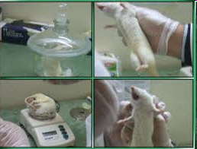
Chronic Toxicity
Chronic toxicity refers to harmful effects produced by long-term, low-level exposure to pesticides.
There is not a standard measure like LD₅₀ for chronic toxicity.
Notes:
By definition, the testing for chronic toxicity takes a long time----may be years of data gathering

Slide 54
Routes of Entry
There are three ways in which pesticides may enter your body.
  Dermal (through the skin)
  Inhalation (through the nose and respiratory system
  Oral (through the mouth and digestive system)
Notes:
Different rates of exposure via each route of exposure

Slide 55
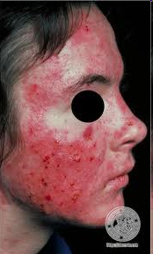
Dermal Entry
Wet, dry or gaseous forms of pesticides can be absorbed through the skin.
Entry may occur any time a pesticide is mixed, applied, or handled, and is often undetected.
Skin varies in its capacity to act as a barrier to pesticide absorption.
Notes:
If time---use reference and determine which route of exposure is most significant for Carbofuran?

Slide 56
Comparative Rates of Dermal Absorption for Different Parts of the Body
Absorption continues to take place on the affected skin area as long as the pesticide is in contact with the skin.
Seriousness of the exposure depends on the size of the skin area contaminated, the length of time the material is in contact with the skin, and the amount of pesticide on the skin.
Notes:
Dermal sorption of a given pesticide varies on different parts of the body.

Slide 57
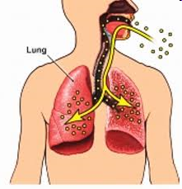
Inhalation Route
Whether as dusts, fumes, or
spray mists, pesticides can be
drawn into your lungs as
you breathe.
Inhalation of pesticides can occur by breathing smoke from burning containers; breathing fumes from pesticides while hazcating; and inhaling fumes while consolidating mixtures.

Slide 58
Oral Route
Pesticides can enter the body
through the mouth (also
called ingestion).
More likely to occur as the result of carelessness such as not wearing donning proper PPE or inattentive personal hygiene
Notes:
Hygiene issue….wash hands frequently.

Slide 59
Which Route is More Important?
You can be poisoned no matter which way pesticides enter your body.
  Some pesticides can enter all three ways and poison you (e.g., parathion is toxic regardless of how it is absorbed).
The dermal and inhalation routes of entry are likely to be the most important routes.
Liquid pesticides containing solvents and oil based pesticides are absorbed quickly compared to dry pesticides.
Notes:
If time—ask students to use references to evaluate these bullets for pesticide Carbofuran

Slide 60
Effect of Exposure
Exposure of pesticides may also result in the following:
  Carcinogenic effects
  Mutagenic effects
  Oncogenic effects
  Reproductive effects
  Teratogenic effects
Notes:
carcinogen -Agent (chemical, physical or biological) which is capable of increasing the incidence of malignant neoplasms, thus causing cancer.
mutagen - An agent, such as a chemical, ultraviolet light, or a radioactive element, that can induce or increase the frequency of mutation in test animals
oncogenic -- giving rise to tumors or causing tumor formation; said especially of tumor-inducing viruses
A teratogen is any substance that can cause malformation of the fetus during pregnancy.

Slide 61
In Review
The effect of a pesticide is dependent on a number of factors – the most important is the dose-time relationship.
There are three ways pesticides may enter your body – dermal, inhalation, and oral
The effects of toxicity and exposure are many and varied.
There are two component categories associated with pesticides – active and inert

Slide 62
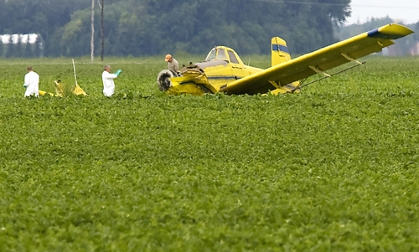
Questions?

Slide 63
FIFRA and Pesticide ER for OSCs
Introduction
Pesticides and Fed/State Regulations
Case Study / Exercise – Temik Pesticide E.R.
Human Impacts
Hazard Recognition
Case Study – Wildlife Baiting Investigation
Environmental Impacts
Case Study – 15 Mile Creek
Case Study / Exercise – Rodeo Town
Conclusion
Notes:
Pesticide Course Agenda – 2012

Slide 64
Module V
HAZARD RECOGNITION
Robert Whittier
OSC, Region 10

Slide 65
HAZARD RECOGNITION
Anatomy of the label
Nomenclature, Formulations
PPE & Decon
Pesticide References

Slide 66

Most Abused Label Statement
“Read and Follow Label Instructions”
Found on every single label
Encourage OSCs to READ
Tips on label info & organization
Benefits OSC performance
  Protecting Health and Safety
    Workforce, Safety of Public, Environment
Notes:
By way of introduction much of this module focuses on the pesticide label.
-The REAAD & FOLLOW is on every label & is really fundamental
-possibly the most “under complied with” part of the label
-many issues with pesticide use and disposal would be much better managed if this instruction were closely followed
-we want to start by telling OSCs there is a lot of job relevant info on labels
-protecting the health and safety of workers & public is always #1 objective
BUT YOU MUST READ THE LABEL!!!!
label info will not otherwise reach you—no osmosis, no magic. Just read
Side note—the label has evolved over the 60+ year history of the program…and many of these changes made the label longer, more detailed, and provided additional info….unfortunately some of that discourages reading…Dan will discuss in more detail
Oh…and there is one more really good reason on next slide

Slide 67

Terrific Reason to
Read/Follow the Label
“It is a violation of Federal Law to use this product in a manner inconsistent with its labeling.”
Notes:
30 sec
This is a typical “MISUSE STATEMENT on most labels
Lets begin now that you have been given the “READ” mantra

Slide 68
“The Label”
A considerable amount of research and development goes into pesticide labeling provides useful information to the applicator, and to the OSC during a response.
0-3
yrs
Test tube to Label
10 yrs +
Product Development
Application
5-7
yrs
Registration Review
Toxicology tests
Degradation studies
Ecological effects
Exposure assessment
10+
yrs
EPA Approval ?

Slide 69
What a Pesticide Label is depends on who you are….
To the manufacturer:
The label is a permit to sell.
To the federal or state government:
The label is the means to control the sale, use, distribution, storage, and sale of the product.
To the buyer or user:
The label is the source of information on how to use the pesticide correctly and legally.
To the OSC
The label provides useful information to responders in the event of a pesticide release….but that is not the primary label purpose

Slide 70
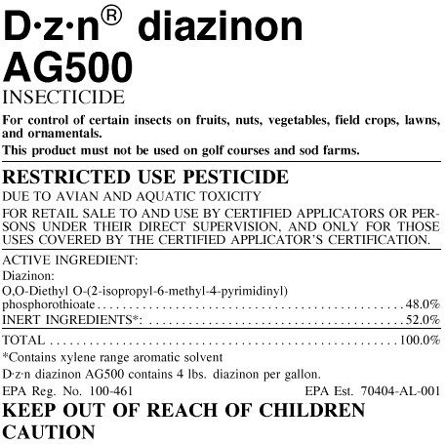
Parts of the Label
1. Trade name or Brand Name & Chemical Name:
The trade name is simply the manufacturer's proprietary name.

Slide 71
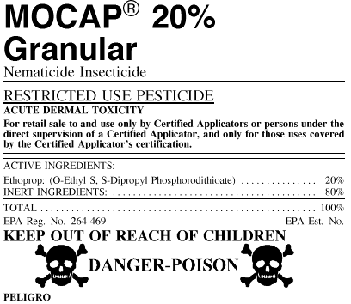
Name and address of manufacturer
Net contents
4.
3.

Slide 72
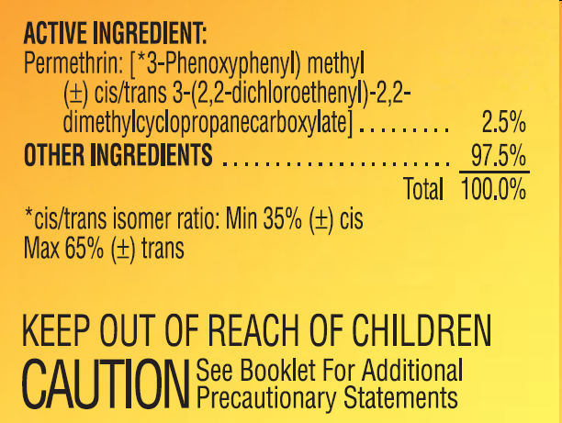
Parts of the Label
5. Ingredients statement. The ingredient statement indicates what active and inert ingredients are in the container. The common name is the generic name accepted for the active ingredients. The chemical name is the ingredients formula.
For example: common name: Banol®
chemical name: Propyl-3 {3-dimethylamino)propyl}-carbamate
monohydrochloride
Note: Inert ingredients for a pesticide formulation may have hazards of their own ….. and be a very large part of the total product !!!!
6. Amount of active ingredient. Expressed in pounds/gallon, or as a percentage
Notes:
Note that in this partial label, the inerts are 97% of the total…VERY IMPORTANT portion of this product

Slide 73

Parts of a Label
Signal words and symbols. -- signal word describes level of human danger
Caution: Slightly toxic orally, dermally, or through inhalation or causes minor skin/eye irritation.
Warning: Moderately toxic orally, dermally, or through inhalation or causes moderate skin /eye irritation.
Danger: Highly toxic and/or corrosive. One teaspoon can be lethal

Slide 74
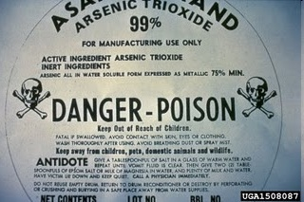
Precautionary statements.
These statements usually follow a signal word to indicate the type of hazard.
Example: Danger—Poison—May be fatal if swallowed
Danger—Corrosive—causes eye damage and severe burns
Environmental hazards:
This product is highly toxic to bees
This product is toxic to fish
Do not apply when runoff is likely to occur
Physical or chemical hazards. Flammable, corrosive

Slide 75
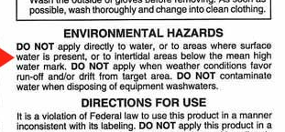
Example
LABEL HAZARD INFO
Notes:
30 second example—OSCs relevant info from the label

Slide 76

OTHER STATEMENTS
Child Hazard Warning. “Keep out of reach of children”
Symbols for highly toxic chemicals. Skull and crossbones symbol, corrosive, etc.
Statement of practical treatment. First aid treatments, eyes-flush with water, skin-wash immediately, etc.
Referral statements. Notes for physicians exposure or poisoning.
Other precautionary statements:
Do not contaminate food or feed.
Remove and wash contaminated clothing before reuse.

Slide 77

Parts of the Label
Use classification:
RESTRICTED-USE PESTICIDE
For retail sale and use only by
Certified applicators or persons
Under their direct supervision
And only for those uses covered
By the certified applicator’s
Certification.
Misuse statement
Directions for use**
Reentry statement**
Category of applicator
Storage and disposal**
.

Slide 78
Formulations & Adjuvants
Liquid formulations:
Aerosols
Emulsifiable concentrates
Fumigants
Solutions
Dry formulations:
Baits
Dusts
Granules
Pellets
Powders
Any significance to the OSC ?
PPE selection
Respiratory protection
Decon
Air monitoring
Remediation
Disposal
Fire Protection
Others?
Notes:
We could add
Disposal
Fire protection safety
etc

Slide 79
Adjuvants are chemicals added to a pesticide to enhance or modify the physical properties of the pesticide.
Surfactants
Oils
Antifoam agents
Buffering agents
Many of these formulations or surfactants have hazardous properties of their own, flammable, corrosive…and toxic.

Slide 80
Pesticide PPE
Consult compatibility charts from the PPE manufacturer
Recommendations from MSDS
PPE should protect against multiple hazards – Inert ingredients are not always inert
Why not the label?
Level of respiratory protection?
Toxicity
Fumes
Aerosols
Dusts

Slide 81
DECONTAMINATION
Lye or Lime Abate Baygon Captan Cyanazine Cygon Dalapon Dichlorvos or Vapona Dursban Malathion Rotenone Sevin Silvex 2,4,5-T | Chlorine Bleach Calcium cyanide Calcium cyanamide Dyfonate Folex Lethane | Do Not Use Chemicals Alachlor Amiben Chlordane (chlorinated hydrocarbons) Diuron Maneb Methoxychlor Pentachlorophenol Tordon Toxaphene Trifluralin 2,4-D
There is the potential of creating toxic by-products! Search reference material for proper decontamination methods.
Notes:
First column….use a basic material to decon equipment
Second Column…..use a bleach solution to decon equipment
Third column….do not use chemicals to decon equipment

Slide 82
Pesticide Reference Material
Notes:
Clearly there is a need for readily available technical material, as there are many thousands of different pesticide active ingredients, and formulations make a much larger number.
We want to introduce you to a few of the tech references now.
Please look at the links listed on your screen…….
The first reference is….....a link to NPIC
The second reference is a link to the Google search engine
The third reference is a link to ……..EPA HQ Website

Slide 83
http://npic.orst.edu/
http://www.epa.gov/pesticides/
http://extoxnet.orst.edu/pips/ghindex.html
http://pmep.cce.cornell.edu/profiles/index.html
https://www.google.com/
Notes:
These links will be the ones we post.
http://pmep.cce.cornell.edu/profiles/index.html worked when I tried it. You must be in the “slide show” mode of powerpoint to get these links to work.

Slide 84
http://npic.orst.edu/
Notes:
I think this one comes up now…..but am open to any order you choose

Slide 85
EPA HQ Website
http://www.epa.gov/pesticides/
Notes:
This one is next

Slide 86
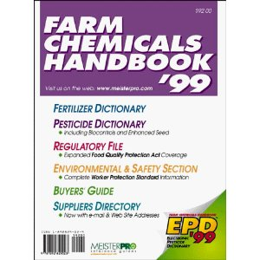

The Farm Chemicals Handbook
The FCHB is a very good source for cross-referencing common and chemical names for many obsolete pesticides.
Now “Crop Protection Handbook”
Notes:
This one is next----I could not find a link that did not charge for online use.
This is available in hard copy and online. Online versions may have a charge for use.
We have an example entry on a slide coming up from Farm Chemicals Handbook

Slide 87

The Label and MSDS are great sources of information available to users and responders for products in use today.
So now what?
Notes:
This is a partially destroyed label that is not fully readable. Not uncommon for EPA to encounter such conditions (or worse) in the field. Should we blow this up a bit on an added slide?

Slide 88
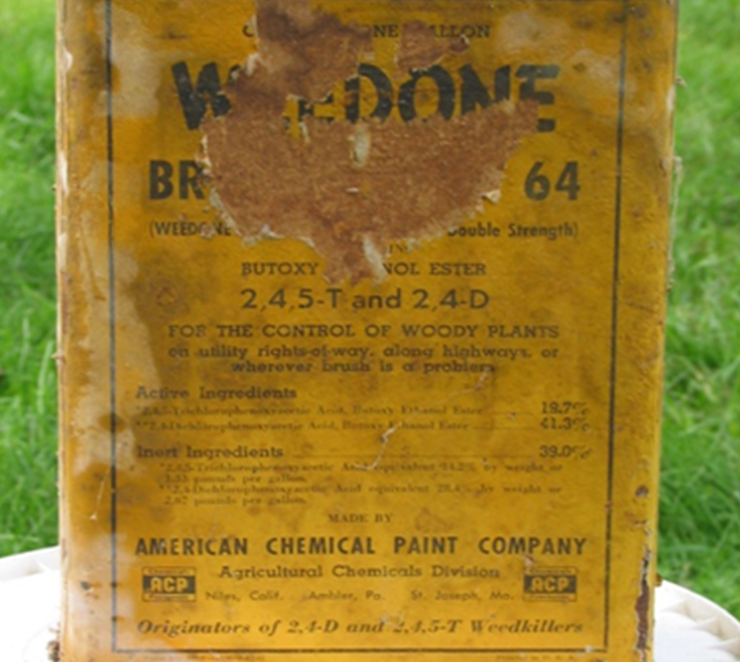
Notes:
Here is a closer view of the label
Look a bit further down the label…..2,4,5-T and 2,4-D For control of woody plants
So this is a herbicide
The active ingredients are a mixture2,4,5-T and 2,4-D
We can get info on the active ingredients from tech references.
Can we get any info on the “inert ingredients”? Flammable?
Use links provided.
You can rather quickly ascertain what sorts of safety precautions are in order using these tech references

Slide 89
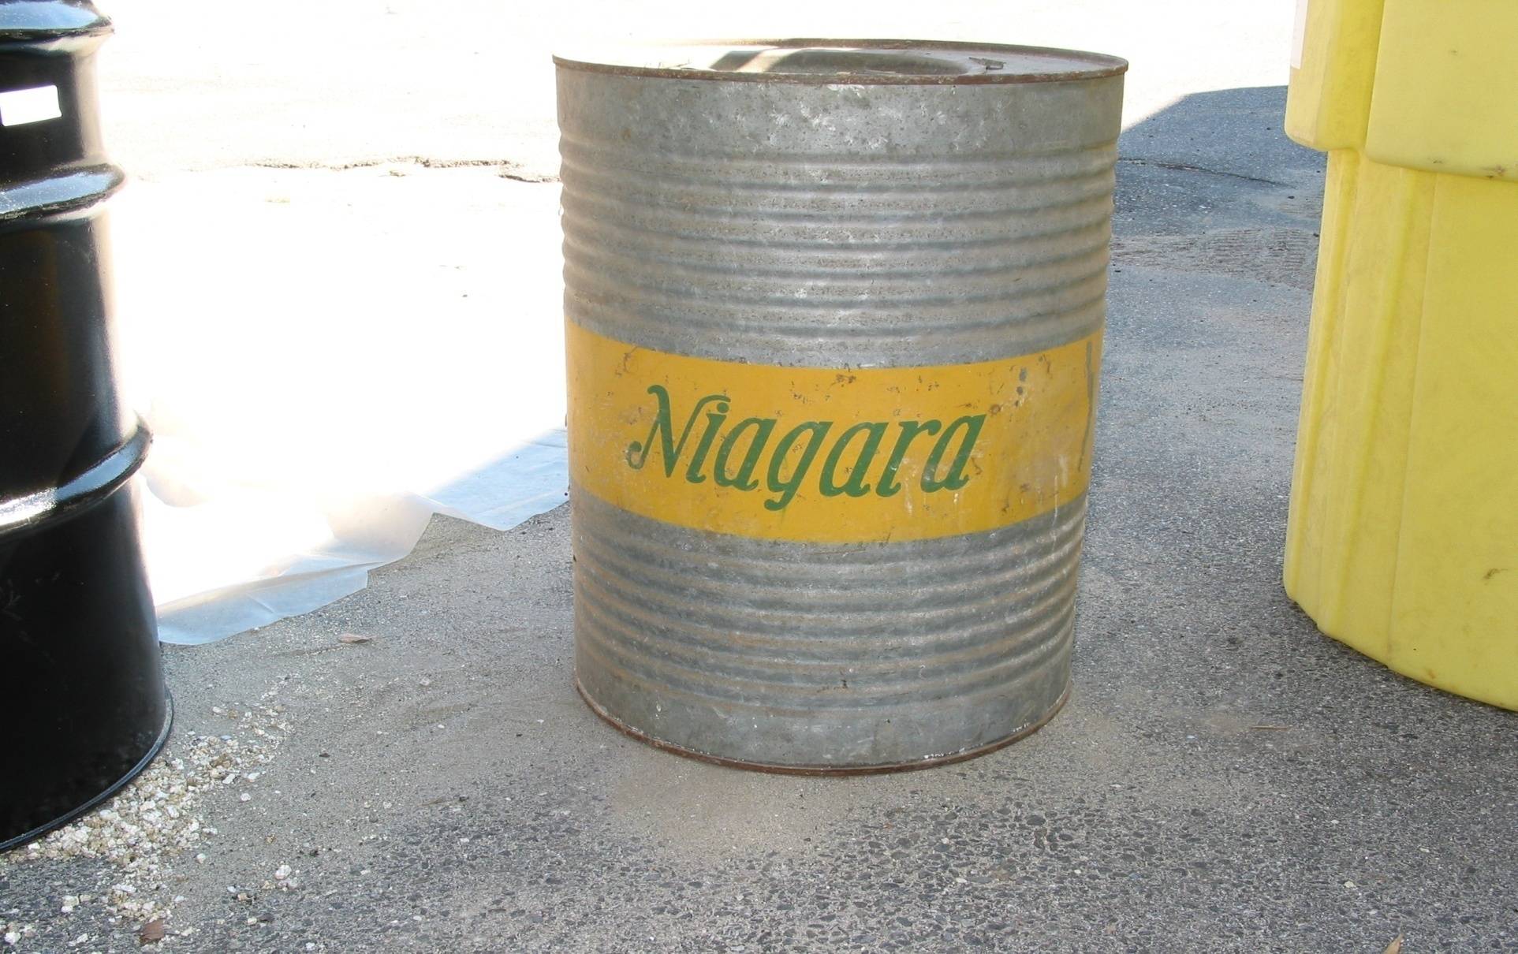
Just a trade name? What next?
Notes:
Use the links …….try NPIC
Then try Google

Slide 90
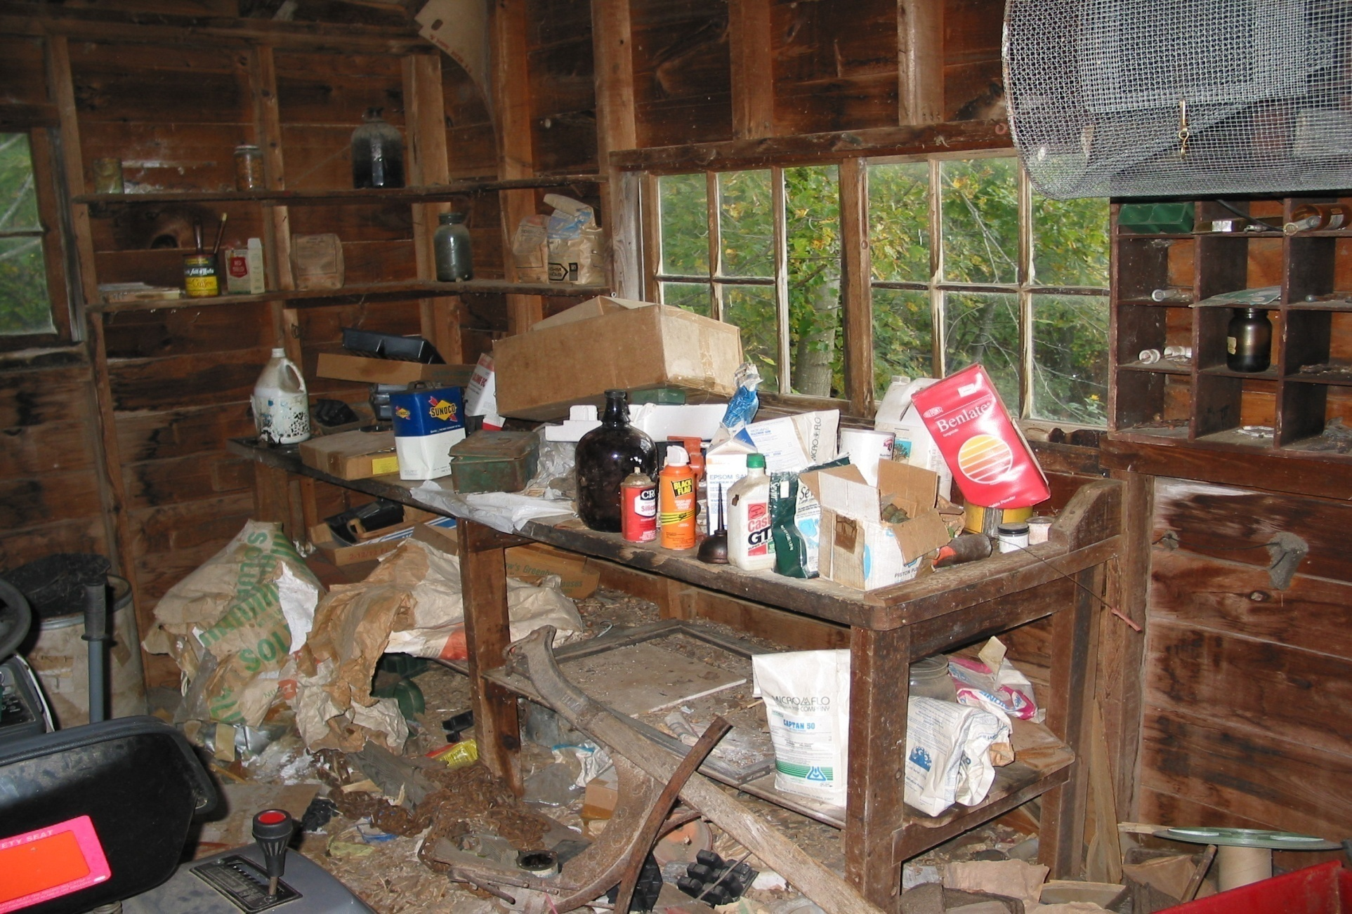
So what are some other references available?
Notes:
Farm Chemicals Handbook…….older editions may be better.

Slide 91
Farm Chemicals Handbook page
Notes:
This was 1986 version of FCH, and in hard copy it cost $46.00
Partial page—not shown are other headings including “Handling and Storage”; “Application”, “Formulations” and a chemical formula for the active ingredient.

Slide 92
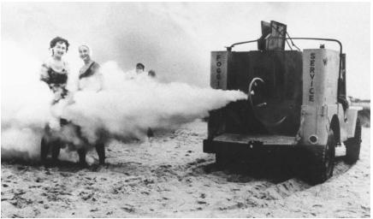
QUESTIONS ?

Slide 93
Pesticide Response
Case Study
Module 6
Kathy Halbur
OSC, Region 5
Notes:
This fictional case study is about a Criminal Investigation of illegal use of pesticides for wildlife “baits” .
This is an unusual situation for an OSC, as the Removal program is operating as an “agent” for CID in a FIFRA case. The OSC role is not the classic SF/OPA model.
You should get an exposure to working with EPA CID and to pursuing a criminal case gathering technical data for evidence.

Slide 94
SETTING
A wealthy influential TN man opened a game bird hunting preserve. Hunting was by fee. The preserve stocked quail, dove, pheasant, other birds.
Wild Bald Eagles, Falcons, and several species of endangered hawks began eating significant quantities of the stocked game birds.
Notes:
This case study is fictional. The training highlights that are important to EPA OSCs are based on real as well as fictional settings. Some FIFRA cases may be very grisly!

Slide 95
SETTING
Poisoned baits were placed to kill the birds of prey, as they hindered the goal of the hunting preserve…making money…..even if it killed the Endangered Species
What is baiting?
What is poison baiting?
Notes:
Baiting is generally providing an artificial food source for an animal
Poison may be added to the bait to kill or harm the animal consuming the bait.
Poison Bait Advantages : Easy, cheap, effective killer, that does not require humans “on site” (like shooting) . There are a “legal baits” such as rodenticides…like rat poisons. Here the herbicide is misused, a clear label infraction.
Poison Bait Disadvantages: kills non-target species, illegal if the product label is not followed (exactly.).

Slide 96
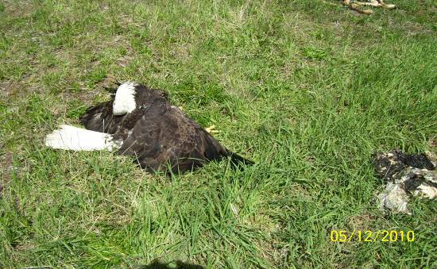
Pesticide Response Case Study
TN farmer suspected of poisoning wildlife with Carbofuran (Cancelled pesticide)
U.S. Fish & Wildlife Service lead agency
  TN Dept of Natural Resources and U.S. EPA support agencies
USFWS obtained search warrants for evidence raid (seven warrants)
  Single day to
  collect as much
  evidence as possible
Notes:
.
Use a reference source now …and in 3-4 min give me some technical info on Carbofuran
determine the EPA status of the pesticide. …all students look it up..Cancelled\? Suspended? 4- 5 min exerciise that all OSCs would go thru on any such Red phone call.
What is the label (law) actual violation?
Looks like a criminal case….who does OSC need to contact on this case?
Is general communication limited ? To whom? How strict is the comms?
Why does search warrant last only 1 day? Seems short time…how about 3 days?. Access/search & seizure is a matter of US Constitutional law. (4th amendment). Judges are VERY specific about warrants. Almost always short duration and quite specific in what law enforcement seeks to find.

Slide 97
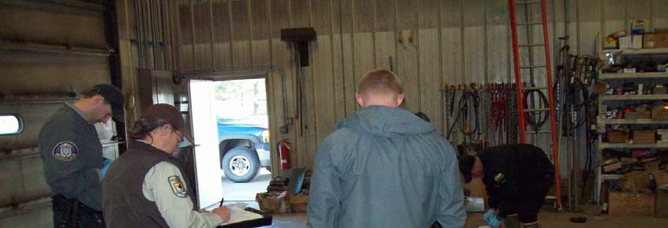
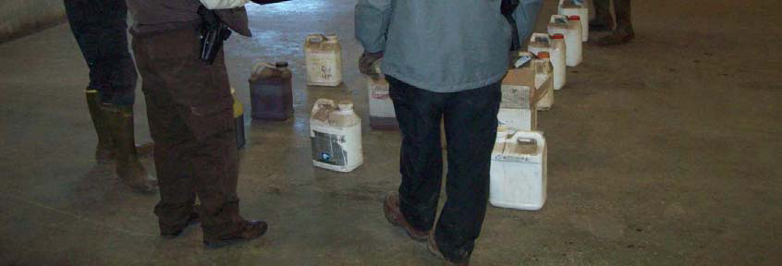
Pesticide Response Case Study
US EPA CID requested OSC & START assistance with the warrant execution
  Overall site health & safety
  Sampling of unknown chemicals
  Sampling of bait piles
  Overpacking of carbofuran
  Overpacking of bait piles
  Documentation
  T&D assistance
  Evidence for a criminal
  vs civil prosecution
Notes:
This has some similarity to a classic EPA drum cleanup. Unknowns in containers or on bait
Ask a student for a short explanation of each element
HASP
—because it very toxic..PPE protocols need to be tight
What is “Baiting?”- very bad way to kill animals…may be slow and painful—illegal and immoral for most folks
What kind of Samples will make good direct evidence?
Over-packing & doc & T & D---chain of custody In legal case
Evidence for a criminal prosecution has to be “beyond a reasonable doubt” Might put this at about 90% certainty
Evidence for a civil prosecution is “preponderence of” -- 51% certainty
http://www.abcbirds.org/abcprograms/policy/toxins/profiles/carbofuran.html

Slide 98
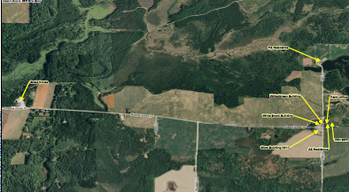
Pesticide Response Case Study
9,500 acres
  Meadow habitat for upland game birds
  Heavily wooded areas
6 buildings (barns)
Multiple residences
19 bait piles
~100 officials
Notes:
100 people knew of 14 bait piles—big case. Residences involved (danger )
In NJ they say 3 men can keep a secret….as long as 2 of ‘em are dead. Bait piles w/ carbofuran---what animals were these folks trying (illegally) to kill?
According to this url—lots of birds of prey killed by this style of baiting.
http://www.abcbirds.org/abcprograms/policy/toxins/profiles/carbofuran.html

Slide 99
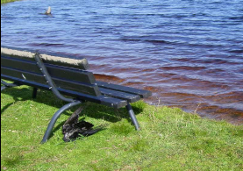
Pesticide Response Case Study
Three Teams
  Chemical Team – Farm Buildings & Residences
    Levels B & C
    Two START & OSC
    CID, USFWS, TNDNR
  Bait Pile Team – Woods
    Level C & D
    Four START
    CID, USFWS, TNDNR
  Dead Animal Collection – Sitewide
    TNDNR Wardens
  One START overall Health & Safety
Over 50 samples collected
Notes:
How the response (CI) was organized
CID lead and OSC/START tech support-make this clear
Dead animals– evidence---50 samples is a lot for a case like this….other Regions might use 25 (or 100) samples)
What is the oral and dermal LD50 for carbofuran? Answer:The oral LD50 is 5 to 13 mg/kg in rats, 2 mg/kg in mice, and 19 mg/kg in dogs. The dermal LD50 is >1000 mg/kg in rabbits, [5]. Ld0 varies with exposure rount and test animal…but is low (quite toxic
How are you going to find out? http://extoxnet.orst.edu/pips/carbofur.htm
Is that info in the HASP?
WHY NO STATE AG? THEY HAVE THE LAB EXPERTISE AND THE STATE VET. Discuss. WHY NO EPA FIFRA FOLKS?
Answer: CID –loose lips sink ships, FIFRA might have been helpful

Slide 100
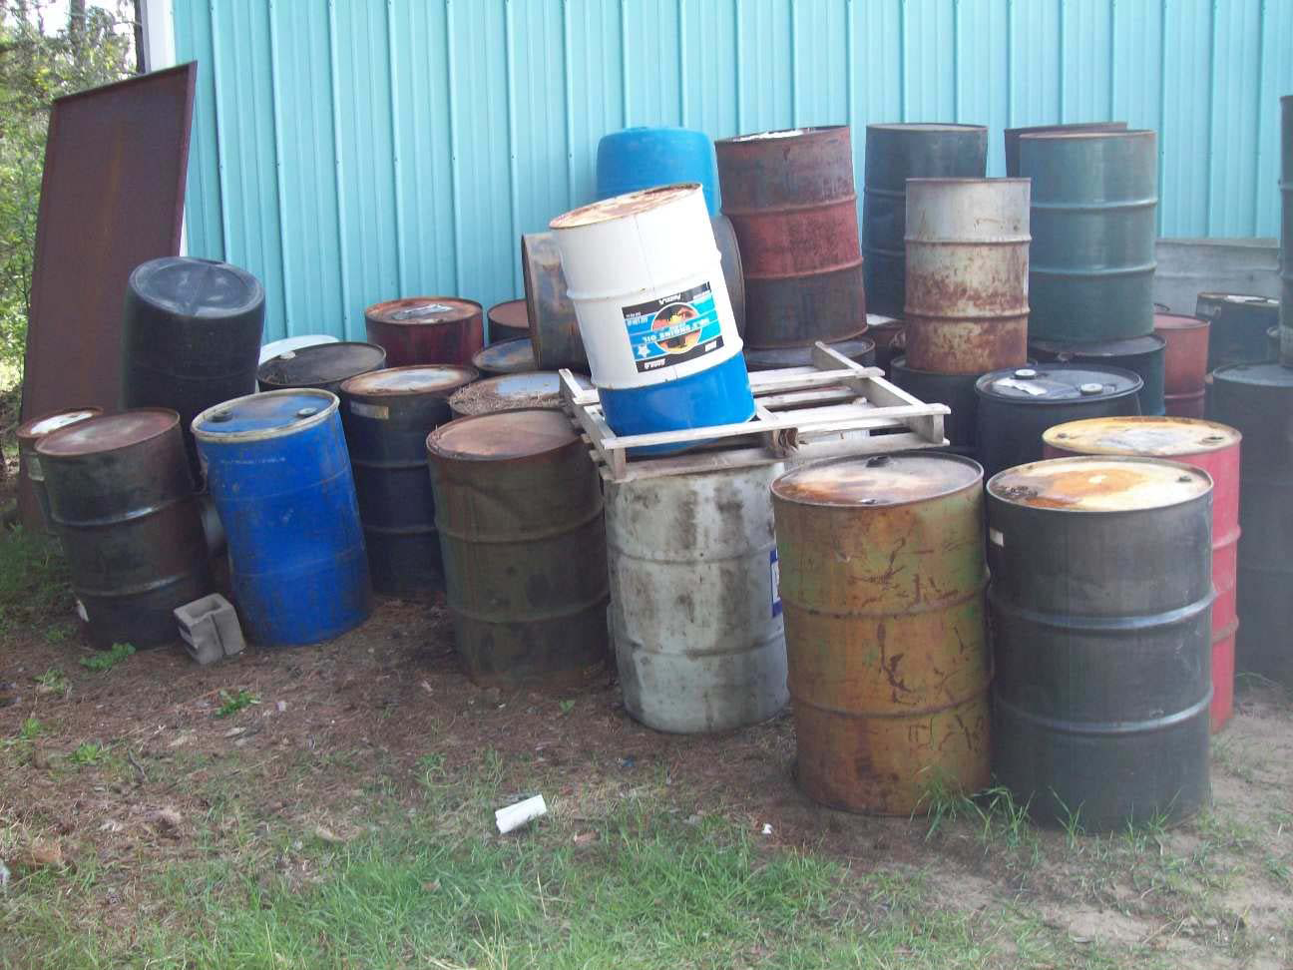
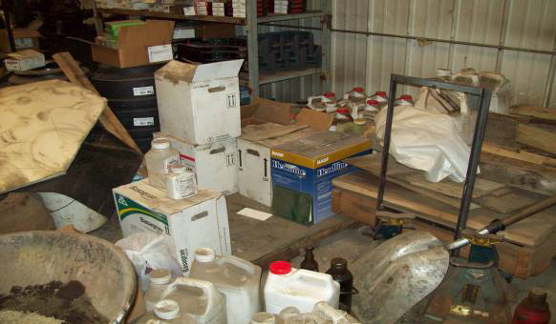
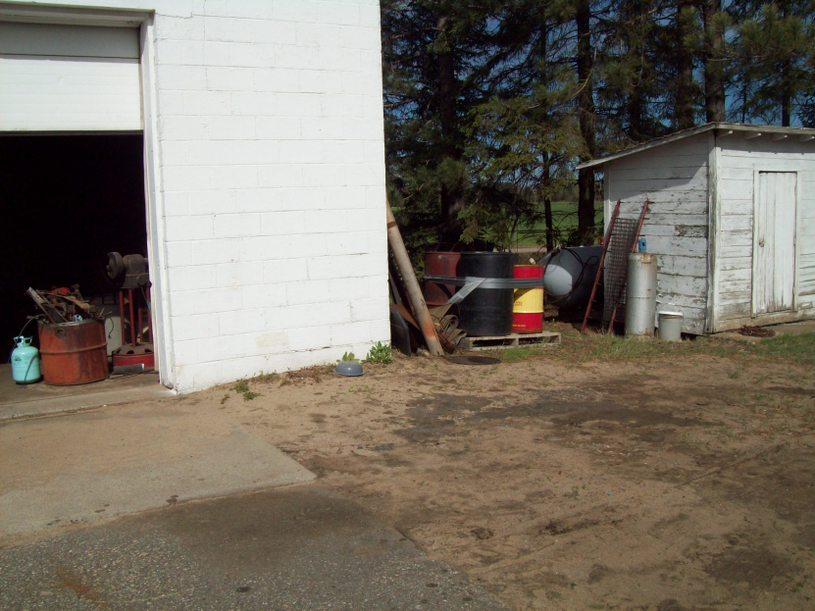
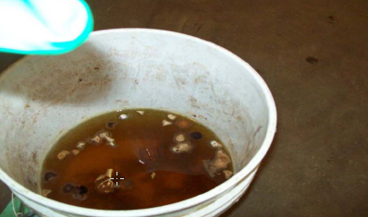
Chemical Team
Notes:
FIFRA is the only env fed statute where the recognized objective of the product is to introduce it into the environment with the clear intent to kill (plants or animals).

Slide 101
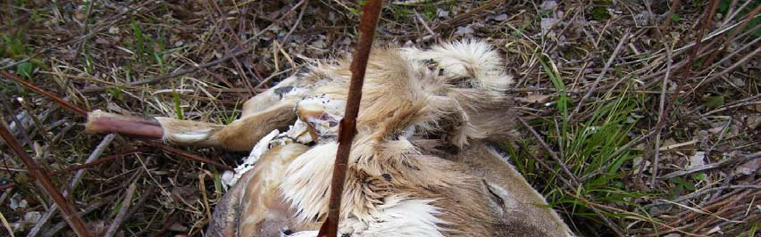
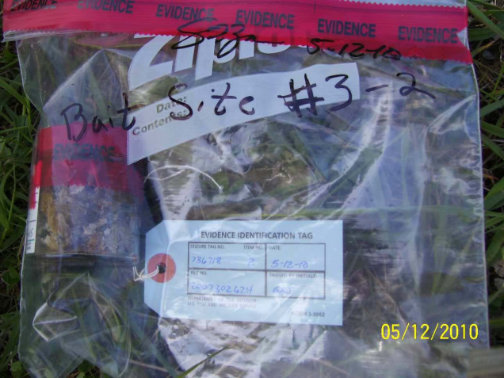
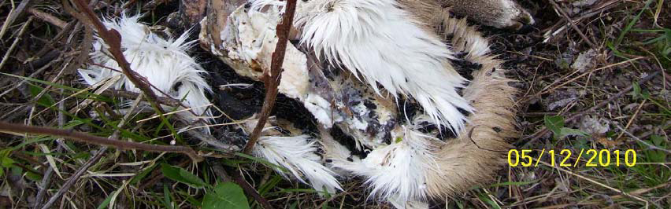



Bait Pile Team
Notes:
Pic explanations

Slide 102

Pesticide Response Case Study
Issues:
  Authority
    Warrants issued under US FWS authority
    CID: FIFRA
    Not considered a CERCLA Site
    (creating a cost recovery issue)
  Extremely secretive
    Investigation since 2007
    TNDNR Warden undercover
    Prominent property owner
  Time constraints
  Evidentiary procedures
  Property owner and farm staff present
Notes:
Get the access right –4th amendment to US constitution
Warrants grant access (not voluntary)
Why have the “bad guys” present?

Slide 103



Pesticide Response Case Study
Issues (continued)
  No pesticide expertise
    State Ag Agency (TN Dept Ag) purposely excluded
    CID & OSC – very limited FIFRA knowledge
Notes:
Dept Ag, OSCs, START are the only tech savy folks present

Slide 104
Questions?
Notes:
What kind of deeply twisted person would do this?
Read from Tech literature how animal will die/suffer

Slide 105
FIFRA and Pesticide ER for OSCs
Introduction
Pesticides and Fed/State Regulations
Case Study / Exercise – Temik Pesticide E.R.
Human Impacts
Hazard Recognition
Case Study – Wildlife Baiting Investigation
Environmental Impacts
Case Study – 15 Mile Creek
Case Study / Exercise – Rodeo Town
Conclusion
Notes:
Pesticide Course Agenda – 2013

Slide 106

Pesticide Environmental Impacts

Slide 107

Pesticide Environmental Impacts
Normal application of pesticides
  spray,
  dust,
  fumigate,
  aerosols,
  gases,
  Biocontrols
  Etc.
Result – broad environmental dispersal
Notes:
Pesticide application is a broad and diverse matter…highly variable application dependant upon pesticide. This means that all environmental media may be affected. Give example of each
Spray—malathion on vegetables for sucking insects
Dust-sevin dust on veggies for chewing insects
Fumigate-soils treated with methyl bromide
Aerosols-suspended ultrafine droplets or particles
-Bacillus thuringensis-cabbage lopers
Etc
This is the deliberate placement (broad dispersal) of chemicals (or agents) into the environment…very different from traditional goals of SF actions….to keep chemicals out of the environment.

Slide 108

What happens to “Leftovers”?
Unintended targets
Residual-NOT helpful
Degradable
  Bacteria/fungi readily decompose
  UV, Hydrolysis, oxidation, etc
  Non-halogenated
Persistent
  Bacteria/fungi do NOT readily decompose
  Not readily degraded by UV, hydrolysis, oxidation
  Halogenated (F, Cl, Br, I)

Slide 109


Major Persistence Factors
Sunlight – UV degradation
  Indoors vs outdoors
Oxygen availability
  Anaerobic vs aerobic
    Soils, sediments, water bodies
    Anaerobic or aerobic organisms
Pesticide persistence=BIG SCIENCE
Notes:
Persistence is defined as “stays in the environment a long time” one year? One growing season? One decade?
There are numerous factors that affect persistence. A few for OSC consideration-
UV—sunlight component (breaks down organic materials—car dash board
This is a major factor –methyl parathion cotton insecticide for outdoor vs indoor
Oxygen directly or biologically degrades most organics
Presence/absence of O2 determines the biota.
Aerobic organisms work fast, anaerobic more slowly (general expectation)
The issue of pesticide persistence is a well studied scientific field of study. complex

Slide 110

Bioaccumulation-Biomagnifacation
Environmental Fate & Transport
Directly Toxic to Non-targets – Fish, crabs, birds-not just insects
Bio-accumulation-fat tissue burden
Bio-magnification-concentration in organism much greater than application rates and increases up the food chain
Notes:
Some lessons were learned from indiscriminant use of DDT & other chlorinated hydrocarbons. pointed to evidence linking them to death of nontarget creatures (organisms other than those that the pesticide is intended to kill), such as birds.
(1) Direct toxicity. It was discovered that DDT was toxic to fish (especially juveniles) and crabs, not only to insects.
(2) Indirect toxicity, related to its persistence. (It's persistence came in part from its insolubility, from the fact that it was a synthetic, recently introduced compound. Nature does NOT bond Carbon directly to a Halogen. This means that microorganisms, such as bacteria, lacked enzymes capable of degrading C-Cl -- basically they hadn't evolved to use it as an energy source.
The pesticide manufacturers argued that the minute amounts found in the environment couldn't possibly be killing nontarget organisms
. However, some experimental work demonstrated that even small amounts of some of the pesticides could affect the survival and reproduction of some species. More important, research demonstrated that, although concentrations were very low in the soil, atmosphere and water, concentrations were higher in plants, higher still in herbivores, and still higher as one moved up the food chain.
The indirect toxicity related to two principles :
(1) Bioconcentration – the tendency for a compound to accumulate in an organisms's tissues (especially in fatty tissues for fat soluble organochlorines such as DDT) and
(2) Biomagnification. – an increase in concentration up the food chain.
(These terms are sloppily used; sometimes "bioaccumulation" is also used to mean either of these, and people often use all of these terms interchangeably.)

Slide 111


Slide 112
Study of DDT Biomagnification/Bioacccumulation
In water = 0.000003 ppm (3 ppt )
In zooplankton = 0.04 ppm (micro-animals eating many micro-plants)
In minnows = 0.5 ppm (bioconcentration + biomagnification-each minnow eats lots of zooplankton, and acquires their cumulative DDT burden.)
In large fish = 2.0 ppm
In ospreys (fish eating birds) = 25.0 ppm
Concentrations increased 10 million times
Notes:
DDT is the most famous (infamous insecticide), and a well studied one. Historical research is presented to illustrate an environmental trend.
Because DDT was (is) persistent, there was abundant opportunity for it to be taken up from the environment by organisms. For example, in the estuarine ecosystem next to Long Island Sound, the following concentrations of DDT were found:
In water = 3 ppt (0.000003 ppm)
In zooplankton = 0.04 ppm (bioconcentration and biomagnification from eating plants)
In minnows = 0.5 ppm (bioconcentration + biomagnification) (Because of the inefficiency of energy transfer, each minnow has to eat lots of zooplankton, and so acquires quite a burden from them.)
In large fish = 2.0 ppm
In ospreys (fish eating birds) = 25.0 ppm
Thus, concentrations had increased 10 million times up this progression, largely because of biomagnification.
This is a fundamental environmental fate and transport trend true of chlorinated hydrocarbons and the food chain

Slide 113

Fate & Transport Issues
DDT impairs calcium metabolism in birds
Credited with extinctions/endangerment of eagles, pelicans and falcons
Seals and Eskimo’s
bear fat DDT burden
Human breast milk
1962
Notes:
These concentrations were not directly lethal to the highest order carnivores, but did impair their reproduction. DDT (actually, its breakdown product DDE) reduced the deposition of calcium in eggshells. The birds thus produced thinner shell that cracked more readily during incubation.
The populations of many predatory populations (the highest order carnivores), such as bald eagles and brown pelicans were nearly eliminated. The peregrine falcon disappeared in the eastern US as a result of reproductive failures by the 1960's. (hence Rachel Carson’s title “silent spring” alleges one future spring season, no birds would sing
DDT (as DDE, a breakdown products from DDT) also appeared in the fatty tissues of seals and Eskimos, far from any area of use, indicating that, because of its persistence, it was being transported for long distances in the atmosphere and then being washed from the atmosphere by rains. It also showed up in human breast milk at remarkably high concentrations -- so high that the milk couldn't legally be sold through interstate commerce if it were cow's milk! DDE is the most widespread contaminant in human milk around the world

Slide 114

Pesticide Spill on Ag Land
CERCLA – FIFRA roles
Farmer Jones applies 2,4-D-based herbicide on his wheat crop to control broad leaf weeds
Jones follows label instructions for dilution of concentrate—0.25% active ingredient 2,4-D or 2500 ppm 2,4-D
Overspray results in soil residual
Notes:
2,4-D is a herbicide that works by functioning as a plant growth hormone analog in broad leaf plants. It is widely used for control of broadleaf weeds in monocot crops (low effect on many grasses). The objective of the spray is to cover the foliar surface. Any that runs off or misses the leaves is overspray. Some overspray hits the soils and analytical tests reveal some residual in the soil of Farmer Jones wheat fields.
The label instructions are followed

Slide 115

CERCLA vs FIFRA
Accident spills 2,4-D tank in wheat field
OSC Guy Smiley responds
“Hot spot” at spill
Background 2,4-D -field soil 30ppm to 1800ppm
How much soil cleanup needed?
What is State Dept of Ag and Forestry (SDAF) opinion of situation?
Does FIFRA or CERCLA apply? To what?
Notes:
Farmer Jones has a tractor and spray rig overturn and spills the herbicide tank in one area of the field…big mess!
OSC Smiley finds a concentration hot spot (visible stain), and collects 6 background samples from widespread areas of the 40 acre wheat field. The average 2,4-D concentration of the 6 background samples is 1800 ppm.
SDAF can likely help here….dan/bob---tell me how DAF could react.
Which statute applies? To what parts of the field?
Got a buddy at SDAF?

Slide 116

Questions & Answers

Slide 117
FIFRA and Pesticide ER for OSCs
Introduction
Pesticides and Fed/State Regulations
Case Study / Exercise – Temik Pesticide E.R.
Human Impacts
Hazard Recognition
Case Study – Wildlife Baiting Investigation
Environmental Impacts
Case Study – 15 Mile Creek
Case Study / Exercise – Rodeo Town
Conclusion
Notes:
Pesticide Course Agenda – 2013

Slide 118

Fifteen Mile Creek Herbicide Spill,
The Dalles OR, 8/22/00
Dan Heister, OSC, USEPA Region X
Oregon Operations Office
811 SW Sixth Ave.
Portland, OR
97204

Slide 119
Take Aways for this Case Study
State Ag, EPAHQ, and Manufacturer can be an asset
The Label can expedite clean up and save $$$$
Clean ups usually take back seat to commerce
Cooperative RPs are invaluable
When in doubt don’t put it out
It helps to be lucky
Notes:
The worst time to make friends is when you need them.

Slide 120
The Incident and Fire
August 22, 2000 at 4:36 AM
Un-placarded tractor trailer heading west on I-84 goes out of control
Over half the load goes off the north side of Fifteen Mile Creek bridge
Fire Dept. responds at 4:56 AM to call from driver stating there is a “small fire”

Slide 121
The Incident (cont.)
Upon arrival tractor on I-84 and trailer contents below the bridge are fully engulfed
Gresham Haz Mat called in, I-84 closed in both directions
Fire allowed to burn out; no water
FOSC, START, SOSC, and FOSS allowed to enter spill area at 3:30 PM

Slide 122

Notes:
Multi modal transportation complications, Creek much higher in photo than at time of spill.

Slide 123


Slide 124
THE RELEASE
Of the 4140 gallons (1656, 2.5 gal.jugs) of Goal 2XL on board:
570 jugs in tact on I-84 with14 leaking
25 full and 80 ruptured jugs in the creek
Total of 1047 jugs (2617 gallons, approx. 20K lbs.) burned or spilled

Slide 125
THE RELEASE (cont.)
Approx.400 yds of creek impacted from I-84 bridge to Columbia River, the creek had a very low flow at the time of the incident
All aquatic life killed in affected area (trout, lamprey, crayfish, invertebrates)
Unknown quantity released to Columbia River (no apparent fish kill)

Slide 126
Goal 2XL, by Rholm and Haas
Halogenated pre-emergent and post-emergent commercial grade herbicide
Active ingredient *Oxyfluorfen @ 22%
*(2-chloro-1-[3-ethoxy-4-nitrophenoxy]-4-[trifluoromethyl] benzene)
Inert solvents: Naphtha (51%), N-Methyl-2-pyrrolidone (9%) Napthalene (8%)
Hazardous chemical under 29 CR 1910.1200, immediate and delayed health hazard.

Slide 127
Goal 2XL (cont.)
Class 3 Carcinogen
Goal 2XL not a RCRA regulated waste, treated as pollutant and contaminant.
Oxyfluorfen is extremely toxic to aquatic life in both water and sediments
Oxyfluorfen has a specific gravity of 1.08

Slide 128
Oxyfluorfen Half-Life
Water: 7 days
Soil: 40 days
Anaerobic Sediment: 600 days
Fish Tissue ?

Slide 129


Slide 130


Slide 131
ESA and Other Considerations
Columbia Summer Chinook run in full swing
Tribal gill net season to open 8/30/00
100 year old Sturgeon in pool at mouth of creek
Winter Steelhead run on Creek Dec.-Feb.
Limiting further damage to Lamprey population upstream*
Archeological concerns

Slide 132
The Players
The RP: Prime Trucking Inc., Springfield, MO
RP Contractors:Foss Environmental, Polaris, Interfluc, North Creek Lab, Diving and Salvage
Feds: USEPA*, ACoE, BPA, USFWS, BIA,
State: ODEQ, WDoE, ODFW, WDFW, OHD, ODOT, OSP, ODA, WSDA
Tribal: Confed. Tribes of the Warm Springs, Yakima, Umatilla, Nez Perce

Slide 133
The Players (cont.)
Local: The Dalles Fire Dept., Gresham Haz Mat, County Health, Dalles Irrigation District, S+W Conservation District
Others: Rohm and Haas, Union Pacific, Media, Fishermen (rec+ com), Columbia Barge Assoc., Local Growers (upstream irrigators)
* OSCs: Dan Heister, Bill Longston, Tony Barber
*START: Suzanne Dolberg, Jeff Fowlow, Dave Ikeda, Charlie Gregory

Slide 134
Immediate Steps
Get I-84 Open
Close Fishing
Close Beach
Stop Irrigation, check system
Conduct Initial Assessment
Clean up containers and debris from wreck
Prevent sediment migration
By-pass clean creek water to Columbia*
Notes:
State Ag worked with grower groups to irrigate up stream out of season to assist in manaaging water

Slide 135
Phase 1:
To isolate, control, and manipulate water in each Zone to prevent contamination of the adjoining Zone, while minimizing waste water generation.

Slide 136

The Damn, I Mean the Dam

Slide 137


Slide 138
Water Weenies, Sandbags and the Great Tube

Slide 139


Slide 142


Slide 143


Slide 144


Slide 145
Hog and Haul
Pro’s
Get in and get out
More certain and familiar
Minimize H2O generation during sediment extraction
Con’s
Resource intensive
Vulnerable to the river level and upstream flow
Strategically more challenging
More weather sensitive

Slide 146


Slide 148
Evaporation vs Ground Application
25 cents a gallon
90 mile rt
2.5 cents a gallon
12 mile rt
At 1,750,000 gallons, you do the math. Make sure you read the label and consult your State Dept. of Ag.
Notes:
$450K vs $44K

Slide 149


Slide 150
The Big Dig 9/15-19/2000, 1800 to 0600

Slide 151


Slide 152


Slide 153


Slide 157
Tons Removed, Samples Taken and $
Approximately 2000 cubic yards
Approximately 1700 samples
$5 million

Slide 158
FIFRA and Pesticide ER for OSCs
Introduction
Pesticides and Fed/State Regulations
Case Study / Exercise – Temik Pesticide E.R.
Human Impacts
Hazard Recognition
Case Study – Wildlife Baiting Investigation
Environmental Impacts
Case Study – 15 Mile Creek
Case Study / Exercise – Rodeo Town
Conclusion
Notes:
Pesticide Course Agenda – 2013

Slide 159
Pesticide Broker Exercise / Scenario
Based on current response case
Names/locations changed
  Litigation under consideration
Fact settings altered to accomplish training objectives
Interactive questions posed
Some (weak) humor injected

Slide 160
Pesticide Broker Exercise / Scenario
What is a pesticide broker?
  A dealer who specializes in rare, suspended and cancelled pesticides.
  Accumulation facilitated by “existing stocks” provisions in most FIFRA cancellations.
  Over time many storage locations become “Mad Scientist” clean-up, or worse…. fires.
  Gray Market
Notes:
Dan does this slide

Slide 161
Definition of Broker?
http://www.epa.gov/region9/pesticides/PesticideImportersFactSheet.pdf
http://www.epa.gov/compliance/resources/publications/monitoring/fifra/manuals/fifra/fiframanch_14.pdf
Believe it or not, some people don’t always follow the law. Contempt, desperation, cost saving (greed), won’t get caught, etc….
Notes:
You can look these up later.
FIFRA (statute) does not use term “broker”---term of art

Slide 162


Pesticide Import/Customs Broker
Calvin Field - A Tale Of Woe
Calvin Field - broker for many years
Accumulated pesticides in warehouse.
Warehouse at county fairgrounds in Rodeo Town, CO
High desert
Low rainfall
Fairgrounds
1 block
Fairgrounds
1 block

Slide 163

Rodeo Town, CO
Normal population 2,952 (2010 Census)
During Rodeo Roundup Festival, June 1-7, population 29,500
Notes:
Biggest event of year—important to Rodeo Town
Much $$ infused into local economy

Slide 164

Pesticide Import/Customs Broker
Calvin Field
Calvin’s historical broker activities were given periodic close attention by CO Dept. of Ag-Pesticide Division
  Several administrative fines, no felonies
  No inspections warranted for last 7 years
Notes:
Calvin is a local “character” in Rodeo Town, was head of the Chamber of Commerce and his nephew is a long time State Rep.

Slide 165

Pesticide Import/Customs Broker
Calvin Field
Alzheimers-debilitated - 2011
  Slowed brokering -2002
  Stopped active brokering - 2007
  Never stopped accumulating (cancelled and suspended) pesticides
  Warehouse
    disorganized
    disrepair
    Full of pesticides
    condemned
Do not enter

Slide 166

June 1--Fire Marshal
Re-inspects Warehouse
Inspection Findings (June 2):
  Roof leaks (sheet metal destroyed in storms)
  Many pesticide containers in disarray
    Labeled and unlabeled
    Damaged and undamaged
    A few “leakers”
    Many with this diamond
  Does this excite the Fire Marshal?
Notes:
Choices Yes No
NFPA diamond discussion? Fire Marshalls typically don’t have any better grasp of pesticides than OSC’s. They rely on placards, MSDS’s, and bills of lading. The NFPA gives them a fast and dirty “Bad Thing” snapshot.
This is exciting because this is dangerous stuff as explained on the next slide

Slide 167

3
4
2
w
Notes:
This NFPA diamond explanation came from internet. The yellow highlighted numbers beside the explanation boxes are the ones the Fire Marshal saw in the warehouse…..scared the “be-jabbers” out of him. Fire Marshalls typically don’t have any better grasp of pesticides than OSC’s. They rely on placards, MSDS’s, and bills of lading. The NFPA gives them a fast and dirty “Bad Thing” snapshot.

Slide 168

Inspection Findings
74 Drums
  Some leaking
  Many with unreadable labels

Slide 169

Inspection Findings
241 of these containers
  Half are damaged
  What are they?
  What are your concerns?
Aluminum Phosphide
Active Ingredient
Notes:
Choices for Q1: Pesticide, water reactive, high toxicity, low LD50, all of the above none of the above
Individuals will answer Q2 ---no poll

Slide 170

Inspection Findings
326 of these containers
  What are your concerns?
Notes:
Check all that apply Choices: A: need technical data; B: significant volume present; C: manufacturer is no longer in business D : herbicide (plant poison) with no known animal toxic effects
Answer is A & B

Slide 171


Inspection Findings
Fiber drums & other containers
  Numbers uncertain
Notes:
Fire Marshall struggling to get his brain around the situation, pondering next steps. Talks to Field’s wife who says the products still have value and their son is searching for a buyer. Son reportedly sold a batch when dad (Calvin Field) was admitted to the assisted living center.

Slide 172
Inspection Findings
Fire Marshal requests EPA and CO Ag assistance
Both will meet Fire Marshal on site
  48 hours earliest mutually-convenient time
  June 4 (during rodeo)

Slide 173
Your Technical Evaluation?
Overall opinion?
What are the top 2 items of concern?
  Unknowns present
  Target 6 Plus
  PHOSIDAL (Aluminum Phosphide)
  Calvin Field, nephew of State Rep.
Why?
NPIC
http://www.npic.orst.edu/
800.858.7378
USDA Fumigation Handbook (Chapter 1)
http://www.gipsa.usda.gov/publications/fgis/handbooks/fumigation/Fumigation-ch-1.pdf
Notes:
Check all that apply Choices: Unknowns Present; Target 6 Plus; Phosidal (Aluminum Phosphide); Calvin Field’s political connections;
-NPIC has re-worked their home page.
-Google search for “aluminum phosphide” gives USDA fumigation handbook as one choice. Info on socks (sachets) on page 7 this reference
-Calvin Field relationships inserted for humor, but CO Ag may be sensitive to this family fact

Slide 174

Discussion
What will you be prepared to tell the Fire Marshal on June 4?
  Threats to health/environment ?
  Warehouse contents prioritized ?
  Recommendations ?
  Other ?
Notes:
Check all that apply Choices Toxicity info; Reactivity info; Quantity of each material present; Condition of containers; Which materials pose the most urgent need for stabilization: Sense of urgency to take action;
These questions require the responder to do some homework . Research is first. Priorities of addressing materials will be based upon the technical research; the quantity present; and other local considerations (leaking roof, automatic fire suppression system, etc)
Recommendations is the outcome of this homework.
Other----do you convey a sense of urgency?

Slide 175

Discussion
Contact CO Ag rep prior to June 4 field trip?
  “Calvin Field Broker” file
    Enforcement history (FIFRA delegated)
    May include complaints
    Historical inspection reports/photos
    (Some) inventory information
  Joint strategy for moving case forward
  Relationship building
    “C” in OSC
Notes:
Choices Yes No

Slide 176

…but on evening of June 2
5.5 inch rainfall
The rain DID NOT dampen enthusiasm of the 23,000 Rodeo festival attendees
Leaking roof DID create a problem at Field Pesticides
The pesticide issue caused cancellation of all Rodeo activities on the evening of June 2
June

Slide 177

Aluminum Phosphide Reaction with Water
Notes:
Note this is an embedded video clip

Slide 178

Then, The Party Really Got Started
When the Volunteer Fire Department attempted to extinguish with water
  VFD put lots of wet stuff on the hot smoky parts
  VFD withdrew promptly
  No injuries
  Local evacuation due to phosphine off-gassing
Notes:
Chief ordered VFD to stand down and move crosswind when he got radio reports of “cans skittering around on the floor, popping like a flash camera, and catching fire ”…..and the fumes from this were killing the rats and roaches running around in the warehouse. They would run away from the fire-front and then fall over dead.”
Noe to Dan—Pendleton had a stray dog (canary in coal mine)

Slide 179

Field Pesticides Fire & Chemicals
Fire allowed to burn
Rodeo arena in background
Notes:
Let it burn. Rodeo arena in background.

Slide 180

Fire investigators exposed
Dizzy
Blacked out
ER-observed, treated, discharged
EPA Lead subsequently requested

Slide 181

Burning aluminum phosphide
PPE?
Notes:
What PPE do we use here? Check correct answer Level A; Level B; Situation specifics dependent
Why? We have some intact product in badly damaged packaging. What do we do with that? Options

Slide 182

Unknowns
Notes:
What happened to this 55 gal steel drum? It “cooked” in the fire.
Bottom bulged from Boiling Liquid &/or Expanding Vapor….did It explode? Unknown…..can not see top or seams (BLEVE)

Slide 183

Discussion
Some intact product remained after the fire
  What are options for managing?
Notes:
CO Ag ideas?
Ask Dan for help

Slide 184
Take Away Messages
Make a State Ag pesticide contact your friend (via Regional Pesticide staff)
http://npic.orst.edu/reg/state_agencies.html
Become familiar with tech references on pesticides
Get experienced help (OSC Dan Heister)
Except WMD, only chemicals you will encounter specifically designed to harm/kill

Slide 185
ANSWERS
Questions?

Slide 186
Certificates
If you are interested in receiving a certificate for participating in this training, please send an email to Austin Oelschlager, Tetra Tech, at austin.oelschlager@tetratech.com
An electronic certificate will be emailed to you within 30 days

Slide 187



New Ways to stay connected!
www.cluin.org
Follow CLU-IN on Facebook, LinkedIn, or Twitter
  https://www.facebook.com/EPACleanUpTech
  https://twitter.com/#!/EPACleanUpTech
    http://www.linkedin.com/groups/Clean-Up-Information-Network-CLUIN-4405740

Slide 188

Resources & Feedback
To view a complete list of resources for this seminar, please visit the Additional Resources
Please complete the Feedback Form to help ensure events like this are offered in the future
Need confirmation of your participation today?
Fill out the feedback form and check box for confirmation email.

