Slide 1
Implementing Greener Cleanups through ASTM's Standard Guide Webinar Introduction November 17, 2015
Carlos S Pachon
Superfund Program
US Environmental Protection Agency
Washington, DC
pachon.carlos@epa.gov
1
Notes:
Thank you for the invitation.
The information I share with you today represents the work of many people, I hope I do it justice.

Slide 2
Agenda
Opening & Introduction to Greener Cleanups
ASTM’s Standard Guide for Greener Cleanups: Show me How it Works! Deb Goldblum
Applying the Guide across programs
TSCA PCB cleanups: Michelle Mullin – EPA R10
Superfund: Beth Sheldrake EPA R10 and Mike Miller of CDM
Brownfields: LeeAnn Tomas-Foster, Chicago PBC
RCRA-CA: John Simon, project completed in CT
Discussion & Q&A

Slide 3
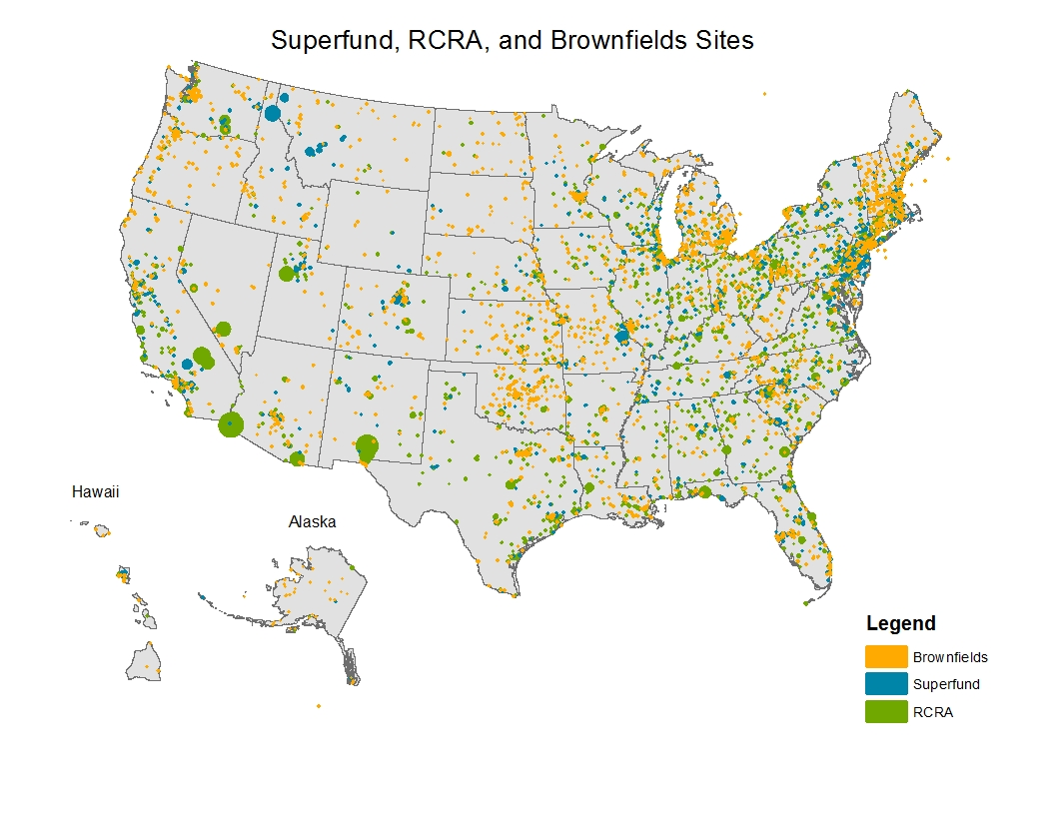
EPA Cleanup Programs Address Contamination at Sites Near 51% of the U.S. Population
Approximately 156 million people live within 3 miles of our SF Remedial, RCRA CA, and Brownfields sites that received EPA funding (roughly 51% of the U.S. population), including approximately 52% of all children in the U.S. under the age of 5.
OSWER’s Cleanup Programs, including the UST program, address over 500,000 sites and close to 22 million acres
 | Tanks | Superfund Remedial | Brownfields | RCRA CA | Total
Sites | 514,123 (96.6%) | 1,739 (0.3%) | 12,718 (2.4%) | 3,747 (0.7%) | 532,327
Acres | 514,123 (2.2%) | 4,281,604 (18.7%) | 177,356 (0.8%) | 17,951,871 (78.3%) | 22,924,954
Notes:
Contaminated sites addressed by OSWER programs exist in thousands of communities across the U.S. ranging from remote to large urban settings. Many of them are located in economically distressed communities that suffer from disproportionate and adverse environmental exposures.
To help us understand the communities our cleanup programs are working in, OSWER collected data on the population within 1 and 3 miles of our SF remedial, RCRA CA, and Brownfields sites that received EPA funding.
NOTE: UST sites were not included because there are over 500,000 typically small acreage sites (i.e. gas stations) making them present in most communities across the country.
The three mile area surrounding sites was used because it is a good representation of the geographic area where people in a community live most of their lives – where they shop, work, go to school, go out to restaurants, and participate in outdoor activities.
What we found:
Approximately 156 million people live within 3 miles of our Superfund Remedial, RCRA CA, and Brownfields sites that received EPA funding (roughly 51% of the U.S. population), including approximately We also found that our near-site population includes:
52% of all children in the U.S. under the age of 5
50% of all children in the U.S. under 18
65% of all blacks in the U.S.
61% of all Hispanics in the U.S.
62% of all minorities in the U.S.
58% of all households in the U.S. below the poverty level
54% of all people with less than a high school education in the U.S.
While there is no single way to characterize communities located near our sites, looking at the census data we found that the population within 1 and 3 miles of our sites is more minority, low income, linguistically isolated, and less likely to have a high school education than the U.S. population as a whole. These communities may have fewer resources with which to address concerns about their health and environment.
NOTE: It is important to note that proximity to a site does not necessarily represent risk of adverse health effects. The risk of exposure varies significantly across all the different types of contaminated sites.
Explanation of Data:
Data collected includes: site information as of the end of FY11 from CERCLIS, RCRAInfo, and ACRES and census data from the 2007-2011 American Community Survey. Data from FY11 was chosen to correspond most closely to the census data in the 2007-2011 American Community Survey. In FY11 this included 1,393 Superfund sites, 3,689 RCRA Corrective Action sites and 11,568 Brownfields sites. This universe of sites is not the same universe as in Figure 6. A circular site boundary, equal to the site acreage, was modeled around the latitude/longitude for each site and then a 3 mile buffer ring was placed around the site boundary. Census data was then collected for each block group whose centroid fell within the three mile area.

Slide 4
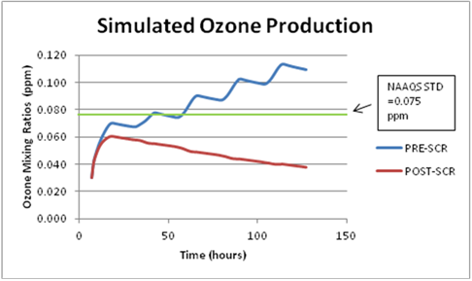
Understanding our environmental footprint:
Remediation projects are resource intensive. Take energy, Superfund Program uses energy to power remedies:
404,000 MT CO2e - 2012 emissions estimate by largest treatment systems
Equivalent to emissions from 25,000 cars
The benefits are real, and both local and global
Source: https://clu-in.org/s.focus/c/pub/i/2545/
4
Notes:
4

Slide 5
Challenge: Lowering the Environmental Footprint of Site Cleanup Projects
Green Remediation*
The practice of considering all
environmental effects of remedy
implementation and incorporating
options to minimize the environmental
footprints of cleanup actions.
*as defined by US EPA, a.k.a. greener cleanups, etc.
Notes:
5
5
NOT just about GHG
NOT about the greenest technology
The same as green remediation
Integral to more sustainable cleanups
Not about moving the end point
11/16/15
5

Slide 6
Addressing the Environmental Leg of Sustainability: Core Elements of Green Remediation
“Minimize, Reuse, and Recycle…”
“Reduction, Efficiency, and Renewables…”
“Conserve, Protect, and Restore…”
“Protect Air Quality, Reduce Greenhouse Gases…”
“Improve Quality, Decrease Quantity of Use…”
Notes:
From Green Remediation definition slide:
Green Remediation is the practice of considering all environmental effects of remedy implementation and incorporating options to minimize the environmental footprints of cleanup actions.
Significant work remains to be done cleaning up contaminated sites in the US over the coming decades, EPA has estimated over $200 billion in work to achieve established cleanup goals.
Across EPA Programs we are looking at how we can achieve these cleanups with a lower environmental footprint, and w/o changing the cleanup endpoint (note to speaker – a footprint reduction does not justified a fence to address exposure pathway over an aggressive source treatment).
Notes for Core Elements of Green Remediation:
At EPA we define a site cleanup projects environmental footprint as a composite of five “core elements”. Not all core elements apply to every site, and we don’t seek to eliminate every last bit of each. We look for the “heavy hitters” for any given cleanup and look for the 20% of actions that get us 80% reduction.

Slide 7
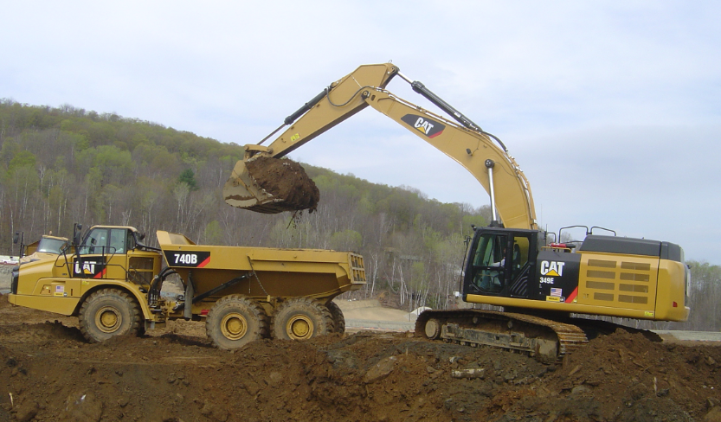
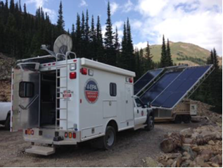
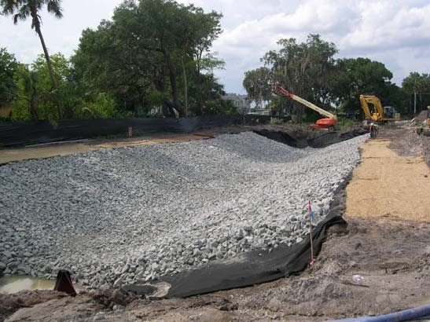
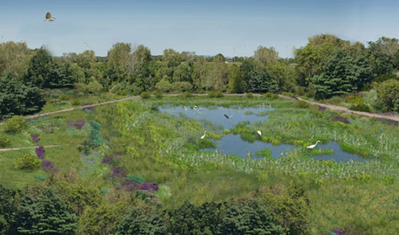
Examples of Greener Cleanup Best Management Practices*
Clean Air: Next generation Tier 4 equipment with diesel-electric power train & NOx, PM reduction (VT)
Energy: An off-grid 25kW hybrid Solar system at a Superfund site (CO)
Materials & Waste: use of recycled concrete for creek bed material to limit (GA) erosion
Water: Constructed wetlands manage stormwater and provide habitat (CT)
* https://clu-in.org/greenremediation/profiles
Notes:
Beneficial Reuse of Materials/Reduction of Materials and Waste Reduction
Actions taken related to the beneficial reuse of materials/waste reduction efforts included: use of recycled concrete for creek bed material to limit erosion (i.e., riprap); chipping and mulching of approximately 5,000 cubic yards of trees and stumps removed for heavy equipment operation subsequently sent to local landscaping companies; reuse of on-site soils determined to be clean for on-site use; and concrete recycling.
7

Slide 8
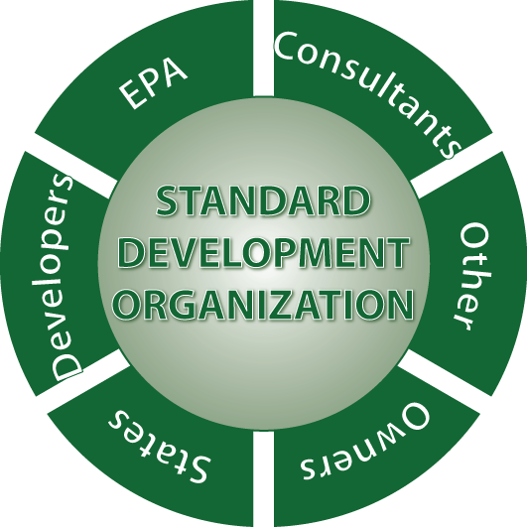
Defining a Greener Cleanup: A Standard Guide
Collaborative effort completed 2009-2013, with ASTM
ASTM is a Standards Development Organization, and it owns the Guide, not EPA
Open participation in development
Process: draft, ballot, vote, revise and repeat
First revision just completed (Fall 2015)
Notes:
DEVELOPING A STANDARD
The first thing we did ---was to create a framework - for evaluating the environmental footprint -of cleanup activities.
We also did research on standards development. We thought we could create this ourselves, but that’s not allowed:
-There’s a law that directs federal agencies to develop standards WITH external stakeholders
You do this through a standards developing organization; and you need consensus to get a standard released;
100 % consensus

Slide 9
The Role of the ASTM Guide in Greener Cleanups
ASTM Standard Guide for Greener Cleanups (E2893):
Codifies best practices and defines a process for reducing environmental footprint
Includes over 160 BMPs and outlines process for straight BMP application or use of quantification
Useful protocol for contracting purposes
Results in a transparent documented process that is reported publicly
Small cleanup project, or standard cleanup approach
Green Remediation Goals in Cleanup Project (Client request, Contractual Requirement, Regulatory requirement, etc)
Select and apply specific best management practices
Large complex projects
Quantify footprint, prioritize reduction targets

Slide 10
Sustainability Principles in Cleanup Programs Now and in the Future…
Minimize diesel emissions
Promote use of renewable energy
ENVIRONMENT
ECONOMIC
SOCIAL
Minimize use of virgin material
Minimize waste generation
Promote water efficiency
Minimize habitat disturbance
Preserve greenspace through reuse
Facilitate land reuse
Engage communities in site decisions
Provide employment opportunities
Protect human health and the environment
Revitalize local economies
Notes:
…members of the public affected by a Superfund site have a right to know what the Agency is doing in their community and to have a say in the decision-making process. (Superfund Community Involvement Handbook).
By Law, Superfund requires community input in remedy decisions and implementation
EPA parallels the International Association for Public Participation 7 “core values of public participation”
EPA has a CI policy since 1981, and nearly 100 CI Coordinators across the 10 regional offices
Technical assistance (grants and services) are provided to ensure communities are independently advised on challenging technical issues
Our experience shows good CI results in better remedies
Environ mental justice link
…members of the public affected by a Superfund site have a right to know what the Agency is doing in their community and to have a say in the decision-making process. (Superfund Community Involvement Handbook).
In Superfund, Remedial Action Objectives factor reasonably anticipated future landuse*.
EPA serves as an active partner in helping to return sites to productive uses
Funding reuse assessments and redevelopment planning
Removing reuse barriers, real or perceived
Partnering with local governments, communities, developers, and other interested stakeholders
Beyond cleanup: Sites ready for anticipated reuse is a key Superfund “GPRA” goal
Annually 300 businesses at 142 Superfund sites with redevelopment has taken place generate $8.8 billion in sales, 25,000 jobs and $1.6 billion in employment income

Slide 11
Signs of Progress
Agency policy supporting greener cleanups, starting in 2008
Tool: ASTM Standard Guide for Greener Cleanups released in 2013, recently updated and soon to be posted
Breadth: ASTM Standard Guide for Greener Cleanups is now in use at sites in all major US programs
Experience: Consulting and engineering sector companies are building greener cleanups into their operations, and gaining experience applying the Standard Guide
Drivers: EOs, EPA Strategic Plan, Contracts and increasing references to the Standard Guide in State cleanup programs
Results: Application of greener cleanup Best Managment Practices (BMPs) at site cleanups, and cleanups with lower footprints
Notes:
TSCA
Region 10 – Adherence to Standard as a condition of approval; first TSCA site to post summary document on ASTM website (Boeing, Everett, WA)
Region 1 – Recommends adherence to Standard in approval letter
RCRA
Region 1 - First site to post summary document on ASTM website (Pharma & Upjohn Site, New Haven, CT)
Region 5 - MOU with GM for greener cleanups
Superfund
Three draft SF SOWs announced on FedBizzOpps calls for consideration of footprint reductions and references the Standard. The SF contracts are worth about $500M over 10 years
Regions have implemented the Standard at fund lead sites; Region 10 summary is posted on CLU-In
Brownfields
Training for grantees at the Brownfields conference
Illinois used RLF to support cleanups at two Chicago Public Building Commission (PBC) Brownfield sites; PBC now embraces Standard
Greener cleanup standard technical support available for Brownfields sites
Federal Facilities
Fort Gillem (Forest Park, GA) contractor included the Standard in their contract proposal, which was accepted by the Army
States
Five States highlight the standard on their websites
Wisconsin and Massachusetts call for reporting footprint reductions as part of their cleanup programs
MA policy strongly encourages use of the Standard to meet regulatory requirement

Slide 12
Thank You!
Carlos Pachon pachon.carlos@epa.gov
EPA Office of Superfund Remediation and Technology Innovation
US EPA, Washington DC
http://cluin.org/greenremediation

