Slide 1


Long-Term Performance of Biochemical Reactors for Passive Treatment of Mine-Impacted Water
Robert (“B.T.”) Thomas
Jim Bays
April 23 2019
www.jacobs.com | worldwide

Slide 2
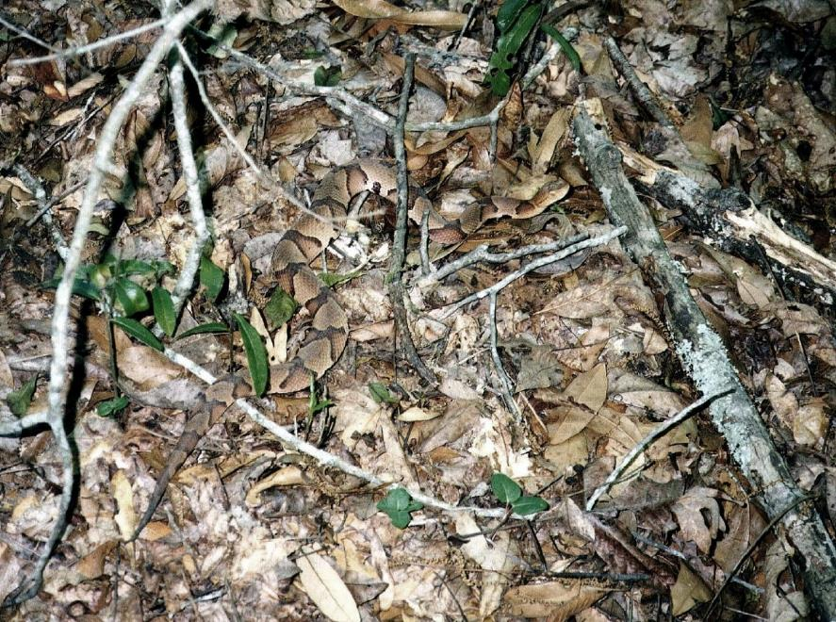
Health and Safety Moment
Biological Hazards
Can you spot
the copperhead?
  Found in much of North America
  Pit viper, typically 2 to 4 feet in length
  Hemolytic venom (destroys red corpuscles)
  Bite is not usually fatal to humans,
  but long and painful recovery
  is common.

Slide 3

Health and Safety Moment
Biological Hazards
Can you spot
the copperhead?
  Found in much of North America
  Pit viper, typically 2 to 4 feet in length
  Hemolytic venom (destroys red corpuscles)
  Bite is not usually fatal to humans,
  but long and painful recovery
  is common.

Slide 4
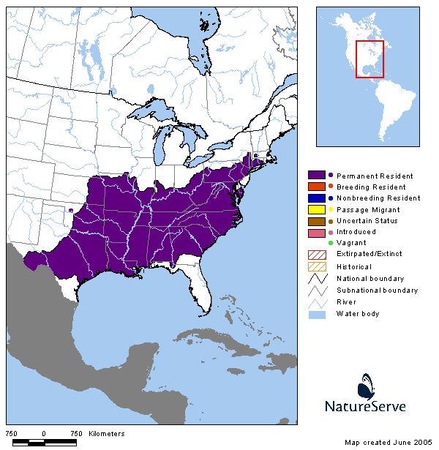
Health and Safety Moment
Biological Hazards
www.tnwatchablewildlife.org

Slide 5
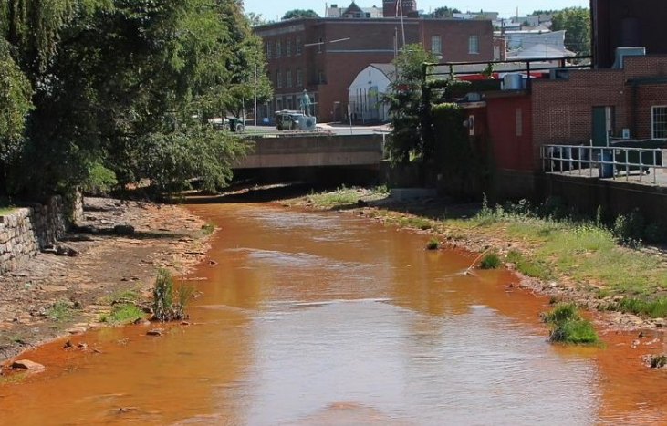

Today’s
Outline
What is Passive Treatment
What are Biochemical Reactors
Coal Mac System
Mayer Ranch System
Conclusion
Notes:
This presentation is organized as an overview of biochemical reactor technology as a form of passive treatment of mine impacted water.
Our focus is on two examples of biochemical reactor projects where we collaborated with our clients on design and where we have had the benefit of receiving follow-up data summaries and observations by the site manager. This has allowed us an opportunity to track performance directly and draw conclusions on the relative merits of using biochemical reactors for improving water quality.
We’ll conclude with a summary of key points and look forward to discussing and responding to your questions.

Slide 6
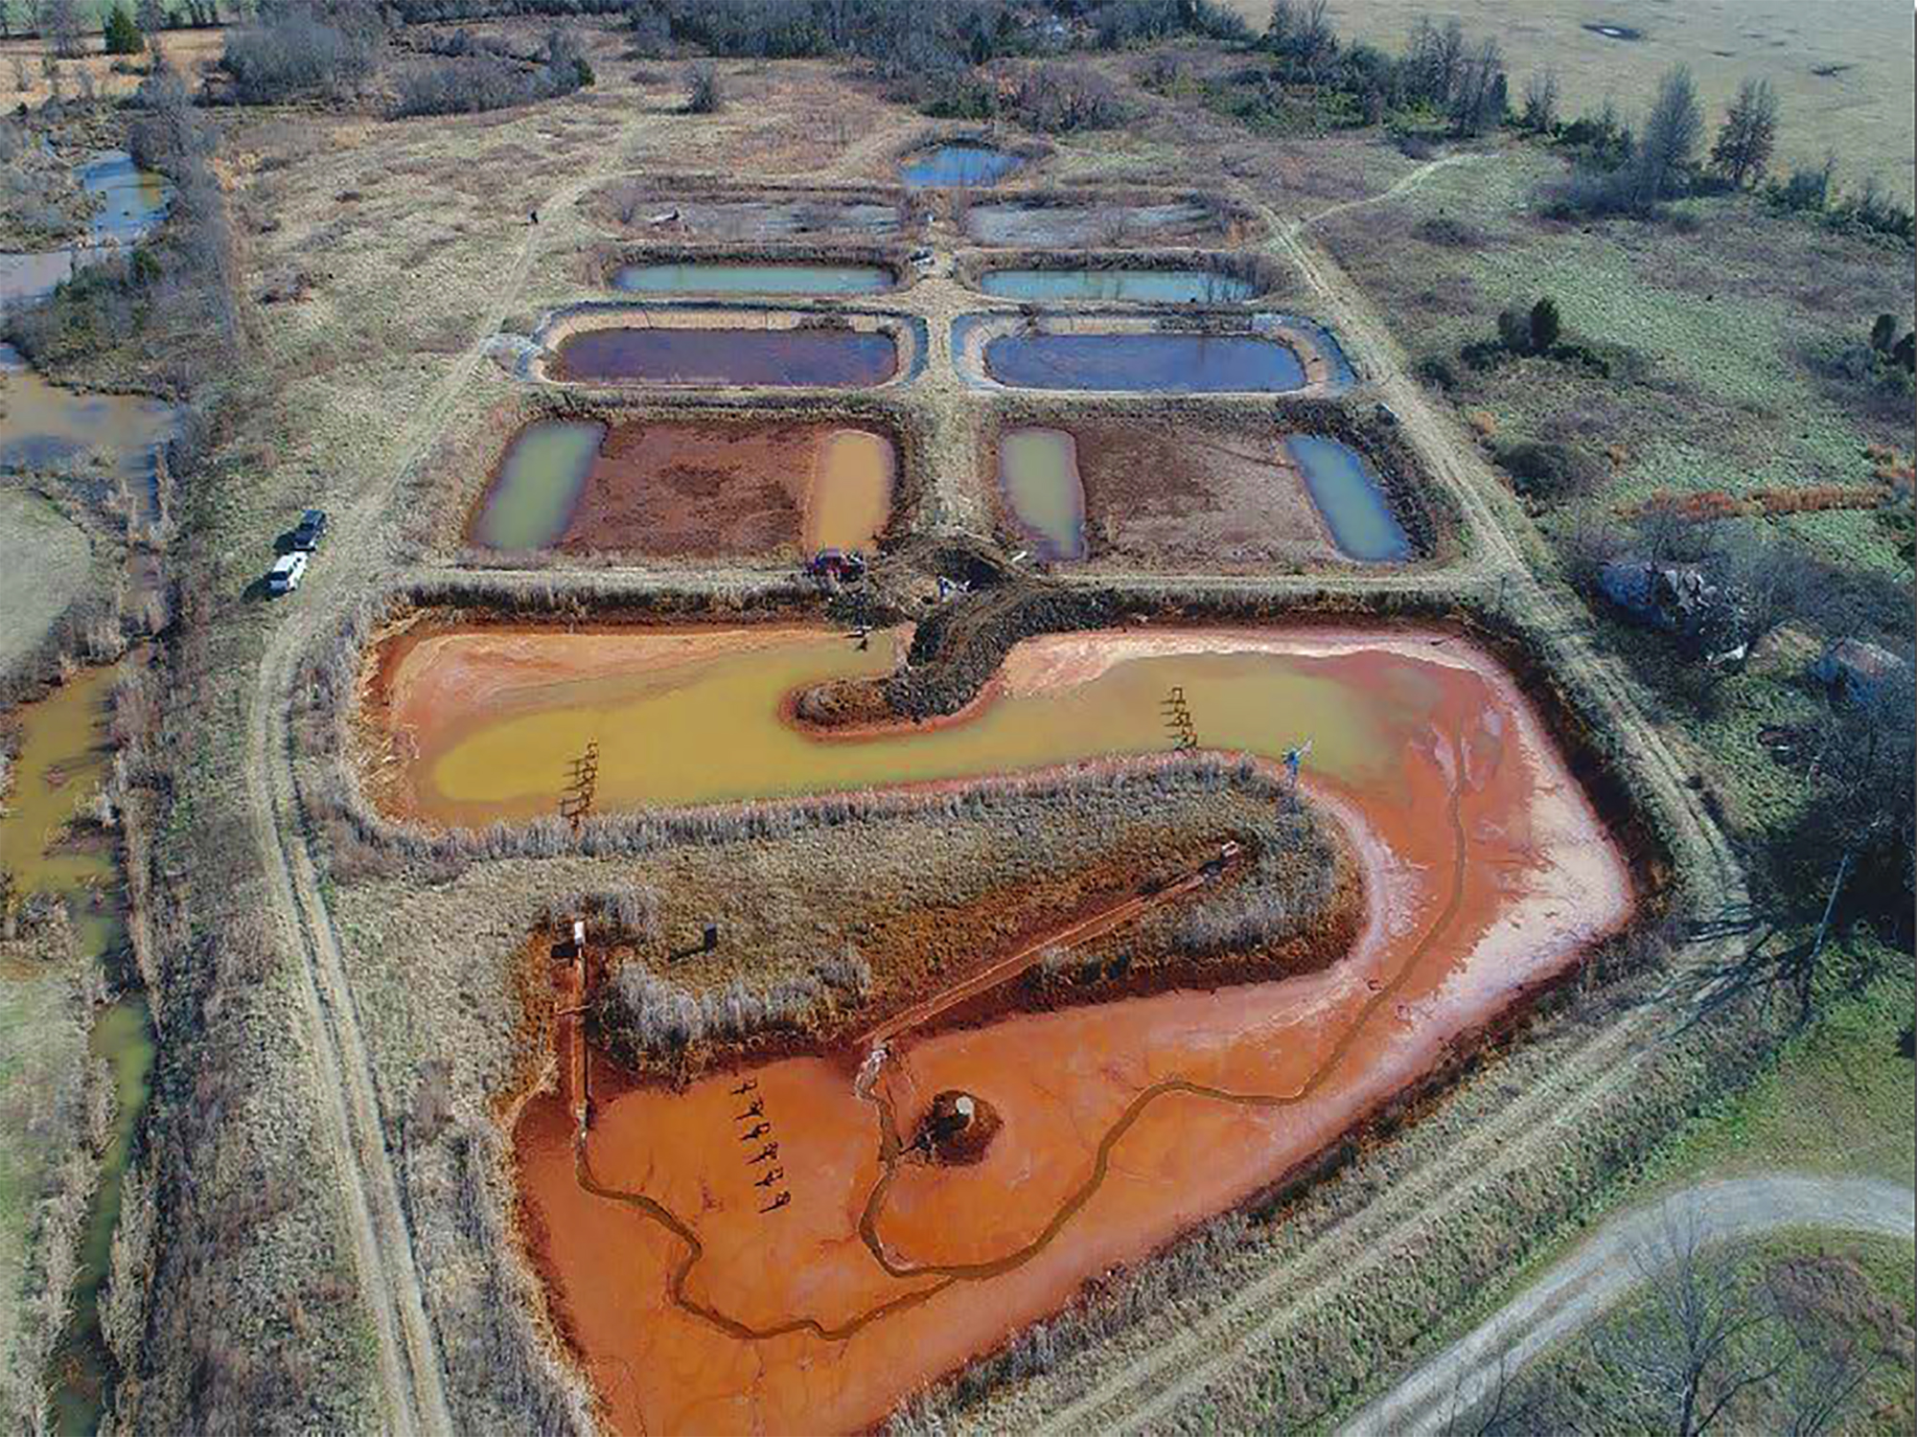
What is
Natural Treatment
Any low maintenance mine impacted water (MIW) treatment method that does
not require continual chemical addition
and monitoring.
Based upon historic observations of natural polishing of mine impacted waters in natural wetlands.
  Advantages
  Substantially lower construction & operating cost
  Low maintenance
  No or limited use of power and chemicals
  Limited health & safety risks
  Can be installed in remote locations
Natural Treatment approaches are applied at mine sites through the design and construction of engineered Passive Treatment Systems
Notes:
Natural treatment systems provides lower cost solution, where feasible, for many of the water source and settings just described.
Natural treatment is a low maintenance treatment method for mine impacted water that does not require continual chemical addition and monitoring and relies on passive biological and chemical processes occurring at their natural rates.
The history of natural treatment is drawn from simple observations made 30 or more years ago from natural wetlands receiving water from mines, and noting that water quality was improved through passive biological and chemical actions. This has led to a significant effort over the past few decades to isolate and optimize through design those parts of wetlands (for example: sediments, open water) that provide the key treatment. So now we have a host of tools we’ll describe that may not resemble wetlands much but mimic their functions.
The advantages of using Natural Treatment Systems over an active treatment system can include:
Substantially lower construction & operating costs
Low maintenance
No or limited use of power and chemicals
Limited health & safety risks
Can be installed in remote locations
Natural Treatment approaches are applied at mine sites through the design and
construction of engineered Passive Treatment Systems

Slide 7

Sustainability in Industry
Multiple Forms and Benefits
Jacobs and Envision Lead the Way in Sustainability
Quality
of Life
Triple bottom line driver
Many forms
  Water use reduction
  Energy reduction
  Carbon capture/emission reduction
  Resource recovery
  Residuals reduction and recycling
  Land conservation and restoration
  Community benefits
Can be quantified for rating/ranking
Climate
and Risk
Leadership
Economic
Environment
Social
Natural World
Resource
Allocation
Envision Categories of Evaluation
Notes:
The use of passive treatment systems is typically viewed as a sustainable approach to management. Where feasible, the use of natural materials and emphasis on reducing water and energy use while utilizing mine land and topography to accomplish the treatment can minimize environmental effects of treatment.
Sustainable approaches typically address environmental effects, economic benefits, and social needs, or the triple-bottom line. This approach can be assessed through ranking systems such as Envision, where five broad categories of sustainable features can be quantified. The use of natural treatment systems can influence sustainability rankings significantly.

Slide 8

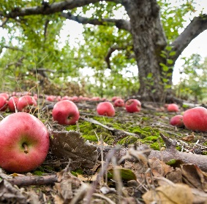


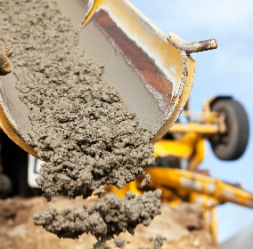
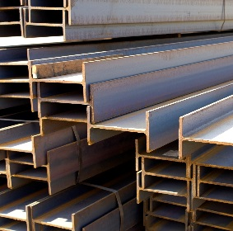

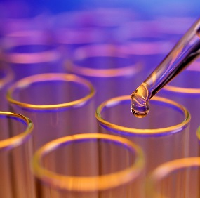
Natural Treatment Where Feasible
Can Show Greater Sustainability Than Conventional
Natural Systems
Conventional Systems
Sun
Gravity
Land
Biomass
Concrete
Steel
Electricity
Chemicals
$
Water Treatment
Water Treatment
$
$
$
Notes:
Natural treatment systems can be more sustainable than conventional, where feasible.
Natural systems utilize the same chemical and biological processes for treatment as conventional systems. Where conventional systems build tank-based treatment reactors of concrete, steel and move water and add compounds using electricity and chemicals, natural treatment systems are typically land-based systems that rely upon gravity flow and locally available sustainable substrates to provide the media and biological habitat that sustains these processes at natural rates.
As a result, fewer staff are required to operate and time in the field and monitoring processes are significantly reduced.

Slide 9
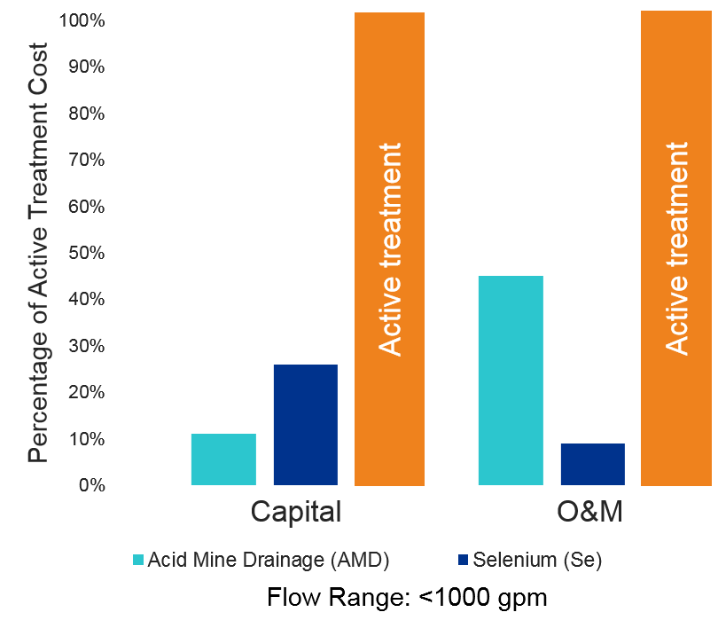
Passive Capital and Operations & Maintenance (O&M)
Costs Are Lower Than Active Treatment
Lower Structural Requirements
Lower Power Cost
Lower Labor
Lower Monitoring
Lower Chemical Cost
Lower Residuals Cost
Locally Available Media
Notes:
Passive treatment capital and O&M costs are typically lower than active treatment.
This figure shows capital and O&M costs for acid mine drainage systems and selenium treatment systems as a proportion of active costs. The literature and experience tells us that passive treatment may cost one-fourth of the cost of active treatment to build. Operations are less expensive too, ranging from approximately 10-40% of active treatment.

Slide 10
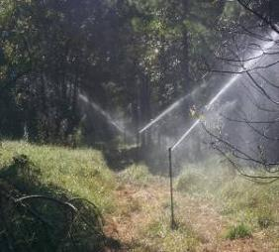
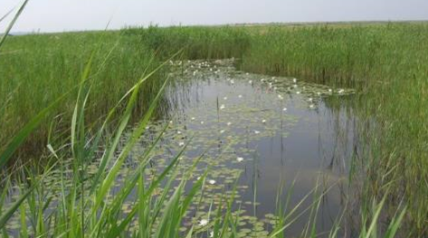
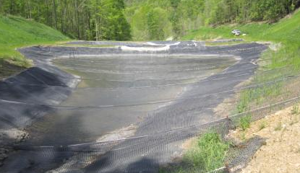
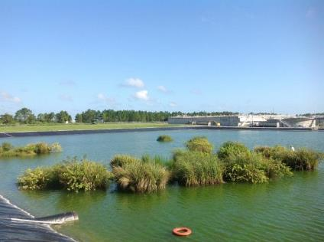
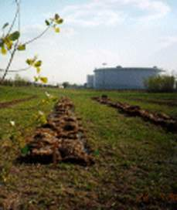
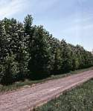
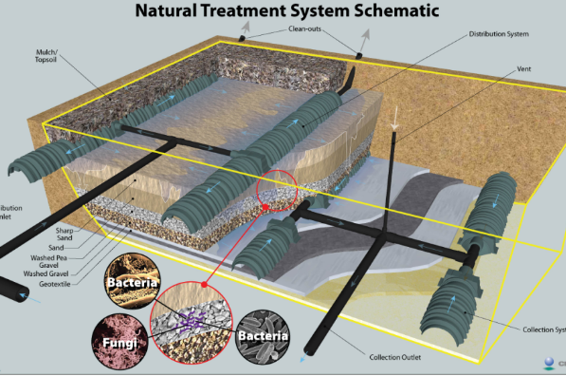
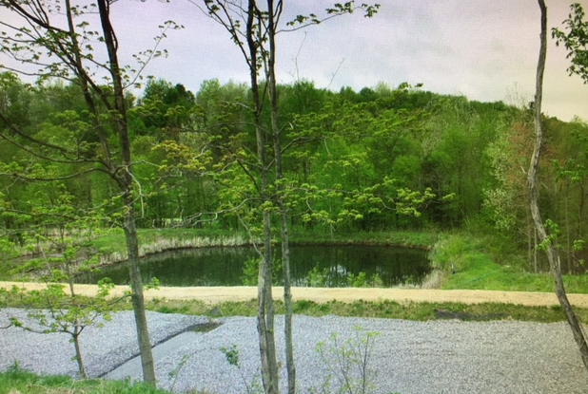
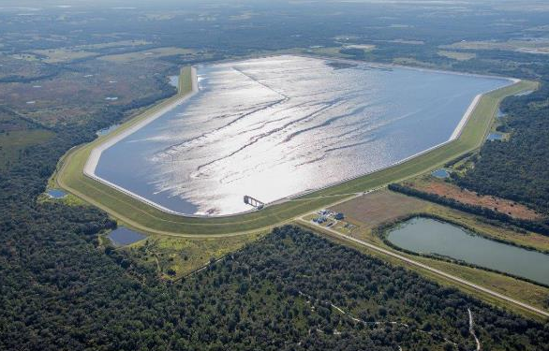
The “Natural Treatment Toolbox” Spans the Spectrum of Upland to Wetland Ecosystems
Upland Systems
Wetland Systems
Passive Media Beds
Ponds & Aquatics
Land Application
Surface Flow
Biochemical Reactors
Ponds & Floating Wetland Islands
Engineered Plant Systems (Phytoremediation)
Subsurface Flow
Limestone Beds
Aeration
Notes:
The natural treatment “toolbox” spans the spectrum of upland to wetland ecosystems engineered to achieve project water quality objectives.
Our starting perspective is that, with any water quality issue, there is probably a natural treatment system that can mimic nature that can be applied to solve the problem.
That includes a range of possibilities, shown here from left to right, that includes upland systems like land application and engineered plant uptake systems, to surface flow and subsurface flow wetlands, to passive media beds such as anaerobic biochemical reactors, and to ponds, which may include floating wetlands or aeration systems.
These types of systems and the benefits they bring can be reviewed and compared to see whether any of them “fit” the environmental setting of the project.
For this presentation, we are focusing on biochemical reactors. Their history as a technology is drawn from observations of the improvement effect on metal and nutrient pollution by natural wetlands, particularly the sediments, and natural underlying aquifer soils and materials.

Slide 11
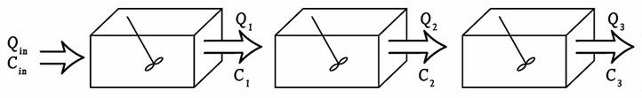
Integrating Passive Treatment Systems
The Rationale and Benefits of a “Treatment Train”
Unit Process Approach
Sedimentation
Bio transformation
Conditioning
Compartmentalization
Manageability
Notes:
Another concept we want to introduce is that the BCR is rarely implemented as a single unit treatment process. Instead, as we’ll show in our examples, we will typically employ multiple cells in series of one or more type of system to complement BCR treatment.
As we mentioned earlier, this may include a sedimentation basin for precipitate formation and settling, followed by a biological transformation step using a BCR and a final conditioning or polishing step, to remove residuals produced by the biological process. This rationale then is based upon the idea of the unit process approach.
A second rationale for developing a sequence of systems is to compartmentalize flow. This means that a system could be divided into smaller systems primarily to improve the hydraulics. Treatment wetlands typically function as a series of 3 mixed tanks in series. Reactors have similar hydraulic characteristics and can be modeled as such. The primary benefit of this approach is to minimize the potential for short-circuiting.
The final consideration is operationally, where there may be a need to route flows from one unit to another parallel treatment train to allow access for maintenance or other reason.

Slide 12
Biochemical Reactor Plans
Require Systems Approach
Notes:
Stepping back a bit further, the treatment train concept can be expanded to include multiple treatment processes as a system, where an initial equalization step leads to a primary treatment process such as sedimentation followed by the biological treatment process (analogous to secondary treatment) and a tertiary treatment process for water quality polishing. This concept also includes the understanding that the treatment media will require replacement or regeneration. This process perspective is appropriate for both passive and active forms of treatment.

Slide 13
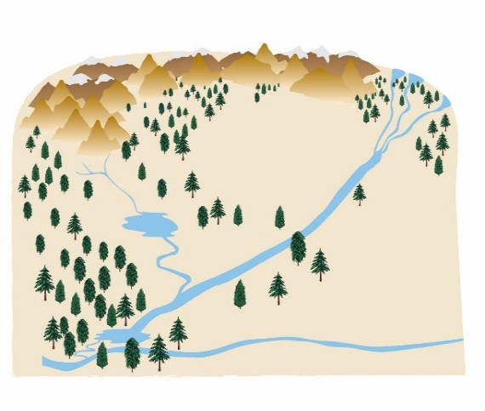



Mine Impacted Waters
Range Widely in Source and Composition
  Mining
  Surface water: oxidized metals, solids (suspended and dissolved)
  Groundwater: leachate (reduced metals (Fe, Mn), hydrocarbons, nutrients
  Manufacturing
  Process WW: nutrients, metals, organics, inorganic
  Concentrate: inorganic
  ions, metals
  Stormwater: solids, metals, nutrients, organics
Valley fills
Mine adit
Waste rock piles
Seeps
Pits
Mill
  Power
  FGD: metals (Se, Hg), salts, inorganics (S, Ca), hydrocarbons
  Concentrate: inorganics, metals
  Stormwater: solids, metals
  Cooling water: temperature, algal solids, antiscalants
Leachates
Tailings
Notes:
Since we’re focusing on mine-water for this presentation, the figure on the left notes the many forms that water can be found in on mining projects. This includes surface drainage from mines and rock piles to groundwater seeps and leachate, all of which may be contaminated by dissolved metals, inorganic ions and other substances such as nitrogen.
The potential for water quality impacts varies widely these types of waters and there is rarely a single pollutant that requires treatment.
This description of the mine water pollutant environment can be generalized more broadly to other industrial sources, such as manufacturing and power. These facilities can generate process wastewaters and concentrates and impact site stormwater. All tend to have in common that metals and inorganic ions occur at concentrations significantly above background or may exceed water quality criteria.
Also, the flow and timing of these waters are typically in ranges beyond what may naturally occur and require management.

Slide 14
Two Main Water Chemistry Types with Respect to BCR Design
Oxyhydroxide-bearing Water
Non-oxyhydroxide bearing water
Water with iron (Fe²⁺ or Fe³⁺) and/or aluminum.
Fe/Al-oxyhydroxide precipitates can clog porosity and greatly reduce longevity
Requires (mainly abiotic) pretreatment units to remove before BCR
Mn-bearing water passes through BCR units and is typically treated in post-treatment units
Water that does not require chemical pretreatment prior to BCR (no oxyhydroxide-bearing metals)
May require sedimentation unit to remove TSS (i.e., wetland or settling basin)
Notes:
This wide range of types of waters will require different approaches to treatment based upon their water chemistry.
From the perspective of applying biochemical reactors appropriately, we make two distinctions in water chemistry. First, constituents that will form oxy hydroxide precipitates will require a step to allow this process to occur before flowing to a BCR. The precipitates can clog or reduce longevity of the substrate. This pretreatment step will remove iron and aluminum from the influent water. This treatment is primarily chemical in nature. Mn bearing water will pass through an organic BCR, typically, and is treated by a post BCR process.
The second type of water does not include oxyhydroxide bearing water and does not require chemical pretreatment. Some degree of sedimentation may be required for TSS removal if inorganic solids are part of the water stream.

Slide 15
Periodic Table of
Passive Treatment
1 |  |  |  |  |  |  |  |  |  |  |  |  |  |  |  |  | 18
1
H | 2 |  |  |  |  |  |  |  |  |  |  | 13 | 14 | 15 | 16 | 17 | He
 |  |  |  |  |  |  |  |  |  |  |  |  | 6 | 7 | 8 | 9
Li | Be |  |  |  |  |  |  |  |  |  |  | B | C | N | O | F | Ne
11 | 12 |  |  |  |  |  |  |  |  |  |  | 13 |  | 15 | 16 | 17
Na | Mg | 3 | 4 | 5 | 6 | 7 | 8 | 9 | 10 | 11 | 12 | Al | Si | P | S | Cl | Ar
19 | 20 |  |  | 23 | 24 | 25 | 26 | 27 | 28 | 29 | 30 |  |  | 33 | 34
K | Ca | Sc | Ti | V | Cr | Mn | Fe | Co | Ni | Cu | Zn | Gz | Ge | As | Se | Br | Kr
 |  |  |  |  | 42 |  |  |  |  | 47 | 48 |  |  | 51
Rb | Sr | Y | Zr | Nb | Mo | Tc | Ru | Rh | Pd | Ag | Cd | In | Sn | Sb | Te | I | Xe
 | 56 |  |  |  |  |  |  |  |  | 79 | 80 | 81 | 82
Cs | Ba | La* | Hf | Ta | W | Re | Os | Ir | Pt | Au | Hg | Tl | Pb | Bi | Po | At | Rn
 | 88
Fr | Ra | Ac~
Anaerobic
Oxidizing
Passive untreatable
Oxidizing and anaerobic
Actinide Series
92
U
Gusek, 2009
Notes:
At this stage in the development of passive treatment technology, there have been many projects completed by our firm and others that have demonstrated that passive treatment is an effective method of improving water quality.
This figure shows the familiar periodic table of elements, with colors that show elements shown to be treatable through anaerobic reduction (in blue), as we showed you for selenium in our first example, and through oxidation and precipitation (in orange), as we showed for our examples of alkaline and acidic iron-dominated waters.
What is striking about this chart is that you can see that most experience with metals show that they are treatable with biological reduction. This is why we have built our case studies around the BCRs; they are effective and space efficient.
Also, some contaminants such as arsenic, and common nutrients such as nitrogen and phosphorus, require a sequence of aerobic and anaerobic processes.
Finally, many salts such as chloride in light blue are environmentally conservative and are not treatable directly by passive treatment. In these cases, active treatment or dilution are common approaches.

Slide 16
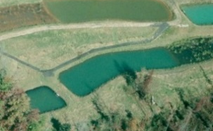
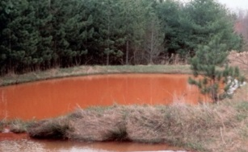
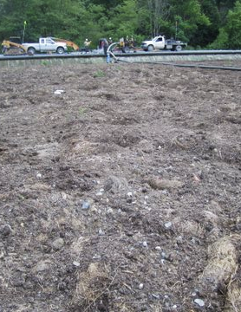
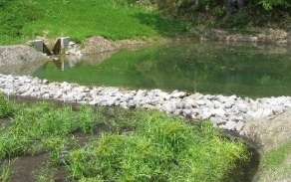
Types of
Passive Treatment Operational Units
Abiotic/geochemical-based units
  Commonly limestone-based
  Based on abiotic design parameters
  Raise pH, add alkalinity, and/or neutralize/reduce mineral acidity
  Precipitation/removal of iron and aluminum
  Often used as pretreatment units to biological-based units
Biological-based units
  Engineered to promote biological activity
  Anaerobic units for trace metal removal (BCRs)
  Aerobic units for polishing 2nd parameters
  Cold climate operation
  Largest unit(s) in a passive treatment design
Notes:
Now that we’ve introduced the idea of precipitate bearing water and the wide range of water types that may be encountered, we want to return to the idea of the passive treatment system toolbox.
Designers can take different passive units (tools) from their passive treatment toolbox to build a system unique to each chemistry and site condition
For mine- and industrial wastewaters , the toolbox is divided into two categories either 1) abiotic or geochemically based units or 2) biological treatment units.
The abiotic units are often used as pretreatment tools to biological-based units; they are commonly limestone-based and designed on abiotic geochemical reactions such as how much acidity can be neutralized per unit area, per day.
The typical goal is to raise pH, add alkalinity, and/or neutralize and reduce stored metal acidity. This typically results in precipitation and removal of iron and aluminum.
The biologically-based units are engineered to promote either 1) anaerobic biological activity that results in the precipitation of metal sulfides or the transformation to elemental forms or 2) aerobic units used for polishing secondary parameters, such as excess biological oxygen demand, color, and sulfide.
Because they rely upon hydraulic residence times of one or more days, they can be the largest unit in a passive treatment design
One of the main concerns regarding any biological treatment is year round operation in cold climate conditions. The biological-based units can be insulated using treatment media and soil to permit year-round operation in extremely cold environments.

Slide 17
What is
Biochemical Reactor
Biochemical reactor (BCR) units are common in PTS design, especially where sulfate reduction is desired as the removal mechanism for trace metals
The BCR media is designed to support high levels of anaerobic microbial activity over an extended timeframe (>10 years)
Metal removal is through both biological and abiotic removal mechanisms (mainly sulfide precipitation)
Downstream APC units are typically installed to re-oxidize the BCR effluent
and remove any excess sulfide before discharge to the environment
Oxidation
pond
Water
Organic matter
Limestone
Notes:
A typical biochemical reactor consists of a compostable organic layer overlying a subsurface drain to create vertical water flow through the substrate and a water control structure to keep the organic layer flooded thereby promoting and maintaining anoxic conditions. The media is designed using locally available and sustainable materials to supply long-term carbon and minimize permeability loss. These systems are designed to last 10 – 20 years.
Due to the high carbon content and the anaerobic nature of the biochemical reactor, the effluent tends to contain elevated biological oxygen demand, color, and excess sulfide with no dissolved oxygen. As such, biochemical reactors are designed and constructed with an accompanying aerobic polishing cell (APC) that is designed to remove the biological oxygen demand and color, oxidize any residual sulfide, and raise the dissolved oxygen of the final effluent. The aerobic polishing cells can be either fill and drain gravel bed units that operate by slowly filling and then rapidly draining, surface flow wetlands, or some combination of both.
Although biologically based, both biochemical reactors and aerobic polishing units can be effectively operated in cold climates by simply burying and insulating the units.

Slide 18
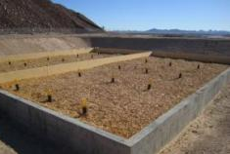
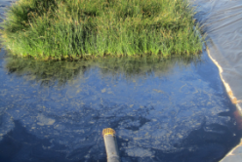
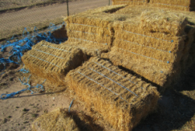
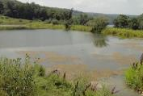
Biochemical Reactors are
Constructed Anaerobic Substrates
Wood
  Chips, sawdust
Grass
  Hay
Peat
Limestone Sand
Manure and Soil
Natural Power
  Gravity
  Solar
ITRC 2013
Notes:
Bioreactors are typically constructed using locally available, readily compostable organic materials such as woodchips and sawdust, hay, peat, limestone sand, and manure. The woodchips provide long-term structural support to the substrate as the more readily degradable products start to break down. Manure is typically added in very small amounts to provide a microbial seed to the substrate; however, large amounts of manure are avoided to minimize excessive biological oxygen demand following start-up. Limestone sand is added to help buffer the substrate to near-neutral conditions.
History of substrates – why do we design this way, RAPS/SAPS experience

Slide 19
How do
Biochemical Reactors (BCR) Work?
  Anaerobic trace metal removal units
  Designed to promote “elemental reducing”
  microorganisms (Fe, Se, SO4)
  Removal of trace metals as either sulfide or elemental precipitates
  Designed using empirically-based loading models
  Typically 1 – 4 day hydraulic residence time (load based)
  Removal of hydrolysable metals (Fe, Al) in
  pretreatment units
H⁺ + HS⁻ → H₂S
H₂S + M²⁺ → MS_{(s)} + 2H⁺
e.g. H₂S + Pb²⁺ → PbS + 2H⁺
Notes:
Biochemical reactors are designed to support “elemental reducing” microorganisms. For the majority of systems, this means sulfate reduction to generate sulfide, which in turn, can react to precipitate trace metals from solution. However, biochemical reactors can also be designed specifically to reduce other elements that impact water quality. For example, selenium, chromium, or even uranium can be biologically reduced resulting in the direct precipitation of these metals in the BCR substrate.
Because these units are biologically based, they typically require longer residence times than other passive treatment units. On average, the hydraulic residence time of a typical biochemical reactor is on the order of 1 – 4 days, but could be significantly longer. Biochemical reactors are designed based on empirically-based loading models for the main contaminant of concern and are sized to handle the largest flow and under the coldest temperatures expected
As Jim noted previously, hydrolysable metals, such as iron or aluminum, should be removed in pretreatment passive units to maximize the longevity of the BCR unit. If these metals are not removed in advance of BCR treatment, they can form oxyhydroxide precipitates within the BCR pore space, effectively clogging the unit and rendering it ineffective.

Slide 20
Competitive Exclusion:
Electron Tower Theory
Aerobic respiration ½ O2 + 2e- + 2H+ -> H2O
Denitrification 2NO3- + 12 H+ +10e- -> N2+6H2O
Manganese reduction MnO2 + 4H+ + 2e- ->Mn2+ + 2H2O
Iron reduction Fe(OH)3 + 3 H+ + 2e- -> Fe2+ + 2H2O
Sulfate reduction SO42- + 10H+ +8e- -> H2S + 4H2O
Methane production CO2 + 8 H+ + 8e- -> CH4 +2 H2O
Process | Eh (mV)
Aerobic respiration | +330
Denitrification | +220
Manganese reduction | +200
Ferric to ferrous reduction | +120
Sulfate reduction | -150
Methanogenesis | -250
Organic carbon substrate provides electrons via microbial process
Notes:
While bioreactors are designed with the intent of supporting a specific microbial process such as sulfate reduction or selenium reduction, the reality is that bioreactors host a consortium of different anaerobic microbial communities that utilize different terminal electron acceptors and compete for the organic substrate. Typical electron acceptors utilized by microorganisms are oxygen, nitrate, ferric iron, sulfate, and carbon dioxide. Microbes tend to oxidize organic substrates by the using the electron acceptor that provides the most energy. The electron tower relates the amount of energy a given microbial population can gain from an electron acceptor. For example, oxygen, which is at the top of the electron 'tower', provides microbes with more free energy (via oxygen reduction) than any other electron acceptor. Carbon dioxide, which is used as the electron acceptor by methanogenic bacteria, yields the least energy of all the electron acceptors, and is therefore located at the bottom of the 'tower'. Thus, the electron tower schematically depicts the order of electron acceptor utilization based on the free energy a given microbial population can gain from reduction of a given electron acceptor.
Thus, for a BCR influent water with a high nitrate load, the denitrifying bacteria will outcompete the sulfate reducers until all of the nitrate is reduced because denitrification is higher in the electron tower than sulfate. So when designing a BCR, the nitrate load must be included with the metal loading for sizing the BCR during design.

Slide 21

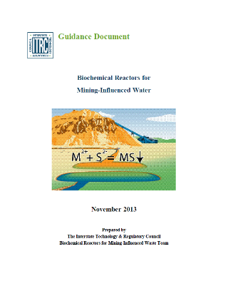
History of
Bioreactors
Tuttle et al., 1969, “Microbial Sulfate Reduction and Its Potential Utility as an Acid Mine Water Pollution Abatement Procedure”. Applied Microbiology; 17(2): 297–302
  “A mixed culture of microorganisms degraded wood dust cellulose, and the degradation products served as carbon and energy sources for sulfate-reducing bacteria.”
Agricultural denitrifcation bioreactors
Wildeman et al, 1993, Wetlands Design for Mining Operations – example from Big Five
ITRC (Interstate Technology & Regulatory Council). 2012.
Biochemical Reactors for Mining Influenced Waste. BCR-1. Washington, D.C.: Interstate Technology & Regulatory
Council, Biochemical Reactors for Mining-Influenced
Waste Team
Notes:
The concept of using sulfate reduction for mine drainage abatement dates back to the late 1960’s with seminal paper by Tuttle and others. They found that a community of microorganisms broke down compostable organic matter to small chain organic acids that were then utilized by sulfate reducing bacteria. The sulfate reducers, in turn, generated sulfide and alkalinity which neutralized mine drainage and precipitated metals from solution.
In the early 1980’s, bioreactors started being used for denitrification of agricultural runoff. Researchers found that simple woodchip beds could rapidly reduce nitrate in effluent from agricultural tile drainage fields.
Several early bioreactors for the treatment of mine drainage, originally called sulfate reducing bioreactors or SRBRs, were tested in the late 1980’s and early 1990’s. The bioreactor pilot study at Big Five Tunnels in Colorado led to the publication of a bioreactor design manual by Wildeman and others in 1993.
Other bioreactors, such as the Forest Queen in Silverton, CO which was built in 1998 and Luttrell near Helena, MT which was built in 2002, have been operated seasonally, but have not been extensively studied.
In 2012, the ITRC published a guidance document for BCR design and operation and includes several case studies

Slide 22
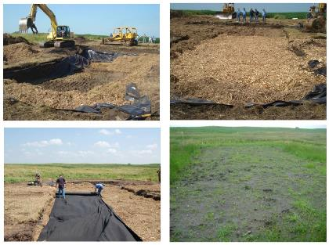
BCRs Commonly Used for
Nitrate Reduction
Applied throughout Midwest
Long track-record
Wood chips
Removal Range: 2-18 g NO3-N/m3
media per day
HRT~<<1 day
www.sdcornblog.com
Warnecke et al 2011
Schipper 2012
Notes:
Some of the earliest bioreactors were built in the early 1980’s for denitrifying agricultural run-off. They were mainly woodchip based, but have a long-track record in the Midwestern US. Because nitrate reduction is so rapid, these early bioreactors were able to achieve between 2 to 18 grams of nitrate reduced per cubic media of substrate per day and residence times were on the order of only a few hours.

Slide 23
BCR Longevity
Factors Affecting Lifespan
Carbon Depletion
Hydraulic Conductivity Decline
Possible cause:
  Sizing – too small?
  Carbon source
Has it happened?
  No record for denitrifying BCRs
  Pilot projects exhausted C source
Low potential based on half-life
  Anaerobic media 36.6 yrs
  Aerobic media 4.5 yrs
    Moorman et al 2008
Ultimately depends on contaminant load
Excess inorganic solids
  Pre-treatment for solids reduction
Media consolidation
  Include heterogeneous mix of media. Some use gravel
  Consider maintenance “fluffing”
Precipitation of metals
  Create intermediate process units for settling
Notes:
A typical consideration related to the systems approach is the need to factor in the BCR lifespan.
Experience and study tells us that two common factors that warrant consideration include carbon depletion and hydraulic conductivity decline.
The first is possibly attributable to inadequate sizing or the wrong carbon source. But published experience doesn’t exist that shows a BCR “wearing out” although in our experience, we’ve seen occasions where pilot projects may be depleted of carbon if carried on past their design plan.
In general though, the expectation is that anaerobic substrates will last a long time because the decompose at much slower rates than aerobic substrates.

Slide 24
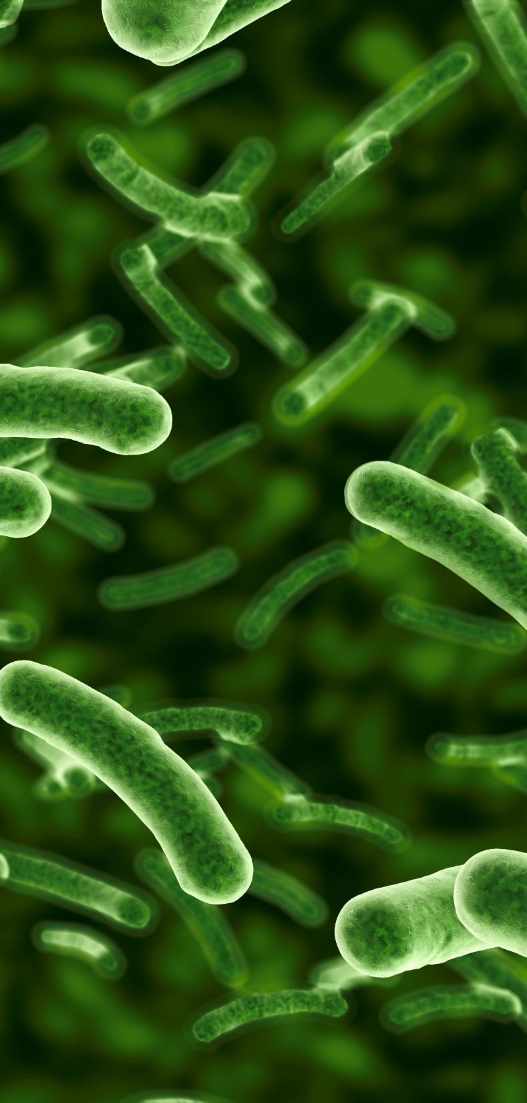
BCR Longevity
Two Case Studies
Case Study 1: Coal Mac Se Treatment System
  ~8 years of continuous, compliant operation
  ~$5K in annual Operation and Maintenance
Case Study 2: Mayer Ranch PTS
  ~10.5 years of continuous, effective operation
  ~$10K in annual Operation and Maintenance
  One maintenance “event” after 8 years to rejuvenate BCR substrate hydraulics ($4K)

Slide 25
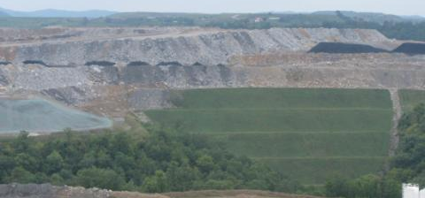
Case Histories
Pilot and Full-Scale Passive Treatment in WV
Overview
Location
Two outlets assigned stringent selenium discharge standard:
  4.7 ug/L monthly mean
  8.2 ug/L daily max
Conducted barrel studies to formulate substrate, calibrate model
Designed two distinct systems based on landscape, space, treatment
First system July 2011
Second system November 2011
Valley fill drainage from reclaimed mines

Slide 26
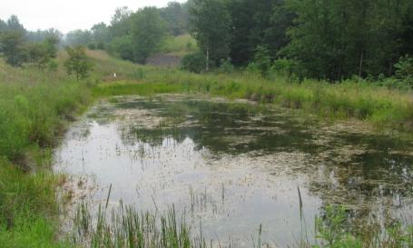

Wetland Processing and Storage of Selenium
SeO₄²⁻
Volatilization
  Organic + SeO₃²⁻ → (CH₃)₂Se
  Volatilized from plant tissues
  5-30% cumulative loss from sediments and plants
Sorption
  Selenite sorbs to sediments and soil constituents: Fe-, Mn- or Al-oxyhydroxides and organic matter
Plant Uptake
  Rapid uptake
  Tissue concentrations increase but not detrimental
  No long term storage in plants; Se transferred to sediments
(CH₃) ₂Se
Org-Se
SeO₃²⁻
nanospheres
HSe⁻¹
Se⁰
Dissimilatory Reduction
  SeO₄²⁻ → SeO₃²⁻ → Se⁰ → Se²⁻
  Anaerobic process (Eh -200 mV, DO<2)
  Distribution in wetland sediments:
  0:13:41:46
  Wetlands: 90% reduction 10 - 16 days
  Bioreactors: 90% reduction <1 - 2 days
Notes:
By anaerobic bacteria:
2CH₂O + SeO₄²⁻ → 2HCO₃⁻¹ + H₂Se

Slide 27
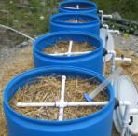
BCR Pilot Testing in Barrels
Established Substrate Preference and Performance (2010)
Pilot System (Jun-Sep 2010)
Average Total Se by Barrel
Four Upflow Media Bioreactors (200 L)
Material | Pilot Barrel
 | A | B | C | D
Woodchips | -- | 20% | 16% | 20%
Sawdust | -- | 20% | 47% | 30%
Hay | -- | 15% | 16% | 20%
Organic Peat | -- | 20% | -- | --
Sphagnum Moss | 100% | 20% | -- | --
Composted Manure | -- | -- | 15% | 23%
Limestone Chips | -- | 5% | 6% | 7%
Total (by volume) | 100% | 100% | 100% | 100%
Four Organic Media (OM) Substrates

Slide 28
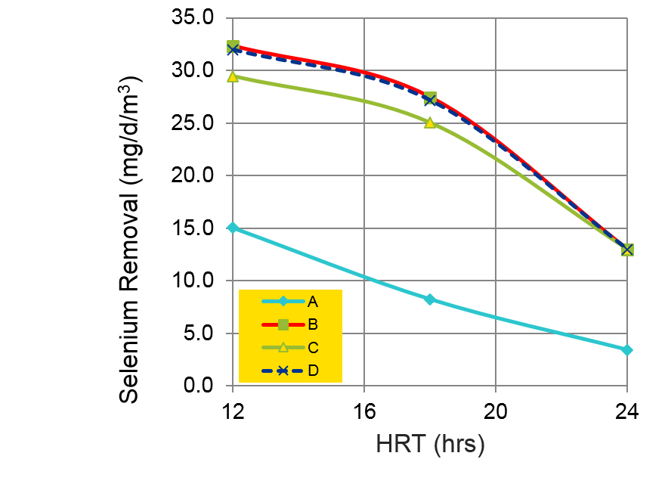
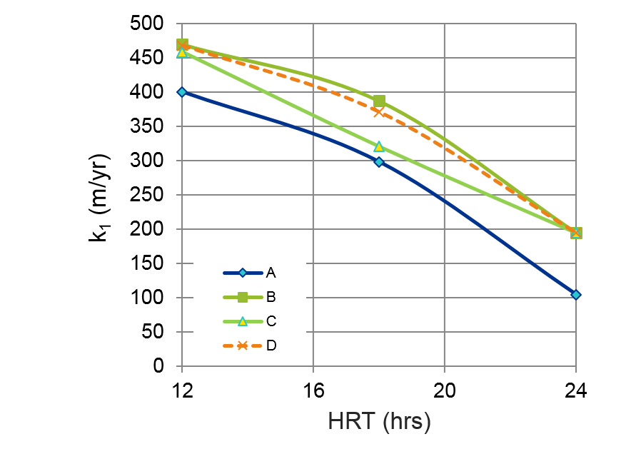
Pilot Established Removal Rates for Target Hydraulic Residence Times
Zero-order volumetric
First-order area-based

Slide 29
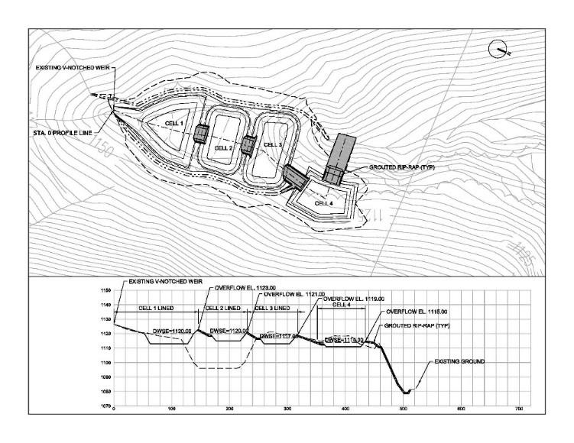
Case History (2011-present)
Full-Scale BCR System for Coal Mine Drainage Se Treatment
Replace existing sed pond
Four cells-in-series:
  0.13 ac Downflow BCR
  Barrel “B” mix
  0.14 ac Anaerobic upflow bed
  Barrel “A” peat
  0.16 ac Fill-and-drain wetland
  Gravel; siphon level control
  0.11 ac Surface flow marsh
1
2
3
4
Source: CH2MHILL (2012)
60 gpm base flow
100 gpm max
12 µg/L mean Se to <4.7

Slide 30
System Consistently Meets Discharge Criteria

Slide 31
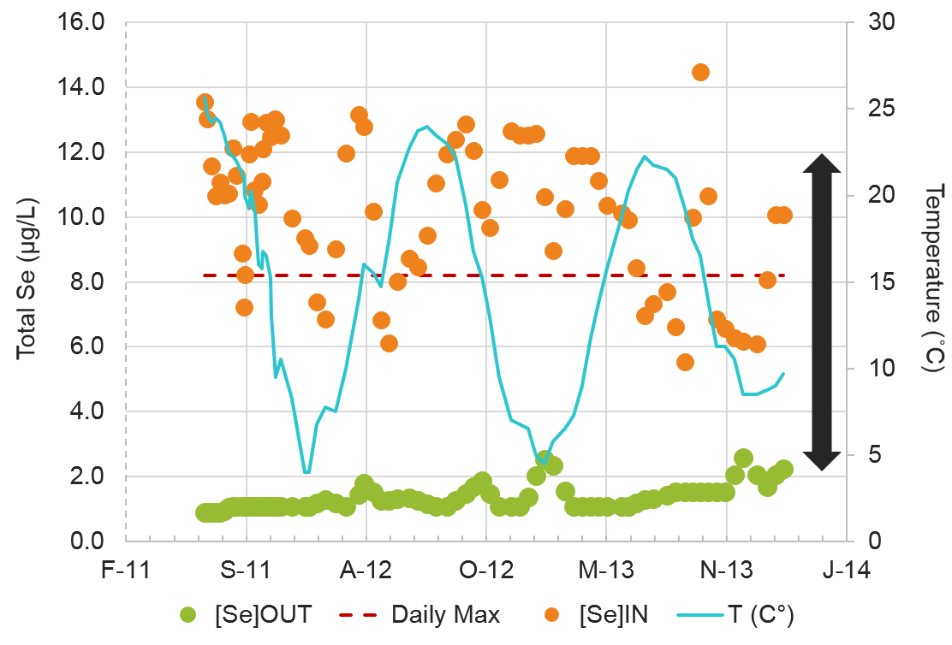
Selenium Meeting Daily Criterion Year-Round
µg/L | In | Out
Average | 10.24 | 1.32
Max | 14.47 | 2.57
Min | 5.53 | 0.90
Range | 8.9 | 1.7

Slide 32
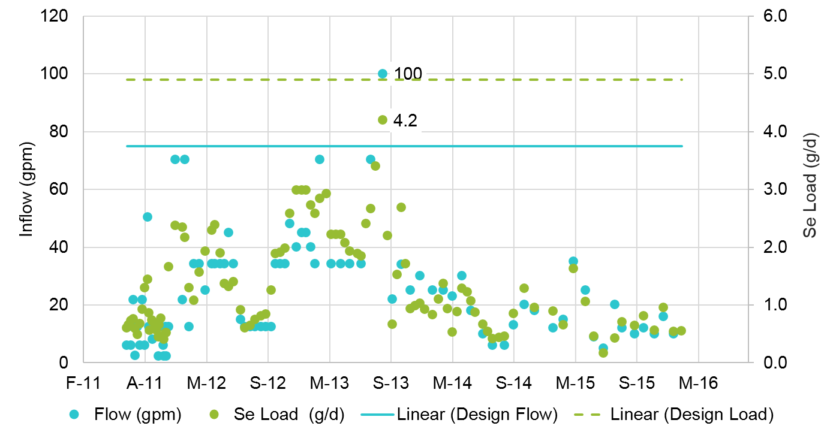
First Five Years
Five-fold Variation in Flow and Load

Slide 33
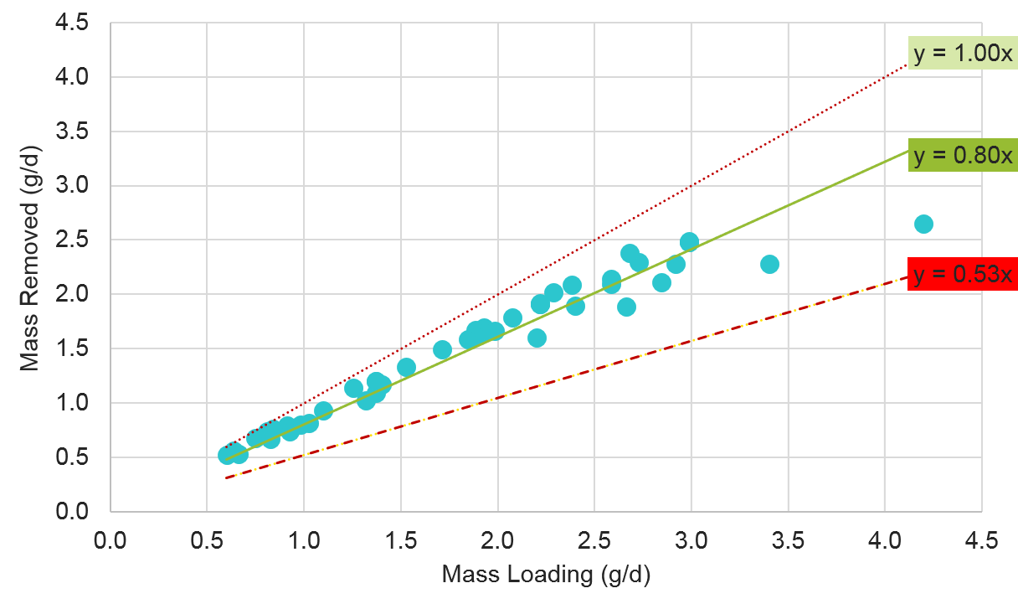
Removal Rate Sustained Substantial Margin Through Loading Rate Increase

Slide 34
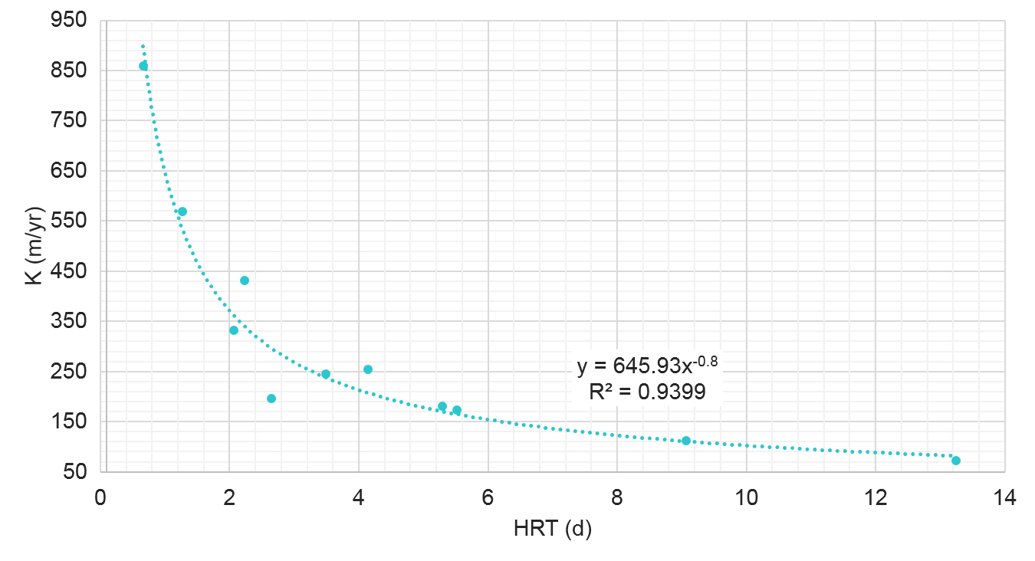
Removal Rate Decreases with Increasing Hydraulic Residence Time

Slide 35
Barrel Selenium Profile Reflects
First-Order Process (2011-2012 Pilot)
A-1
A-2

Slide 36
Vertical Distribution and Speciation of Selenium
Reduction, Sorption, Volatilization (2011-2012 Pilot)
In
Out
In
Out
In
Source: CH2MHILL (2012)

Slide 37
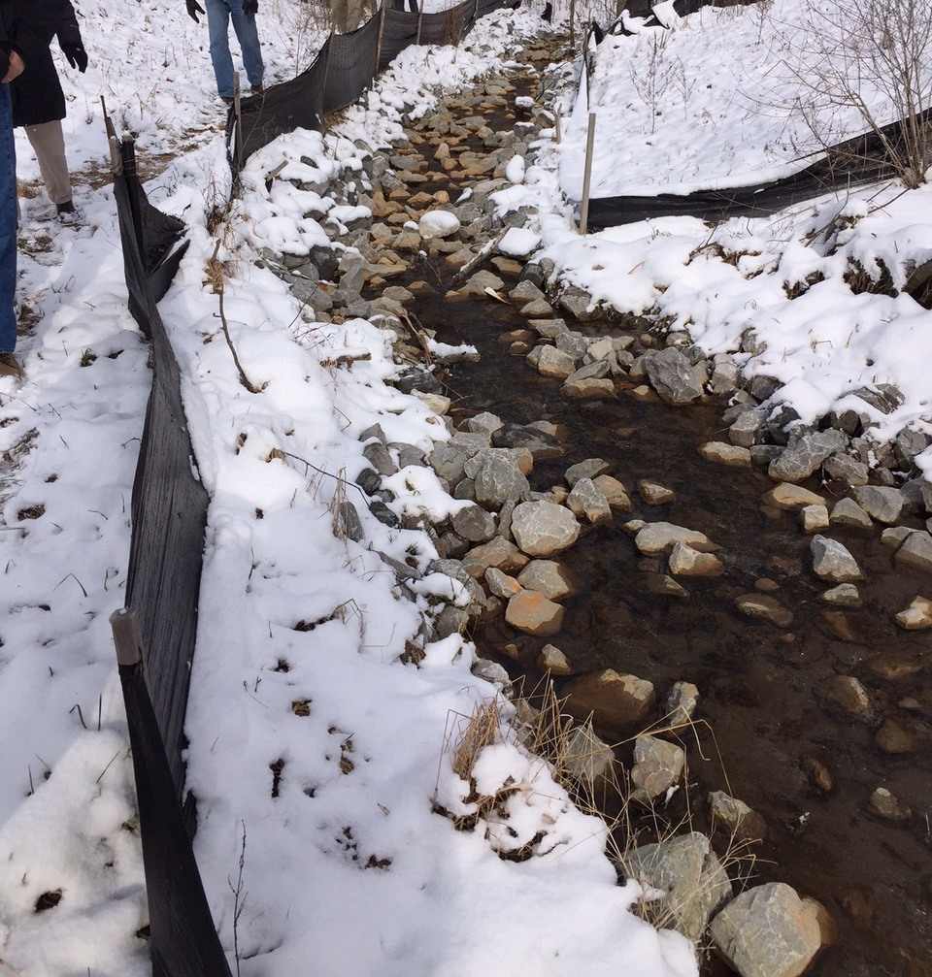
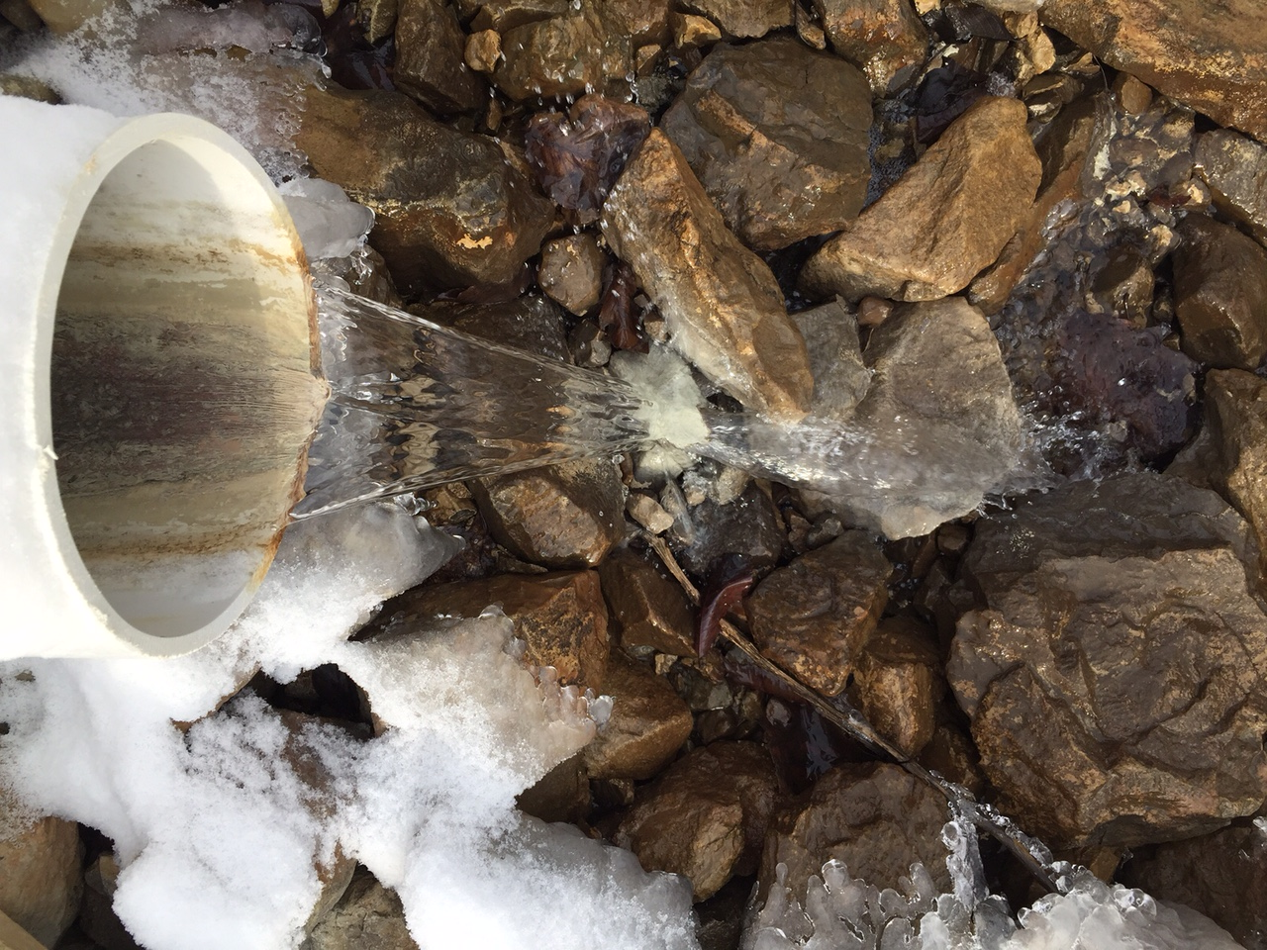
Post-BCR
Flow Needs Polishing
Initial organic color will
be high
Inorganic color often white/ yellow precipitate (elemental sulfur), the oxidation result when pH not optimum for conversion to sulfate
BOD and COD also elevated
> Addition of oxygen
to system

Slide 38
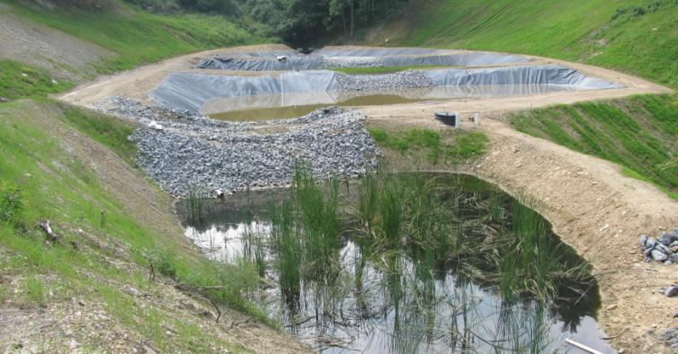
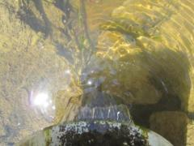
Completed Passive Se Treatment System
Parameter | Influent | Cell 1 Effluent | Cell 2 Effluent | Final Effluent
BOD | 13 | 30 | 26 | 11
COD | 11 | 43 | 84 | 24
NO₂+NO₃-N | 3.6 | 1.5 | 2.4 | 1.2
Total Phosphorus | 0.28 | 0.09 | 0.13 | 0.1
All units = mg/L
^{a.} Monitoring data from February through July 2012
Cell 1 Downflow
Cell 2 Upflow
Cell 3 Fill & Drain Marsh
Cell 4 Surface flow
Source: Thomas, R. (2011)

Slide 39
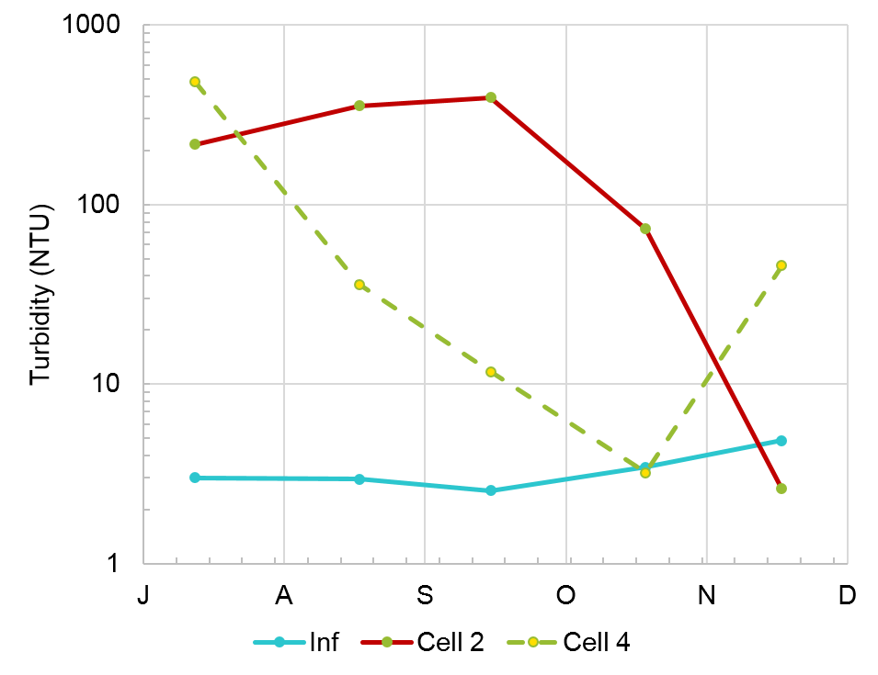
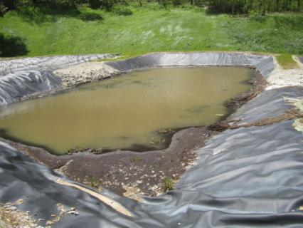

Polishing Wetlands Reduced Turbidity by 83%
Cell 2
Cell 3 into Cell 4

Slide 40
Coal Mac Selenium Treatment System
Natural Systems
Conventional
Systems
BCR+wetland footprint fits (just)
Construction $765K
Natural processes
O&M $15K/yr
Can be made to fit
Construction $18MM
Engineered processes
O&M $500K

Slide 41
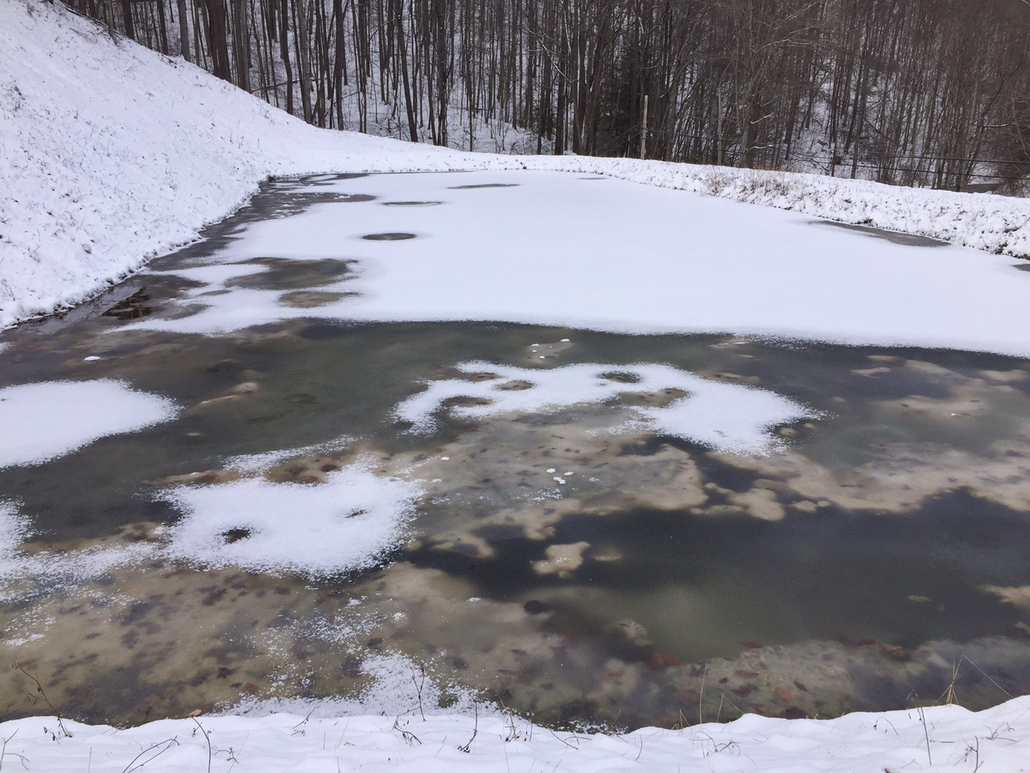
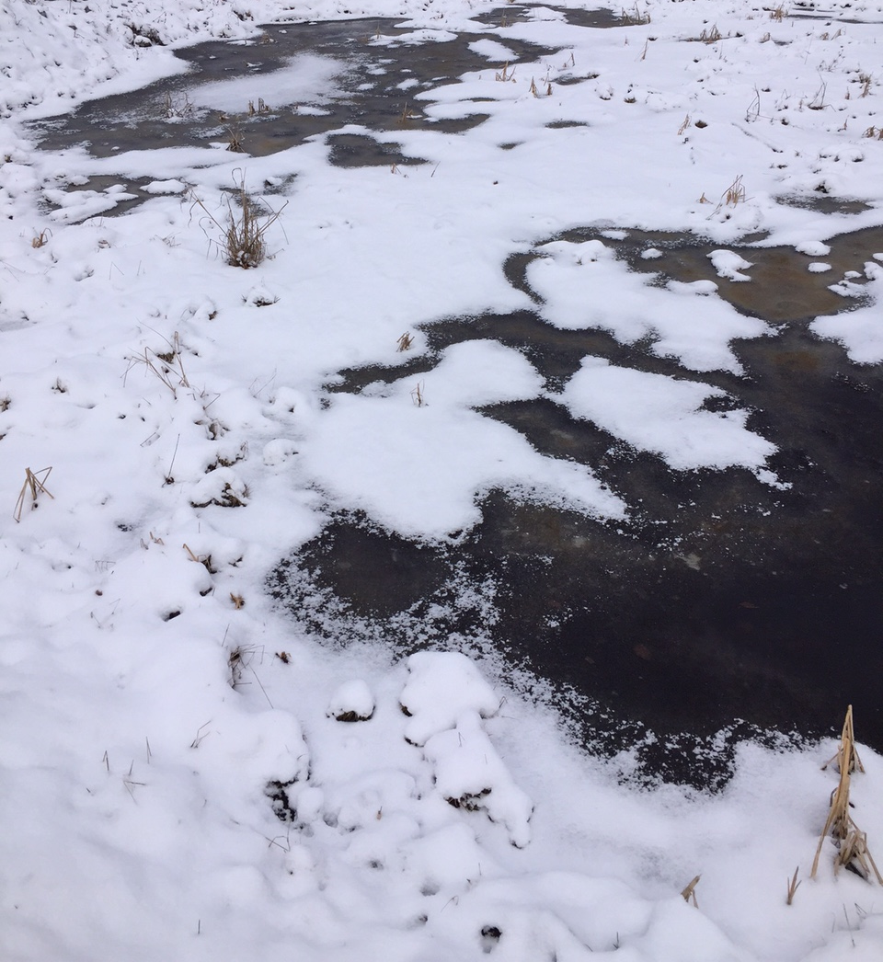
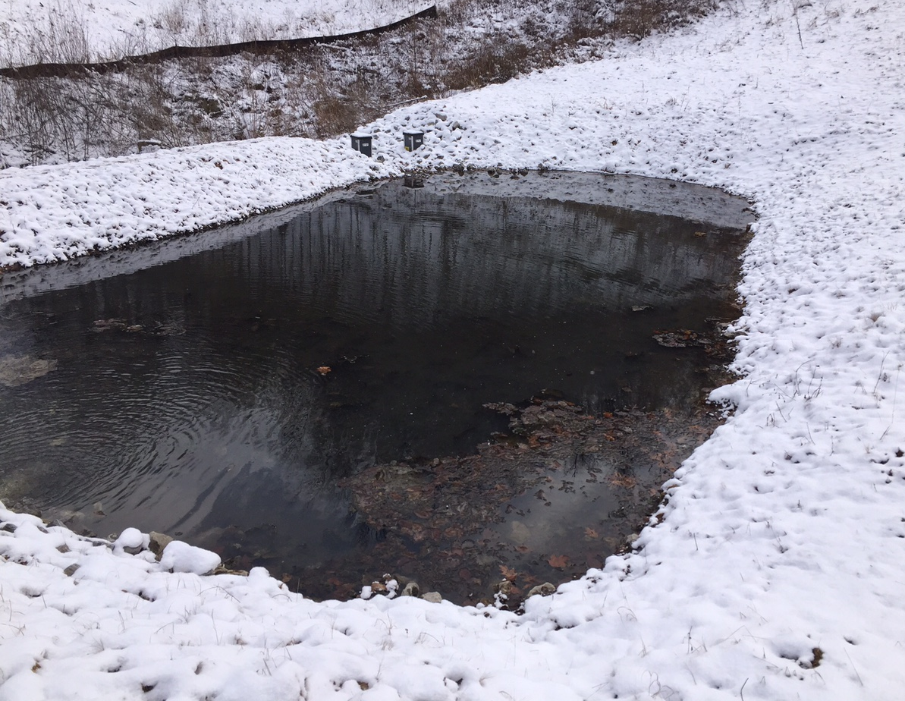
Passive Designs Currently Being Implemented
VDF BCR
VUF Peat
HSSF Polishing

Slide 42
Conclusions
Coal Mac Se BCR System Demonstrates Robust System Longevity
Key Points
8 years continuously compliant performance
  No indication of reduction in lifespan
O&M was budgeted for $15K/yr, reality ~$5K/yr in weekly monitoring
  No substrate adjustment needed
Averaging <$0.32/1000 gallons treated
  Includes hypothetical substrate replacement ~20yrs
Award-winning “innovative” project
Notes:
Jim – I recalculated the average cost – assuming 60 gpm (base flow) and ~$5K/year spent; the cost per 1000 gallons comes out to ~16 cents; we doubled it to include substrate replacement cost amortized over 20 years (i.e., the 32 cent value).

Slide 43

Case Study 2
Mayer Ranch Passive Treatment System
Target artesian discharges of net alkaline mine water
Multiple process units for sequential treatment
Focus on Unnamed Tributary watershed (200 ha)
Location of Original Discharge from Mine Pool after closure
  Mayer Ranch
Dr Robert Nairn, University of Oklahoma
  all of data present in this section is credited to OU/CREW
Notes:
Our second case study is the Mayer Ranch Passive Treatment System that we designed and built in collaboration with our client, Dr Robert Nairn, from the University of Oklahoma. Dr Nairn and his students had been studying several artesian discharges of mine pool water for over a decade when the Mayer Ranch Passive System was constructed in 2008. The Mayer Ranch system is a prime example of a mine chemistry that requires pretreatment to remove hydrolysable iron prior to treatment with a BCR. Bob and his students have continued to maintain and operate the Mayer Ranch system to this day and all of the data presented in this section are credited to our partner, the University of Oklahoma.
Define CREW; Bob is principle investigator

Slide 44







Tri-State Mining District
Oronogo-Duenweg Mining Belt Superfund Site
Cherokee County Superfund Site
Tar Creek
(Ottawa County) Superfund Site
Newton County Mine Tailings Superfund Site
Picher, OK 1926
Notes:
The Mayer Ranch property lies within the south-eastern portion of the Tar Creek Superfund site in the northeastern corner of Oklahoma.
Mention Tri-State, Tar Creek part of

Slide 45








Tar Creek Superfund Site
Tar Creek
Mining 1890s-1960s
1979: discharge to surface
  First from 2 abandoned boreholes on the Mayer Ranch Property in Commerce, Oklahoma
National Priorities List (1983)
Elevated Fe, Zn, Cd, Pb, As in water, chat, soils and biota
Mining “mega-site”
  >1000 surface hectares
  500 km of tunnels, 2600 open shafts and boreholes.
  94 million m3 contaminated water
Six Communities & Ten Native American Tribes
KS
Lytle Creek
OK
Elm Creek
Beaver Creek
Unnamed Tributary
University of Oklahoma comprehensive watershed monitoring
1997 - 2018
Streams, point (artesian discharges), nonpoint (waste pile runoff / leachate) sources
Notes:
The Tar Creek Superfund Site is a portion of the abandoned lead and zinc mining area known as the Tri-State Mining District (OK, KS, and MO)
Includes over 100 square kilometers of disturbed land surface and contaminated water resources in extreme northeastern Oklahoma.
Underground mining from 1890s through 1960s degraded over 1000 surface hectares, and left nearly 500 km of tunnels and over 2600 open shafts and boreholes.
Approximately 94 million cubic meters of contaminated water currently exist in underground voids.
In 1979, metal-rich waters began to discharge into surface water from natural springs, boreholes, and mine shafts; the first known occurrence was observed from two abandoned boreholes on the Mayer Ranch Property in Commerce, Oklahoma

Slide 46

Mayer Ranch
Annual Mass Loadings (kg/yr)
Fe | ~88,730
Zn | ~6,210
Cd | ~5
Pb | ~10
“
EPA concurs with the State's conclusion that the surface water conditions are irreversible
(2005)
”
www.epa.gov/superfund/sites/fiveyear/f94-06003.pdf
Notes:
The average annual mass loading of metals at Mayer Ranch, based on 10 years of data, is almost 89,000 kg of iron and over 6,000 kg of zinc per year. These loadings have been fairly consistent since the Mayer Ranch flows started in 1979.

Slide 47


Mayer Ranch
Passive Treatment Concept
Ponds
  Precipitation and sedimentation
Aerobic Marsh
  Precipitation and Solids Trapping
Biochemical Reactors
  Trace metal removal
  SRB-mediated reduction
Aerobic Polishing
Limestone Beds
  Add alkalinity
  Zn carbonate precipitation
Biochemical Reactor
Notes:
Bob Nairn’s vision for how system should be implemented. These are the components of the system; demonstrate the principle components of an integrated PTS. Recall treatment train concept described earlier. Pretreatment -> BCR -> post-treatment polishing.
I changed Successive Alk Production Systems (SAPS) to Reducing Alkalinity Production Systems (RAPS) since 1) we only have one unit in each treatment train and therefore they are not being used in succession; 2) there are trademark/patent implications with SAPS (and not RAPS, go figure); 3) RAPS is technically more accurate since there is a reduction layer (compost) and an alkalinity layer (limestone) – though in reality probably minimal alkalinity is generated and most is likely generated in the organic layer. This is really more an SRBR than a true RAPS by the very nature of the processes that are found within (i.e., sulfate reduction is the main mode of remediation in this cell)

Slide 48


Mayer Ranch
Passive Treatment System
Oxidation pond
SA
Surface flow wetlands
USEPA funding 2004-10
Ecological engineering field research site for OU
Designed for 1000 L/min flow rate
Six distinct process units
  8 in parallel for total of 10 cells
First PTS in entire Tri-State Mining District
Continuous operation since 11/2008
Limited O&M
Elevated Fe, Zn, Pb, Cd, As influent
Discharge meets criteria
SD
BCR units
Re-aeration ponds
Horizontal flow limestone beds
SB
Polishing pond/wetland
System start up November 2008
Notes:
3.9 acres, 1000L/min is about 250 gpm. Actual flow rate is about 200 gpm.

Slide 49


Mayer Ranch
Water Quality Changes
MRPTS
oxidation cell
under construction, fall 2008
 | In (n=82) | Out (n=43)
pH | 5.95 | 7.02
Alk_{T} (mg/L) | 393 | 224
Fe_{T} (mg/L) | 192 | 0.13
Zn_{T} (mg/L) | 11 | 0.25
Ni_{T} (mg/L) | 0.97 | 0.15
Cd_{T} (μg/L) | 17 | <PQL
Pb_{T} (μg/L) | 60 | <PQL
As_{T} (μg/L) | 64 | <PQL
SO₄⁻² (mg/L) | 2239 | 2057
MRPTS
oxidation cell during managed drawdown,
winter 2017

Slide 50



Mayer Ranch PTS
Total Iron Changes
Dominant mechanisms:
Oxidation and sorption
Cell 1
Fe oxidation, hydrolysis and settling
Fe:107 kg/d → 4 kg/d
Design Fe Removal Rate: 20 g m⁻²d⁻¹
10-year Mean : 20.4 ± 5.4 g m⁻²d⁻¹
Cells 1 and 2N/S
Trace metal sorption to FeOOH(s)
Pb: 70 ± 1.96 → 27 ± 0.82 μg/L
Cd: 17 ± 0.97 → 1.20 ± 0.51 μg/L
As: 62 ± 1.81 μg/L → <PQL

Slide 51


Mayer Ranch PTS
Total Iron Changes
Amorphous ferrihydrite typical of Cell 1 and Cell 2N/2S surface samples
Goethite crystallization in deeper iron oxide samples

Slide 52



Mayer Ranch PTS
Total Zinc Changes
Dominant mechanism:
Bacterial sulfate reduction
Cells 3N/S
SO₄⁻² reduced, organic matter oxidized
Sulfide produced:
S⁻² + M⁺² → MS(s)
Design BSR rate:
300 mmol S m⁻³ d⁻¹
10-year BSR rate range:
200-650 mmol S m⁻³ d⁻¹
Notes:
General comment – exciting to see this density of data and consistency of data over a decade of monitoring; CREW publishes new papers on this system yearly.

Slide 53


Mayer Ranch PTS
Total Zinc Changes
Well-developed ZnS colloidal aggregates on humic materials in VFBR substrates
FeS2 aggregation and framboidal pyrite in VFBR substrates

Slide 54


Mayer Ranch PTS
Total Metal Changes
2010 VFBR Sequential Extractions
2014 VFBR Sequential Extractions
Notes:
Process improves with age – moves almost all sulfide removal with age.

Slide 55





Mayer Ranch PTS
Contaminants of Concern
99.8% DFe
37,000 kg Fe/yr
~750 mt Fe/life
98.6% DZn
1700 kg Zn/yr
~35 mt Zn/life
Fe
Zn
~100% DPb
15 kg Pb/yr
~0.3 mt Pb /life
~100% DCd
3 kg Cd/yr
~0.1 mt Cd/life
Pb
Cd

Slide 56




Mayer Ranch PTS
Other Metals
~100% ΔAs
13 kg As/yr
~0.3 mt As/life
~100% ΔCo
11 kg Co/yr
~0.2 mt Co/life
As
Co
95.5% ΔNi
185 kg Ni/yr
~4 mt Ni/life
30.8% ΔMn
96 kg Mn/yr
~2 mt Mn/life
Ni
Mn

Slide 57




Mayer Ranch PTS
Base Cations
3% ΔCa
6% ΔMg
Ca
Mg
4% ΔNa
5% ΔK
Na
K

Slide 58


Mayer Ranch PTS
BCR Maintenance
After 9 years of operation both BCR units showed significant decrease in permeability
Both units drained and the substrate “flipped” in attempt to recovery the hydraulic properties

Slide 59


Changes in Hydraulic Conductivity
K (m/day)
 | North BCR | South BCR
2008 (pre-construction)
Laboratory-Falling Head | 4.77 | 4.77
2016 (8-years operation)
Laboratory-Falling Head | 0.51 | ---
Field-Falling Head | 0.13 | 0.31
Modified Infiltrometer | 0.19 | 0.17
Slug Test | 1.25 | 0.43
2017 (after flipping)
Field-Falling Head | 4.5 | 4.5
Notes:
Hydraulics impacting longevity. Substrate still working to remove metals, but hydraulics were failing. Flipping the substrate essentially rejuvenating the media.

Slide 60
“Major” O&M Costs
Oxidation Pond |  | BCR
2 x 8” x 5’ Inlet AgriDrains | $1200 | ---
Equipment (Takeuchi TB153) | $1500 | $1900
Stone (for ramp) | --- | $700
Labor | $1000 | $1500
Misc. (pipe, fuel etc.) | $700 | $200
Total | $4400 | $4000
“Major” O&M < $10K ($840/yr)
All monitoring and regular O&M ~ $10K/yr
Notes:
*10K/yr research level monitoring program

Slide 61
Conclusions
Mayer Ranch Passive Treatment System Maintenance Substains Longevity
Key Points
10 years consistent performance
  No reduction in water quality performance
  Maintenance restored hydraulic function
Routine maintenance is land & water-based
  Animals, vegetation, storms, people
Annual O&M was <$10K/year
  BCR substrate “flip” performed for $4K
Average <$0.10/1000 gallons treated
ITRC “Success Story”

Slide 62
Conclusions
Biochemical Reactors Meet Longevity and Performance Requirement
Biochemical reactor technology based on long-term performance of natural systems
Carbon depletion and hydraulic conductivity are potential impacts to longevity
Case histories demonstrate good performance (8-10yrs)
  No adverse performance trends; no indication of carbon-depletion
  No costly substrate replacement
  Hydraulic property of the substrate may be a concern before carbon depletion
  Lower cost operations demonstrated

Slide 63

Acknowledgements
Thanks to Coal-Mac and our collaborating partners in the West Virginia coal mining industry and other industries.
Thanks to Dr. Robert Nairn, his current and former graduate students, and the University of Oklahoma.
Thanks to engineering and science staff at Jacobs.

Slide 64


Questions
Robert “BT” Thomas
Jacobs Project Geochemist
Jim Bays
Jacobs Professional Wetland Scientist
Robert Thomas, Ph.D., is a project geochemist. He has
22 years of experience and expertise in the generation and treatment of acid rock drainage (ARD) and specializes in Passive Treatment Systems for Mine Impacted Water (MIW). BT has led the design and participated as a subject matter expert on numerous passive treatment design projects since joining Jacobs 10 years ago.
Jim Bays is a Professional Wetland Scientist and a Technology Fellow in Natural Treatment Systems with Jacobs. With more than 40 years of experience, Jim specializes in planning and design of natural treatment systems for water quality improvement. His current focus is on passive treatment of selenium and the use of wetlands for treating membrane concentrate.
bt.thomas@jacobs.com
jim.bays@jacobs.com

