Slide 1
Mining Webinar Series:
Successful Implementation of
Biologically-Based Passive Remediation Systems
May 1, 2018

Slide 2
Who is Freeport-McMoRan Inc.?
Freeport-McMoRan Inc. (FCX) is a premier U.S.-based natural resources company with an industry-leading global portfolio of mineral assets. FCX is the world's largest publicly traded copper producer. FCX's portfolio of assets includes the Grasberg minerals district in Indonesia, one of the world's largest copper and gold deposits; significant mining operations in the Americas, including the large-scale Morenci minerals district in North America and the Cerro Verde operation in South America.
Our global workforce, comprised of employees and contractors, includes approximately 53,000 members. FCX has a strong commitment to safety performance, environmental management and to the local communities where it operates. FCX is a founding member of the International Council on Mining and Metals (ICMM) and committed to implementation of the ICMM Sustainable Development Framework.

Slide 3
Environmental Technology and Life Cycle
Transformation
Delivers value across the portfolio by:
  Identifying, developing and deploying technology to more effectively and efficiently manage liabilities
  Developing and deploying experience and expertise to:
    reduce reclamation and closure costs
    reduce closure risk
  Developing residual resource projects and products to reduce holding costs and extend sustainability of facilities
  Increasing project deployment velocity in accordance with market conditions and changing regulations
  Providing data necessary for obtaining agency and public acceptance of innovative programs

Slide 4
Environmental Technology &
Life Cycle Analysis Team
Water Treatment
Source Control
Migration Control
Residual Resources
Life Cycles Analysis
Active water treatment
Liability management
Liability prevention
Monetizing residual assets
Generating offset costs
Liability management
Implement advances in technology
Minimize and manage future liabilities
Develop sustainable practices
Passive Bioremediation

Slide 5
What is ahead?
What constitutes a biologically-based passive bioremediation system?
Factors affecting successful implementation
Design criteria (opportunity for success)
Short break + questions
Test cases
  Laboratory treatability testing
  On-site pilot-scale treatability testing
  Successful implementation
Questions / Discussion

Slide 6
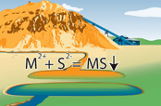
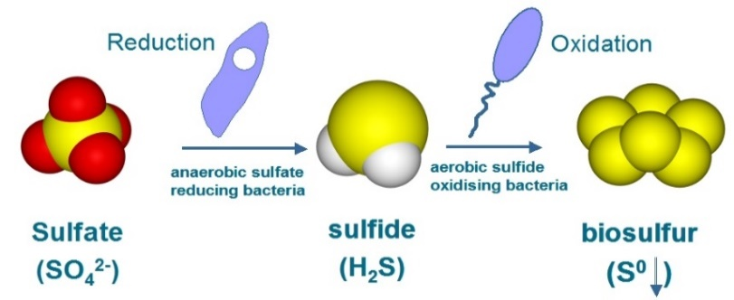
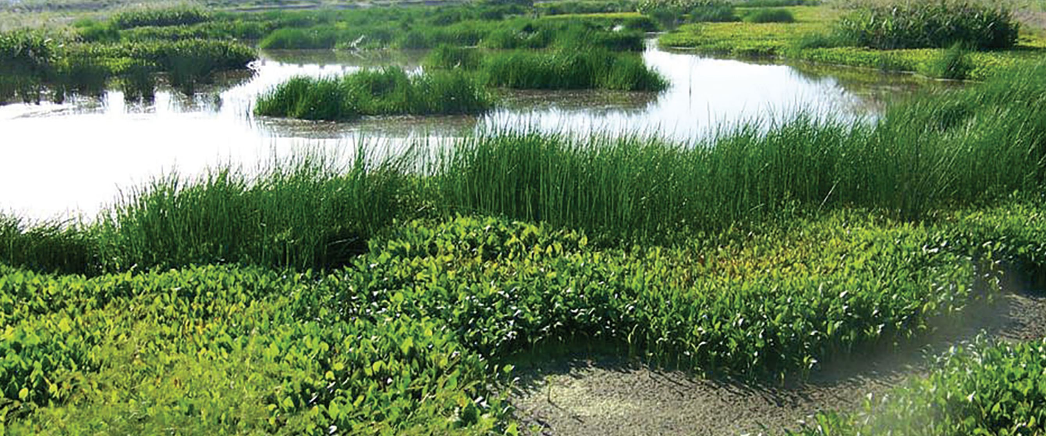
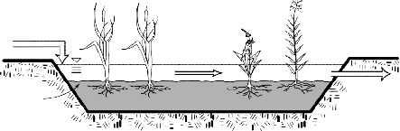
What is a
Biologically-Based Passive Bioremediation System?
Biologically-based passive water treatment strategies
Rock Reactors
Reactive “Barriers”
Sulfate-Reducing Bioreactors
Constructed Wetlands
Enhances natural processes
physical, chemical, and biological

Slide 7
Acronyms Used
BCR – BioChemical Reactor
BOD – Biochemical Oxygen Demand
EBCT – Empty Bed Contact Time
FWS – Free Water Surface Wetland
SRBR – Sulfate-Reducing BioReactor
HRT – Hydraulic Retention Time
NOS – Natural Organic Substrate
MeLR – Metal Loading Rate
MeRR – Metal Removal Rate
SLR – Sulfate Loading Rate
SRB – Sulfate-Reducing Bacteria
SRR – Sulfate Removal Rate
VFW – Vertical Flow Wetland

Slide 8
Active vs. Passive
Sulfate-Reducing Biochemical Reactors (SRBR)
 | Active SRBR | Passive SRBR
Reactor type Microbial growth Electron donor | Tank (stirred) reactor Membrane reactor Submerged packed bed reactor Suspended or attached growth Liquid or gas phase | Packed reactor Attached growth (media = substrate) Solid phase Slowly degradable liquid
Sulfate reduction rate (SRR) & Metal removal rate (MeRR)
Active treatment >> Passive treatment

Slide 9
Primary Components of
Biologically-Based Passive Bioremediation System
Pre-treatment alkalinity reactor
  Alkalinity source (limestone)
  Raise pH to precipitate Al and Fe decreasing acidity loading
Sulfate-reducing biochemical reactor (SRBR)
  Electron source (organic substrate)
    Sulfate (electron acceptor) to Sulfide ions
    Targets metal precipitation as metal sulfides
  Alkalinity source (limestone and sulfate reduction)
    Achieve circumneutral pH

Slide 10
Primary Components of
Biologically-Based Passive Bioremediation System
Constructed wetland or aqueous polishing cell (APC)
  Sequestration (plant roots, stems, and leaves)
  Precipitation (oxides, oxyhydroxides, carbonates)
  Sorption (mineral and biological)
  Sedimentation
  Filtration
  Increase alkalinity
  Increase dissolved oxygen
  Reduced BOD

Slide 11
Biologically-Based Passive Bioremediation System Design Criteria
Flow Rate
  Low flow rates (1 to 50 gpm) most favorable
  Hydraulic retention time (HRT)
    Reaction rates
    Treatment criteria
    Longevity
Mass Loading
  Sulfate – critical to successful SRBR application
  Metals – acidic metals (Al, Fe); metal sulfides (Zn, Cu, Cd, Pb, Ni, Co); oxidized metalloids (Mn)
  Potential toxins (DO, H₂S, antibacterial materials)

Slide 12
Biologically-Based Passive Bioremediation System
Design and Operational Considerations
Water quality objectives
Site conditions and topography
Available infrastructure
Higher flow rates provide less contact time for the same sized sulfate-reducing bioreactor
  Incomplete reactions
  Wash out (bacteria; fine sulfide precipitates)
Potential toxins (dissolved oxygen, excess H₂S, antibacterial materials used in substrate)

Slide 13
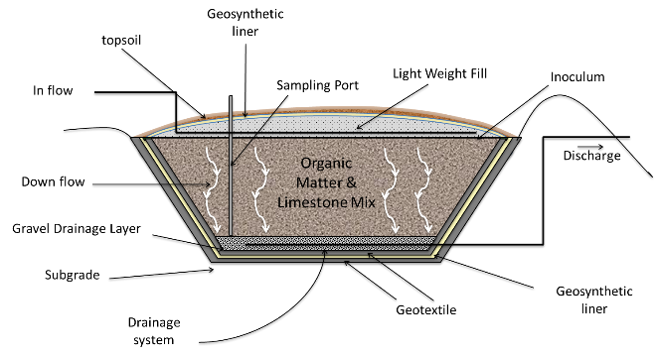
Sulfate-Reducing Biochemical Reactor
SRBR reduces sulfate to aqueous hydrogen sulfide
Metal (Fe, Cd, Co, Cu, Ni, Zn) sulfides precipitate and are removed from the aqueous phase
Adds alkalinity and increases pH (circumneutral)
ITRC, 2013

Slide 14
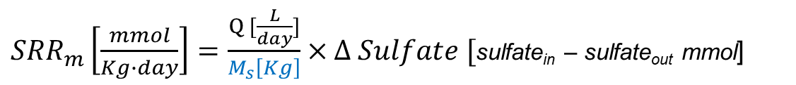
SRBR Design Criteria the Basics
Sulfate Loading / Removal
Sulfate loading rate (SLR)
Sulfate removal
  Sulfate reduction to sulfide
  SO₄²⁻ + 2CH₂O + 2H⁺ → H₂S + 2H₂O + 2CO₂
  e- acceptor e- donor (natural organic substrate) reactive sulfide product
  Sulfate removal rate (SRR) is calculated using
Size of SRBR required is determined based on the SLR and SRR
$${SLR}_{m}\left[\frac{mmol}{day}\right]=Q [\frac{L}{day}]×Sulfate[\frac{mg}{L}]×\frac{mmol Sulfate }{96 mg Sulfate}$$
${SRR}_{m}\left[\frac{mmol}{Kg∙day}\right]=\frac{Q [\frac{L}{day}]}{M_{s}\left[Kg\right]}×Δ Sulfate [$sulfate_{in} – sulfate_{out} mmol]
mass of bioreactor substrate

Slide 15
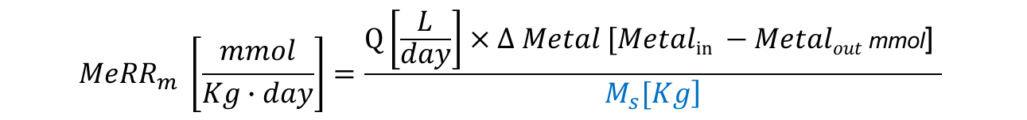
SRBR Design Criteria the Basics
Metal Loading / Removal
Metal loading rate (MeLR)
Cationic metal removal
  Metal sulfide precipitation
M²⁺ + H₂S → MS + 2H⁺ (reactive sulfide)
  Metal removal rate (MeRR) is calculated using
Size of SRBR required is determined based on the MeLR and MeRR
$${MeLR}_{m}\left[\frac{mmol}{day}\right]=Q [\frac{L}{day}]×\sum{Metals [\frac{mmol}{L}]}$$
$${MeRR}_{m} \left[\frac{mmol}{Kg∙day}\right]=\frac{Q\left[\frac{L}{day}\right]×Δ Metal \text{[}Metalin −Metalout \text{mmol}\text{] }}{\left.M_{s}[Kg\right]}$$
mass of bioreactor substrate

Slide 16
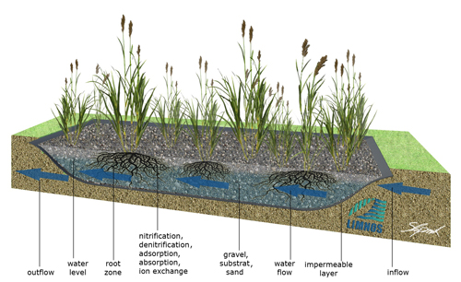
Constructed Wetlands for MIW Remediation
Emphasize specific wetland qualities for improved treatment
Used in conjunction with other treatment technologies
Free water surface and vertical flow wetlands preferred
Targets biochemical oxygen demand (BOD) and manganese
From limnos.si

Slide 17
Constructed Wetland Design Criteria Basics
Loading Rates
Flow Rates
  Hydrology and hydraulics are critical
  Low to moderate flow rates are most favorable
Metal Removal
(physical, biological, and chemical removal processes)
  Sedimentation
  Sorption (mineral and biological)
  Precipitation (oxidation, reduction)
  Filtration
  Sequestration by plants (roots, stems, and leaves)

Slide 18
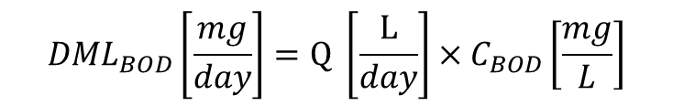

Constructed Wetland Design – Sizing based on BOD
Biochemical oxygen demand (BOD)
  BOD removal must be accounted for when sizing wetlands that emphasize oxidation
  Daily Mass Loading Sizing Method
    Loading rate method
      Daily mass loading
      Size of wetland
      where the daily loading rate (DLR) for BOD = 60 - 100 Kg/ha/day
              EPA (1998) recommends loading rate = 54 lbs BOD/acre/day,
              which results in discharge typically <30 mg/L (Iowa DNR 2007)
$${DML}_{BOD}\left[\frac{mg}{day}\right]=Q \left[\frac{L}{day}\right]×C_{BOD}\left[\frac{mg}{L}\right]$$
${Area}_{BOD}\left[ha\right]={DML}_{BOD}\left[\frac{Kg}{day}\right]$ / ${DLR}_{BOD}\left[\frac{Kg}{ha∗day}\right]$

Slide 19
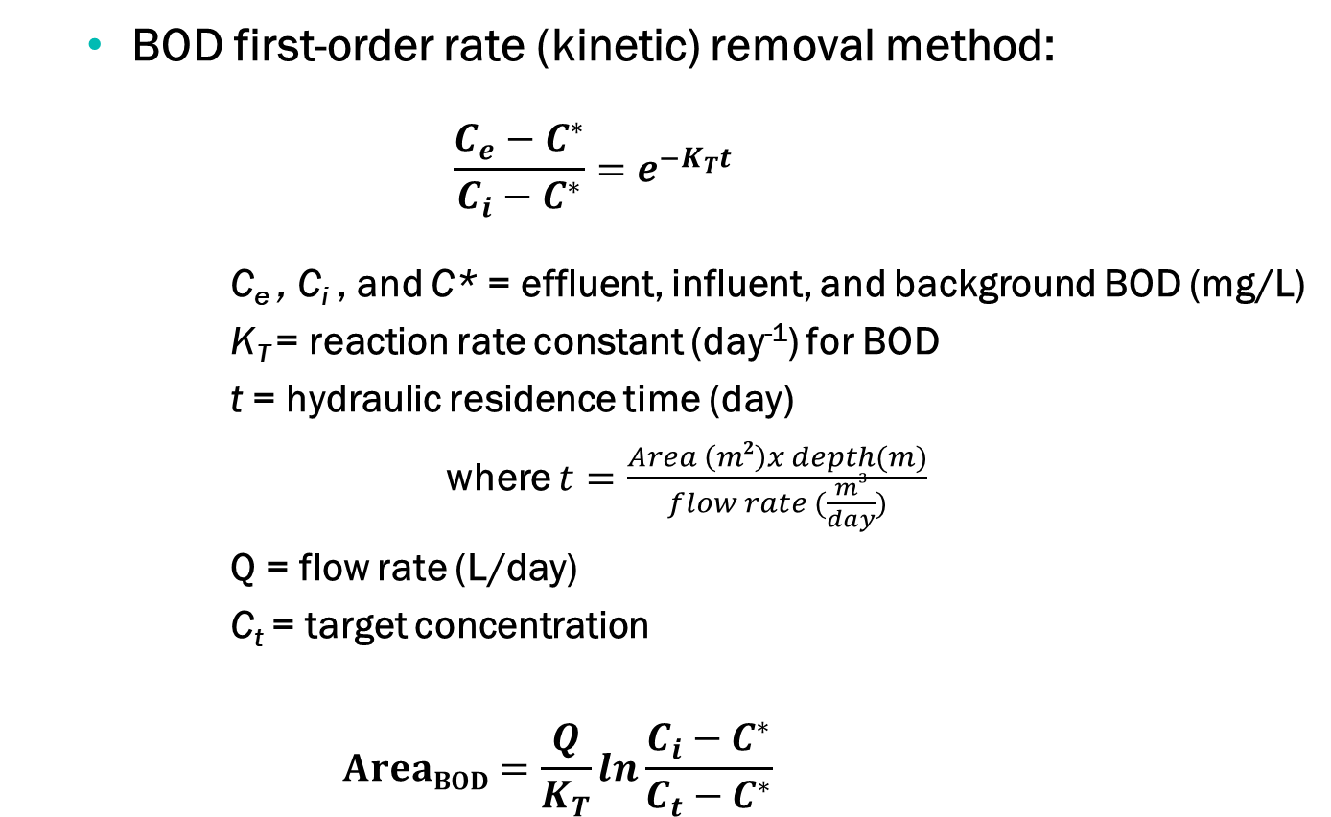
Constructed Wetland Design – Sizing based on BOD
  BOD first-order rate (kinetic) removal method:
    $$\frac{C_{e}−C^{∗}}{C_{i}−C^{∗}}=e^{−K_{T}t}$$
      C_{e} , C_{i} , and C* = effluent, influent, and background BOD (mg/L)
      K_{T} = reaction rate constant (day⁻¹) for BOD
      t = hydraulic residence time (day)
        where $t=\frac{Area \left(m2\right)x depth(m)}{flow rate (\frac{m3}{day})}$
      Q = flow rate (L/day)
      C_{t} = target concentration
      $$AreaBOD=\frac{Q}{K_{T}}ln\frac{C_{i}−C^{∗}}{C_{t}−C^{∗}}$$

Slide 20
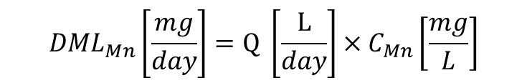

Constructed Wetland Design – Sizing based on Mn
Once BOD has been removed then one can account for biologically-mediated oxidation of Mn when sizing wetlands
  Daily mass loading sizing method
    Loading rate method
      Daily mass loading
      Size of wetland
      where the daily loading rate (DLR) for Mn = 1,000 – 2,000 mg/m²/day
$${DML}_{Mn}\left[\frac{mg}{day}\right]=Q \left[\frac{L}{day}\right]×C_{Mn}\left[\frac{mg}{L}\right]$$
${Area}_{Mn}\left[ha\right]={DML}_{Mn}\left[\frac{mg}{day}\right]$ / ${DLR}_{Mn}\left[\frac{mg}{ha∗day}\right]$

Slide 21
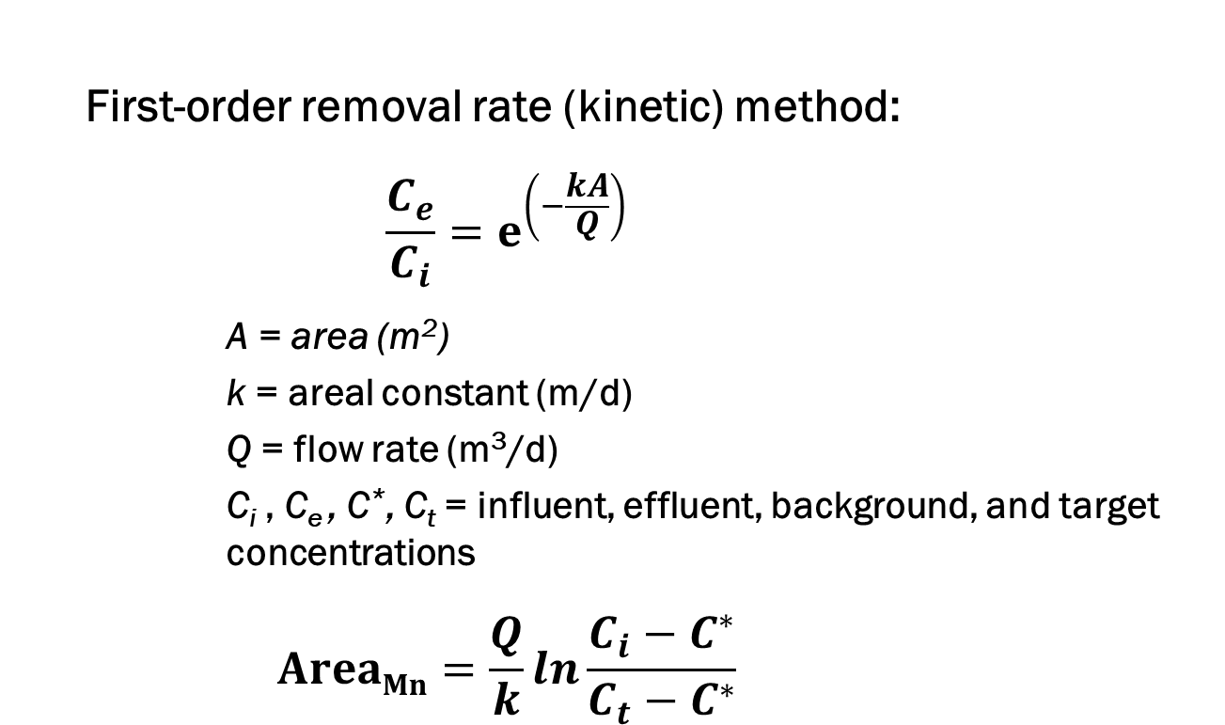
Constructed Wetland Design – Sizing based on Mn
  First-order removal rate (kinetic) method:
      $$\frac{C_{e}}{C_{i}}=e^{\left(−\frac{kA}{Q}\right)}$$
      A = area (m²)
      k = areal constant (m/d)
      Q = flow rate (m³/d)
      C_{i} , C_{e} , C*, C_{t} = influent, effluent, background, and target concentrations
      $$AreaMn=\frac{Q}{k}ln\frac{C_{i}−C^{∗}}{C_{t}−C^{∗}}$$

Slide 22
Biologically-Based Passive Bioremediation System Design Criteria
Data requirements
  Flow rates (variability, seasonality)
  Water chemistry (sulfate & metal loading; anions)
  Site attributes (topography, available area, etc.)
  Substrate / plant availability
  Discharge requirements
  Financial and infrastructure constraints
Initial design criteria calculations
  Sulfate loading/removal rates
  Metal loading/removal rates
  Oxygen loading rate (low metal loadings)

Slide 23
Break (Questions and Answers)

Slide 24
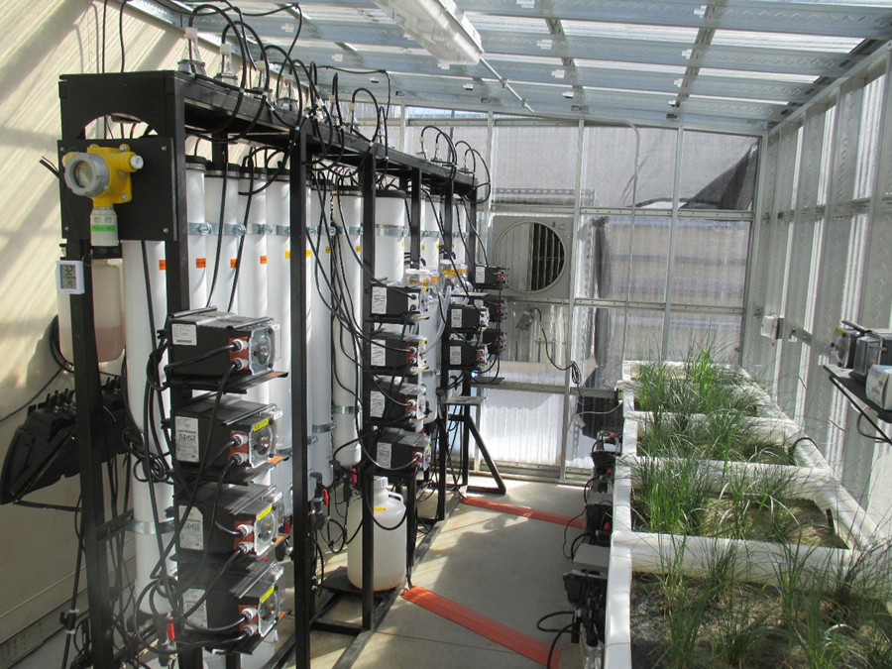
Selected Case Studies – Treatability Testing
Laboratory / Bench-Scale
    Montana, Little Belt Mountains, USA
      Historical MIW
      Seepage water management

Slide 25

Montana Treatability Study (US EPA)
Limestone reactor
  42” tall x 8” diameter
SRBRs
  12 columns (46” tall)
  With limestone pre-treatment (4”diameter)
  Without limestone pre-treatment (4” or 8”diameter)
VFWs
  4 tanks (24” x 24” and substrate 16” deep)

Slide 26
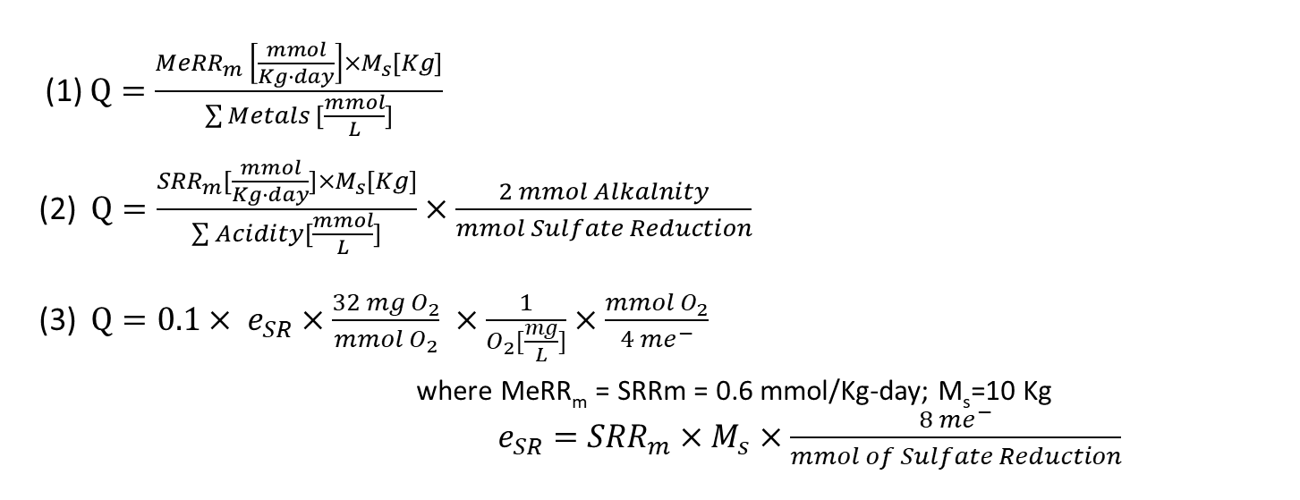
Montana Treatability Study (US EPA)
Initial Flow Rate Calculations
Method | Optimal Flow Rate | Criteria
Metal Reduction ⁽¹⁾ | 1.5 L/day | remove target metals, except Mn
Sulfate reduction ⁽²⁾ | 0.9 L/day | neutralize metal acidity
Oxygen loading ⁽³⁾ | 4.0 L/day | maintain anaerobic condition
$\text{(}\text{1}\text{)} Q=\frac{{MeRR}_{m} \left[\frac{mmol}{Kg∙day}\right]×M_{s}[Kg]}{\sum{Metals [\frac{mmol}{L}]}}$
(2) $Q=\frac{{SRR}_{m}[\frac{mmol}{Kg∙day}]×M_{s}[Kg]}{\sum{Acidity}[\frac{mmol}{L}]}×\frac{2 mmol Alkalnity}{mmol Sulfate Reduction}$
(3) $Q=0.1× e_{SR}×\frac{32 mg O_{2}}{mmol O_{2}} ×\frac{1}{O_{2}[\frac{mg}{L}]}×\frac{mmol O_{2}}{4 me^{−}}$
where MeRR_{m} = SRRm = 0.6 mmol/Kg-day; M_{s}=10 Kg
$e_{SR}={SRR}_{m}×M_{s}×\frac{8 {me}^{−}}{mmol of Sulfate Reduction}$

Slide 27
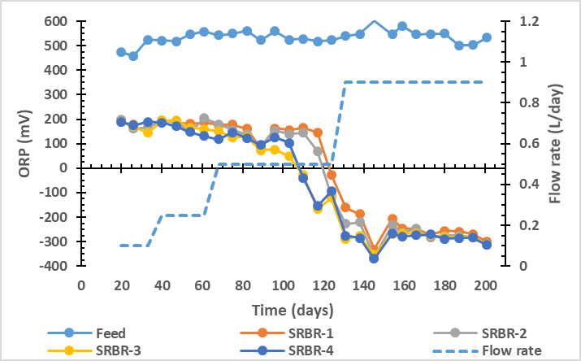
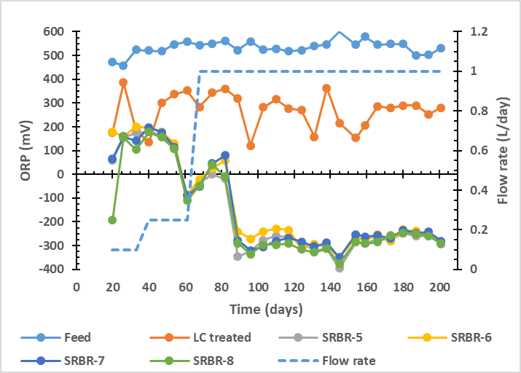
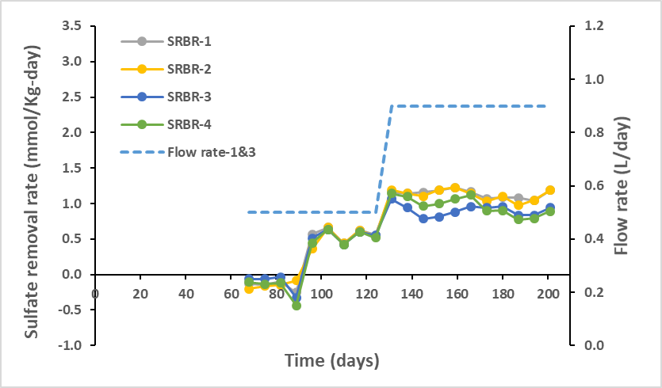
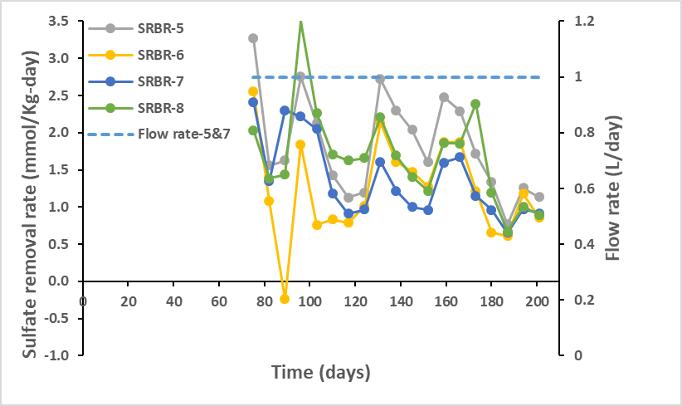
Montana Treatability Study (US EPA)
Laboratory SRBR Data
Without Limestone Pre-Treatment
With Limestone Pre-Treatment

Slide 28
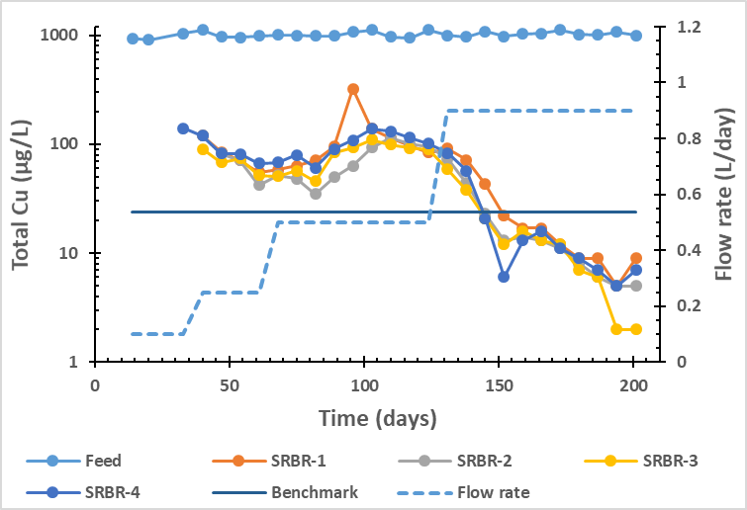
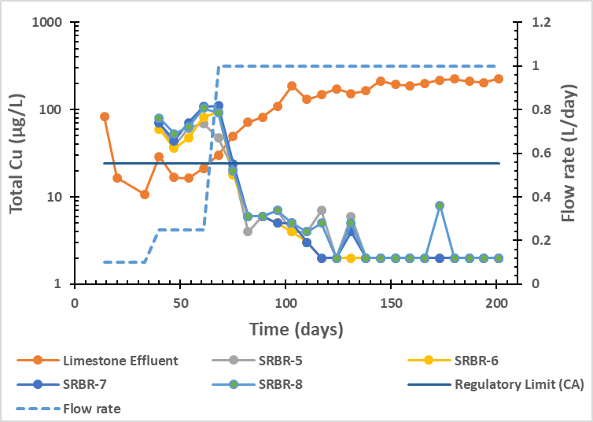
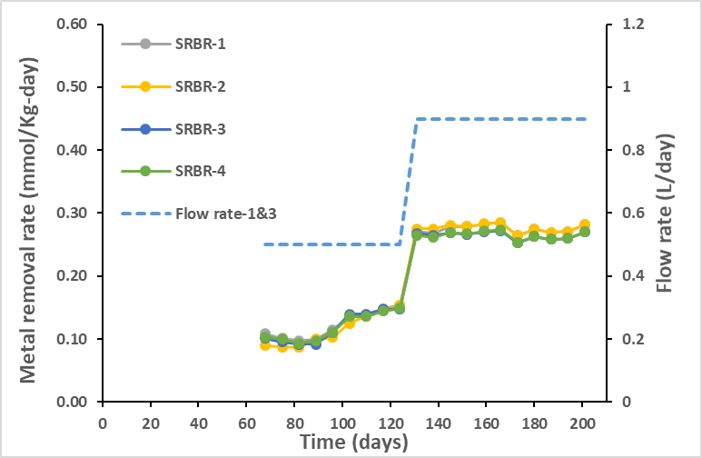
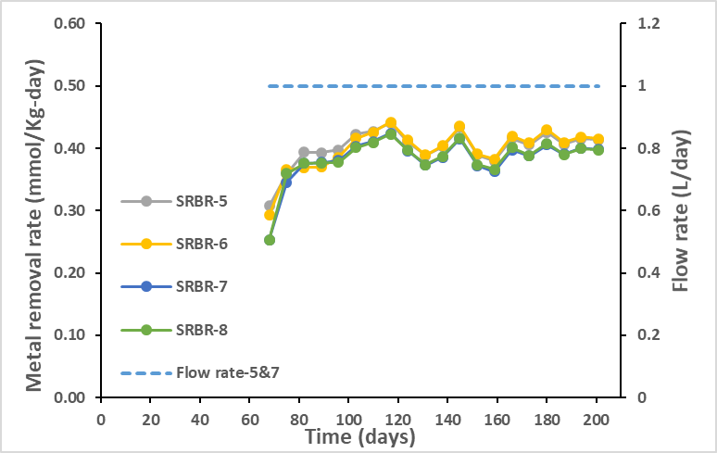
Montana Treatability Study (US EPA)
Laboratory SRBR Data
Without Limestone Pre-Treatment
With Limestone Pre-Treatment

Slide 29
Montana Treatability Study (US EPA) Observations
Collaborative planning is key to success
Flushing of organics during initial low flow test phase led to analytical challenges
Initial inoculation phase of SRBR may not have been required – recommend beginning with low flow
SRR achieved thus far = 0.5 mmol/Kg-day
MeRR achieved thus far = 0.5 to 0.8 mmol/Kg-day

Slide 30
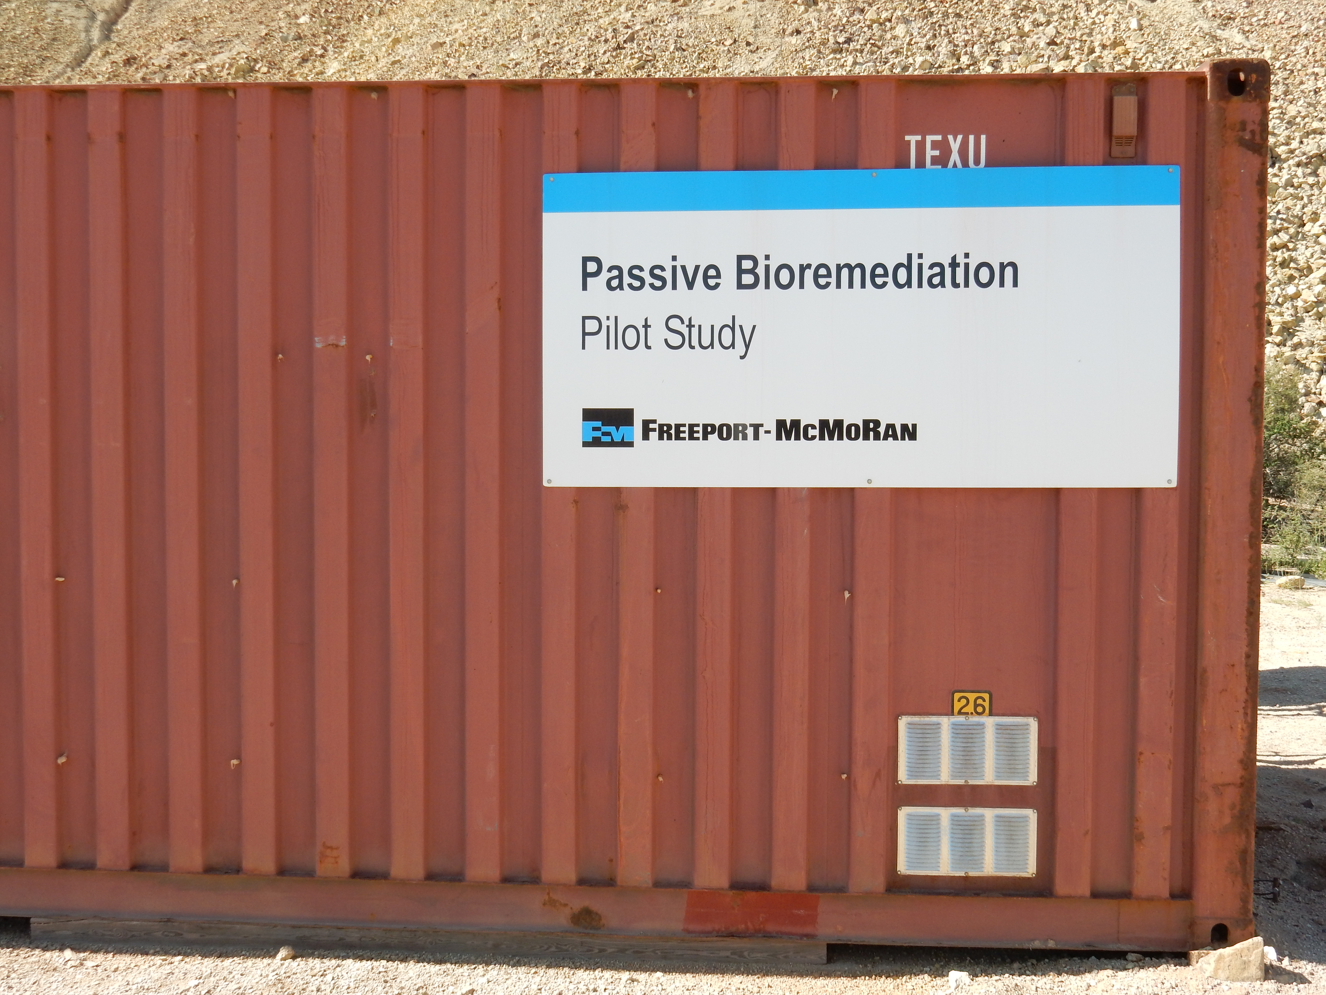
Selected Case Studies – Treatability Testing
On-site pilot-scale treatability testing for full-scale design
    Tyrone, NM, USA
      Operational mine
      Reclaimed leaching facility
      Pre-closure MIW treatability
MIW – high TDS waters (18,000 mg/L) with
  MIW metals
  (Al 850, Fe 67, Cu 970, Zn 340, and Mn 500 mg/L)
  and sulfate (16,000 mg/L)
400 day pilot-scale on-site treatability study

Slide 31
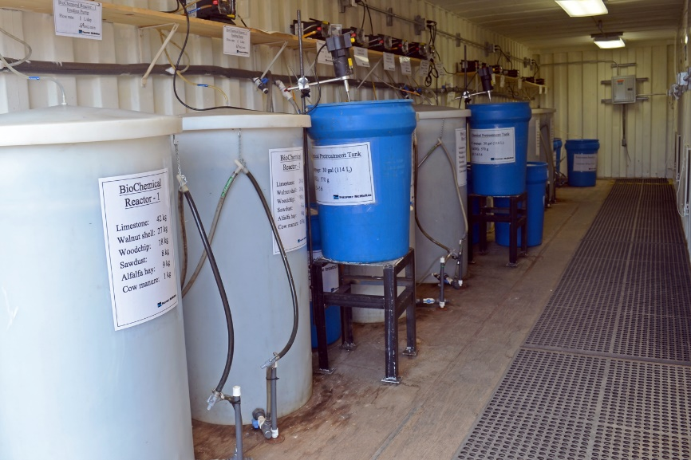
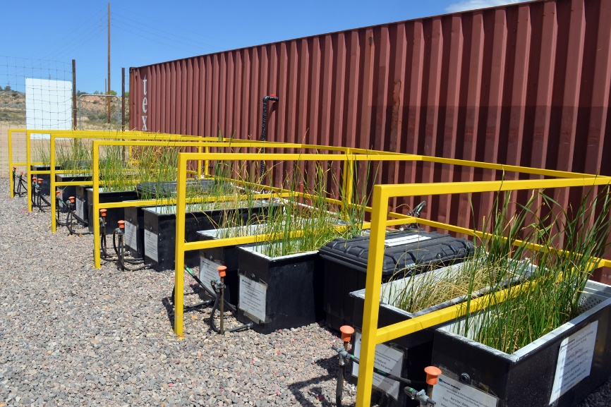
Tyrone Mine Treatability Study
Evaluated 2 pre-treatment strategies
plus 2 SRBR substrate compositions
6 paired - 90 gallon SRBRs operated in down flow configuration
Evaluated treatment effectiveness for paired vertical flow wetlands (VFW) to reduce Mn and BOD following the primary treatment SRBRs.
Area of VFW = 0.62 m² with 40 cm deep substrate
3 native species: Schoenoplectus olneyi, S. acutus, Typha domingensis

Slide 32
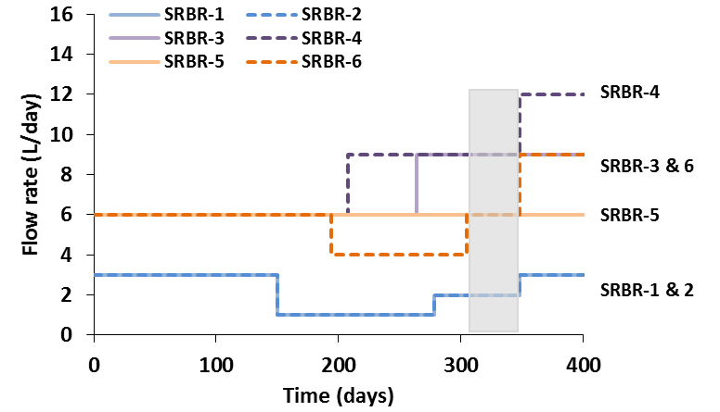
Tyrone Mine Treatability Study - SRBR
Operational flowrates for each of the SRBRs. Shaded area represents the time period of operations at optimal metal removal rate.

Slide 33
Tyrone Mine Treatability Study – SRBR
Metals and sulfate %removal at optimal flowrate for each treatment strategy. Sulfate-16,000, Al-850, Fe-67, Cu-970, Zn-340, and Mn-500 mg/L.
 | Flow rate | HRT | Al (%) | Fe (%) | Cu (%) | Mn (%) | Zn (%) | Sulfate (%)
SRBR-1¹ | 2 L/d | 80 d | 99.3 | 100 | 100 | 68 | 100 | 72
SRBR-2¹ | 2 L/d | 80 d | 98.8 | 96 | 100 | 19 | 100 | 68
SRBR-3² | 9 L/d | 16 d | 80.0 | – | 100 | 26 | 100 | 18
SRBR-4² | 9 L/d | 17 d | 79.3 | – | 100 | 34 | 100 | 30
SRBR-5³ | 6 L/d | 24 d | 73.2 | – | 100 | 10 | 99 | 27
SRBR-6³ | 6 L/d | 26 d | 54.7 | – | 100 | 0 | 100 | 28
Percent Removal = ((Concentration In – Concentration Out) / Concentration In) x 100
1) Primary treatment SRBR without pre-treatment
Calcium hydroxide pre-treatment followed by the primary treatment
Limestone pre-treatment followed by the primary treatment

Slide 34
Tyrone Mine Treatability Study – SRBR
Metal loading and removal rates for each SRBR at optimal flow rates for each treatment strategy.
 | Flow Rate (L/d) | HRT (d) | Metal Removal Rate (MeRR, mmol metal/Kg∙d) |  |  | Sulfate Removal Rate (SRR, mmol SO₄²⁻/Kg∙d)
 |  |  | All metals | All metals except Mn | All metals except Mn, Al, Fe
SRBR-1¹ | 2 | 80 | 0.99 | 0.91 | 0.33 | 1.87
SRBR-2¹ | 2 | 80 | 1.02 | 0.99 | 0.36 | 1.95
SRBR-3² | 9 | 16 | 0.86 | 0.57 | 0.50 | 1.55
SRBR-4² | 9 | 17 | 0.85 | 0.58 | 0.51 | 1.65
SRBR-5³ | 6 | 24 | 0.59 | 0.49 | 0.37 | 1.03
SRBR-6³ | 6 | 26 | 0.51 | 0.51 | 0.39 | 1.11
1) Primary treatment SRBR without pre-treatment
Calcium hydroxide pre-treatment followed by the primary treatment
Limestone pre-treatment followed by the primary treatment

Slide 35
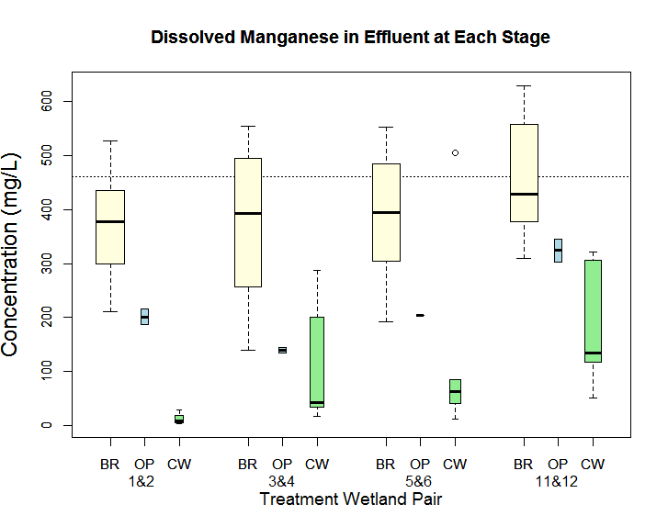
Tyrone Mine Treatability Study – Constructed Wetland
Boxplots summarizing dissolved Mn concentrations in effluent at each stage of the treatment system (excluding pre-treatment)

Slide 36
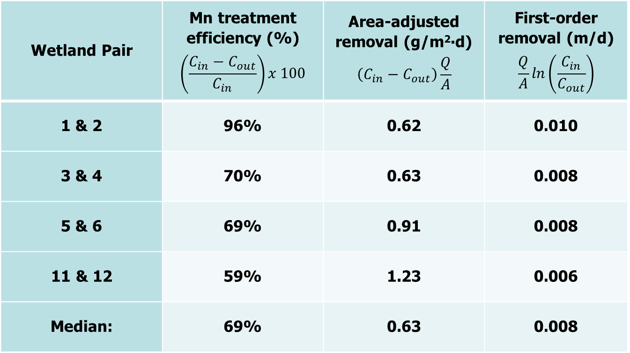
Tyrone Mine Treatability Study – Constructed Wetland
Summary statistics for treatment efficiency, area-adjusted removal, and first-order removal rate of dissolved Mn among constructed wetland pairs.
Wetland Pair | Mn treatment efficiency (%) $$\left(\frac{C_{in}−C_{out}}{C_{in}}\right)x 100$$ | Area-adjusted removal (g/m²∙d) $$\left(C_{in}−C_{out}\right)\frac{Q}{A}$$ | First-order removal (m/d) $$\frac{Q}{A}ln\left(\frac{C_{in}}{C_{out}}\right)$$
1 & 2 | 96% | 0.62 | 0.010
3 & 4 | 70% | 0.63 | 0.008
5 & 6 | 69% | 0.91 | 0.008
11 & 12 | 59% | 1.23 | 0.006
Median: | 69% | 0.63 | 0.008

Slide 37
Tyrone Mine Treatability Study - Observations
Active chemical treatment is more efficient than passive limestone treatment considering chemical costs and maintenance. But requires active system and adds to sludge disposal generation and costs.
Direct MIW treatment is technically feasible, however, an amorphous sludge forms on top layer of SRBR that may decrease efficiency.
Pre-treatment can reduce SRBR size by a factor of 4
High TDS MIW is treatable but treatment objectives critical
    550 mg Mn/L, 980 mg Cu/L, and 380 mg Zn/L
    with 160 mg Fe/L and 940 mg Al/L
Metal removal rates for Cu and Zn were calculated to be
  0.14 - 0.21 mol/m³-d or 0.33 - 0.51 mol/ton-d
Constructed wetland augments SRBR to effectively remove Mn, treat BOD, and remove particulate precipitates following SRBR.

Slide 38
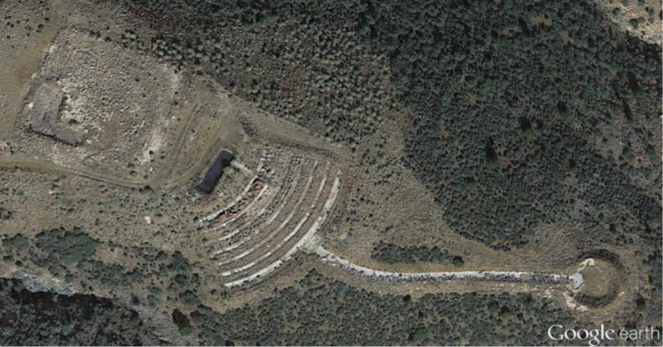
Selected Case Studies – Success
      Iron King, AZ, USA
        Historical mine seep
        Voluntary Remediation Project (VRP)
        MIW management
Glory hole remediated to shed clean water and limit infiltration into mine workings
Biologically-based passive bioremediation system constructed 2009
MIW seepage to SRBR decreased from 10 gpm in 2009 to <2 gpm by 2017

Slide 39
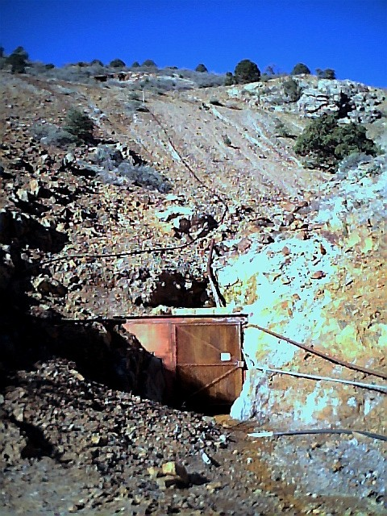
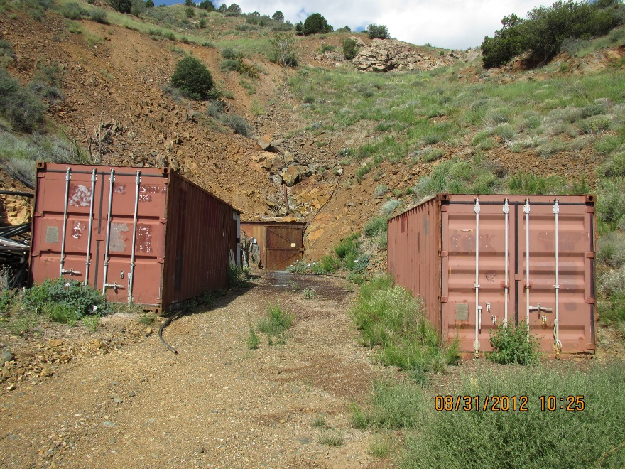
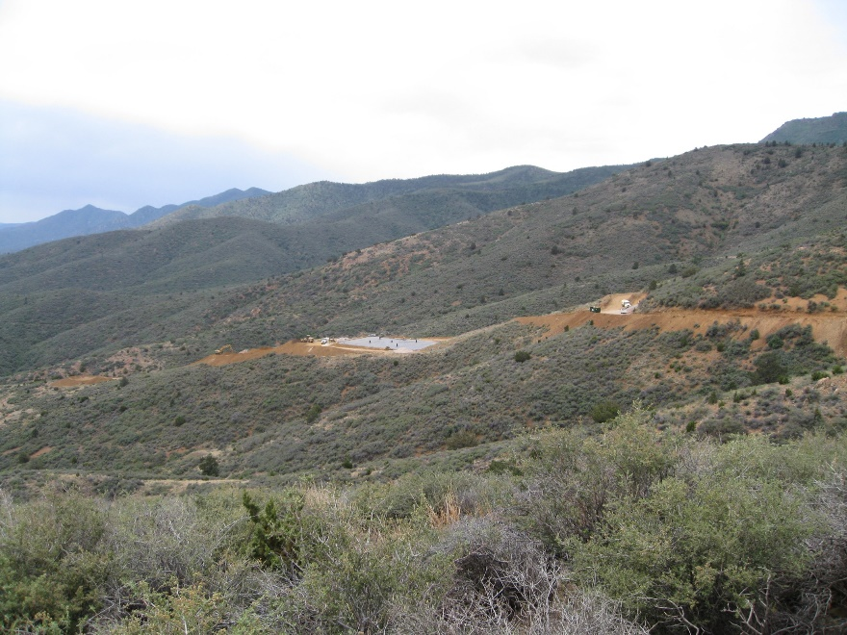
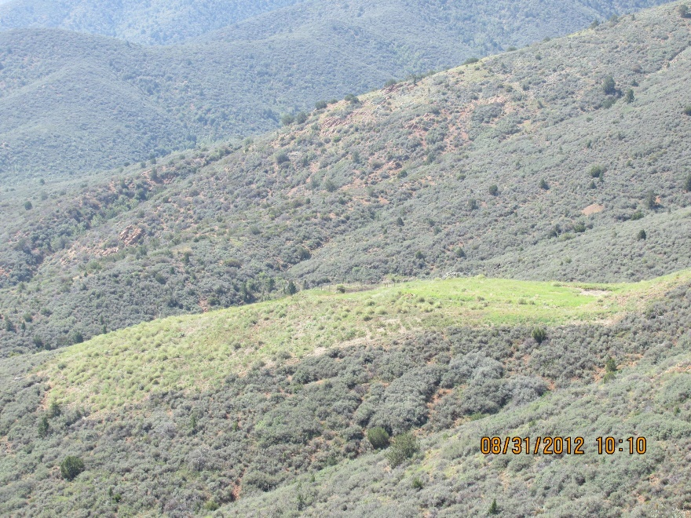
Iron King – Construction and 2012
Adit 2009 – MIW from a glory hole located above the adit.
MIW is collected in the adit and directed to connex then to the SRBR
SRBR &
APC
overview

Slide 40
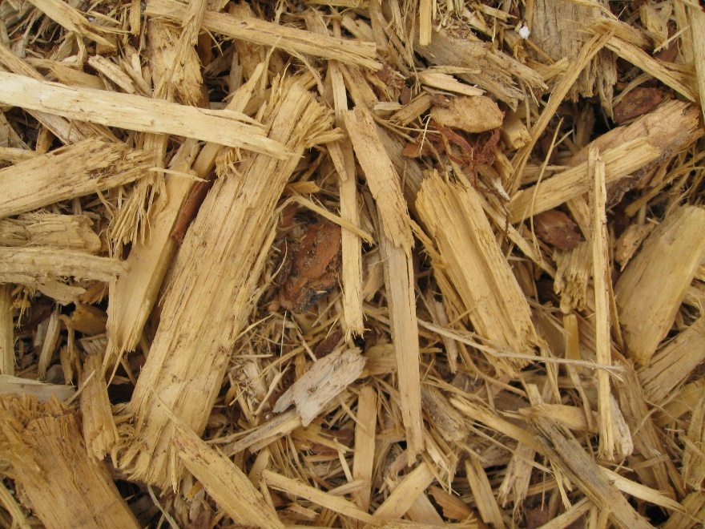
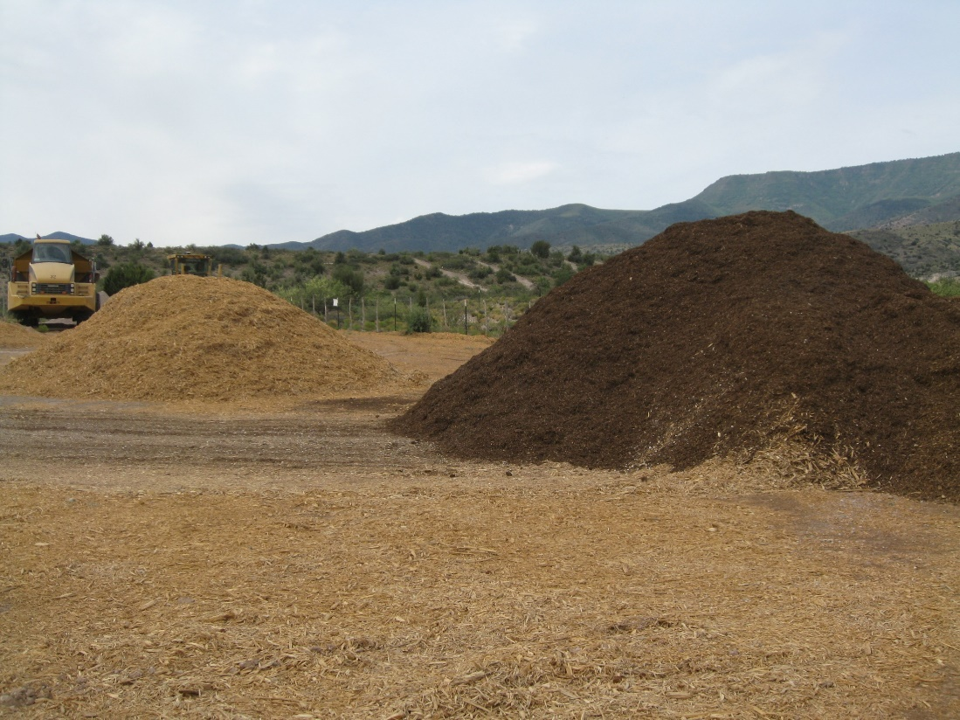
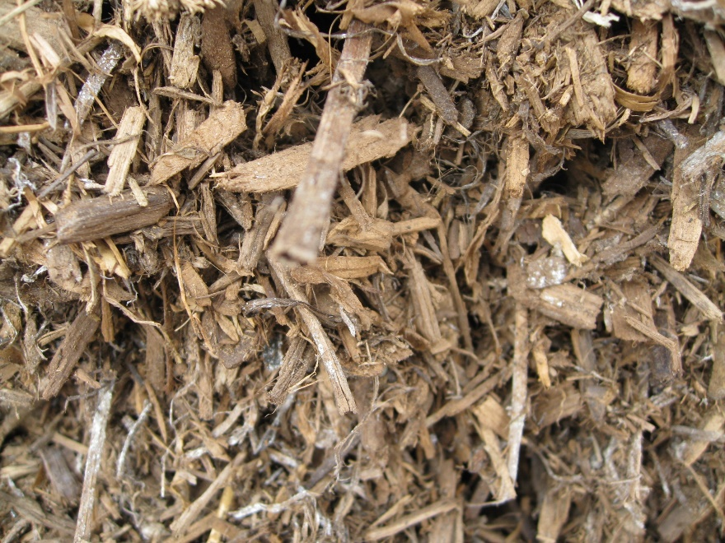
Iron King – The Magic Mix
Substrate composition (wt%):
Wood Chips (aged) (49.5)
Sawdust (10)
Alfalfa Hay (10)
Limestone (30)
Manure (0.5)

Slide 41
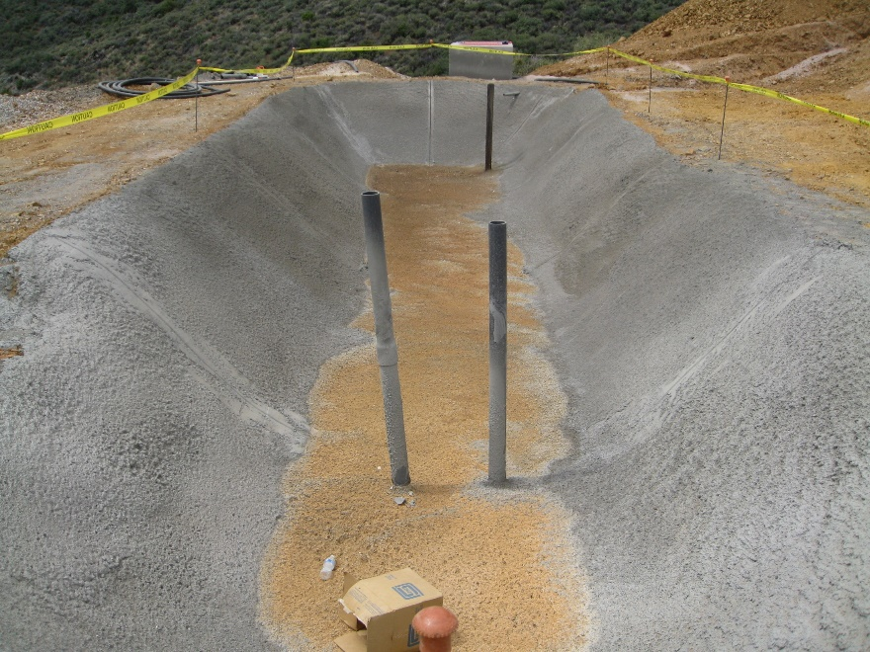
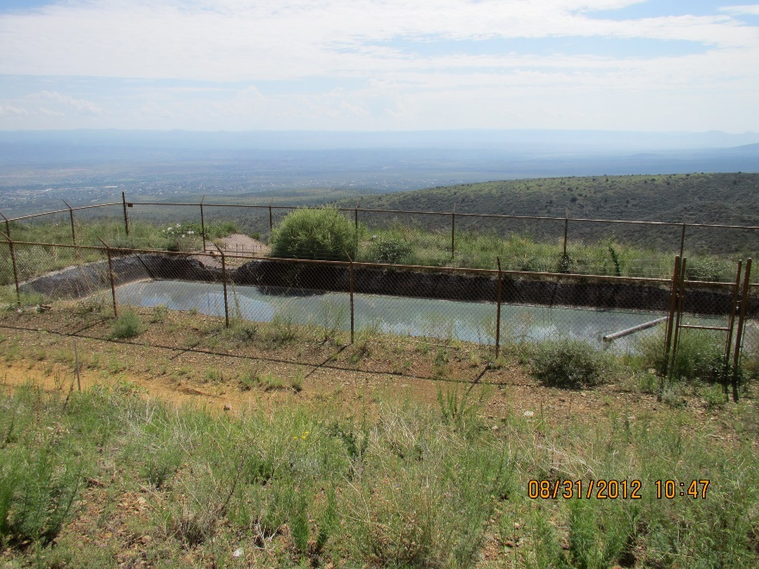
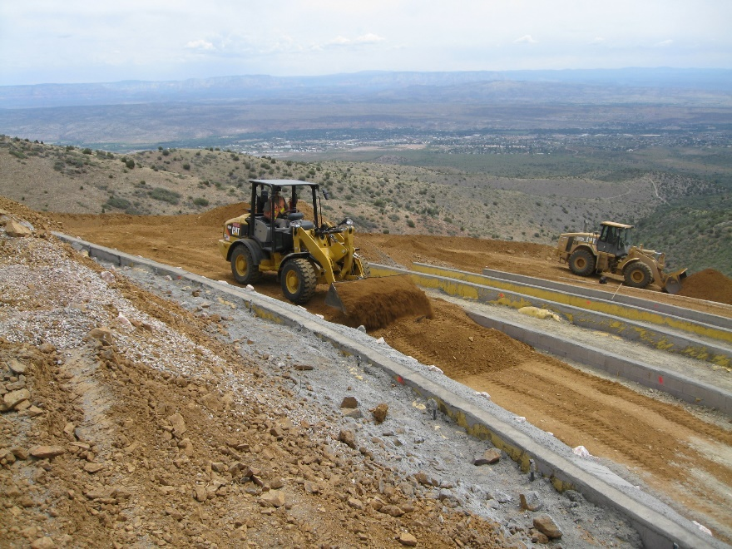
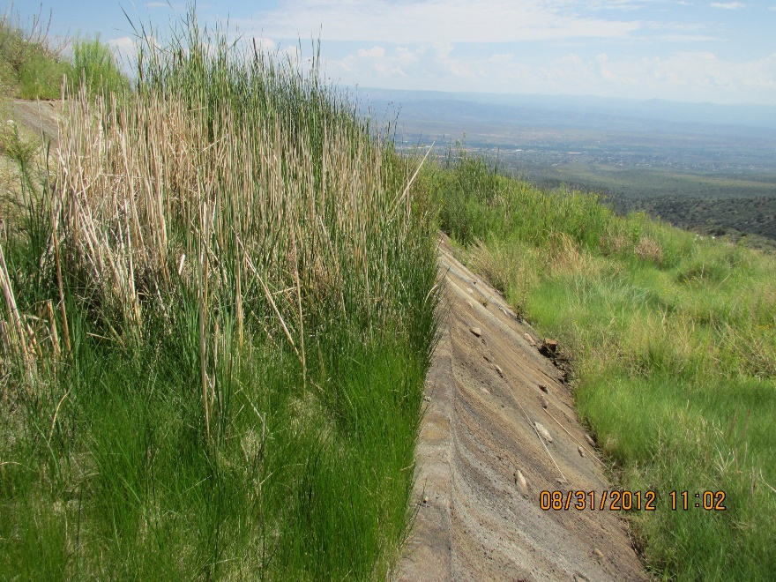
Iron King – Construction and 2012
Settling Pond
Receives water from SRBR, allows settling of particulates and directs effluent to the APC
Aerobic Polishing Cell
(APC)

Slide 42
Iron King – Design and Operational Parameters
Target analytes Zn and Cd
Design flow rate = 7 gpm based on
  5,000 mg/L Sulfate, 130 mg/L Cu, 0.4 mg/L Cd, 150 mg/L Zn
Current operating flow rate ~ 1.8 gpm with
  1,500 mg/L Sulfate, 4.2 mg/L Cu, 0.06 mg/L Cd, 17 mg/L Zn
Current SRBR Effluent Concentrations
  <500 mg/L Sulfate, <0.01 mg/L Cu, <0.03 mg/L Cd, <0.01 mg/L Zn
Zero discharge from APC

Slide 43
Iron King – Successful Implementation – Total Cd

Slide 44
Iron King – Successful Implementation – Total Zn

Slide 45
Iron King – Achieved VRP Objectives and Project Goals
Source control key to longevity of bioremediation system
No pre-treatment required for flow rate and water chemistry
Removal efficiency 99.3% for dissolved Fe, Al, Zn, Cu, and Cd
Dissolved Ni, Se, As, and Be all less than the laboratory detection
SRBR SRR = 0.27 mol/ton-d; 0.12 mol/m³-d
SRBR MeRR = 0.10 mol/ton-d; up to 0.05 mol/m³-d
Settling pond removes suspended particulates leaving the SRBR prior to distribution through APC
APC provides final polishing of water quality and transpiration
7.6 million gallons of seepage treated
Treatment system created a zero-discharge facility

Slide 46
Biologically-Based Passive Bioremediation System Observations
Collaboration and planning key to success.
Ability to treat a wide range of MIW flows and chemistry.
Lab and pilot-scale testing important.
Optimum sulfate removal rate and metal removal rates may be higher than published rates – value of bench and pilot-scale testing.
Water quality objectives for any given project drives the size of the treatment system.
Biologically-based passive bioremediation systems are an effective treatment system for MIW, especially for lower flow applications.

Slide 47
Biologically-Based Passive Bioremediation System Design Criteria
Data Requirements
  Flow Rates (variability, seasonal)
  Water Chemistry (sulfate & metal loading; anions)
  Site Attributes (topography, available area, etc.)
  Substrate / Plant availability
  Discharge Requirements
  Financial and Infrastructure Constraints
Initial Design Criteria Calculations
  Sulfate Loading/Removal Rates
  Metal Loading/Removal Rates
  Oxygen Loading Rate (low metal loadings)

Slide 48
Final Questions and Answers
Webinar Wrap-up

