Slide 1
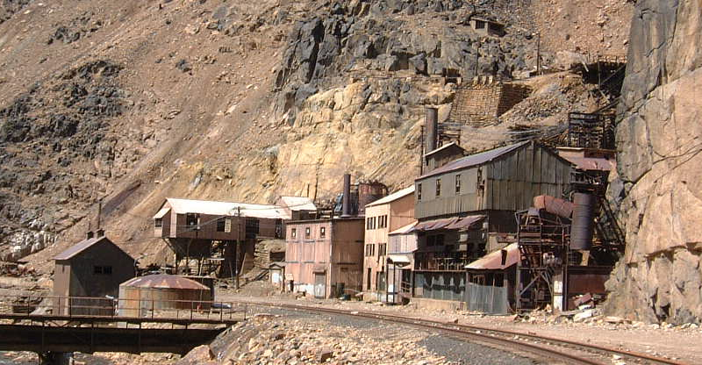
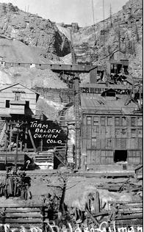
The Eagle Mine Superfund Site case study

Slide 2
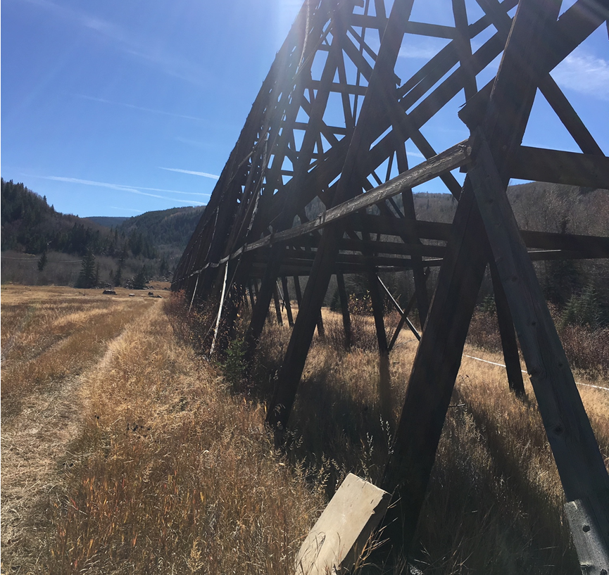
Agenda
Site Background
Enforcement History
Regulatory Framework
Robust Remedy
Getting to Site Completion

Slide 3
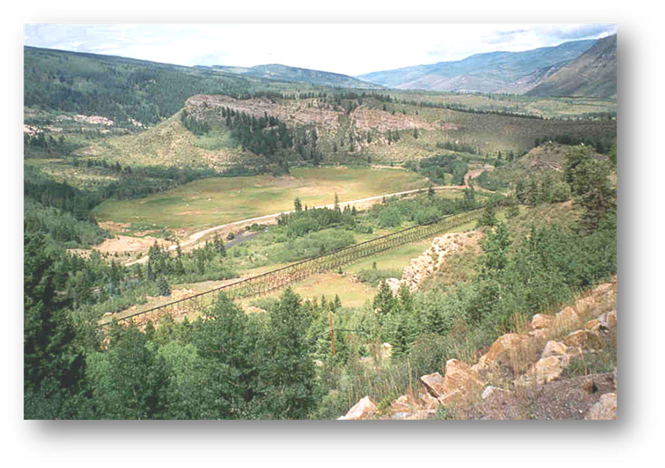
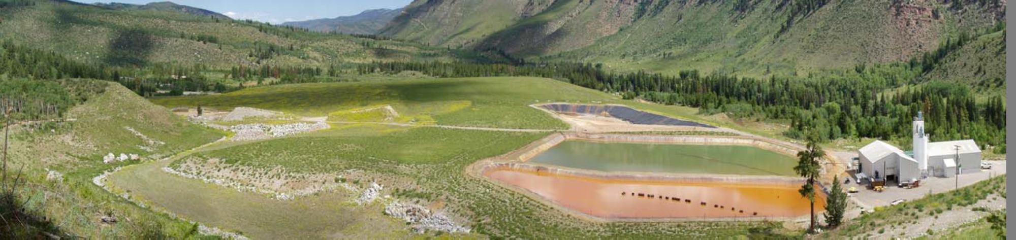
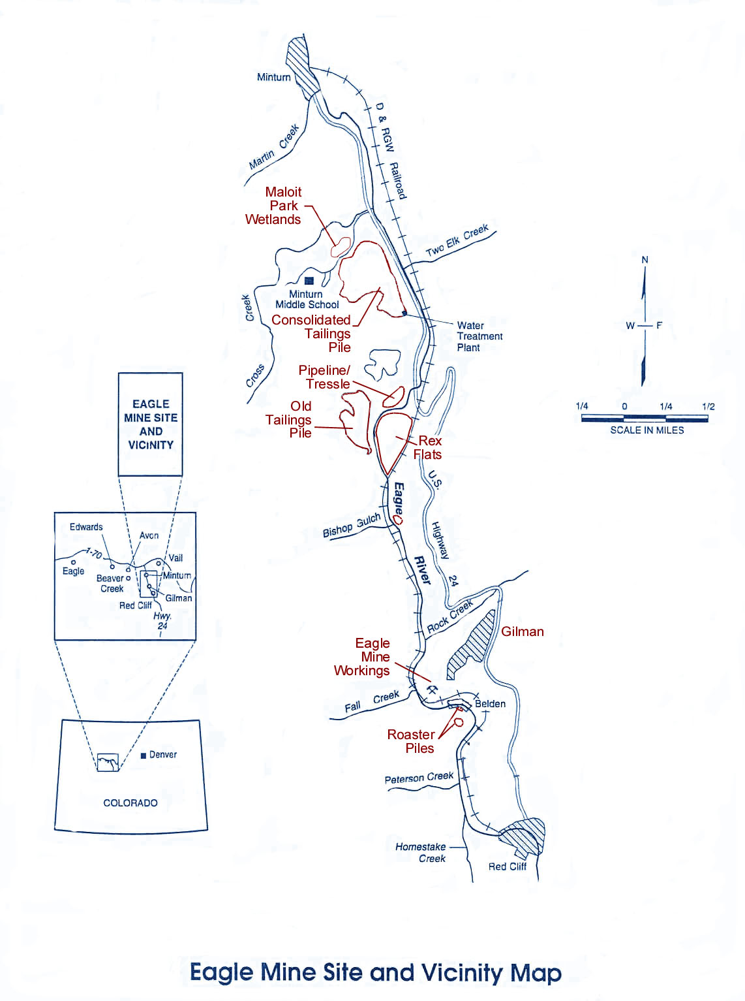
Eagle Mine Workings
Over 65 miles of tunnels located beneath Gilman

Slide 4
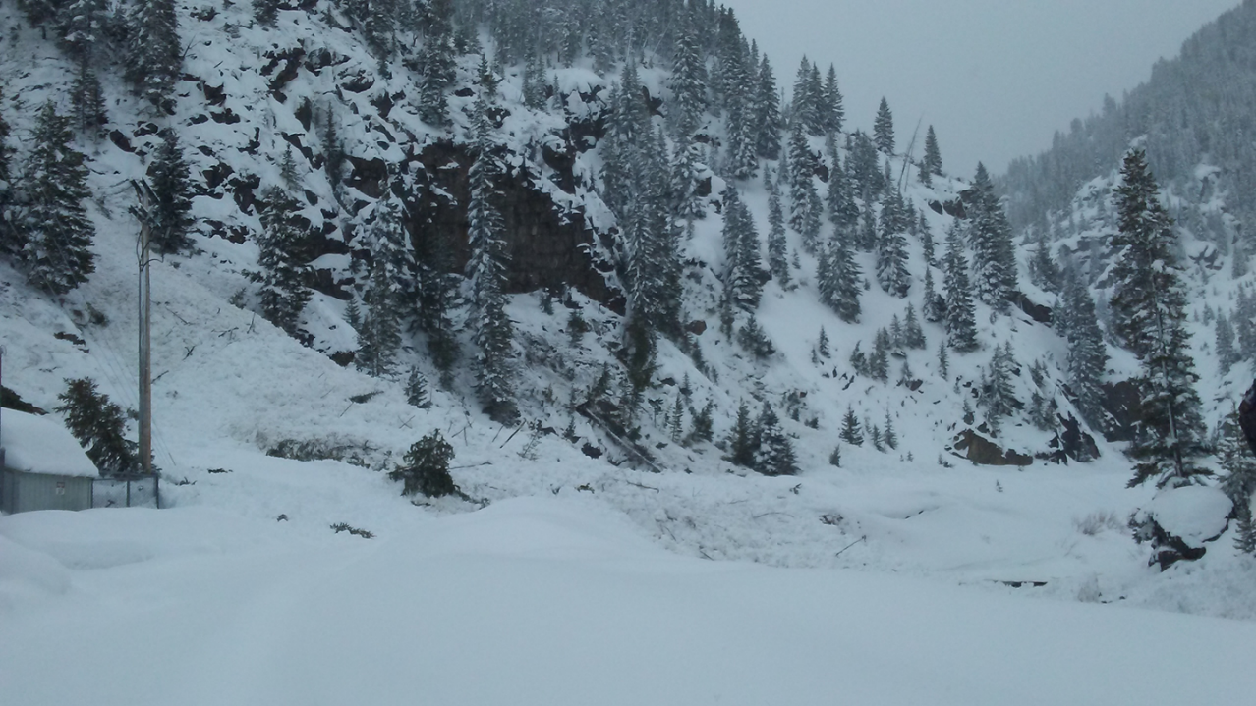
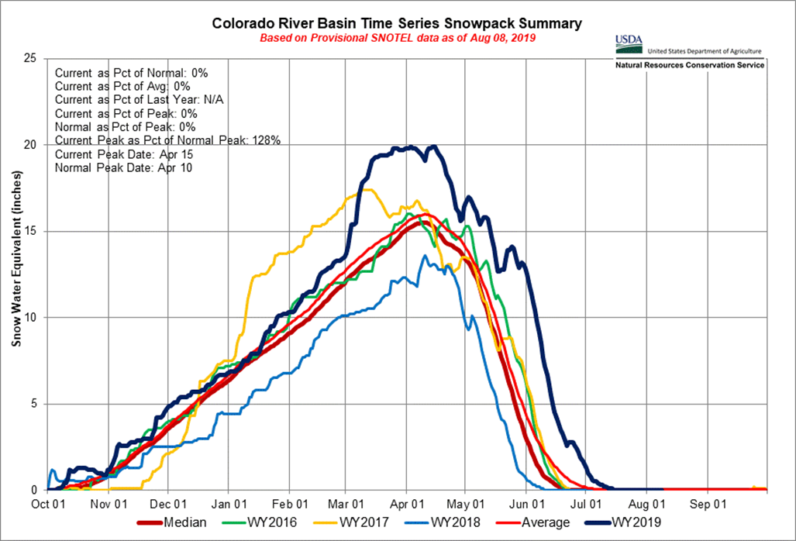
Site Climate

Slide 5
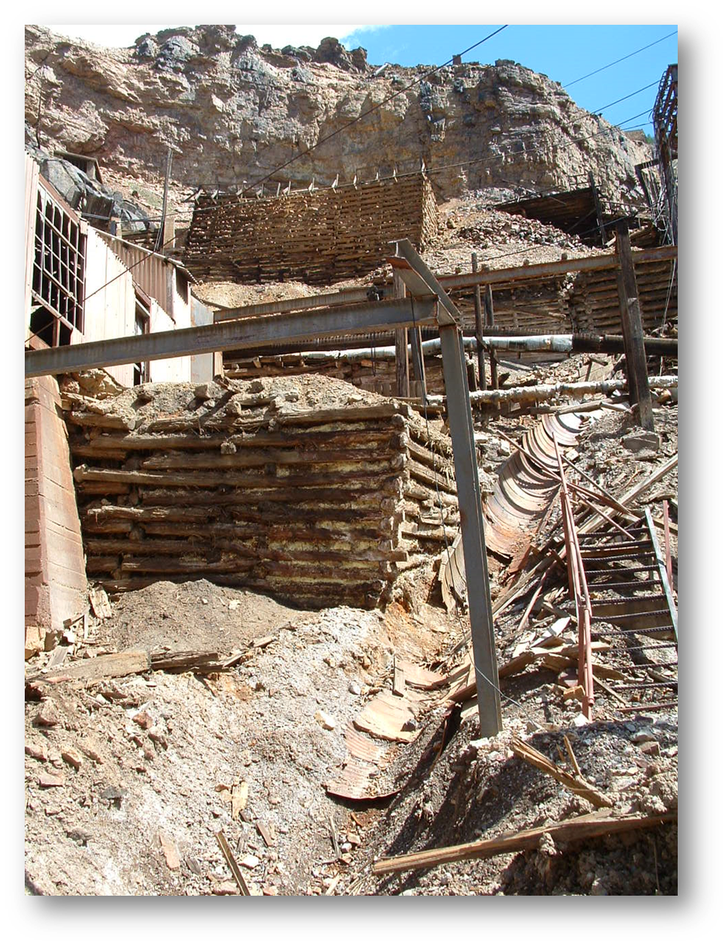
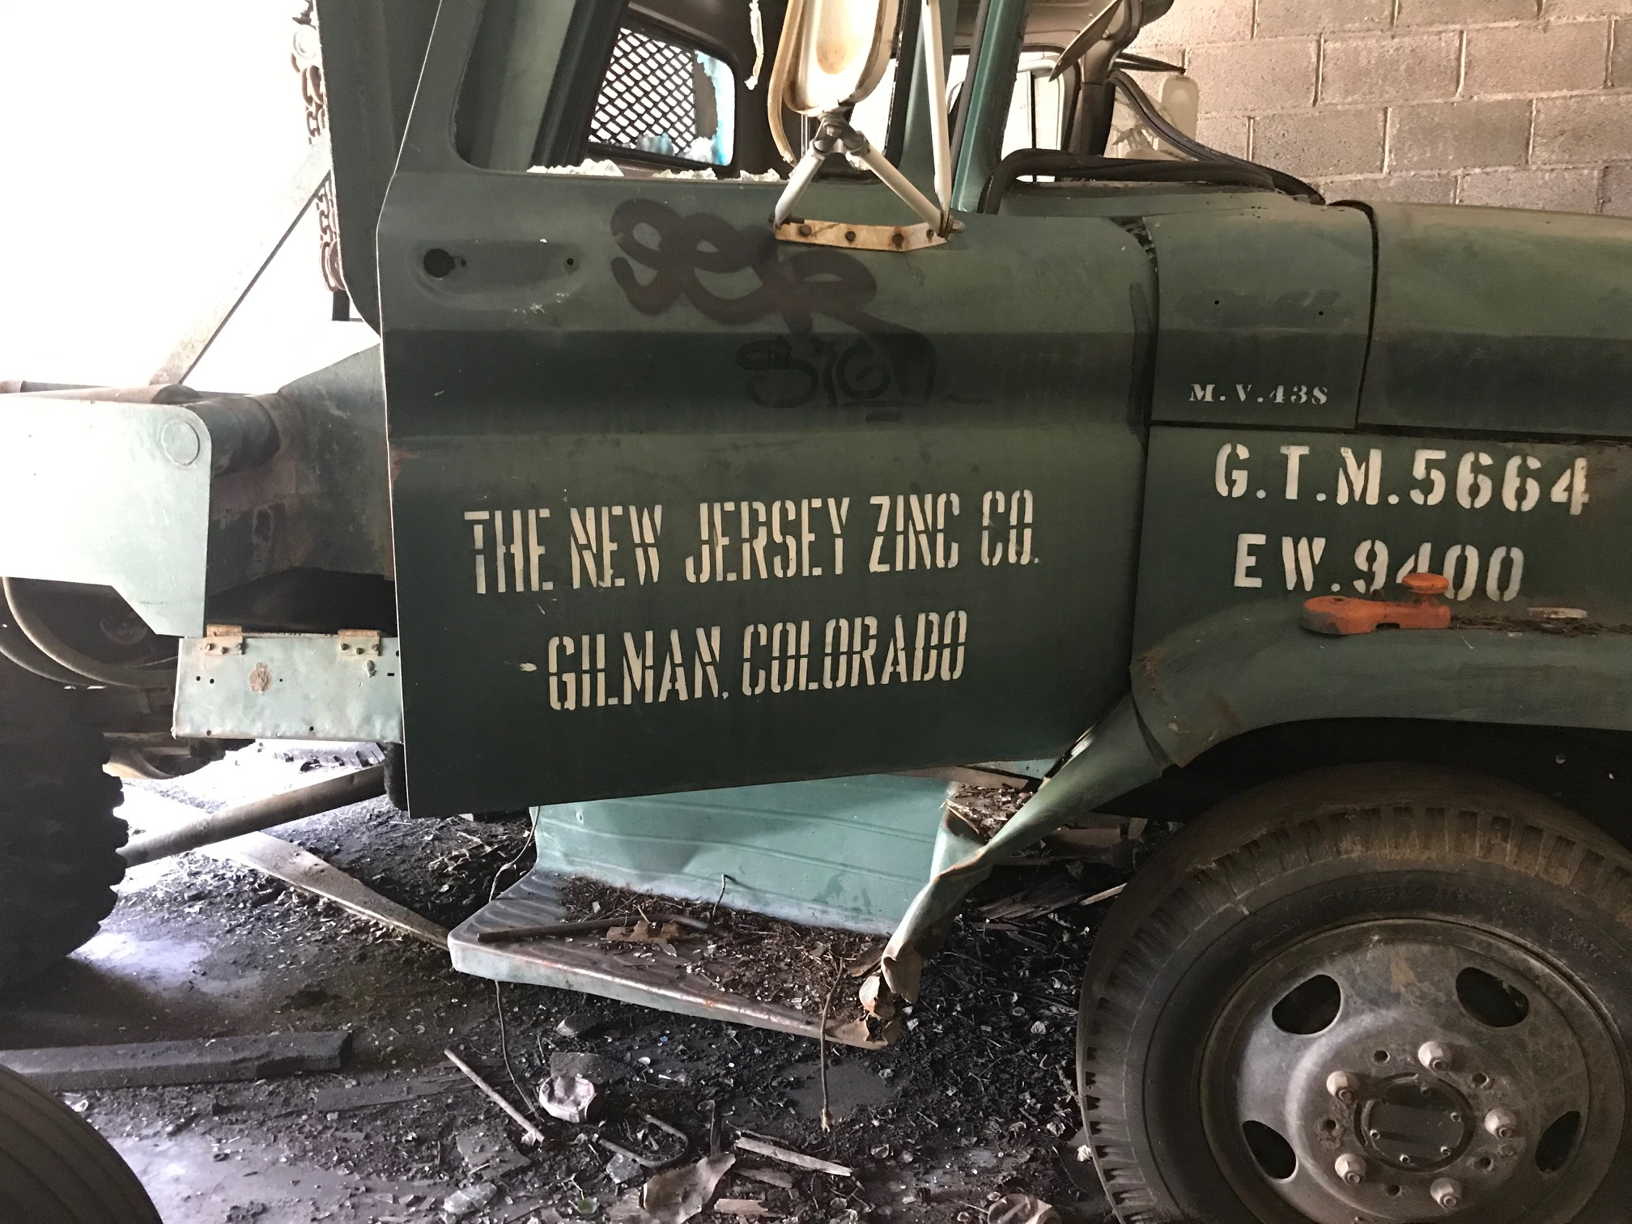
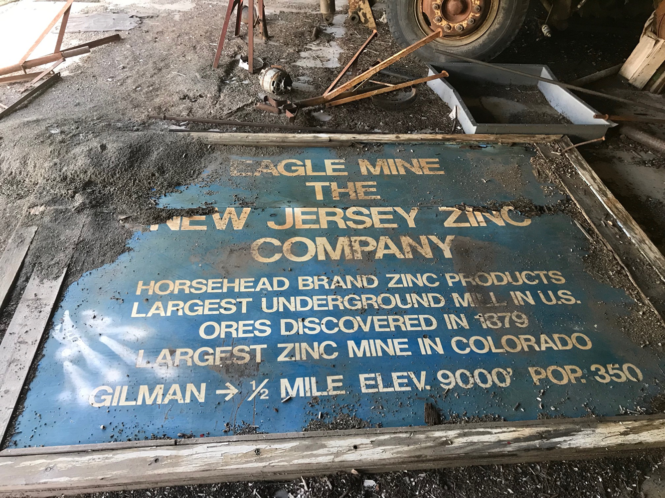
Mining History

Slide 6
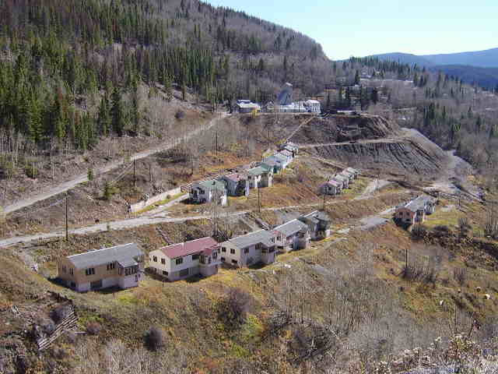
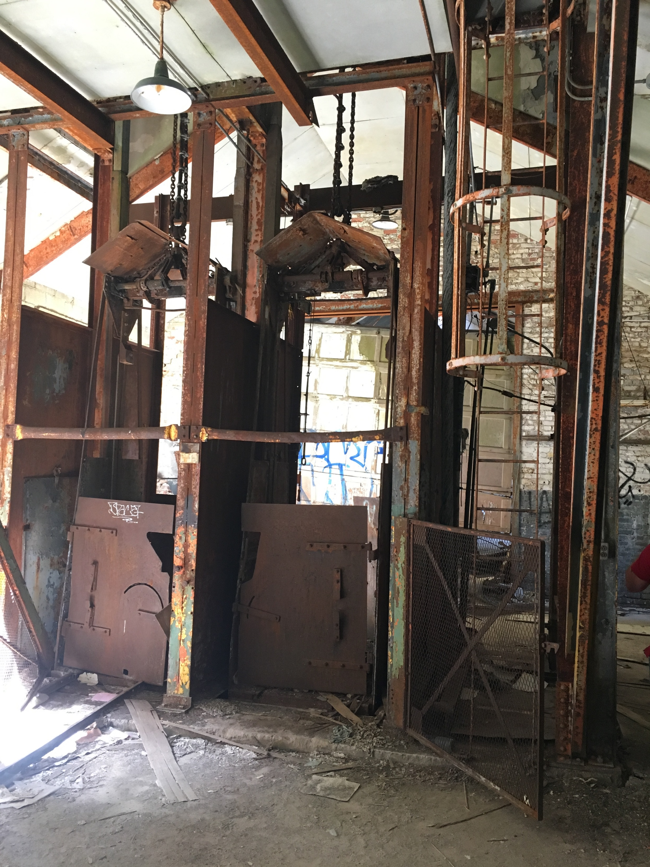
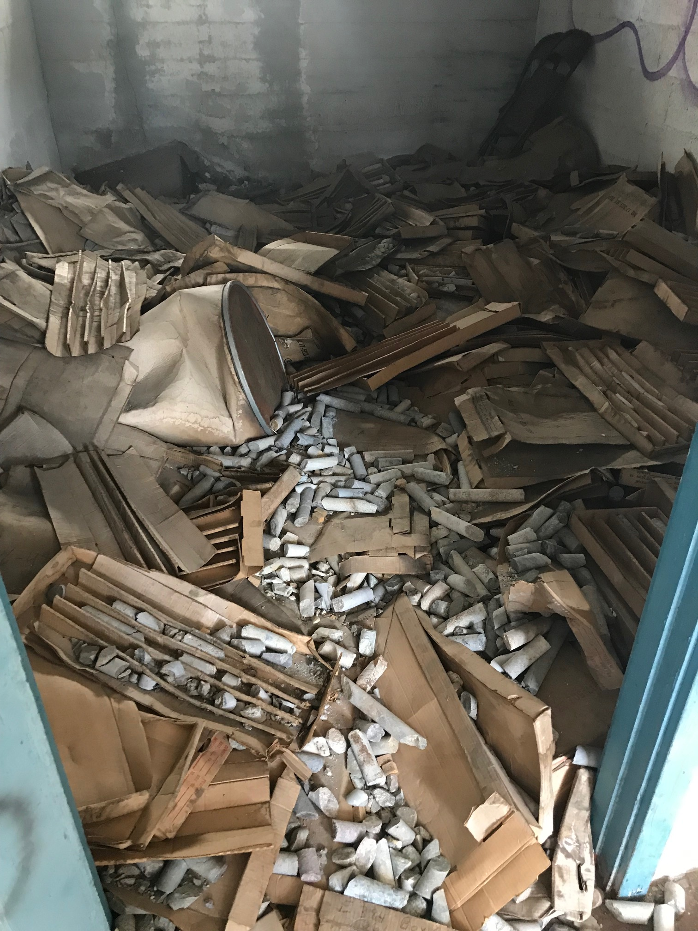
Gilman
Shaft elevators – miners’ entrance into mine
Outbuilding full of abandoned drill cores in Gilman. This one building contained multiple rooms full of cores. (2019)

Slide 7
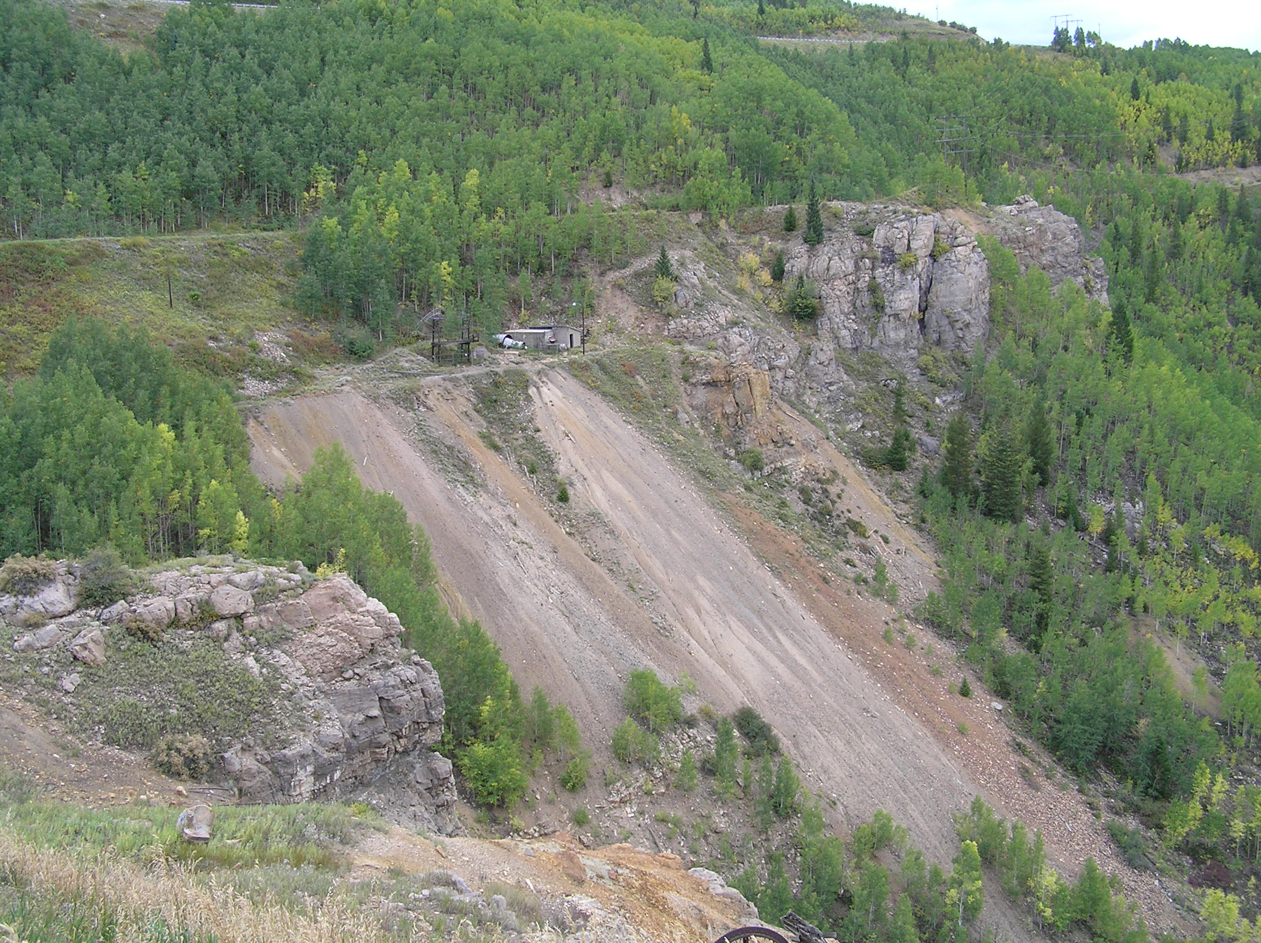
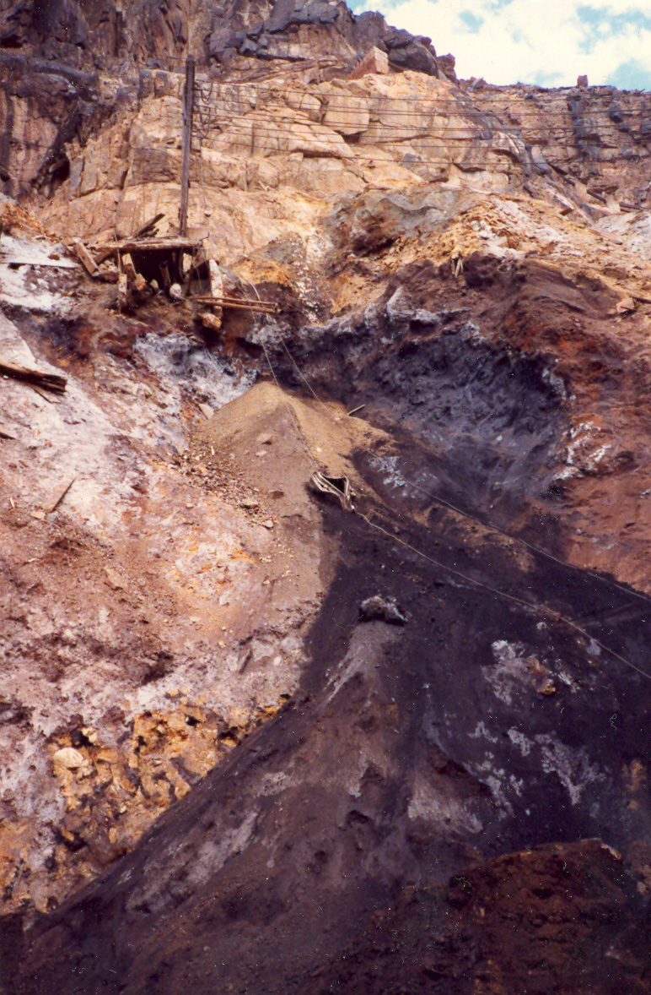
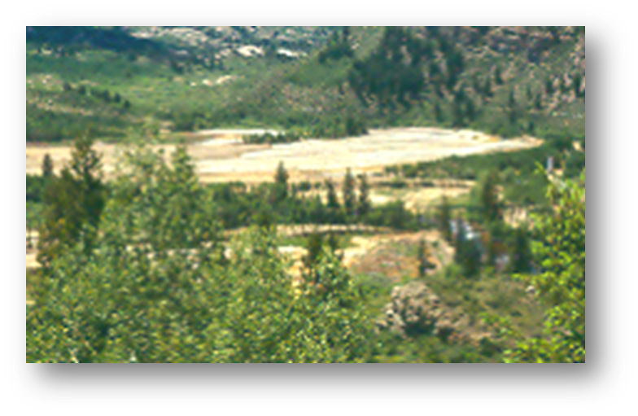
Mine Waste
Waste Rock
Roaster Waste
Tailings
Acid Mine Drainage (AMD)
Roaster Pile 4 in Belden

Slide 8
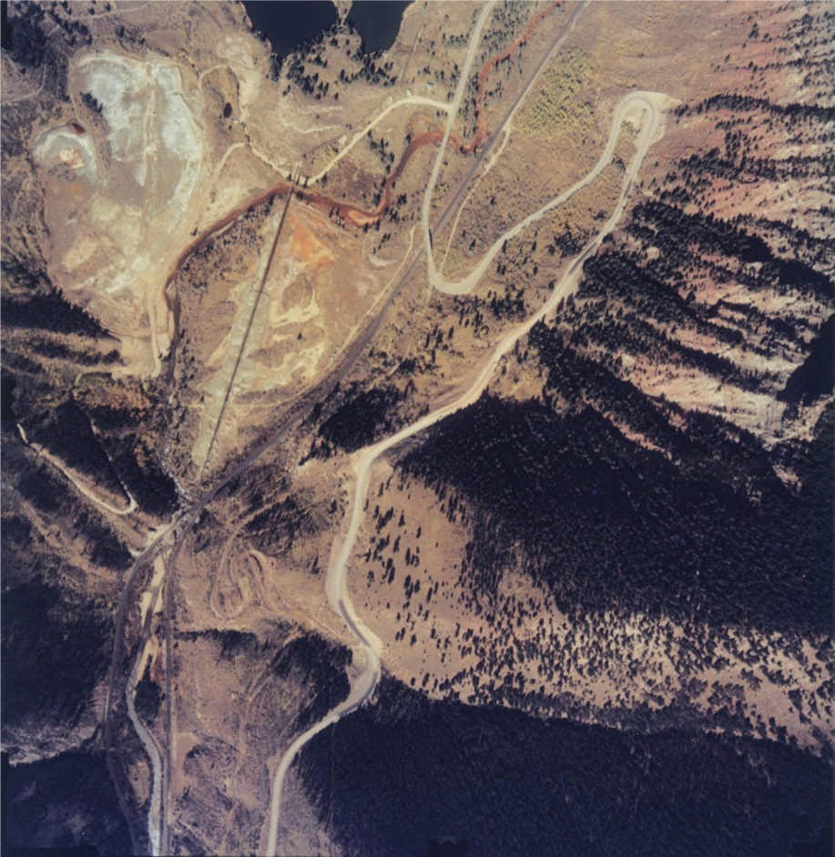
Old Tailings Pile & Rex Flats
Old Tailings Pile
Rex Flats
Tailings Slurry Pipeline/Trestle
Eagle Mine up canyon
1985

Slide 9
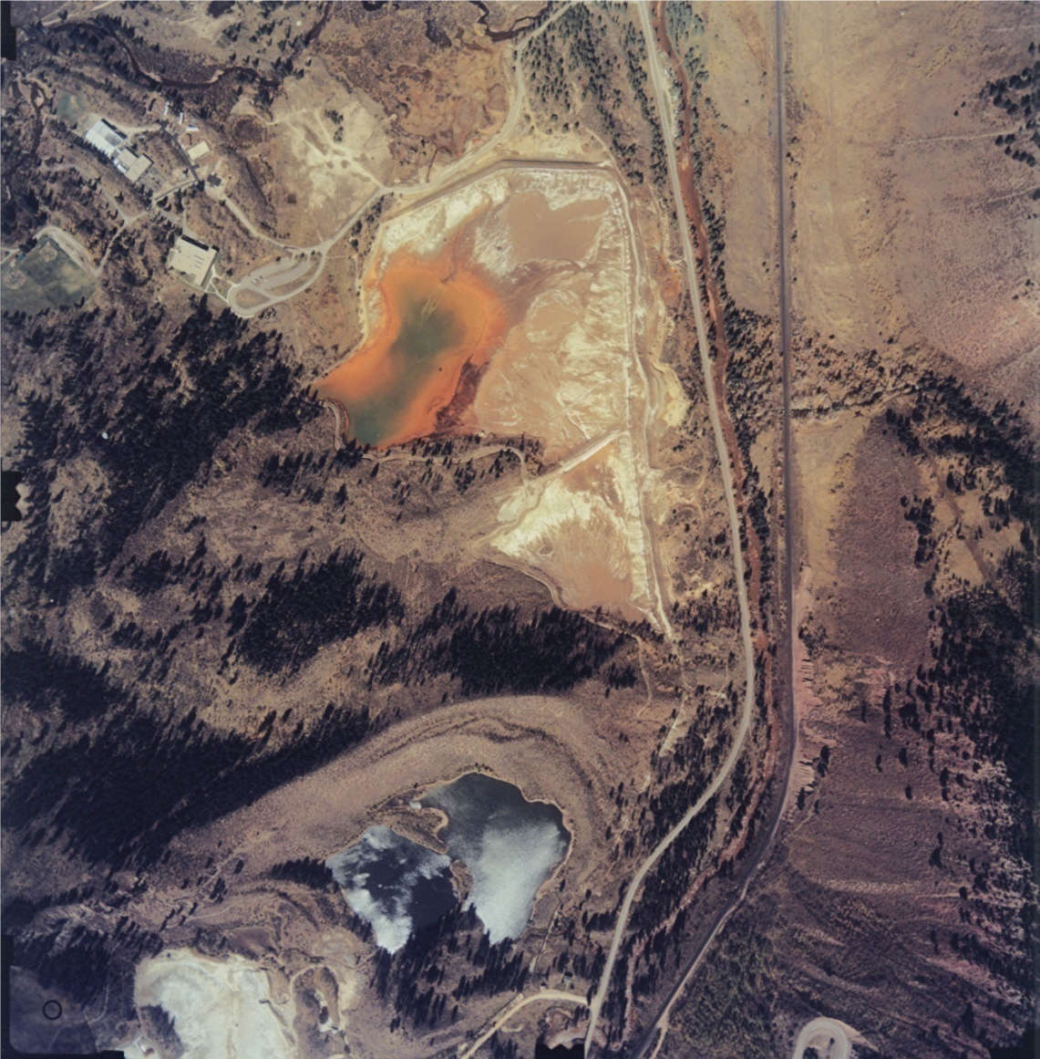
New Tailings Pile
New Tailings Pile
(now Consolidated Tailings Pile)
Area of Current Water Treatment Plant
1985

Slide 10
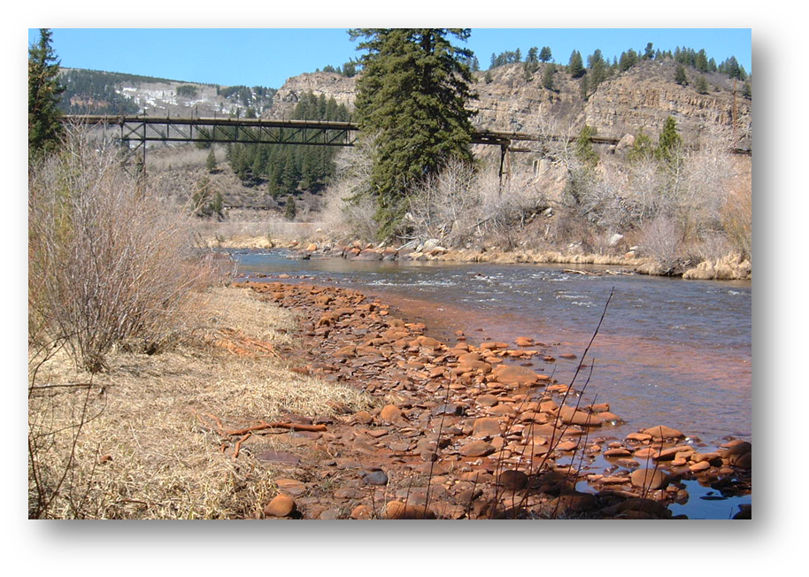
Site Management - 3 Operable Units
OU1: Sitewide Surface Water Quality
  All remedial components targeted at achieving surface water ARARs
  Ecological risk based
OU2: Town of Gilman
  Soils in abandoned town
  Human health risk based
OU3: Battle North Redevelopment
  Soils in Rex Flats, Maloit Park, Old Tailings Pile requiring additional remediation to achieve residential use standards for redevelopment
  Human health risk based
Stained rocks along Eagle River from groundwater flow from Rex Flats.

Slide 11
Enforcement History
Site listed on NPL
1986
1986:
Site MOA
1995:
SSEA
2004:
State MOA
2018:
Site MOU
CERCLA Process
Relevant Enforcement
State NRD & Response Cost Claim
State Consent Decree/Remedial Action Plan
1983
1988
1996
1994
UAO to PRP
1993
EPA OU1 ROD
EPA Consent Decree/Statement of Work
OU1
1999
EPA OU1 ESD
2017
EPA OU1 RODA
2018
Friendly UAO to PRP

Slide 12
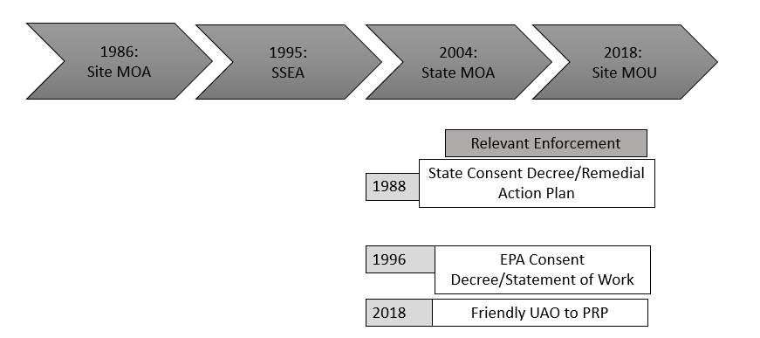
Where are we now? The obstacles.
Patchwork enforcement strategy for OU1
  Confusing to everyone

Slide 13
Where are we now? The obstacles.
Sunsetted provisions from 1996 CD/SOW
  Critical remedial components including water treatment plant
  Narrow provisions

Slide 14
Where are we now? The obstacles.
Regulatory Issues
  Two State-issued discharge permits
    Water treatment plant
    Liberty Well
  When CERCLA & CWA don't agree
    TI waiver for arsenic
  303(d) listing
    Segment change

Slide 15
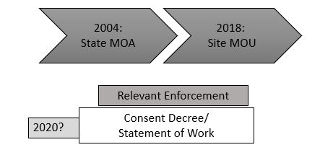
Solution.
New Consent Decree for OU1
  Goals:
    Consolidate all enforcement documents for OU1
    Adopt permit equivalent documents
    Broader and more flexible modification and additional work provisions

Slide 16
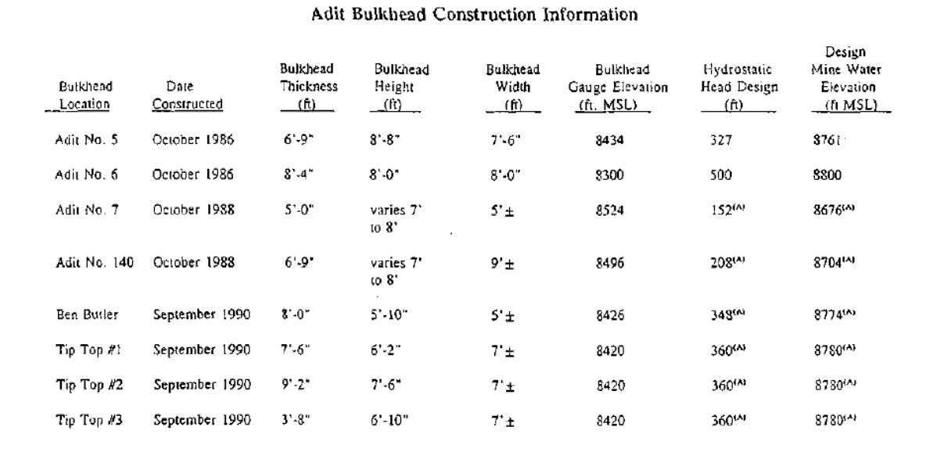
Robust Remedy
1988 State and PRP Consent Decree/Remedial Action Plan:
Flood workings by bulkheads and grouting
Removal of roaster pile wastes and tailings throughout the Site
Consolidation of roaster pile wastes and tailings into CTP
CTP Capping
Setting compliance objectives and long term monitoring for site

Slide 17
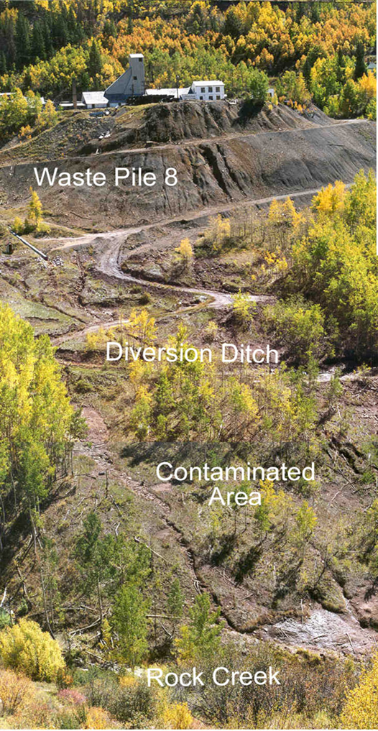
Robust Remedy
  1988 State and PRP Consent Decree/Remedial Action Plan:
    Waste rock pile diversion ditches
    CTP groundwater extraction trenches
    Up gradient diversion trench at CTP
    Diversion of lower Rock Creek around contamination
    Construction of lined surge pond at CTP

Slide 18
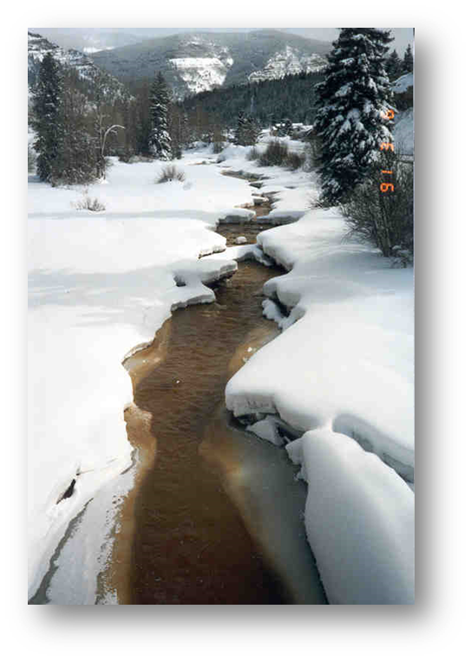
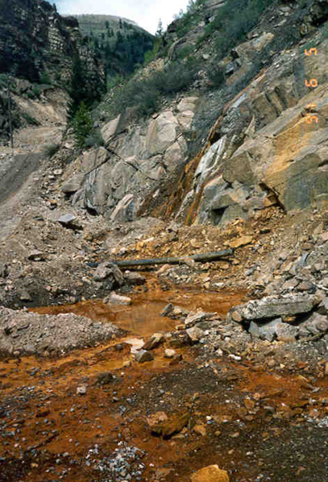
Robust Remedy
1990 Amendment to State and PRP Consent Decree/Remedial Action Plan:
  Construction of WTP
  Second lined surge pond
  Mine seepage collection system
  Expanded gw/sw monitoring
  Temporary sludge disposal at CTP
Acid Mine Drainage from the Eagle Mine workings in 1991
Eagle River in 1991

Slide 19
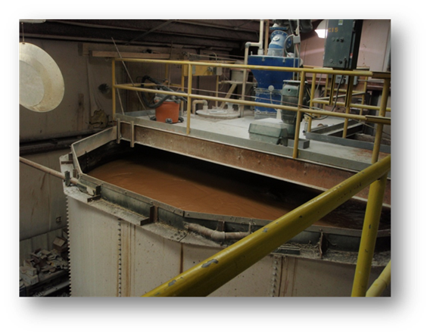
Water Treatment
WTP Influent/Effluent Concentrations
 | Average Influent Concentration (µg/l) | Average Effluent Concentration (µg/l)
Arsenic | 31.63 | 1.04
Cadmium | 76.25 | 0.65
Copper | 167.56 | 4.0
Zinc | 33,080 | 48.58
Note: Arsenic data reported from Ramboll-Environ, 2010 through 8/2014. All other contaminants based on 2014 data only. PQL for Arsenic is 1 µg/l and detection limit for copper is 4 µg/l.

Slide 20
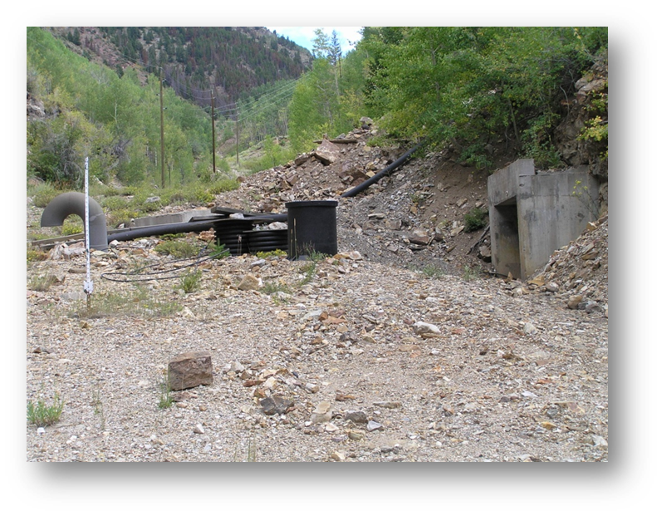
Robust Remedy
1996 EPA and PRP Consent Decree:
  Culvert system to divert clean Rock Creek surface flow
  Mine draw down to maintain mine pool level
  Waste rock pile leachability study
  Completion of CTP cap within 2 construction seasons
  Addition of sludge dewatering and disposal at WTP
Mine draw down system at Adit 5

Slide 21
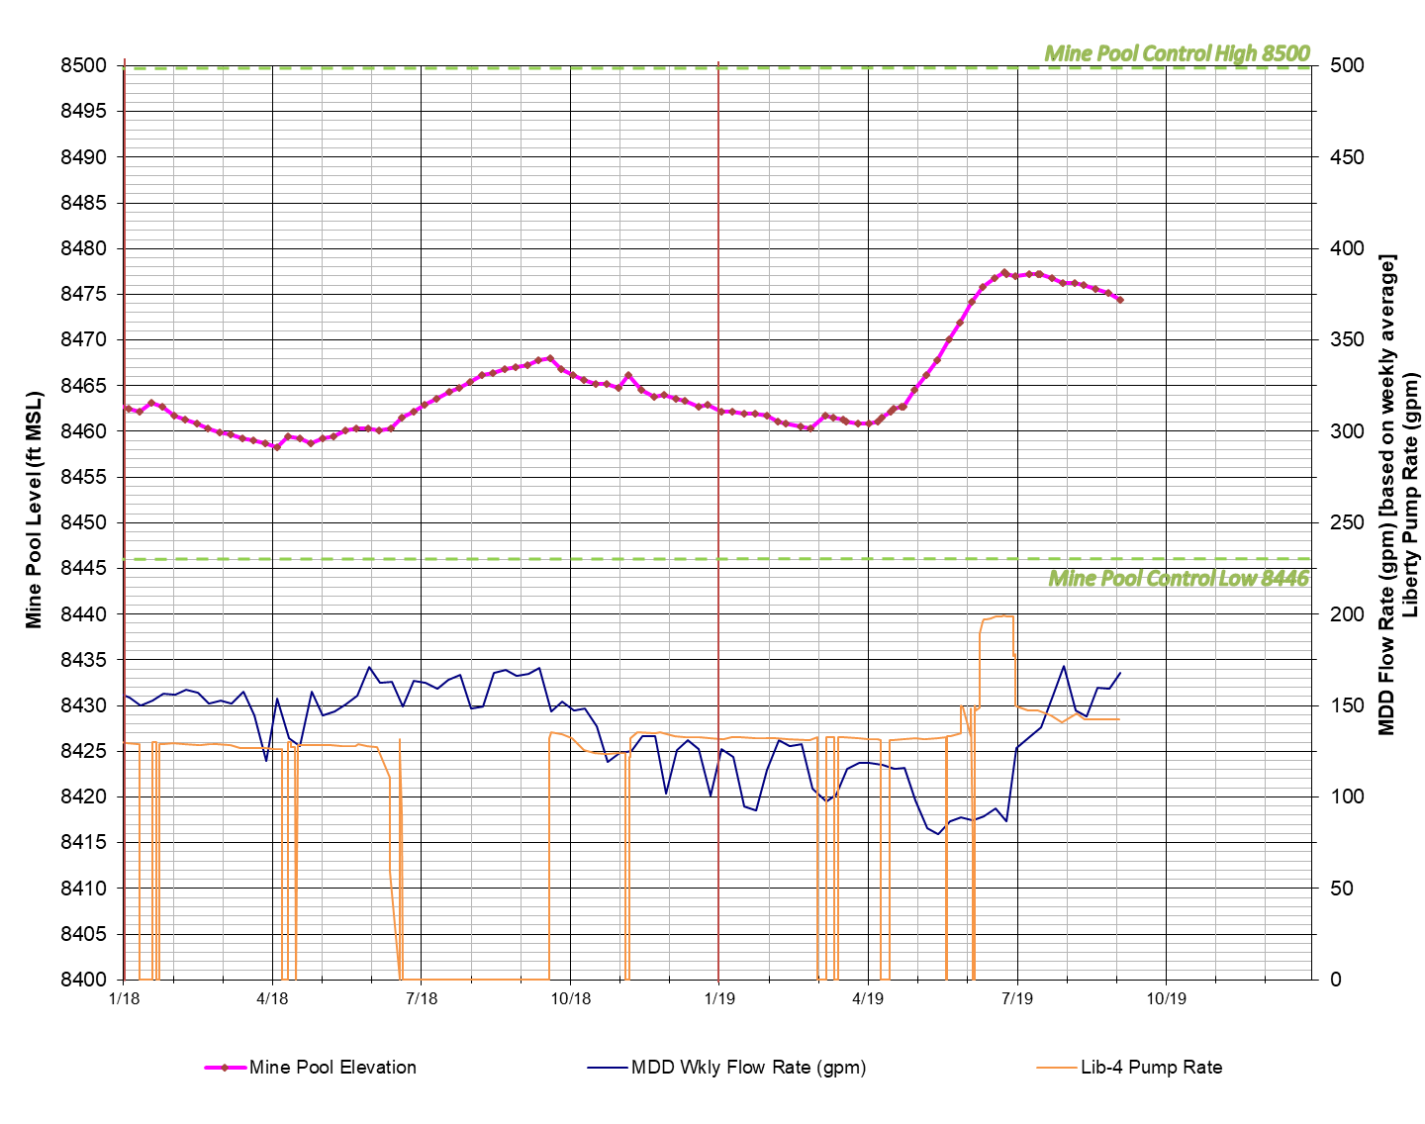
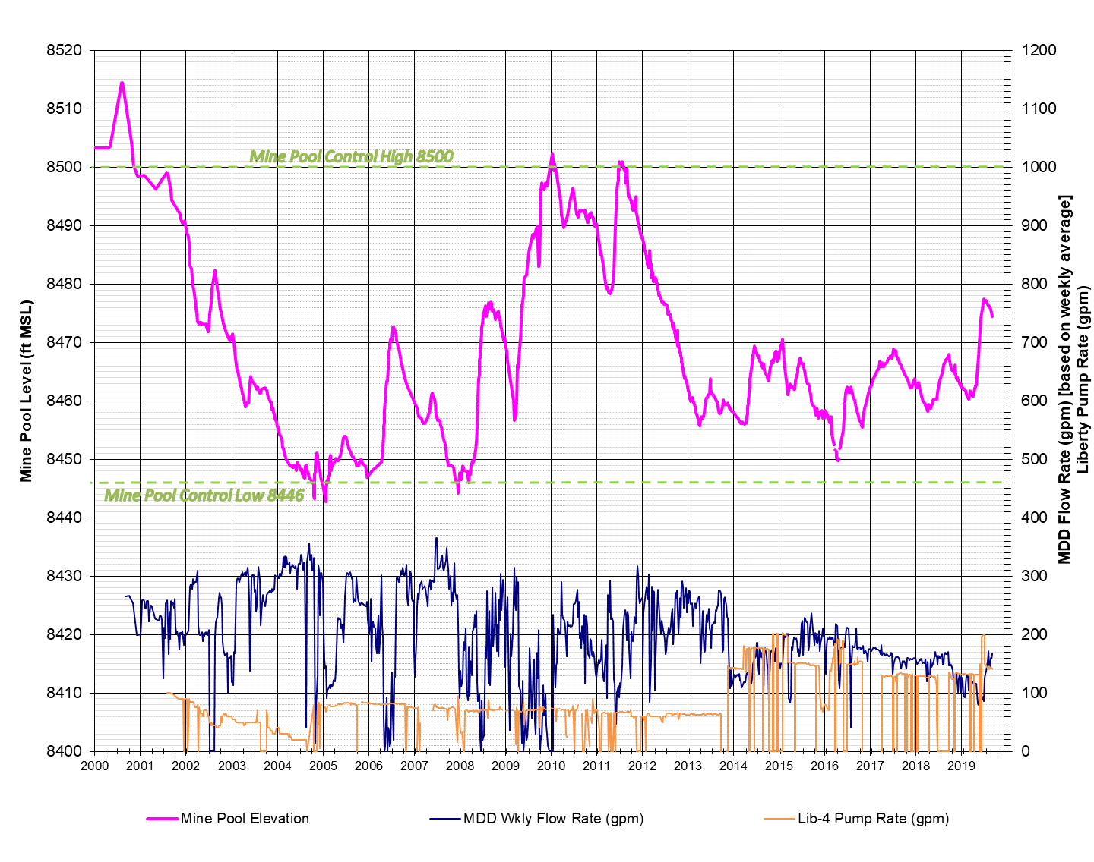
Mine Pool Elevation

Slide 22
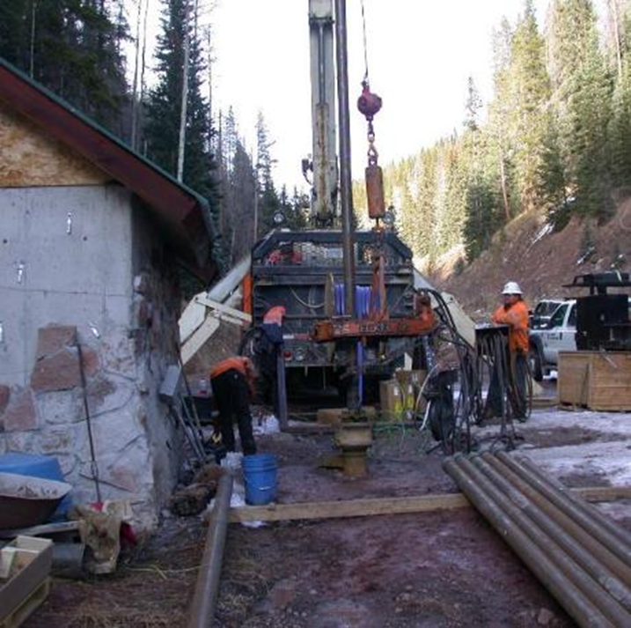
Robust Remedy
1998 ESD
  Liberty Well
  980-foot well
  150 gpm direct discharge into Willow Creek
  State Discharge Permit
Pump replacement in Liberty Well in September 2018

Slide 23
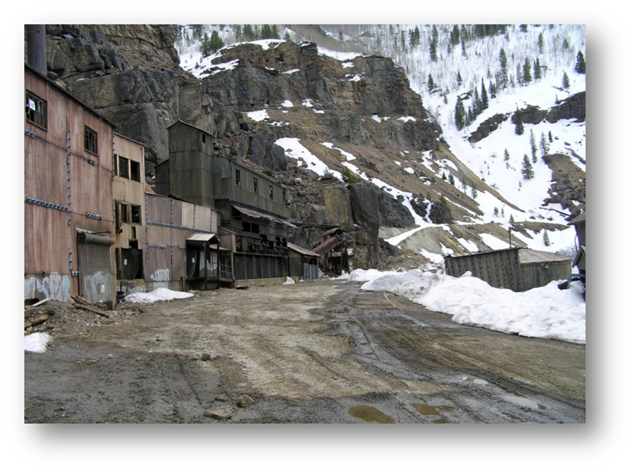
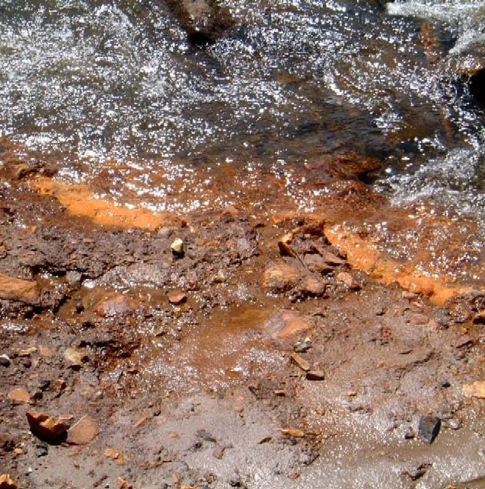
Robust Remedy
2018 Unilateral Administrative Order
  Expansion of existing remedy
  Collection of groundwater at Belden, at the base of Rock Creek and from the Mill Level of the mine
  Conveyance of collected water to WTP for treatment
Iron precipitate forming in an area where groundwater enters Eagle River in Belden

Slide 24
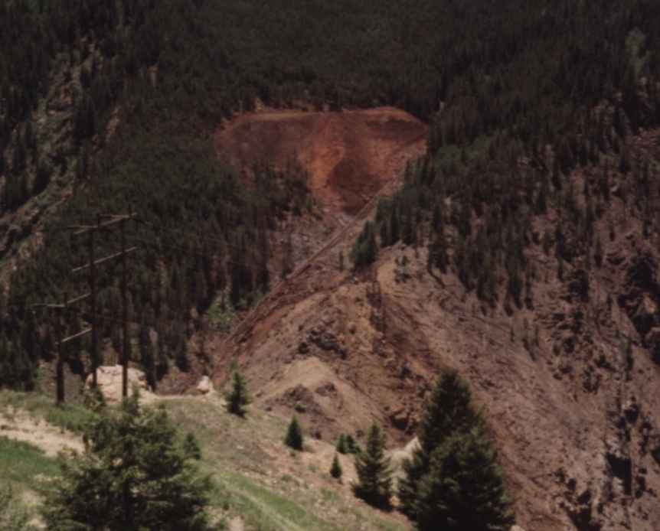
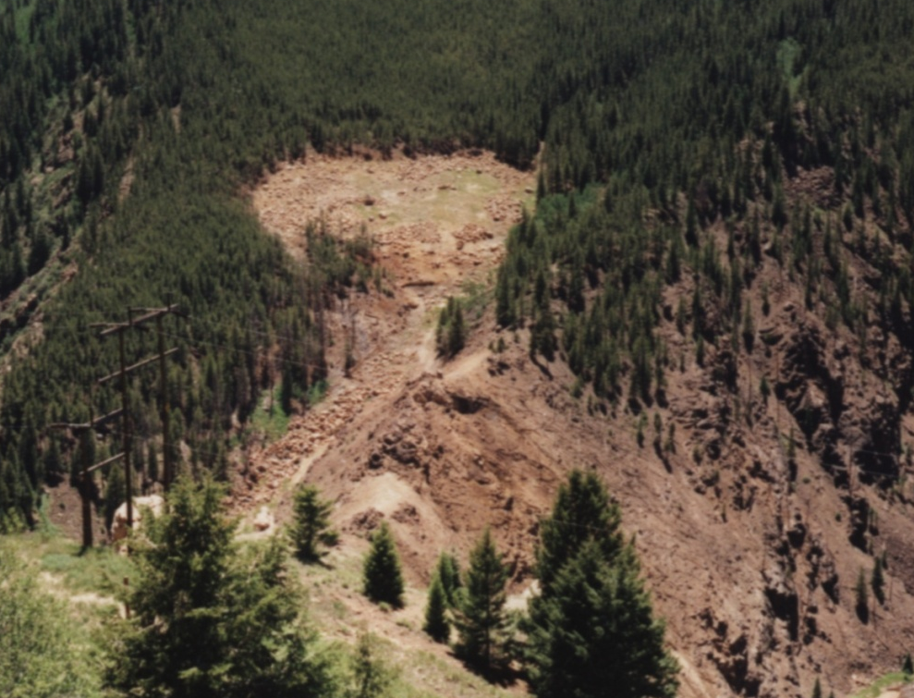
Before and After. . . . . . .
Roaster Pile Remediation
Roaster Pile #1
Prior to Removal
1988
Roaster Pile #1
After Restoration
1994

Slide 25
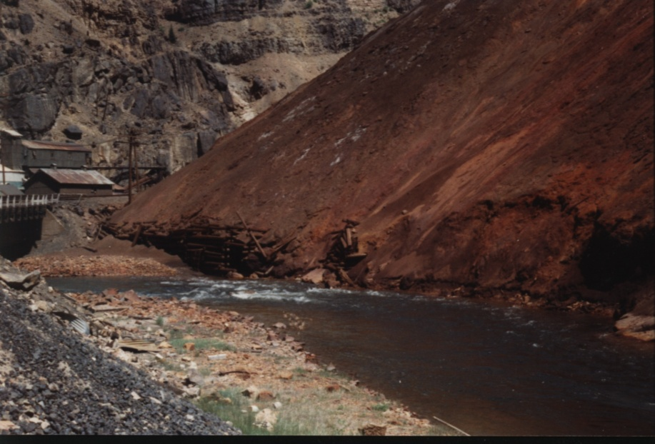
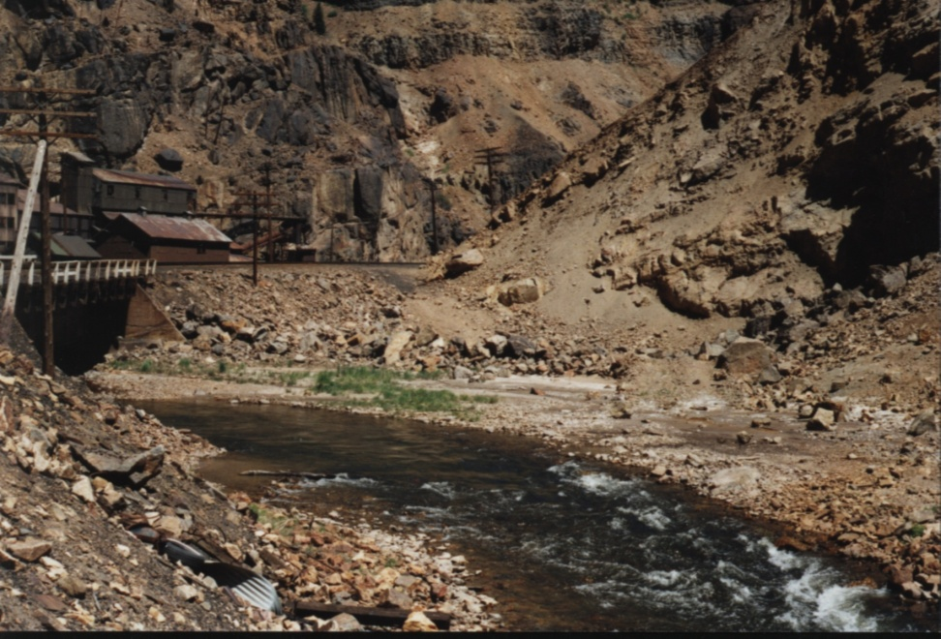
Before and After. . . . . . .
Roaster Pile Remediation
Roaster Pile #3
Before Removal
Circa 1988
Roaster Pile #3
After Remediation
1994
66,300 cubic yards of Roaster material were removed from 5 Roaster Piles in 1988 and 1989 and placed in the CTP.

Slide 26
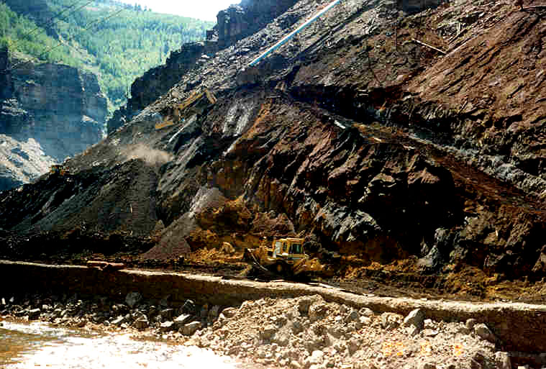
Roaster Pile #3 Remediation

Slide 27
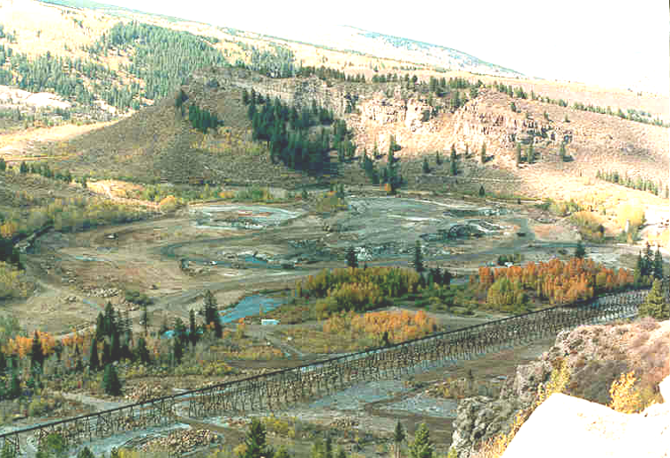
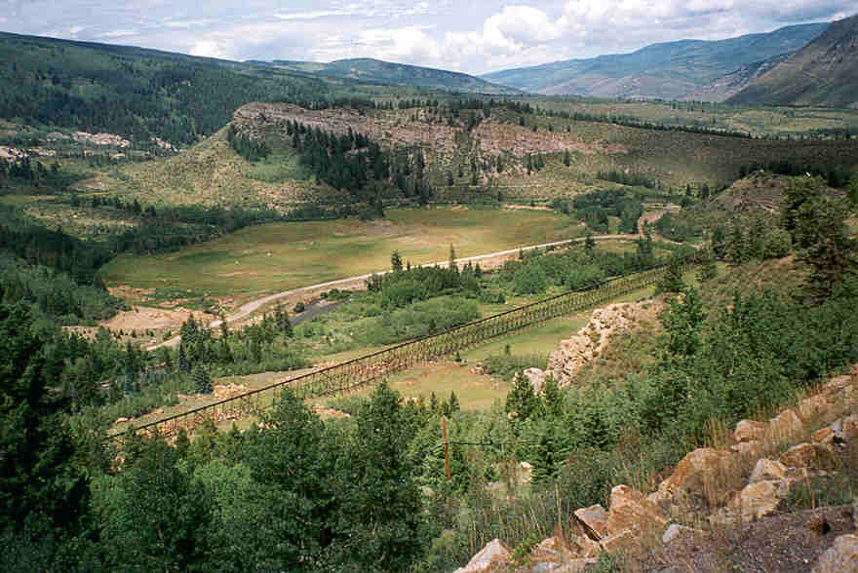
Before and After. . . .
Old Tailings Pile Reclamation
The Old Tailings Pile
in 1989
The Old Tailings Pile
After Reclamation in 1999
Nearly 1 million cubic yards of tailings were removed from the OTP, Rex Flats and Maloit Park and placed in the CTP between 1988 and 1996.

Slide 28
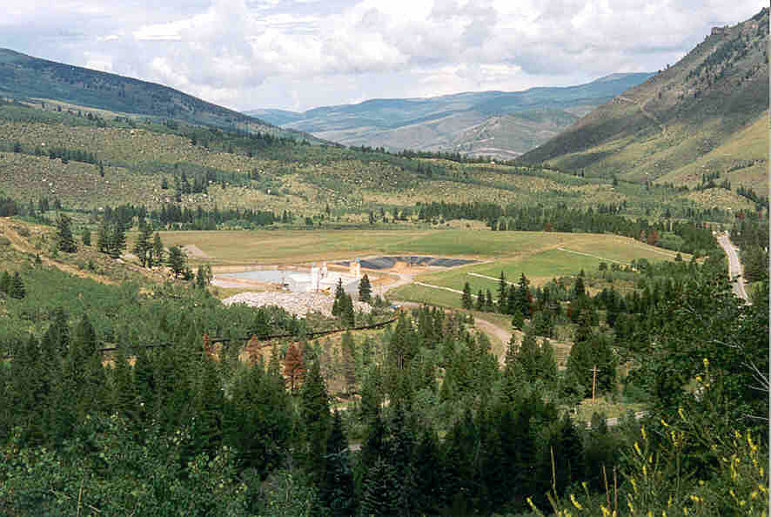
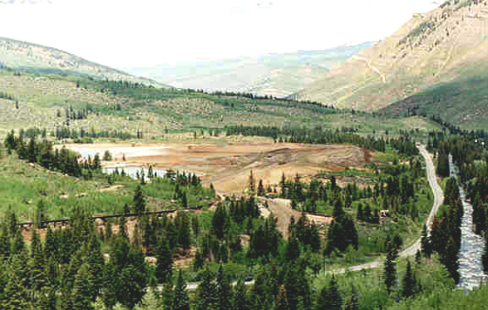
Before and After. . .
Consolidated Tailings Pile Reclamation
The Consolidated Tailings Pile
In 1989
The Consolidated Tailings Pile
After Reclamation
1999

Slide 29
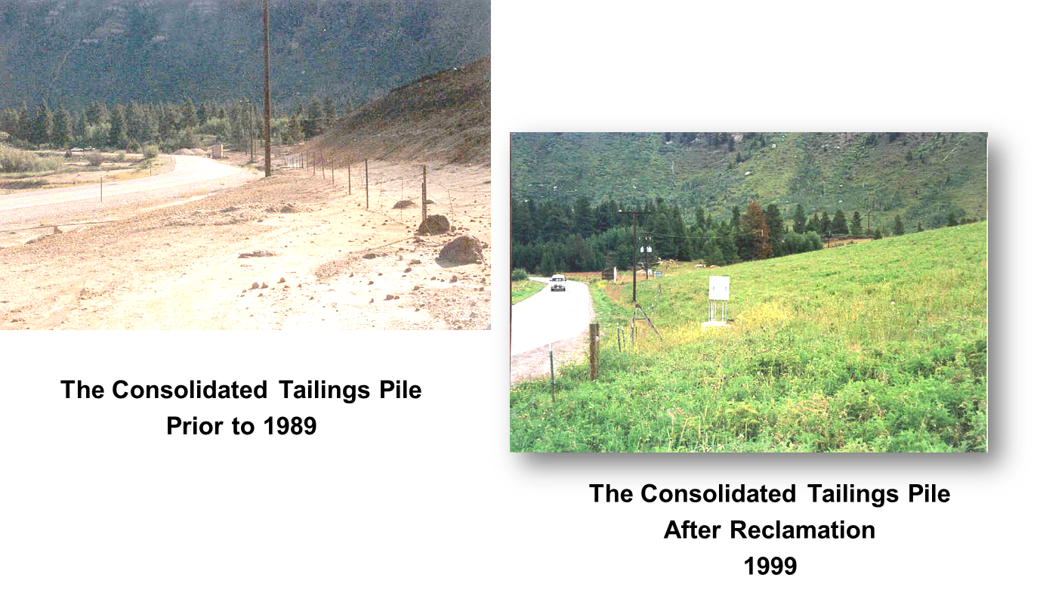
Before and After. . .
Consolidated Tailings Pile Reclamation

Slide 30
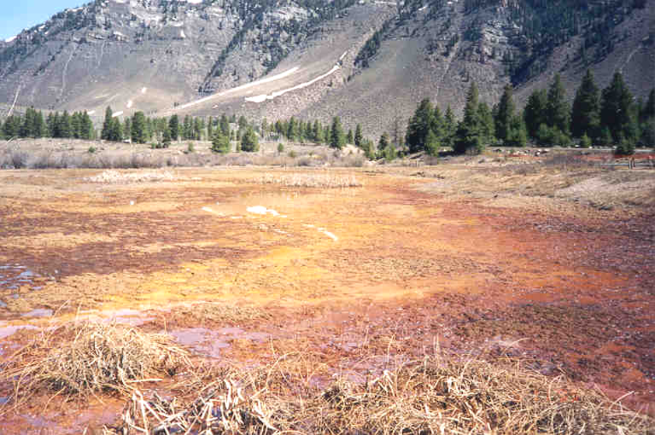
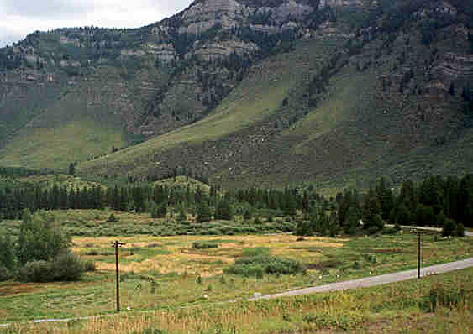
Before and After. . . .
Maloit Park Wetlands
Maloit Park Wetlands
In 1993
Maloit Park Wetlands
After Remediation
1999

Slide 31
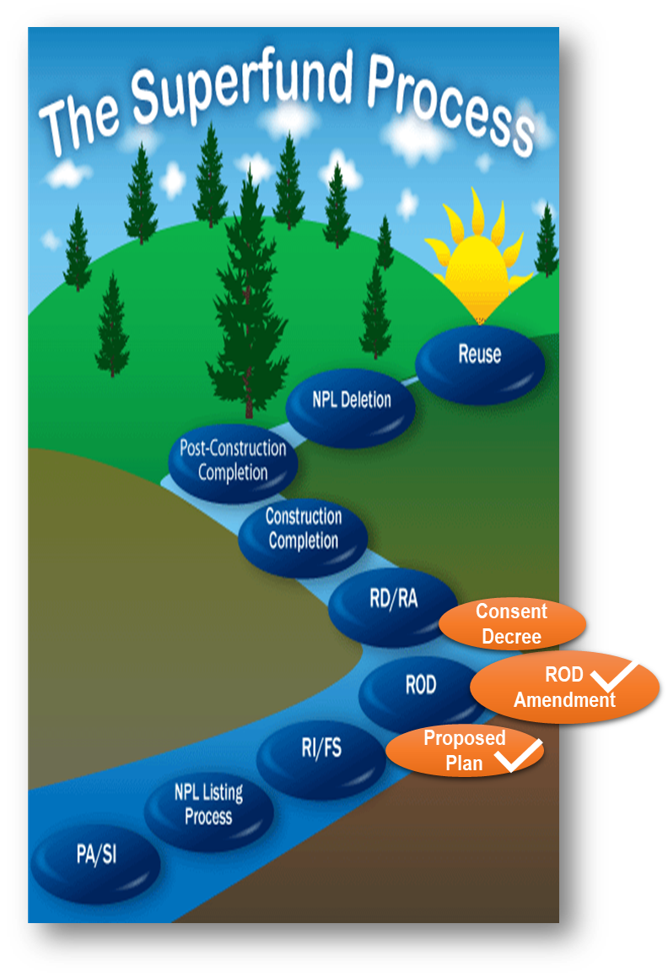
Getting to Site Completion
Lodge CD
Permits > PEDs
GW determination
SWRAU
Site deletion
SWRAU
O&F, O&M
Achieved 2001

Slide 32
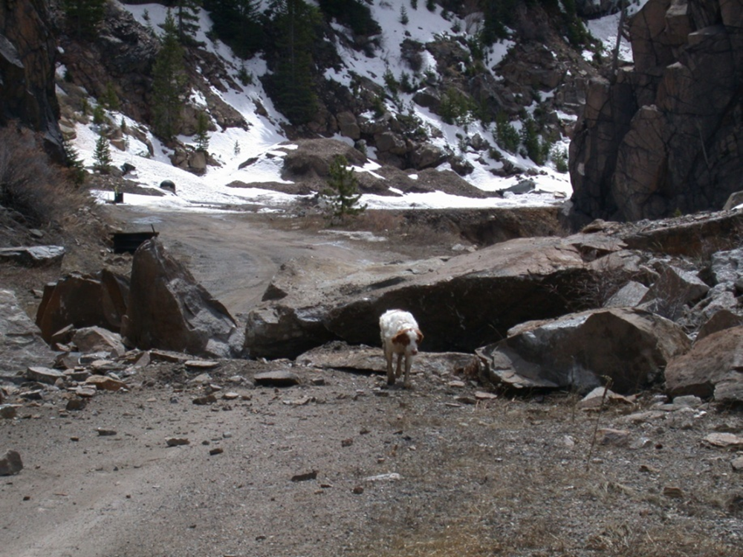
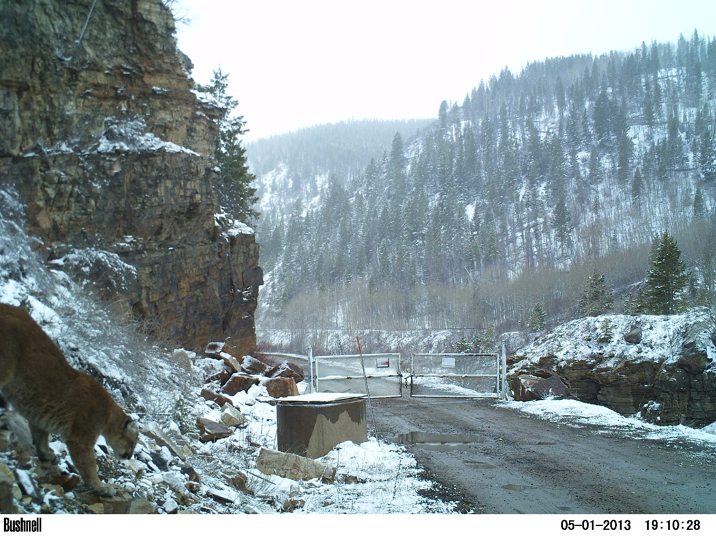
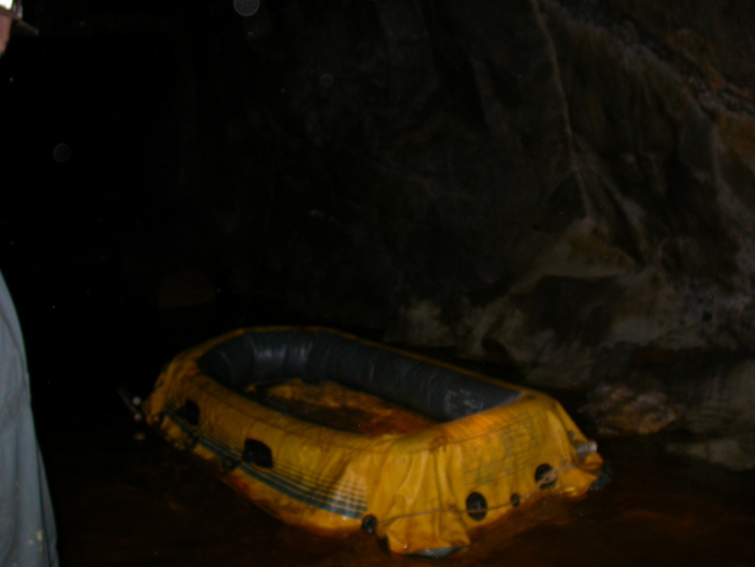
Questions?

