Slide 1
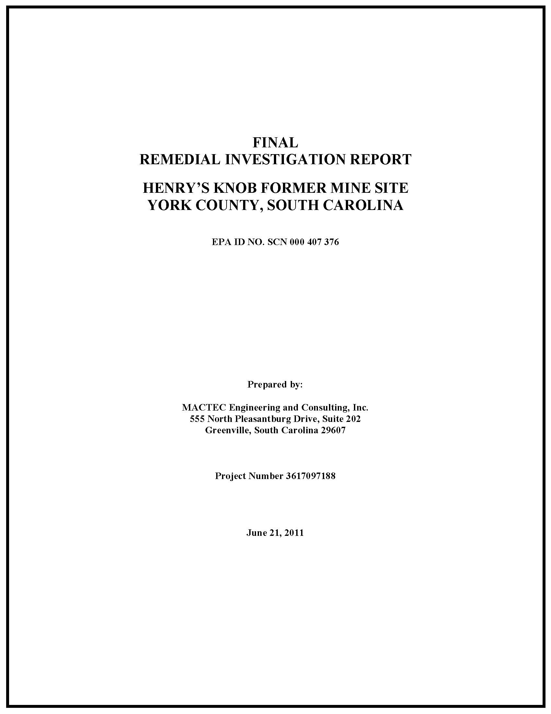
Site Cleanup Remedial Investigation Summary
Remedial Investigation (RI) / Feasibility Study (FS) Work Plan
RI to be conducted in three phases
Three individual field sampling events (Steps 1 though 3)
Investigation conducted from 2005 to 2010
Step 1 included background and area of concern (AOC) surface soil sampling, sediment/surface water sampling, and development of conceptual site model (CSM)
Step 2 included initial groundwater investigation and additional surface water delineation
Step 3 included horizontal extent of groundwater impacts
Final RI Report including Human Health and Baseline Ecological Risk Assessments submitted in June 2011

Slide 2
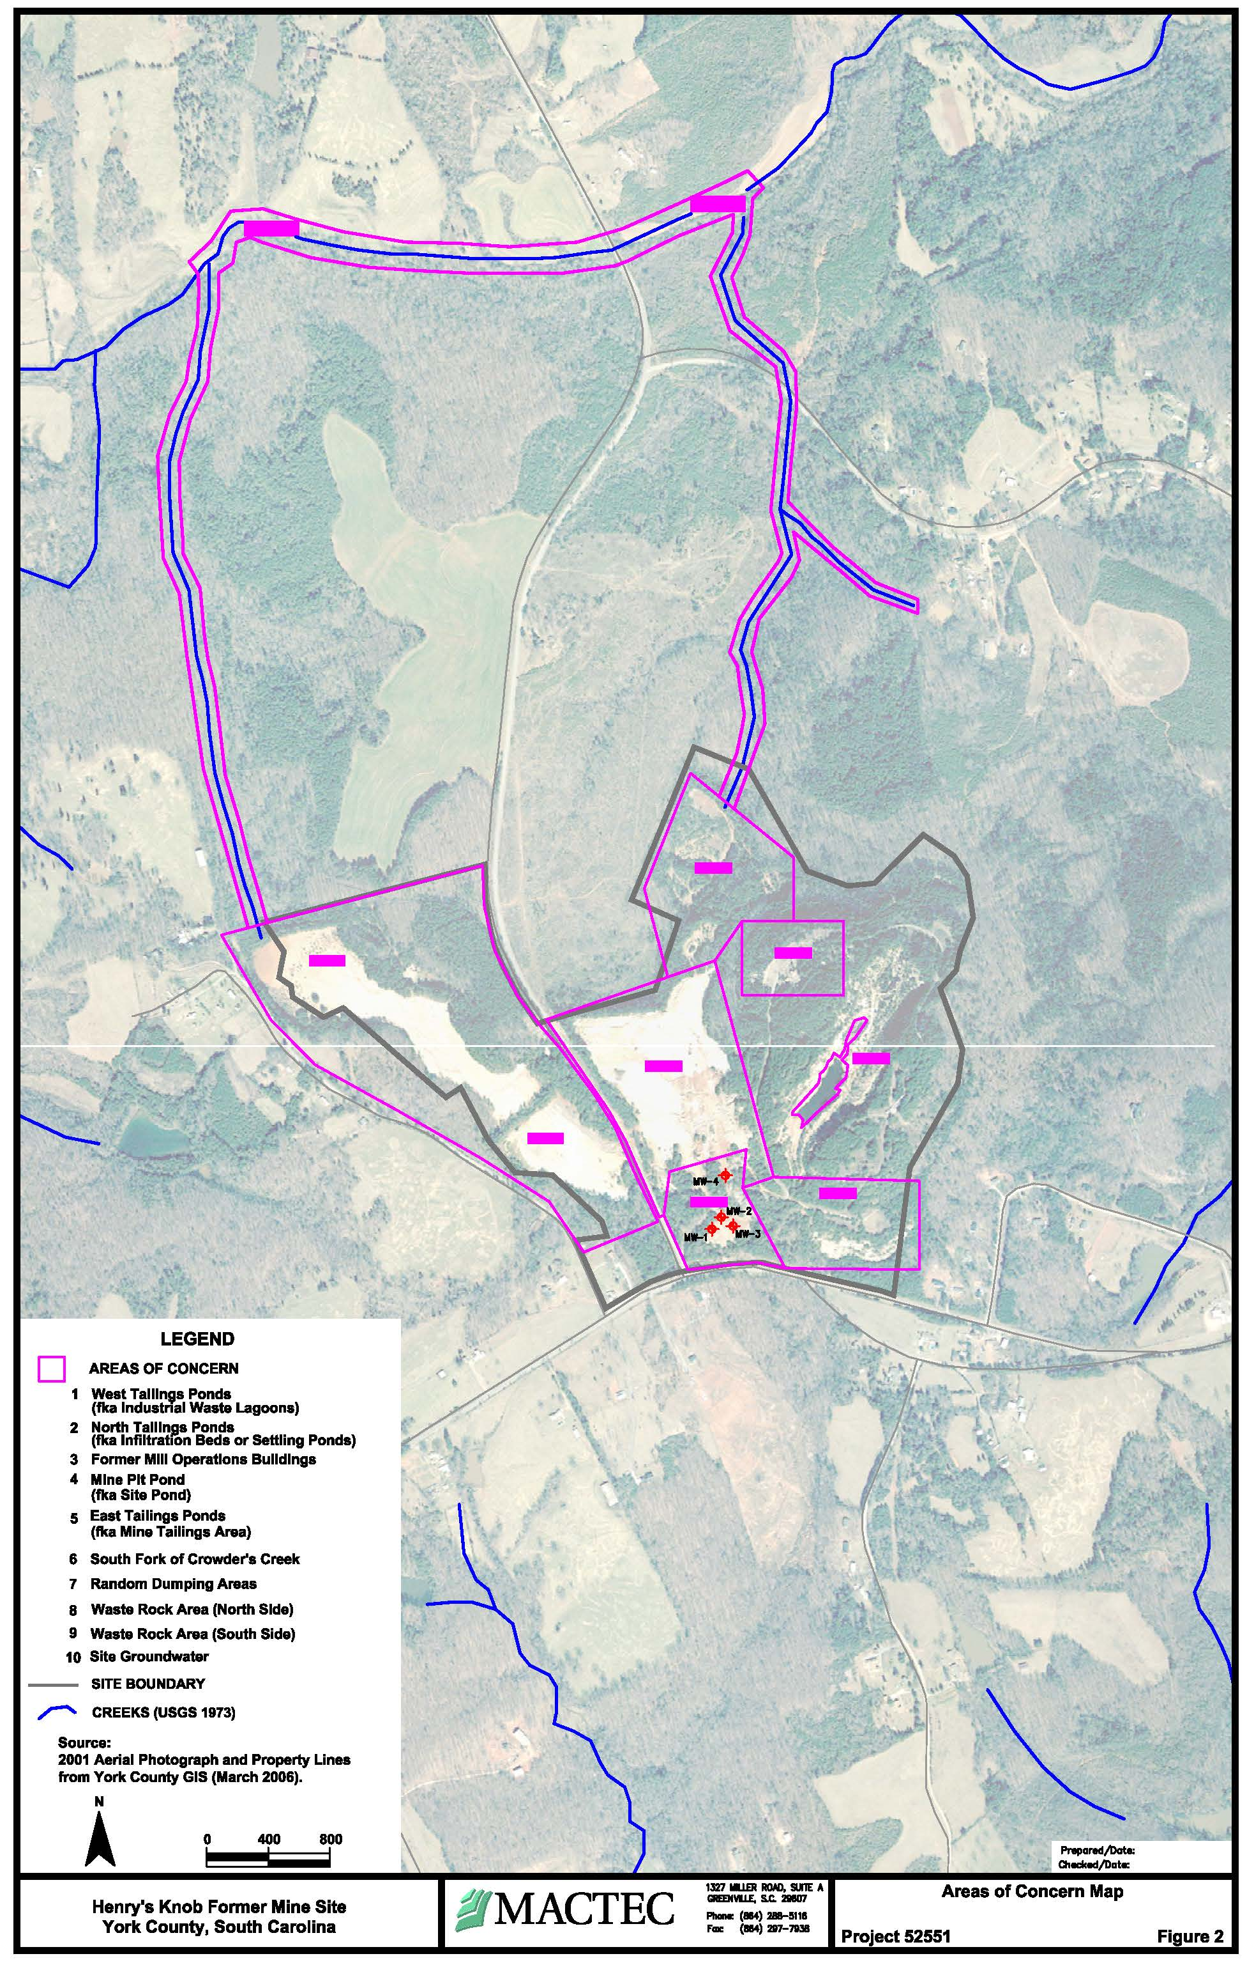
Site Cleanup Remedial Investigation Summary
Areas of Concern (AOC)
AOC #1 – West Tailings Impoundment
AOC #2 – North Tailing Impoundment
AOC #3 – Former Mill Buildings (Tailings/Pyrite Storage)
AOC #4 – Mine Pit Pond (MPP)
AOC #5 – East Tailings Impoundment
AOC #6 – Surface Water
AOC #7 – Random Dumping Areas
AOC #8 – Waste Rock (North)
AOC #9 – Waste Rock (South)
AOC #10 – Site Groundwater
6
2
8
1
5
4
3
9

Slide 3
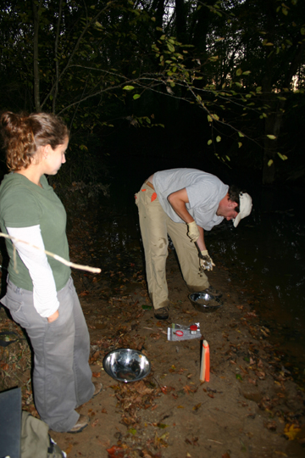
Site Cleanup Remedial Investigation Summary
RI Environmental Sampling
surface soil samples
surface water samples
sediment samples
monitoring wells/piezometers
residential well samples
ecological samples
Post-RI Environmental Sampling
surface and subsurface soil samples
test pits
whole rock samples
monitoring wells/piezometers
residential well samples
groundwater sampling events

Slide 4
Site Cleanup Remedial Investigation Conclusions
Soils
No statistical difference between background metals in soils collected from mineralized zone (ore body outcrops) and non-mineralized zone
Acid Base Accounting (ABA) and paste pH from AOC surface soil samples indicates capacity to produce acid mine drainage (AMD)
Aluminum, iron, and manganese are not particularly elevated in the AOCs when compared to background soils
No unacceptable risk to human health or ecological receptors
Sediment
No unacceptable risk to human health or ecological receptors by sediment
Surface Water (MPP)
Surface water in MPP has minimal hydraulic connection with the underlying bedrock and primarily only along strike of ore body
Impact to pond water results from acid rock drainage (ARD)

Slide 5
Site Cleanup Remedial Investigation Conclusions
Surface Water (Tributaries)
AMD impacts associated with leaching from tailings to groundwater generally restricted to headwaters of tributaries
pH and concentrations of metals generally improve downstream
No unacceptable risk to human health by exposure to surface water
Ecological condition of concern for surface water is low pH and acidity
Groundwater
Groundwater is the primary source of potable water in the site area
Groundwater is present under water table conditions in both overburden soils formed by the in-place weathering of bedrock and in fractured bedrock
Groundwater in site area has relatively low pH (less than 7) and may have elevated metals due to geology, as a result of ARD
Groundwater in monitoring wells installed downgradient from tailings impoundments have very low pH and are impacted by AMD

Slide 6
Site Cleanup Remedial Investigation Conclusions
Groundwater
Based on age of site, history of operations, and release mechanisms, the magnitude and extent of impacts to groundwater are expected to be stable in the future
The boundary of groundwater affected by the site appears stable and should not expand, but is expected to persist
Non-cancer risk to future use of groundwater as a potable water source due to elevated metals, primarily cobalt and manganese
Risk is associated with hypothetical exposure to the highest concentrations of metals reported in site monitoring wells and doesn’t represent risks associated with current use of groundwater as a potable drinking water supply
Remedial action objective developed to prevent use of groundwater that contains concentration of metals that pose non-cancer risks to human health
Due to abundant metals present in geological formations in site area, it’s difficult to differentiate between AMD-impacted groundwater and naturally occuring groundwater impacted by ARD

Slide 7
Site Cleanup AMD-Impacted vs ARD-Impacted Groundwater
AMD is a common environmental impact at former mining sites where iron sulfide minerals (principally pyrite) are present and exposed to water and oxygen, releasing sulfate, iron, and acidity (H⁺)
A simplistic, overall chemical formula that results in AMD is:
Pyrite + Oxygen + Water → Iron Precipitates + Acidity
Acidic waters also promote the weathering of other minerals
Mining and benefication of the ore body resulted in the accumulation of mine residuals in the form of fine-grained tailings and waste rock piles
Fine-grained materials, such as tailings, will result in higher oxidation rates due simply to increased surface areas of pyrite exposed to oxygen and water
The ability of the tailings to continue to produce acid and leach metals is limited only by the presence and amount of pyrite, soluble salts, oxygen, and the availability of water in the form of infiltrating precipitation
Acid Base Accounting (ABA) analysis and paste pH sampling indicated that tailings are a source of AMD, however, waste rock is not a significant source of AMD

Slide 8
Site Cleanup AMD-Impacted vs ARD-Impacted Groundwater
Similar acid weathering conditions occur in the absence of mining operations and is commonly called ARD
Oxidation of pyrite from in-place bedrock, most notably between the water table and the land surface
Increasingly recognized environmental condition at construction sites, transportation corridors, and other areas where bedrock is excavated
Evidence of ARD, including exposed outcrops with weathered sulfide minerals and anomalously elevated metals in stream sediments, are all tools used by the mineral exploration geologist to locate sulfide-bearing mineral deposits
ARD can an occur in potable wells installed in sulfide-bearing bedrock when oxygen is introduced through the well installation and subsequent pumping
ARD has been encountered in private wells along the strike of the ore body as well as along Pat’s Road located along strike of an unmined northwestern kyanite quartzite formation that parallels the ore body at Henry Knob

Slide 9
Site Cleanup AMD-Impacted vs ARD-Impacted Groundwater

Slide 10
Site Cleanup AMD-Impacted vs ARD-Impacted Groundwater
The area around Henry Knob has a remarkable diversity of rock formations and mineral resources
Unusual in the richness and variety of the mineral deposits that they contain
Mineral deposits include, among others, kyanite and manganese
It has been estimated that the principal deposits in the region contain 40 million tons of rock with 10 to 30 percent kyanite
The most significant mining in the area was at Henry Knob, where kyanite was produced with pyrite as a byproduct
Mining has played a significant role from the 1700s to the present
How do we differentiate between groundwater impacted by AMD and naturally-occurring groundwater that may have elevated concentrations of metals, but otherwise no impacts from mining operations?

Slide 11
Site Cleanup AMD-Impacted vs ARD-Impacted Groundwater
To differentiate between naturally-occurring metals in groundwater and groundwater that has likely been impacted by AMD, a combination of geochemical signature (Stiff diagrams) and risk-based screening levels was developed
Both monitoring wells and residential wells were sampled for geochemical parameters that could be used to determine if the samples showed impact from AMD
The geochemical parameters consisted of major anions (bicarbonate, chloride, and sulfate), major cations (calcium, magnesium, sodium, and potassium), ferrous iron, ferric iron, sulfide, acidity, and total alkalinity
Analyte composition and anion-cation balances for these geochemical parameters were used to generate Stiff diagrams

Slide 12
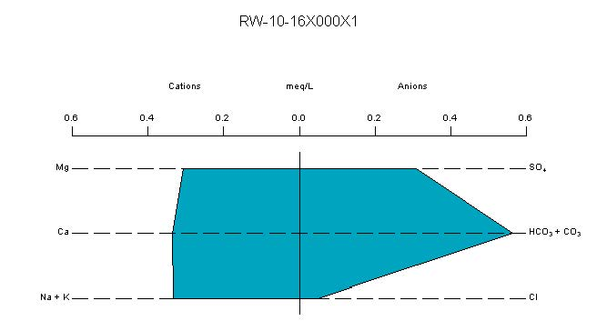
Site Cleanup AMD-Impacted vs ARD-Impacted Groundwater
Stiff diagrams are used to describe and compare geochemical differences in groundwater based on charge balances of the cation and anion species by calculating and plotting equivalent charge concentrations in milliequivalents per liter (meq/L)
A polygonal shape is created from three parallel horizontal axes extending on either side of a vertical zero axis
Cations are plotted on the left side of the zero axis, one to each horizontal axis, and anions are plotted on the right side

Slide 13
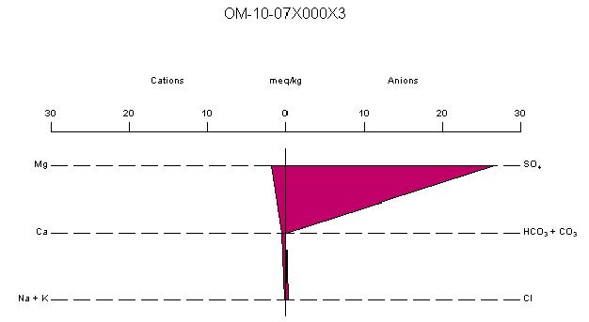
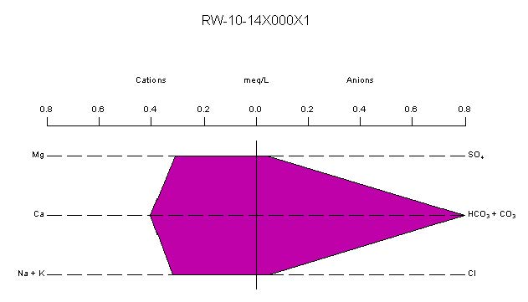
Site Cleanup AMD-Impacted vs ARD-Impacted Groundwater
The geochemical signature of mine-impacted groundwater indicates a charge imbalance that is skewed toward high sulfate concentrations (relative to the cations) and depleted bicarbonate (due to acidity) consistent with geochemical processes responsible for AMD
Where the pennant shape of the Stiff diagram was not observed, the groundwater was interpreted to not have been impacted by AMD

Slide 14
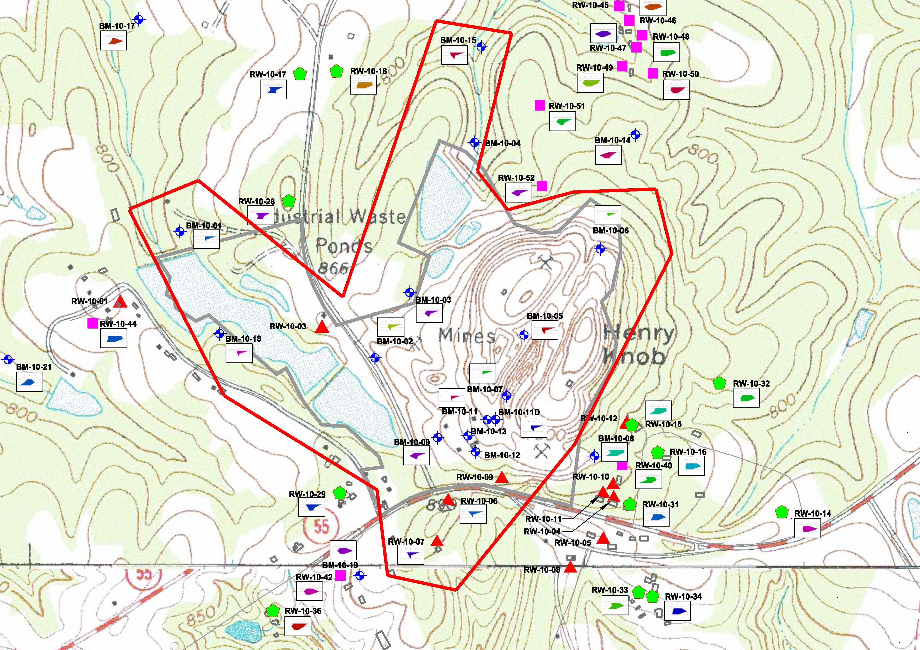
Site Cleanup AMD-Impacted vs ARD-Impacted Groundwater
Patterns in the Stiff diagrams are useful in making a rapid visual comparison of geochemical data and allows discrimination between water from different sources

Slide 15
Site Cleanup AMD-Impacted vs ARD-Impacted Groundwater
Metals were detected in groundwater from the overburden monitoring wells (saprolite), bedrock monitoring wells, and residential water supply wells (most are assumed to be installed in bedrock) at the Site
Although aluminum, cobalt, and manganese were detected with the most frequency at the site, manganese was the most widespread constituent that exceeded the USEPA Regional Screening Level (RSL) in effect at the time of the RI
A concentration contour approximately equivalent to the USEPA RSL for manganese was used in conjunction with Stiff diagrams to develop the extent of AMD-impacted groundwater
Groundwater sample results that exceed the USEPA RSL but do not have Stiff diagrams indicative of AMD were not included within the manganese-impacted groundwater concentration contours

Slide 16
Site Cleanup AMD-Impacted vs ARD-Impacted Groundwater
Figure from RI demonstrating area of groundwater potentially impacted by mining operations
Solid red line indicates boundary of potentially AMD-impacted groundwater based on Stiff diagrams combined with manganese concentrations above the USEPA RSL in effect at the time of the RI
Dashed purple line indicates a manganese concentration contour approximately equivalent to the USEPA RSL

Slide 17
Site Cleanup Regional/Telescoped Groundwater Model
Regional 3D flow model developed using MODFLOW with data input, model runs, and model output using MT3E code in Processing Modflow
Assess potential impacts of dissolved metals (cobalt and manganese) on regional groundwater quality in site area
Further refine CSM
Telescoped model performed using 3D reactive transport code PHT3D
Simulate future transport of low pH groundwater and evaluate groundwater impact to surface water bodies
ARD/AMD simulated through oxidation of pyrite
Subsequent pH reactive transport determined by site-specific geochemical conditions
Evaluate effectiveness of remedial alternatives
Monitored natural attenuation (MNA)
Impermeable cap over tailings
Vegetative cap over tailings
Excavation with off-site disposal
Excavation with on-site disposal (MPP)

Slide 18
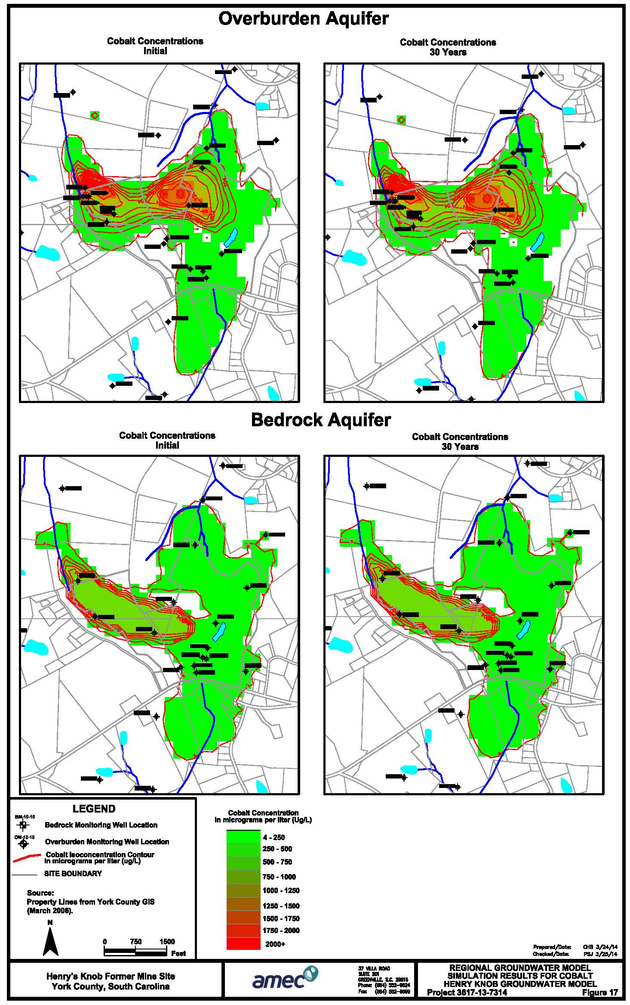
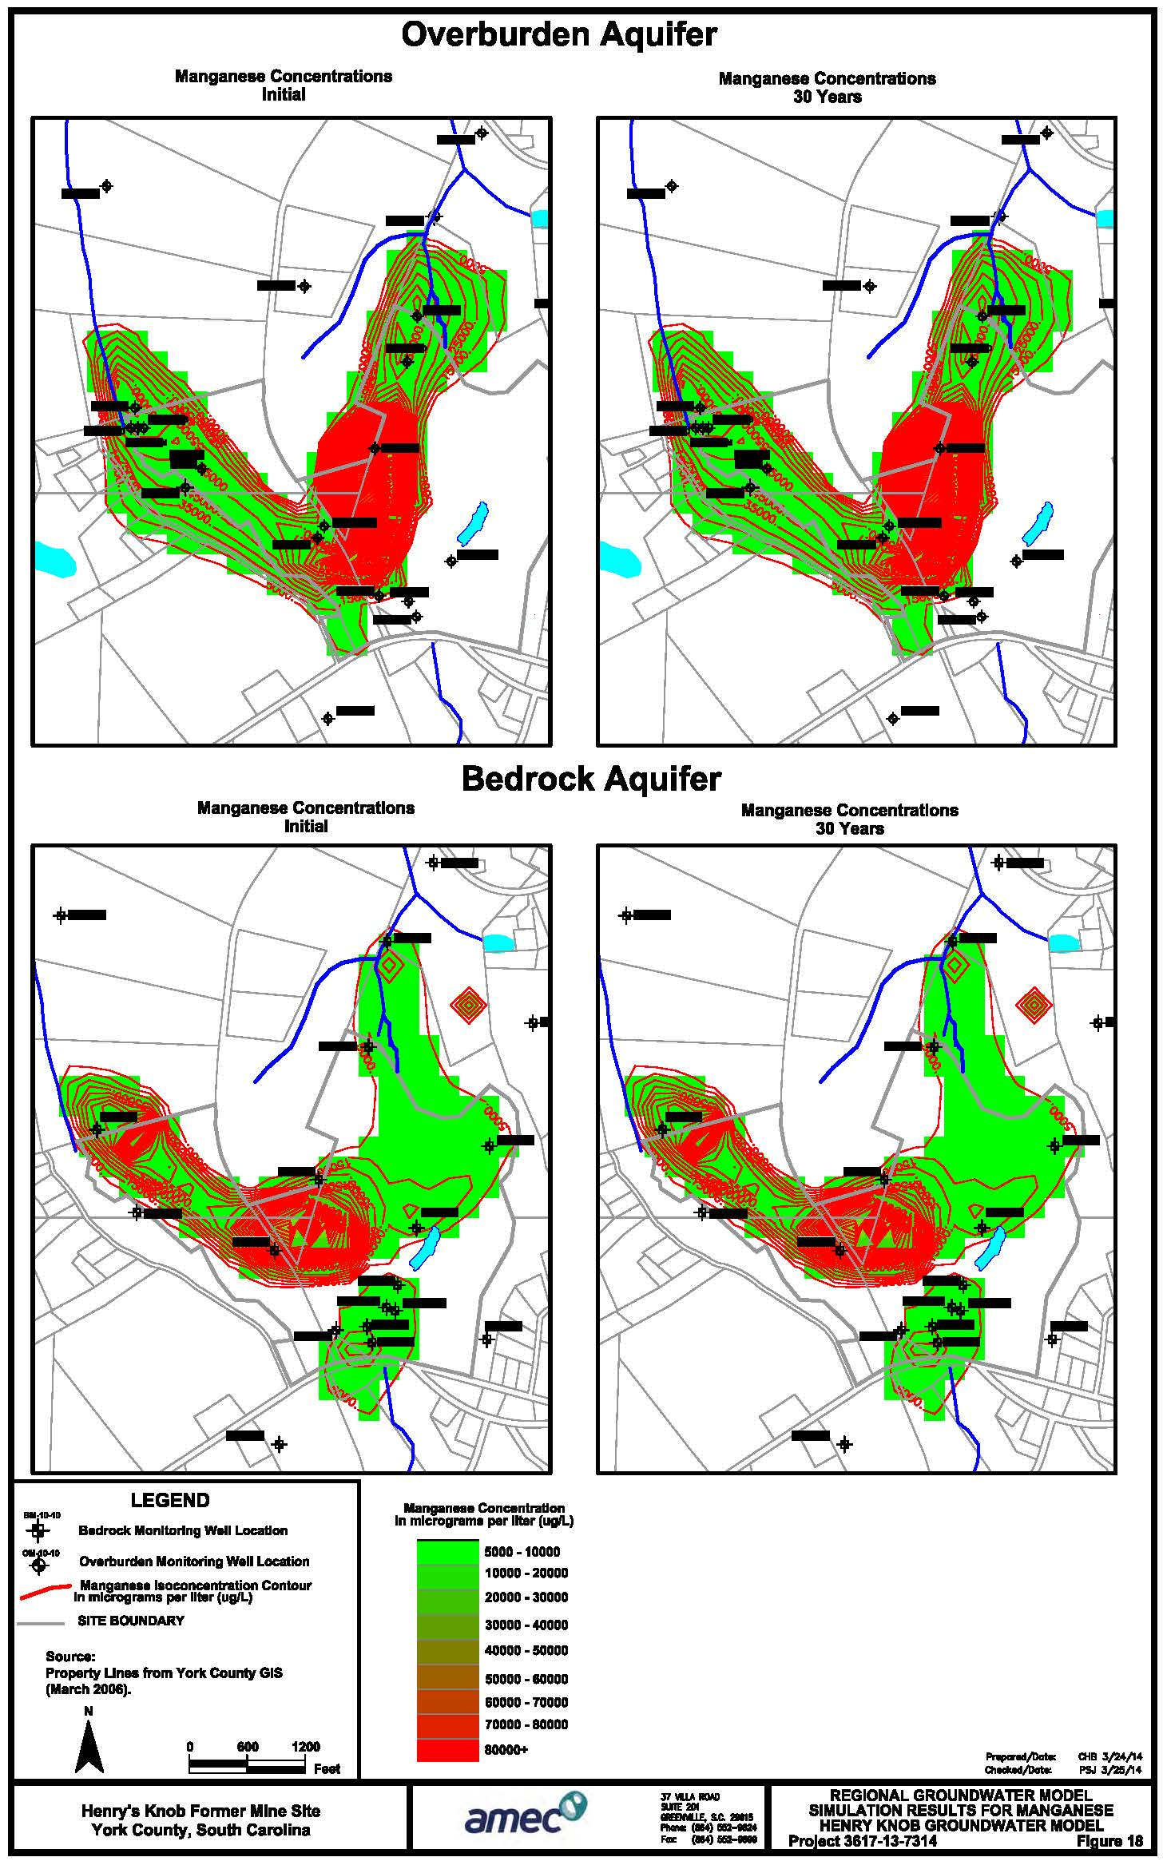
Site Cleanup Regional/Telescoped Groundwater Model
Regional 3D flow model, due to high soil/water partitioning coefficient (Kd) for cobalt and manganese, demonstrated no significant plume migration over 30-year modeling period

Slide 19
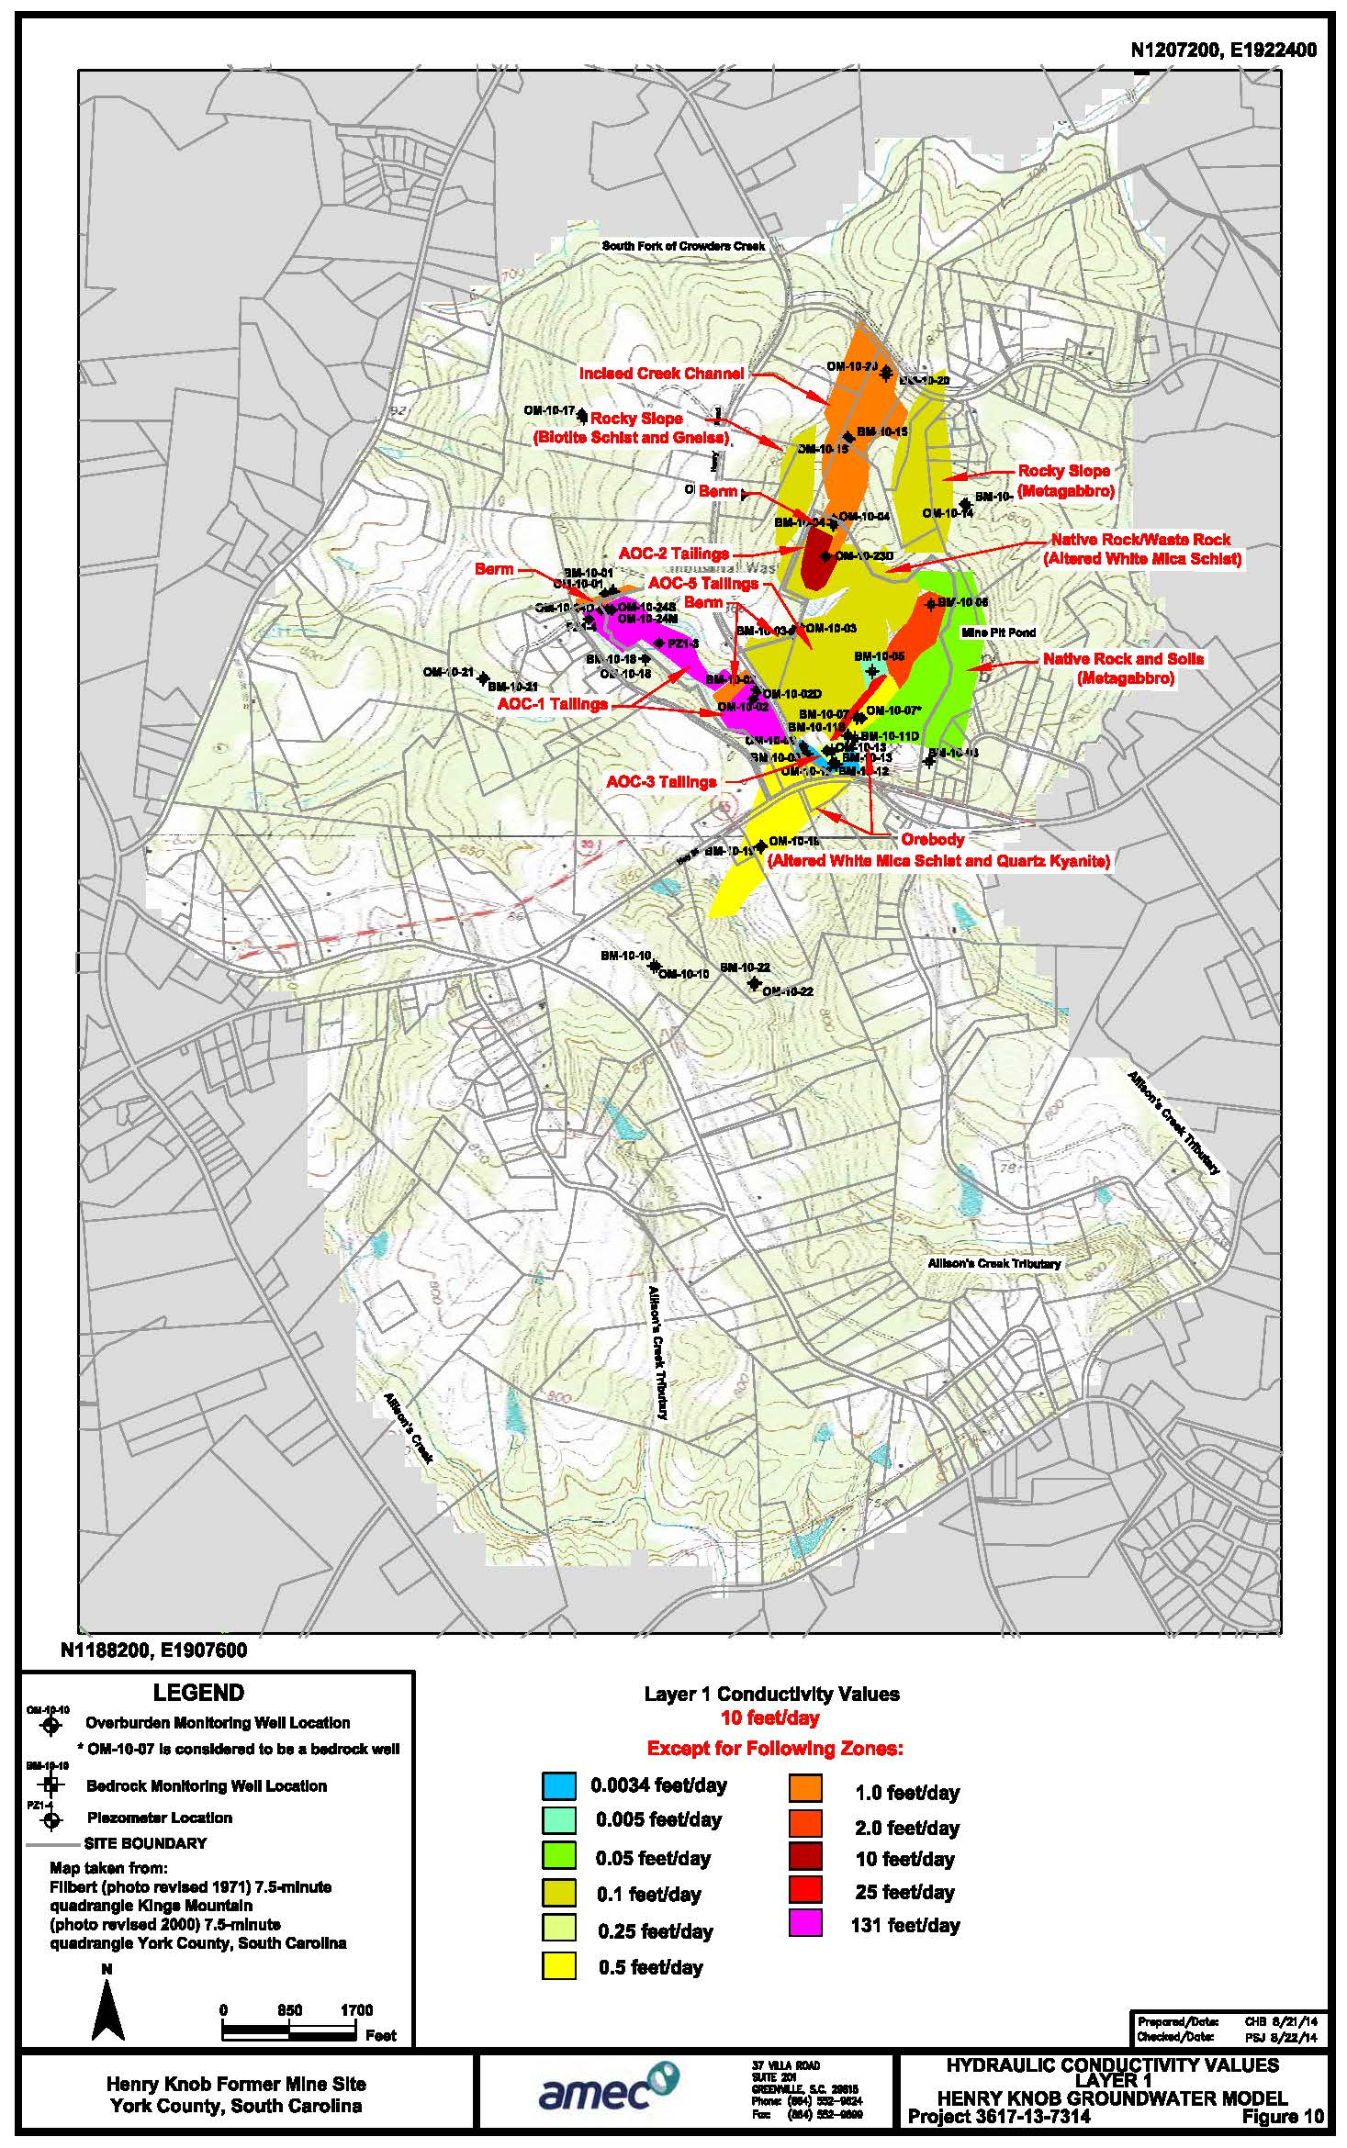
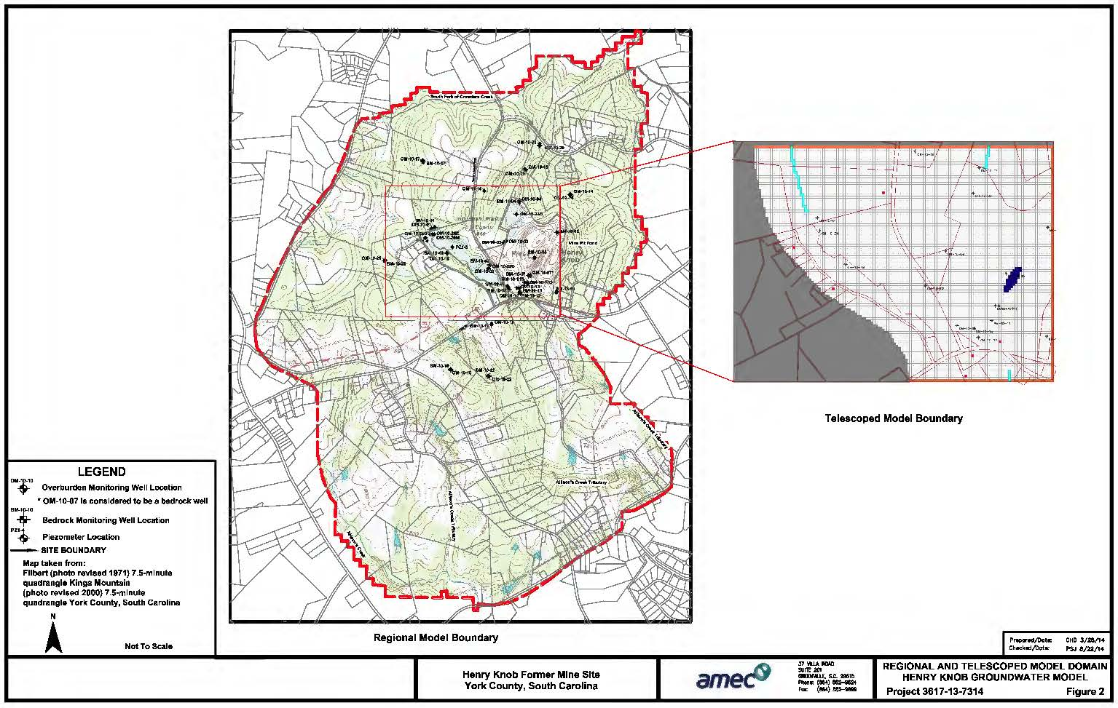
Site Cleanup Regional/Telescoped Groundwater Model
Telescoped models demonstrated pH distribution over the 30-year modeling period for each simulated remedial alternative
Most of impacts noted in Layer 1 (shallow) of model (generally equivalent to overburden)

Slide 20
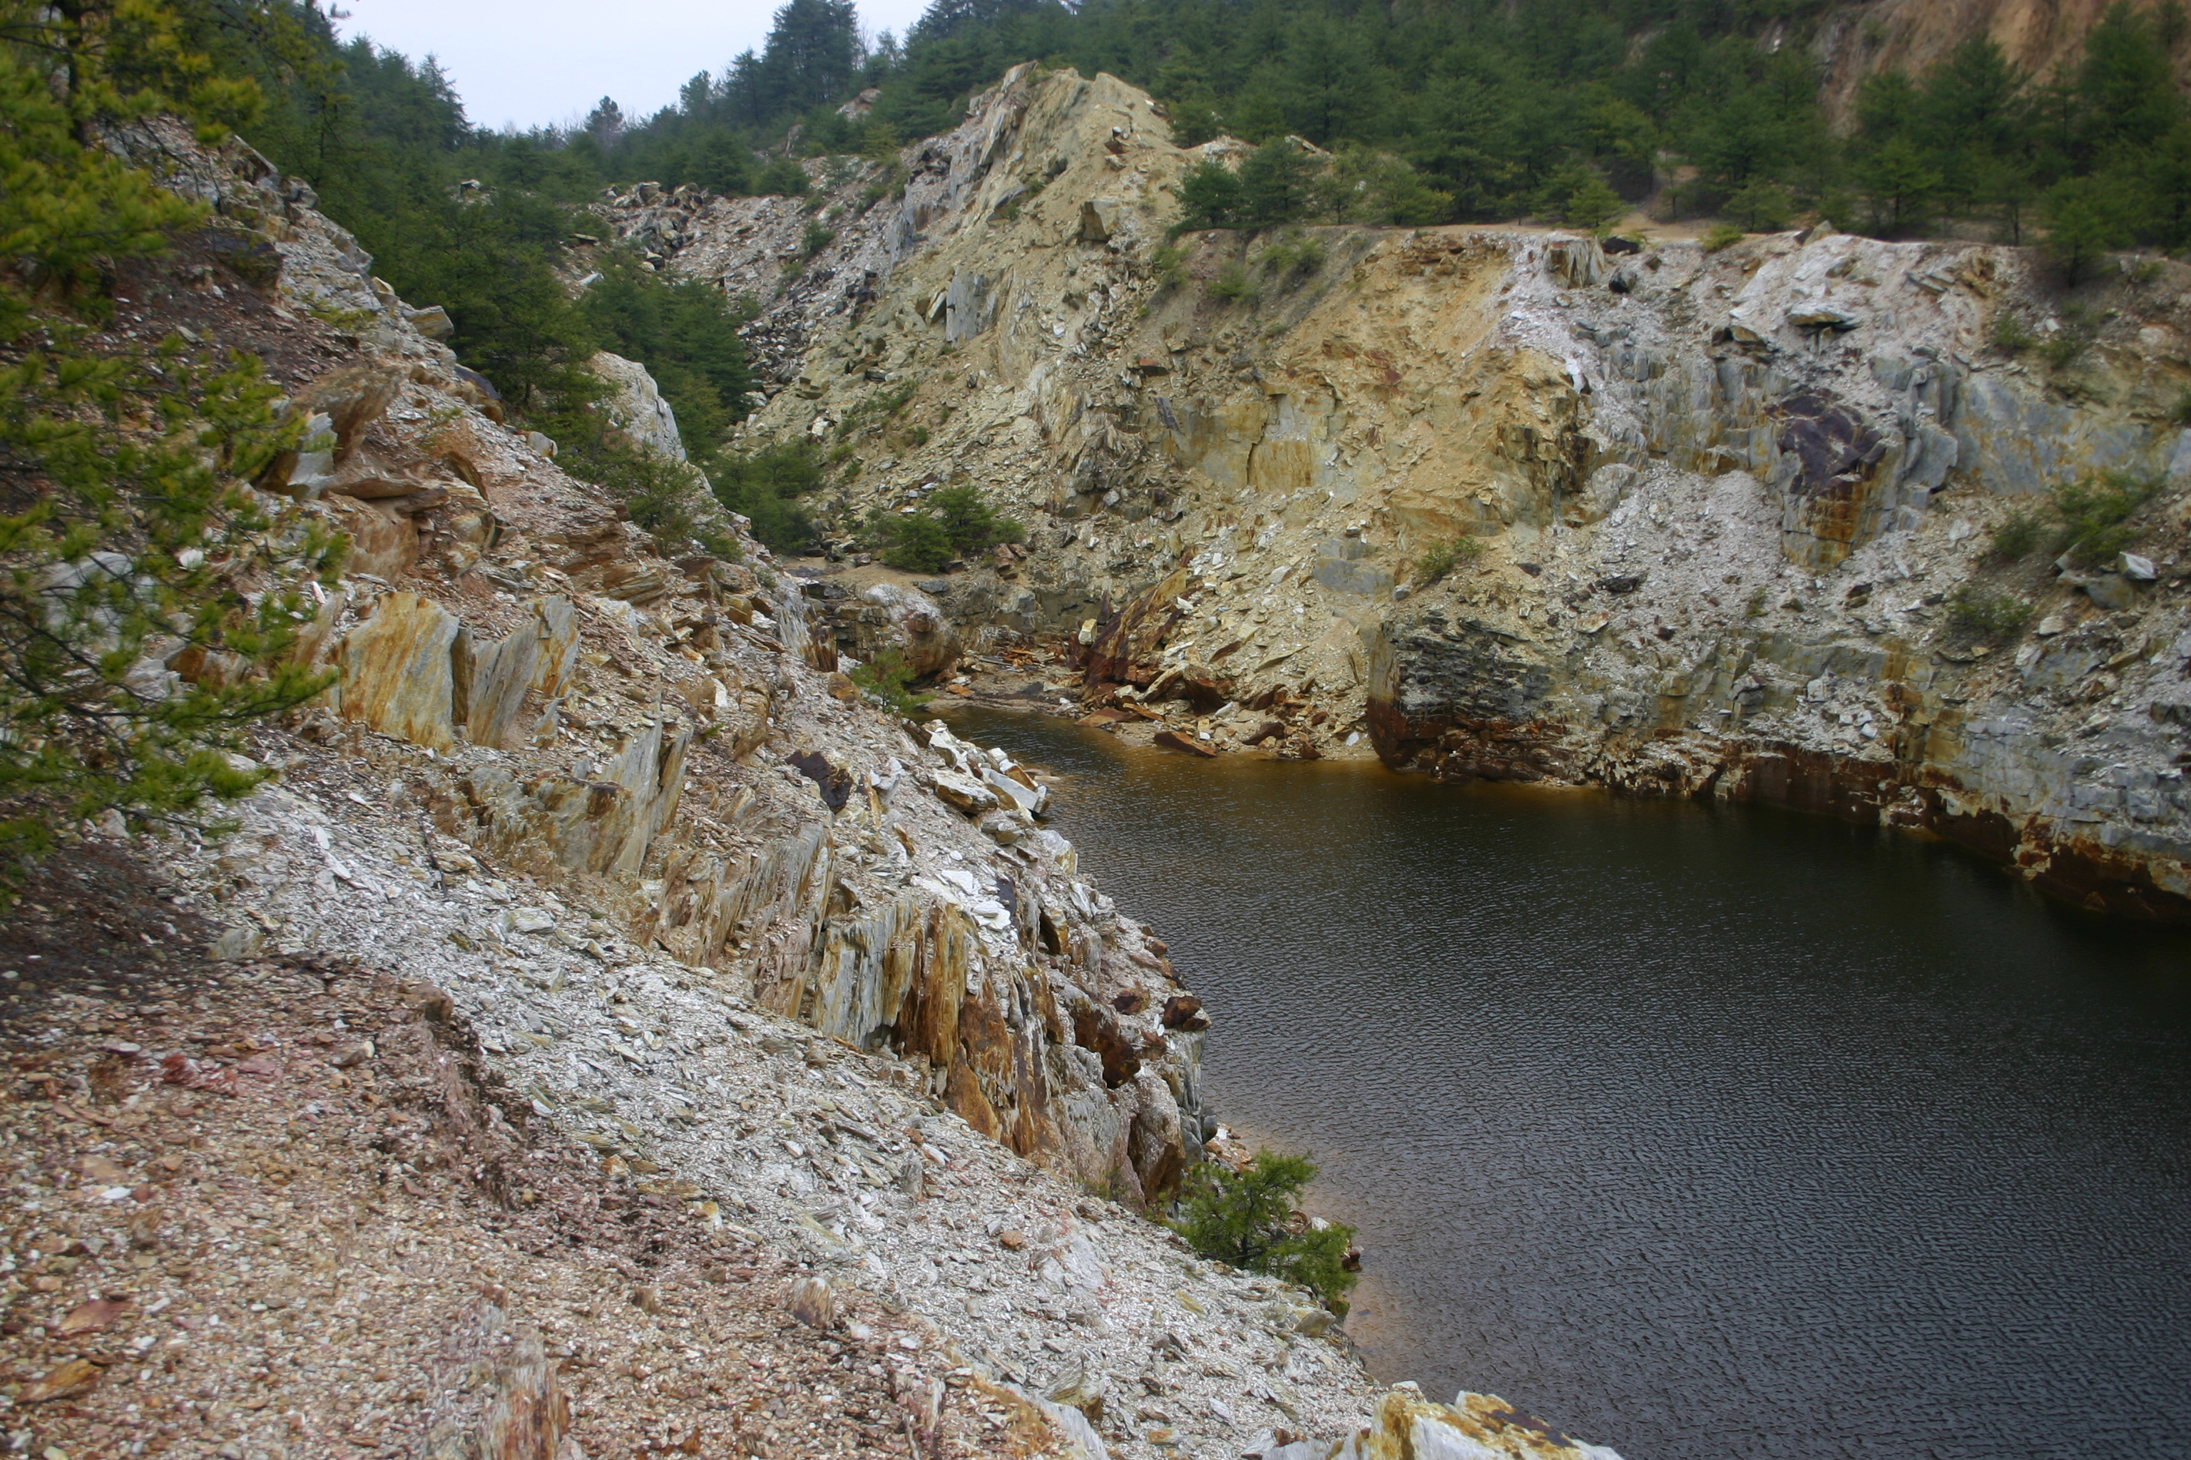
Site Cleanup Regional/Telescoped Groundwater Model
No significant changes in pH for MNA alternative
No significant changes in pH for impermeable cap alternative
Significant improvement in pH over the 30-year modeling period for vegetative cap and excavation alternatives
Due to the relatively high costs for excavation/disposal of the tailings and the increased risk due to vehicular traffic, the installation of a vegetative cover was considered the more feasible alternative
Additional model runs performed to simulate buffering of the water in the MPP indicated some pH improvement, but not enough to overcome the ARD generated from the geology of and surrounding the MPP

Slide 21
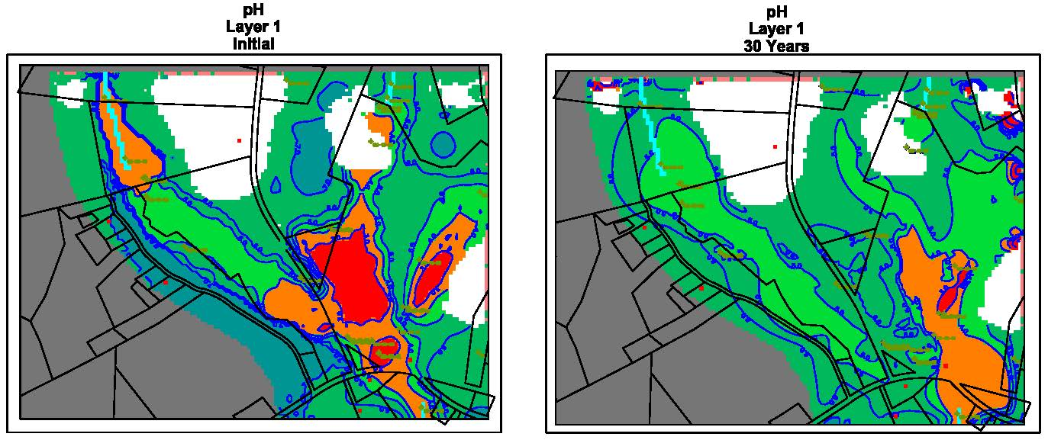
Site Cleanup Regional/Telescoped Groundwater Model
Vegetative Cover

Slide 22
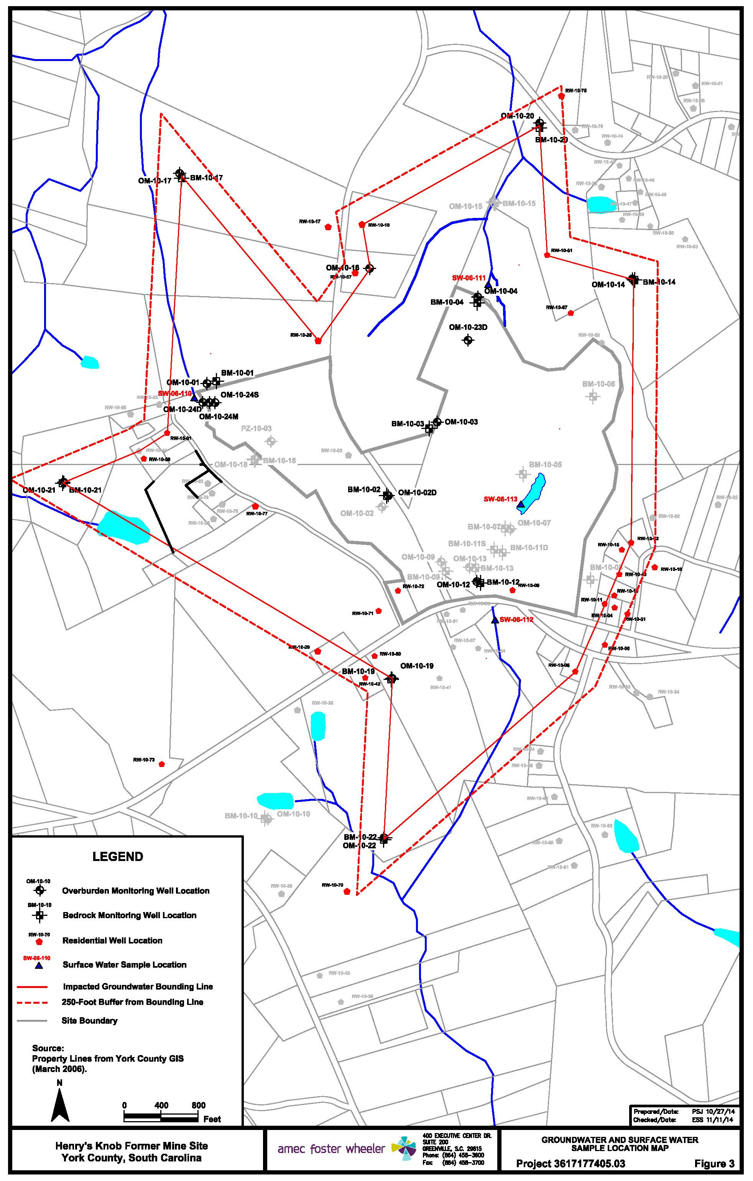
Site Cleanup Groundwater Monitoring Program
Initiated in June 2015
Objectives
Monitor groundwater plume stability in impacted area
Monitor surface water concentrations trends over time
Monitor effectiveness of treatments systems installed as part of Non-Time Critical Removal Action (NTCRA)
Term
Conduct trend analysis on each monitoring point following completion of baseline sampling
Once trend analysis shows metals concentrations are stable or deceasing, monitoring will be terminated

Slide 23
Site Cleanup Groundwater Monitoring Program
Locations monitored in the program
Bounding wells (defines the extent of groundwater impacted by AMD)
7 overburden monitoring wells and 6 bedrock monitoring wells
8 private water supply wells
Interior wells (within area of AMD-impacted groundwater)
9 overburden monitoring wells and 5 bedrock monitoring wells
40 private water supply wells
Surface water locations
Headwaters of West Tributary, East Tributary, and Allison Creek Tributary
MPP
Baseline Sampling
All wells and surface water locations
Quarterly for two years
Baseline completed in first quarter of 2017

Slide 24
Site Cleanup Groundwater Monitoring Program
Subsequent Sampling
Bounding monitoring wells, bounding private wells, interior monitoring wells, and interior private wells with metals concentrations below the Remedial Goals (RG) sampled annually
Interior wells with metals concentrations above the RG sampled semi-annually
Problems encountered due to lack of access
15 private wells (3 bounding and 12 interior) could not be sampled due to lack of access from owner
Access obtained for 13 of the 15 wells in second/third quarters of 2017
Wells will be sampled quarterly for two years unless otherwise abandoned
Remaining two wells will not be sampled due to continued lack of access from property owners

Slide 25
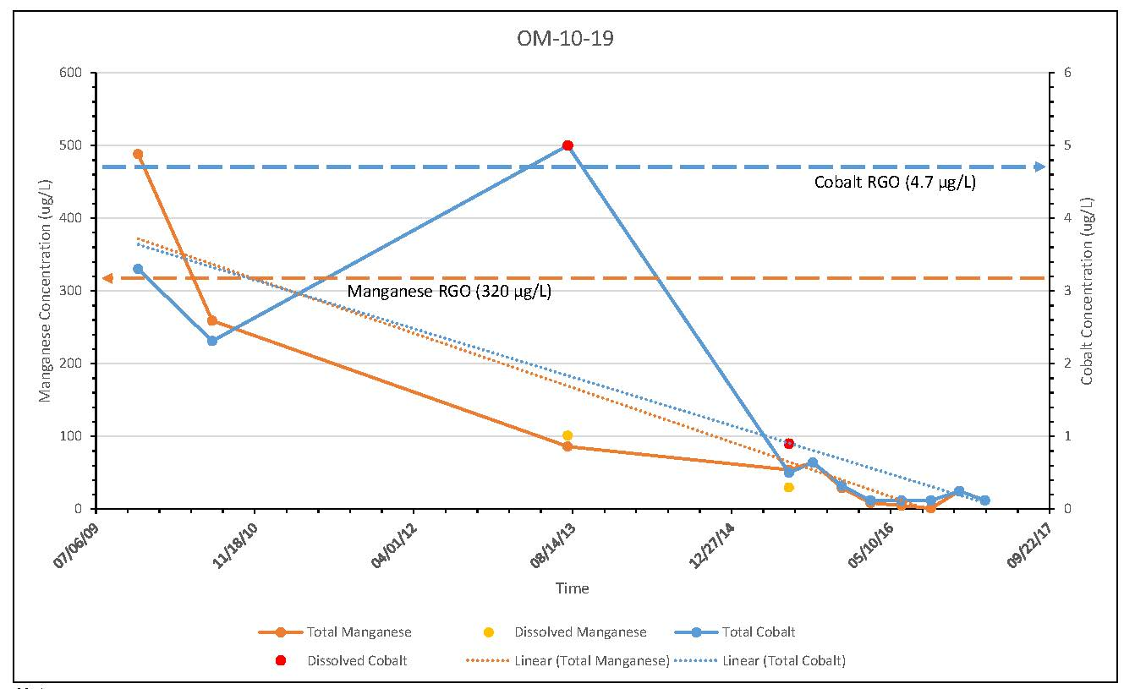
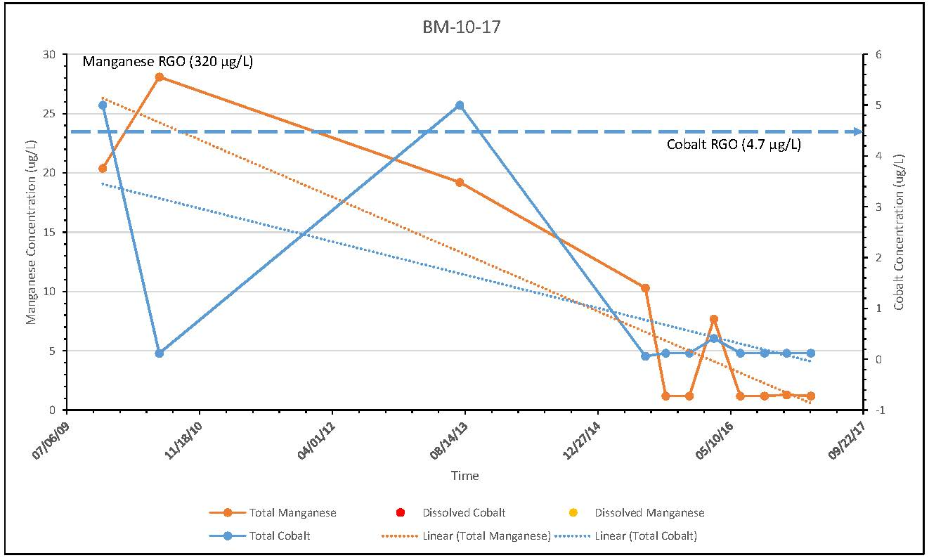
Site Cleanup Groundwater Monitoring Program
Trend Analyses
Bounding Wells
Decreasing cobalt concentrations in overburden, bedrock, and private wells
Decreasing manganese concentrations overburden wells
Decreasing manganese concentrations in over half of bedrock and private wells
Wells with increasing manganese concentrations have relatively neutral pH (not indicative of AMD), are significantly below RG for manganese and in many cases, below the secondary maximum contaminant level (SMCL) for manganese
Interior Wells
Generally decreasing trends for cobalt except where evidence of AMD-impacts noted
Generally decreasing trends for manganese

