Slide 1
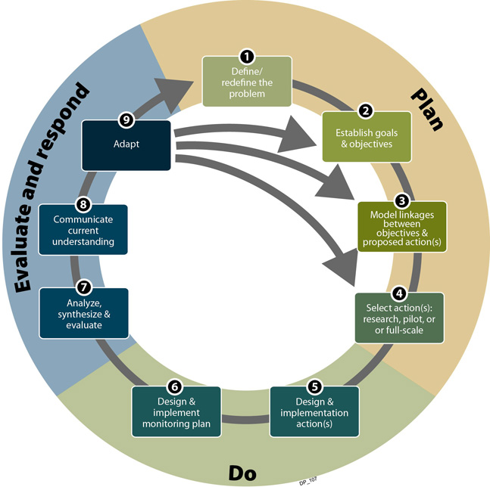
Adaptive Management Approach
  Consultation with USEPA & SCDHEC to implement an Adaptive Management Approach
    Media-specific remedies implemented in steps and evaluated
    A step-wise approach to design and implement technically appropriate and cost effective remedial actions

Slide 2
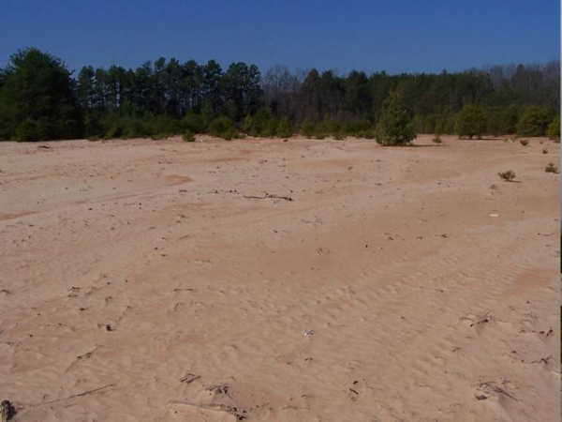
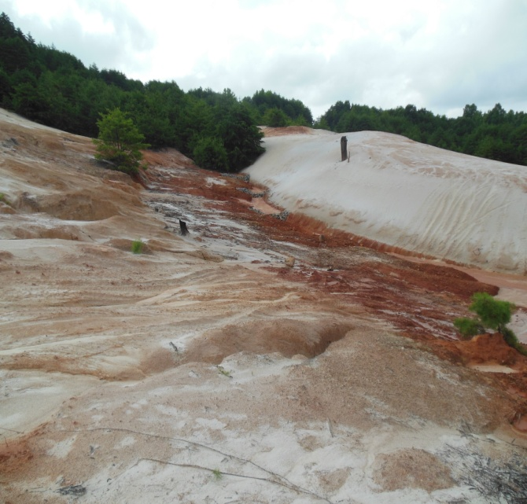
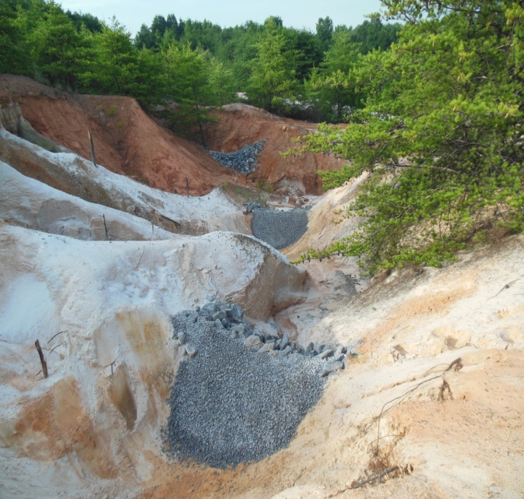
Define Problem and Establish Goals/ Objectives
  Problem:
  Erosion of tailings and tailings acting as a source to acid mine drainage (AMD) to groundwater and surface water near the Site.
  Objectives:
  Promote evapotranspiration to reduce infiltration through tailings
  Stabilize tailings and impoundment features to prevent erosion
  Address visual eyesore

Slide 3
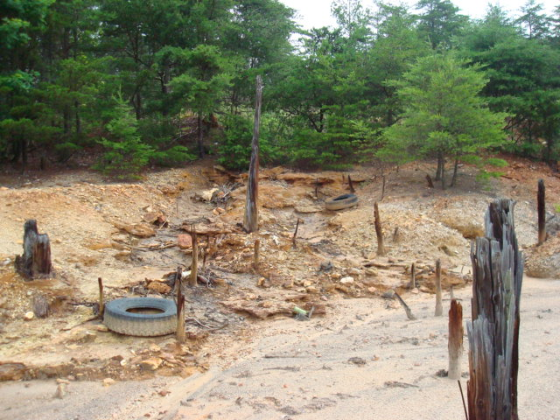
Select Actions
  Pre-Construction Existing Conditions
  AOC 1,2, and 5 tailings mostly silica sand
  AOC 3 (former pyrite storage area) tailings larger sized waste rock
  0% organic matter content
  pH of 2-2.5 standard units
  No plant available nutrients
  Highly susceptible to erosion from wind and stormwater
  Periodic deposition of mine tailings onto public ROWs
  Variations in site topography from relatively flat tailings impoundments to steep undulating slopes
  Deeply incised stormwater erosion channels
  Impoundment dams not maintained (erosion breaches and large tree growth)
  Actions
  Establish Vegetative Cover as Source Control
    Promote evapotranspiration to reduce infiltration through the tailings (mitigate a major AMD source)
    Increase organic matter content and pH of the shallow tailings so that revegetation can occur
    Establish Stabilized Stormwater Drainage Conveyance Channels
    Control surface run-off (mitigate erosion/sedimentation impacts from stormwater)
    Rehabilitate Tailings Impoundment Dams
    Implement stability measures (mitigate breaches)
    Establish acceptable factors of safety (long-term steady state and seismic conditions)

Slide 4
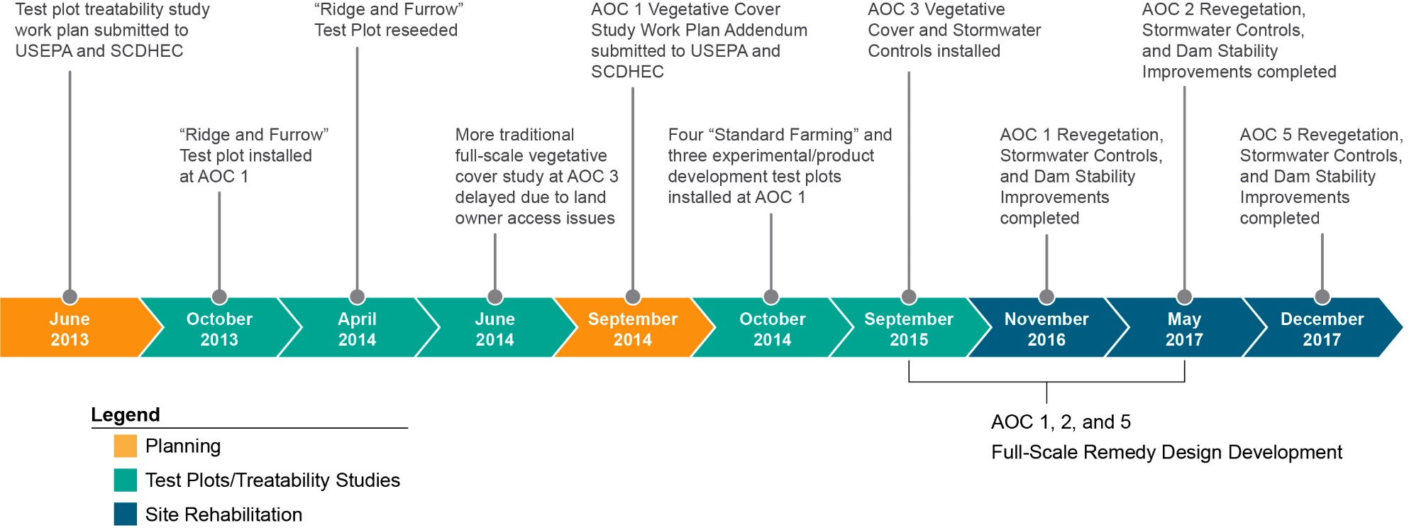
Vegetative Cover Study and Site Revitalization Timeline

Slide 5
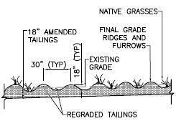
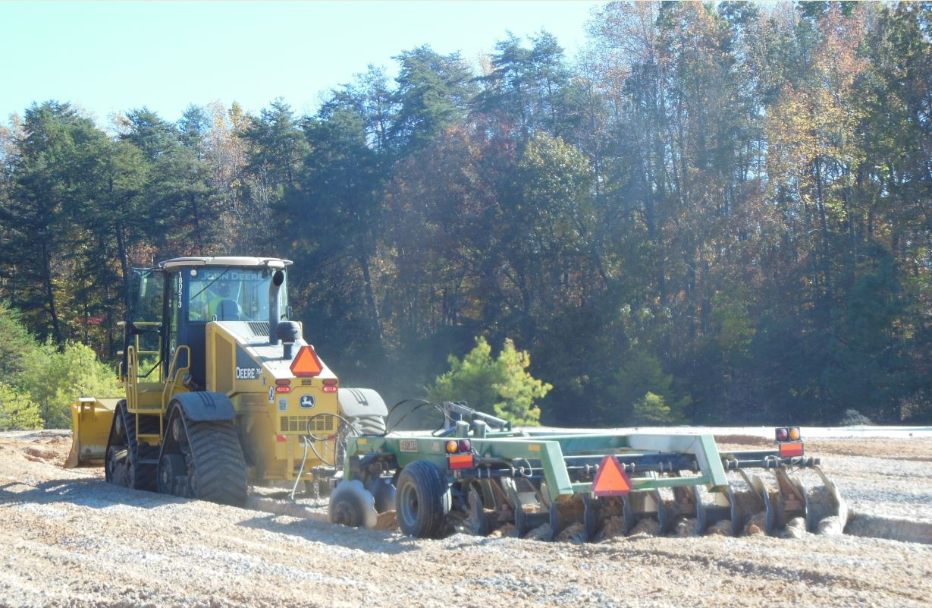
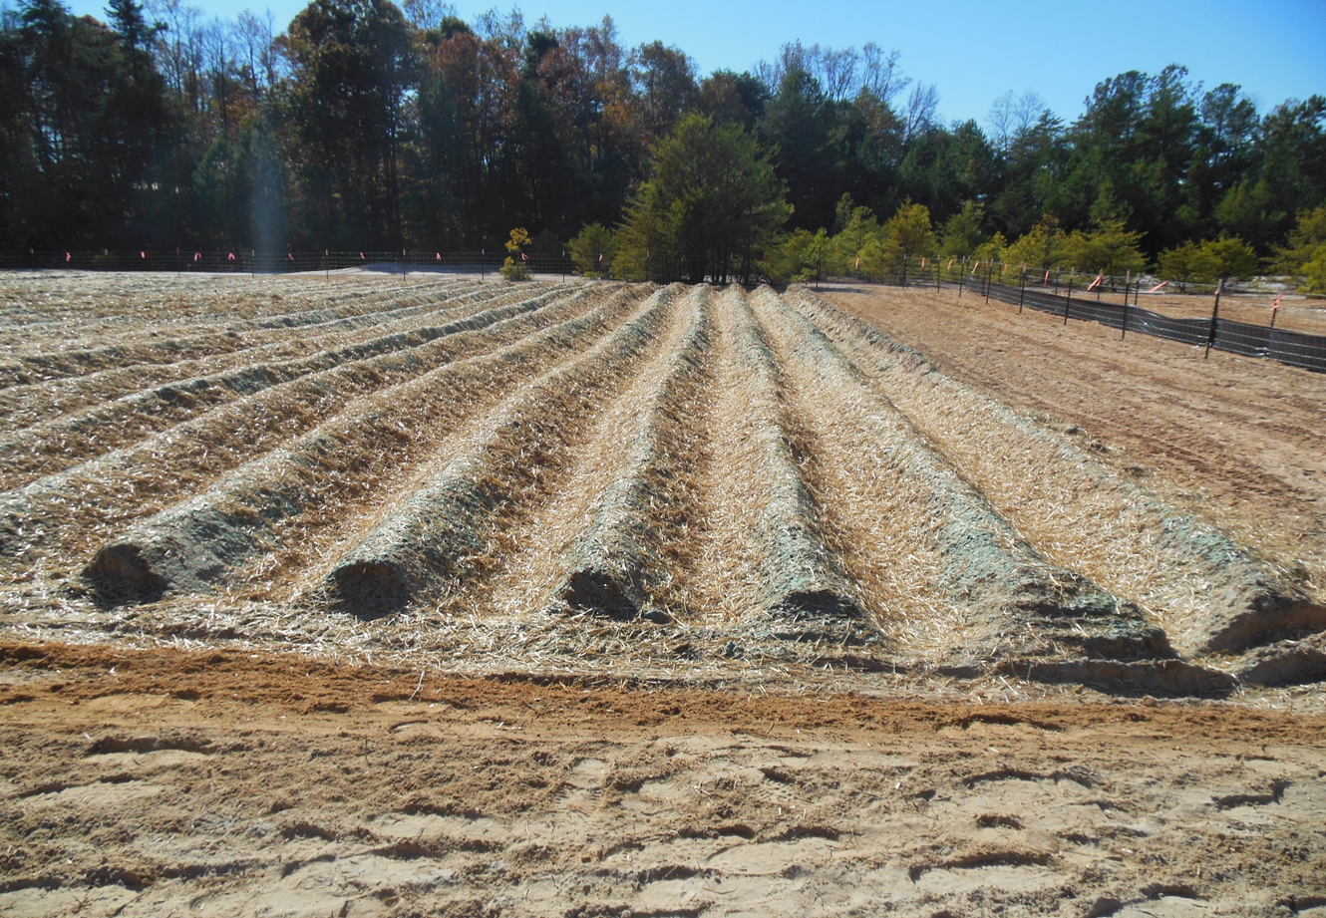
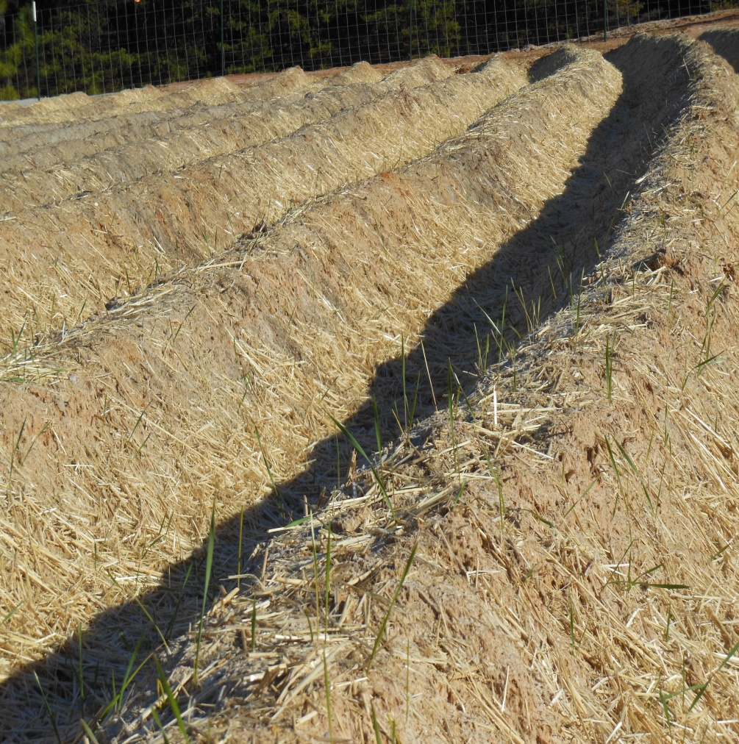
Select Actions – Pilot Study
(Ridge and Furrow Technique)
  Client had successful experience with revegetation at
  another kyanite mine site
  Approach for Henry Knob was to pilot-test vegetative pilot
  study using similar methods
    Develop organic layer (wheat straw) to minimize wicking of
    acidic groundwater to the root zone
    Add alkaline material (limestone) to neutralize acidity
    Recontour tailings with ridges and furrows to promote leaching
    of the surface acidity from the ridges and accumulation of rainfall in the furrows
    Incorporate fertilizer (standard 10-10-10) and native seed mixtures to provide short term and long term reclamation
    Apply surface layer of mulch (wheat straw) and agricultural tackifier to slow moisture evaporation

Slide 6
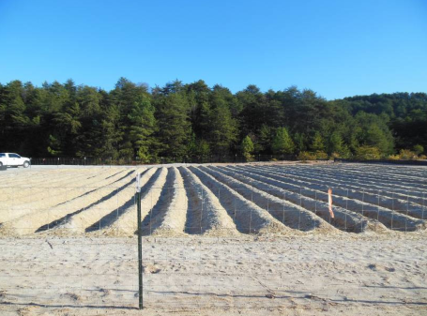
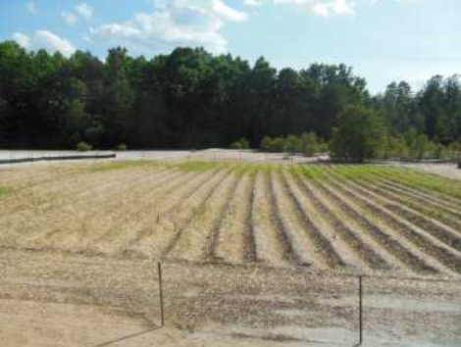
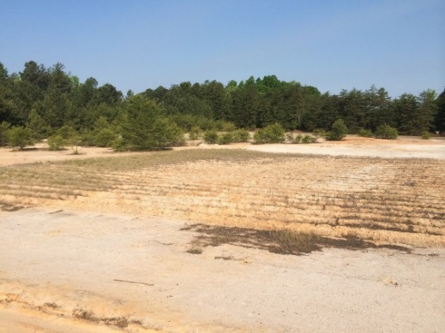
Select Actions – Pilot Study
(Ridge and Furrow Technique) Continued
  Ridge and Furrow Test Plot installed fall 2013
  Not successful, plot abandoned in 2015
December 2013
May 2014
April 2015
  Ridge and Furrow Test Plot Lessons Learned
  Depth to groundwater considered a key difference between the Henry Knob Site and other site where ridge and furrow technique was successful
  Organic material application rate too low
  Use of hydroseeding methods not believed to be effective

Slide 7
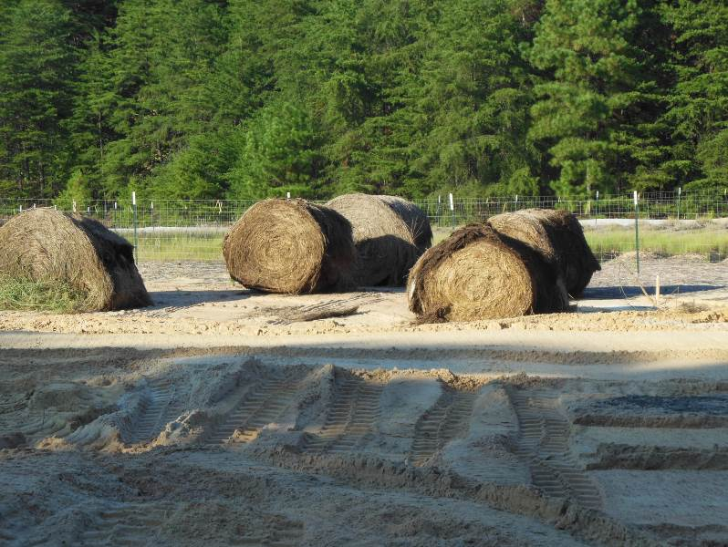
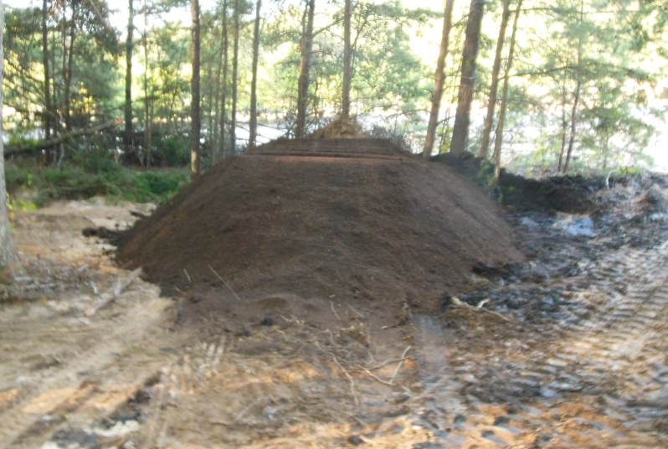
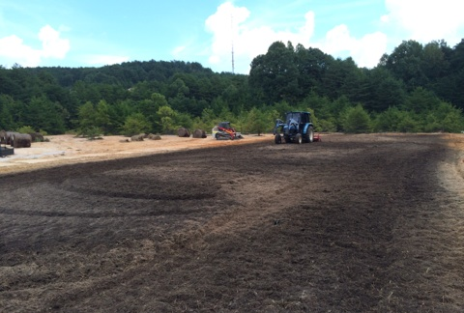
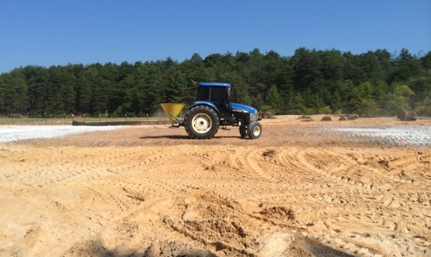
Select Actions – Pilot Study
(Standard Farming)
  Back to basics – keep it simple, keep it sustainable
  Relied upon Amec Foster Wheeler personnel with agricultural
  backgrounds and outreach to the local farming community
  Standard Farming approach
    Eliminate ridge and furrow technique
    Utilize a traditional farm tractor and PTO driven rototiller
    Use of leaf compost to introduce organic matter
    Use of turkey/hen and horse manure
    Increase seed application rate
    Use mechanical seeding in lieu of hydroseeding
    Incorporate a garden type, high calcium, hydrated lime for immediate and short-term pH buffering of acidic soil
    Test the application of a commercial soil supplement to modify soil textural properties
    Test the application of a water retention agent (horticultural product)
    Increase surface mulch (wheat straw) application rate

Slide 8
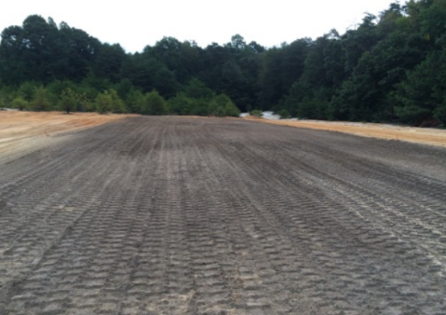
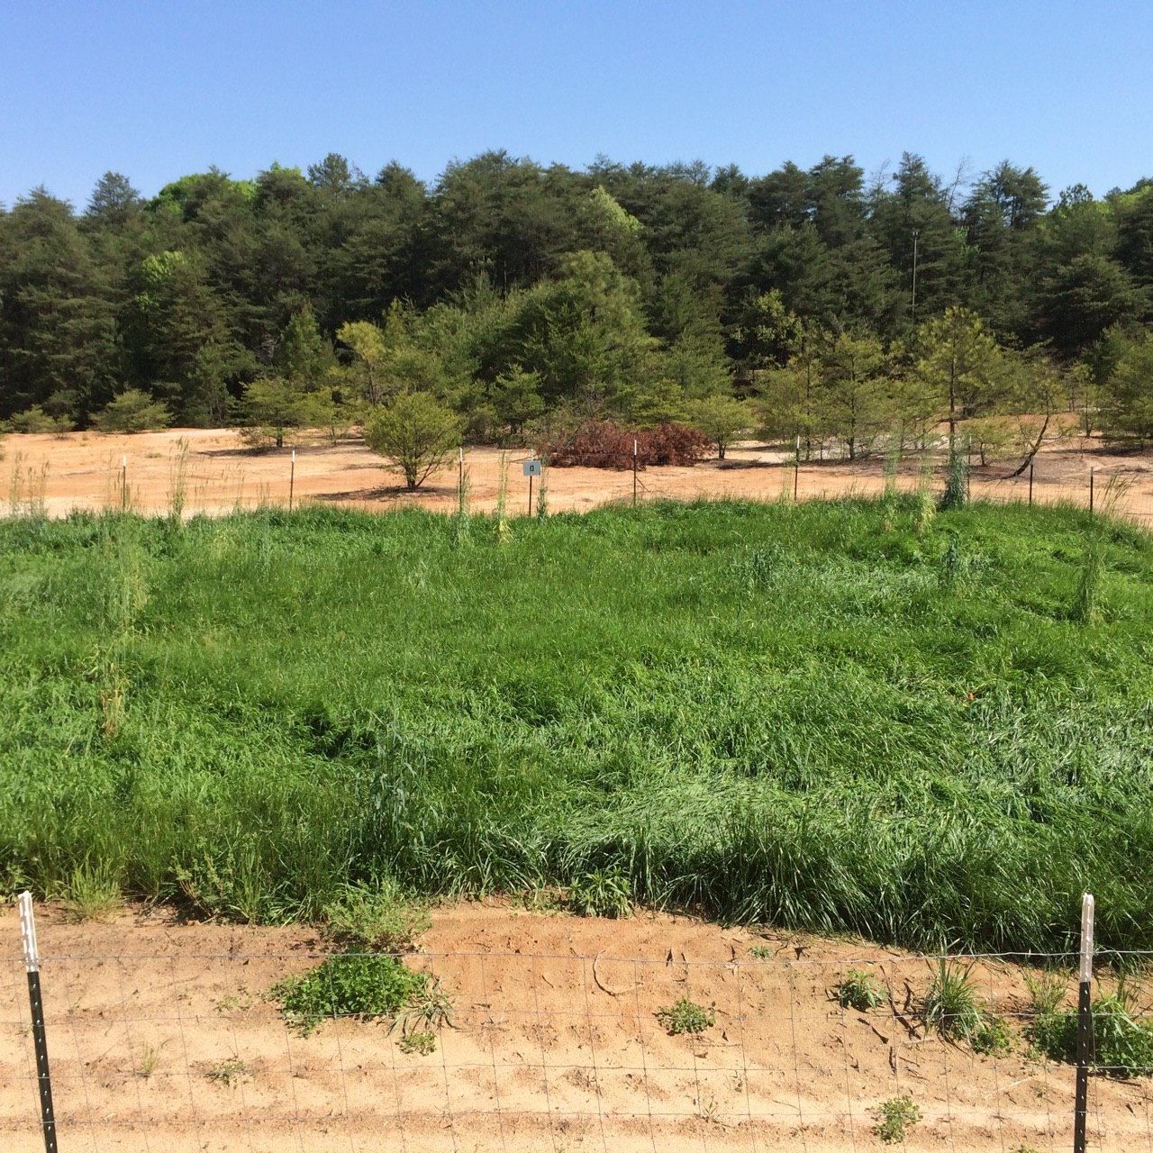
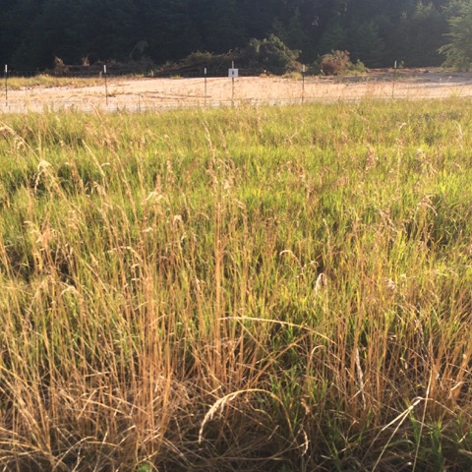
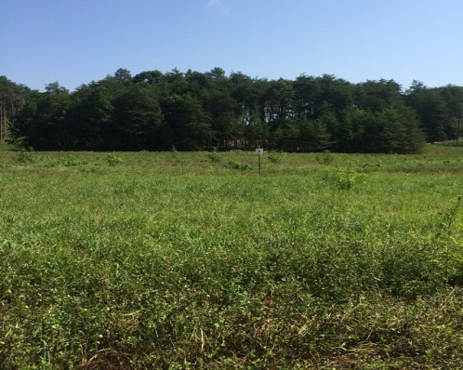
Select Actions – Pilot Study
(Standard Farming Technique) Continued
  Standard Farming Test Plot installed fall 2014
  Very successful, carried to full scale design for AOC 1, 2, and 5
October 2014
June 2015
June 2016
JPH, left off here
  Standard Farming Test Plot Lessons Learned
  Local knowledge and resources important to selecting appropriate materials
  Amend existing tailings to minimize material import quantities
  Mechanical seeding effective
  Reduce agricultural lime application rate
  Increased organic matter content critical
July 2017

Slide 9
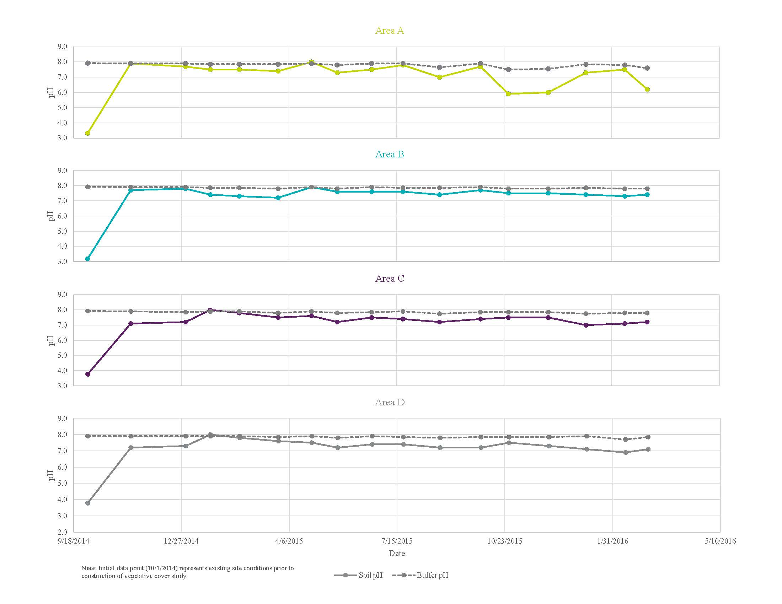
Select Actions – Pilot Study
(Standard Farming Technique) Continued
Standard Farming Technique - Soil pH Results

Slide 10
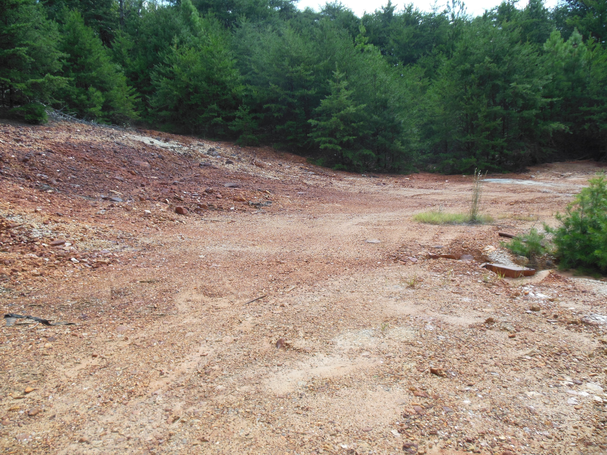
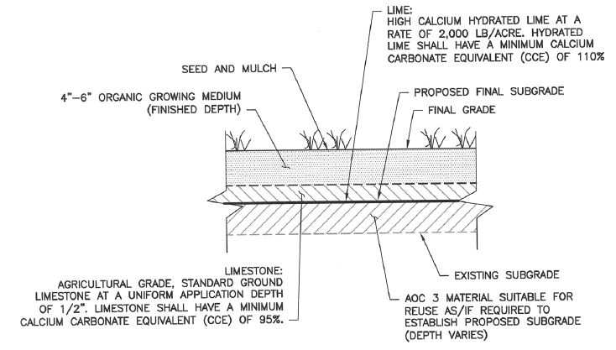
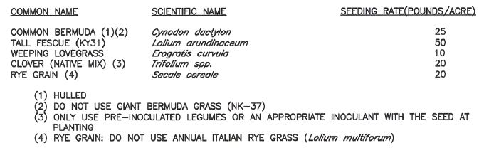
Select Actions – Pilot Study
(AOC 3 Vegetative Cover)
Completed September 2015 and included:
  Construction of a vegetative cover
  Stormwater drainage channel/controls
Materials used during construction:
  650 tons of rip rap (channels)
  600 cubic yards growing medium (leaf compost)
  25 tons of lime
  750 pounds of fertilizer
  90 pounds of grass seed mix
Challenges:
  Site access constraints
  Location of nearby residence
  Physical properties of tailings/material
  Working within ROW of SC Highway 55
Lessons learned:
  AOC 3 material properties are unlike other tailings (additional application of growing medium required)
  Incorporate stormwater controls/channel in designs
  Leaf compost sources and variations in product

Slide 11
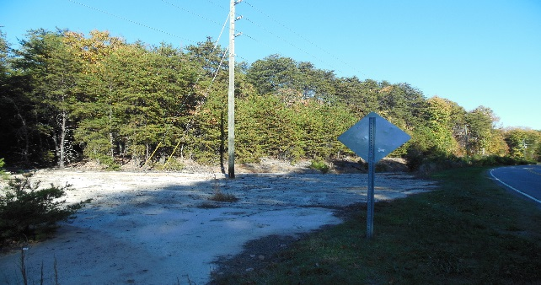
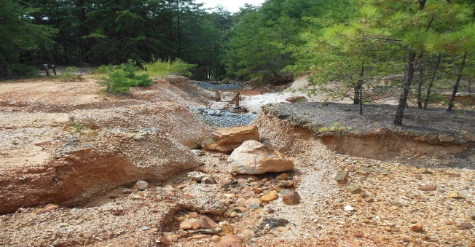
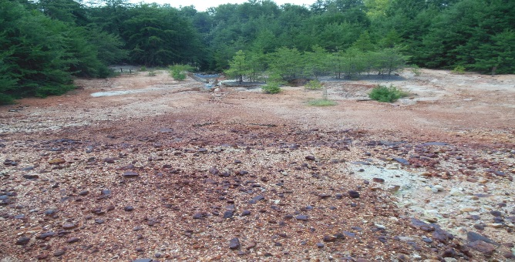
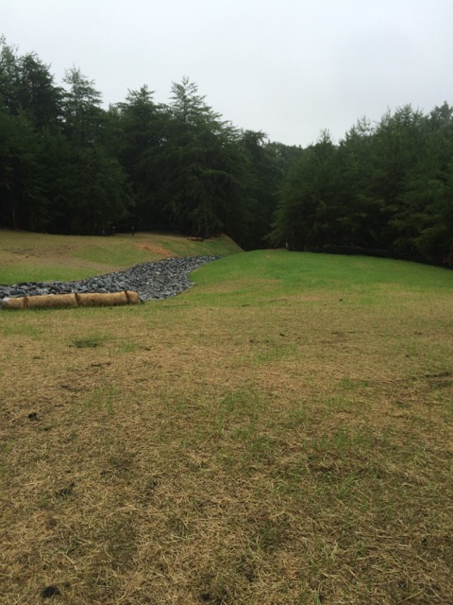
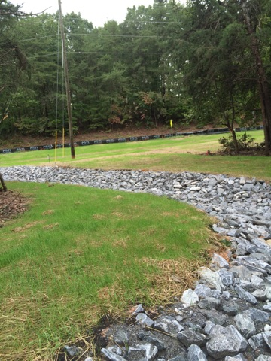
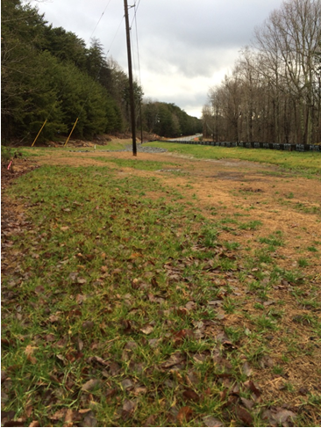
Select Actions – Pilot Study
(AOC 3 Vegetative Cover) Continued
AOC 3 Pre-Construction (2013)
October 2015 (2 weeks after seeding)
February 2016

Slide 12
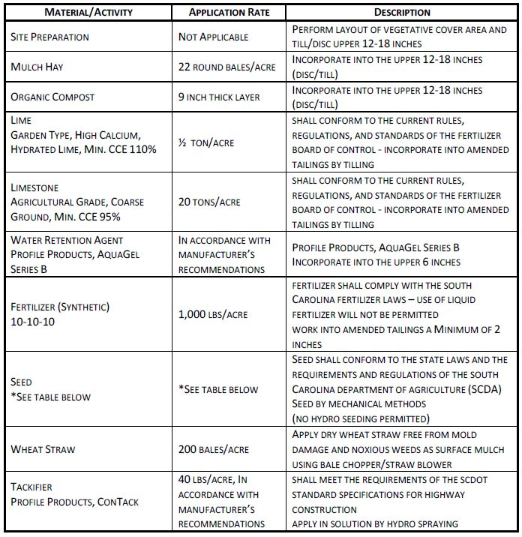
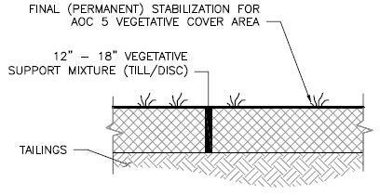
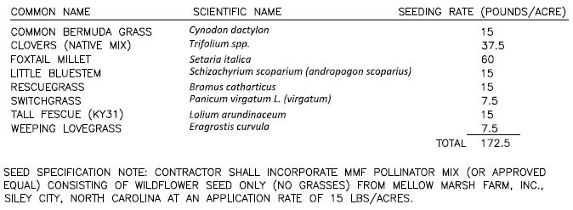
Select Actions
Transition to Full-Scale Remedy
Full Scale Remedy Selection
  A Process of Refinement
    Review results of initial monitoring and analyses
    Continue outreach to the local community
    Further assessment of available products and innovative technologies
    Look for system optimization opportunities
    Consider long-term sustainability and minimization of maintenance requirements
  Incorporation of sitewide drainage channel and dam stability improvements
  Substitution of leaf matter and manure with locally sourced, plant based, food scrap and leaf compost
  Inclusion of pollinator / wildflower seed mix
Full Scale Remedy Selection
A Process of Refinement
  Review results of initial monitoring and analyses
  Continue outreach to the local community
  Further assessment of available products and innovative technologies
  Look for system optimization opportunities
  Consider long-term sustainability and minimization of maintenance requirements
Incorporation of sitewide drainage channel and dam stability improvements
Substitution of leaf matter and manure with locally sourced, plant based, food scrap and leaf compost
Inclusion of pollinator / wildflower seed mix

Slide 13
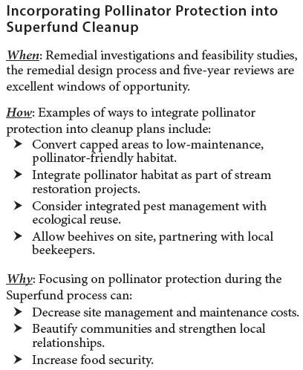
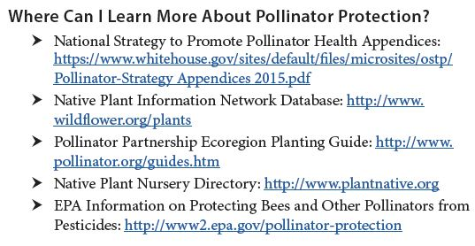
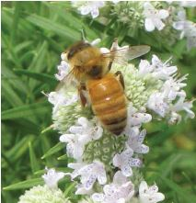
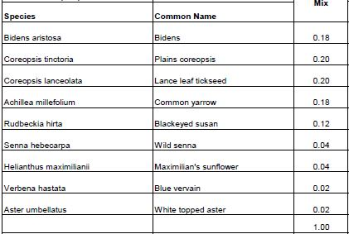
Select Actions
Transition to Full-Scale Remedy

Slide 14
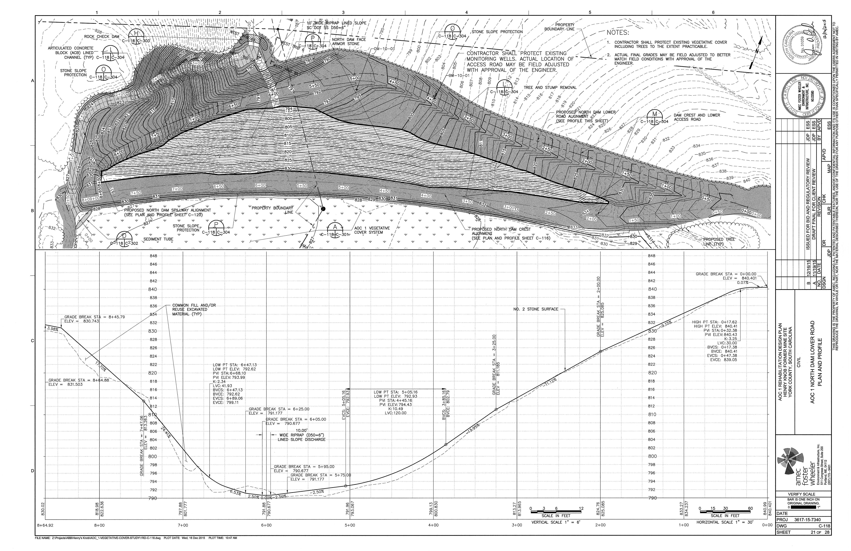
Design and Implement Actions
Transition to Full-Scale Remedy
Full-Scale Remedy Design Development for AOCs 1, 2, and 5
  September 2015 thru May 2017

Slide 15
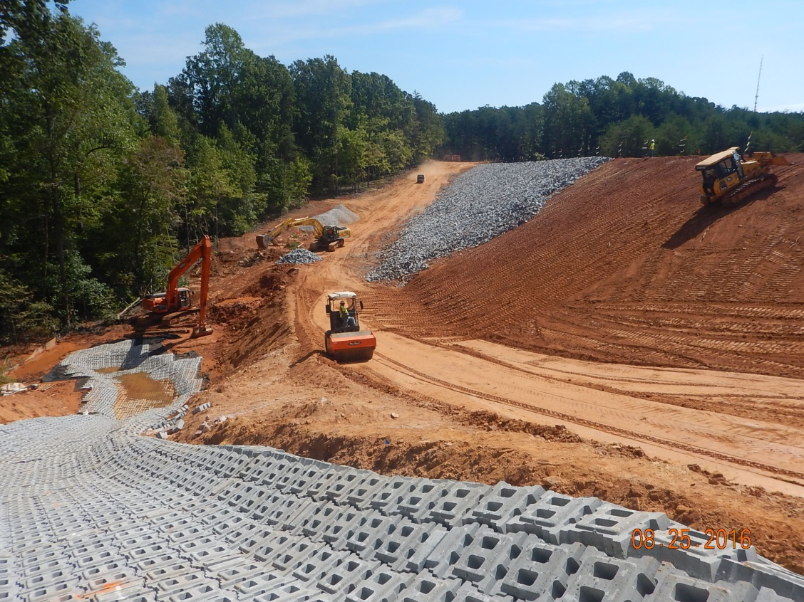
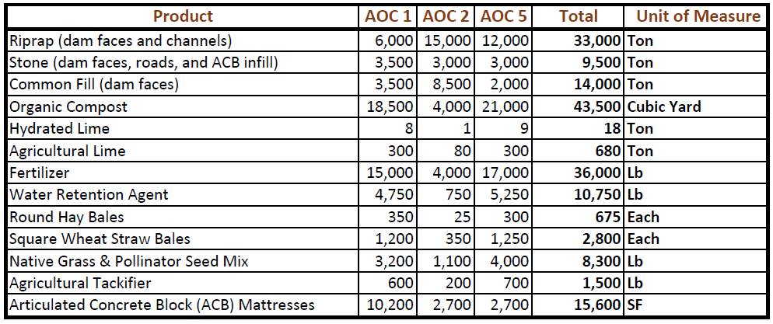
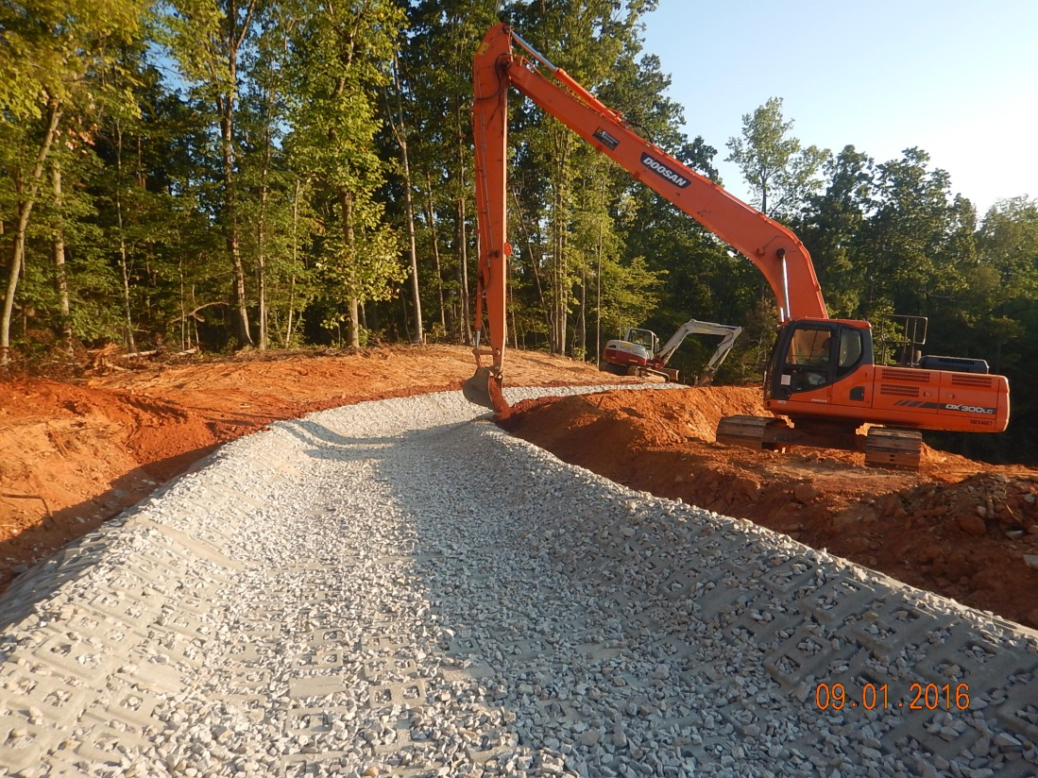
Design and Implement Actions
Transition to Full-Scale Remedy
  Sitewide Rehabilitation and Revitalization (AOC 1, 2, and 5)
    September 2015 thru December 2017 (design/construct)
  Rehabilitation of 65 +/- acres included:
    Construction of stormwater controls (grading and drainage improvements and permanent stabilization of channels)
    Dam stability improvements (removal of existing woody vegetation, grading, armoring of the dam surface, and installation of inclinometers to monitor slope stability
    Construction of a vegetative cover (incorporated into the top 18 inches of the tailings)

Slide 16
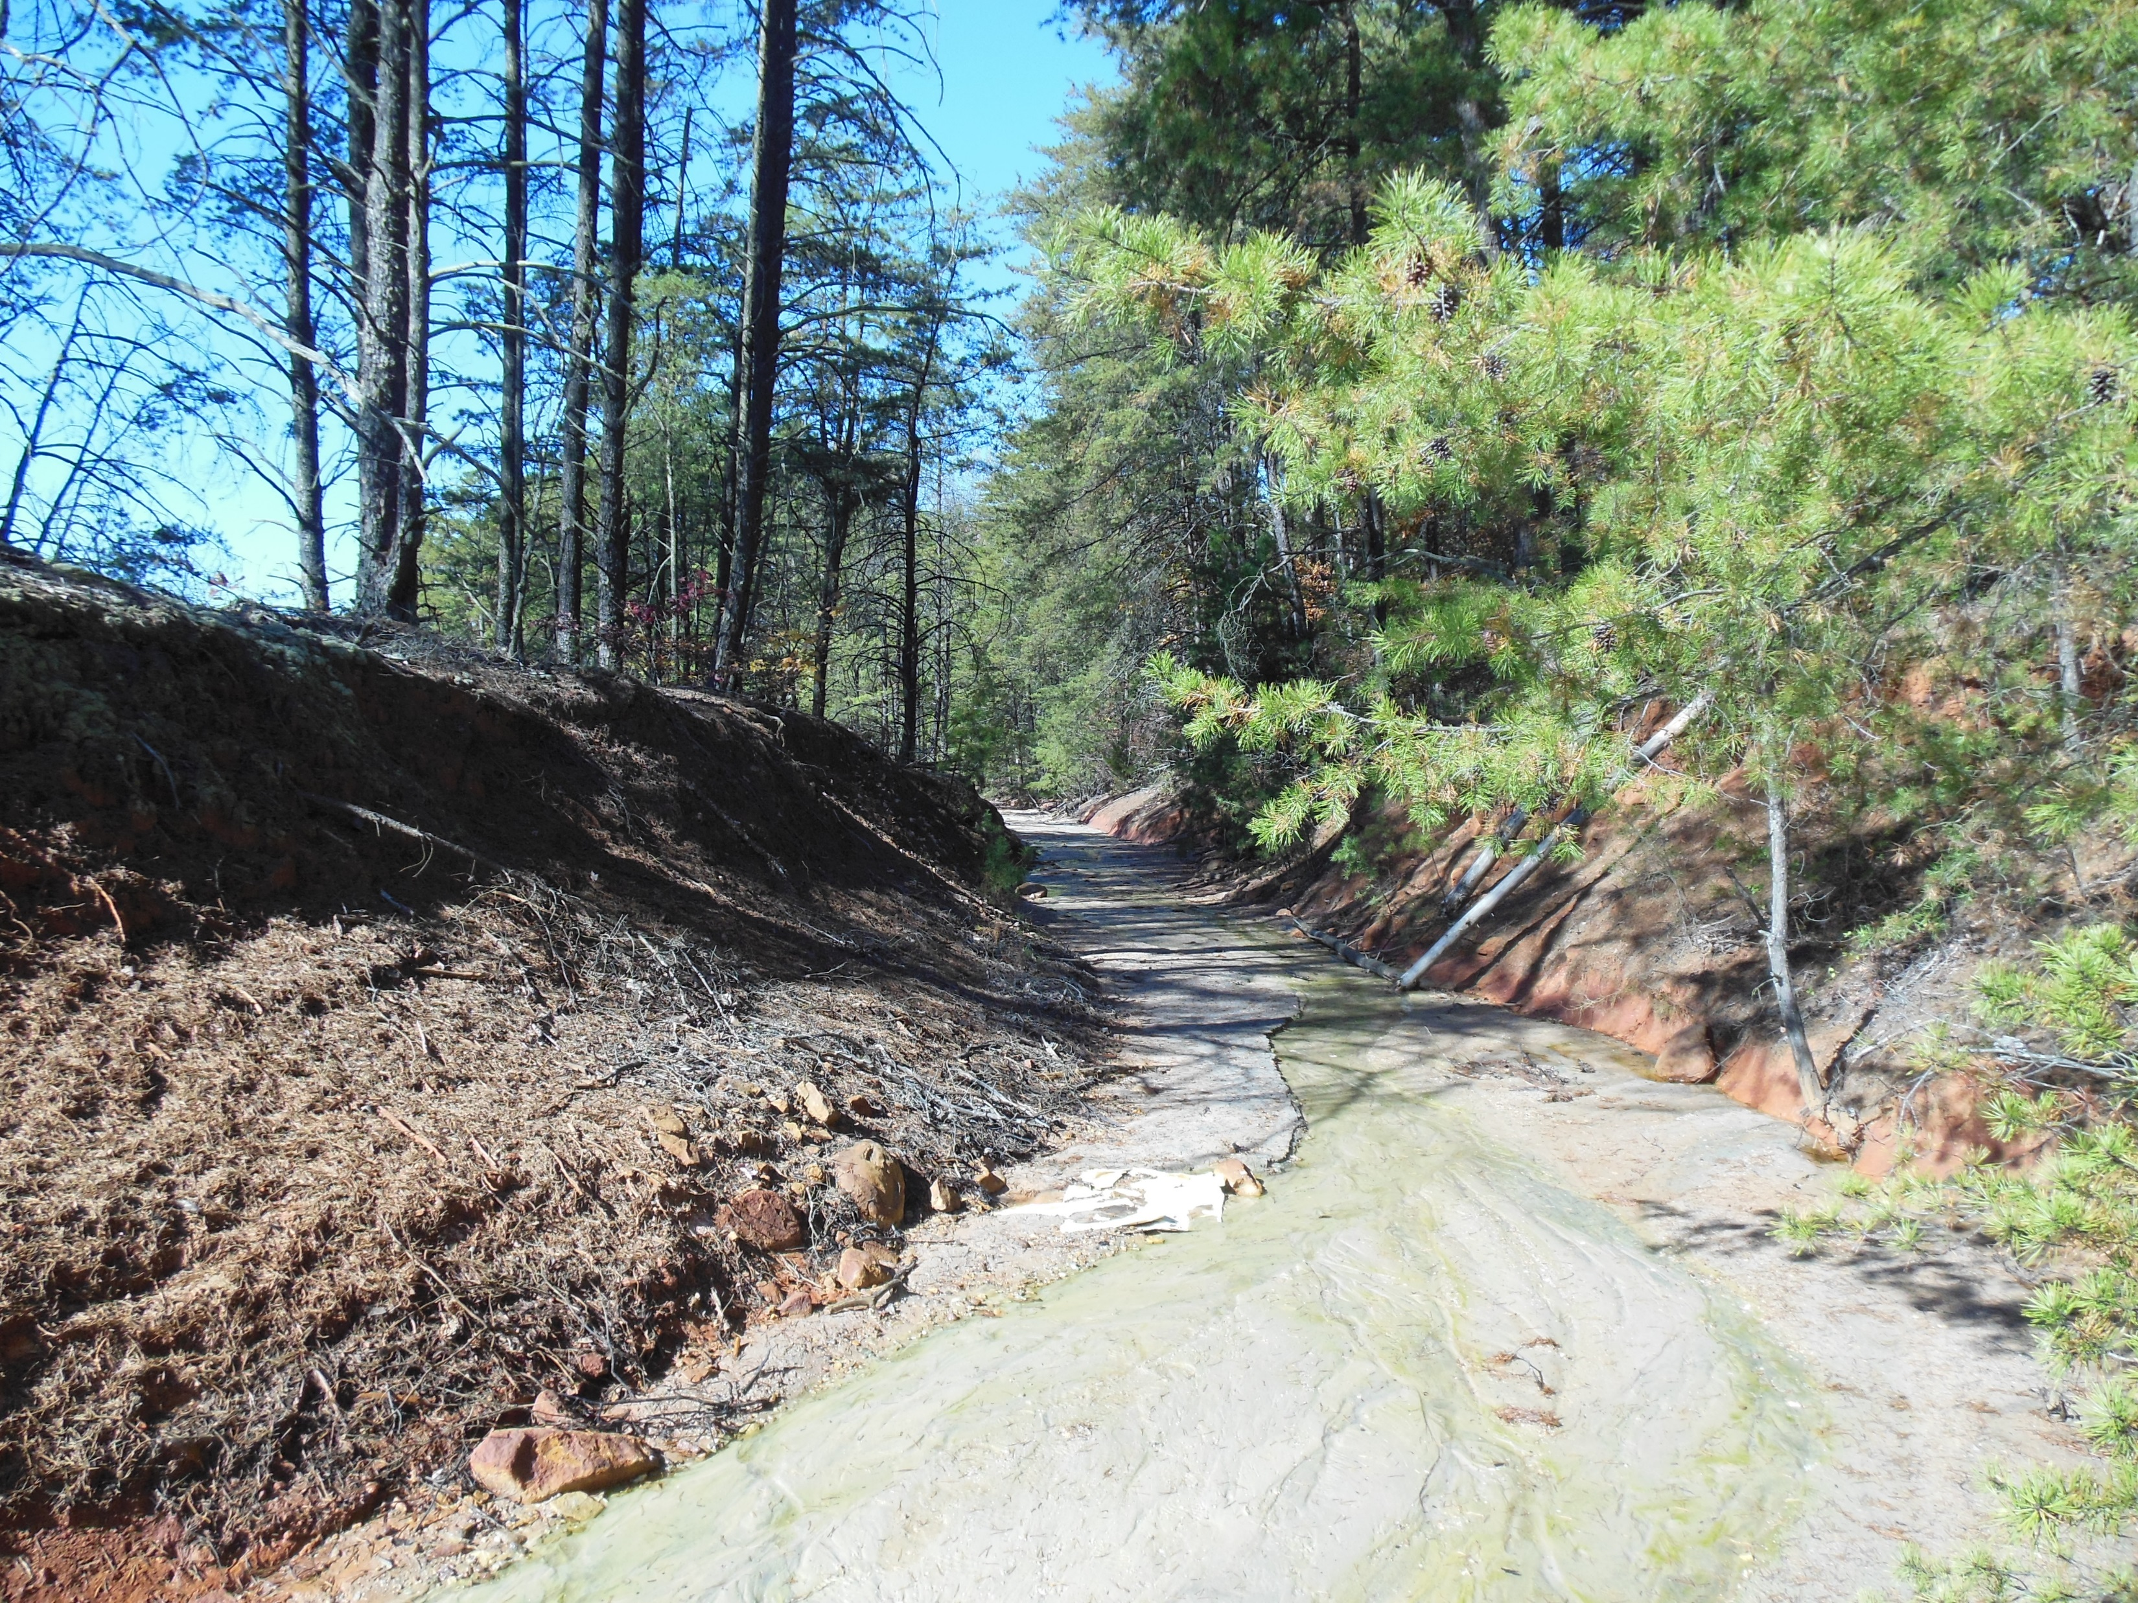
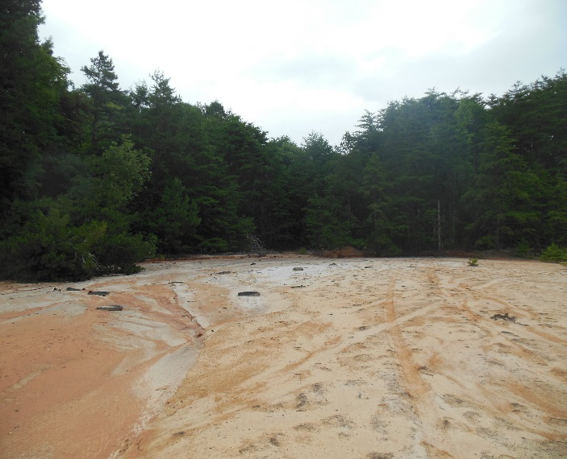
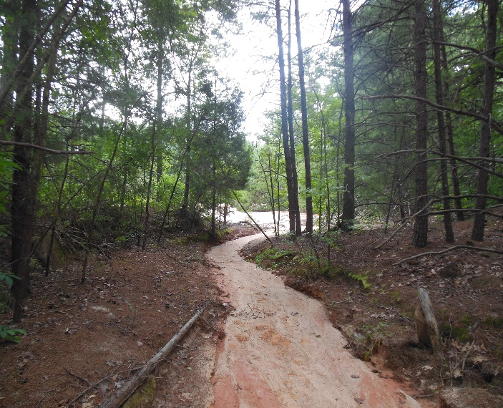
Design and Implement Actions
AOC 1 Revitalization
Stormwater Controls – From this…

Slide 17
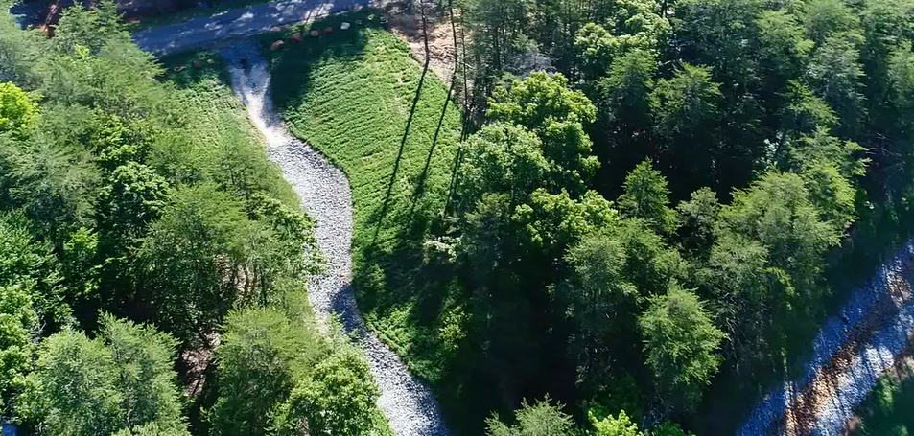
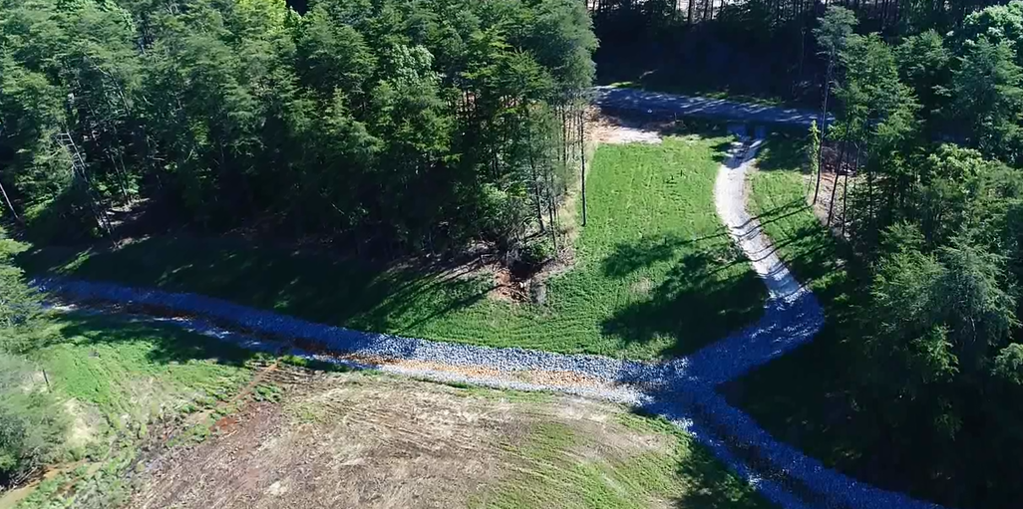
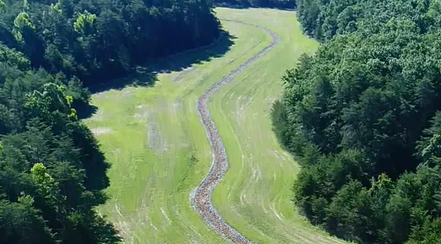
Design and Implement Actions
AOC 1 Revitalization
Stormwater Controls – To this…

Slide 18
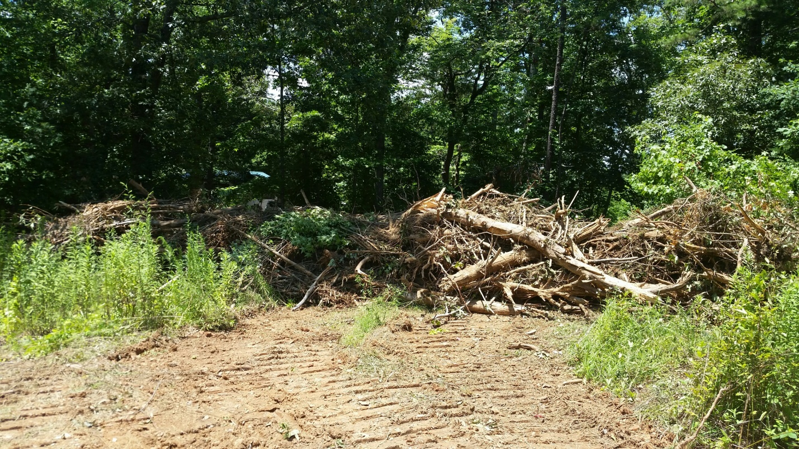
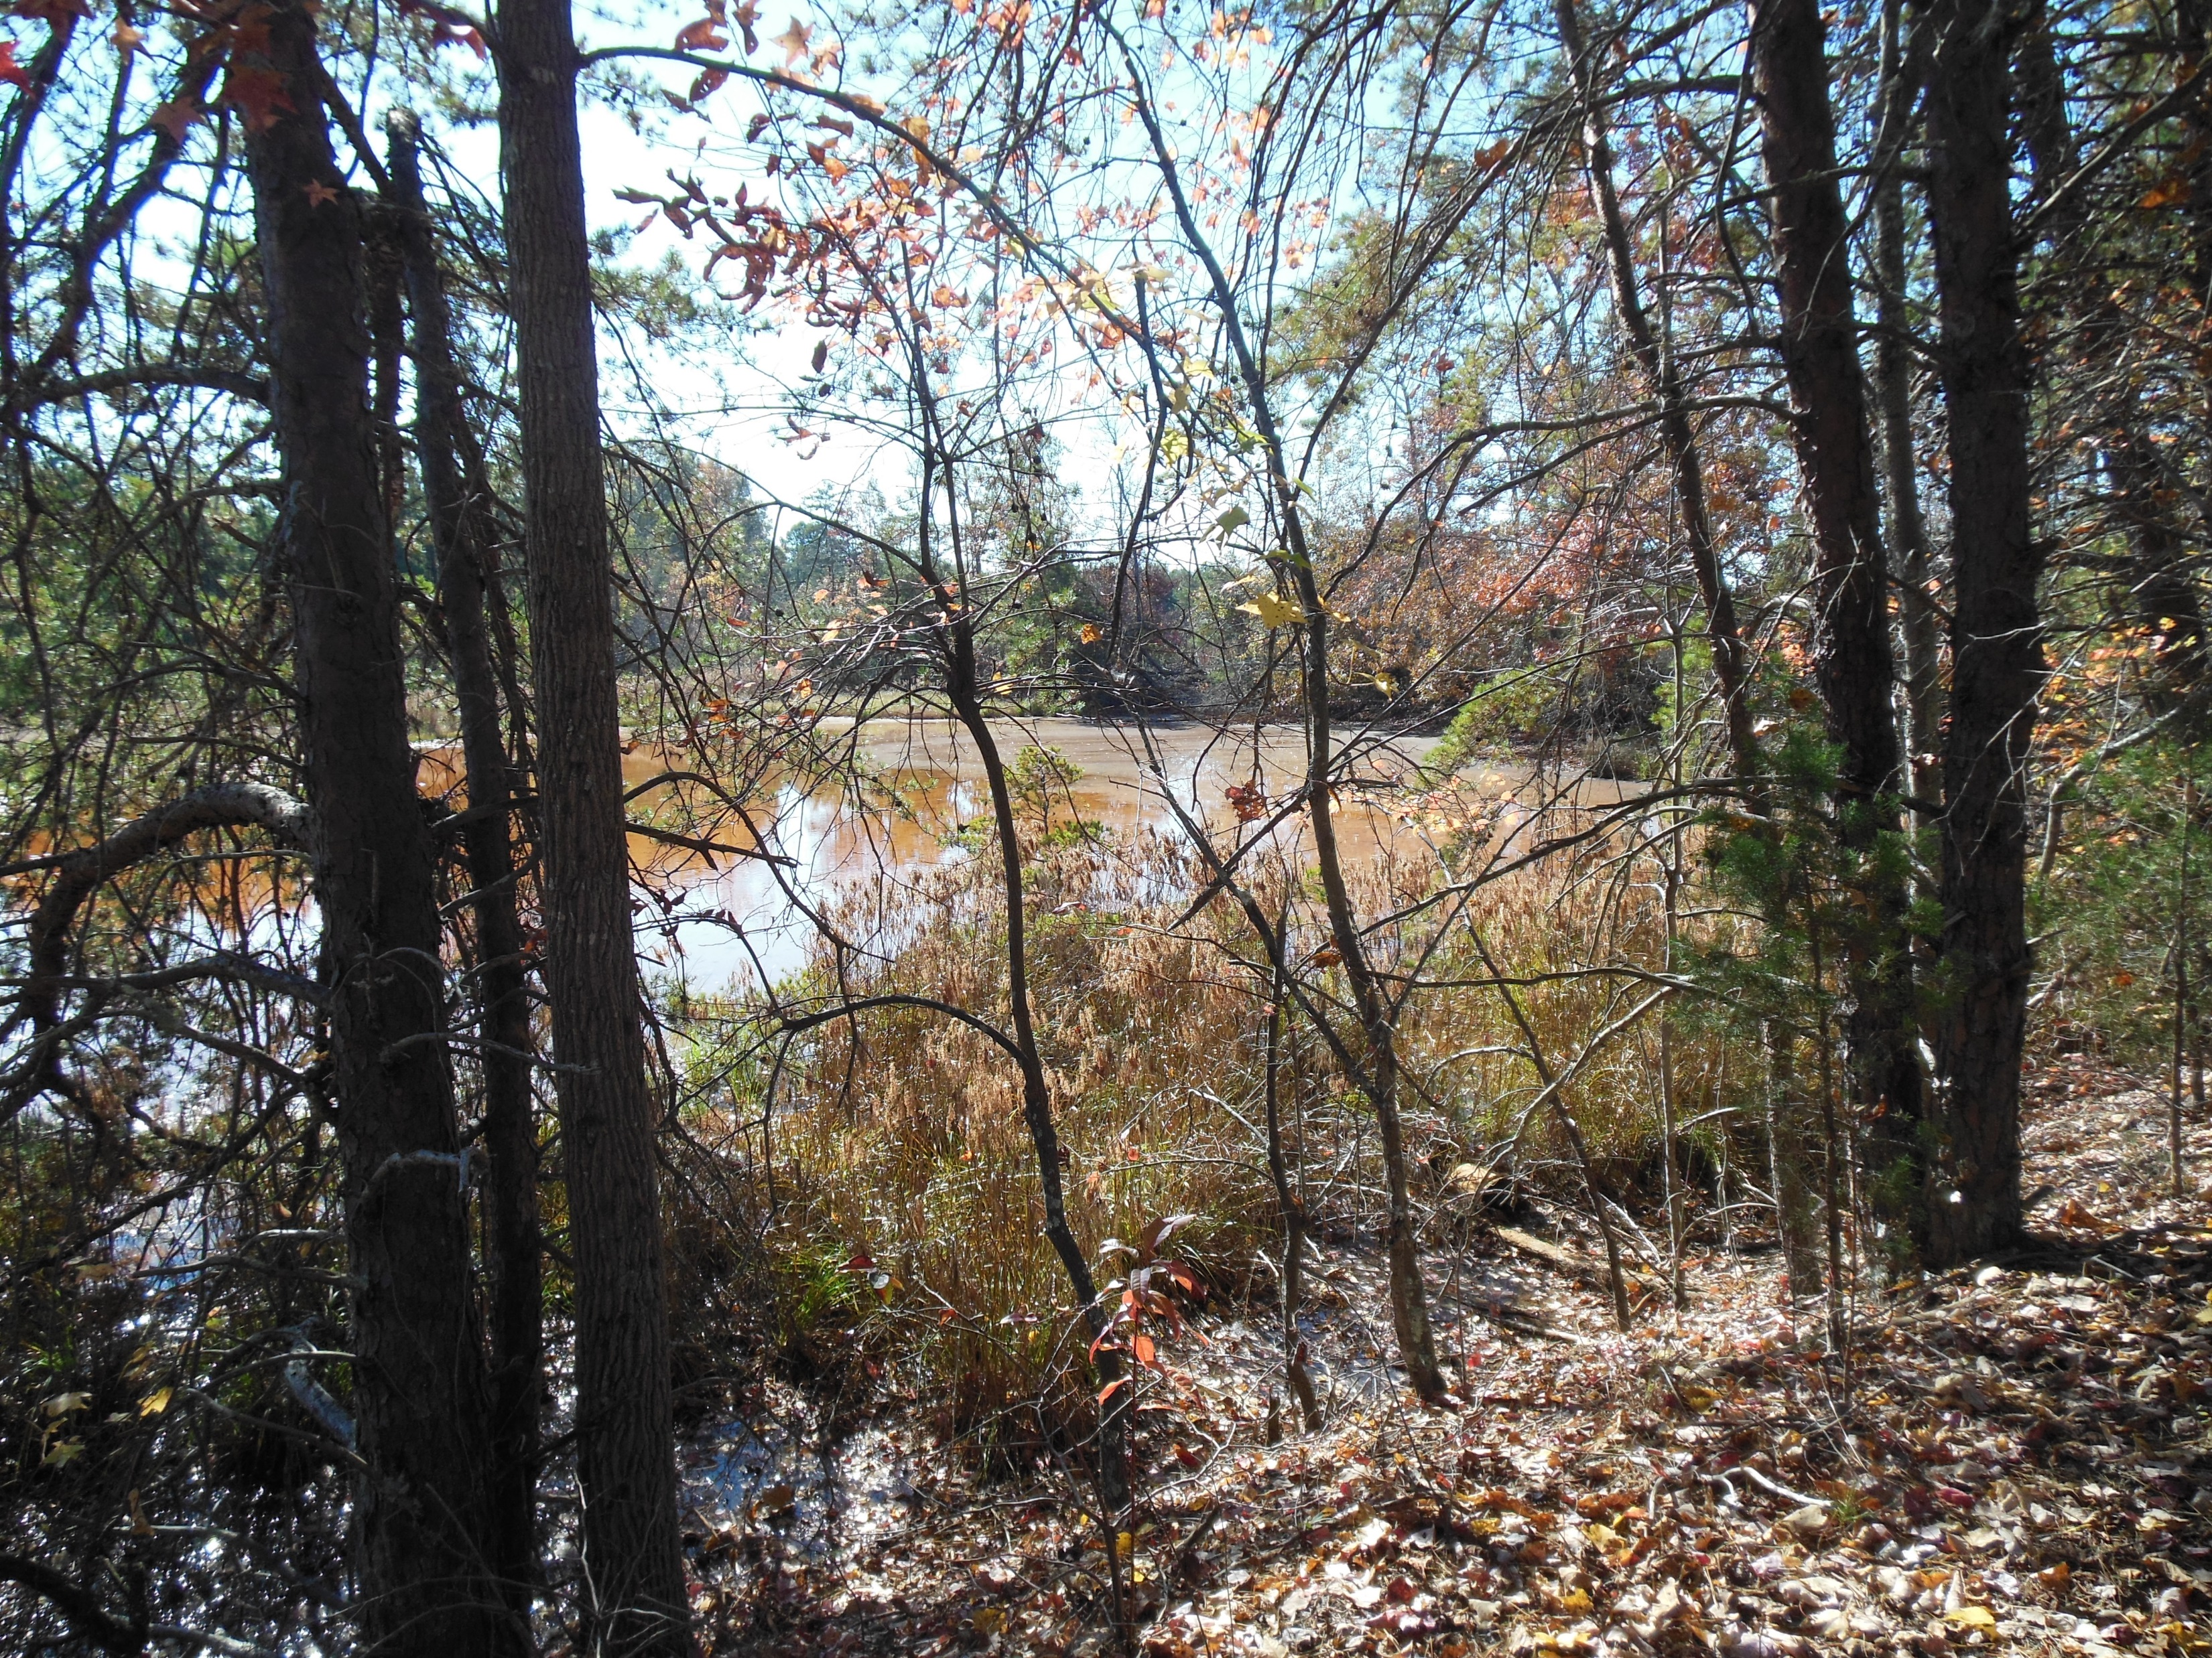




Design and Implement Actions
AOC 1 Revitalization
Dam Stability - From this…..

Slide 19

Design and Implement Actions
AOC 1 Revitalization
Dam Stability – To this…

Slide 20



Design and Implement Actions
AOC 1 Revitalization
Vegetative Cover – From this…

Slide 21


Design and Implement Actions
AOC 1 Revitalization
Vegetative Cover – To this…

Slide 22






Design and Implement Actions
AOC 2 Revitalization
Dam Stability – From this…..

Slide 23


Design and Implement Actions
AOC 2 Revitalization
Dam Stability – To this…..

Slide 24
Design and Implement Actions
AOC 5 Revitalization
AOC 5 Prior to Construction AOC 5 December 4, 2017

Slide 25

Design and Implement Actions
Henry Knob Revitalization Overview

Slide 26




Henry Knob Revitalization
Questions
Eugene Shephard, PE, LEP
Eugene.Shephard@woodplc.com
Paul Johnstone, PG
Paul.Johnstone@woodplc.com
Jason Provencher, PE, PMP, CPM
Jason.Provencher@woodplc.com
Project awarded the 2017 EPA Superfund Reuse Award in Region 4
Link to USEPA Ecological Revitalization of Contaminated Sites Case Study on Henry’s Knob:
https://semspub.epa.gov/work/HQ/100000929.pdf

