Slide 1
Evaluating Health Risks from Inhaled PCBs: Research Needs to Address Uncertainty
Geniece M. Lehmann, Ph.D. (U.S. EPA/ORD)
PCBs in Schools
Risk e Learning Webinar
April 28, 2014

Slide 2
Overview
History of U.S. interest in health risks of PCB inhalation
Human health risk assessment of inhaled PCBs
  Hazard identification
  Dose-response assessment
Uncertainties
Research needs
The views expressed here are those of the authors and do not necessarily reflect the views or policies of the U.S. EPA.

Slide 3
History of PCB use in U.S.
Manufactured from 1929 to 1977
Peak production in 1970 (85,000,000 lbs)
Uses:
Dielectric fluid in transformers
Oil used in motors and hydraulic systems
Electrical devices/appliances containing PCB capacitors
Fluorescent light ballast capacitors**
Adhesives and tapes
Oil-based paints
Plasticizer in caulk and window glazing**
Carbonless copy paper
Floor finish
Ceiling tiles*
Microscope oil
*Has been found in school buildings
**Commonly found in school buildings built 1950s – 1970s

Slide 4
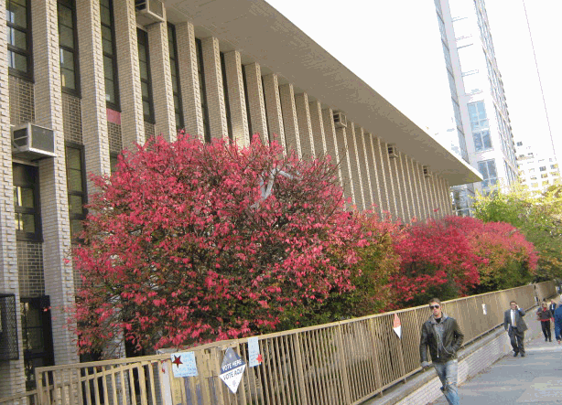
PCBs in indoor air
Herrick et al. (2004). "An unrecognized source of PCB contamination in schools and other buildings." Environmental Health Perspectives 112(10): 1051-1053.
  24 buildings in Boston, Massachusetts area
  Samples of exterior caulk
  8 buildings contained caulk with PCBs > 50 ppm
    Caulk taken from a university student housing building contained 36,200 ppm PCB
MacIntosh et al. (2012). “Mitigation of building-related polychlorinated biphenyls in indoor air of a school.” Environmental Health 11: 24-33.
  One elementary school in Massachusetts with PCB-containing caulk (range 1,830 – 29,400 ppm PCB)
  Mean indoor air PCB concentration > 500 ng/m³
Similar indoor air PCB concentrations have been reported for other buildings constructed with PCB-containing caulk
  Kohler et al. (2005). “Joint sealants: An overlooked diffuse source of polychlorinated biphenyls in buildings.” Environmental Science and Technology 39(7): 1967-1973.

Slide 5
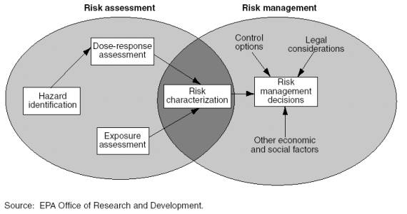
Do PCBs in indoor air pose a health risk?

Slide 6
How Can We Assess Human Health Hazard from Inhaled PCBs?

Slide 7
Health Effects of PCB Exposure
Observed in humans
(exposed by multiple routes)
Cancer (melanoma, non-Hodgkin lymphoma, breast cancer)
Thyroid effects
Immunotoxicity
Reproductive effects
Developmental neurobehavioral toxicity
Observed in animals
(exposed by ingestion)
Cancer
Hepatotoxicity
Thyroid effects
Immunotoxicity
Reproductive effects
Developmental neurobehavioral toxicity
Observed in animals
(exposed by inhalation)
Hepatotoxicity
Thyroid effects
Immunotoxicity
Neurotoxicity

Slide 8
Health Effects of PCB Exposure
Observed in humans
(exposed by multiple routes)
Cancer (melanoma, non-Hodgkin lymphoma, breast cancer)
Thyroid effects
Immunotoxicity
Reproductive effects
Developmental neurobehavioral toxicity
Observed in animals
(exposed by ingestion)
Cancer
Hepatotoxicity
Thyroid effects
Immunotoxicity
Reproductive effects
Developmental neurobehavioral toxicity
Observed in animals
(exposed by inhalation)
Hepatotoxicity
Thyroid effects
Immunotoxicity
Neurotoxicity

Slide 9
Health Effects of PCB Exposure
Observed in humans
(exposed by multiple routes)
Cancer (melanoma, non-Hodgkin lymphoma, breast cancer)
Thyroid effects
Immunotoxicity
Reproductive effects
Developmental neurobehavioral toxicity
Observed in animals
(exposed by ingestion)
Cancer
Hepatotoxicity
Thyroid effects
Immunotoxicity
Reproductive effects
Developmental neurobehavioral toxicity
Observed in animals
(exposed by inhalation)
Hepatotoxicity
Thyroid effects
Immunotoxicity
Neurotoxicity

Slide 10
Health Effects of PCB Exposure
Observed in humans
(exposed by multiple routes)
Cancer (melanoma, non-Hodgkin lymphoma, breast cancer)
Thyroid effects
Immunotoxicity
Reproductive effects
Developmental neurobehavioral toxicity
Observed in animals
(exposed by ingestion)
Cancer
Hepatotoxicity (~40)
Thyroid effects (~40)
Immunotoxicity (~40)
Reproductive effects (~40)
Developmental neurobehavioral toxicity (~30)
Observed in animals
(exposed by inhalation)
Hepatotoxicity (1)
Thyroid effects (1)
Immunotoxicity (1)
Neurotoxicity (1)

Slide 11
PCB Inhalation Data - Animals
Treon et al. (1956). "The toxicity of the vapors of Aroclor 1242 and Aroclor 1254." American Industrial Hygiene Association Quarterly 17(2): 204-213.
Study Design
Cats (n = 1), rabbits (n = 4), guinea pigs (n = 6), rats (n = 10) and mice (n = 10) exposed 7 hours/day, 5 days/week for 213 days
1.5 mg/m³ Aroclor 1254
Hepatotoxicity
Caveats
Single PCB dose tested
Some study animals died for reasons unrelated to treatment
Uncertain exposure characterization

Slide 12
PCB Inhalation Data - Animals
Casey et al. (1999). "Aroclor 1242 inhalation and ingestion by Sprague-Dawley rats." Journal of Toxicology and Environmental Health, Part A: Current Issues 56(5): 311-342.
Study Design
Rats exposed 23 hours/day for 30 days (n = 8)
0.0009 mg/m³ Aroclor 1242
histopathological changes in the thyroid, thymus, and urinary bladder
increased serum thyroid hormone concentrations
neurobehavioral changes
Caveats
Single PCB dose tested
Whole-body exposure
Incomplete exposure information

Slide 13
PCB Inhalation Data - Animals
Hu et al. (2012). “Subchronic inhalation exposure study of an airborne polychlorinated biphenyl mixture resembling the Chicago ambient air congener profile." Environmental Science and Technology 46: 9653-9662.
Study Design
Rats exposed 1.6 hours/day,
5 days/week for 4 weeks (n = 12)
0.52 mg/m³ PCBs
Investigated: pulmonary immune responses; histopathology (liver, lung, thymus, spleen, kidney, and thyroid); cytochrome P450 enzyme induction (liver and lung); redox status of glutathione (serum, liver and lung); and hematological parameters
Observed: a shift to more oxidized glutathione in serum and elevated hematocrit
Caveats
Single PCB dose tested
Short exposure duration

Slide 14
PCB Inhalation Data – Animals (Rats)
 | Treon et al. (1956) | Casey et al. (1999) | Hu et al. (2012)
Exposure Duration | 7 hours/day 5 days/week 213 days | 23 hours/day 7 days/week 30 days | 1.6 hours/day 5 days/week 28 days
Dose | 1.5 mg/m³ (Aroclor 1254) | 0.0009 mg/m³ (Aroclor 1242) | 0.52 mg/m³ (PCBs to mimic Chicago air)
Effects Observed | Hepatotoxicity | Thyroid effects Immunotoxicity Neurotoxicity | Minimal toxicity
Notes on Exposure | Whole body exposure Uncertain exposure assessment | Whole body exposure Uncertain exposure assessment | Nose-only exposure

Slide 15
Do PCBs in indoor air pose a health risk?

Slide 16
What Research Would Reduce Uncertainty?
Accurate Exposure Assessment
What is the congener profile of the PCB mixture?
Comprehensive Health Effect Evaluation
Developmental neurotoxicity
Immunotoxicity
Changes in thyroid hormone levels

Slide 17
What Research Would Reduce Uncertainty?
  Well-characterized inhalation exposure
    Based on measurements of PCBs in air or on measures of PCB body burden?
    RESEARCH NEED: PBPK models describing the kinetic properties of inhaled PCBs (and possibly dermal absorption of airborne congeners)
PCBs in air
Reflect inhalation exposure at a given time
PCB body burden
Reflects accumulated exposure over time and across all exposure routes
Epidemiology

Slide 18
What Research Would Reduce Uncertainty?
  Well-characterized inhalation exposure
    Based on measurements of PCBs in air; do not rely solely on measures of PCB body burden
  Key health effects measured
    Serum thyroid hormone levels (e.g., tT₄ and TSH)
    Susceptibility to infection or antibody responses to immunization
    Neurodevelopmental effects in children
Epidemiology
Airborne PCBs

Slide 19
What Research Would Reduce Uncertainty?
  Studies with monkeys or rats
  Chronic & developmental exposure
    Chronic = 42 months (monkeys); 24 months (rats)
    Developmental study
  Exposed to at least 2 PCB concentrations, preferably 3 or more
    Dose response information
  Exposed by whole-body or nose-only?
Animal Studies
Whole-body
Potential for confounding oral exposure
Nose-only
Stress may confound results
Limited daily exposure duration
Limited animal number

Slide 20
What Research Would Reduce Uncertainty?
  Studies with monkeys or rats
  Chronic & developmental exposure
    Chronic = 42 months (monkeys); 24 months (rats)
    Developmental study
  Exposed to at least 2 PCB concentrations, preferably 3 or more
    Dose response information
  Exposed by whole-body or nose-only?
Animal Studies
  Measure health outcomes
    Developmental neurobehavioral effects (e.g., response inhibition)
    Immunotoxicity (e.g., antibody responses in monkeys or NK cell activity in rats)
    Changes in thyroid hormone levels (e.g., decreased tT₄ and increased TSH)

Slide 21
Additional Factors to Consider
Congener composition of the PCB mixture administered in animal studies
IMPACTS:
Physicochemical properties
Toxicity

Slide 22

Lower-chlorinated congeners tend to be more volatile
Higher-chlorinated congeners tend to be resistant to metabolism & bioconcentrate in the food chain

Slide 23
Health effects of oral PCB exposure*:
Hepatotoxicity
Thyroid effects
Immunotoxicity
Neurotoxicity
Higher-chlorinated PCB congeners
Lower-chlorinated PCB congeners
“Dioxin-like” congeners
PCB 77
PCB 81
PCB 105
PCB 114
PCB 118
PCB 123
PCB 126
PCB 156
PCB 157
PCB 167
PCB 169
PCB 189
*observed in animal studies

Slide 24
Additional Factors to Consider
Congener composition of the PCB mixture administered in animal studies
  Which available mixtures, when volatilized, will yield a congener profile most similar to a typical human inhalation exposure?
a
b
ª Simcik et al. 1998. Environ Sci Technol 32: 251-257.
^{b} Chiarenzelli et al. 2001. Environ Sci Technol 35: 3280-3286.

Slide 25
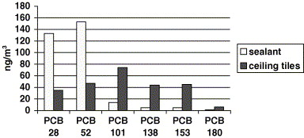
Additional Factors to Consider
Congener composition of the PCB mixture administered in animal studies
  Which available mixtures, when volatilized, will yield a congener profile most similar to a typical human inhalation exposure?
Heinzow B et al. 2007. Chemosphere 67: 1746-1753.

Slide 26
Additional Factors to Consider
Congener composition of the PCB mixture administered in animal studies
RESEARCH NEEDS:
Individual PCB congener analyses of indoor and outdoor air in a variety of human exposure contexts to better characterize the range of relevant inhalation mixtures and the congeners present
Toxicological data from a number of different mixtures spanning the range observed in human exposure contexts

Slide 27
Additional Factors to Consider
Toxicological endpoints unique to inhalation exposure
CONSEQUENCES OF ORAL AND INHALATION EXPOSURES MAY DIFFER:
There may be congeners present in air that are not typically found in the diet.
There may also be differences in tissue distribution or metabolism between the inhalation and oral routes of exposure.

Slide 28
Additional Factors to Consider
Toxicological endpoints unique to inhalation exposure
RESEARCH NEEDS:
Epidemiological and toxicological studies of PCB inhalation that investigate health endpoints other than those previously shown to be associated with oral PCB exposure

Slide 29
Research to Reduce Uncertainty
  Human or animal studies:
    Subjects exposed to PCBs by inhalation
    PCB exposure well-characterized
  Studies of chronic or developmental exposures in monkeys or rats
  Animal studies testing ≥ 2 PCB concentrations (preferably ≥ 3)
  Candidate health outcomes
    Developmental neurobehavioral effects on executive function
    Immune suppression
    Decreased serum tT₄ and increased serum TSH
  PBPK models describing the kinetic properties of airborne PCBs
  Individual PCB congener analyses of indoor and outdoor air
Contact Information
Geniece Lehmann
+1-919-541-2289
lehmann.geniece@epa.gov

